Slide 1
Ensemble Prediction: A Personal Perspective.
By
Tim Palmer
University of Oxford

Slide 2
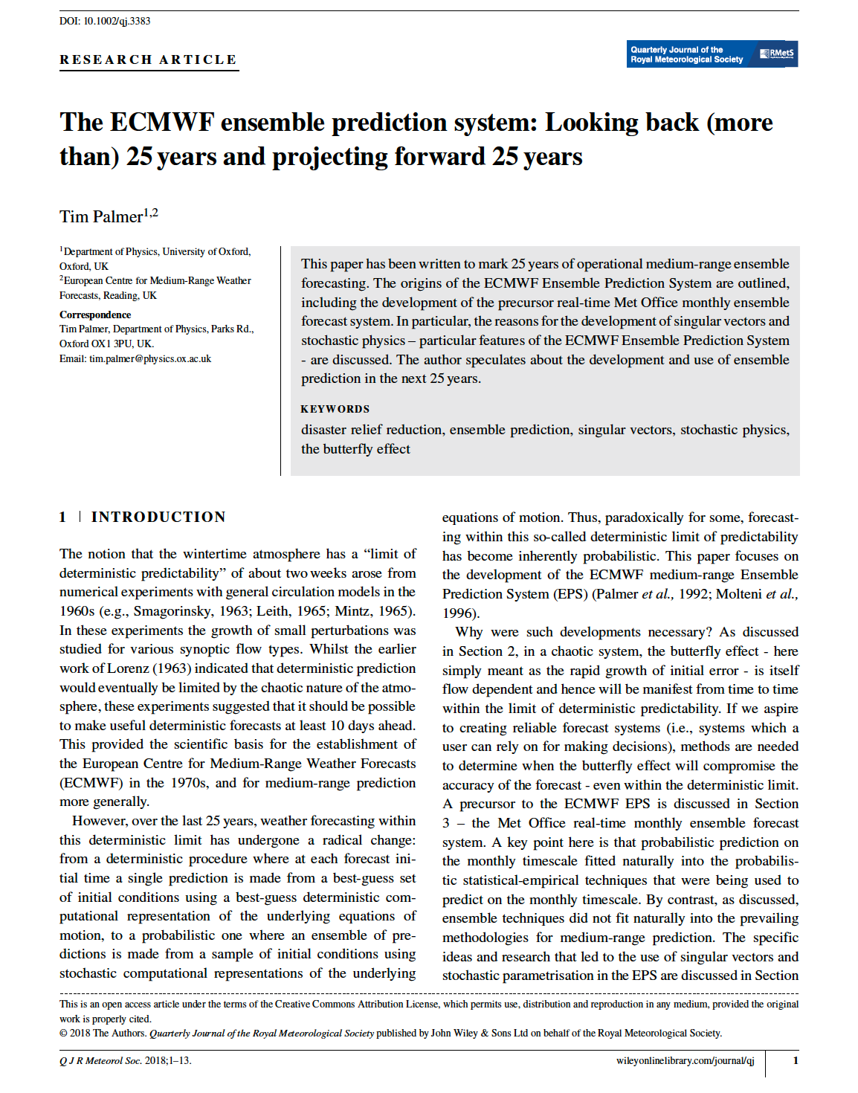

Slide 3
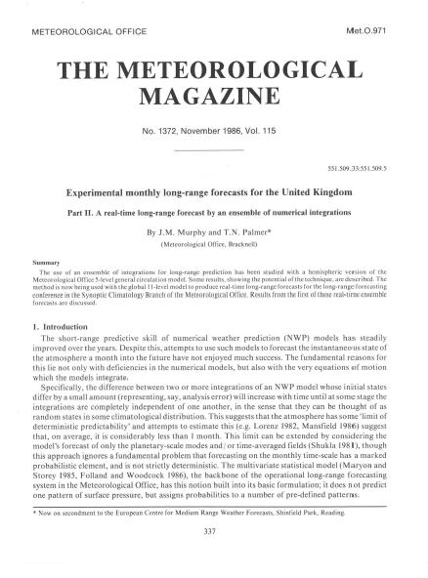
Origins of ensemble forecasting lie in sub-seasonal (monthly) prediction
Eg Namias, Epstein, Leith, Miyakoda.
1985: The First Operational Real-Time Ensemble Forecast

Slide 4
End of the 1980s
Probabilistic forecasts using a combination of statistical-empirical and ensembles of numerical models.
Deterministic numerical forecasts
Limit of deterministic predictability
< 10 days
> 10 days

Slide 5

“Well, you chaps were a fat lot of good last night….if you can’t forecast the worst storms for several centuries three hours before they happen, what are you doing?!” Ian Buerk, Main BBC Anchor Man to On-Duty TV Weather Forecaster
October 1987

Slide 6
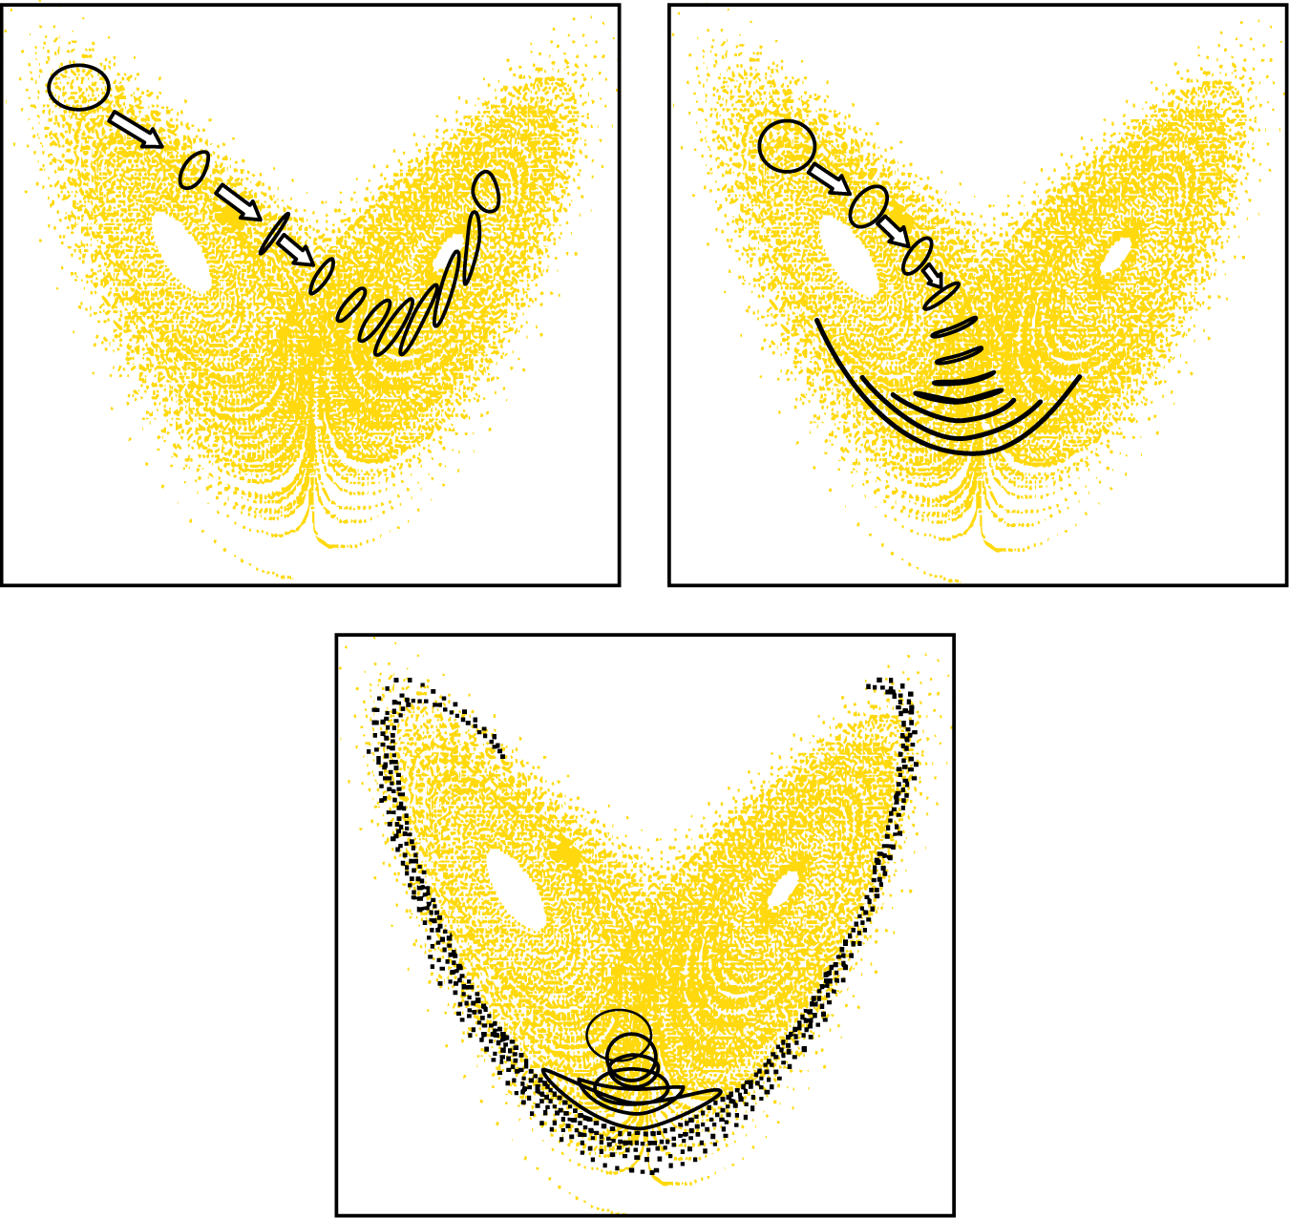
The Butterfly Effect exists intermittently inside the Deterministic Limit!
Semi-predictable
Semi-deterministic
Predictable
Deterministic
Very unpredictable
(c.f. October 1987)
Non-deterministic
In a nonlinear system, predictability depends on the starting conditions. There is no fixed deterministic limit!

Slide 7
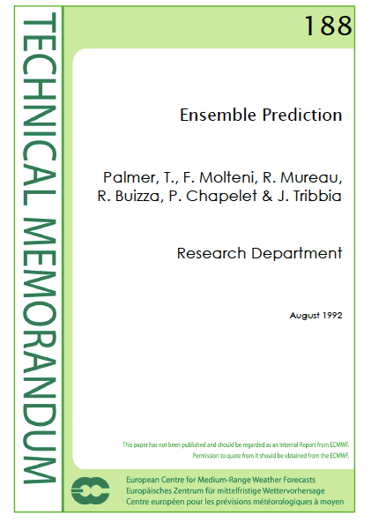
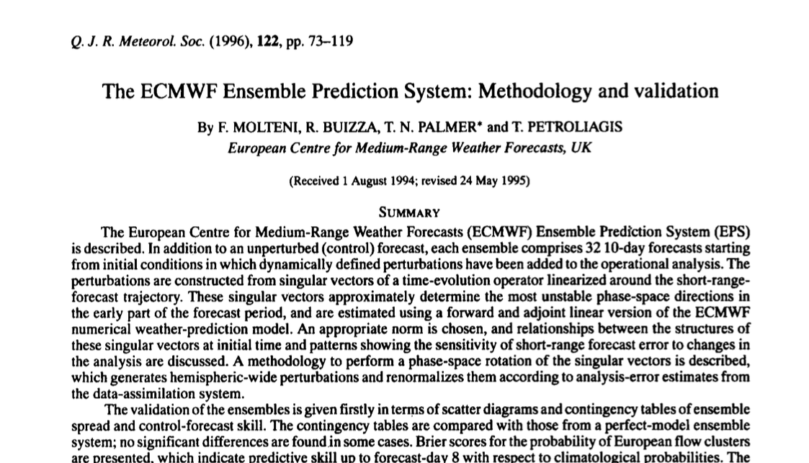

Slide 8
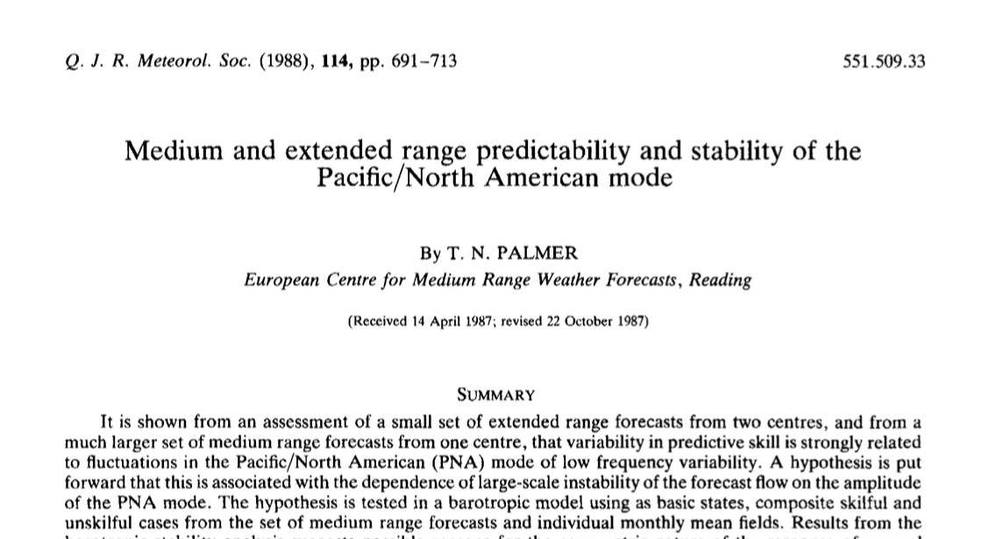
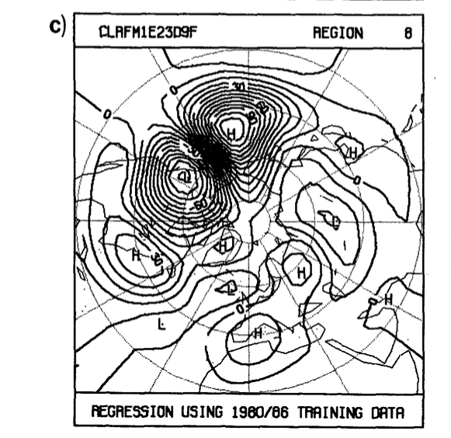
Cf Miyakoda et al, 1982

Slide 9
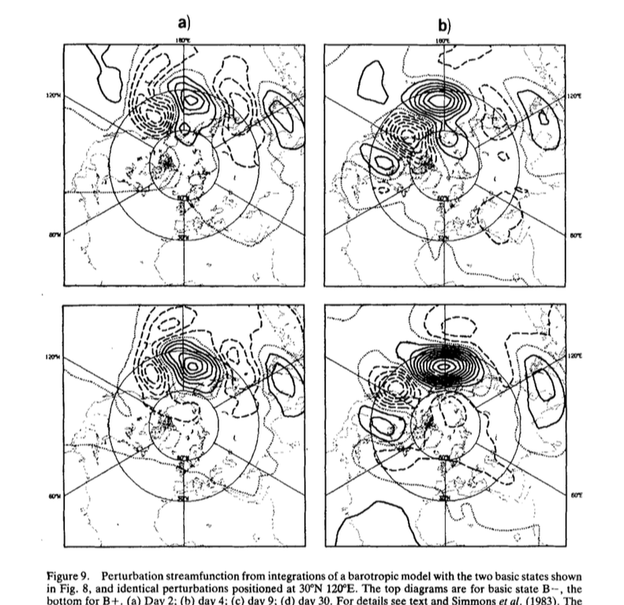
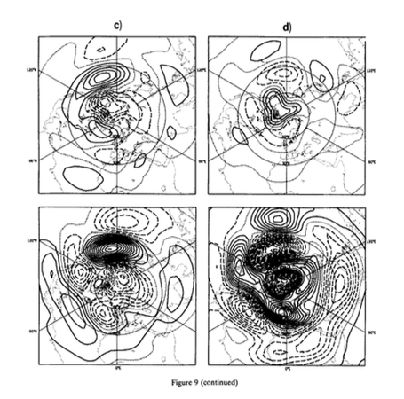
Integrations with a Barotropic Vorticity Equation Model
DAY 2
DAY 4
DAY 9
DAY 30
PNA+
PNA-
Not explainable by normal-mode instability

Slide 10
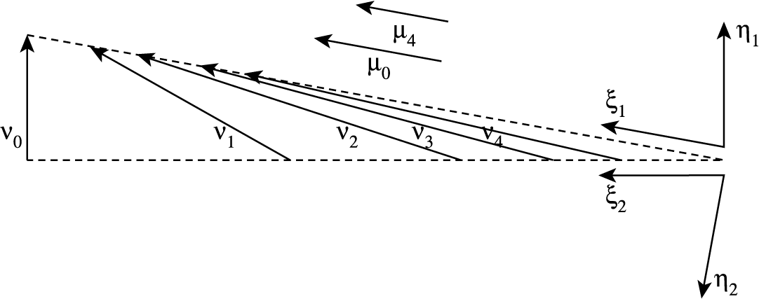
If eigenvectors are not normal (operator not self-adjoint), perturbation growth is not bounded by the dominant eigenvalue

Slide 11
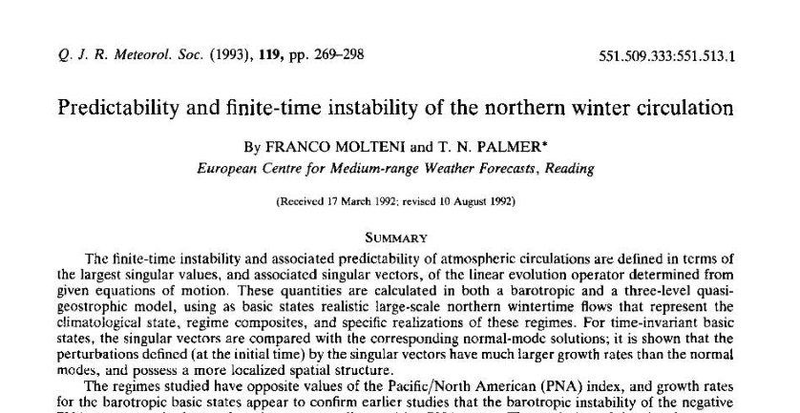
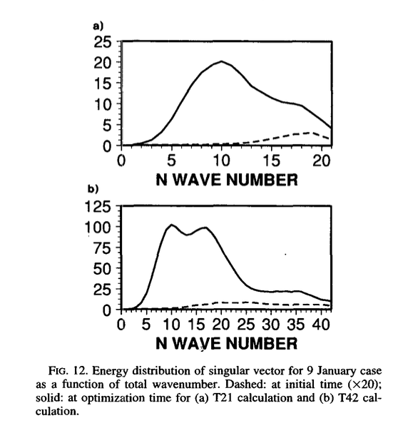
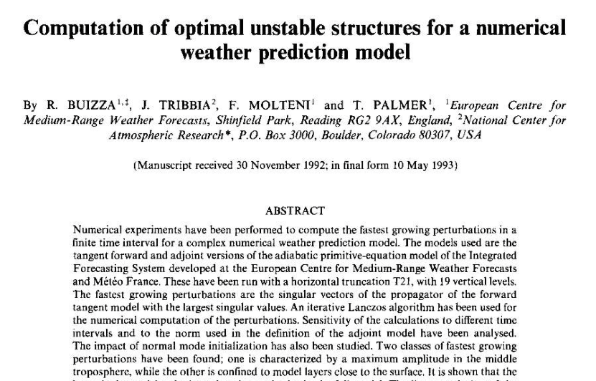
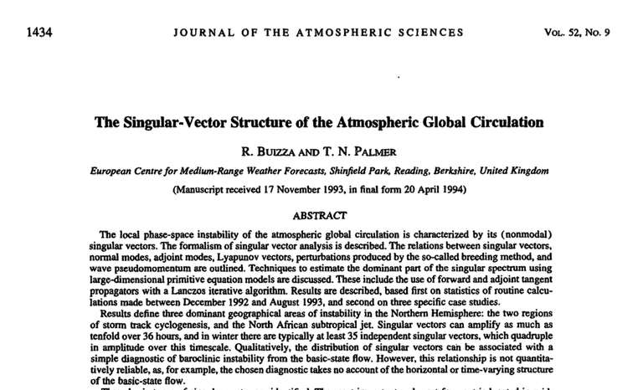
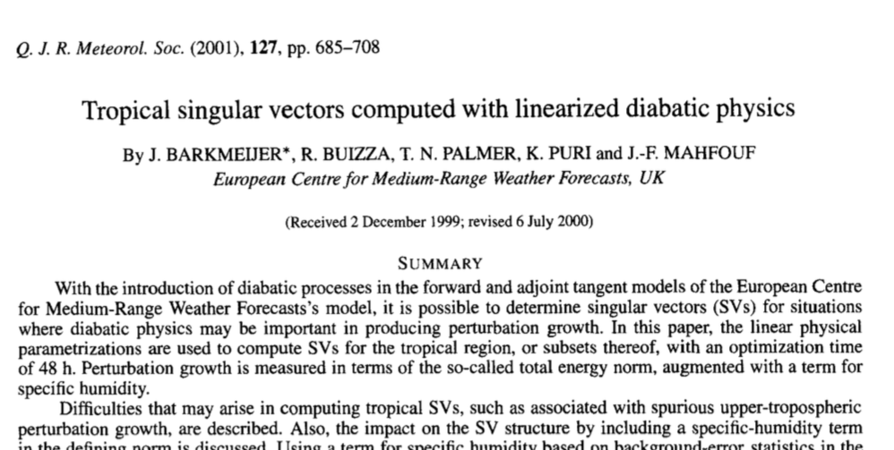
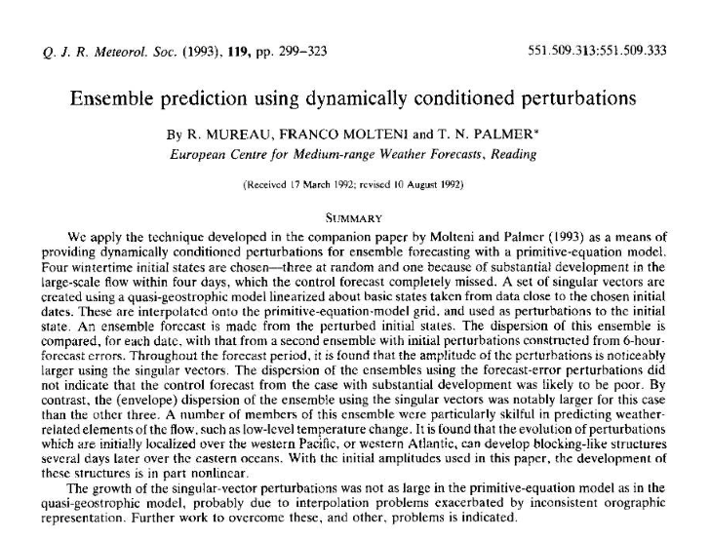
Singular Vectors
evolved
initial
From Buizza and Palmer, 1995

Slide 12
Simon Lang: Personal Communication

Slide 13
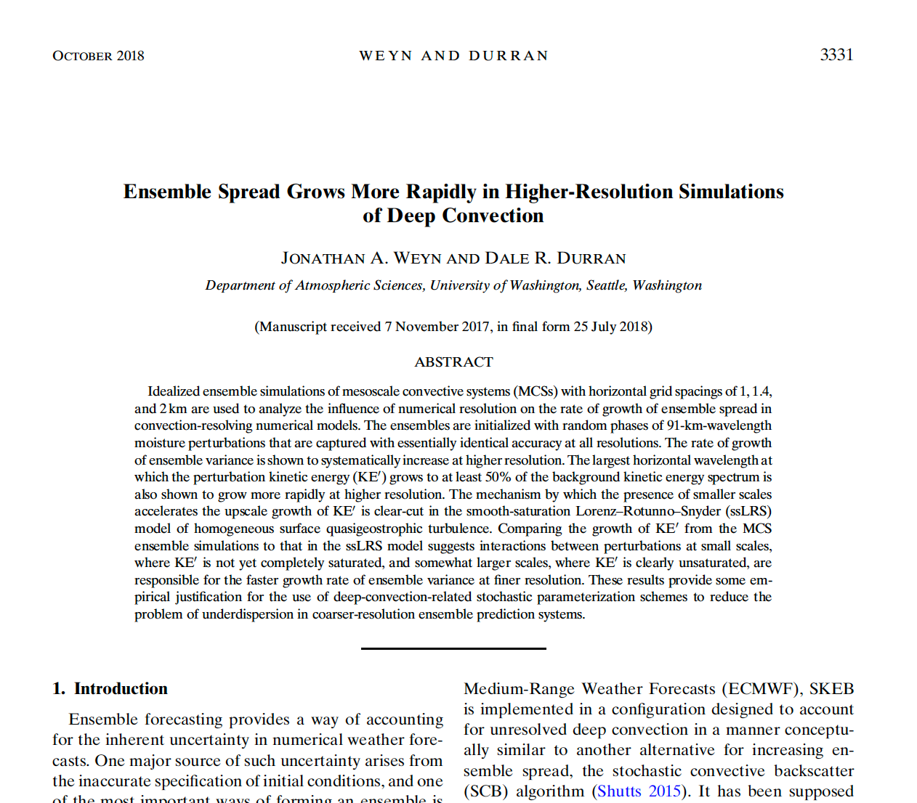

Slide 14
ECMWF EPS spread/skill better balanced than other operational ensembles.
Martin Janousek: Personal Communication

Slide 15
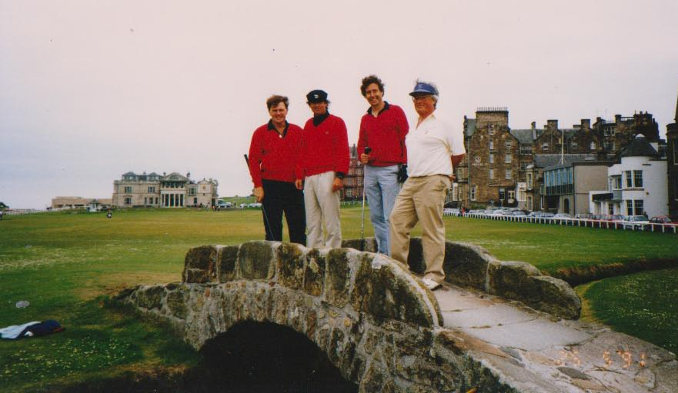
Stochastic Physics

Slide 16
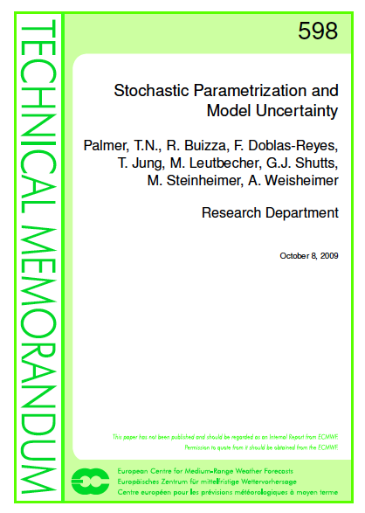
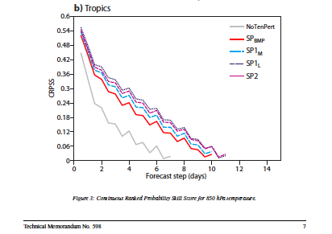

Slide 17
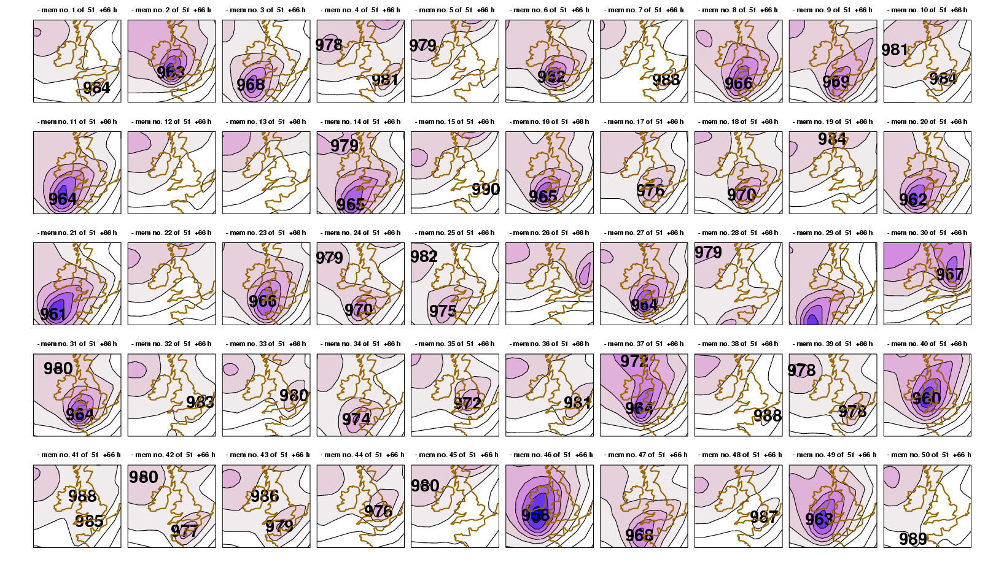
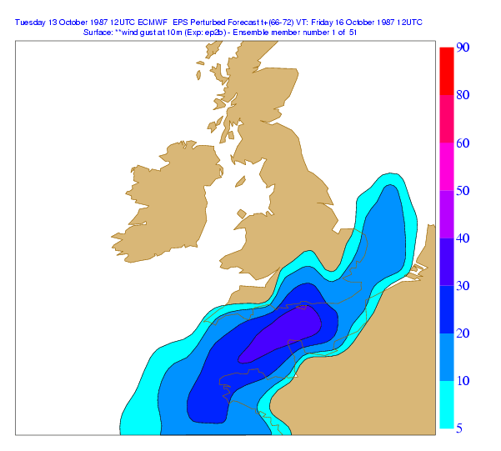
October 87 Storm Ensemble Re-forecast: Very Unpredictable – Very Chaotic!
D+2.5 days
50 forecasts with slightly different initial conditions (with thanks to Martin Leutbecher)
What to do with this information? Don’t take the ensemble mean!! Rather, create probability forecasts
Probability of hurricane-force gusts on October 16th 1987

