Slide 1
The ECMWF Ensembles
of Analyses and Forecasts
Roberto Buizza^{1,2}
(1): Scuola Superiore Sant’Anna (Pisa, Italy)
(2): ECMWF (Reading, UK)

Slide 2
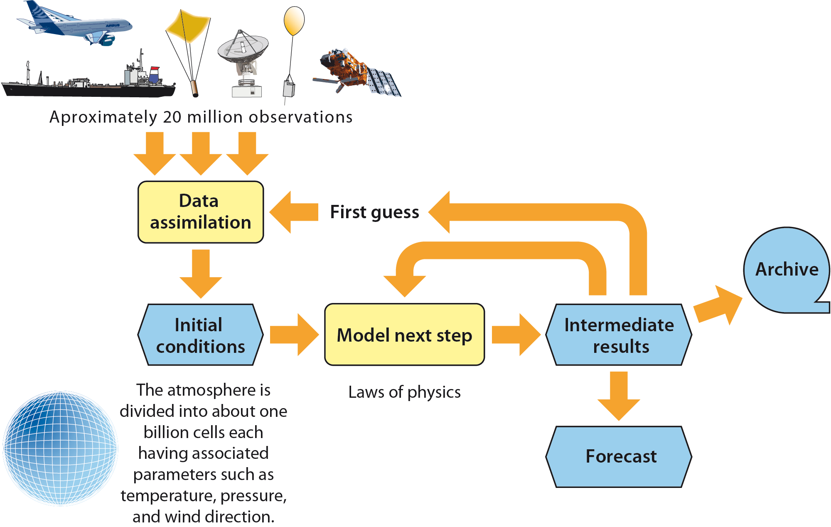
The NWP process: from obs to forecasts
The ECMWF ensembles aim to simulate all sources of errors.
Model uncertainties
Observation
errors
ICs’ uncertainties

Slide 3
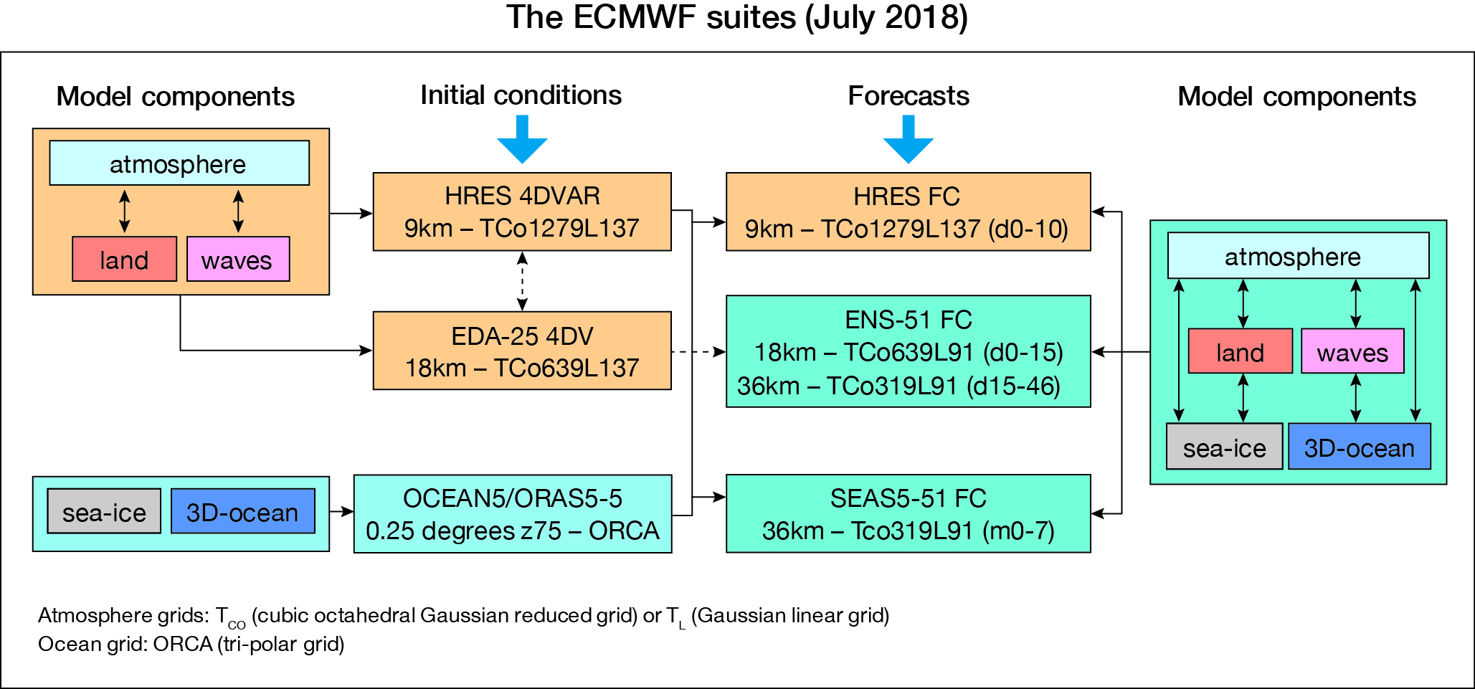
Ensembles are key (the ECMWF o-suite in 2018)

Slide 4
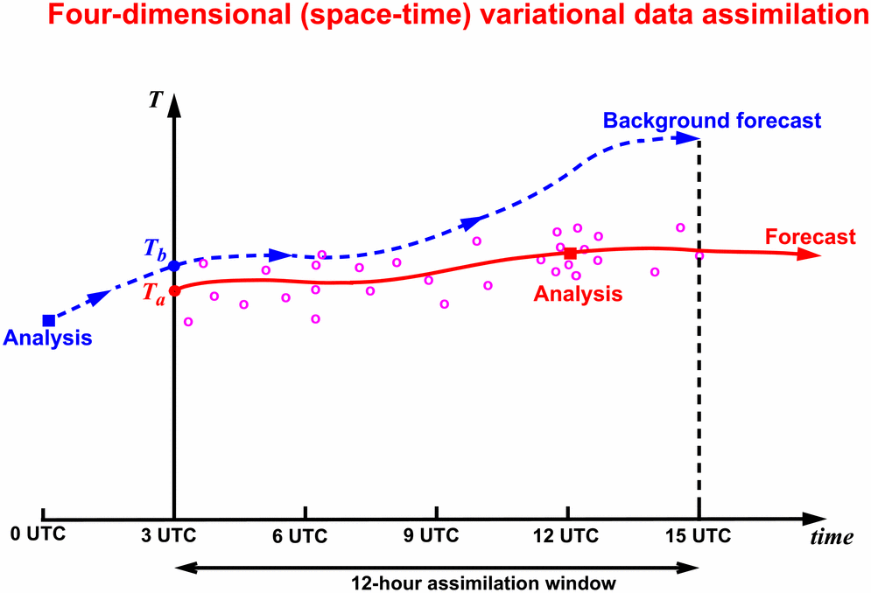
The 4 ECMWF ensembles
Since 2008, ECMWF has been running 4 ensembles:
The 25-member Ensemble of Data Assimilation (EDA)

Slide 5
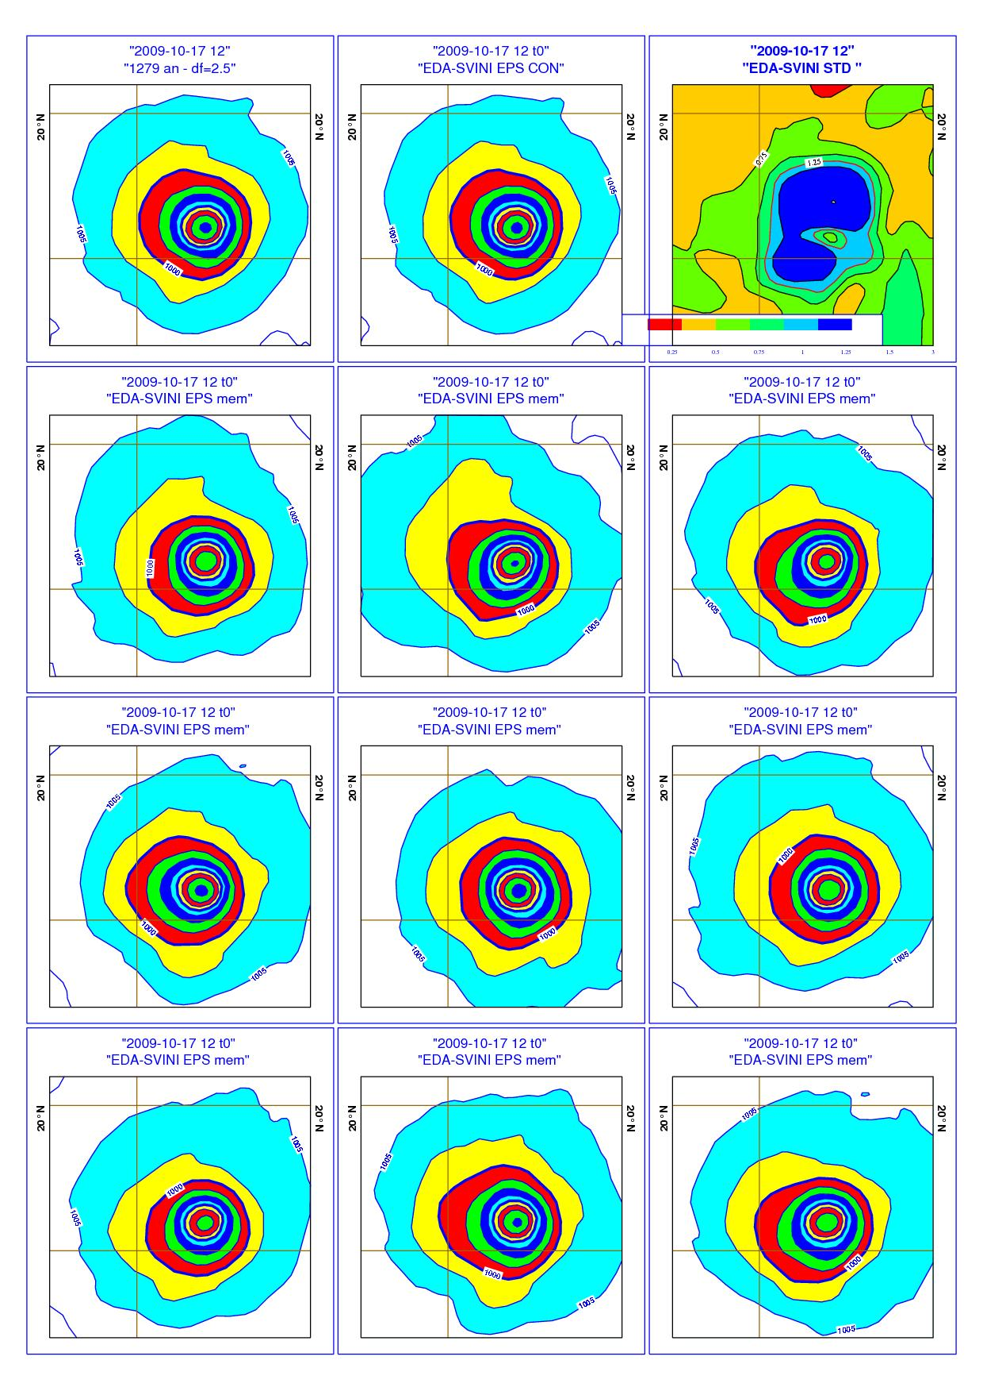
The 4 ECMWF ensembles
Since 2008, ECMWF has been running 4 ensembles:
The 25-member Ensemble of Data Assimilation (EDA)

Slide 6
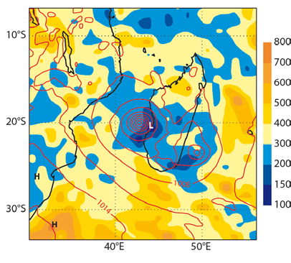
The 4 ECMWF ensembles
The EDA 25 members provide the next cycle’s analyses (the HRES 4d-Var and the EDA) with flow dependent background error statistics. They are also used to simulate initial uncertainties in the forecast ensembles.
Background error correlation length scale for long(p_{msl}) and p_{msl}
4DV₀₀
Un-pert obs
EDA(-12h) var/covar
EDA₀₀
Perturbed obs
Model err
4DV₁₂
Un-pert obs
EDA(-12h) var/co-var
EDA(-12h) var/covar

Slide 7
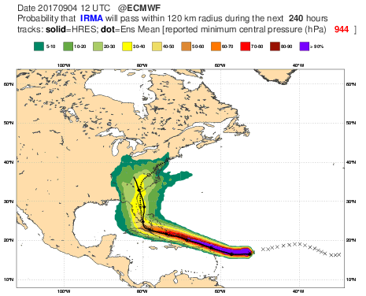
The 4 ECMWF ensembles
Since 2008, ECMWF has been running 4 ensembles:
The 25-member Ensemble of Data Assimilation (EDA)
The 51-member medium-range/monthly ensemble (ENS)

Slide 8
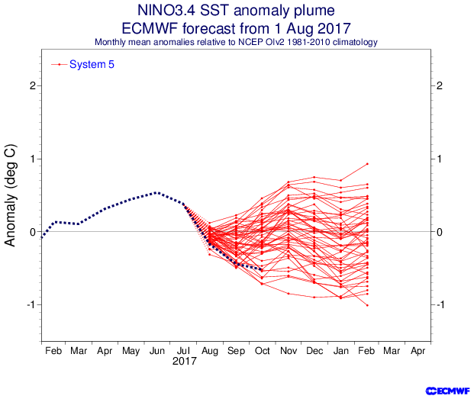
The 4 ECMWF ensembles
Since 2008, ECMWF has been running 4 ensembles:
The 25-member Ensemble of Data Assimilation (EDA)
The 51-member medium-range/monthly ensemble (ENS)
The 51-member seasonal ensemble (SEAS5)
obs

Slide 9
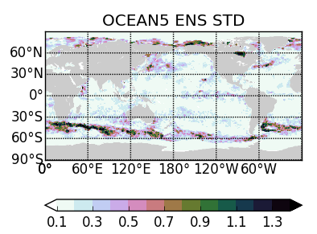
The 4 ECMWF ensembles
Since 2008, ECMWF has been running 4 ensembles:
The 25-member Ensemble of Data Assimilation (EDA)
The 51-member medium-range/monthly ensemble (ENS)
The 51-member seasonal ensemble (SEAS5)
The 5-member ocean ensemble (OCEAN5)
(H Zuo, K Mogensen)

Slide 10
Key characteristics of the 4 ECMWF ensembles
Ensemble | # | Atmosphere Resolution | Ocean Resolution | Sea-ice | OBS and IC unc | Model unc | Frequency
4DVAR HRES(d0-10) | 1 | Tco1279L137 (9km) | 0.25deg-z75 (25km) | LIM2 | -- | -- | 4/day
EDA | 25 | Tco639L137 (18km) | -- | -- | OBS | SPPT(3L) | 2/day
ENS (d0-15) | 51 | Tco639L91 (18km) | 0.25deg-z75 (25km) | LIM2 | IC | SPPT(3L) | 2/day (4/day to d6.5)
ENS (d15-46) | 51 | Tco319L91 (36km) | 0.25deg-z75 (25km) | LIM2 | IC | SPPT(3L) | 2/week
SEAS5 (m0-7/13) | 51 | Tco319L91 (36km) | 0.25deg-z75 (25km) | LIM2 | IC | SPPT(3L) & SKEB | 1/month
OCEAN5 | 5 | -- | 0.25deg-z75 (25km) | LIM2 | OBS | N | 1/day

Slide 11
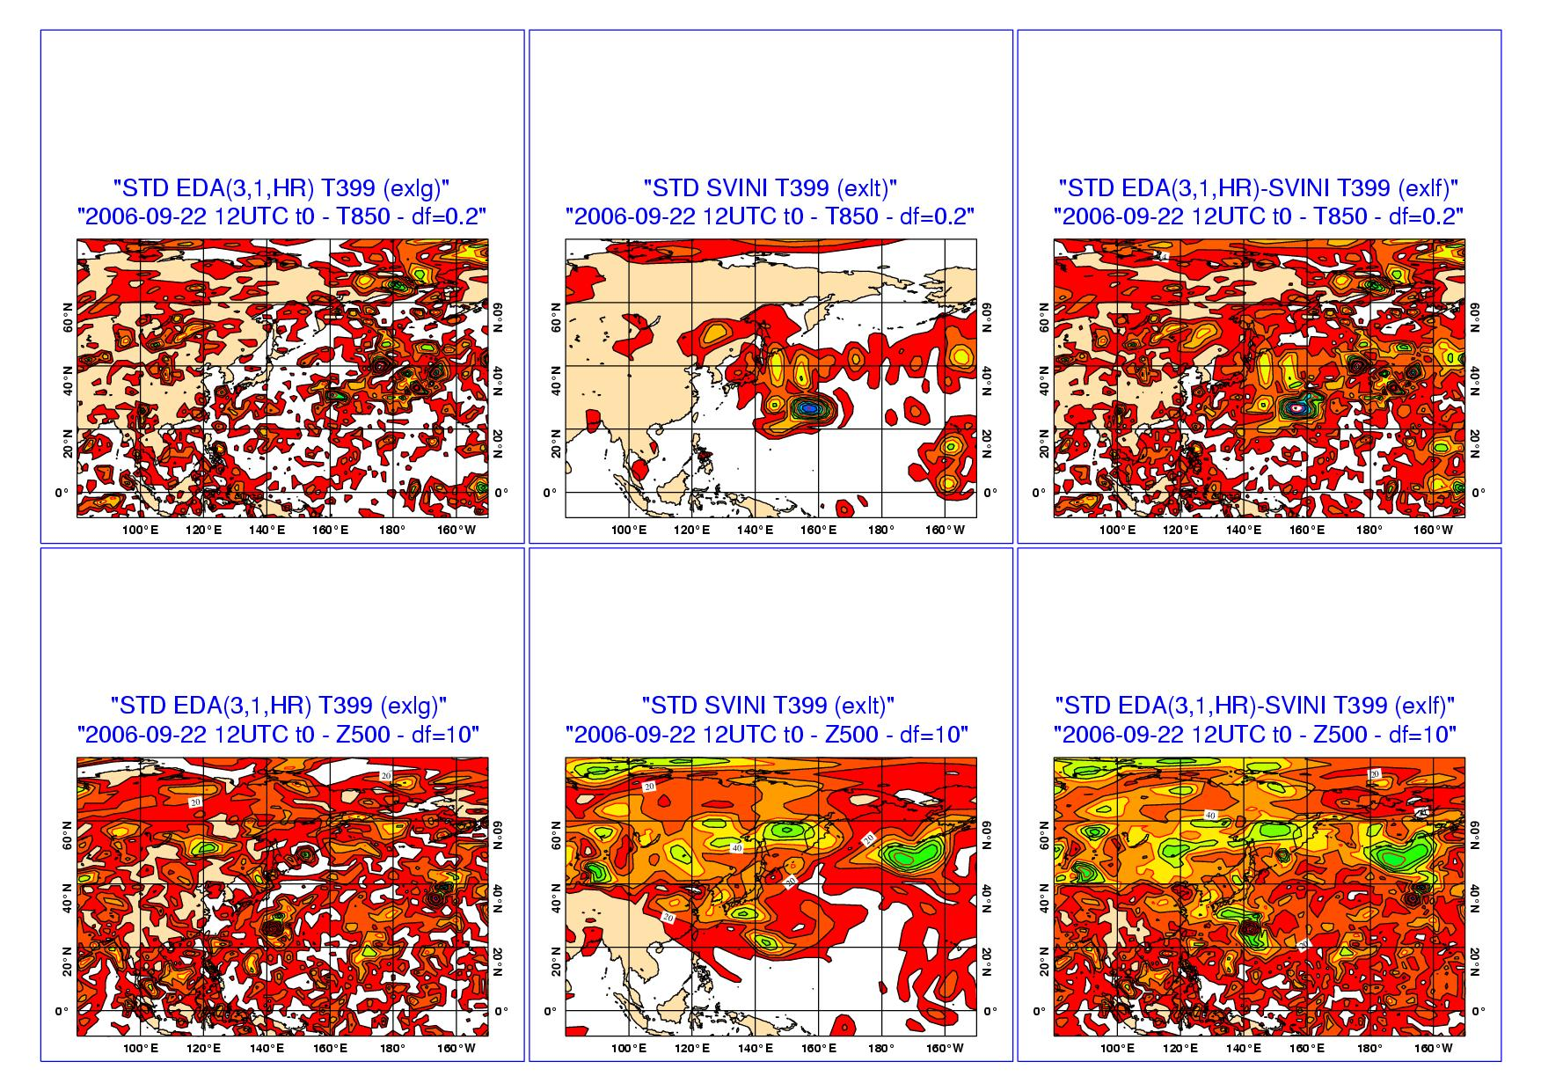
Initial uncertainties estimated with SVs & EDA
EDA SVs EDA+SVs
Two sets of initial perturbations are used:
EDA-based perturbations to simulate the effect of obs errors
Singular vectors to capture the initial error components that could lead to the fastest error growth

Slide 12
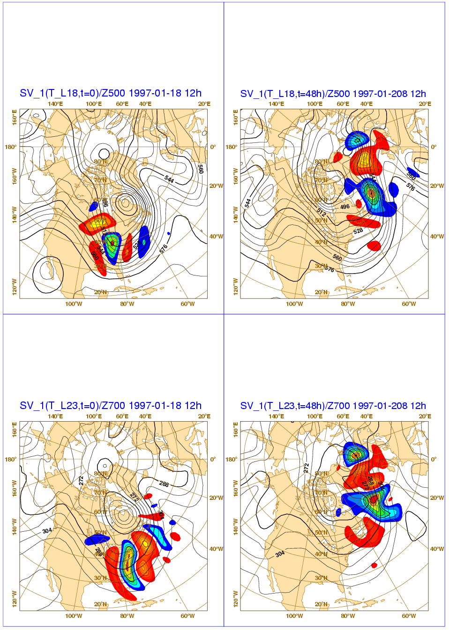
The SVs key characteristics
T=0
T=+48h
Singular vectors identify the perturbations with the fastest (total energy) growth over a 2-day period.
They are computed solving an eigenvalue problem:
500hPa
700hPa

Slide 13
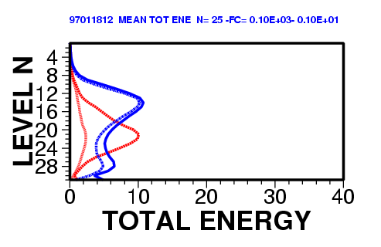
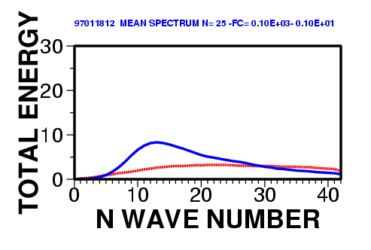
The SVs key characteristics
Singular vectors are still computed at rather low resolution (T42L91).
At initial time, they have most of their (potential) energy on the small scales.
As they grow, potential energy is transformed into kinetic energy.
Energy flows from the smaller to the larger scales.
In the vertical, perturbations propagate from the lower to the upper levels.

Slide 14
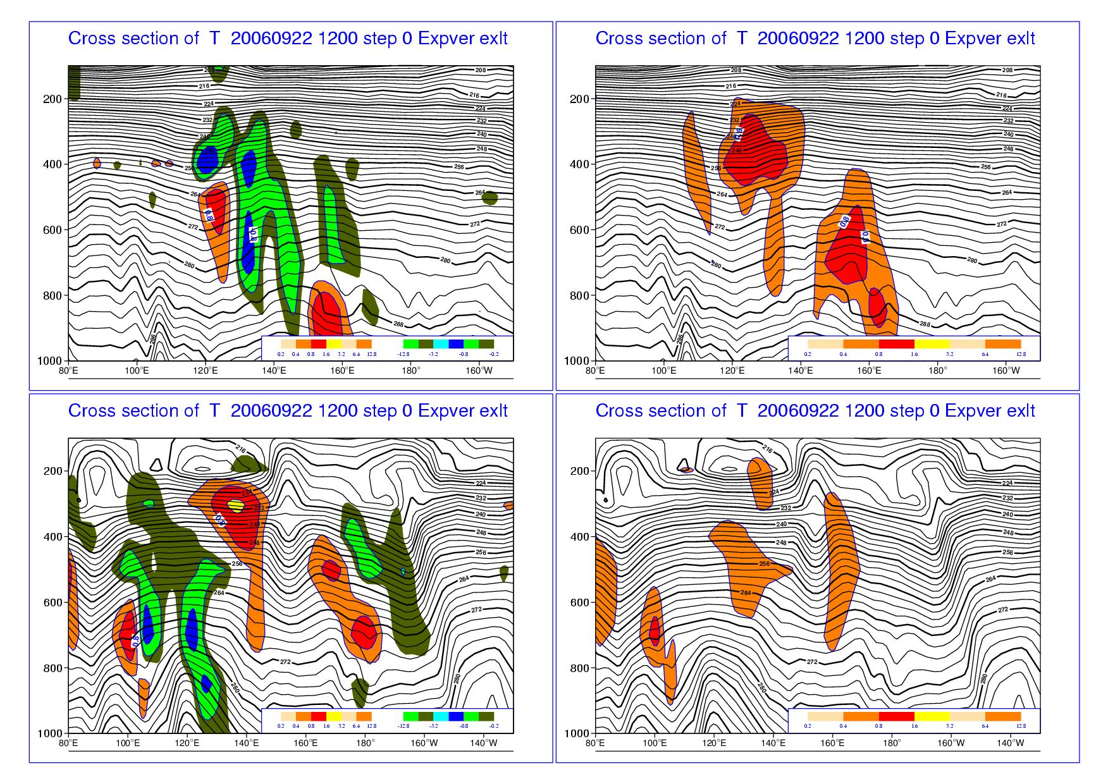
The SVs key characteristics
SV(Temp) SV(U-comp)
Singular vectors:
are spatially localized;
have a larger component in potential than kinetic energy
show a westward tilt with high, typical of baroclinically unstable structures.
30°N
50°N

Slide 15
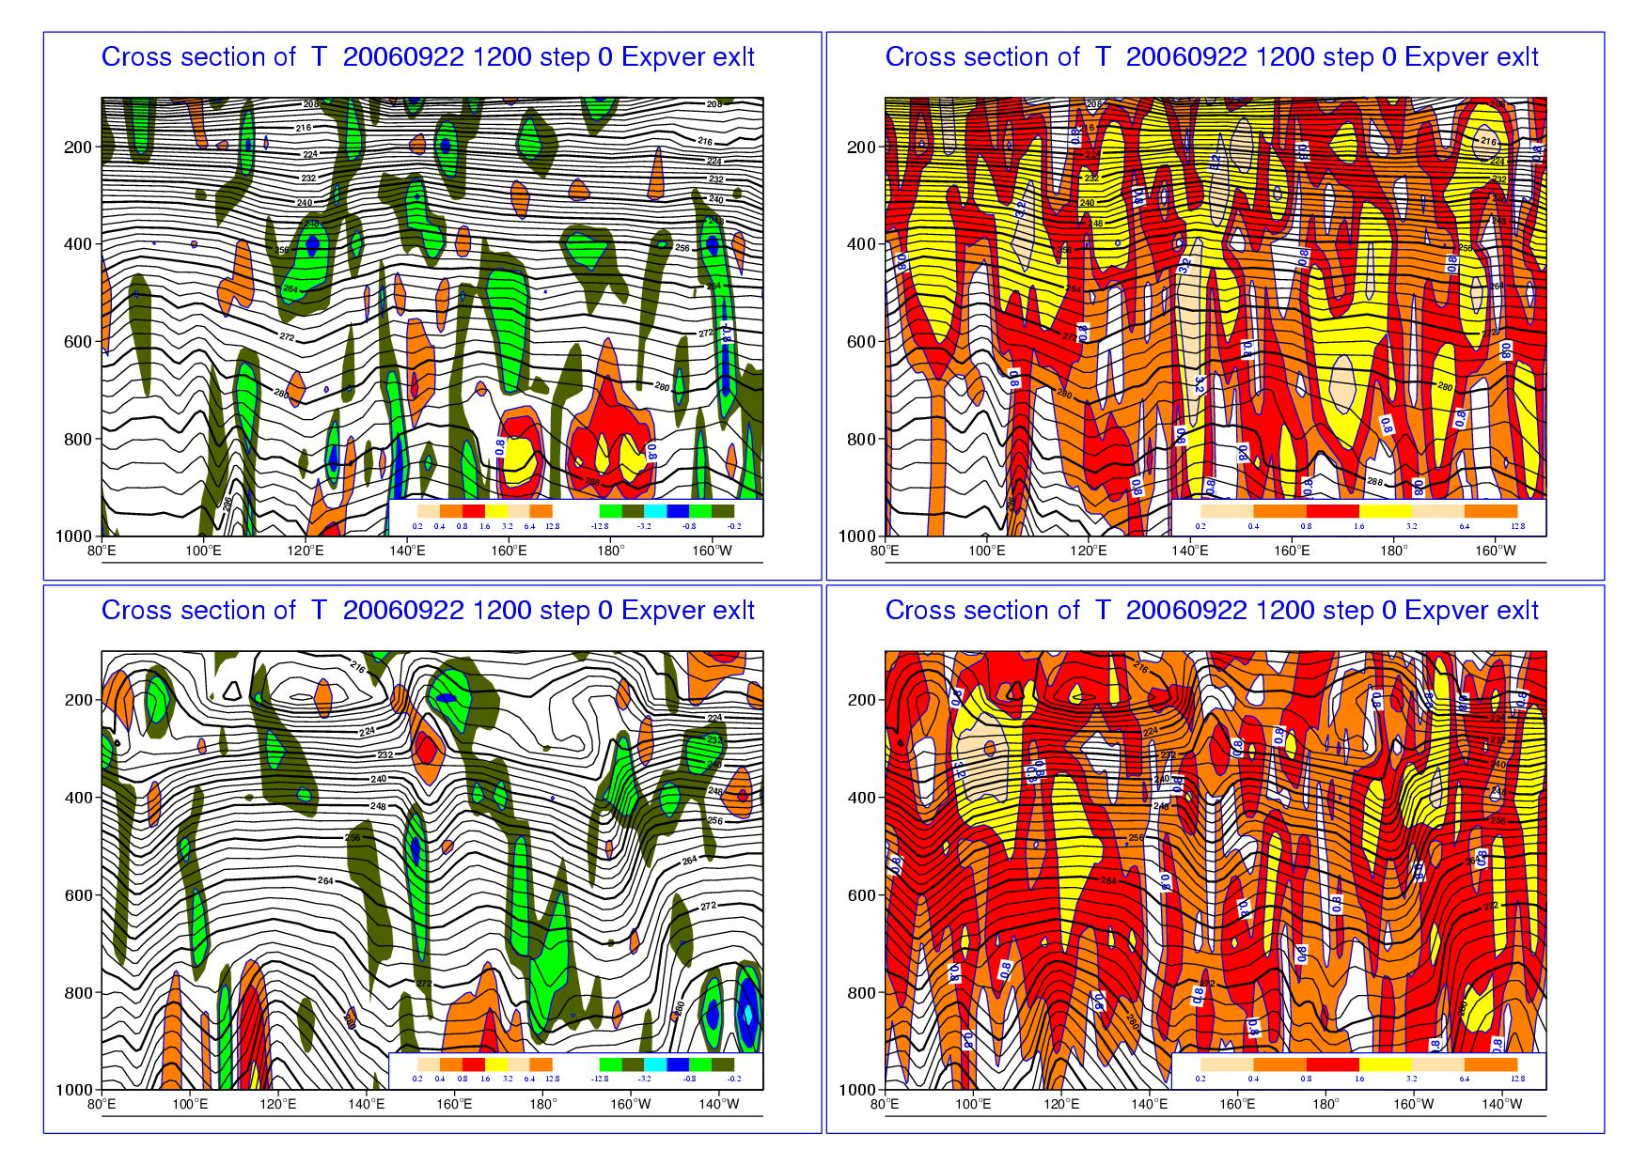
The EDA-based perturbations
SV(Temp) SV(U-comp)
EDA-based perturbations:
include smaller scales;
are less localized in space;
have a similar amplitude in potential and kinetic energy;
30°N
50°N

Slide 16
Stochastic model uncertainties
Each ensemble forecast is given by the time integration of perturbed equations
SPPT: Stochastically Perturbed Parameterized Tendencies
(to represent uncertainty associated with parameterisations)
SKEB: Stochastic Kinetic Energy Backscatter
(to represent unresolved upscale energy transfer)

Slide 17
Stochastic model uncertainties [SPPT(3L)]
Model uncertainties are linked to the approximate description of the physical processes, and to the coarse resolution of our models.
They are simulated by perturbing the tendencies by stochastic perturbations with 3 spatial and temporal characteristic scales.
r

Slide 18
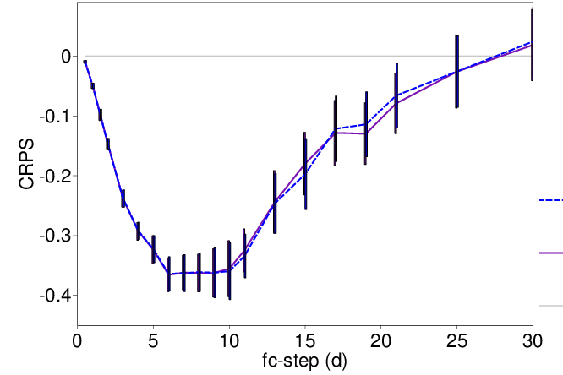
Stochastic model uncertainties [SPPT(3L)]
Tropics
The introduction of the simulation of model uncertainties has improved the ENS reliability and accuracy.
Since June 2018 (cycle 45r1) the same stochastic physics’ scheme SPPT(3L) is used in the EDA and ENS.
SEAS5 includes also the SKEB scheme.
SPPT
SPPT + SKEB
[Results based on U200; ENS run with TCo255/TCo159, 46 dates (2013-2014), with 20 members]

Slide 19
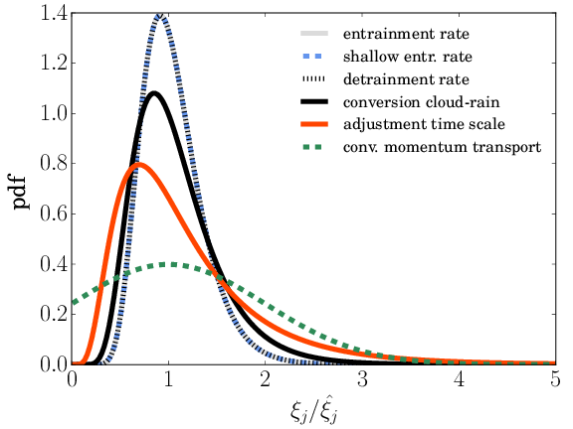
Stochastically Perturbed Parameterisation [SPP]
Stochastically Perturbed Parametrisations (SPP) (Ollinaho et al., 2017, QJRMS):
e.g. convection scheme parameters are perturbed with numbers drawn from distributions shown.
Parameters/variables within parametrisation schemes are multiplied with noise from a 2D random pattern:
correlated in space (2000 km) and time (72 h).
Under development and testing, with 20 independent perturbations in parametrisations of sub-grid orography and vertical mixing, radiation, cloud and large-scale precipitation and convection.
So far results indicate SPP not as effective as SPPT.

Slide 20
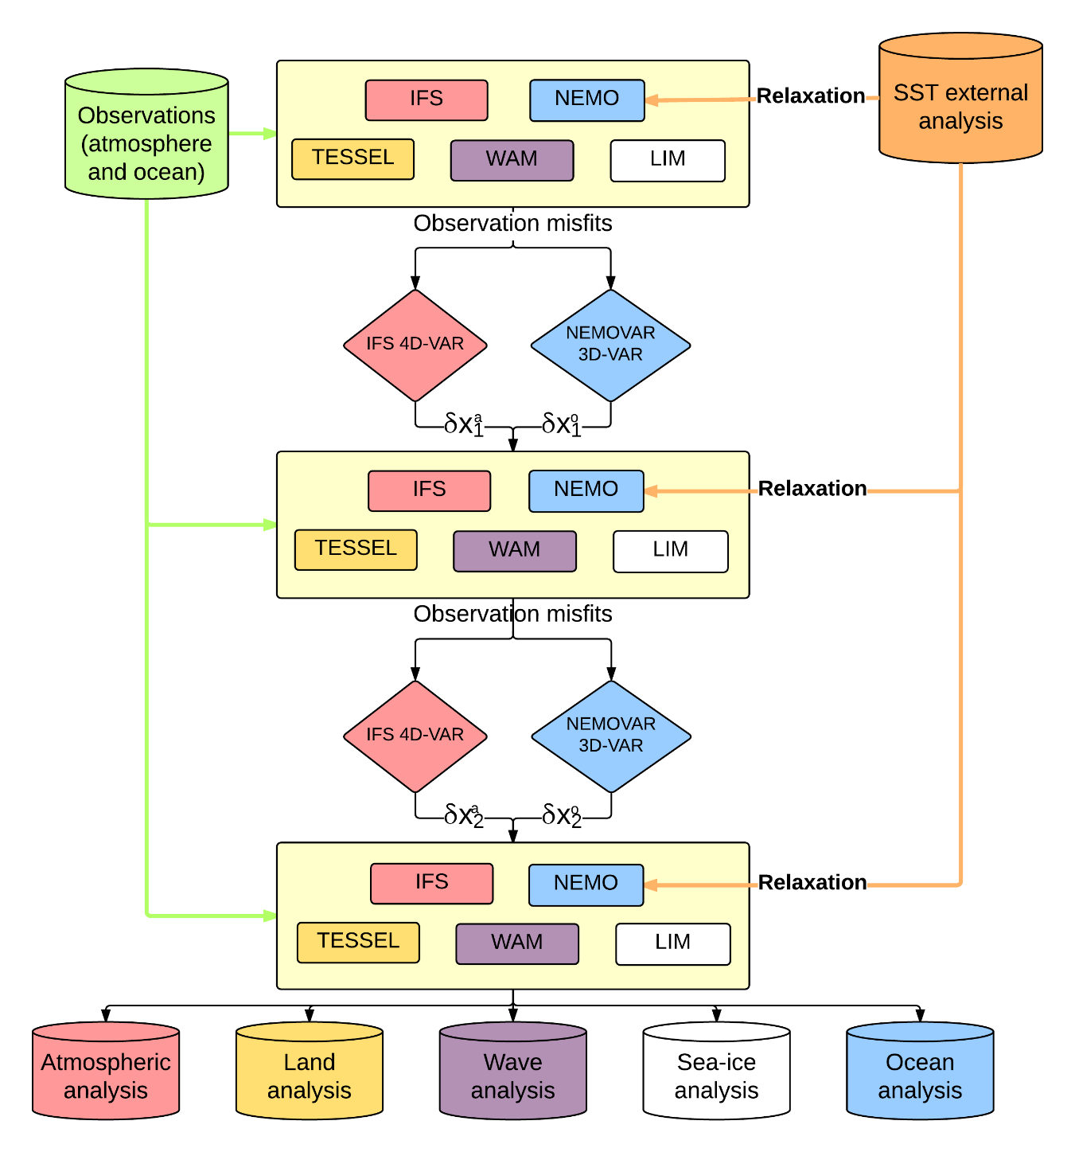
CERA: the ECMWF coupled DA
The coupled model computes observation misfits in each outer iteration
The SST computed in NEMO and constrained by relaxation
The atmospheric and ocean increments are computed in parallel to correct the initial state
The analysis is dynamically consistent with the coupled model

Slide 21
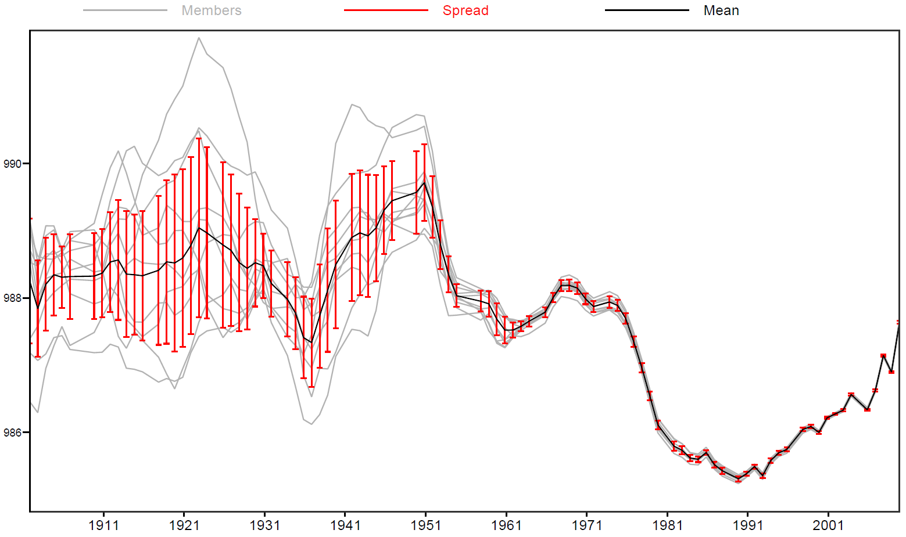
CERA20C: 110y of ensemble coupled reanalyses
CERA-20C (EU-FP7 ERACLIM2 proj): a 10-member ensemble of coupled reanalyses spanning 110 years (1901-2010). CERA20C gives an estimate of the uncertainty of the past climate (more/better obs lead to smaller spread).
Mean sea-level pressure (60S-90S)

Slide 22
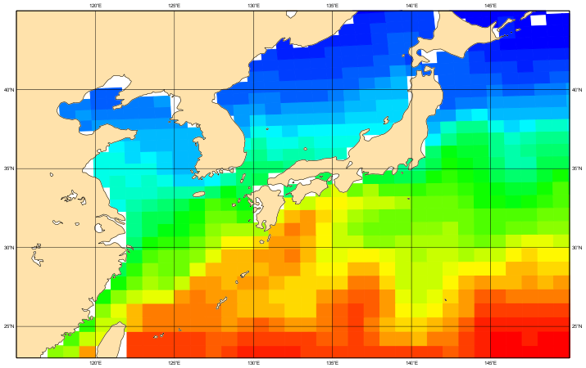
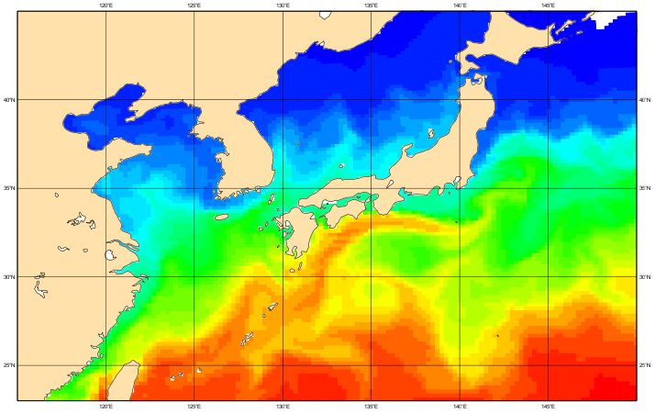
CERA-SAT
The CERA DA system is being used to generate CERA-SAT, a coupled ensemble reanalysis of few years (2008-to-date) of the satellite era:
Atmosphere (IFS) from 110km to 65km
Ocean (NEMO) from 1 degree (42 levels) to ¼ degree (75 levels)
Satellite assimilation
1 degree
1/4 degree

Slide 23
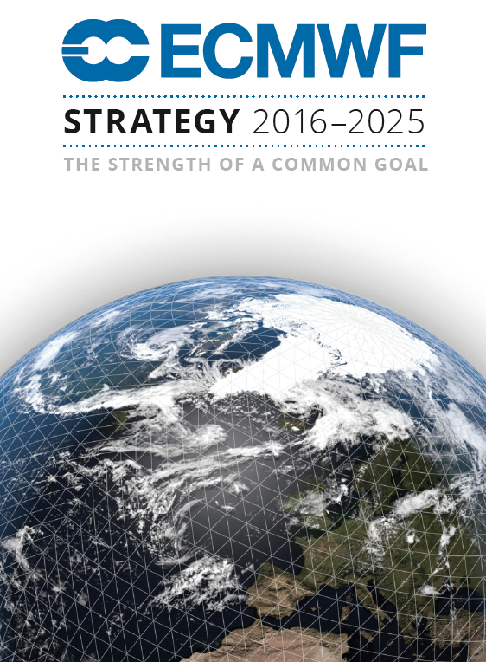
The future: focus on five key areas
As stated in our strategy 2016-2015, by:
Improving our model (processes, uncertainty est) and assimilation system
Assimilating more observations
Building more consistent Earth-system ensembles of analyses and forecasts
Increasing the ensembles’ resolution
Understanding predictability

Slide 24
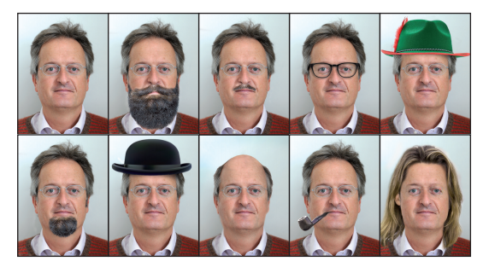

Always remember: an ensemble is better than one, even if it is special!!

