Slide 1
Met Office global ensemble prediction developments
Warren Tennant, Neill Bowler, Helen Titley
Acknowledgements: Rebecca Stretton, Mohamed Jardak, Phil Gill and Anette van der Wal
Bureau of Meteorology – R&D Workshop 2018
Melbourne, 26-30 November 2018

Slide 2
Global NWP configuration (PS41)
Technical component | Deterministic | MOGREPS-G
Resolution (grid point) | 2560x1920 reg lat/lon = 10km (in mid-latitudes) | 1280x960 reg lat/lon = 20km (in mid-latitudes)
Vertical levels + Time-step | 70 levels (model top 80 km) and Time-step = 4min | 70 levels (model top 80 km) and Time-step = 7.5min
Science configuration | GA6.1 – Walters et al (2017) GL8.1 – Walters et al. (2017) in review | GA6.1 – Walters et al (2017) GL8.1 – Walters et al. (2017) in review
Forecast length & frequency | 7-days at 00Z and 12Z 2.5-days at 06Z and 18Z | 17 pert + 1 control = 18 members to 7-days every 6 hours. Lag two cycles to form 36-mem ensemble
Initial conditions | 4D-hybrid-VAR | Interpolated from high-resolution deterministic analysis
Initial condition perturbations | none | Ensemble Transform Kalman Filter (using 44 members)
Stochastic physics | none | SKEB + Stochastic Perturbation of Tendencies (SPT) (Sanchez et al, 2016, doi:10.1002/qj.2640)
Surface perturbations | none | Sea-surface temperature, soil-moisture and deep soil-temperature (Tennant and Beare, 2014)

Slide 3
PS41 : Forecast model changes
Upgrade Global Land version from GL6 to GL8:
Multi-layer snow scheme which improves winter 2m temperatures due to improved insulation of the ground by snow-cover
Improved parameterisation of surface roughness (turbulent fluxes) for the ocean and sea-ice leads to more realistic wind forecasts but also slightly increases the positive near-surface wind-speed bias
Improved albedo over land and sea
Replace stochastic physics Random Parameter scheme (RP2) with Stochastic Perturbed Tendencies (SPT)
Improved ensemble spread, especially 2m temperature in extra-tropics and 850hPa temperature in the tropics

Slide 4
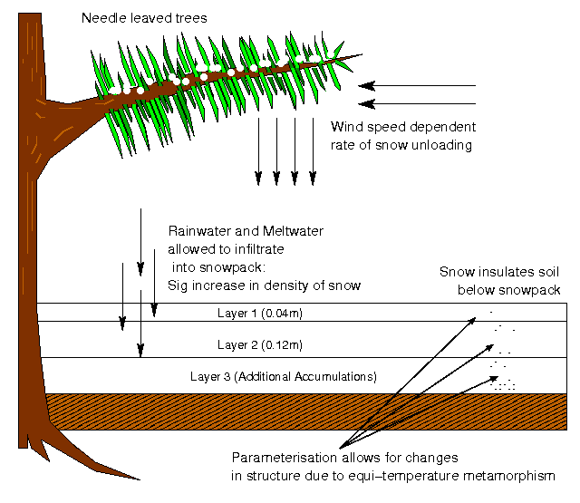
Multi-layer snow scheme
GL8 snow scheme better represents the insulating effects of a snowpack by using multiple layers with different properties to processes like:
conduction of heat through the air within the snowpack
equi-temperature metamorphism (vapour sublimes from protrusions on snowflakes and is deposited in hollows so that snowgrains become more rounded over time)
rainwater and meltwater is allowed to infiltrate into the snowpack which significantly affects its density
unloading of snow from needle-leaved trees is wind-speed dependent
Warm near-surface air temperature bias over snow is reduced, which also improves Pmsl scores

Slide 5
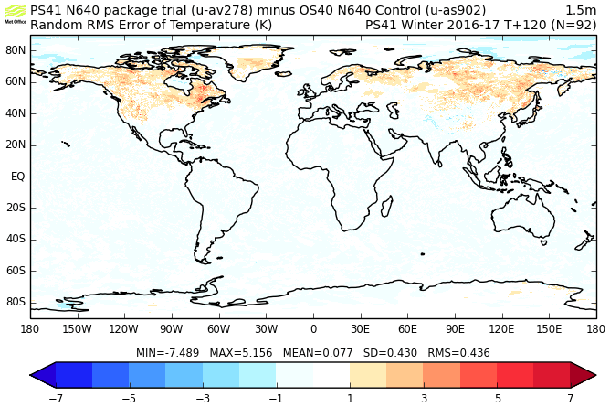

2m Temperature error at 5 days (DJF16/17)
Does increase variability so that the random component of the error is greater (left)
Consistent improvement in bias of 1.5m temperature, especially over snow-covered ground (right)

Slide 6
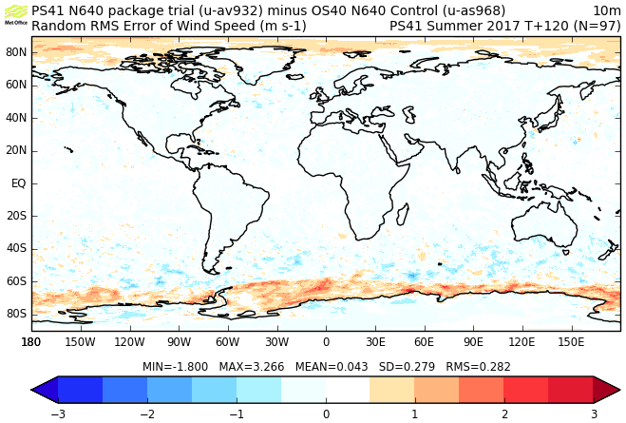
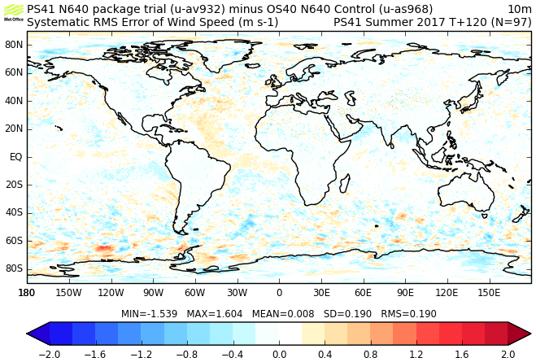
10m wind-speed error at 5 days (JJA17)
Increase in random component of error near sea-ice edge, but improved in westerlies (left)
Change to systematic component of overall error is small. Some evidence of coherency in the North Atlantic

Slide 7
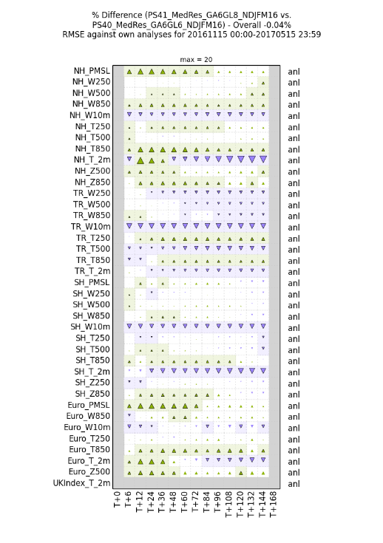
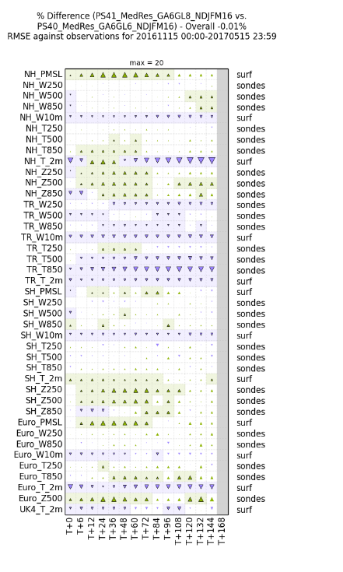
GL8 Impact
Overall neutral impact from GL8, but notable improvements to:
Pmsl in NH
geopotential heights
2m temperature over snow covered areas
Similar signal against Obs, own Anl and EC Anl

Slide 8
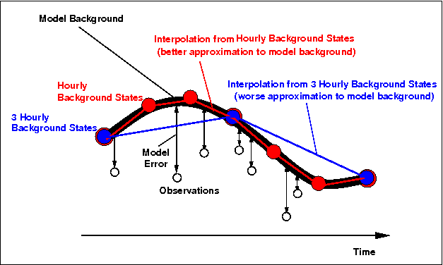
PS41 : Data Assimilation changes
New satellite observation data: RTTOV12 upgrade, T & Q from GNSS on FY-3C, surface winds from Indian Scat-Sat, increased aerosol data from NASA
New moisture incrementing operator to improve radiance assimilation in the presence of cloud and precipitation, with assimilation of low-peaking AMSU-A channels (4 & 5) in all-sky conditions – analysis increments now include qCl, qCf and q
Increased sampling frequency of background forecasts (3 hourly -> hourly) in OPS Processing to exploit non-linear processes better in our hybrid 4dVar data assimilation
New interpolation method for ASCAT Soil Moisture observations to remove diamond-shaped regions of “no-observation” at high resolution
…simple technical changes can have substantial benefit…

Slide 9
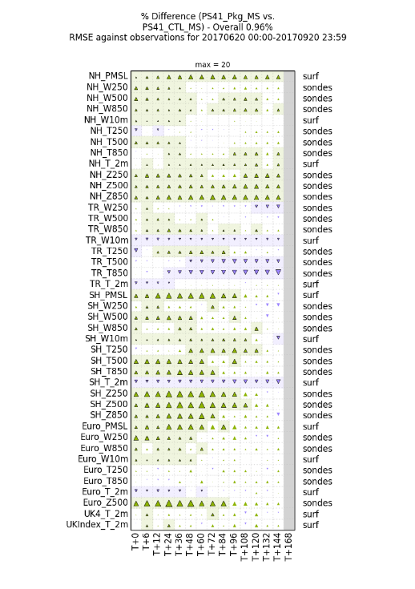
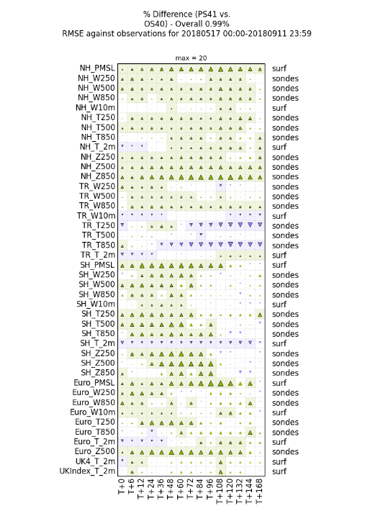
How does PS41 performance compare to the package trials?
Package trial results (left) – strong positive signal
Actual PS (right) – different year, but similar period. Very similar!
This might be a first, because historically something has always gone pear-shaped
We also saw consistent scorecards at different resolutions giving us confidence that lower resolution trialling is robust
Ensemble performance is strongly dependent on the deterministic model (next slide…)

Slide 10
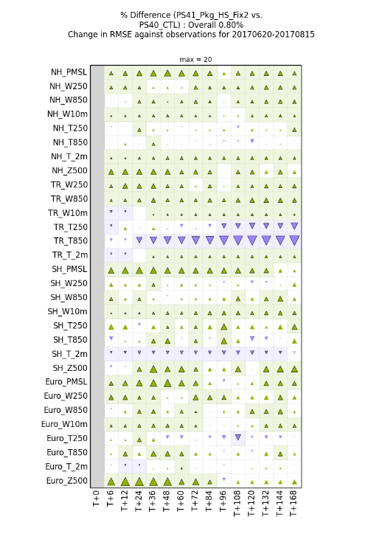
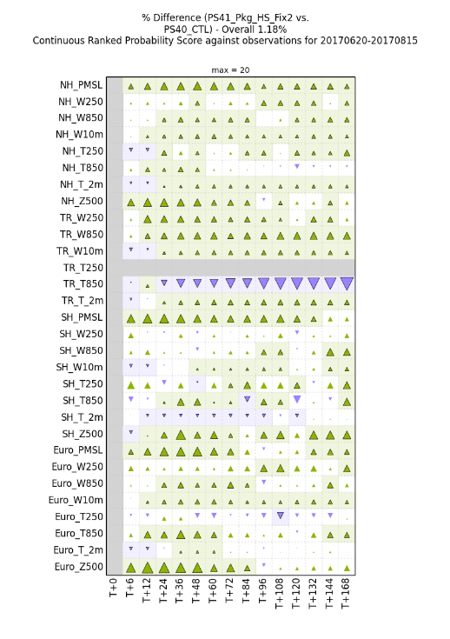
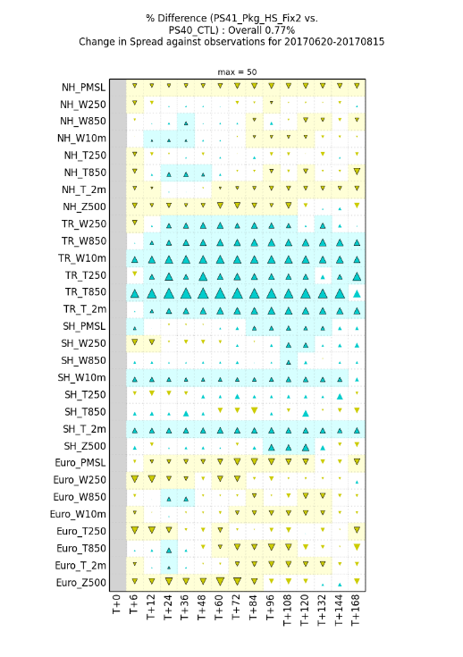
PS41 Impact on MOGREPS-G performance (vs Obs) RMSE (left), CRPS (centre), spread (right) up triangle indicates increase in skill/spread, shading denotes significance

Slide 11
Verification summary
Strong positive scores all round – similar to results from PS40
Reduced 2m temperature bias [esp over snow] with improved RMSE errors at short lead-times, but increased at longer lead-times
GL8 increases 10m wind-speed generally with improved RMSE scores in the extra-tropics but increased RMSE in the tropics
T850 in tropics worse against radiosondes, but improved against EC analysis and own analysis at longer lead-times
SPT addresses a long-standing issue of an under-dispersive ensemble in the tropics
Improved CRPS scores almost throughout – showing that we have a more reliable ensemble (spread matches error better)
Good consistency of scores between seasons and resolutions
 | Index Obs | Index Anl | Index EC | CRPS Obs | CRPS Anl
High-res winter | +1.0 | +2.6 | +2.6 | +1.1 | +2.7
High-res summer | +1.3 | +1.4 | +1.2 | +0.7 | +2.1
Med-res winter | +0.8 | +1.2 | +1.5 | n/a | n/a
Med-res summer | +0.9 | +1.4 | +1.4 | n/a | n/a
PS41 May-Sep18 | +1.4 | +1.7 | n/a | +1.1 | +2.8

Slide 12
Ensemble configuration (shifting uncertainty)
From current operational ETKF configuration PS41
…to…
En-4DEnVar planned for PS43 due for implementation around Sep 2019
Notes:
The primary part of any ensemble prediction system is to perturb the initial conditions of each member. In MOGREPS this is a set of perturbations that are added to the control analysis (which is interpolated from the high resolution deterministic data assimilation system). Currently our 4d-Var and ensemble system is only linked using the 4d-hybrid-Var, but in future the two systems could be a single system 4d-En-Var.

Slide 13
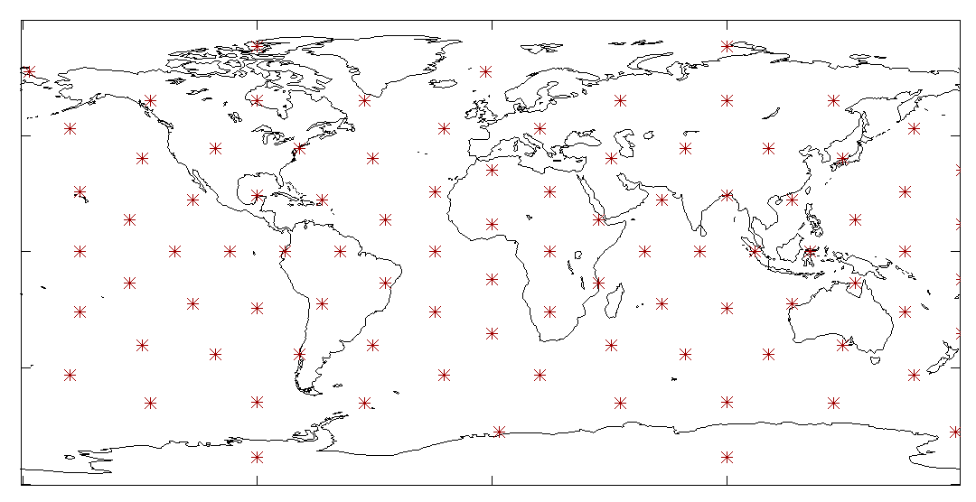
Ensemble Transform Kalman Filter (ETKF)
Generates analysis perturbations by transforming the forecast perturbations (rotating and rescaling within the perturbation subspace)
Calculate transform matrix using observations local to a limited set of points, approximately evenly distributed around globe in 92 regions (see fig → )
Interpolate transform matrix to intermediate grid points
Adaptive level-dependent inflation to maintain spread

Slide 14
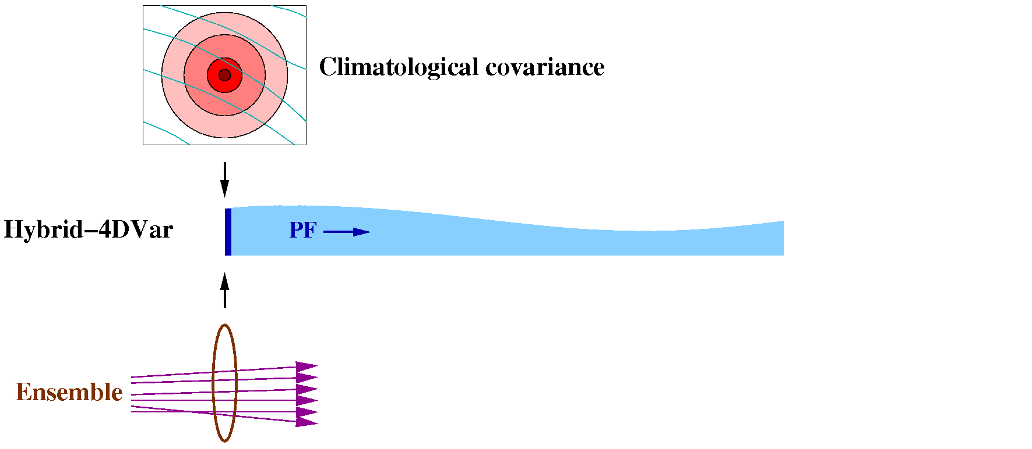
Hybrid-4DVar (current Met Office global deterministic data assimilation configuration)
Hybrid: Combines information from static and ensemble covariances
Linear Perturbation Forecast (PF) model used to propagate information forwards over the DA window (expensive)
Ensemble covariances are noisy – need to be localised
Only takes ensemble information from start of window

Slide 15
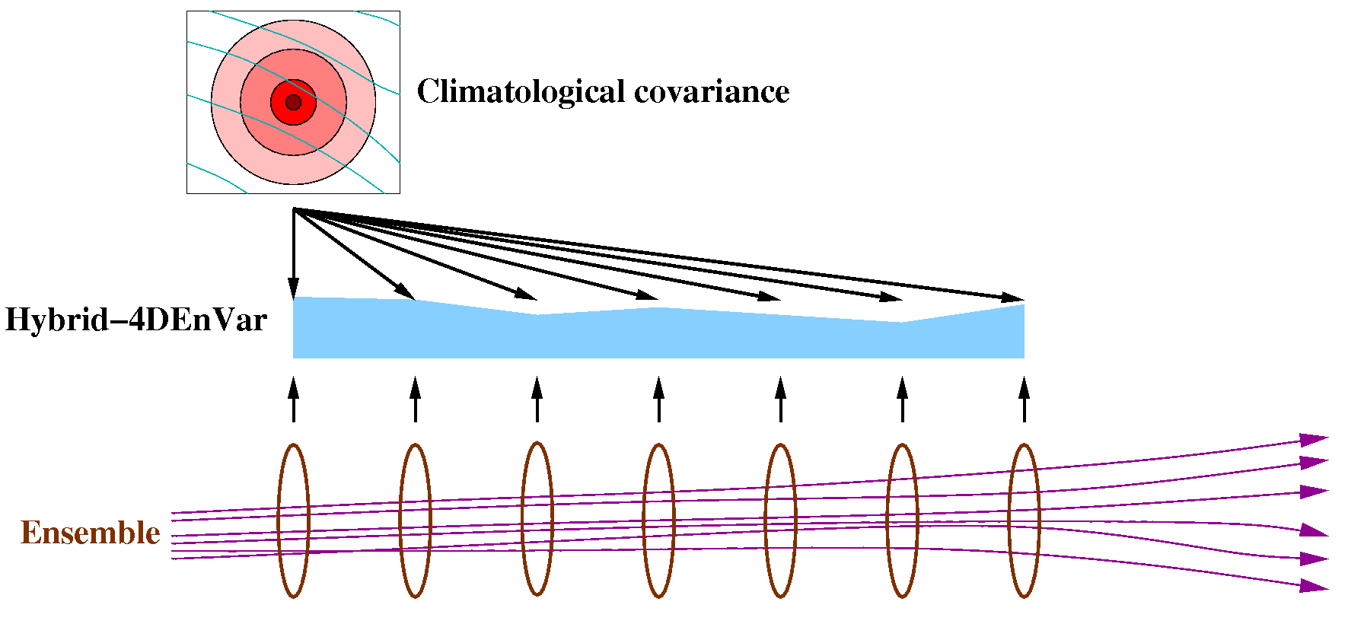
Hybrid-4DEnVar Data assimilation: Hybrid-4DVar → Hybrid-4DEnVar
No PF model, but much more IO required to read ensemble data.
Each iteration ~8 times faster with 200 members.
Analysis consists of two parts:
A 3DVar-like analysis based on the climatological covariance B_{c}
A 4D analysis consisting of a linear combination of the ensemble perturbations.
Localisation is currently in space only: same linear combination of ensemble perturbations at all times.

Slide 16
Ensemble update: ETKF → (Hybrid-)En-4DEnVar En-4DEnVar
The 4DEnVar executable can also do an ensemble of analyses: En-4DEnVar:
(For each member, create increments relative to its own background trajectory.)
Routines were added to deal with perturbed observations, inflation, etc..

Slide 17
Ensemble 4d-Ensemble-VAR “…the small print…”
Ensemble of data assimilations (i.e. the En-4DEnVar step):
Perturbed observations
“Mean-pert” method, to reduce computational cost
“Simple self-exclusion” method to prevent inbreeding
Inflation to account for DA deficiencies:
RTPP: Relaxation to Prior Perturbations
RTPS: Relaxation to Prior Spread
To account for model uncertainties:
Stochastic Perturbed Tendencies (SPT)
SKEB: Stochastic Kinetic Energy Backscatter
Additive inflation based on scaled historical analysis increments, plus bias correction
To account for other uncertainties:
Random perturbations to SST, soil moisture and soil temperature
Ensemble of data assimilations (i.e. the En-4DEnVar step):
“Mean-pert” method, to reduce computational cost
“Simple self-exclusion” method to prevent inbreeding
Smooth Gaussian localisation (600km standard deviation, ~2222km equivalent cut-off)
Hybrid co-variances – 50% Bc / 50% Be
Partial re-centring with deterministic analysis to maintain consistency with deterministic forecasts
Inflation to account for DA deficiencies:
RTPP: Relaxation to Prior Perturbations (maintains good spread, but perturbations too large-scale and too balanced)
RTPS: Relaxation to Prior Spread (realistic effect on scale and balance of perturbations, but poor at maintaining spread)
To account for model uncertainties:
Stochastic Perturbed Tendencies (SPT) [aka Stochastic Perturbation of Physics Tendencies SPPT]
SKEB: Stochastic Kinetic Energy Backscatter
Additive Inflation (AI): scaled historical analysis increments, plus bias-correction (three month historical archive)
To account for other uncertainties:
Random perturbations to SST, soil moisture and soil temperature (as with ETKF ensemble system)

Slide 18
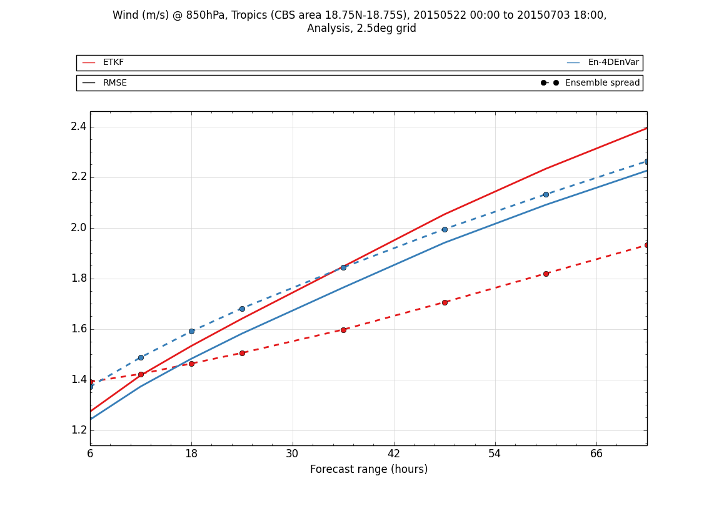
Comparing ETKF – En-4DEnVar
ETKF has good spread at initial time, but grows too slowly in the tropics
En-4DEnVar has much faster spread growth, and this matches errors better
Mainly due to additive inflation for model errors
Similar results seen for other variables
RMSE (solid) and spread (dashed) of wind at 850 hPa for the tropics, measured against ECMWF analyses

Slide 19
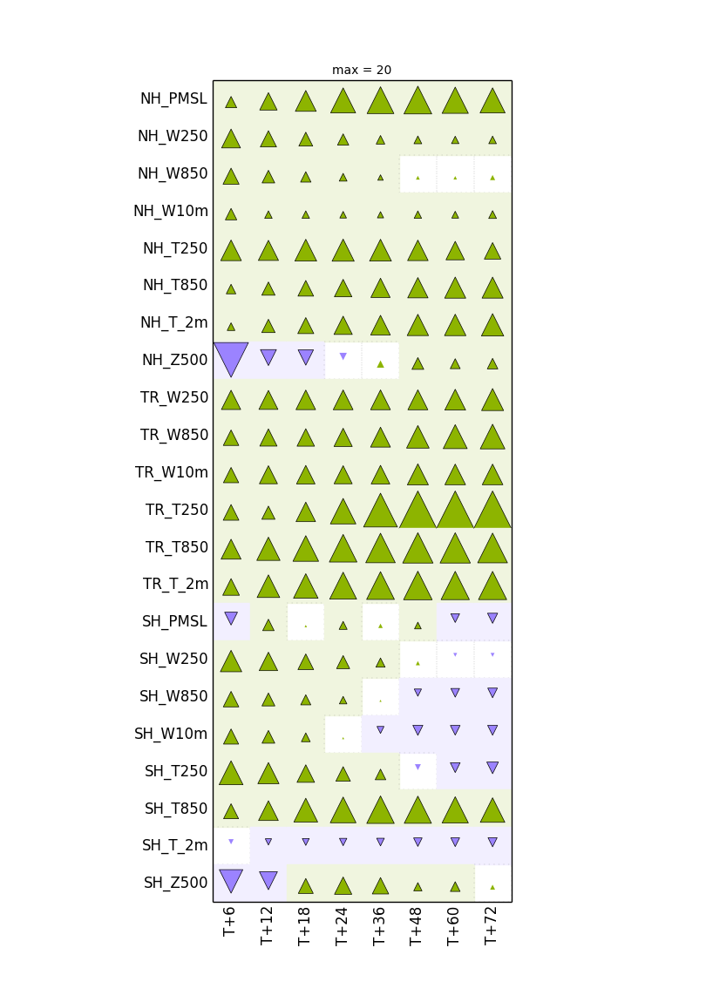
Baseline configuration vs. ETKF-based ensemble
“Ensemble scorecard”, based on CRPS: Continuous Ranked Probability Score.
New ensemble much better.
Change ∝ area of triangle
: at least 20% better
: statistically significant change
% change in CRPS vs. ECMWF analyses

Slide 20
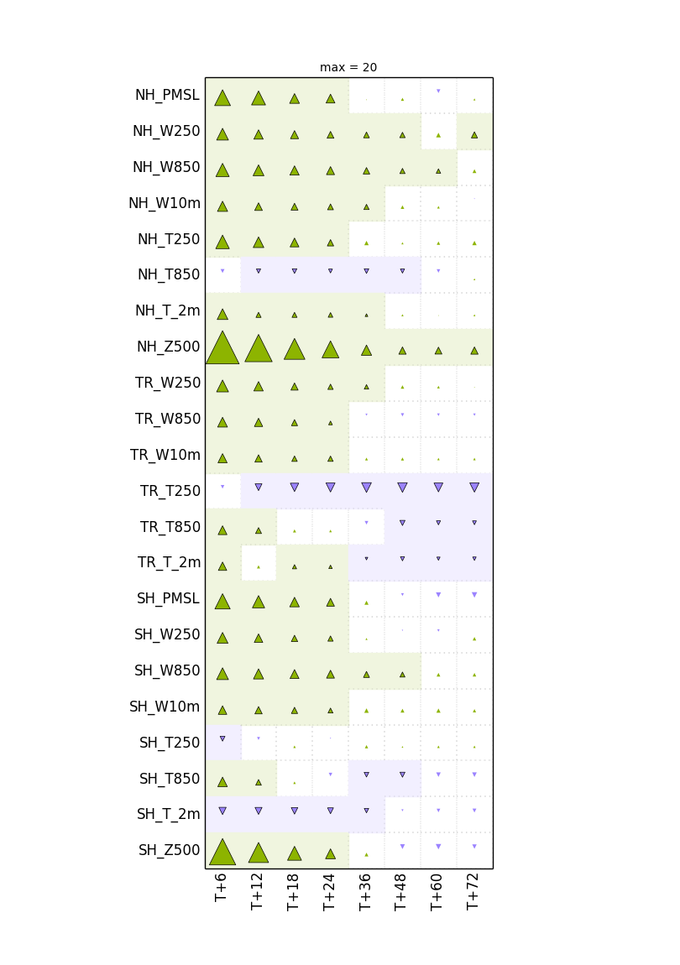
Further improvement: Partial recentring
Baseline fully recentres around the deterministic analysis:
Partial recentring gives benefit:
Ensemble mean
Det. analysis
Ensemble mean
Det. analysis
% change in CRPS vs. ECMWF analyses

Slide 21
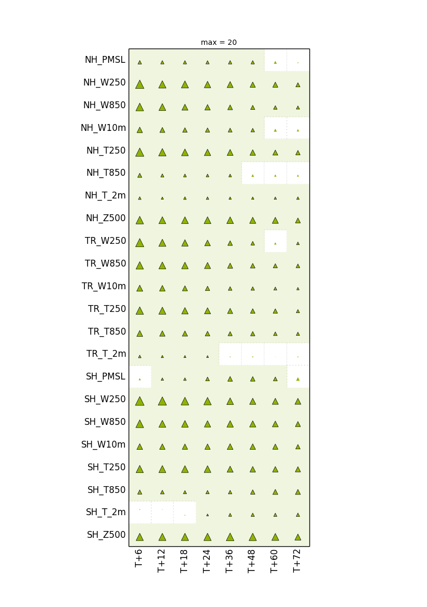
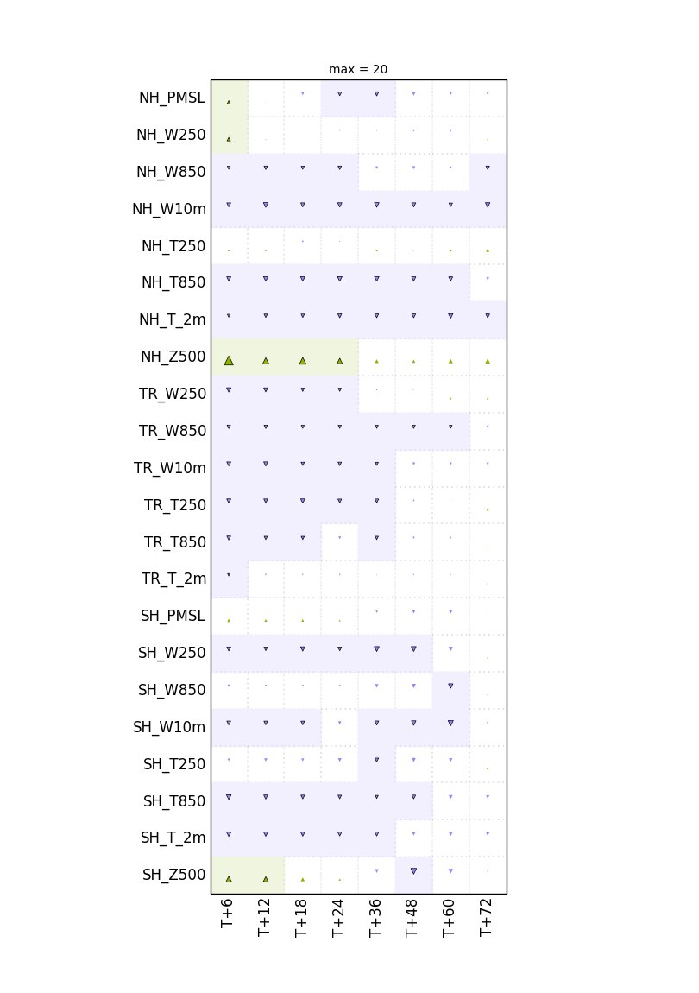
Effect of ensemble size
Testing the effect of changes 44m to 100m
When recentring, increasing ensemble size makes little difference
When running without recentring, increasing ensemble size has large benefits
Ensemble size increases do not affect perturbation structure
Or:
Ensemble scores are insensitive to changes in perturbation structure
% change in CRPS vs. ECMWF analyses

Slide 22
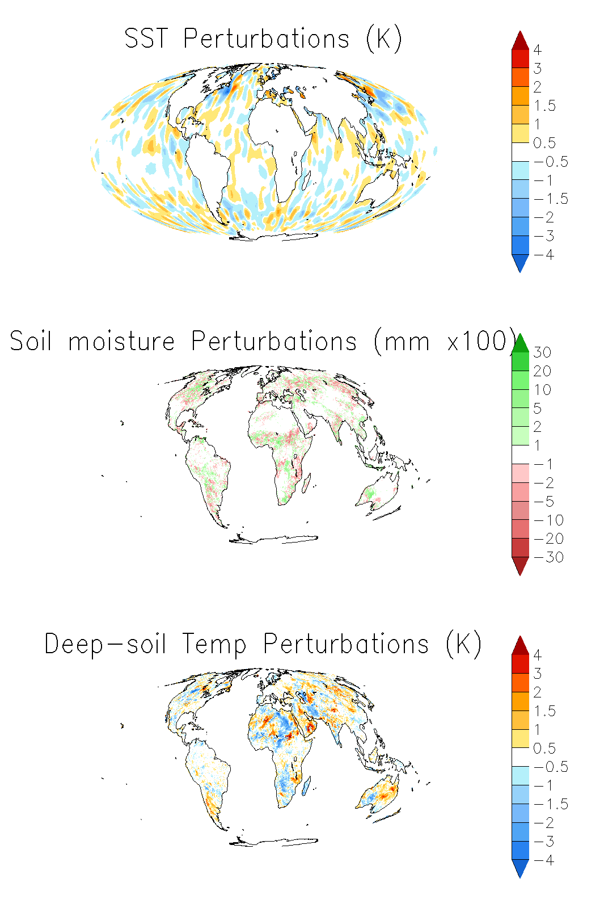
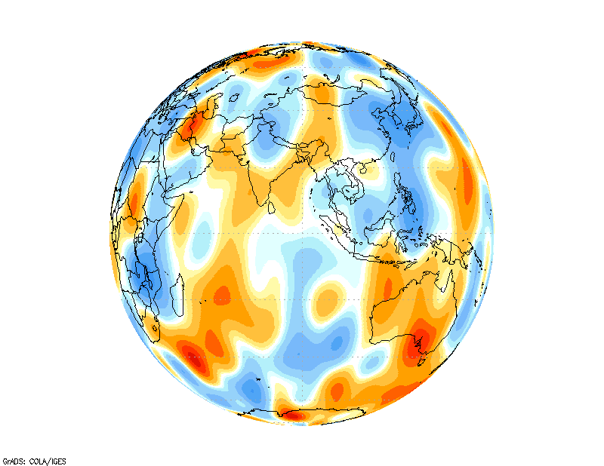
Stochastic physics and other perturbations in MOGREPS-G
SKEB – wind increments injecting Kinetic Energy at prescribed scales and locations to account for missing physical processes
SPT – perturbs physics tendencies to account for model uncertainty
SST / soil-moisture / deep-soil temperature perturbations to account for uncertainty in surface state
SPT forcing pattern
Notes:
Stochastic Kinetic Energy Backscatter (SKEB) scheme implemented in MOGREPS in 2010 (Tennant et al, 2011, MWR:139)
Forcing pattern used as basis for horizontal and vertical structure of perturbations to the wind field at every timestep. This pattern evolves in time following an AR1 process.
The vertical structure is tilted westward with height such that large scales shift by half a wavelength over the depth of the troposphere.
Figures show the change in the SKEB forcing pattern between the New dynamics (GA3-5) and ENDGame (GA6) dynamical cores.

Slide 23
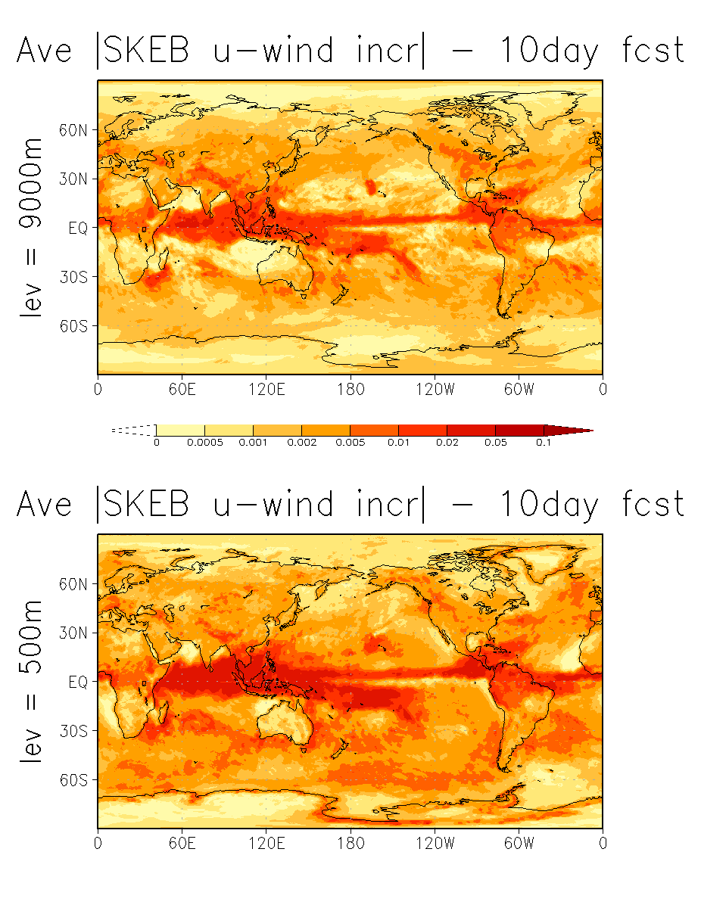
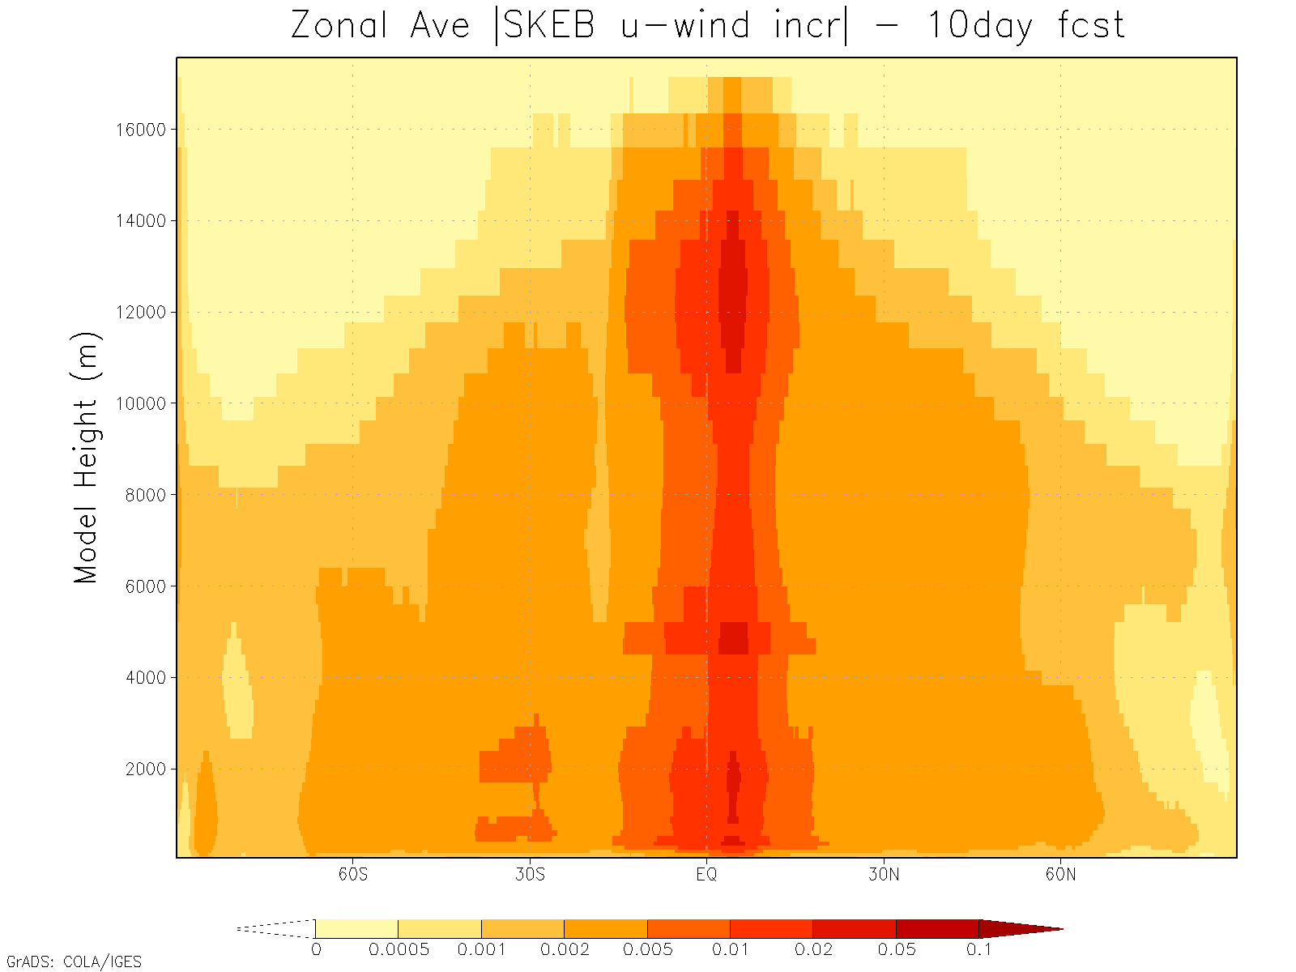
SKEB wind increments (m.s⁻¹)
10-day average of ABS{u-wind incr}
Focuses on areas of deep convection and extra-tropical synoptic systems (by design)
Also targets boundary-layer turbulence

Slide 24
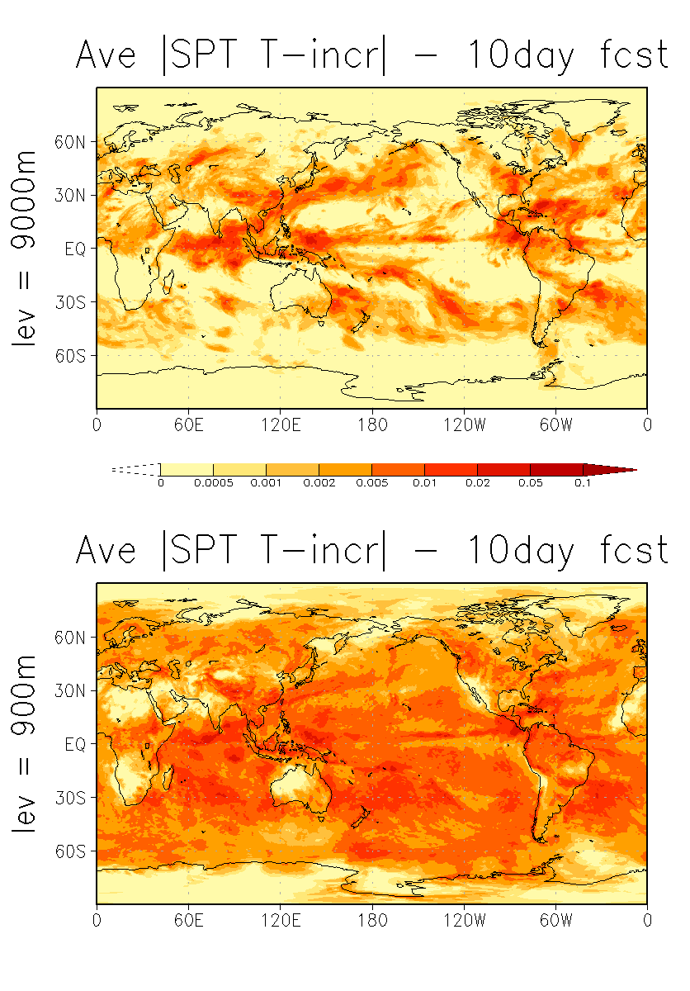
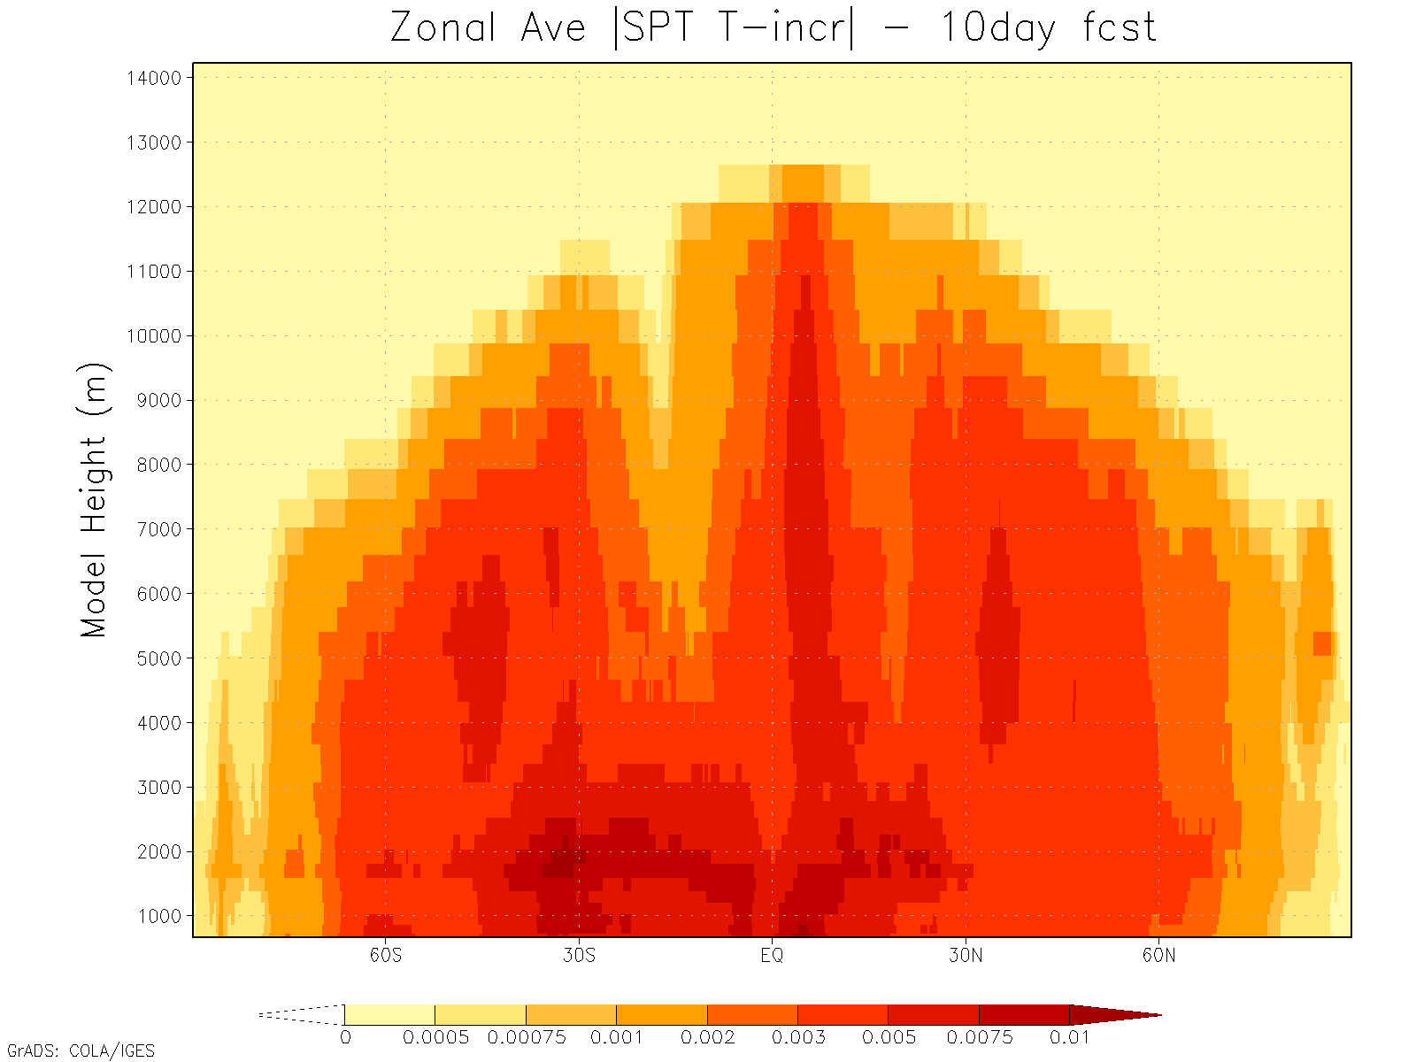
SPT temperature increments (K.timestep⁻¹)
10-day average of ABS{T-incr}
More spatial spread than SKEB
Flow-dependent
Can become too strong where physics produces large tendencies, e.g. convection

Slide 25
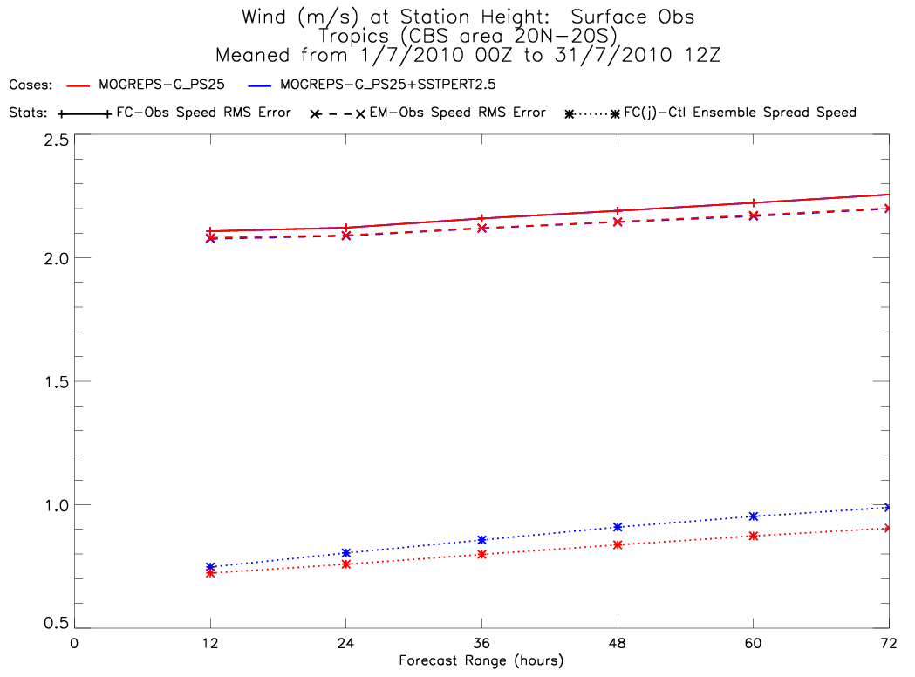
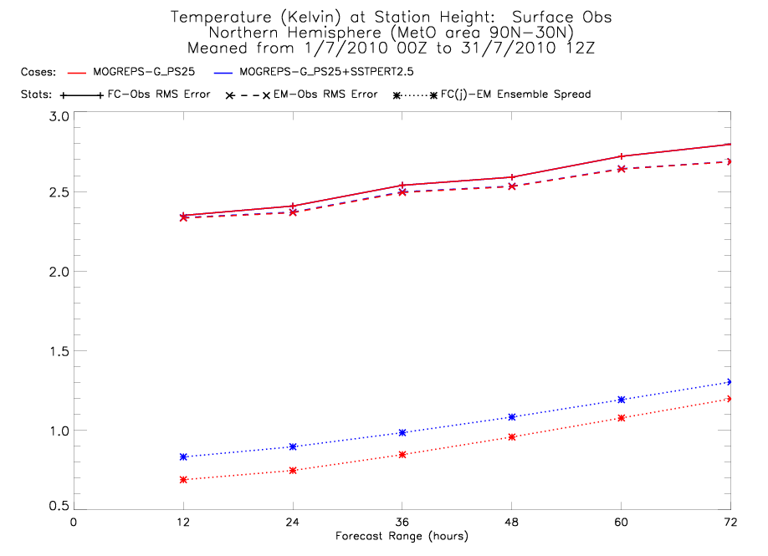
SST Perturbations: Verification scores

Slide 26
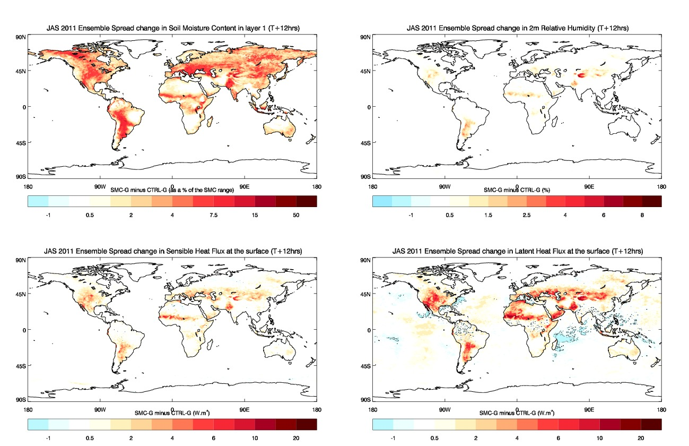
Soil-moisture perturbations Change in spread T+12h
Good localised impact on spread of heat fluxes
Focus on semi-arid areas prone to higher variability in soil-moisture
Greater impact in summer hemisphere

Slide 27
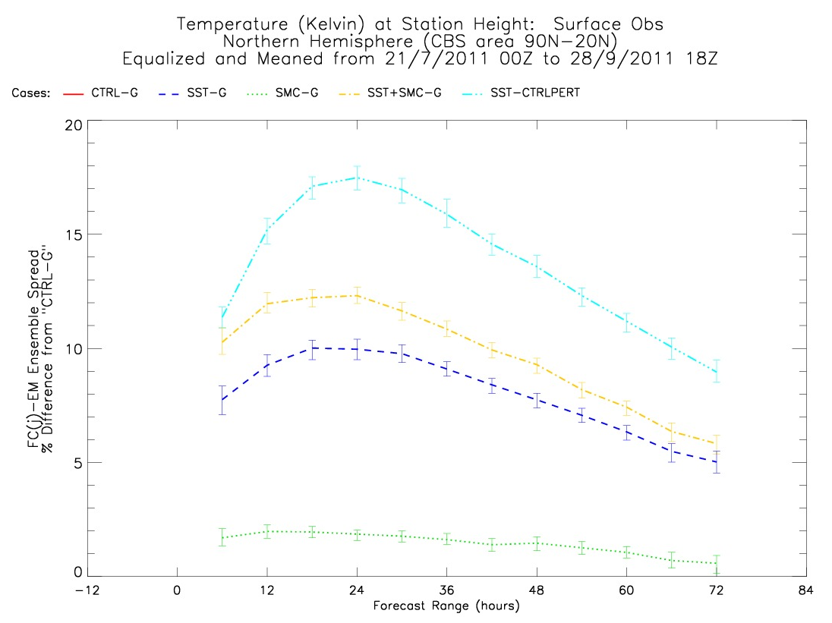
SST + Soil-moisture perturbations Mean change of T2m spread in NH
SST perturbations (blue) have biggest single impact on 2m temperature spread
Impact of soil-moisture (green) perturbations complements SSTs
ETKF perturbations are reduced (lower inflation) when surface perturbations included (implied by cyan line)

Slide 28
Additive inflation
6 hours
AddInf1
AddInf2
AddInf3
AddInf4
AddInf5
AddInfX: Randomly selected historical analysis increment. (With scaling.)
From 3-month archive for the same season, but a different year.
Also add in the 3-month mean increment, as a bias correction. (No scaling.)

Slide 29
Additive inflation
Archive of analysis increments k=1...N_{a}
Average analysis increment
Random select N_{e} increments from the archive j=1...N_{e}
For each 6h window, add these increments to the ensemble, removing the sample average
Contains information on the model bias

Slide 30
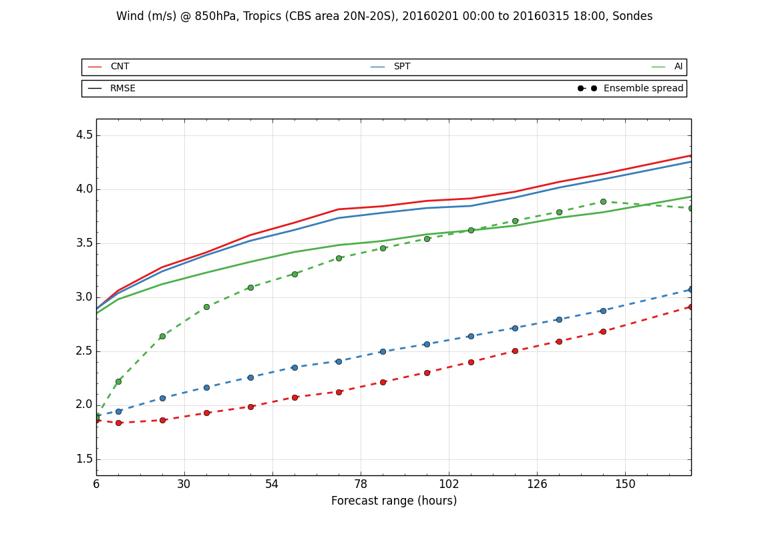
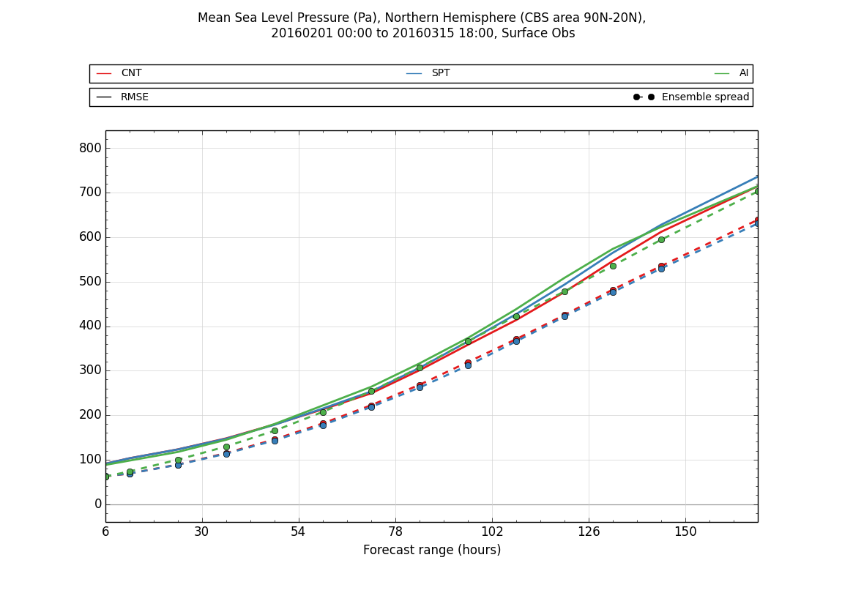
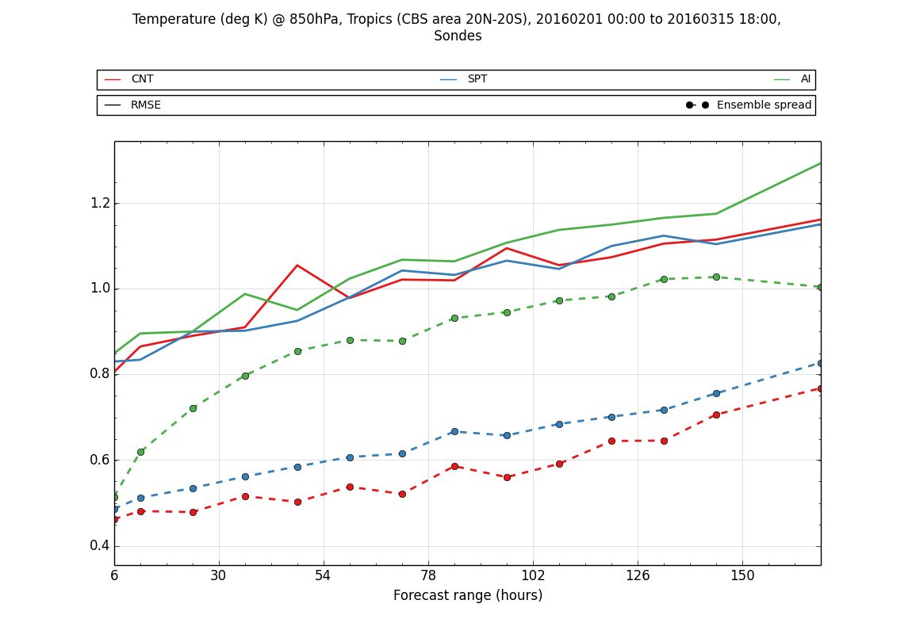
Spread vs Error - AI, SPT and SKEB
AI is most effective at controlling ensemble spread globally
MOGREPS-G (ETKF):
SKEB and SPT equivalent in extra-tropics
SPT better than SKEB in tropics
Spread/error gap at T+6h is combination of observation error and ETKF deficiency

Slide 31
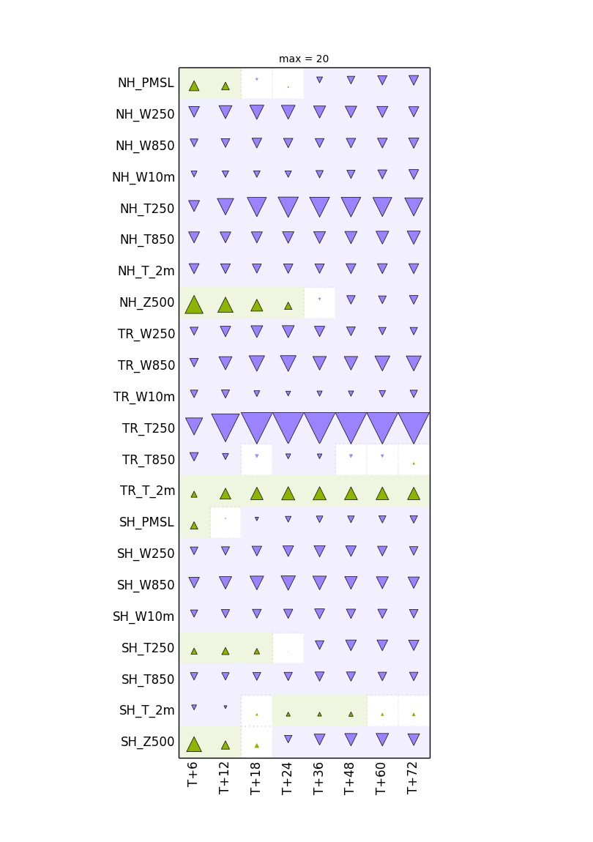
Replacing Additive Inflation
Tested a variant of SKEB, which includes temperature perturbations
Greater level of perturbation overall
Also uses online bias-correction taken from additive inflation
Still considerably worse than additive inflation across wide range of variables
Additive inflation looks to be hard to beat (in our model)
% change in CRPS vs. ECMWF analyses

Slide 32
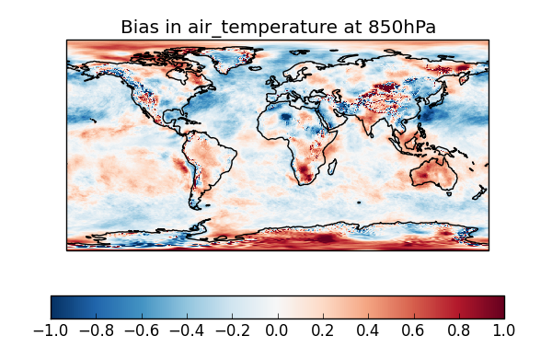
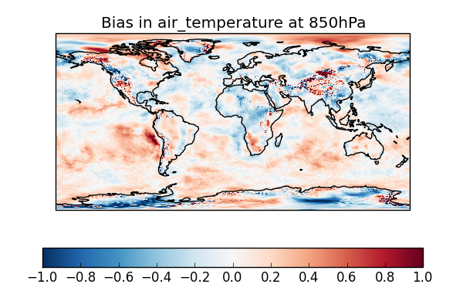
Effect of (AI) bias-correction on forecast bias
No bias-correction – T+24
With bias-correction – T+24
Verified against deterministic analyses

Slide 33
Summary of En-4DEnVar vs ETKF
ETKF
basic horizontal localisation and no vertical localisation
doesn’t use the variational framework, so poorer assimilation of satellite data
Kalman Gain much different from that of hybrid-4DVar
adaptive inflation scheme gives an unphysical semi-diurnal variation in spread
software completely separate from the hybrid-4DVar software
En-4DEnVar
uses sophisticated model-based localisation already built into VAR code
variational scheme similar to deterministic data assimilation
can use hybrid covariances that are similar to those used in hybrid-4DVar
total overhaul of the inflation methods
4DEnVar is an option in the VAR code, with additions to support ensemble updates

Slide 34
MOGREPS-G vs other centres
Standard CBS-style verification
Tropical cyclone performance (tracks)
-With thanks to the verification team for various graphics
Notes:
The primary part of any ensemble prediction system is to perturb the initial conditions of each member. In MOGREPS this is a set of perturbations that are added to the control analysis (which is interpolated from the high resolution deterministic data assimilation system). Currently our 4d-Var and ensemble system is only linked using the 4d-hybrid-Var, but in future the two systems could be a single system 4d-En-Var.

Slide 35
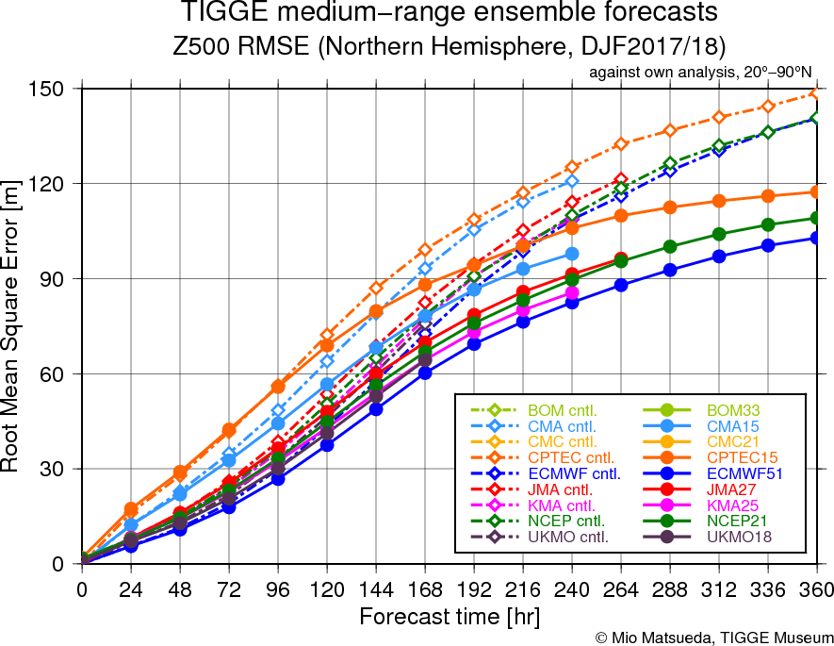
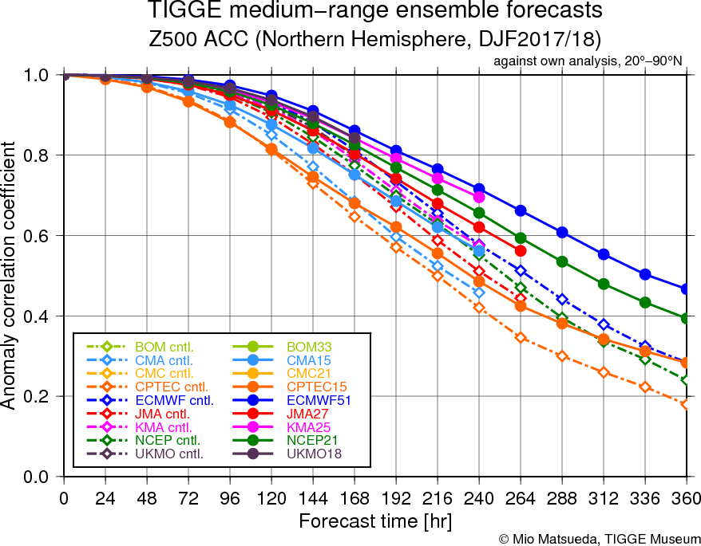
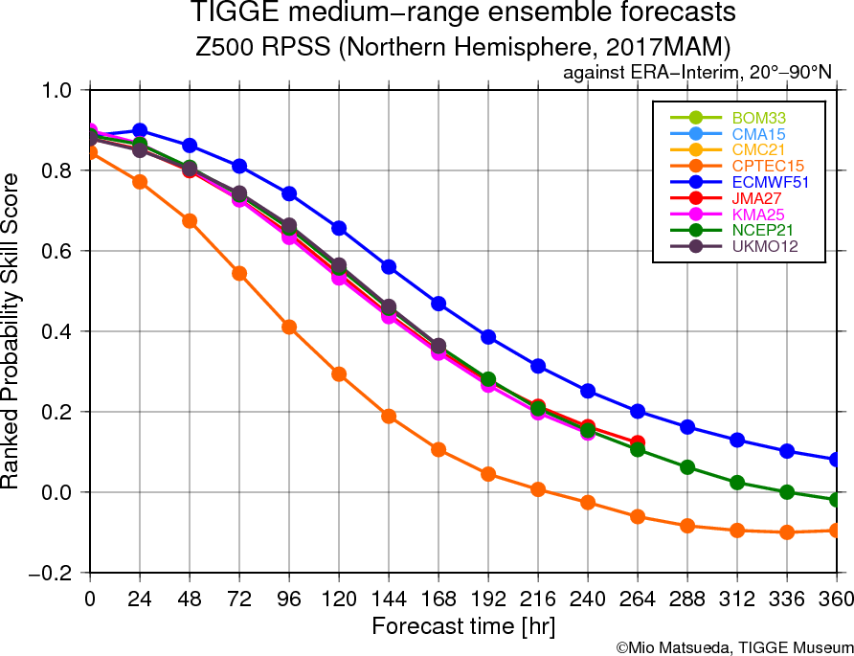
TIGGE Museum EPS comparison of 500Z (NH)

Slide 36
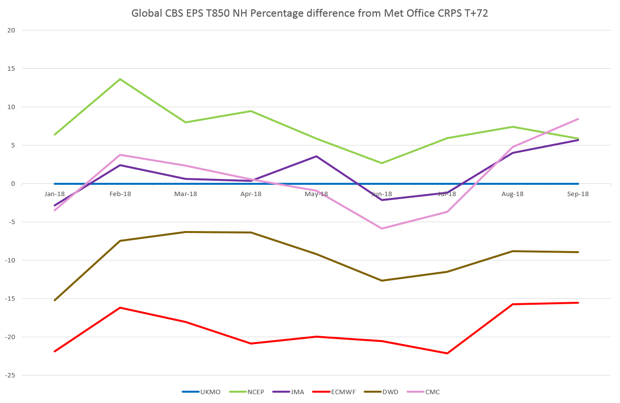
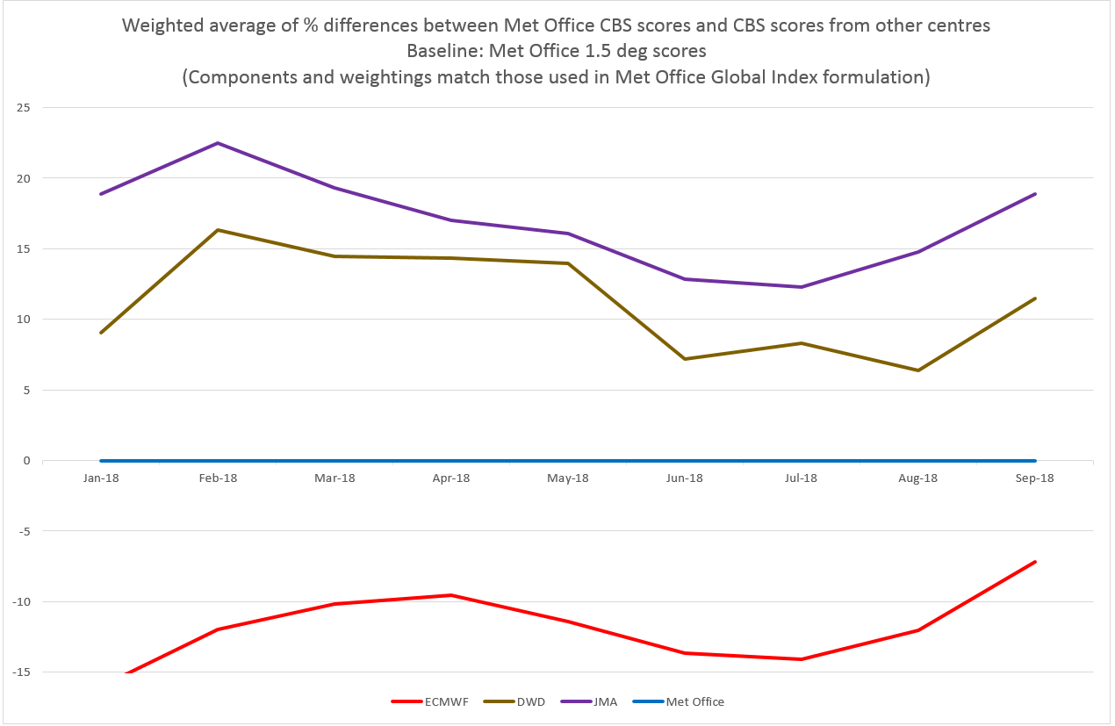
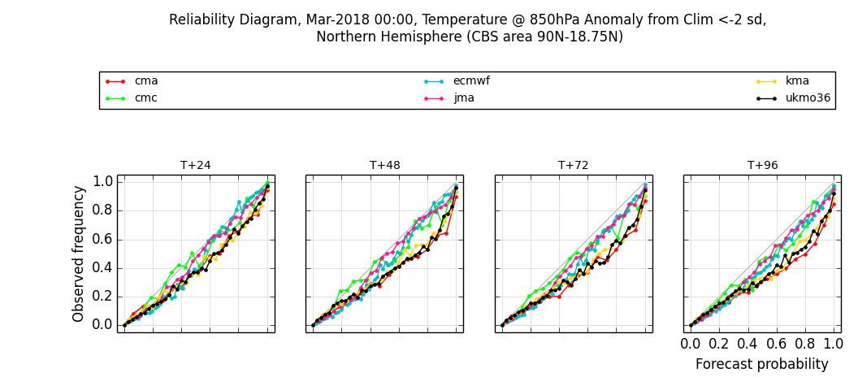
Ensemble inter-comparison
NH T850 CRPS
CRPS Index time-series
Met Office preparing to share ensemble verification scores with CBS comparison pages hosted at JMA
Our CRPS looks good for some fields, e.g. Pmsl, 500Z, but poorer for T850
UM bias?
insufficient spread in tropics
For internal monitoring we propose a summary index
Reliability scores categorised by climatology regime can be used to investigate ensemble spread

Slide 37
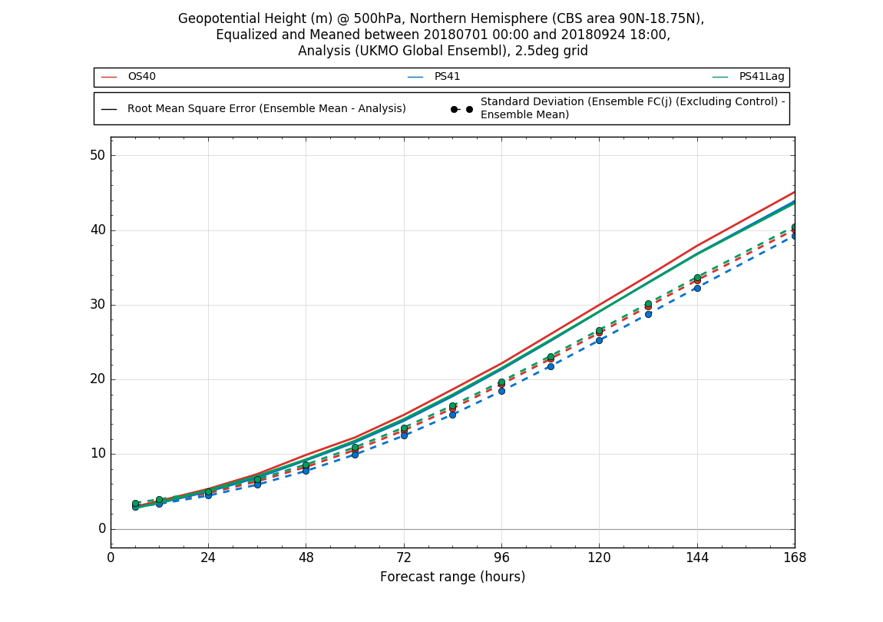
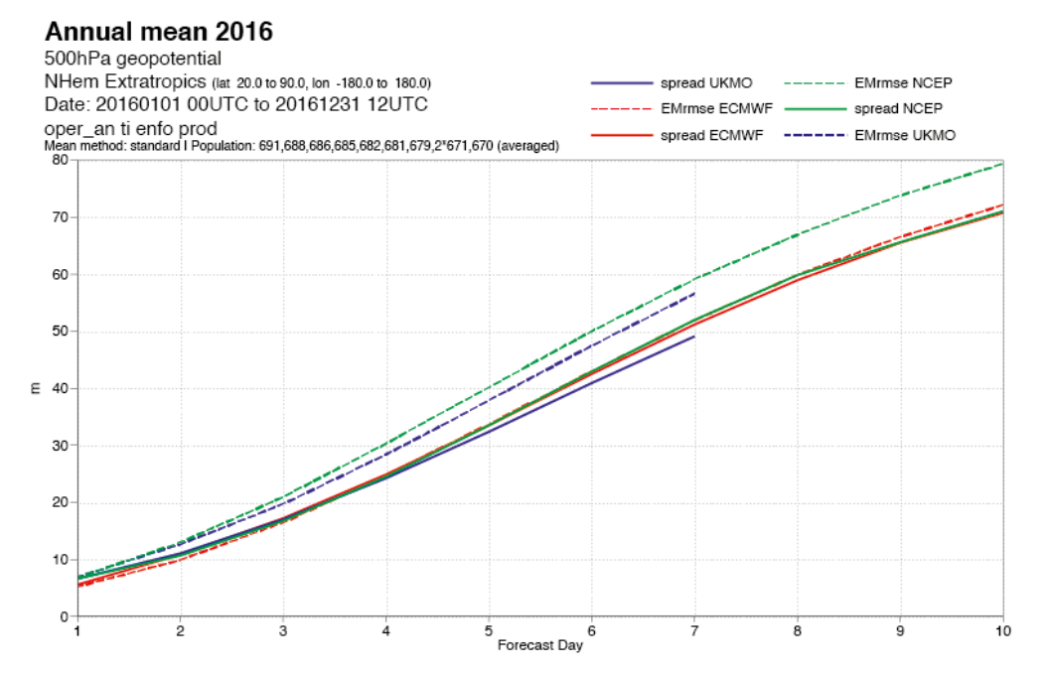
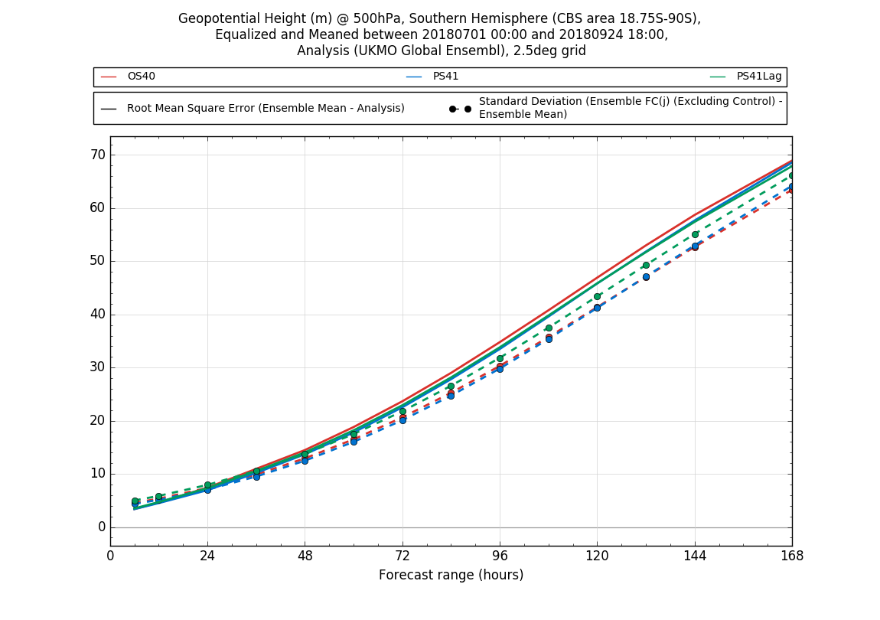
Spread vs Error inter-comparison
MOGREPS-G and NCEP EPS have deficient spread compared to ECMWF
Lagging two cycles reduces the spread deficiency (compare PS41Lag with PS41 - right)

Slide 38
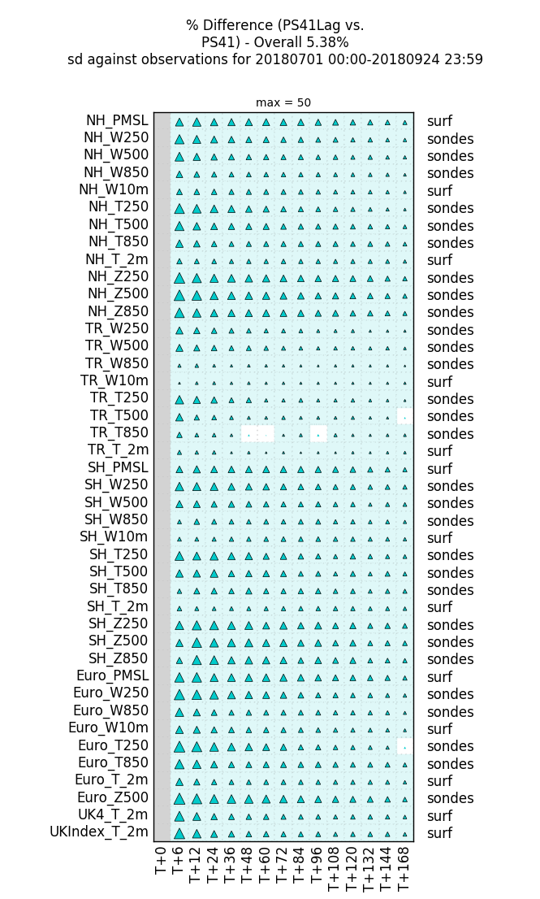
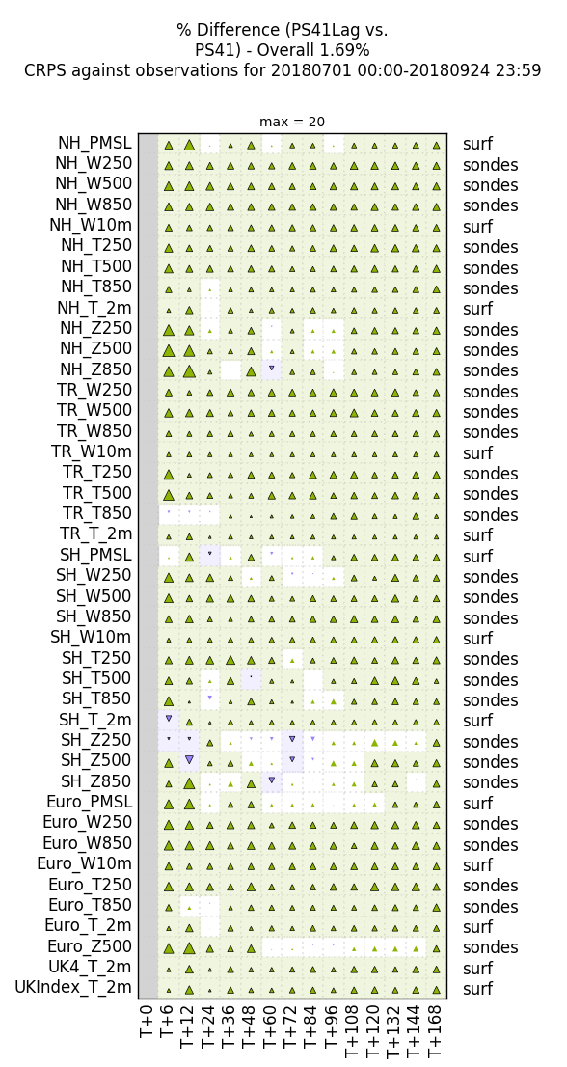
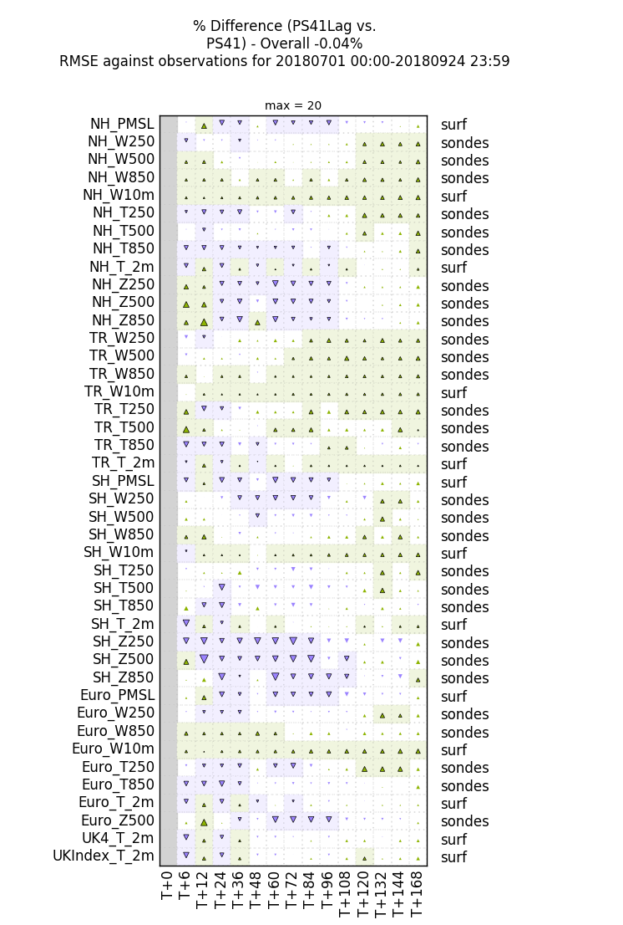
Effect of Lagging on Spread, CRPS, RMSE

Slide 39
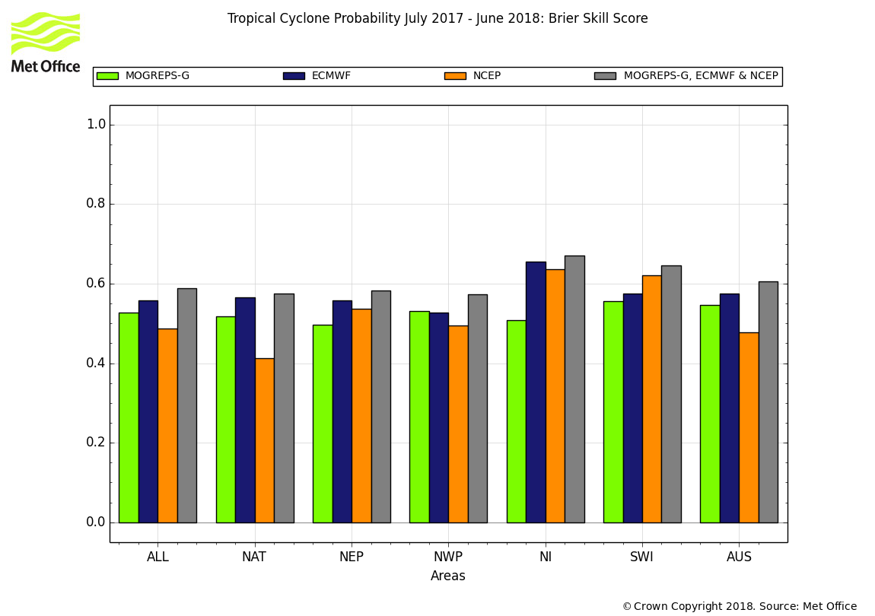
Tropical Cyclone 7-day strike probability forecasts 88 named storms in Jul 2017 – Jun 2018
No single ensemble system is best in all areas for strike probability
MOGREPS-G in 2nd place overall
Multi-model system always best for this metric
Brier Skill Score
Rebecca Stretton

Slide 40
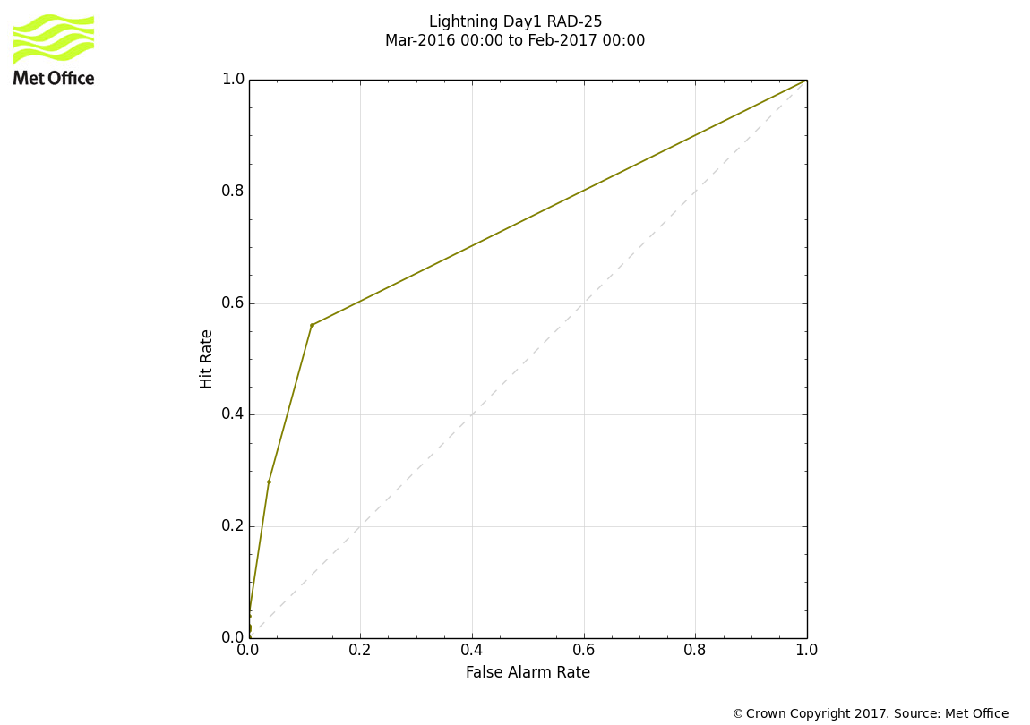




Verification of 24-hr tropical cyclone activity forecasts 82 named storms in Jan 2017 – Dec 2017
Perfect Skill
T+72 Reliability diagram
T+72 Relative Economic Value
ROC Area
0.5 = no skill
1 = perfect skill
No Skill
ROC Area
Relative economic value
Area under the ROC curve
Rebecca Stretton

Slide 41





Examples of strike probability forecasts
Irma (2017)
Two examples of storm-based verification that illustrate the benefit of multi-model ensembles: Irma (2017) vs Matthew (2016).
In both cases, the multi-model ensemble is of comparative skill to the strongest performing model
Brier Skill Score
Matthew (2016)
Brier Skill Score

Slide 42

Thanks for listening!!
Parallel Suite Information
Visit the MOSRS nwpscience wiki:
Main global trialling/implementation page (for each PS):
https://code.metoffice.gov.uk/trac/nwpscience/wiki/ParallelSuites/PS41/Global/PackageTrials
Model information pages for current and previous PS:
https://code.metoffice.gov.uk/trac/nwpscience/wiki/ModelInfo

