Slide 1

BoM ACCESS-GE global ensemble prediction systems
Michael Naughton
michael.naughton@bom.gov.au
Bureau R&D Workshop
Ensemble Methods: Nowcasting to Climate Change
26 November 2018

Slide 2
BoM has been developing and running ensemble numerical weather prediction systems in research mode since the second half of the 1990's, originally based on the Australian global and regional NWP systems, and then on ACCESS versions of the UK Met Office MOGREPS systems. Up until now, these EPS systems have been run in research demonstration and operational trial versions. ACCESS NWP systems are scheduled to become operational in the first half of 2019.

Slide 3
The first Bureau global EPS (GASP-EPS) was developed for the Bureau's GASP global spectral model using the singular vector initial conditions perturbation method developed at ECMWF. It was run quasi-operationally in the Bureau's operational suite from 2002 to 2009.
An Australian region EPS (LAPS-EPS) was developed and run from 2002-2005, based on the Bureau's Australian region LAPS system, which included both perturbed initial conditions and perturbed physics.

Slide 4
From 2006 onwards, BoM, CSIRO and Australian universities started the Australian community climate and earth systems simulator (ACCESS) national partnership. ACCESS NWP systems are predominantly based on the corresponding UK Met Office Unified Model (UM) systems. The global ACCESS-G system became operational in 2009.

Slide 5
The ACCESS-GE global EPS system was developed from 2007 onwards, based on the MOGREPS-G system. ACCESS-GE has been running routinely in near-real-time since around 2010.

Slide 6
Skill performance of both the GASP-EPS and ACCESS-GE EPS systems has been comparable to operational EPS systems in other major world meteorological centres.

Slide 7
The current ACCESS-GE2 60 km resolution version has been running routinely since 2014 as a demonstration system. ACCESS-GE2 has been used by several groups to develop downstream ensemble products.

Slide 8
The ACCESS-GE3 version currently running in pre-operational trials is planned to become operational in 1Q 2019. It is based on the 2017 Met Office PS39 system, at 33 km resolution.

Slide 9
ACCESS-GE3 skill improves upon ACCESS-GE2, in line with forecast skill improvement of ACCESS-G3 relative to ACCESS-G2.

Slide 10
There are a number of major differences in the upgrade from APS2 to APS3, which all contribute to the forecast improvement:
EPS: ​increased number of ensemble members, additional forecast model perturbations;
Model: increased resolution, change from new dynamics to ENDGame UM dynamical core;
Data assimilation: hybrid ensemble 4D-VAR, upgraded background error covariances and introduction of new observations sources.

Slide 12
Extra slides

Slide 13
BoM NWP Ensembles – Status / Plans
Bureau is developing global and city-scale ensembles: ACCESS -- GE and CE.
As with nearly all ACCESS NWP systems, based on analogous UKMO systems (MOGREPS, etc)
Current operational NWP suite ("APS2") has no ensemble systems.
The APS2-dev version of GE ("GE2") continues to be run as a research demonstration real-time trial.
Relatively old now: UM 8.2, N216 (60km) resolution
Operational Ensembles will be part of upcoming "APS3" suite
Global:
"GE3" is in development, planned for operations Q1-2019
integral component of global modelling now, due to hybrid-VAR
UM 10.6, N400 (33km) resolution (UKMO PS39 model and DA components)
18 members (though subject to compute cost)

Slide 14
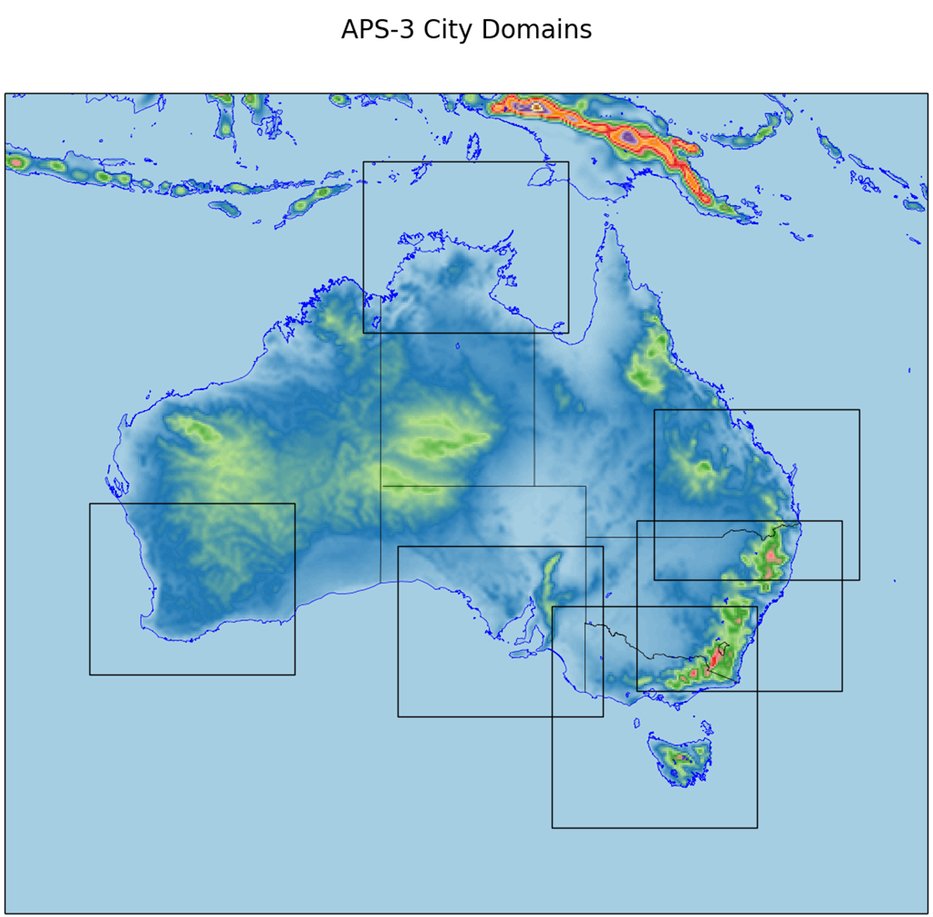
BoM NWP Ensembles – Status / Plans
Operational Ensembles will be part of upcoming "APS3" suite
City-scale:
"CE3" is in development, planned for operations Q2-2019
Six domains (right) at 2.2km resolution
Based on PS39 MOGREPS-UK, but RA1-M and RA1-T physics used on different domains
12-18 members (compute permitting), 36-hour FCs, four times a day
Planned for operations Q2-2019

Slide 15
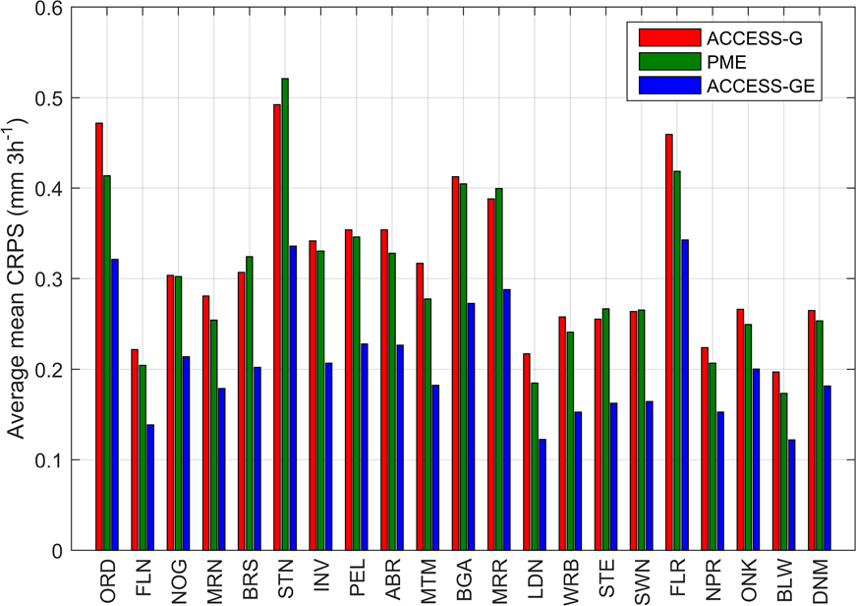
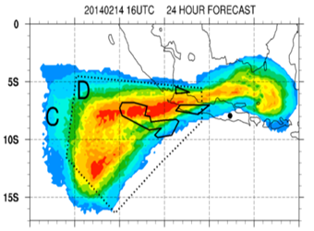
BoM NWP Ensembles – GE2
Research system, but real-time running and supporting demonstrations including:
Streamflow forecasts, and volcanic-ash dispersion
(David Robertson, CSIRO)
Average (all lead-times) precip CRPS, across all catchments
PME = Poor Man's Ensemble
(Richard Dare)
Probability map of ash-concentration amount
GE2 driving HYSPLIT dispersion model
Notes:
The error in the rainfall forecasts from ACCESS-GE is consistently smallest.

Slide 16
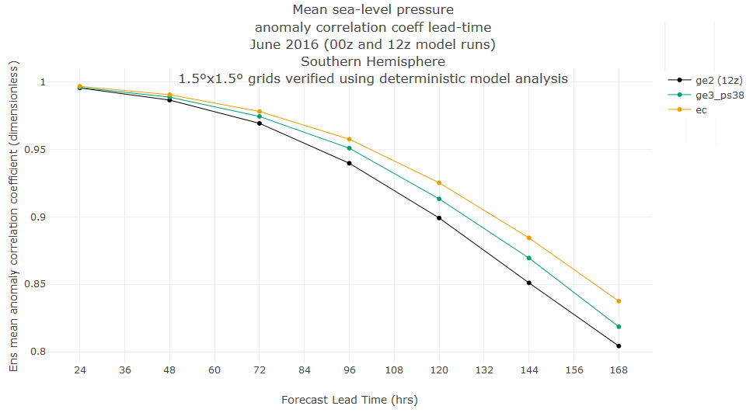
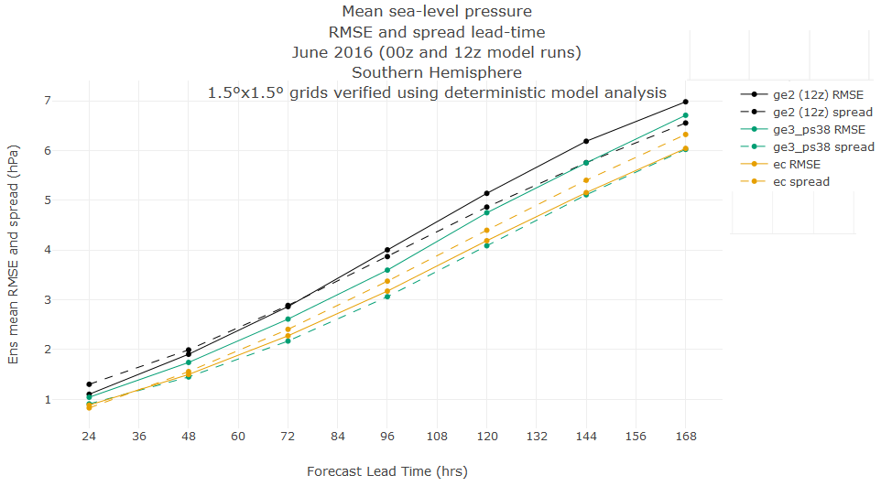
BoM NWP Ensembles – GE3 Trials
Full-resolution (N400) trials still running, but low-res (N216) PS-38 trials encouraging
Notes:
GE2 (operational) = BLACK, GE3 (low-res N216, PS-38, trial) = GREEN, ECMWF = GOLD
Metrics against lead-time out to seven days.
Left: Ensemble-mean Anomaly-correlation against lead-time
Right: Ensemble-mean RMSE (solid) and Ensemble-spread (dashed) against lead-time.

