Slide 1

Implementation and preliminary results of high resolution Ensemble Prediction System at NCMRWF
Abhijit Sarkar, Ashu Mamgain, Paromita Chakraborty, Kiran Prasad Siripurapu and E. N. Rajagopal
email: abhijit@ncmrwf.gov.in
National Centre for Medium Range Weather Forecasting (NCMRWF)
Ministry of Earth Sciences,
Noida 62, Uttar Pradesh, India

Slide 2
Main difference between 33km NEPS and 12km NEPS
 | 33km NEPS (N400) | 12km NEPS (N1024)
Grid Points | 800 x 600 | 2048 x1536
Members | 44 perturbed + 1 cntl | 22 perturbed +1 cntl
Initial condition perturbations | Perturbations in θ, π, q, u, & v by ETKF method | Perturbations in θ, π, q, u, & v by ETKF method and perturbations in SST , SMC & Deep Soil Temp
Model Physics Perturbations | Stochastic Kinetic Energy Backscattering and Random Parameter Schemes | Stochastic Kinetic Energy Backscattering and Random Parameter Schemes
Observations Assimilated in NEPS | AIRS, ATOVS, Aircraft, GOESClear, GPSRO, IASI, Satwind, Scatwind Sonde, Surface | AIRS, ATOVS, Aircraft, GOESClear, GPSRO, IASI, Satwind, Scatwind Sonde, Surface, SEVIRIClear, SSMIS
Long Forecast Start time | 44 members at 00 UTC | 11members and Cntl at 00 UTC and 11 members at 12UTC of previous day

Slide 3


12-km NCMRWF-EPS in TIGGE Portal

Slide 4
Cold start of high resolution NEPS
  IC Perturbation Method – Ensemble Transform Kalman Filter (ETKF) method
  Model Perturbation – Stochastic physics (SKEB2), Random Parameters (RP)
  All the 22 ensemble members are coldstarted from the same initial condition (analysis of NCUM) but with perturbed model physics.
  In the next cycle ETKF applies a transformation matrix on these 22 forecast perturbations and multiplies with an inflation factor to generate 22 analysis perturbations.
  These analysis perturbations are added to the deterministic analysis by Incremental Analysis Update (IAU) method to generate 22 initial conditions for the next cycle.

Slide 5
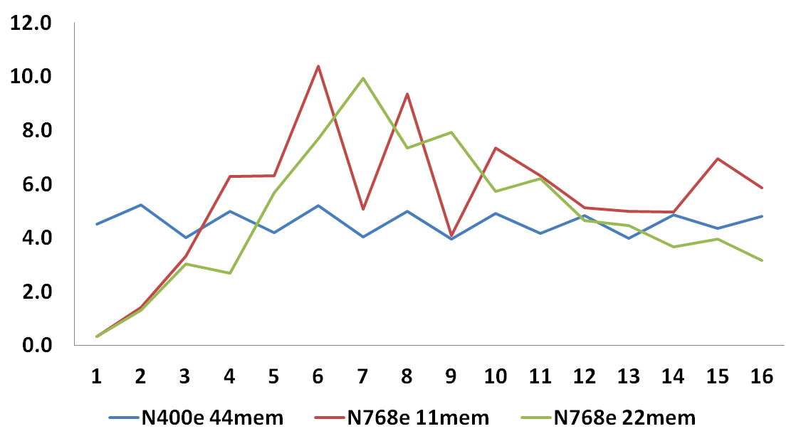
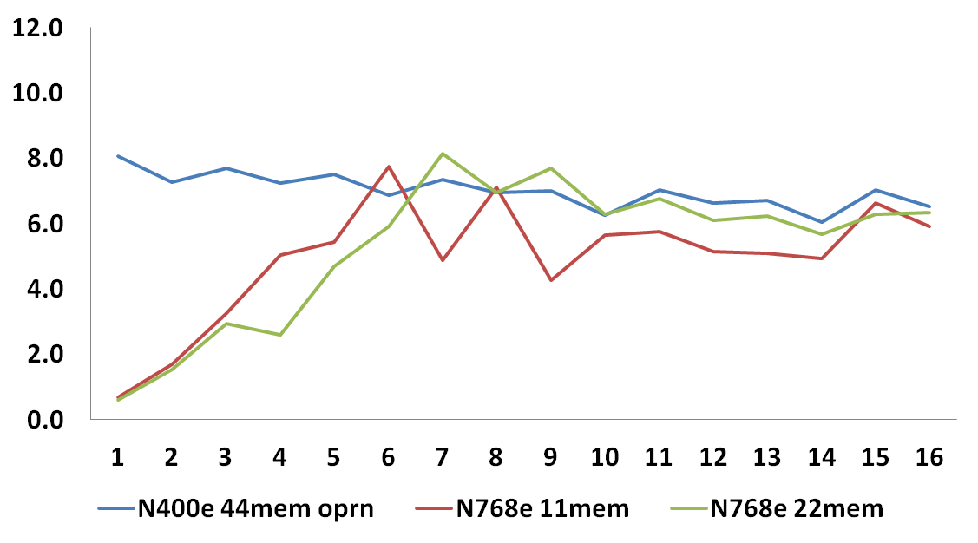
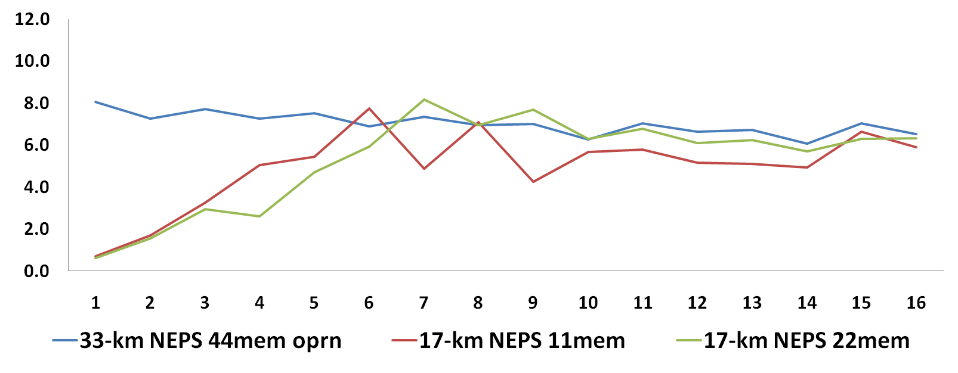
Ensemble spread in Specific Humidity (kg/kg) x10⁻⁴
(a) 20 m height
(b) 5600 m height
No. of ETKF cycles
No. of ETKF cycles
The figures indicate that the spread in specific humidity of cold started high resolution EPS took about 17 cycles (6hrs) to arrive at the spread of operational EPS spread

Slide 6
  Both N1024 and N400 were operational during the period
  1st June 2018 – 16th July 2018
  Model performances are compared using
  RMSE- Spread relationship
  Brier Score
  Reliabilty and sharpness diagrams
  Relative Operating Characteristic
  The selected domain of comparison :
  Northern Hemisphere and southern Hemisphere (for RMSE-spread relationship)
  RSMC region (0 – 40 N & 50 - 100 E)
  The Parameters selected for comparison:
  Geo-potential height at 500 hPa
  Precipitation

Slide 7
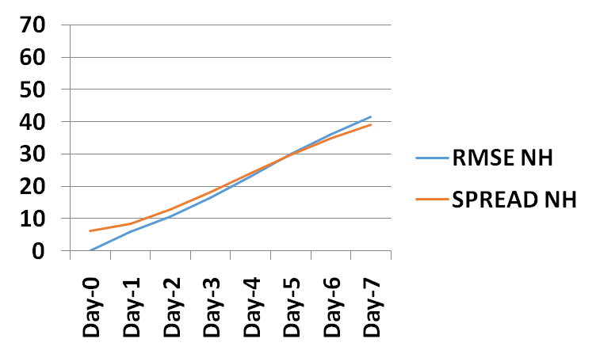
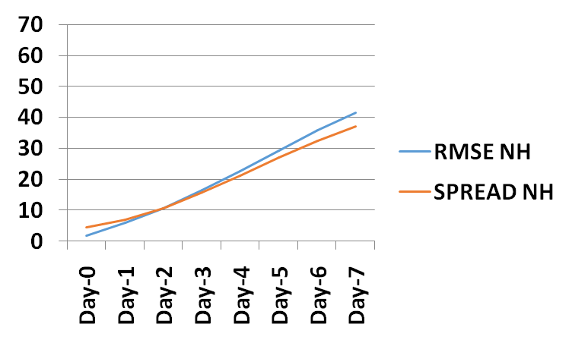
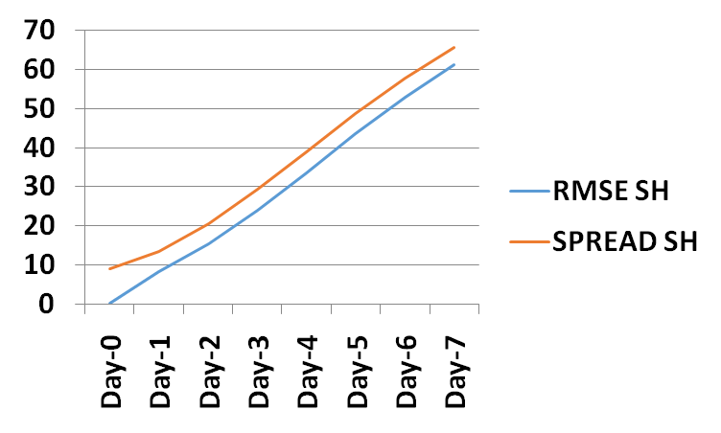
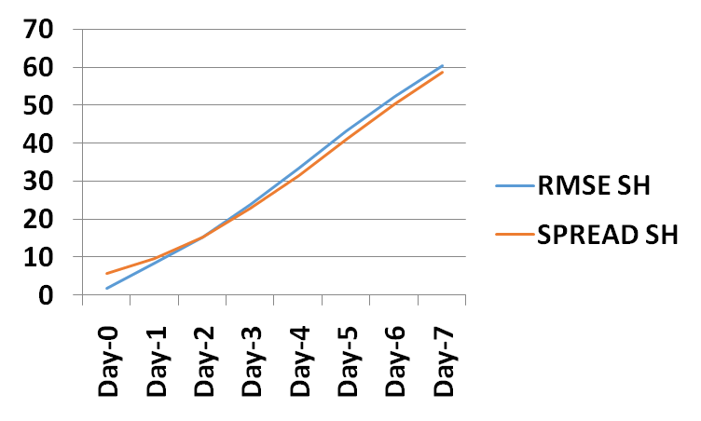
RMSE-SPREAD Relationship
Geopotential Height
33-km
12-km
RMSE/Spread (m)
RMSE/Spread (m)

Slide 8
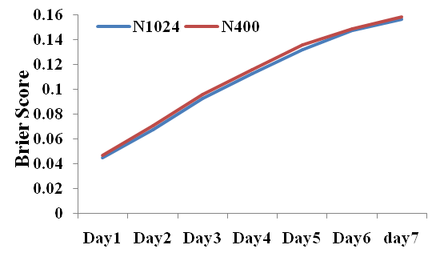
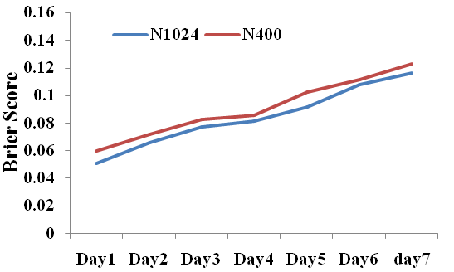
Brier Score
Northern hemisphere
RSMC Region
Brier Score of N1024 is less than that of N400 both in NH & RSMC
Difference in Brier Score is more prominent in RSMC Region
Growth of Brier score with forecast lead time is less in RSMC than in NH

Slide 9
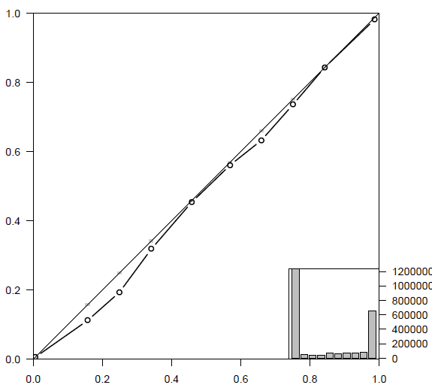
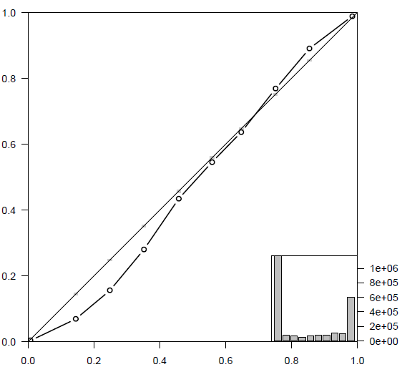
Reliability Diagram
Geopotential Height at 500 hPa
Northern Hemisphere
Day 1
N1024
N400
Observed Relative Frequency
Observed Relative Frequency
Forecast Probability
Forecast Probability

Slide 10
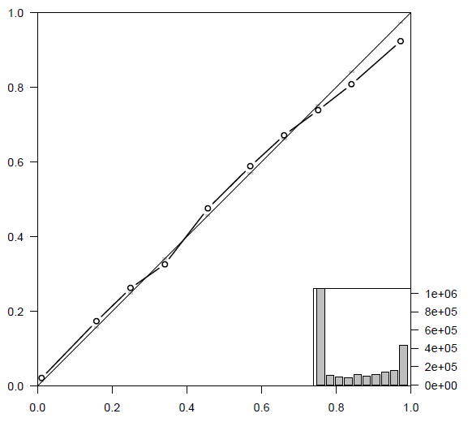
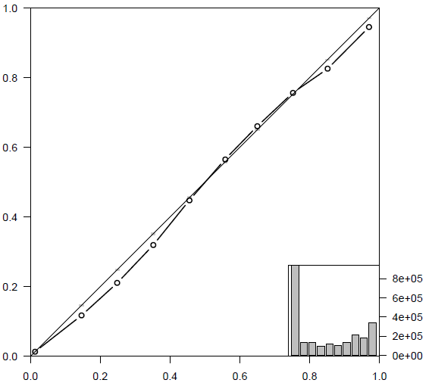
Reliability Diagram
Geopotential Height at 500 hPa
Northern Hemisphere
Day 3
N1024
N400
Observed Relative Frequency
Observed Relative Frequency
Forecast Probability
Forecast Probability

Slide 11
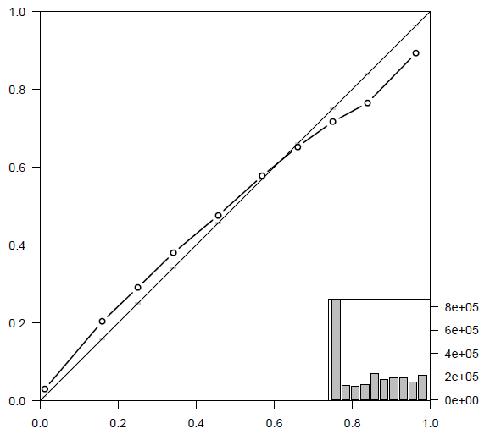
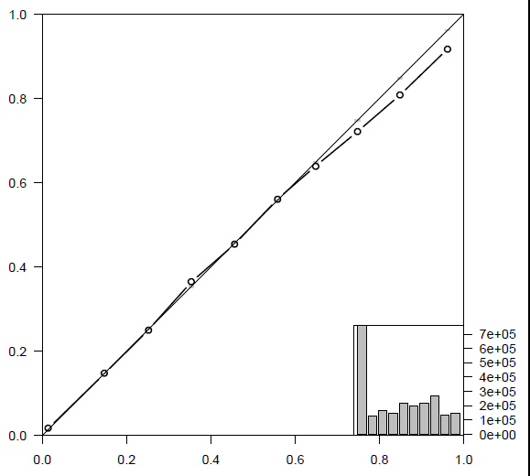
Reliability Diagram
Geopotential Height at 500 hPa
Northern Hemisphere
Day 5
N1024
N400
Observed Relative Frequency
Observed Relative Frequency
Forecast Probability
Forecast Probability

Slide 12
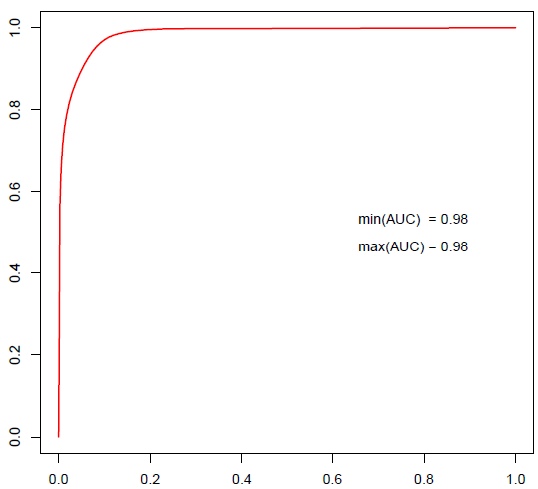
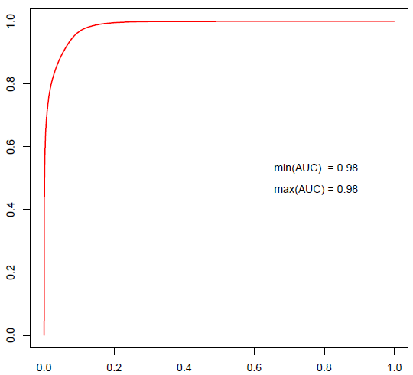
ROC Curve
Geopotential Height at 500 hPa
Northern Hemisphere
Day 1
N1024
N400
AUC=0.98
AUC=0.98
True Positive Rate
True Positive Rate
False Positive Rate
False Positive Rate

Slide 13
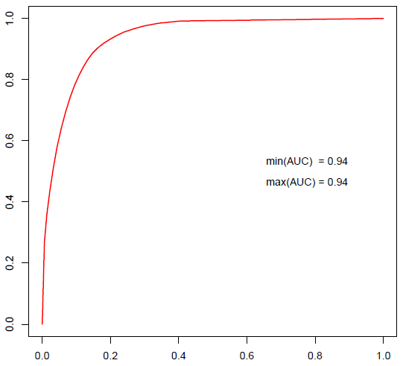
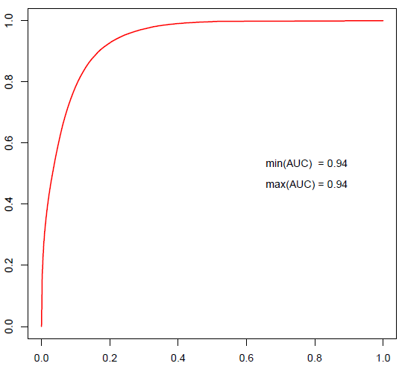
ROC Curve
Geopotential Height at 500 hPa
Northern Hemisphere
Day 3
N1024
N400
AUC=0.94
True Positive Rate
AUC=0.94
True Positive Rate
False Positive Rate
False Positive Rate

Slide 14
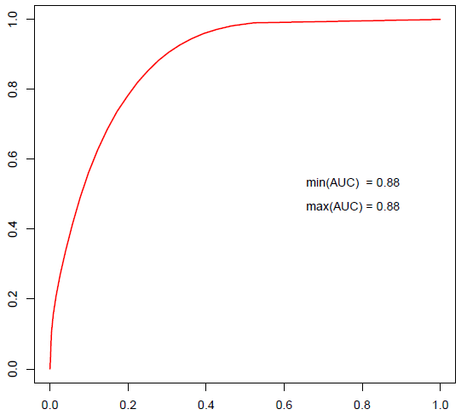
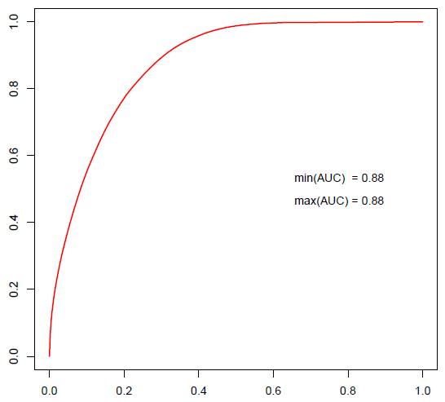
ROC Curve
Geopotential Height at 500 hPa
Northern Hemisphere
Day 5
N1024
N400
AUC=0.88
True Positive Rate
AUC=0.88
True Positive Rate
False Positive Rate
False Positive Rate

Slide 15

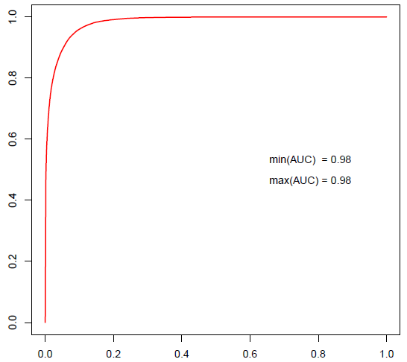
ROC Curve
Geopotential Height at 500 hPa
RSMC Region
Day 1
N1024
N400
AUC=0.98
True Positive Rate
AUC=0.98
True Positive Rate
False Positive Rate
False Positive Rate

Slide 16
ROC Curve
Both N400 and N1024 show good capability to discriminate
between events and non-events in day1, day3 and day5 forecasts
over NH
Performance over RSMC is as good as over NH in day1 forecast
in discriminating events and non events
Both N400 and N1024 shows good discrimination property
in precipitation forecasting

Slide 17
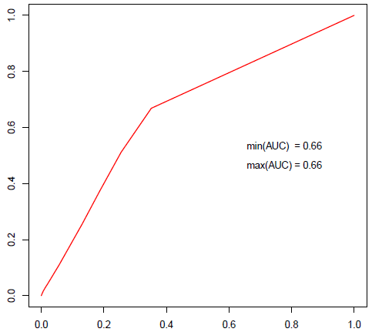
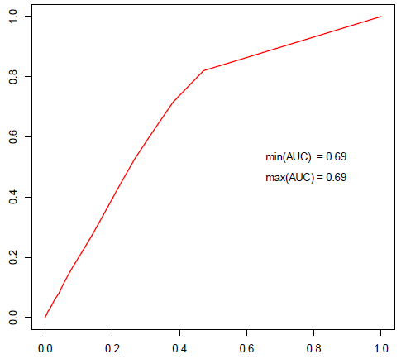
ROC Curve
Precipitation (> 6.5 cm/day)
RSMC Region
N1024
Day3
N400
AUC=0.66
AUC=0.69
True Positive Rate
False Positive Rate
False Positive Rate

Slide 18
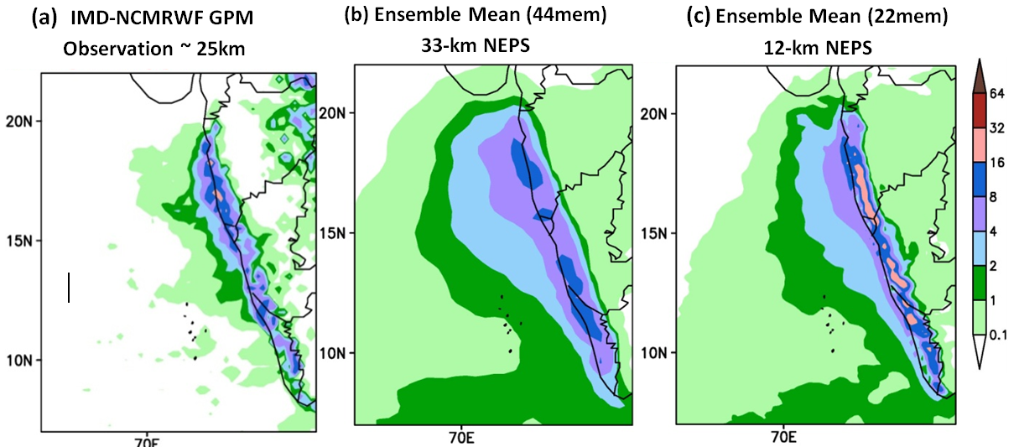
Ensemble Mean of a heavy rainfall event
IMD-NCMRWF (GPM SAT+Gauge) Rainfall (cm/day) observations for 10th June 2018 are shown in (a). Ensemble mean Day 5 forecast valid for 10th June from (b) 33-km NEPS and (c) 12-km NEPS

Slide 19
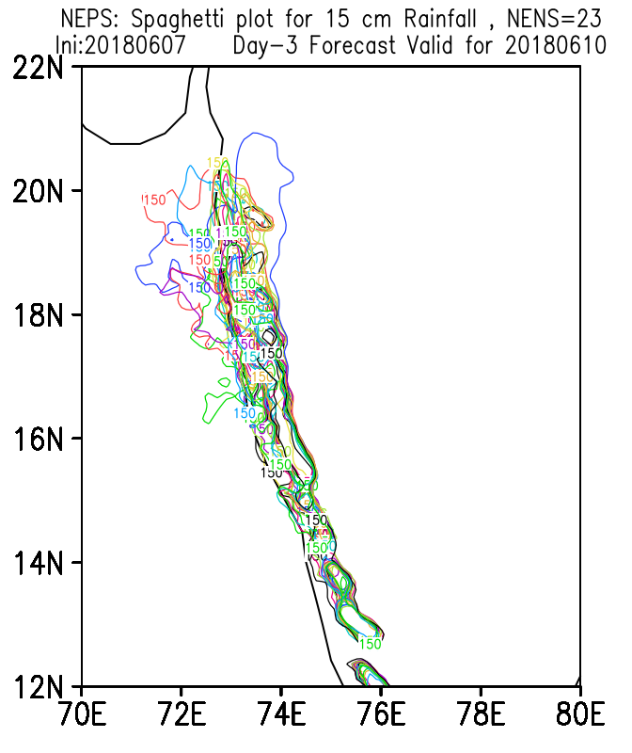
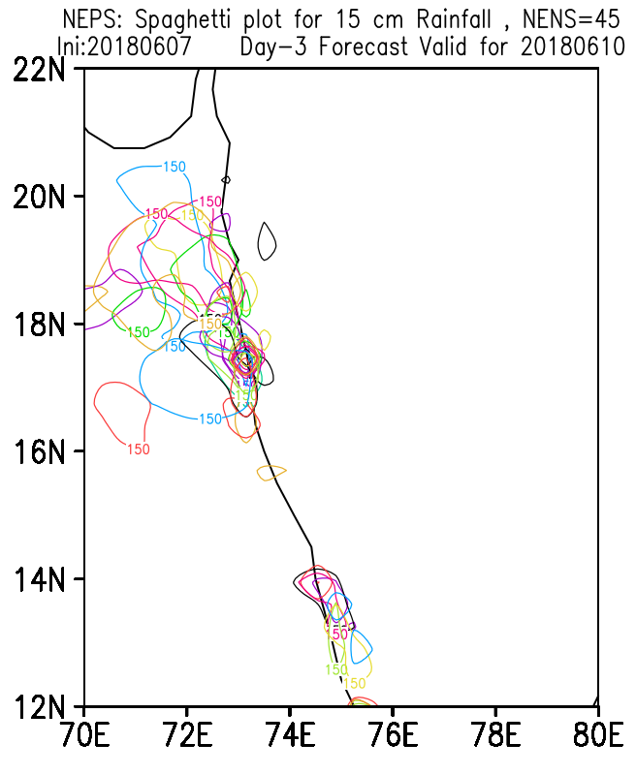
12-km NEPS
33-km NEPS

Slide 20
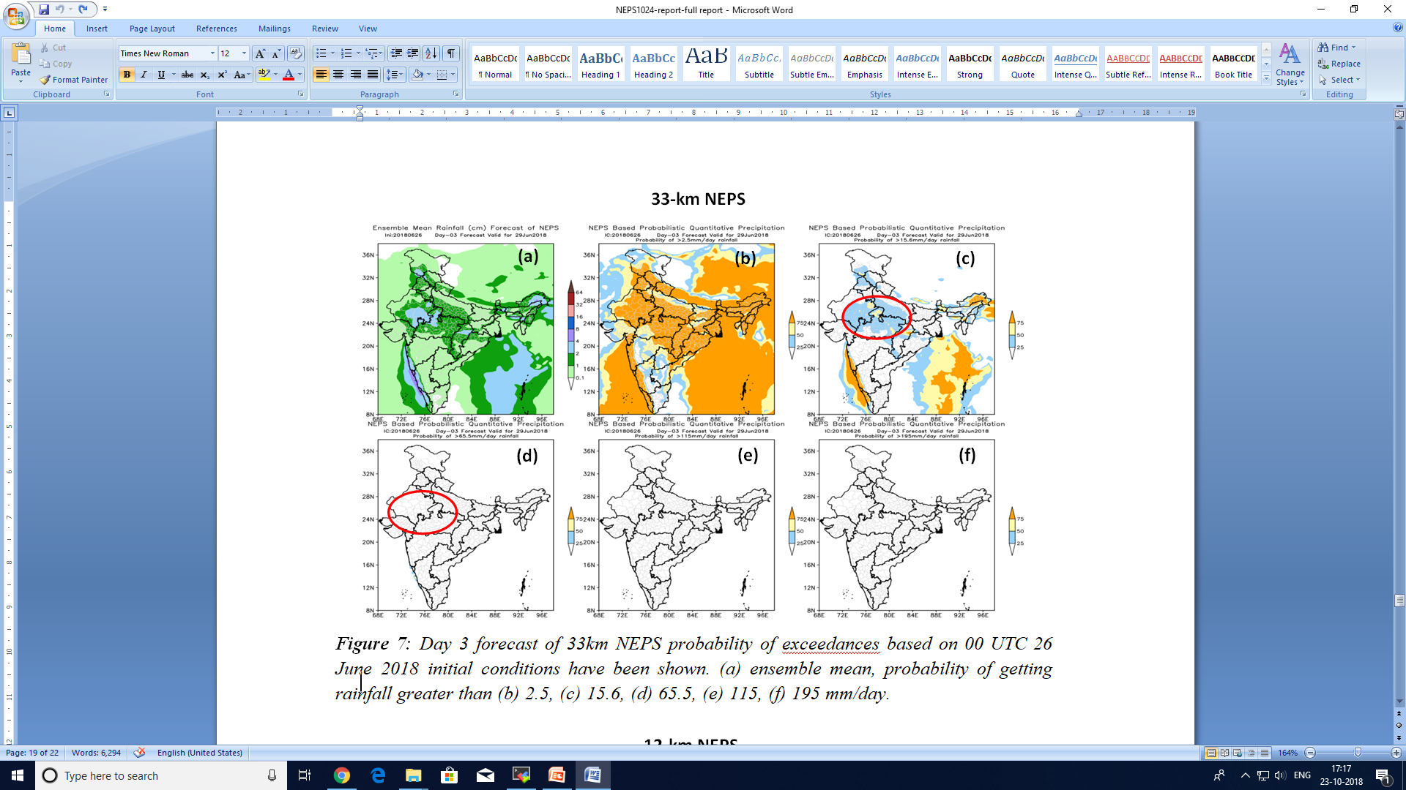
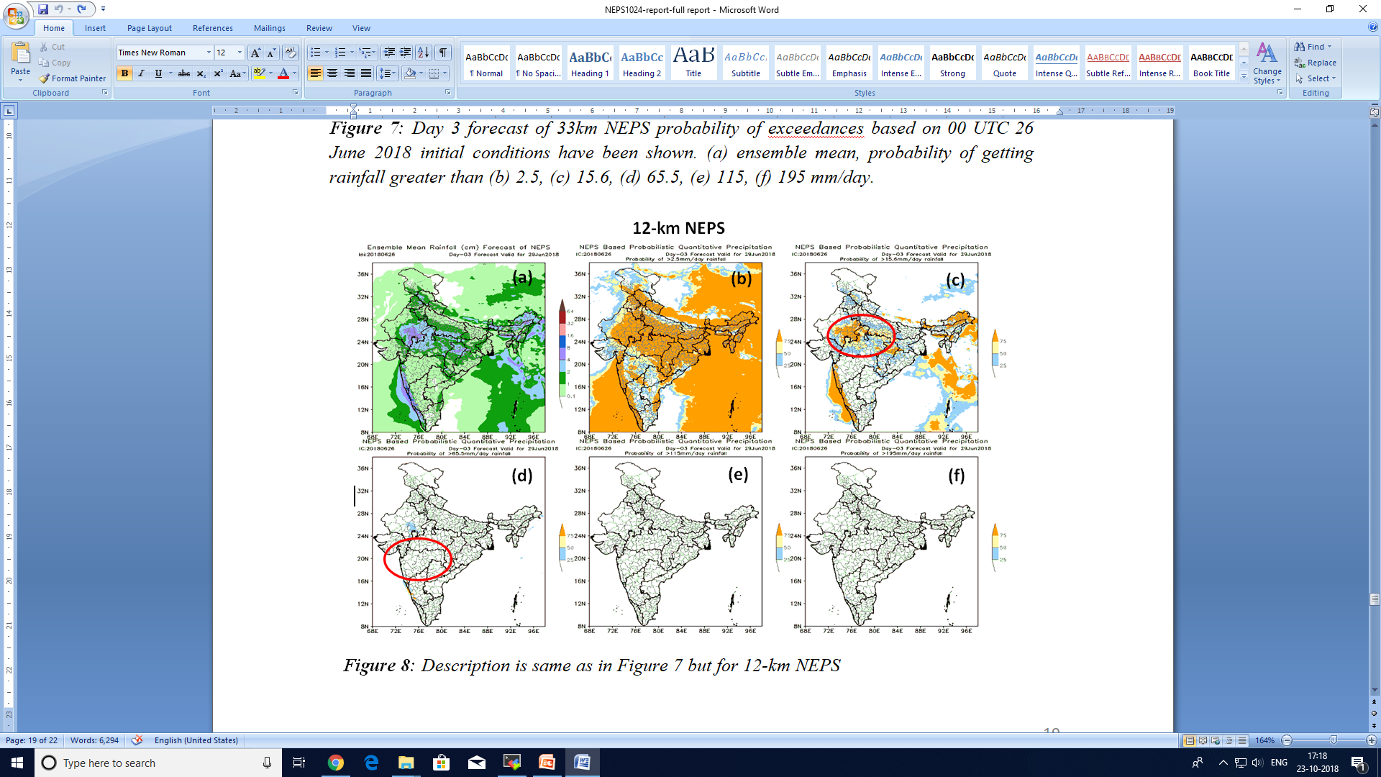
Probability of rainfall exceedance
Day 3 forecast of 33km NEPS probability of exceedances based on 00 UTC 26 June 2018 initial conditions have been shown. (a) ensemble mean, probability of getting rainfall greater than (b) 2.5, (c) 15.6, (d) 65.5, (e) 115, (f) 195 mm/day.

Slide 21


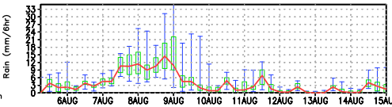
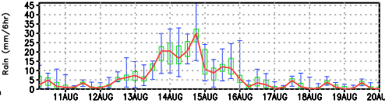
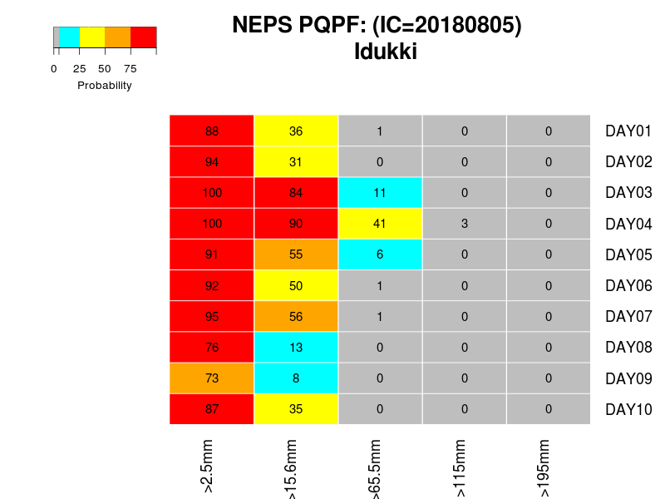
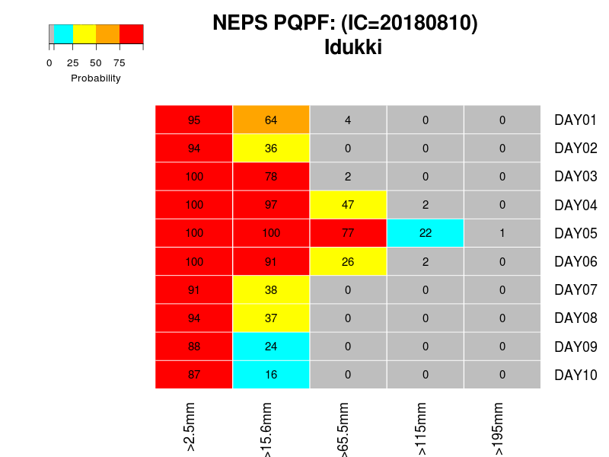
NEPS rainfall Forecast EPSgrams for Idukki based on (a) 5th Aug 2018 & (b) 10th Aug 2018
(a)
(b)
PQPF chart for Idukki based on (c) 5th Aug 2018 and (d) 10th Aug 2018
(c)
(d)

Slide 22
4km NEPS-R Configuration
Members | Control + 11 members
Driving model | Global 12km NEPS (N1024)
Domain | (1200 X 1200) 62⁰ E -106⁰ E and 0⁰ - 40⁰ N
Vertical levels | 80 levels up to 38.5 km
Science configuration | Singv4p1, Proto-RA1T
LBC frequency | 3 hourly
Forecast Length | 75hrs
Model time step | 60 seconds
Convection | Explicit
MIHIR-HPC (CrayXC40) configuration
No of nodes | 86
No of processors | 1536 (18 procs per node)
Wall clock time | 1hr 26 minutes (75 hours forecast)

Slide 23
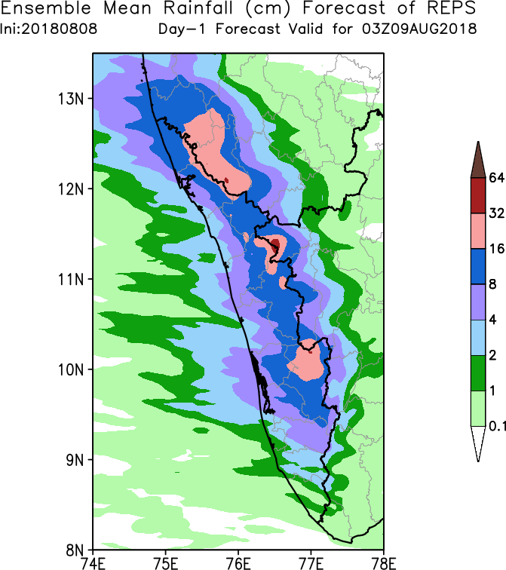
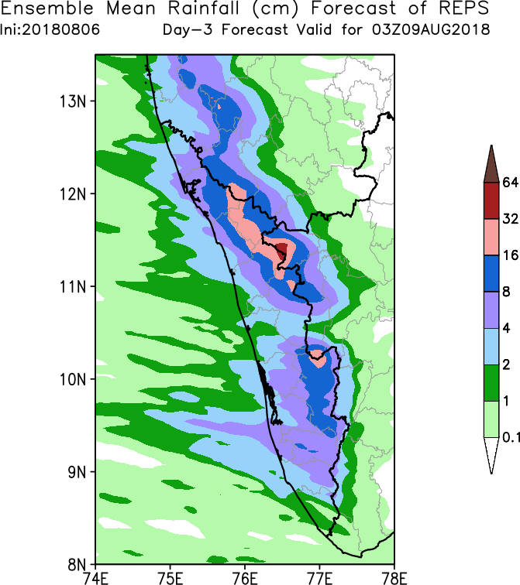

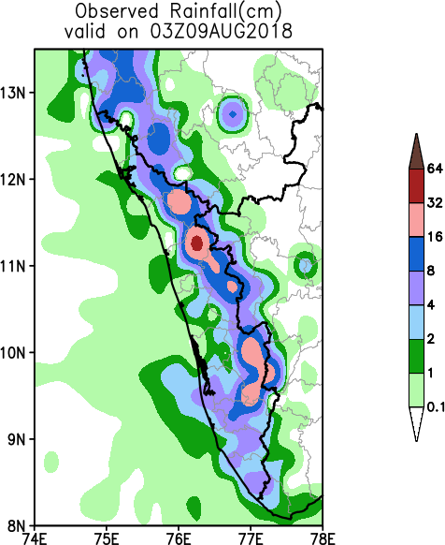
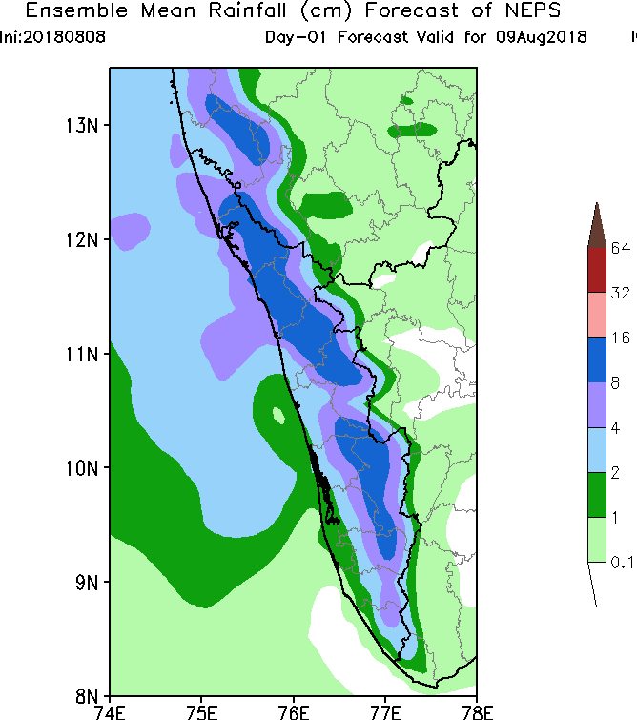
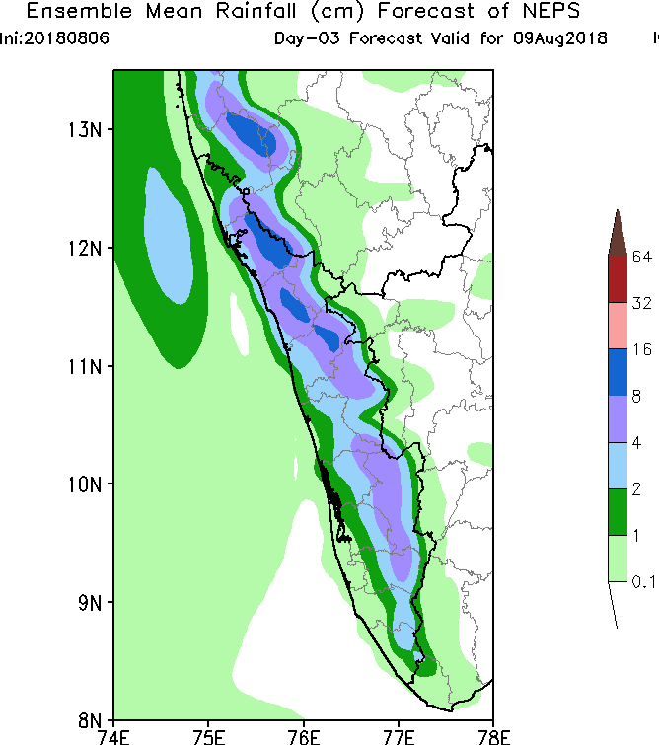
Ensemble mean Rainfall (cm/day) Forecast valid on 9th Aug 2018
4km NEPS-R
Day-1
Day-3
Observation
12km NEPS-G

Slide 24
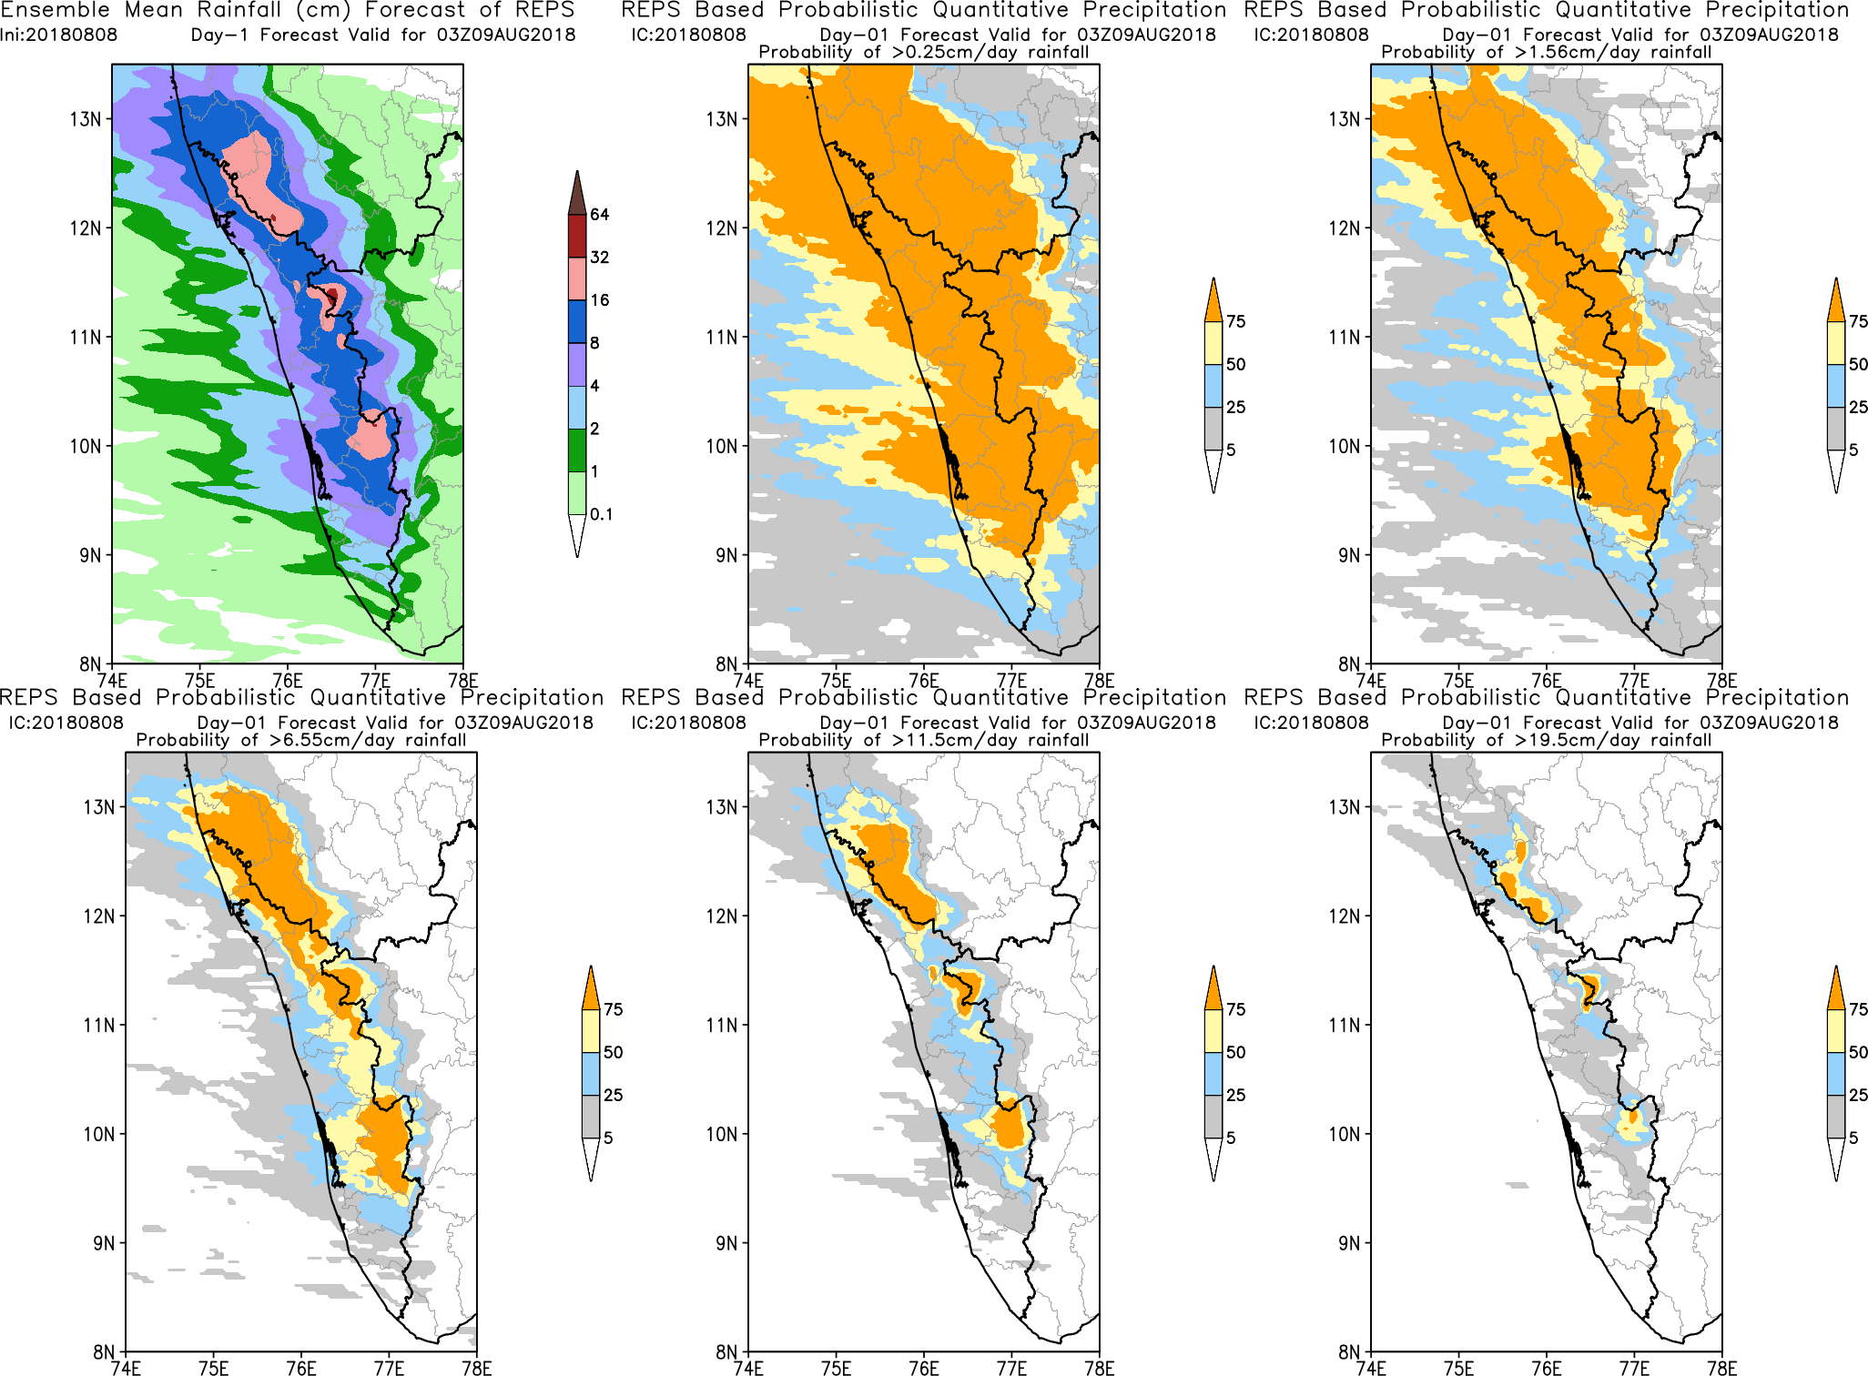

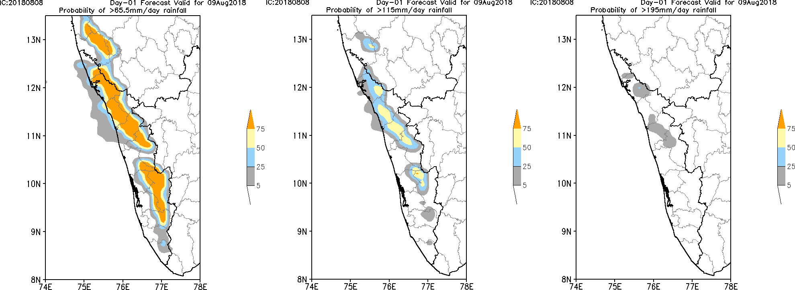
Probabilistic Quantitative Precipitation
Day-1 valid for 03Z09AUG2018
IC:20180808-00UTC
4km NEPS-R
>65.5mm/day
>115mm/day
>195mm/day
Observation
12km NEPS-G

Slide 25
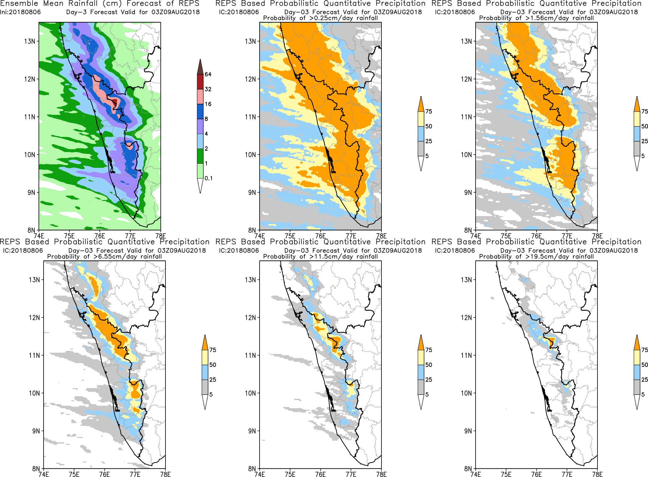
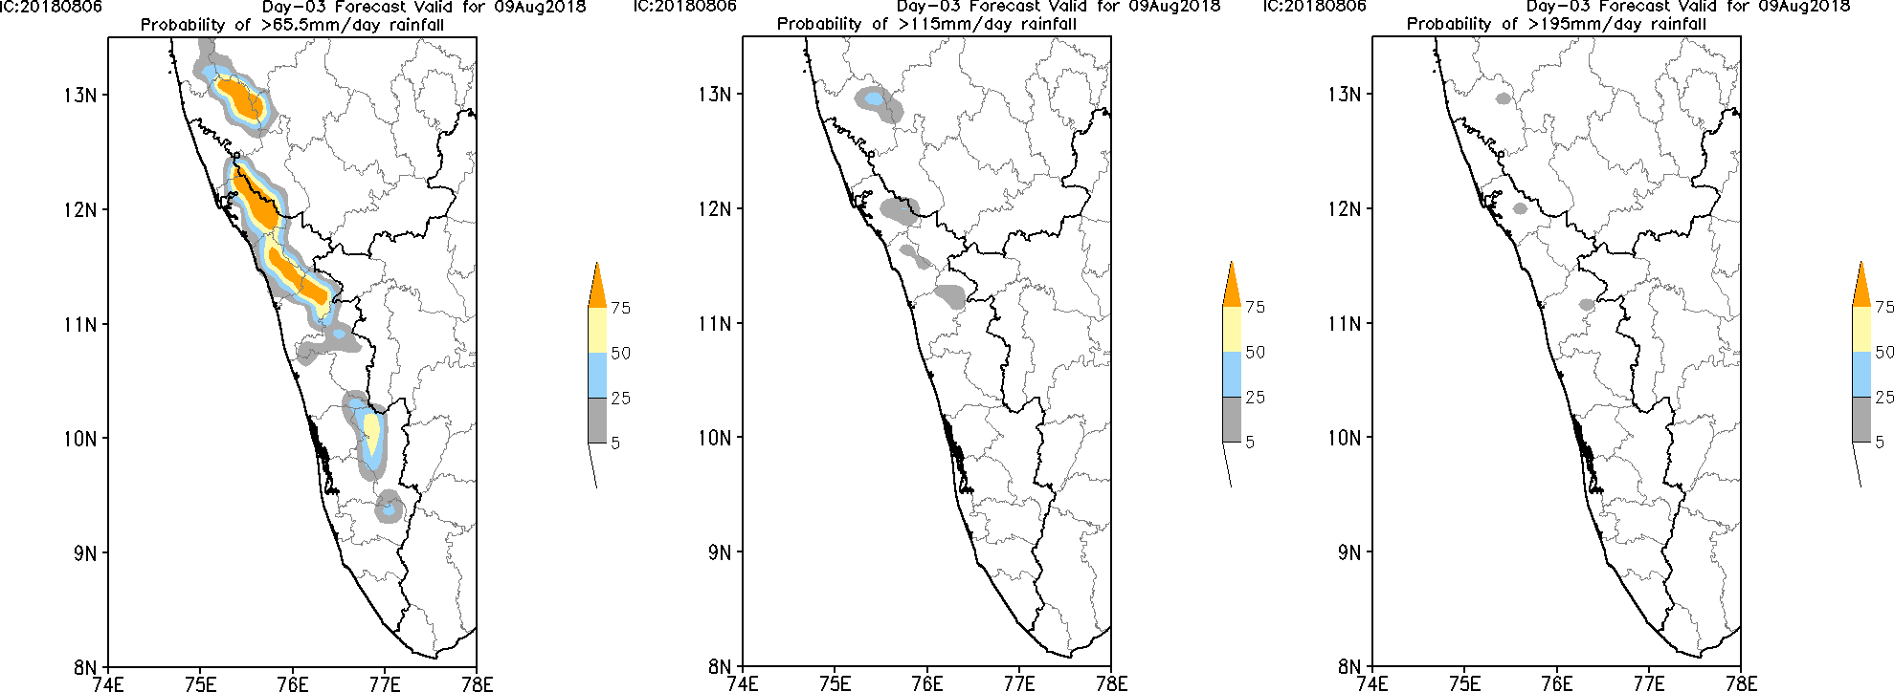
Probabilistic Quantitative Precipitation
Day-3 valid for 03Z09AUG2018
IC:20180806-00UTC
4km NEPS-R
>65.5mm/day
>115mm/day
>195mm/day
Observation
12km NEPS-G
25

Slide 26
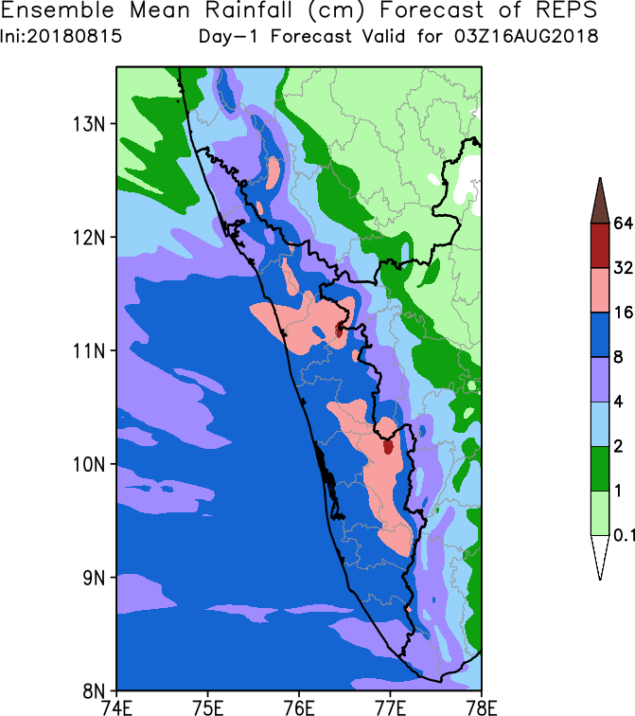
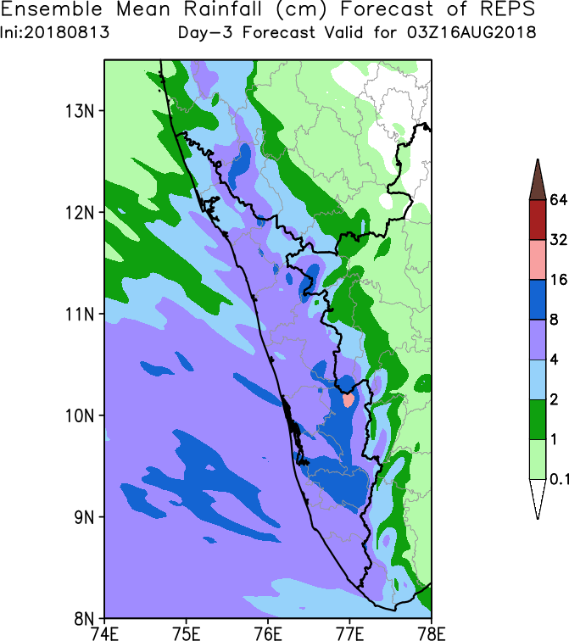
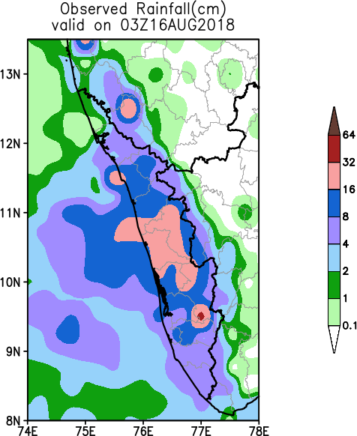
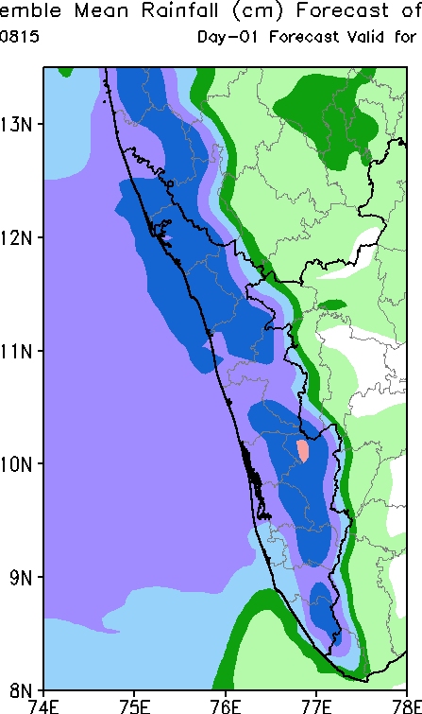
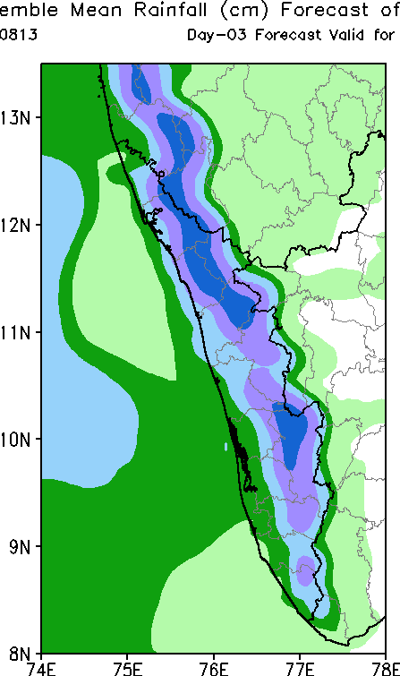
Ensemble mean Rainfall (cm/day) Forecast valid on 16th Aug 2018
4km NEPS-R
Day-1
Day-3
Observation
12km NEPS-G

Slide 27
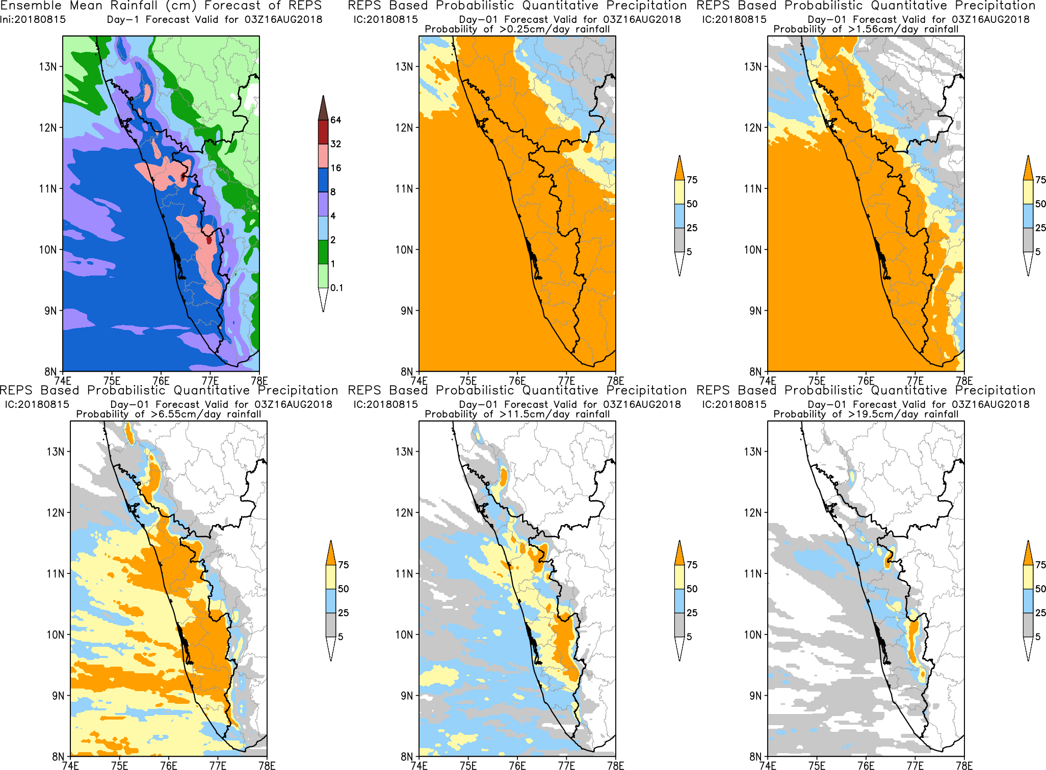
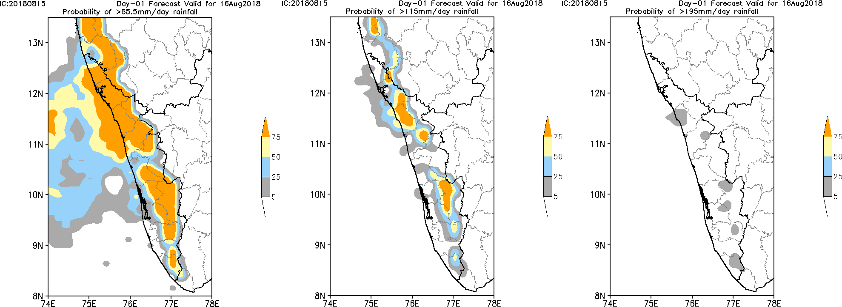
Probabilistic Quantitative Precipitation
Day-1 valid for 03Z16AUG2018
IC:20180815-00UTC
4km NEPS-R
>65.5mm/day
>115mm/day
>195mm/day
Observation
12km NEPS-G
27

Slide 28
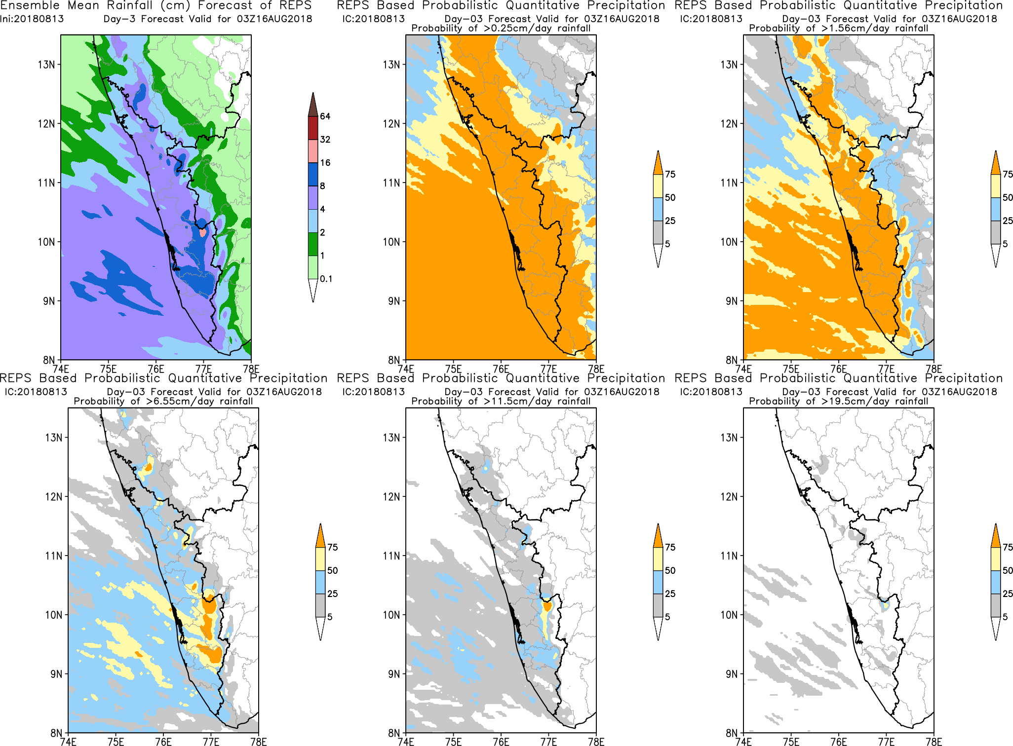

Probabilistic Quantitative Precipitation
Day-3 valid for 03Z16AUG2018
IC:20180813-00UTC
4km NEPS-R
>65.5mm/day
>115mm/day
>195mm/day
Observation
12km NEPS-G
28

Slide 29



DAY-1 Forecast
IC:20181009-00UTC
Observed Rainfall (cm)
Valid for 03Z10Oct2018
ENSEMBLE MEAN RAINFALL(cm)
Day 1 forecast valid for 03Z10Oct2018
Observation
4km NEPS-R
12km NEPS-G

Slide 30



Probabilistic Quantitative Precipitation
Day-1 valid for 03Z10OCT2018
IC:20181009-00UTC
4km NEPS-R
>65.5mm/day
>115mm/day
>195mm/day
Observation
12km NEPS-G
30

Slide 31



DAY-3 Forecast
IC:20181009-00UTC
Observed Rainfall (cm)
Valid for 03Z12Oct2018
ENSEMBLE MEAN RAINFALL(cm)
Day 2 forecast valid for 03Z12Oct2018
Observation
4km NEPS-R
12km NEPS-G

Slide 32




Probabilistic Quantitative Precipitation
Day-3 valid for 03Z12OCT2018
IC:20181009-00UTC
4km NEPS-R
>65.5mm/day
>115mm/day
>195mm/day
Observation
12km NEPS-G
32

Slide 33
Summary and Conclusion
Brier Score of N1024 is less than that of N400 both in NH & RSMC
Both N400 and N1024 show good reliability over NH
N1024 shows slightly more reliability over NH in Day 1 & Day 3
forecast
Both N400 and N1024 shows very good capability to discriminate
between event and non-event in day1, day3 and day5 forecasts over
NH for geopotential height.
Both N400 and N1024 shows good discrimination property
in precipitation forecasting (AUC – .69 & .66)
N1024 performs better than N400 in predicting heavy rainfall events
over orographic and non-orographic regions
Both 4km NEPS-R and 12km NEPS-G successfully predict the Very
Heavy rainfall for the selected extreme events.
NEPS-R predicts higher probability of heavy rainfall compared to
NEPS-G

Slide 34
THANK YOU
National Centre for Medium Range Weather Forecasting Ministry of Earth Sciences, Noida62, Uttar Pradesh, India http://www.ncmrwf.gov.in

