Slide 1
IITM 12 km resolution (T1534) global ensemble prediction
system based on GEFS: Evaluation of extreme precipitation
events over Indian region
Parthasarathi Mukhopadhyay
& Team
Indian Institute of Tropical Meteorology, Pune, India
Dr. V. S. Prasad and Team, NCMRWF, Noida
Bureau of Meteorology R &D workshop, 26-30 November 2018

Slide 2
SCHEMATIC OF GEFS (SL) T1534 (12.5 km) L64 RUNNING AT IITM
GDAS
EnKF – GSI Hybrid Data Assimilation System
Ensemble Initialization method: Ensemble Karman Filter (EnKF) scheme.
The 6-hr forecasts from the previous cycle
20 Perturbed members
Analysis (Control)
Tropical Storm Relocation (if storm is present)
Centering of the perturbations on the ensemble control analysis (Distributes the spread around analysis instead of Ensemble Mean
FORECAST: 21 members runs for 192 hrs (8 days)
GFS Semi-Lagrangian T574 (approx 12.5 km at equator); L64 vertical resolution
The stochastic total tendency perturbation (STTP) to enhance model uncertainty
POST PROCESSING : 240 hr (10 days) forecast
Resolution: 0.125⁰x0.125⁰
Products: 21 members, Ensemble mean, Ensemble Spread

Slide 3
SCHEMATIC OF GFS (SL) T1534 L64 RUNNING AT IITM
GDAS
EnKF – GSI Hybrid Data Assimilation System
Analysis(Control)
FORECAST: GFS Semi-Lagrangian T1534 (approx 12 km at equator)
L64 vertical resolution
Runs for 240 hrs (10 days)
Model being run with scale aware convection param
POST PROCESSING
120hr (10 days) forecast
Resolution: Regular grid and Gaussian grid at different resolutions
0.125⁰x0.125⁰ / 0.25⁰x0.25⁰ / 0.5⁰x0.5⁰ / 1⁰x1⁰

Slide 4
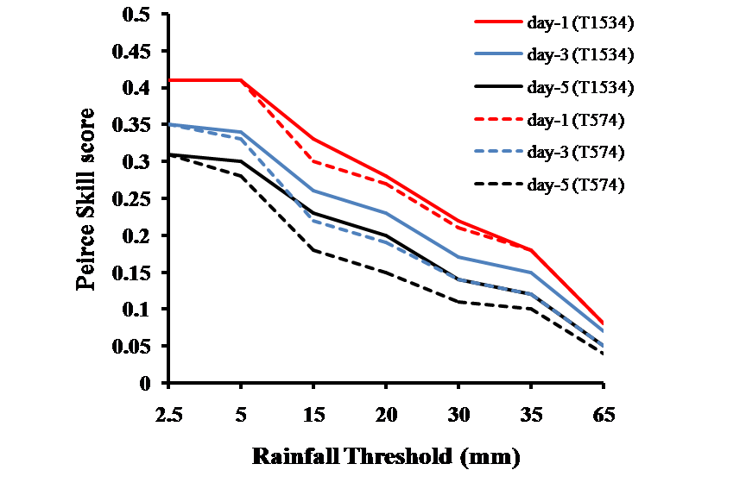
Peirce Skill Score (High Resolution global 12.5 km model gives better skill (The skill of GFS T574 with 3 day lead is now extended to 5 days with T1534 ~12.5 km global GFS
Prasad et al. NCMRWF

Slide 5
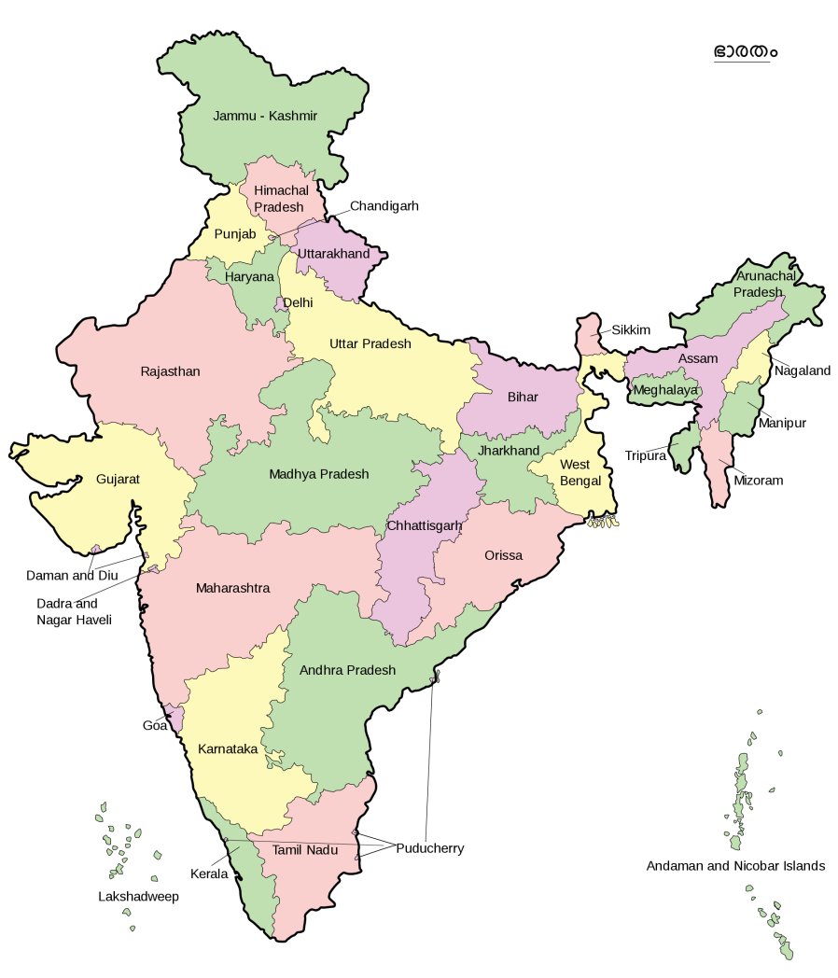
Development of a high resolution (12Km) Global Ensemble Weather Forecasting System (GEFS)
HIGH RESOLUTION (12 km) GFS MODEL APPLICATION TO THE SOCIETY
The Forecasting system based on deterministic GFS T1534 (12km) has been configured, tested, modified and implemented ahead of time in July 2016
The forecasting system is handed over to IMD for national operation since January 2017 ahead of time
Forest Fire monitoring with GFS 12 km forecast
Heavy rainfall forecast with GFS 12km
Application to district & blocks for agricultural forecast
Cyclogenesis with 3 to 4 days lead time
Solar and Wind energy forecasting with GFS 12 km forecast

Slide 6
GFS FCST: All India Rainfall time series from 6th June to 16th September 2018
Y axis: Rainfall (mm/day)

Slide 7
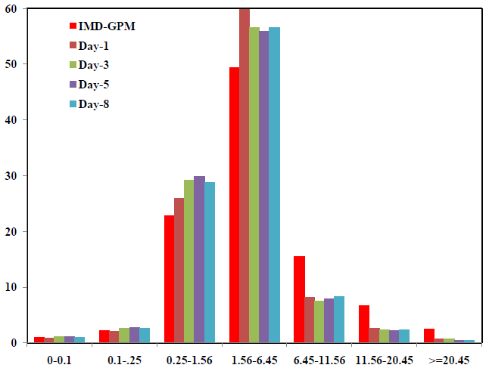
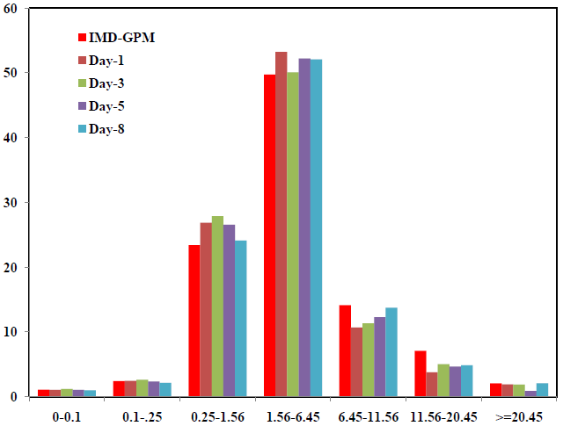
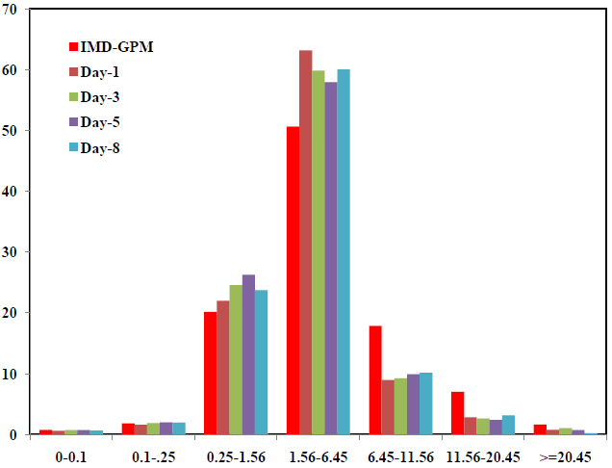
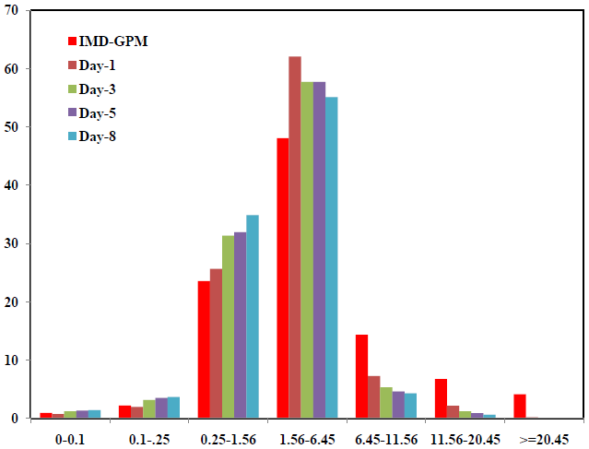
GFS T1534 : JJAS 2018
GFS T1534 : June
Model captures even the heavy and extremely heavy categories with good lead
GFS T1534 : July
GFS T1534 : August
X-axis: cm/day
Y-axis: Contribution to total rain (%)

Slide 8
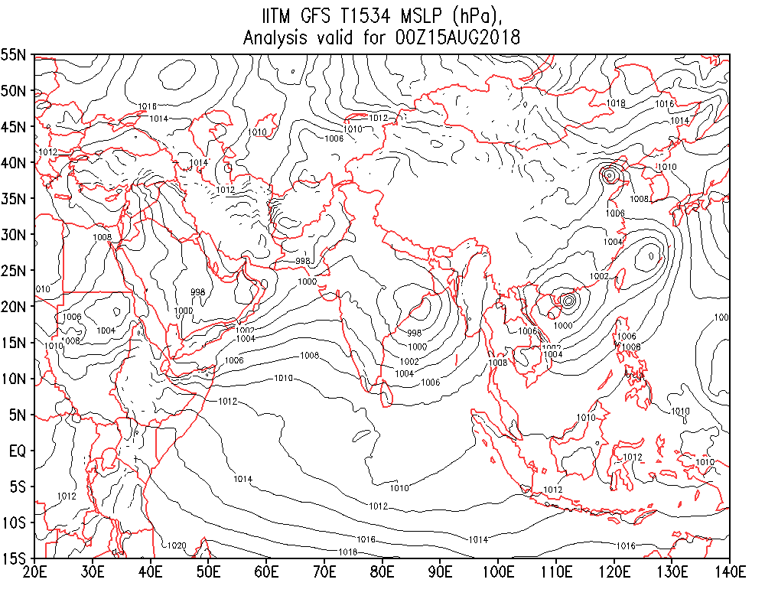
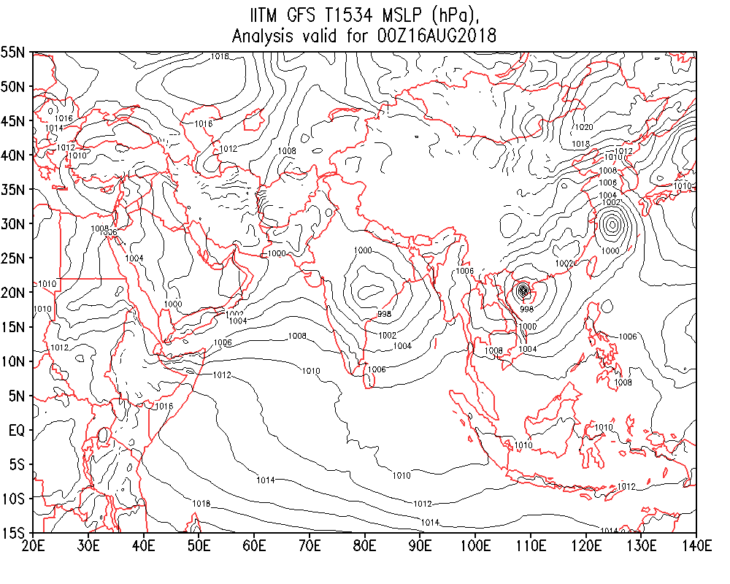
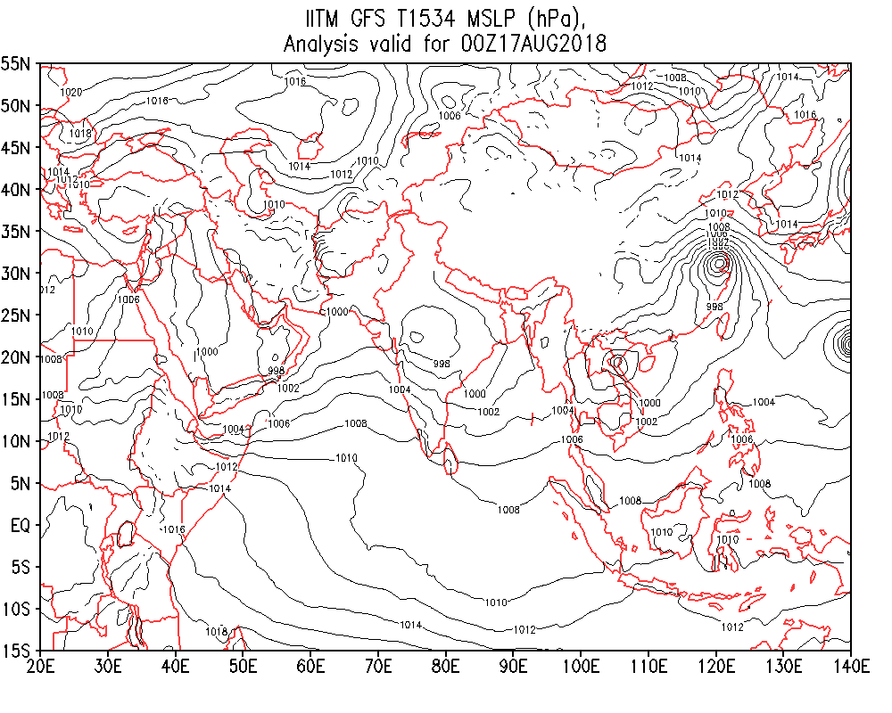
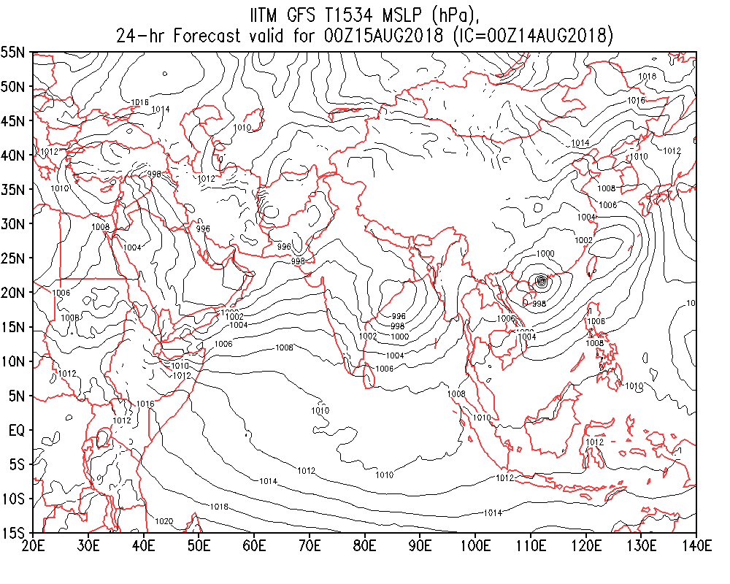
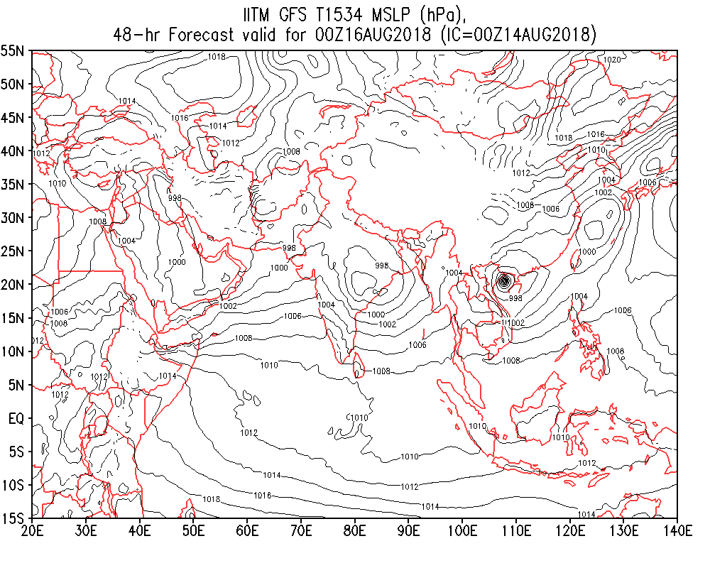
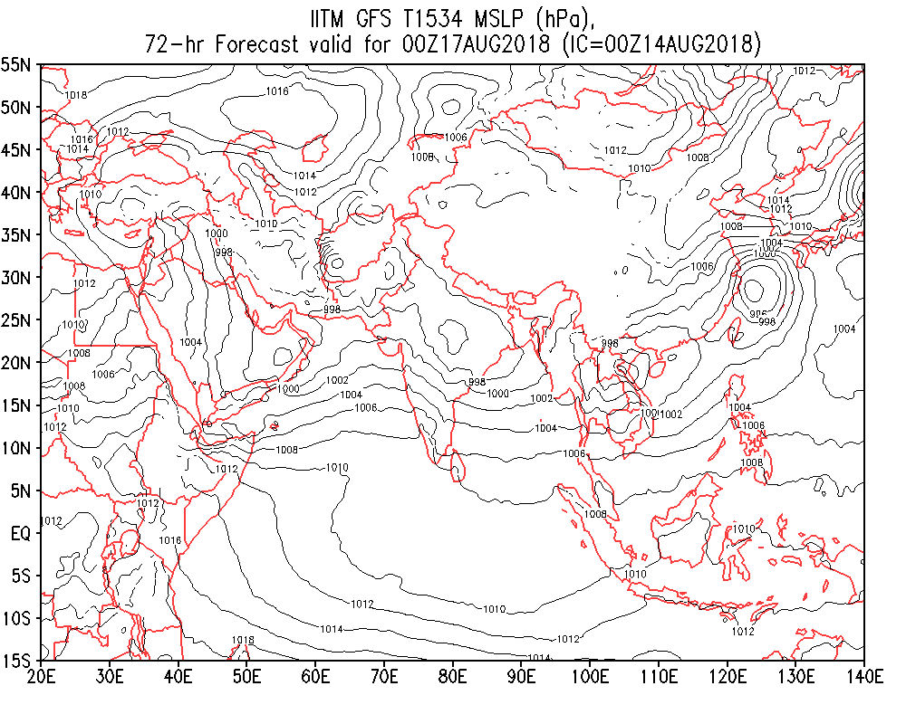
Analysis from GFS T1534
2018081500 2018081600 2018081700
FCST from 2018081400 IC, valid for
2018081500 2018081600 2018081700

Slide 9
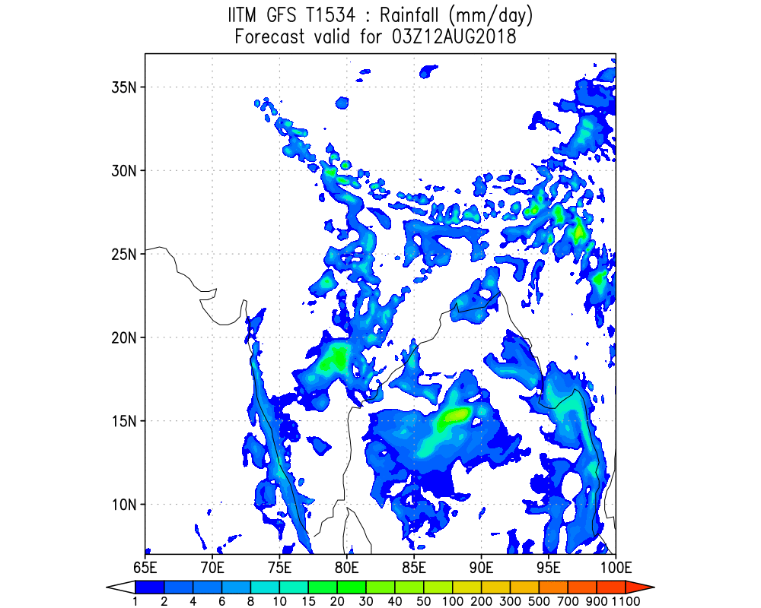
11 Aug IC

Slide 10
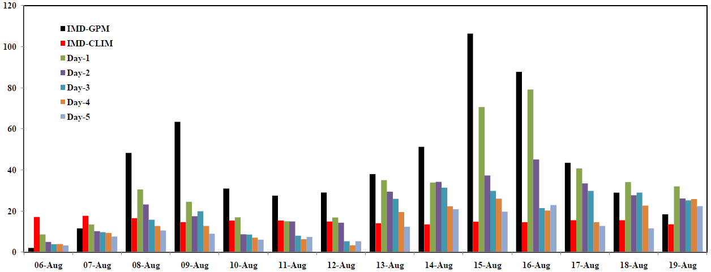
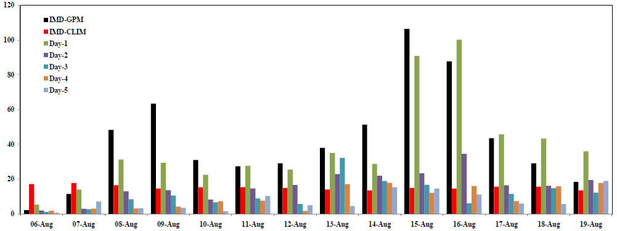
Rainfall (mm/day) time series over Kerala during 06-19Aug, 2018
GFS version 14
GFS version 14 with CS convection scheme

Slide 11
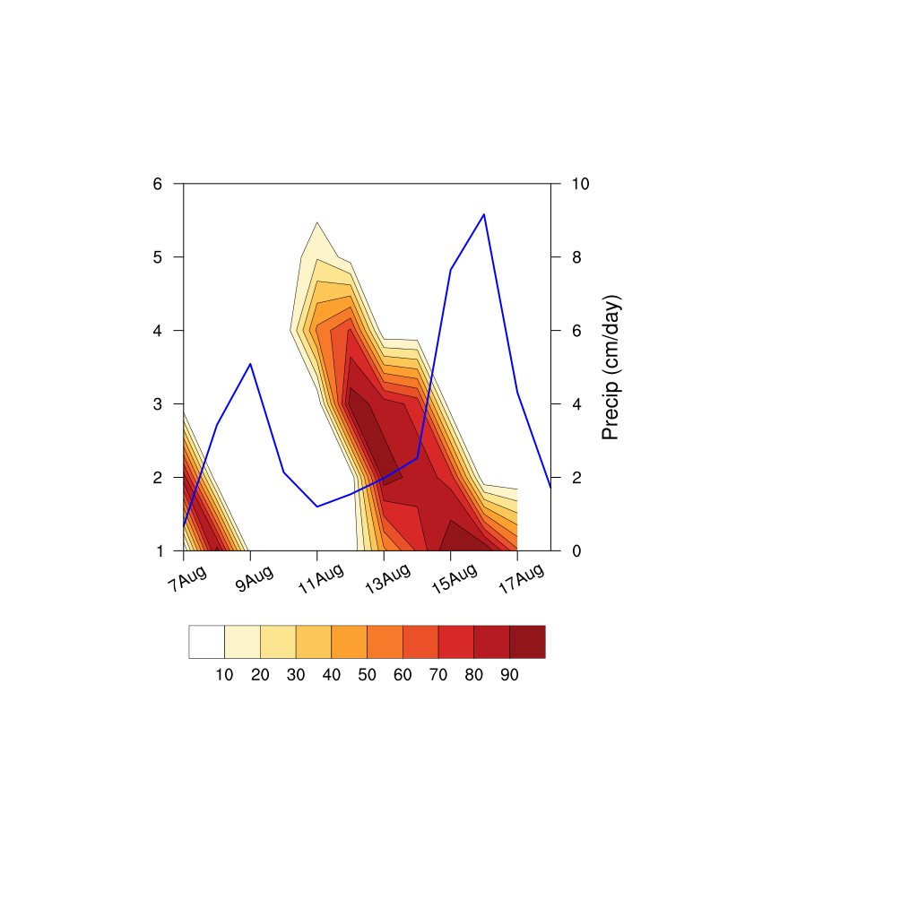
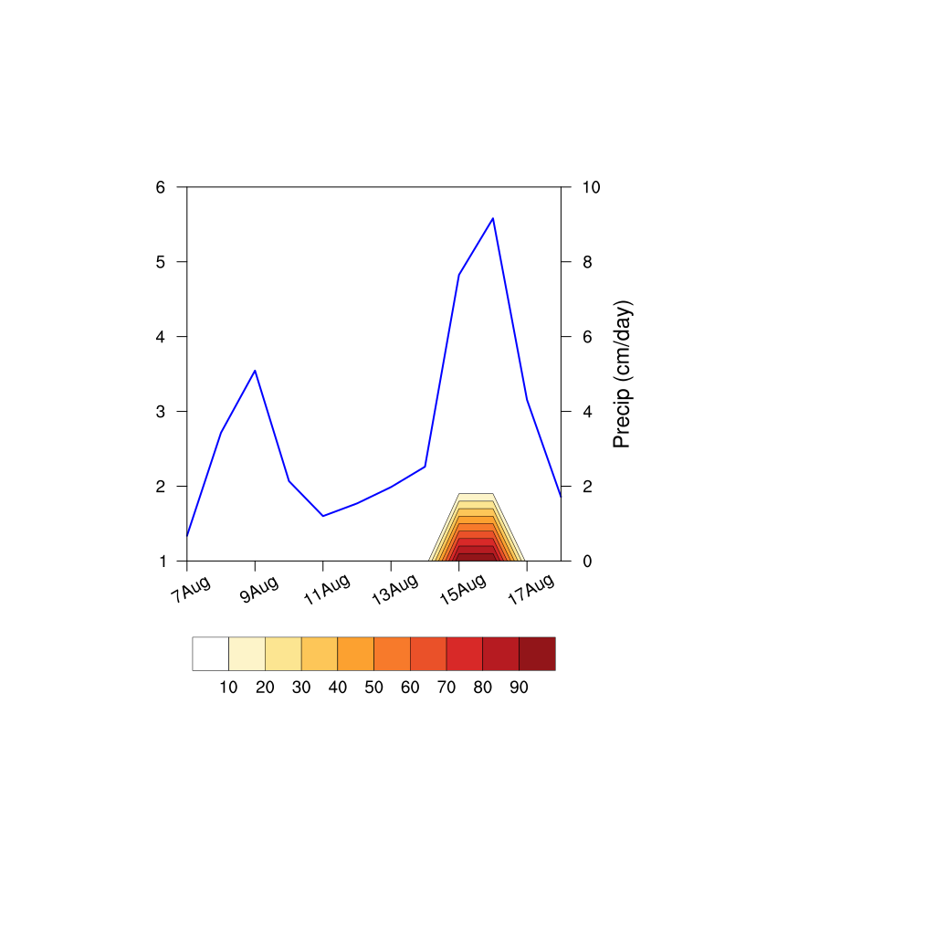
GEFS T1534
Clim+1SD
Clim+2SD
Lead (Days)
Lead (Days)
%

Slide 12
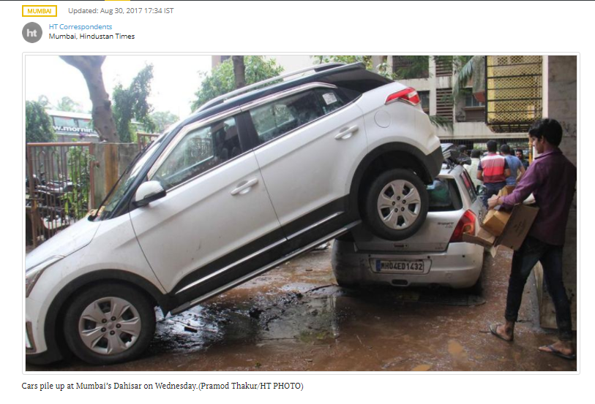
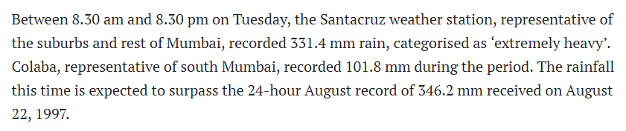
Source: Hindustan Times

Slide 13
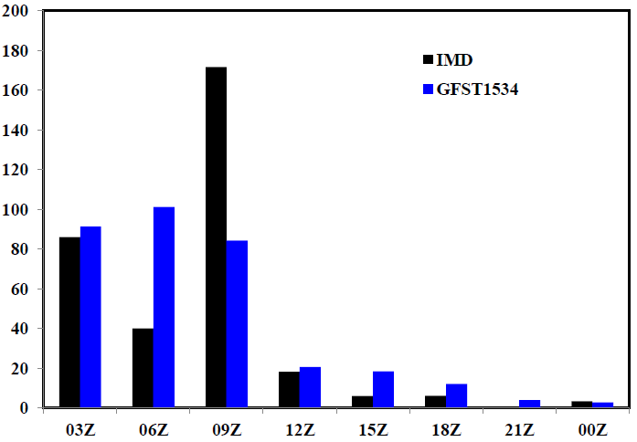
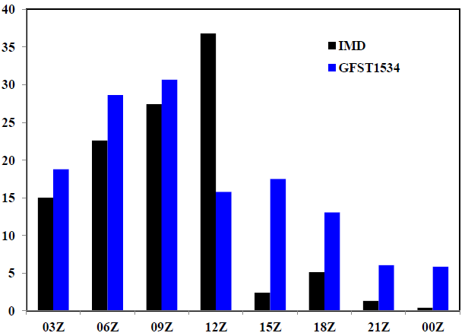
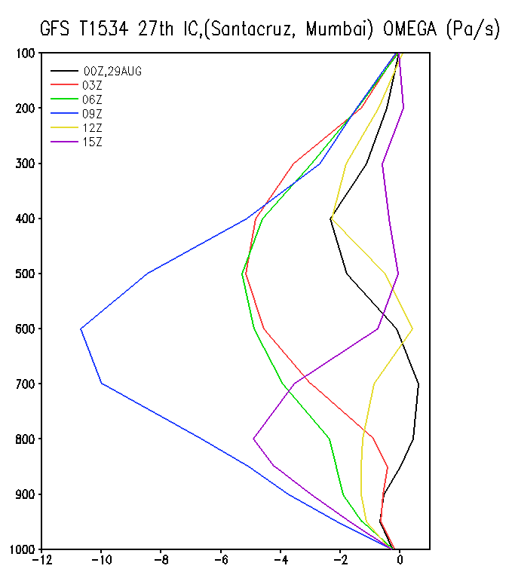
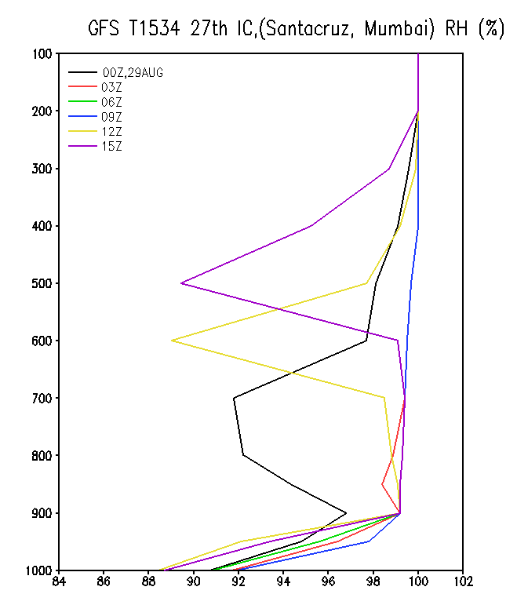
Santacruz, Mumbai Rainfall (mm/hr)
Based on 27th IC
Colaba, Mumbai Rainfall (mm/hr)
Based on 27th IC
29th August, 2017
Forecast valid for 29AUG with IC 27AUG
Strong vertical vel (10 Pa sec⁻¹) at 09UTC
900 hPa to 200 hPa totally saturated during 03, 06, 09Z

Slide 14
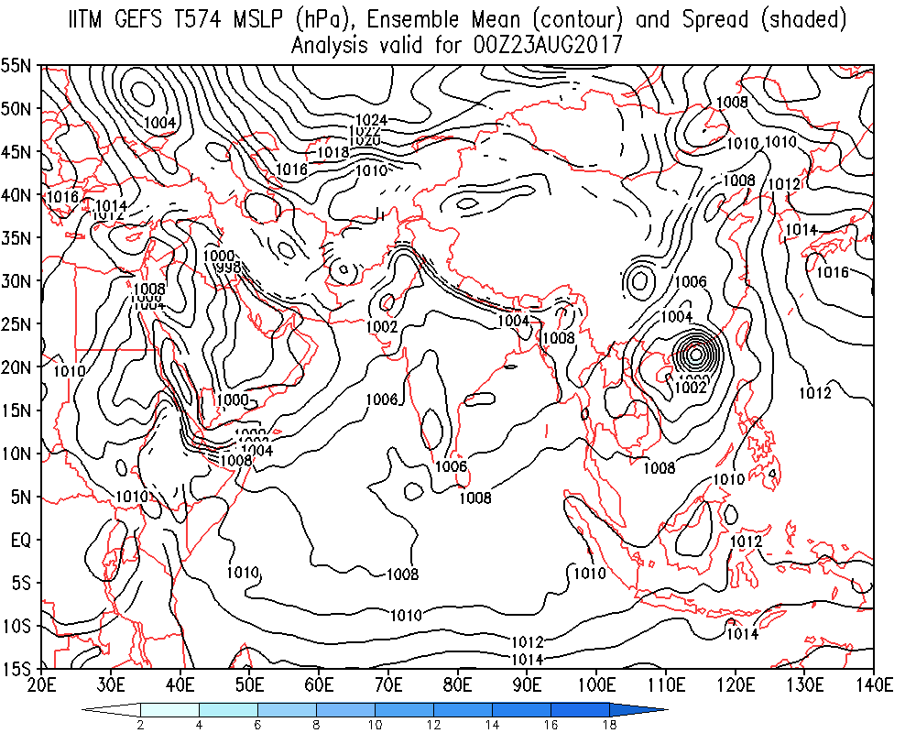
GEFS Forecast based on 23rd August 2017 Initial condition
MSLP Ensemble Mean and Spread
GFS and GEFS Captured
formation of Low on 27th over BOB and coastal Odisha.
Its intensification and westward movement Odisha –MP-Gujarat from 27th – 31st
The vertical extent upto 500 hPa with southward tilt

Slide 15
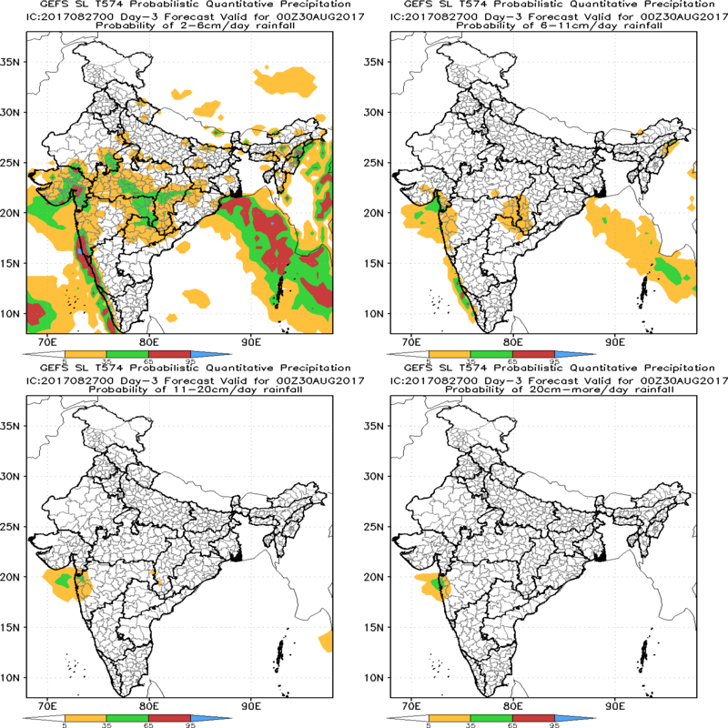
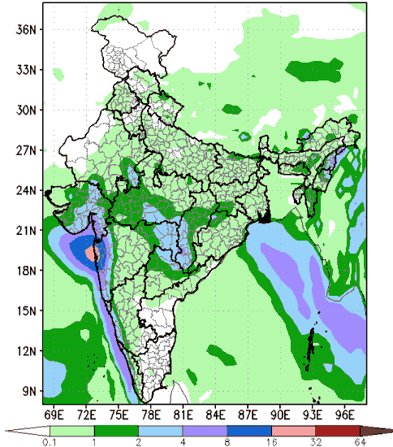
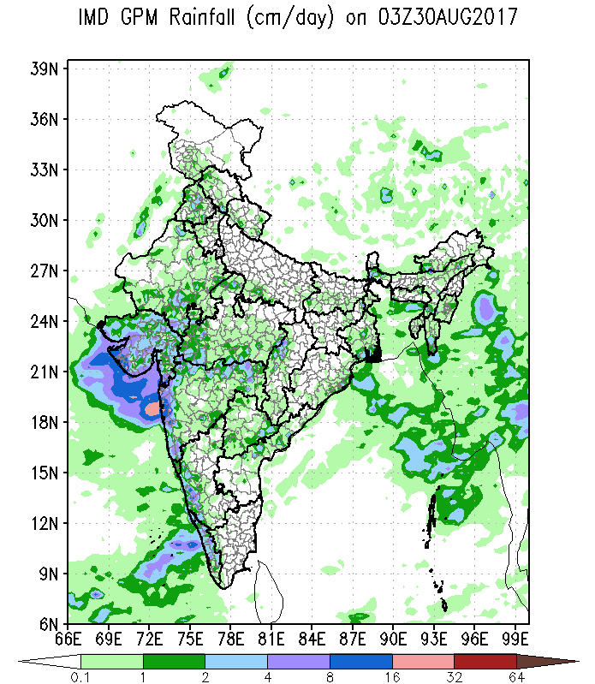
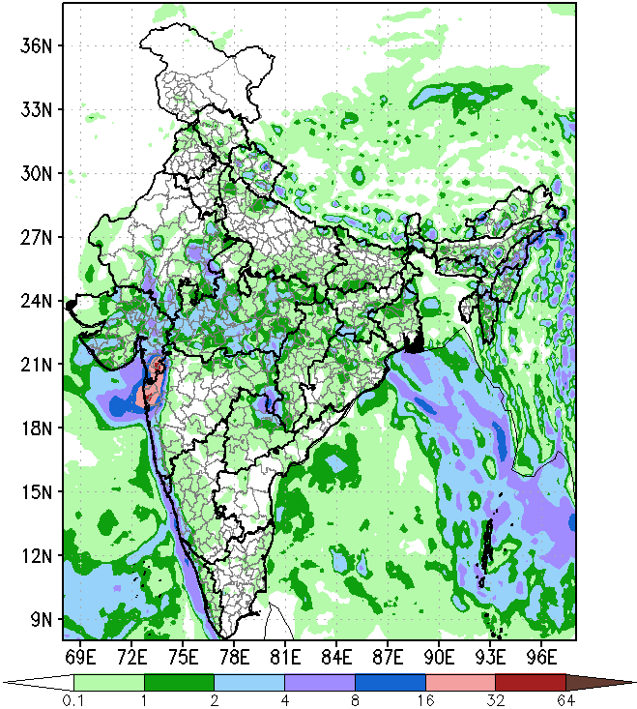
Forecast of Extremely Heavy rainfall over Mumbai valid for 30th August 2017 based on 27th August IC.
Day 3 GEFS T574 Probabilistic Quantitative Precipitation Forecast
Probability of 2-6 cm/day rain Probability of 6-11 cm/day rain
GEFS T574 Day 3 Forecast
Observation
30th August 2017
GFS T1534 Day 3 Forecast
Probability of 11-20 cm/day rain Probability of 20 cm/day and above rain

Slide 16
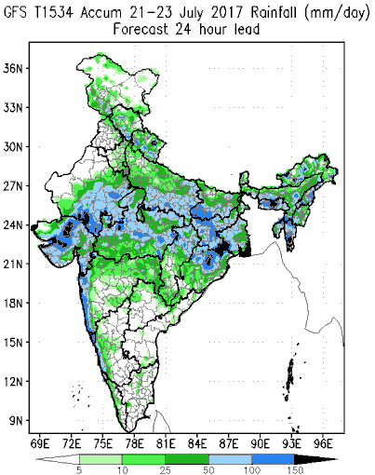
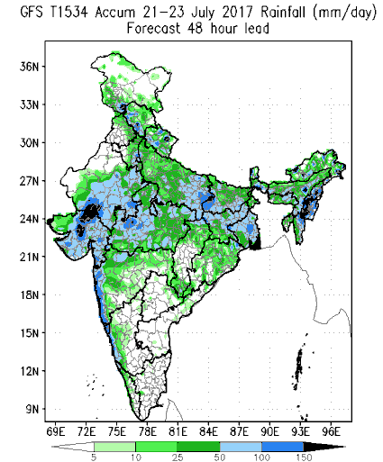
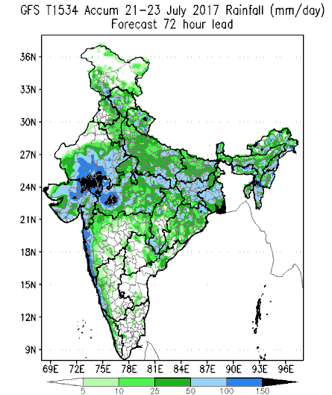
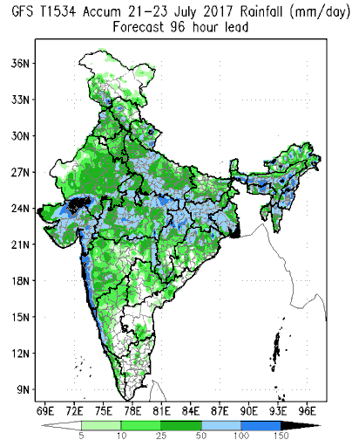
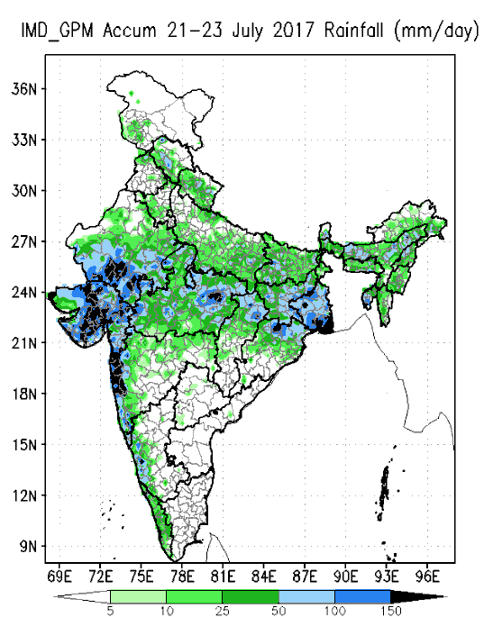
Heavy rainfall FCST over Gujarat by GFS 12km
+24h FCST
+48h FCST
+72h FCST
+96h FCST
IMD OBS

Slide 17
Summary
The deterministic and ensemble forecast at (12.5km) by GFS/GEFS T1534 shows significant improvement in predicting localized extremely heavy rain over India
The GFS/GEFS T1634 shows enhancement of skill by 2 days as compared to T574 as the skill of 5 day forecast by T1534 is found to be the skill of 3 day forecast by GFS T574.
GFS/GEFS T1534 predicts the genesis of cyclone and also heavy rain events with 3 to 5 days lead time.
The ensemble based short range prediction system by GEFS T1534 shows noted improvement in generating the probabilistic forecast for different rainfall categories during heavy rain events.
Improved assimilation and high resolution global (12.5 km) GFS model have enabled to achieve significant improvement in predicting localized extremely heavy rainfall over Indian region with 3 to 5 day lead

