Slide 1
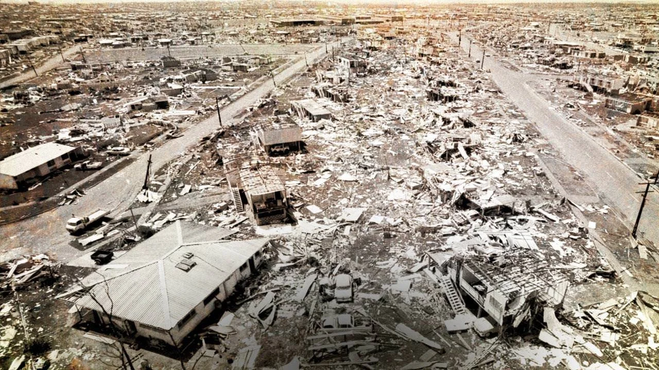
Ideas for ensemble tropical cyclone prediction Jim Fraser, Jeff Kepert, Peter Steinle Environment and Research Division, Bureau of Meteorology, Melbourne Bureau R&D Workshop – 26 Nov 2018
Aftermath of Cyclone Tracy, Darwin - 26 Dec 1974

Slide 2
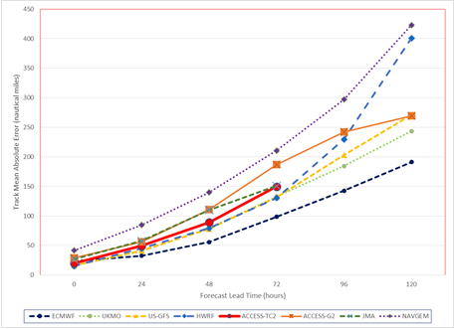
Deterministic NWP - TC track error growth
Even the best deterministic models suffer from TC track and intensity errors that grow with the forecast lead time:
Mean TC forecast model track errors for 160 NH TC basetimes, Aug-Oct 2016
This uncertainty is significant for decision makers!

Slide 3
TC Service and Operations Workshop, Sep 2017: Customer requirements
1. Maintain a focus on uncertainty and probabilistic modelling, even in genesis. They are making risk based decisions, and therefore want to know the range of possibilities, not just 1 or 2 scenarios. Examples of key customer requirements from the workshop were:
"Where do we deploy our limited number of vehicles that can drive through floods?"
"Where do we send our sandbag stock?"
"When and which evacuation centres do I open?"
"When should the airport be closed?"
"When do we have to stop evacuating people?"
2. Focus on information being available further out (e.g. 5 days prior)
An example was that ports need more than 3 days notice to tie everything down properly; having 5 days would enable planning.
3. Continuously updated information: They are waiting for our products to make decisions, more frequent updates are desirable;
4. Severity: obviously important, anything we can do to better model intensity is valuable.

Slide 4
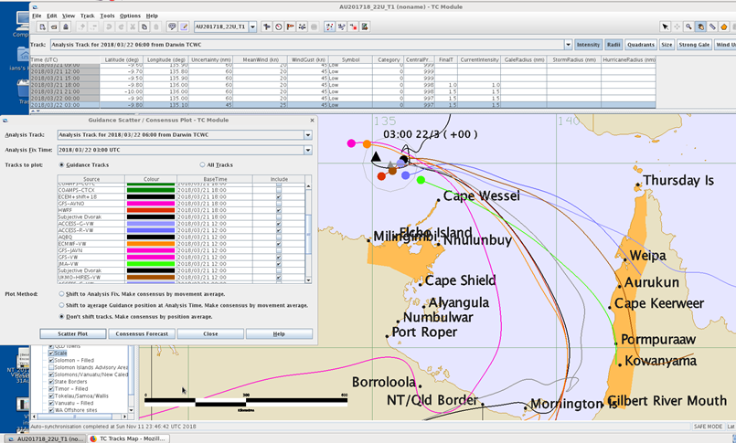
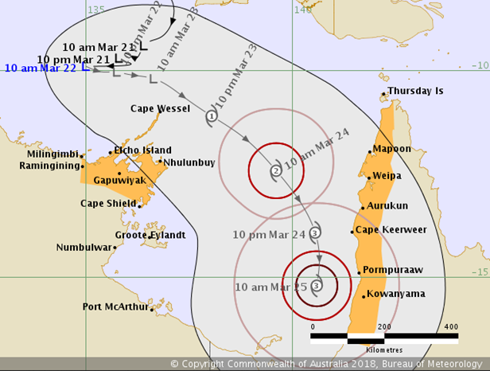
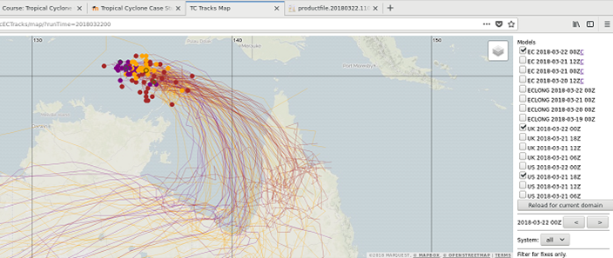
Current operational methodology – Consensus forecasts combining multiple models
Ian Shepherd, BoM NT.

Slide 5
Use of multi-model ensembles is a pragmatic approach that reduces calibration errors, especially where models have similar skill but different types of systematic error.
Still room for improvement, e.g. better models, bias correction etc.
Richard Swinbank, TIGGE,,,

Slide 6
JIP-TC: Ensemble Prediction System Bias Corrector (EPS-BC)
EPS-BC bias corrects ECMWF-EPS storm intensity and structure, based on data from the previous two seasons.
Resulting wind forecasts are then used to drive AUSWAVE-EPS wave model to produce probabilistic wave forecasts

Slide 7
JIP-TC: Ensemble Prediction System Bias Corrector (EPS-BC) cont…
EPS-BC displays improved forecast skill compared to the uncorrected ECMWF-EPS:
Vmax RMSE improved 41% (day 1) to 46% (day 10)
R34 & central pressure improved 23%(day1) to 30%(day10)
Possible future EPS-BC improvements:
EPS-BC currently only using the ECMWF-EPS forecasts but could be extended to also use the UKMO-EPS, GFS-EPS and ACCESS-GE3 (available next year) wind fields to cover more of the forecast probability distribution…
Extend EPS-BC domain to include NE Australia.

Slide 8
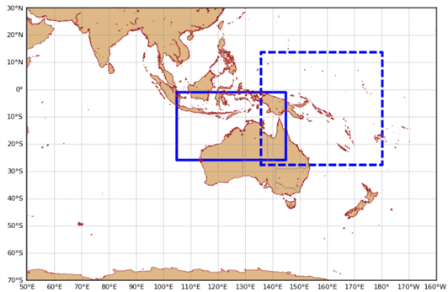
Improving the base model forecasts: High resolution NWP models
Current deterministic TC models:
ACCESS-TC2: Up to 3 relocatable domains @12km to +3 days
ACCESS-TCX: Fixed NW-Australia @ 4km to +5 days
Coming next year: ACCESS-TC3 @4km to +3 days.
"Convection permitting" using RA1-T physics.
Still only a deterministic model, so not sampling the range of possibilities

Slide 9
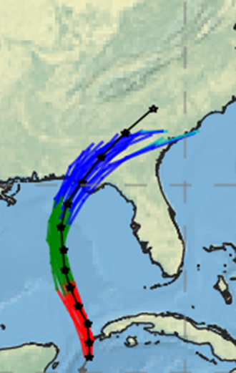
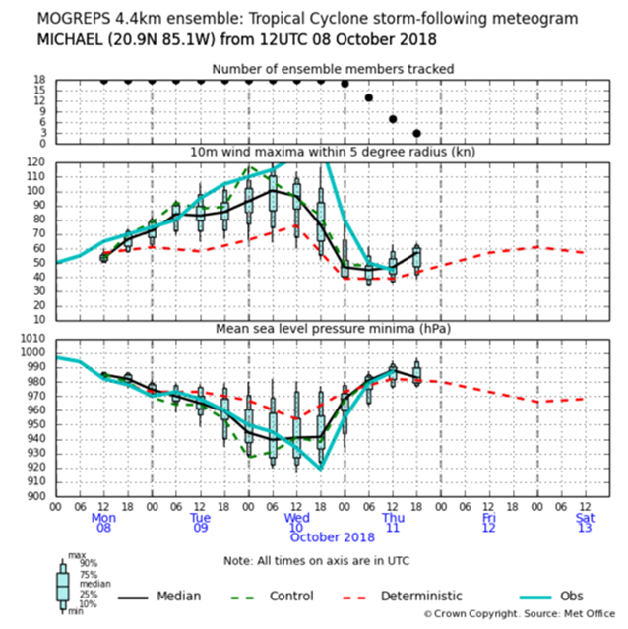
The future: Convection Permitting Ensembles?
UKMO (Stuart Webster et al) are already running real-time two downscaling ensemble systems at convection-permitting resolutions:
1. The UKMO Atlantic Tropical Cyclone 4.4 km ensemble
Run “on demand” out to T+120 twice daily over a relocatable domain.
e.g. Hurricane Michael:
Stuart Webster, UKMO…

Slide 10
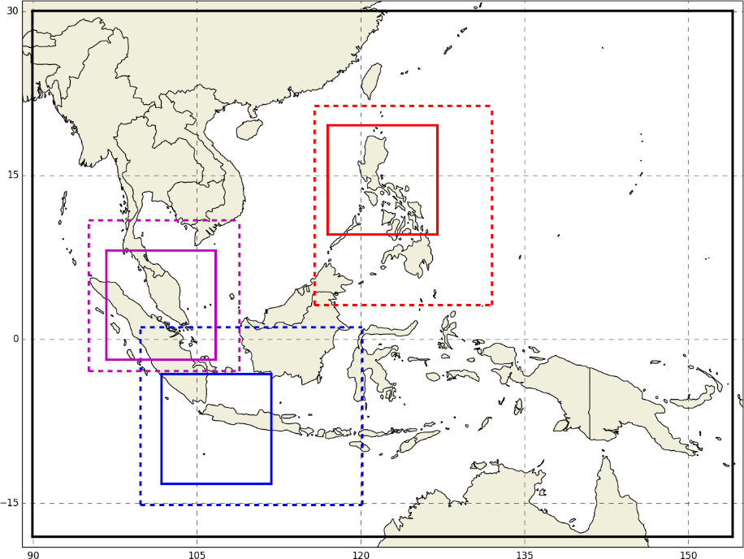




UKMO Convection Permitting Ensembles
2. The UKMO Southeast Asia real-time ensemble
Forecasts run from 00z and 12z analyses each day (as part of WCSSP SE Asia project).
18 members, nested inside N640 MOGREPS-G
Outer convection-permitting model over whole of SE Asia
Nested inside that, three set of multiply-nested models, one set for each partner country.
8.8 km resolution mirrors the ½ resolution cost-saving approach of the global.
Stuart Webster, UKMO…

Slide 11
UKMO Convection Permitting Ensembles
Although the 8.8km convection-permitting model is well inside the convection "grey zone" it apparently produces useful TC track results! (Although some problems noted with forecast under spread.)
An initial test of the UKMO ensemble nesting suite was run at NCI during Chris Short's visit to BOM last week.
Convection permitting ensembles are extremely expensive to run but could be an ACCESS "APS4" option on the next BOM supercomputer???

Slide 12

Jim Fraser Jim.Fraser@bom.gov.au

