Slide 1
Hourly cycling and time-lagging: a new configuration for MOGREPS-UK
Aurore Porson, Anne McCabe, Jo Carr, Bruce Macpherson, Rob Darvell, Rachel North, Susanna Hagelin, David Walters, Ken Mylne, Adrian Semple, Steve Willington
26th-30th November 2018
Bureau of Meteorology R&D workshop

Slide 2
Introduction to the new configuration
PS42 package trial results and objective verification
Objective verification to T+120
Subjective assessment to T+120
Conclusions

Slide 3
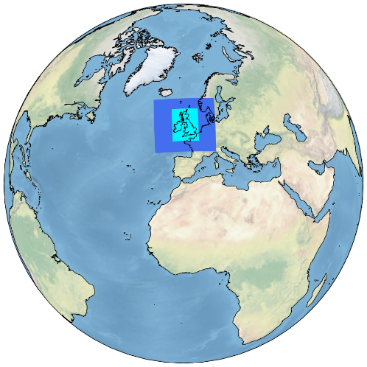
Up to PS41 (end of 2018), MOGREPS-UK is a 6-hourly ensemble model with 12 members
The UK convective scale ensemble
  12 members
  54 h forecast length
  Runs 4 cycles per day at 03, 09, 15 and 21 UTC
  2.2 km resolution on the inner domain, 4 km in the variable resolution zone
  Boundary conditions from the Met Office global ensemble, MOGREPS-G
  Initial conditions for each ensemble member are provided by the deterministic UK model (UKV) analysis with perturbations from MOGREPS-G added to these
In PS42 (trials finishing in October 2018), we have a new hourly configuration, which includes 18 members.This new hourly configuration runs to T+120.
www.metoffice.gov.uk © Crown Copyright 2018, Met Office

Slide 4
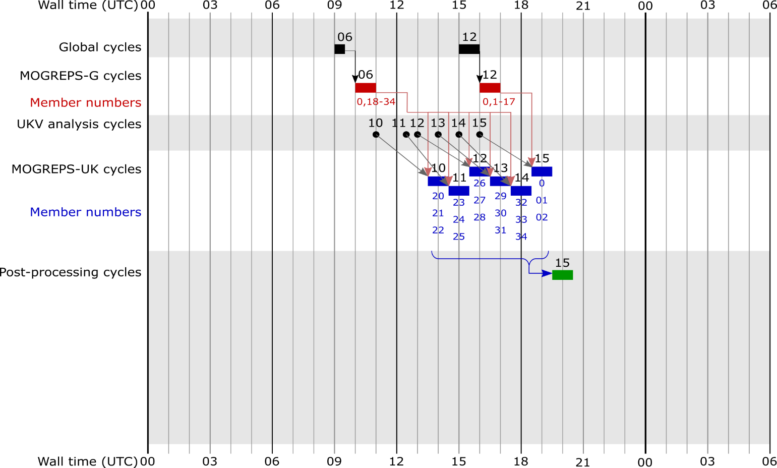
This takes advantage of UKV now running hourly 4DVar and the recent increase in number of global ensemble members
It runs a small ensemble (3 members) every hour and use time-lagging to create a larger ensemble (18 members per 6h cycle)
Courtesy of David Walters
www.metoffice.gov.uk © Crown Copyright 2018, Met Office

Slide 5
Benefits of the hourly cycling
The motivation for this new configuration is to:
  Take advantage of the newest UKV analysis
  Increase the ensemble spread by “spreading” the members around different analyses and different forcing conditions.
  Create a more frequently updated ensemble and less 'jumpy' forecast
  Compared to MOGREPS-G, provide a better probability assessment up to 5 days of severe cases sensitive to resolution
  Compared to the UKV, provide a better evaluation of the warning areas of severe cases up to 5 days.

Slide 6
PS42 package trial results

Slide 7
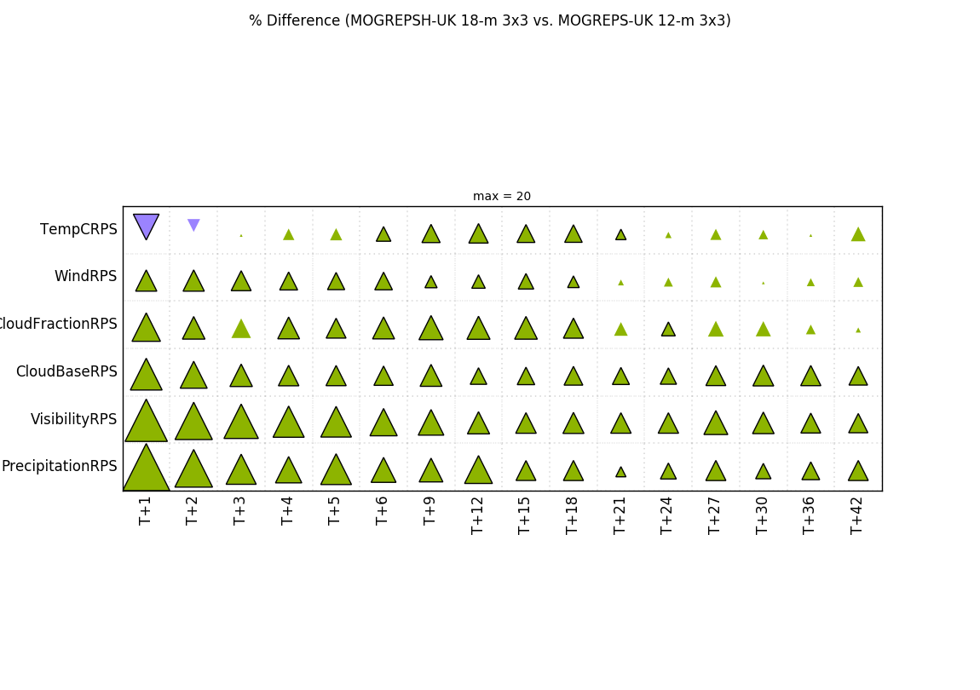
PS42 package results (driven by PS42 UKV and global packages) – winter
1) Temperature sensitive to differences in the times of the analyses between the 2 configurations.
02 Dec 2017 – 01 Jan 2018
2) Smaller improvements at later forecast times

Slide 8
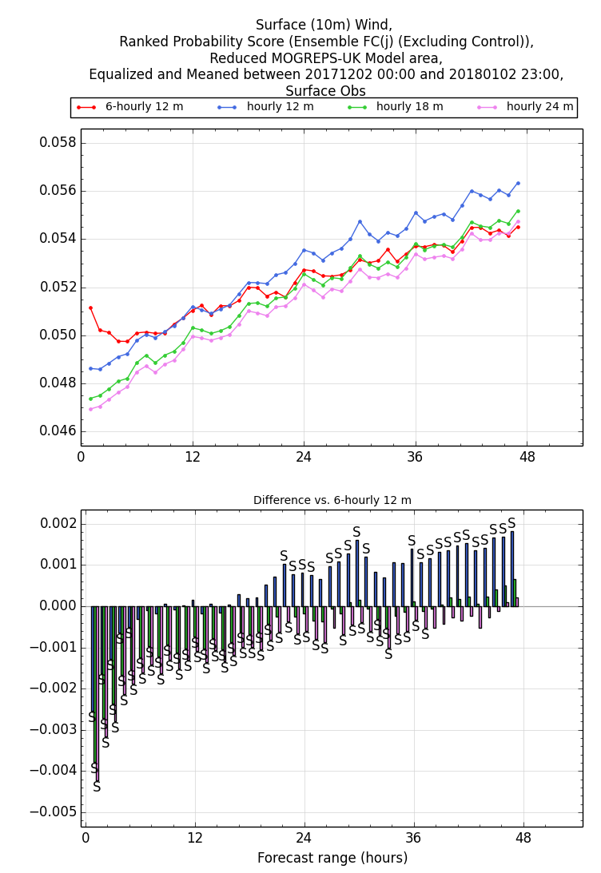
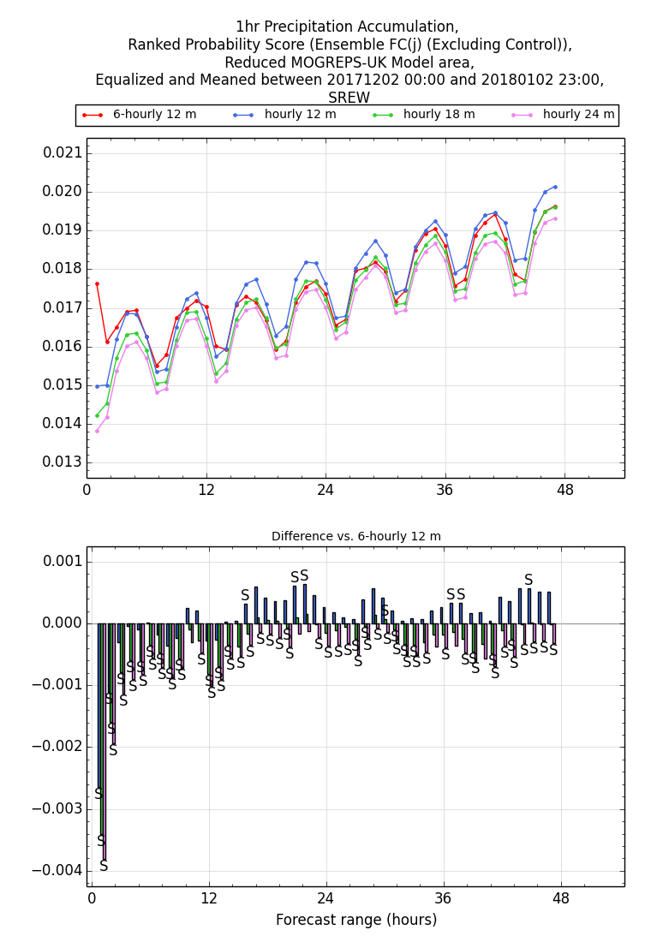
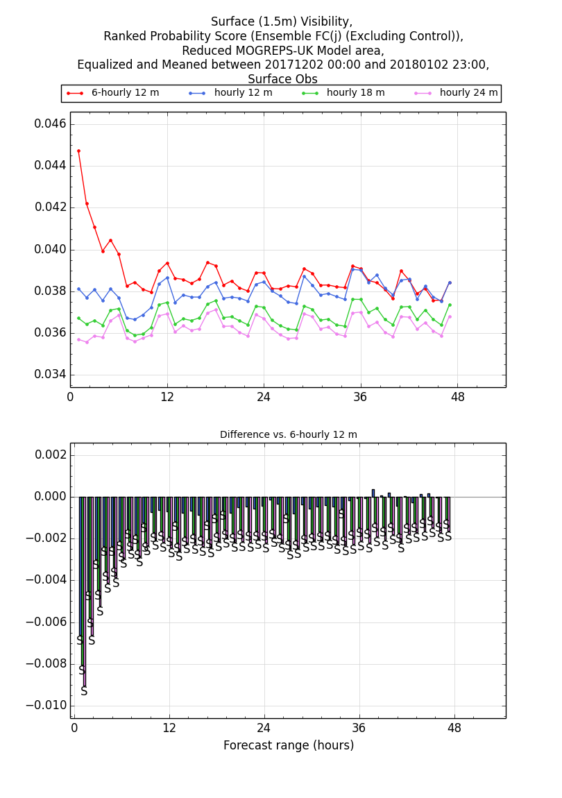
Examples of impact of lead time on performance for wind, precipitation, visibility
The 12-m 6-hourly becomes better than the 12-m hourly model
Advantage smaller with increasing lead times
Advantage smaller with increasing lead times
Advantage smaller with increasing lead times

Slide 9
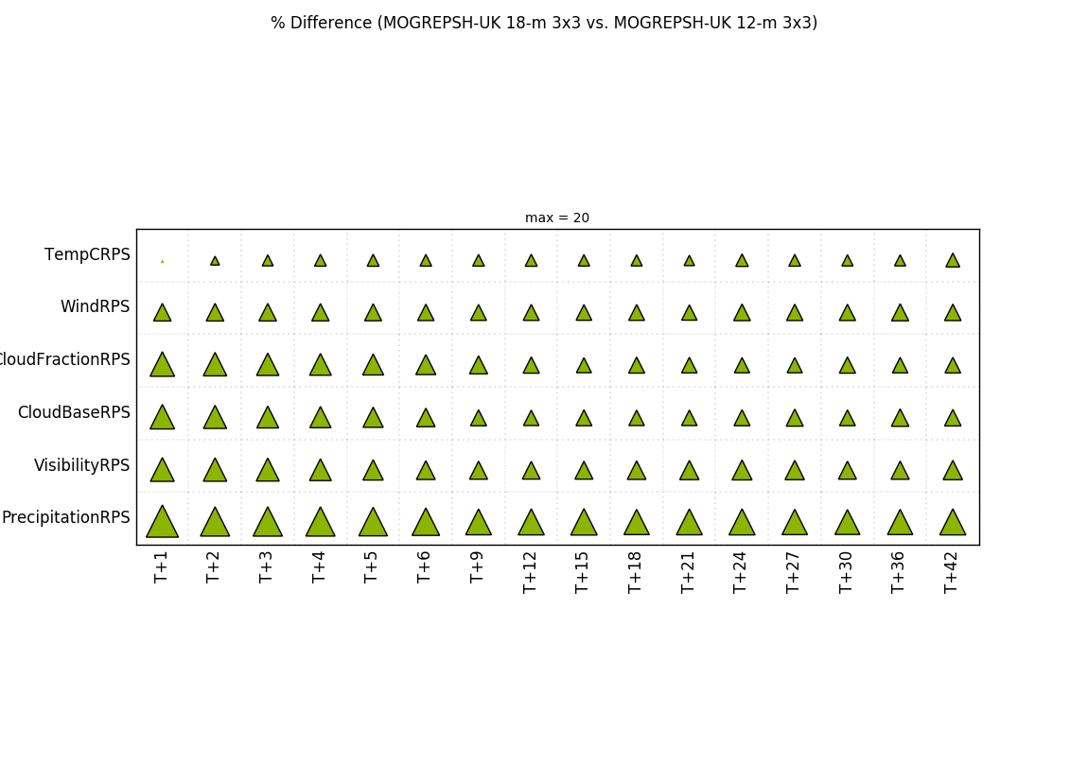
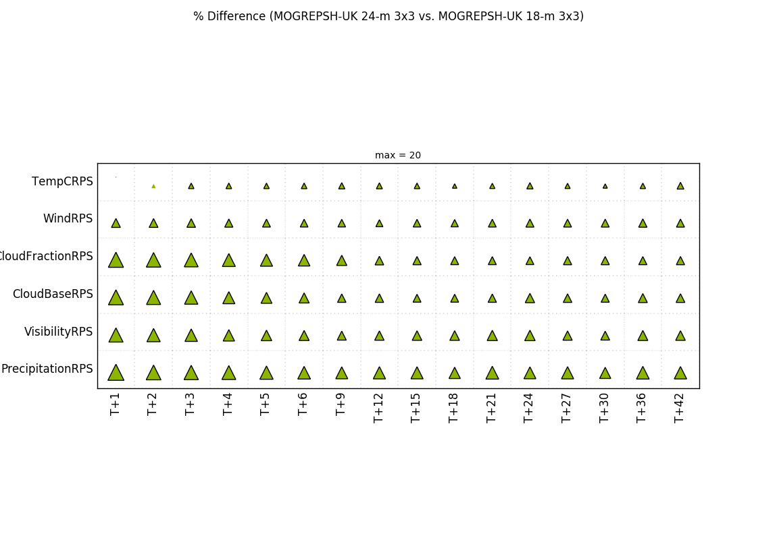
Impact of time-lagging
18-m hourly against 12-m hourly
Smaller improvements in the temperature scores in the short-range as well as decreasing performance with increasing lead times are not specific to the differences between the 6-hourly and hourly configurations. They are also intrinsic characteristics of the way we build our time-lagging configuration.
Here, we show the score cards for the hourly cycling model only, with increasing members through time-lagging. We see that the temperature scores do not change much in the short-range. The other fields also show a small decrease in the advantage of time-lagging with increasing lead times. This is related to the older forcing conditions to the ensemble.
24-m hourly against 18-m hourly
Notes:
Temperature impact in short-range associated with the nature of time-lagging and error growth in temperature!

Slide 10
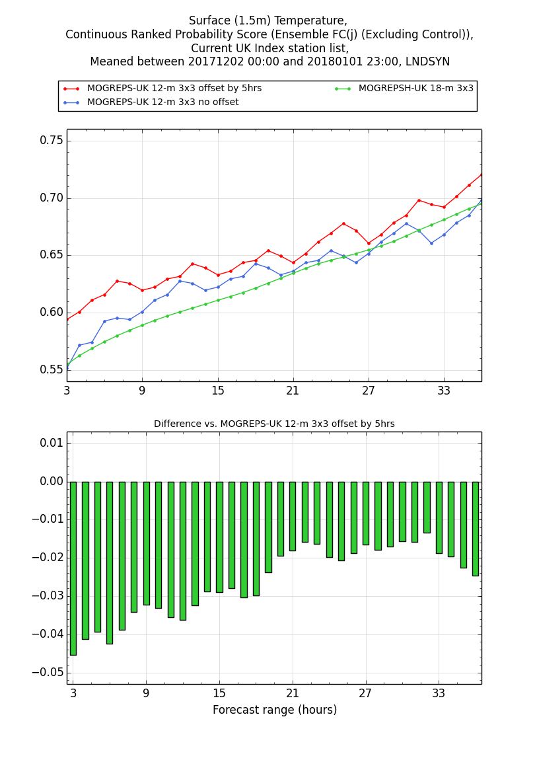
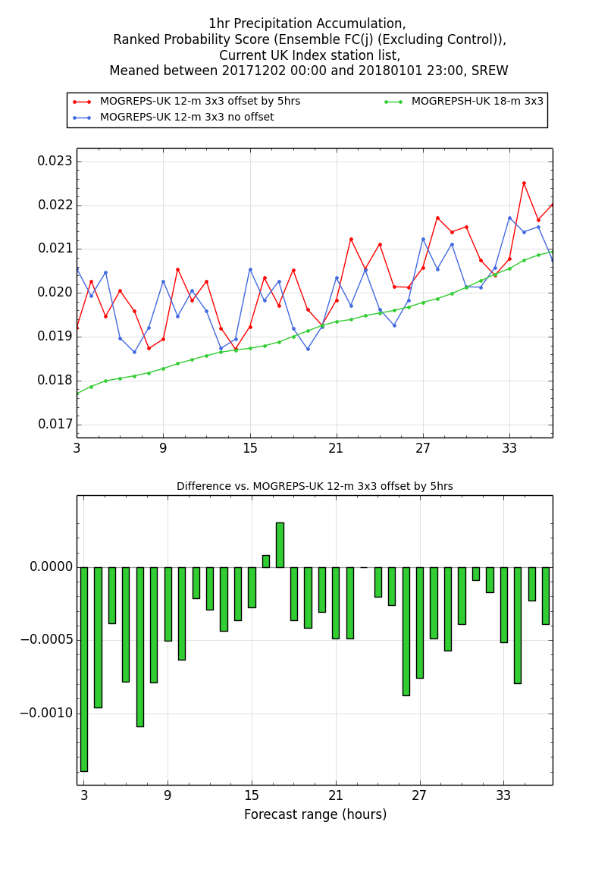
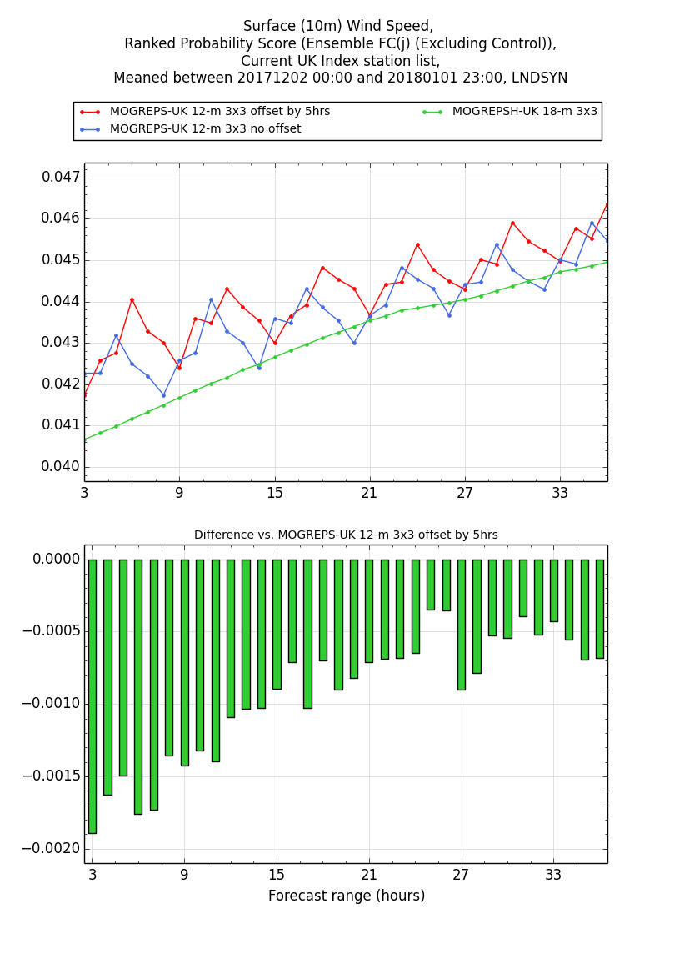
No offset 6-hourly performing better than hourly
Offset 6-hourly NOT performing better than hourly
Another way to view the impact of time-lagging is to take into account the offset in time in the comparison. Here we penalise the 6-hourly configuration by a maximum discrepancy of 5 hours. So we set the T+5 forecast time to be T+0 forecast time in the red line.

Slide 11
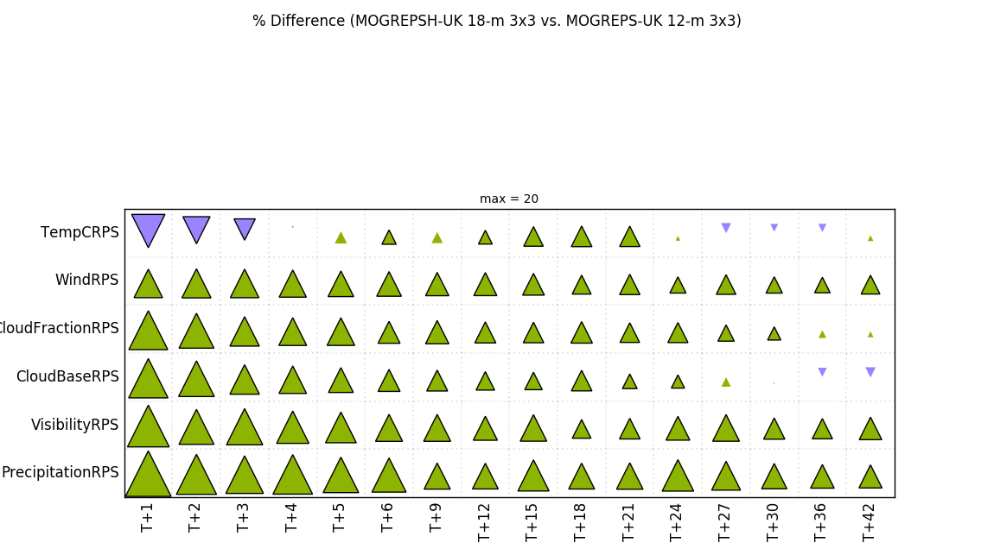
PS42 package results (driven by PS42 UKV and global packages) – summer
02 July 2017 – 01 August 2017
Similar results to the score card for the winter trial.
Impact on temperature and cloud base slightly worse past T+24 and T+36 respectively.

Slide 12
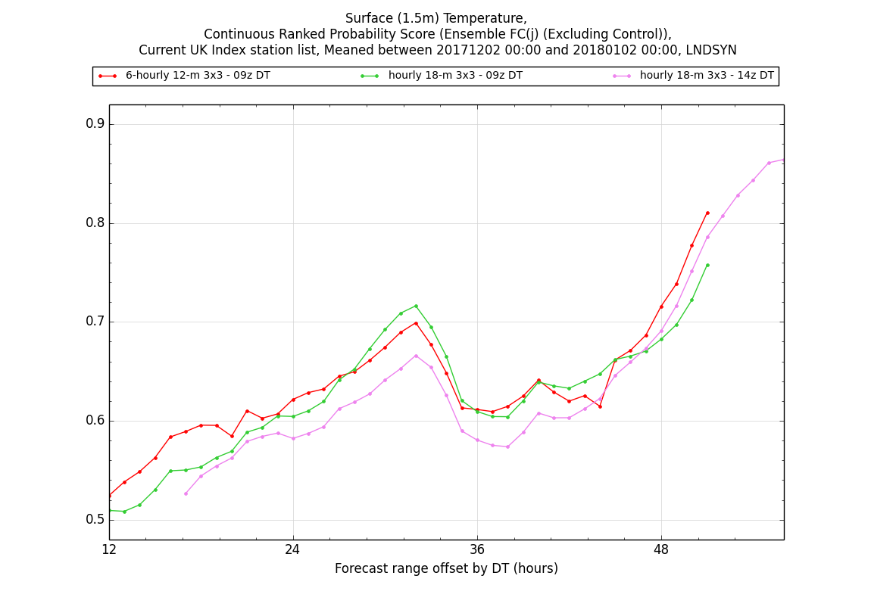
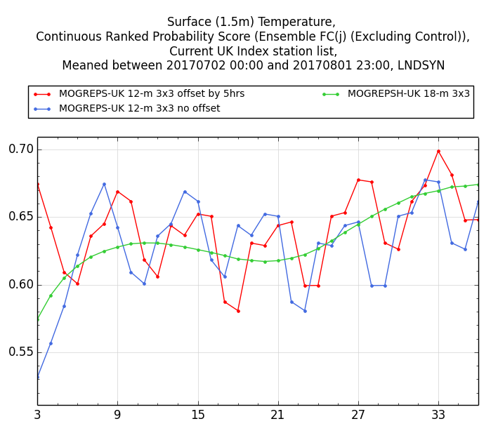
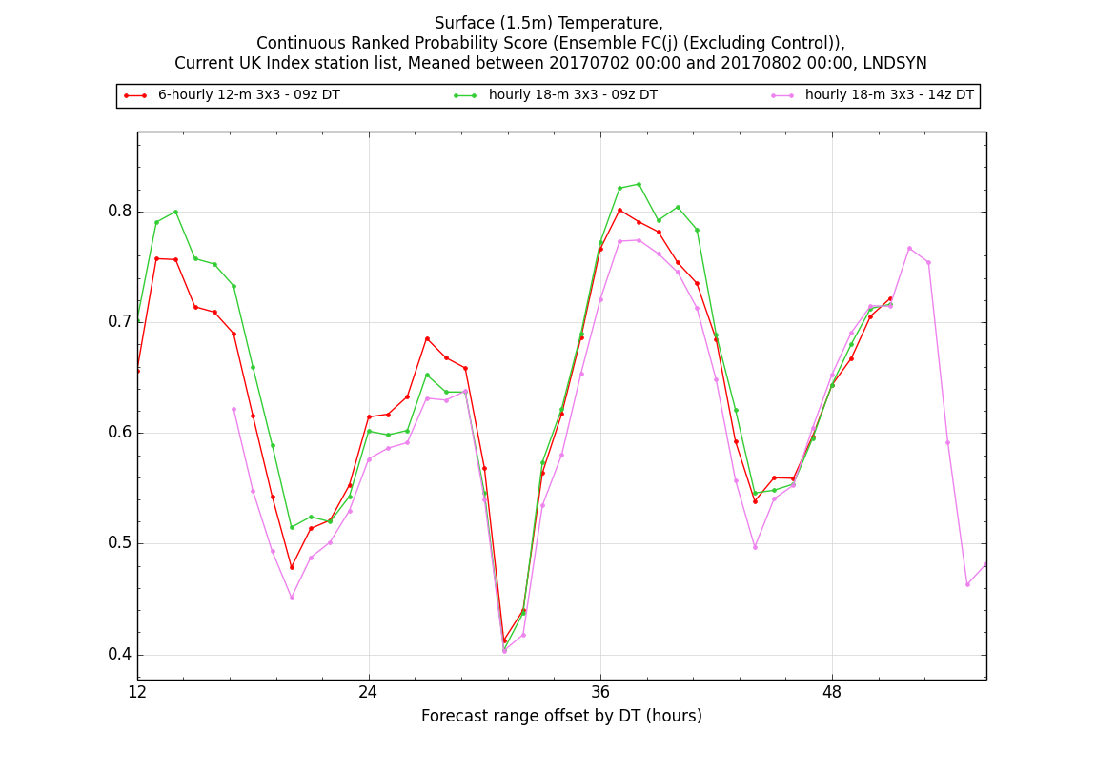
Slowly varying CRPS in winter
Rapidly varying error growth in CRPS in summer
Taking into account forecast offset is important to understand the short-range as well as the long-range impact
Notes:
For the summer trial, we see that the temperature is more sensitive to the time-lagging configuration. This is thought to be related to more rapidly varying error growth in the summer than in the winter, caused by the large temperature diurnal oscillations. No specific difference in the bias was found between the two seasons.

Slide 13
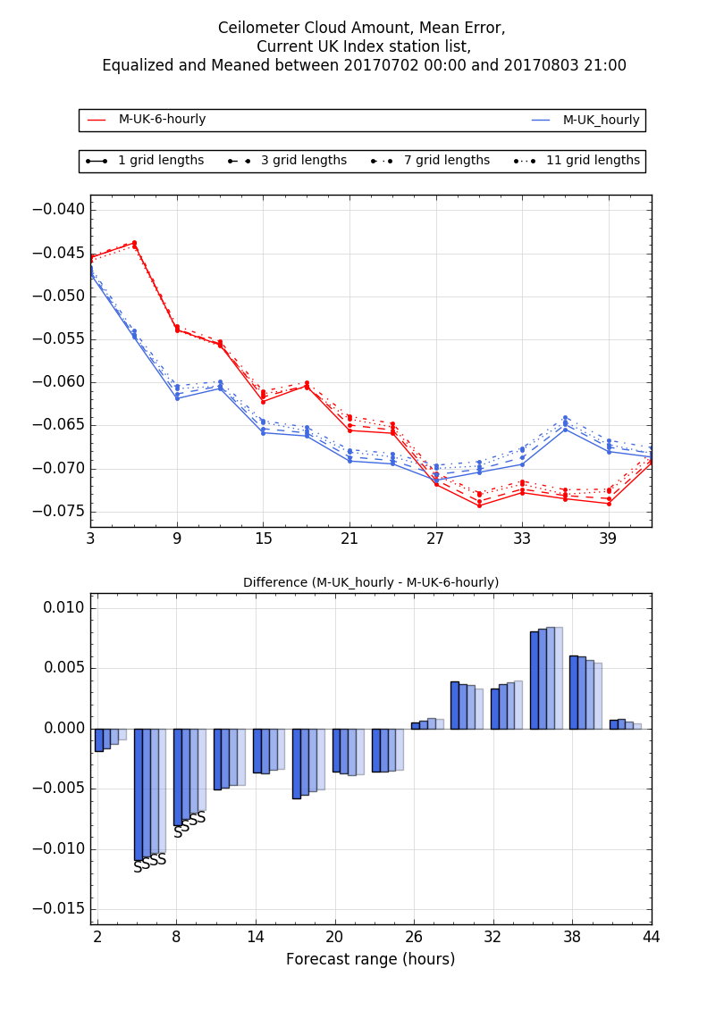
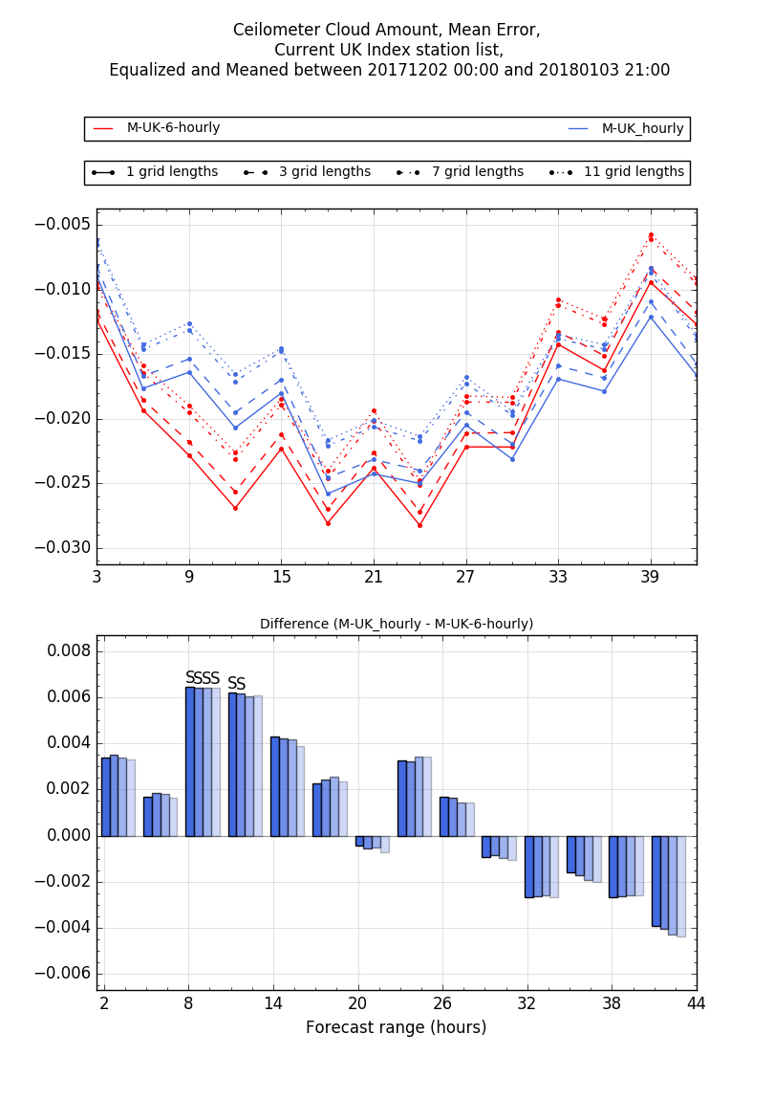
Cloud amount bias summer
Cloud amount bias winter
Mean error (bias) is worse in the summer in the short-range, despite improvement in RPS in the short-range.
Mean error (bias) is better in the longer range, despite less improvement in RPS.
Opposite results for winter, where biases match variation in RPS performance.
Notes:
I have noticed a difference in the clouds between the summer and the winter. In the summer, as a function of forecast range, the mean error does not match the RPS. By this, I mean that when the RPS shows an improvement for the hourly model, the mean error shows worse scores for the hourly model. However, the two metrics are more consistent in the winter.
This information should not be used to explain the poorer scores in temperature in the summer trial score card at the end of the forecast as the mean error in the clouds is actually better at the end of the forecasts for the hourly as seen here (left plot) and there is no difference in the bias in temperature anyway at the end of the forecasts between the 6-hourly and the hourly configurations (not shown here).

Slide 14
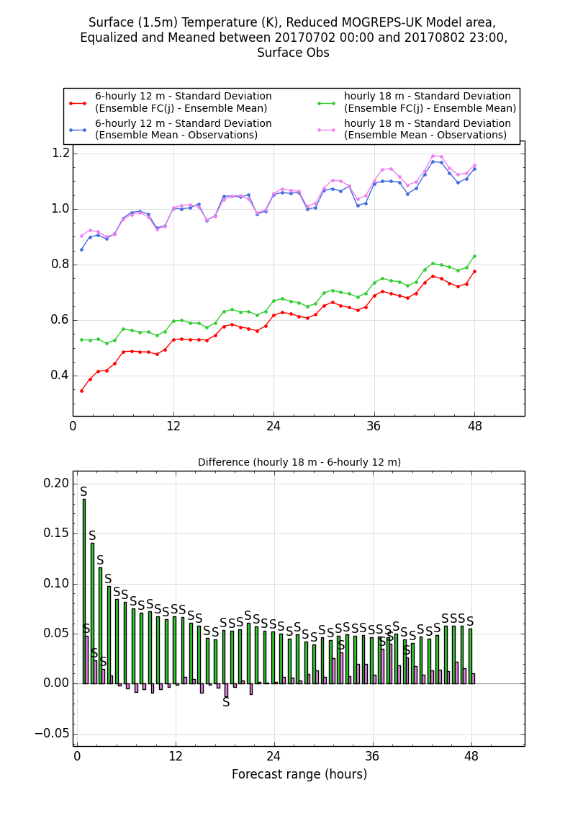
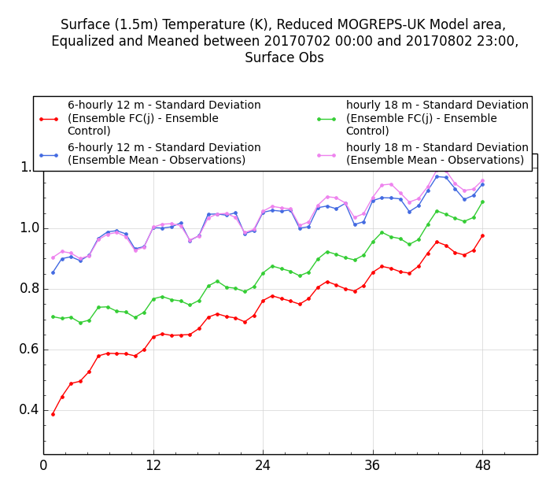
Impact on spread
Increase in ensemble spread (standard deviation). The increase is larger for larger time-lagging configurations, up to T+18.
This is for wind and T and both seasons of trials.
RMSE (as RPS/CRPS analysis before) is better for the hourly configuration in the short-range.
Ensemble still underspread overall.
Separate ROC analysis also shows that the hourly configuration is more reliable.
Forecast range
Forecast range

Slide 15
Conclusions
Hourly MOGREPS-UK scores are:
  mostly better in the short-range
  in some cases, they become worse than the 6-hourly at longer range.
  we argue that this is due to the use of different (older) MOGREPS-G conditions as well as an offset in forecast time
Temperature more sensitive in the short-range, but due to nature of time-lagging and the rapid growth in errors
Hourly ensemble improves (increases) spread
  but ensemble overall still underspread (discussion on Friday)
Forecast frequently updated
  For the guidance to 3-5 days, the choice of which cycles to use is important
  For a clean comparison with a 36-member MOGREPS-G ensemble, we need a 50-50 split in the forcing conditions of the hourly MOGREPS-UK or develop a post-processed 36-member ensemble.

Slide 16
Objective verification to T+120
Benefits of using hourly ensemble against the UKV. The control member of MOGREPS-UK compares well to the UKV
Benefits of using MOGREPS-UK against MOGREPS-G

Slide 17
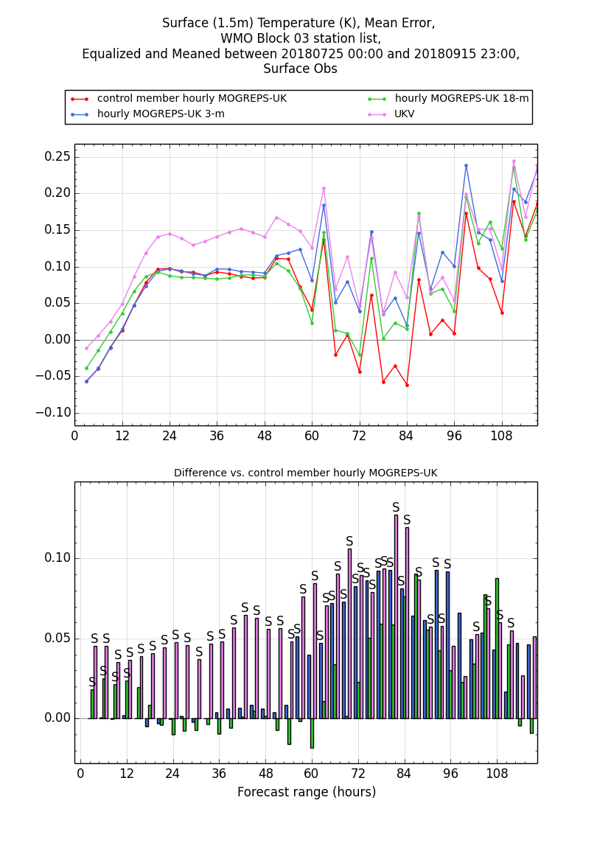
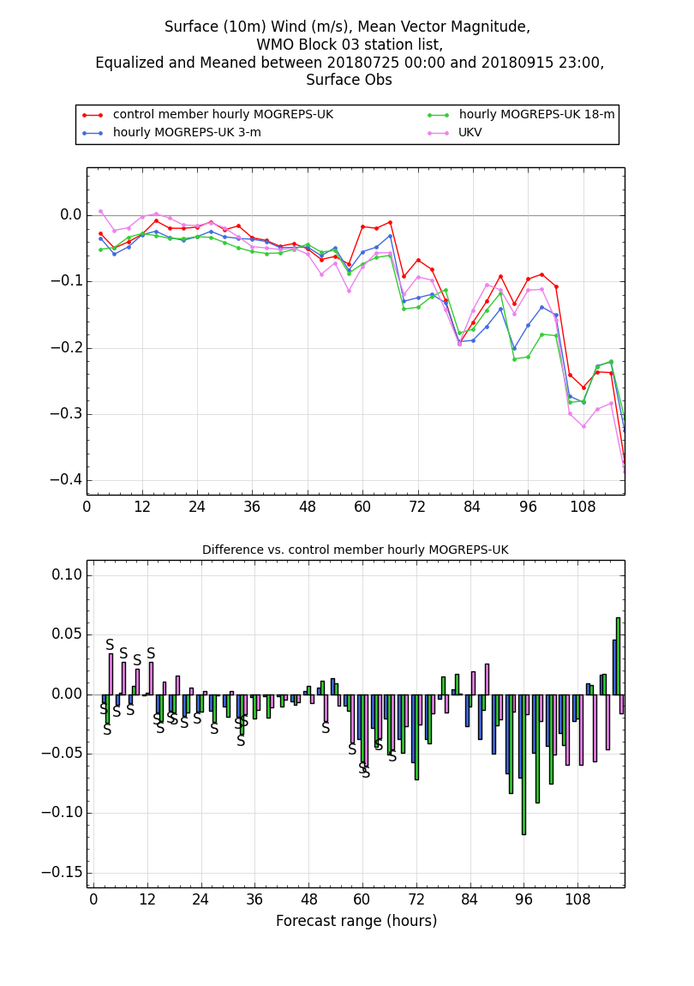
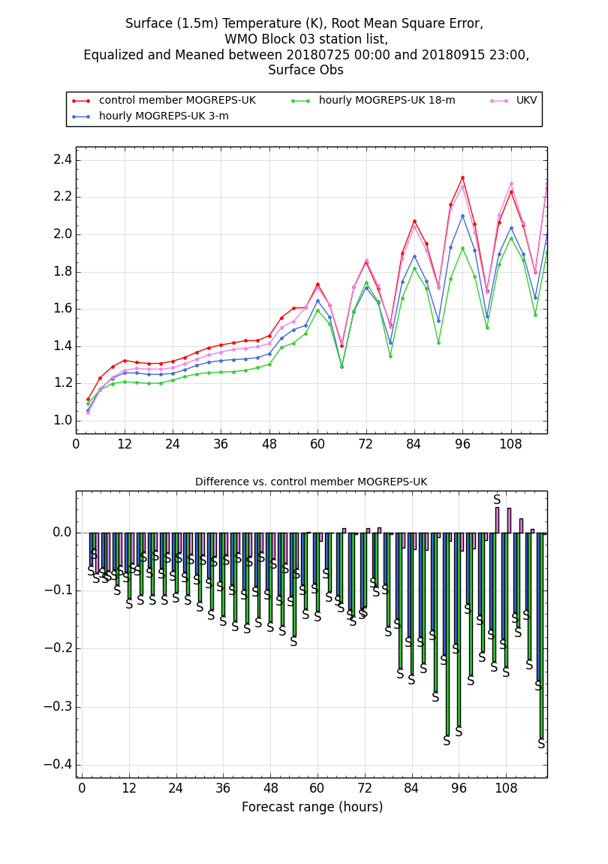
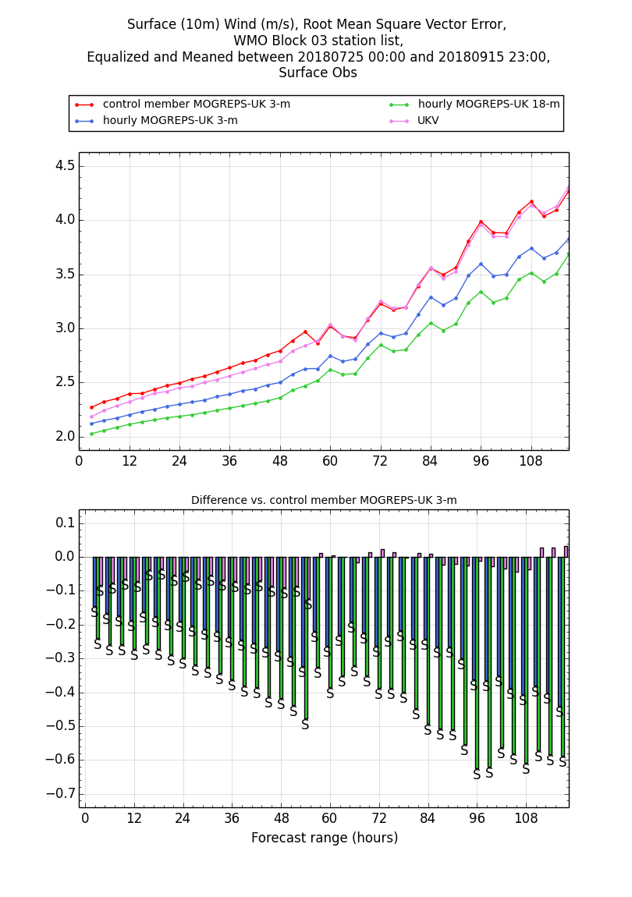
Grid-point verification hourly MOGREPS-UK and UKV to T+120. These bias plots show that the control member from MOGREPS-UK is competitive against the UKV.
Grid-point verification hourly MOGREPS-UK and UKV to T+120. These RMSE plots show that the hourly 18-m MOGREPS-UK performs better than the 3-m ensemble, the control member and the UKV.
Advantage of using an ensemble!
Advantage of using an ensemble!

Slide 18
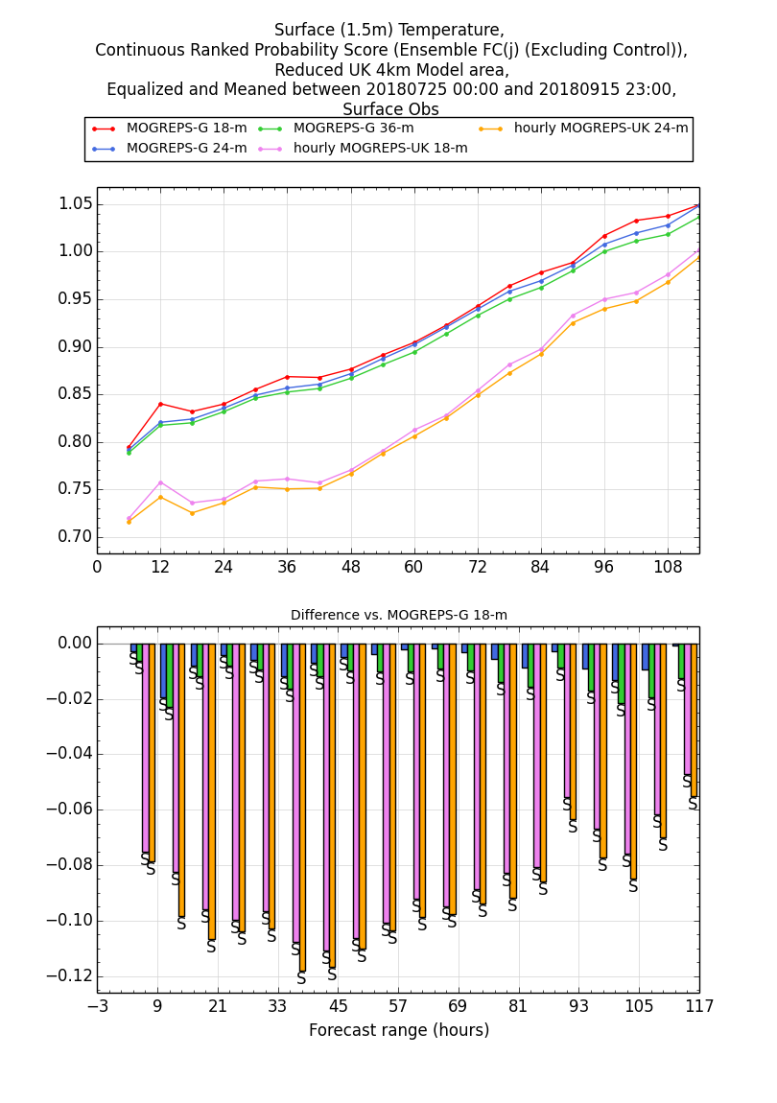
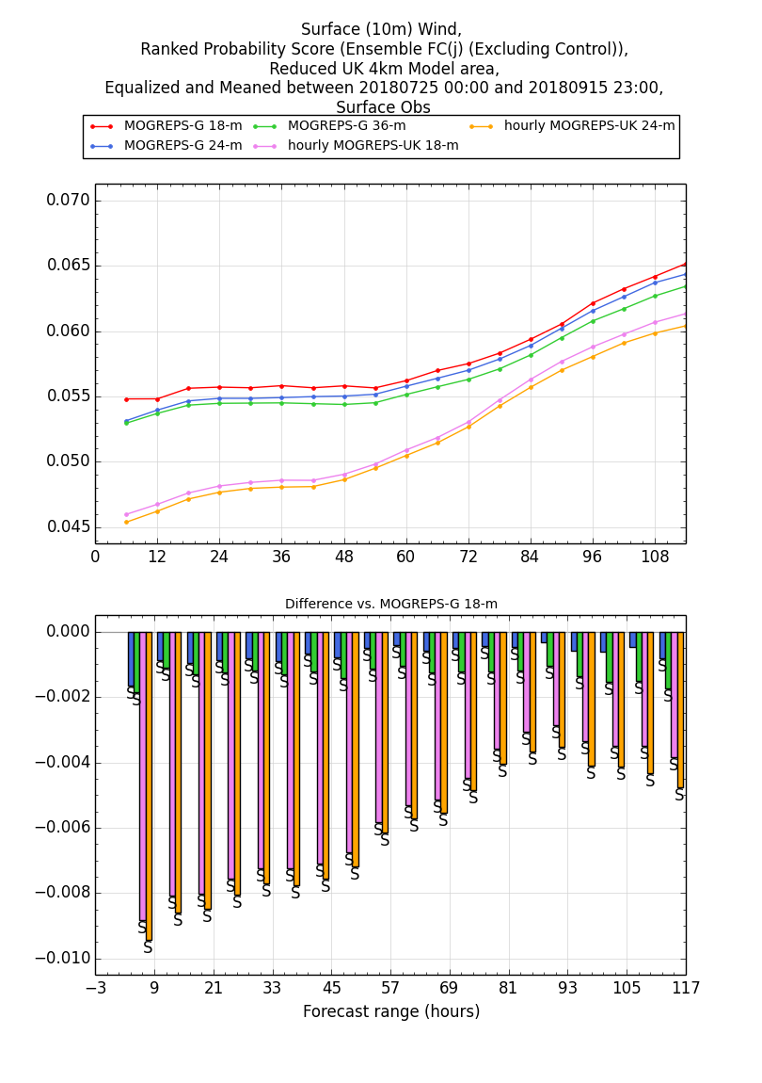
Grid-point verification hourly MOGREPS-UK and MOGREPS-G to T+120. RPS/CRPS plots
For wind and temperature, MOGREPS-UK is better than MOGREPS-G

Slide 19
Subjective assessment Testbed
Adrian Semple with Steve Willington, Will Lang and Laura Paterson
Carried out in Operations Centre during October 2018
8 Cases dependent on current weather (long anticyclonic periods). Cases cover active mobile fronts, active waving fronts, and strong warm conveyor with orographic enhancement associated with Storm Callum

Slide 20
Subjective Assessment Testbed Conclusions
Both ensembles were observed to add value in some cases relative to single deterministic runs by correctly indicating probabilities away from the deterministic run (although this comparison was not explicitly part of this testbed).
MOGREPS-G and MOGREPS-UK Hourly are very similarly performing ensembles.
There was in general very little difference between the guidance from MG and MUKH.
The higher resolution MUKH clearly did add structure to the probabilities under situations which would benefit from the higher resolution, although effects are generally small.
It is anticipated that MUKH might be of more benefit in other weather regimes (particularly convective and fog). It is recommended that these weather regimes are evaluated at a later date.

Slide 21
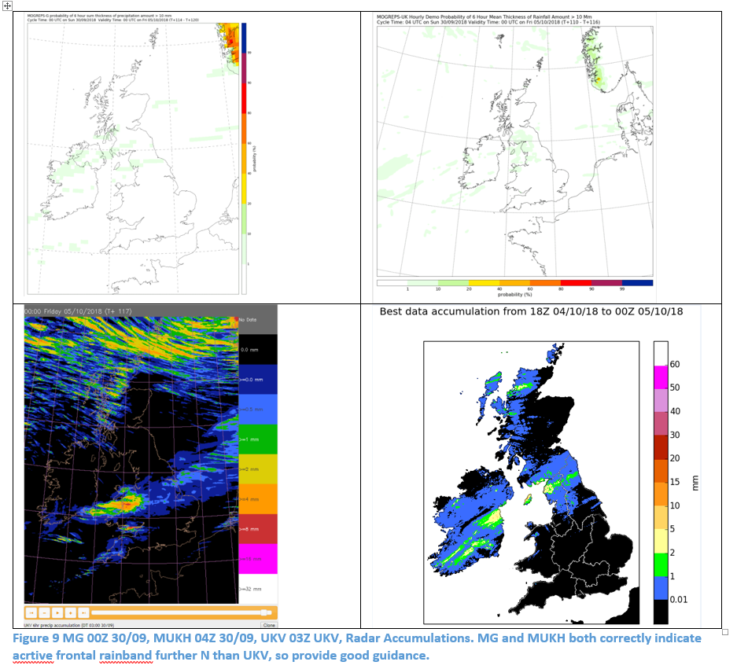
Added Value by the ensembles over the deterministic UKV in some cases – example.
Ensembles adds value by correctly indicating probs are further N than UKV
UKV frontal band is too far S at T+177

Slide 22
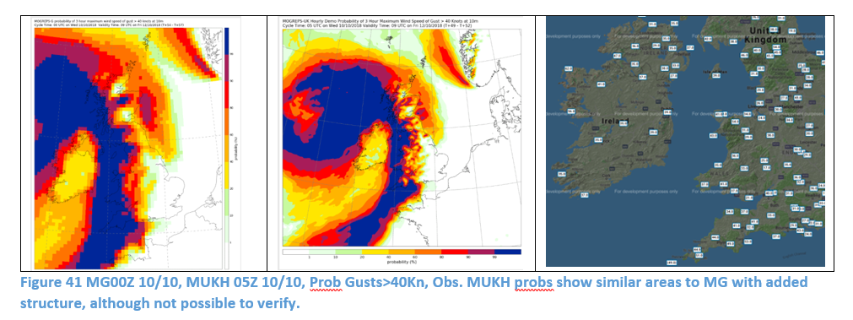
Higher resolution MUKH adds structure to the probabilities under situations which would benefit from the higher resolution.
Added structure of wind gust probs look realistic
Forecast Range ~ T+57
Although broader MOGREPS-G remains equally good guidance for issuing warnings

Slide 23
Subjective assessment to T+120: other cases
Would MOGREPS-UK (hourly cycling) add value to the assessment of severe weather up to 5 days?
The comparison is made against MOGREPS-G (MOGREPS-UK hourly cycling is chosen to be having the same boundary condition as MOGREPS-G) and against the control member of the ensemble, seen as a close representation of the UKV.

Slide 24
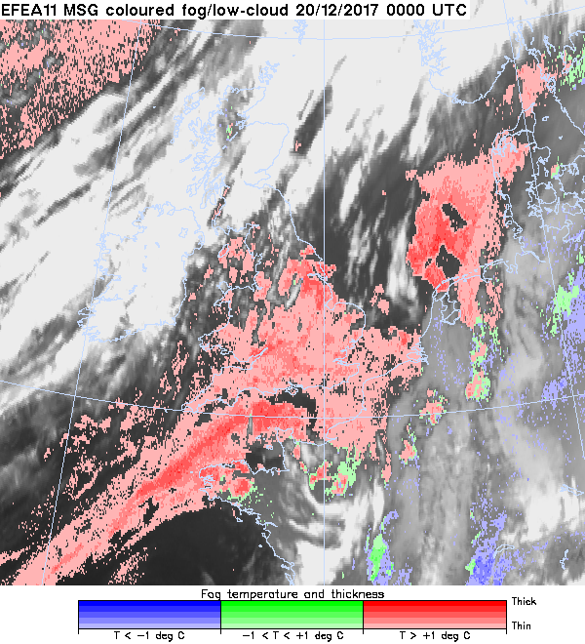
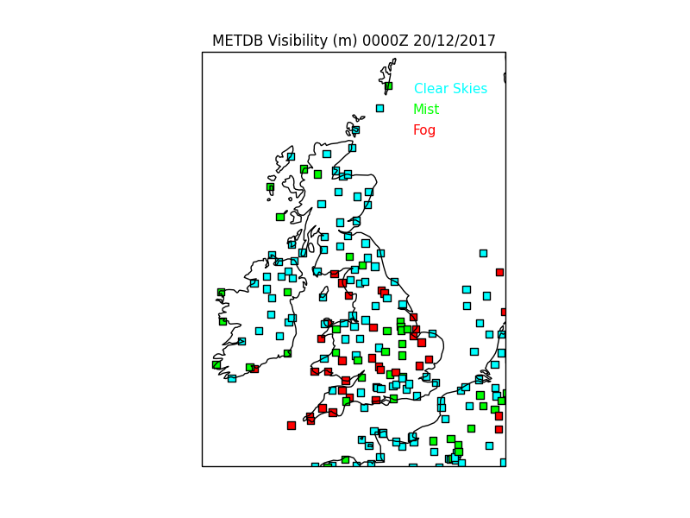
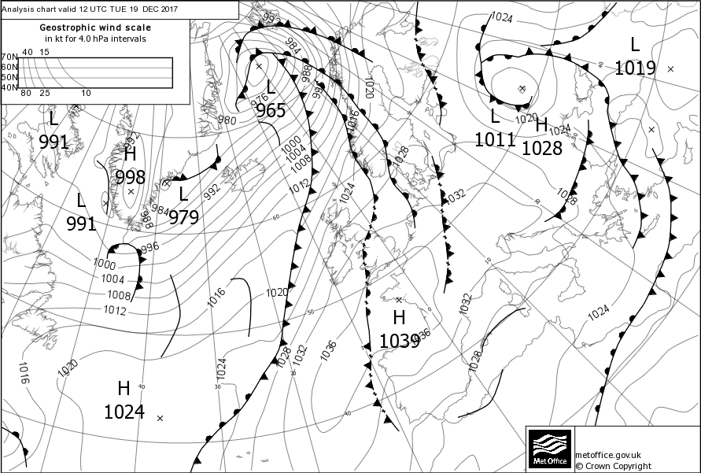
20th December 2017. Anticyclonic. Stratus. Fog. Very weak warm front over far SE England during Tuesday evening, with high dew point air following from the west across cold ground, leading to areas of ST which lowered to the surface to give fog even at low level.

Slide 25
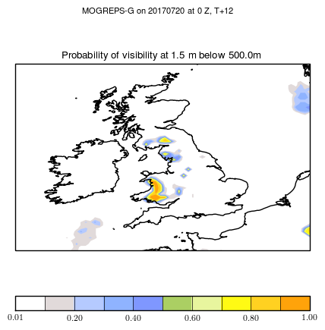
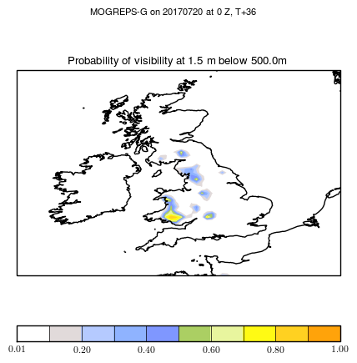
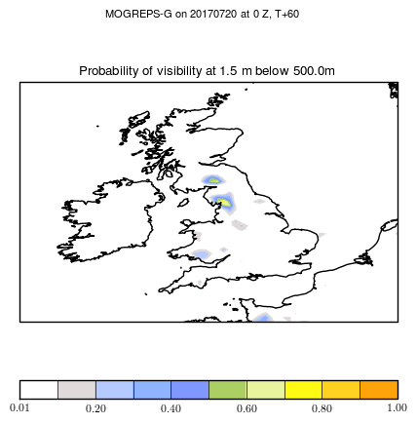
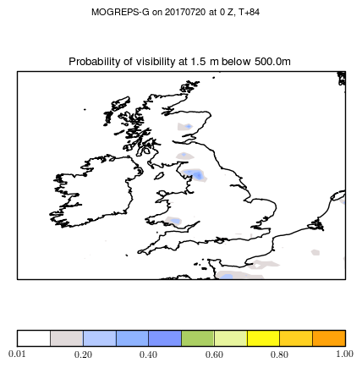
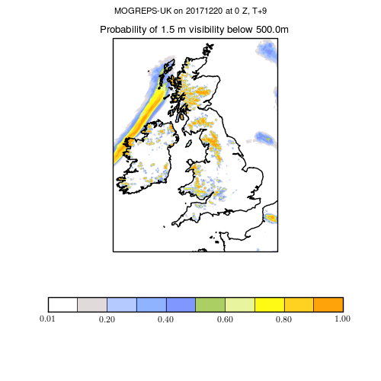
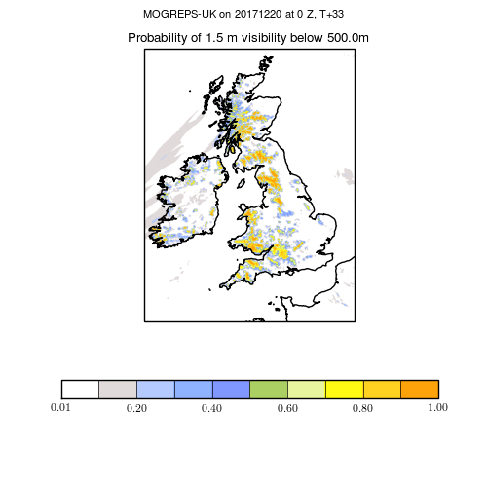
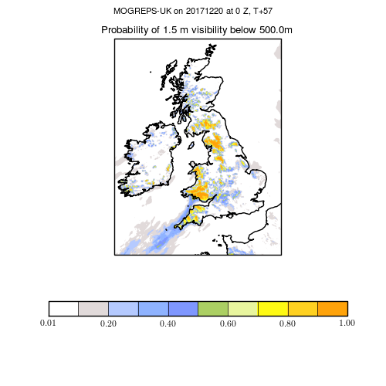
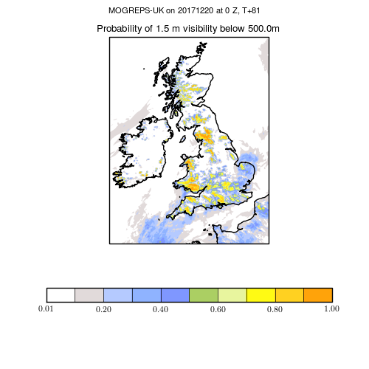
Hourly probabilities of visibility < 500 m valid at 00Z, 20th Dec 2017 for MOGREPS-G raw data.
T+12
T+36
T+60
T+84
Hourly probabilities of visibility < 500 m valid at 00Z, 20th Dec 2017 for MOGREPS-UK raw data.

Slide 26
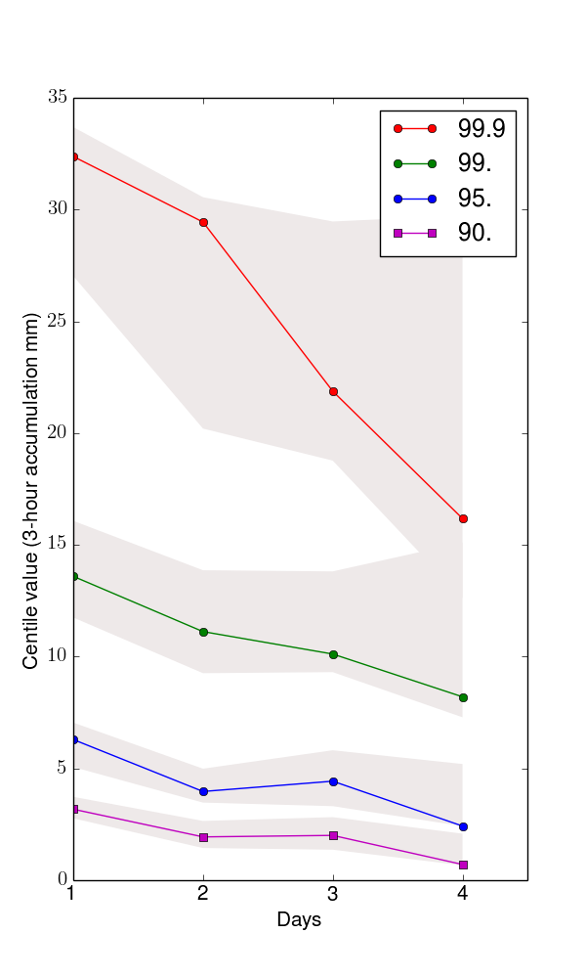
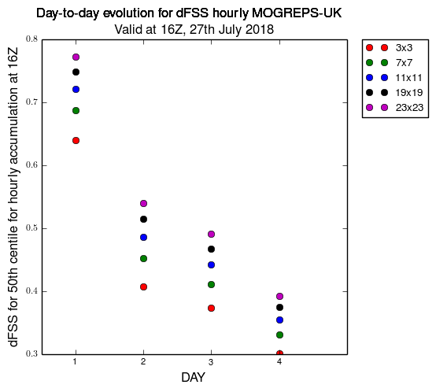
What happens from Day 1 to Day 4 for a severe convective case?
Less confidence in the prediction of severe events. Spread in the organisation of the convection between the members.
Spatial variability (spread) between members increasing (based on the 50th centile).
Ensemble spread
Control member
99.9th centile
Control member
99th centile
Ensemble spread

Slide 27
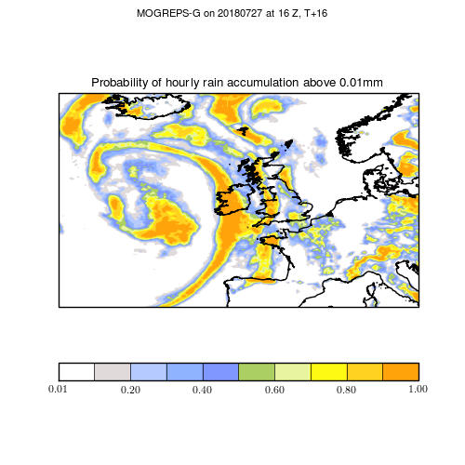
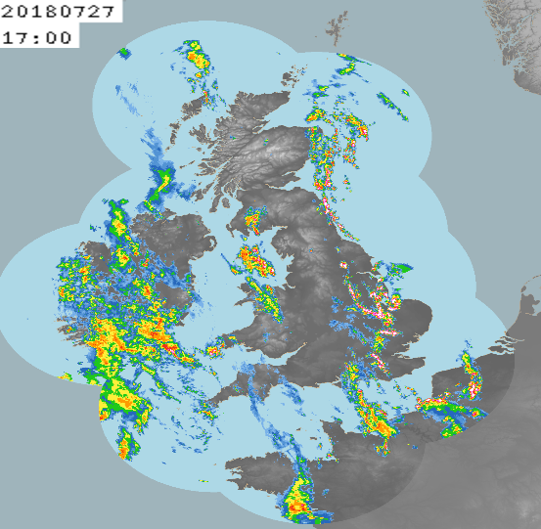
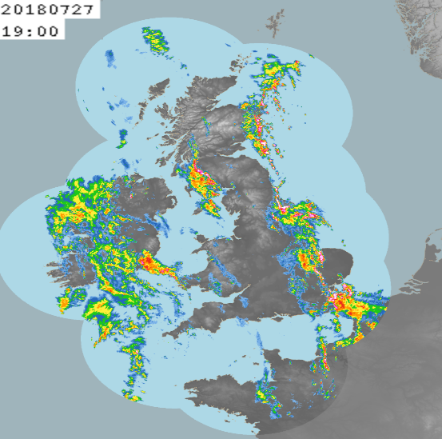
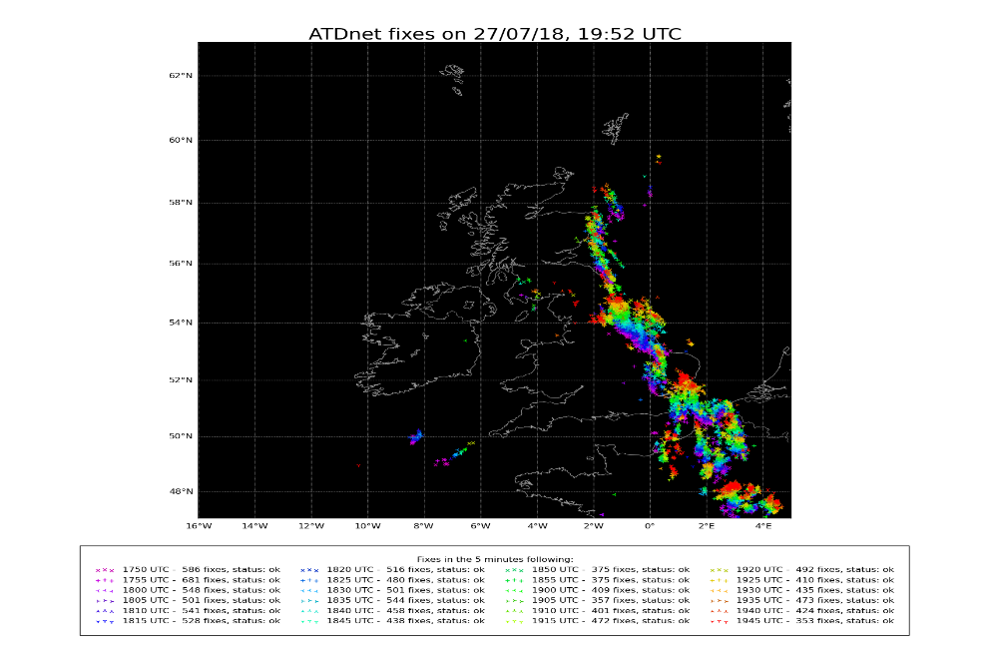
27th July 2018. End of the heat wave. Convective instability builds up following a prolonged period of heat and dryness over England.
Heavy showers first developed at about 16Z over the south-east, and strong convection developed over the south of England (Kent and East Anglia, Lincolnshire). By 19Z, a line of heavy showers and lightning strikes can be seen over the whole eastern coast of England.
FFC: High CAPE, warm plume, surface convergence, upper trough, high surface temperatures all coming together and leading to deep convection and heavy showers. Also, showers moving northwards from France.

Slide 28
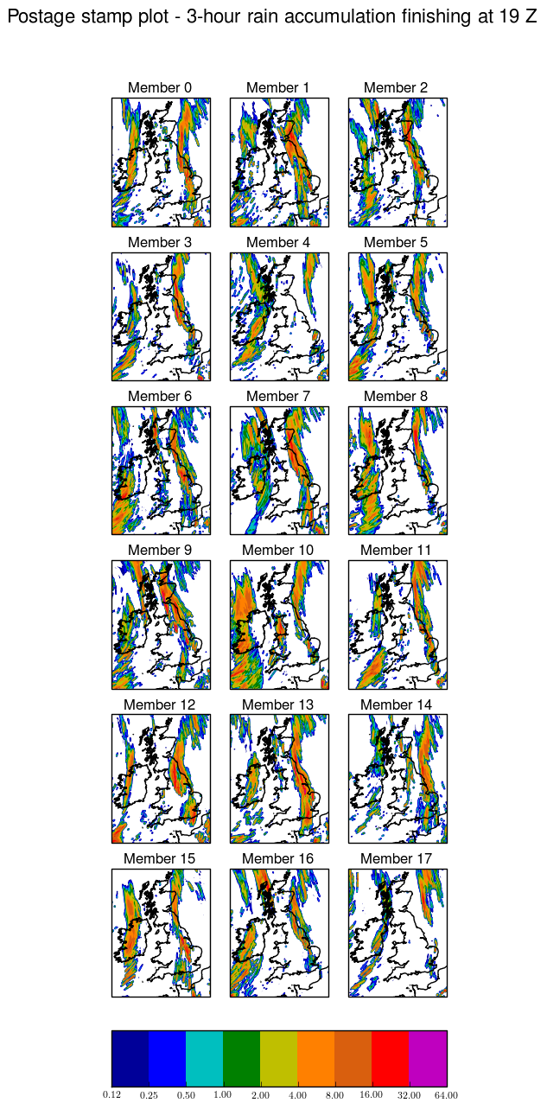
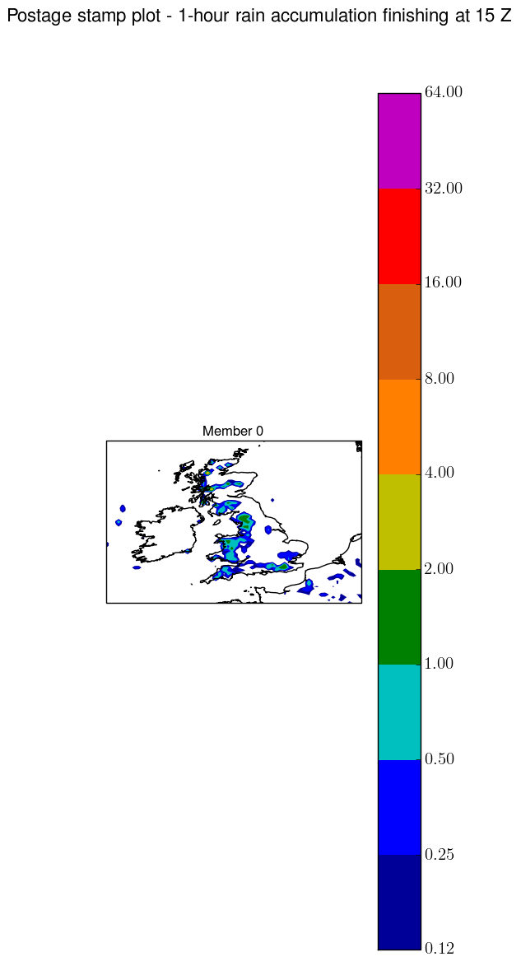
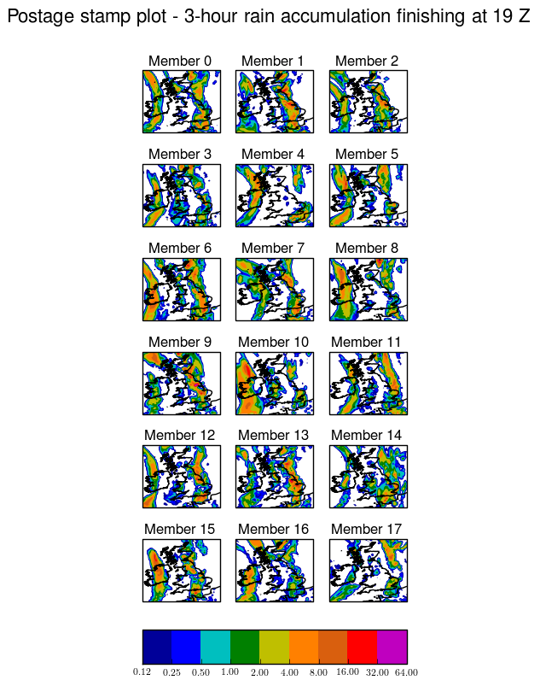
MOGREPS-UK
MOGREPS-G
Rain accumulation over 3 hours in mm, valid between 16Z-19Z on the 27th July 2018. At first sight, the postage stamp maps look similar between the two models. Some members as member 16 show a different organization of convection. Ensemble mean probabilities will be examined next.
We will show that MOGREPS-UK captures more severe rain than MOGREPS-G over specific areas and that the warning areas are better defined by MOGREPS-UK.

Slide 29
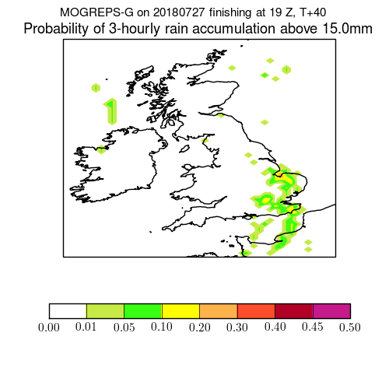
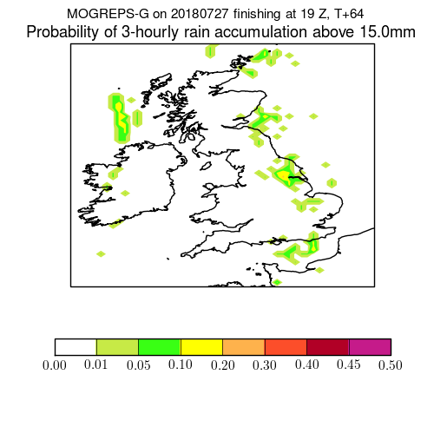
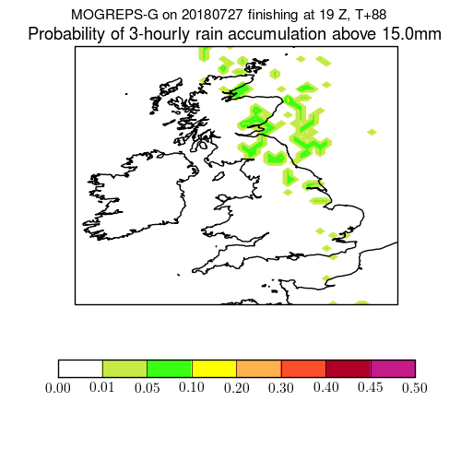



3-hourly probabilities of precipitation for > 15 mm valid for 16Z-19Z, 27th July 2018, are plotted here for MOGREPS-G raw data.
3-hourly probabilities of precipitation for > 15 mm valid for 16Z-19Z, 27th July 2018, are plotted here for MOGREPS-UK data. Neighbourhood-processed with neighbourhood size of 11 points.

Slide 30



Extreme members from MOGREPS-G
Probability of capturing severe weather at long lead times over a specific area:
For a threshold of 15 mm (over 3 hours), MOGREPS-UK has a larger probability of capturing the event.
For severe weather (ie, > 30 mm over 3 hours), the predictability at DAY 3 (T+85) is still higher in MOGREPS-UK, but the number of events gets very small (ie, ~0.1 % at DAY 3, compared to ~1% at DAY 0).

Slide 31

13th July 2018
FFC: Convergence lines and upper level forcing triggered heavy thundery showers across parts of England and Wales from Friday morning through until evening time. The signal of shower development was well captured in UKV and MOGREPS-UK. There were some disagreement between WV imagery and GM model leading up to this event, creating some uncertainty in the development of showers away from the convergence lines.

Slide 32



The intensity of the showers is better in MOGREPS-UK. The organisation is fairly similar among the members as it is forced by large-scale conditions, so we would expect the members to share a similar organisation.

Slide 33


The organisation of the convection is also different as shown here by these products depicting the probability of convergence. MOGREPS-UK captures a general pattern of convergence where the showers occur. This suggests that the interaction with the dynamics is better represented with the increase in resolution.

Slide 34



29th May 2018
CHIEF: Main issue was that successive runs of UKV performed extremely poorly capturing westward-moving thunderstorms across southern England. This thunderstorm caused flooding and impacted travel, e.g. massively reducing flow rates in and out of London airports. Aviation forecasters commented that UKV's poor performance also impacted automated products for customers.

Slide 35




MOGREPS-UK 6-hourly
MOGREPS-UK hourly
Probabilities of exceeding the 99th centile in each configuration. Similar forecasts regarding the ensemble mean. Probabilities smaller for the hourly model. This may be due to more spread.

Slide 36

Using the hourly cycling (sets of 3 members) to build up trends, estimate confidence and/or spread. Latest analyses are depicted with darker colors.
Positive impact of highlighting the trend over the last 6 sets of analyses for the showers SE of England. This product adds value compared to the ensemble mean, as it highlights the areas with greater sensitivity to the latest UKV analyses (darker colors). Note that some areas (Ireland for example) show no difference between the successive sets of forecasts).

Slide 37

3-hourly rain accumulation at T+13
With the hourly configuration, we can use the information from the latest UKV analyses to build trends (darker colors) and increase confidence in the definition of the warning areas.
With the 6-hourly configuration, all members have to be treated in the same way. No additional information is provided to the forecasts (hence random colors).

Slide 38


Difference guidance between the 2 ensembles.
MOGREPS-G misses the event near London (impact on aviation customers).
So added value from MOGREPS-UK.

Slide 39




Event near London – major impact on aviation customers.
Meteograms showing the area-averaged probability above 3 mm over 3 hours, finishing at 16Z on the 29th May 2018, over the black box.
Confidence in the event decreases with time.
MOGREPS-UK better captures the event however.

Slide 40
Conclusions
The predictability of severe cases up to 5 days is challenging and best studied with the support of an ensemble configuration. This is mostly because the confidence in the event itself as well as the spatial representation of the event evolve considerably with lead time.
For a lot of cases, MOGREPS-UK offer a similar guidance to MOGREPS-G in the warning areas and even intensity of rainfall.
However, there are cases where the impact of resolution is important. These are mostly related to the orographic enhancement as well a better organisation of the convection with the dynamics. The prediction of fog cases seems to be also better represented in MOGREPS-UK.

Slide 41
New developments for MOGREPS-UK (2018/2019/2020)
Upgrade from 70 to 90 vertical levels (2019)
Analyse sensitivity to new En-4DEnVar DA scheme in MOGREPS-G (2019). Mohamed Jardak, Neil Bowler at al.
Introduction of new random parameters to the stochastic physics (2019)
Changes to the UKV DA scheme. Hybrid covariances will be introduced using MOGREPS-UK model errors (2020)
www.metoffice.gov.uk © Crown Copyright 2018, Met Office

Slide 42
Thank you for your attention!
Any questions?
aurore.porson@metoffice.gov.uk
www.metoffice.gov.uk © Crown Copyright 2018, Met Office

Slide 43
Backup slides subjective assessment

Slide 44

MOGREPS-G and MOGREPS-UK Hourly are very similarly performing ensembles. Case Example – Storm Callum
Forecast Range ~ T+108
Similar errors occurs in both ensembles
MOGREPS-G
MOGREPS-UK H
Radar Accums
Similar skill for S Wales floods

Slide 45



Higher resolution MUKH adds structure to the probabilities under situations which would benefit from the higher resolution.
Forecast Range ~ T+102
MOGREPS-G
MOGREPS-UKV H
Added structure in MUKH – here verifies well…but not always…
obviously depends on predictability…here UKV verifies well too!
UKV DET
RADAR ACCUM

Slide 46




12th July 2018
Hourly accumulation (mm), 14-15Z, 12th July 2018 (T+24)
Orographic enhancement in MOGREPS-UK
MOGREPS-UK
MOGREPS-G

Slide 47

At long lead times, the ensemble becomes a more useful tool than a deterministic model. This is illustrated here by comparison the control member of the ensemble, against the ensemble mean.
Forecast provided by the control member is not representative of the event. Advantage of using an ensemble to capture the warning areas.

Slide 48


27th December 2017 Cyclonic. Frontal Ppn. Showers. Thunderstorms. Snow. Convective. Frost. Gales. Complex disrupted upper trough moving east into northern France and the southern North Sea. This interacting with a trough extending across Ireland and Scotland such that by afternoon the two features have merged to form one large scale trough with axis over the North Sea by evening. Very windy to the rear of the surface depression - 72kn gust in Sea area Dover with 45 to 55kn over other southern and eastern parts (30 to 40kns inland).
We see better guidance for the areas of precipitation, but not for the areas of gust.

Slide 49






6-hourly probabilities of precipitation > 3 mm valid for 03Z-09Z, 27th Dec 2017 for MOGREPS-G raw data.
6-hourly probabilities of precipitation > 3 mm valid for 03Z-09Z, 27th Dec 2017 for MOGREPS-UK with neighbourhood of size 11.

Slide 50




MOGREPS-UK (right column) shows a lot more detail in the areas of wind gusts over land than MOGREPS-G (left column).
For the low threshold (15 m/s), MOGREPS-UK however has less confidence over East Anglia than MOGREPS-G, as seen at this lead time on previous slide.
For the high threshold (20 m/s), MOGREPS-UK shows more confidence at capturing the strong wind gusts over the seas.
However, this shows that MOGREPS-UK does not add much value to the guidance.
Wind gusts over a 3-hour window (06Z-09Z) at T+81

Slide 51
Backup slides objective verification

Slide 52




New HiRA stats for time-lagging. Currently only to T+41
Comparison to UKV.
The UKV is treated as a probability field by using different neighbourhood sizes from 3x3 to 11x11. For all 4 fields examined here, MOGREPS-UK at the grid-scale performs better than even a 11x11 UKV probability field.

Slide 53


What happens if we take the hourly cycling model driven by the same MOGREPS-G conditions as the 6-hourly model? (e.g. for wind speed)
New hourly cycling using same MOGREPS-G forcing as 6-hourly model. So impact of MOGREPS-G forcing important for accuracy of forecasts. Depending on the cycle, we see benefits as early as T+6 or beyond T+24

Slide 54

Time-lagging versus neighbourhood processing?
02 Dec 2017 – 01 Jan 2018
18-m hourly vs 12-m 6-hourly
02 Dec 2017 – 01 Jan 2018
18-m hourly vs 12-m 6-hourly 11x11

Slide 55


Cloud base seems less sensitive, but otherwise most fields would show a reduction in the scores with increase in forecast lead times. Grid-point or HiRA statistics.
Notes:
Another slide to show the impact on the RPS as a function of forecast range.

Slide 56

CRPS temperature
The temperature field is more sensitive to the latest DA analysis than the other fields, which explains the errors at the beginning with the time-lagging configuration.
Larger neighbourhoods show larger errors, indicating that the DA update affects non-linearly specific locations more than others.
Notes:
On this slide, we just wanted to show more attention to the impact of the size of the neighbourhood. The impact on the temperature scores is more important for larger neighbourhood sizes. Perhaps this suggests that the DA has corrected the temperature more at certain grid boxes than others and that using a larger size of neighbourhood means that we see a bigger impact of the correction instead of just looking at a small scale. ??

Slide 57


Other scores to keep an eye on when PS42 goes live…
Positive bias introduced in the visibility. This occurs for both winter and summer.
The summer trial shows a slight positive bias in precipitation.
However, smaller bias at the beginning.
Notes:
On this slide, we show some new results for the biases. I spotted that the bias in visibility (for both summer and winter) is better to T+6. However, this then becomes a positive bias between T+6 and T+24. In the winter, the bias starts as positive (so visibilities become too high from the start). So although the RPS in visibility shows an improvement in the short-range, we introduce a bias in the visibility due to the use of older analyses and forcing conditions. It is interesting though to have a positive metric for one field (ie, RPS) and a negative metric (ie, mean error) for the same field at the same forecast range.
I also spotted a better bias in the precipitation in the very short range again, but then turning into a slight positive bias at longer lead times, sometimes with significance. This is only for the summer.

Slide 58
Backup slides for PS42 package - product availability- resources

Slide 59
MOGREPS-UK PS42 package content
Hourly cycling: 3 ensemble members per cycle, centred on a new UKV analysis
One control member runs every 6 hours (on 03, 09, 15, 21UTC cycles, as before)
Boundary conditions and initial-condition perturbations provided by MOGREPS-G, updated every 6 hours (as before)
The resulting ensemble is time-lagged over 6 cycles to create an 18-member ensemble. This time-lagging is repeated at every hour in the verification and post-processing system. So every hour we have a new ensemble run from 6 different analyses and depending on the DT time, different forcing conditions
Upgrade to UM 11.1
  UM build includes bugfix branches to restore bit-reproducibility and remove the frequent model failures (BiCGStab) seen at version 10.9
  https://code.metoffice.gov.uk/trac/um/ticket/4215
  https://code.metoffice.gov.uk/trac/um/ticket/4176
We also propose to run all the forecasts out to T+126 in the parallel suite
  Package trials ran to T+54 as did the OS41 controls

Slide 60
Availability of products
New MOGREPS-G products complete ~ hh+7hr10min. For hourly MOGREPS-UK the delay is currently ~hh+6hr. So the latest available pairs of runs through the day are expected to be:
08 UTC - 00 M-G and 02 M-UK
09 UTC - 00 M-G and 03 M-UK
10 UTC - 00 M-G and 04 M-UK
11 UTC - 00 M-G and 05 M-UK
12 UTC - 00 M-G and 06 M-UK
13 UTC - 00 M-G and 07 M-UK
14 UTC - 06 M-G and 08 M-UK
Model start times are hh+3h30, as for 6-hourly. This is necessary for the 03, 09, 15, 21UTC cycles to allow for seamless hallswitching (dependent on MOGREPS-G file mirroring). Future work is expected to shorten this required offset
11 UTC is the ideal comparison time with 36-m MOGREPS-G to detect contribution from resolution in impact of MOGREPS-UK.
(05 M-UK ensemble shares same 50-50 split in driving from 18/00 UTC MOGREPS-G)

Slide 61
Resource implications (based on OS41)
Compute resources are approx. 3.5 times larger, comparing six hourly cycles with one 6-hourly cycle
  Need 42 nodes per member to obtain T+126 forecasts within the hour
  Currently use 18 nodes per member to run to T+54 within the hour
  Good news for PS42: UM 11.1 is approx. 7% faster than 10.9 !
Data volume: extra 1.4 TB (max.) required on disk for six hourly cycles compared with one 6-hourly

