Slide 1
APS3 ACCESS City Ensemble (CE3)
Towards Convective Scale Ensemble NWP at the Bureau
Shaun Cooper with the assistance of Charmaine Franklin, Chun-Hsu Su, Gary Dietachmayer, Ilia Bermous, Imtiaz Dharssi, Jin Lee, Lawrie Rikus, Martin Dix, Mike Naughton, Milton Woods, Monika Krysta, Nathan Eizenberg, Peter Steinle, Robin Bowen, Susan Rennie, Tan Le, Vinod Kumar, Wenming Lu + ESM

Slide 2
ACCESS City Ensemble (CE3) Details
CE3 is based on the UKMO's PS39 MOGREPS-UK.
18 members.
Ran 4 times a day: 03Z, 09Z, 15Z and 21Z.
2.2 km inner (uniform) resolution stretching (variable resolution) to 4 km at boundaries.
6 domains.
38 hour forecast length.
Has the RA1-M (mid-latitude) and RA1-T (tropical) physics options.
Initial conditions provided by ACCESS-C3.
Boundary conditions and large scale perturbations provided by ACCESS-GE3.

Slide 3
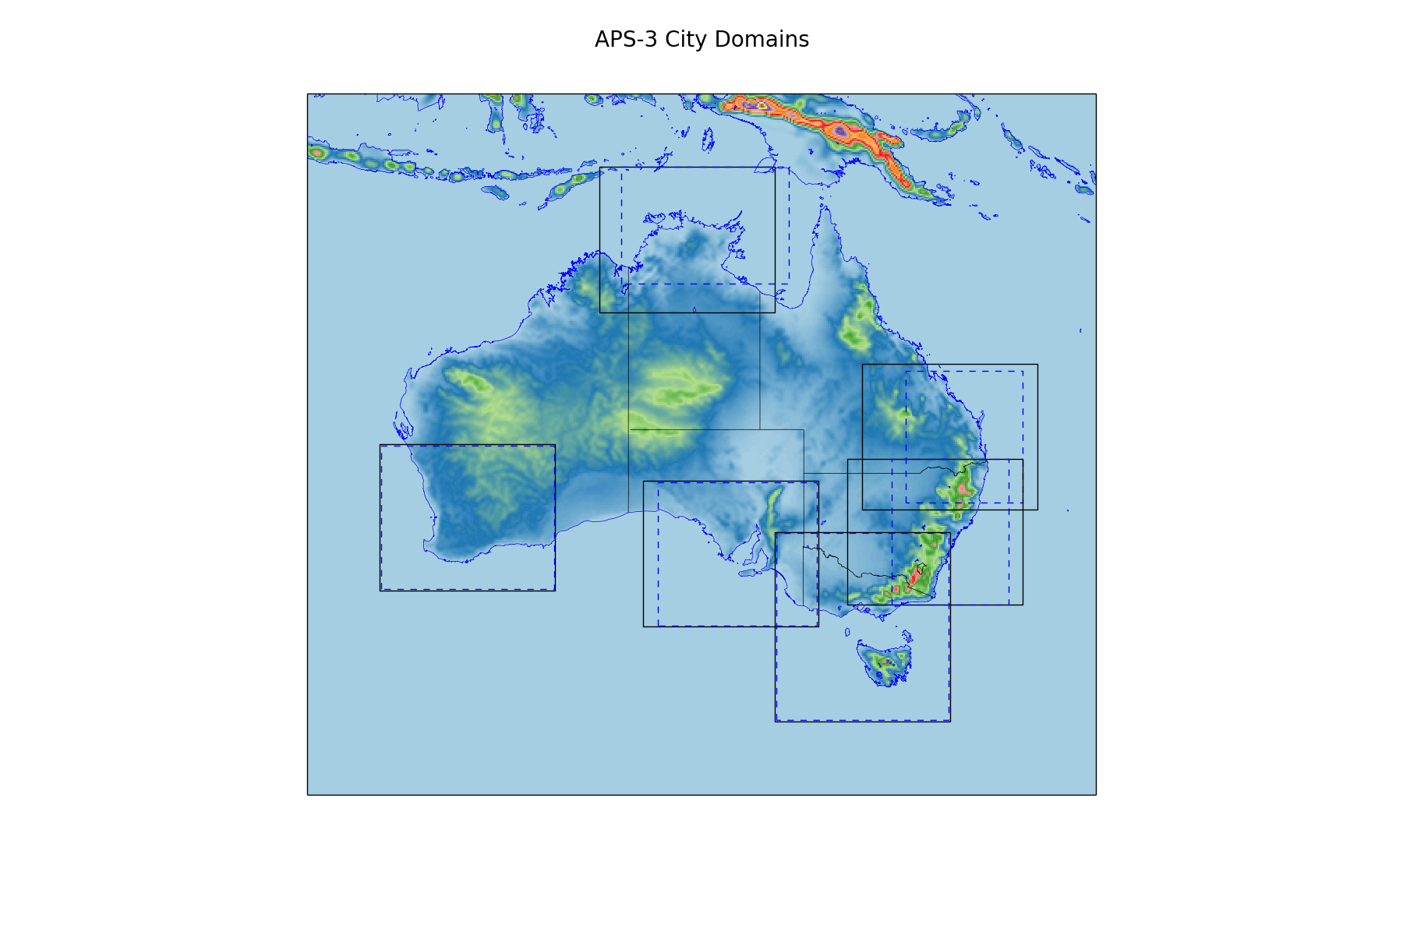
Notes:
Black lines are the APS3 domains. Dashed Blue lines are the APS2 domains. (Slight offset applied to Perth and VicTas for visual affect. These domains are unchanged.)

Slide 4
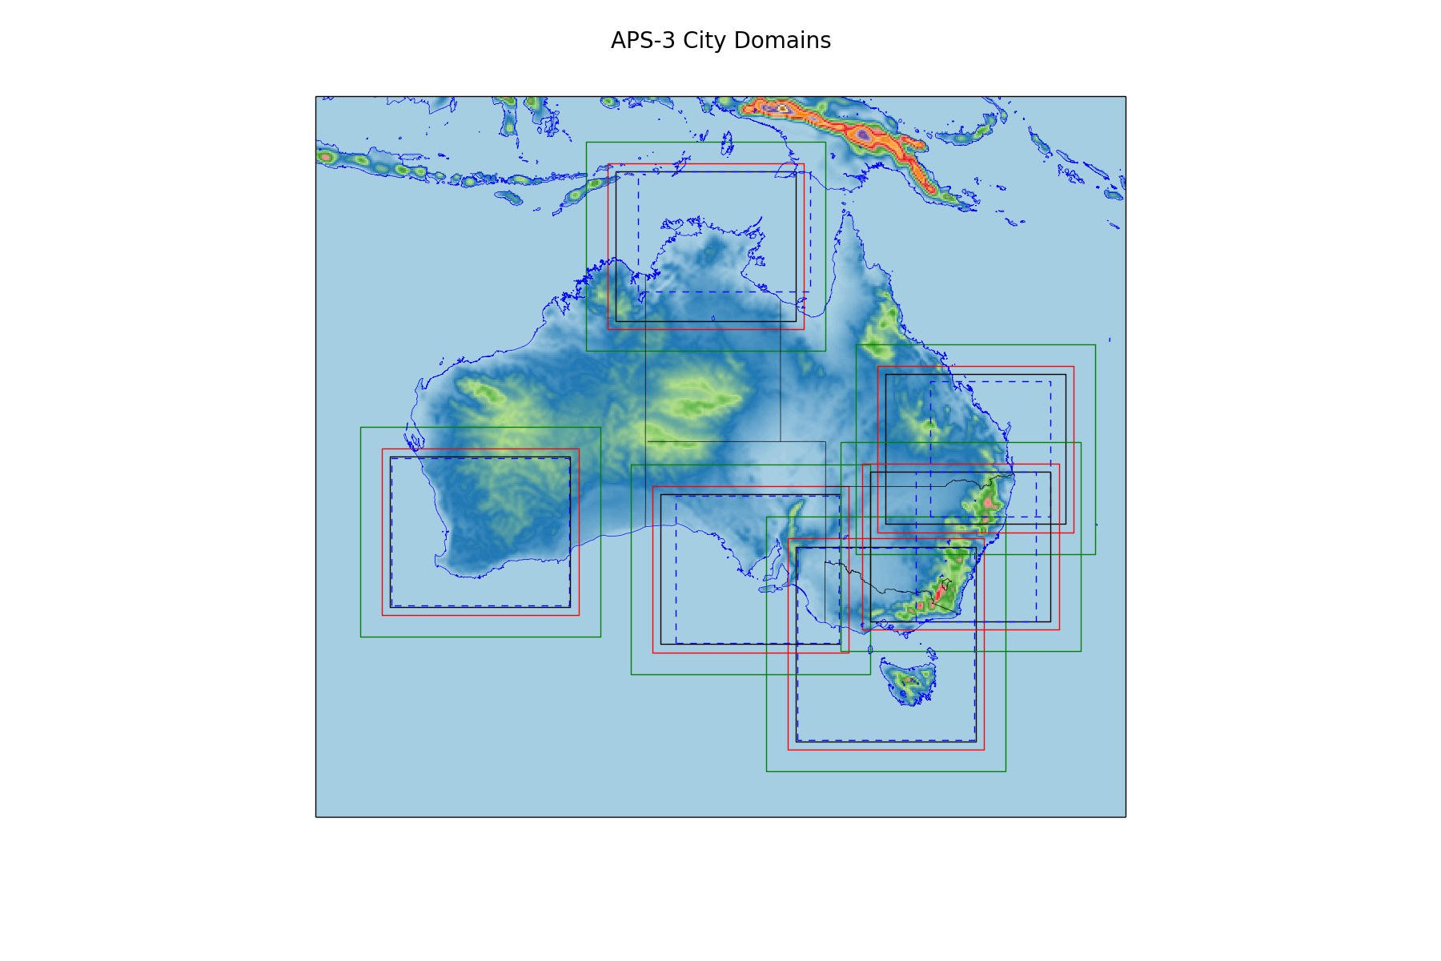
Notes:
Green lines are the outer boundary. Red is the start of the transition zone black are the APS3 (uniform grid) domains.

Slide 5
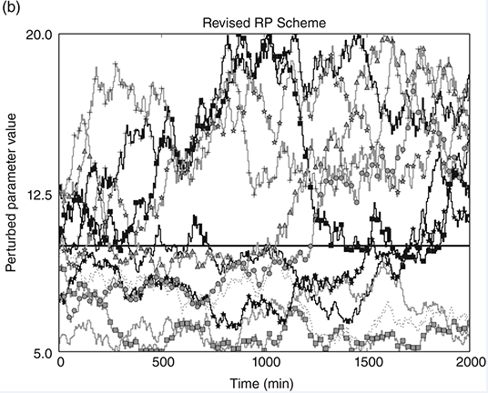
Spread Generation
Large scale perturbations and LBCs from GE3.
Stochastic Physics: The Random Parameter (RP) Scheme.
  Varies 10 parameters.
  Main physical process covered:
    Mixing in the boundary layer.
    Cloud formation.
    Cloud-top diffusion.
    Precipitation.
    Droplet settling near the surface.
    Adapted from Figure 2 of McCabe et al., 2016.
    McCabe A, Swinbank R, Tennant W, Lock A. 2016. Representing model uncertainty in the Met Office convection permitting ensemble prediction system and its impact on fog forecasting. Quarterly Journal of the Royal Meteorological Society 142: 2897–2910, doi:10.1002/qj.2876.

Slide 6
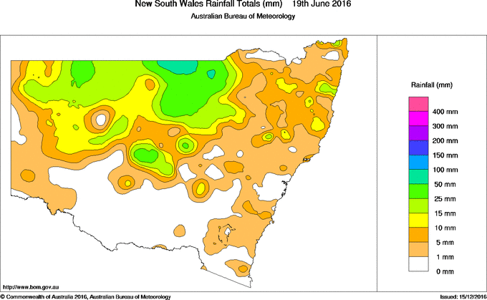
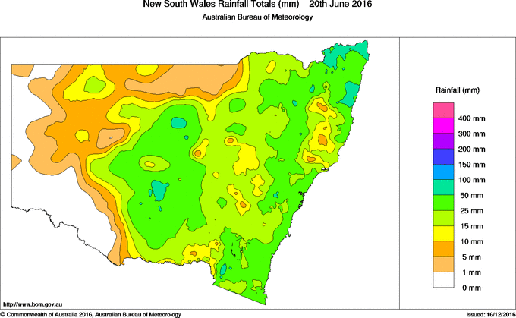
East Coast Low June 18-19, 2016.
Precipitation from 9 am June 18 to 9 am June 19.
Precipitation from 9 am June 19 to 9 am June 20.

Slide 7
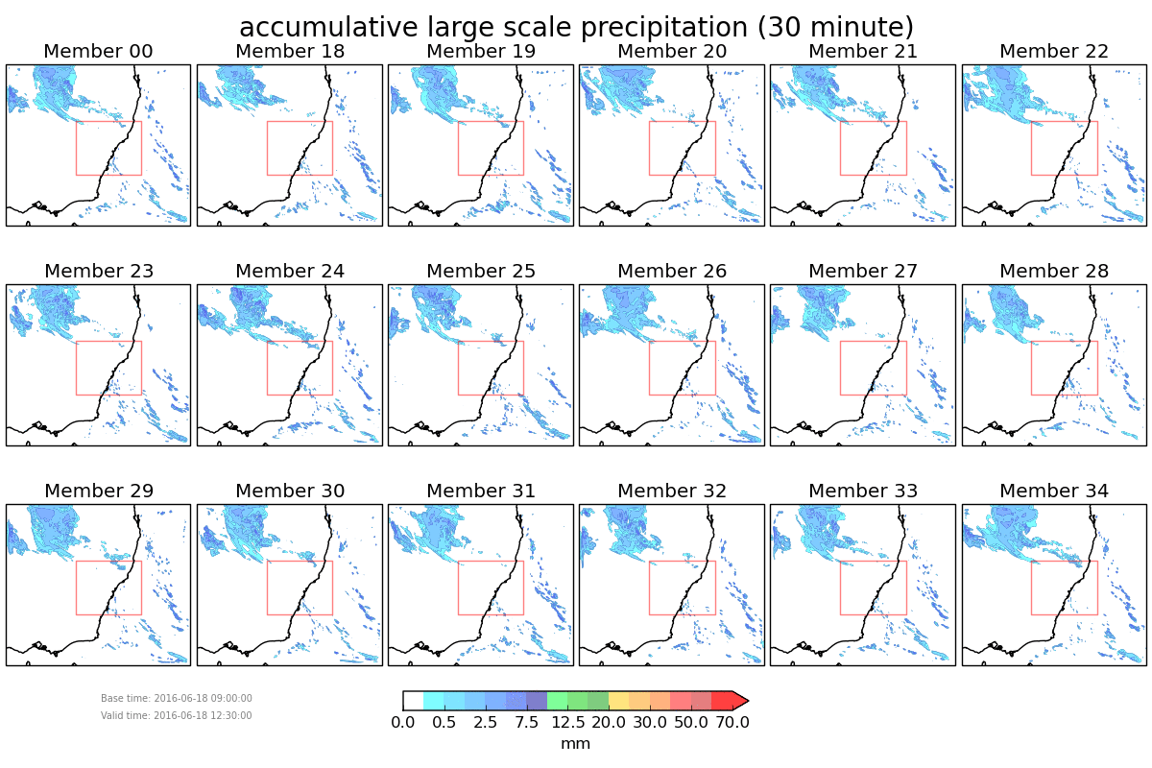

Slide 8
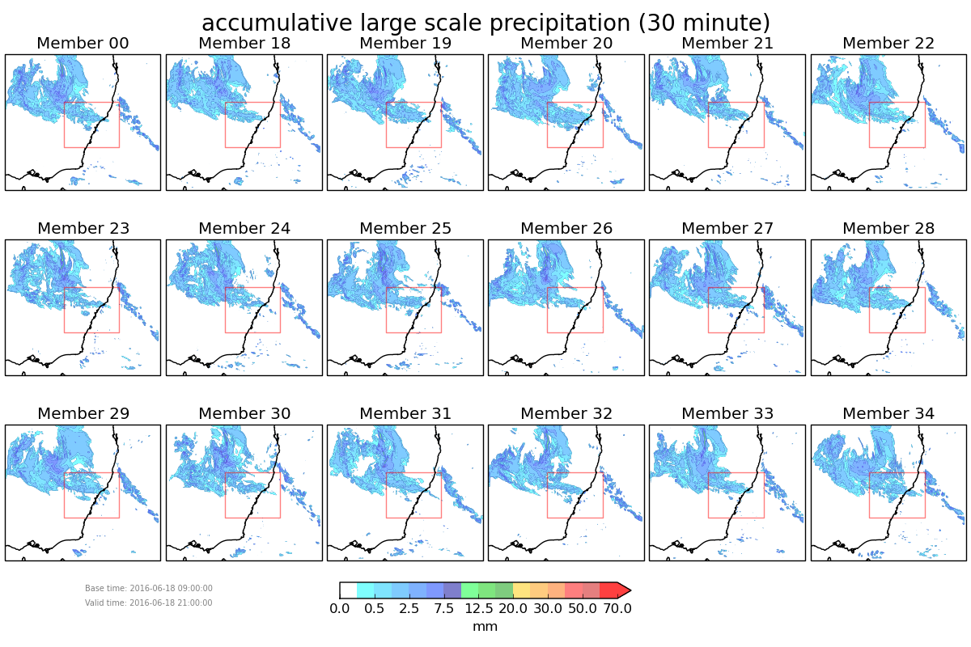
18 member CE3 forecast.
12 hour forecast lead time.
30 minute rainfall accumulation forecasts.
Red rectangles are Rainfields3 mosaic domain.

Slide 9
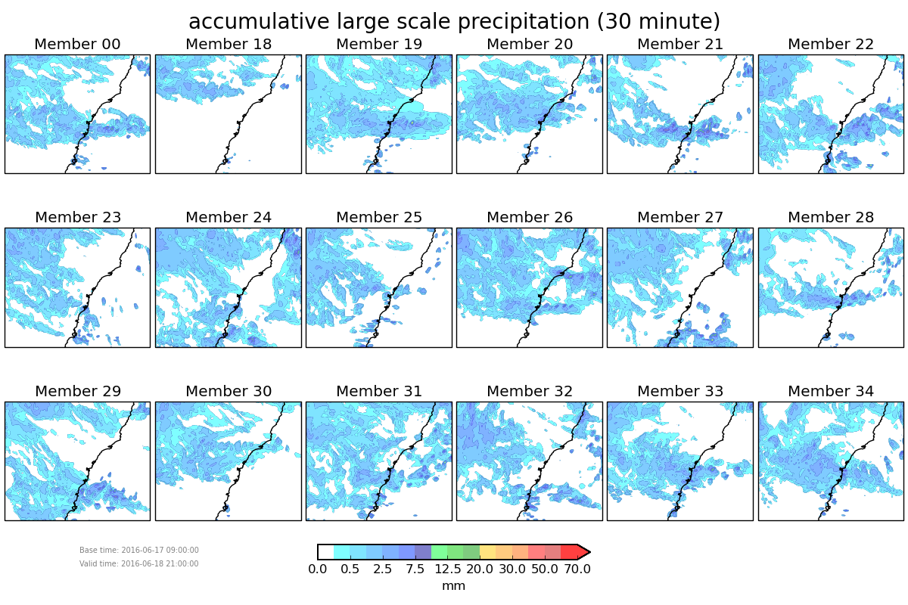
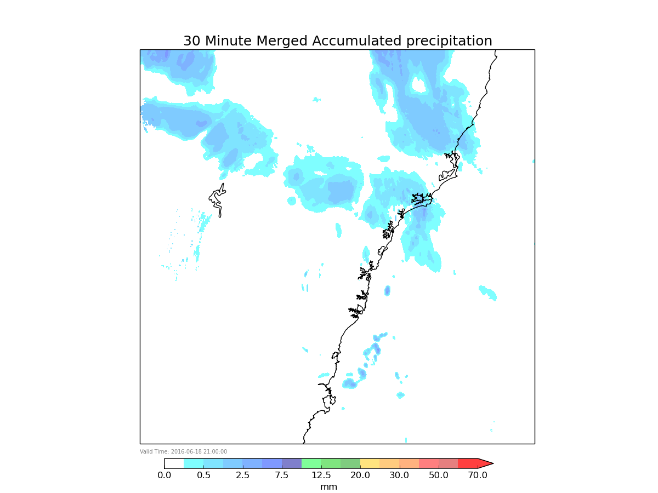
36 Hour Forecast
Notes:
Plot on the left is the Rainfields3, 30 minute, radar/gauge merged product, valid at 21Z on 2016-06-18.
The plot on the left is the ensemble over the RF3 domain, the red rectangles from the previous slide (simply extracted from the ensemble, not reprojected to the projection b/w the RF3 observations and ensemble are different).
Forecasts are valid at 21 Z on 2016-06-18.

Slide 10
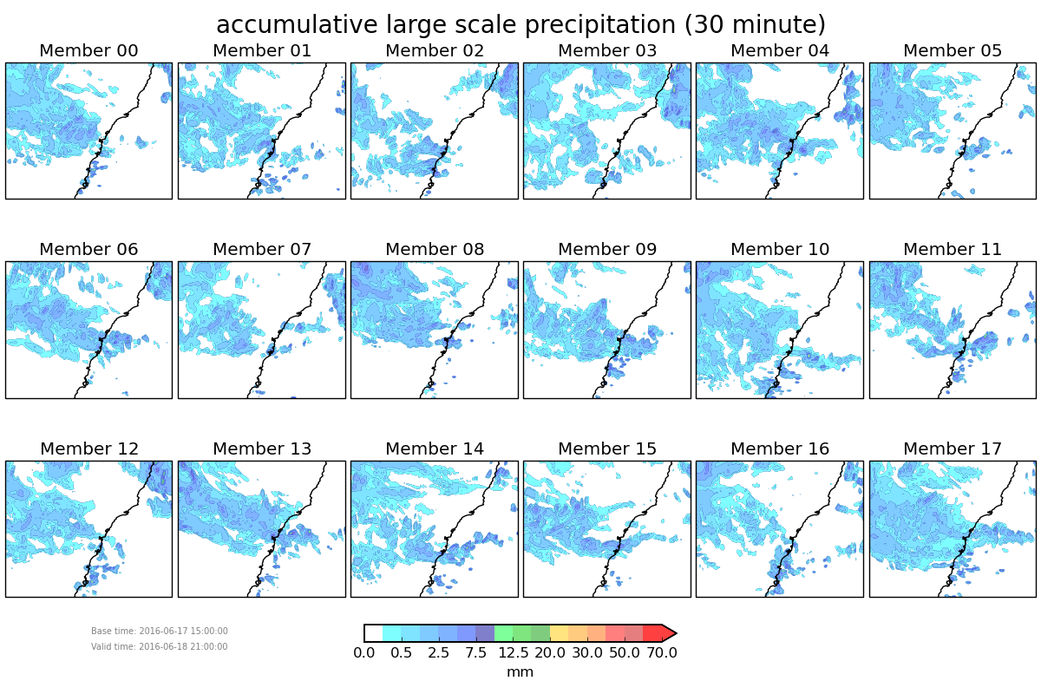
30 Hour Forecast
Notes:
Plot on the left is the Rainfields3, 30 minute, radar/gauge merged product, valid at 21Z on 2016-06-18.
The plot on the left is the ensemble over the RF3 domain, the red rectangles from the previous slide (simply extracted from the ensemble, not reprojected to the projection b/w the RF3 observations and ensemble are different).
Forecasts are valid at 21 Z on 2016-06-18.

Slide 11
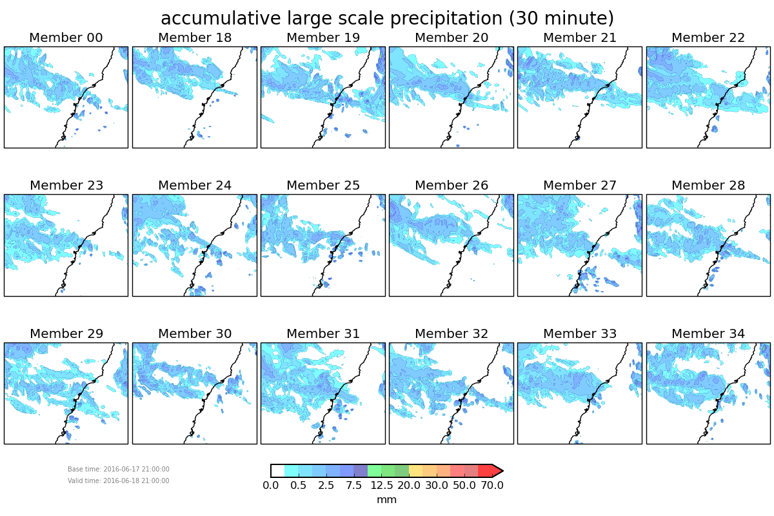
24 Hour Forecast
Notes:
Plot on the left is the Rainfields3, 30 minute, radar/gauge merged product, valid at 21Z on 2016-06-18.
The plot on the left is the ensemble over the RF3 domain, the red rectangles from the previous slide (simply extracted from the ensemble, not reprojected to the projection b/w the RF3 observations and ensemble are different).
Forecasts are valid at 21 Z on 2016-06-18.

Slide 12
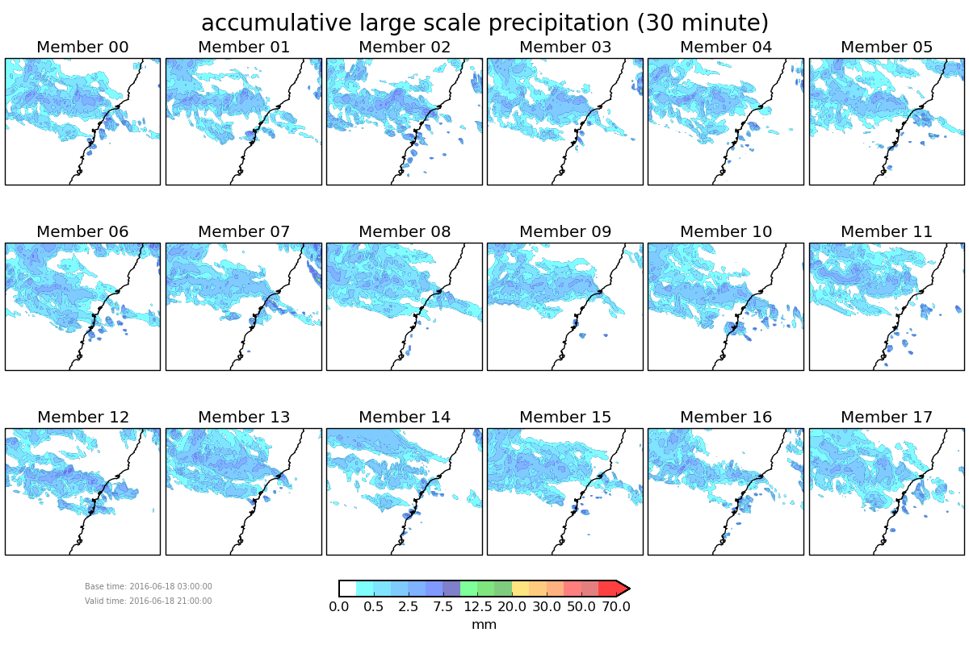
18 Hour Forecast
Notes:
Plot on the left is the Rainfields3, 30 minute, radar/gauge merged product, valid at 21Z on 2016-06-18.
The plot on the left is the ensemble over the RF3 domain, the red rectangles from the previous slide (simply extracted from the ensemble, not reprojected to the projection b/w the RF3 observations and ensemble are different).
Forecasts are valid at 21 Z on 2016-06-18.

Slide 13
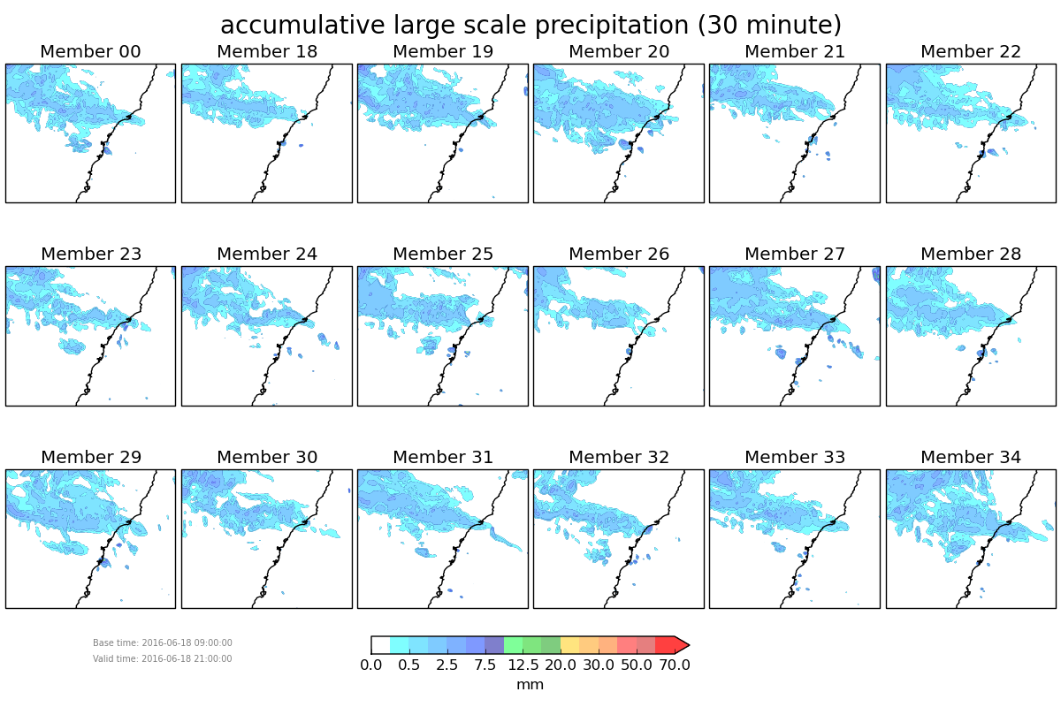
12 Hour Forecast
Notes:
Plot on the left is the Rainfields3, 30 minute, radar/gauge merged product, valid at 21Z on 2016-06-18.
The plot on the left is the ensemble over the RF3 domain, the red rectangles from the previous slide (simply extracted from the ensemble, not reprojected to the projection b/w the RF3 observations and ensemble are different).
Forecasts are valid at 21 Z on 2016-06-18.

Slide 14
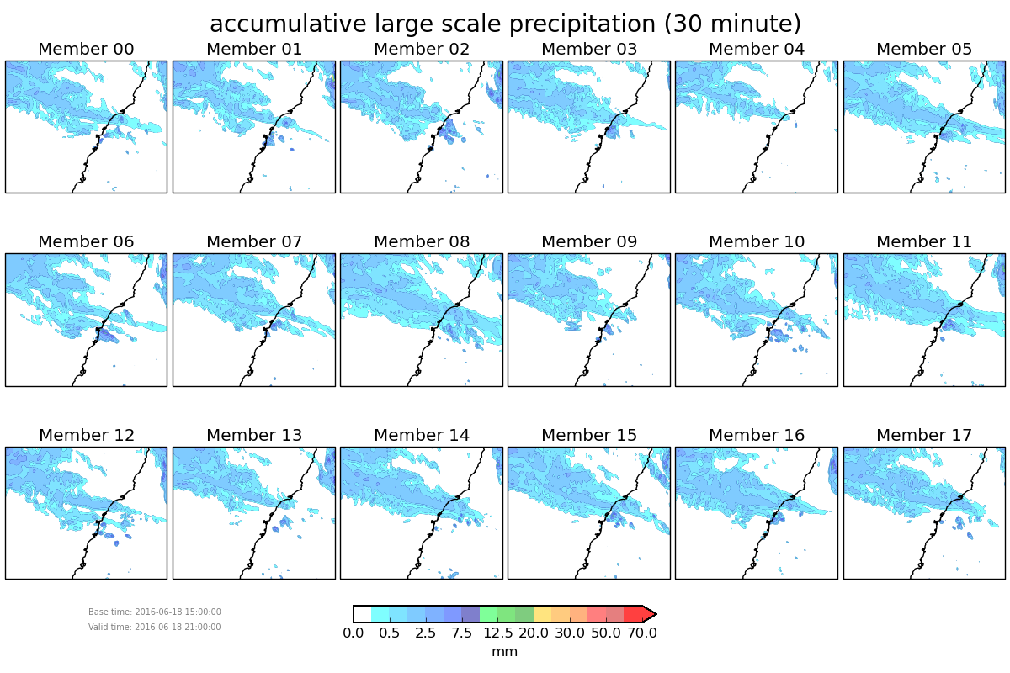
6 Hour Forecast
Notes:
Plot on the left is the Rainfields3, 30 minute, radar/gauge merged product, valid at 21Z on 2016-06-18.
The plot on the left is the ensemble over the RF3 domain, the red rectangles from the previous slide (simply extracted from the ensemble, not reprojected to the projection b/w the RF3 observations and ensemble are different).
Forecasts are valid at 21 Z on 2016-06-18.

Slide 15
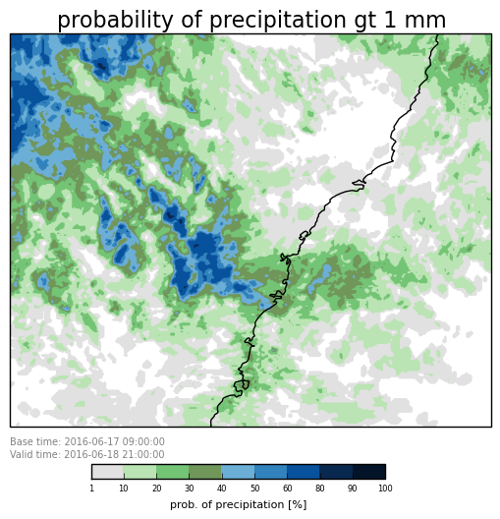
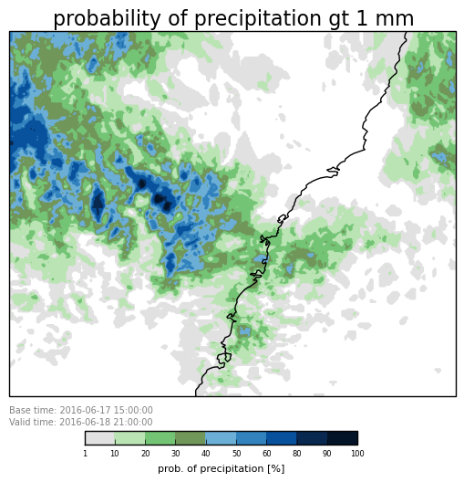
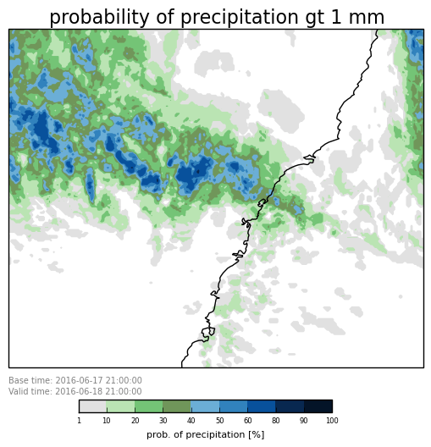
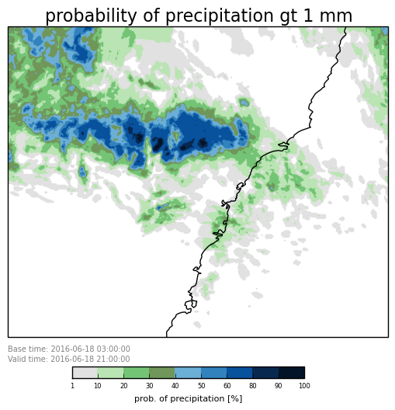
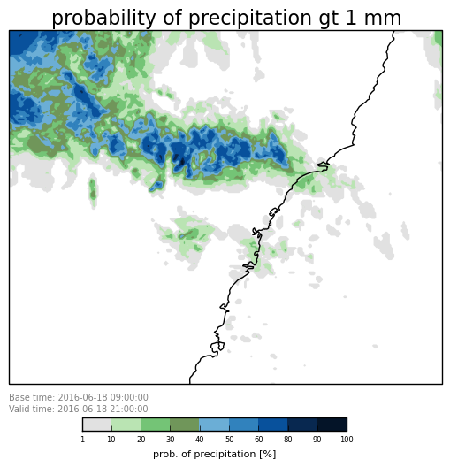
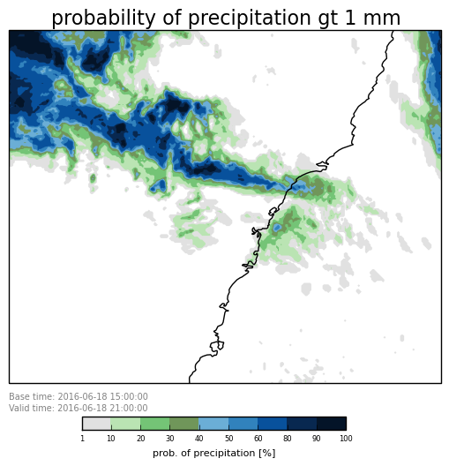
36 Hour Forecast
30 Hour Forecast
24 Hour Forecast
18 Hour Forecast
12 Hour Forecast
6 Hour Forecast
Notes:
Plot on the left is the Rainfields3, 30 minute, radar/gauge merged product, valid at 21Z on 2016-06-18.
The plot on the left is the ensemble over the RF3 domain, the red rectangles from the previous slide (simply extracted from the ensemble, not reprojected to the projection b/w the RF3 observations and ensemble are different).
Forecasts are valid at 21 Z on 2016-06-18.

Slide 16
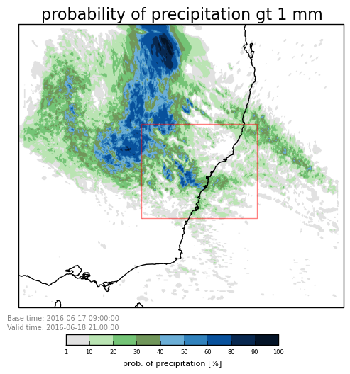
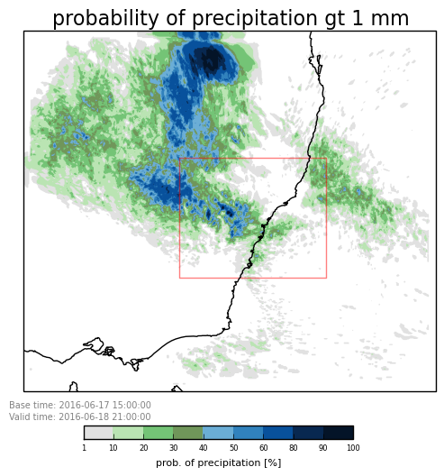
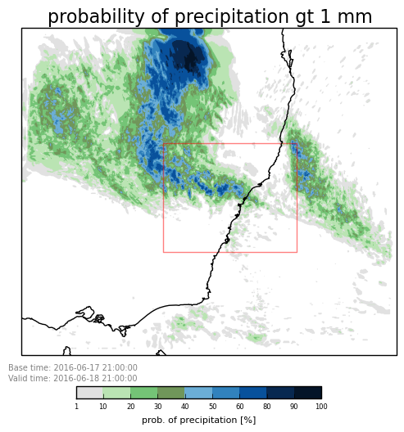
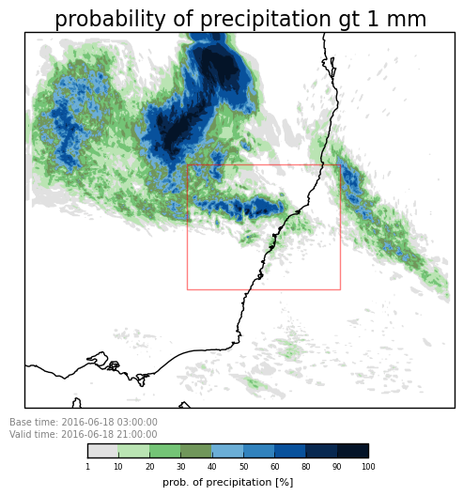
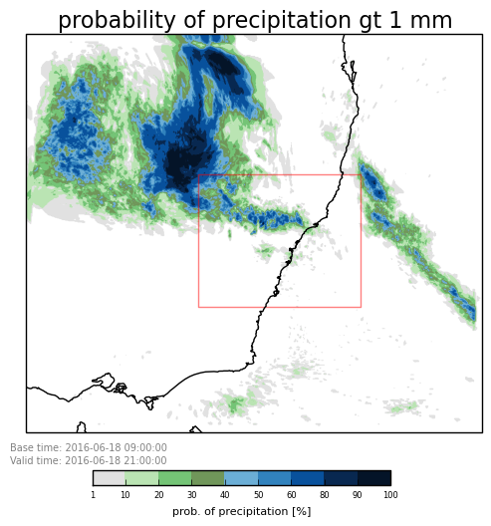
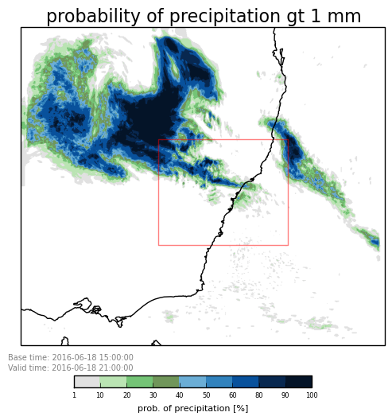
36 Hour Forecast
30 Hour Forecast
24 Hour Forecast
18 Hour Forecast
12 Hour Forecast
6 Hour Forecast
Notes:
Plot on the left is the Rainfields3, 30 minute, radar/gauge merged product, valid at 21Z on 2016-06-18.
The plot on the left is the ensemble over the RF3 domain, the red rectangles from the previous slide (simply extracted from the ensemble, not reprojected to the projection b/w the RF3 observations and ensemble are different).
Forecasts are valid at 21 Z on 2016-06-18.

Slide 17
Current and Future Activities
The ECL case from mid June 2016 has been run nested in the full resolution Global Ensemble data on the Bureau's mid-range supercomputer.
Porting of the Suite onto the Trial platform will commence next week.
  Hindcast and real time trials.
The selected physics settings will be tested in CE3.
  C3 tested RA1-M and RA1-T over different domains.
Formal Verification.
  The Bureau has never verified a convective scale ensemble before.
Aiming for Operations in Quarter 2.

Slide 18
Thank You
Shaun.cooper@bom.gov.au

