Slide 1


High-resolution ensemble prediction of the Australian East Coast Low of April 2015
Dragana Zovko-Rajak, Kevin Tory, Robert Fawcett and Jeff Kepert
Bureau of Meteorology and Bushfire & Natural Hazards Cooperative Research Centre, Australia
R&D Workshop
Melbourne, 26 November 2018

Slide 2
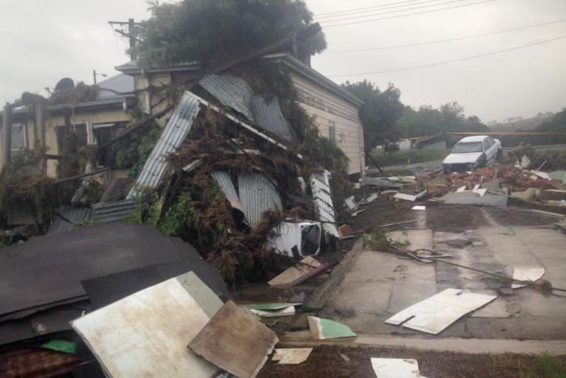
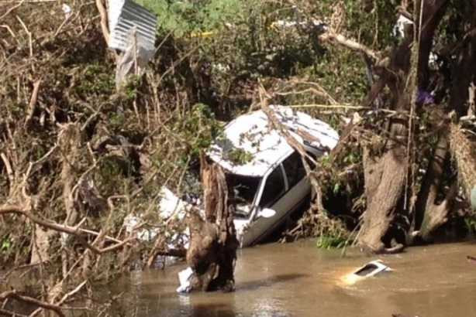
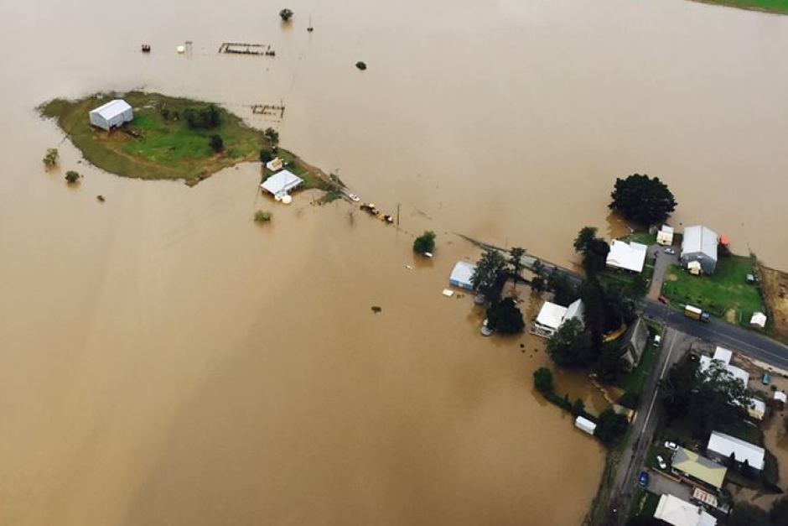
East Coast Low
Intense low pressure systems that form close to the east coast of Australia
20-23 April 2015, worst impact on 21 April
Strong winds, heavy rain, flash flooding, coastal erosion, at least 4 deaths
Widespread damage, >200 000 houses without power, 24-hr rainfall total of over 300 mm

Slide 3
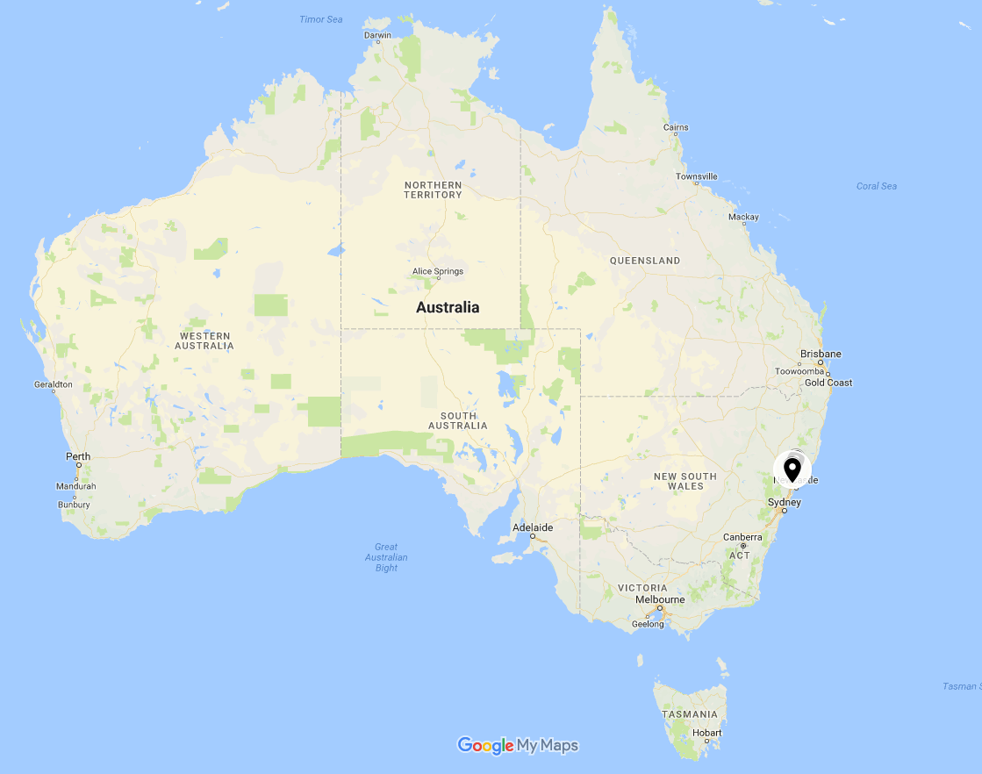

Slide 4
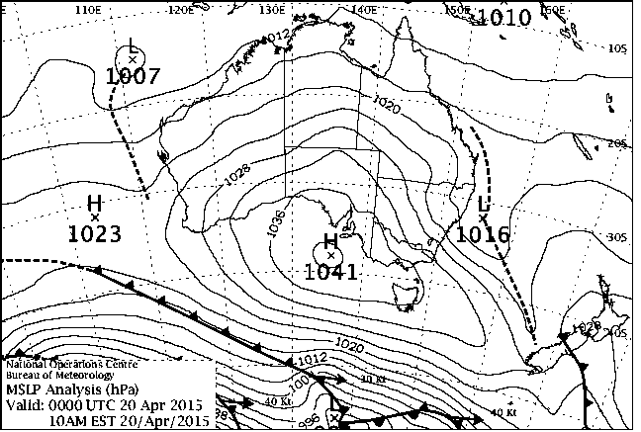
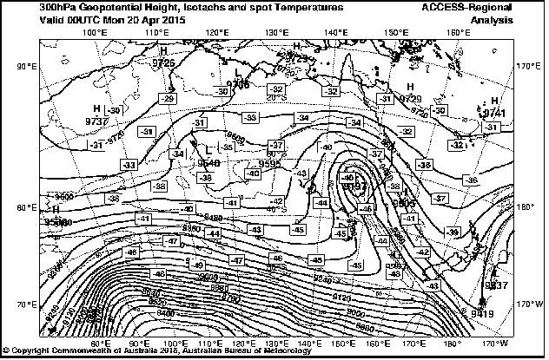
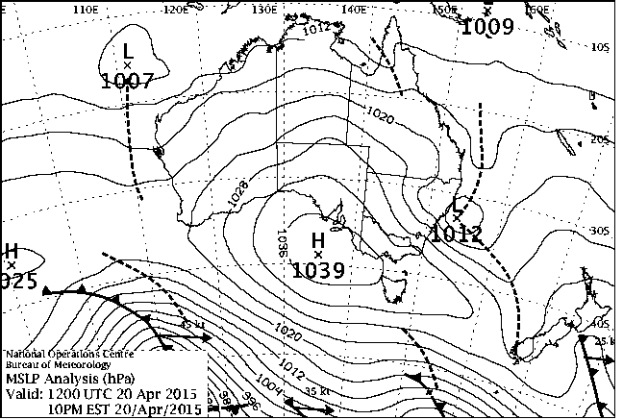
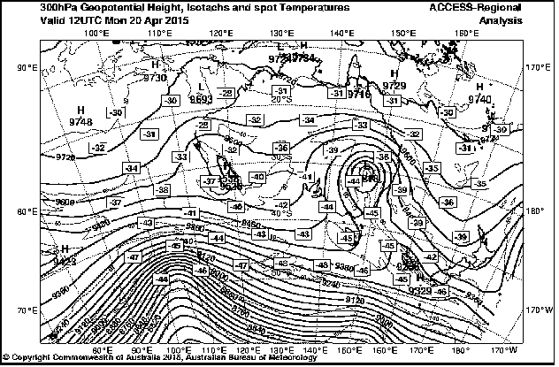
East Coast Low-Synoptics
0000 UTC 20 April 2015
1200 UTC 20 April 2015

Slide 5
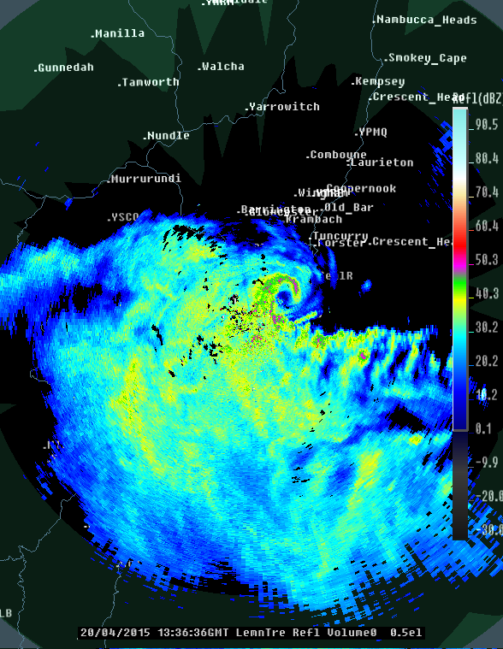
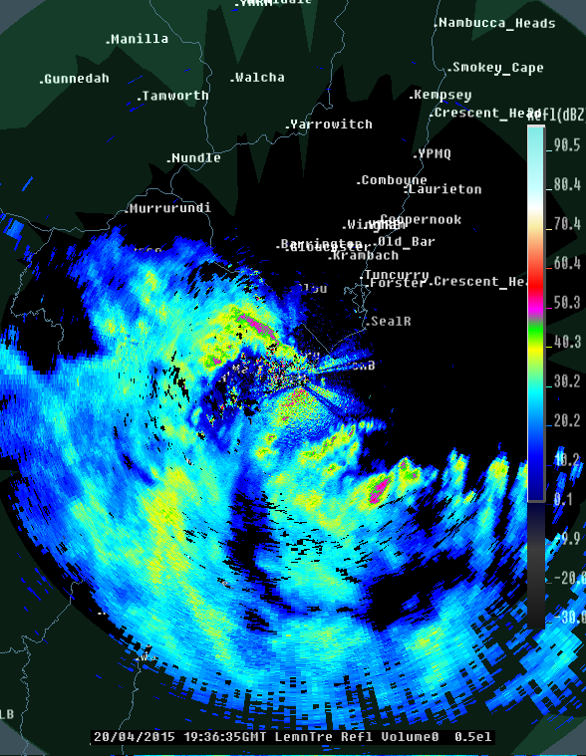
East Coast Low
1336 UTC 20 April 2015
1936 UTC 20 April 2015

Slide 6
High-resolution ensemble prediction
High-resolution ensembles are future of severe weather prediction
Need to learn how to use this information in the best possible way
Analysis provides better understanding of the dynamics of the event
Learn about predictability of the event

Slide 7
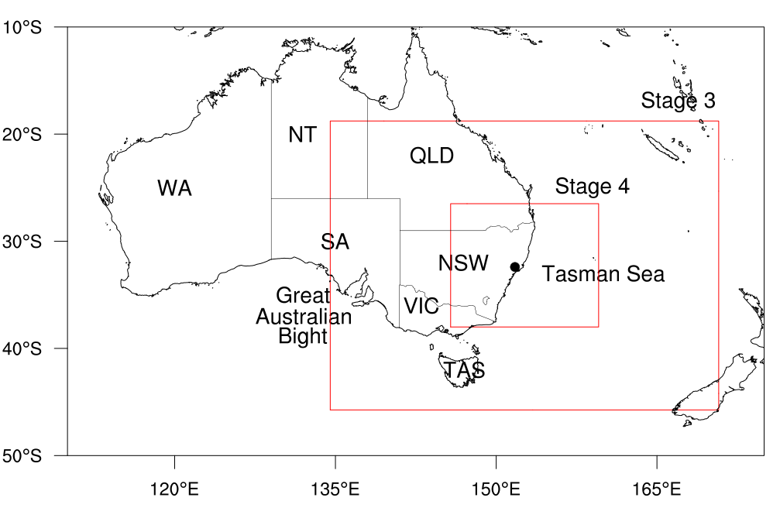
Set up and design of ensemble simulations
Ensemble of 24 simulations
Initialised from the 24 members of the ACCESS-GE model
Valid at 0000 UTC 20 April 2015
Global – 4 km – 1.3 km, 70 levels

Slide 8
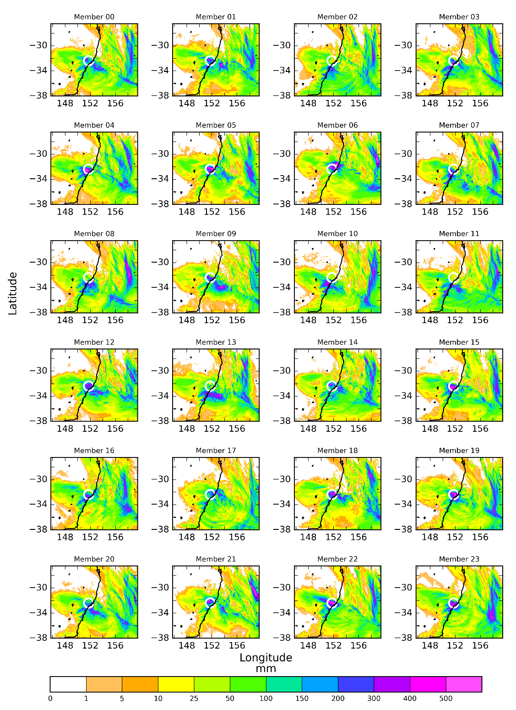

Slide 9
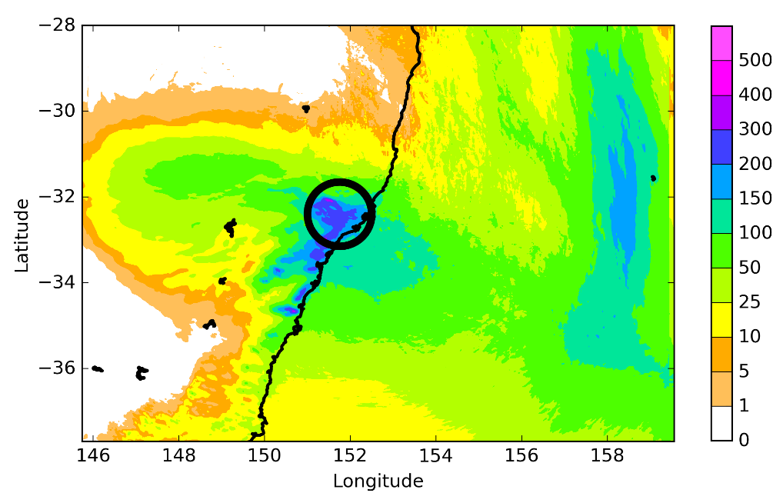
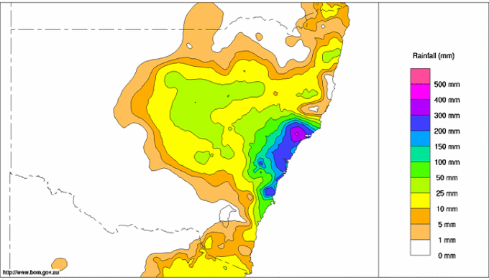
48-HR RAINFALL VERIFICATION
(ENSEMBLE MEAN)
Ensemble identifies Dungog as the area at significant risk of extreme rainfall

Slide 10
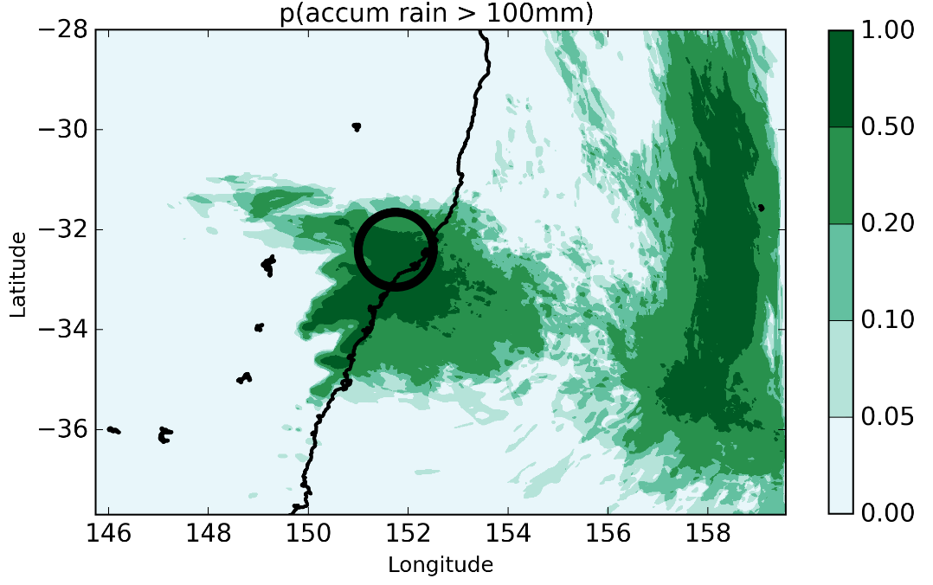
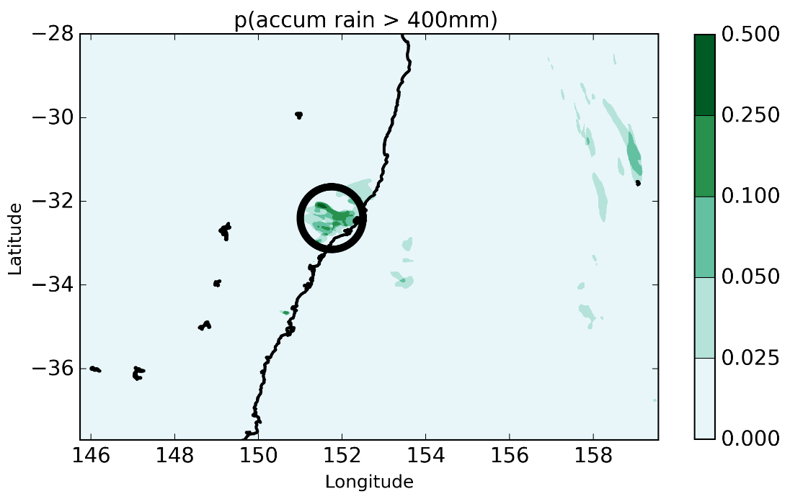
RAINFALL PROBABILITIES
Probabilities of 48-hour rainfall total exceeding 100 mm and 400 mm
Probabilities of 48-hour rainfall exceeding 100 and 400 mm

Slide 11
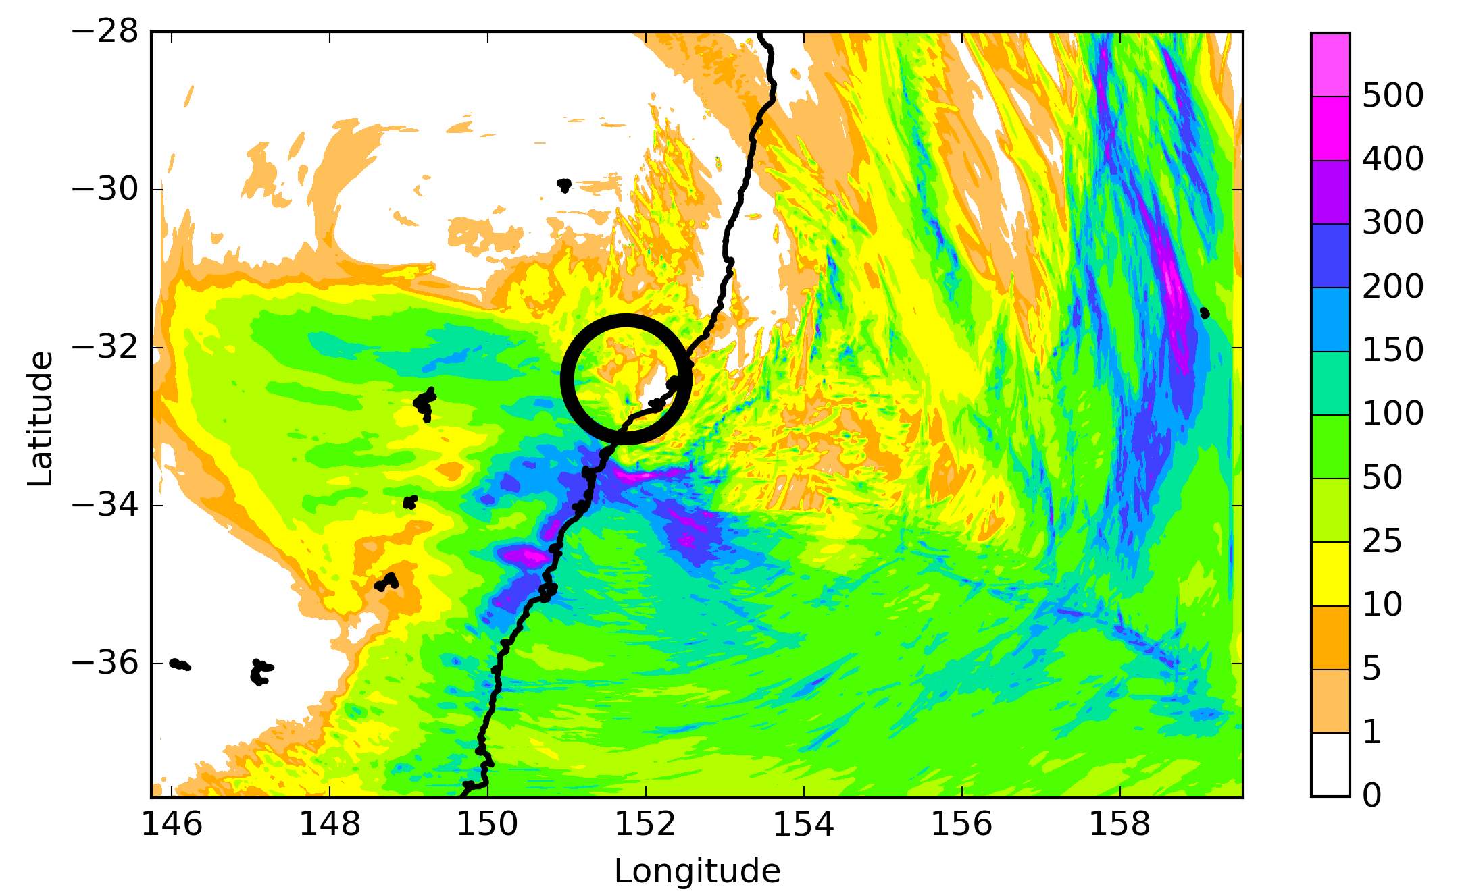
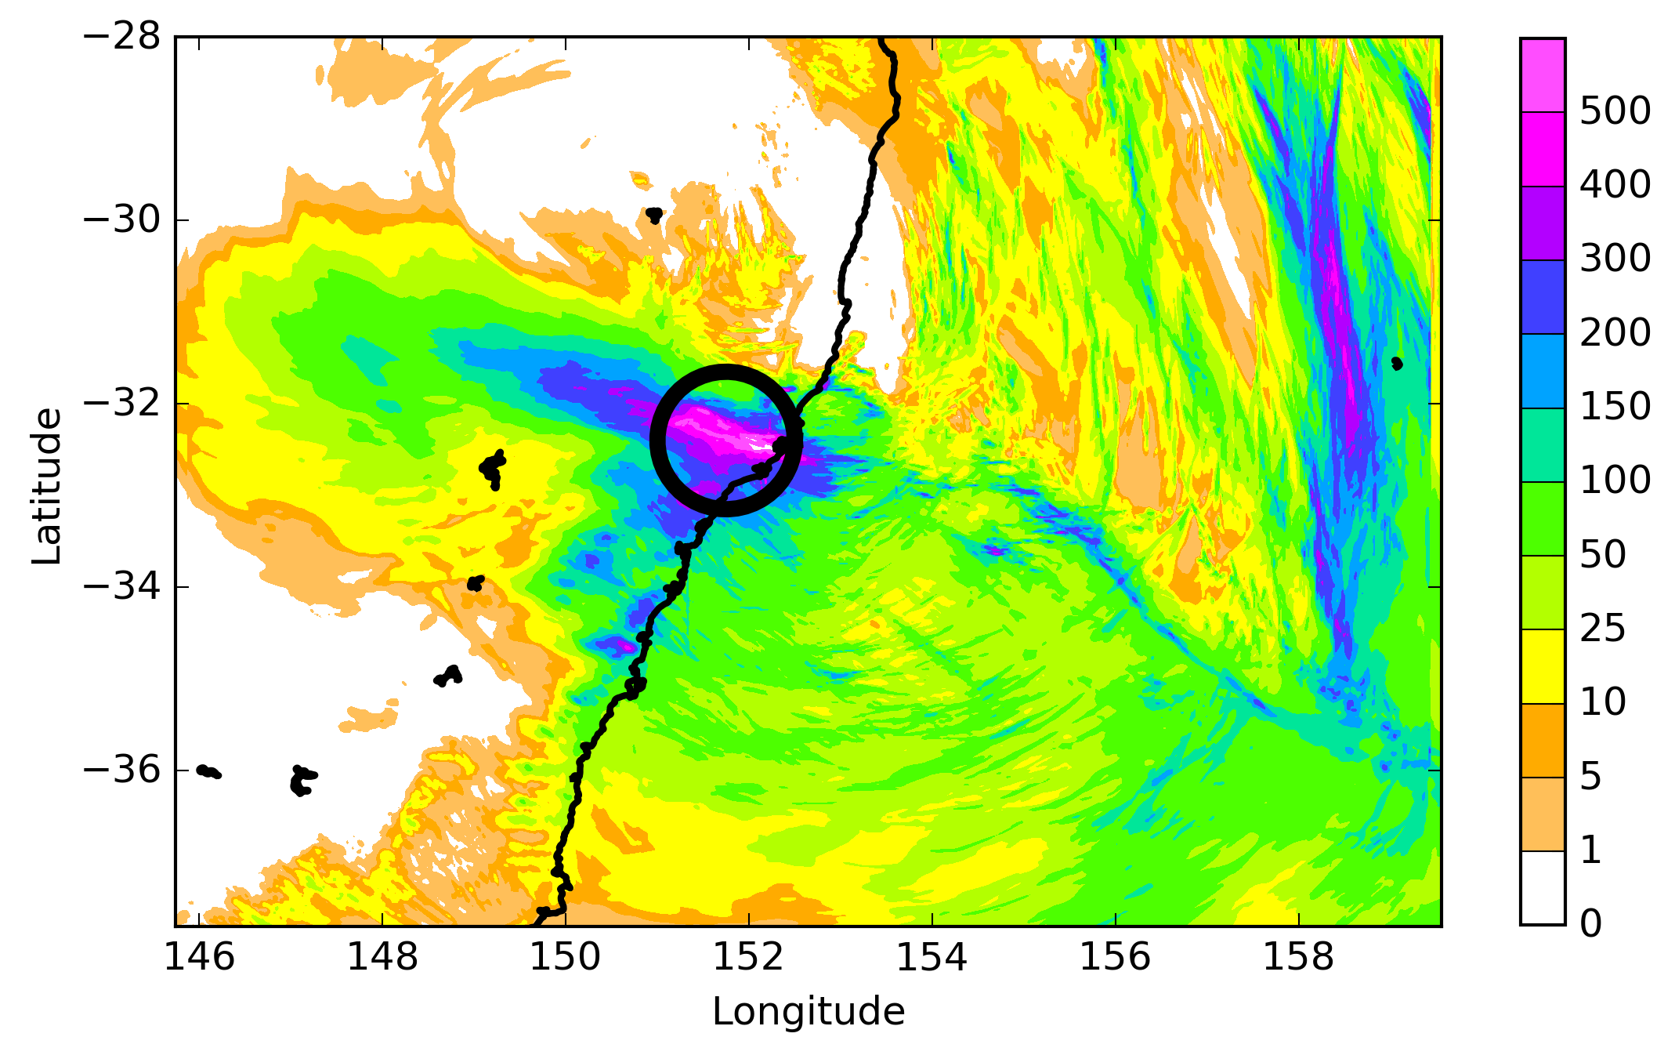
Dry ensemble member
Wet ensemble member

Slide 12
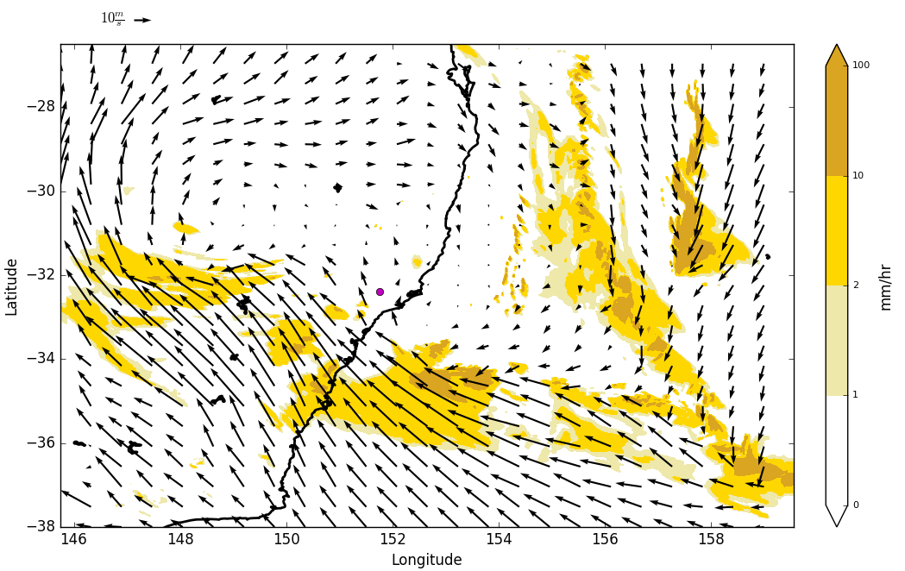
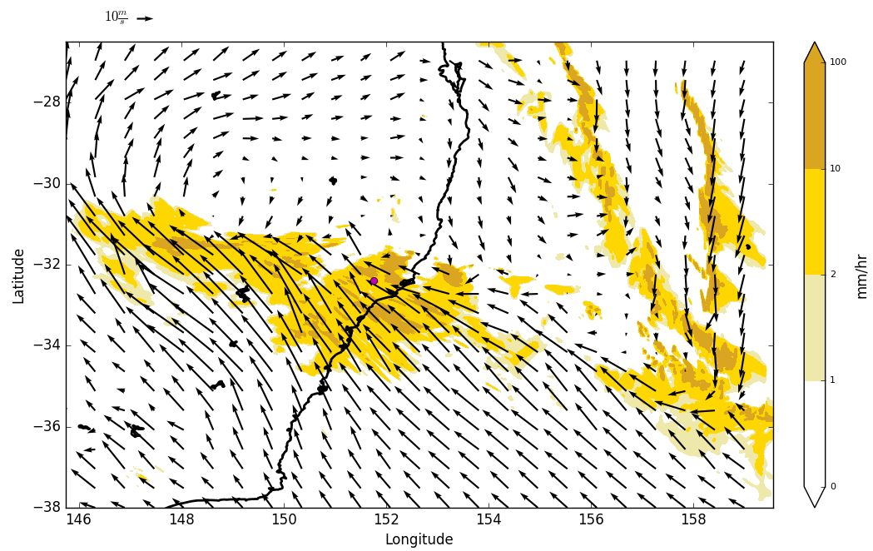
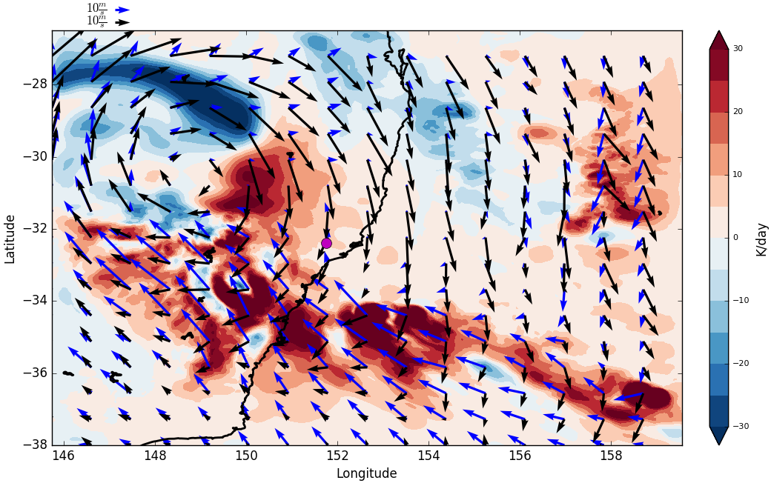
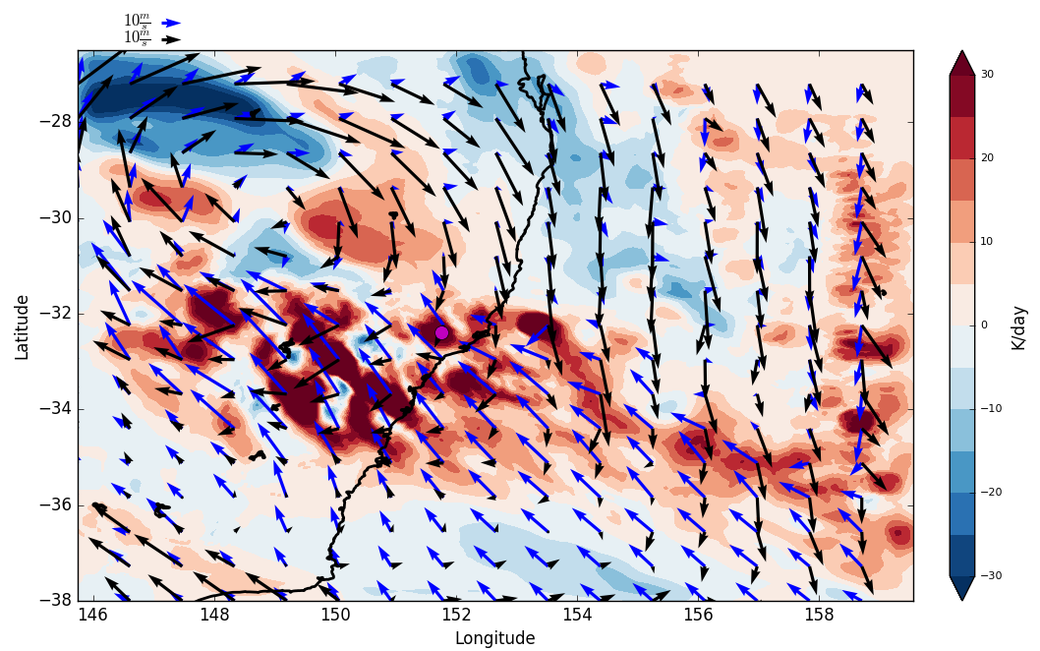
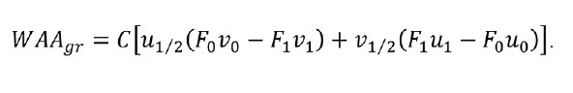
Low-level winds (m/s) and rainfall (mm/hr)
Dry member Wet member
Thermal advection diagnostic and 5.5 km winds (black) and 1.5 km winds (blue)
Isentropic ascent (red) - rain
Isentropic descent (blue) - dry
Tory (2014, AMOJ)

Slide 13
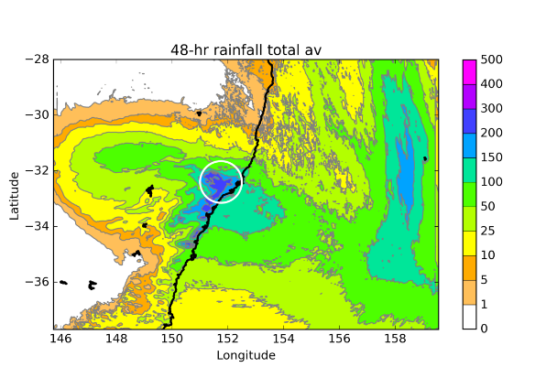
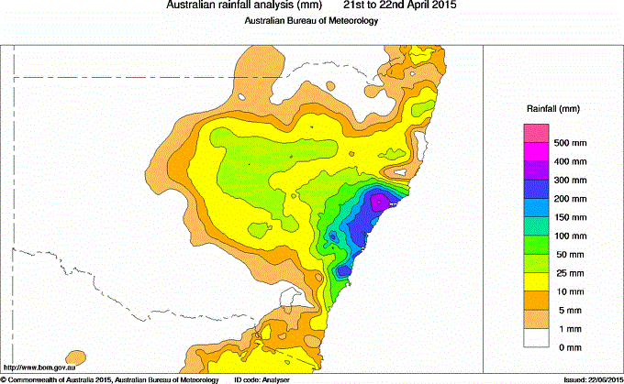
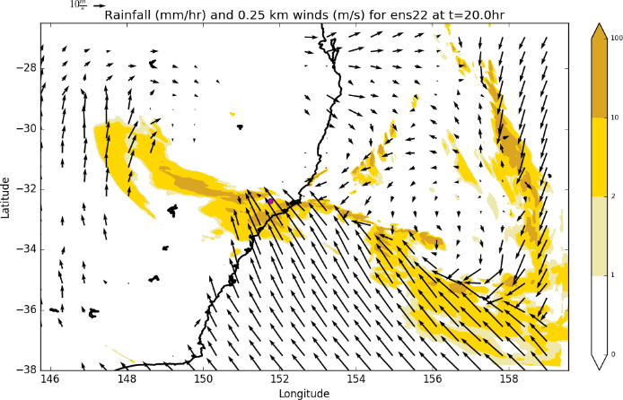
Summary
The ensemble identifies area of highest risk
Rain occurs along the low-level convergence lines to the south and east of the main low centre
Extreme winds to the south of the low, small vortices form along the shear line
Differences between ensemble members lead to localised differences in rain and strongest winds

