Slide 1
Climate model dependence and the Ensemble Dependence Transformation of CMIP projections
Bishop, C.H. and Abramowitz, G., 2013: Climate model dependence and the replicate Earth paradigm. Climate Dynamics. 41. 885-900.
Abramowitz, G. and Bishop, C. H., 2015: CMIP projections and the Ensemble Dependence Transformation. J. Clim., 28, 2332-2348.
Craig H. Bishop
School of Earth Sciences and Centre of Excellence for Climate Extremes, University of Melbourne
Gab Abramowitz
ARCCSS & Climate Change Research Centre, UNSW, Sydney
Ned Haughton
ARCCSS & Climate Change Research Centre, UNSW, Sydney
Notes:
This is a very short talk for a large topic
Still in development

Slide 2
Outline
Ensemble based climate prediction and model dependence
The Climate Probability Distribution (CPD), why it matters and why it hides during rapid climate change.
Relationship between observations and the mean and variance of the CPD and how CMIPx ensembles do not satisfy these relationships
An Ensemble Dependence Transformation (EDT) that makes CMIPx type ensembles more “like” a CPD ensemble.
Application of method to create climate forecasts of the CPD
Conclusions

Slide 3
Climatic Probability Distribution (CPD)
CPDs give probability of observing values of temperature, wind, rain or environmental phenomena – such as droughts, heat waves, tropical cyclones or high amplitude inter-decadal oscillations.
Climate change detection and impact assessment requires the CPD, not just the mean.
If the climate system were static, the CPD would be well approximated by historical data.
But green-house gas concentrations are rapidly increasing, and current atmospheric concentrations of carbon dioxide, methane, and nitrous oxide have increased to levels unprecedented in at least the last 800,000 years! (IPCC, 2013, SPM)
It is impossible to determine the CPD from observations alone during this type of climate change.
Could we do it with ensembles and observations?

Slide 4


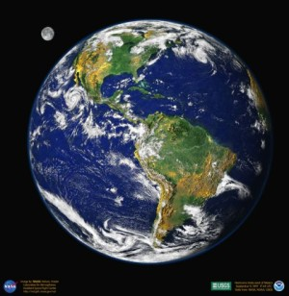
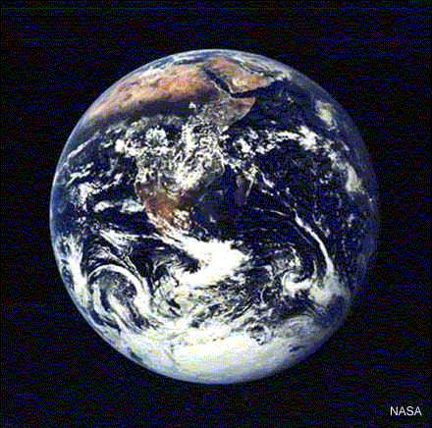
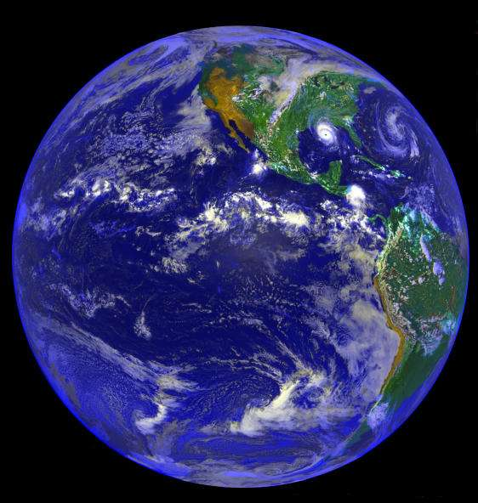
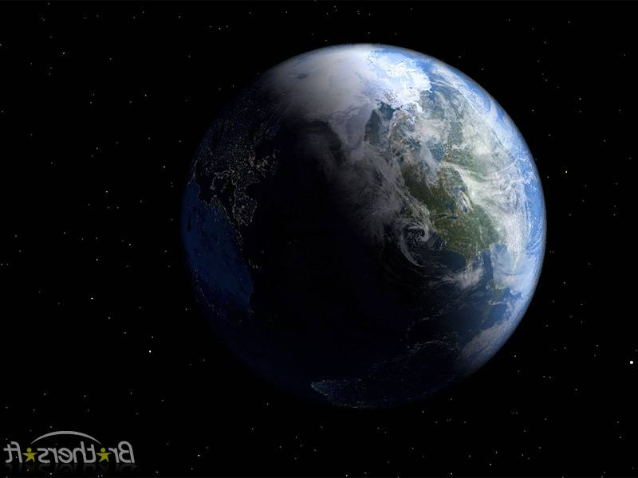

Exoplanets, Slartibartfast and replicate Earths
Imagine a very large number of Earth replicates that experienced the same orbital / solar / GHG forcing
Each Earth has a very different atmosphere / ocean state as a result of chaotic processes
Behaviour across replicate Earths defines the CPDF in presence of climate change; e.g. frequency of weather categories
Climate models can be viewed as attempts to create replicate Earths conditioned on the observations used for model development and initialization
Slartibartfast: Magrathean planet designer
Hitchhikers guide to the Galaxy (D. Adams)

Slide 5
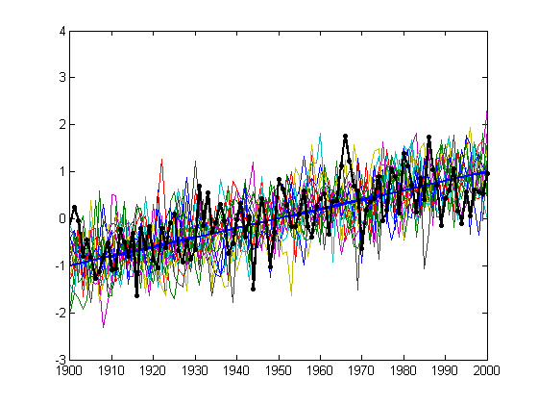
Relationship of our Earth to the replicate Earth ensemble
Weather Anomaly
Chaotic nature of Earth-system makes it impossible for any replicate Earth to have same trajectory as our Earth
Replicate Earths in Color
Replicate Earth mean in Blue
Our Earth in Black
Our Earth
Replicate Earth mean
time
Mean of distribution of replicate Earths (blue line) is the linear combination of Earths that minimises the mean square distance from our Earth’s observations.

Slide 6
Relationship of our Earth to the replicate Earth ensemble
Weather Anomaly
Chaotic nature of Earth-system makes it impossible for any replicate Earth to have same trajectory as our Earth
Replicate Earths in Color
Replicate Earth mean in Blue
Our Earth in Black
Our Earth
Replicate Earth mean
time
Time average of variance of replicate Earths equals the mean square error of climate forecast based on mean of the replicate Earths.

Slide 7
How would the differences between replicate Earths and our Earth covary?
We use A to denote the model-observation difference covariance matrix. In this case, the models are perfect replicate Earths
For details see on-line supplemental material of Bishop, C.H. and Abramowitz, G., 2013: Climate model dependence and the replicate Earth paradigm. Climate Dynamics. 41. 885-900 .

Slide 8
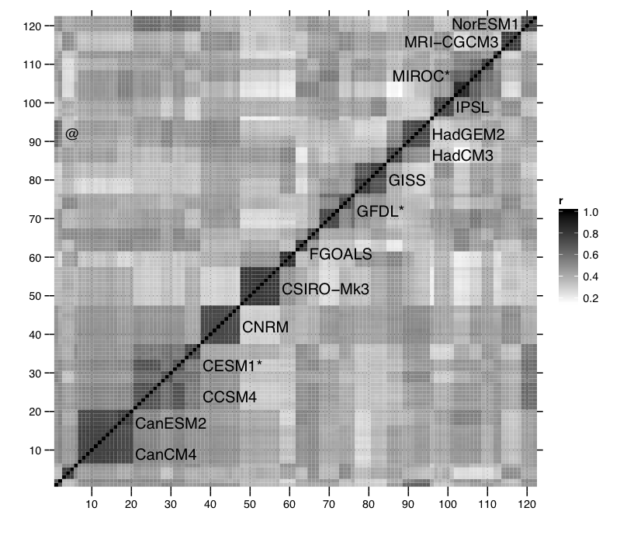
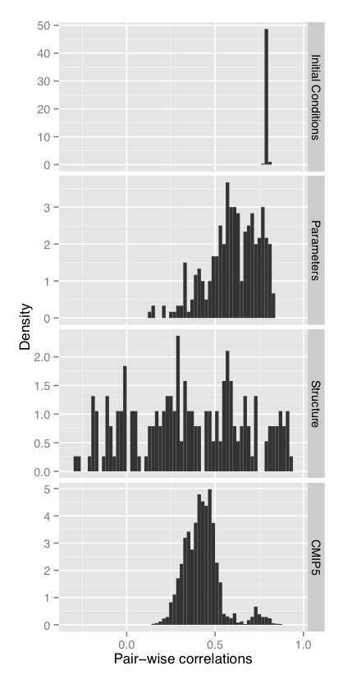
CMIP ensembles do not look like replicate Earth ensembles
A model-observation
difference correlation matrix
from CMIP5
Off diagonal elements
should equal 0.5
Haughton et al, in review, Climate Dynamics.

Slide 9
CMIP ensembles do not look like replicate Earth ensembles
(continued)
The mean of the CMIP ensemble is not the minimum error variance estimate, and
The time average of CMIP ensemble variance is not equal to the mean square error of its mean.

Slide 10
Ensemble Dependence Transformation
Ensemble created by sampling with frequency is like a replicate Earth ensemble in that (a) its sample mean is the minimum error variance estimate, and (b) its variance equals the error variance of the sample mean.

Slide 11
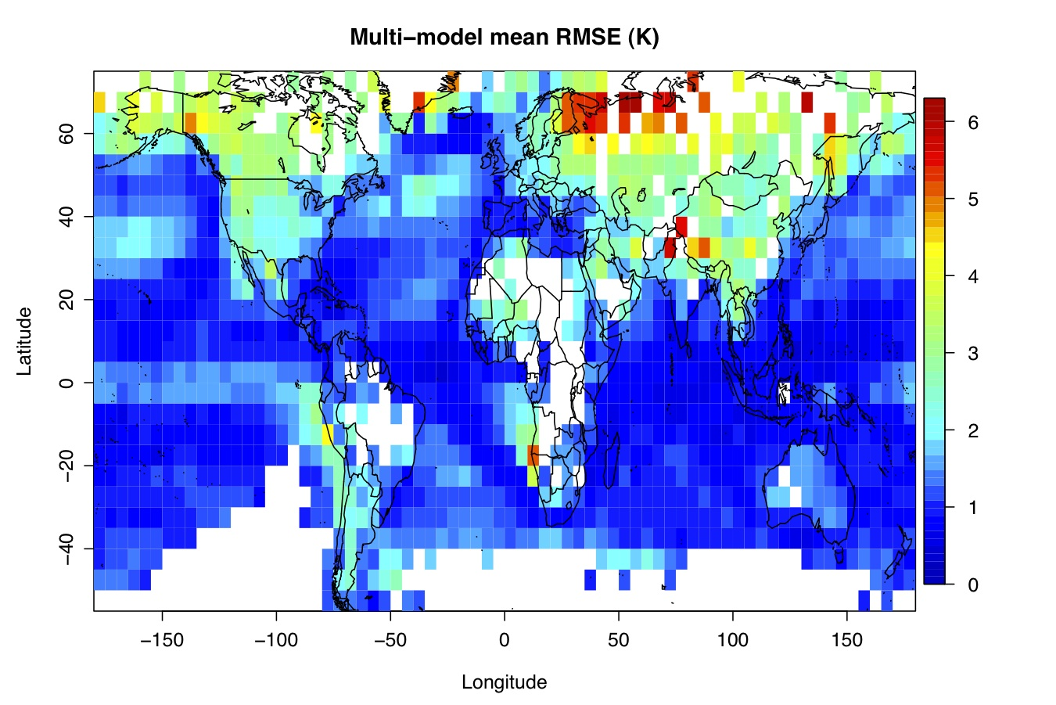
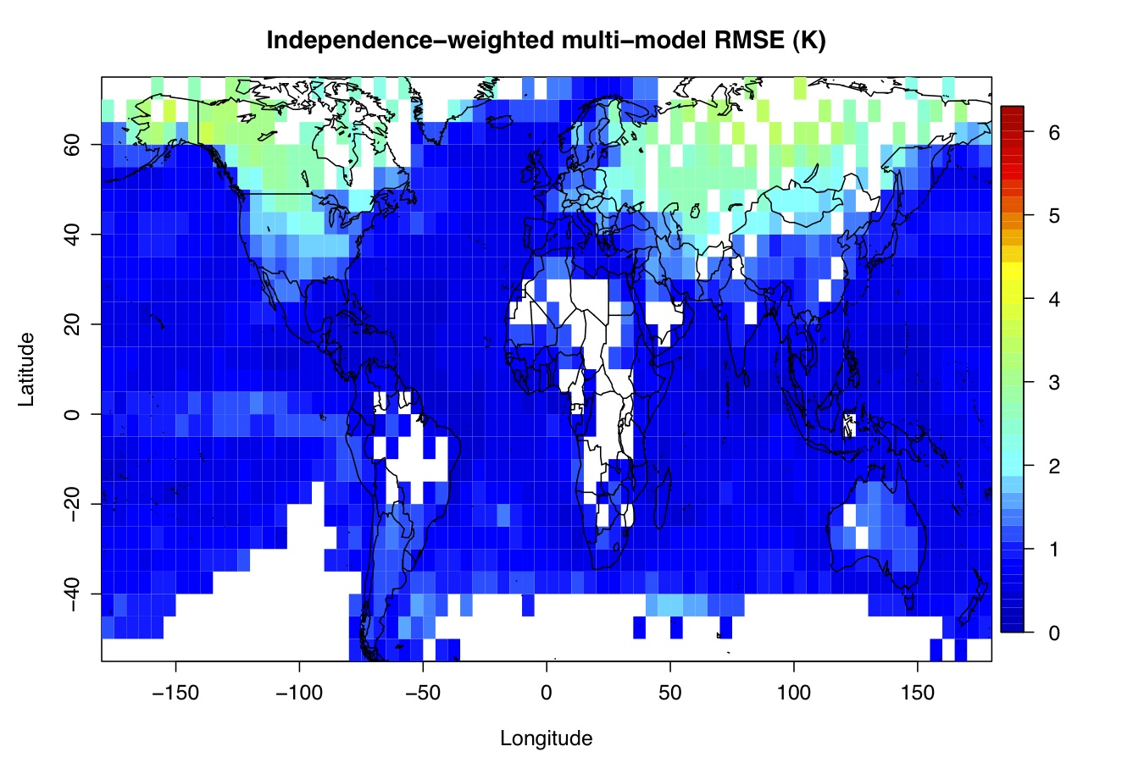
Hindcast (historical) test
Bishop and Abramowitz, Climate Dynamics, 2013
24 CMIP3 models
HadCRUT3 observed monthly surface temperature 1970-1999
Analysis on HadCRUT3 5°×5° grid cells
White grid cells => >20% missing data
A little more detail…

Slide 12
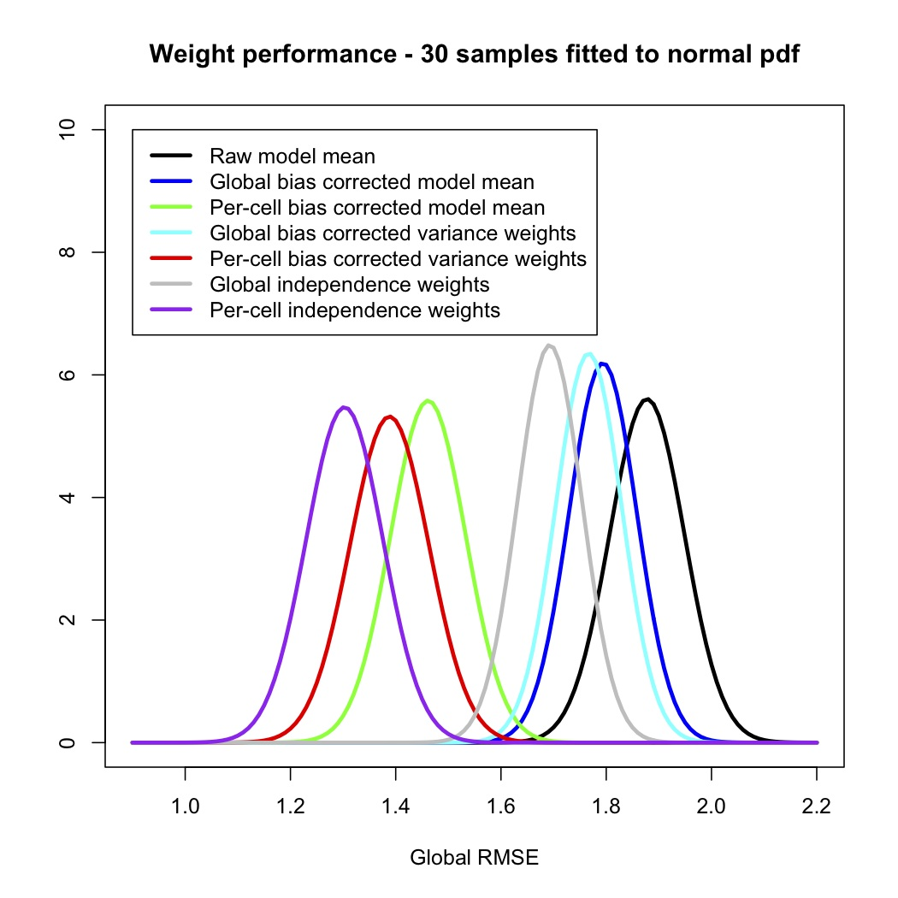
Global RMSE (out of sample)
Bishop and Abramowitz, Climate Dynamics, 2013
Apply weights globally
Apply weights at each grid cell
Multi-model mean
Accounting for inter-model error correlations gives greater improvement than basing weights solely on error variance of each model.

Slide 13
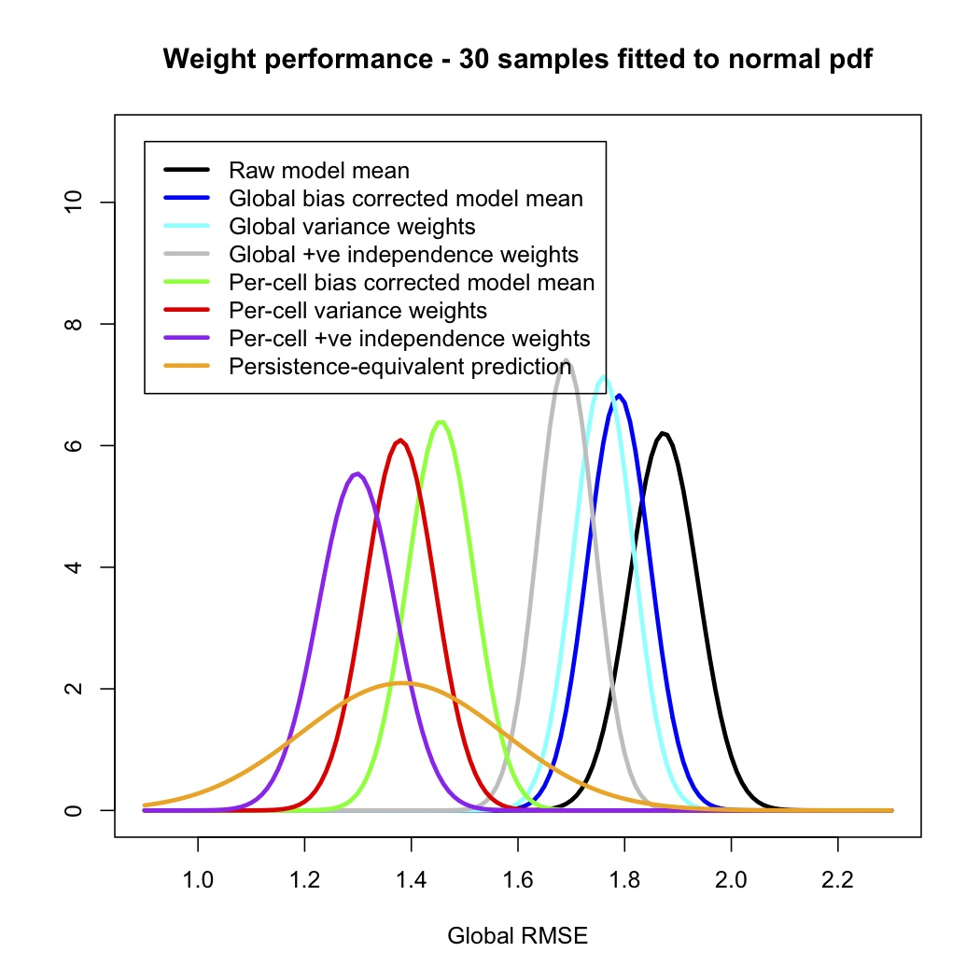
Bishop and Abramowitz, Climate Dynamics, 2013
Global RMSE (out of sample)
Note that observations have zero error of representation whereas the coarse resolution climate models are likely to have large flow dependent error of representation.
Superiority of mean of transformed ensemble more impressive in the light of this fact.
mean of 1970-1999 observations minus observations from test year

Slide 14
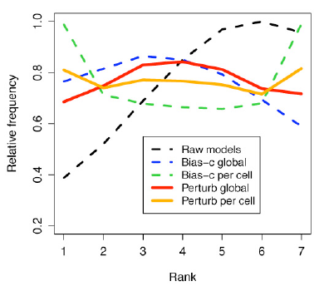
Rank Frequency Histograms for M=6
0
1
Bishop and Abramowitz, Climate Dynamics, 2013
At each grid cell and time, take n samples from a uniform distribution [0,1] to select an n-model ensemble
Vary size of ensemble to achieve flat histograms
Raw and bias corrected ensembles were found not to give reliable probabilistic forecasts for any ensemble size
The most accurate forecast (orange line) – which is based on differing weights for each grid cell – was found to give approximately reliable probabilistic forecasts for M=6 and M=5.
For smaller values of M , the extreme ranks were under-populated by the verifying observation. For larger values of M, the extreme ranks were under-populated.
Does this mean the effective local ensemble size is about 5.5?
The ensemble forecast based on one set of global weights gave its flattest RFH for M=9.
Flat line (zero slope) indicates that ensemble frequencies give reliable probabilistic forecasts

Slide 15
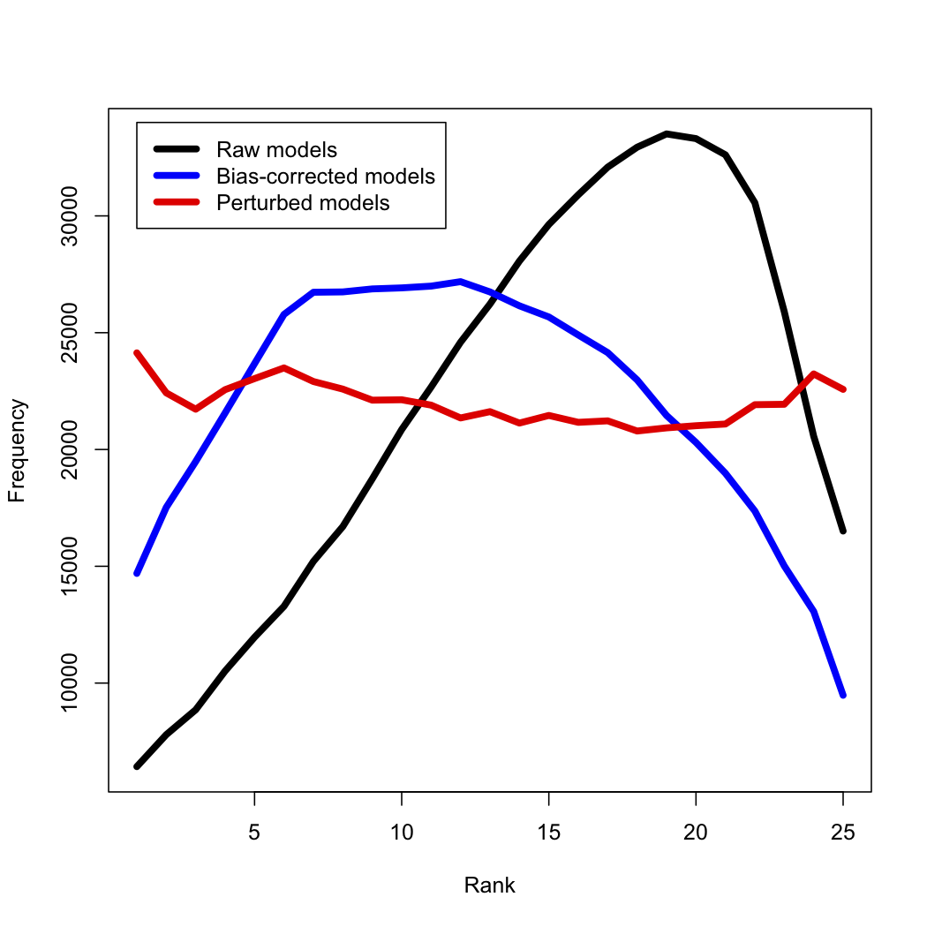
Test 1: Is EDT distribution distinguishable from obs?
Rank histogram
For a single grid cell, at a single time step, what is the rank of the observed value in the observed + model set?
Perturbed models behave more like replicate Earths (drawn from the same distribution as obs) than raw or bias corrected CMIP3 models (flatter histogram)
Under the rank histogram test, the EDT members are barely distinguishable from the observations => reliable EDT probabilities.
Bishop and Abramowitz, Climate Dynamics, 2013

Slide 16
Forecast Test
Take an ensemble of K CMIP5 climate forecasts initialized in the late 1800s and subject to prescribed future Green house gas forcing scenarios.
Replace real 20th century observations by pseudo-observations from one of the models and then use these to derive the ensemble transformation weights.
Apply the derived transformation to the 21st century ensemble and measure the performance of this transformed ensemble.
Repeat the experiment using a different model as the pseudo-Earth

Slide 17
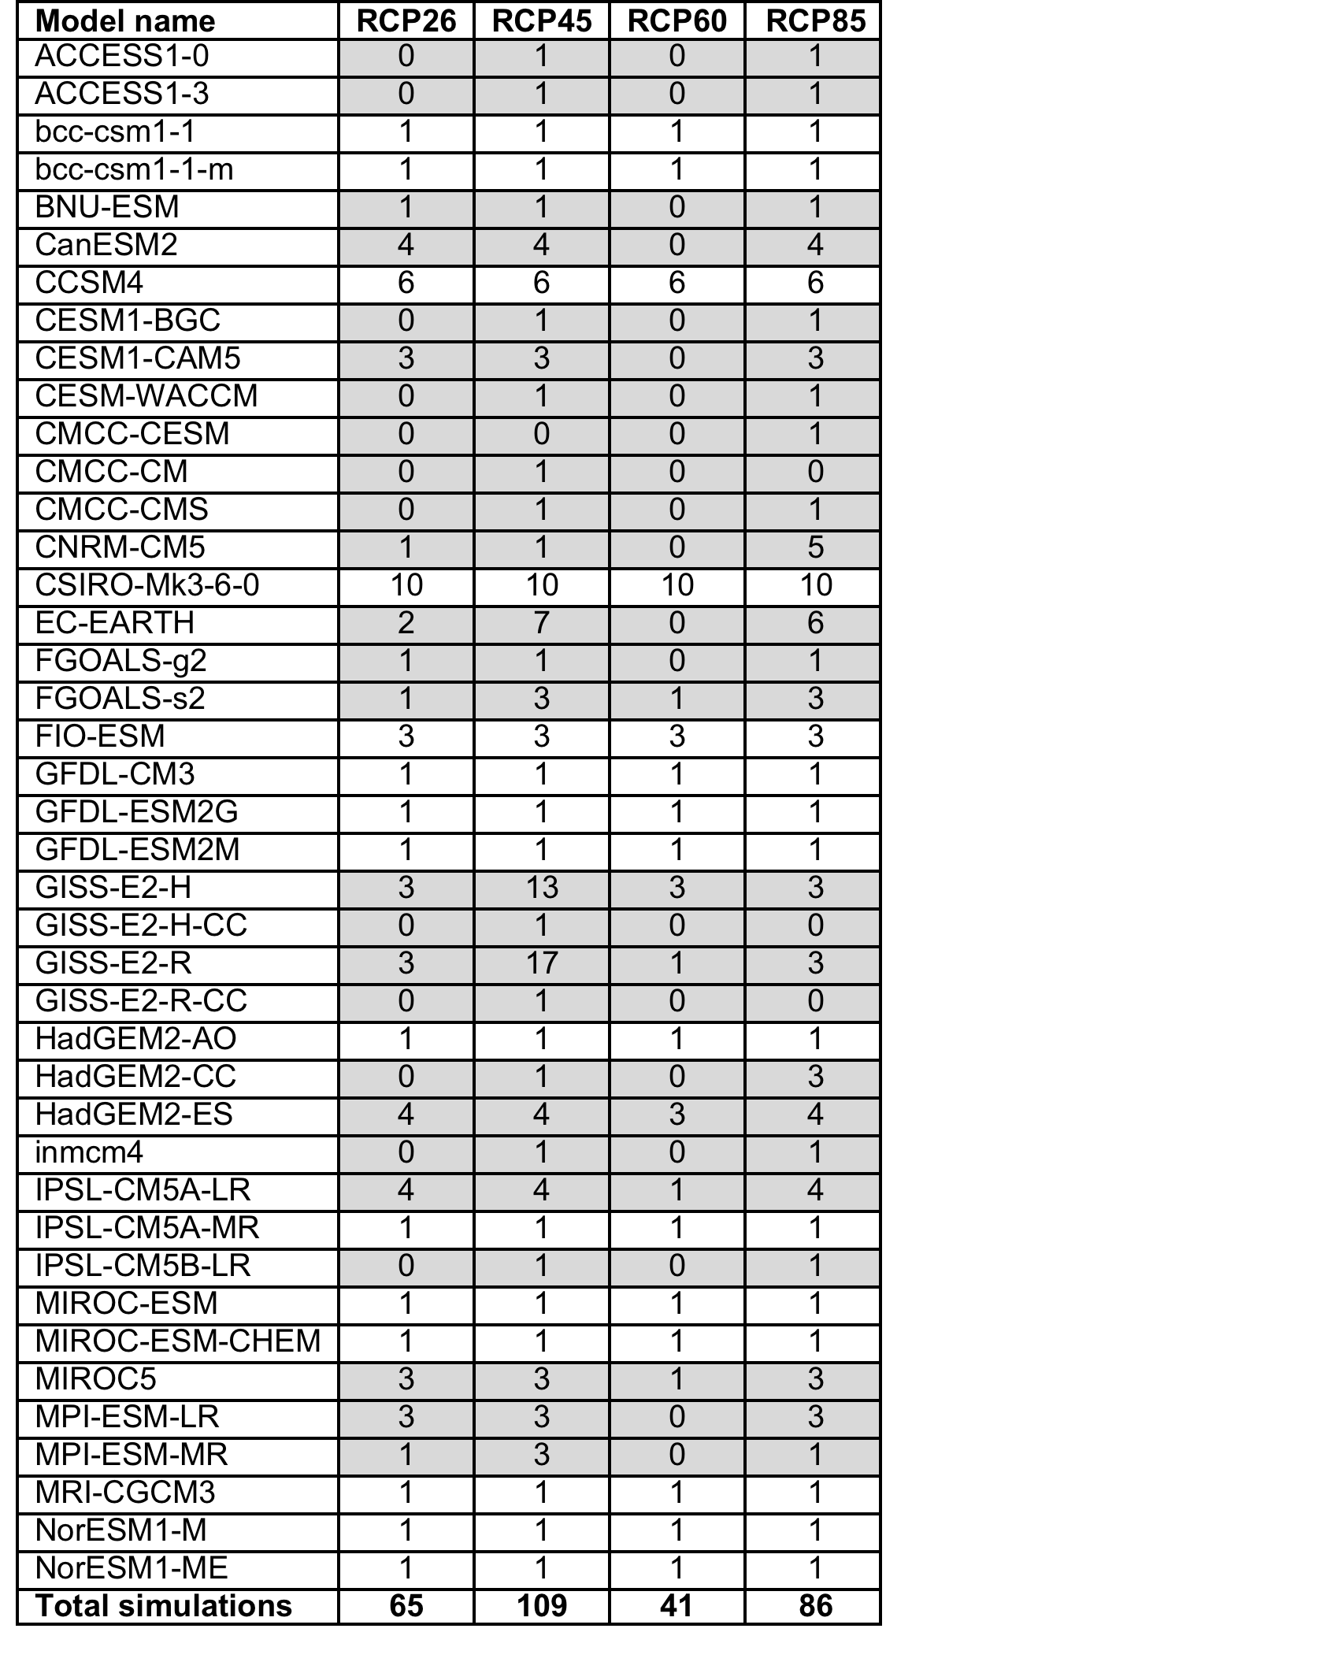
List of models contributed to CMIP for differing Representative Concentration Pathways (RCPs)

Slide 18
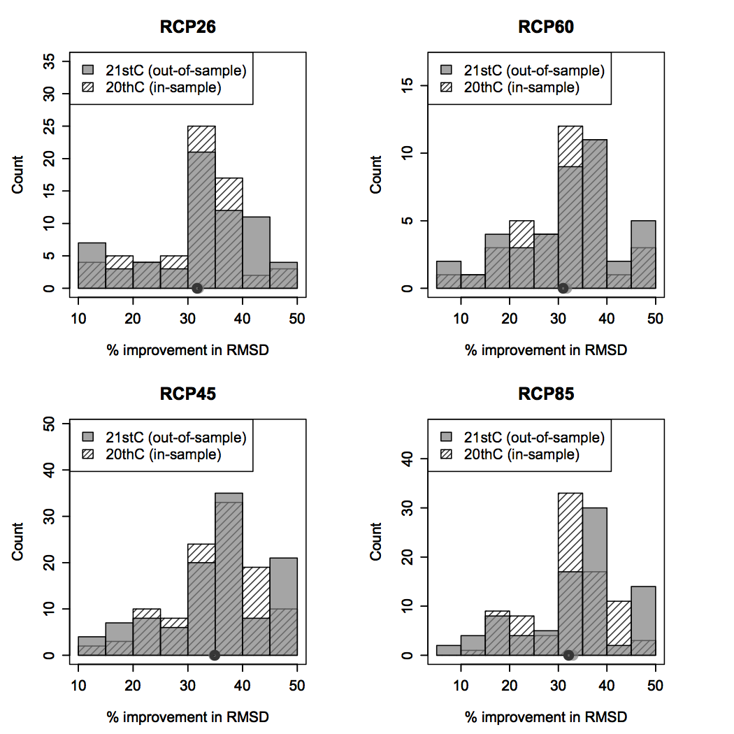
Is EDT mean better than CMIP mean out of sample?
Model-as-truth / perfect model experiment
Train on 20C, test throughout 21C
Histograms show improvement in ensemble mean RMSD over all possible models as truth
In all 301 trials, EDT mean had smaller RMSD than CMIP bias corrected mean. On average EDT mean RMSD more than 32% smaller.
Abramowitz and Bishop, J Climate, 2015.

Slide 19
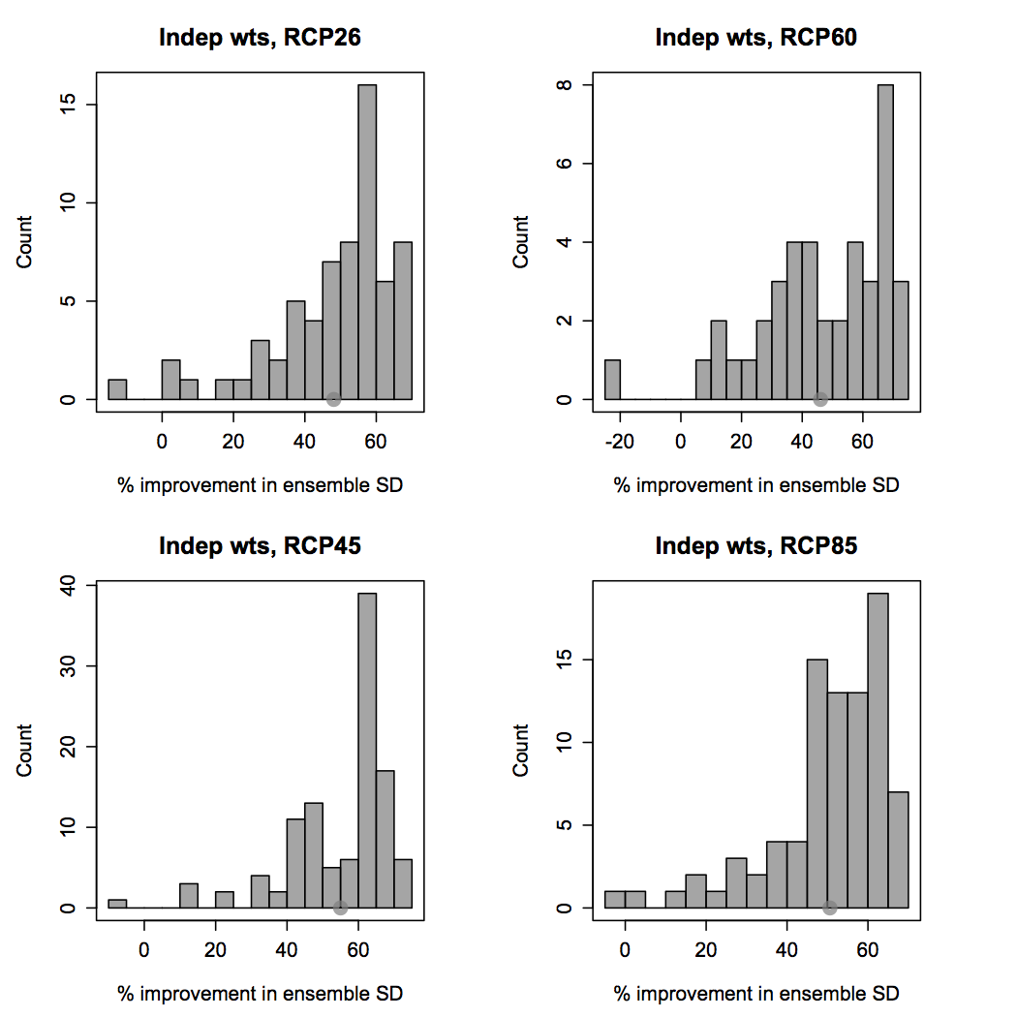
Can the EDT better predict the future CPD variance?
Model-as-truth / perfect model experiment
Train on 20C, test throughout 21C
Histograms show improvement in ensemble SD over all possible models as truth
For the majority of cases, EDT predicted the future CPD standard deviation better than the bias corrected CMIP ensemble.
The mean improvement was about 50%.
Abramowitz and Bishop, J Climate, 2015.

Slide 20
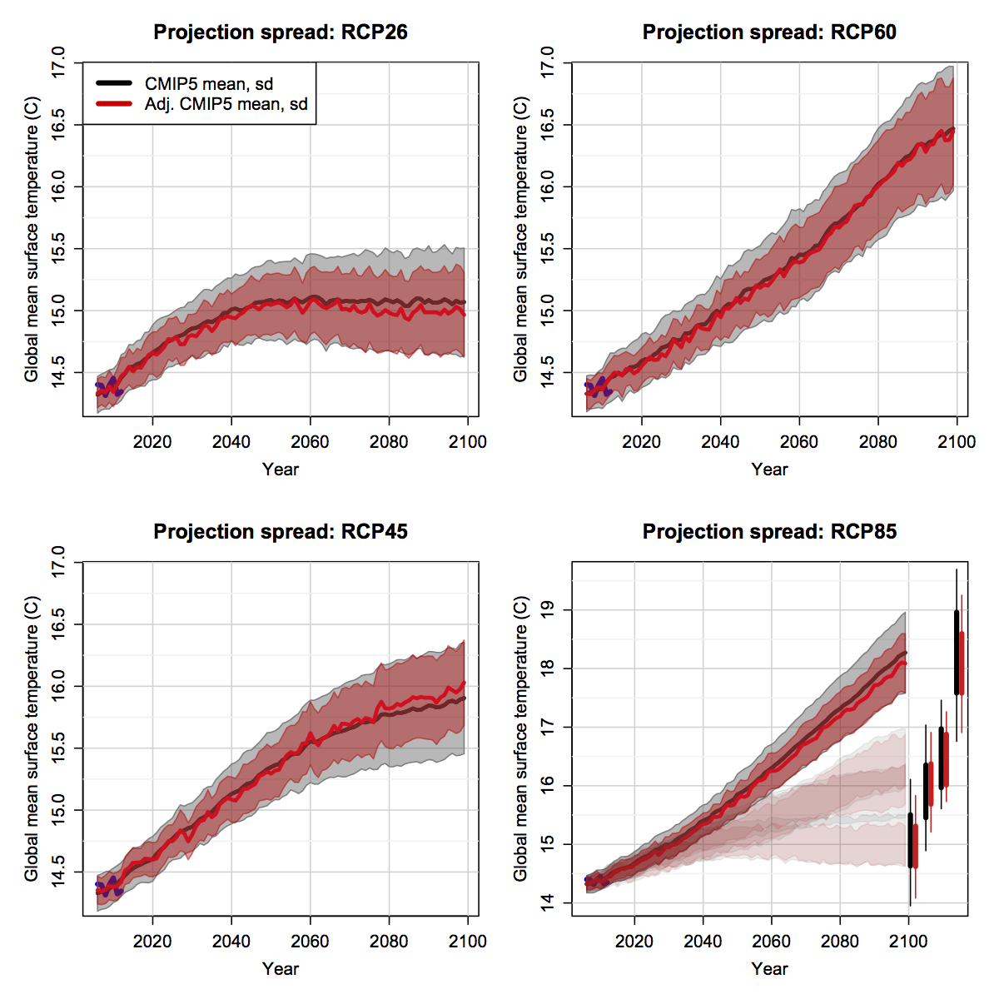
Transformation to a replicate Earth like ensemble
(i.e. accounting for dependence – global tas)
Using HadCRUT4 as obs reference – monthly 5˚x5˚
2005-2012 shown in blue
Ensemble variance drops ~20%
Abramowitz and Bishop,
(2015, J Climate)
Notes:
What might perfect mean? Another Earth with immeasurably similar initial conditions

Slide 21
Conclusions
An ideal ensemble would sample the Climactic Probability Distribution (CPD).
The instantaneous CPD and its variance are formally unobservable but can be plausibly estimated and predicted by applying the EDT to ensembles of models of the quality found in the CMIP5 ensemble.
Earth replicate ensemble defines the CPD but is imaginary. Nevertheless, it provides:
  A framework for understanding role of chaos in climate prediction,
  properties that ensemble post-processing schemes should aim to emulate
Application of the EDT to the CMIP5 ensemble led to forecast ensemble means with marked reductions (~30% on average) in RMSD. It also greatly improved (50% on average) on average improved the prediction of future CPD variance.
Accounting for dependence in CMIP5 has a considerable effect on global and regional 21st C projections of surface air temperature.

Slide 22
Future Work
Implications for Attribution and Detection
Use in medium range weather forecasting
Ensembles of sub-ensembles?
How should the performance of a coupled climate model in “weather forecasting” or “seasonal forecasting” mode influence the weight it is given in a CPD forecast.

