Slide 1

Hybrid ensemble Var for a limited area model
Monika Krysta¹, Susan Rennie¹, Shaun Cooper¹, Peter Steinle¹, Xudong Sun¹, Jin Lee¹ and Jim Fraser¹
¹Environment and Research Division, Bureau of Meteorology, Melbourne
monika.krysta@bom.gov.au

Slide 2
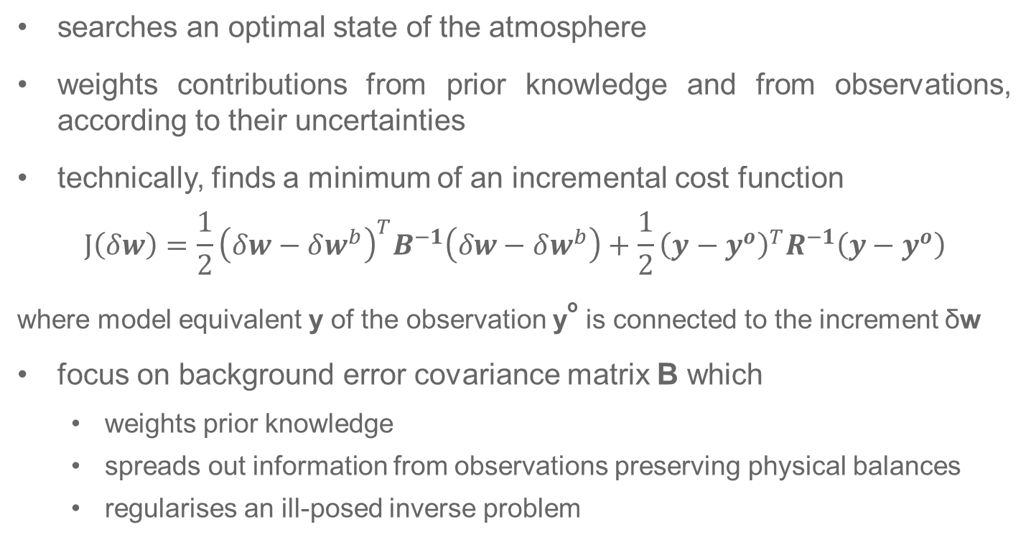
Variational data assimilation
searches an optimal state of the atmosphere
weights contributions from prior knowledge and from observations, according to their uncertainties
technically, finds a minimum of an incremental cost function
$$J\left(δw\right)=\frac{1}{2}{\left(δw−δw^{b}\right)}^{T}B^{−1}\left(δw−δw^{b}\right)+\frac{1}{2}{\left(y−y^{o}\right)}^{T}R^{−1}\left(y−y^{o}\right)$$
where model equivalent y of the observation yº is connected to the increment δw
focus on background error covariance matrix B which
weights prior knowledge
spreads out information from observations preserving physical balances
regularises an ill-posed inverse problem
Notes:
Data assimilation strives at providing an optimal state of the atmosphere by weighting contribution from prior knowledge about the state of the atmosphere and from observations.
Prior knowledge is usually represented by a past forecast valid at the time of optimisation and its contribution to the optimised state of the atmosphere is weighted by an error covariance matrix, commonly called a background error covariance matrix in the context of variational data assimilation.
Grid point-wise specification of the covariances in this matrix is not tractable, let alone due to storage requirements it would entail.
The parameters intervening in covariance modelling are estimated using samples of atmospheric states as produced by NWP simulations over selected past periods and transferred to a cycling system where they remain static over long periods of time.
The covariance model constructed in this way accounts for climatological features of the flow and, in addition, its model is based on strong hypotheses of isotropy and homogeneity.

Slide 3
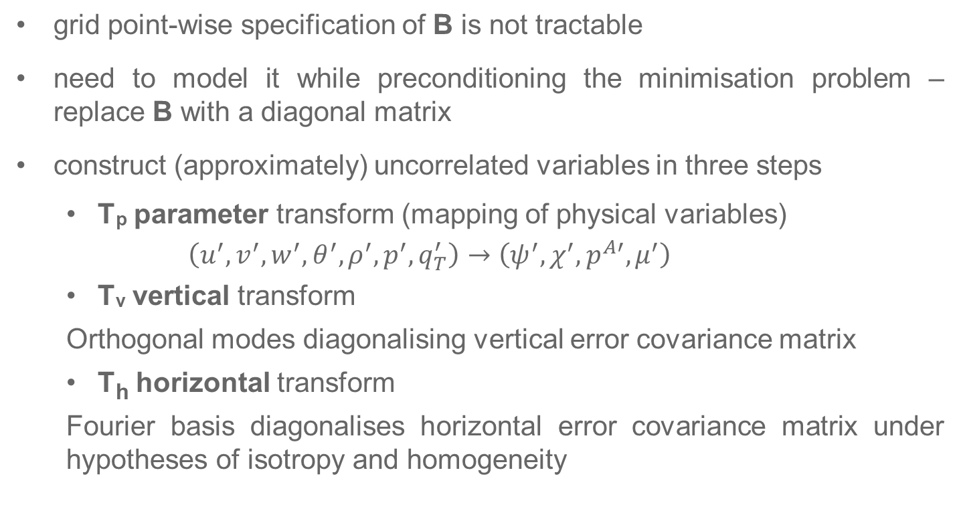
Model representation of background error covariance matrix B
grid point-wise specification of B is not tractable
need to model it while preconditioning the minimisation problem – replace B with a diagonal matrix
construct (approximately) uncorrelated variables in three steps
T_{p} parameter transform (mapping of physical variables)
$$\left(u^{′},v^{′},w^{′},θ^{′},ρ^{′},p^{′},q_{T}^{′}\right)→\left(ψ^{′},χ^{′},p^{A′},μ^{′}\right)$$
T_{v} vertical transform
Orthogonal modes diagonalising vertical error covariance matrix
T_{h} horizontal transform
Fourier basis diagonalises horizontal error covariance matrix under hypotheses of isotropy and homogeneity

Slide 4
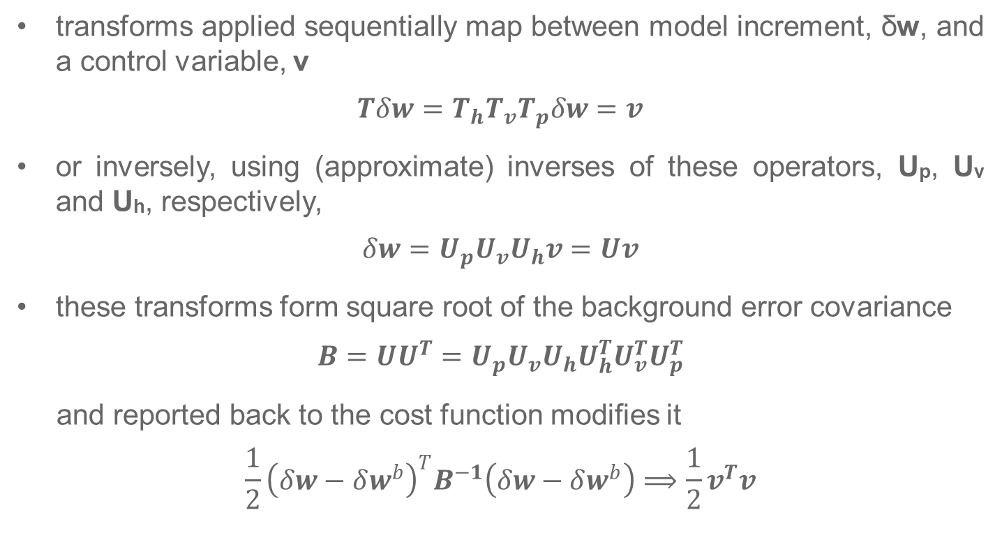
Mappings between model space to control space
transforms applied sequentially map between model increment, δw, and a control variable, v
$$Tδw=T_{h}T_{v}T_{p}δw=v$$
or inversely, using (approximate) inverses of these operators, U_{p}, U_{v} and U_{h}, respectively,
$$δw=U_{p}U_{v}U_{h}v=Uv$$
these transforms form square root of the background error covariance
$$B=UU^{T}=U_{p}U_{v}U_{h}U_{h}^{T}U_{v}^{T}U_{p}^{T}$$
and reported back to the cost function modifies it
$$\frac{1}{2}{\left(δw−δw^{b}\right)}^{T}B^{−1}\left(δw−δw^{b}\right)⟹\frac{1}{2}v^{T}v$$

Slide 5
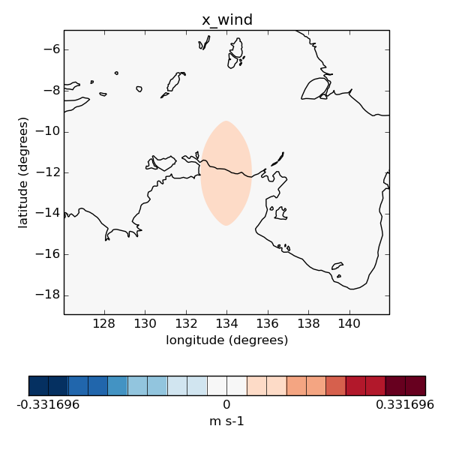
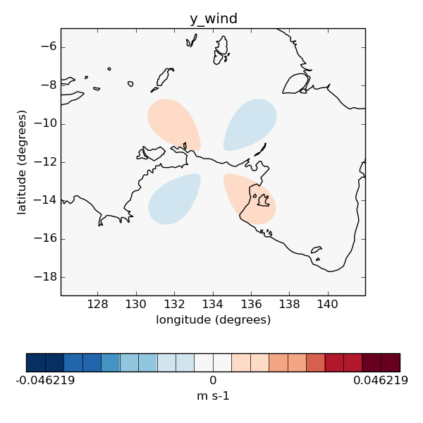
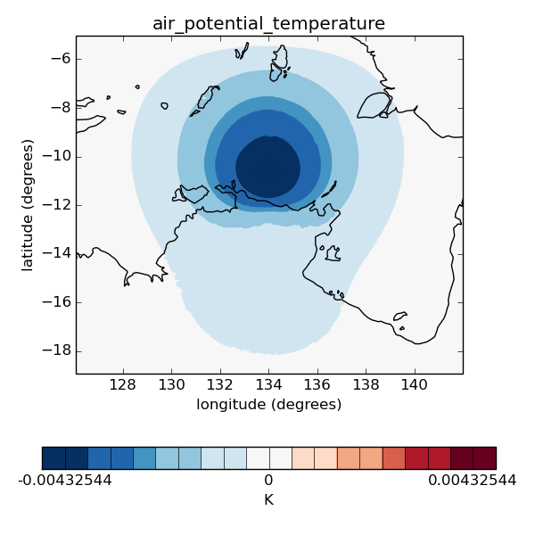
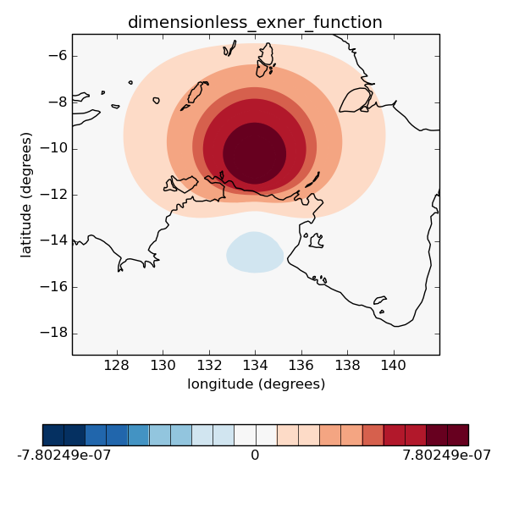
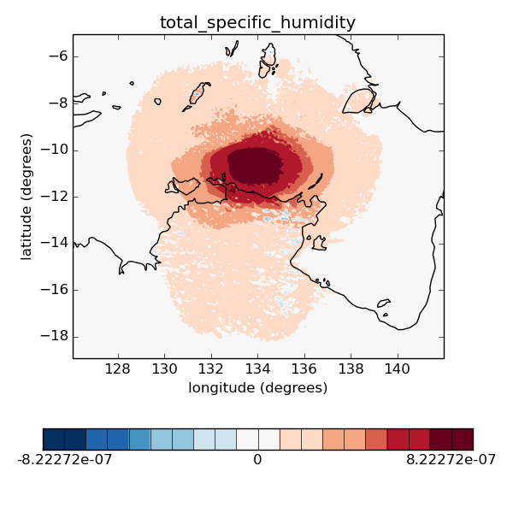
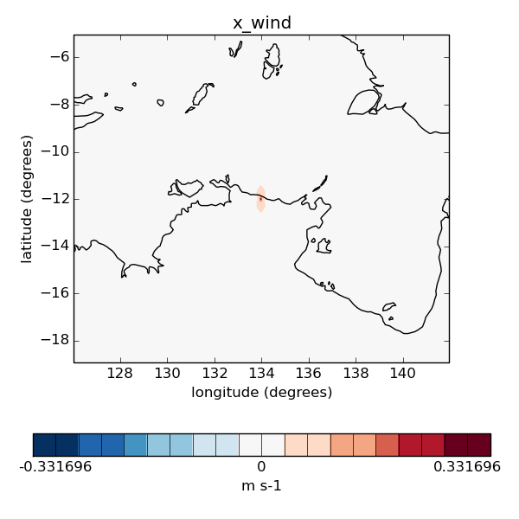
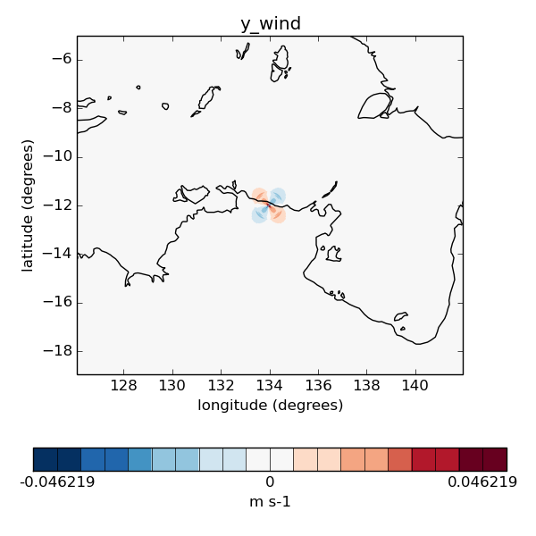
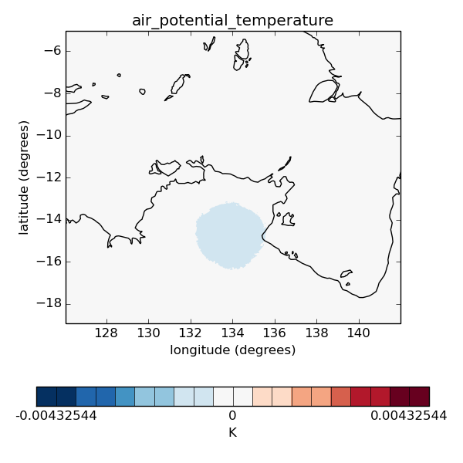
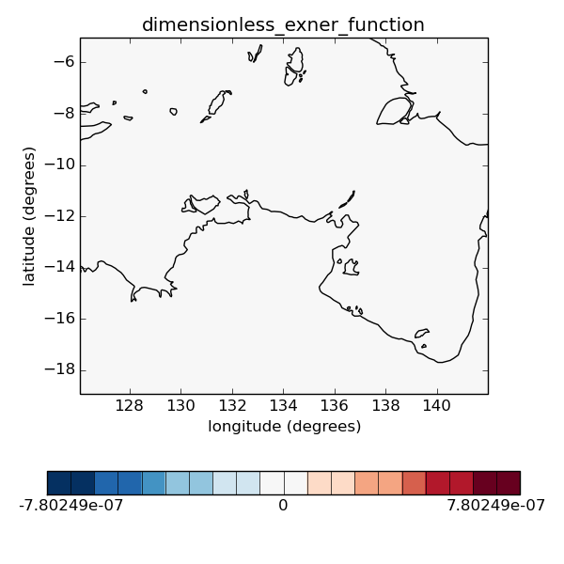
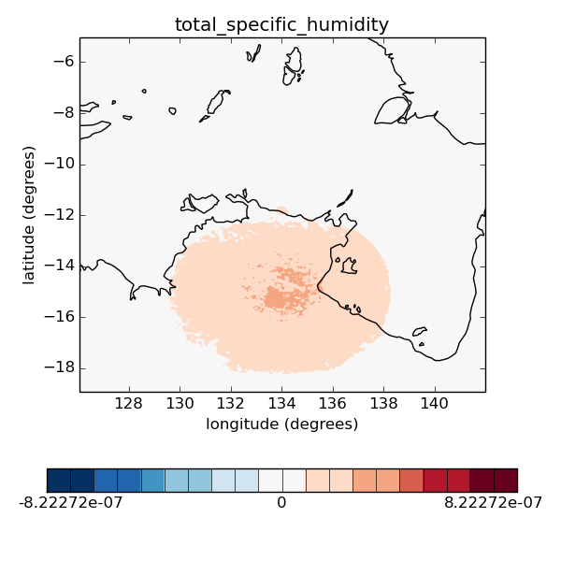


Single observation experiments u observed
Original transform order - vertical transform applied in grid-point space (one vertical covariance matrix averaged throughout the domain)
$$B=U_{p}U_{v}U_{h}U_{h}^{T}U_{v}^{T}U_{p}^{T}$$
u
v
θ
p
q
Swapped transform order – vertical transform applied in spectral space (one vertical covariance model per each horizontal wavenumber)
$$B_{s}=U_{p}U_{h}U_{vs}U_{vs}^{T}U_{h}^{T}U_{p}^{T}$$
Notes:
u is observed at nz=10 which is 452 m
The horizontal cross sections are at z=0
And the day is 2017 01 15 T 0600 Z

Slide 6
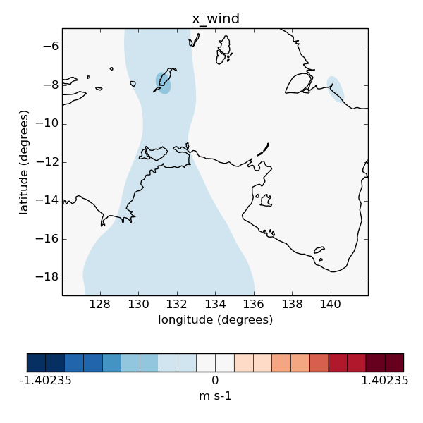
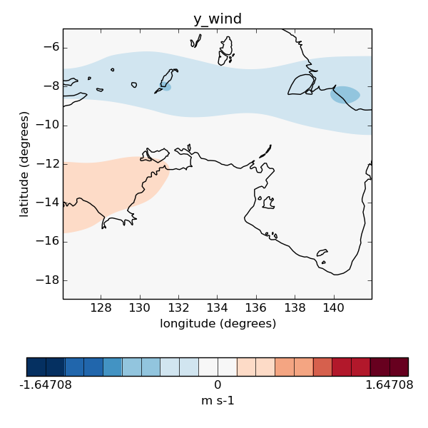
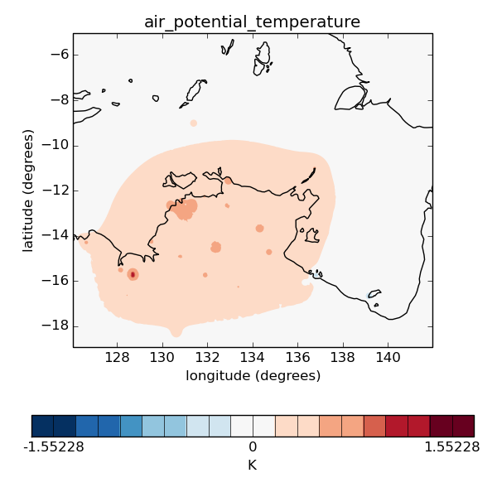
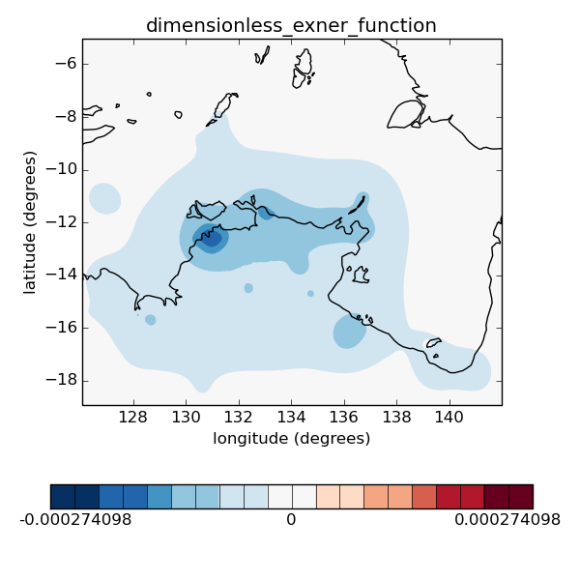
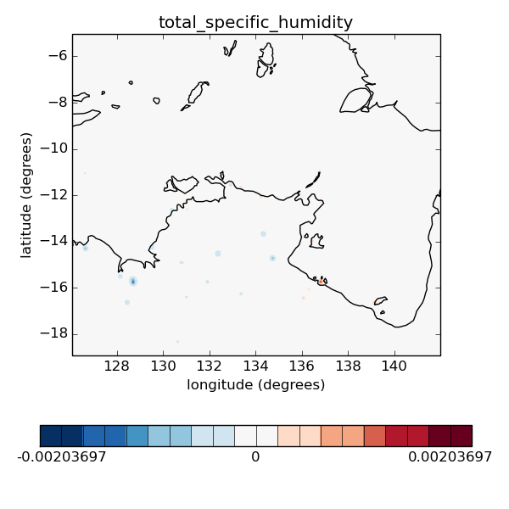
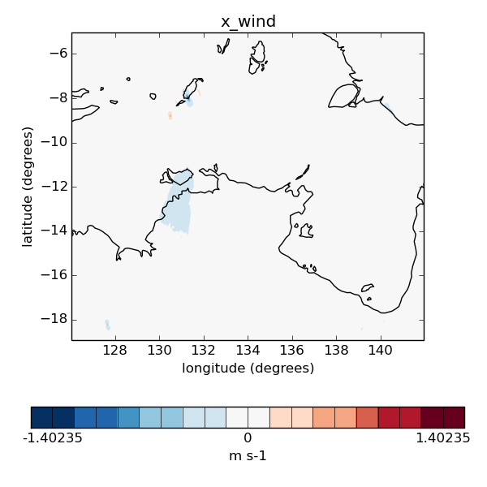
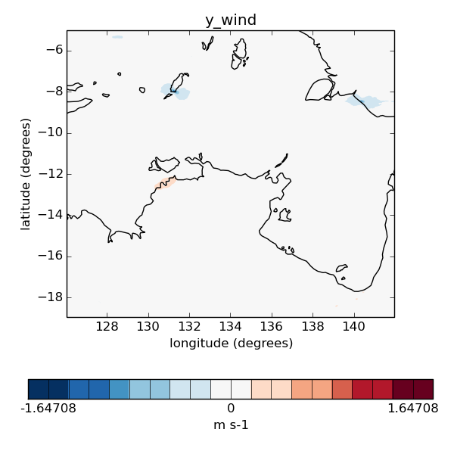
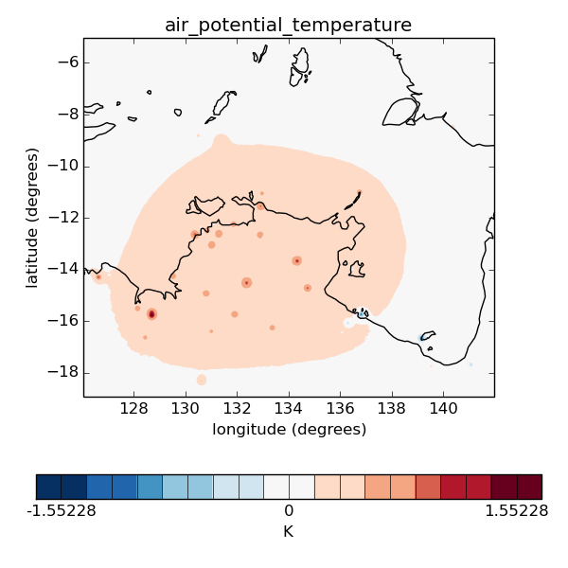
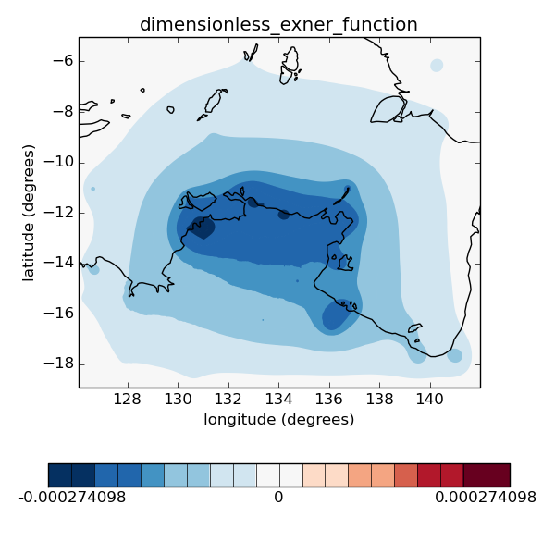
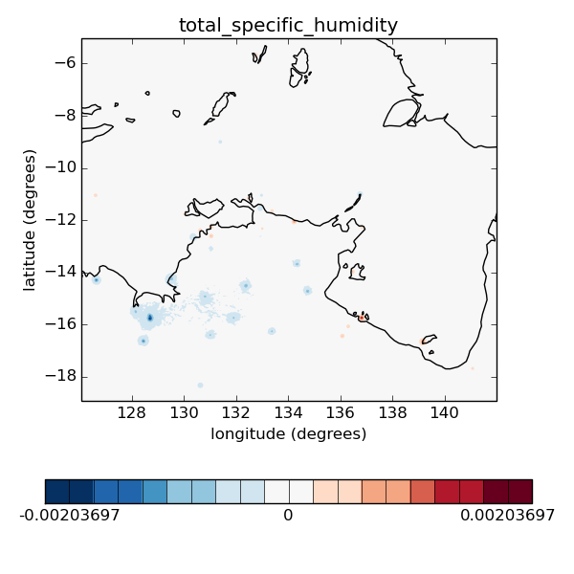
Analysis increments
Original transform order
u
v
θ
p
q
Swapped transform order
Smaller influenced regions

Slide 7
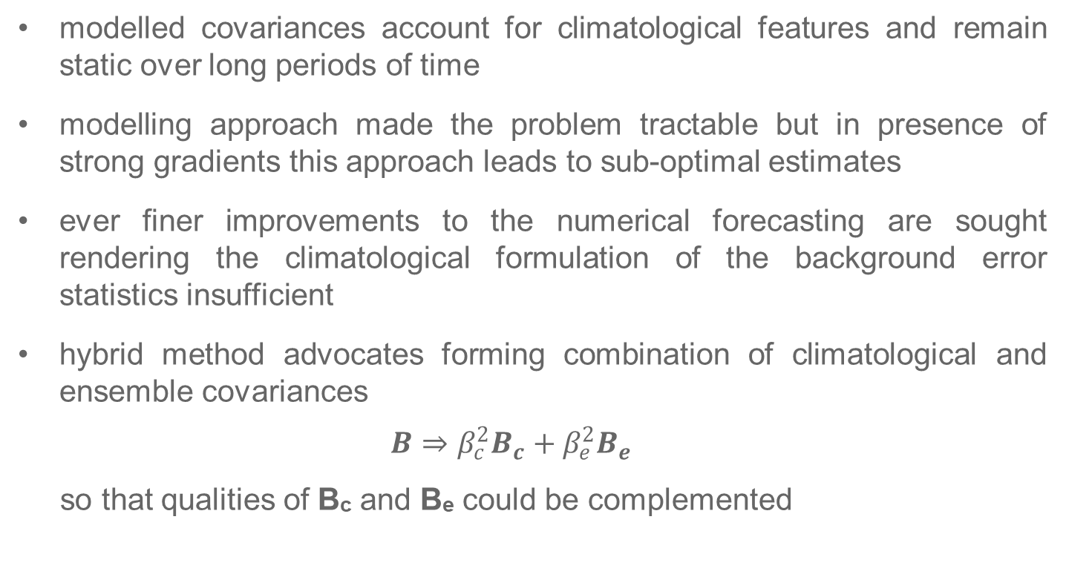
Hybrid method
modelled covariances account for climatological features and remain static over long periods of time
modelling approach made the problem tractable but in presence of strong gradients this approach leads to sub-optimal estimates
ever finer improvements to the numerical forecasting are sought rendering the climatological formulation of the background error statistics insufficient
hybrid method advocates forming combination of climatological and ensemble covariances
$$B⇒β_{c}^{2}B_{c}+β_{e}^{2}B_{e}$$
so that qualities of B_{c} and B_{e} could be complemented

Slide 8
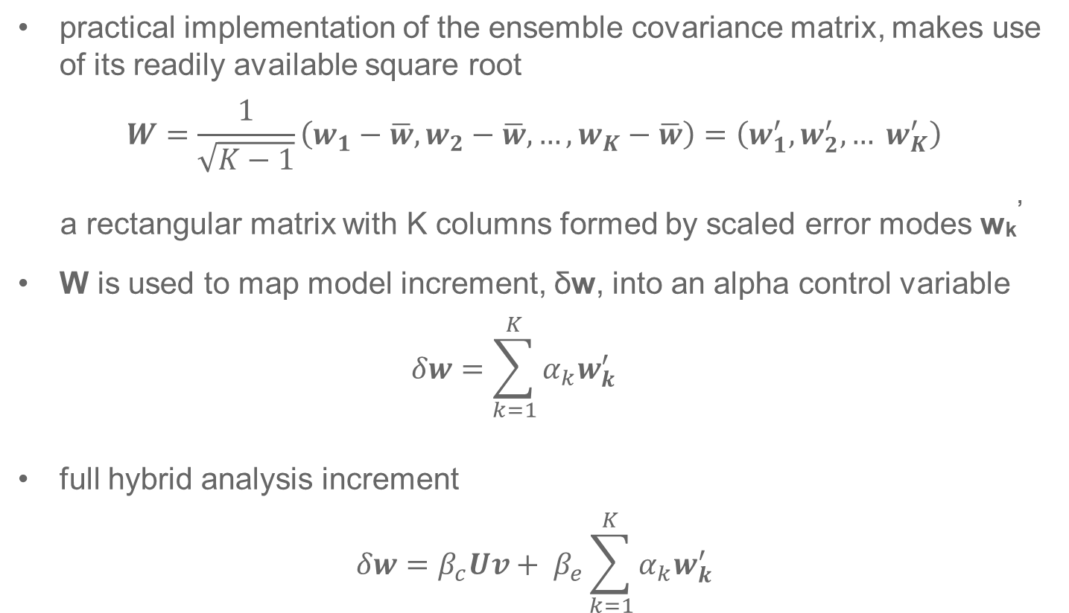
Ensemble covariance matrix
practical implementation of the ensemble covariance matrix, makes use of its readily available square root
$$W=\frac{1}{\sqrt{K−1}}\left(w_{1}−\overline{w}, w_{2}−\overline{w}, …, w_{K}−\overline{w}\right)=\left(w_{1}^{′}, w_{2}^{′},… w_{K}^{′}\right)$$
a rectangular matrix with K columns formed by scaled error modes w_{k}’
W is used to map model increment, δw, into an alpha control variable
$$δw=\sum_{k=1}^{K}{α_{k}w_{k}^{′}}$$
full hybrid analysis increment
$$δw=β_{c}Uv+ β_{e}\sum_{k=1}^{K}{α_{k}w_{k}^{′}}$$

Slide 9
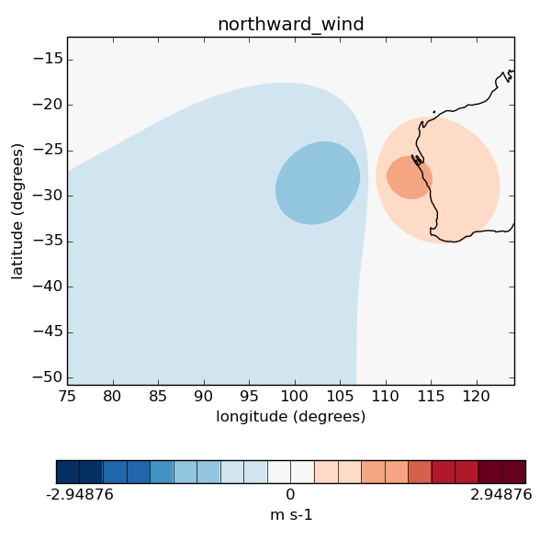
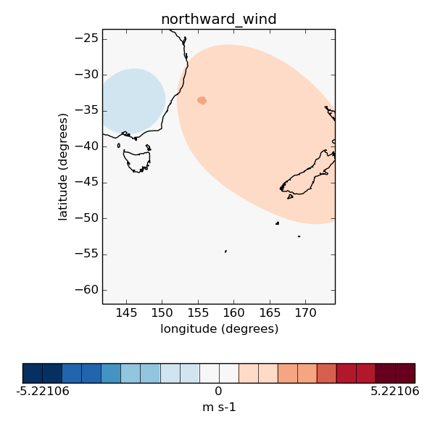
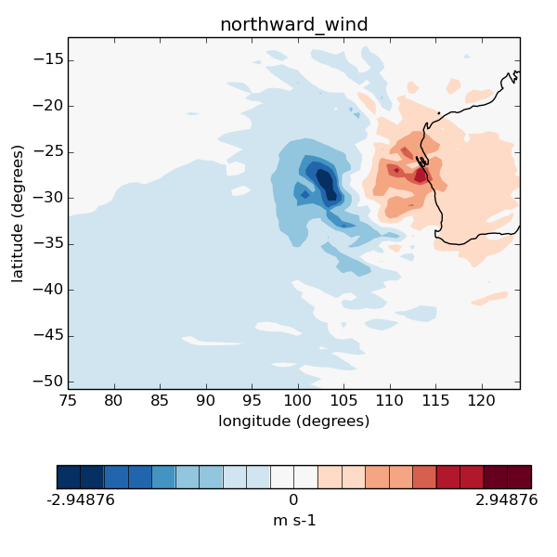
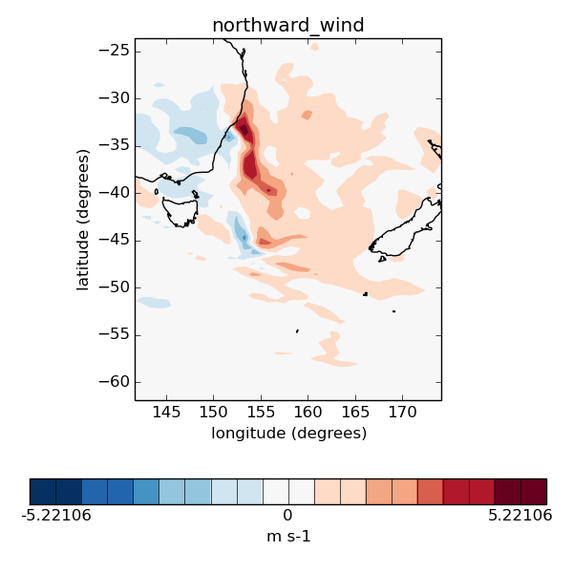
Analysis increments in global hybrid 4d-Var Single observation tests
Standard 4D-Var
with climatological B
Hybrid 4D-Var
with a combination
of B_{c} and B_{e}
Courtesy Xudong Sun

Slide 10
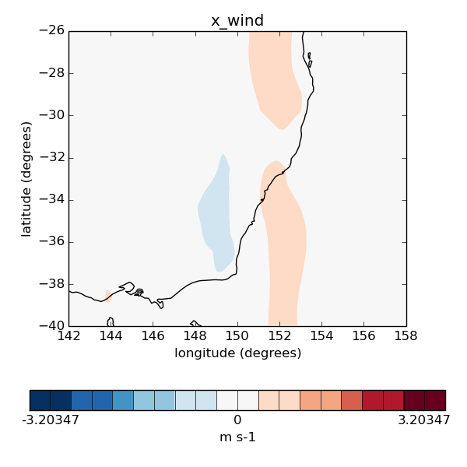
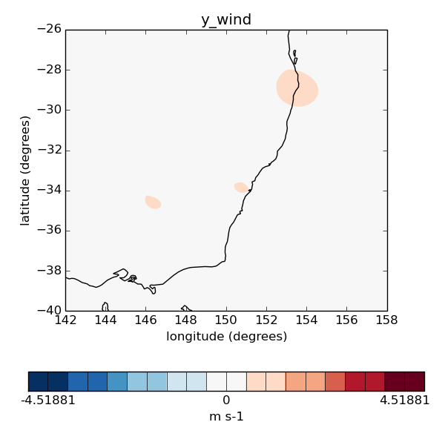
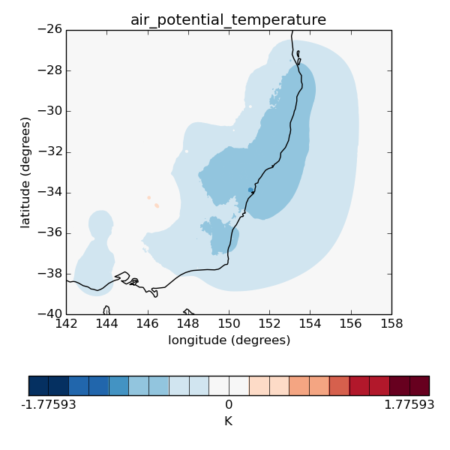
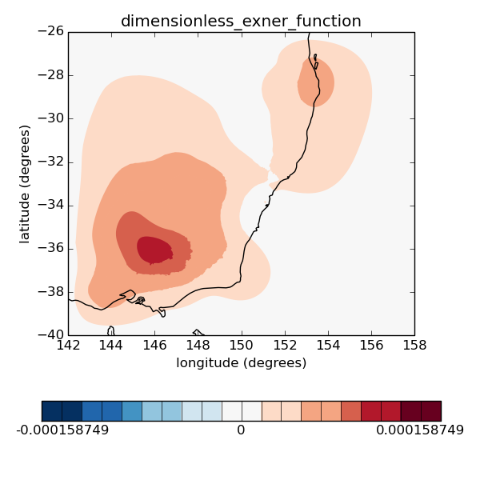
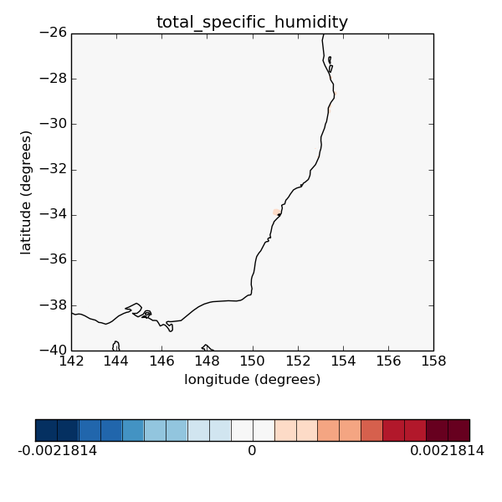
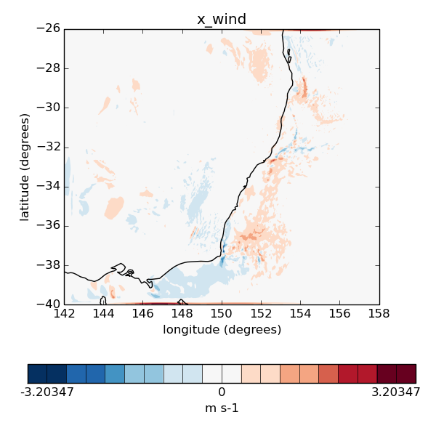
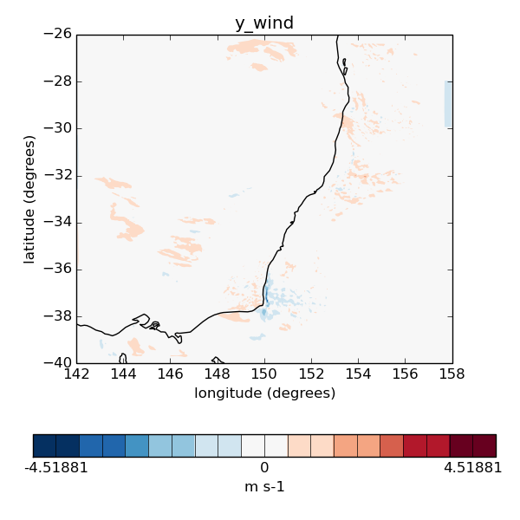
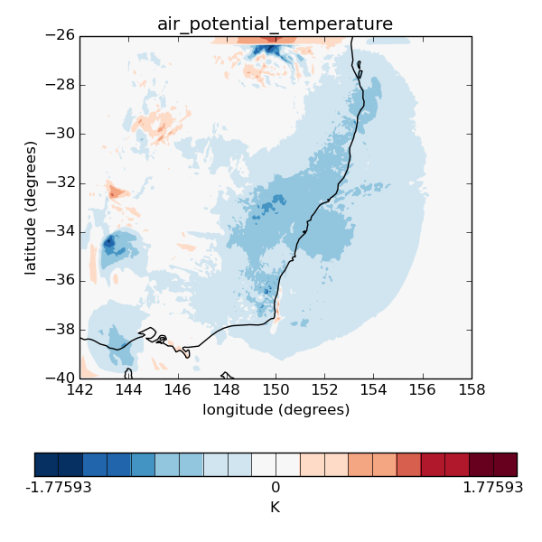
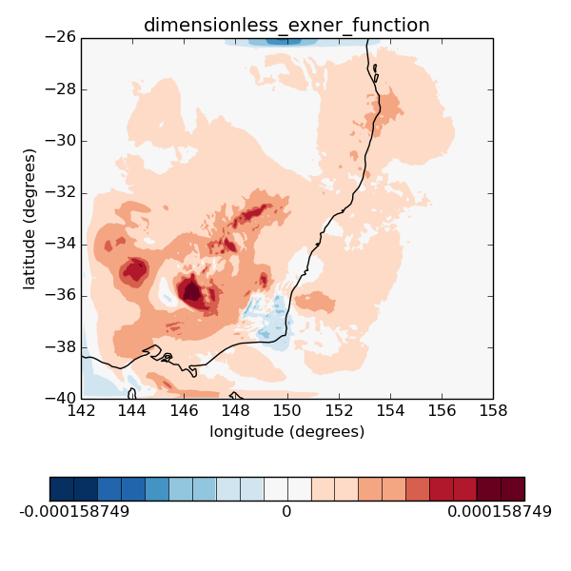
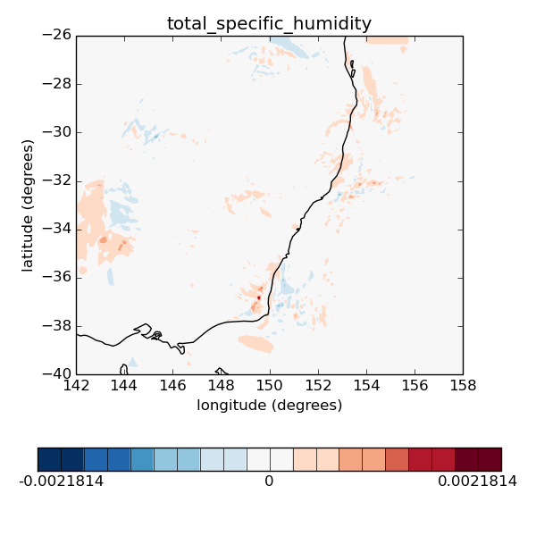
Hybrid analysis increments for a LAM
Climatological B
u
v
θ
p
q
Hybrid B

Slide 11
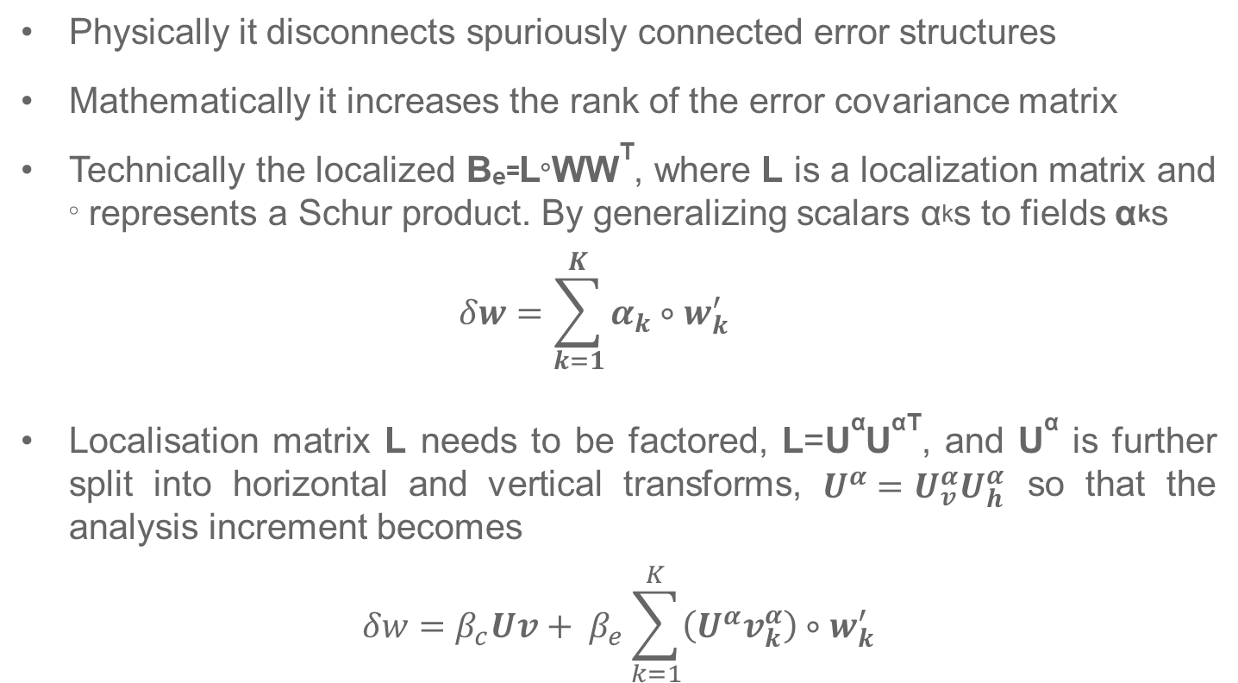
Localisation
Physically it disconnects spuriously connected error structures
Mathematically it increases the rank of the error covariance matrix
Technically the localized B_{e=}L◦WW^{T}, where L is a localization matrix and ◦ represents a Schur product. By generalizing scalars α_{k}s to fields α_{k}s
$$δw=\sum_{k=1}^{K}{α_{k}∘w_{k}^{′}}$$
Localisation matrix L needs to be factored, L=U^{α}U^{αT}, and U^{α} is further split into horizontal and vertical transforms, $U^{α}=U_{v}^{α}U_{h}^{α}$ so that the analysis increment becomes
$$δw=β_{c}Uv+ β_{e}\sum_{k=1}^{K}{\left(U^{α}v_{k}^{α}\right)∘w_{k}^{′}}$$

Slide 12
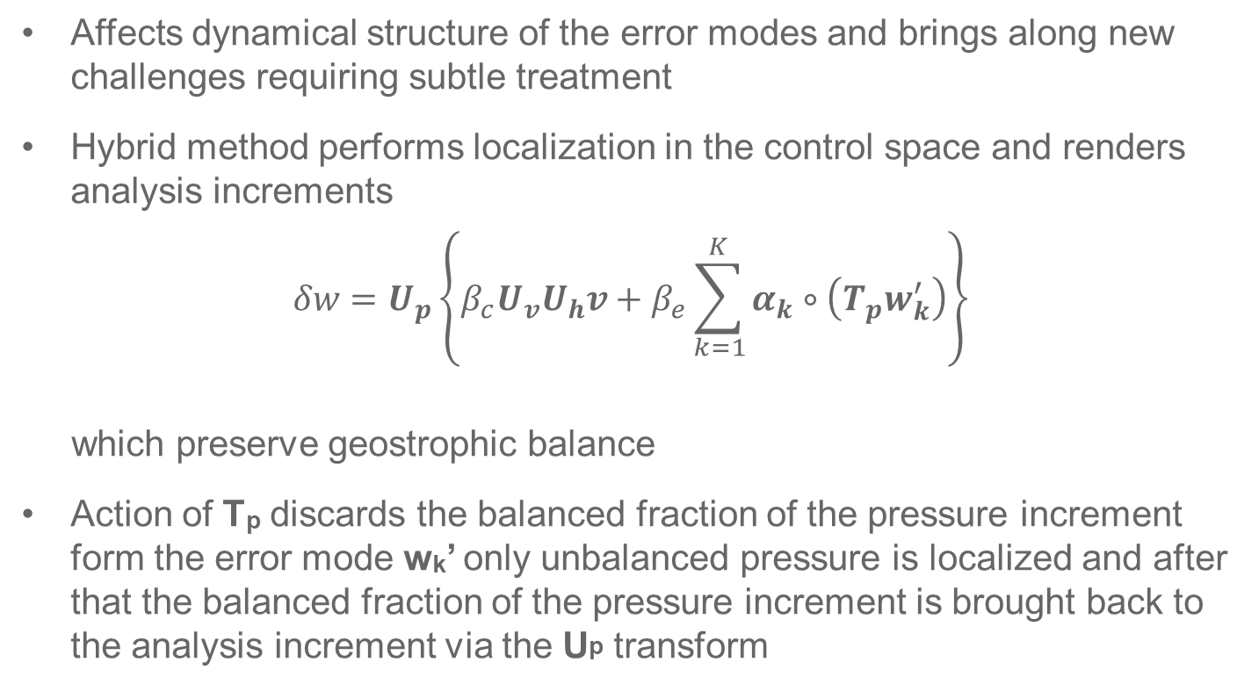
Localisation
Affects dynamical structure of the error modes and brings along new challenges requiring subtle treatment
Hybrid method performs localization in the control space and renders analysis increments
$$δw=U_{p}\left\{β_{c}U_{v}U_{h}v+β_{e}\sum_{k=1}^{K}{α_{k}∘\left(T_{p}w_{k}^{′}\right)}\right\}$$
which preserve geostrophic balance
Action of T_{p} discards the balanced fraction of the pressure increment form the error mode w_{k}’ only unbalanced pressure is localized and after that the balanced fraction of the pressure increment is brought back to the analysis increment via the U_{p} transform

Slide 13
Implementation at BoM
default hybrid in the upcoming global operational system, G3/GE3
at present, one-way coupling of the city system, C3/CE3: C3 provides high resolution analysis to form a high resolution initial condition for the CE3 system but no ensemble feedback is brought back to C3
hybrid will be a two-way coupling as CE3-like ensemble will be used to build B_{e} which will be employed in variational data assimilation in a C3-like system
BoM is actively working on porting a hybrid capability for a limited area model as developed at the Korea Meteorological Administration
initial implementation will be connected to the C3/CE3 system in an off-line mode using the ensemble members as precalculated by CE3
an option for an on-line generation of the ensemble members is available.
both hourly 3D-Var and hourly 4D-Var will be supported
Notes:
the operating environment and the system components are shared so that ultimately a two-way feedback system could be developed

Slide 14
Thank you

Slide 15
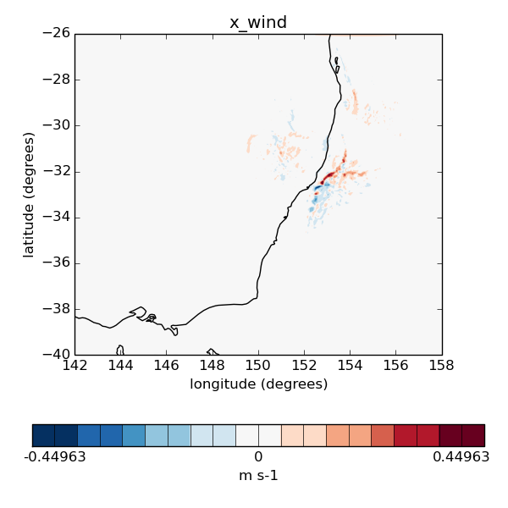
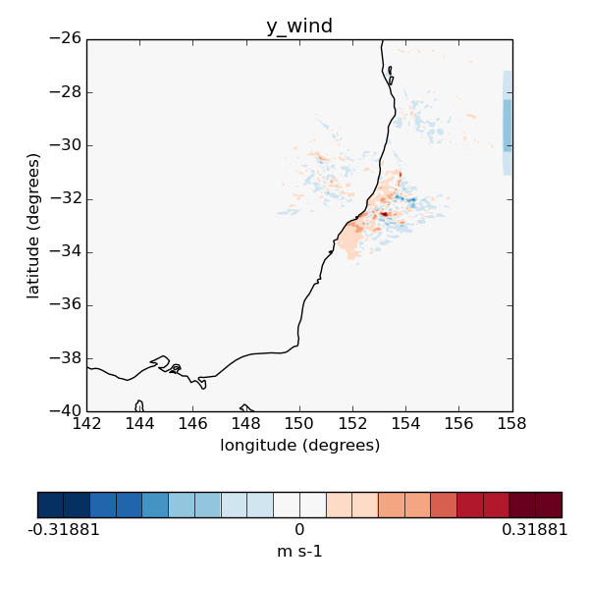
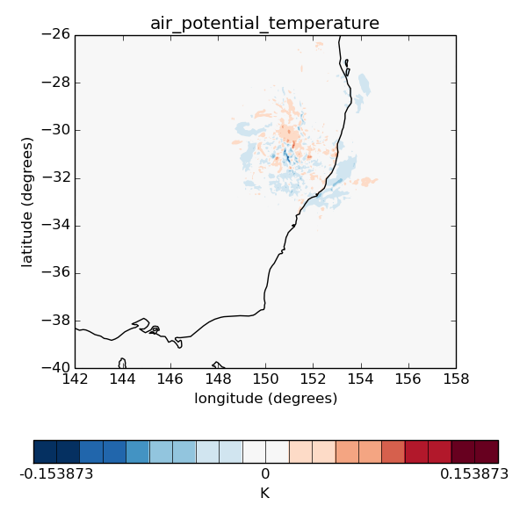
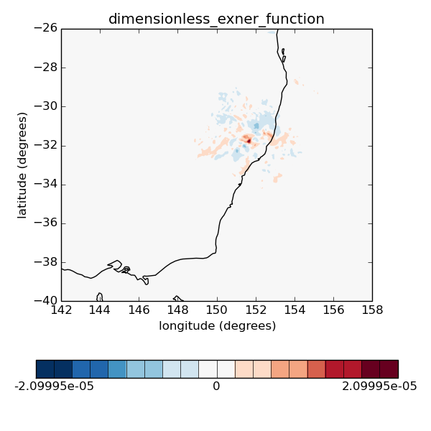
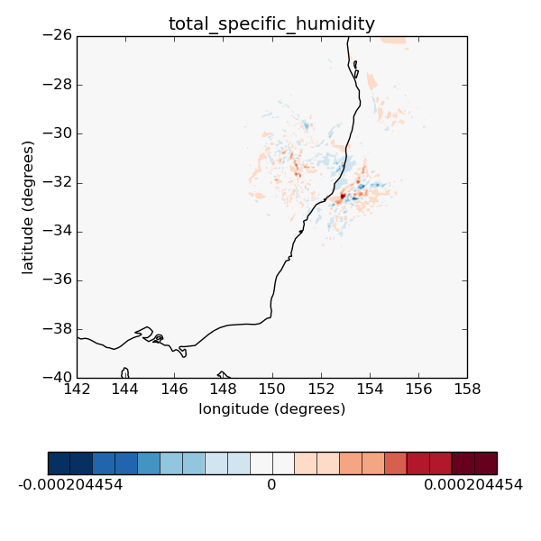
Hybrid single observation experiments
Hybrid transform order

