Slide 1
STEPS radar rainfall nowcasting
Carlos Velasco, Mark Curtis, Sandy Dance, Alan Seed
Science to Services
Bureau of Meteorology

Slide 2

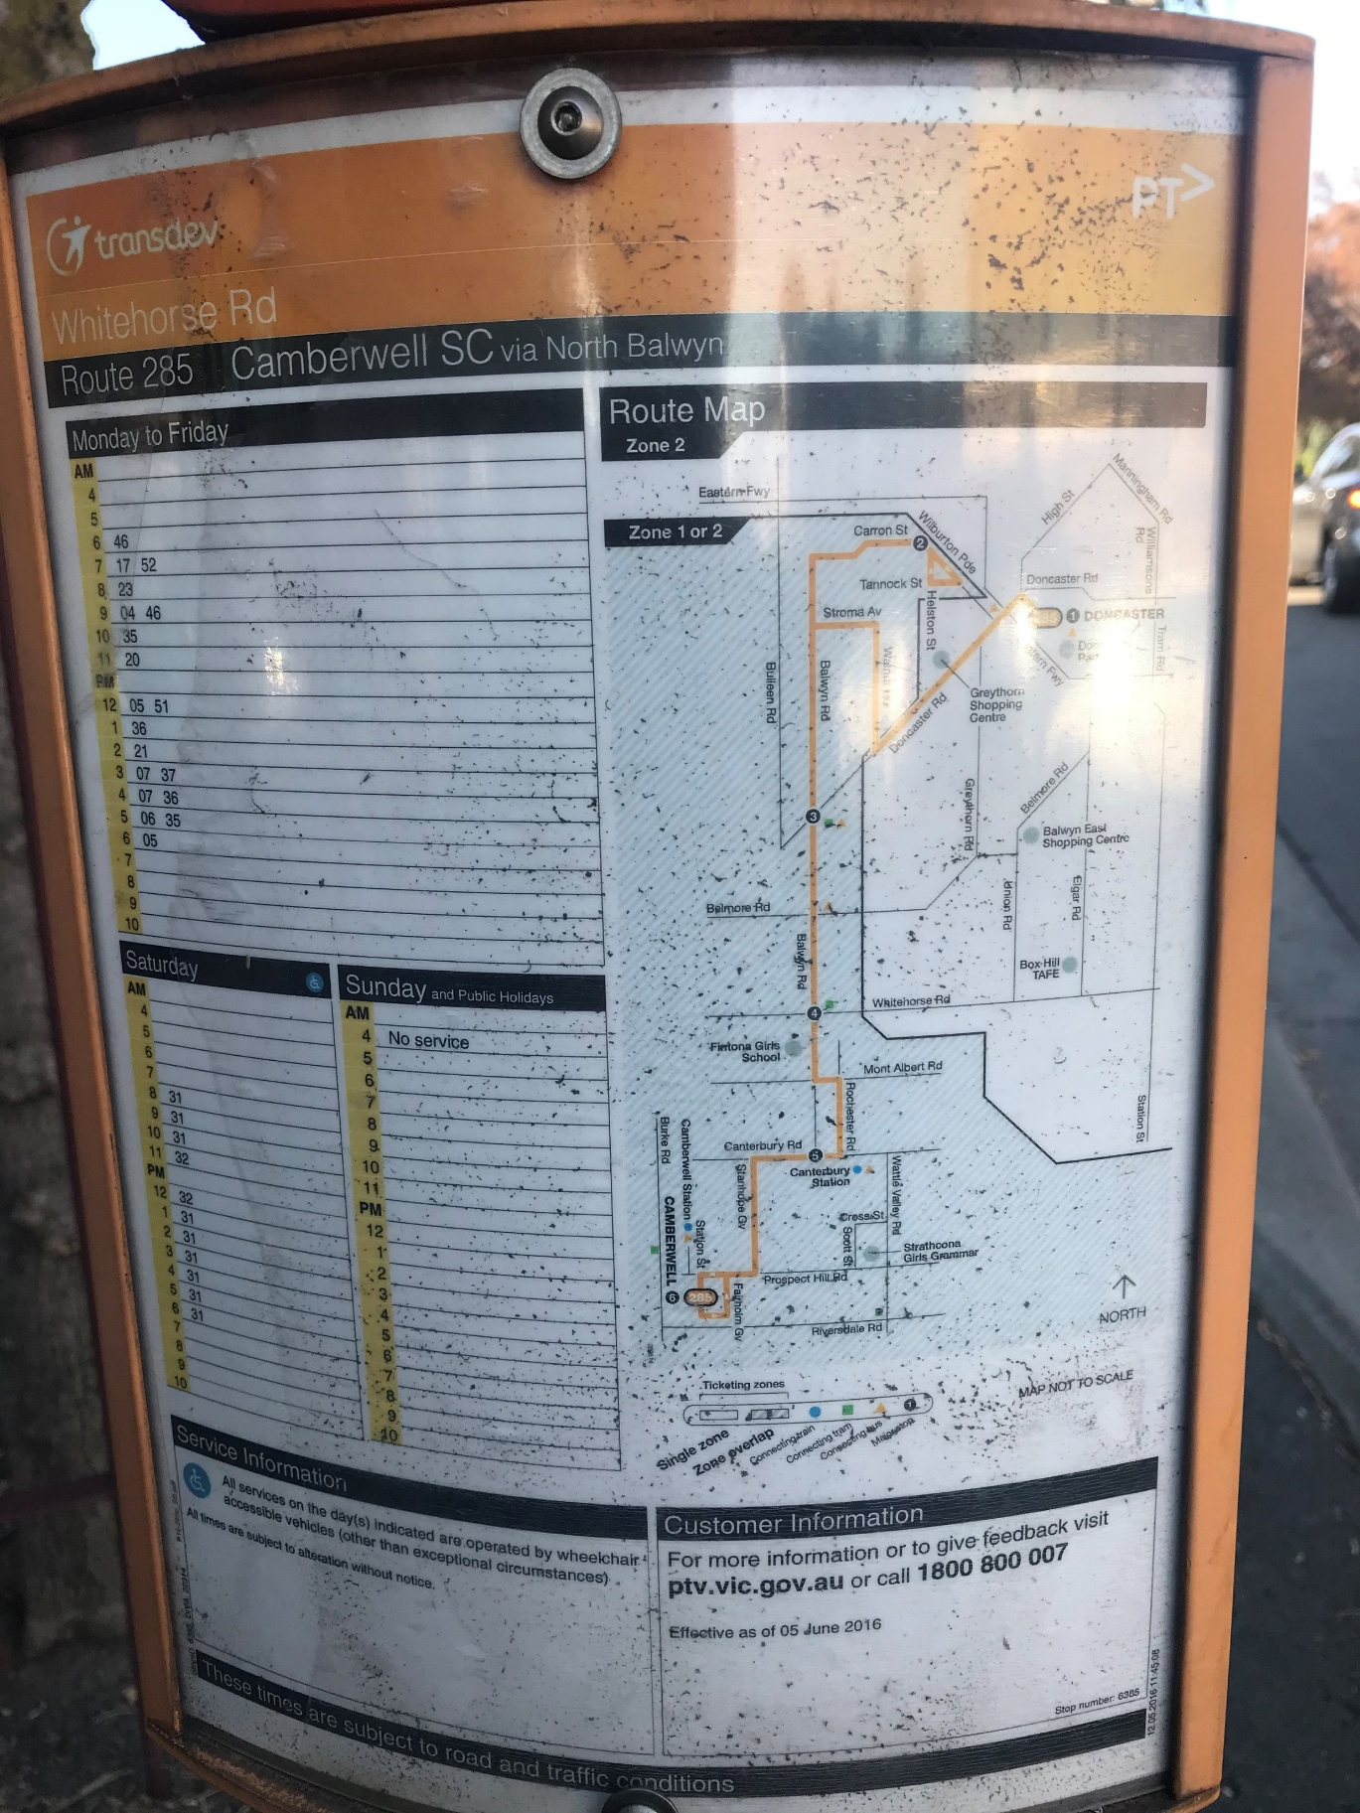
Climate
Nowcasting

Slide 3
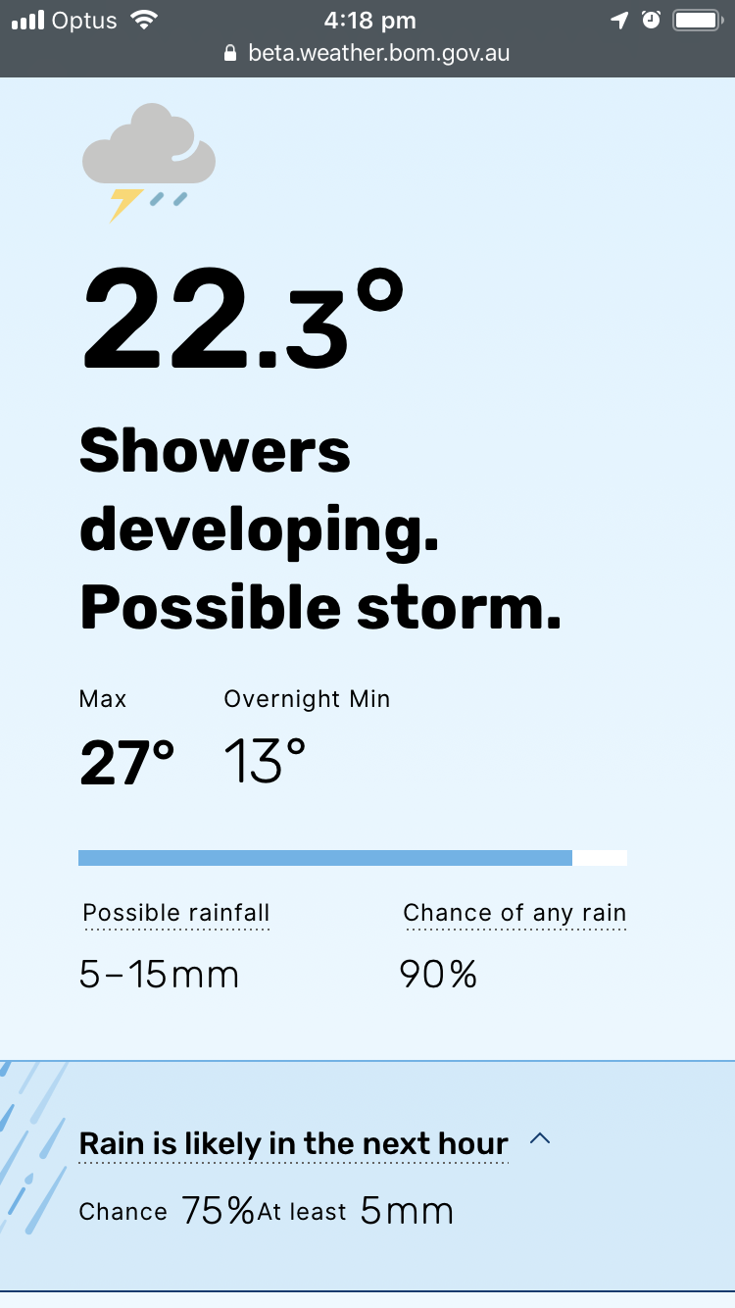
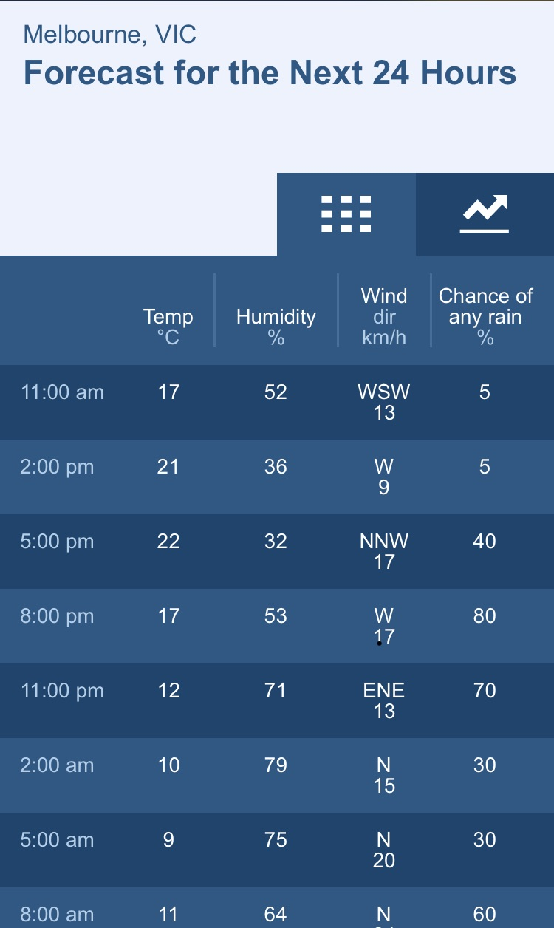
Forecasting
Nowcasting
NOWCASTING

Slide 4
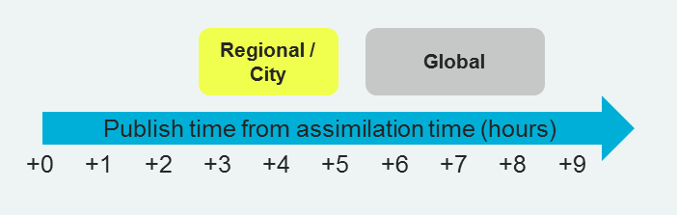
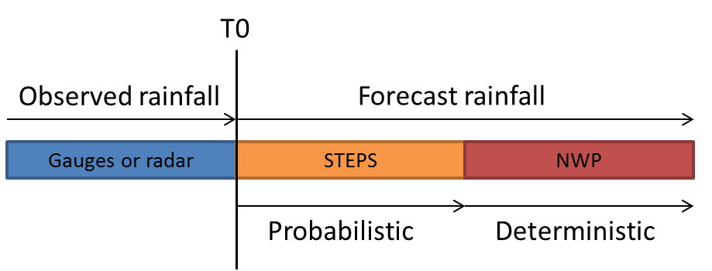
Some advantages of Nowcasting (STEPS)
Continuous Updates
Data Assimilation every 5-10 minutes
Short time steps (minutes)
Rapid delivery of new forecasts
A new set of forecasts every 5-10 minutes
Blend multiple sources of information (radar, NWP, satellite)
Suitable for hydrological purposes
Including flash flooding
Large number of members can be calculated
Statistical method
Suitable for parallel computations
QPN

Slide 5
STEPS implementations at the Bureau
System | Lead time | # domains | size | resolution | members | update
Radar | 120 min | 4 | 250 km | 0.5 km 5 min | 30 | 5 min
Radar+ NWP | 12 h | 9 | 512 km | 1 km 10 min | 30 | 10 min
Seamless | 5 days | 16 | 1000 km | 2 km 1 h | 32 | 6 h

Slide 6
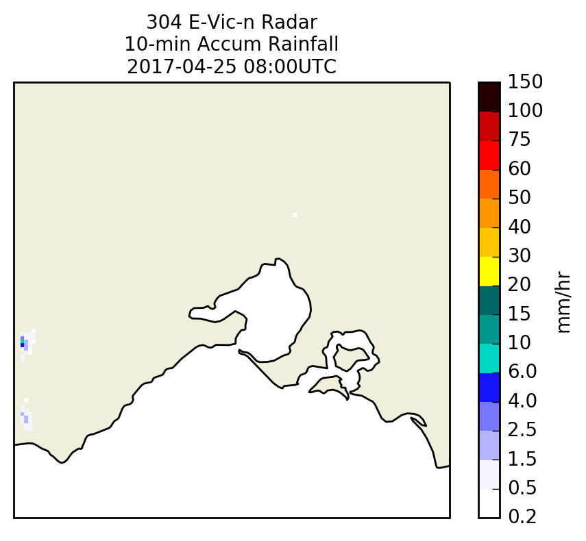
Observed
Observed Rainfall (Rainfields)
from 0800UTC to 1120UTC
MEMBER #1
STEPS forecast rainfall
from 0940UTC to 1120UTC
STEPS: Short Term Ensemble Prediction System
Nowcasting- Radar only – up to 90 minutes
Notes:
The forecast rainfall field looks like rain and can be used to force hydrological models and calculate probabilities

Slide 7
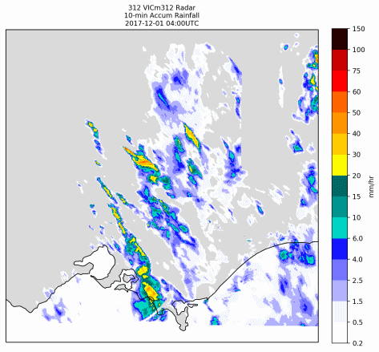
Observed Rainfall (Rainfields)
Multi-radar mosaic
from 0400UTC to 0500UTC
(Radar rainfall data only available inside red outlined area)
STEPS (NWP + Radar) forecast rainfall
from 0500TC up to 12 hours ahead
(Only first 4 hours of forecast rainfall showed in the animation)
(NWP rainfall predictions help to fill areas without radar data and extend QPN duration)
STEPS: Short Term Ensemble Prediction System
Nowcasting (Radar + NWP) – up to 12 hours
Notes:
The forecast rainfall field looks like rain and can be used to force hydrological models and calculate probabilities

Slide 8
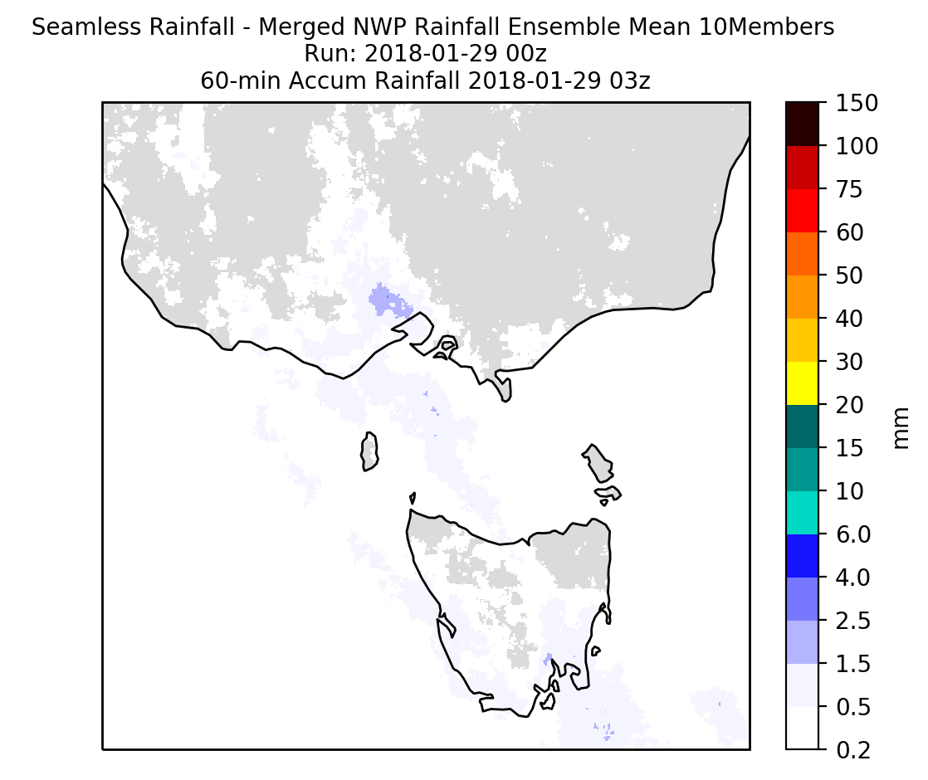
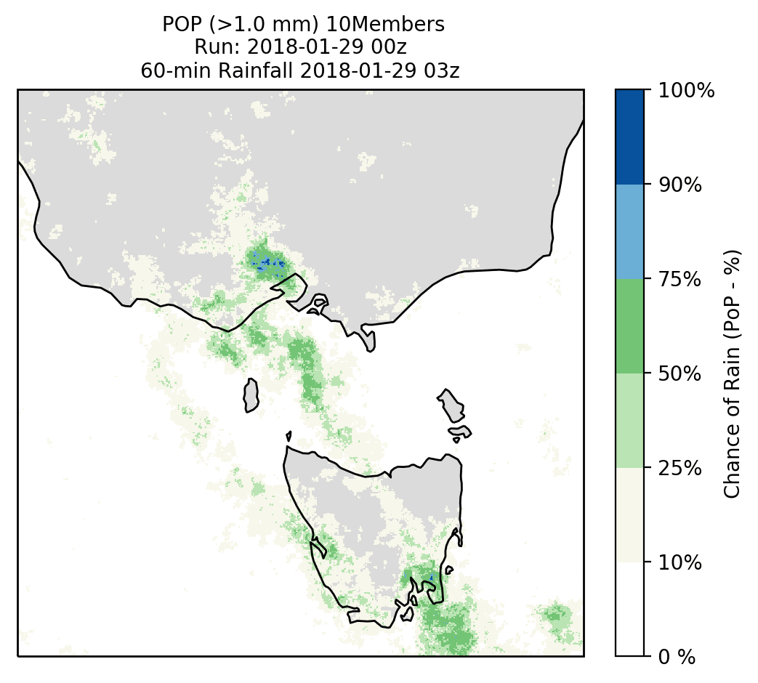
Seamless Rainfall Ensembles – R&D Testing – Examples
Blending ACCESS-R and ACCESS-G NWP rainfall forecasts
1000 x 1000 km at 2km pixels – Hourly rainfall - Up to 5 days ahead
10 members Rainfall ensemble
Mean Hourly Rainfall
Probability of Precipitation
Run: 2018 01 29 00z

Slide 9
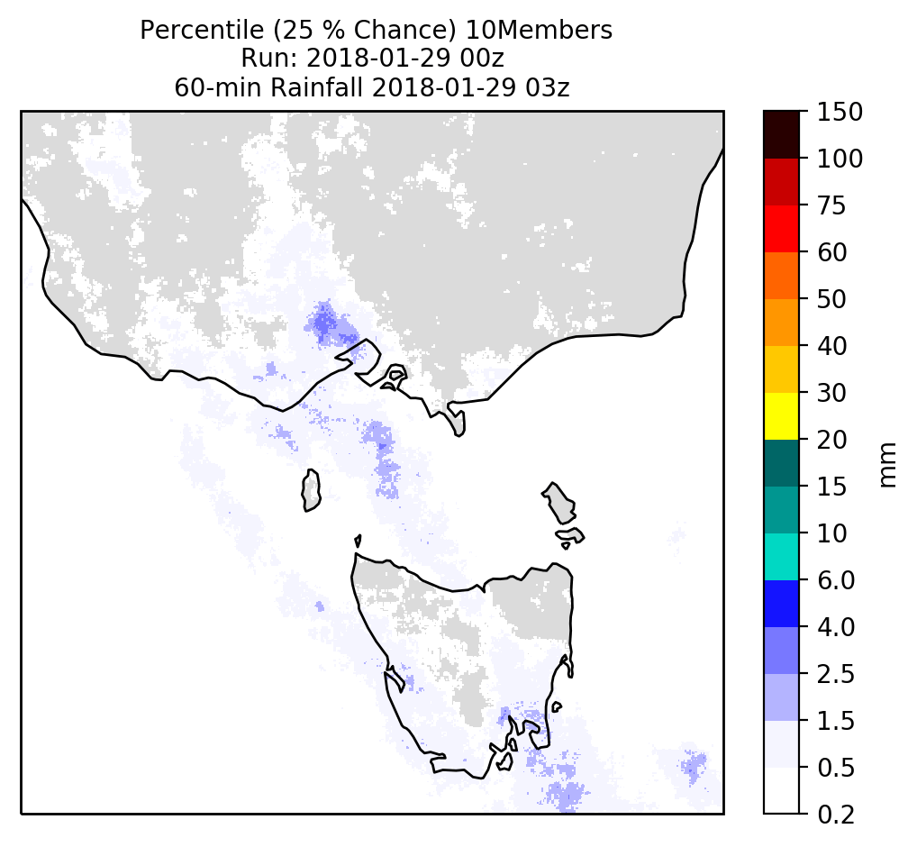
Seamless Rainfall Ensembles – stage
Blending ACCESS-R and ACCESS-G NWP rainfall forecasts
1000 x 1000 km at 2km, 1 h resolution out to 5 days
32 member ensemble
Mean Hourly Rainfall
25% Chance of more than
Run: 2018 01 29 00z

Slide 10
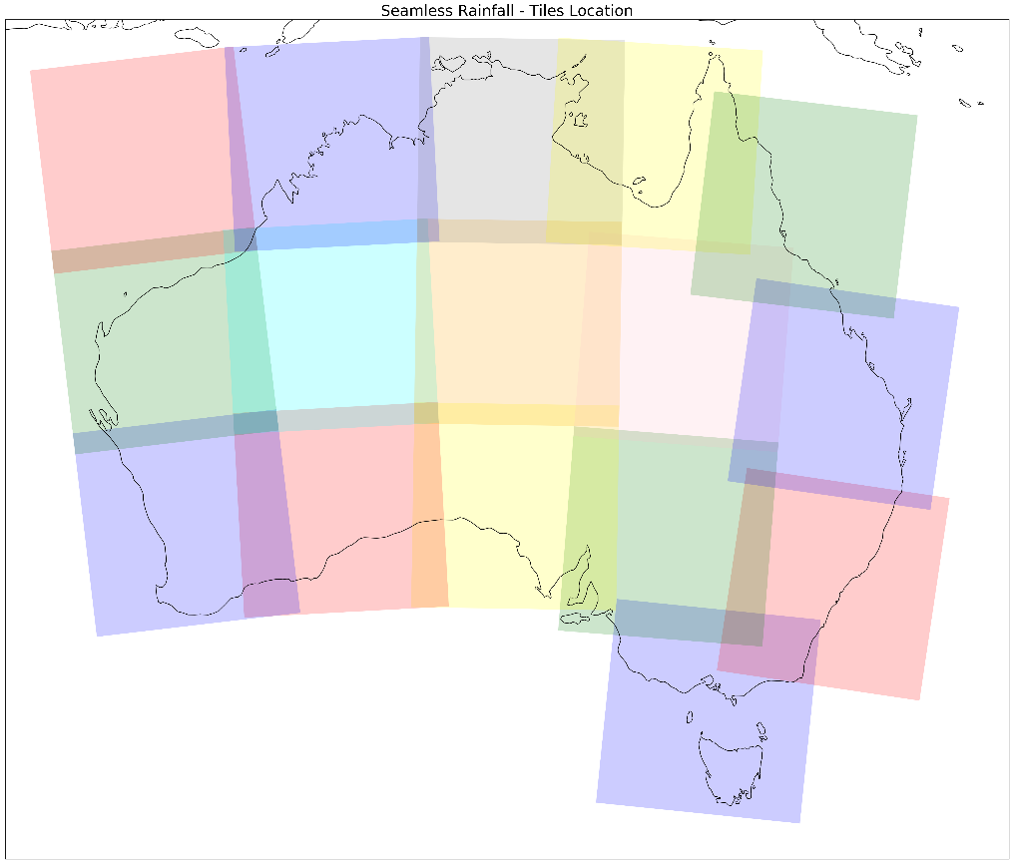
Seamless Rainfall Ensembles – 16 Domains
Development Tiles

Slide 11
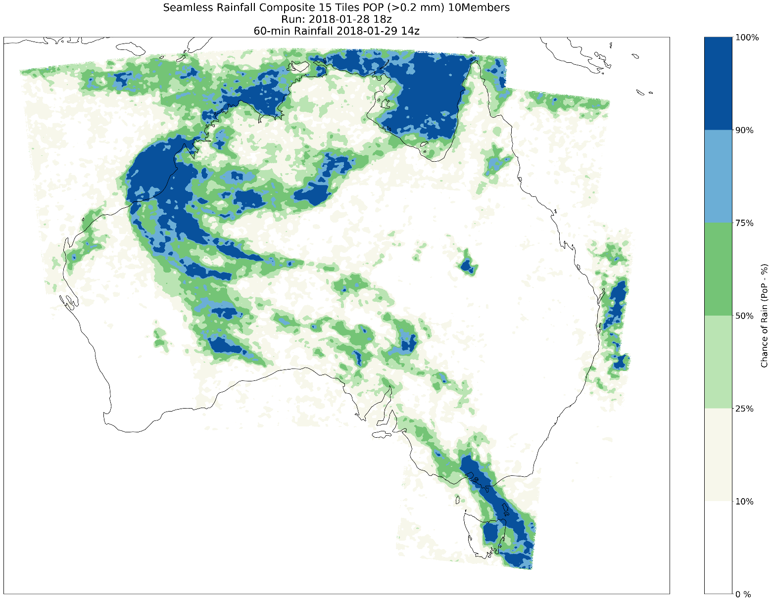
Seamless Rainfall Ensembles – R&D Testing – Examples
Development Tiles
Seamless Rainfall
16 Tiles – 10 Members
PoP (>0.2 mm)

Slide 12
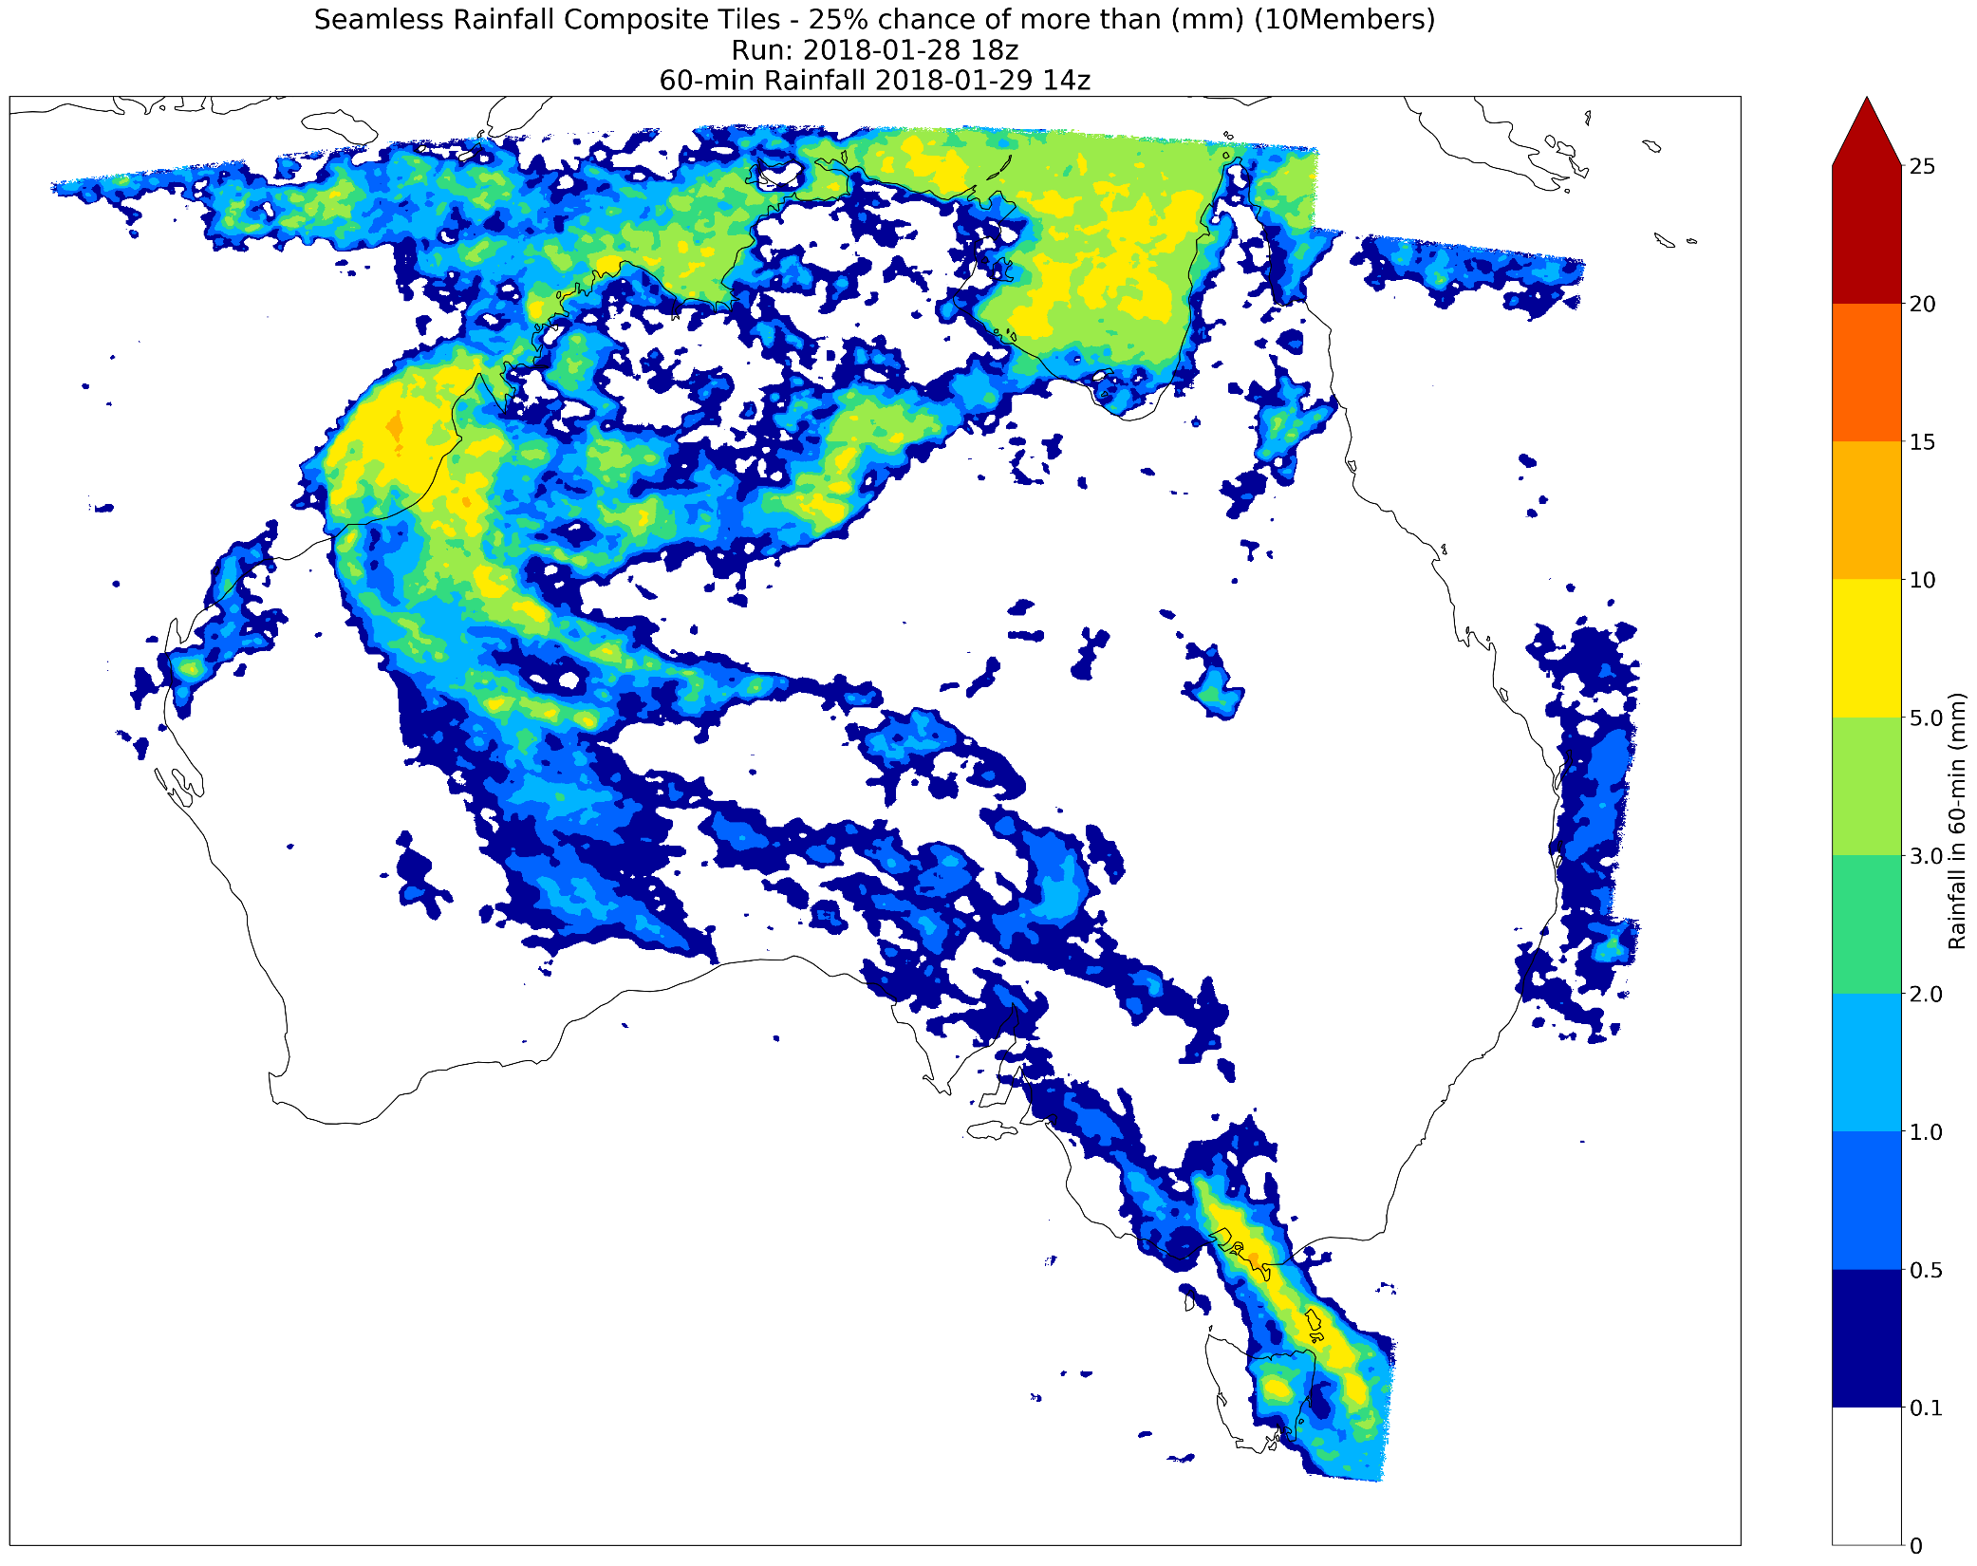
Seamless Rainfall Ensembles – R&D Testing – Examples
Development Tiles
Seamless Rainfall
16 Tiles – 10 Members
Percentile 25%

