Slide 1
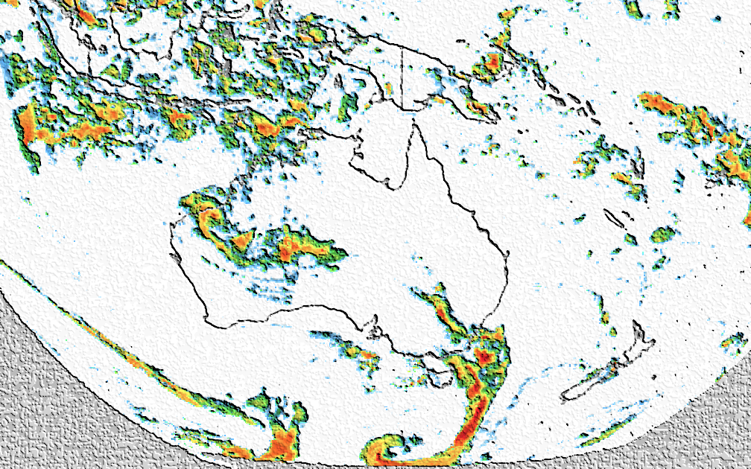
Continental rainfall ensembles derived from multi-source blended analysis
Luigi Renzullo ¹, Carlos Velasco ², Alan Seed ², Beth Ebert ², Leon Majewski ², Mark Broomhall ², Albert van Dijk ¹, Pablo Rozas-Larraondo ¹, & Siyuan Tian ¹
¹ Australian National University, Canberra ACT
² Bureau of Meteorology, Melbourne Vic.

Slide 2
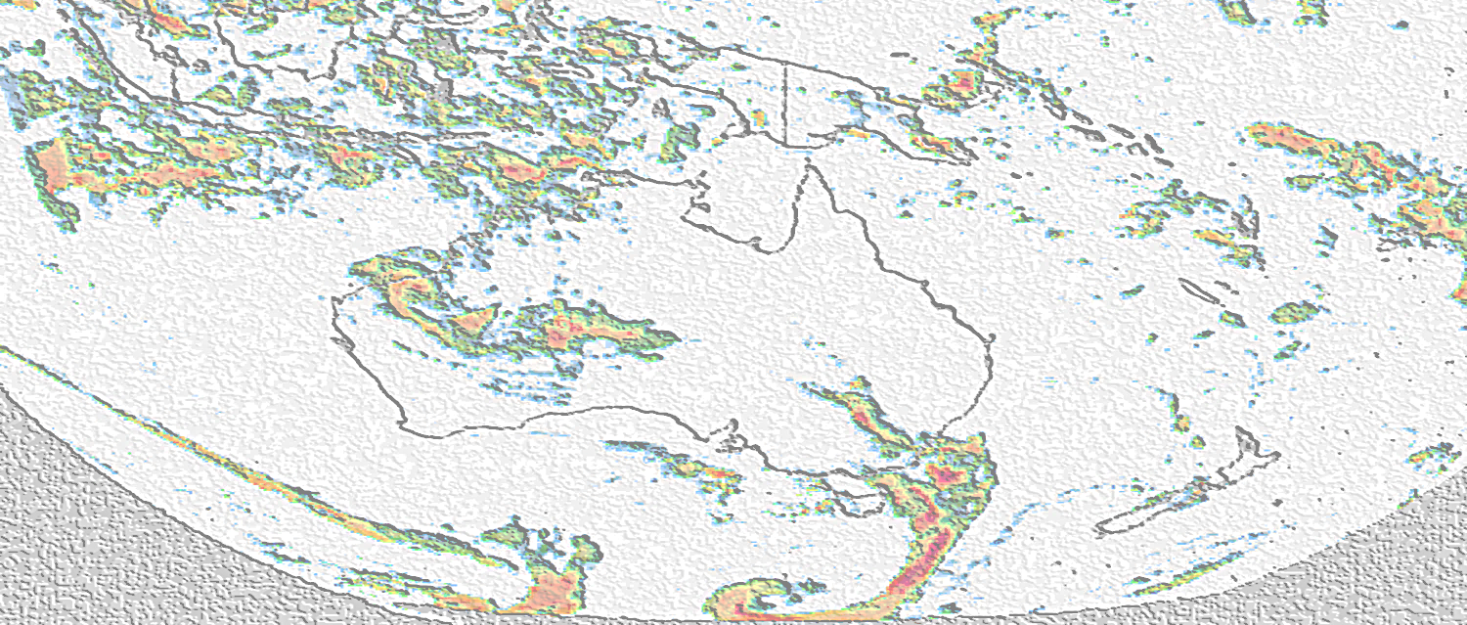
Outline
Background
  WIRADA project 2016-17
National-scale real-time blended rainfall analysis
  Current thinking about sources data & blending methods
Ensemble generation
  Perturbed analysis with noise
Next steps
  Method development

Slide 3
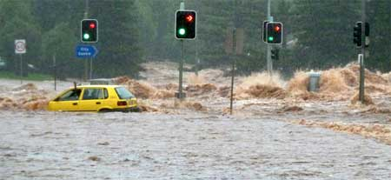
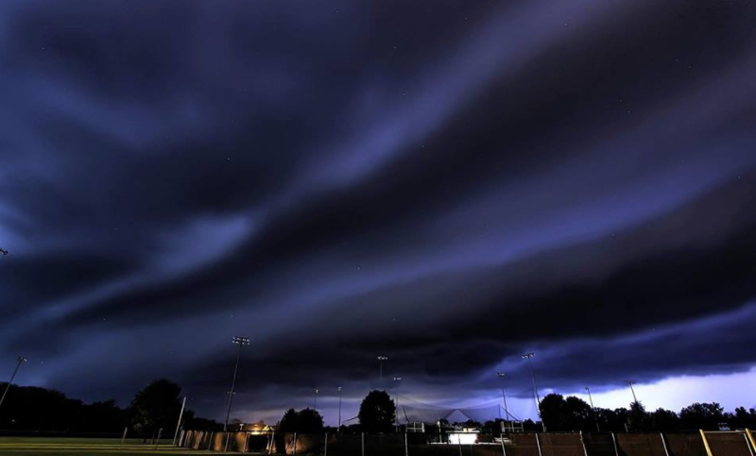
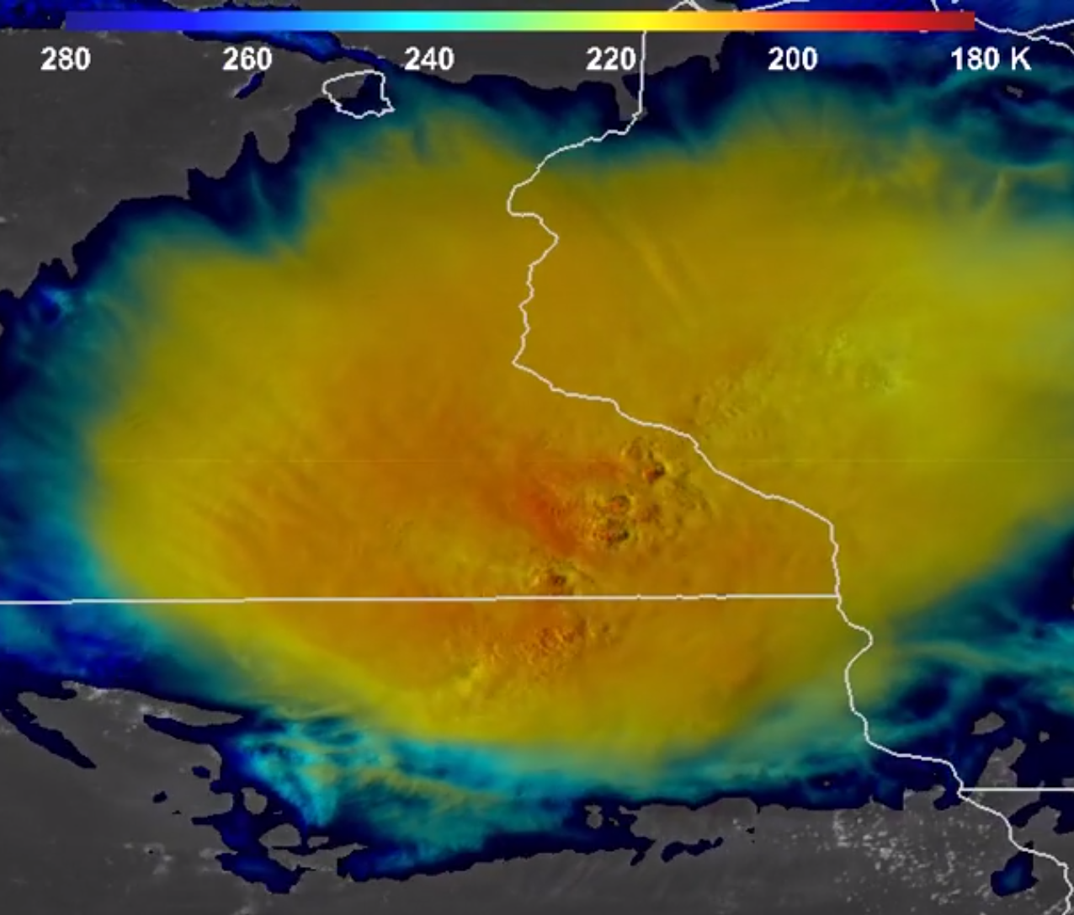
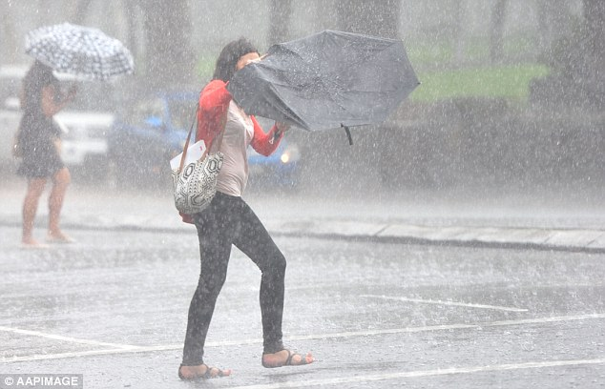
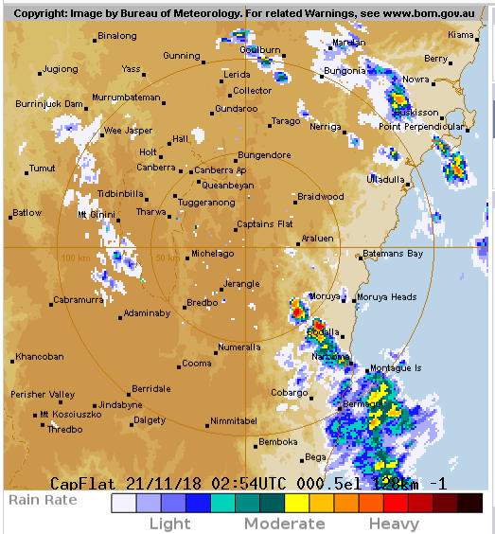
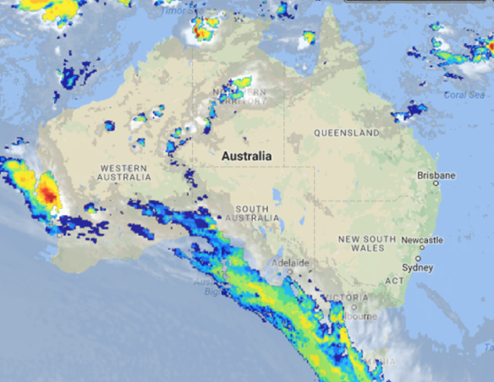
Background
Why do we need real-time national rainfall?
Urgency
Input for riverine and flash-flood forecasts
Estimating and predicting storm severity
Provide timely advice to all Australians
Verify model performance
Subdaily (~hourly) rainfall for process studies
WIRADA project objective: explore candidate data & develop method for blending multiple sources of rainfall information to produce real-time & near real-time gridded rainfall analyses for Australia
~60-min accum. updates every 30 min
Ensembles spatially explicit representation of rainfall uncertainty
Accurate representation of rainfall spatial structure

Slide 4
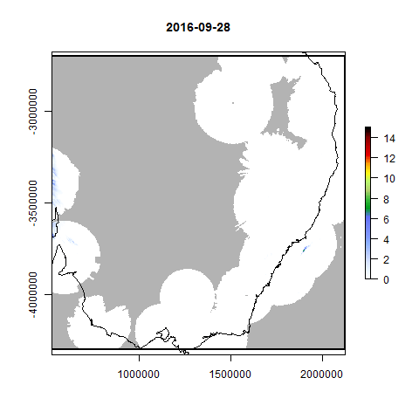
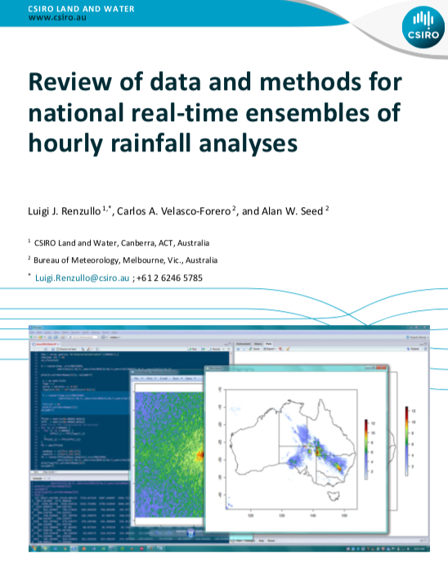
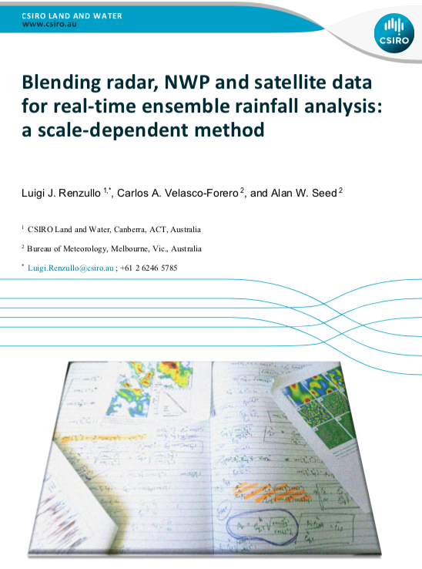
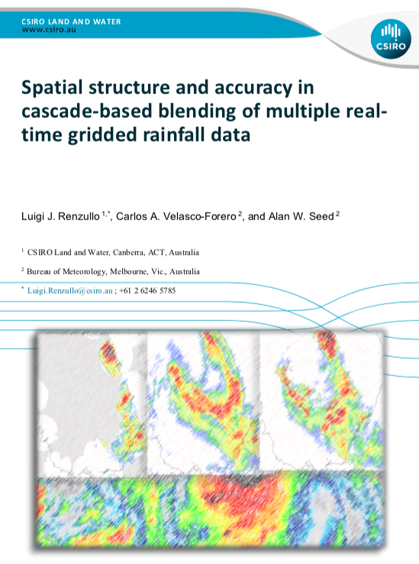
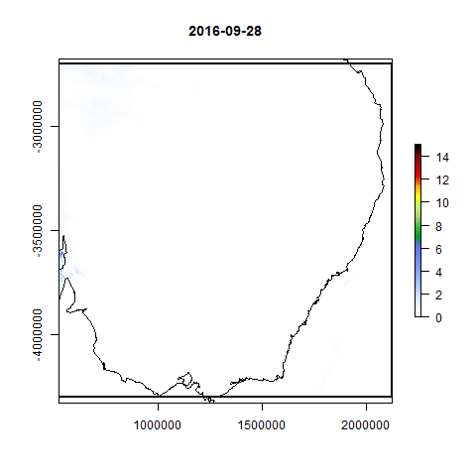
Background - WIRADA
Original Rainfields v3.0 mosaic
https://publications.csiro.au/rpr/
Scale-dependant blending where higher weight is given to the product which performs best at a particular spatial scale
However, evaluation showed that averaging the data seemed to do a good job too
Blended Rainfields, ACCESS-R & IMERG product

Slide 5
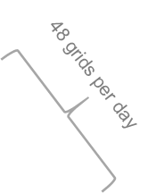
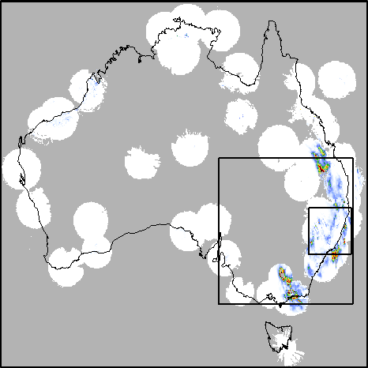
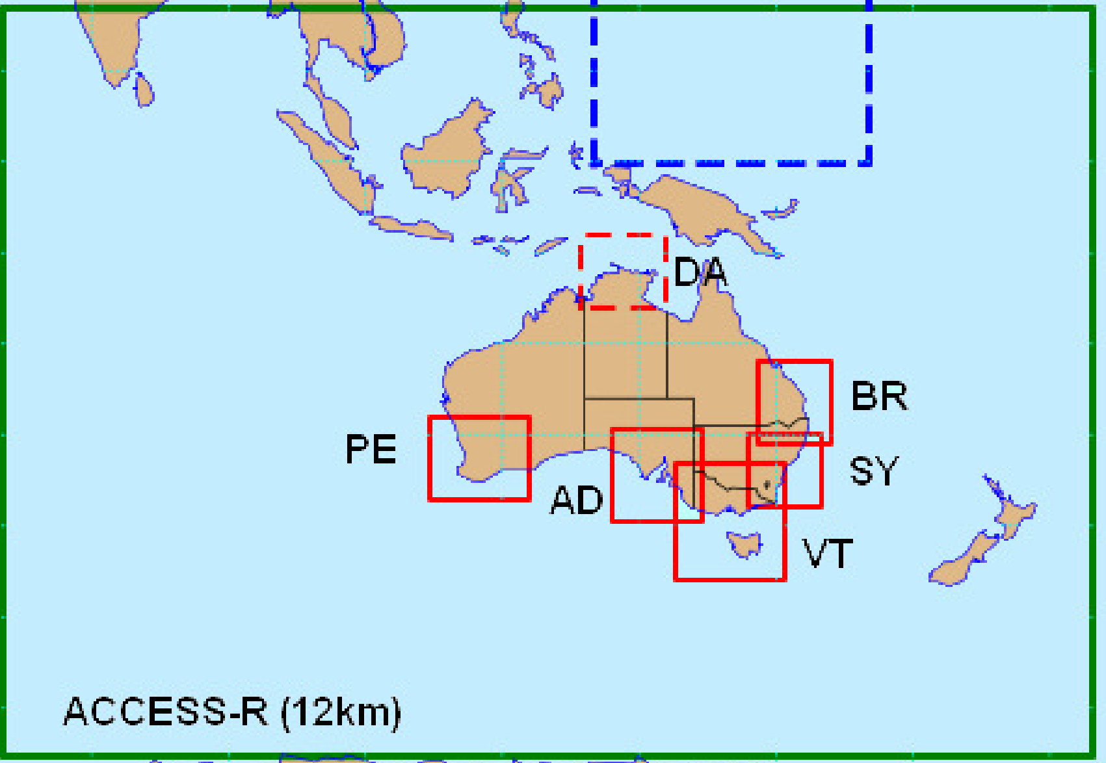
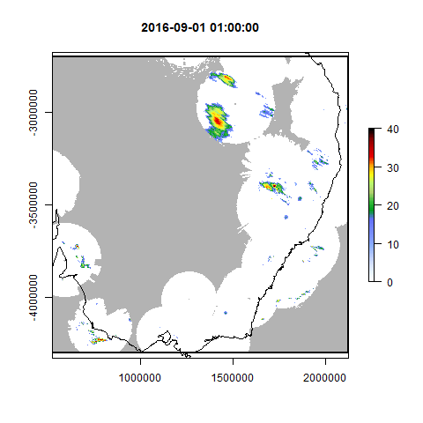
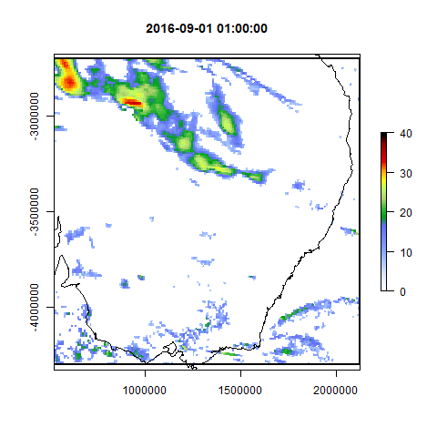
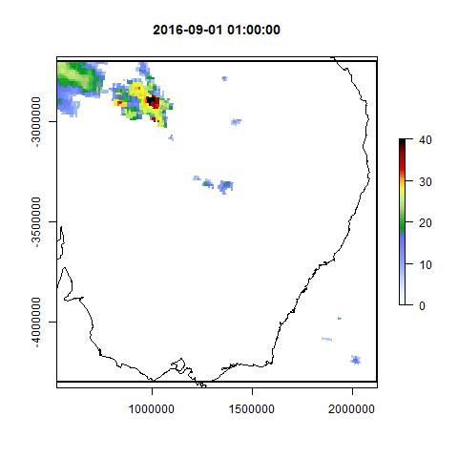
National-scale real-time blended rainfall
Radar
NWP
Satellite
Rainfields v3.0
- high quality
- gauge correct
- 60 min accum.
every 30 mins
- 2 km resolution
- ~10 minute
latency
ACCESS-R
- forecasts
- 60 min accum.
out to +72 hrs.
- 0.11º x 0.11º resolution
- 00,06,012,18Z
- T+6 - +11 used (no latency)
Global Precipitation Mission (GPM) IMERG
- rain rates (mm hr⁻¹)
- every 30 mins - latency ~ 4 hrs (“E”) /
- 0.10 º x 0.10 º ~ 12 hrs (“L”)
mm hr ⁻¹
mm hr ⁻¹
mm hr ⁻¹
11.5
11.5
2.75
11.5
2.75
2.75
0.65
0.65
0.15
0.65
0.15
0.15
< 0.05
< 0.05
< 0.05
All data for Sept 2016 processed to consistent hourly rainfall, equal-area projection, resolution & spatial extent

Slide 6
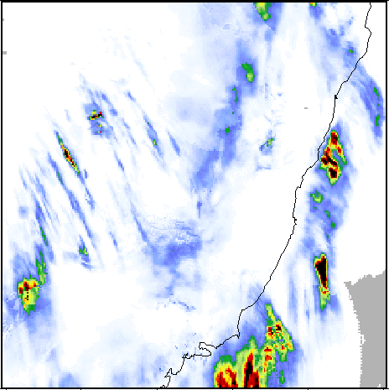

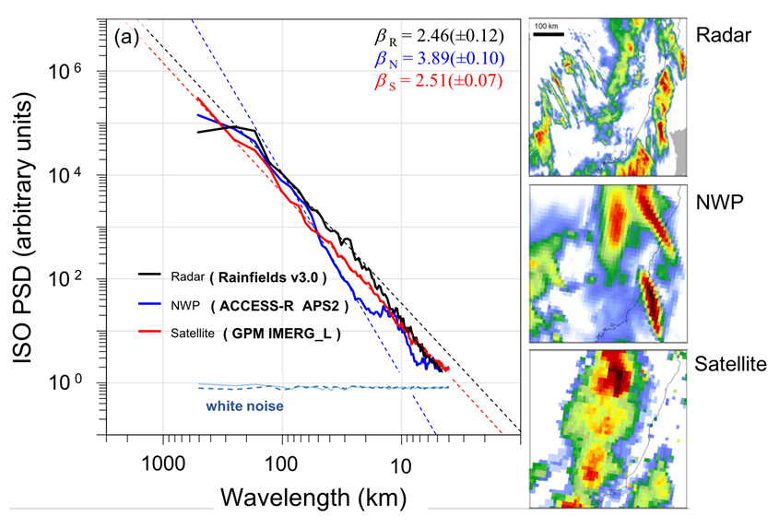
A brief note on rainfall scaling
Well known scaling properties of rainfall: i.e. the presence of spatial & temporal structure across a wide range of scales.
Scaling observed power law in Power/Energy spectrum, i.e. following power law
10 ⁹
Radar
10 ⁷
ISO PSD
10 ⁵
White noise
1000
100
10
Wavelength (km)
Spatial structure captured differently across scale by various products
Scaling-dependent blending aims to maintain best representation of structure across the widest range of scales.

Slide 7
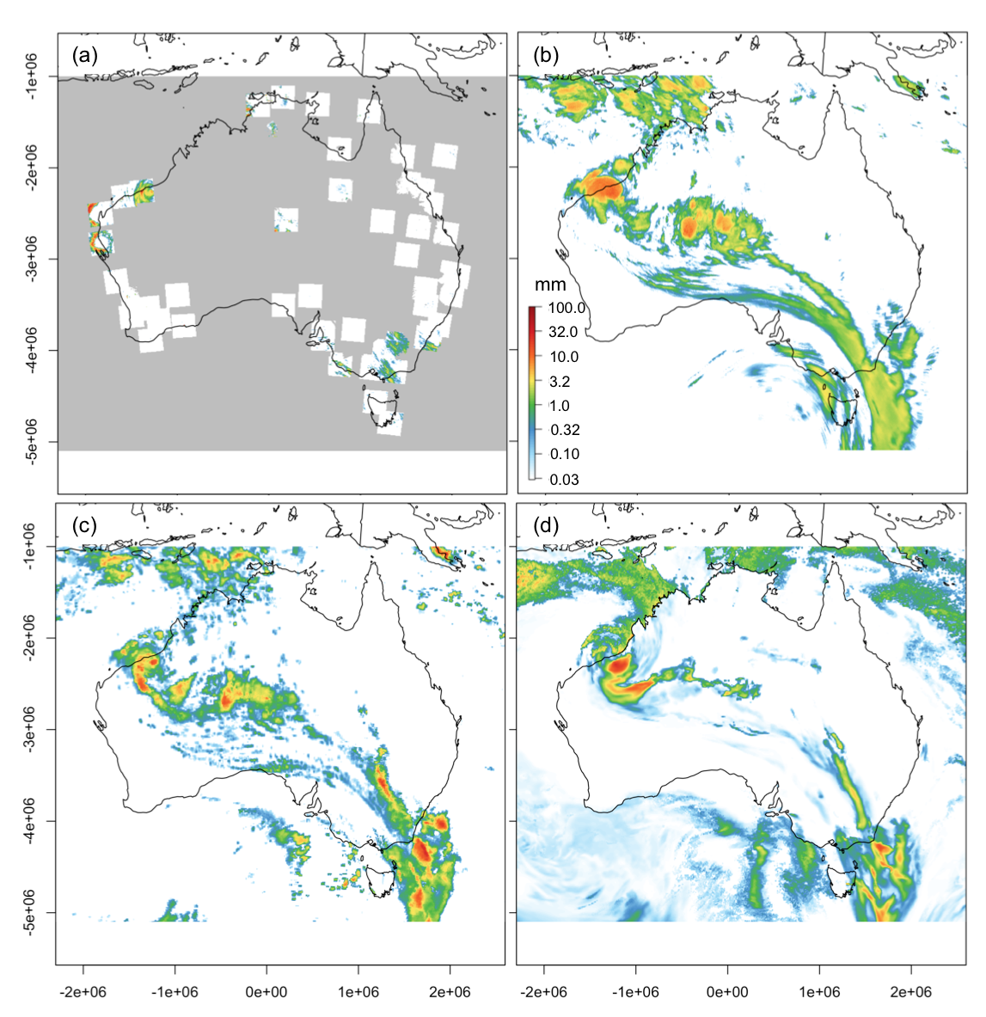
National-scale real-time blended rainfall
Sources will vary between
Real-time (~10 min)
  ACCESS forecasts (T-6)
  Himawari-8
  Rainfields
Near real-time (~4-12 hrs)
  ACCESS
  GPM IMERG
  Rainfields
Blending methods to be explored
- Scale-dependent blending
- Weighted averaging (e.g.
MSWEP - Beck et al.
2016; 2017a,b)

Slide 8
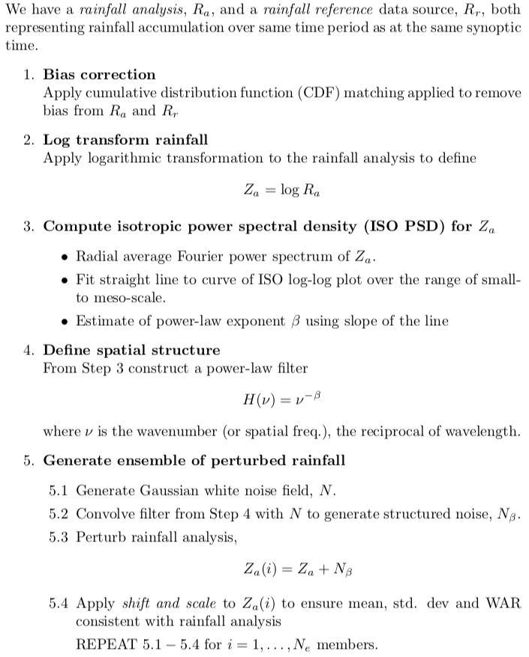
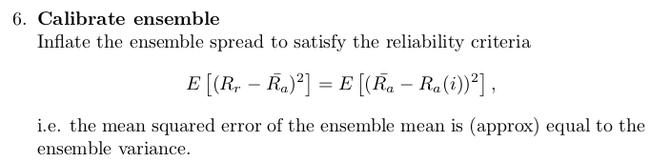
Ensembles
Represent the spatial uncertainty of the rainfall analysis
  Has to work in real-time
Perturb analysis with spatially structured weights
  Structure provided by rainfall analysis
  (Seed 2003; Pegram et al., 2011; Seed et al., 2013; Niemi et al., 2014; Nerini et al., 2017)

Slide 9
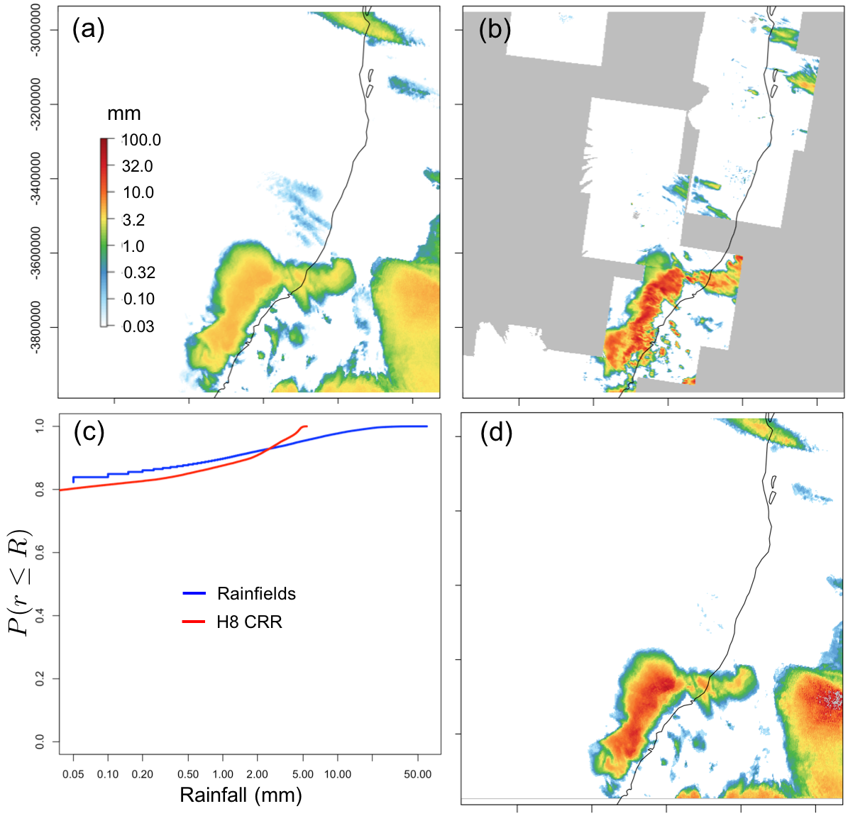
Ensembles
Bias correction of rainfall analysis against reference
Matching CDF’s
Ideally reference captures ‘true’ rainfall distribution
Figure: Estimates of 60 min accumulated rainfall to 12:30 hrs UTC on 26 Oct 2017: (a) Himawari-8 (H8) CRR; (b) Rainfields (c) empirical CDF’s; and (d) corrected H8.

Slide 10
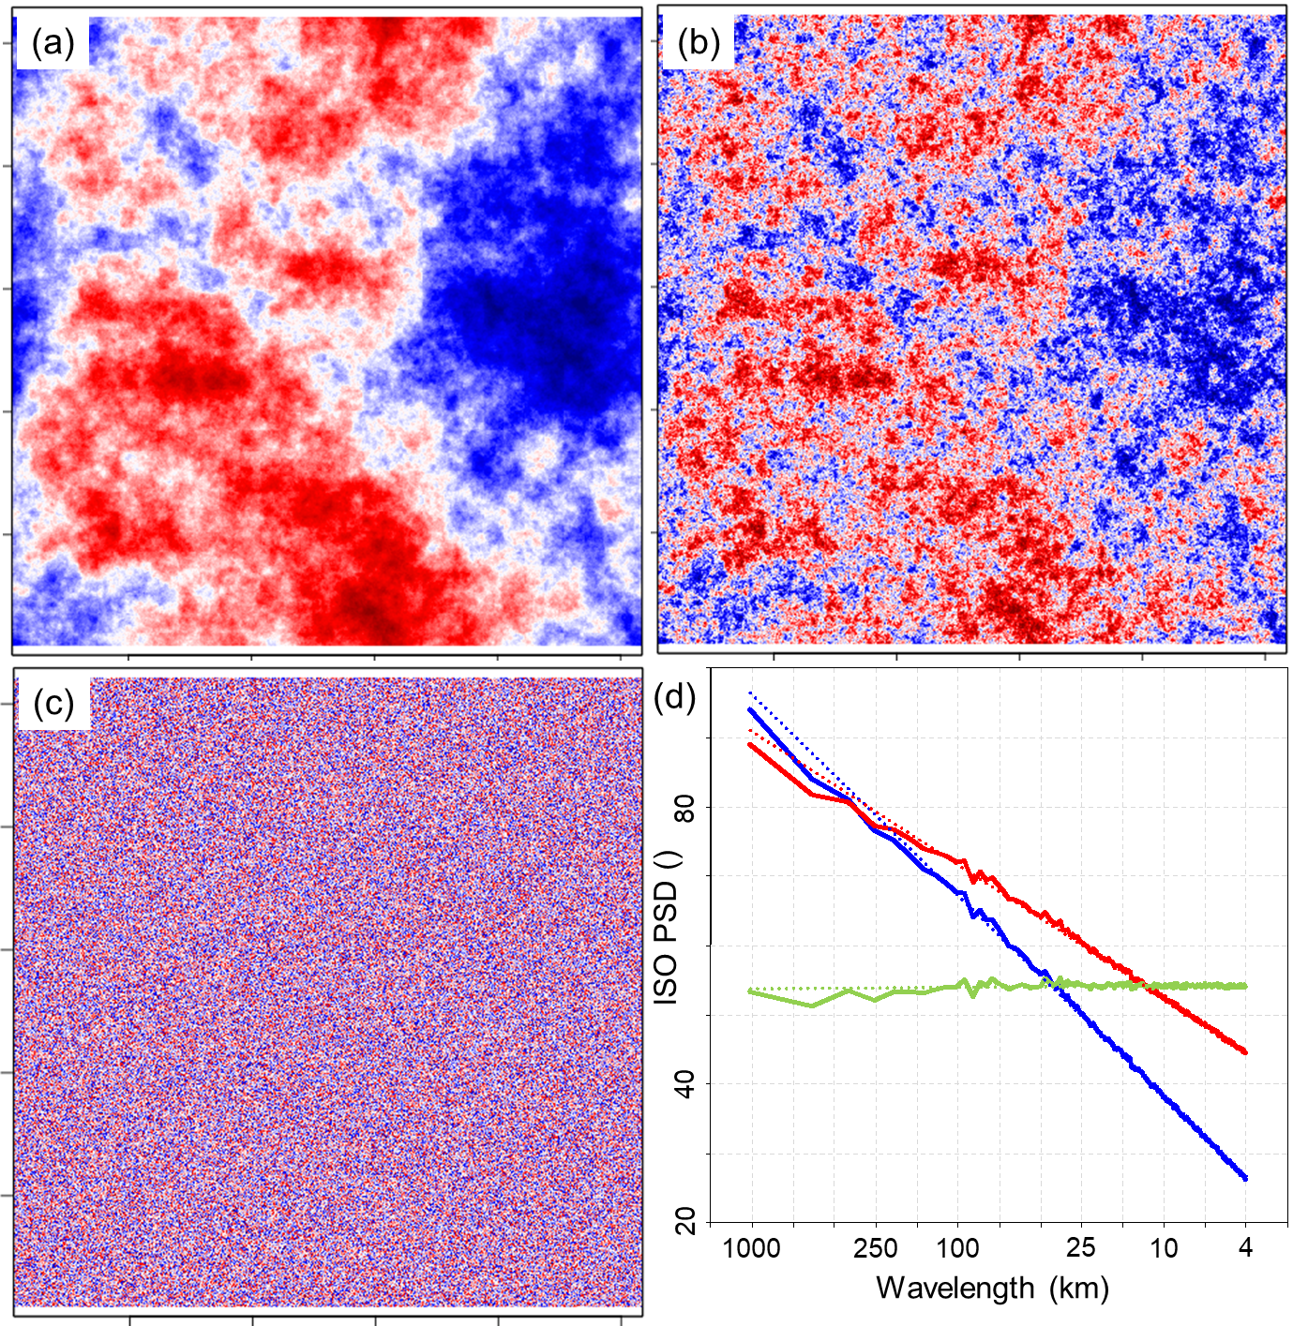
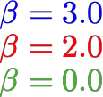
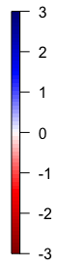
Ensembles
Synthetic noise
Constructed by convolving a power law filter
with a field of Gaussian white noise
(extension to include spatial
anisotropy of rainfall)
1000 km

Slide 11
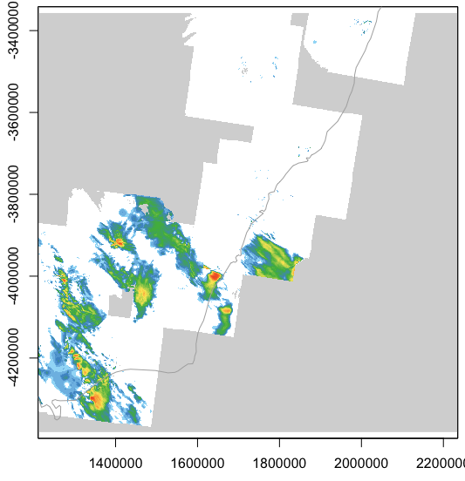
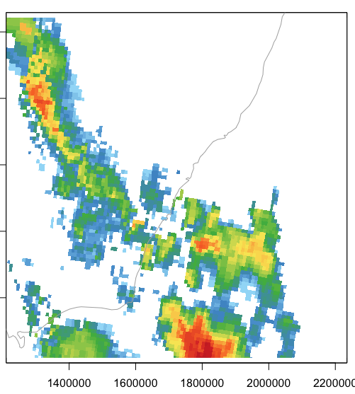
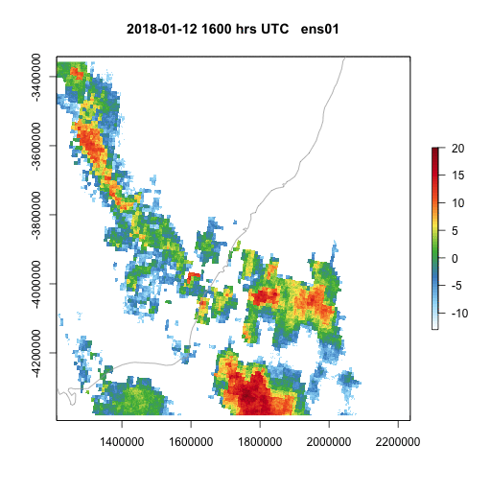
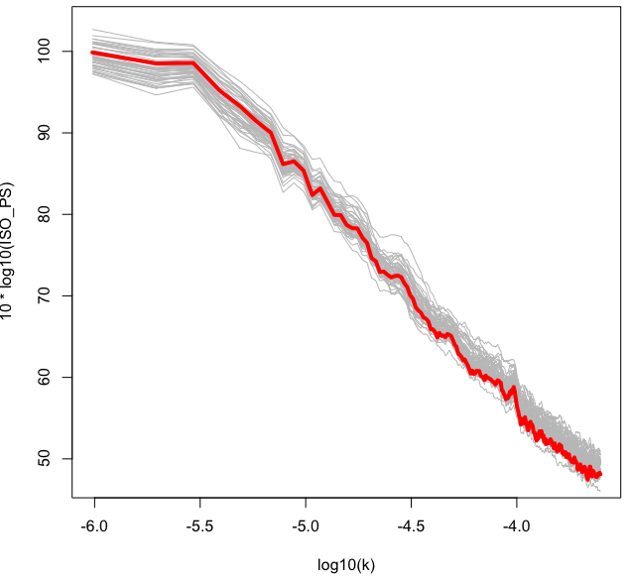
Ensembles
(a)
(b)
Figure: (a) Rainfields and (b) GPM IMERG for a 1000 km x 1000 km area 12 Jan 2018 16000 hrs UTC
50 member ensemble
analysis
ensemble

Slide 12
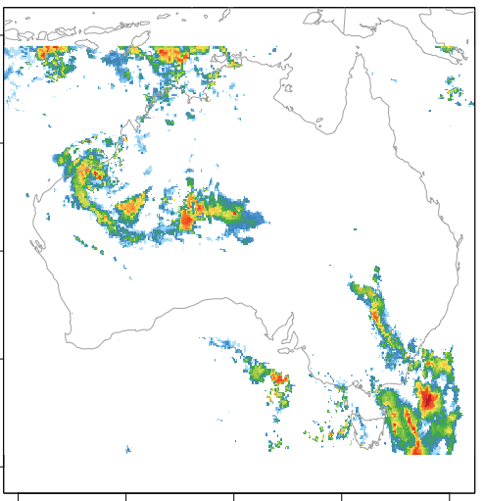
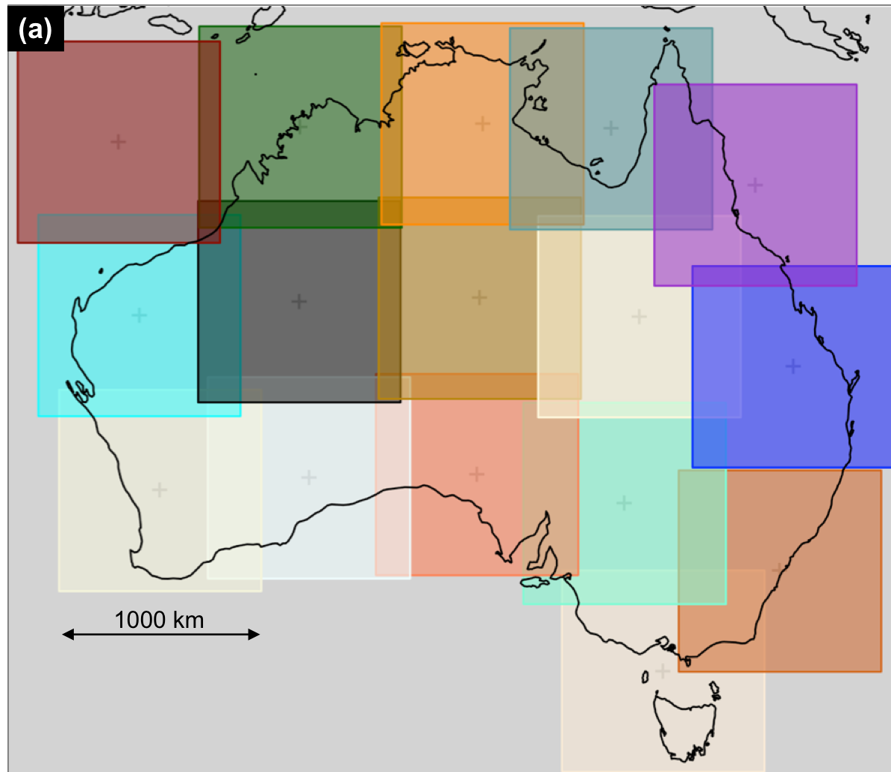
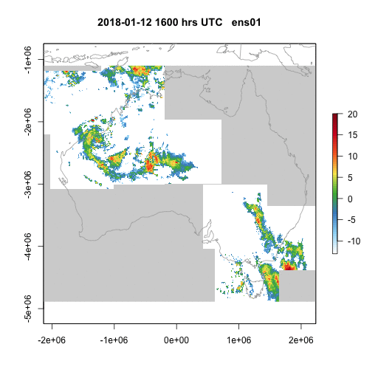
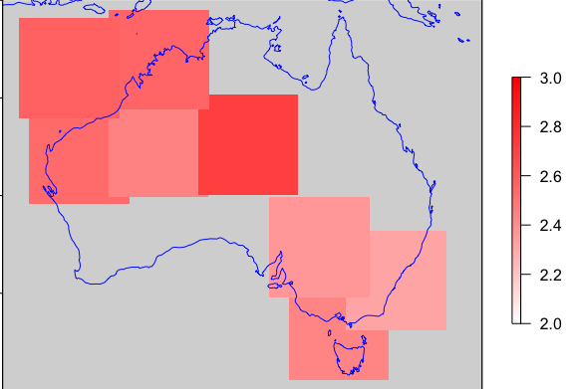
Ensembles
Nation-wide application
1000 km x 1000 km overlapping tiles
Rainfall analysis
Spectral exponent

Slide 13
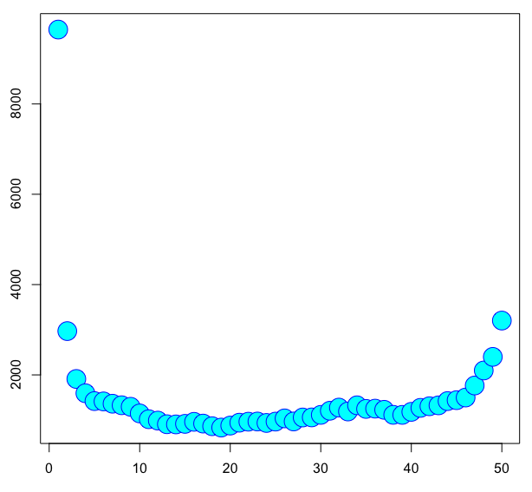
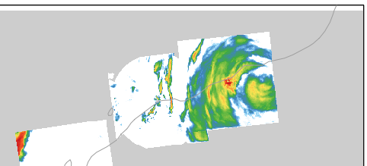
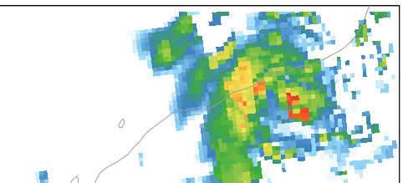
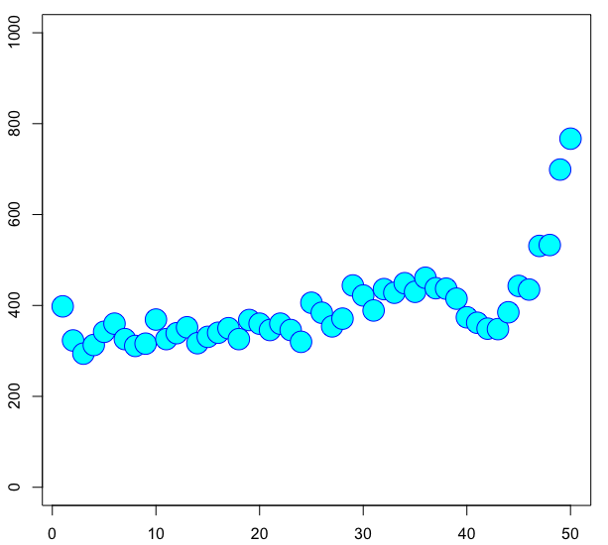
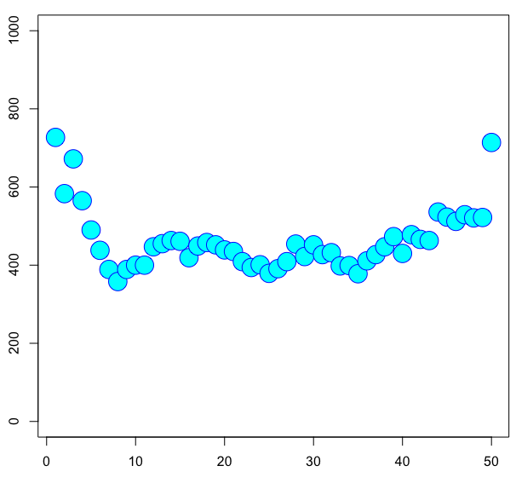
Ensembles
Rank histograms
Rainfields
GPM IMERG
Ensemble rank
Ensemble rank

Slide 14
Next steps
Multi-source blended rainfall analysis for Australia
  Multiple sources of real-time rainfall for comprehensive, accurate coverage
  Apply & evaluate blending method
    Scale-dependent blending – revisit & further develop approach
    MSWEP – spatially-varying weighted combination of source data
Rainfall ensembles through perturbed analysis
  Structured noise to preserve scaling properties of rainfall
  Perturbed rainfall analysis – fast method for national-scale application
    Tiled approach to address non-stationarity of rainfall
  Ensemble calibration
    Need further development & evaluation to ensure reliability

