Slide 1
A seasonally coherent calibration (SCC) model for post-processing numerical weather predictions
Q J Wang and Tony Zhao
Department of Infrastructure Engineering, The University of Melbourne

Slide 2
Forecast calibration
Bias
Skill
Reliability
Climatology

Slide 3
SCC
,
Bayesian Joint Probability modelling
Log-sinh transformations
Bivariate normal distribution
Zero values treated as censored data
Maximum likelihood method

Slide 4
SCC
,

Slide 5
SCC
,

Slide 6
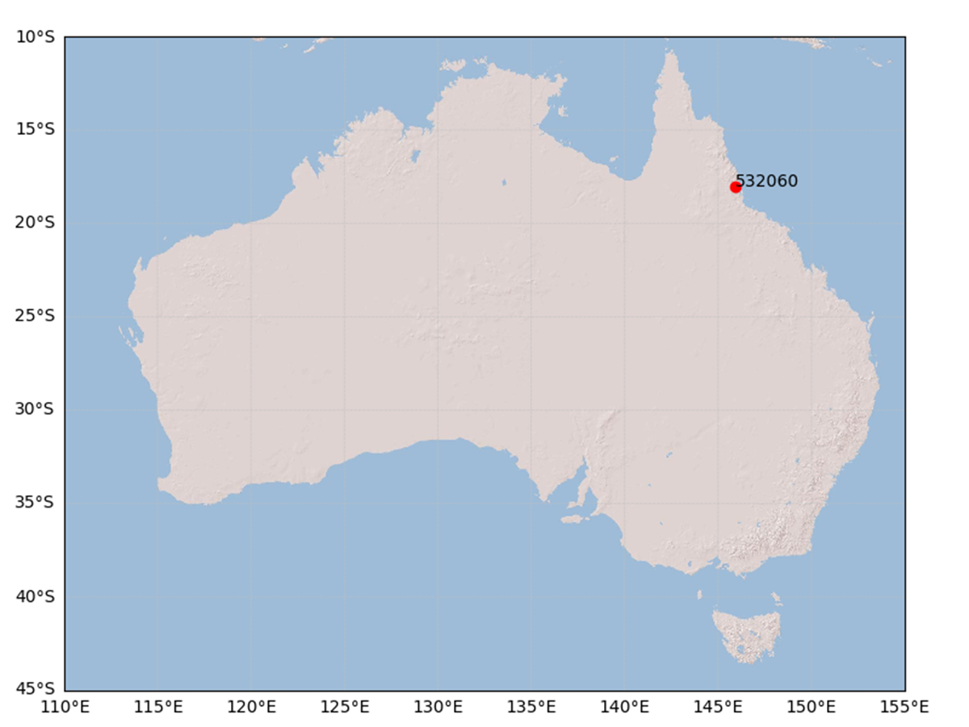
A study case

Slide 7
Study case
Forecast data
ACCESS-G APS1 (deterministic)
2011-2013 (4 years)
Observed data
2007-2016 (10 years)
Calibration
Daily precipitation
Lead times: 1-10 days ahead

Slide 8
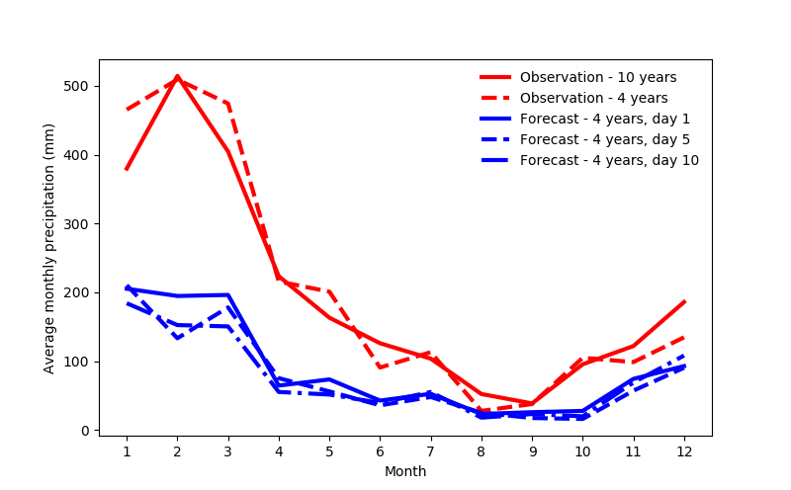
Average monthly precipitation

Slide 9
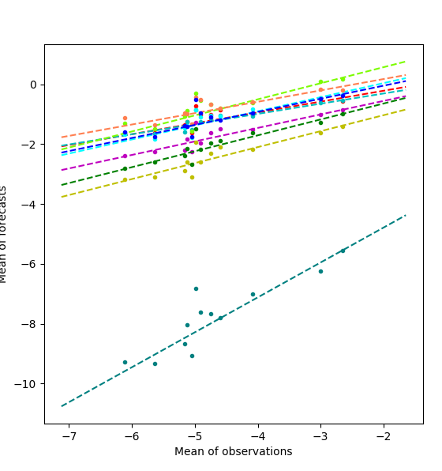
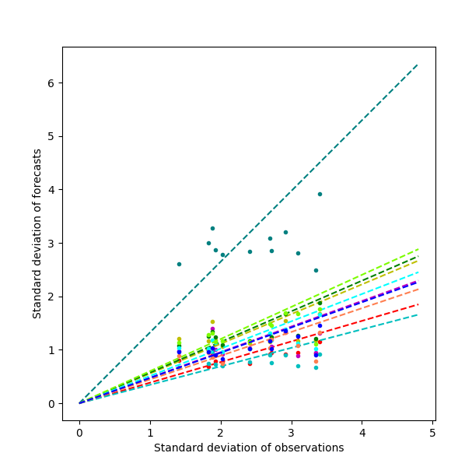
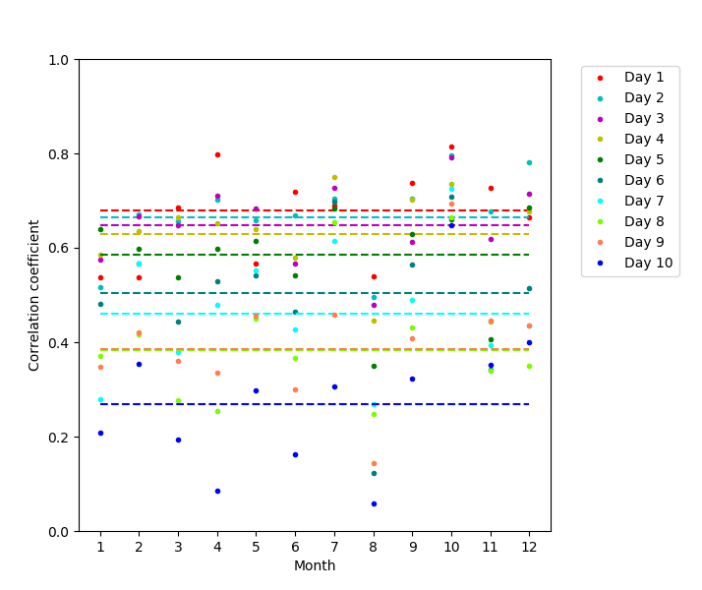
Relationships

Slide 10
SCC
,

Slide 11
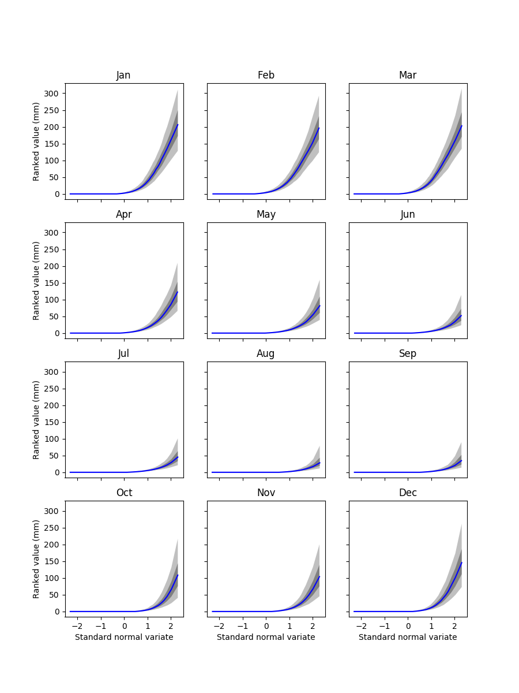
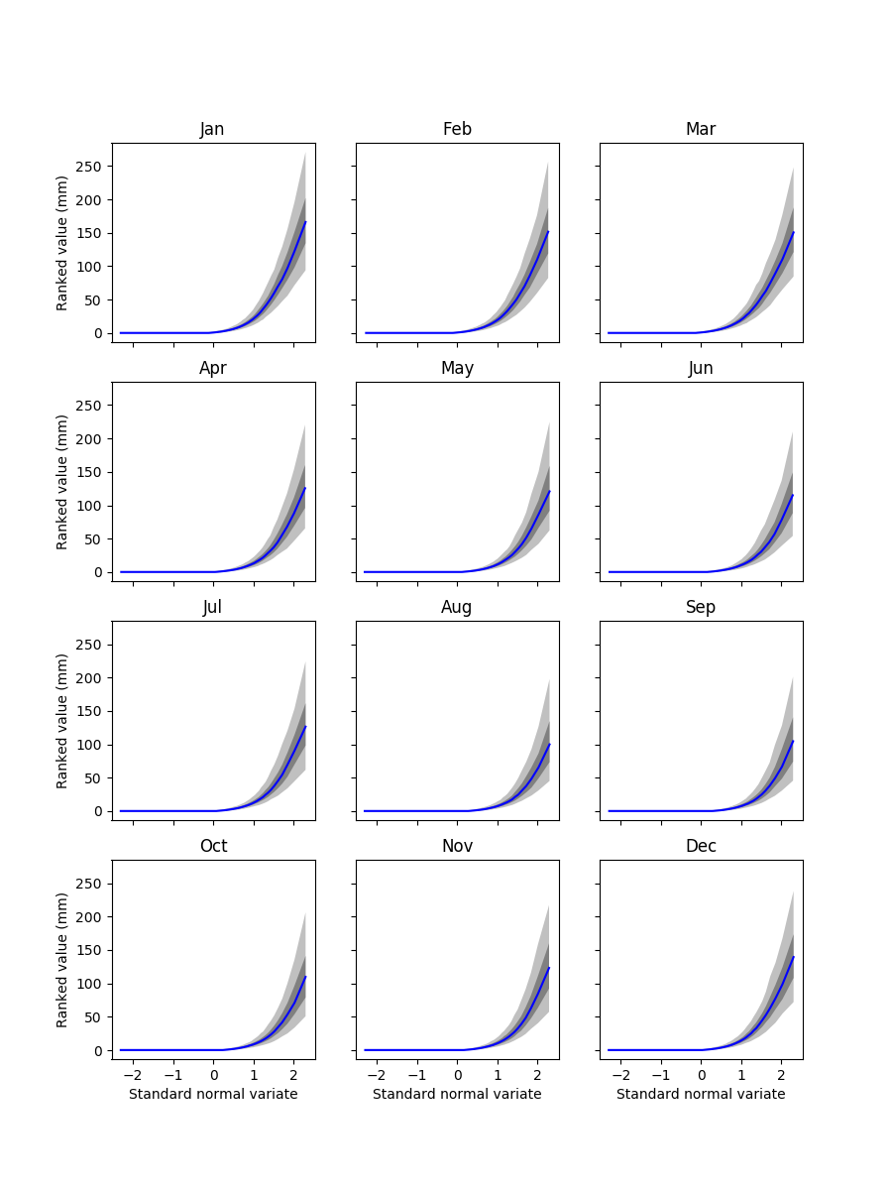
Climatology – Day 10
SCC
RPP

Slide 12
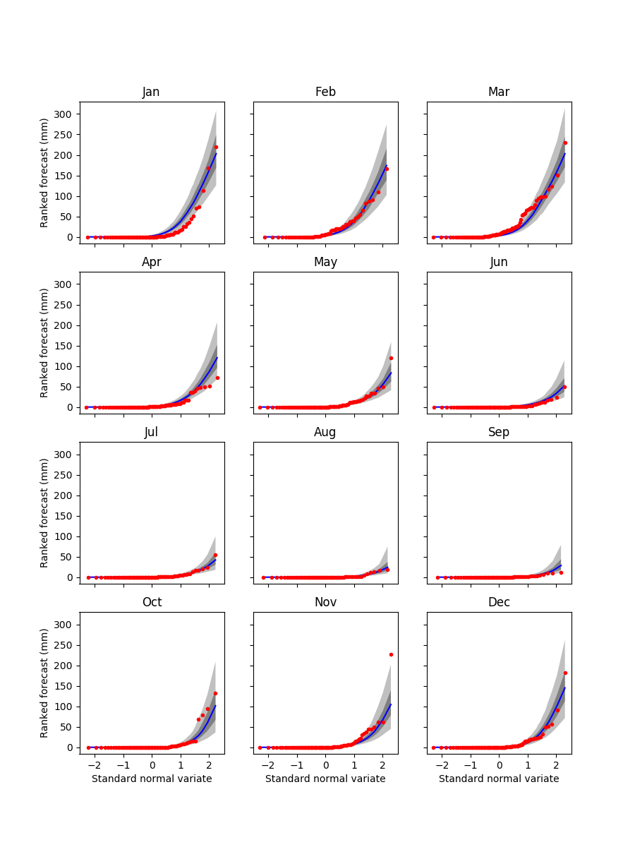
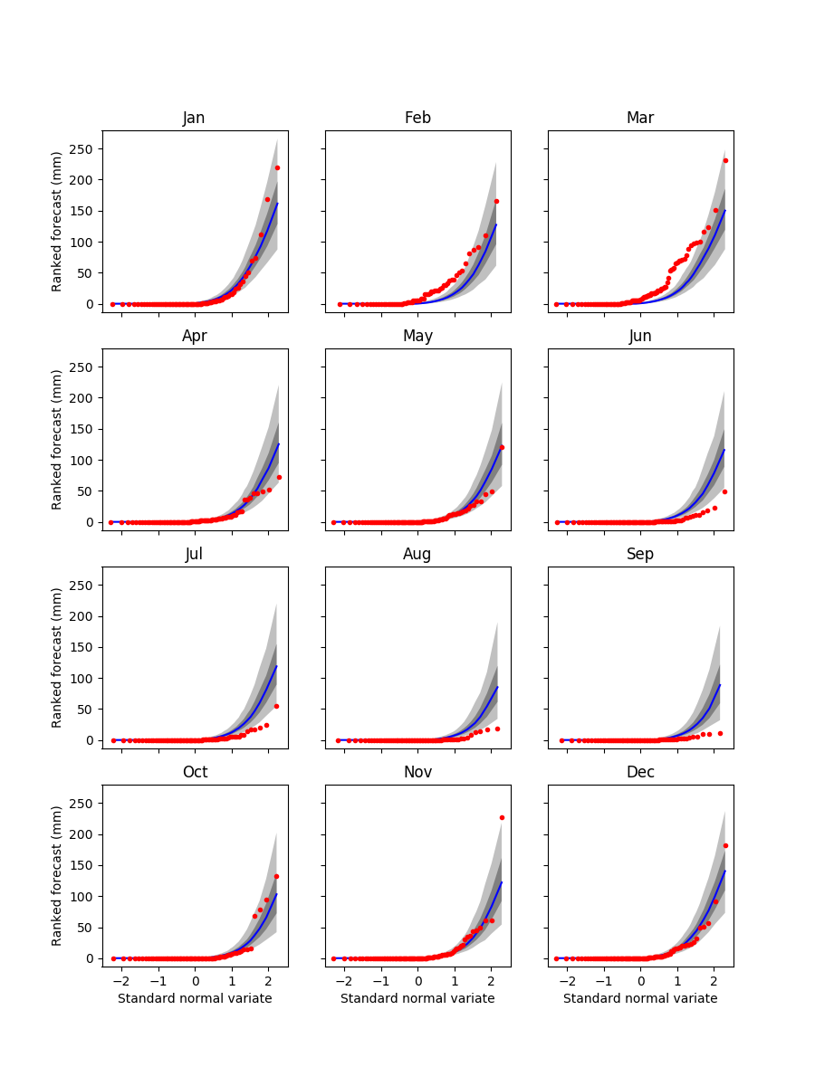
Climatology – Day 10
SCC
RPP

Slide 13
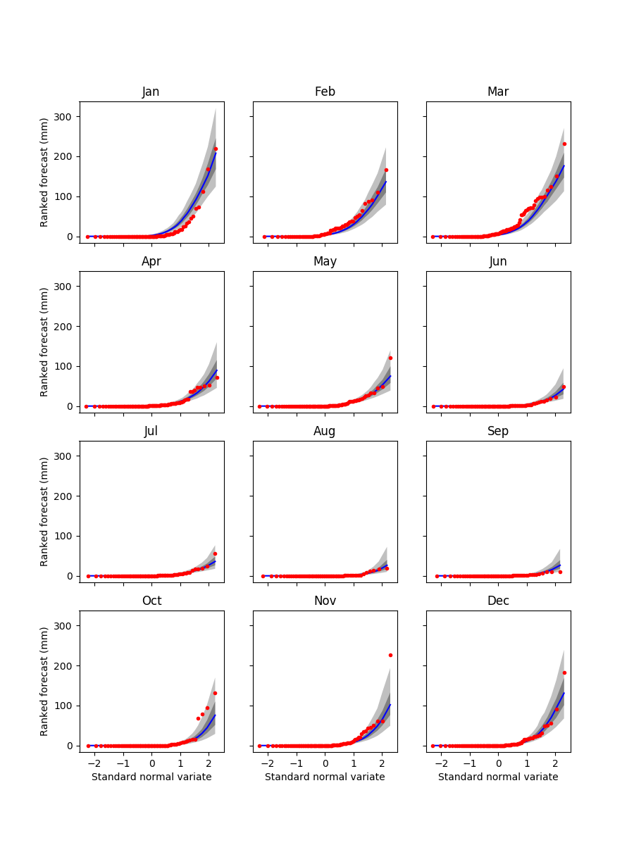
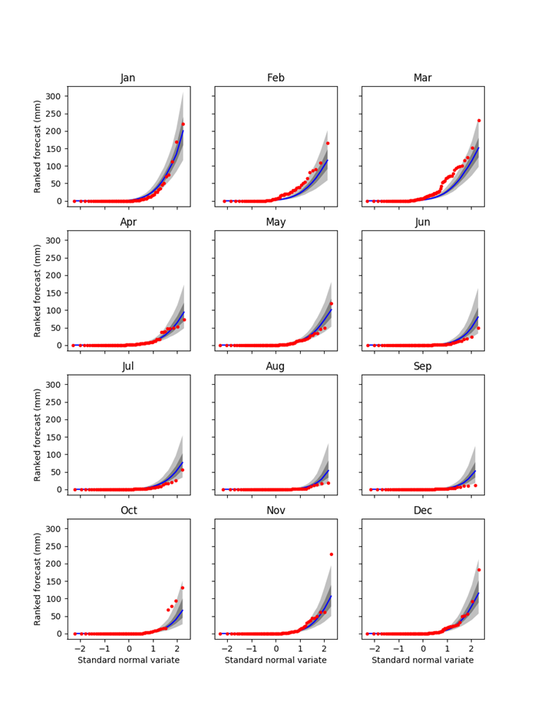
Climatology - Day 1
SCC
RPP

Slide 14
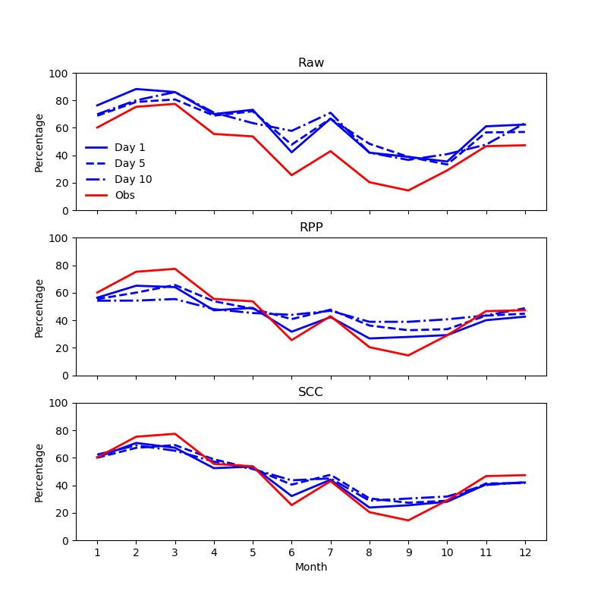
Percentage of wet days

Slide 15
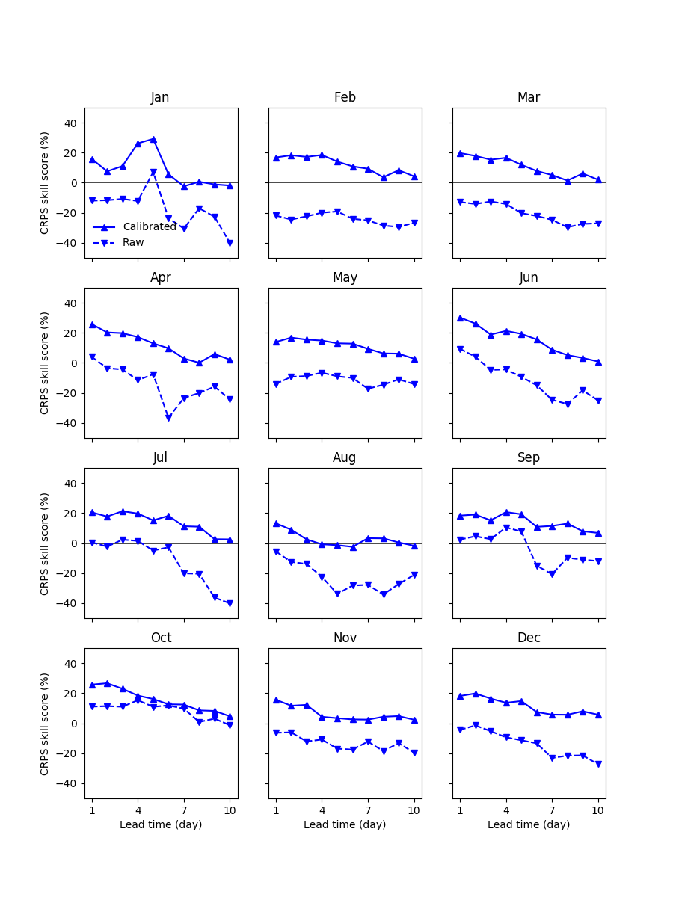
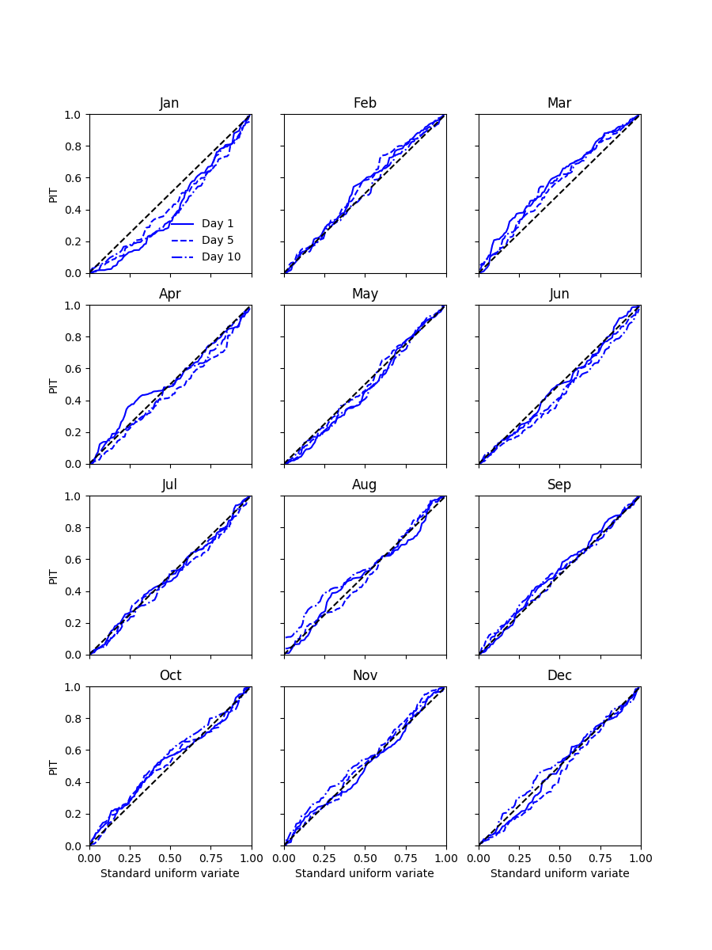
Reliability and skill - SCC
Reliability
Skill

Slide 16
Summary
Forecast climatology should be checked
The SCC model
Can work with short NWP archive data
Correct seasonal climatology
Reliable ensemble spread
Much improved skill over raw forecasts

