Slide 1
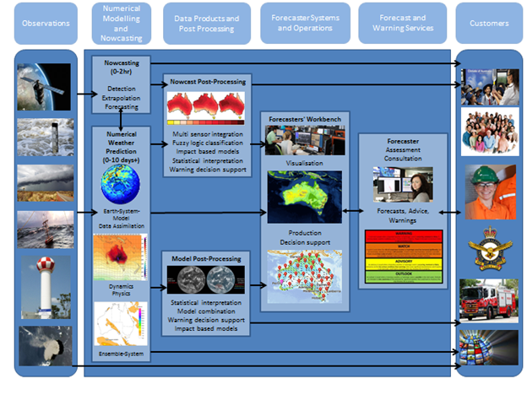
Plans for ensemble services in the Bureau
Ensemble working group
Needs -> services -> underpinnings -> roadmap
Some links to presentations today

Slide 2
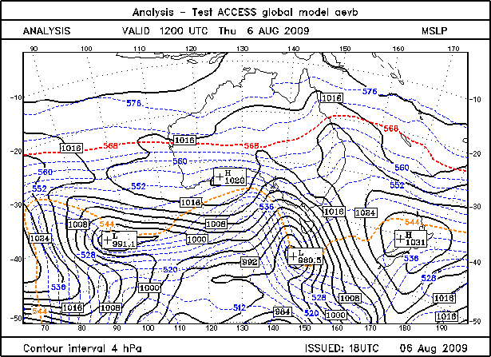
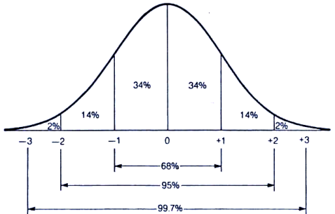
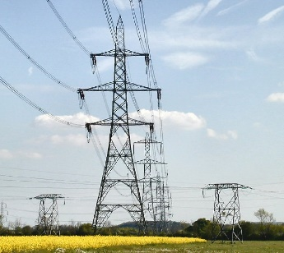
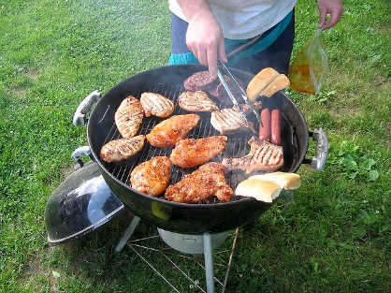

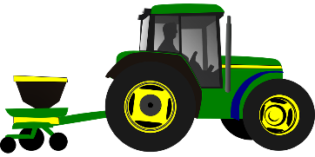


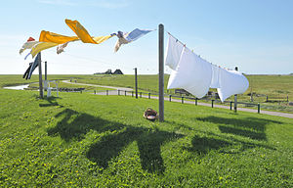
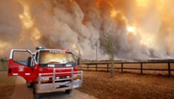
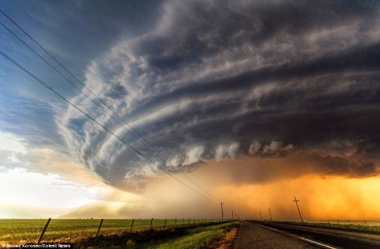
Ensembles, uncertainty and decisions - multi-valued forecasts
Ensemble
Post-processing
Mean and spread (distribution) information
Allow users to tailor decisions based on ensemble-based risk and scenario information – EPP output can support many services and applications.
Notes:
Users can choose their own risk thresholds at which to act. Some users may use the full probability distribution.
One of the stories of the Met Office and EMS visits is data to the users.
One can show that ensemble forecasts are inherently more valuable than deterministic forecasts.

Slide 3
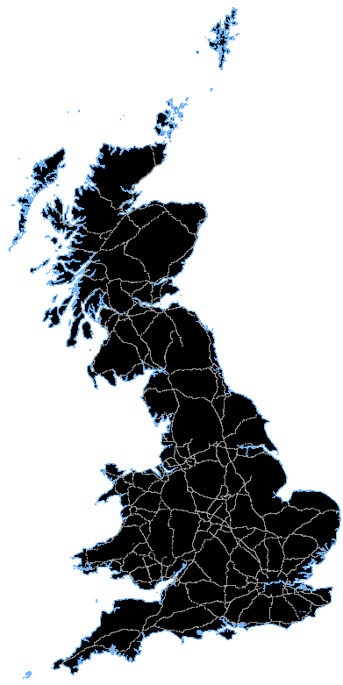
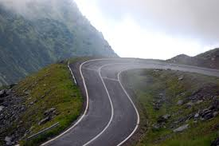
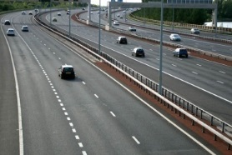
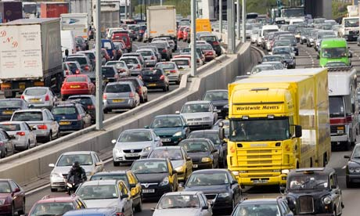

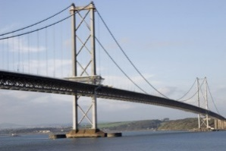
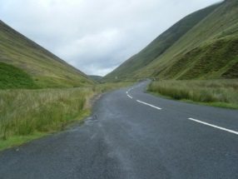
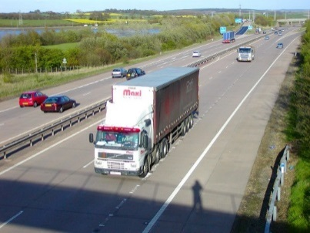

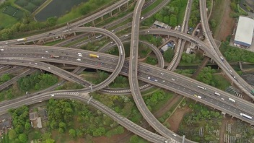
Risk = Prob(Hazard) X Vulnerability X Exposure Hazard Impact Model - Vehicle Overturning
Hazard
Vulnerability
Exposure
Probability of wind gusts exceeding thresholds
Altitude
Number of lanes
Other features e.g. bridge
Road orientation
Number of vehicles on road
x
x
What matters is not what the weather will be, but what the weather will do, and what decisions will be made in response.
Sometimes bring user algorithms to the data; sometimes send data to users.
Notes:
Despite the major challenges with data, the Natural Hazard Partnership’s Hazard Impact Model has a showcase impact model named the Vehicle OverTurning Model which has been researched and developed at the Met Office.
The hazard part of the model uses the Met Office ensembles to calculate the probability of wind gusts exceeding vehicle overturning thresholds.
The vulnerability section uses datasets from which road altitude, the number of lanes, other road features and road orientation can be derived.
The exposure part relates to the number of vehicles on the road derived from Department for Transport data.
These three factors are combined into a value which forecasts Risk of Disruption to the road network during a high wind event out to 36 hours.
Notes not to say: wind gust thresholds were determined using laboratory testing by Birmingham university, the lowest threshold is 51mph for unloaded heavy good vehicles and the highest threshold is 80mph for loaded heavy goods vehicles.

Slide 4
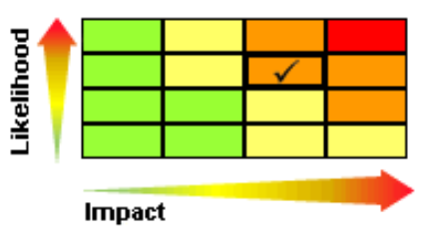
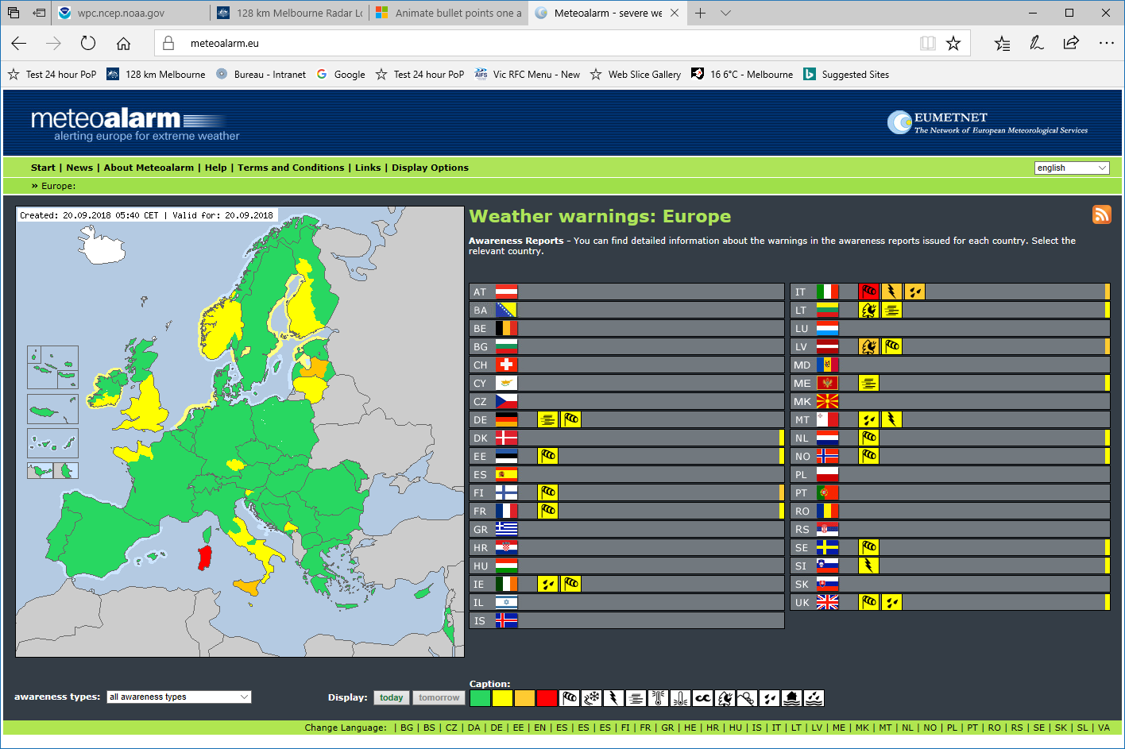
Probability, risk and impact forecasts
WMO session – extreme weather alerting and costs
WMO looking at global Meteoalarm implementation. Meteoalarm to provide impact guidance.
Global multi-hazard alerting system; ultimately impacts.

Slide 5
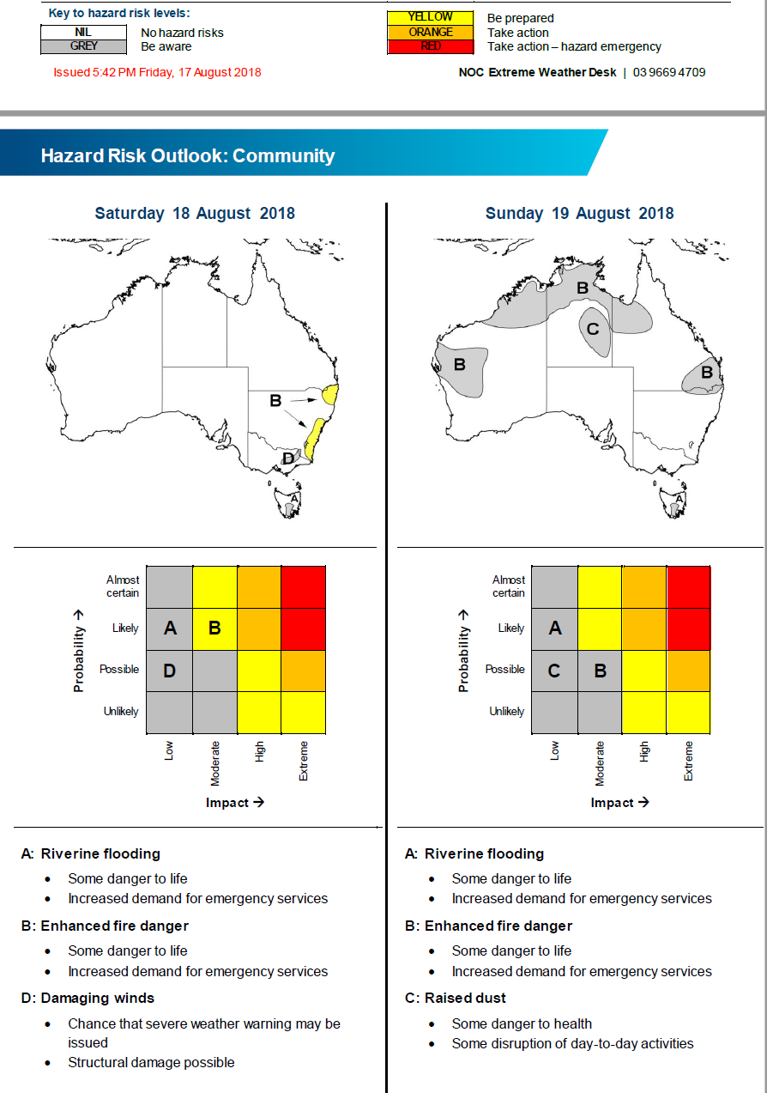
Early probabilistic tiered hazard services
Notes:
Best supported by post-processed ensembles

Slide 6
Impact guidance and user modelling
Impacts
Simple internal – probabilistic fire danger indices
Complex internal – streamflow modelling
Complex external – fire spread modelling – send ensemble members, bias & spread corrected for some applications.
Weird & wonderful user applications – user-chosen thresholds, time periods, …

Slide 7
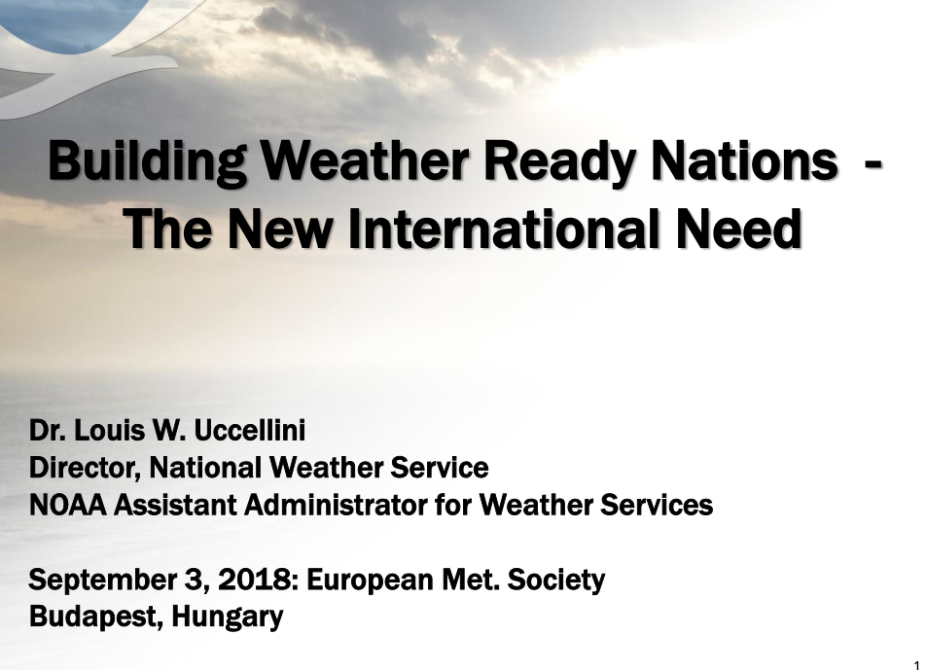
'The last mile'

Slide 8
Common directions from EMS conference
Automation of routine using ensemble post-processing
Ensemble-based risks and impacts
High-resolution rapid update nowcasts and short-range forecasts (5 minute updates…)
Communication & the last mile
Not so easy to automate discussion with an embedded Meteorologist

Slide 9
Some of the service areas needing ensemble / risk / impact information
Rainfall (multiple timeframes)
Consistent across timescales and weather vs hydrology
Different projects – observing, obs nowcasting, NWP nowcasting, medium range, beyond.
Manageable detail (CAM filtering)
Heat stress – agriculture & people
Thunderstorms – different timescales (multi-model ensembles)
Energy markets
Wind, solar, temperature; timing can be critical in short term. Interested in all timescales incl climate change.
Aviation – focus on detail, updates & shorter time ranges; wind vectors; fog; …
Needs more vertical level info than other users
Hydrology – different timescales
TCs
…

Slide 10
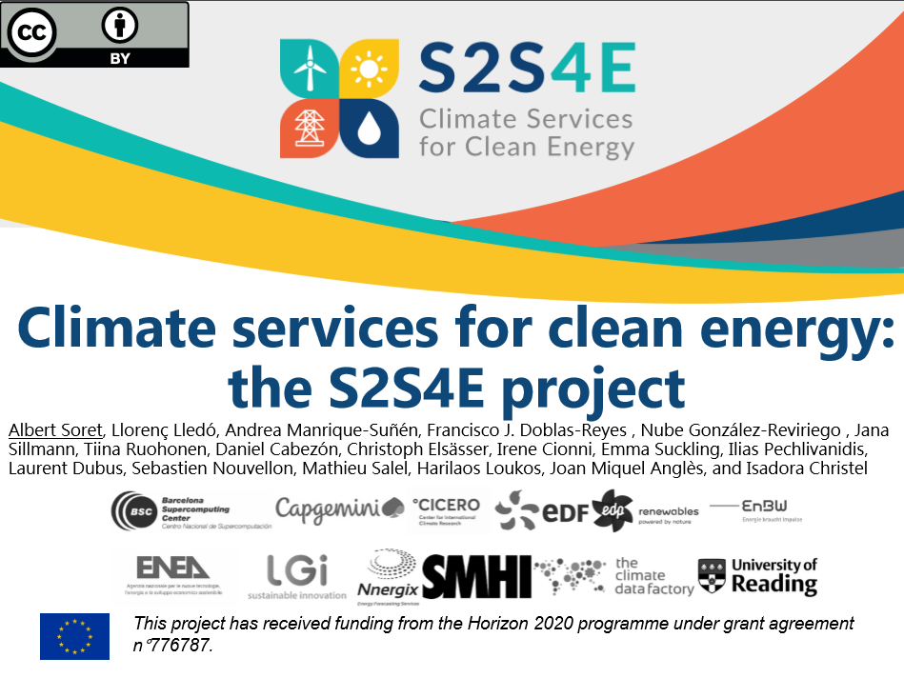

Slide 11
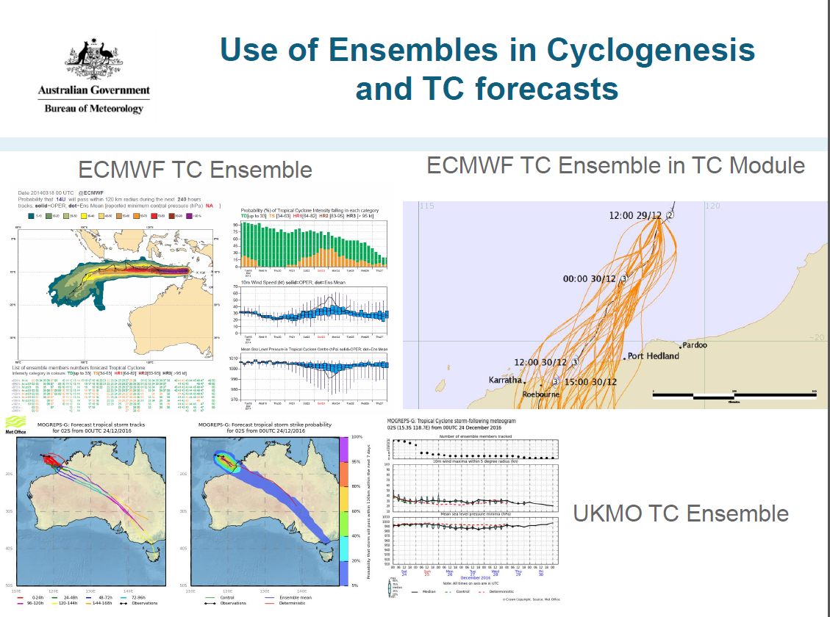
Forecasters & others can produce useful qualitative ensemble displays.

Slide 12
Exceedance probabilities over time
Max / min over what time ranges for what field in what day?
Some options for different time periods:
24 hours
Night (12h) |  |  |  |  |  | Day (12h) |  |  |  |  |  |  |  |  |  |  |  | Night (12h)
 |  |  |  |  |  | Morning |  |  |  |  |  | Afternoon
1 | 2 | 3 | 4 | 5 | 6 | 7 | 8 | 9 | 10 | 11 | 12 | 13 | 14 | 15 | 16 | 17 | 18 | 19 | 20 | 21 | 22 | 23 | 24

Slide 13
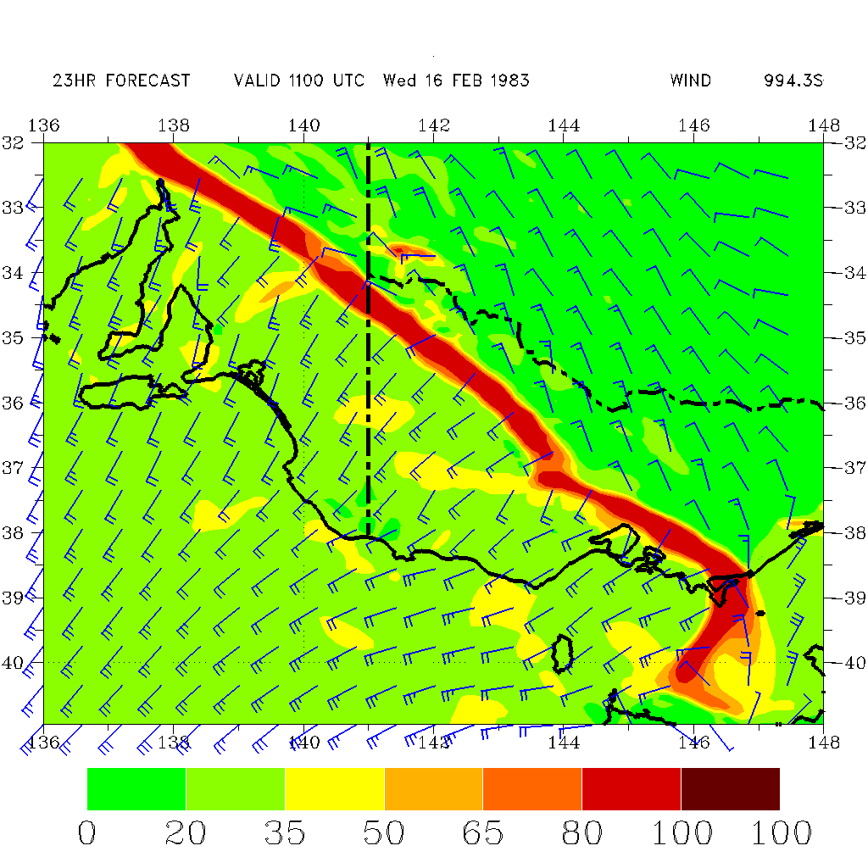
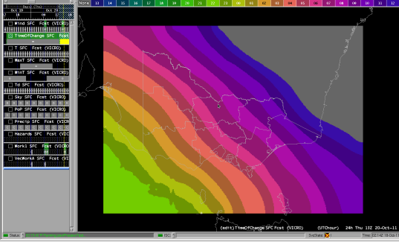
Uncertainty in timing
Users may want to know the earliest or latest
some threshold may be breached
Wind direction may change

Slide 14
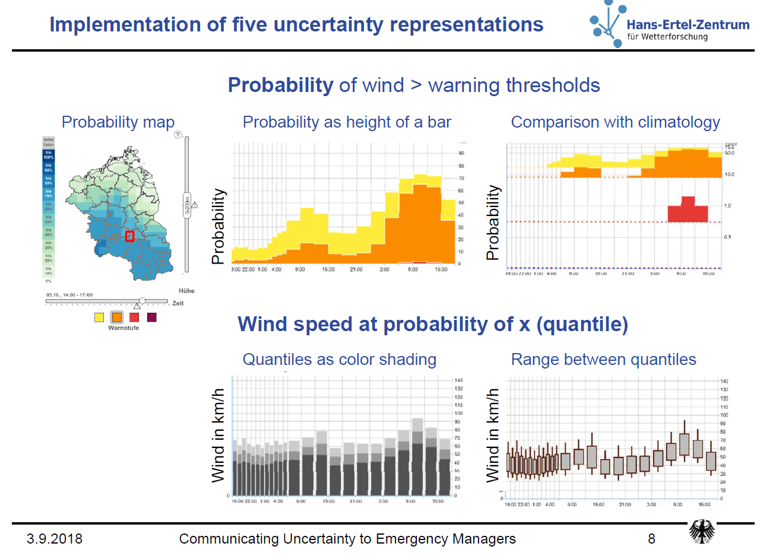
Time
Time
Time
Time
Survey looked at
What presentation was preferred
Ability to interpret
Notes:
Martin Goeber, DWD

Slide 15
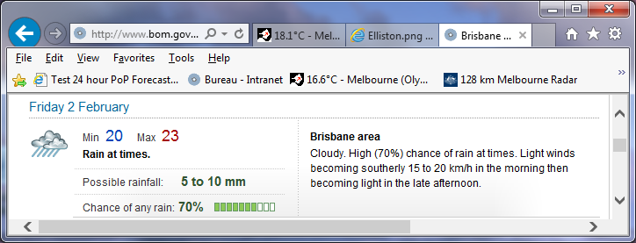
New calibrated ensemble daily rainfall probability guidance
Bureau rainfall forecasts (above) are supported by post-processed guidance (below) from ensembles of numerical weather prediction models.
Notes:
Background: the 50% and 25% exceedance rainfall amounts (quantiles) match the possible rainfall range in official forecasts.
25% or 10% exceedance can be thought of a higher rainfall amount that one might get; 50% exceedance is near a best guess; one might usually expect to get at least the 90 or 75% amount.
The point of the plots is not to go into detail, but to visually indicate the sort of guidance that supports forecasts.
Future: expect at least this much (or as little as); expected amount; possibility of exceeding high amount.

Slide 16
underpinnings
Extended ADFD – length & probabilities
NWP: ACCESS CAM ensemble; & ACCESS & international global weather & sub-seasonal+ ensembles
Reanalyses for error detection & correction
Calibrated (GOCF, IMPROVER) and uncalibrated post-processing; derivation of probabilities; supports
Scenarios, products
Alerting – various sorts for internal & external users. Much should be driven by probabilities – both for internal users and increasingly external users. Many don't want probabilities, but many do.

Slide 17
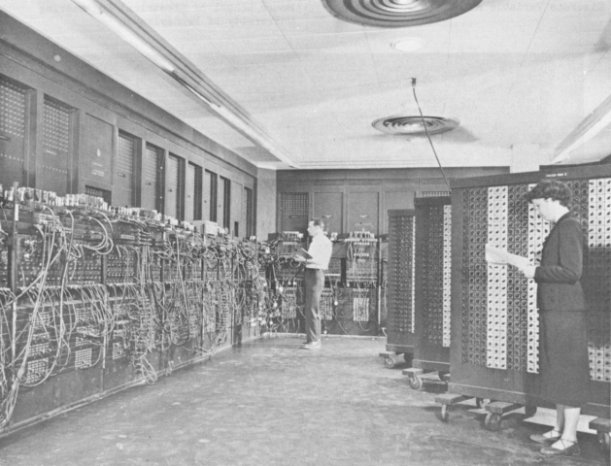
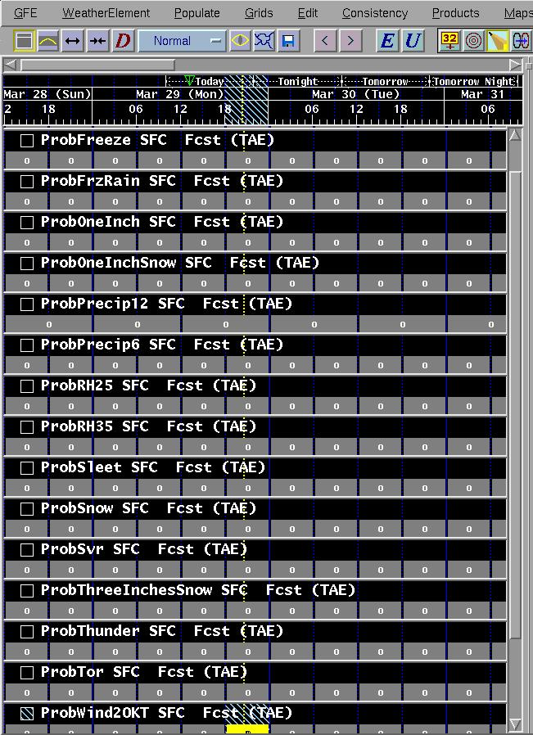
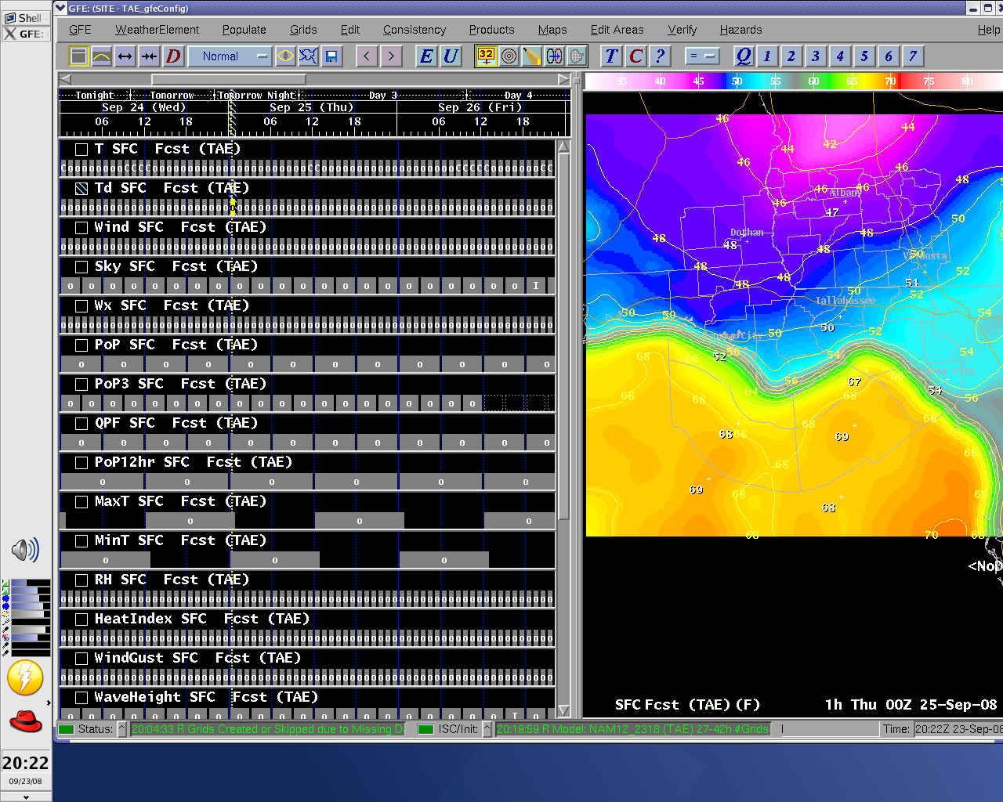
NWP models (GFS40, NAM12, local WRF, GEM, & ECMWF)
GFE Procedure & Smart tools
MOS (ADJMAV, ADJMET, Gridded GFS MOS)
Confidence Grids:
Other (Bias-corrected GFS40 & NAM12, some SREF)
A quick way to look for “high impact” weather events –
dozens instead of
hundreds of grids
Notes:
Much effective alerting should be based on probabilities of exceeding thresholds over an area, rather than on a deterministic forecast.

Slide 18
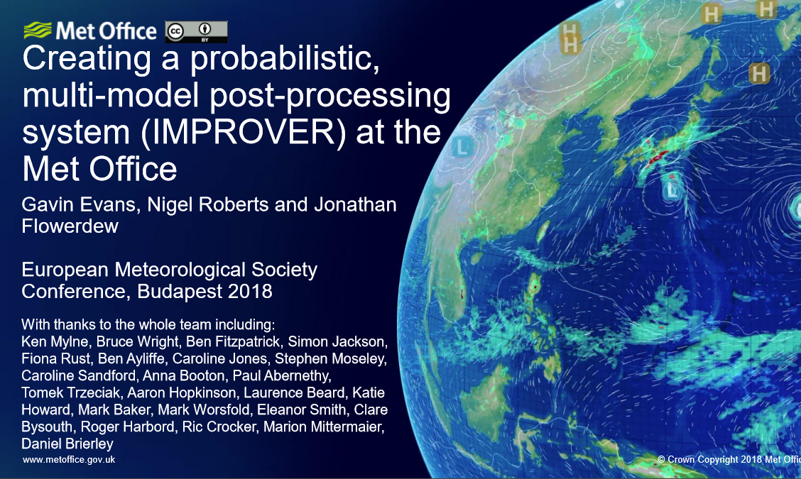

Slide 19
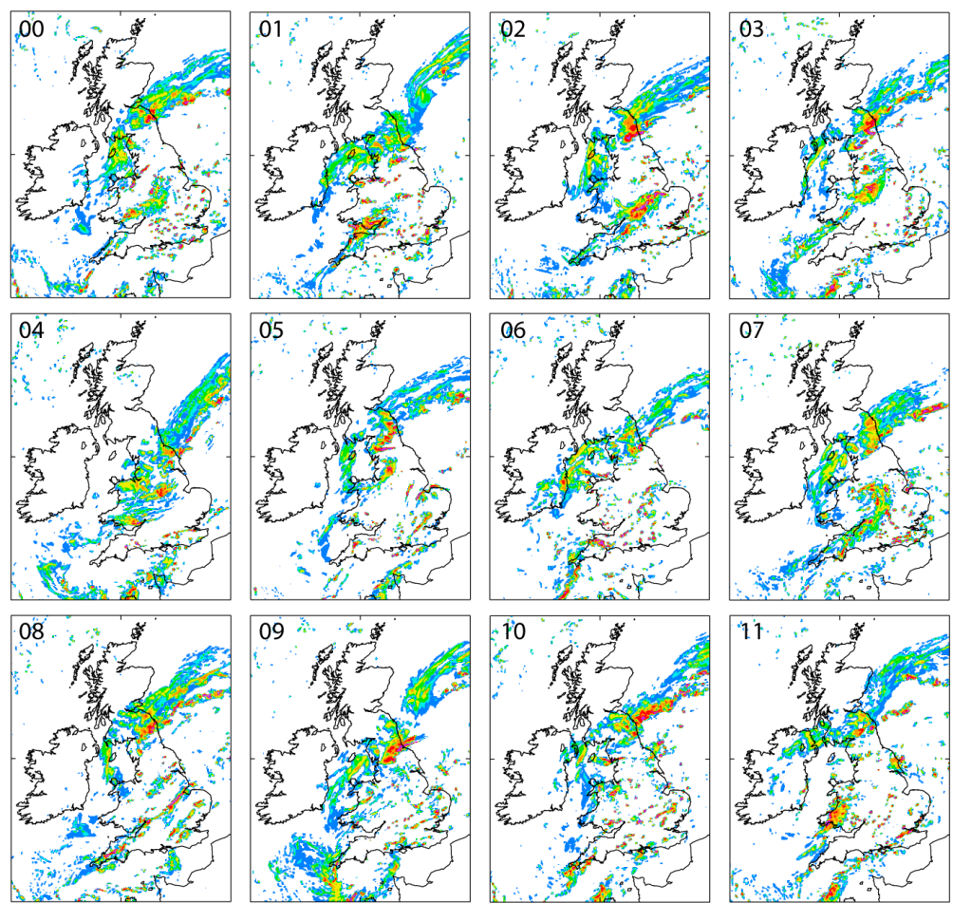
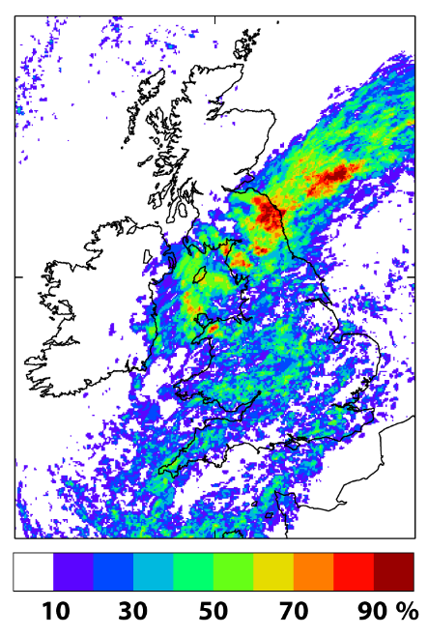
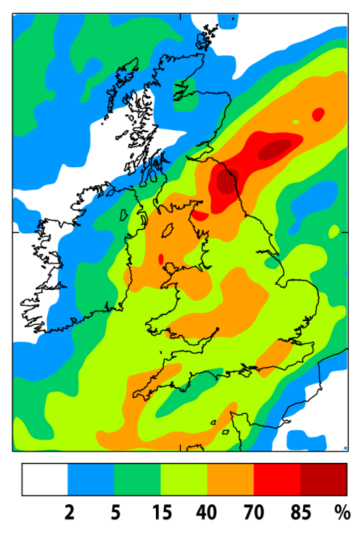
Making a probability forecast
Ensemble + neighbourhood
X
Gaps because of under-sampling
Smooth probabilities with additional neighbourhood processing
But what is the right sized neighbourhood ?

Slide 20
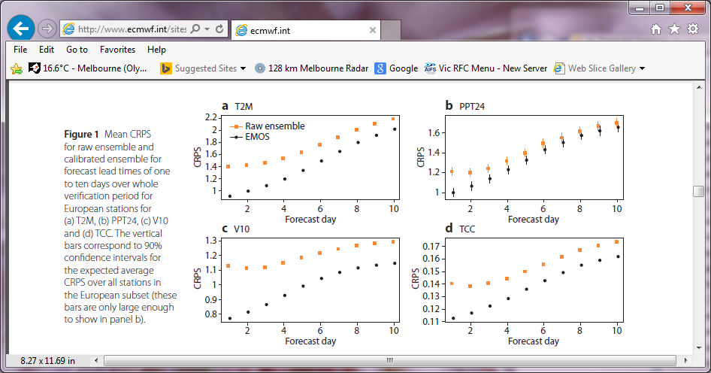
ECMWF experience (2015)
Better
Notes:
Multi-model ensemble would be expected to add more skill (e.g. Cui et al)

Slide 21
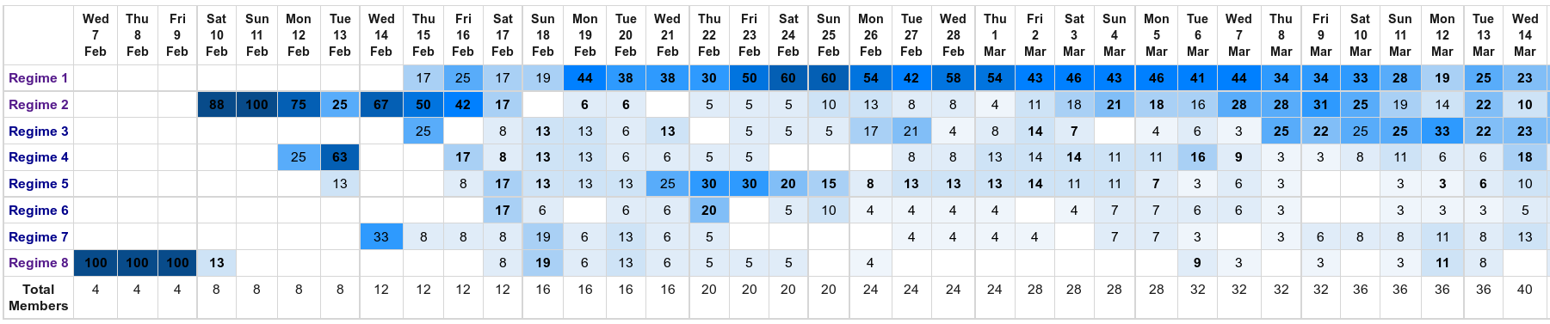
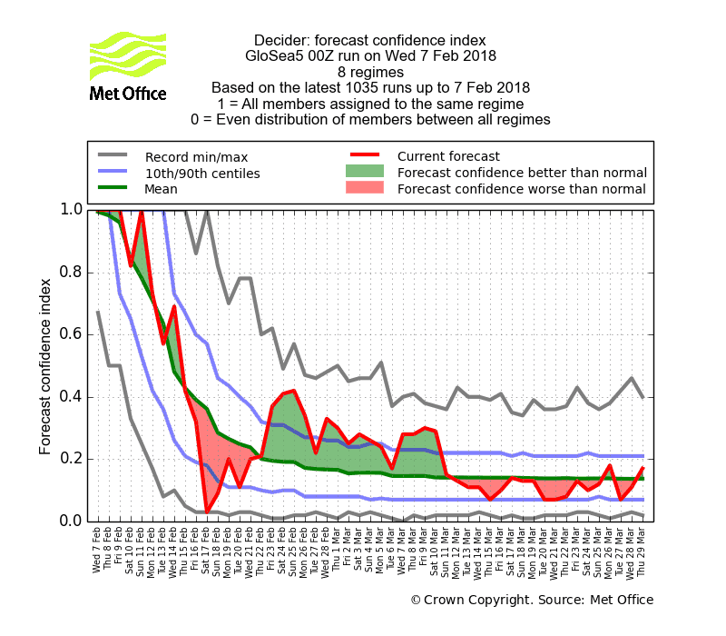
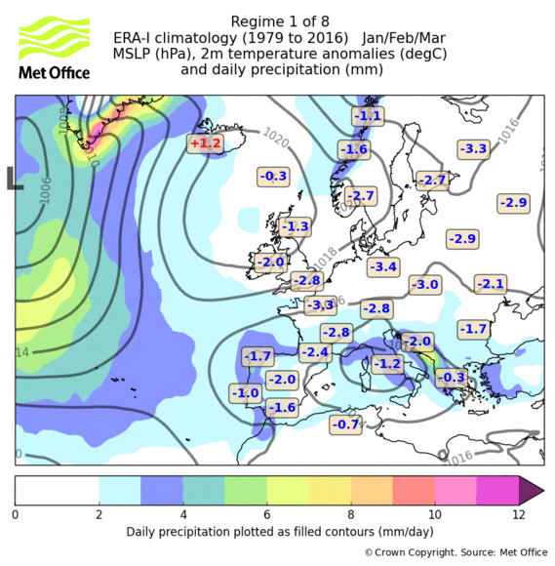
Decider – 5 week weather regime forecast (8 regimes) GloSea5 0000 UTC run on Wed 7 February 2018
Unusually high forecast confidence for Regime 1 (shown on left) occurring from late February onwards
Cold outbreak started 24 Feb

