Slide 1
Delivery of the next Bureau NWP products and benefits in 2019
A seven-year programme to enhance the computational and numerical prediction capabilities of the Bureau’s forecast and warning services (2014-2021)
Tim Pugh
Tuesday 27 November 2018

Slide 2



Supercomputer Program
Supercomputer
Australis Go-Live on 30 June 2016 (phase 1)
2018 HPC Upgrade investment (phase 2)
Realised benefits:
  Reduced risk and duration of outages
  Capacity to produce Weather and Climate ensembles for probabilistic forecast information
More accurate Particularly for the location, timing and direction of rainfall, storms and wind changes
More up-to-date More frequent forecasts available
More valuable For decision makers, by quantifying forecast outcome probabilities using ensembles
More responsive Through capability to produce additional, on-demand, detailed forecasts for multiple extreme weather and hazard events across Australia.

Slide 3
Supercomputer Program Schedule
 | FY14-15 |  | FY15-16 |  | FY16-17 |  | FY17-18 | FY18-19 |  | FY19-20 |  | FY20-21 |  | FY21-22
Oracle HPC system | Operations |  |  |  | End-of-life
ACCESS Prediction Sys #2 | Development |  |  | To Ops | Production |  |  |  |  | End-of-life
1.5km City-Scale NWP |  |  |  | Development |  | To Ops | Production |  |  | End-of-life
MDC Data Centre | Procurement |  | Commission |  | Operations
Cray XC40 HPC System | Procurement |  | Install | Test | Operations |  |  |  |  |  |  |  |  | End-of-life
ACCESS Prediction Sys #3 |  | Plan | Development |  |  |  |  |  | To Ops | Production |  |  |  | End-of-life
Mid-term HPC Upgrade |  |  |  |  |  |  |  | Plan | Install | Test | Operations
ACCESS Prediction Sys #4 |  |  |  |  |  |  |  | Plan | Development |  |  | To Ops | Production
We are here…

Slide 4
APS3 Models - Delivery Schedule
ACCESS-R3 (TBA)
ACCESS-G/GE3
Scientific Trial
(hindcast & realtime)
Release Candidate
(verification trial)
Production Release
(officially supported)
ACCESS-C/CE3
Scientific Trial
(hindcast & realtime)
Release Candidate (verification trial)
Production Release (officially supported)
ACCESS-TC3
Scientific Trial (hindcast & realtime)
Release Candidate
(verification trial)
Production Release (officially supported)
Oct’18
Nov’18
Dec’18
Jan’19
Feb’19
Mar’19
Apr’19
May’19
Jun’19
Jul’19
Aug’19

Slide 5
Future Business Impacts of
Australis HPC system not meeting computing demand
Meets demand? | 2018 |  |  |  | 2019 |  |  |  | 2020 |  |  |  | 2021
 | Q1 | Q2 | Q3 | Q4 | Q1 | Q2 | Q3 | Q4 | Q1 | Q2 | Q3 | Q4 | Q1 | Q2 | Q3 | Q4
Severe Weather (NPP commitment) | YES | YES | YES | YES | YES | YES | YES | YES | 80% | Exceeds margin for service resilience
On-Demand (TC, Storm Surge, EER, Volcanic Ash, Smoke…) | YES | YES | YES | YES | 37% OVER | Production jobs must utilise PROD & STAGE to meet on-demand schedule (Exceeds margin for service resilience)
Routine (Global, region, city-scale, climate, marine, ocean…) | YES | YES | YES | YES | YES | Production jobs must utilise PROD & STAGE to meet routine schedule (impact to development, service disruptions for maintenance)
Development (Climate S2, APS3, APS4, NAS, OceanMAPS, ADEPT..) | YES | YES | YES | congested G3, C3 and S2-HC delays |  | Less available on STAGE over time as new models transition, production load expands (delays to complete science trials, pre-production trials, incremental updates, incident resolution)
Mix Loads
Dev & Production jobs
can access all HPC nodes
HPC Upgrade
Production jobs move to new HPC service
and development to utilize existing HPC service
End-of-Program
(End of NPP funding)

Slide 6
Cray® XC50TM
Complete Dec’19
Build: commencing
January 2019
>5000
teraflops
√
Cray® XC40TM
Completed June’16
Previous System
104
teraflops
1660
teraflops
2015
2016
2017
2018
2019
2020
2021

Slide 7
APS Review
Stakeholder Engagement
Aviation
Agriculture
Defence
NOC
Community Forecast
Water
Energy
Oceans
PS-TC
PS-Flood
PS- Thunderstorm
PS- Fire

Slide 8
Business Demands for Numerical Weather Prediction
Sector | Sector Needs | Outcome | Output
Public Safety-Fire | "When a fire is active, it's important to know what the forecasts are with as much detail and accuracy as possible for particular locations, so that I can give the correct info for planning the right evacuation" | Increased quantifiable information for specific locations. Increased accuracy | City-scale model APS: CE3, CE4 Ultra-scale model APS4: UX
Aviation | “I’m managing the airport and would like to know how long there is to get planes on the ground before the thunderstorm hits and what flights to advise to delay from other airports." | Information about severe weather for specific locations as quickly as possible. Increased accuracy Rapid situational update | City-scale model APS: CE3, CE4 Ultra-scale model APS 4: UX Rapid Analysis APS 4: NAS
Agriculture | "I need to understand the probability of rain 7-14 days ahead of more than 20mm rain, so that I can manage my pastures and move my livestock to a suitable location for best survival rates". | Provide probability of severe weather at a longer timescale, even if the confidence is lower. Increased accuracy Extended forecast lead time | Global-scale model APS 3: GE3 Extended lead time APS 4: GE4
Public Safety-Cyclone | "I need to understand the probability of where a cyclone may impact so that I can prepare the community and resources from an emergency services perspective.". | Information about the probability of the area of impact Increased accuracy and quantifiable information | Global-scale model APS: GE3, GE4 Ensemble TC APS 4: TCE
Energy | "I need to know the amount of solar radiation reaching the ground, so that I can plan the productivity of major solar farms and make high value decisions and ensure that there is enough power available to meet demand. I need timescales of 3 hours to 3 days." | Information on solar radiation up to 3 days for specific locations | City-scale model APS: CE3 APS: CE4

Slide 9
NWP Modelling Suite Changes and Business Outcomes
Outcomes | Response to Business Needs | Model Change | Customers
Provide probability of severe weather at a longer timescale, even if the confidence is lower | Better characterisation of uncertainty in global forecasts Information on 7-14 days lead time, with estimate of uncertainty Increased model accuracy | Global-scale model Increase forecast lead time to 14 days Increase ensemble resolution to 20km Increase to 24 ensemble members Improves initial state of global model | Agriculture Public Safety-Cyclone Energy
Information about the probability of the area of impact | Better characterisation of uncertainty in forecasts for TC track and intensity | TC ensemble model Deploy ensemble TC suite of 12 members, 72hr fc, 4km resolution Improves initial state of TC model | Public Safety-Cyclone Energy
Information about high-impact weather for specific locations as quickly as possible. Information up to 3 days for specific locations | Rapid update of short term forecast at high spatial resolution for high-impact weather events Better characterisation of uncertainty in city-scale forecasts Increased lead time for improved cloud, wind and rain forecasts | City-scale model Increase the frequency of model runs up to 24 times per day, 12hr lead time Increase the forecast lead time to 72hr, 4 times per day Increase to 18 ensemble members Improves initial state of city models | Public Safety-Fire Aviation Energy
Information about severe weather as quickly as possible. | A best analysis of current conditions over all of Australia with rapid update | National Analysis System Deploy national analysis suite of 9 members, hourly update | Energy Aviation
Information about high-impact weather for specific locations as quickly as possible | Improved accuracy of short term forecast at high spatial resolution for high-impact weather events | Ultra-scale model Deploy a 200-300m grid resolution NWP model runs up to 8 times per day, 12 hr lead time, 3DVAR | Public Safety-Fire Aviation
Sufficient forecast data to assess, validate and train downstream models | An extensive reforecast period for new NWP systems to allow training of downstream models | Global-scale and City-scale models Increased reforecast period to supply 12-18 months of data | Public Safety Flood Warnings and Stream Forecasts
Notes:
Better characterisation of uncertainty in forecasts (ensemble NWP)
Rapid update nowcasting/short term forecasting at high spatial resolution for priority domains
A best feasible analysis of current conditions over all of Australia with rapid update
An extensive reforecast period for new NWP systems to allow training of downstream models.
Other business needs include:
Information on 7-14 days lead time, with estimate of uncertainty-Ensemble
Information out to 3 days lead time at high spatial resolution for priority areas, with estimate of uncertainty- Data Assimilation and update cycle through C3 and CE3
Accuracy in terms of additional resolution, however this is seen as a lower priority than characterisation of uncertainty (i.e., larger ensemble size rather than slightly higher resolution, noting that doubling the resolution requires 10 times the compute).

Slide 10
Thank you
Any questions?
Tim Pugh, tim.pugh@bom.gov.au

Slide 11
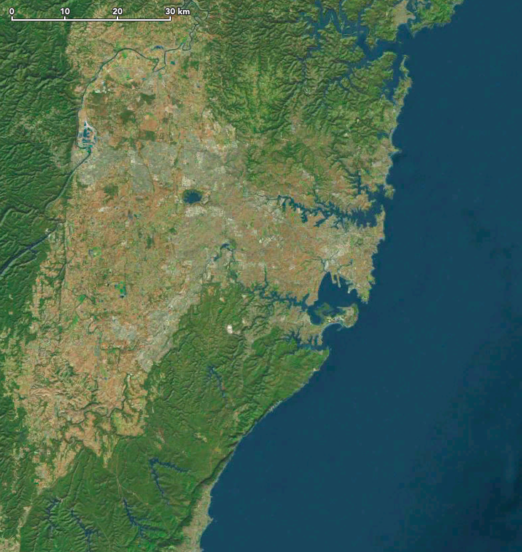
GLOBAL NWP GRID CELLS
2010 – 80km cell, 3.1M cells
(288 x 215 x 50 levels)
2013 – 40 km cell, 21M cells
(640 x 481 x 70 levels)
2016 – 25 km cell, 55M cells
(1024 x 769 x 70 levels)
2019 – 12 km cell, 220M cells
(2048 x 1537 x 70 levels)
4DVAR data assimilation
18 member ensembles
12 km
25 km
40 km
80 km
Notes:
No change to forecast and frequency
2 x 10-day forecasts per day
2 x 3-day forecasts per day

Slide 12
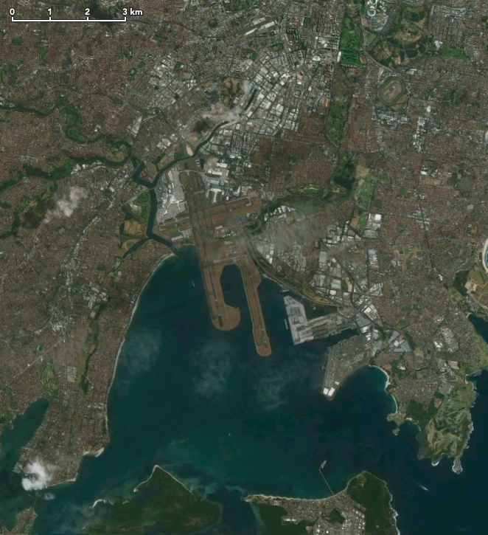
CITY-SCALE NWP RESOLUTION
2010 – 5 km cell, 2.8M cells
(240 x 240 x 50 levels)
2013 – 4 km cell, 8.4M cells
(334 x 362 x 70 levels)
2016 – 1.5 km cell, 42M cells
(814 x 738 x 70 levels)
2019 – 1.5 km cell, 49M cells
(840 x 840 x 70 levels)
hybrid VAR data assimilation
12 member ensemble
1.5 km
4 km
5 km
12 km

Slide 13
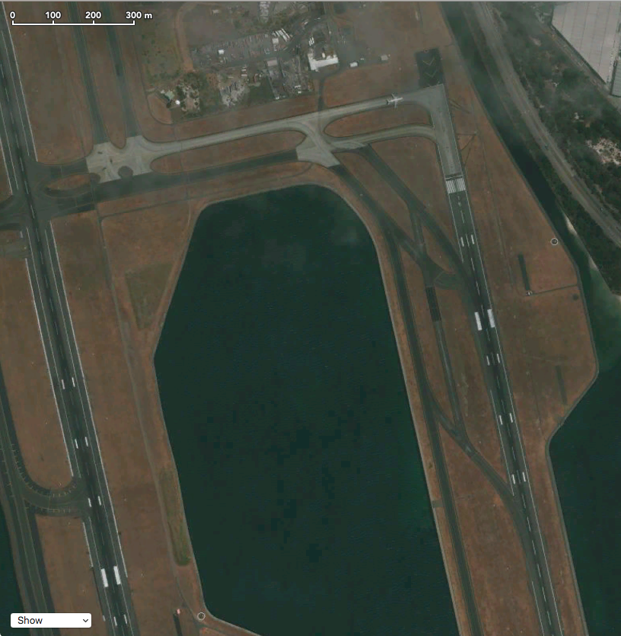
AIRPORT-SCALE NWP RESOLUTION
(disclaimer: future models and plans are subject to change)
FY2020 – trial of new NWP model for
specific industries with 200-300 m cells and
initially incorporating a 200 km wide box
2020 – 300 m cell, 34M cells
(700 x 700 x 70 levels)
12-hour fc, every 3 hours
Forecast and frequency of runs to be
determined with customers, but initially
envisioned to be 12-hour forecasts
every 3 hours.
300 m
1500 m

Slide 14
Notes:
Dotted lines are existing ACCESS-C2 model domains.
Solid lines are the new ACCESS-C3 model domains, some domains have been expanded to reduce open boundary effects and improve forecasts.

Slide 15
Benefits of greater compute power in NWP
Model view improvements
Finer grid resolution
More frequent updating
Greater resilience to failure
Better representation of probabilities
Service view improvements
Cyclones
Severe Storms
Fires
Flooding rains
Track
Intensity
Structure
Location
Lead Time
Intensity
Wind speed
Wind Direction
Local Detail
Location
Volumes
Lead Time
User view improvements
Industry
Community
Infrastructure
Emergency Services
Fewer false alarms
Shorter close-downs
Better decisions
More time for preparedness and evacuation
Fewer loss of lives
Increased preparedness
Less damage
More effective deployment
Faster recovery

