Slide 1
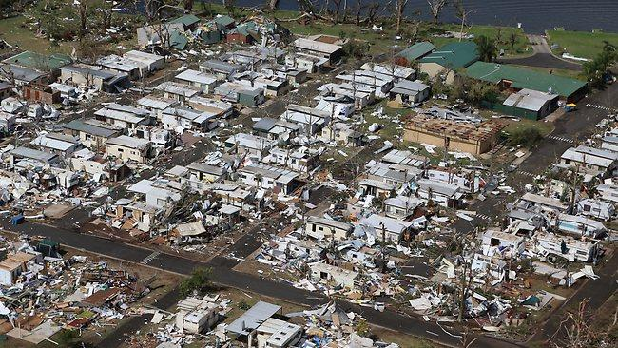

Use of ensembles in forecasting and communicating hazardous weather
- An operational meteorology perspective
Dean Sgarbossa
Science Support Meteorologist,
Extreme Weather Desk,
National Forecast Services
Notes:
This presentation is will ask hypothetical questions to prompt thought experiments and processes, while highlighting operational requirements with respect to the EWD.

Slide 2
Efficient interrogation in the age of
“big data”
Provide a more efficient, physically consistent and enhanced ingredients-based forecast process that:
- decreases the amount of mental load on the operational meteorologist
- decreases the number of individual fields/parameters required to be interrogated
- increase the detection efficiency of potential high-impact weather events to improve the diagnosing, forecasting, warning and communication of hydrometeorological hazards.
Implemented by:
- strategically and intelligently combining individual fields into composite fields/parameters that highlight where the environment is conducive to a hazard
- effectively alerting the operational meteorologist of areas where the environment is conducive to a hazard and significance of the hazard
- prompts the operational meteorologist to investigate further and critically analyse the environment (inform targeted intervention to automated systems)
- cascading guidance from parameter space, through CAM derivatives to nowcasting.

Slide 3
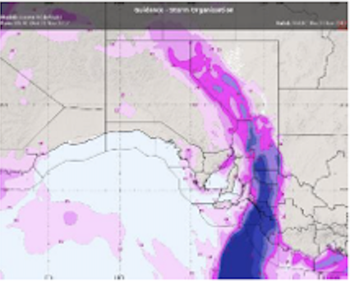
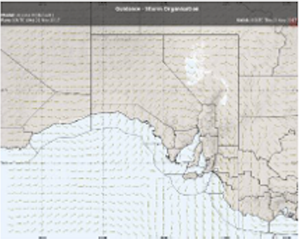
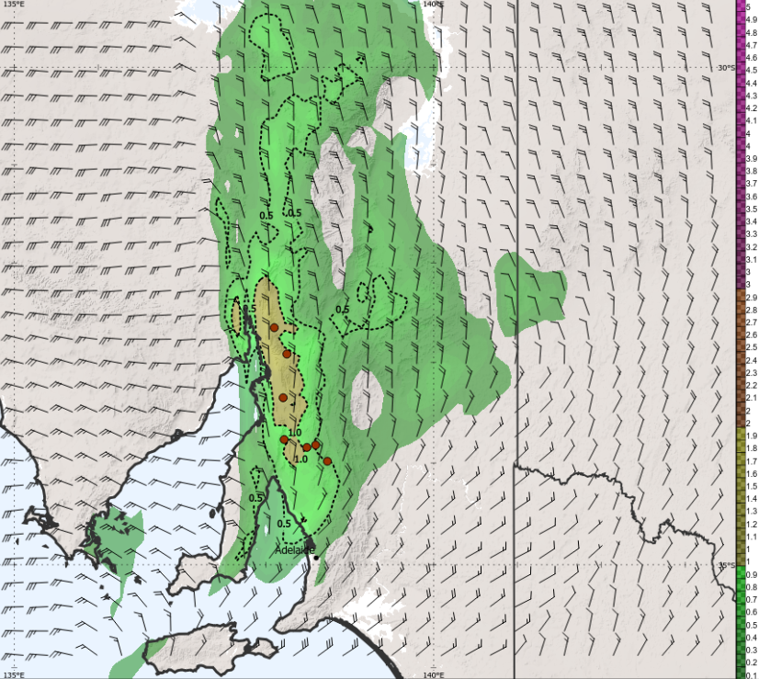
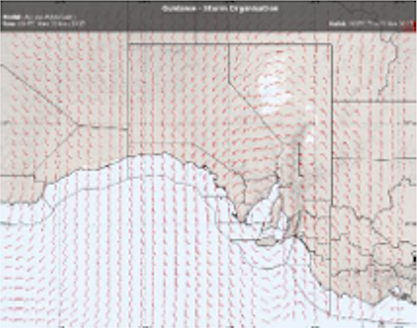
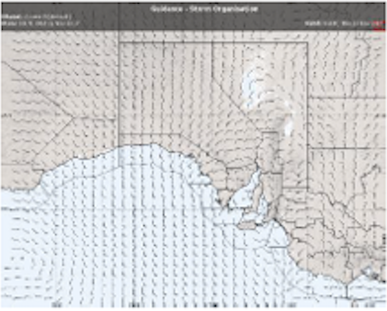
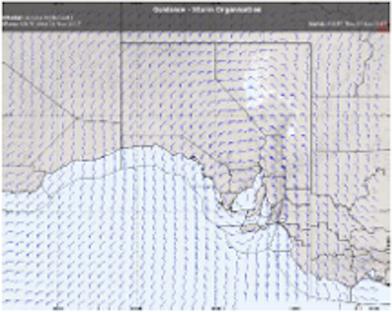
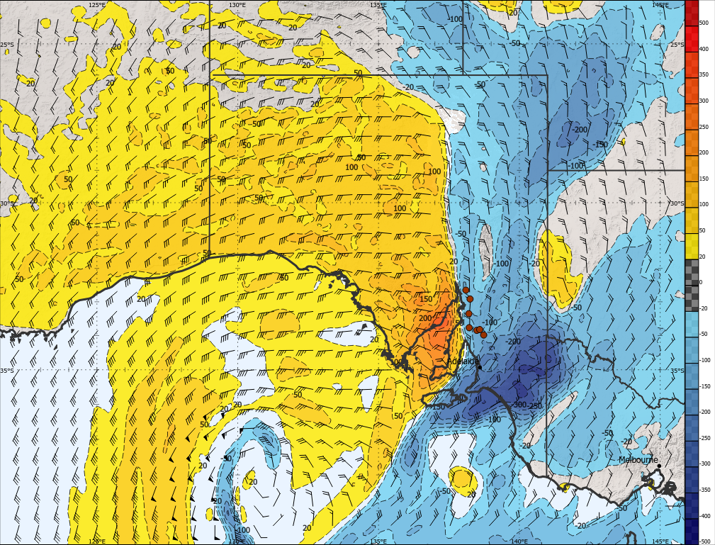
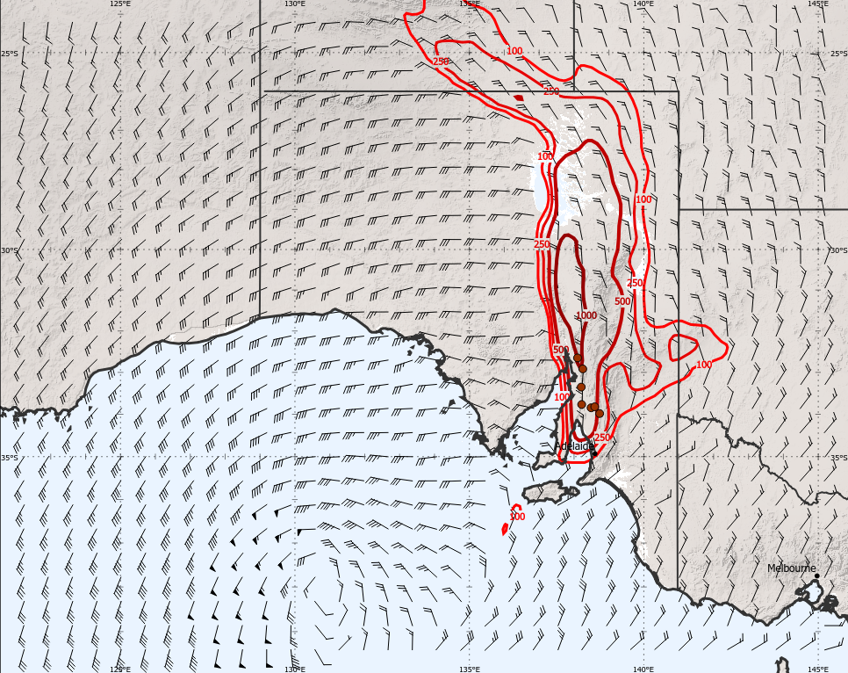
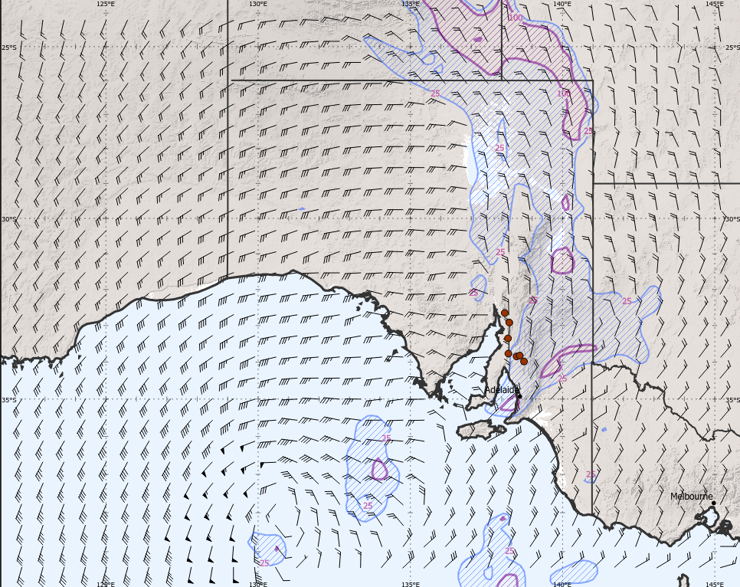
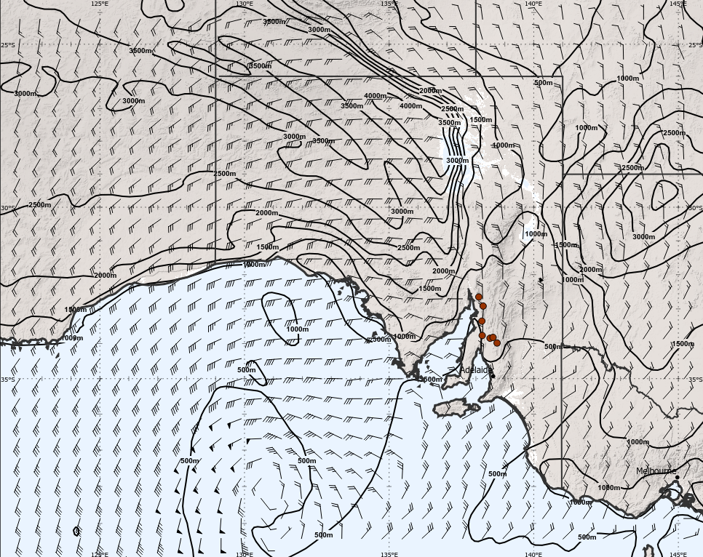
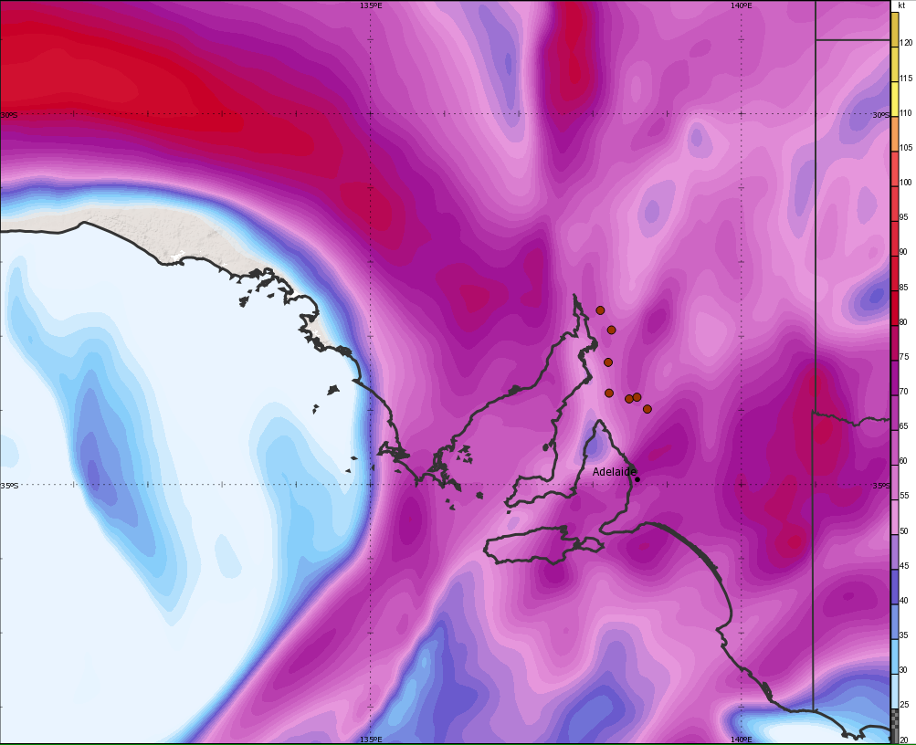
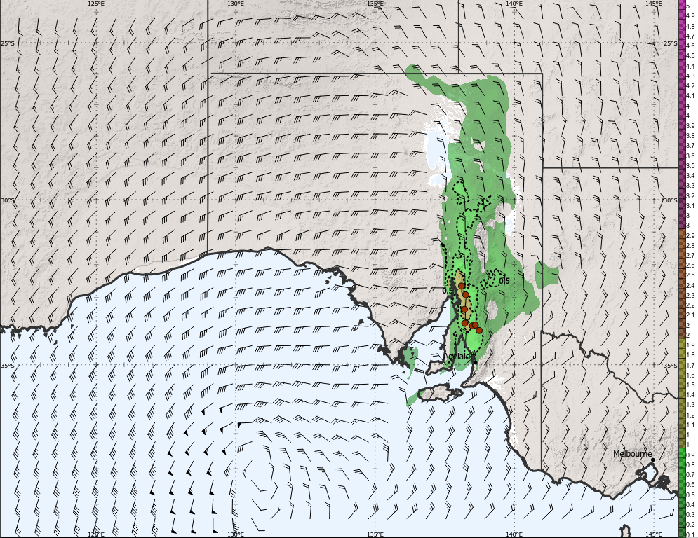
Efficient interrogation in the age of
“big data”
Vertical Wind Shear
10 m – 1 km AGL
Storm Relative Winds
10 m – 1 km AGL
Storm Motion Vector
10 m AGL Wind
6 km AGL Wind
10 m – 1 km AGL Storm Relative Helicity
ML-CAPE
ML-CIN
ML-LCL
10 m - 6 km AGL Bulk Wind Difference (Shear)
Significant Tornado Parameter

Slide 4
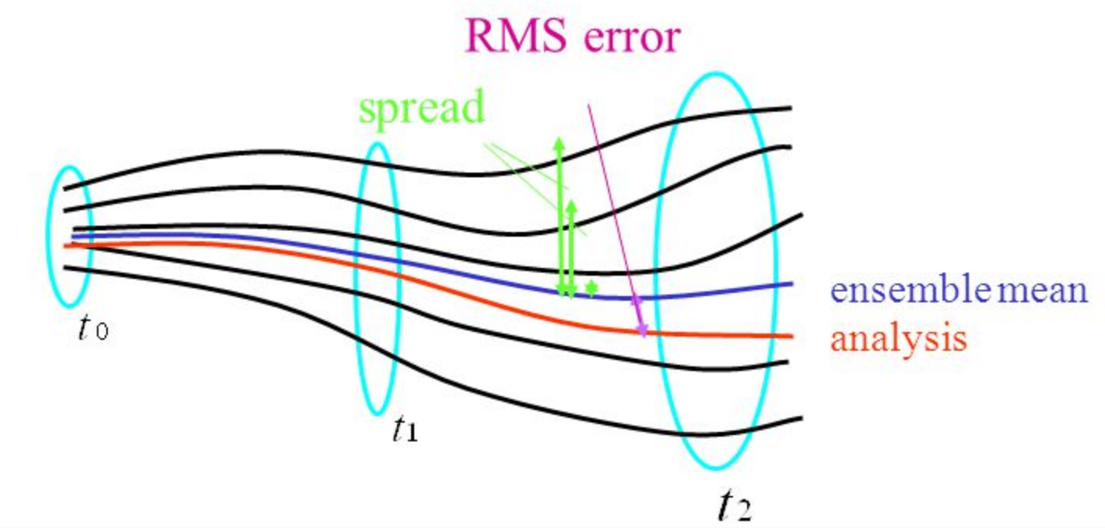
Ensemble guidance considerations
From an operational perspective, ideally EPS’ should provide:
quantitative measure of confidence and uncertainty (probabilities) - critical for impact-based forecasting
depict variability of outcomes
inform decision-support systems and procedures
- warning required if probability of occurrence > threshold
- alignment with cost/benefit/risk analysis strategies
each ensemble member reflects a physically realistic solution
with an equal likelihood of occurrence
have sufficient spread such that:
- predictable states should have small ensemble spread
- unpredictable states should have large ensemble spread
- as lead time decreases, so too does the probabilistic envelope spread reflecting increasing probabilities and confidence.
Berner, J. 2015: Representing model uncertainty in weather and climate: stochastic versa multi-physics representations. https://slideplayer.com/slide/3521258/

Slide 5
Ensemble guidance considerations
Challenges:
Lack of spread of the ensemble members, with a tendency for the ensemble probability curves to fluctuate with deterministic control member subsequent model runs.
- leads to a false sense of confidence in a solution
How do operational meteorologists interpret ensemble guidance and probabilistic data?
- paradigm shift for operational meteorology
- deterministic forecast solutions more readily assist operational meteorologists with confirming, correcting and nudging conceptual models to probabilistic solutions that attempt to explain uncertainty and confidence in a range of solutions.
How do operational meteorologists effectively explain probabilities, percentiles and confidence in a fashion that resonates with, and is useful in the decision-making processes of our customers?
Do our customers and general public really understand (or want) probabilistic guidance?
Will current EPS development continue to reduce ensemble spread due to the verification metrics and tuning of NWP and EPS to return improving verification statistics?
Notes:
- RA1M and RA1T variants?

Slide 6

Ensemble guidance considerations
Challenges:
Is a combination of EPS and lag ensemble, or multi-model and lag super-ensemble a better approach?
- e.g. SPC Storm-Scale Ensemble of Opportunity (SSEO)
- The Wisdom of the Crowds (Surowiecki 2005) approach
Can we vary ensemble members by physics schemes; i.e. UM RA1M and RA1T?
Identifying and filtering of ”better” performing ensemble members based on flow regimes and history performance
- does this defy the basic concept that each ensemble member is a physically realistic solution of equal probability of occurrence?
- are we suitably qualified to make a decision on which ensemble members should be omitted?
- individual ensemble member performance could be beneficial to operational meteorologists and developers alike.
Notes:
SSEO now HREF v2
Omitted … since they represent a physically realistic solution?

Slide 7
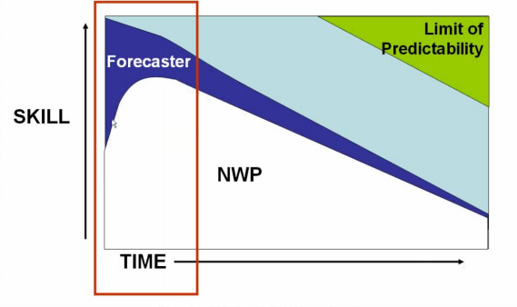
Guidance – Parameter Space
Provide a "heads up" regarding risk of thunderstorms and severe thunderstorm phenomena
Days 0-7 but dominates days 1-7
Largely NWP-based
Largely qualitative based on deterministic NWP
Probabilistic via climatology or explicitly via EPS or lag ensembles
CAMS:
Days 0 to 1
Provide refined, more detailed and precise forecasts of the risk of hazards.
Confirm environmental assessment from parameter space and conceptual model using CAM output
- e.g. convective mode, storm organisation, etc.
CAMs
Parameterised NWP

Slide 8
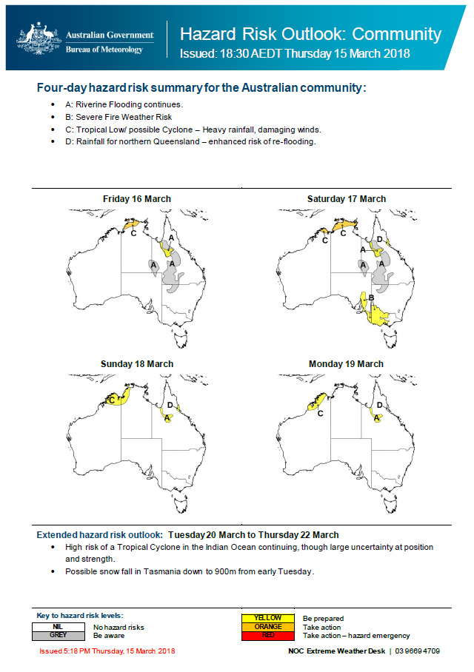
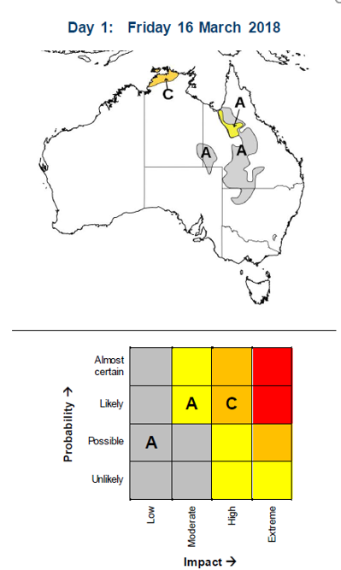
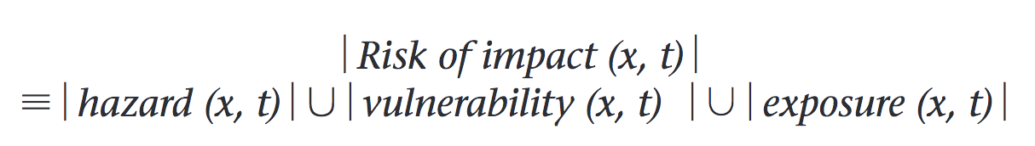
National Hazard Outlook
Structured and a considered methodology of assessing hazard impact and risk with an increased emphasis on integrating risk management into organisational activities, processes and decision-making.
Impact probability-based approach informs communication strategies, contingency planning and flexible resourcing strategies to facilitate incident management and surge support in high-impact weather events.
Aligned and consistent with:
- Post Event Review Management (PERM)
- Bureau’s Enterprise Risk Management Framework 2017-2020
- ISO 31000 Risk Management

Slide 9
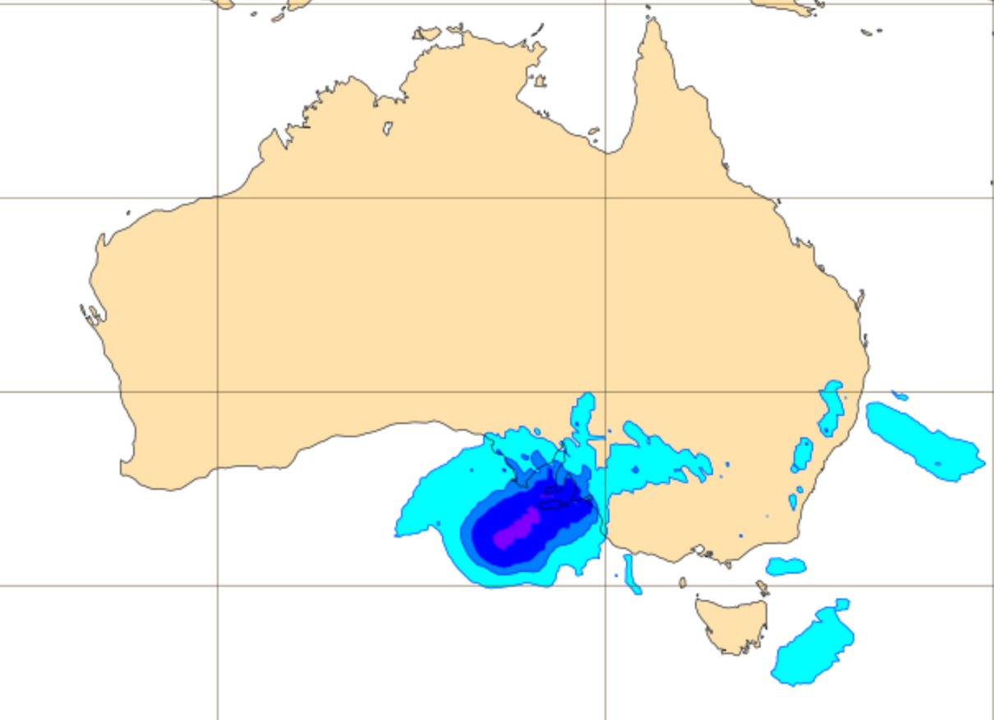
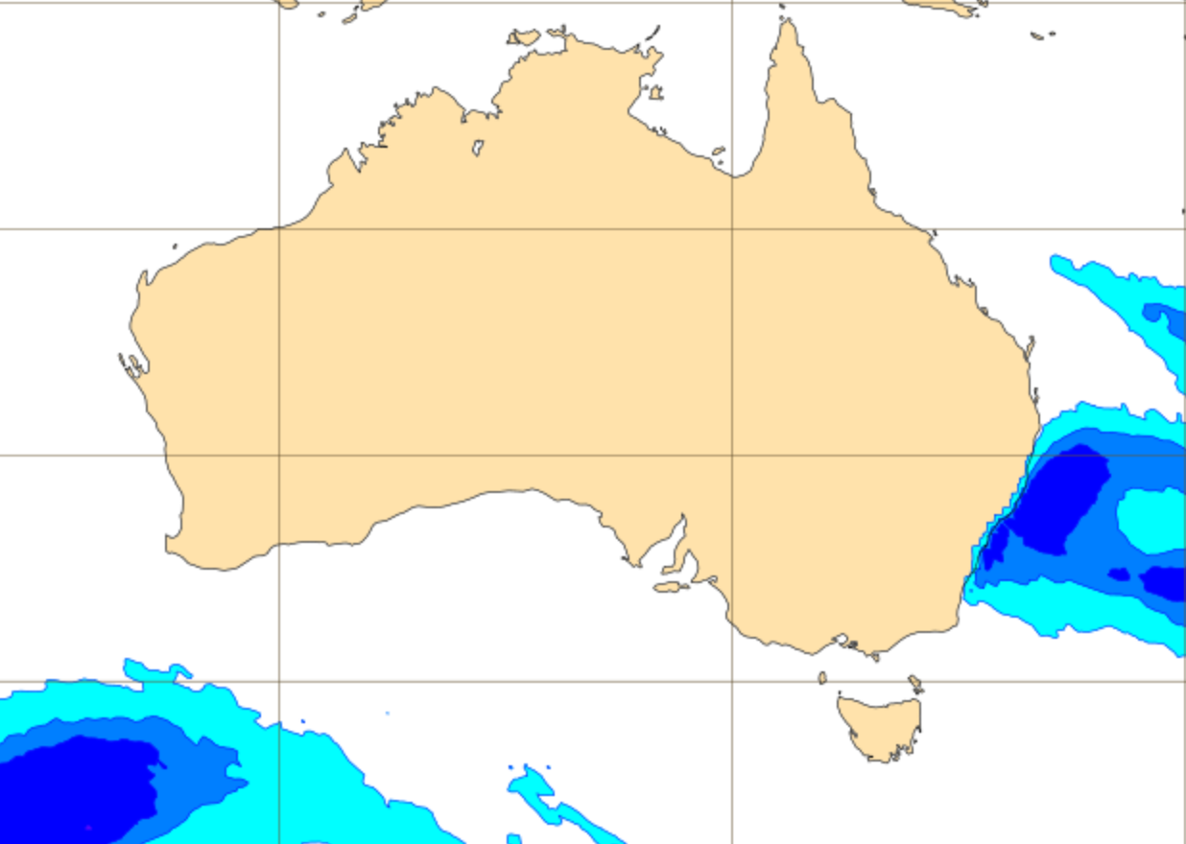
National Hazard Outlook
a)
Guidance Required:
Probability of hazard or standard warning criteria (e.g. wind gust > 90 km/h)
24-hr probability of hazard to efficiently diagnose and identify hazards
Higher temporal resolution to communicate timing of greatest risk of hazard (3-hr, 6-hr etc.)
Not only probability, but significance
- relate to previous impacts (how long since) or ARI/AEP
- measure of significance via comparison to climatology
- Example: instead of P(QPF > fixed threshold), require P(QPF ≥ point-based 10% AEP).
Combined probability of hazard:
- P(wind speed ≥ threshold) ) ∩ P(QPF ≥ threshold) (water ingress)
- P(significant wave height ≥ 4 m) ∩ P(swell period ≥ 10 s) (dangerous surf)
- P(precipitable water > σ) from climatology (heavy rainfall).
b)
Probability of a) 10 m AGL wind gust ≥ 90 km/h over 24-hrs to 00 UTC 22 November 2018, b) wind speed ≥ 25 kt and QPF ≥ 1 mm 24-hrs to 00 UTC 29 November 2018.
Notes:
Use re-analysis to calculate climatology fields

Slide 10
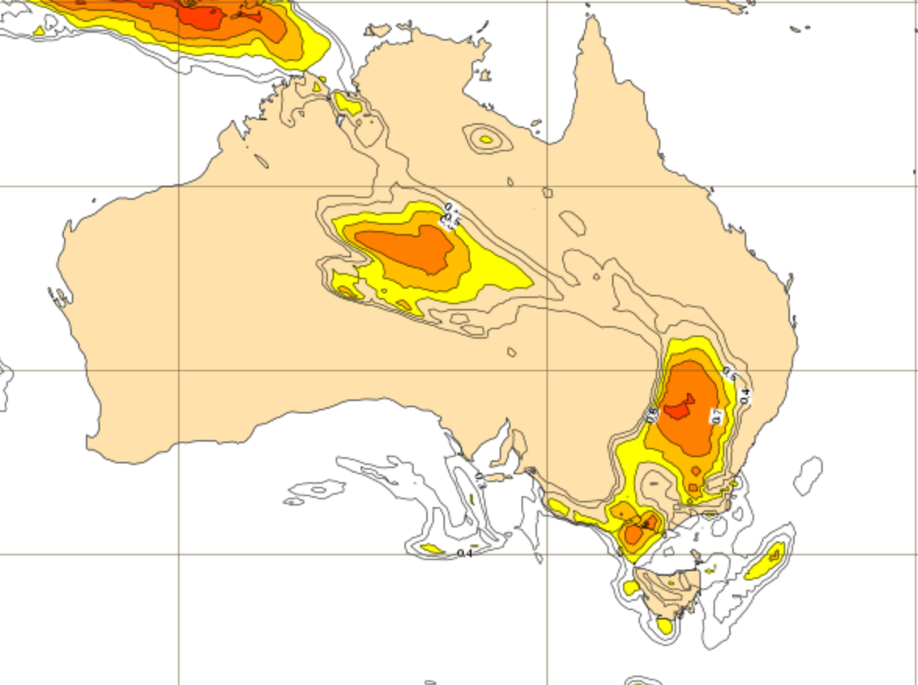
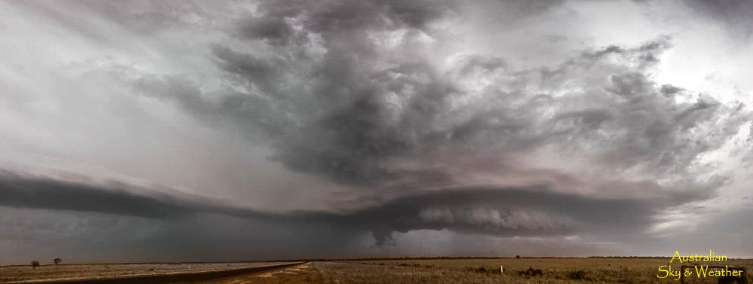
National Hazard Outlook
ECMWF Extreme Forecast Index (EFI):
Compares forecast parameters with ECMWF model derived 20 year climatology (with respect to 14 days either side of the day in question)
Value of +1 indicates all Ensemble Prediction System (EPS) members are above absolute maximum of climatology.
EFI value of -1 indicates all EPS members are below absolute minimum of climatology (temperature for example).
EF >0.7 threshold is commonly used (e.g. NZ Met Service) to highlight potentially significant events.
Shift Of Tails (SOT) fields can provide guidance on how extreme an event might be;
- positive SOT indicates 10% or more EPS members forecast values exceeding 99th percentile of model climate.
- Operationally, one can compare fields with the 99th percentile of the field to gauge the “quantitative” aspects of the event.
a)
b)
a) ECMWF EFI CAPE-SHEAR and b) Nevertie, NSW supercell – 20 November 2018 (Jane O’Neill).
Notes:
This has the very potential to not only highlight where and when a high-impact event may occur, but also to more effectively communicate to our stakeholders the significance of the event which feeds into the impact (community and operation) assessment of an event.
Issue is this is only available on a web-based viewer, but require it within visualisation and product preparation software.

Slide 11
National Convective Hazard
Risk Forecasts
EWD prepare national probabilistic hazard risk forecasts for lightning and convective phenomena
- probability of occurrence within 10 km of a point
First-guess forecast guidance provided by Calibrated Thunder (Bright et al. 2005) which utilises a 5-member lag ensemble.
Forecast process includes use of normalised convective parameters that identify environments conducive to severe convection or convective phenomena which can be used to produce probabilistic guidance:
- P(WMAXSHEAR ≥ threshold) ∩ (QPF ≥ 0.25 mm) (severe thunderstorms).
- P(SigHail ≥ 0.4) (~2 cm) ∩ P(SigHail ≥ 1) (5 cm)
- P(STP ≥ 1) (EF2+ tornadoes)

Slide 12
National Convective Hazard
Risk Forecasts
Combine parameterised regional/global deterministic/ensemble model output with CAM ensembles
Where is the environmental conducive to a hazard in parameter space and confirmed by CAM output?
- Calibrated Thunder and neighbourhood probability of light flash count ≥ 1
- STP and UH paintball
Include climatology data
- P(MU-CAPE ≥ 1000 J/kg) ∩ P(BWD ≥ 20 kt) from parameter space
- P(UH ≥ threshold) from CAM
- historical frequency of occurrence of the pair of probabilities within 10 km of a point (EWD definition)

Slide 13
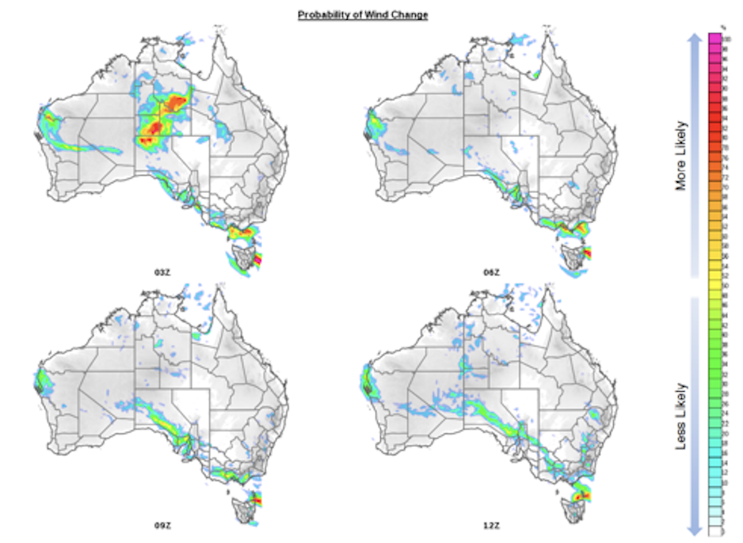
Fire Weather
Neighbourhood P(Wind Change)
- WCRI, ICON, Frontogenesis function
P(T ≥ threshold) ∩ P(wind ≥ threshold)
P(FDI ≥ threshold); e.g. P(Severe FDI)
P(FDI > % AEP); climatology from re-analysis
P(Dry Lightning)
- P(QPF ≤ 2.5 mm) ∩ Calibrated Thunder
- P(QPF ≤ 2.5 mm) ∩ P(Light Flash count ≥ 1)

Slide 14
Guidance – Nowcasting
Rapid update forecasts and warnings
Combination of environmental assessment via deterministic NWP, CAM NWP, CAM EPS, pseudo-observations, remote sensing and observations.
Ingest observational data into forecaster conceptual model, correcting their conceptual model and NWP model guidance.
Forecaster has greatest input and adds greatest value.
Mesoscale Analysis
- Best guess of what the atmosphere looks like now
- Near real-time parameters
RADAR
- Signatures
- Processing via Rainfields3 / TITAN / WDSS
Nowcasting

Slide 15
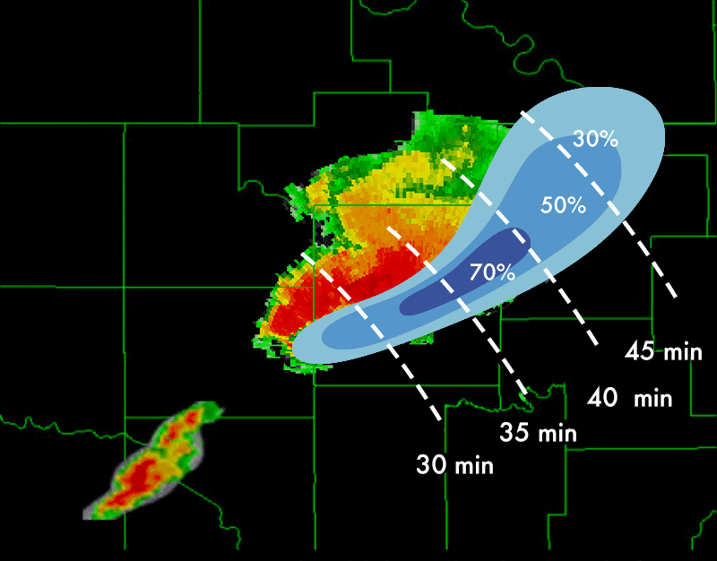
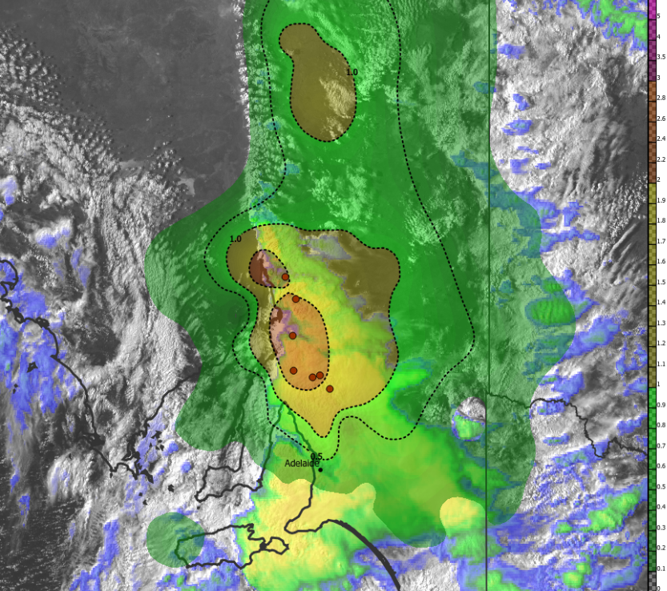
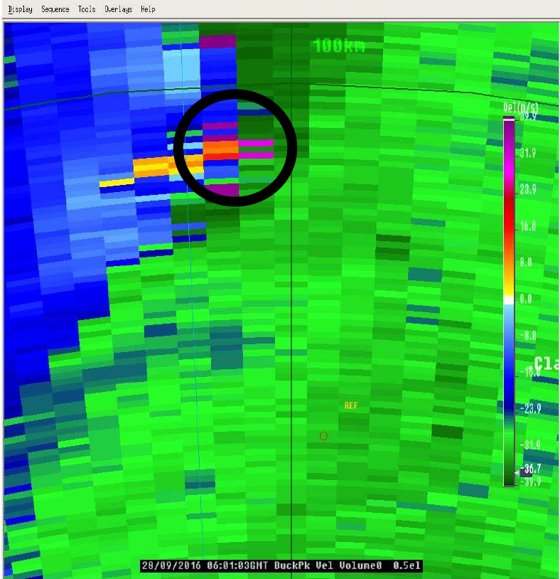
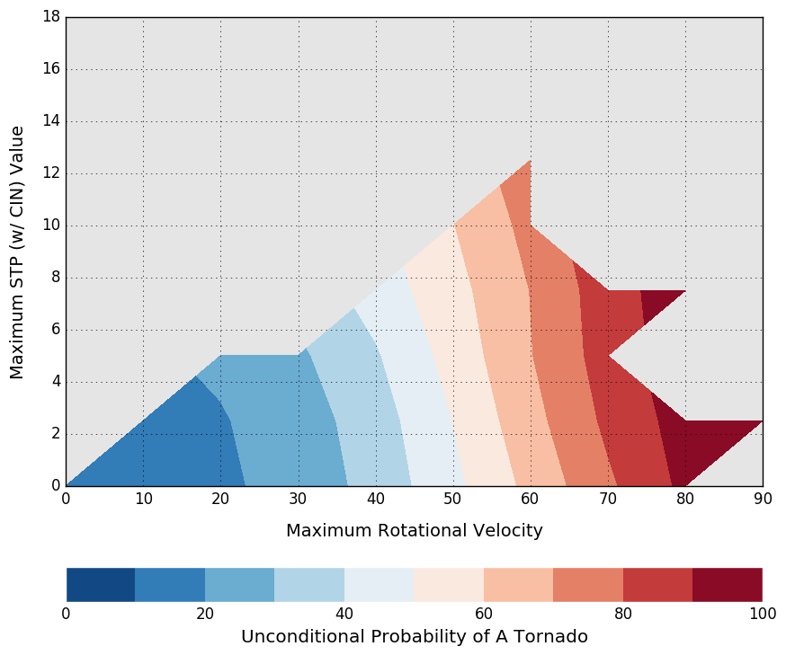
Nowcasting + Warning
Mesoanalysis derived composite parameters
- comparison with climatology (significance)
- Probabilities derived from climatology of environment and direct observations (probability of tornado example below)
RUC EPS derived P(thunderstorm track or phenomena)
NOAA NSSL Warn on Forecast approach
Sounding Analog Retrieval System (SARS)
STP = 2.7
0.5° 𝒗_𝒓𝒐𝒕 = 62 knots
Probability of a tornado ~70%

Slide 16
Extreme Weather Desk
Thank you…
Building an additional layer of capability to respond to extreme weather.
Dean Sgarbossa
EWD Science Support Meteorologist
dean.sgarbossa@bom.gov.au

