Slide 1
Utilising research to improve bushfire management
Simon Heemstra, November 2018

Slide 2

Research Utilisation
Why isn’t the research being used?

Slide 3
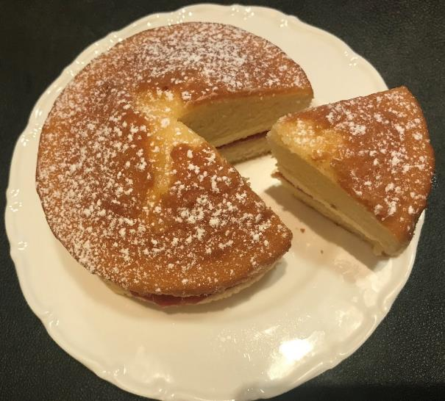
Research Utilisation
Are we investing enough in utilisation?
Research effort
Utilisation effort

Slide 4
Utilisation steps for research adoption
Understanding of research
Engagement with researchers
Ability to interpret
Tools to support utilisation
Policy and process development
Training
Familiarisation and socialisation
Maintenance and support

Slide 5
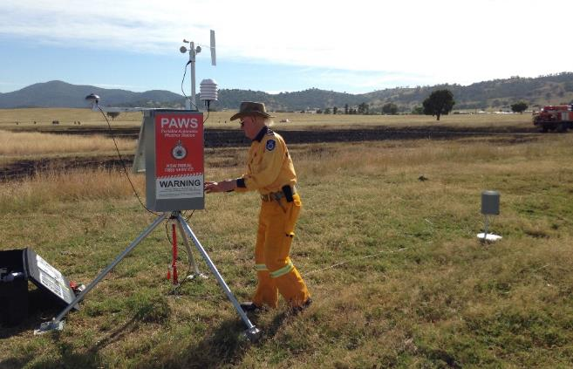
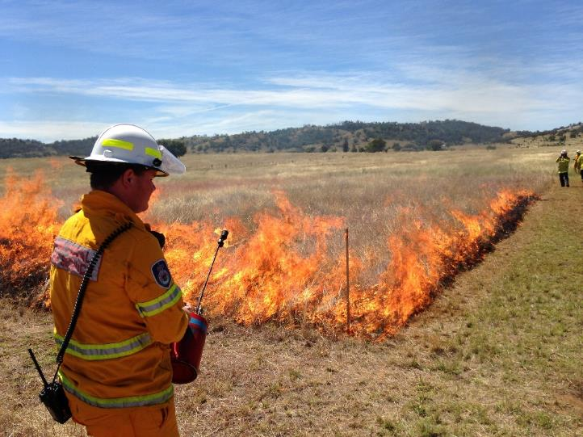
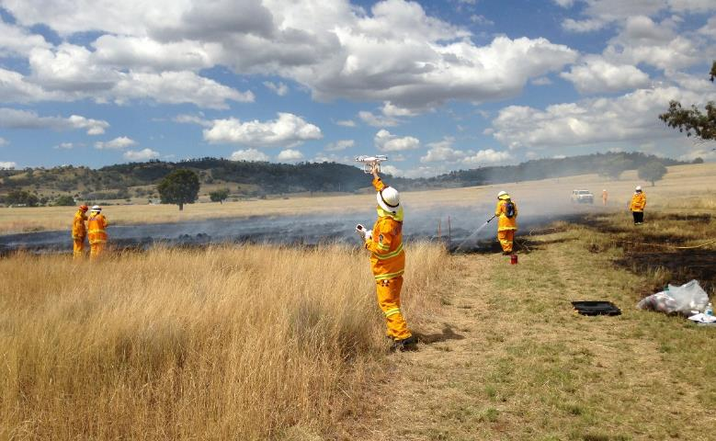
Research Engagement
CSIRO Grassland Curing

Slide 6
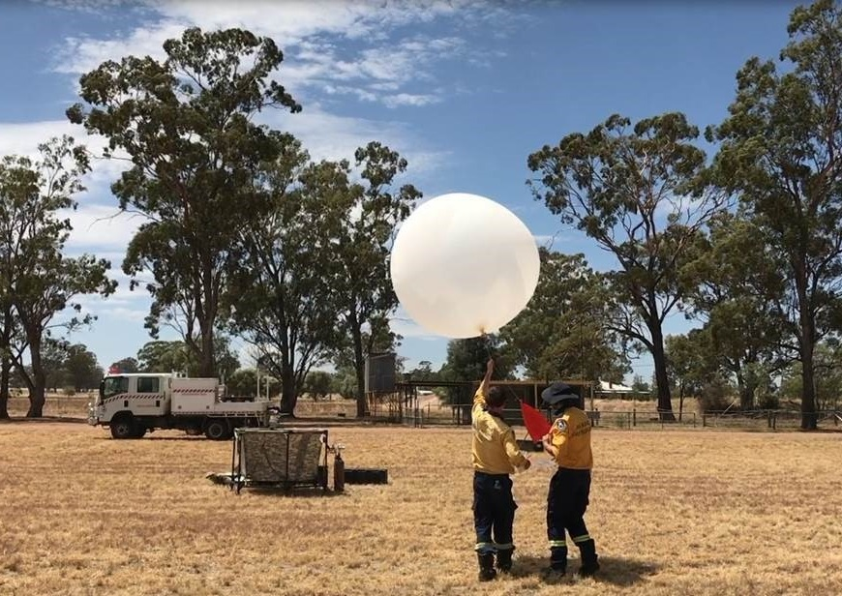
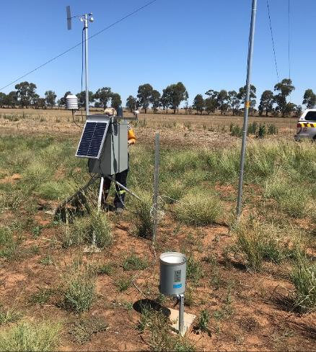
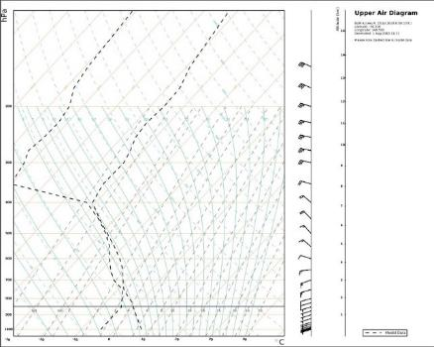
Ability to interpret

Slide 7
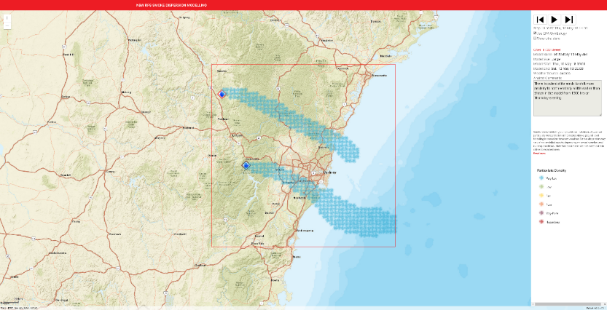
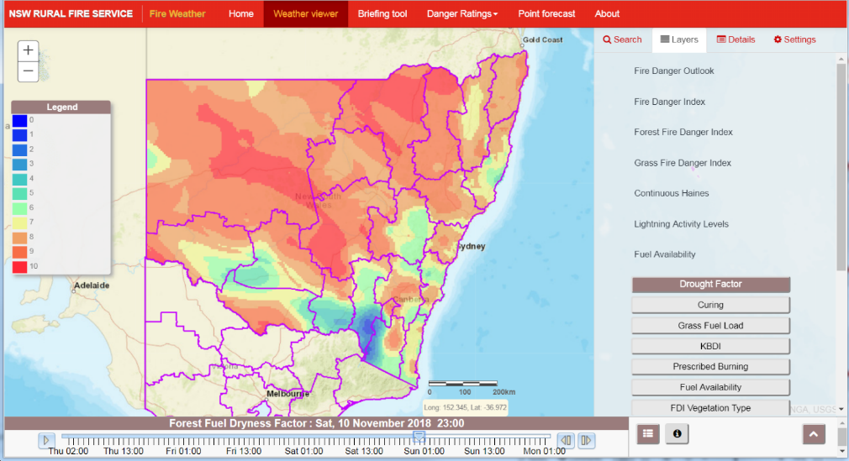
Tools to support operational use

Slide 8
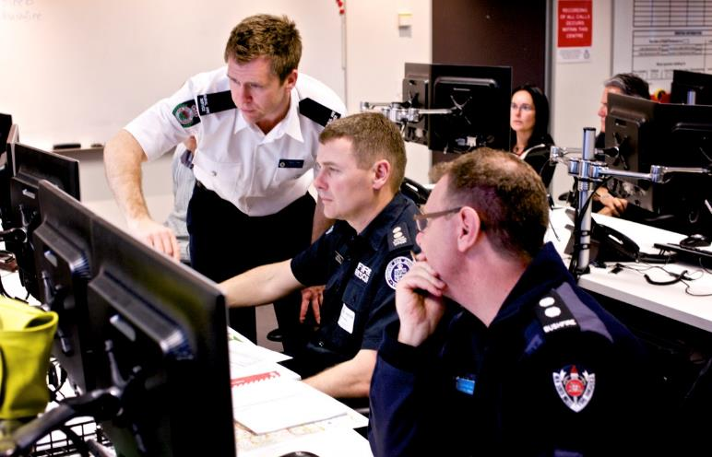
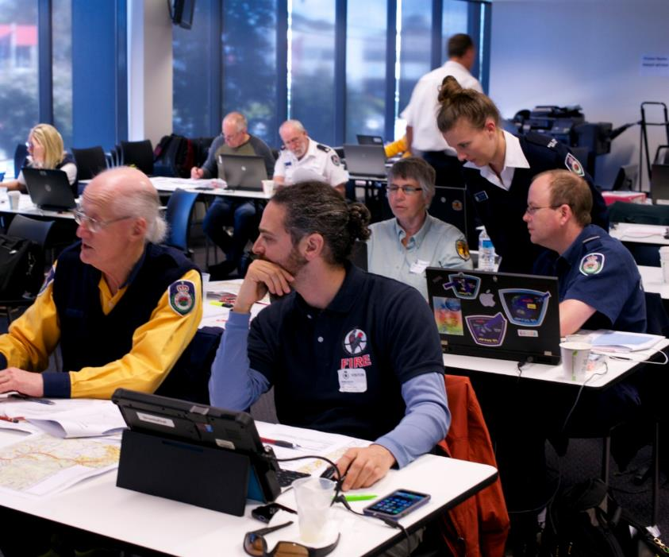
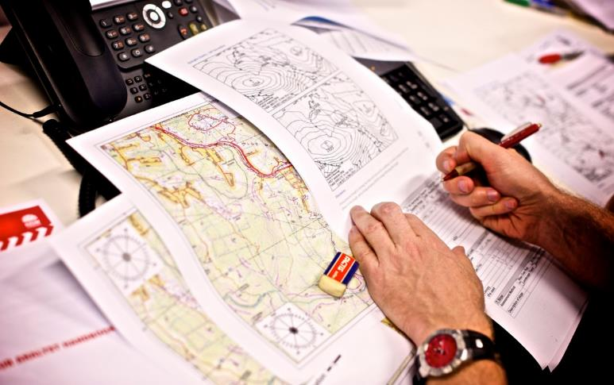
Training and support

Slide 9
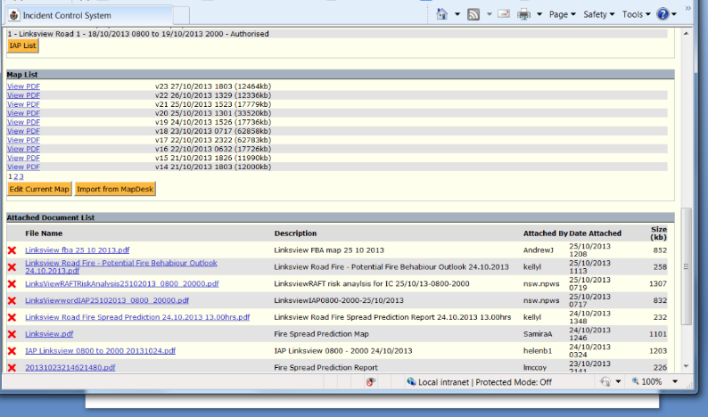
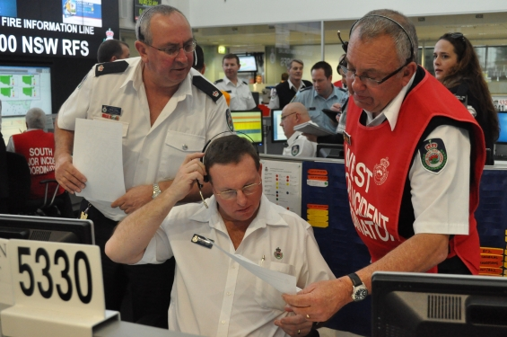
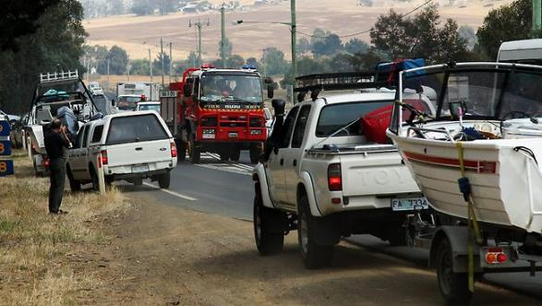
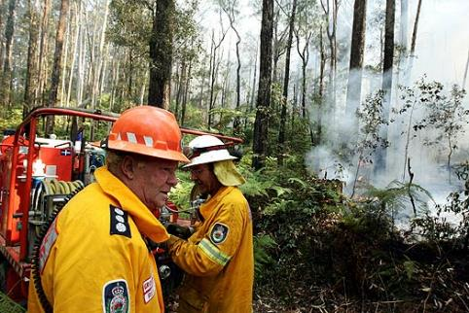
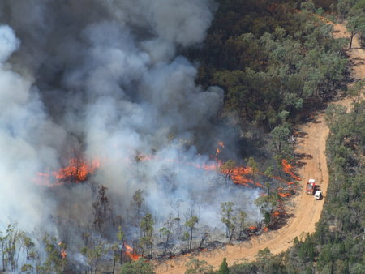
Familiarisation and socialisation

Slide 10
Evolution of Formal Predictive Services capability in NSW Fire Management
2013
January Fires,
Post Event Evaluation Report UoW.
Fire Behaviour Analysis Project Final Report
October 2013 Blue Mountains event
2015
National accreditation 6 FBANs.
Wambelong Inquiry. Coroners recommendations released.
RFS/NSW Government response to recommendations.
2014
Staff Enhancements. Total FBAN Unit 8 Staff including Meteorologist.
Wambelong Coronial Inquiry.
UoM/Tolhurst Assessment of Fire Behaviour Predictions for Wambelong Fire, January 2013
2009 -2010
2009 Black Saturday
2010 Fire Behaviour Analysis and Smoke Plume Modelling project commencement.
Current Portable Atmospheric Sounding capability. Fleet of 24 PAWS
Predictive Services Unit established 9 F/T staff plus 4 Regional FBAns
17 FBAns accredited over 100 attended FBAn training
National Fire Danger Ratings Pilot

Slide 11
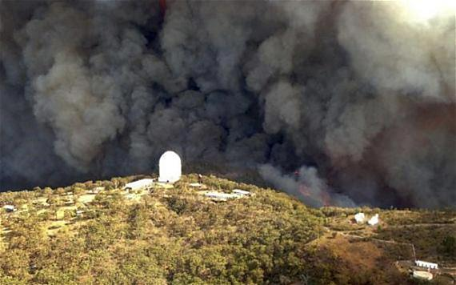
Wambelong Fire 2013
56 000 ha
56 homes
Evacuations
FBA
Notes:
Started Sat Jan 12 2013

Slide 12
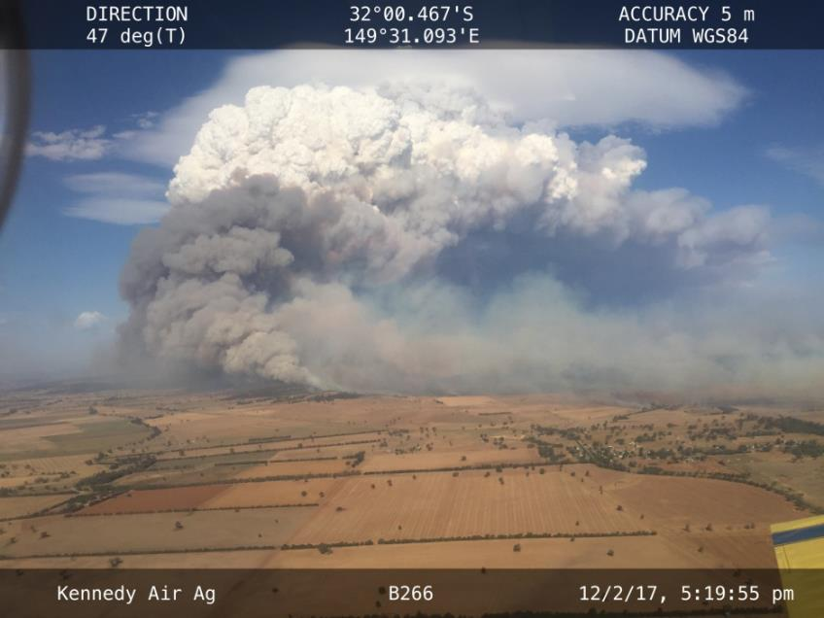
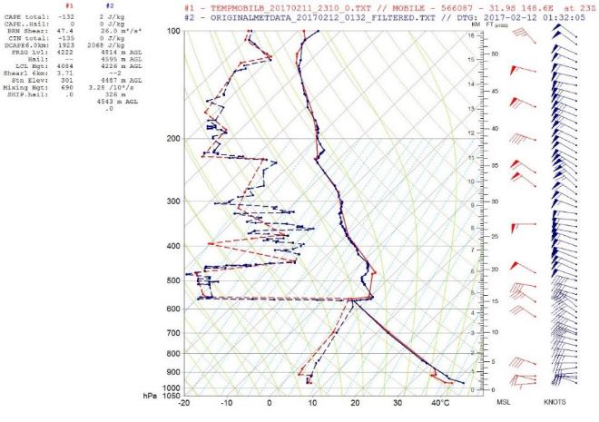
Research into Operations example
Sir Ivan 2017
Notes:
Fire Behaviour Capability since 2010
Weather Balloons – 2016
Deployed in 2017 for Sir Ivan Fire
Provided advanced warning of atmospheric instability

Slide 13
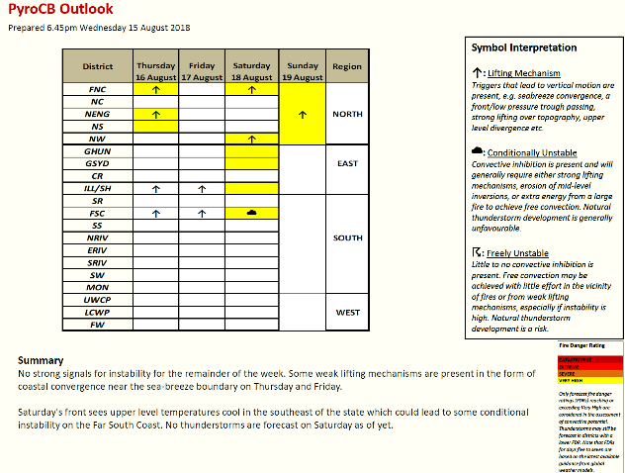
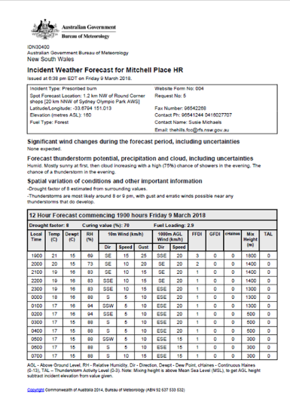
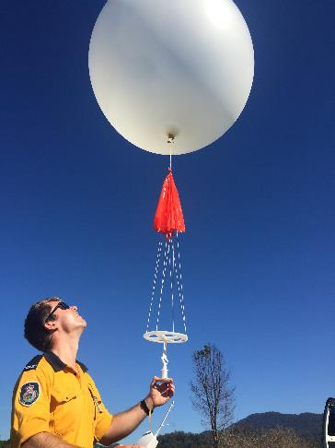
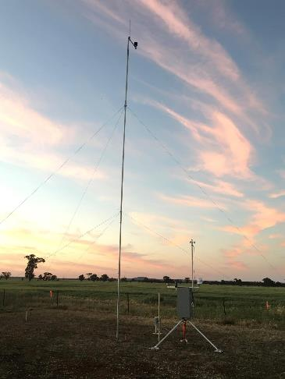
Enhancing Situational Awareness

Slide 14
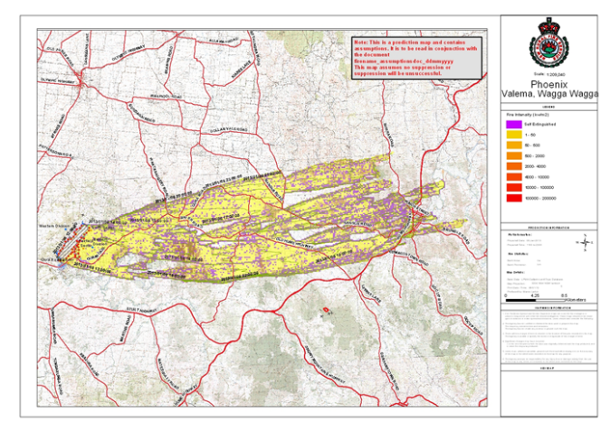
Fire Behaviour Modelling – Deterministic vs Probabilistic

Slide 15
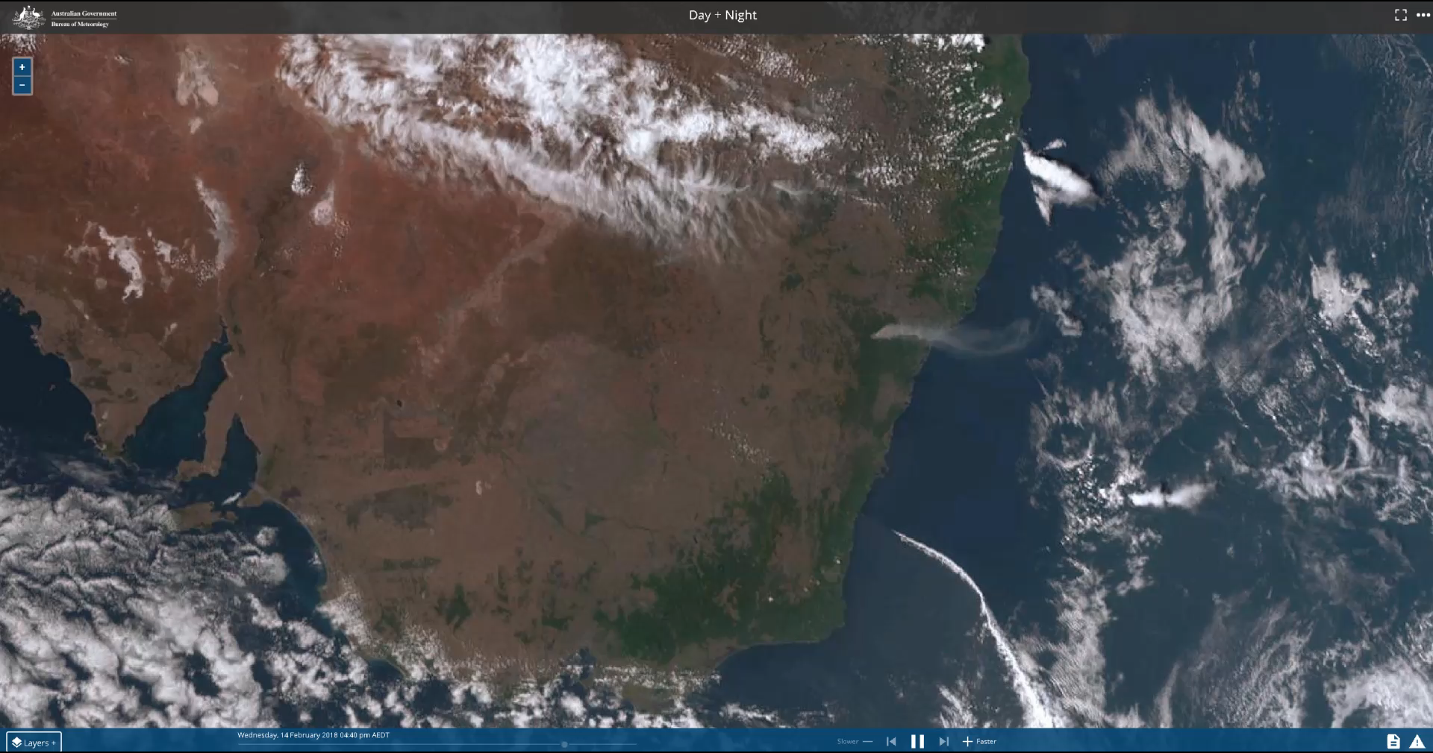
Satellite Imagery

Slide 16
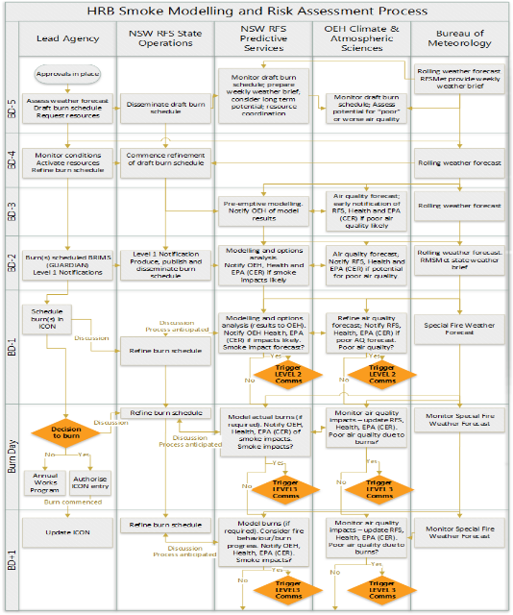
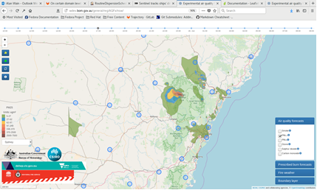
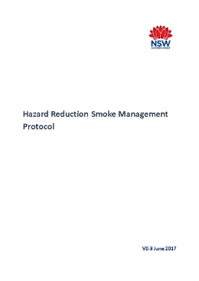
Smoke Dispersion Modelling
Pilot of interagency protocols
  Routine smoke modelling hazard reduction burns
AQFx
Notes:
Protocols developed and being trial for Smoke Modelling and Risk assessment and interagency Communications. They aim to where possible minimize smoke impact on the community and to improve communication between agencies.
Has lead to PPS undertaking routine smoke modelling and the need for additional information

Slide 17
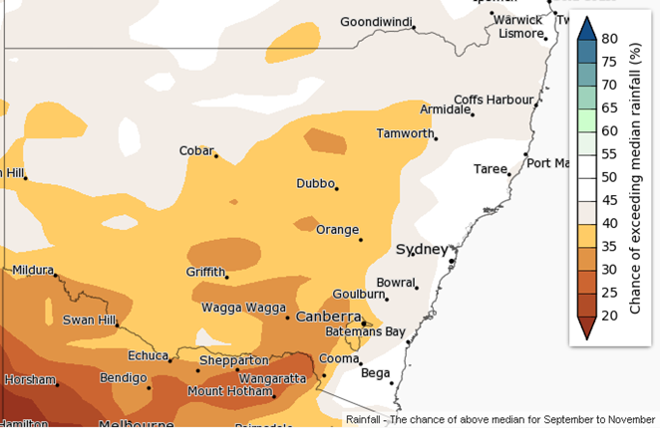
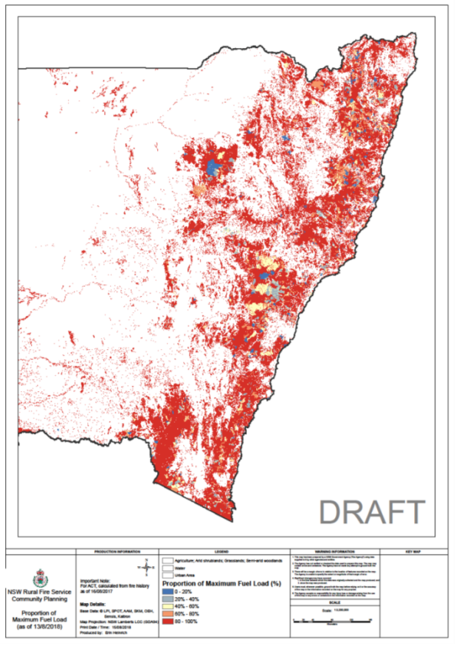
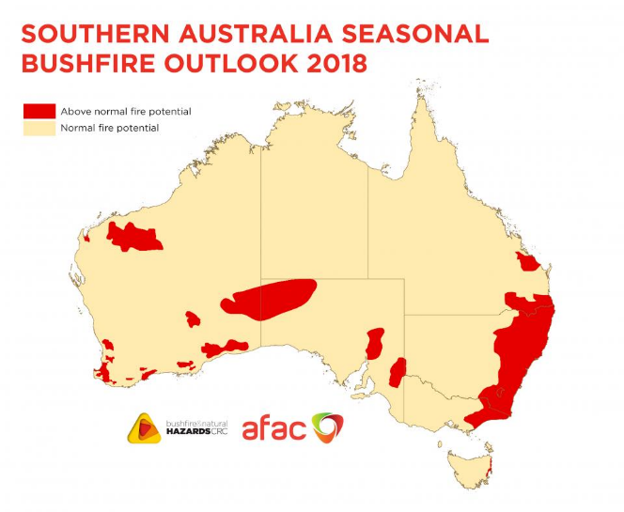
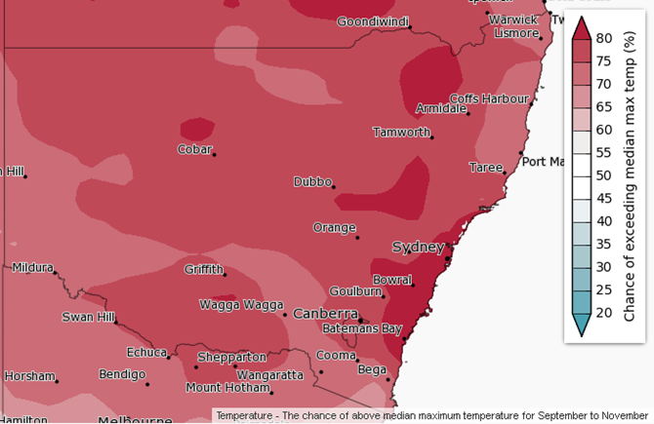
Seasonal Outlook Products

Slide 18
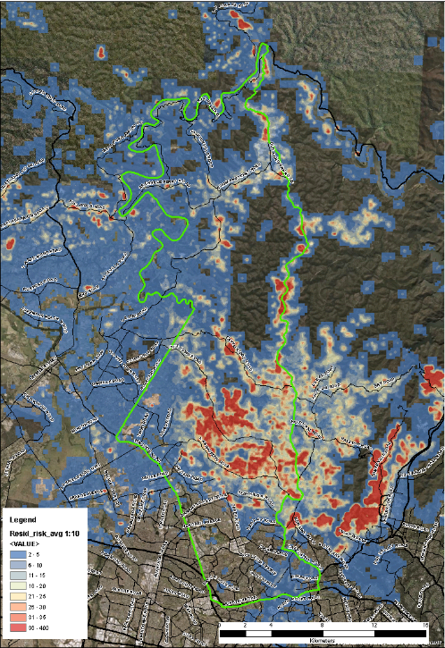
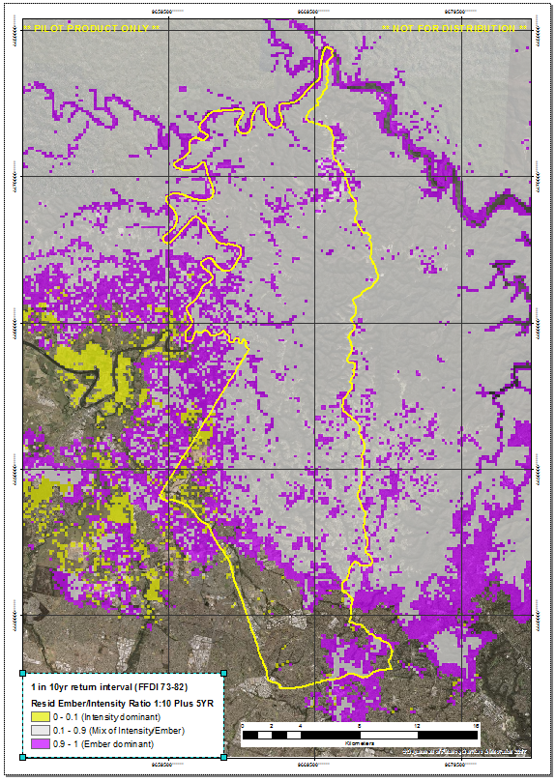
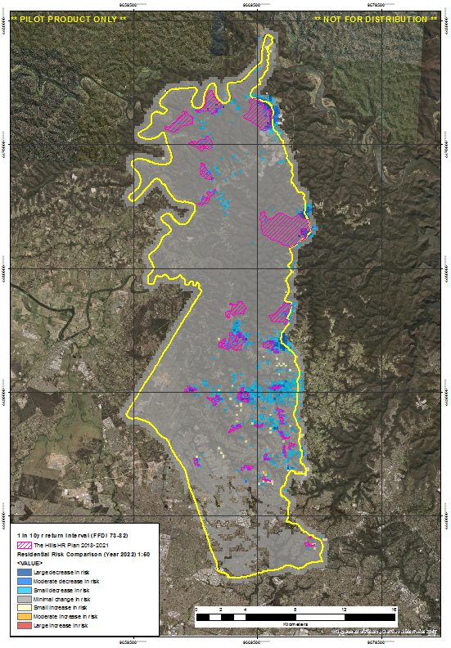
Bush Fire Risk Management Planning
Notes:
Left slide – residential risk for 1:10 year event (FFDI 73-82)
Middle slide – identify where residences are at threat from embers attack, rather than direct flame
Right slide – reduction in risk due to implementation of hypothetical HR plan over 3years

Slide 19
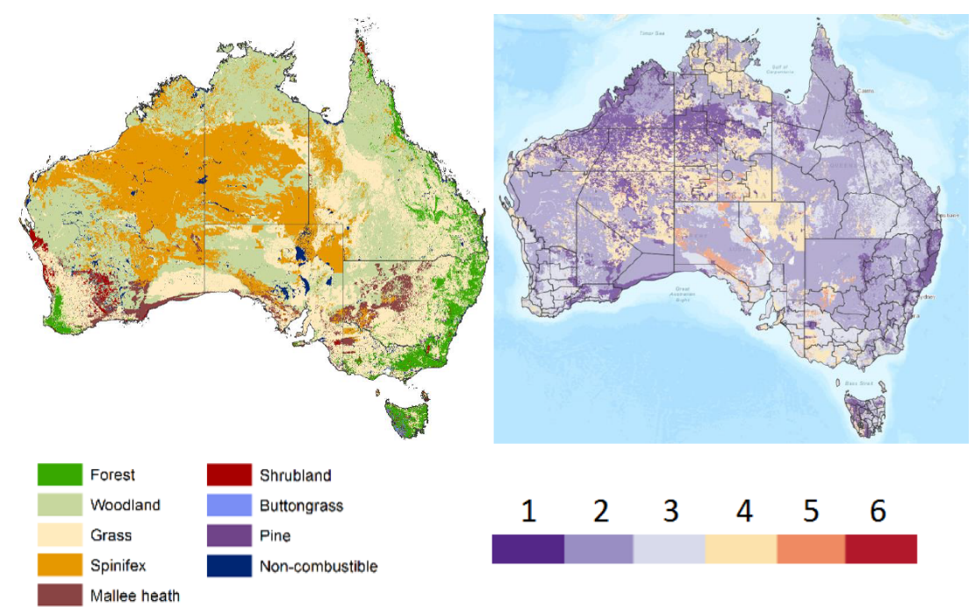
National Fire Danger Rating System
Notes:
NFDRS 3 year program starting July 2019 to implement new fire danger rating system
Calculations depends on fuel information and weather forecasts, both of which are uncertain
Ensembles could be used to understand confidence of rating forecasts, e.g. Category 4 with 10% change of Category 5
Could also help to mitigate the issues caused by needing to have cut-offs between categories, which are currently handled informally using ‘discretionary range’.

Slide 20
