Slide 1
River Operations: Decision-making approach and requirements for the Murray
Andrew Bishop Senior River Operator, MDBA

Slide 2
Presentation Overview
A bit about the MDBA
What do River Operators do?
Decision making – short v long term
Emerging incentives for change
Source model – combining tools
Conclusions

Slide 3
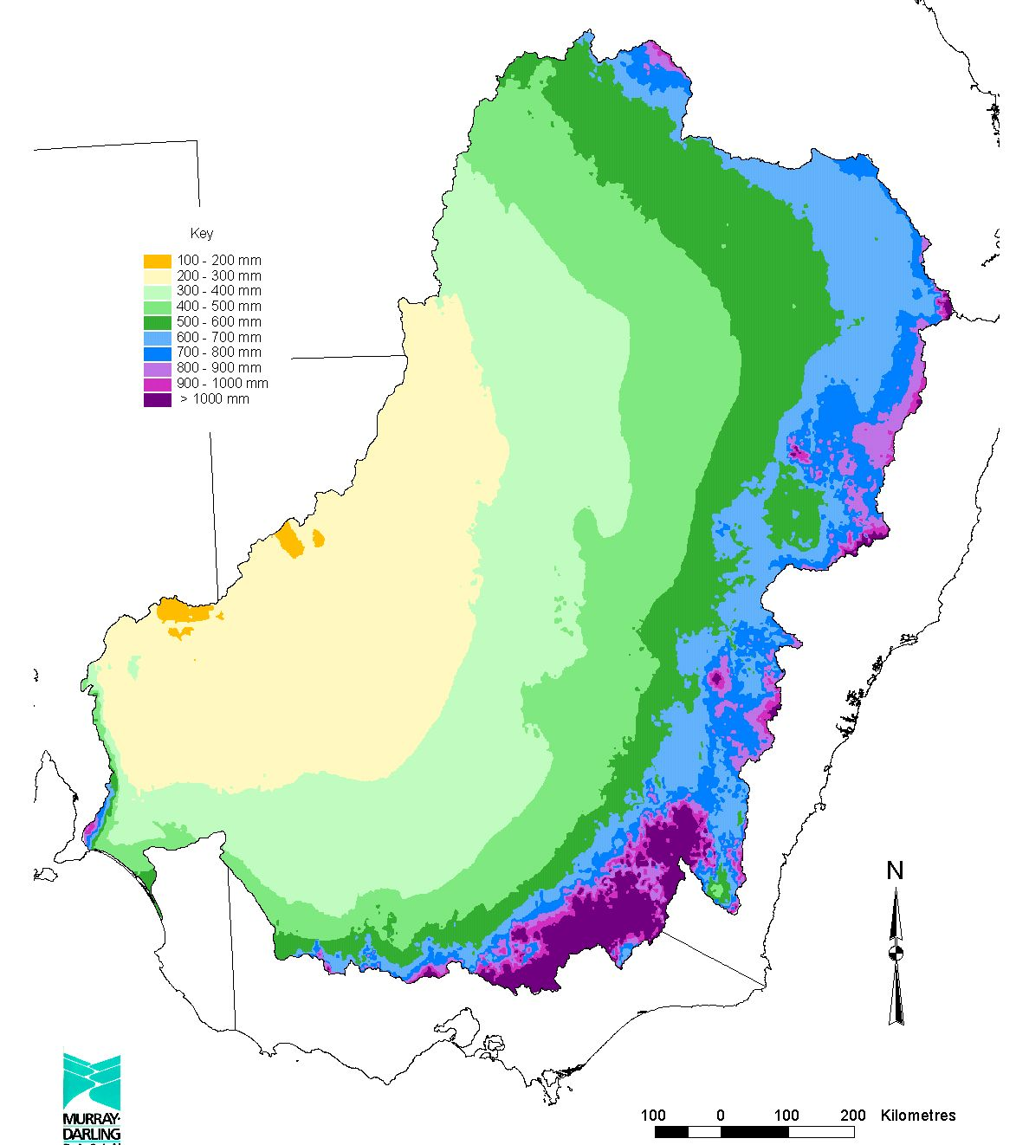
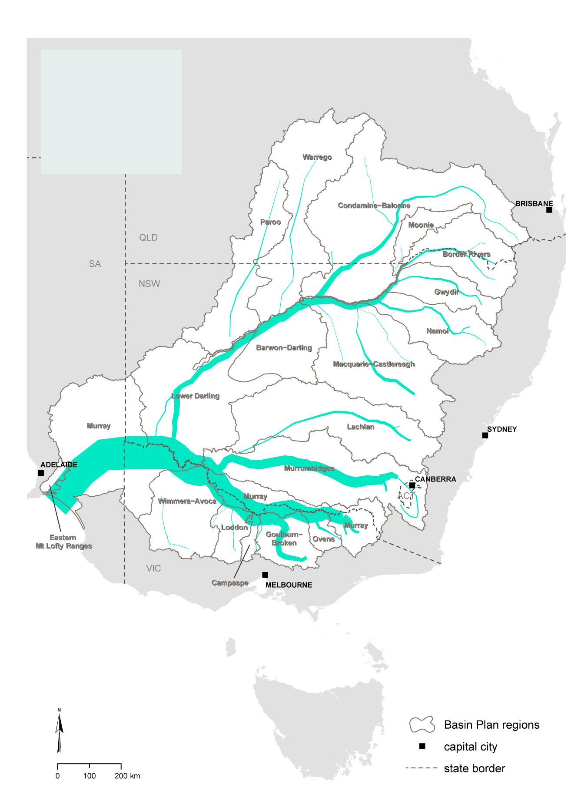
The Murray-Darling Basin and the MDBA

Slide 4
Murray-Darling Basin Agreement

Slide 5
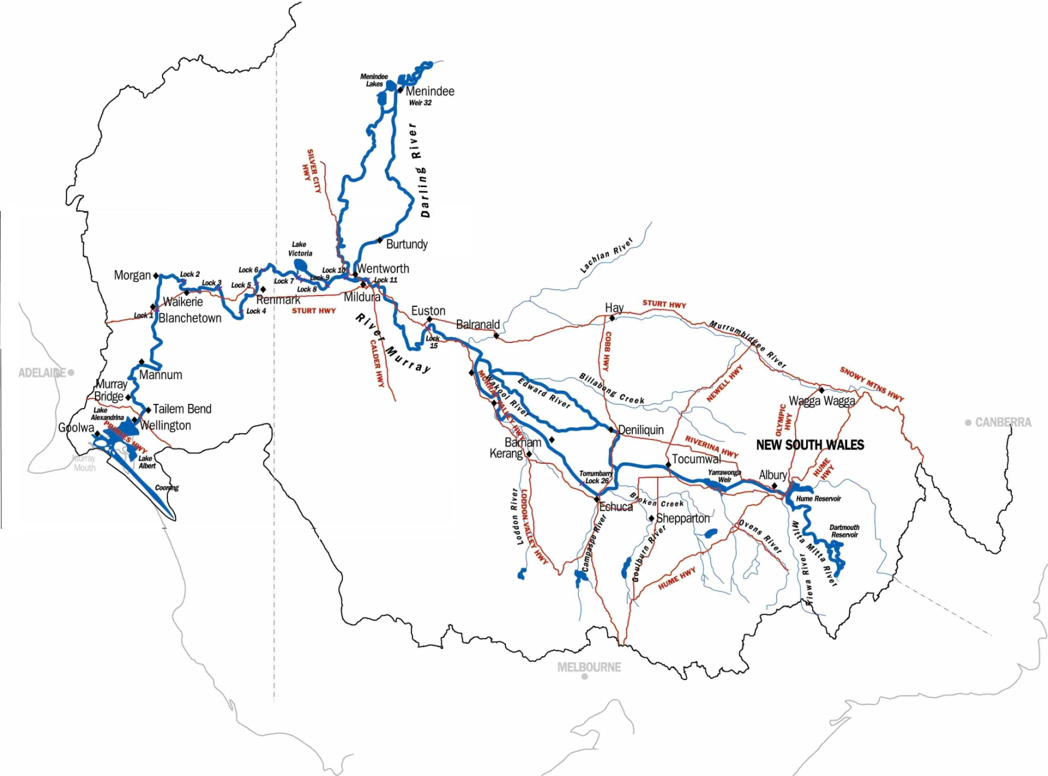
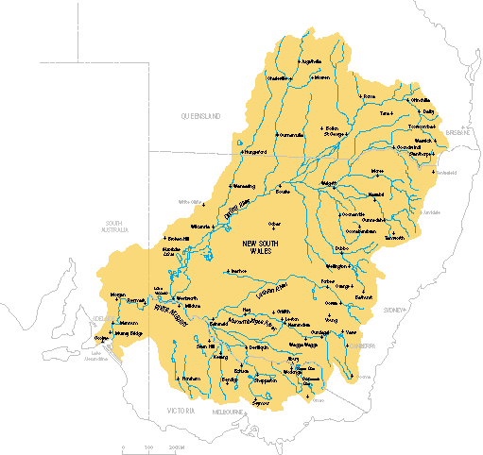
River Murray System

Slide 6
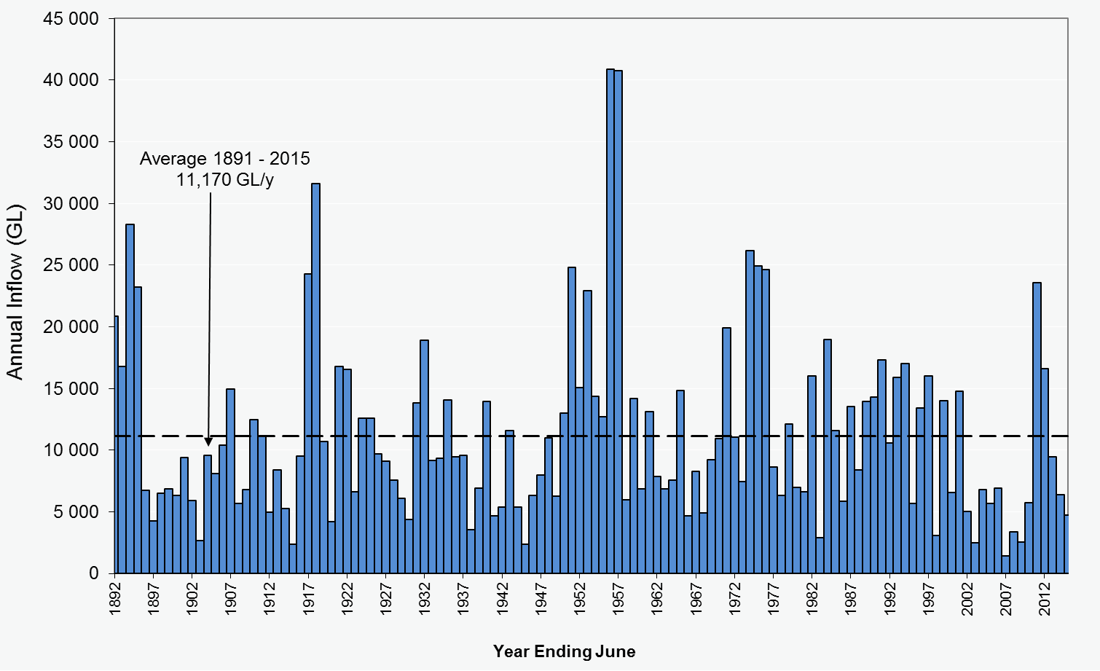
Inflows – highly variable!

Slide 7
River Operators: what do they do?

Slide 8

Crystal balling the future

Slide 9


Slide 10
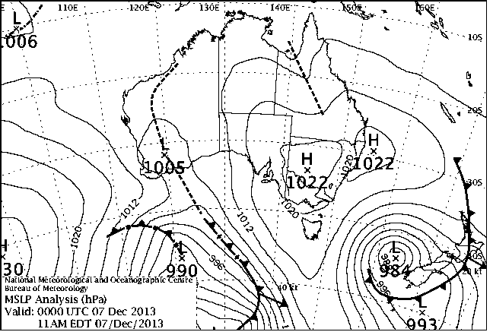

Slide 11

But in complex systems…
The future cannot always be predicted!
Future uncertainty means risk!
…So, what do River Operators really do?

Slide 12
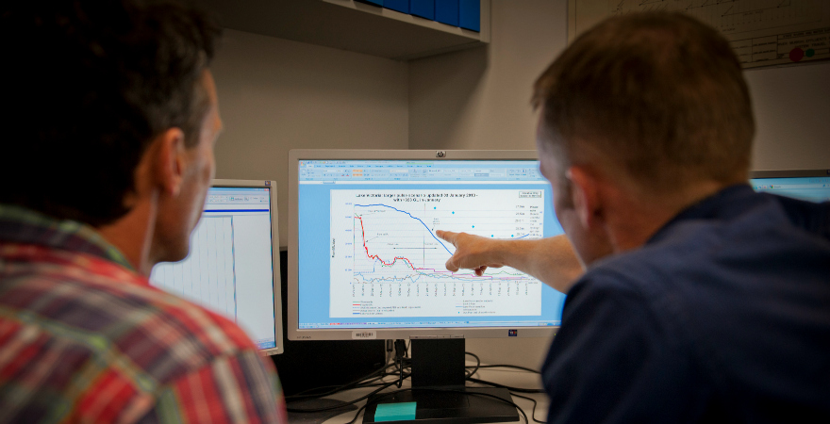

Slide 13
Making decisions with future uncertainty…
Two key decisions to make…
Should I change something today?
(responsive, current / short-term focus)
Should I change future assumptions/objectives?
(anticipatory, planning / longer-term focus)

Slide 14
Managing uncertainty - keys to success!
Understand your system
Know its current condition
Explore forecast scenarios that may occur
… exercise judgement

Slide 15
Practical requirements
Data
(Observed and Forecast)
Decision support tool
(System model and forecast scenarios)
Workflow processes
(Efficiency, Automation, Reporting)

Slide 16
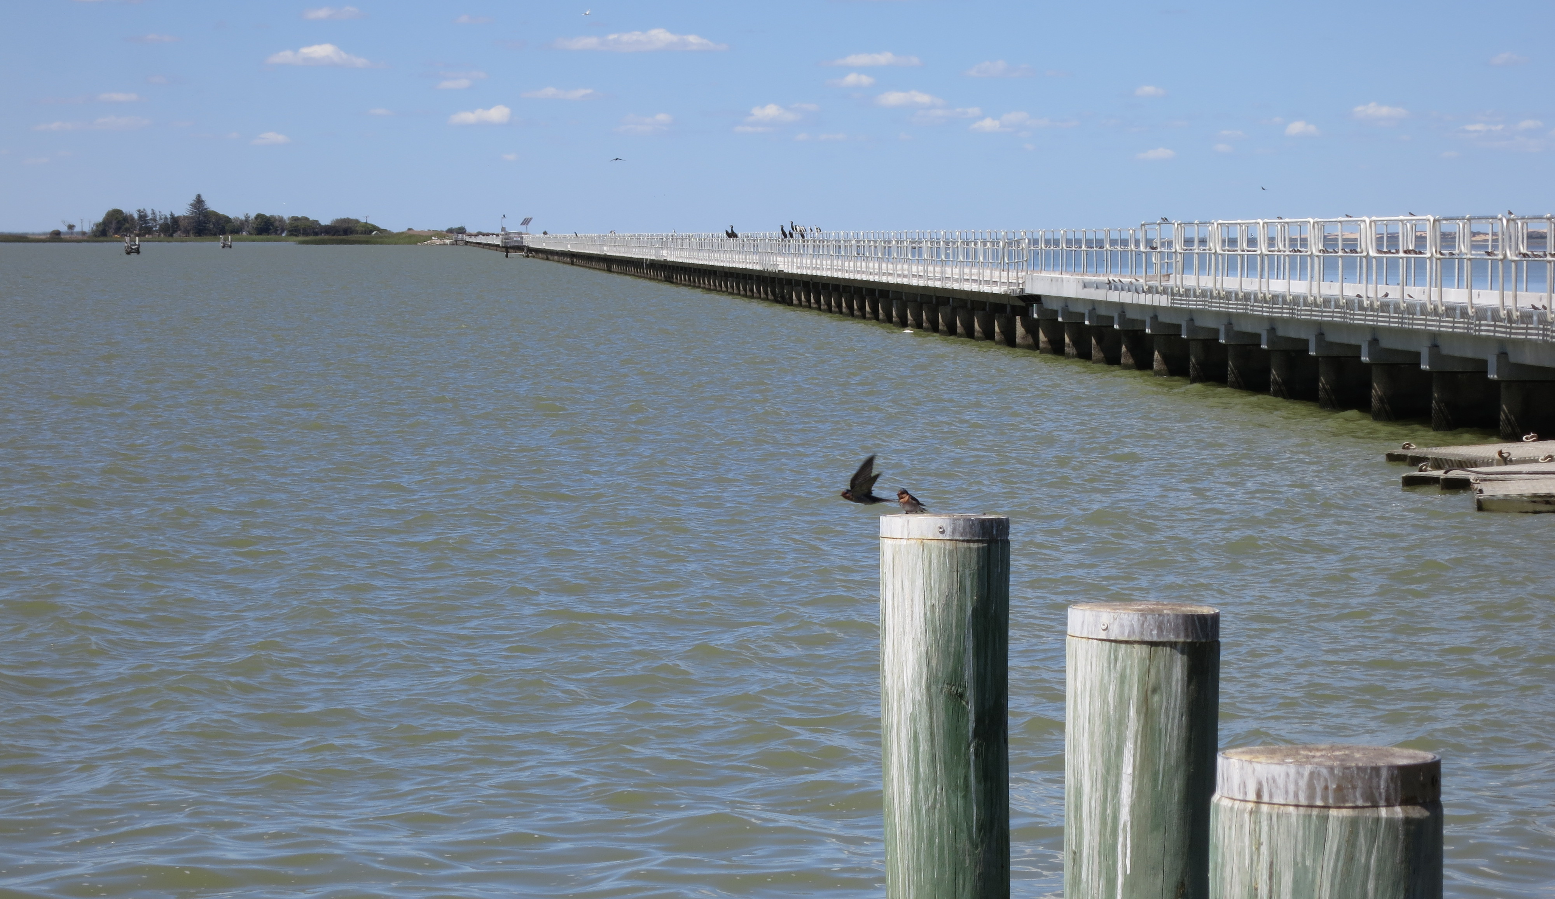
Current decision support tools

Slide 17
Short-term v Long-term
Currently two main decision support tool
Short-term decisions: daily spreadsheet model
Deterministic – within range of weather and demand outlooks
Long-term decisions: monthly planning model
Probabilistic – Wet -> Dry climate/demand scenario analysis. Operations adapt as conditions evolve. Resource assessment.

Slide 18
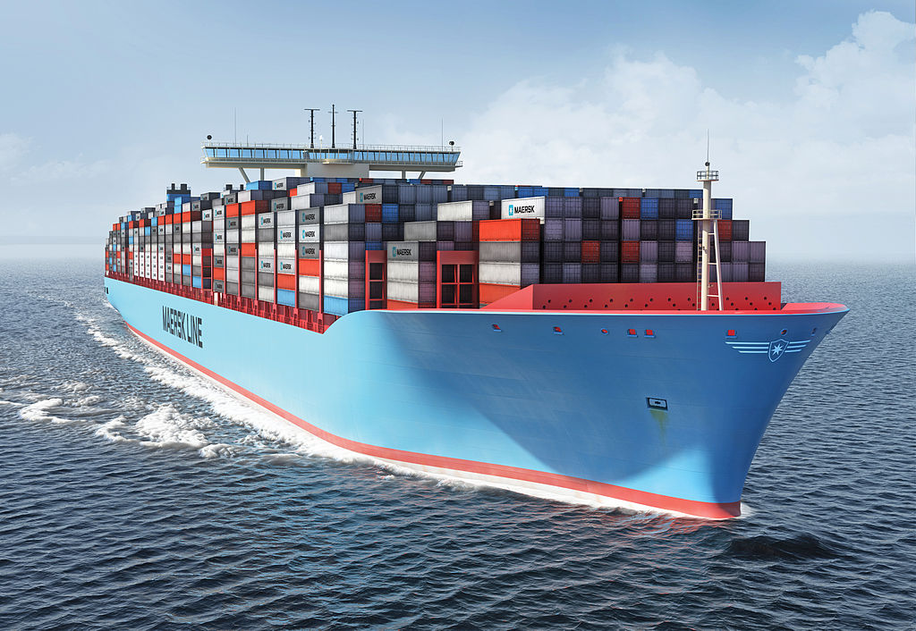
Challenges – ‘steering the ship’…
‘Steerable’ - but momentum difficult to shift!
This is problematic because system outcomes are sensitive to changes – particularly wetter v drier… never track on one predictable scenario!
Risks amplified because we operate both ‘efficiently’ while also ‘ensuring supply’ – competing objectives that tighten margin for error!

Slide 19
‘Balance’ competing objectives, manage risk
Solution…
Narrow down range of likely futures (model/forecasts)
Tease out critical risks and trade-offs – what if …??
Set a ‘course’ for today
Repeat tomorrow! (continuous iteration)

Slide 20
New incentives for change…

Slide 21
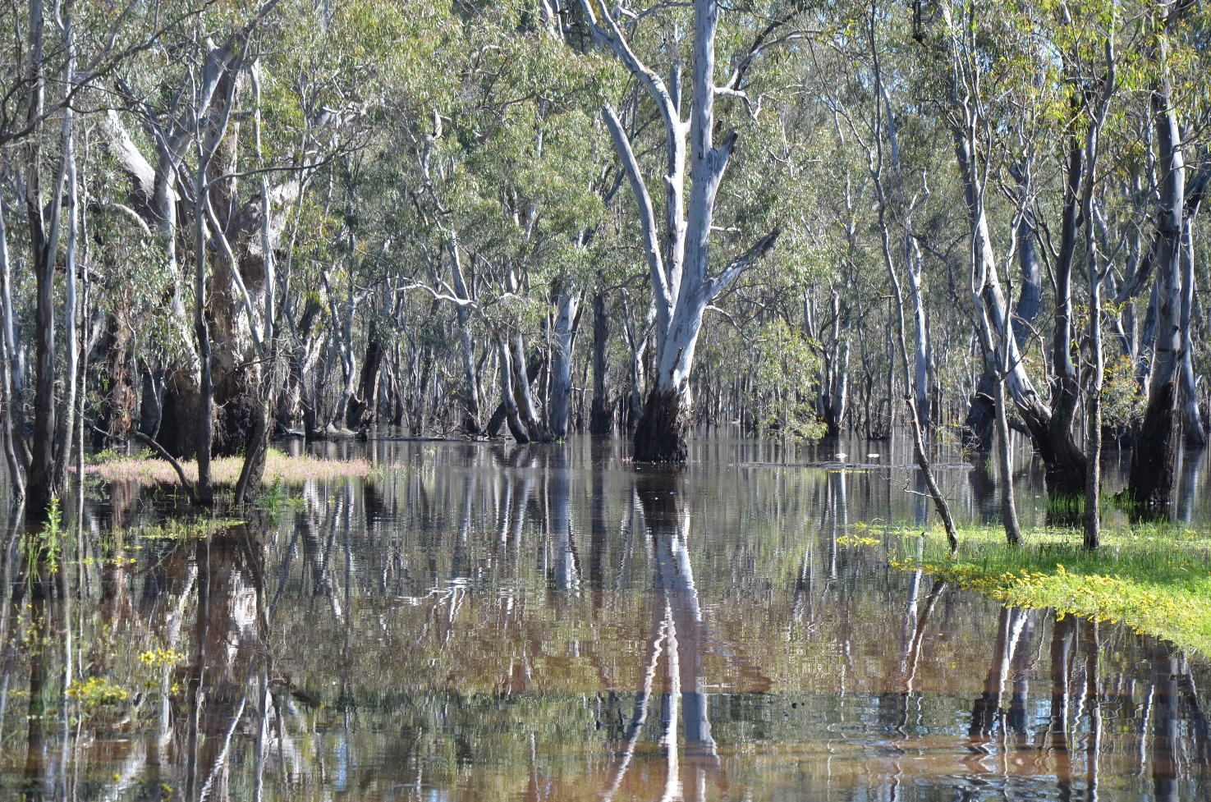
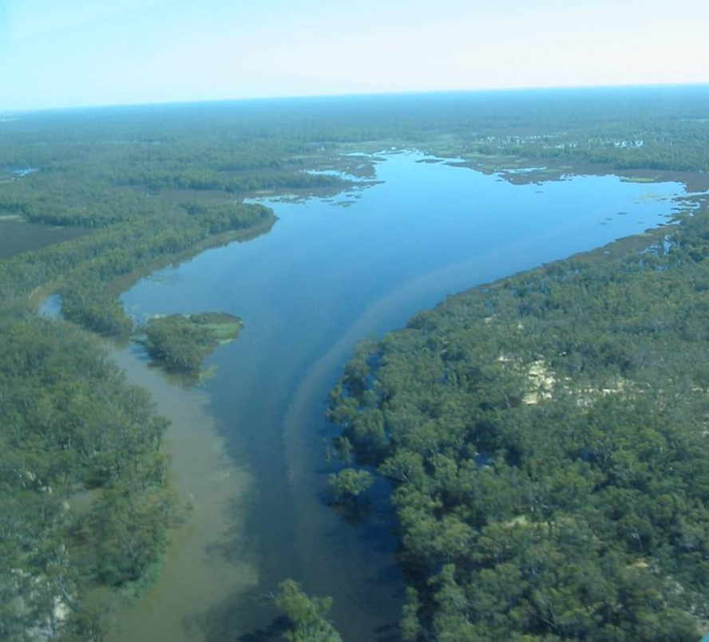
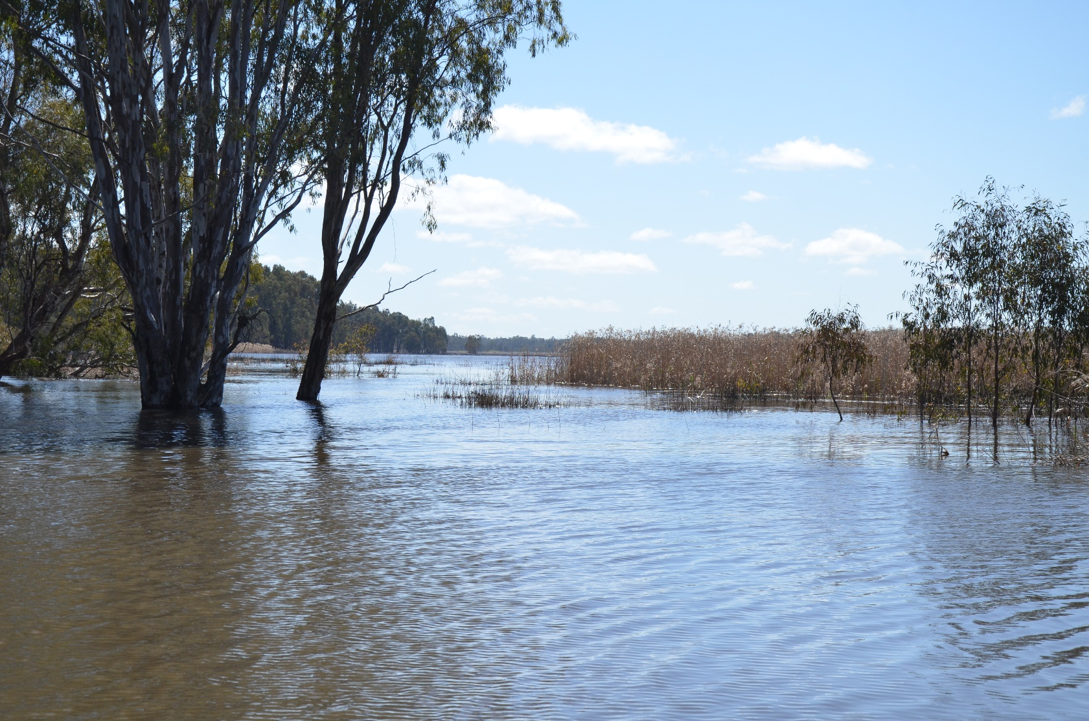
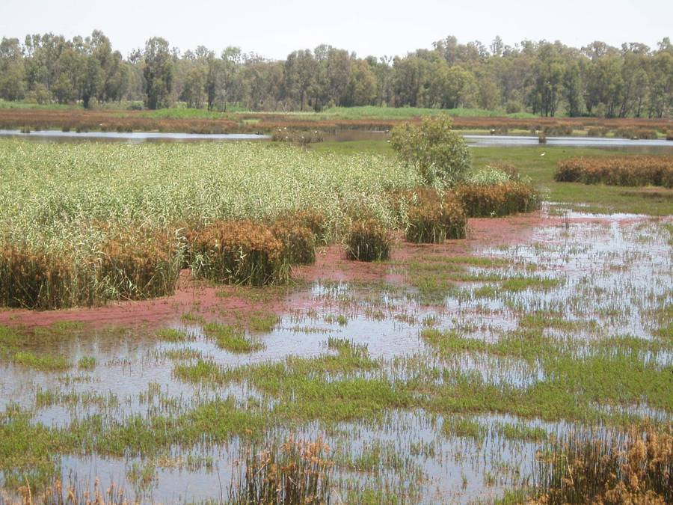

Slide 22
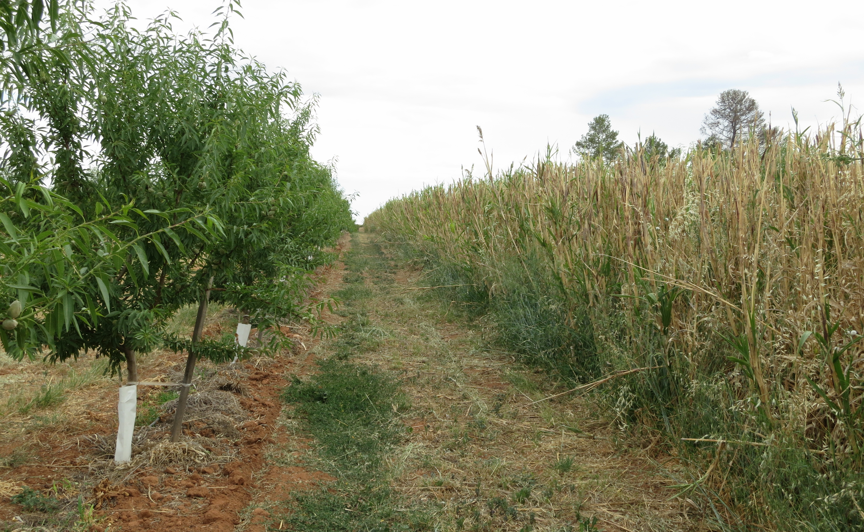

Slide 23
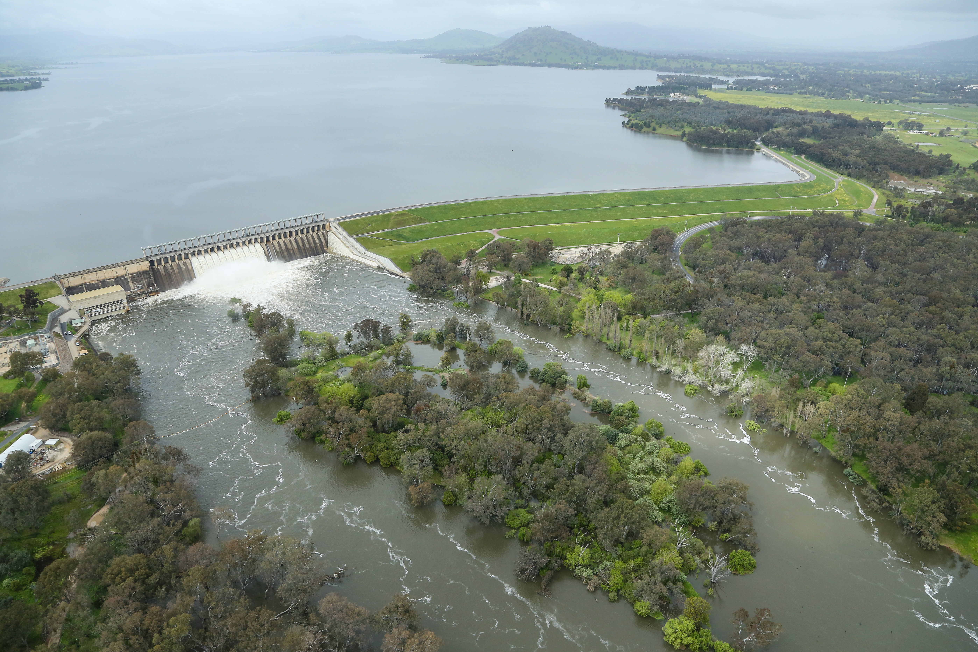
Combining decision support tools - Source

Slide 24

New decision support tool
MDBA developing new Source models
Long-term investment with eWater:
Planning model
Operations model
A key objective – combine short/long term decision tools and more effectively use streamflow and climate outlooks in scenarios – narrow down range of possibilities and decrease risks

Slide 25
Operations model - progress so far…
Planning ≠ Operations…
So, modified planning model and added a range of new functionality:
Forecast models (inflow, unaccounted difference, demand)
‘Tabular editor’ interface to override / ‘drive’ model/scenarios
Routing validation – dry, wet periods (2016 flood)
Integration with real-time data, including BoM climate/demand forecasts

Slide 26
Still to come…
Critical software user requirements (eWater)
Adapting elements of the model to suit operations
Environmental water accounting – complex!
Expanded range of scenarios
Expand BoM forecast inputs, including streamflow

Slide 27
Conclusions
Rain, climate and streamflow forecasts are a critical input to river operations decision-making, but they form part of an overall scenario analysis and risk assessment approach used to manage significant variability, uncertainty and complex interrelated rules, trade-offs and objectives
MDBA is working to update our decision support tools to improve our operations and deal with new drivers such as environmental water use, shifting demand patterns and increasing expectations – our new Source operations model will help make better use of Bureau and other forecast products.
Methodical transition to ensure highly developed and robust workflow systems, usability, performance and workflow integration

Slide 28
Thank you.

