Slide 1
The value of Ensembles on planning the energy system for the future
November 2018
Presented BY Daniel Guppy

Slide 2
Agenda
Temperature drives demand
Temperature de-rates supply and network assets
Using CCiA data understand future extreme operating conditions
Temporally downscale daily climate data
Consider impact of temperature on supply and demand

Slide 3
Temperature drives demand Extreme temperature drives extreme demand

Slide 4
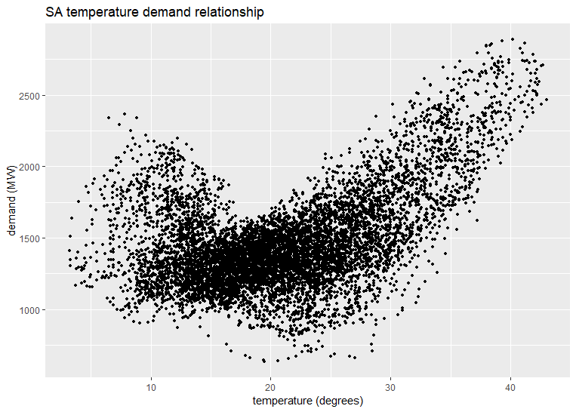
Temperature drives demand

Slide 5
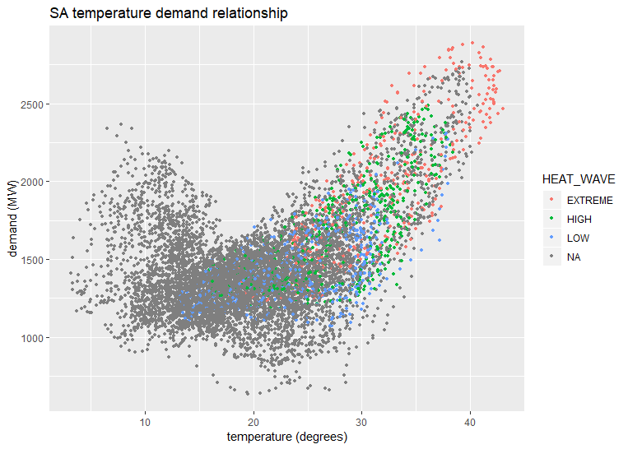
Temperature drives demand
Heatwave
Low – three days above 30
High – three days above 32.5
Extreme – three days above 35

Slide 6
Temperature de-rates generation

Slide 7
Temperature de-rates generation
Thermal generation – typical gas turbines begin to de-rate at 35˚C and can de-rate as much as 5% and 8% for ambient temperatures of 40˚C and 45˚C, respectively. Sustain periods of high temperatures impact generators ability to cool.
Solar farms – some utility power system inverters de-rate around 10% when operating at 50˚C. Inverters operating in the distribution network can also de-rate by 10% or more at 50˚C.
Wind farms – typical wind farm turbines in the NEM experience 100% de-rating for temperatures between 35˚C and 45˚C, and will return to service when the temperature drops around 1˚C to 5˚C from the cut-out temperature.
Source: AEMO 2018 ISP

Slide 8
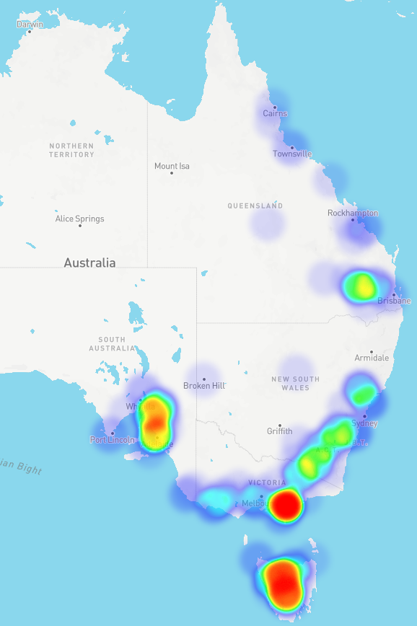
Temperature de-rates generation
NEM generation density map

Slide 9
Temperature de-rates networks

Slide 10
Temperature de-rates networks
Transmission lines – short-term transfer capability can be reduced up to 14% for a temperature increase from 35˚C to 40˚C. For 500 kV lines, this reduction can be as high as 250 MW. Conductors expand at high temperatures, and at extreme temperatures are at risk of irreversible expansion, resulting in permanent reduced capability.
Power electronics – the Basslink DC interconnector between Victoria and Tasmania automatically limits capacity progressively when ambient temperatures at Loy Yang reach 43˚C or above, or when temperatures at George Town reach 33˚C or above.
Source: AEMO 2018 ISP

Slide 11
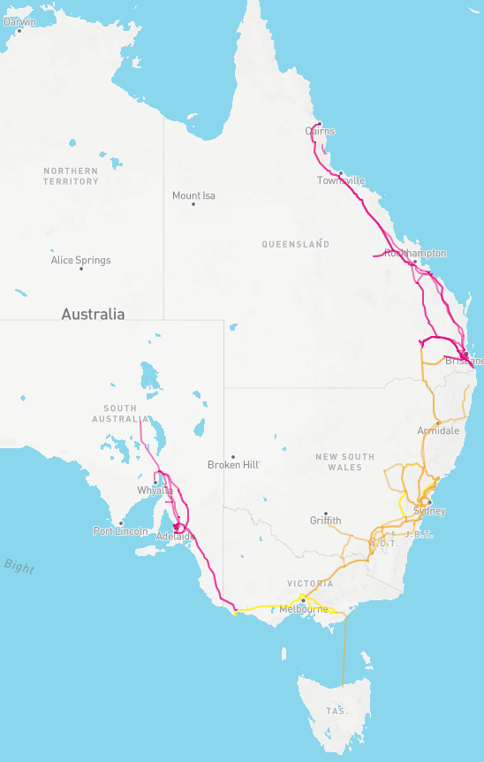
Temperature de-rates generation
NEM transmission assets map

Slide 12
Using CCiA data understand future extreme operating conditions

Slide 13
Using CCiA data understand future extreme operating conditions
Quantile-Quantile matching for temporal downscaling
Collect daily min/max temperature projection data from CCiA for each ensemble member in the forecast horizon (2018-2050)
Collect historical actual half-hourly temperature station observations and calculate daily minimum, median and maximum (1998-2018)
Calculate the empirical temperature CDF of projected daily temperatures data
Calculate the empirical temperature CDF of historical daily observations
Map historical temperature quantiles to projected temperature quantiles and assign a scaling factor
Interpolate daily scaling factors to half-hourly and scale
AEMO treats each historical year scaled to each ensemble member as a simulation of future weather.
Final table is 20 historical years x 8 models x 32 forecast weather years

Slide 14
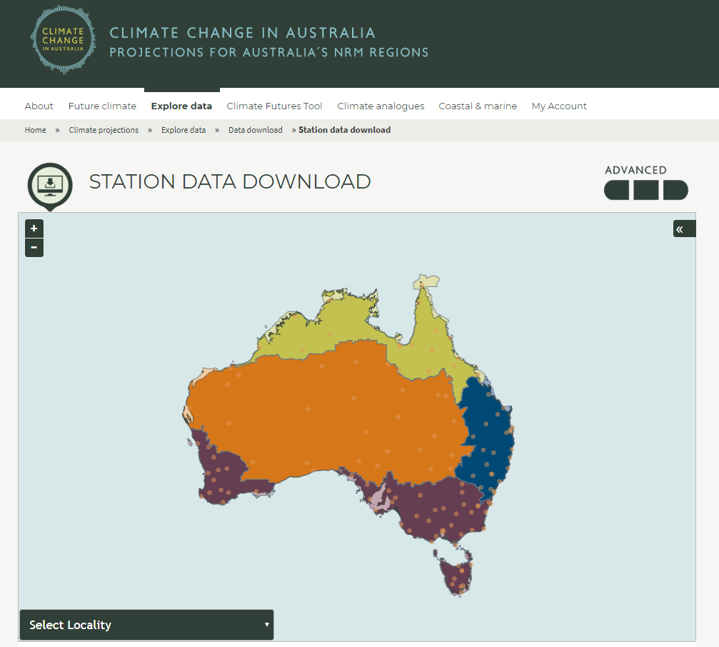
Using CCiA data understand future extreme operating conditions
ClimateChangeInAustralia.gov.au
AEMO Use:
Daily Stations data
Daily average, minima and maxima temperature data
8 different climate models in Ensemble
Temperature Threshold Calculator

Slide 15
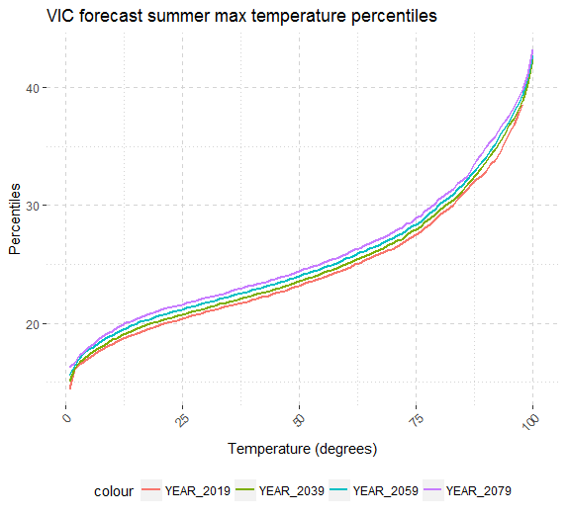
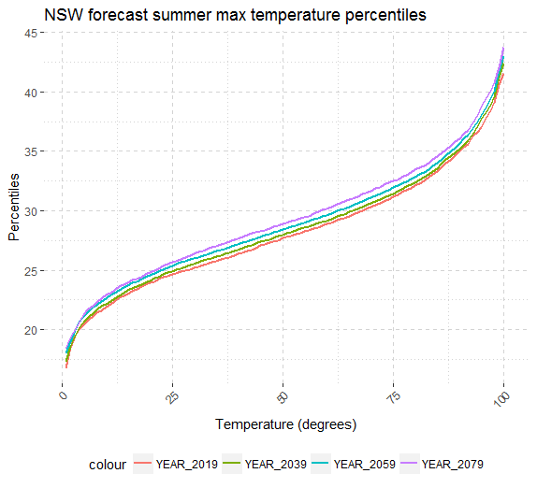
Using CCiA data understand future extreme operating conditions
Quantile match historical daily max temperature station data to model data

Slide 16
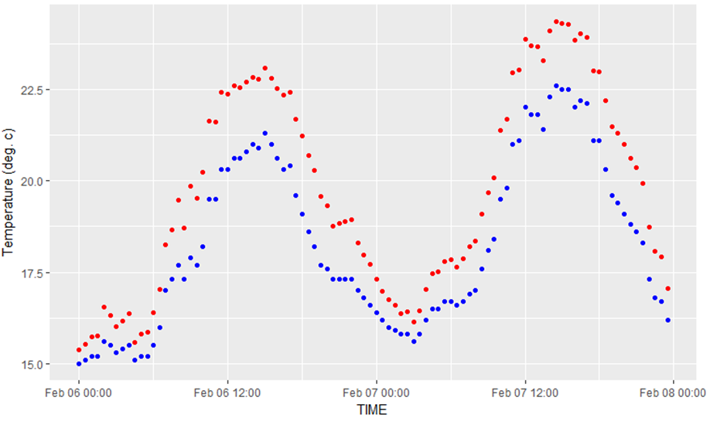
Using CCiA data understand future extreme operating conditions
NSW - Temperature 6 and 7 Feb 2000 vs 6 and 7 Feb 2030

Slide 17
Using CCiA data understand future extreme operating conditions
Global climate ensemble models vs station temperature data for same overlapping time period

Slide 18
Using CCiA data understand future extreme operating conditions
Extreme temperature average for 1995 (left) and projected for 2070 (right) in eastern Australia
Source: AEMO 2018 ISP and CCiA threshold calculator

Slide 19
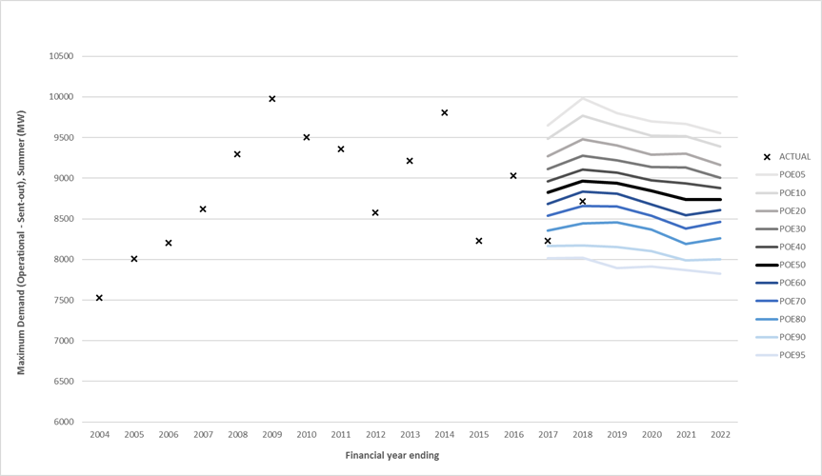
Using CCiA data understand future extreme operating conditions
Maximum demand Probability of Exceedance forecasting
demand = f(weather)
Probabilistic distribution of weather drives the probabilistic distribution of energy demand

Slide 20
Questions

