Slide 1
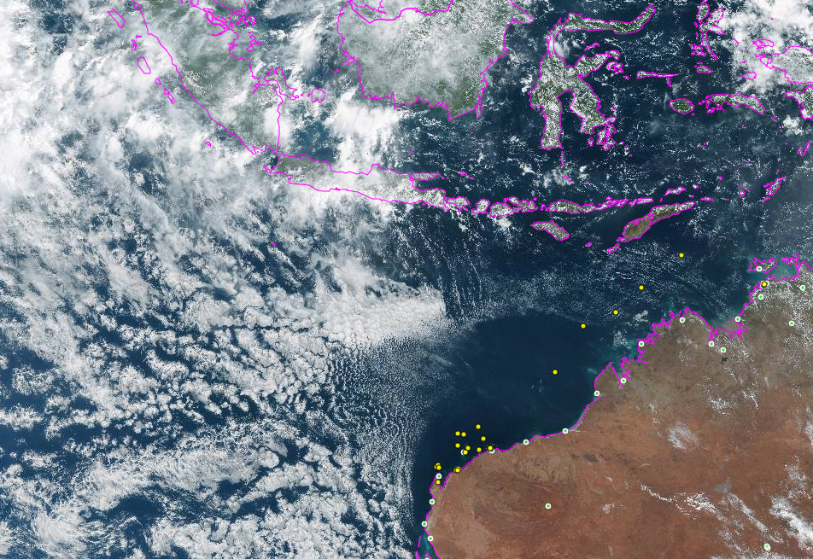
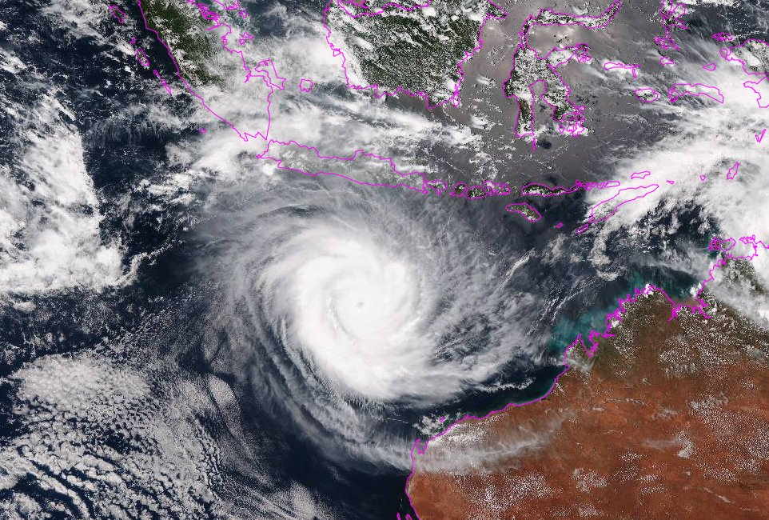
Use of Ensembles in Tropical Cyclone Forecasting

Slide 2
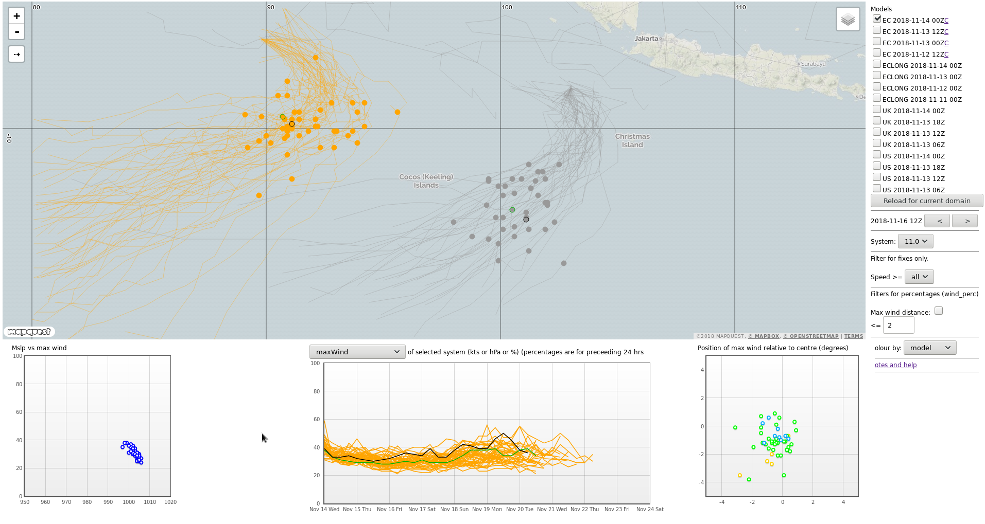
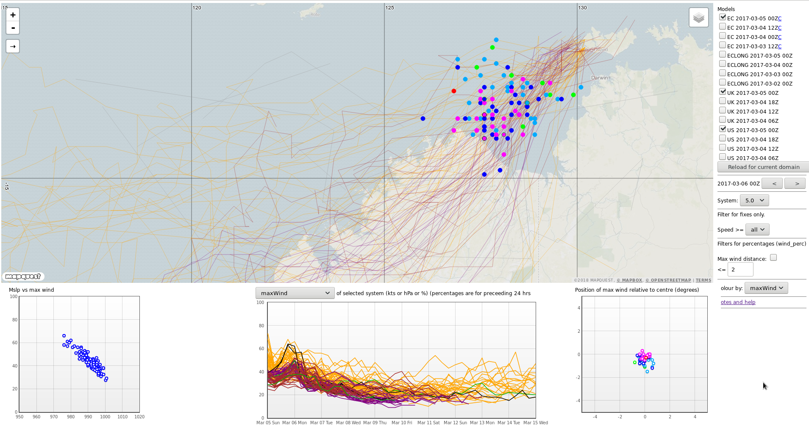
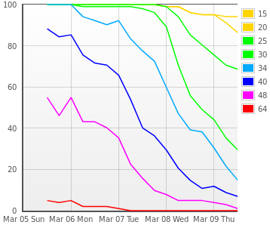
Ensemble Forecast Track Map

Slide 3
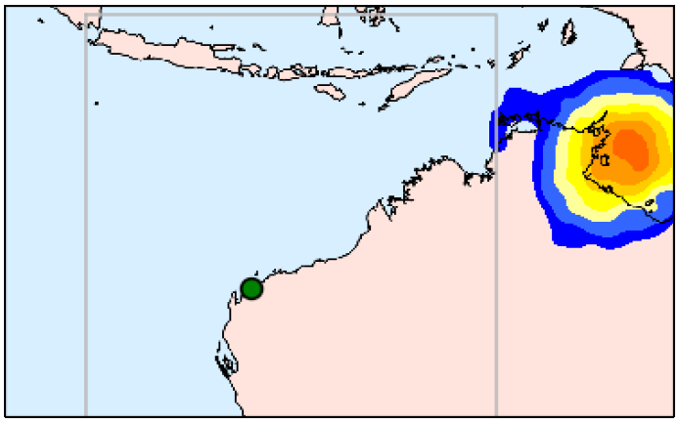
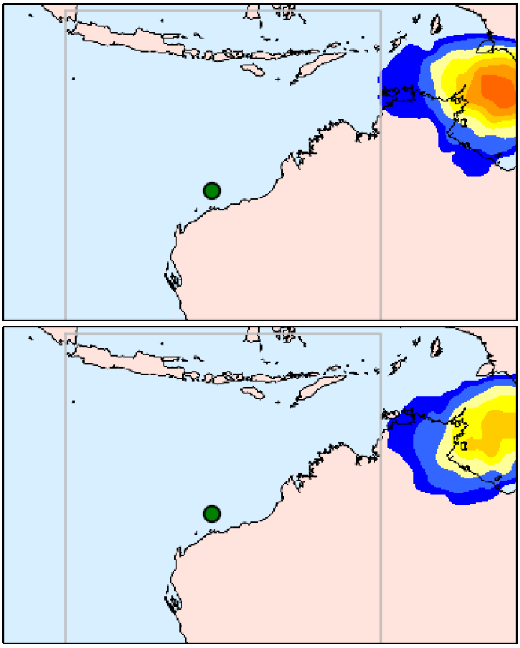
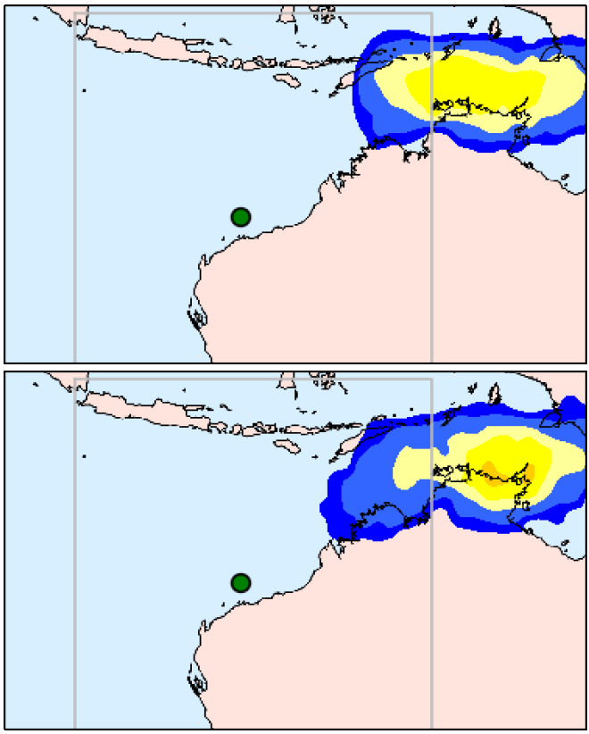
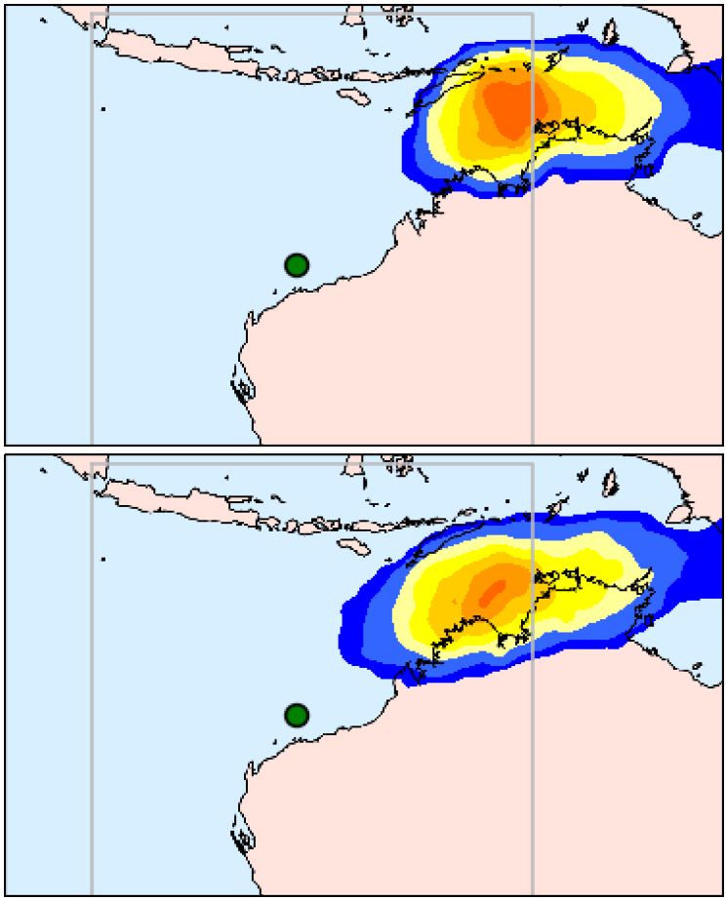
Uncertainty in location
Forecast Run
Forecast 9th
Forecast 10th
Forecast 11th
Forecast 12th
Friday 16th
Friday 16th
Friday 16th
Friday 16th
Forecast Day
Saturday 17th
Saturday 17th
Saturday 17th

Slide 4
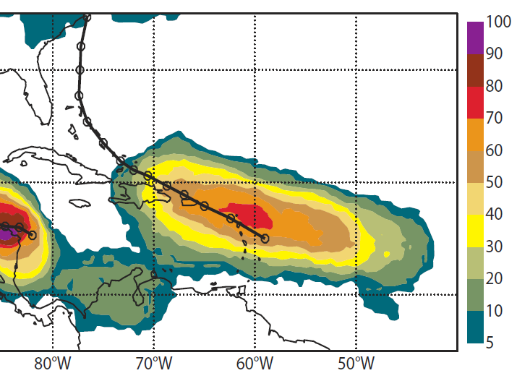
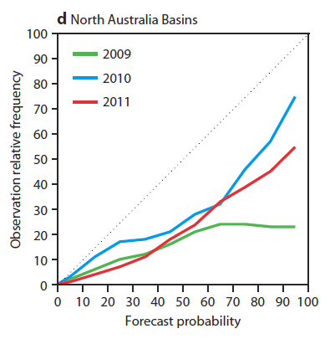
Probability of Tropical Cyclone
Over-forecast
Vitart et al (2011)
Notes:
Vitart, F., Prates, F., Bonet A. and C. Sahin, 2011, New tropical cyclone products on the web,ECMWF Newsletter No. 130 – Winter 2011/12

Slide 5
Probability of Tropical Cyclone
Eg. 70-75% of ensemble members have a 34 knots system for Tuesday

Slide 6
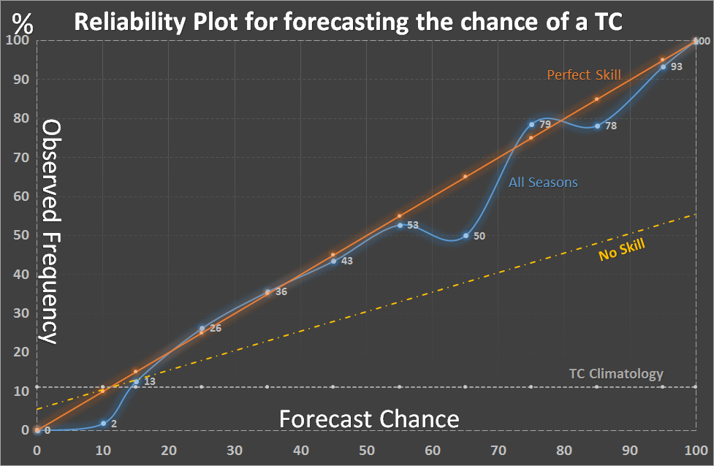
Forecast Verification

Slide 7
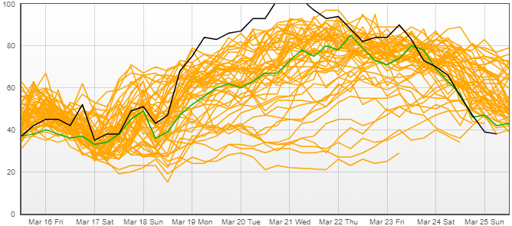
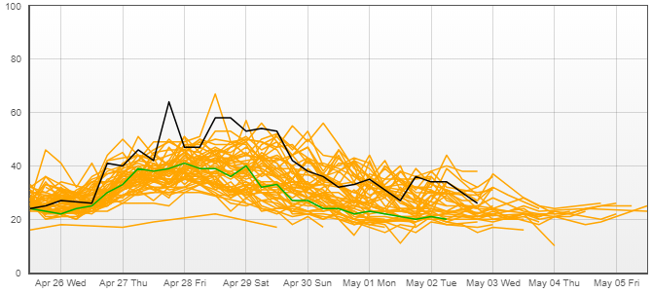
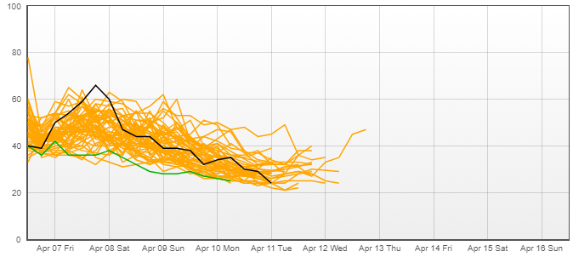
Intensity Forecasting
STC Marcus
STC Frances
STC Ernie

Slide 8
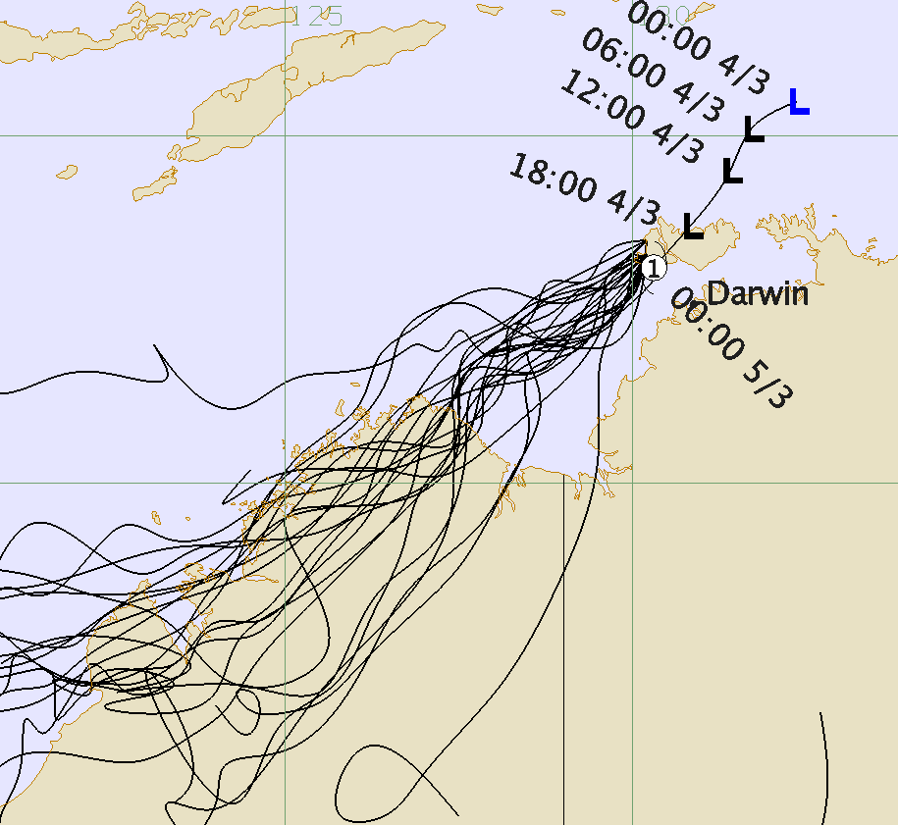
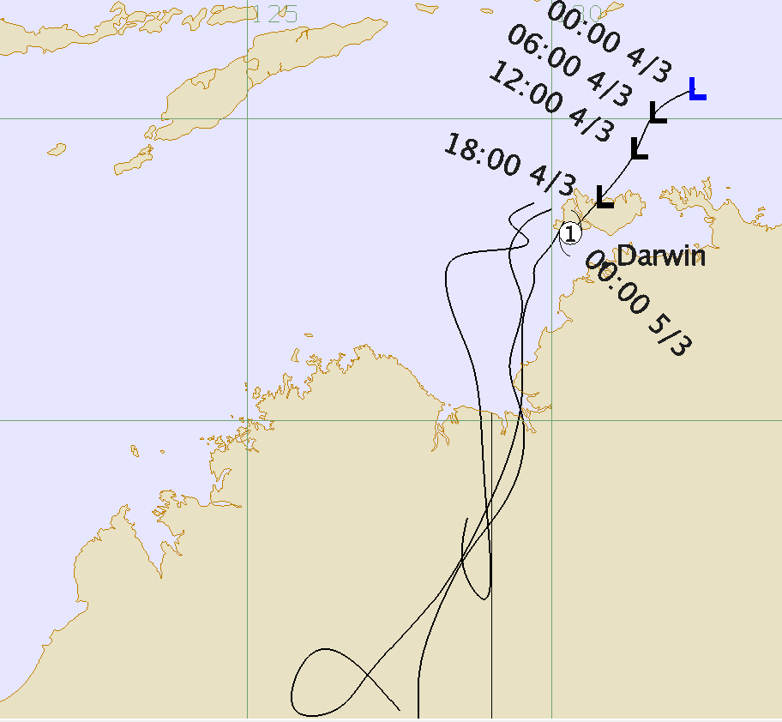
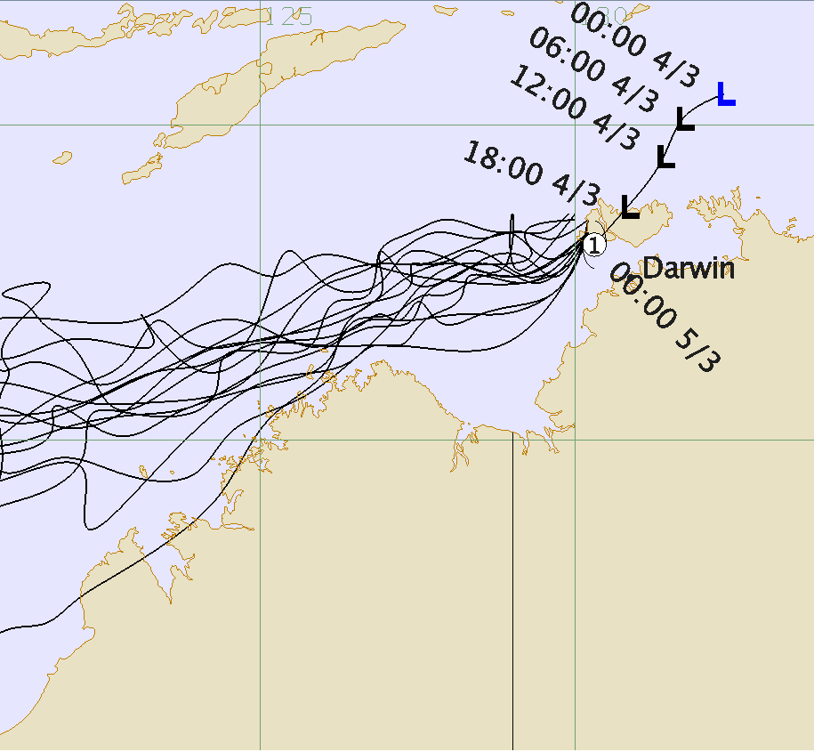
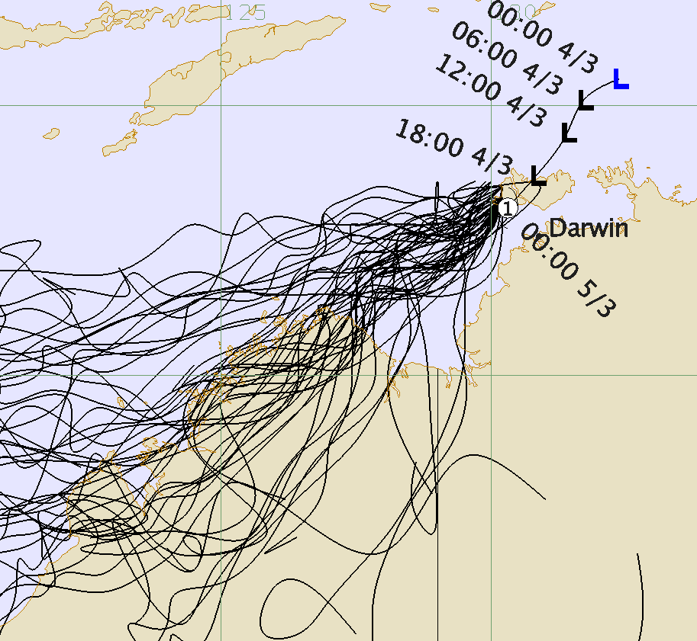
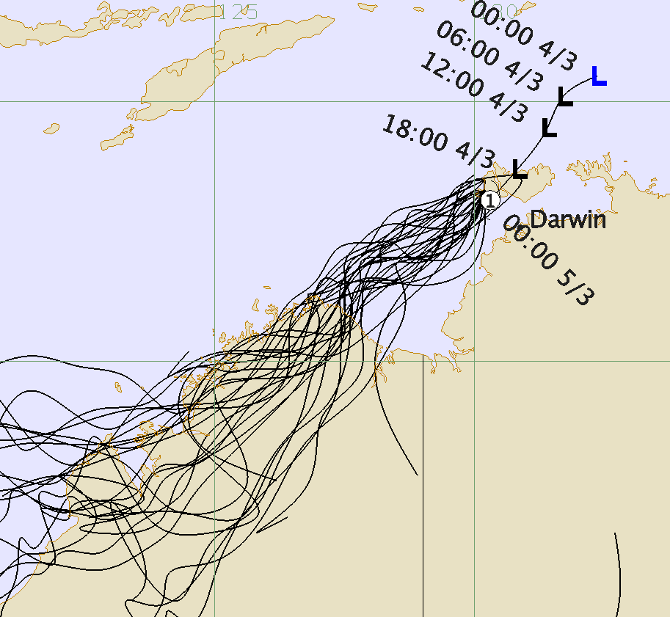
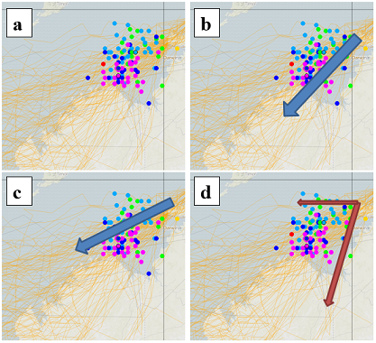
Communication

Slide 9
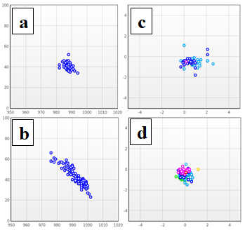
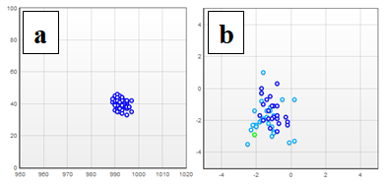
Structure

Slide 10
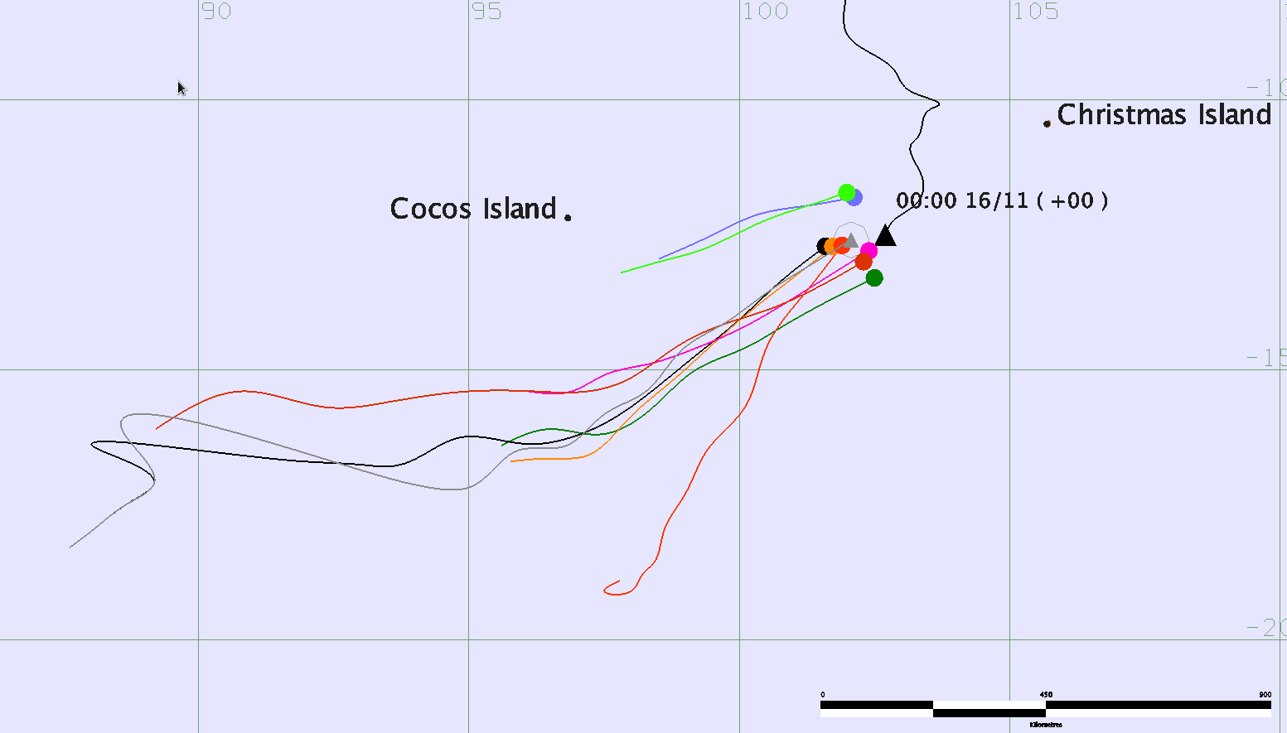
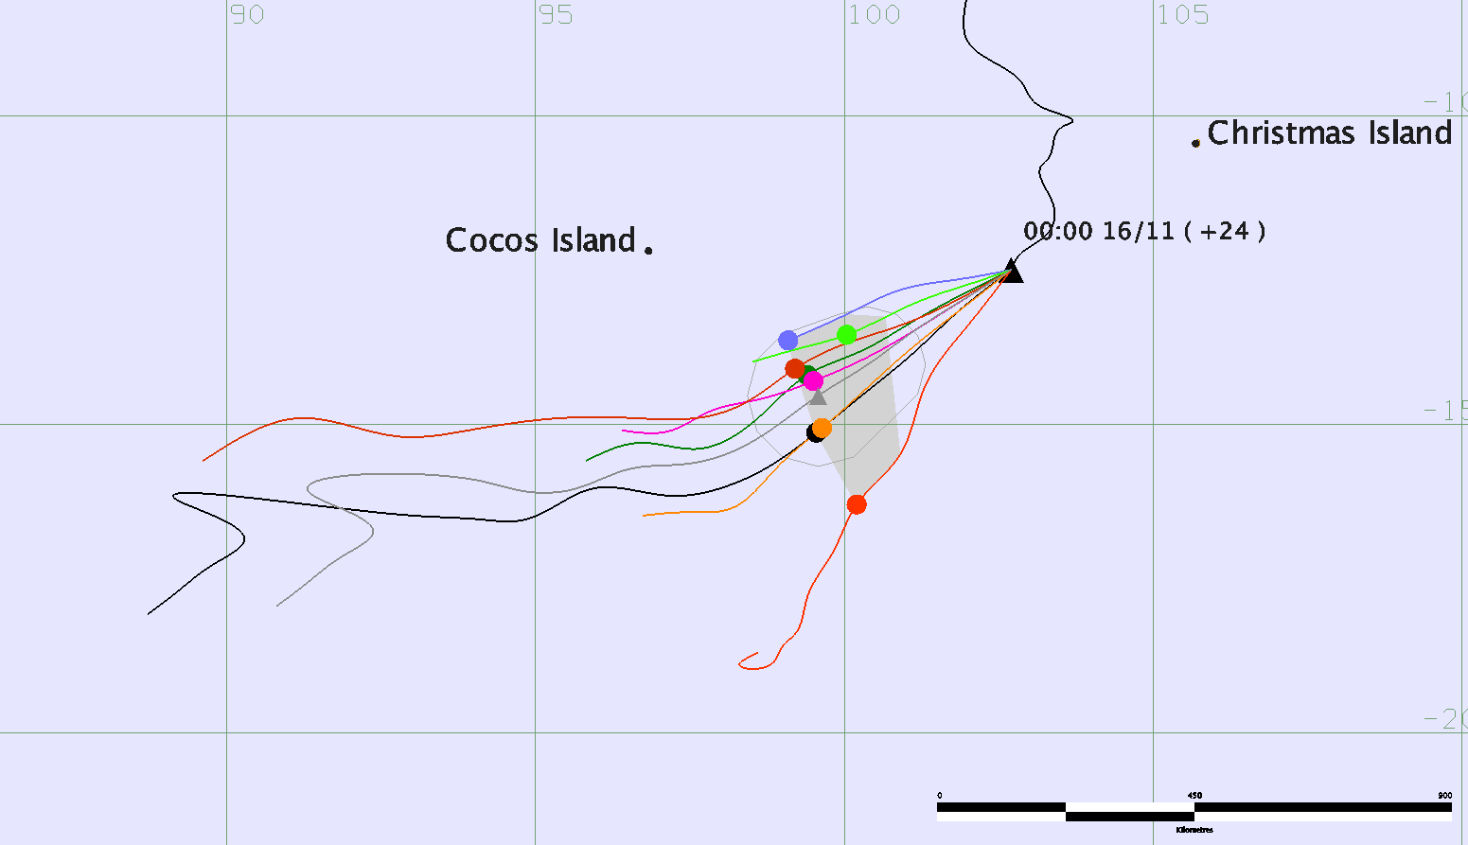
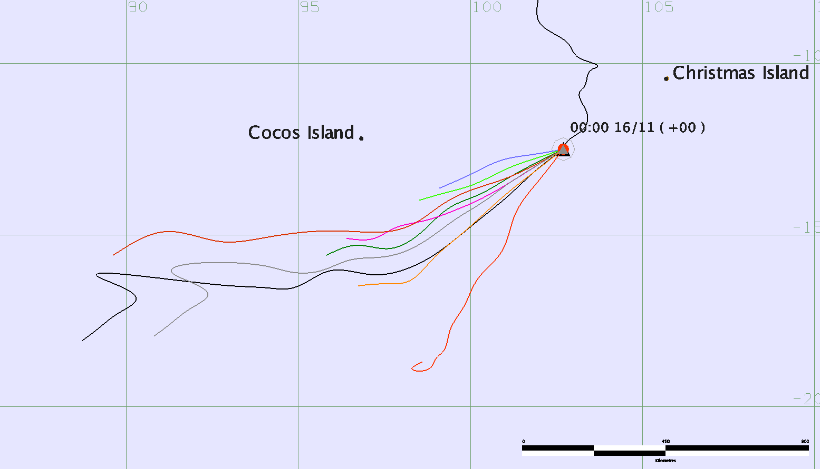
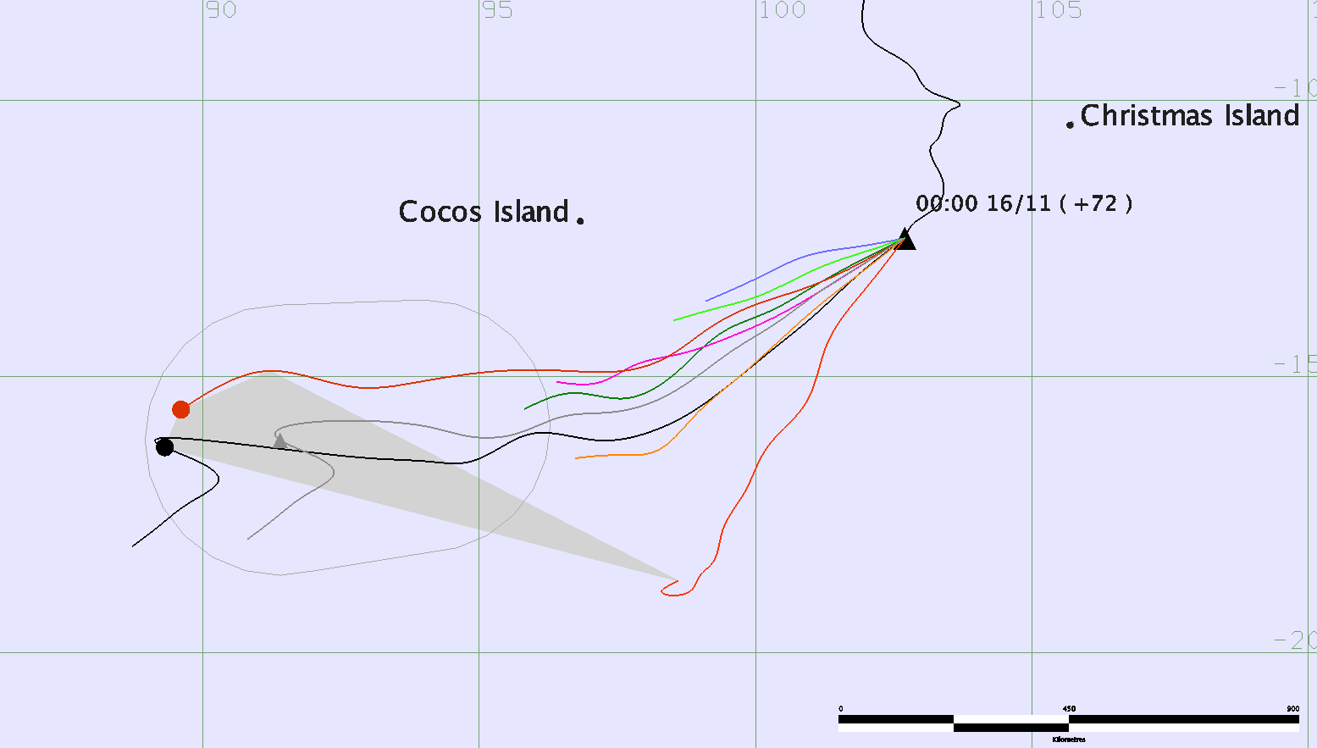
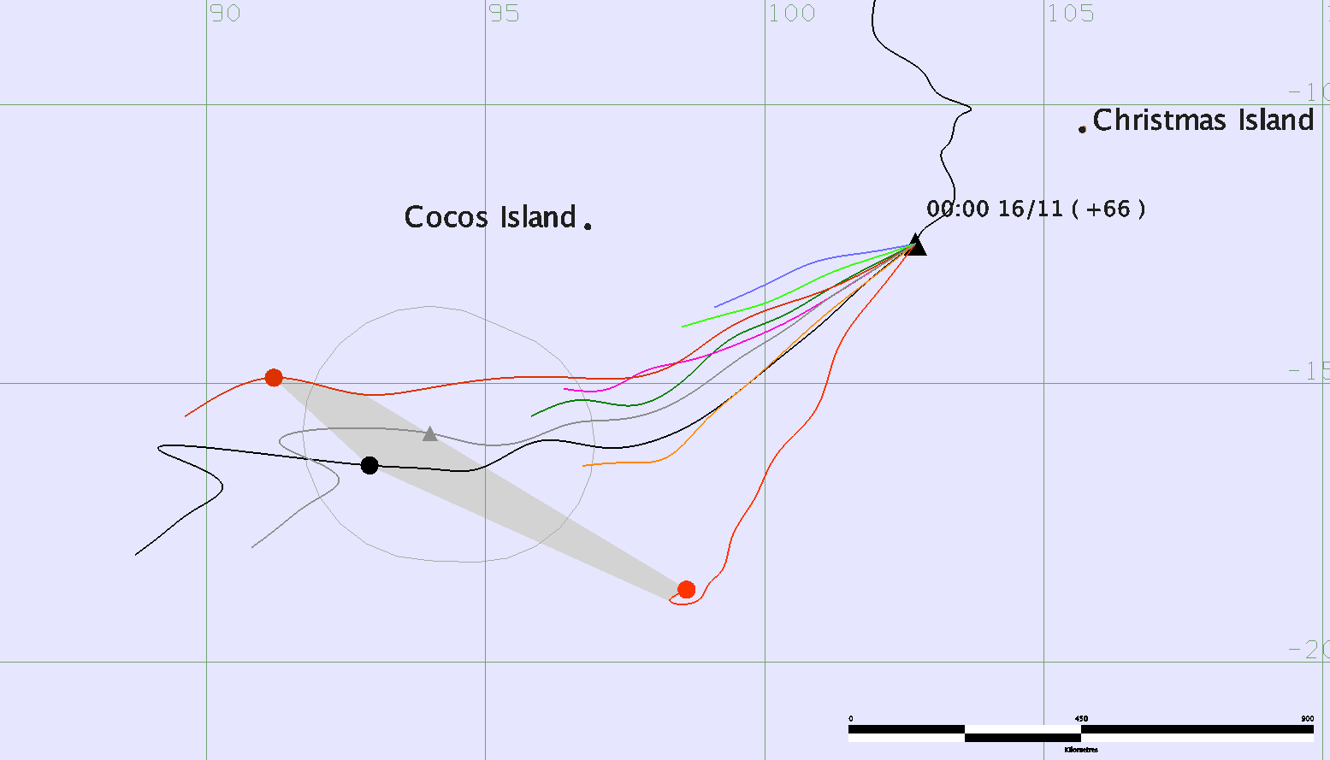
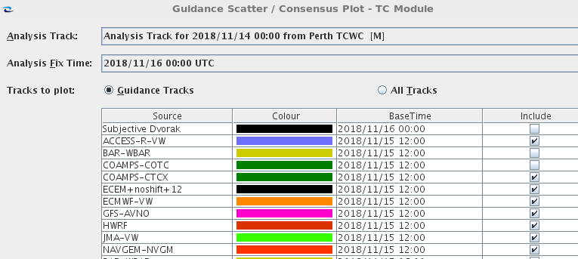
TC Track Forecasting

Slide 11
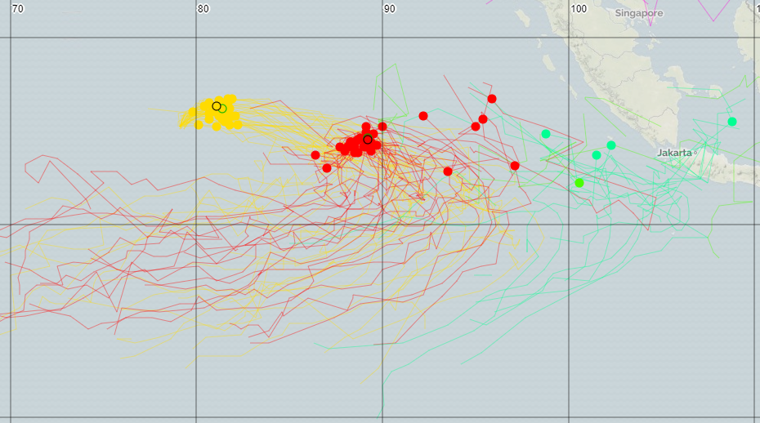
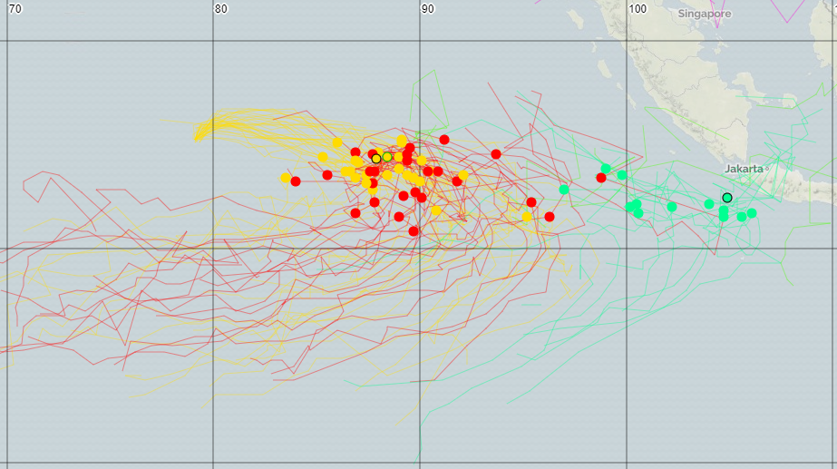
Issues: Clustering
+36 hours

Slide 12
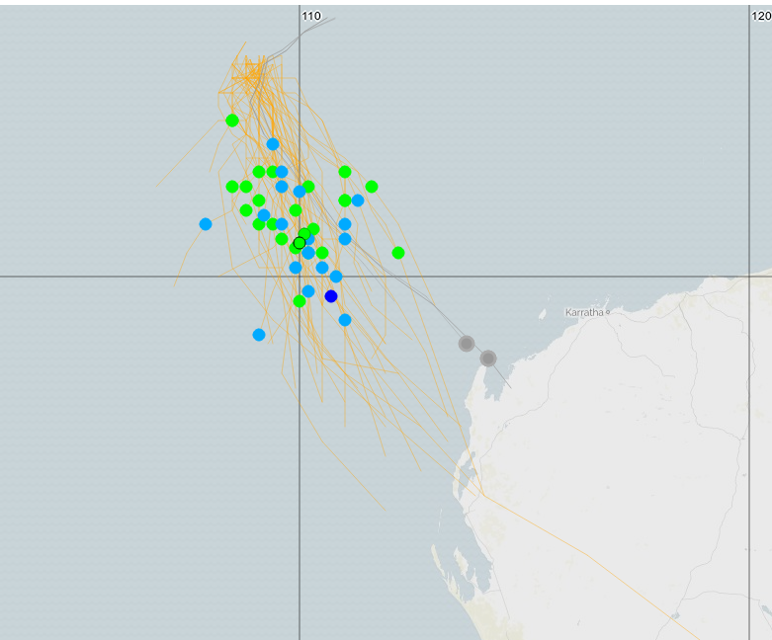
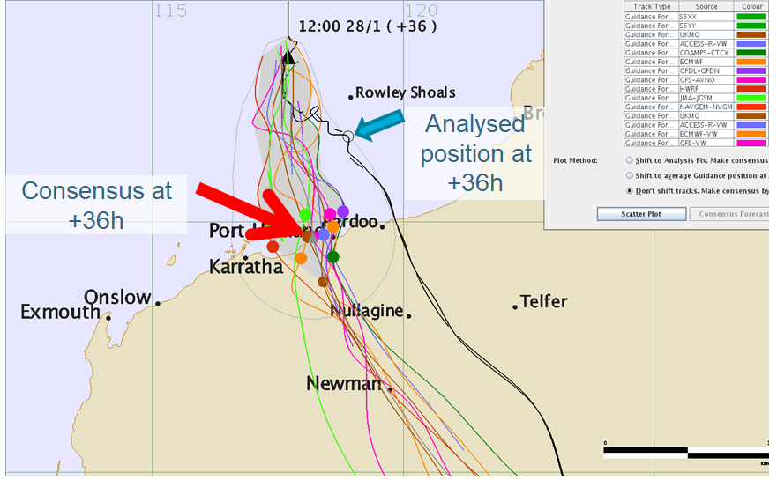
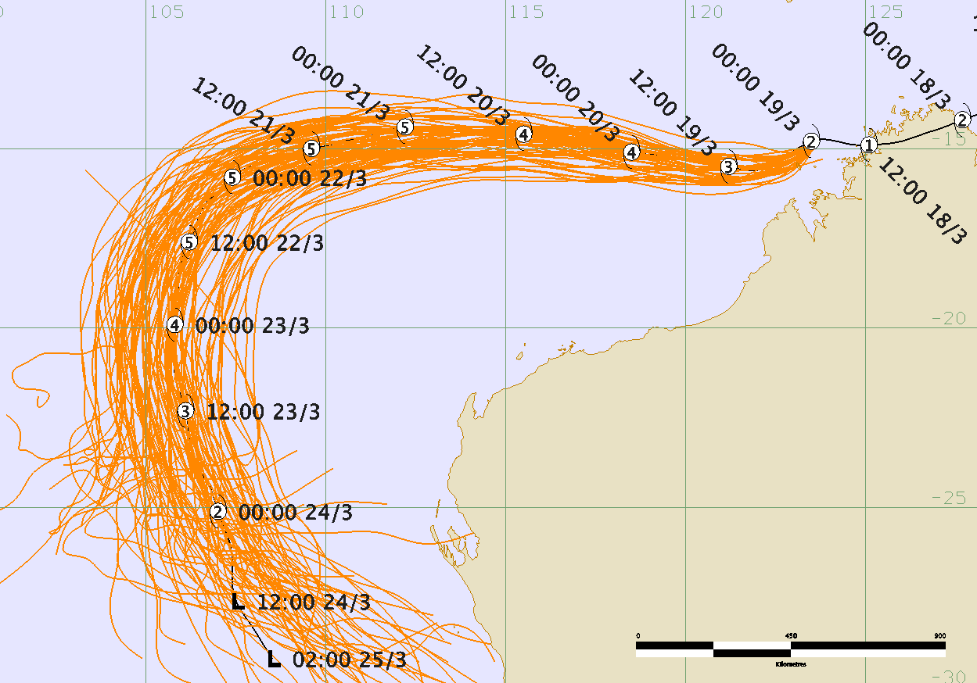
Issues: All Possibilities
TC Quang
Post-event best track

Slide 13
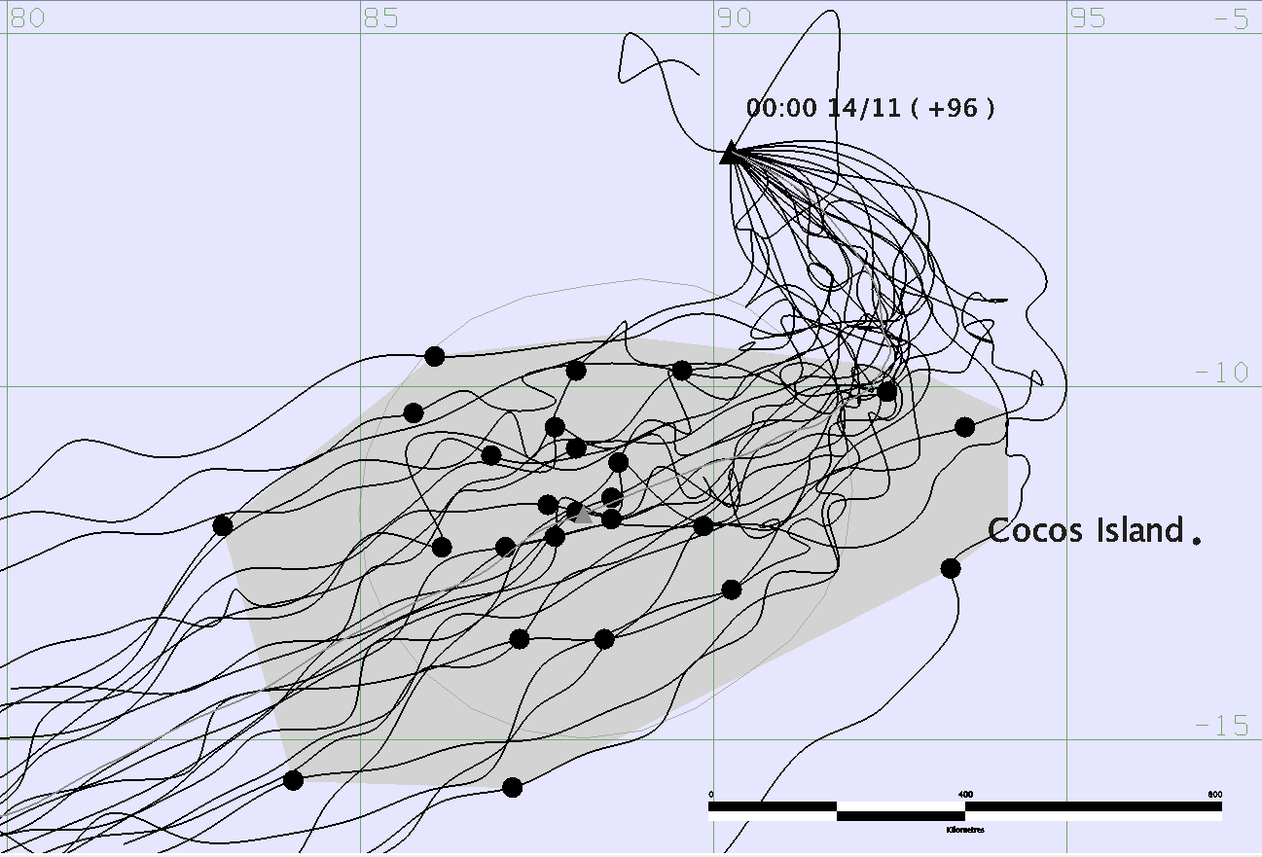
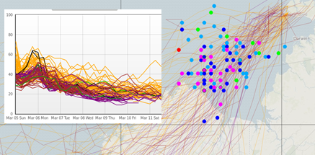
Future work
Intensity
Uncertainty
Clustering
Ensembles

Slide 14

Use of Ensembles in Tropical Cyclone Forecasting
Thank you…
Matt Boterhoven
Matthew.Boterhoven@bom.gov.au

