Slide 1
Disaster Risk Management – A (meteorological) outcome of ensemble modelling
Alasdair Hainsworth
(Formerly Chief, Disaster Risk Reduction Services Division, WMO
ADS/ADHP Bureau of Meteorology

Slide 2
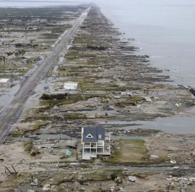
Talk outline
Personal Background
DRM – Why it’s important
DRM – Why it’s important to you
Some WMO Programmes and Projects

Slide 3
Who is he?
Operational forecaster with Bureau >20 years
12 years in Policy (Head Office)
5 years responsible for Weather Forecast and Warning Services
Nearly 3 years as Chief Disaster Risk Reduction Services Division in WMO – cross cutting through WMO and other UN Agencies
Assisted in developing the definitions and indicators for the Sendai targets
Worked on SEEMHEWS
GMAS
Categorising and cataloguing project

Slide 4
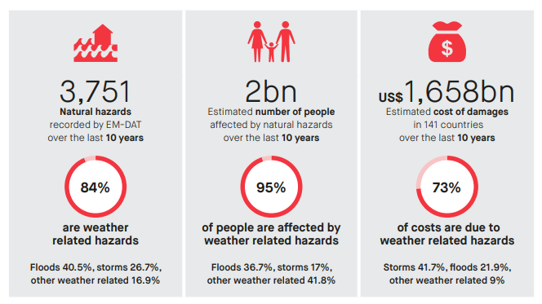
Disasters by numbers
Deaths are much higher in LDC, SIDS than developed nations
Losses and damage overall greater in developed nations
BUT
Disasters take/consume greater proportion of GDPs in LDC, SIDS than developed nations → impacts are greater
LDCs and SIDS spending more to recover – hampering growth and development – vicious cycle
From IFRC World Disasters Report 2018 (using CRED data)
Notes:
Why is DRM important – because of the vast number of people who are killed or injured by disasters each year and the incredible amount of loss and damage they cause
Deaths rates are much higher in Less Developed Countries and Small Island Developing States.
, however, Loss and damage is greater in developed nations with greater infrastructure that is vulnerable to high impact weather/climate events. Nearly 66% of all loss and damage occurred in 3 countries (US, China and Japan)
However, the impacts of disasters on LDC and SIDS is greater by proportion of their GDPs. They lose a greater prop of their GDPs to disasters and spend a greater proportion of their GDPs recovering from disasters

Slide 5
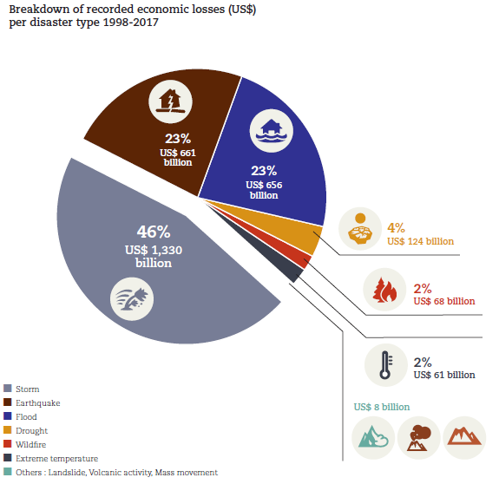
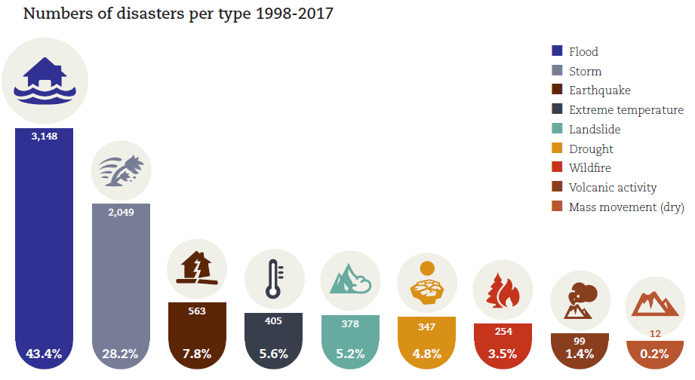
Whilst geophysical events are responsible for more deaths overall, weather, climate and hydrological events are more frequent and cause more loss and damage
From UNISDR/CRED Economic Losses, Poverty and Disasters 1998-2017

Slide 6
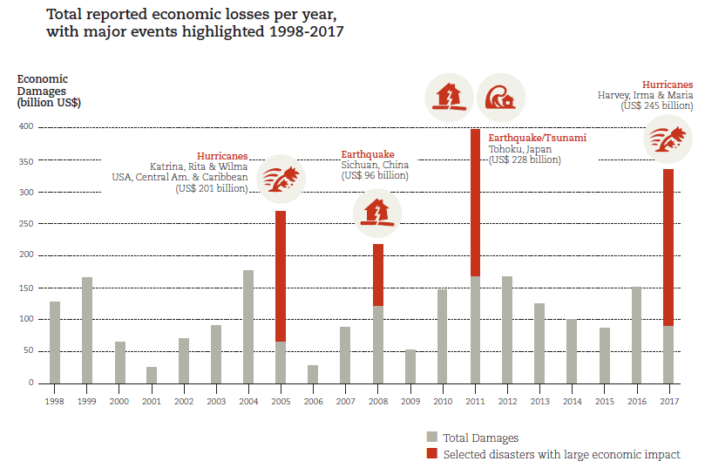
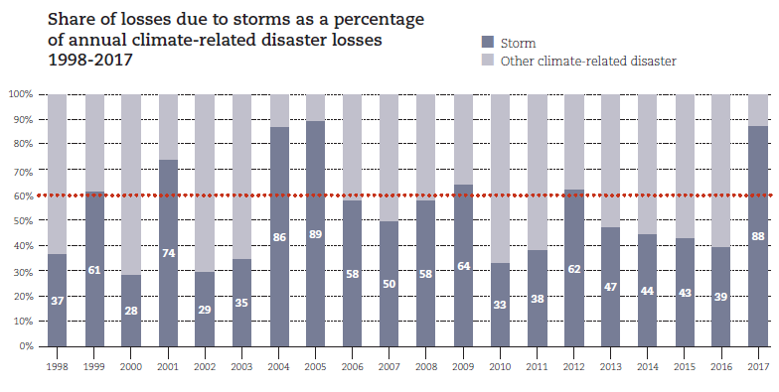
Many (>90%) of these events can be forecast → with adequate planning and preparation (remember PPRR), losses can / should be reduced These are the events being focused on at workshop
From UNISDR/CRED Economic Losses, Poverty and Disasters 1998-2017
Notes:
Imagine if we (the meteorological community) could save the World even 15% of the more than $2.2 Trillion – more than $300 BILLION - of these losses over the next 20 years? And this figure is conservative. This would pay for meteorological and hydrological services around the world a few times over.

Slide 7
Sendai Framework for DRR 2015-2030
In 2016, the UN Secretary-General launched “The Sendai Seven Campaign” to promote each of the seven targets over seven years. These targets start with (a) “aiming to lower average per 100,000 global mortality between 2020 and 2030 compared to 2005-2015”, and (b) “substantially reduce the number of affected people globally by 2030”. In 2018, the focus is on target (c) “Reduce direct disaster economic loss in relation to global gross domestic product (GDP) by 2030.”
Focus on decreasing vulnerability and increasing resilience
“Build back better”

Slide 8
Sendai Framework for DRR 2015-2030
In 2016, the UN Secretary-General launched “The Sendai Seven Campaign” to promote each of the seven targets over seven years. These targets start with (a) “aiming to lower average per 100,000 global mortality between 2020 and 2030 compared to 2005-2015”, and(b) “substantially reduce the number of affected people globally by 2030”. In 2018, the focus is on target (c) “Reduce direct disaster economic loss in relation to global gross domestic product (GDP) by 2030.”
Focus on decreasing vulnerability and increasing resilience
“Build back better”

Slide 9
So how, in a tangible manner, can you make a difference?
Greater focus on impacts
What the weather will DO not what the weather will BE
As budgets for NMHSs decreases in real terms, must be smarter in the way we work and interact with disaster risk/emergency managers
They want to know the likelihood of occurrence and its impacts on the vulnerable
Severe TC Winston and Typhoon Haiyan well forecast – poor community outcomes
Increasing requirement to model IMPACTS not elements

Slide 10
International frameworks
Sendai Framework for Disaster Risk Reduction 2015-2030
Sendai Framework aims to guide multi-hazard management of disaster risk in development at all levels. Six targets to be achieved by 2030, including a substantial reduction of global disaster mortality, No. of affected people and direct disaster economic loss through, inter alia, the increase in availability of and access to multi-hazard early warning systems and disaster risk information and assessments (Target G).
The Paris Agreement
Parties recognize the importance of averting, minimizing and addressing loss and damage associated with the adverse effects of climate change, including extreme weather events and slow onset events, and the role of sustainable development in reducing the risk of loss and damage.
Warsaw International Mechanism on Loss and Damage
The Warsaw international mechanism on loss and damage associated with impacts of climate change, including extreme events and slow onset events facilitates and promotes, inter-alia, understanding of and expertise in approaches to address loss and damage associated with the adverse effects of climate change, and the collection, sharing, management and use of relevant data and information
UN Sustainable Development Goals

Slide 11
What is wmo doing to assist?
Assisting in the development of the Sendai Framework for DRR 2015-20130 target indicators
Nearly every nation has signed up and now there is a framework monitor to which all countries will (non-bindlngly) report
Developing definitions around meteorological, hydrological and climate related events
Urging its Members NMHS to have a greater focus on impacts
Improving Member’s NMHS’s access to data
Eg SWFDP, IDMP, FFGS

Slide 12
Resolution 9 (Cg-17)
IDENTIFIERS FOR CATALOGUING EXTREME WEATHER, WATER AND CLIMATE EVENTS
Decides to standardize weather, water, climate, space weather and other related environmental hazard and risk information and develop identifiers for cataloguing weather, water and climate extreme events;
Requests the Executive Council to provide oversight on the standardization of hazard information for loss and damage assessment;
Requests the Commission for Basic Systems to develop, in collaboration with all technical commissions and regional associations, a proposal on standardized identifiers for cataloguing hazardous events for consideration by the Executive Council;
Requests the Secretary-General to take the necessary actions, within the available budgetary resources, to facilitate the work on this important issue.

Slide 13
Key Event Atributes
Description
- UUID
32 Character random sequence
- Identifier
Originator (name of institution that is recording the event)
- Record creation
- Event start
Date & Time
- Event end
Event
- Event type
From WMO Event Types list (Primary or System)
- Area
Recognized spatial datatype (e.g. Geodatabase, shapefile)
- Headline
From a controlled list
- Description of event
Open text description of event (e.g. winds 45 knots gusting to 55 knots)
- Linkage
UUID reference link to related events (e.g. Storm)
- Status
Status of record (i.e. in progress / complete)

Slide 14
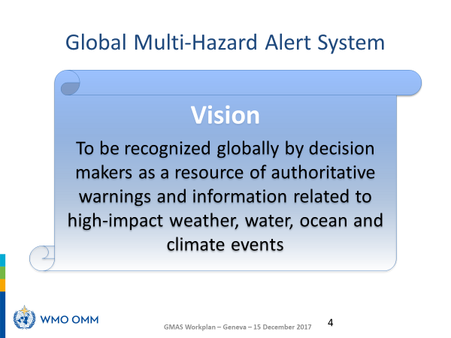
Global Multi-Hazard Alert System (GMAS)

Slide 15
GMAS
GMAS Concept
Focuses on benefits to and requirements of users,
Emphasizes that NMHSs are official authoritative source and in most countries, a single voice, on weather warnings,
Considers role of RSMCs in providing guidance to Members (e.g. tropical cyclones, and climate products),
Considers both meteorological and hydrological aspects,
Accommodates public and private capacities and use cases,
Takes into account other service providers such as GDACS,
Utilizes Common Alerting Protocol (CAP) or other industry standards to enable a robust mechanism for aggregating warnings from Members
Global Multi-Hazard Alert System
Notes:
The key drivers for the development and implementation of GMAS are the addressing of
major gaps in Multi-Hazard Early Warning Systems (MHEWS) at national, regional and
global levels
In 2015, governments, agencies, NHMSs, WMO representatives and the wider disaster risk
reduction community gathered together in Sendai, an area itself devastated by the Great
Japan Earthquake, to discuss and formulate what has now become the ground-breaking
Sendai Framework for Disaster Risk Reduction. In Sendai all parties agreed upon the
requirement for enhancing services, strengthening regional and global collaboration and
developing science based methodologies to support Multi-Hazard Early Warning Systems.
This forms the basis for Target G of the Sendai Framework – to substantially increase the
availability of, and access to, multi-hazard early warning systems and disaster risk
information and assessments to people by 20301

Slide 16
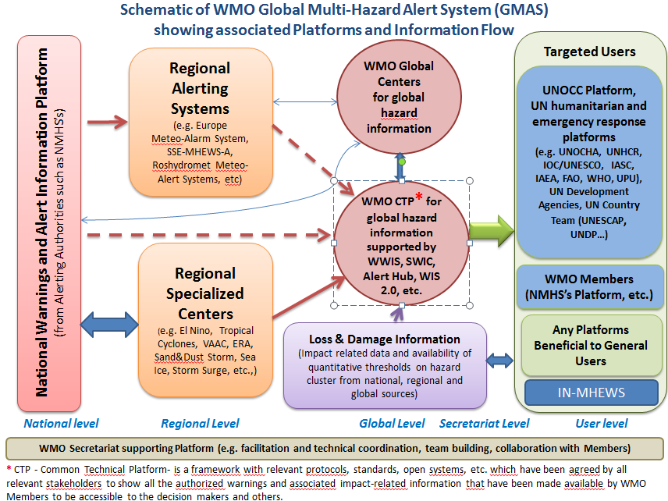

Slide 17
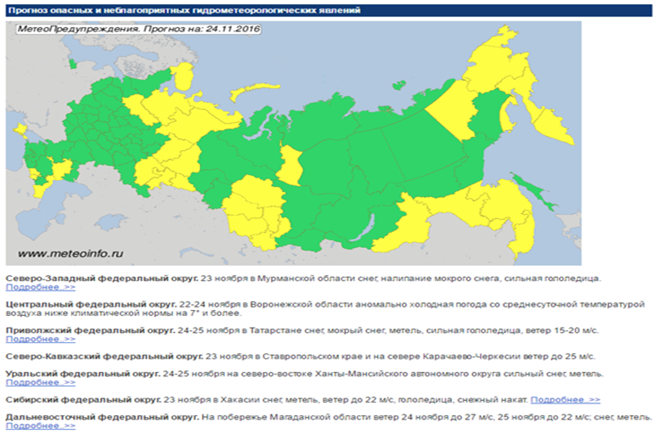
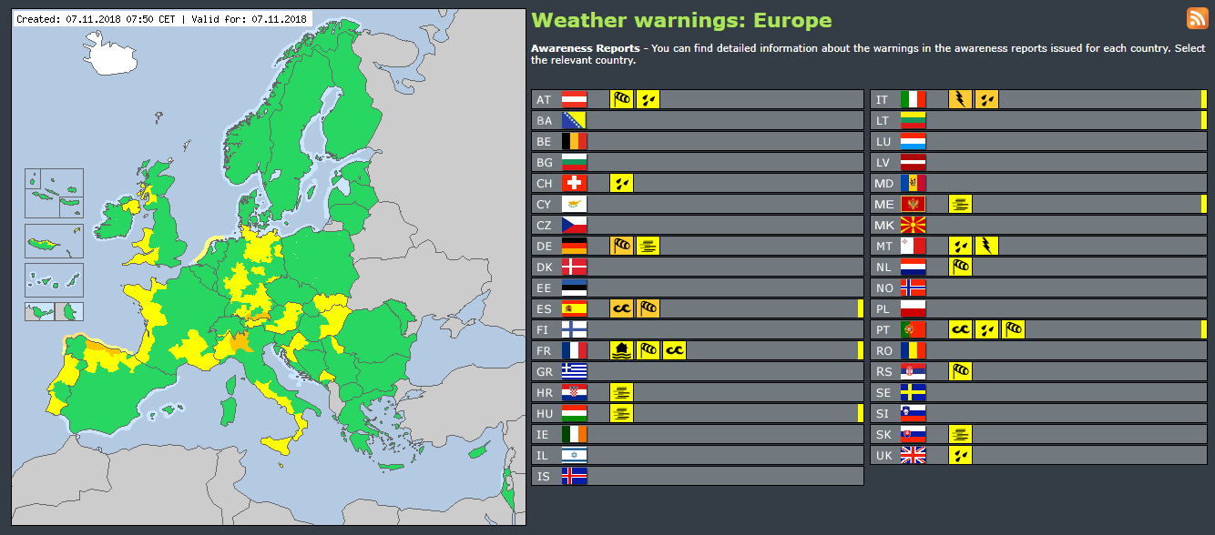
GMAS – ultimate Destination Combine the various display formats around globe
Notes:
Combining existing display formats such as Meteoalarm and MeteoInfo or (most likely) developing a new format.
Central repository of warnings – possibly based on existing Severe Weather Information System (SWIC)
Global coverage of graphical warning information – colour coded on impacts not necessarily severity

Slide 18


GMAS – ultimate Destination Combine the various display formats around globe
Meteoalarm
Meteoalert - MetInfo

Slide 19
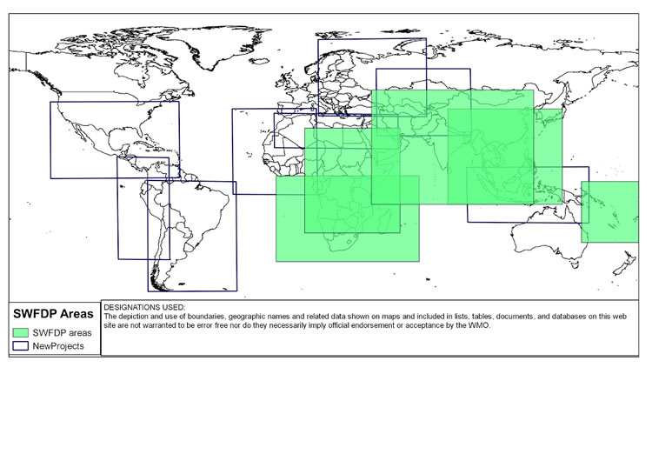
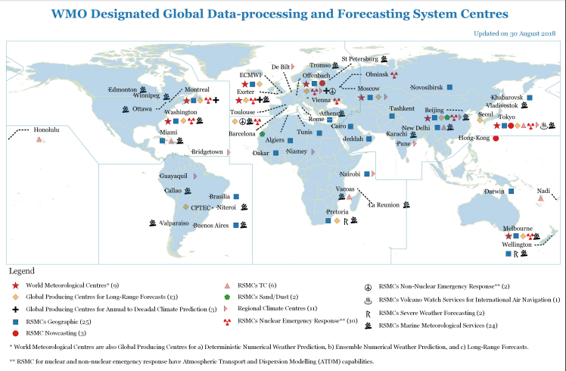
Severe Weather Forecasting Demonstration Program (SWFDP)
Designed to assist those Members with limited capacity to produce numerical guidance
Transitioning to more digital service

Slide 20
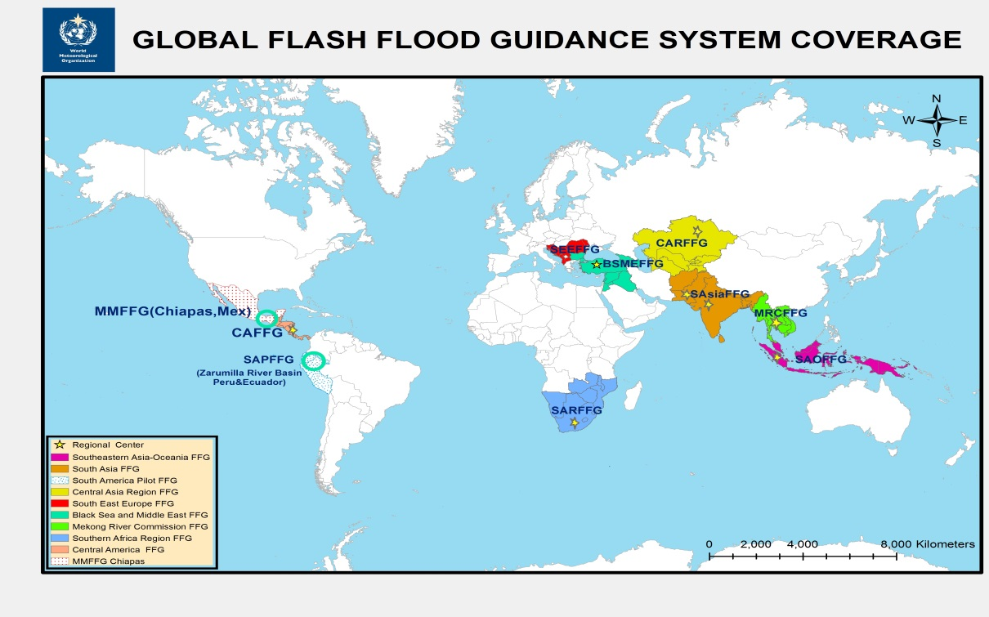
Flash Flood Guidance System (FFGS)
The WMO Commission for Hydrology (CHy) jointly with the WMO Commission for Basic Systems (CBS) and in collaboration with the US National Weather Service, Hydrologic Research Center (HRC), and USAID/OFDA have developed the concept of the Flash Flood Guidance System (FFGS) with global coverage. The concept has been endorsed by the Fifteenth WMO Congress and is being implemented through a series of regional projects with funding from USAID.
Flash Flood Guidance System with global coverage enhances early warning capabilities of the NMHSs, currently covers fifty two (52) countries and more than two billion people around the world saving lives and decreasing economic losses.

Slide 21
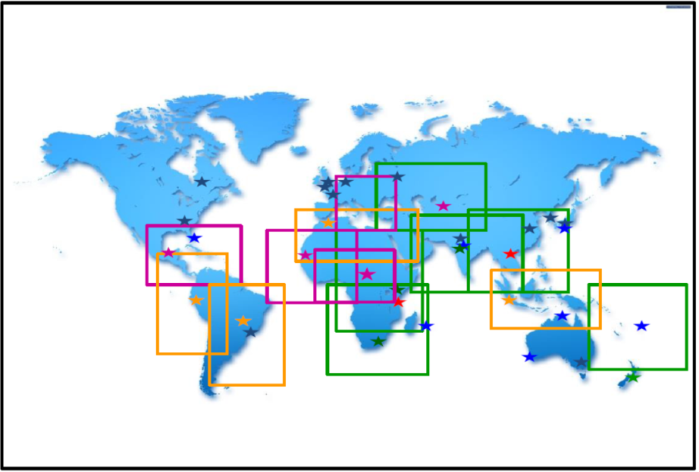
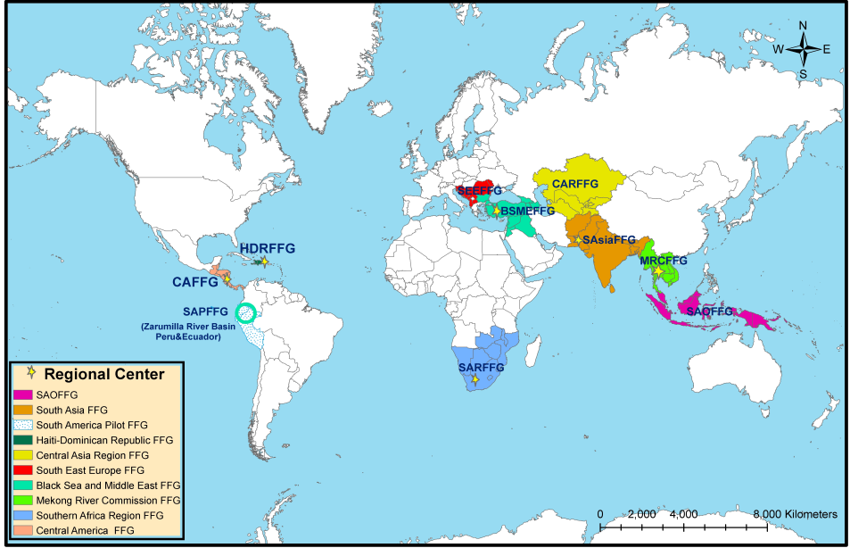
Possible Linkages Between SWFDP and regional FFG Systems
SWFDP
FFGS
SAOFFGS-SWFDP-SAO
MRFFGS-SWFDP-SEA
SAsaiFFGS-SWFDP-BoB
CARFFGS-SWFDP-CA
SARFFGS-SWFDP-SA
BSMEFFGS-SWFDP-SEE
CAFFGS-SWFDP-Caribbean

Slide 22
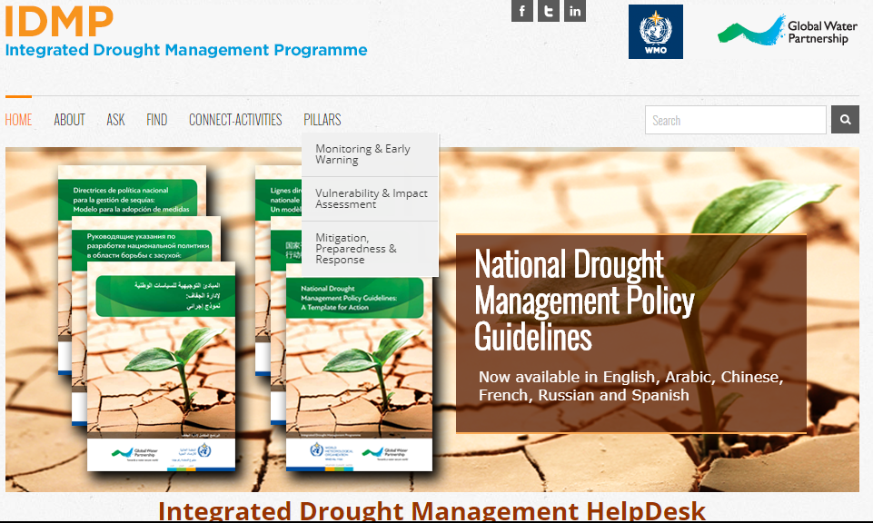
Integrated Drought Management Programme (IDMP)
Provides policy and management guidance
Notes:
The IDMP works with a wide range of partners with the objective of supporting stakeholders at all levels by providing them with policy and management guidance through globally coordinated generation of scientific information and sharing best practices and knowledge for integrated drought management. The IDMP is a contribution to the Global Framework for Climate Services (GFCS) especially with regards to GFCS priority areas of disaster risk reduction, water, agriculture and food security. It especially seeks to support regions and countries to develop more proactive drought policies and better predictive mechanisms.

Slide 23
Thank you!

Slide 24
Cascading Event Records
Event UUID: random string of 32 characters
114bd279-dde4-48c9-b20d-db1c967bfa4c
3fdaa43c-51d0-414f-a26a-e23de203aa76
Regional (e.g. Europe)
Convective
Cyclonic
Global (ad hoc analysis)
National
(e.g. Germany)
Heavy rain
Flooding
Strong gale
f3df3f02-7574-4ffe-beea-021af820bc47
0882b06f-ed9a-40d2-9f96-df0da7130ee9
3b3a30ec-03f3-445d-8f86-76cb5447e9ee

Slide 25
Primary and System Events List
Partial Headline list

Slide 26
Headline Events List

Slide 27
Example of applications
Tracking policy outcomes by governments
Risk management (public and private sector)
Risk identification (hazard component)
Risk reduction (e.g. codes and standards)
Risk transfer (insurance, risk facilities, cat bonds)
Research
Tracking trends in event frequency, severity and distribution
On causal contributions of hazards, exposure and vulnerability to losses

