Slide 1
Advances in the Bureau's Disaster Mitigation Policy
Shoni Maguire, Carla Mooney, Shannon Panchuk and Marcelle Munro
Disaster Mitigation Policy
27 November 2018

Slide 2
Multi-hazard Impact-based Forecast & Warning Services: an Integrated Approach
The Bureau’s strategic intent is to better link impact-based forecast and warning services with our emergency services partners and the community
The initial phase of a project to audit the current Bureau hazard forecasts and warnings against the best practice attributes of an end-to-end multi-hazard impact-based forecast and warning service
The next steps is to engage with our emergency services partners to 'reality check' our findings, informing the implementation of a program of work to 2022

Slide 3
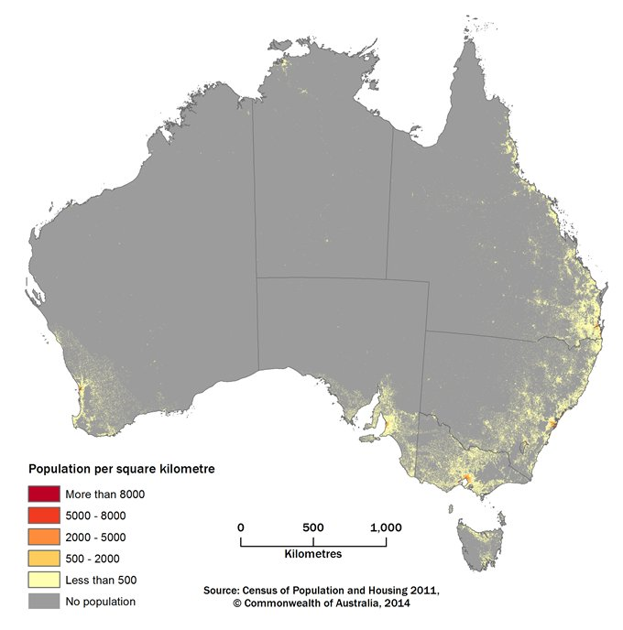
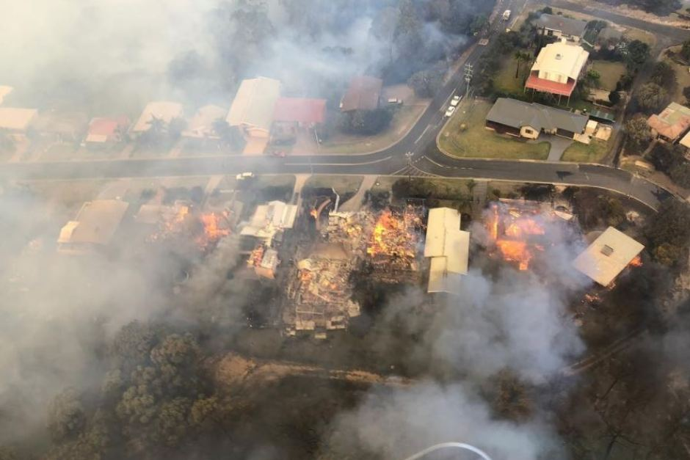

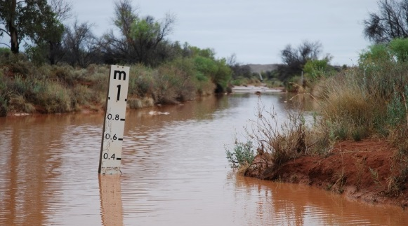

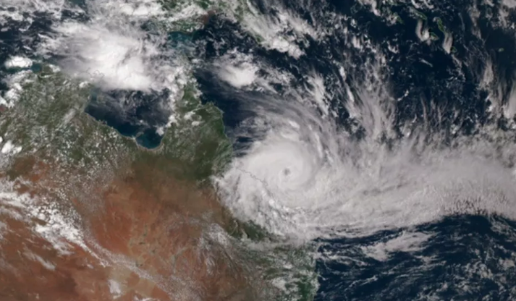
Australia's Current and Changing Hazard Risk

Slide 4
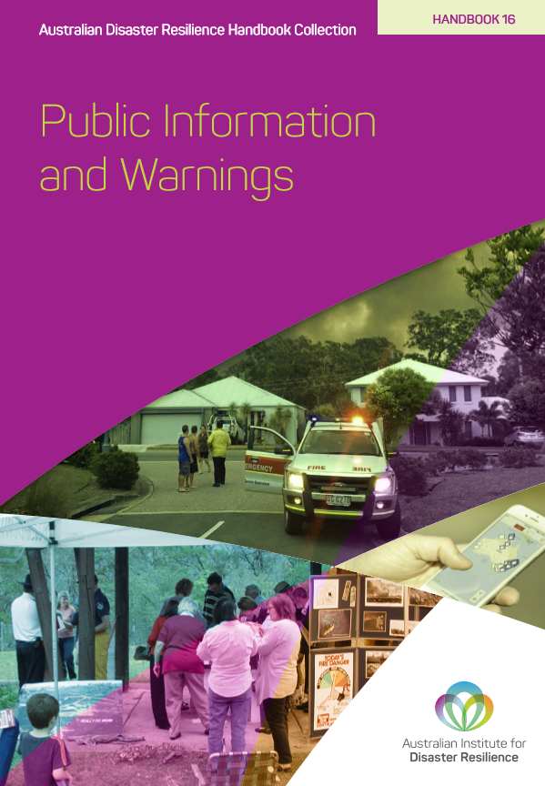
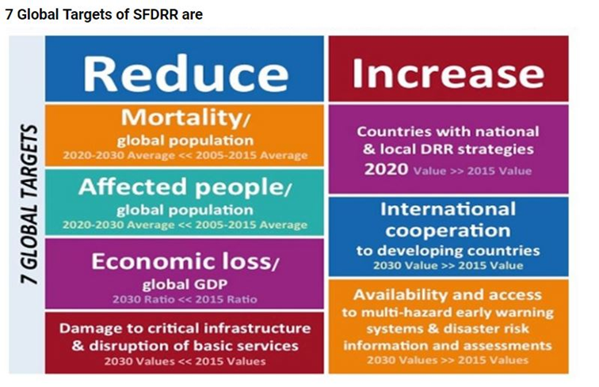
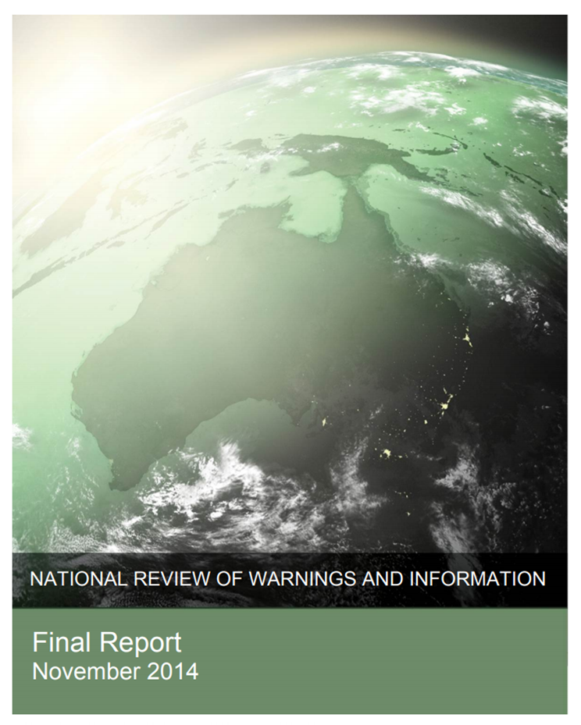
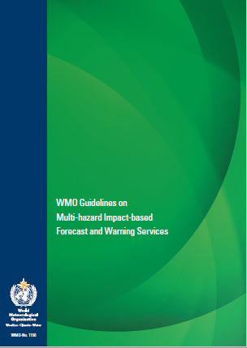

National and International Drivers

Slide 5
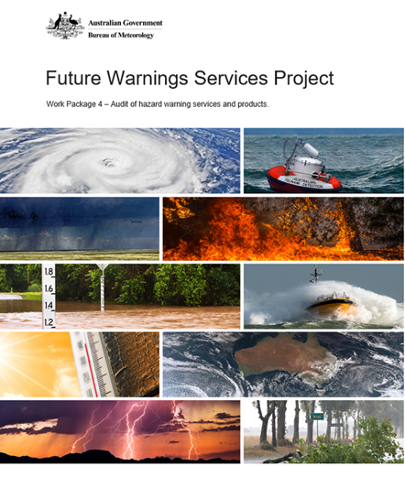
Core audit team assembled - audit scope and tool determined
Survey tool developed, tested and refined
Surveys completed by wide range of SMEs
Survey data verified by upline manager
Analysis and summary of findings by project team
Audit findings used to inform key high level strategic project documents
Literature review of best practice impact warning services - attributes developed
Overview of the Audit
Process

Slide 6
Audit of warnings products and services
The project audited 11 services that provide warnings to the public:
Water Hazards Impacting Public Safety
  Riverine Flooding
  Tsunami
Extreme Weather
  Fire Weather Services
  Heatwave Services
  Tropical Cyclone Services
  Thunderstorm Services
  Severe Weather Services
  Thunderstorm Asthma Service
  National Multi-hazard Services
Weather & Marine Services
  Public Weather Services
  Marine & Ocean Services
  State & Territory Managers
  Community Outreach
  The project audited 57 products that come under these services.

Slide 7
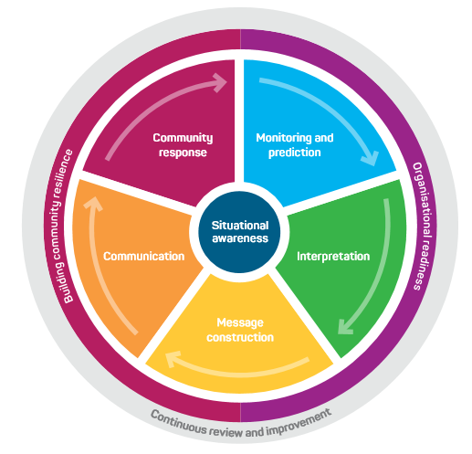
Total Warning Framework
Attributes of the Total Warning System were used as the basis of a survey to test our hazard services and products
Source: Australian Institute of Disaster Resilience

Slide 8
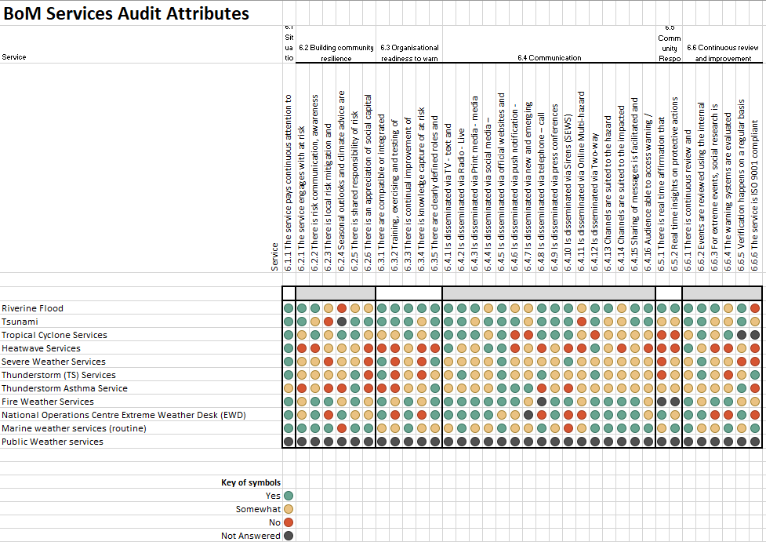
BoM Services Audit – Attributes

Slide 9
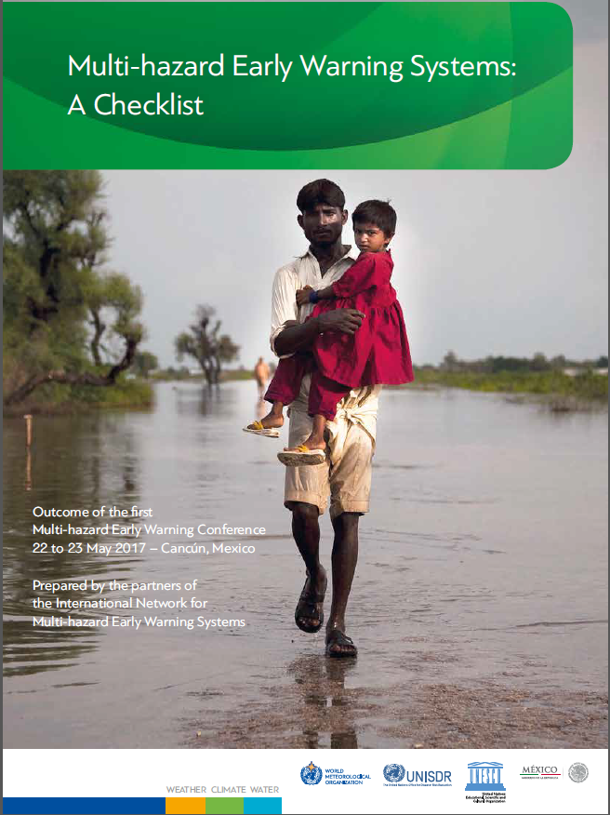
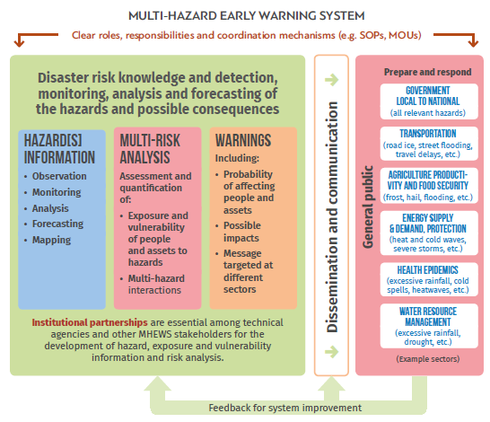
WMO Guidelines on Multi-Hazard Impact Based Warning

Slide 10
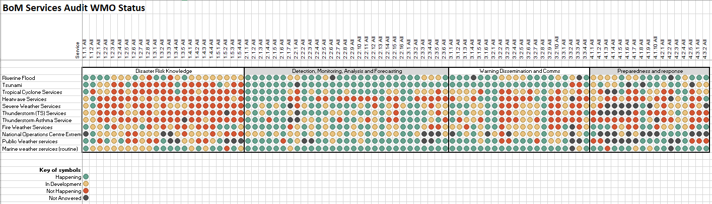
BoM Services Audit - WMO Status Heatmap

Slide 11
Identified gaps
Contextual rating system
Common mapping systems
Dynamic graphical formats
Consistent application of CAP-AU
Integrated products
Compliance framework for new warning services
Verification system for impact-based warnings
Geospatial location of warnings
Spatial and temporal presentation of warnings
Consistent delivery of warnings by all partners
Heatwave warning services
Archive of warnings
Post event community impact analysis

Slide 12
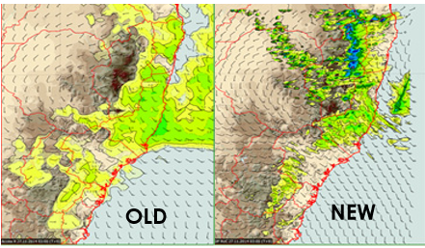
Next steps:
Prioritisation process in development:
  What does the community want?
  What do our Emergency Management partners require?
  Greatest impact on lives lost
  Easy fixes
  Underpinning systems

Slide 13
Thank you
Shoni Maguire
National Manager, Disaster Mitigation Policy
shoni.maguire@bom.gov.au
Notes:
Photo: (Alison Pouliot)

