Slide 1
Integrated Model post-PROcessing and VERification
IMPROVER
BoM Ensembles Workshop
Tuesday 27 November 2018
Notes:
The new Met Office integrated post-processing and verification system

Slide 2
With thanks to…
Post-processing: Paul Abernethy, Ben Ayliffe,
Mark Baker, Gavin Evans, Kathryn Howard,
Simon Jackson, Caroline Jones, Stephen Moseley, Tim Pillinger, Nigel Roberts, Fiona Rust,
Caroline Sandford, Mark Worsfold, Bruce Wright
Verification: Clare Bysouth, Rob Coulson,
Ric Crocker, Rob Darvell, Jonathan Flowerdew, Roger Harbord, Teresa Hughes, Simon Jackson, Marion Mittermaier
Software systems team: Laurence Beard,
Anna Booton, Ben Fitzpatrick, Aaron Hopkinson, Tomasz Trzeciak
Management: Dan Brierley, Sean Coultas, Ken Mylne
Notes:
Large project involving many people…

Slide 3
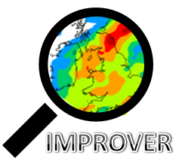
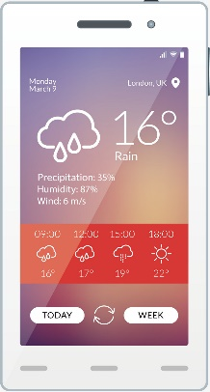

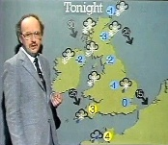
Why the need?
Back in the day
Now
A coarse-resolution forecast every few hours
x
Ops Centre
Ensembles, convection-permitting NWP, hourly
Challenges:
Require local forecasts anywhere anytime
Consistency (spot, gridded, ensemble)
Data volume for meteorologists
Need to fully exploit all km-scale models
Nature of forecast corrections has changed
Require a probabilistic approach
Selected local site forecasts for customers

Slide 4
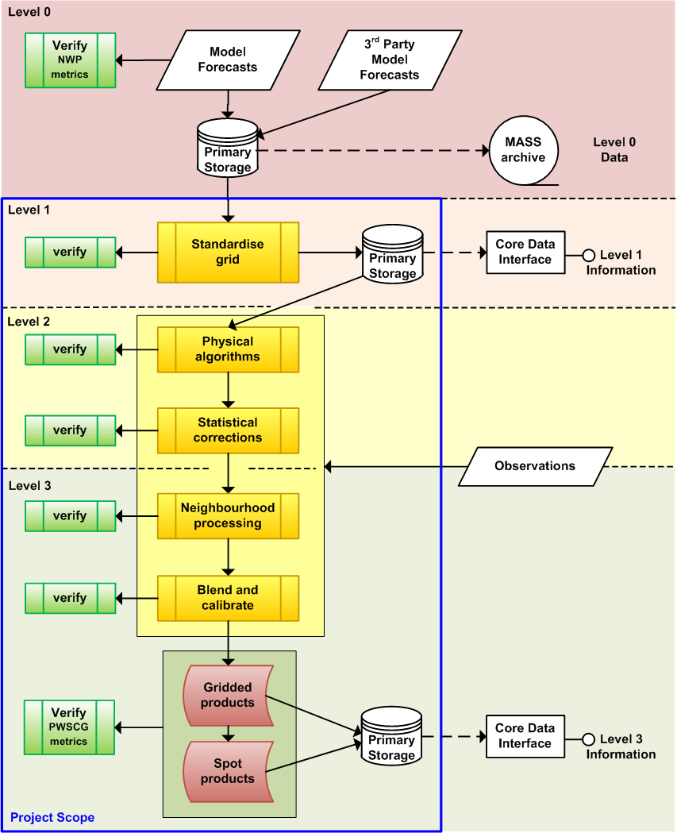
Post-processing review
One-year review of post processing for the future
Nigel Roberts and Marion Mittermaier. Key deliverable report (2016) - 'A post processing science and verification strategy for 0-15 days for 2016-2020 and beyond.'
Single modular processing chain
Sequential ‘physical’, ‘statistical’ and ‘neighbourhood’ processing
Probabilistic at the core
Spot forecasts from probabilities at the end
Verification at every stage
Seamless from nowcast to medium range
Notes:
(Level 1: abstract/decouple from model-specific grids; Level 2: improved single-source forecasts; Level 3: blended forecasts – not quite what diagram shows…).
Single chain, spot derived from grid: improve consistency.
Modular: Reduce maintenance costs, improve robustness.
Probabilistic: Fully exploit ensembles and the use of uncertainty information to improve decision-making.
Part which I lead: Verification to support development of each component, and only use those which add value.

Slide 5
IMPROVER verification aims
Measure “the impact of each stage of the post-processing” ...
  ... focussing on probabilistic forecasts ...
  ... using a basket of scores ...
  ... without rewriting the verification system
Use this in historic trials and operational monitoring...
Feedback to scientific development:
  Measure performance, see if you’ve met target
  Statistics essential to assess ensemble forecasts
  Identify priorities for improvement
  Adjust parameters/options to optimise performance
  Understand impact of each step
  Assess magnitude / importance of a given aspect
  Scientific method: hypothesis, test, learn, iterate
  Spot the unexpected
  Provide evidence for management, customers, …
  Complement unit tests and case studies
  – scientific quality assurance
  Identify how upstream changes affect each step
  Compare performance in different seasons
  …
Notes:
Historic trials: Quick results with multiple new configurations on representative period, developers working in parallel, like we do in NWP.
Operational monitoring: check for degradations in any component, track performance of all the same components and scores over time, accumulate data covering all seasons and long periods, allowing examination of rarer thresholds, etc
Why spend time on trials and verification? Seeing whether we’ve met the target is only a small part. Rich tapestry of intelligence to help you understand and improve your system. Thus integral part of process, not just something you do at the end.
Sci method: test assumptions; confirm steps doing what you think they’re doing (right results for right reasons)
So want trials to be cheap and frequent…

Slide 6
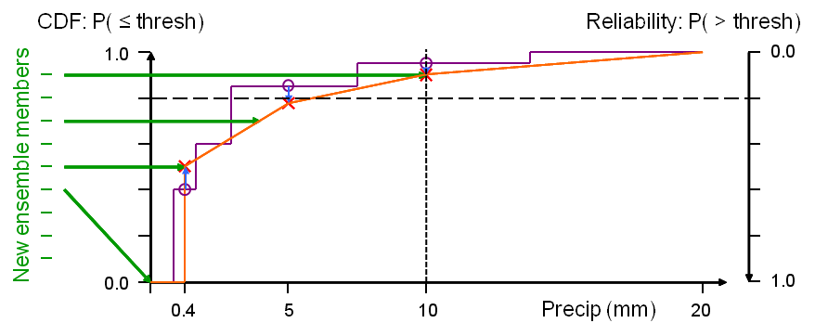
Different ways to express uncertainty
IMPROVER presents the set of possible outcomes in three different formats:
  ensemble members
  probabilities to exceed specified thresholds
  Forecast value for specified percentiles
These are just different ways of describing the same Cumulative Density Function (CDF):
Our main existing ensemble verification capability only accepts ensemble members
  So convert back to ensemble members before verification:
  'ensemble reconstruction' / 'Ensemble Copula Coupling' (ECC)
Notes:
[PDF formats]. Not only is IMPROVER a probabilistic system, but different stages present the uncertainty information [PDF] in different ways to support different processing and use cases.
Ensemble members: set of equally-likely sample states, as produced by raw models and already understood by ABV. The most general format, and the only one to encode space/time/inter-variable relationships required to derive spatial/temporal averages, etc.
These are just different slices across a CDF (the integral with respect to threshold of a PDF). [Since ensemble members are supposed to be 'equally likely', you can regenerate them as the set of equally-spaced percentiles required to give a flat rank histogram: 1/(N+1), 2/(N+1), … N/(N+1) (this is all you need for the main grid-scale verification; you get the multivariate relationships by assigning these quantiles to members in the same order as the raw ensemble).]

Slide 7
Processing Chains

Slide 8
Processing chain
Extract spot forecast
Verification
Diagnostics follow a broadly similar processing chain:
Physical corrections
Threshold to create probabilities
Neighbourhood processing
Time lag individual models
Blend models
Weather types
Verification
Verification
Verification
Verification
Verification
Verification
Notes:
Images on following slides from:
UK ensemble (MOGREPS-UK) from 21Z on 2 January 2018
Validity time: 3 January 2018 at 03Z (T+6)
Storm Eleanor

Slide 9
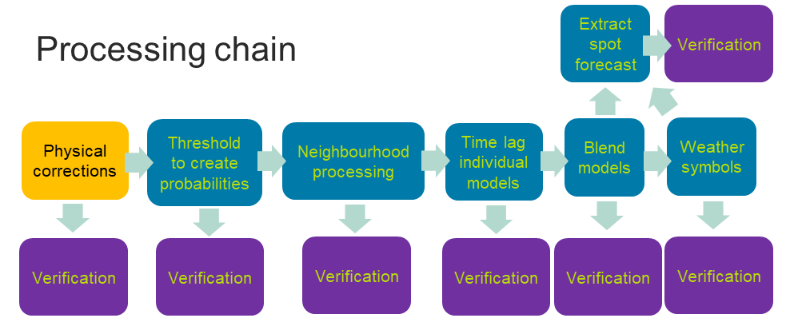
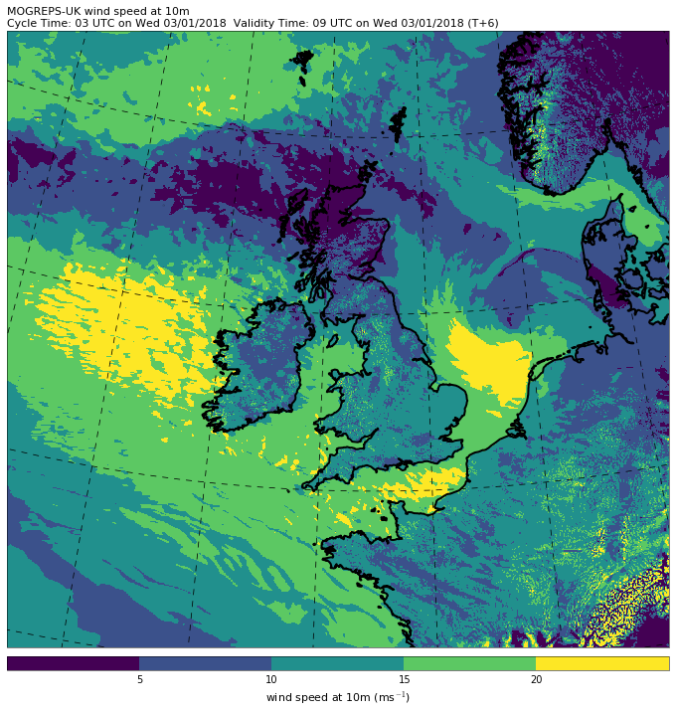
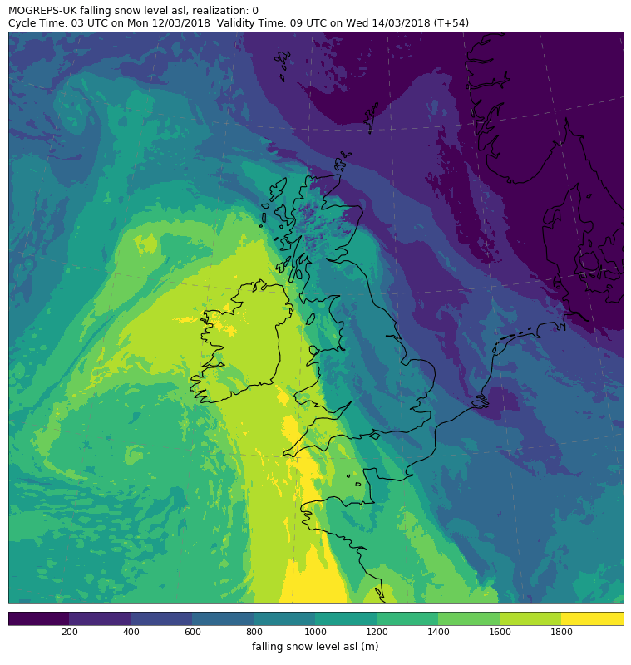
Physical corrections
Wind downscaling
Roughness correction
Height correction
Snow falling level
Does snow reach the surface?
More detail over more detailed orography
5 10 15 20
wind speed at 10m (m s⁻¹)
200 400 600 800 1000 1200 1400 1600 1800
snow falling level asl (m)

Slide 10
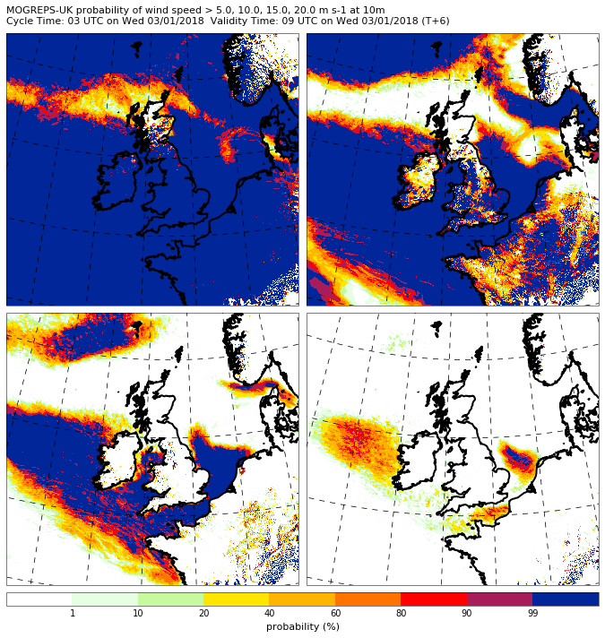
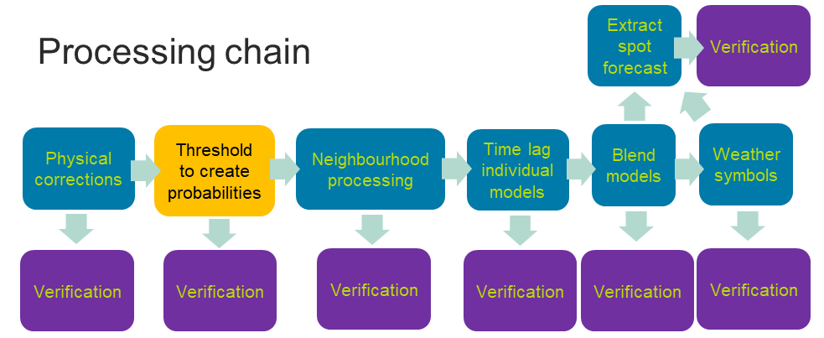
Threshold to create probabilities
Thresholding the ensemble members creates probabilities of whether a given probability has been exceeded.
Threshold need to be sufficiently fine to avoid information loss.
5 m s⁻¹
10 m s⁻¹
15 m s⁻¹
20 m s⁻¹
1 10 20 40 60 80 90 99
probability (%)

Slide 11
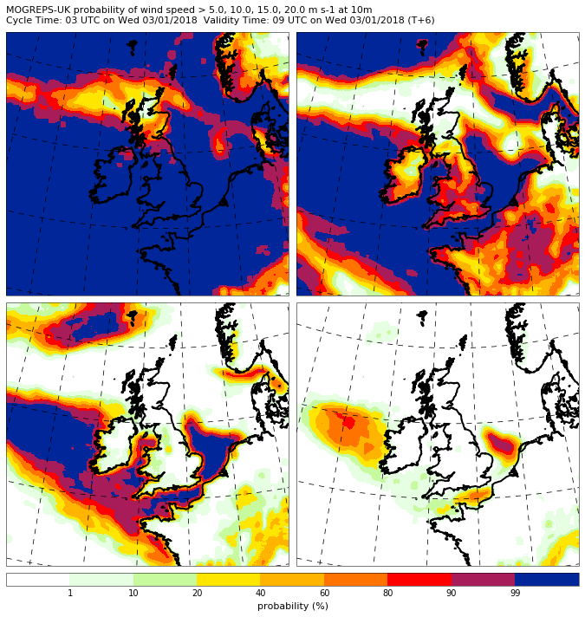
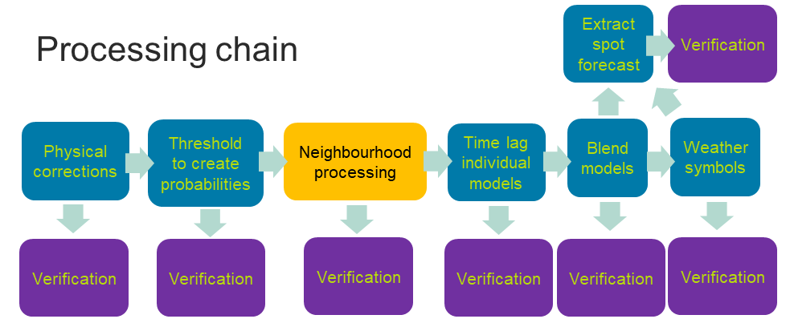
Neighbourhood processing
Assume neighbouring grid points are equally likely forecasts for a central grid point.
Find mean probability within the neighbourhood.
5 m s⁻¹
10 m s⁻¹
15 m s⁻¹
20 m s⁻¹
1 10 20 40 60 80 90 99
probability (%)
Notes:
Just like additional members

Slide 12
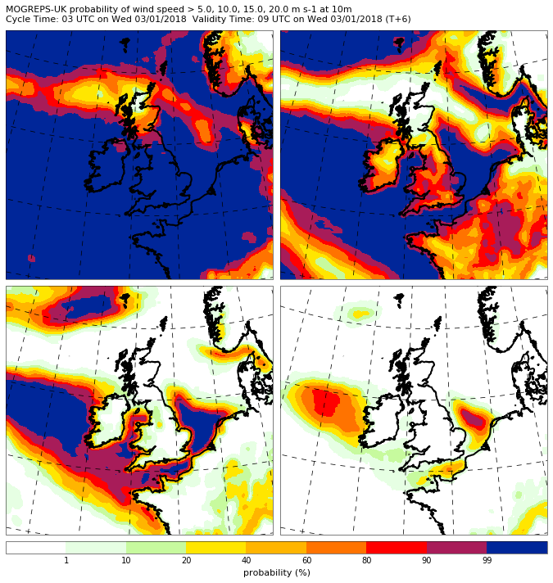
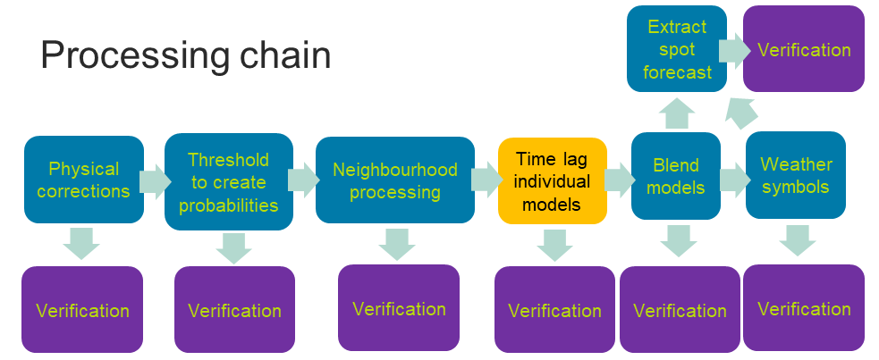
Time-lagging
Combine two cycles with equal weights at all grid points
5 m s⁻¹
10 m s⁻¹
15 m s⁻¹
20 m s⁻¹
1 10 20 40 60 80 90 99
probability (%)
Notes:
Just like additional members

Slide 13
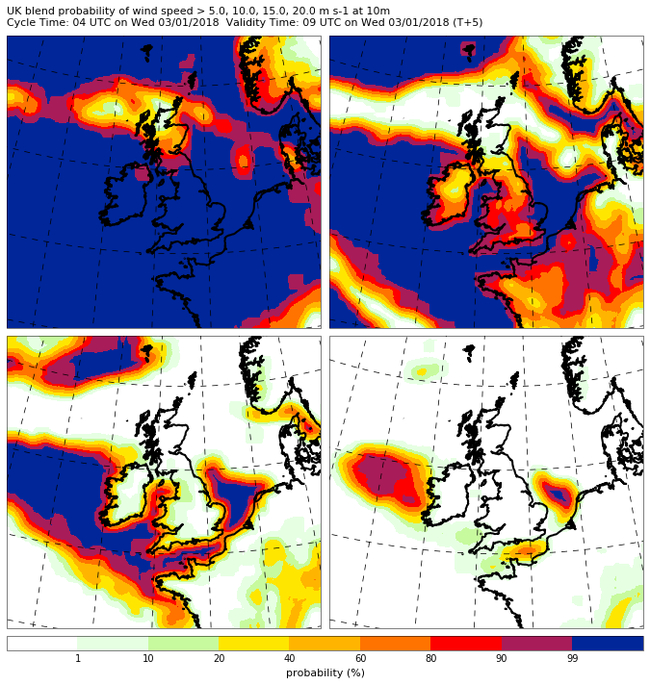
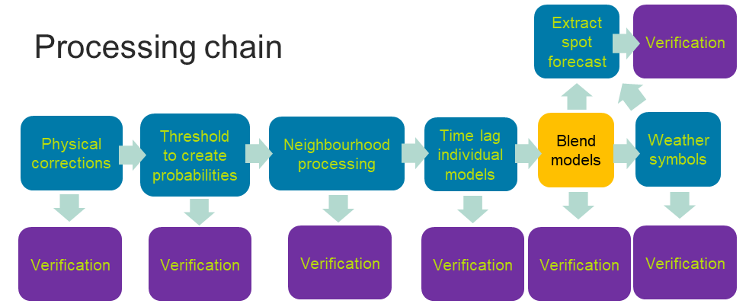
Multi-model blending
Combine time-lagged UK ensemble and time-lagged UK deterministic
5 m s⁻¹
10 m s⁻¹
15 m s⁻¹
20 m s⁻¹
1 10 20 40 60 80 90 99
probability (%)
Notes:
Just like additional members

Slide 14
Multiple model blending
Extrapolation
Blend probabilities
Hourly UKV – most useful model T+2 to ~T+10 time-lagged (available in ~1h)
MOGREPS-UK / UKV – 3 members hourly
MOGREPS-G / global
8d
ECMWF EPS
15d
0
12h
1d
2d
3d
4d
5d
6d
Notes:
Longer term vision for multi-model blending. [also mentions nowcast]

Slide 15
Verification through the chain
Examples from one month trial (November 2017)
Notes:
Some brief examples of the results – early system, so primarily illustrating capability and the kind of things we can learn.
Main verification of full PDF. Many stages, graphs quite complex (useful information!) just highlight some of the main messages.

Slide 16
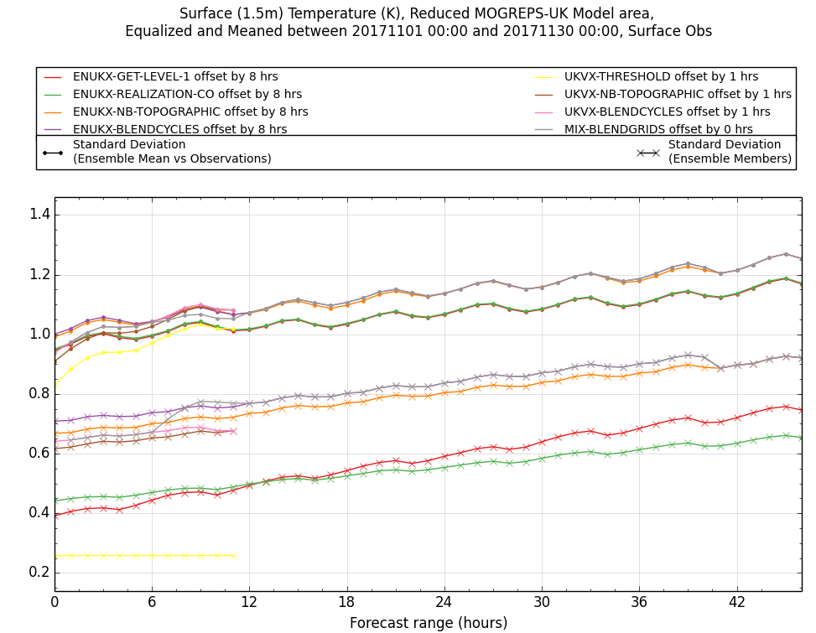
Temperature: Spread and Error
Spread (x):
  Nbhood (and blending) increase spread
Ensemble mean error (•):
  Prob not harming error
  Nbhood increases error (neighbourhoods too large)
  Inter-cycle blend not optimal
  Blendgrids beneficial
Notes:
Nbhood adding spread – improves match of spread to error, though getting into territory where may actually be overspread once observation error taken into account.
Conversion to probabilities and back not changing SDE: 1C thresholds are sufficiently finely spaced and ECC broadly working. [Spread increase at short LT 1C thresholds but not harmful, decrease at long LT may be related to ensemble size but not harming SDE. Other results show unintended extra interpolation which we will remove].
Nbhood not just finding additional samples from same PDF, but pulling in samples from different PDFs and thus degrading error. Test smaller neighbourhoods.
Blendcycles degrading error. UKV errors increase rapidly at start of forecast, so more weight to most recent forecast?
Blendgrids two benefits: UKV better than ensemble at short range, but blend better than both in nontrivial 6-12h region (independent information so combination better than either alone). Suggests blending more sources, lead times, etc.

Slide 17
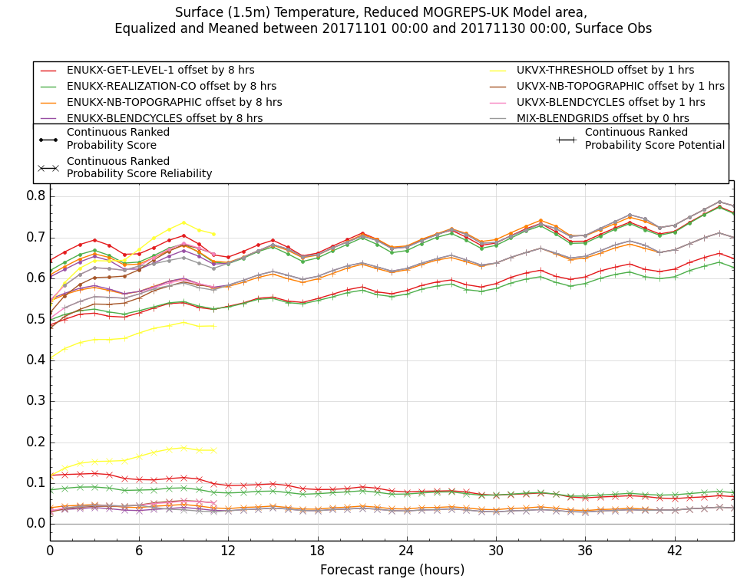
Temperature: CRPS
CRPS (•) measures quality of full PDF. Lower is better
Nbhood reduces reliability penalty (x) at the expense of ‘potential’ (+)
Nbhood more net benefit to UKV (no prior spread)
Lower is better
Notes:
Continuous Rank Probability Score – what you’d use as an overall measure of the quality of the probabilistic forecast. Decomposed into reliability penalty (when you say a 10% chance of rain, does it rain 10% of the time?) and potential (does your system distinguish cases where rain is unlikely from those where it is likely?)
Reliability can in principle be fixed by relabeling, whereas potential is the fundamental predictive capability of the system. So improving the ‘easy’ bit at the expense of the ‘fundamental’ bit. Look to improve neighbourhood processing (eg find optimal size) and explore optimal combination with statistical methods (which can in principle fix unreliability without harming potential; as indeed nbhood does for visibility). Comparison with earlier trial shows topographic nbhood already a big improvement on equally large non-topographic nbhood.
Potential for even greater skill if we could dress the UKV without degrading its potential (yellow +).
Hint in limited time of how different scores tell you different things (also looked at bias…).

Slide 18
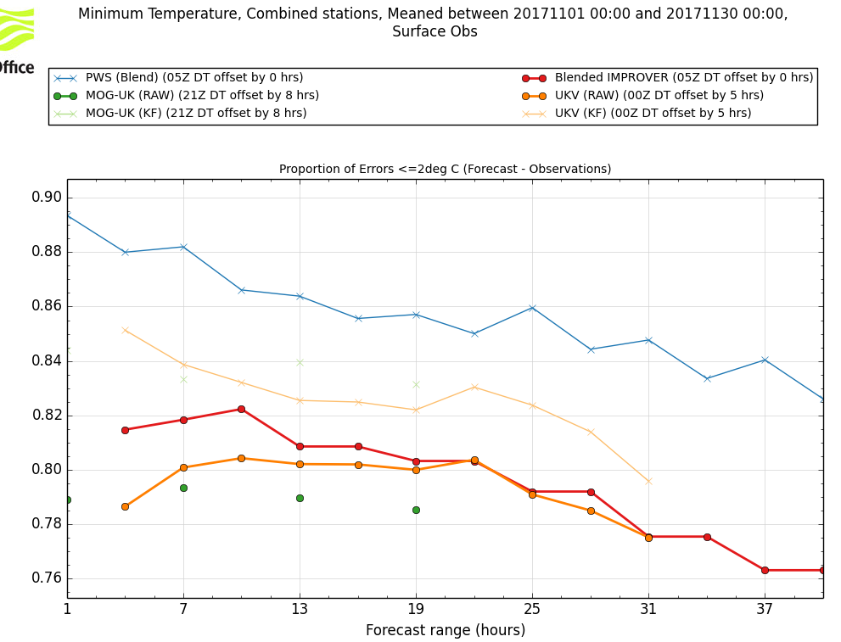
Verification of final spot forecasts
(night-time minimum temperature)
Traditional deterministic forecast extracted as 50th percentile
IMPROVER beating operational downscaled forecasts (thick orange/green):
KF and more blending should provide further improvement
05Z DT
Higher is better
Notes:
Point at which we make direct comparison with the current post-processing system.
Just one (admittedly most positive) example.
Plot shows forecasts of night-time minimum [21-09 UTC labelled as 00 UTC] from cycles throughout the day; 05 UTC forecast used by the PWSCG metrics is T+19h.
Good results considering IMPROVER untuned (unlike operational system), lacks physical several steps, and metric doesn’t measure value of uncertainty information.
[Superiority to downscaled forecasts is metric-specific: the latter generally have better RMSE]
Possible reasons for superiority: nbhood accounting for cloud timing/location uncertainty, oper dscale may not be so well tuned for winter night-time min as other situations.
[Do need to improve statistical correctness of calculation: this early system took minimum of hourly medians, without accounting for potential different timings in different scenarios]
Operational results show potential further improvement from KF and more blending.
[Spot verif through chain will help unpick these results]

Slide 19
Topographic neighbourhood processing

Slide 20
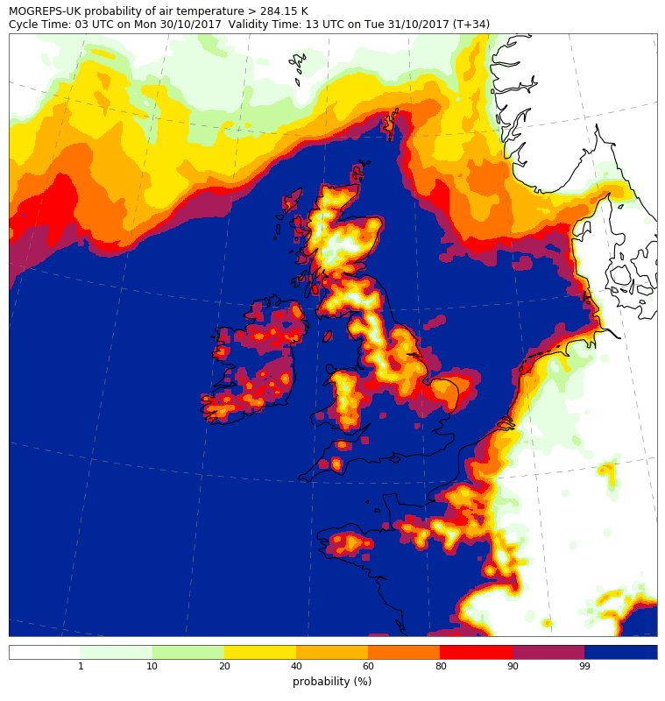
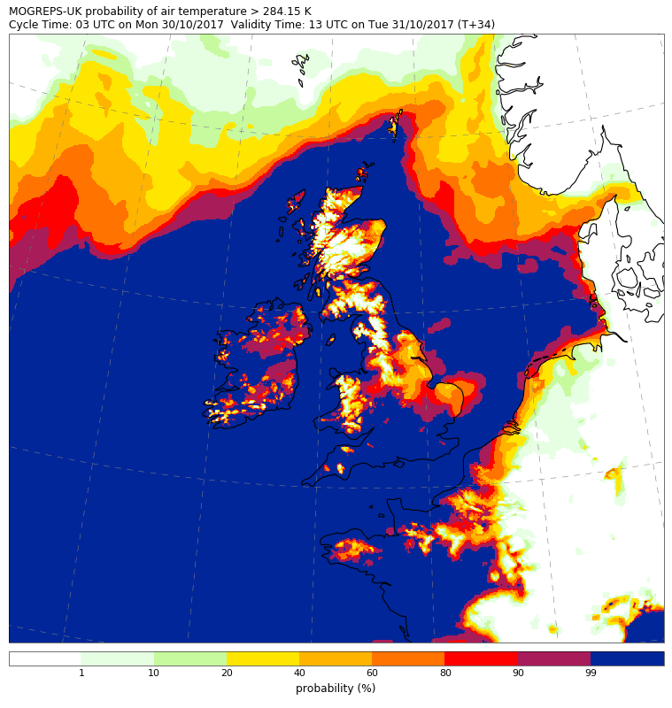
MOGREPS-UK probability that air temperature > 11°C
Normal neighbourhood processing
Topographic neighbourhood processing

Slide 21
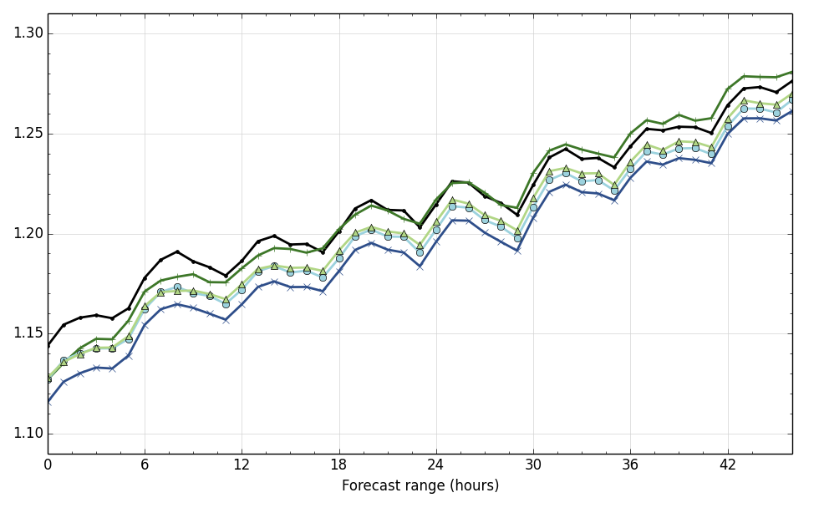
How does it verify?
Non-Topographic neighbourhood
6km
10m wind speed (m/s)
Continuous Rank Probability Score
Mogreps-UK (UK ensemble)
Before neighbourhood processing
Topographic neighbourhood
6km
Lower is better
Topographic neighbourhood
3km
Non-Topographic neighbourhood
3km

Slide 22
Snow falling level
Adjusting rain/snow boundary to high-resolution orography

Slide 23
Snow falling level process
Calculate wet bulb temperature on height levels
Find the height that the integral crosses a threshold
Integrate down to the surface
Fill in missing data
Notes:
Focuses on wet-bulb temperature as this is what drives the melting of snow flakes (when this value exceeds 0ºC).
Integrating allows a single value of how much melting a snow-flake has encountered. Excludes negative values as snow-flakes do not refreeze in the time available before reaching the surface.
Integral threshold is 90 K.m (Kelvin metres). This is a tunable value achieved by empirical means.
Fill in missing data – this is not covered in these slides but includes interpolating below UM surface and across orographic features to produce a continuous realistic field.
Plots from 20180301T0300Z ukvx T+12.

Slide 24
Using the snow falling level
Find snow falling level
Generate percentiles from a neighbourhood
Extract the probability that the snow falling level is at the surface (& mean over realizations)
Multiply with probability of precipitation
Notes:
Find p(snow not melted before reaching surface), averaged over neighbourhood and members.

Slide 25
Nowcasting
Notes:
[Omit if short of time]

Slide 26
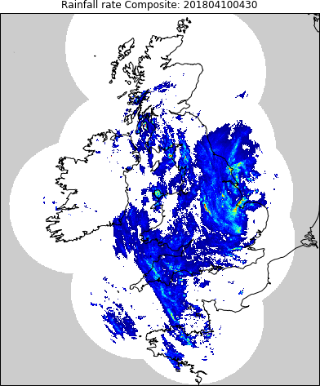
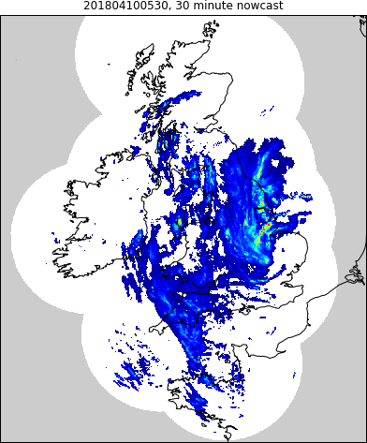
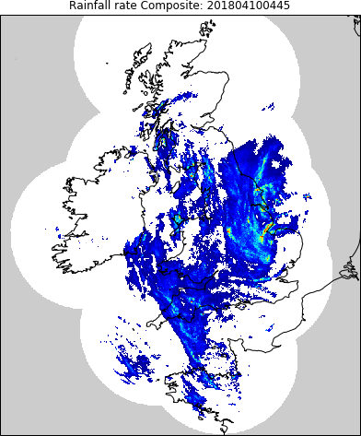
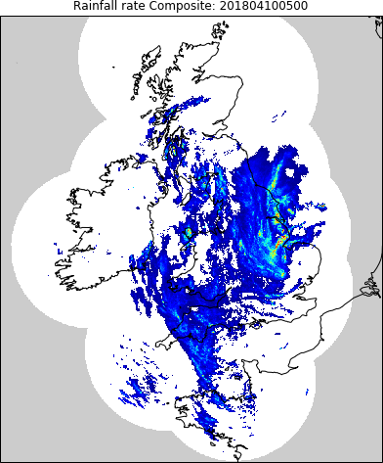

Advection nowcasting of precipitation
Calculate optical flow advection velocities
Advect rates to required lead times
x24 lead times
New open source Python implementation for IMPROVER, based on relevant STEPS code
Rapid update (15 minute) to 6 hours lead time
New Rose suite (MONOW) will also nowcast lightning, and potentially other variables (TBD)
Simple deterministic extrapolation
Notes:
Based on part of STEPS, but trying to simplify given issues with that system and shortening window before hourly NWP becomes superior.
Obtain spread by neighbourhood processing, deal with limits of predictability by blending (in probability space) with NWP.

Slide 27
Blended nowcast (radar + UKV)
Neighbourhood-processed exceedance probabilities (eg 0.1, 1, 4, 10 mm/h)
Spatially varying blend weights:
100% UKV outside (extrapolated) radar coverage area at all lead times
Will account for radar rainfall detectability limit (out of range / beam too high)
1
UKV
Forecast weight
Nowcast
0
0
2
4
6
Lead time (hours)
Notes:
These bits in main IMPROVER suite.

Slide 28
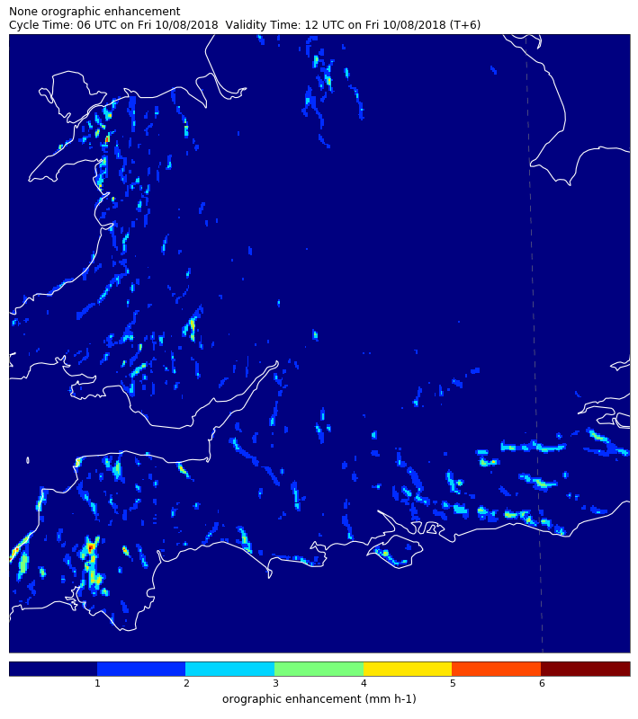
Planned refinements: orographic enhancement
Enhancement of rainfall over complex orography due to uplift & seeder-feeder mechanisms
Orographic component should not be advected, or used in advection velocity calculation
Notes:
Mimicking treatment in radar processing and STEPS; will be calculated in MONOW

Slide 29
Planned refinements: model steering flow
Calculate optical flow advection velocities
Model steering flow
Advect rates to required lead times
Valid only where there is precipitation – zero elsewhere
Limit to advection displacement forecast
Compare optical flow vectors to model wind forecasts and select the best match
Use this wind field for forward advection of precipitation
Non-zero velocities available for the whole domain
Rainfall can be advected further over the course of the nowcast

Slide 30
Weather symbols

Slide 31
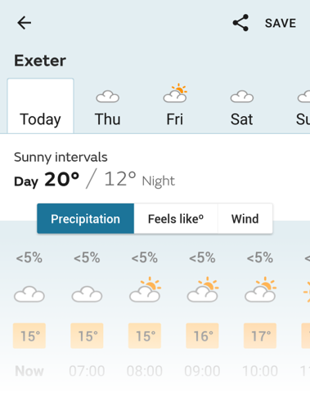


Weather Symbols
Widely used and recognised public weather service product
Production simplified using probabilistic data

Slide 32


A decision tree…
P > 50%
or
P > 50%
0.03 mm/hr
0.03 mm/hr
False
True
Check for rain in vicinity
Check to see if it’s heavy

Slide 33











A decision tree…
Notes:
Go through a series of such decisions … until you reach a symbol

Slide 34
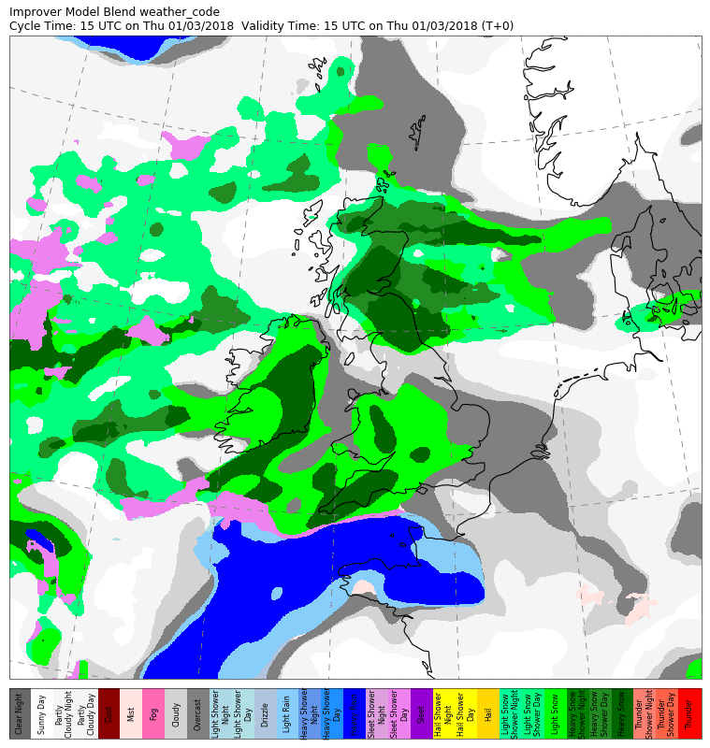
Key colours
Heavy snow
Light Snow
Sleet
Light Rain
Heavy Rain

Slide 35
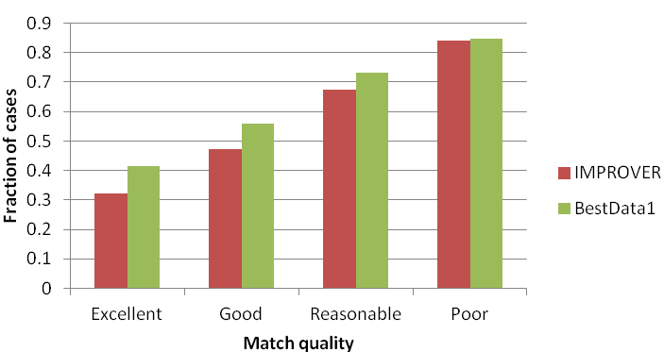
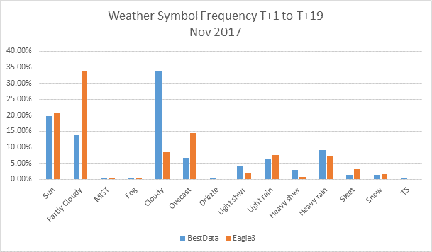
Weather symbol verification
Higher is better
IMPROVER poorer match to observations than current operational forecasts (new untuned algorithm with untuned inputs…)
Need to decompose scores
Some large differences in symbol frequencies – which is right?
Notes:
Metric assigning a match quality category to each possible combination of forecast weather symbol and observed weather type. IMPROVER has fewer high-quality matches than current operational system.
Unsurprising: new untuned algorithm, untuned input chains (eg ensure probs reliable), condensing to deterministic symbol inevitably loses information and complicates defining (and thus implementing) what symbol is supposed to mean, …
Split scores by weather type, site, … understand sensitivity of new metric, …
As a first step to understanding the difference… diffs in cloud and showers
Need an observational equivalent to understand whether the IMPROVER frequencies are a problem or something else.

Slide 36
Summary and future plans

Slide 37
A modular, extensible post-processing system with thorough test coverage.
Open-source https://github.com/metoppv/improver
Python-based, with use of Iris, numpy, etc
Physical and statistical post-processing techniques applied
Probabilistic outputs – making the most of burgeoning number of inputs
Verification built-in – enabling appraisal of new methods of post-processing
Notes:
Worth adding a health warning of some kind that we are building the foundations and some of the more fancy things like machine learning or the latest statistical methods, or fancy severe-weather diagnostics, or ensemble clustering and regime types can, in principle, be built in afterwards. We can’t run before we can walk when we first go operational, but we’re not forgetting these things in the design. The same goes for nowcasting of hazardous weather and nowcasting of variables other than precipitation.
An overarching principle is that we do the least necessary as far as derivation of variables or model correction is concerned. We are not trying to do what might be done better inside the NWP model and potentially mask model improvements unless there is measurable benefit or no alternative. But of course, if there is measureable benefit that gives the customer a better output, we do it and we should keep exploring new ideas.

Slide 38
Future plans
More
MOST
More models
More diagnostics
More techniques
More extensive trialling
More intelligent spot extraction
Time
Go operational 2019/20
Notes:
Nice picture! Worth putting in (or mentioning) building in statistical processing (EMOS, KF & potentially options for other methods).
There is also the requirement to provide top-level outputs for the Operations Centre dashboard being developed in the MOST project. This is outputs like probabilities of something over a threshold in a region in a time window – starting simple.
… and verification tools (spot through chain, precipitation rates, observation error, spot ensemble, mapped plots, time/space windows, verif vs analyses used for stat pp, additional variables like “Feels like” T, FSS, precipitation scenarios, equivalent operational verification, …)

Slide 39
Questions

