Slide 1
Use of ensemble guidance for operational forecasting and transition to Met Office IMPROVER framework
Gary Weymouth and Ensemble Post-Processing team – Philip Riley, Tim Hume, Tom Gale, Andrew Charles, James Canvin, Anja Schubert, T'Mir Julius, Xiaoxi Wu, Ying Zhao
Some verification from Forecast Systems Team under Michael Foley
Need for EPP & high level plans
Recent EPP achievements & challenges
IMPROVER (with Met Office)

Slide 2

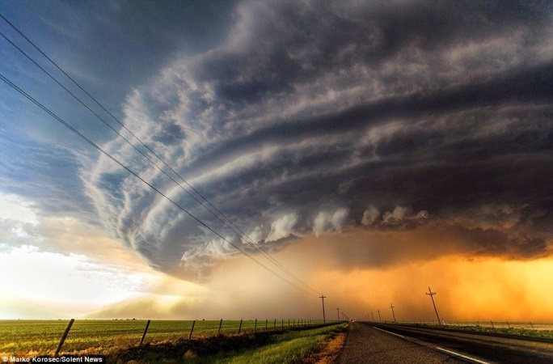
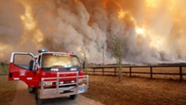

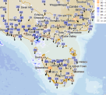

Improved guidance – Enabler of weather forecast service strategies and better user decisions
Change focus of forecaster effort
Technology, supercomputing, modelling, forecasters only have value if they lead to valuable user decisions
value
Notes:
On the cusp of being able to automate much of the generation of forecasts in non-warning situations to enable forecasters, guidance & systems delivering the most value (which is not always an accuracy question).
Note the automation also has the side-benefit of being more reproducible and enables greater accuracy when it matters more.

Slide 3
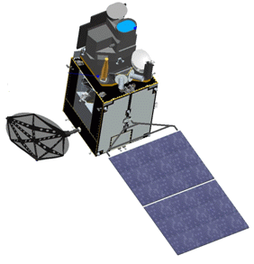
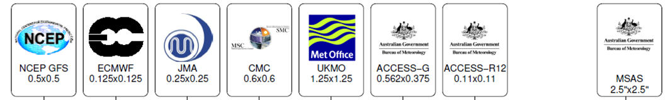
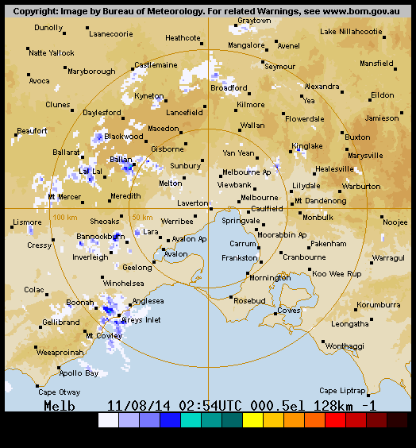
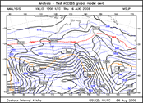
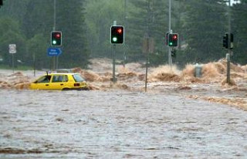
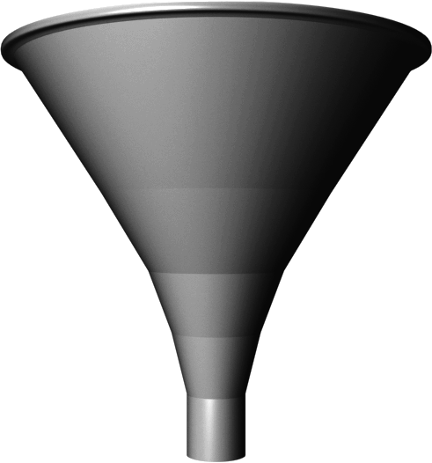

Post processing turns data flood into usable information
ACCESS-C
Himawari-8
Statistical post-processing:
Higher value.
Increased accuracy.
Condensed information; abstraction layer.
Uncertainty information.
Bias correction
Downscaling
Multi-model composite
Poor user (public, forecasters, .…)
Notes:
"Too much information for people"
Explain ensembles here – monte-carlo technique – vary initial conditions within uncertainty.
Ensemble mean typically lower RMSE than deterministic forecast (basically due to cancellation of random errors).
GPP acts as an abstraction layer or decoupler.

Slide 4
Temporal focus of different initiatives in value chain
Verification, infrastructure, …
Services, products, dissemination, … -> to users
Weather forecast systems – derived fields, forecast policies, displays, …
Nowcast post-processing
EPP / IMPROVER
Sub-seasonal post-processing
Automation, Uncertainties, Impacts
EPP
Convective parameters
Calibrated Thunder
TIFS
Rainfields
STEPS
Seamless Rainfall
ACCESS
ACCESS-C/CE
ACCESS-G/GE, ECMWF, …
ACCESS-S
ACCESS-R
NWP
0h 0-3/6h 3/6-12h 12h-10 days >10-30d 30+d
Analyses Obs nowcast NWP nowcast Short to Medium-range Sub-seasonal Seasonal
Notes:
Some Bureau directions
Greater automation of forecasting – current focus on routine
Restructure of aviation into 2 regions – affects surge capacity hence automation
Take advantage of high-res guidance incl ensembles
Thunderstorm guidance
General skill improvements
Nowcasting & short-range forecasting
Alerting
Slow move into probabilistic and impact services
Still defining how to provide different products & services – e.g. role of cloud; algorithms to data or vice-versa.

Slide 5
EPP focus
IMPROVER operational at Met Office
IMPROVER operational at Bureau
2017/18 18/19 19/20 20/21 21/22
Automation support (GOCF)
End of GOCF
Daily Rainfall
Coastal temperature
Use ensembles incl ACCESS. Show value from super-computer.
Daily rainfall, wind & temperature improvements
Met Office IMPROVER
Development and testing
Implementation
Improvement
Guidance to support existing and enhanced automation, new & better existing services through full ensembles, probabilities / risk / uncertainty, impacts / impact processing framework, NWP nowcasting, seamless forecasts, higher accuracy
Aurora TROPS
Spin-up
Seamless rainfall for hydrology
Seamless rainfall for hydrology
Seamless rainfall for weather forecasting (includes using GOCF/IMPROVER)
Calibrated Thunder using lagged ACCESS ensemble
Calibrated Thunder ACCESS-GE3 ensemble
Calibrated Thunder improved calibration
Calibrated Thunder using super ensemble

Slide 6
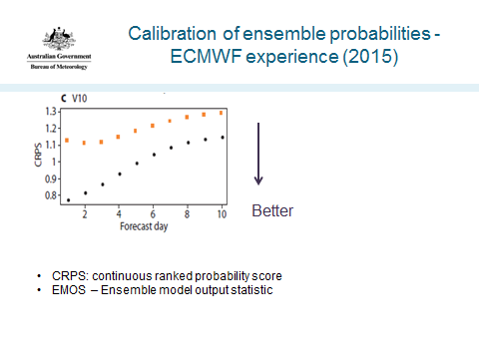
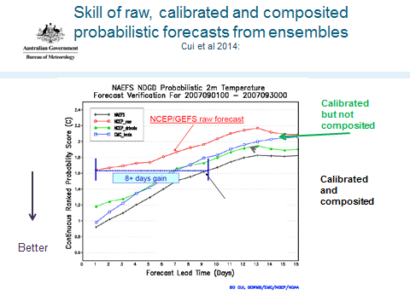
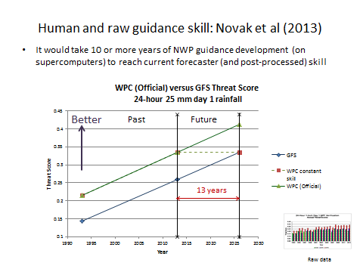
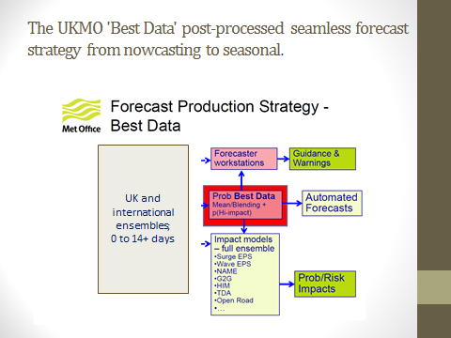
Post-processing elsewhere
Most automation requires support by post-processed guidance
Need to continue NWP, post-processing, computing and service developments.
Need to combine local and international guidance.

Slide 7
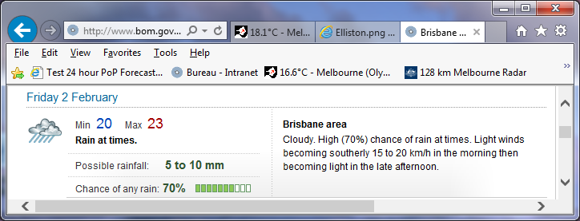
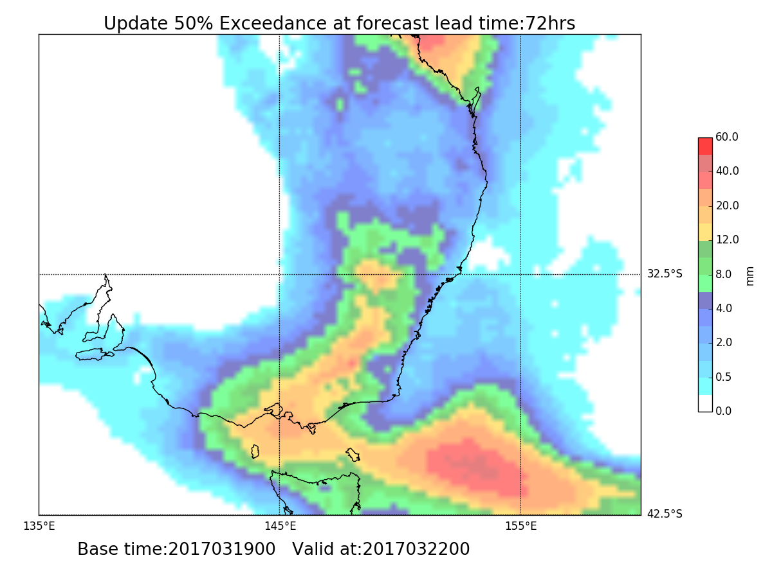
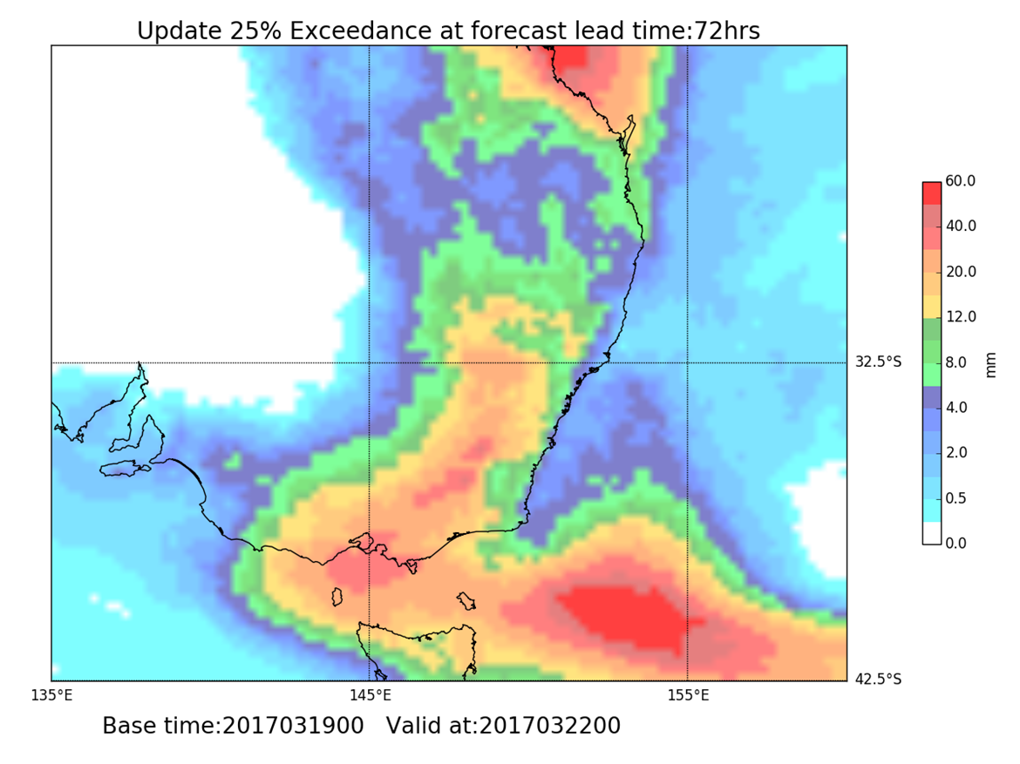
New calibrated ensemble daily rainfall probability guidance
Bureau rainfall forecasts (above) are supported by post-processed guidance (below) from ensembles of numerical weather prediction models.
Notes:
Background: the 50% and 25% exceedance rainfall amounts (quantiles) match the possible rainfall range in official forecasts.
25% or 10% exceedance can be thought of a higher rainfall amount that one might get; 50% exceedance is near a best guess; one might usually expect to get at least the 90 or 75% amount.
The point of the plots is not to go into detail, but to visually indicate the sort of guidance that supports forecasts.

Slide 8
Improvements to GOCF daily rainfall guidance
Spring 2016
Improved calibration
Rescheduling
+12 - 24h lead time
Cumulative lead time gain:
Early 2018
Change to business rule
+12h lead time (?)
+24-36h
July 2018
ECMWF ensemble
Handle dew
Rescale for points
0.5 -> 0.25 degree res
+24h lead time
+48-60h
> 2 days
Mid 2019
Lag ECMWF ensemble
ACCESS-GE3
Downscaling
+6h lead time
+54-76h
~3 days
Notes:
NWP skill advances at the rate of about 1 lead day per decade.
Use of ECMWF ensemble also prepares for use of ACCESS-GE3.

Slide 9
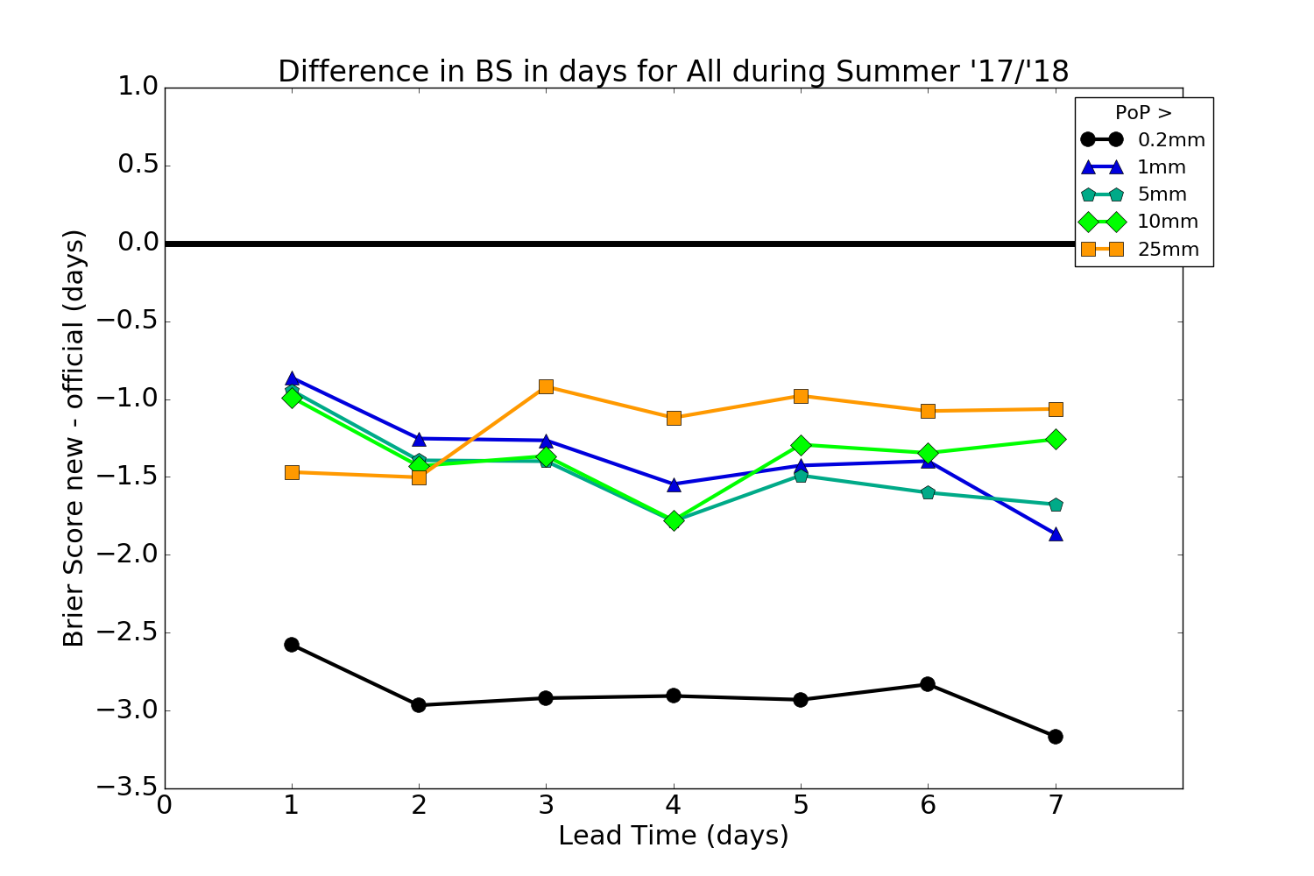
Projected skill difference Official minus new GOCF in lead days, Australia, Summer 2017/18. Forecasters did not have access to the new GOCF
Caveats
Forecasters should adapt to the new GOCF guidance.
Prior to early Dec 2017, business rules encouraged forecasters to bias 0.2mm probabilities low.
0.2mm exceedance verification is highly sensitive to how observations of 0.2mm are treated (re dew).
Dashed lines = large uncertainty
Official better
GOCF better
New GOCF – Official = (New GOCF – Old GOCF) + (old GOCF – Official)
ex GOCF verification ex Jive
Note: BS = Brier Score (like RMSE for probabilities)
Notes:
Large measured improvements to 0.2mm skill are due to rescaling of probabilities to be reliable against observations, and how observations of exactly 0.2mm rain are treated. Skill of official minus old GOCF is from Jive, and for 0.2mm exceedances, the simple mean of filtered and unfiltered results is taken.
T'Mir: The way I chose which plots were 'unreliable' (dashed lines, asterisked in the legend) was that I took the minimum value of (degradation by day / Dev Brier score) and if that was < 0.02, the plot is dashed. Plots that are missing, but still present on the legend are missing because data was missing. These also come up as asterisked because of the way Nulls are handled in the packages I used.

Slide 10
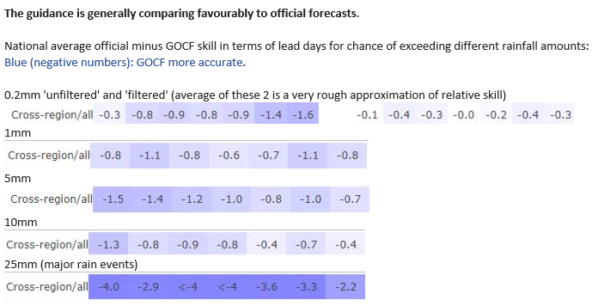
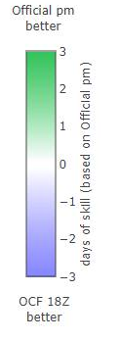
Recent verification – 2 months after introduction & just before automation introduction
Notes:
Note 2 GOCF rainfall benefits:
Automation
Support of improved forecasts
Potentially discuss training & services.

Slide 11
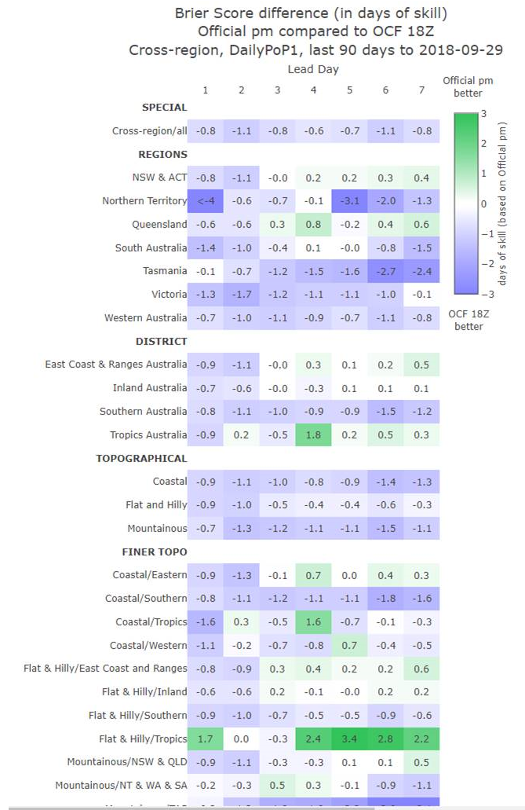
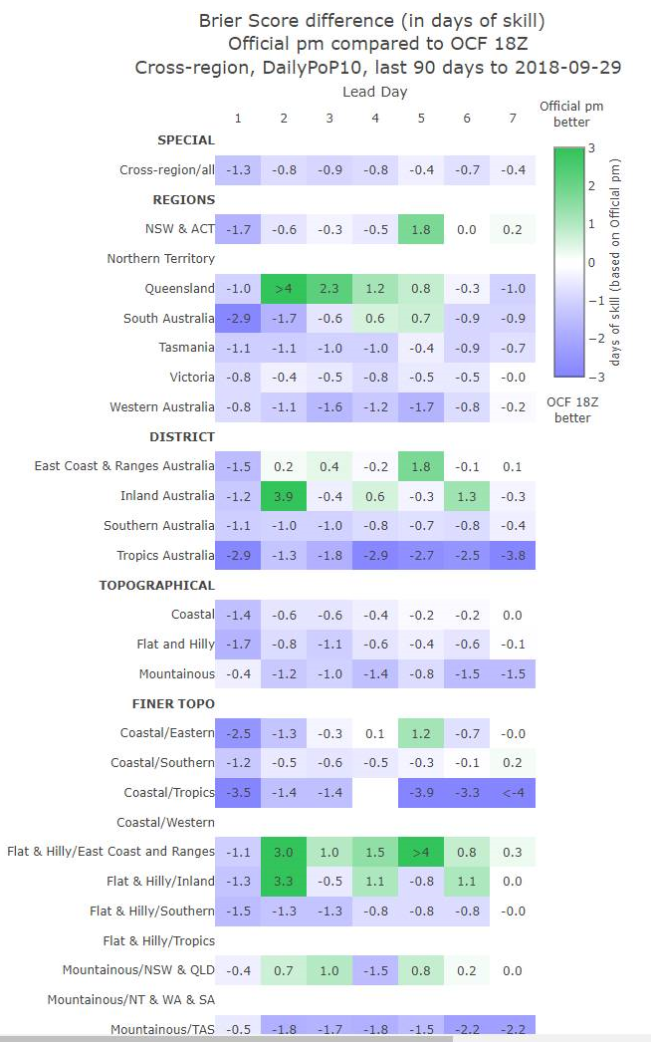
Recent verification – 2 months after introduction & just before automation introduction
Pr (>1 mm)
Pr (>10 mm)
Notes:
Note 2 GOCF rainfall benefits:
Automation
Support of improved forecasts
Potentially discuss training & services.

Slide 12
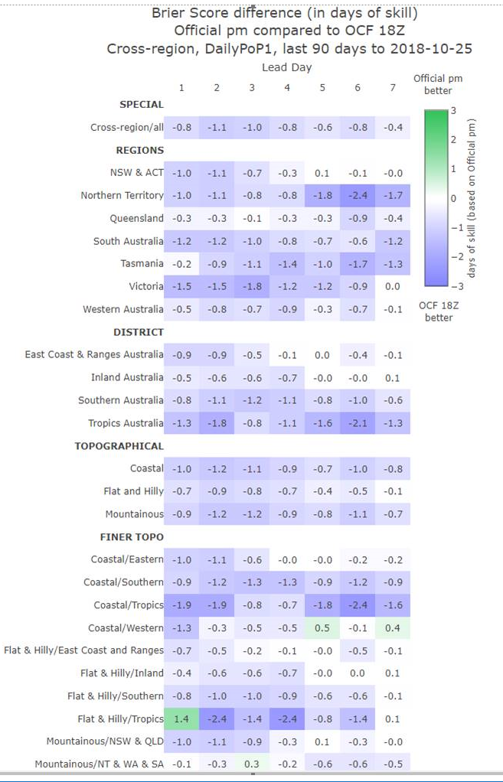
Recent verification – 3 months after introduction
Notes:
Note 2 GOCF rainfall benefits:
Automation
Support of improved forecasts
Potentially discuss training & services.

Slide 13
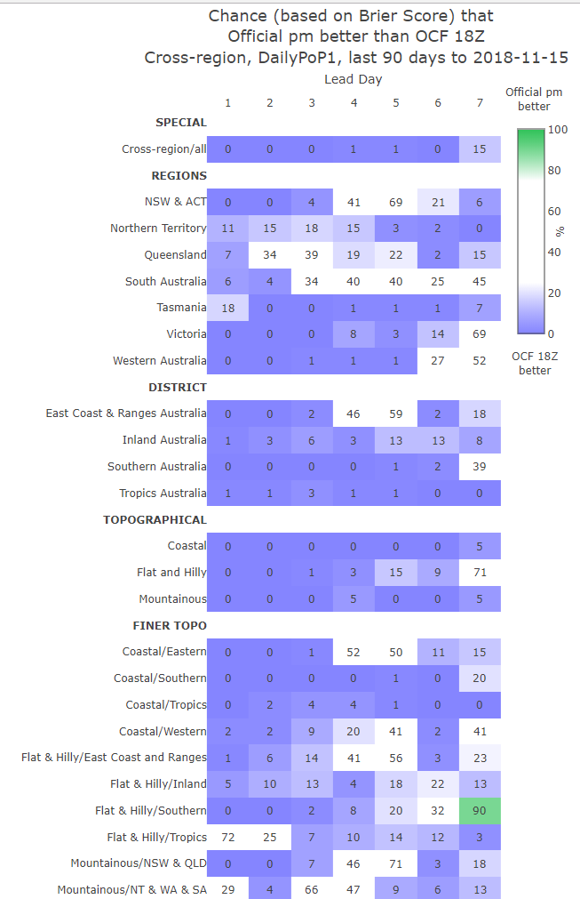
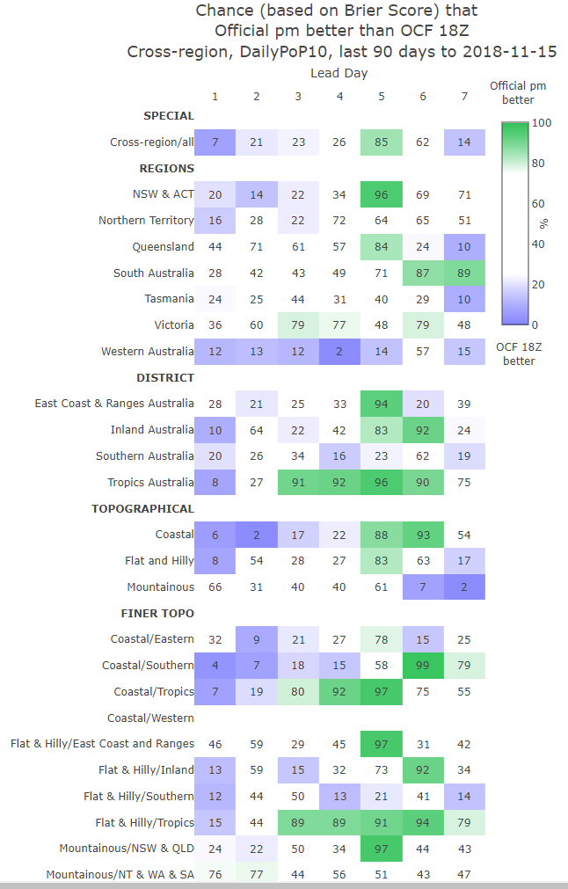
Recent verification – last 90 days
Pr (>10 mm)
Pr (>1 mm)
When to intervene?
Perceived under-forecasting of PoPs at rain gauge scale
Case studies…
Expect plusses & minuses if official & guidance have equal skill
Official equal or better means new guidance has supported dramatic improvement in official skill
Notes:
Note 2 GOCF rainfall benefits:
Automation
Support of improved forecasts
Potentially discuss training & services.

Slide 14
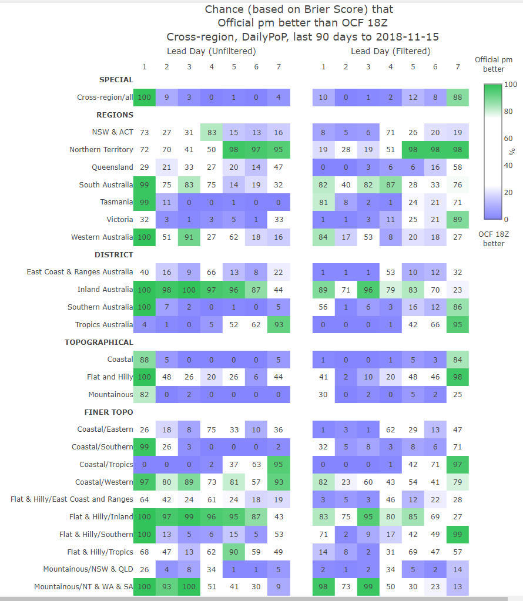
Recent verification – last 90 days
Notes:
Note 2 GOCF rainfall benefits:
Automation
Support of improved forecasts
Potentially discuss training & services.

Slide 15
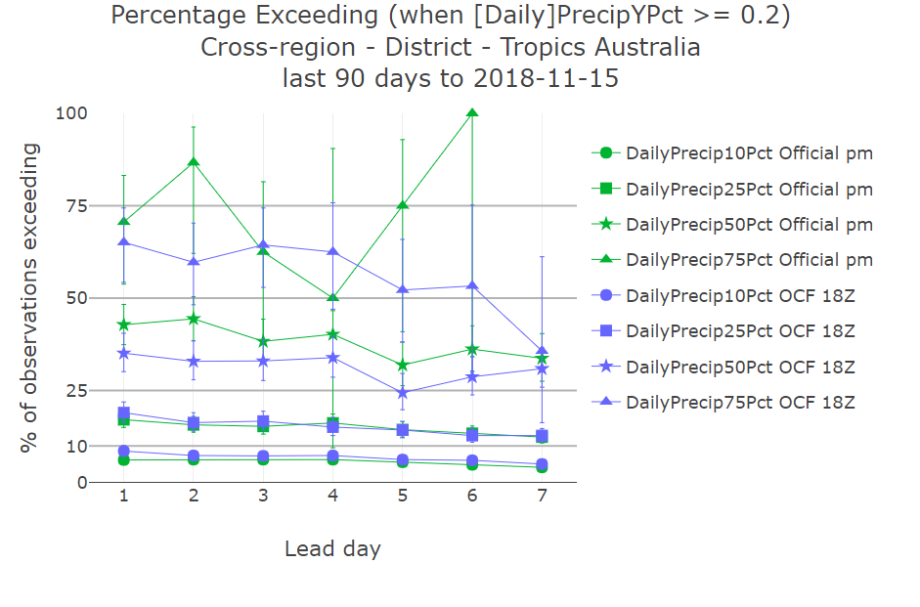
Recent verification – last 90 days
Notes:
Note 2 GOCF rainfall benefits:
Automation
Support of improved forecasts
Potentially discuss training & services.

Slide 16
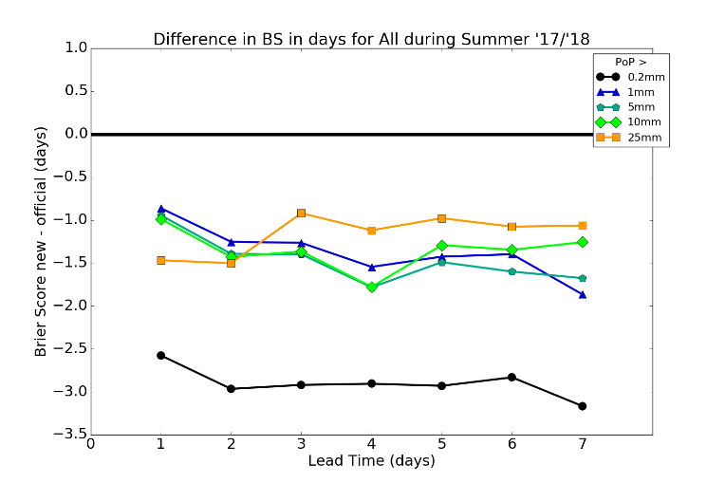
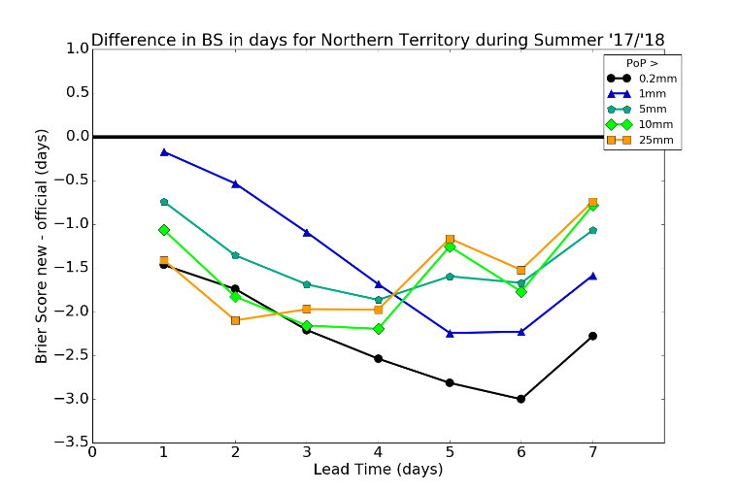
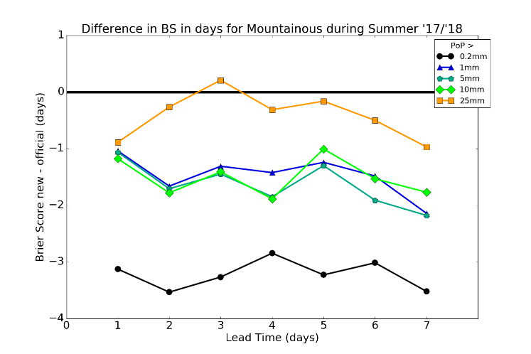
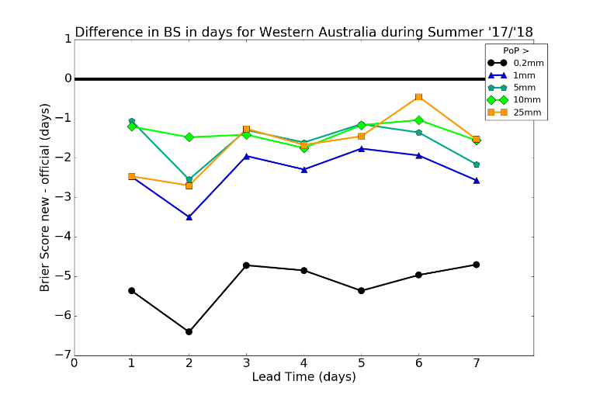
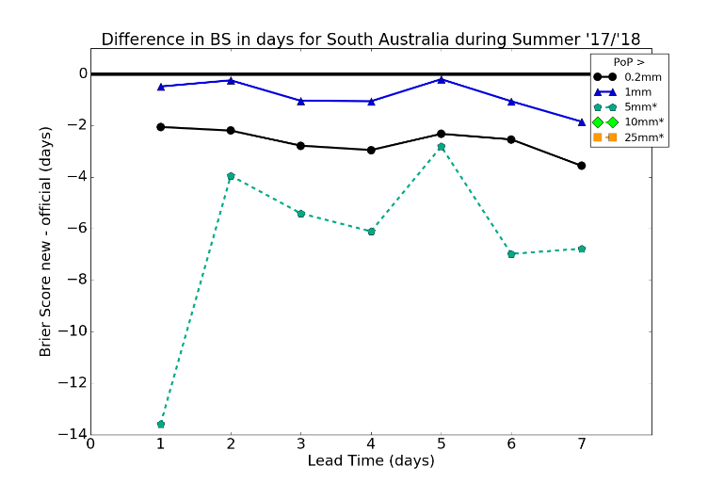
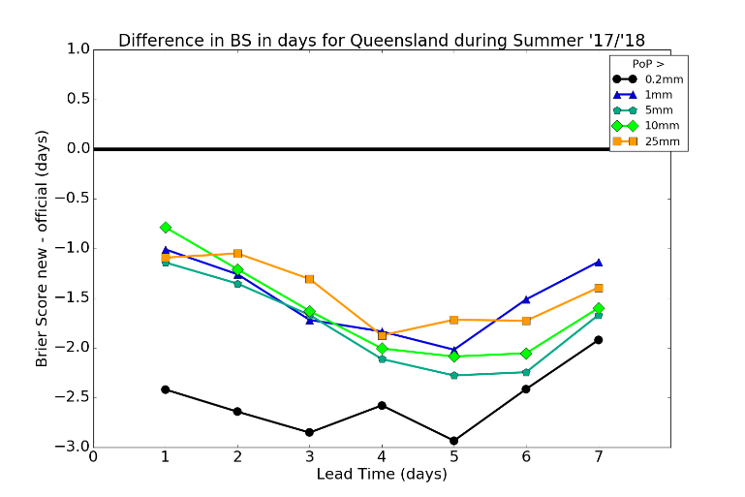
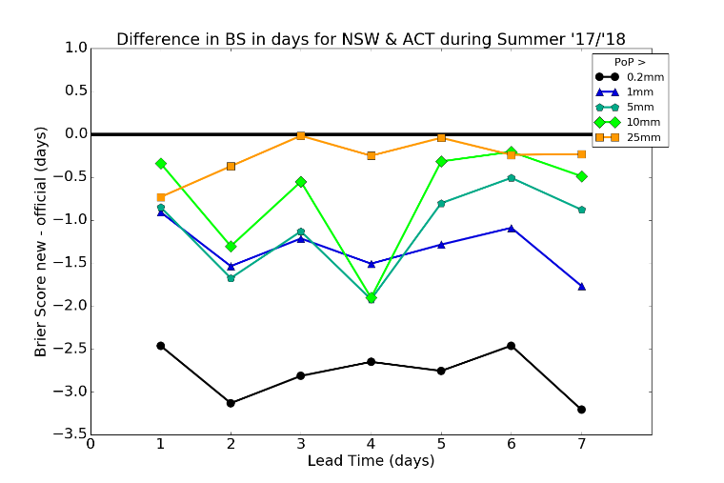
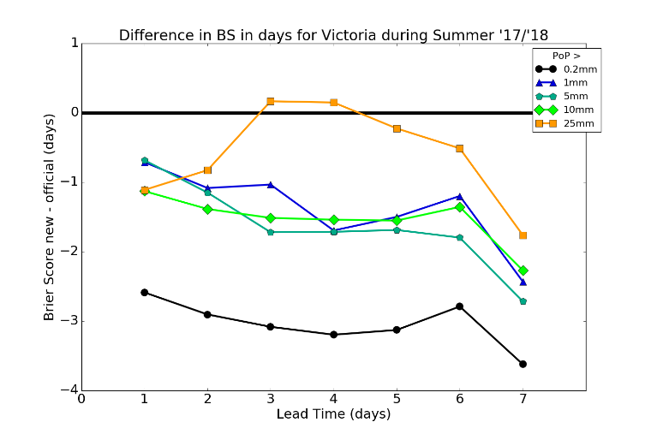
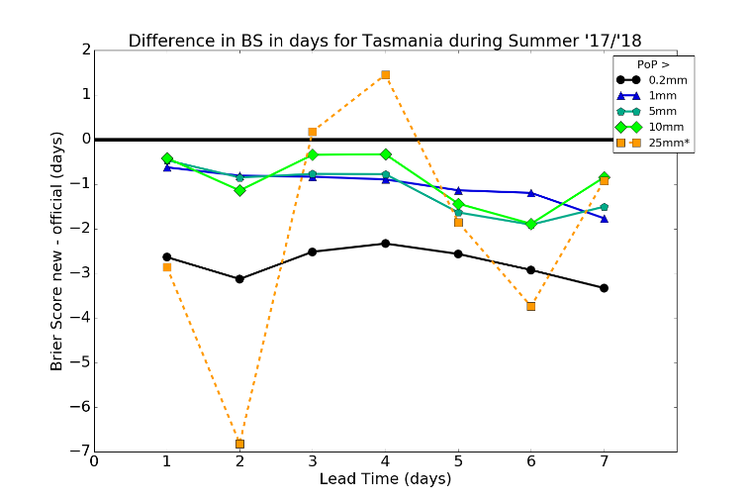
Projected skill difference Official minus new GOCF in lead days, Summer 2017/18. Forecasters did not have access to the new GOCF
All
Official better
NT
Mountainous
GOCF better
WA
SA
Qld
NSW / ACT
Vic
Tas
Notes:
Large measured improvements to 0.2mm skill are due to rescaling of probabilities to be reliable against observations, and how observations of exactly 0.2mm rain are treated. Skill of official minus old GOCF is from Jive, and for 0.2mm exceedances, the simple mean of filtered and unfiltered results is taken.
Unreliable results are indicated using an empirical rule and subjective threshold, based on level of raw skill.

Slide 17
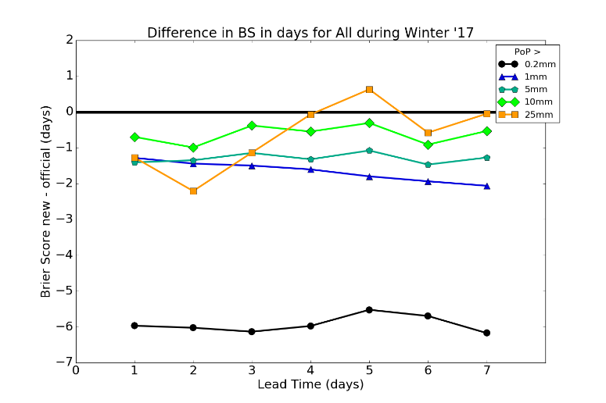
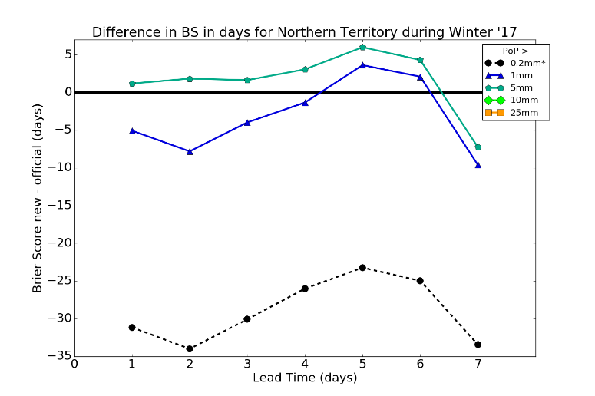
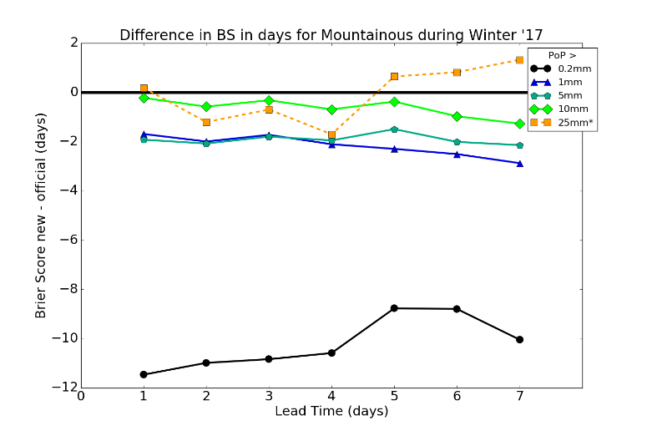
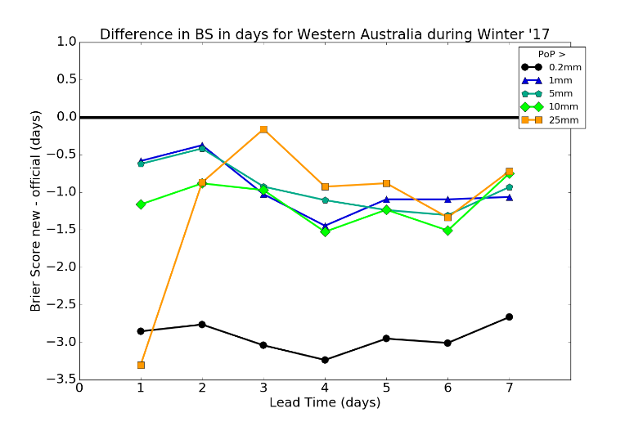
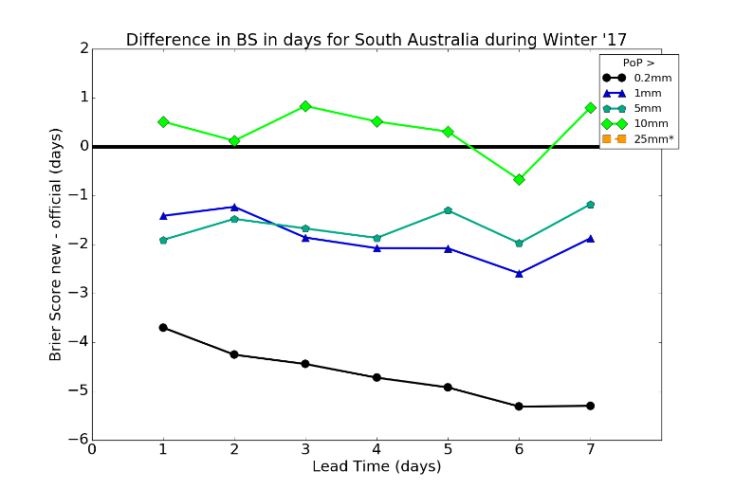
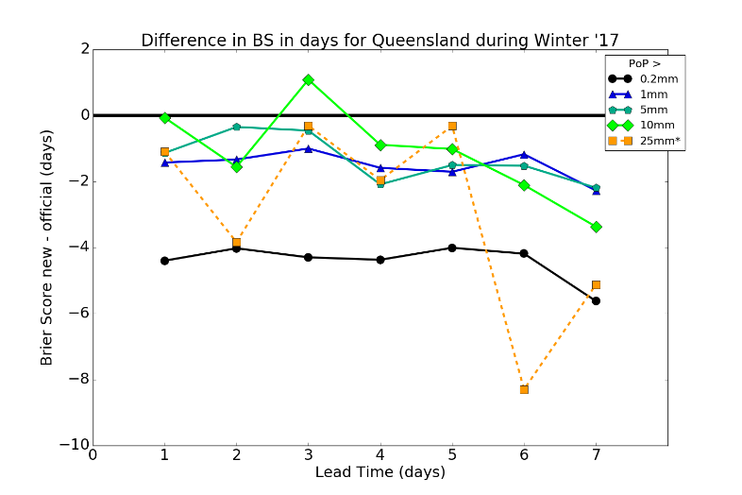
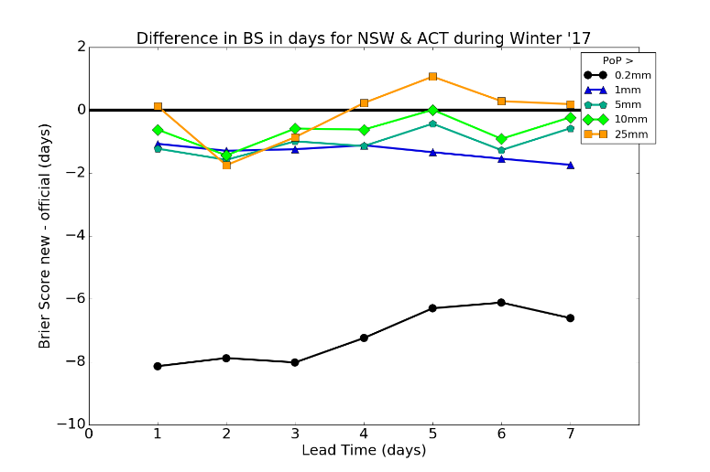
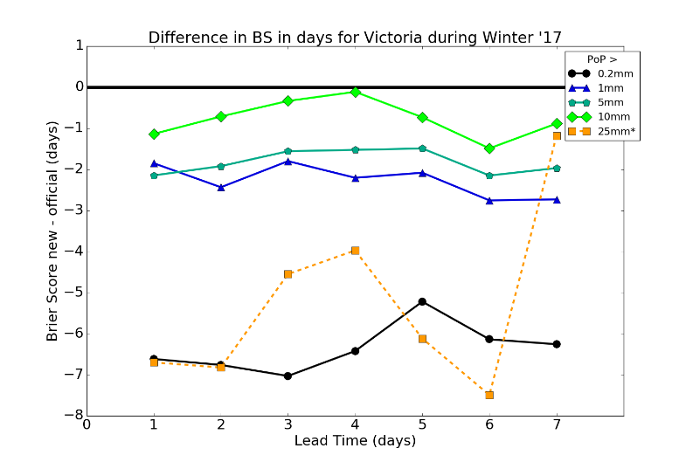
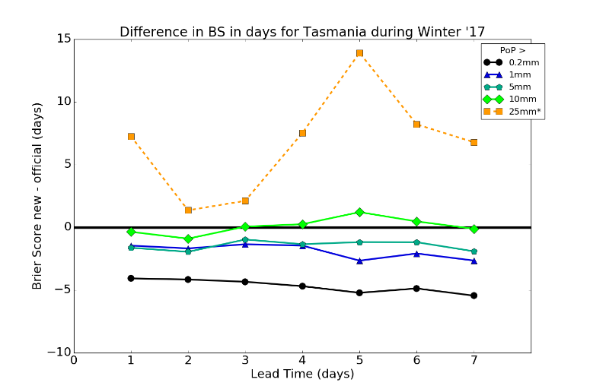
Projected skill difference Official minus new GOCF in lead days, Winter 2017 Forecasters did not have access to the new GOCF
All
Official better
NT
Mountainous
GOCF better
WA
SA
Qld
NSW / ACT
Vic
Tas
Notes:
Large measured improvements to 0.2mm skill are due to rescaling of probabilities to be reliable against observations, and how observations of exactly 0.2mm rain are treated. Skill of official minus old GOCF is from Jive, and for 0.2mm exceedances, the simple mean of filtered and unfiltered results is taken.
Unreliable results are indicated using an empirical rule and subjective threshold, based on level of raw skill.

Slide 18
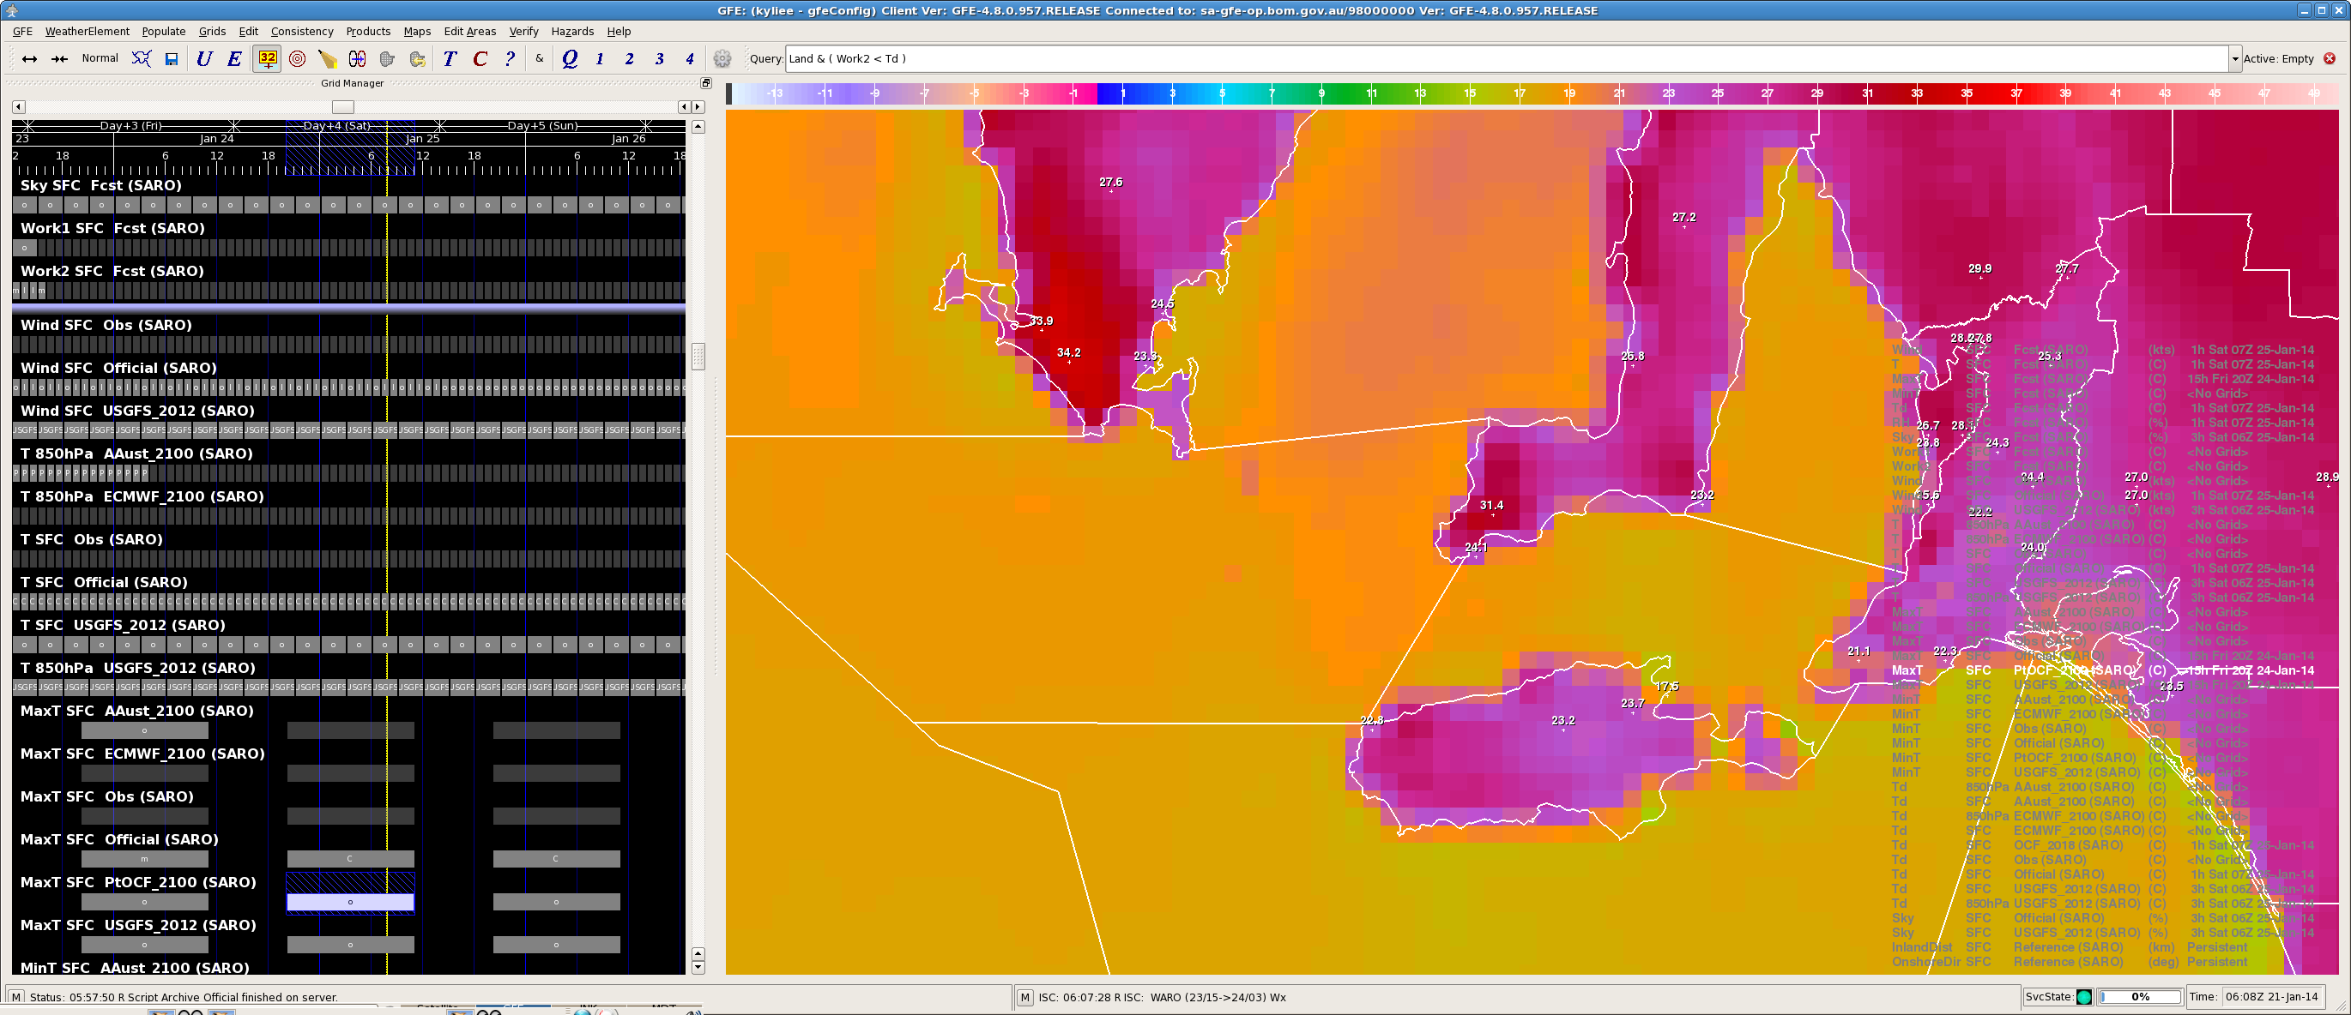
Coastal temperature 'hotspot' issues – roles of GFE 'serp' and GOCF maximum temperature guidance
'Hotspots' arise from using 'serp' interpolation in GFE: Serp spatially spreads site adjustments that match GOCF max of hourly temperatures to SiteOCF daily max temperatures.
If GOCF forecasts daily max temperatures directly, serp should not be needed, hence eliminating hotspots.
Notes:
Note that selectively choosing to no apply serp at particular sites can ameliorate some of the known hotspot issues. However, this also reduces the availability of locations to constrain serp where they are most needed, potentially reducing skill; hence that approach cannot be scaled up.

Slide 19
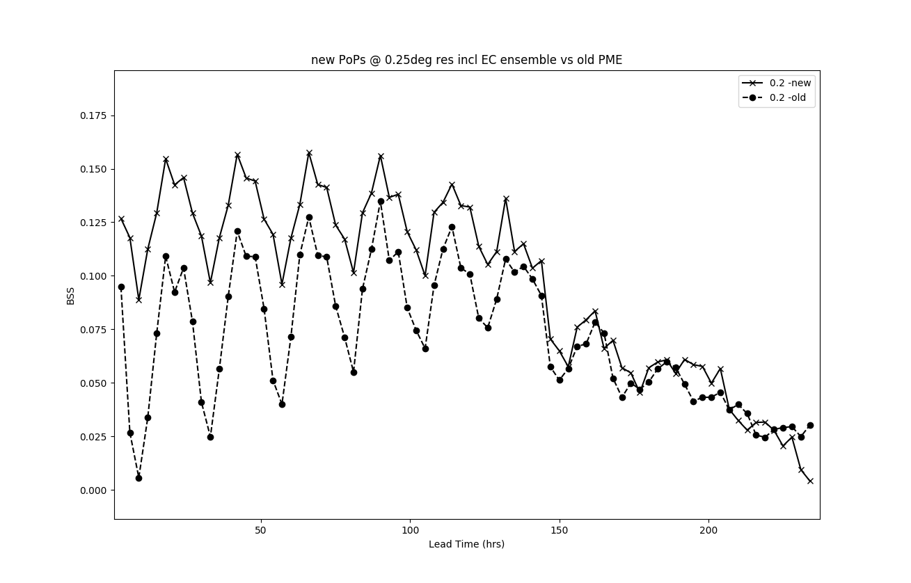
Improved 3-hourly rainfall guidance in early development

Slide 20
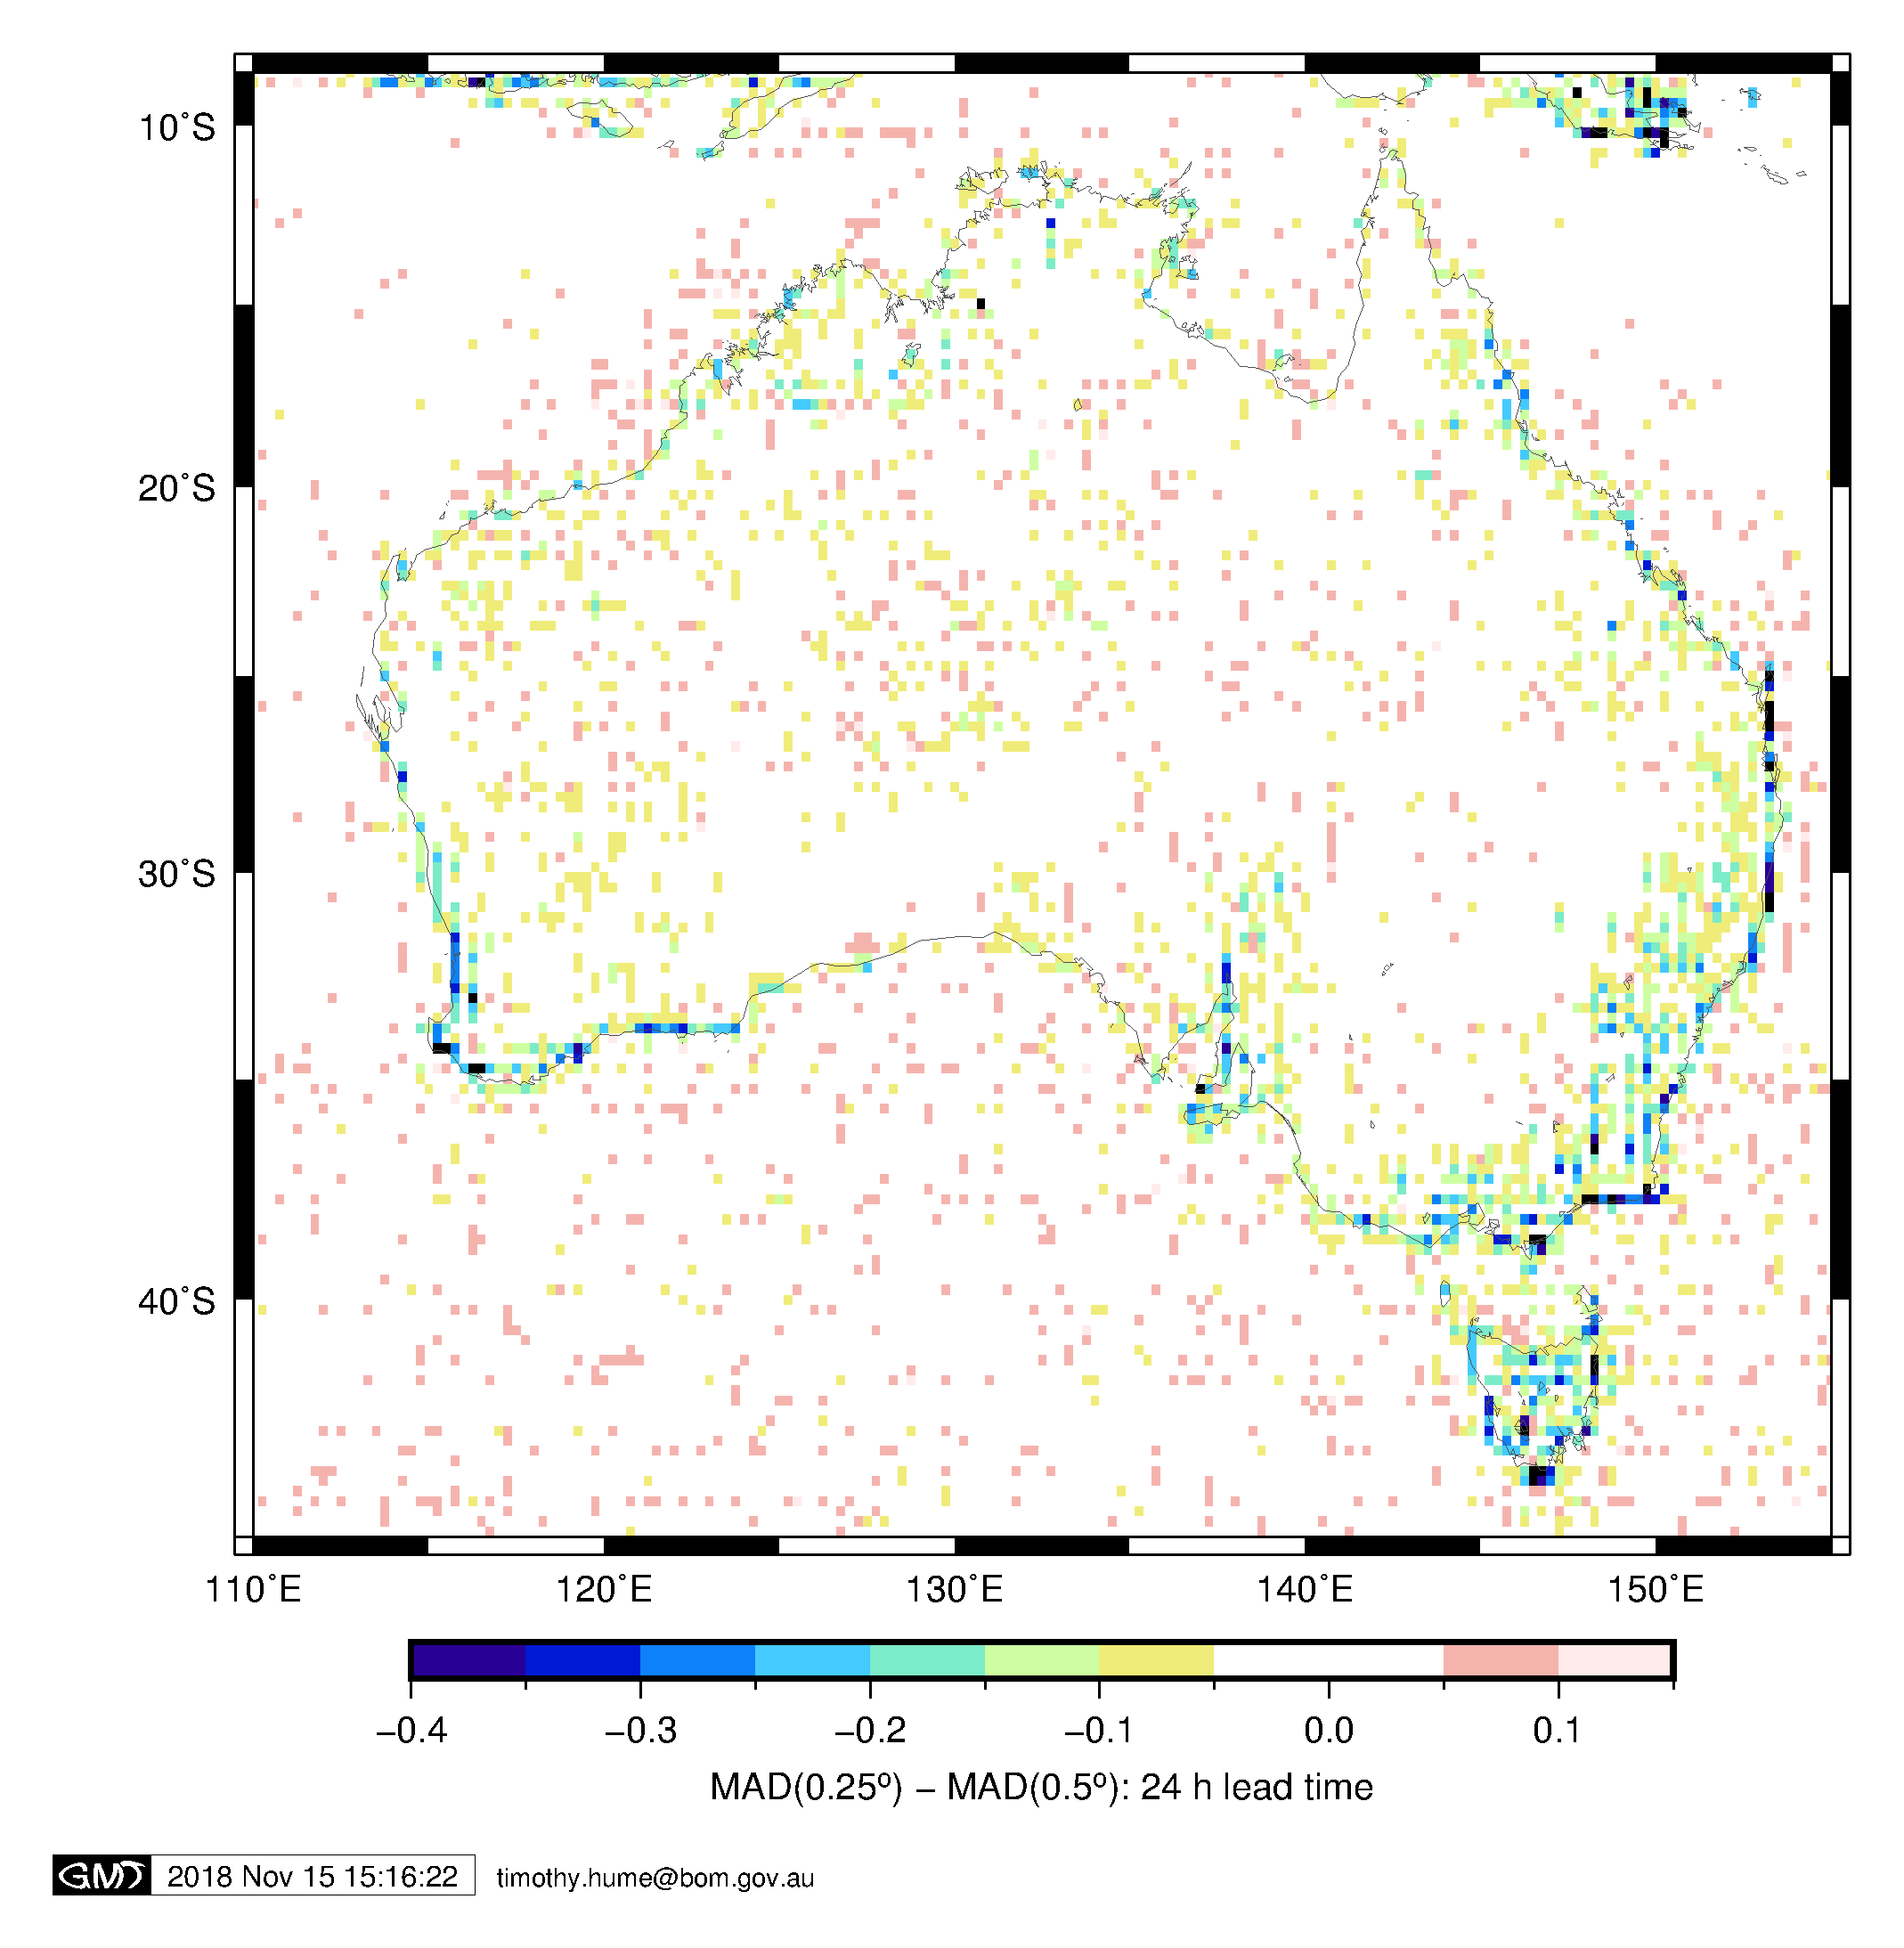
Improved wind guidance in development

Slide 21
Other automation supports
Transition to new computer (Aurora)
Basic utilisation of local and international single-model ensembles (e.g. ACCESS-GE3, CE3)
GOCF guidance produced hourly instead of interpolated from 3-hourly
Downscaling from global ensembles
…

Slide 22
IMPROVER
Fully probabilistic multi-model ensemble
Fully use CAM ensembles
rapid updates
Seamless
Simple impacts

Slide 23
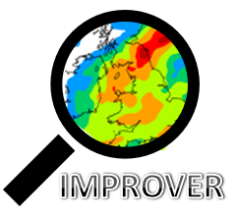
IMPROVER – a new strategy for integrated post-processing and verification for the convective scale age
Ken Mylne, Hd(Verification, Impacts and Post-Processing)
Thanks to Nigel Roberts, Bruce Wright, Ben Fitzpatrick, Simon Jackson, Marion Mittermaier and many others

Slide 24
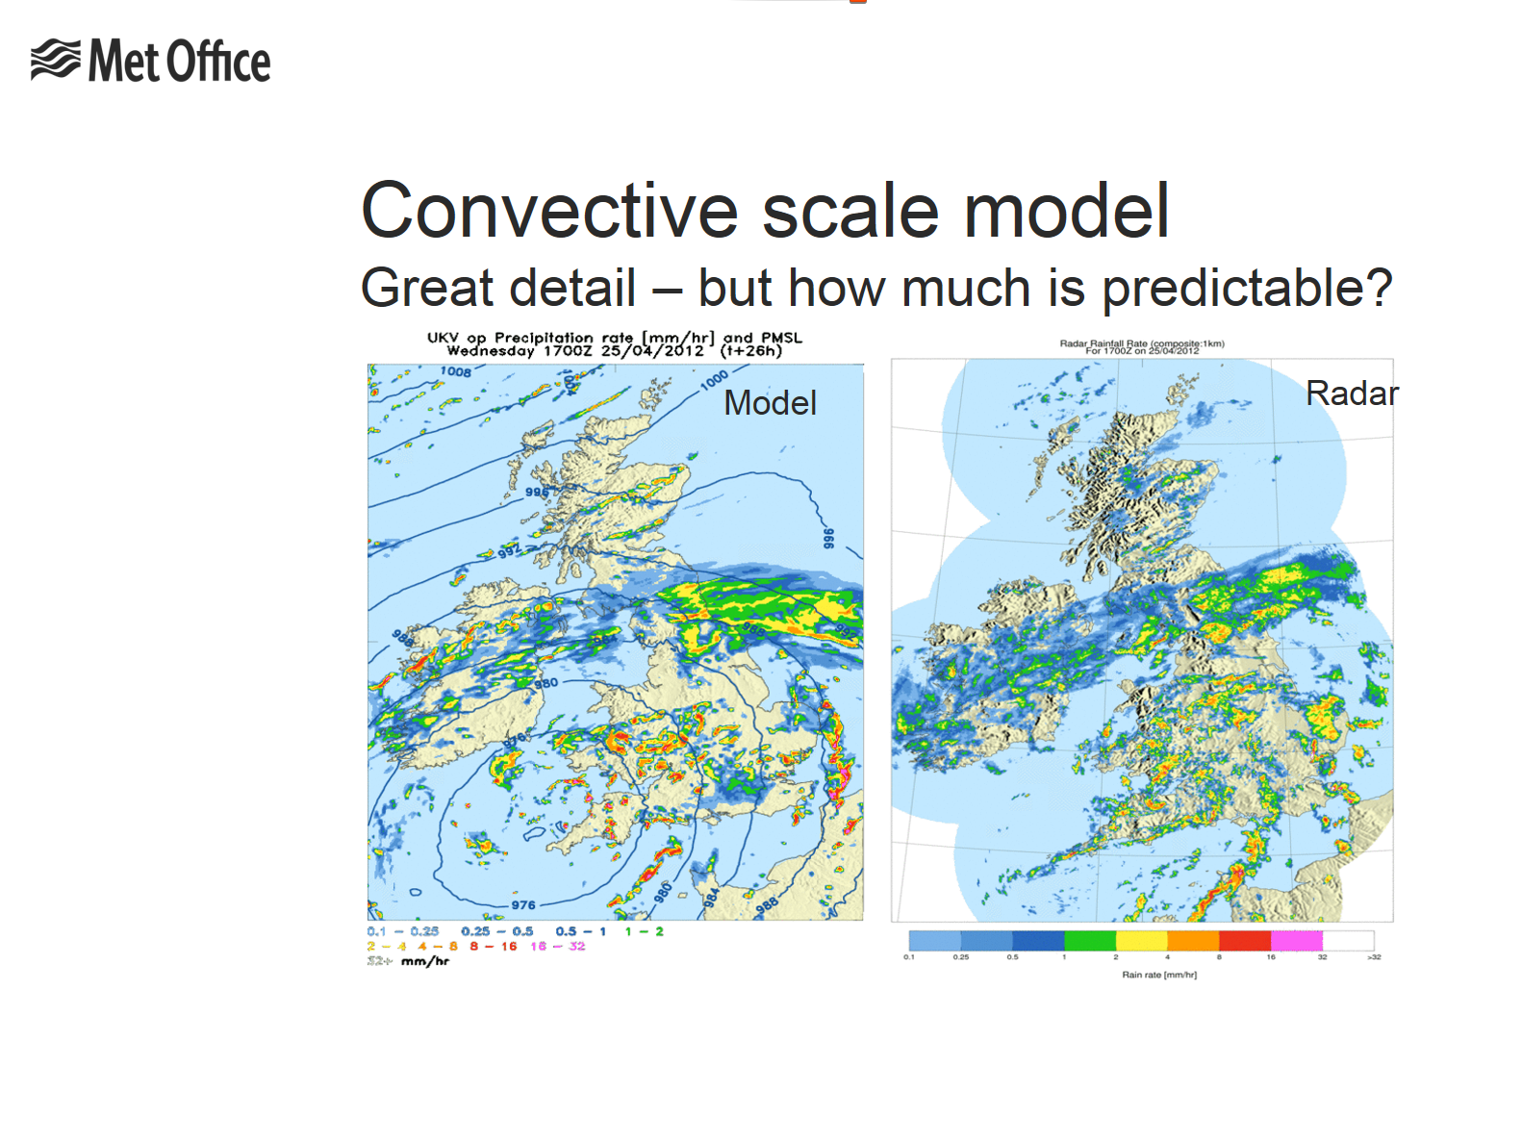

Slide 25
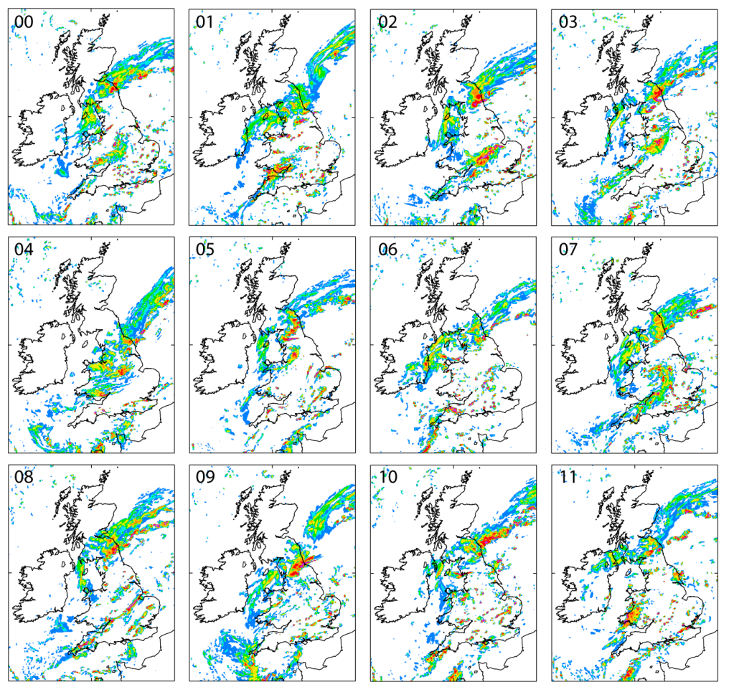


Making a probability forecast
Ensemble + neighbourhood
X
Gaps because of under-sampling
Smooth probabilities with additional neighbourhood processing
But what is the right sized neighbourhood ?

Slide 26

IMPROVER Science
Single, integrated, modular processing chain
Sequential application of ‘physical’, ‘statistical’ and ‘neighbourhood’ processing
Probabilistic at the core – forecasts blended using probabilities
Spot forecasts from probabilities
Verification at every stage
AWS
AWS
Notes:
I’ve added a bit here – to include spot forecasts and blending.
It might be worth having a slide or something that says what level0, level 1, level 2 and level 3 are (and “Service Hub” and “Value Streams”)

Slide 27
EPP focus
IMPROVER operational at Met Office
IMPROVER operational at Bureau
2017/18 18/19 19/20 20/21 21/22
Automation support (GOCF)
End of GOCF
Daily Rainfall
Coastal temperature
Use ensembles incl ACCESS. Show value from super-computer.
Daily rainfall, wind & temperature improvements
Met Office IMPROVER
Development and testing
Implementation
Improvement
Guidance to support existing and enhanced automation, new & better existing services through full ensembles, probabilities / risk / uncertainty, impacts / impact processing framework, NWP nowcasting, seamless forecasts, higher accuracy
Aurora TROPS
Spin-up
Seamless rainfall for hydrology
Seamless rainfall for hydrology
Seamless rainfall for weather forecasting (includes using GOCF/IMPROVER)
Calibrated Thunder using lagged ACCESS ensemble
Calibrated Thunder ACCESS-GE3 ensemble
Calibrated Thunder improved calibration
Calibrated Thunder using super ensemble

