Slide 1
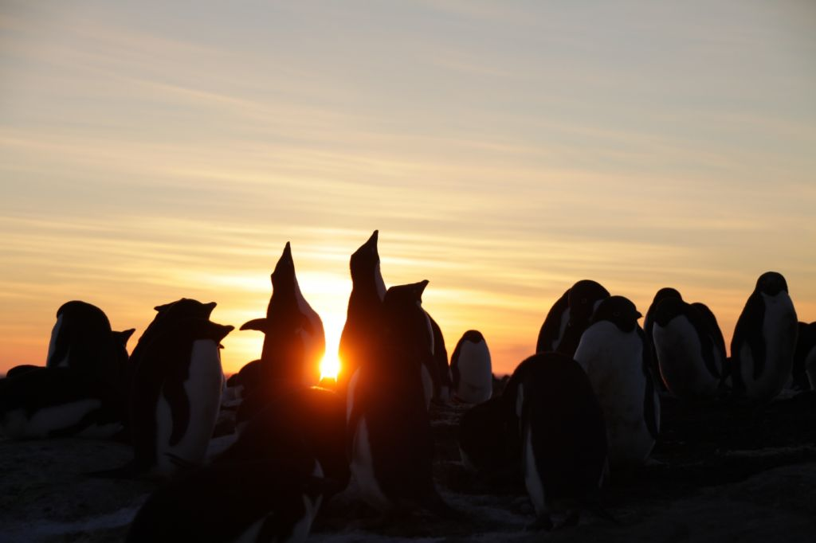
Probabilistic Forecasts Supporting Australian Antarctic Operations
Scott.carpentier@bom.gov.au Manager Antarctic Weather Services
Background on Australian Antarctic Program
How we use probabilities as a service
Comments

Slide 2
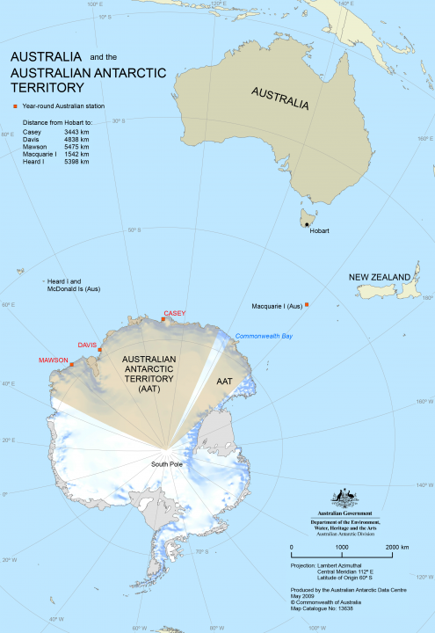
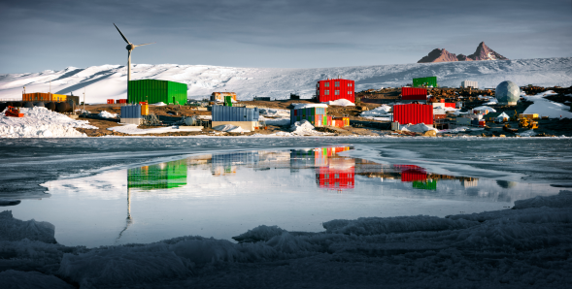
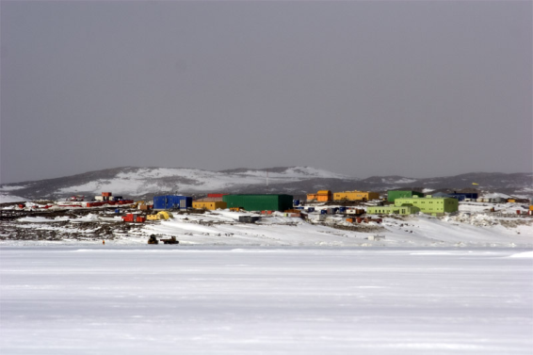
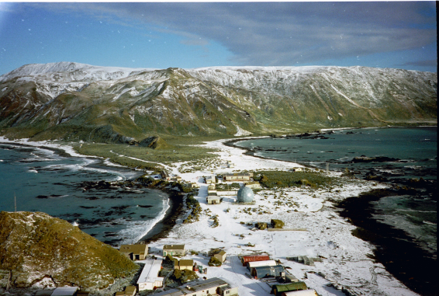
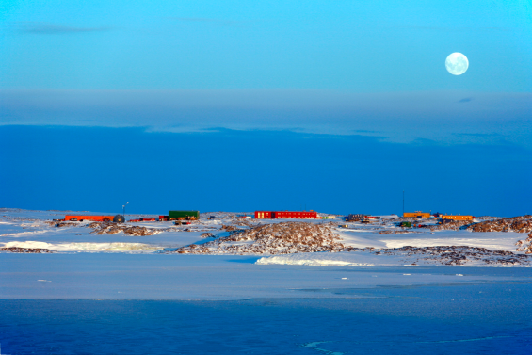
Fun Facts Australian Antarctic Territory ~5.9 million km² or 80% the size of the Australian mainland
Mawson (1954)
Davis (1957)
Macquarie Is. (1948)
Casey (1969)
Photos by Christopher Wilkins (AAD)
Notes:
AAT is about 9 times the size of Texas at 0.7 million km2 or ~80% the size of Australian mainland.

Slide 3
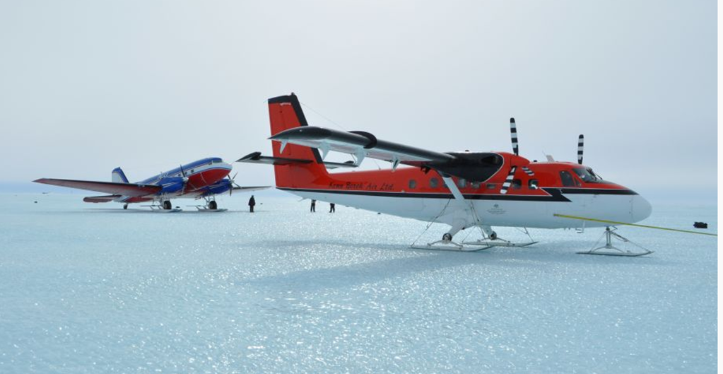
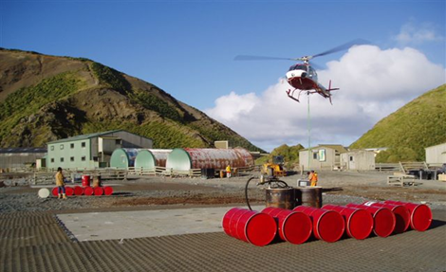
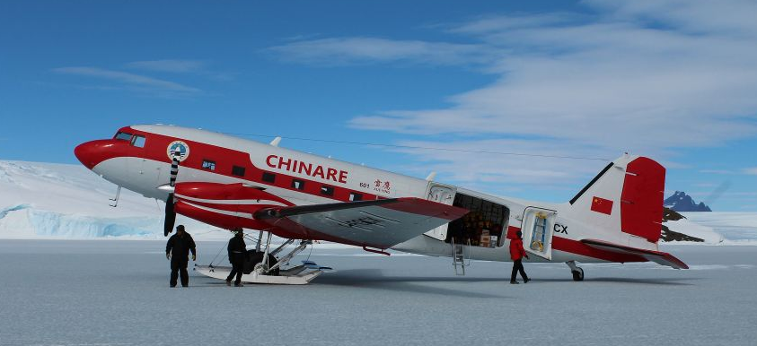
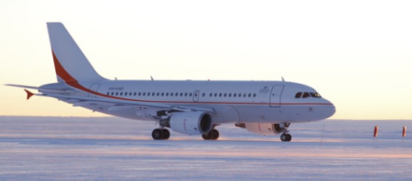
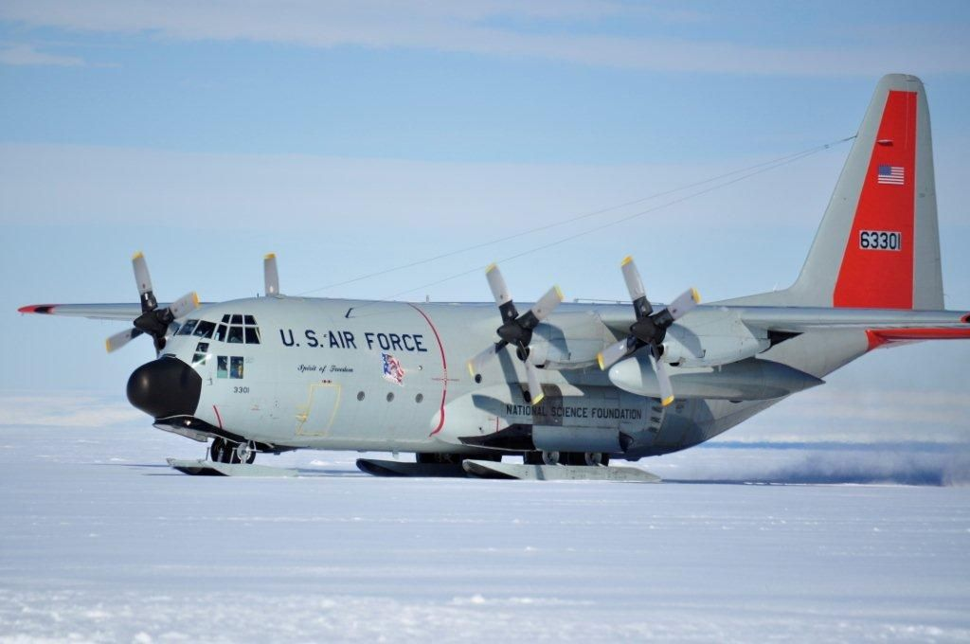
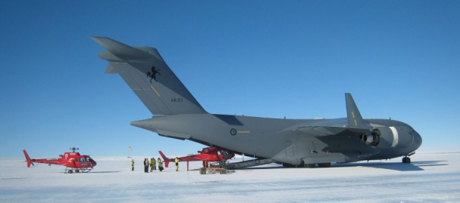
Australian Antarctic program Air transport
HeliRes Squirel B3
Chinare Basler
KBA Basler and Twin Otter
Skytraders Airbus A319
USAP Hercules LC130
ADF Globemaster C17
photos courtesy of AAD

Slide 4
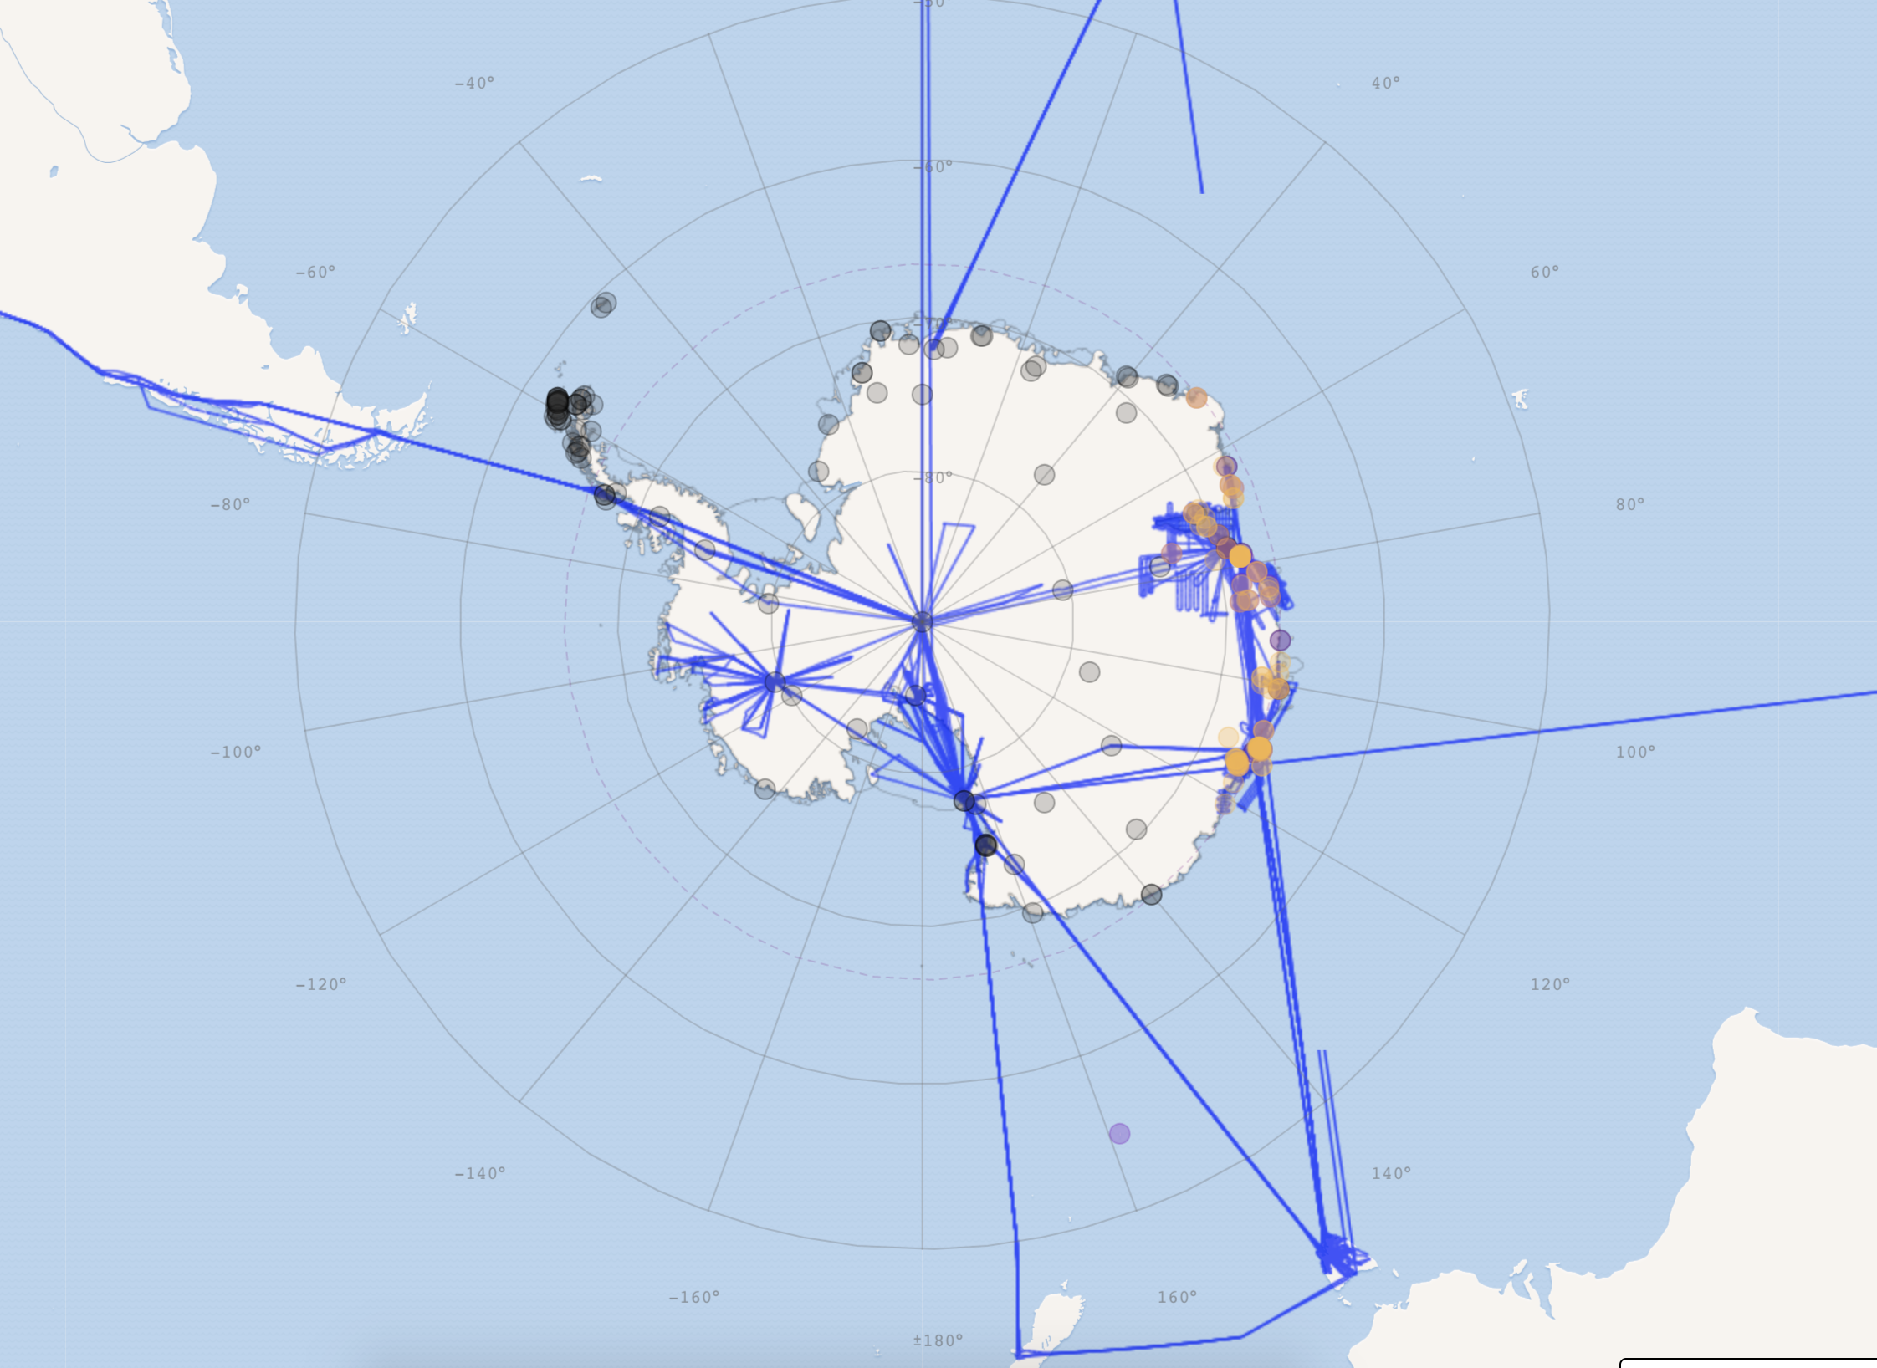
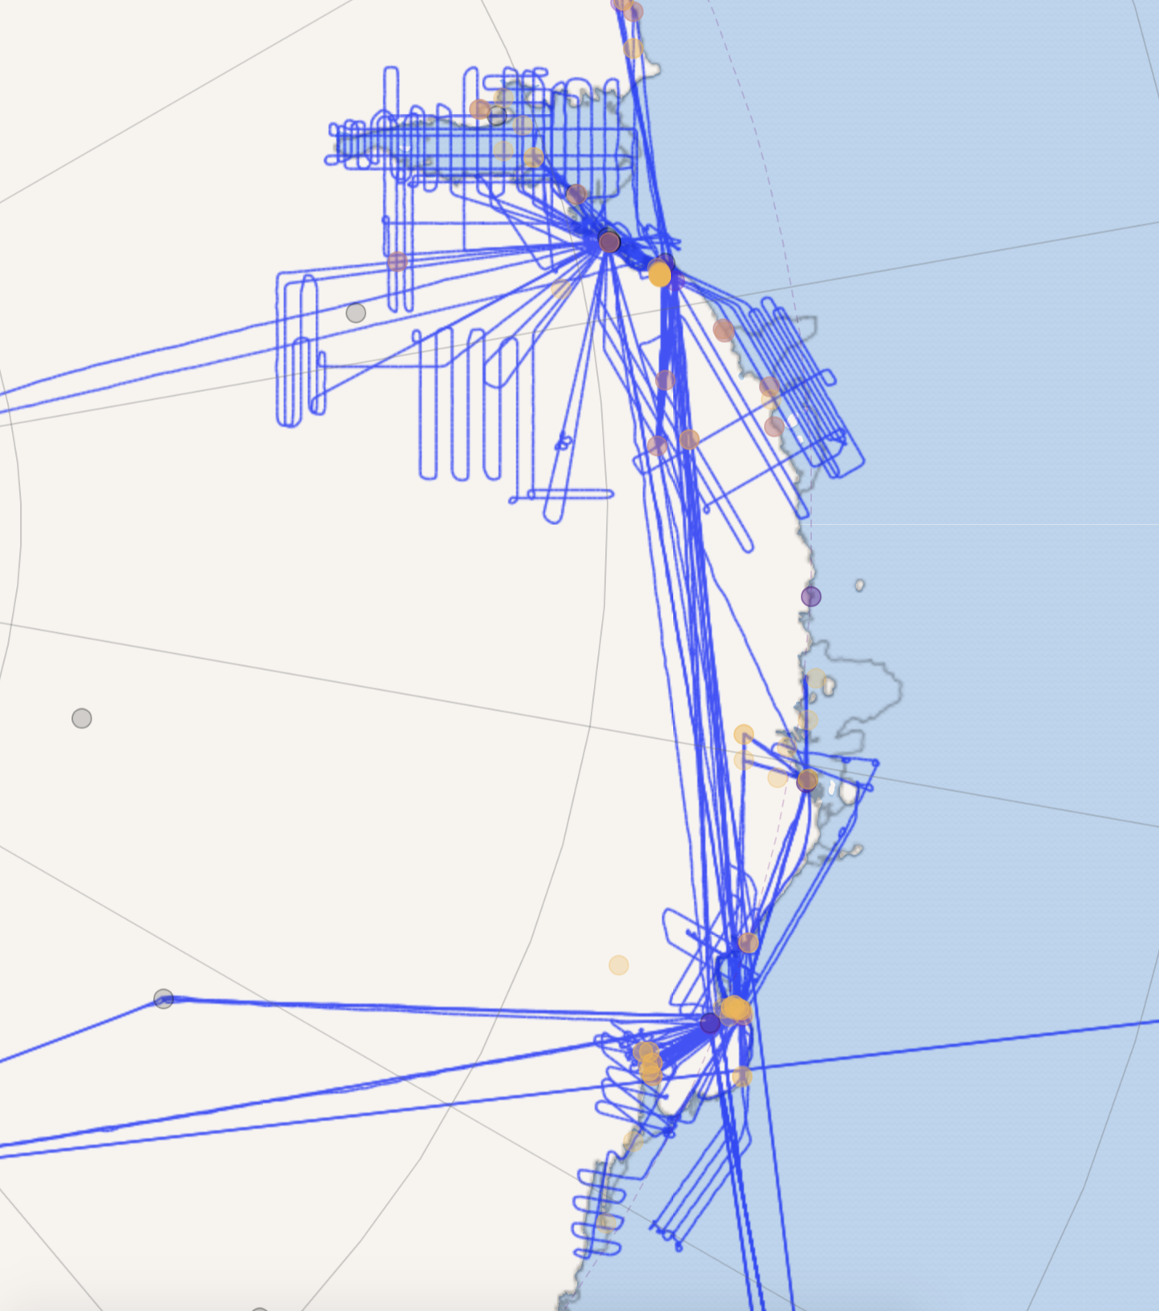
Australian Antarctic program Air transport – 2017-18 season tracks
photos courtesy of AAD

Slide 5
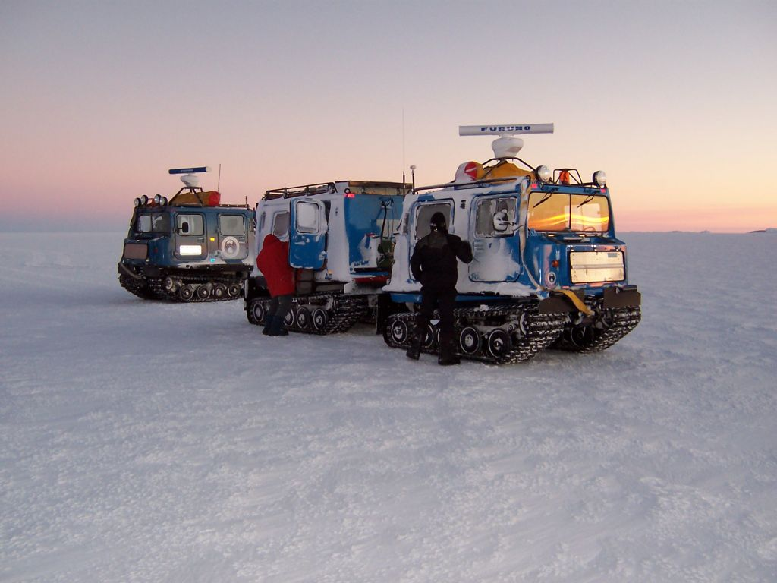
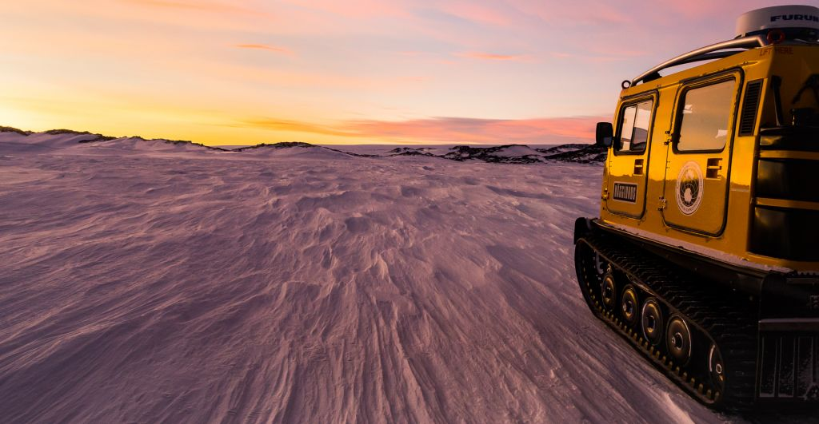
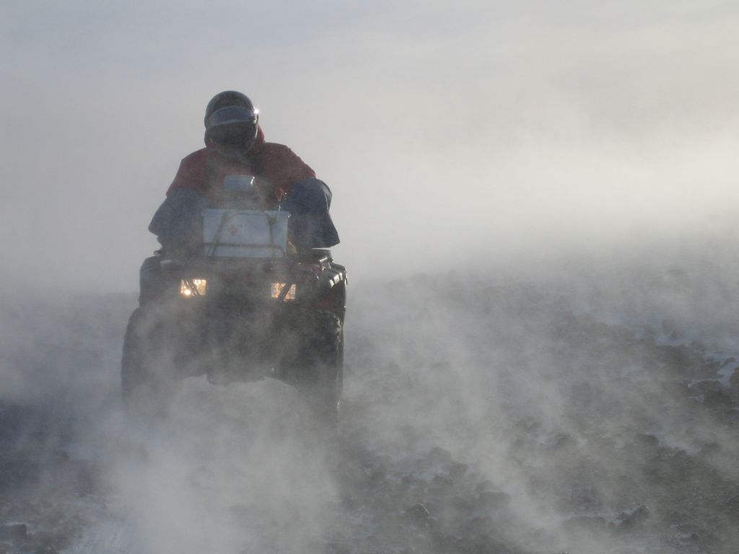
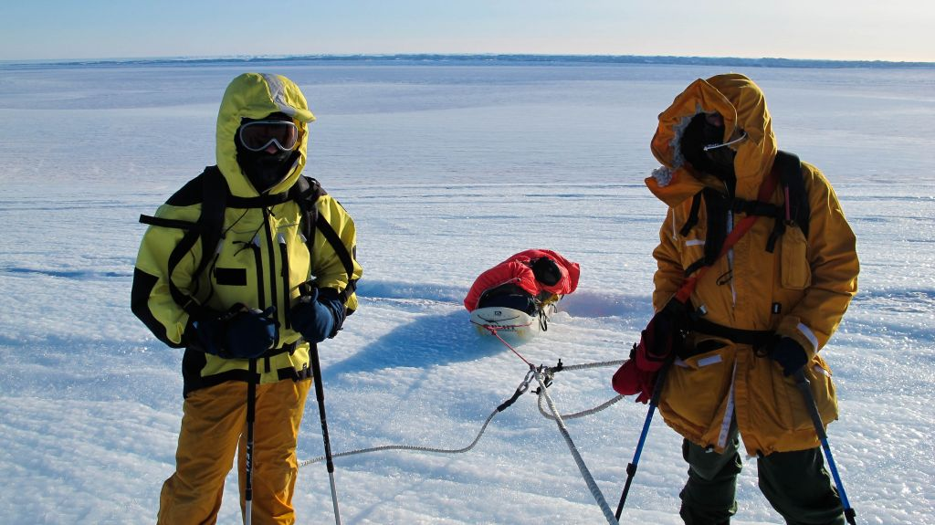
Australian Antarctic program Land Transport
photos courtesy of AAD

Slide 6
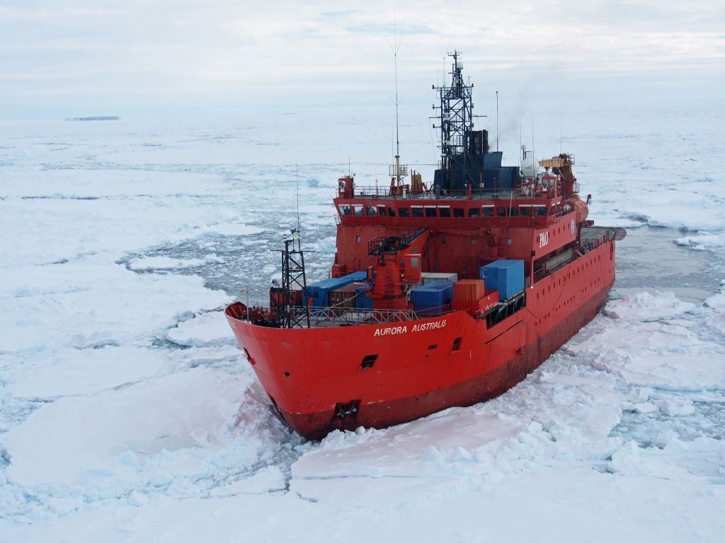
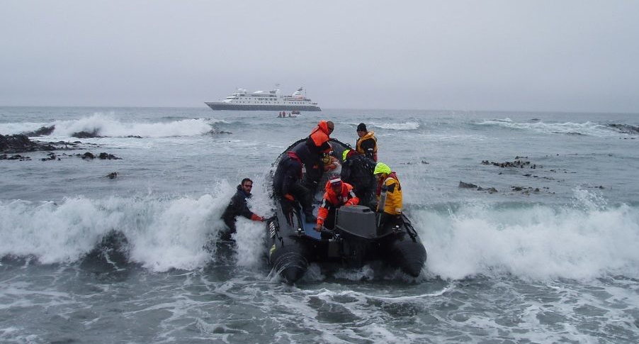
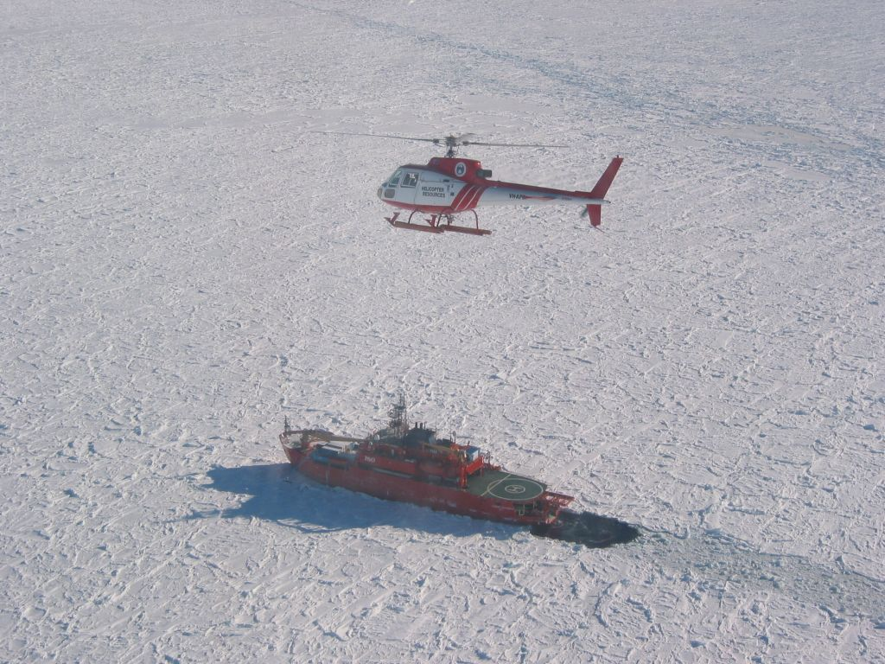
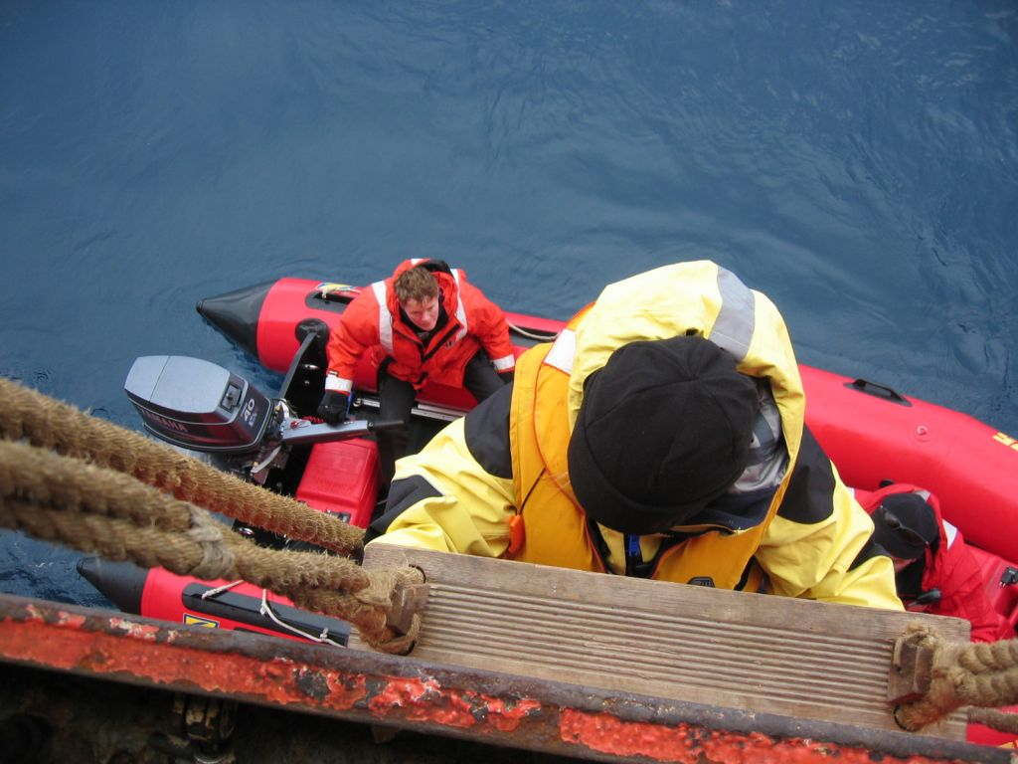
Australian Antarctic program Maritime transport
photos courtesy of AAD

Slide 7
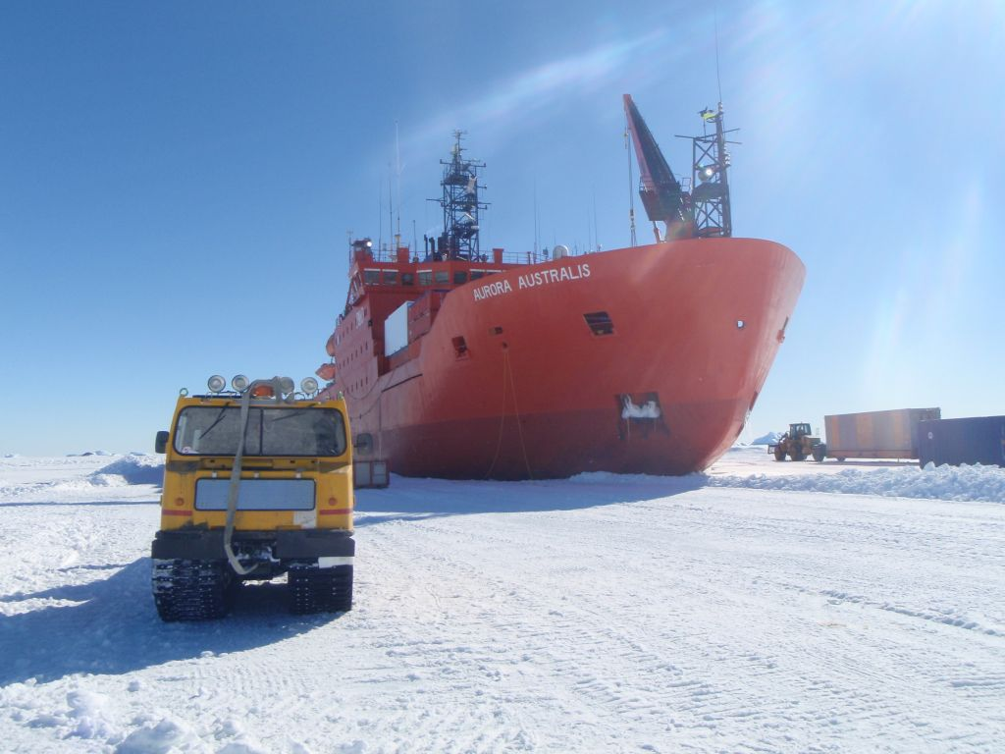
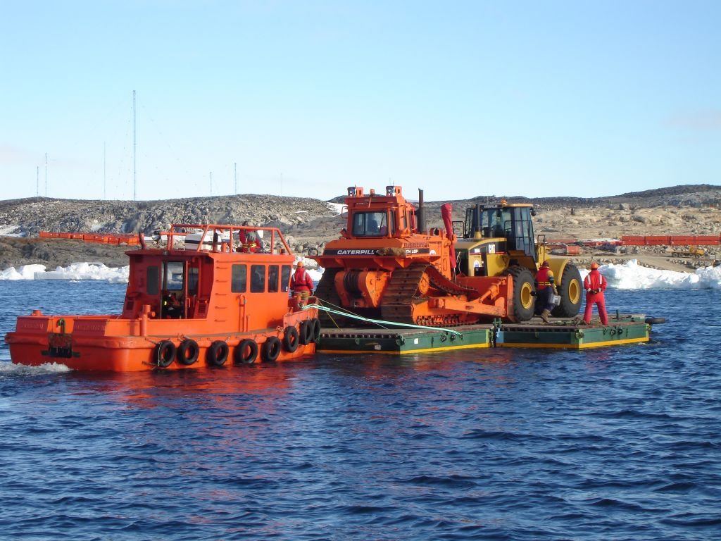
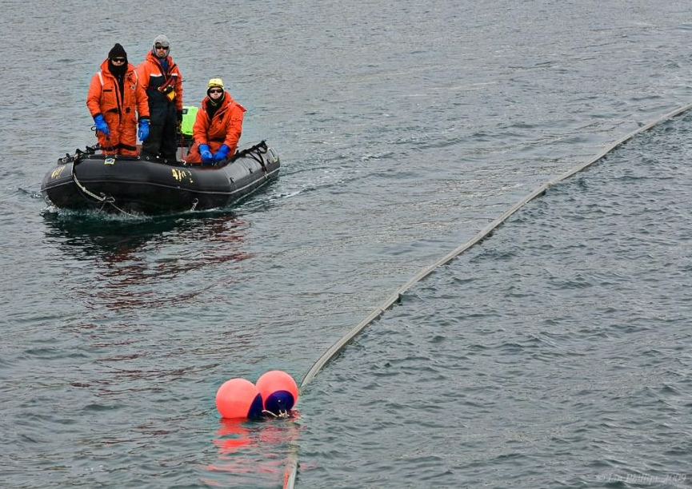
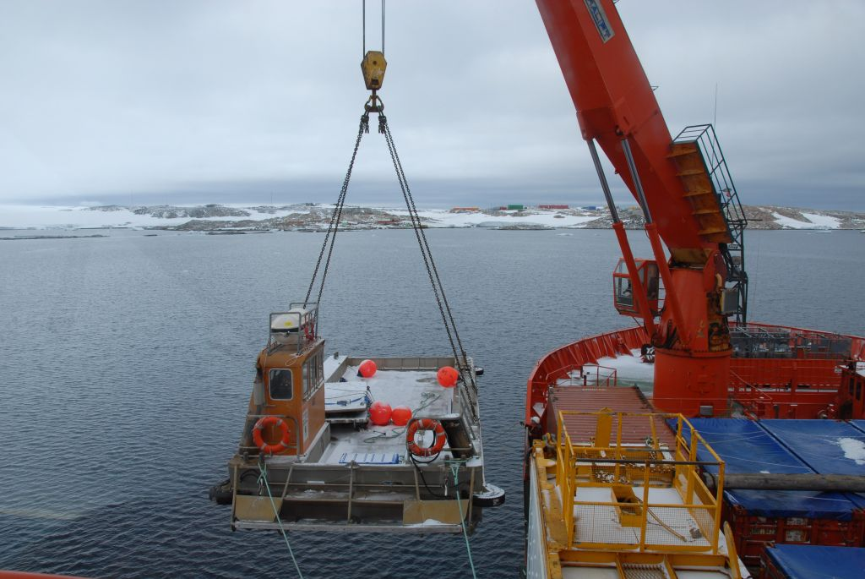
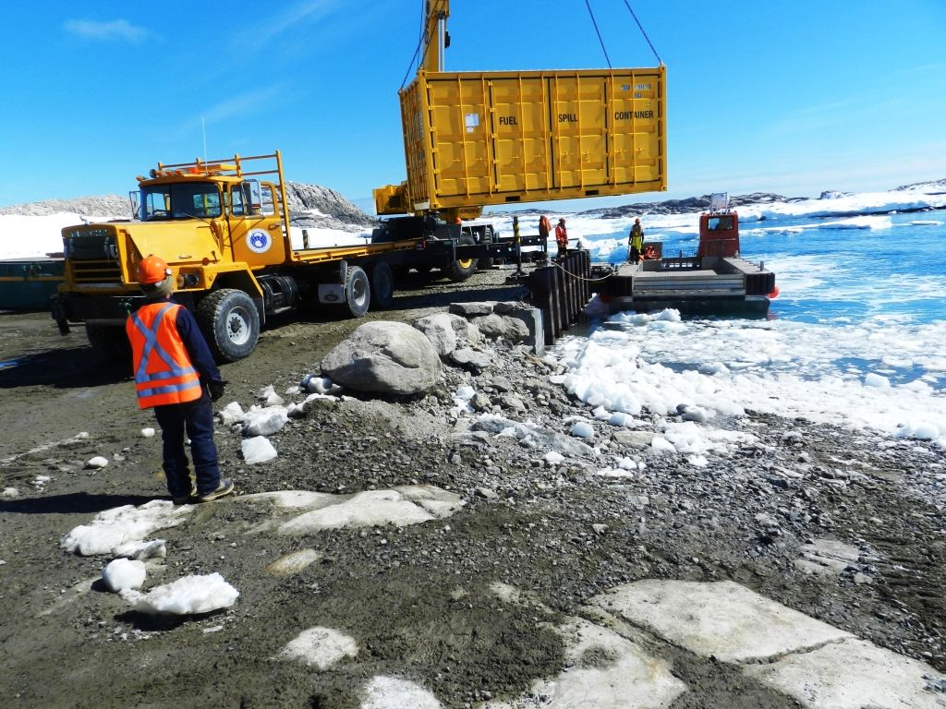
Australian Antarctic program Resupply and Research
photos courtesy of AAD

Slide 8
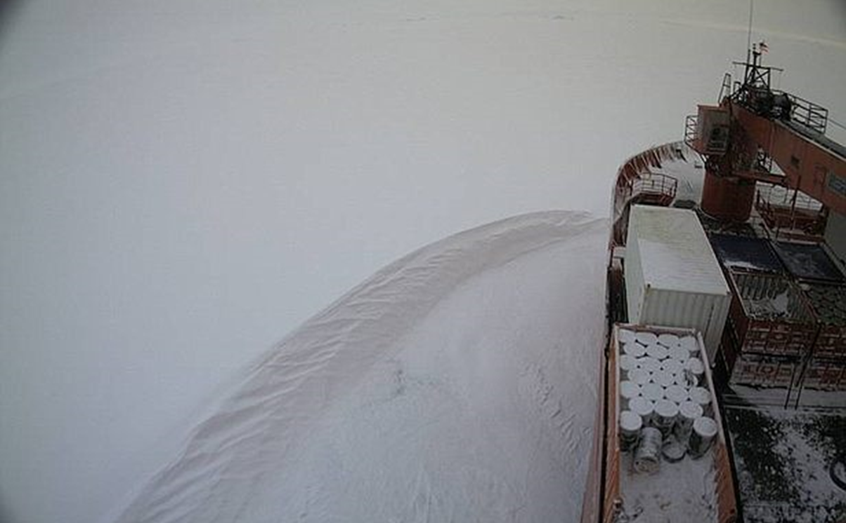
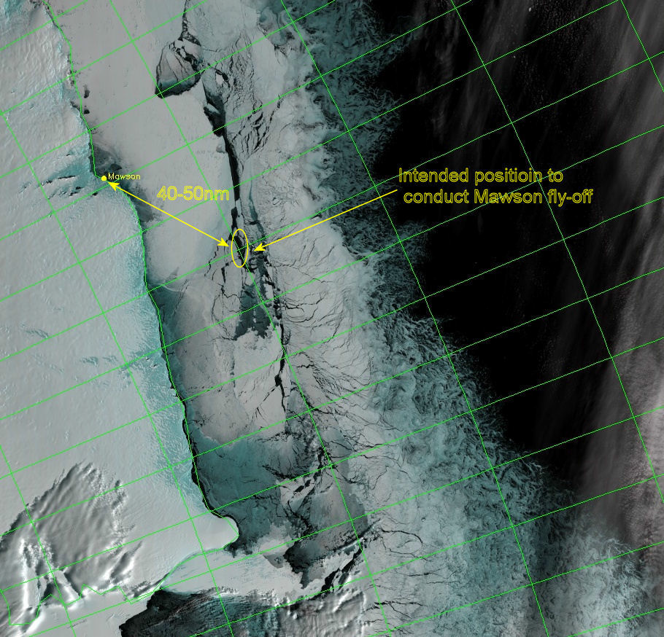
Mawson Helicopter Resupply
Credit: Robb Clifton – COMNAP Sea Ice workshop

Slide 9
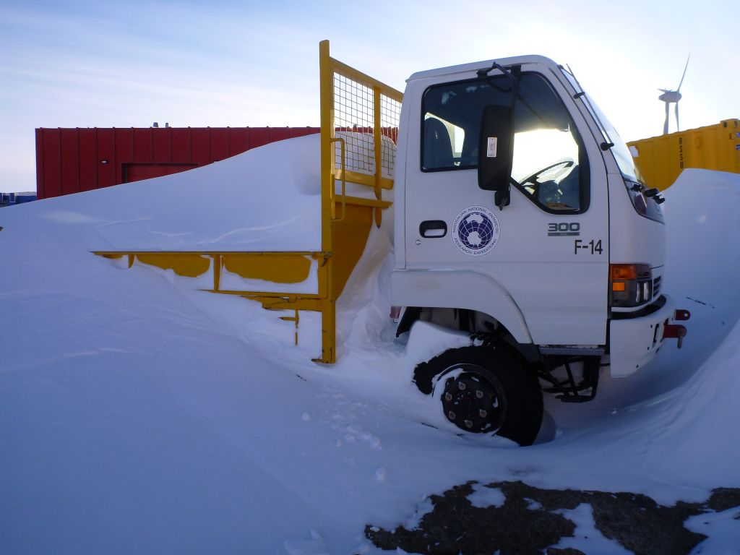
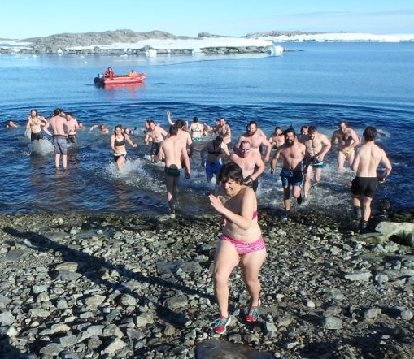
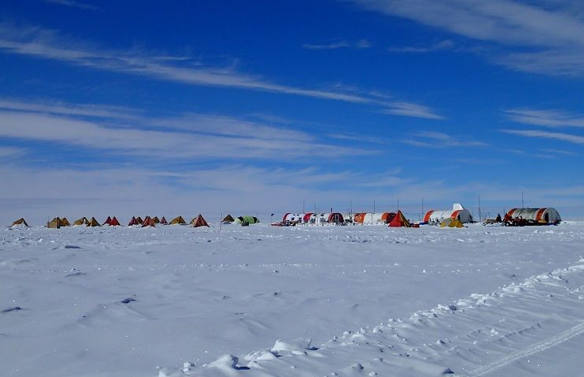
Australian Antarctic program Public Weather
Parked out at Casey
Oz day swim
Aurora Basin
photos courtesy of AAD

Slide 10
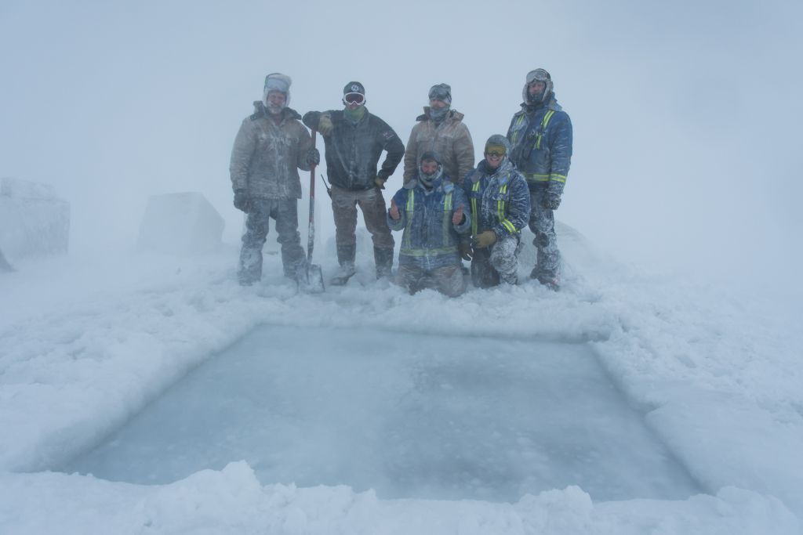
Midwinter Swim

Slide 11
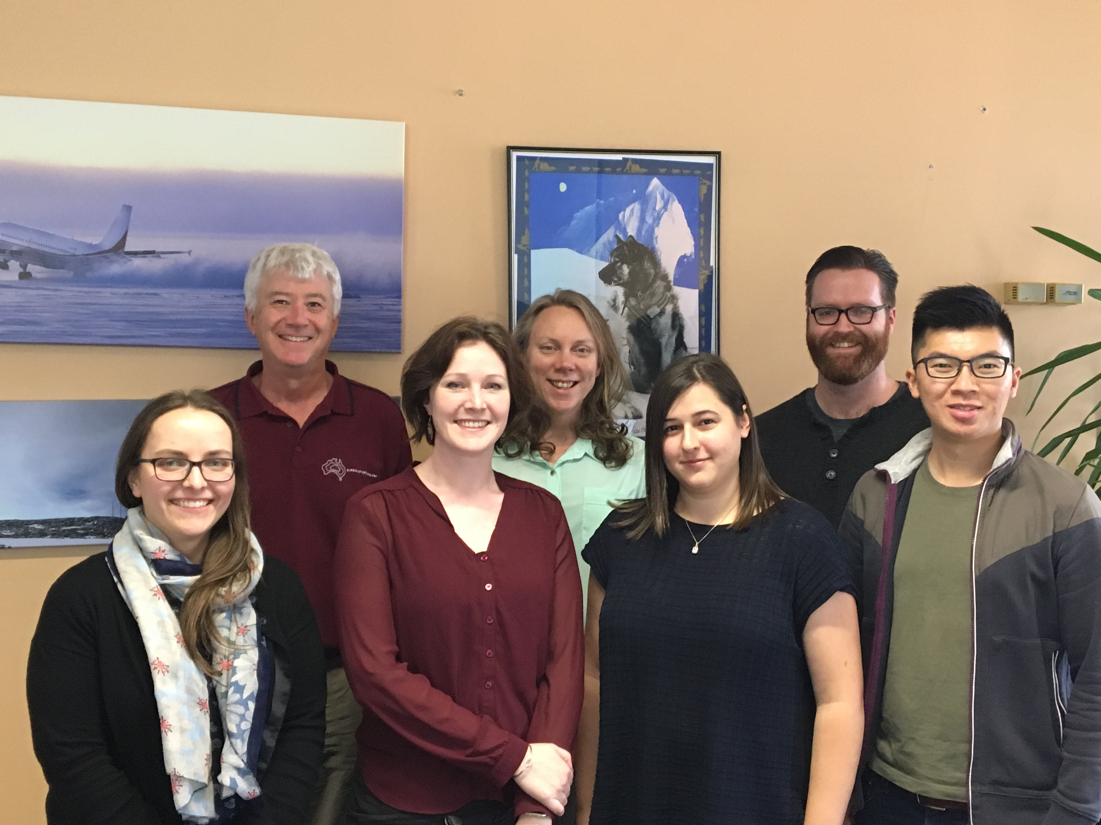
2018-19 Met Team Hobart- Brisbane-Nowra-Melbourne

Slide 12
Operational Thresholds Resupply example
Wind > 15kt: Fuel transfer ceases due to risk of damaging floating fuel lines.
Wind > 25kt: Small boats (IRBs) cease operating due to passenger safety.
Crane (for lifting cargo) shut down.
Wind > 35kt: Aurora Australis moves offshore (to avoid anchor dragging).

Slide 13
Operational Thresholds Midwinter Swim
Wind < 15 knots.
Air temperature > -30ºC !!!

Slide 14
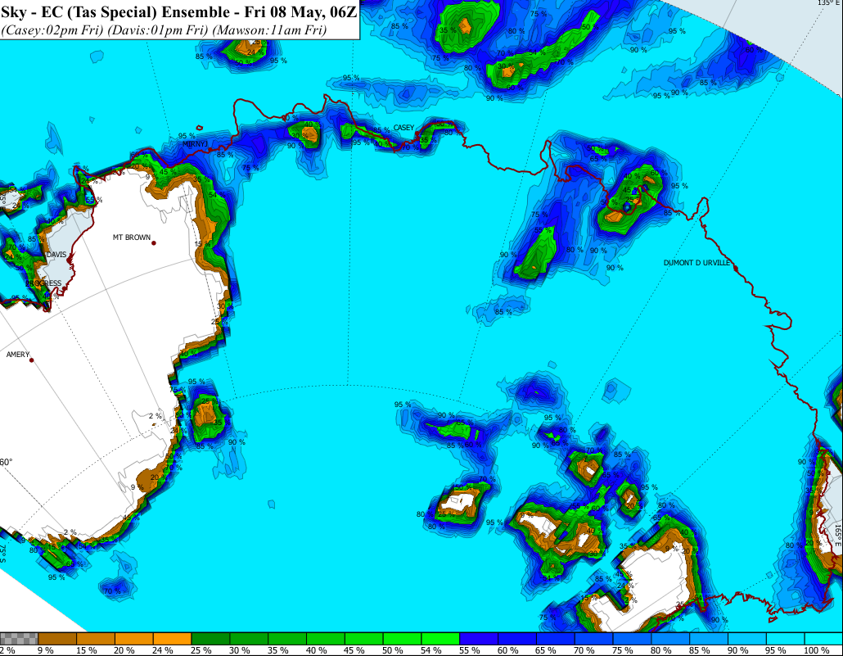
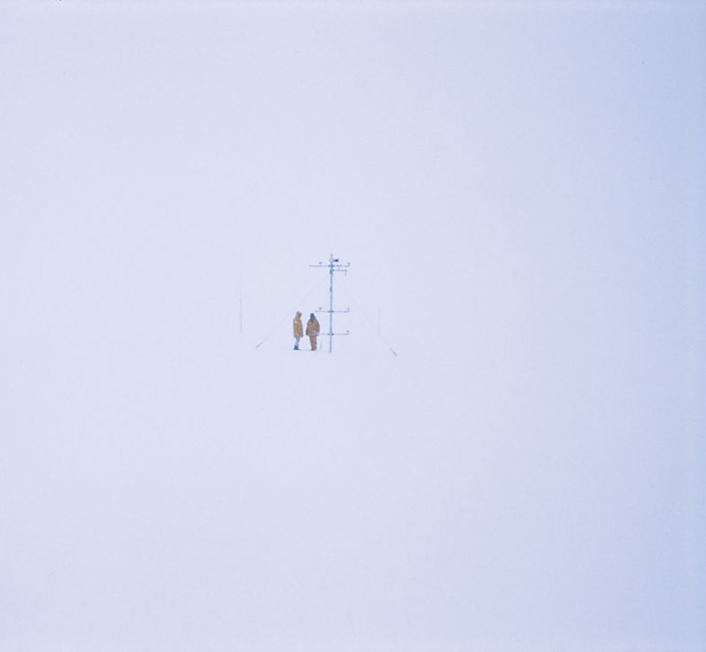
Risk of Whiteout: probability of >5 okta Automated Probabilities we don't routinely disseminate

Slide 15
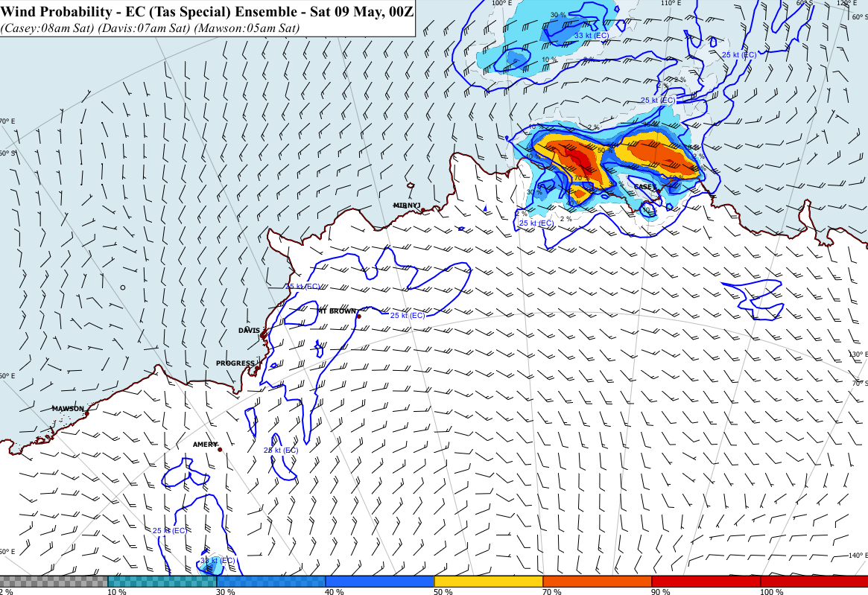
Probability of exceeding 33 knots Automated products we don't routinely disseminate

Slide 16
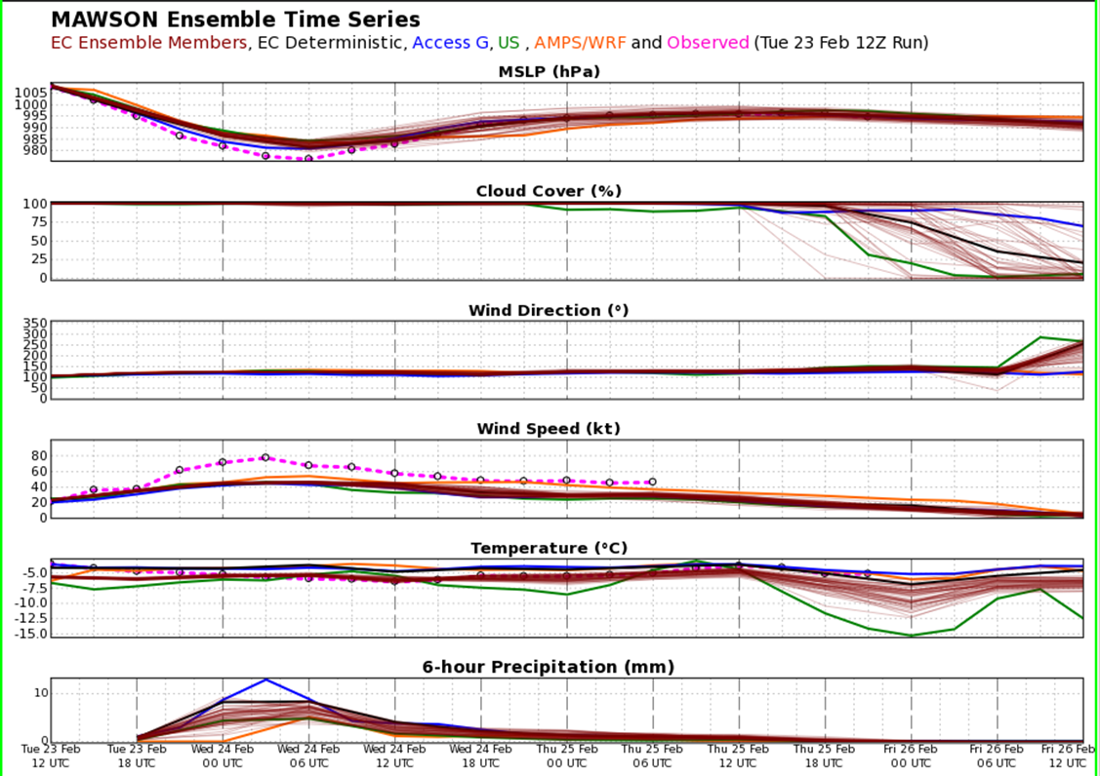
Observations vs Model

Slide 17
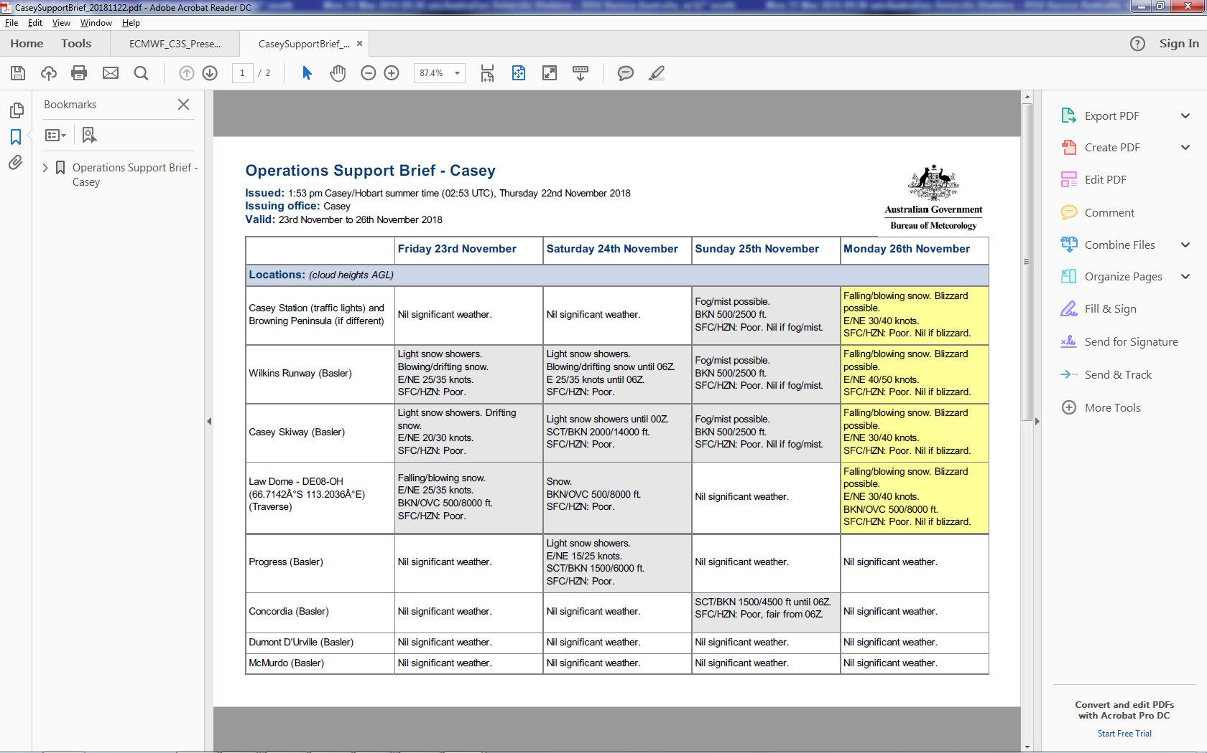
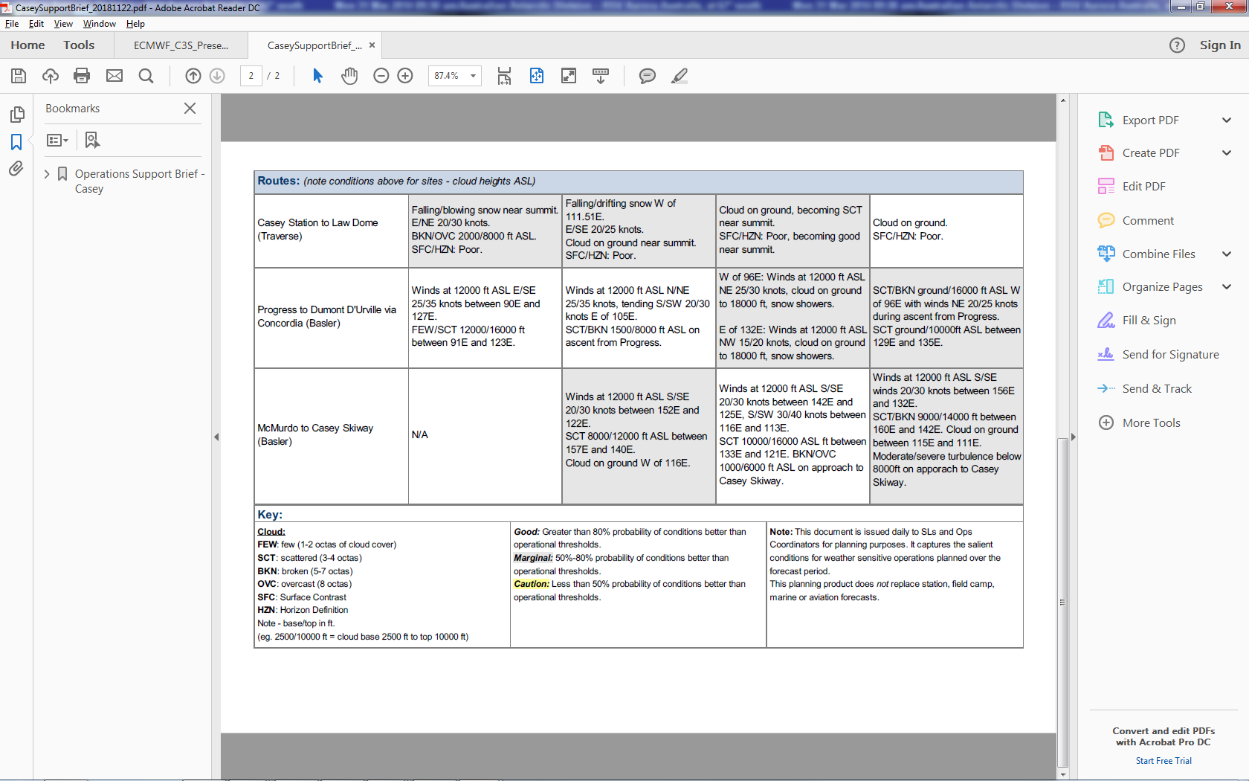
Operations Support Brief

Slide 18
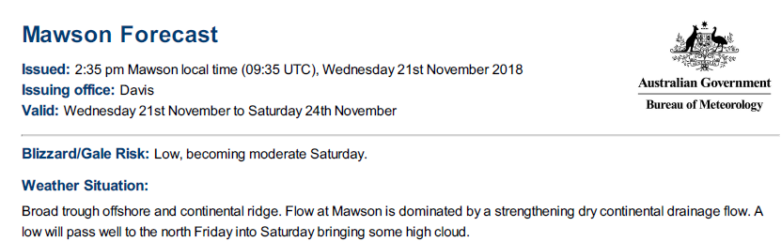
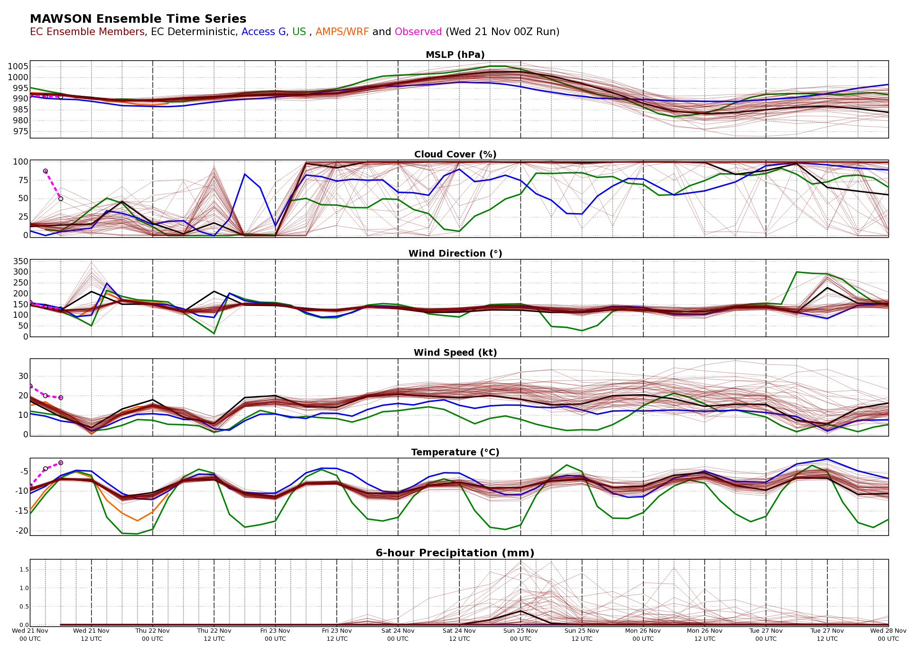
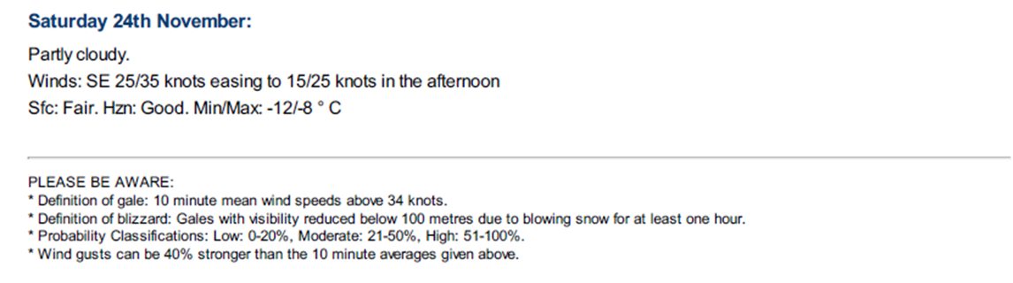
Public Weather Poor Mans Ensemble + deterministic forecast with Blizzard Risk

Slide 19
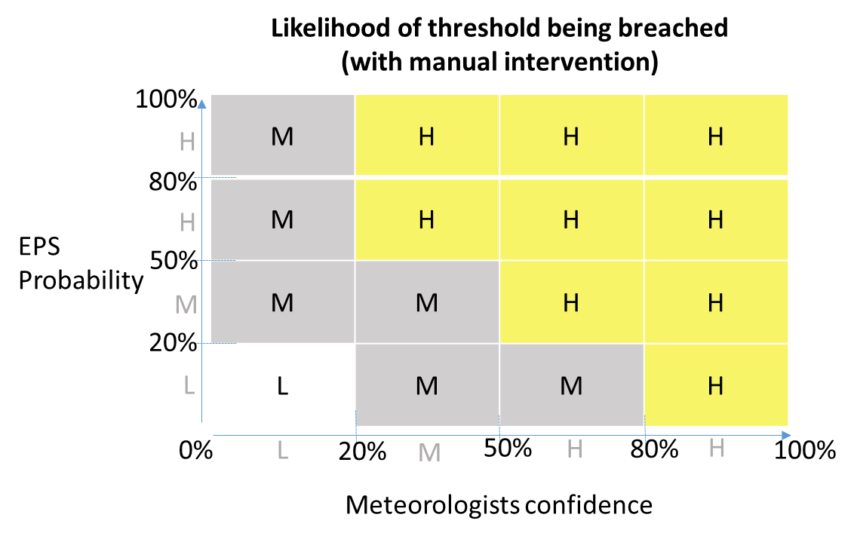
The likelihood of operational thresholds being breached:
Low: 0-20% chance of occurrence;
Moderate: 21-50% chance of occurrence;
High: 51-100% chance of occurrence.

Slide 20
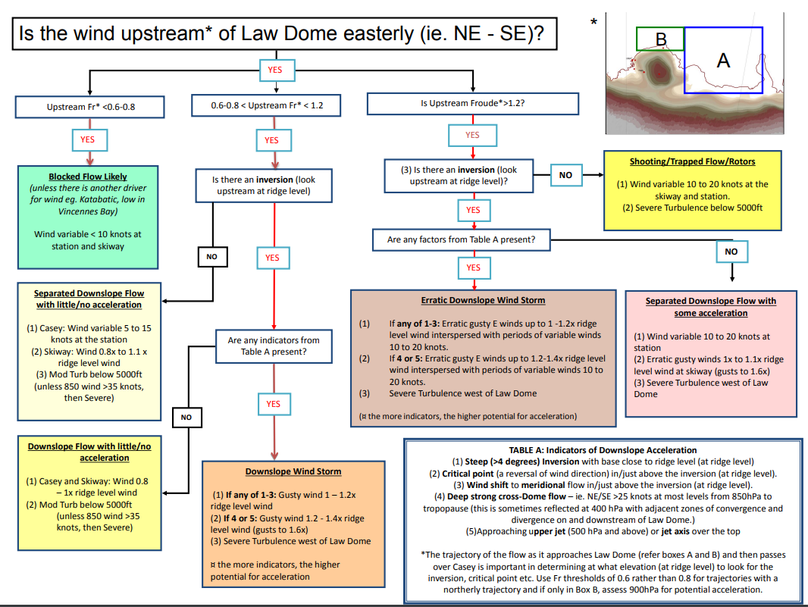
Standardising Forecast Evaluation for a transient workforce

Slide 21
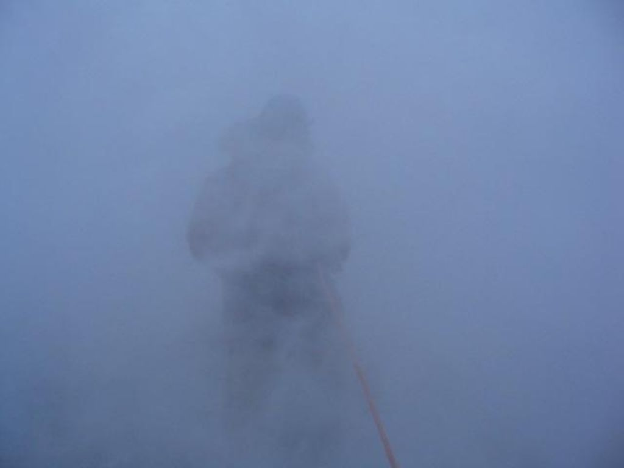
Ops coordinator feedback
…The Support Brief has great value in providing probabilistic information to inform decision making on all operational activities. I see it as highly useful for looking at proposed general work around station especially where high risk activities are involved, and also for station based project support, even Field activities close to Station on station limits (i.e. survival training)…
Many thanks again.
Jacqueline Comery BA, BEng(Hons), CPEng, NPER
Operations Coordinator 2018/19
Casey Station, Antarctica | 66° 16′ 55″ S, 110° 31′ 39″ E
Australian Antarctic Division
Department of the Environment and Energy
T: 0011 672 12 8888
Int Ex: 8888
E: jacque.comery@aad.gov.au

Slide 22
Conclusions and Comments
All Antarctic activities are high risk due to the high consequences when things go wrong. It follows that probability forecasts are highly valued, as every decision considers risk.
Our likelihood levels (low, moderate and high) are customised wrt to the expeditions risk tolerance. eg. a high likelihood >50%.
The current low EPS fidelity wrt high impact weather thresholds limits service automation.
The likelihood matrix (table 2) addresses this by adding meteorologist skill, but that costs HR.
How decision makers and forecasters use probabilities is highly subjective!
Investment in training, standardisation of forecaster value adding, linking to operational thresholds and collaborative product design are all critical.

Slide 23
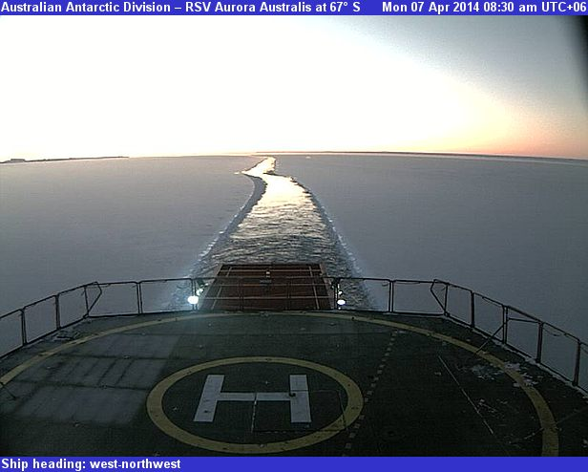
Scott Carpentier Manager Antarctic Meteorology scott.carpentier@bom.gov.au
Thank You
Thank you

