Slide 1
USE OF CONVECTION-ALLOWING MODEL ENSEMBLES IN FORECASTING SEVERE CONVECTIVE HAZARDS
Harald Richter¹ and Dean Sgarbossa²
Presenting author’s e-mail: harald.richter@bom.gov.au
¹ Science to Services, Australian Bureau of Meteorology, Melbourne, Australia
² Extreme Weather Desk, Australian Bureau of Meteorology, Brisbane, Australia

Slide 2
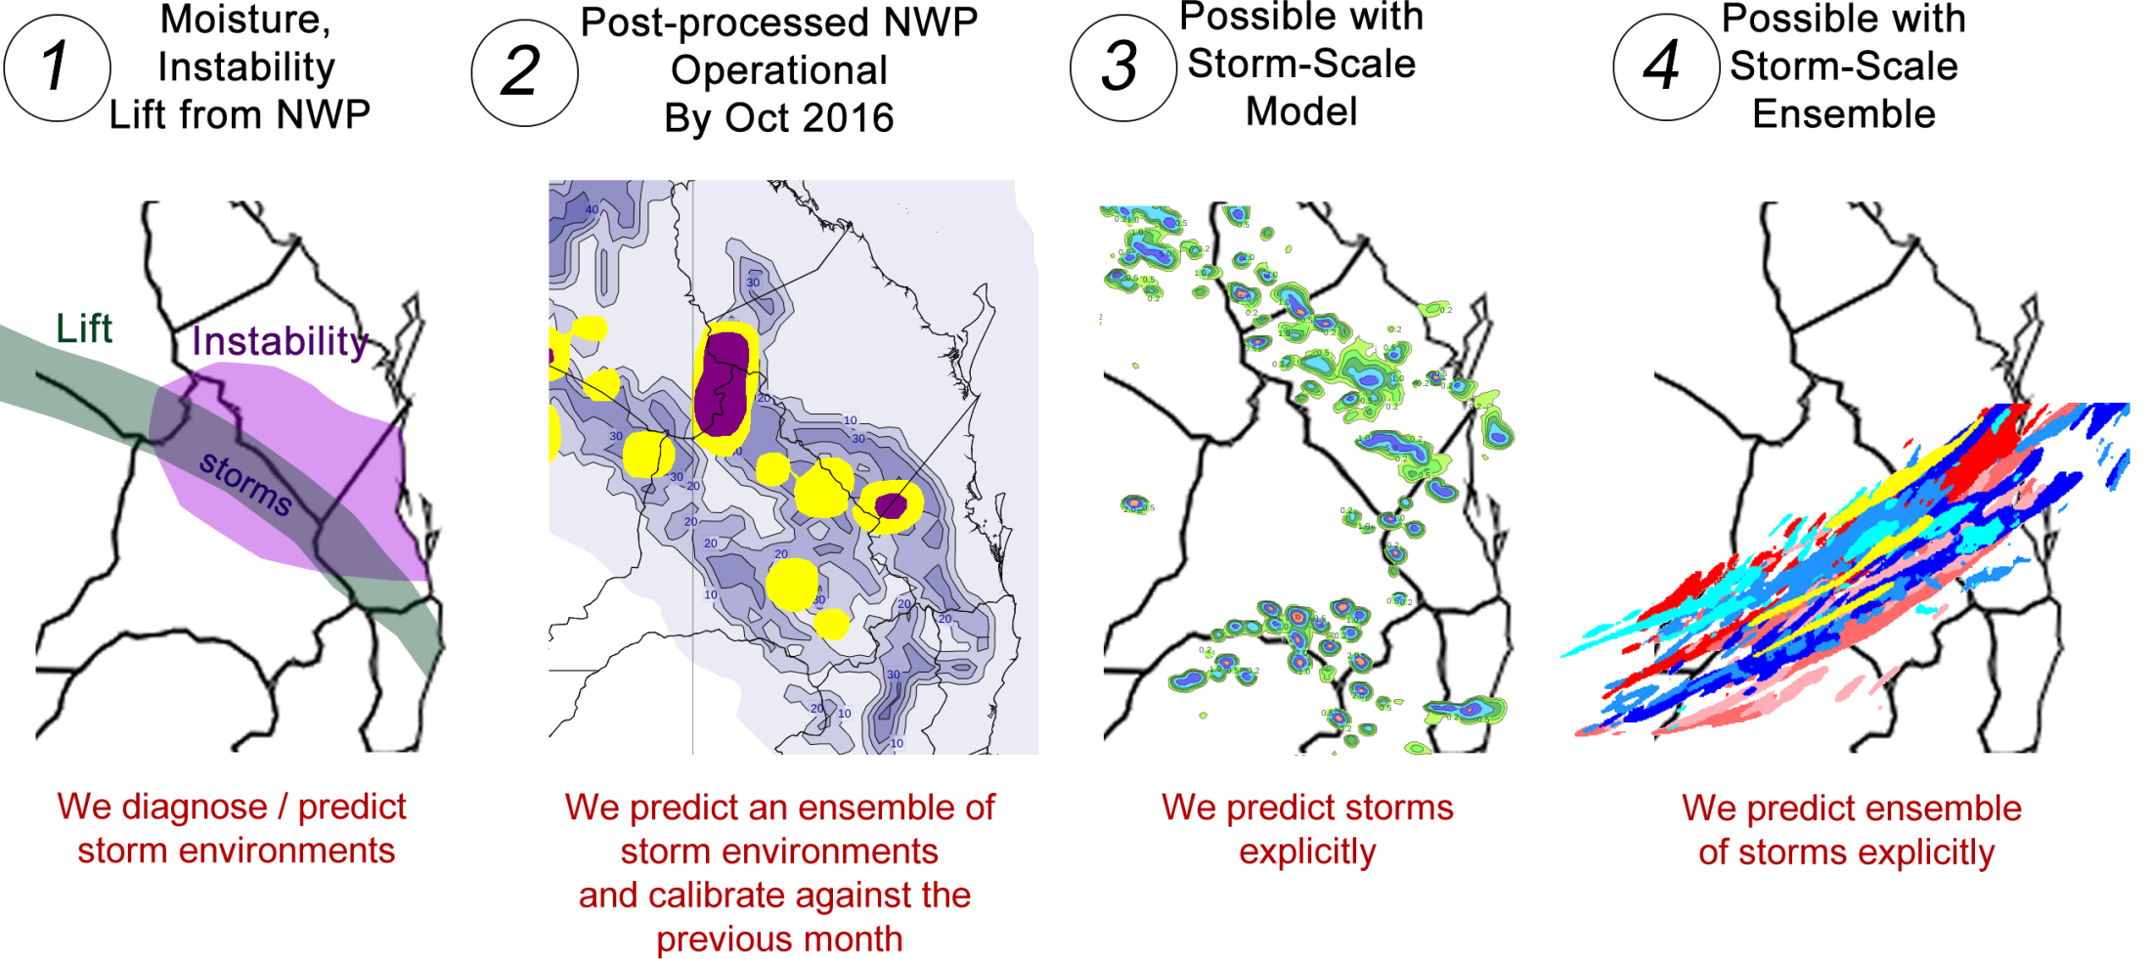
Evolution of NWP-Based Convective
Forecasting
This talk: Focus on 3 and 4

Slide 3
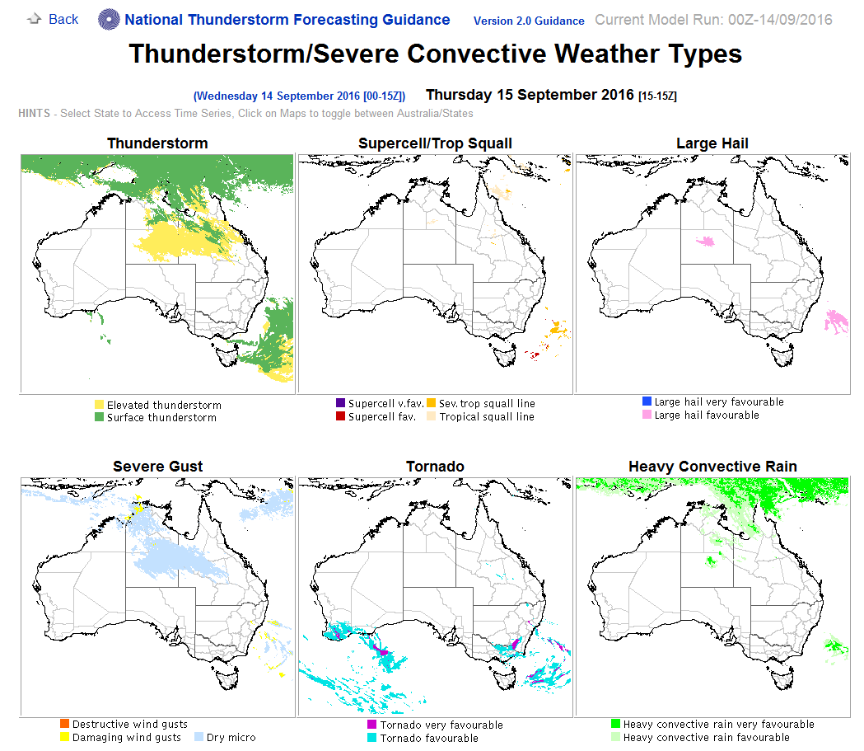
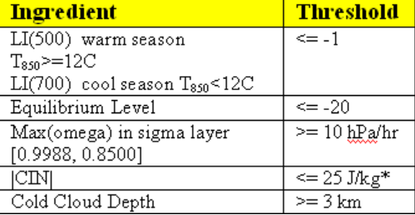
1: National Thunderstorm Forecast Guidance System
Notes:
8 top level diagnostics:
4 storm types (sfc-thunder; elev thunder; supercell; trop. Squall line)
4 hazards (large hail; damaging wind; tornado; heavy rain)

Slide 4
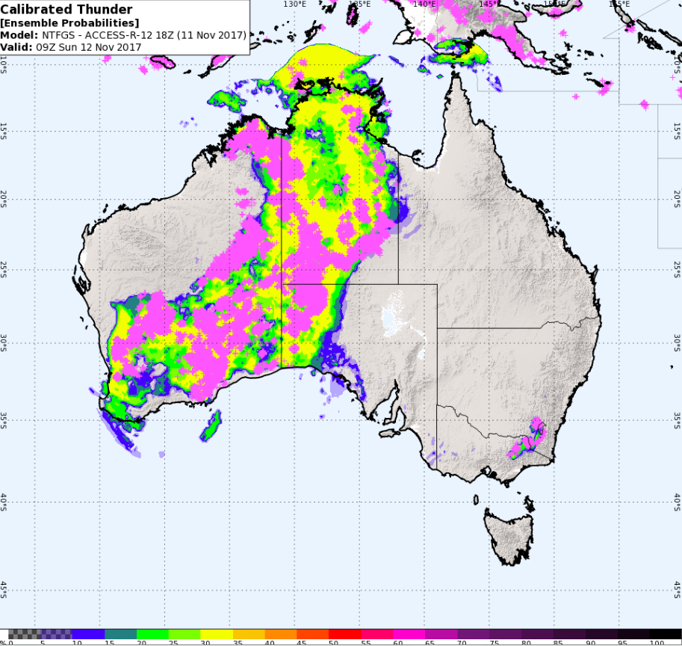
2: Calibrated Thunder
Calibrated Thunder
Probabilities:
3-hourly ACC-R out
to 2 days
6-hourly ACC-G out
to 8 days
24-hourly ACC-G out
to 8 days
24-hourly ACC-R
(1 period)
Notes:
4

Slide 5
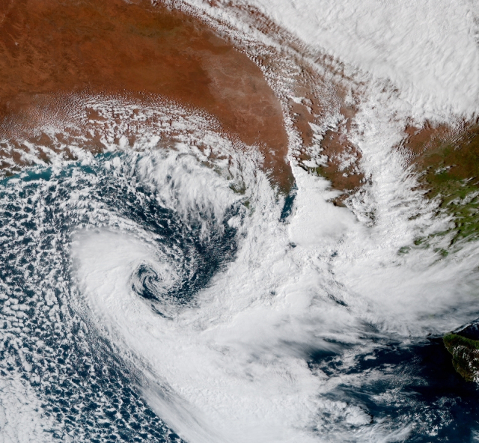
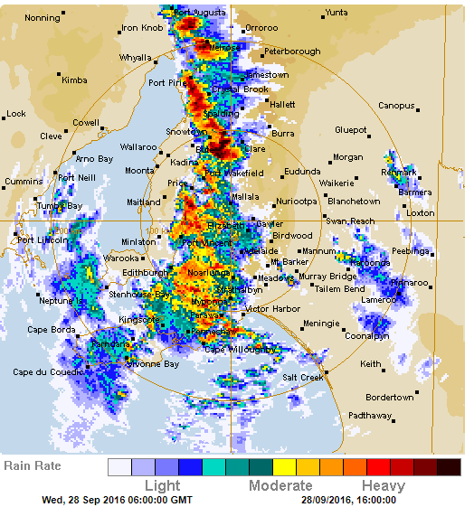
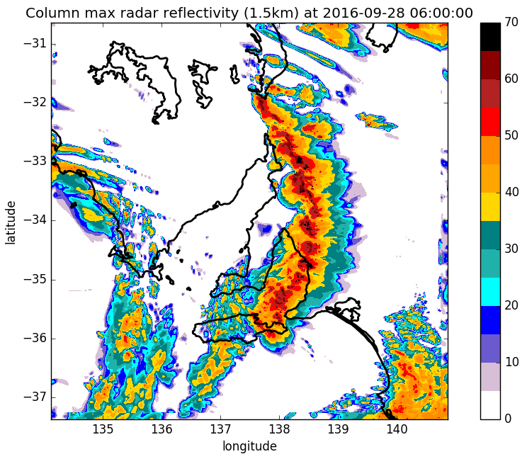
South Australia QLCS Tornado Outbreak 28 September 2016 (0600 UTC)
Thanks Dragana
Zovko-Rajak
15Z/27 1.5 km RA1M run (f015)

Slide 6
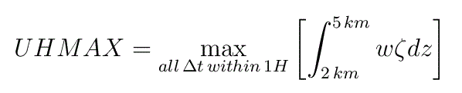
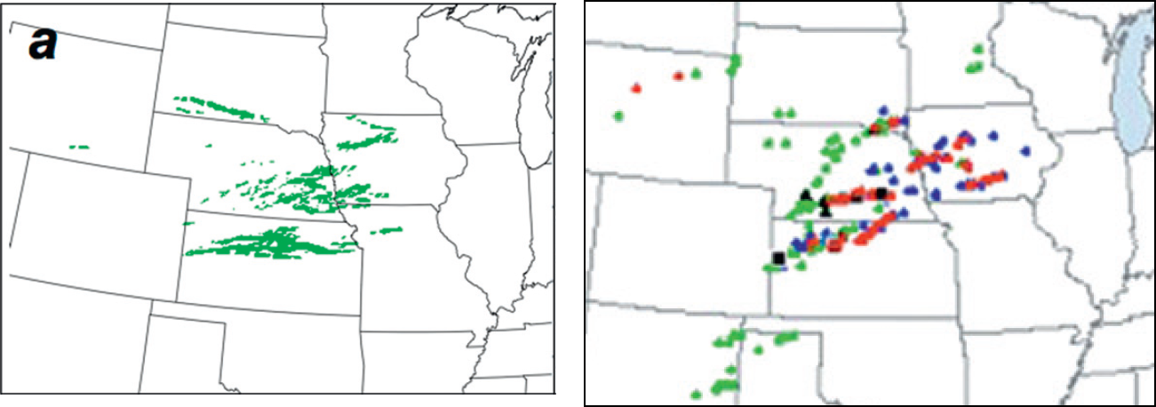
3: CAM Storm Attributes: Updraft Helicity
Maximum updraft helicity over 24 hours (Sobash et al. 2011):
24
Tornado
Hail
Other
UHMAX > 34 m² s⁻² during period
12Z/29 – 12Z/30 May 2008
Storm reports during period
12Z/29 – 12Z/30 May 2008

Slide 7
Model data for the following slides:
5-member CAM ensemble on 1.5 km grid
“C3” model for the Adelaide (AUS) domain (v10.6 – ish)
Model runs used:
  member 1: 00 UTC/28 Sep 2016
  member 2: 18 UTC/27 Sep 2016
  member 3: 12 UTC/27 Sep 2016
  member 4: 06 UTC/27 Sep 2016
  member 5: 00 UTC/27 Sep 2016
  ICs and LBCs from ~12.5 km ACCESS-R2 run
  Maximum fields produced for 3-9 UTC/28 Sep
  Visualisations that follow based interaction with the
  HWT (Norman)
Thanks Susan Rennie
Science to Services, Bureau of Meteorology

Slide 8
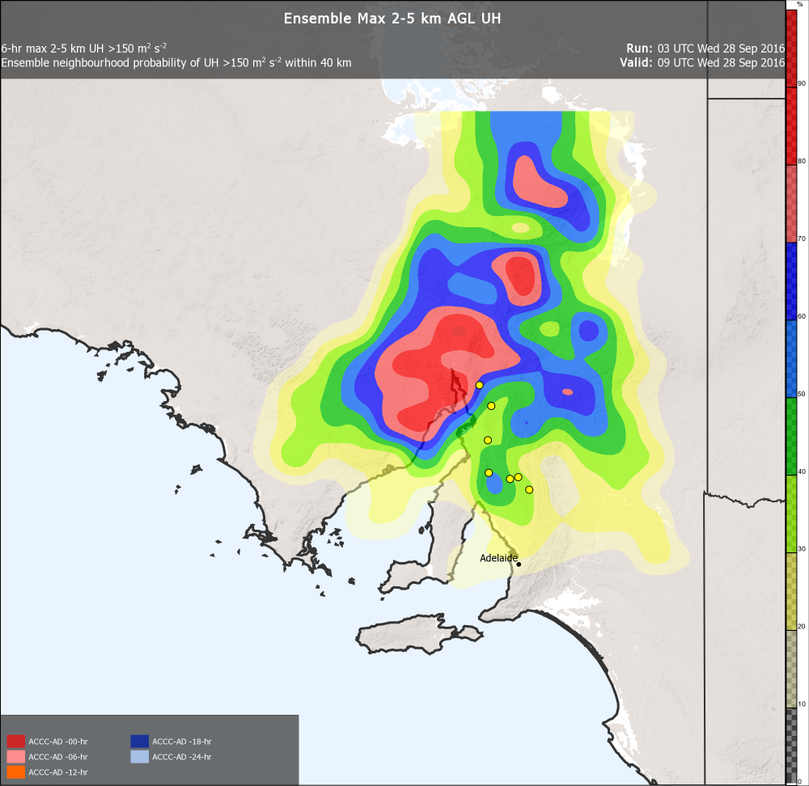
Neighbourhood Maximum Probability
for the 5-member CAM ensemble
Thanks Dean Sgarbossa

Slide 9
Neighbourhood Probabilities
summary of an ensemble CAM forecast for rotating updrafts
no individual member UH information or information on
ensemble distribution of UH magnitude

Slide 10
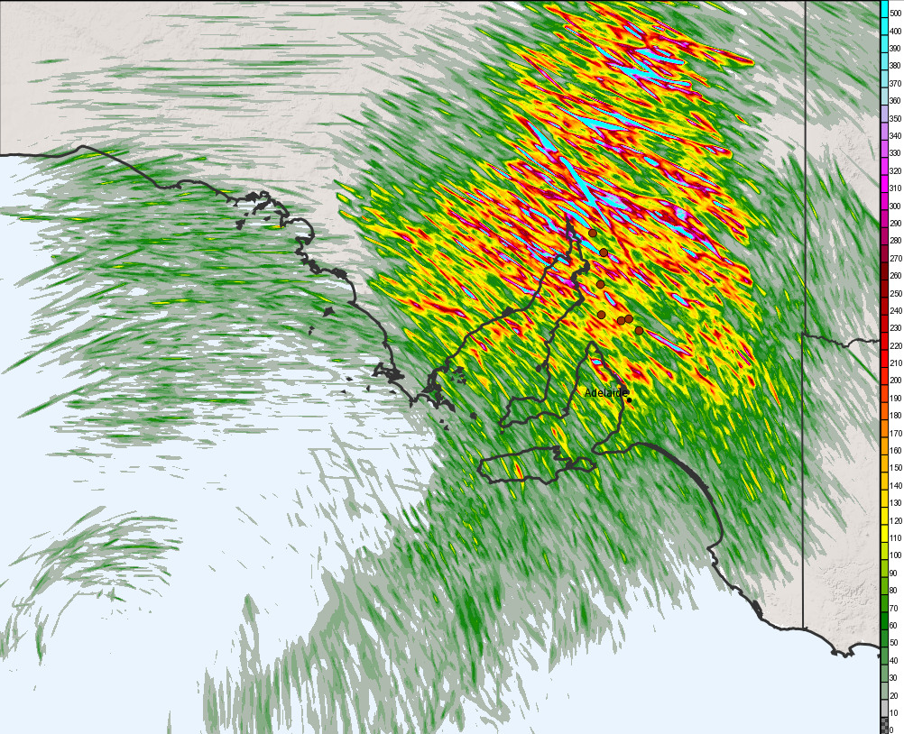
6-hr UH max (3z-9z)

Slide 11
Ensemble Maximum Plots
also aggregates individual member information
the full updraft helicity magnitude ensemble distribution
can be seen
Useful to add probabilistic context through overlaying
neighbourhood probability contours
large UH > 300 m² s⁻² & low (~20%) probabilities →
low probability of a strong rotating storm
large UH > 300 m² s⁻² & higher (≥ 70%) probabilities →
moderately likely strongly rotating supercell

Slide 12
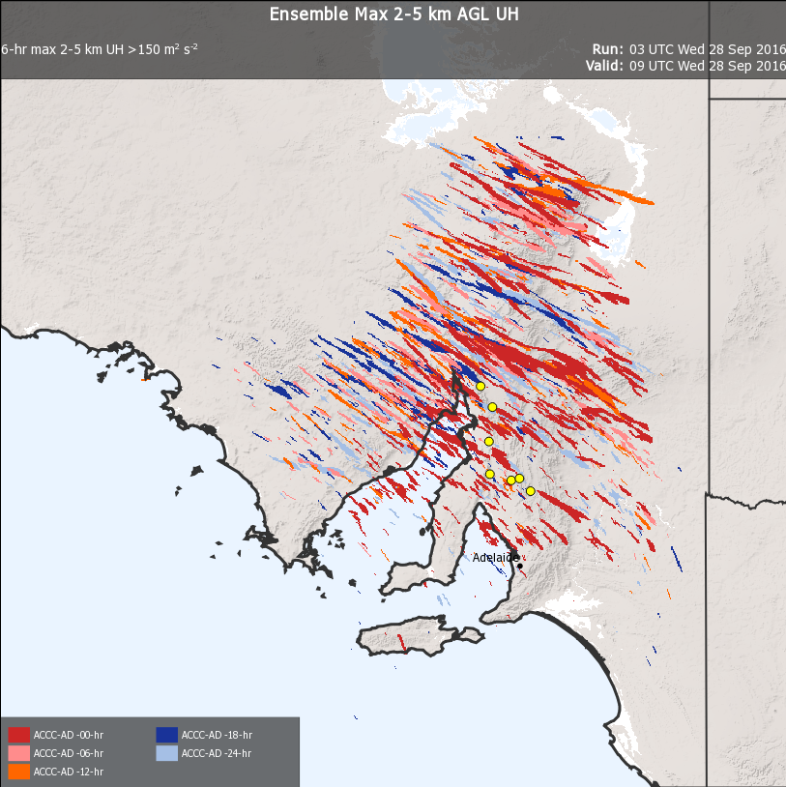
Paintball Plot

Slide 13
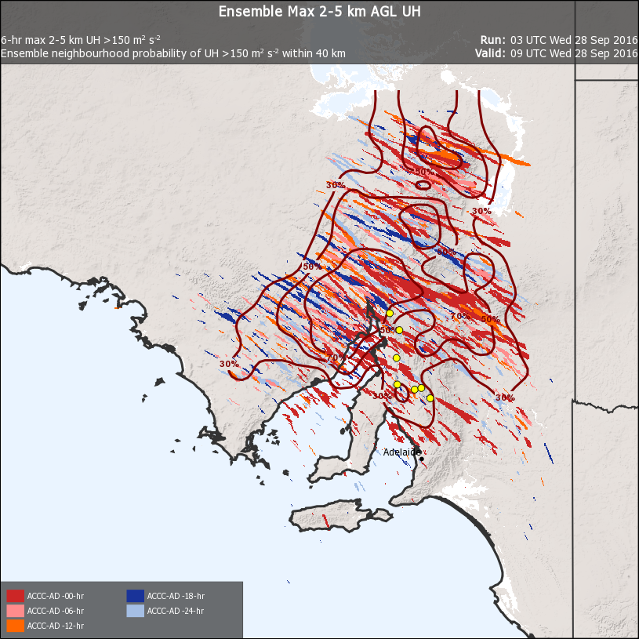

Slide 14
Paintball Plots
Smooth / non-noisy visualization of individual member
information
shows supercell swath length, width and orientation
narrow swaths indicative of discrete supercells; wider swaths
more likely to indicate MCS tracks
Colour choice can be used to subset lagged members and
indicate model time trends

Slide 15
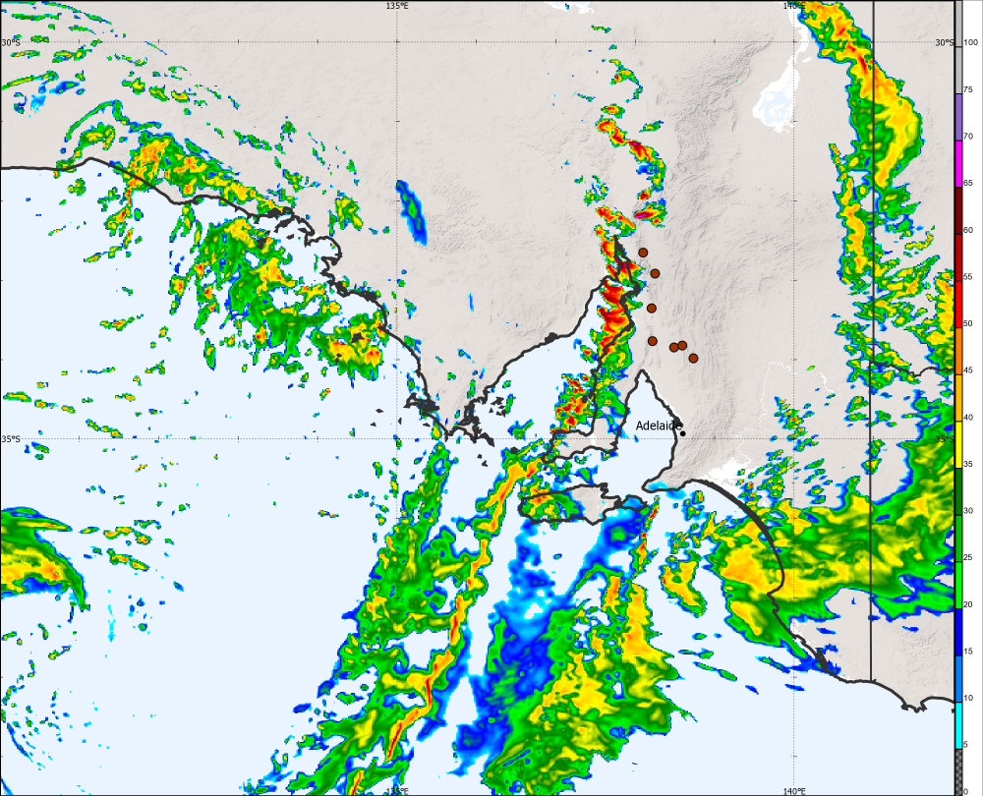
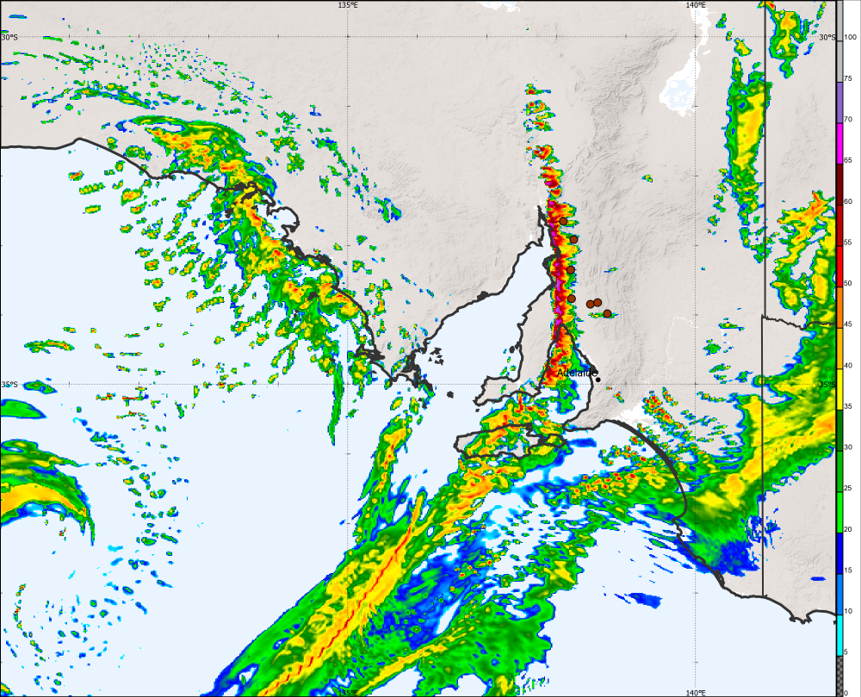
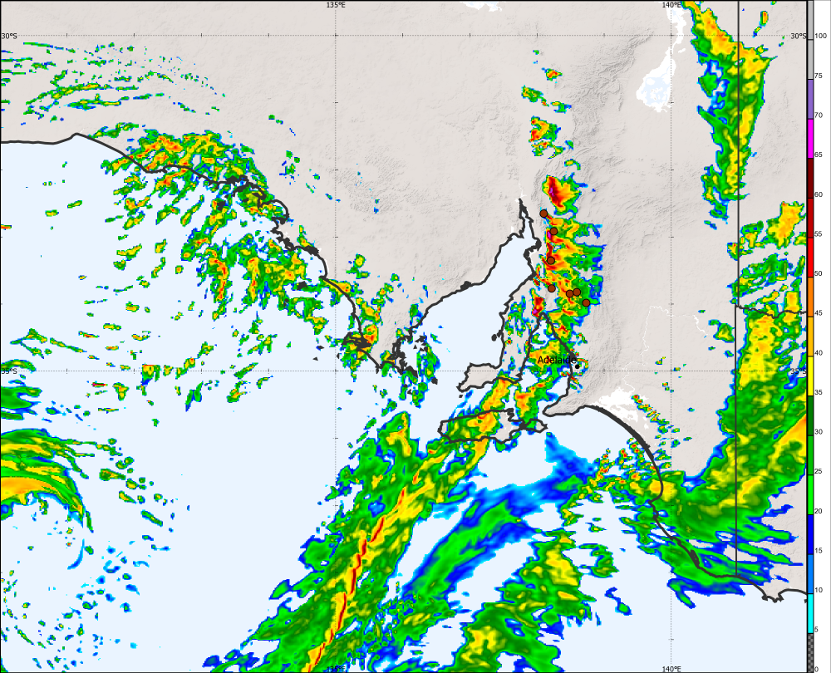
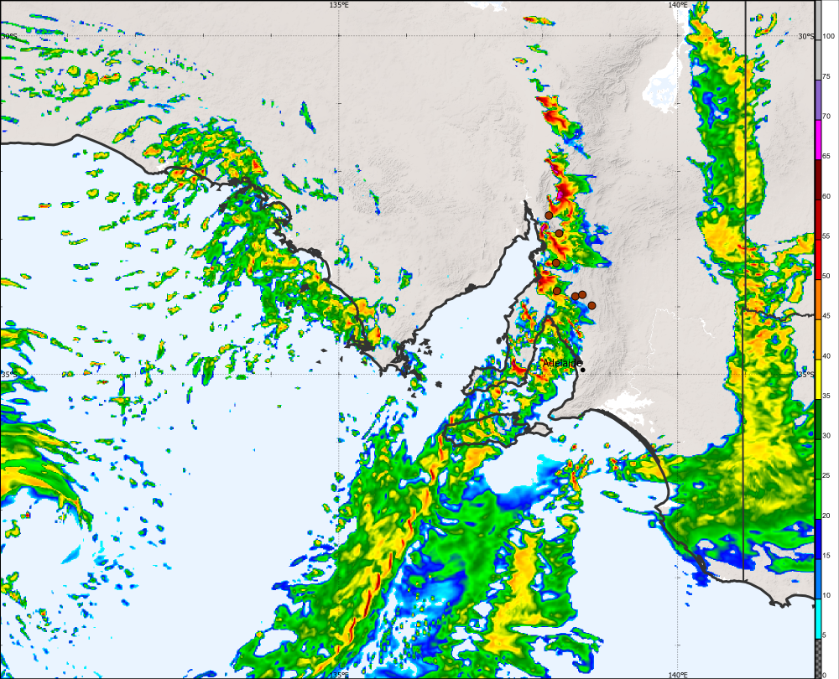
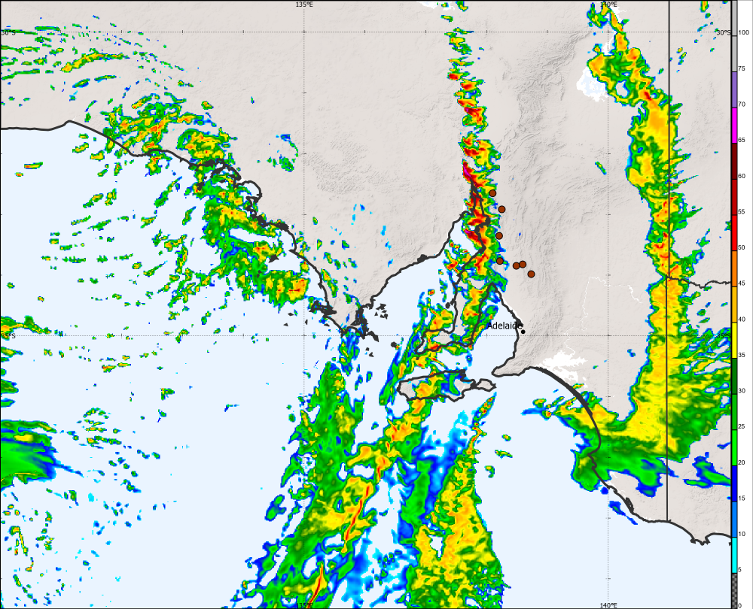
Postage Stamps

Slide 16
Postage Stamps
showing individual members aids in building forecaster’s trust
in the summary fields
allows forecaster to conceptualise a predicted convective
scenario and subsequently assess the plausibility of the individual
member solutions

Slide 17
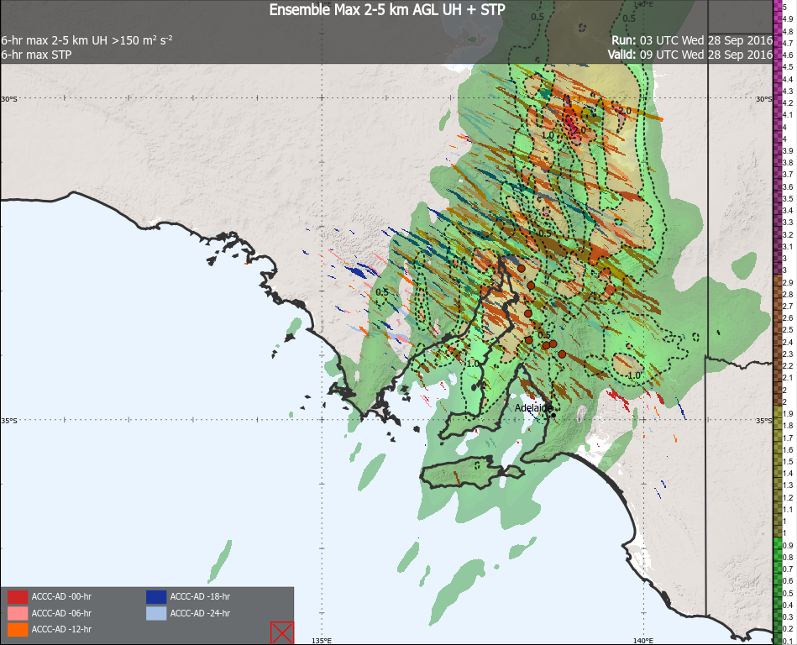
Combine Storm Attribute and
Storm Environment Information

Slide 18
Summary
Model-based convective forecasting is evolving from previous forecasts of storm
environments to useful explicit storm forecasts
Explicit UM model storms can be ‘mined’ for information pertinent to the actual
storm timing, placement, mode and severity through a focus on assorted storm
attributes such as UH or simulated reflectivity
UH and simulated reflectivity from CAM ensembles and be displayed in a range of
ways to provide more summative or more member-specific information

