Slide 1
Challenges in ensemble dispersion modelling of volcanic ash
Chris Lucas
Science to Services/Bureau of Meteorology
Contributors: Meelis Zidikheri, Rod Potts, Mey Manickam

Slide 2
Aims of Volcanic Ash Research
Research in support of operations at Volcanic Ash Advisory Centre (VAAC)
Ultimate goal is to provide users with a 3-D view of the observed and forecast position of the ash cloud
Probabilistic
Quantitative
Required tools
Advanced satellite retrievals
Ensemble NWP
Dispersion modelling
These components need to be integrated

Slide 3
Dispersion Ensemble Prediction System (DEPS)
HYSPLIT dispersion model
(Up to) 28 member ensemble
Bureau ACCESS model (G, R, GE)
US GFS model
ECMWF
Products
24-30 hour forecasts
Probability of mass load above set threshold (0,1,2,4,8 g/m2)
Probability of concentration > 0 g/m3 in selected levels
Mass load of each ensemble member
Model runs on-demand, user initializes from source
The current version only considers the meteorological uncertainty

Slide 4
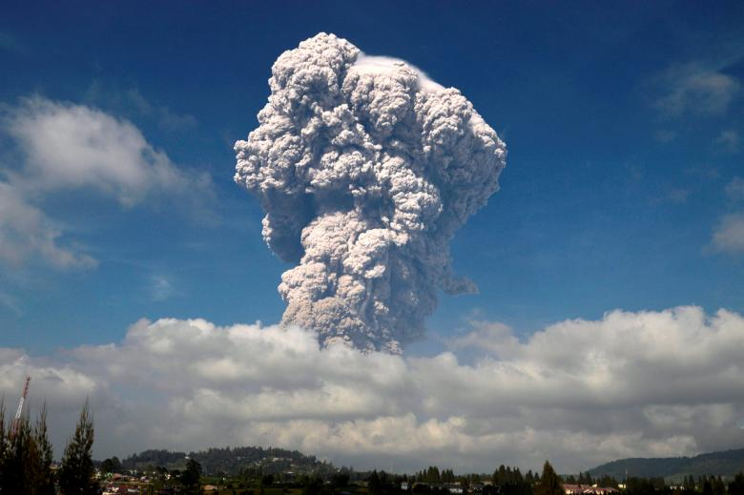
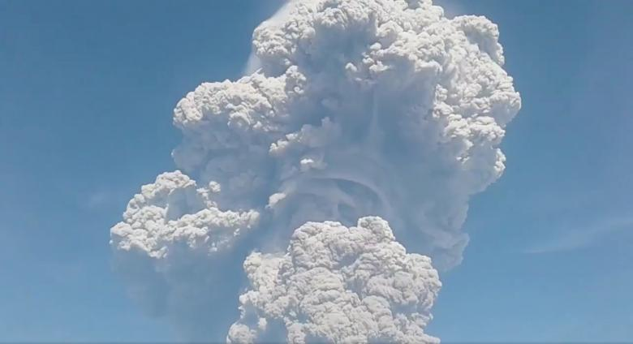
Sinabung -- 19 Feb 2018
Eruption ~0200 UTC/19 Feb, northern Sumatra
In daylight, and relatively convection free (at first)
CALIPSO overpass directly over cloud at 0705 UTC
Complex behaviour and composition of volcanic cloud
Images: Reuters (https://www.reuters.com/news/picture/mount-sinabung-erupts-idUSRTX4XYFN)

Slide 5
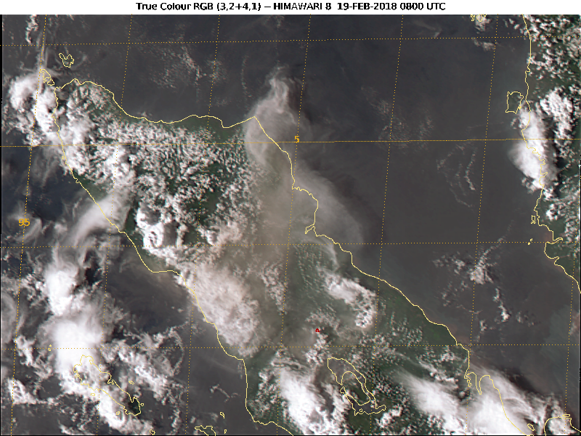
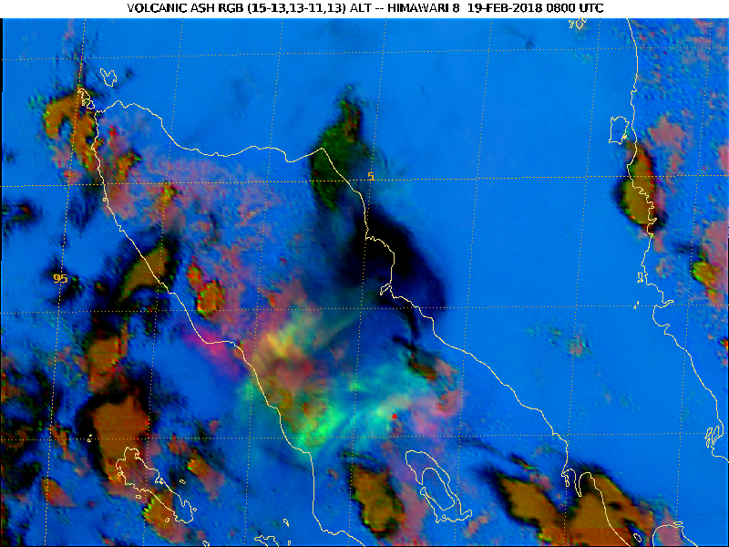
Satellite Imagery (0800 UTC)
Volcanic Ash RGB
Ice/ash mix
'True Colour' RGB
SO2
ash

Slide 6
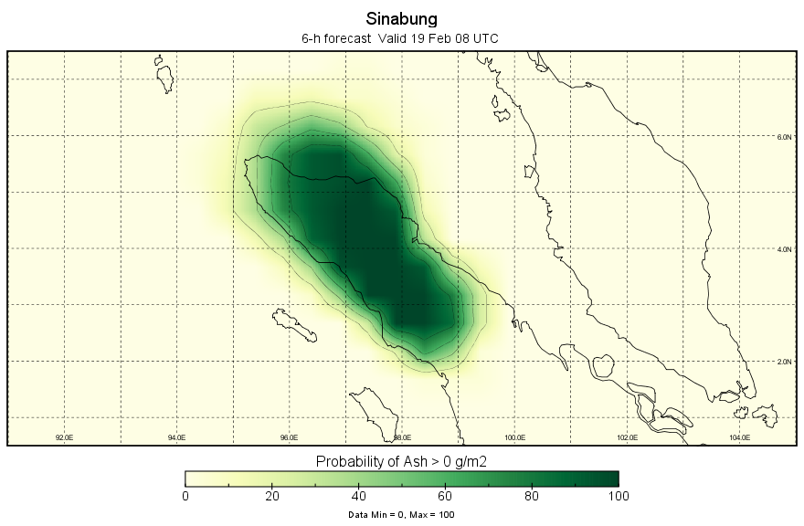
DEPS 6-hr forecast
Ash/No-ash Probability

Slide 7
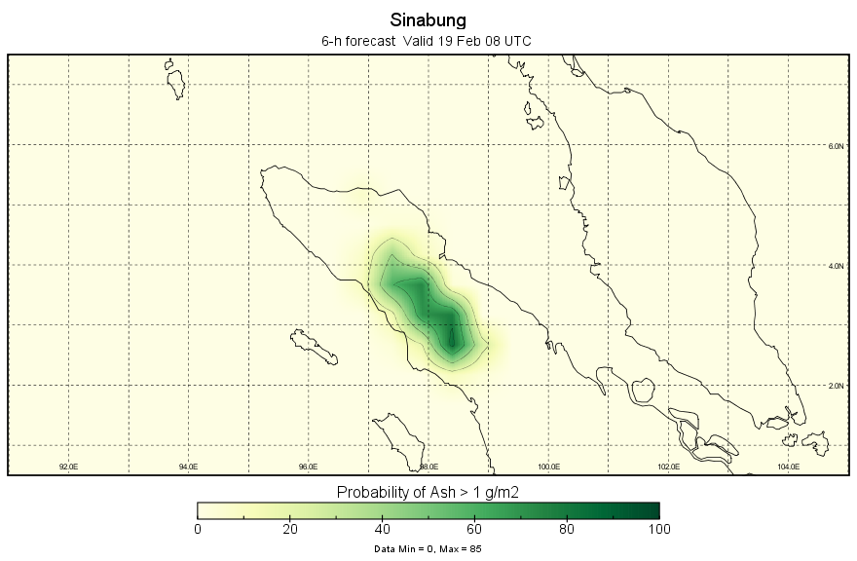
DEPS 6-hr Forecast (2)
Probability of >1 g/m2 ash

Slide 8
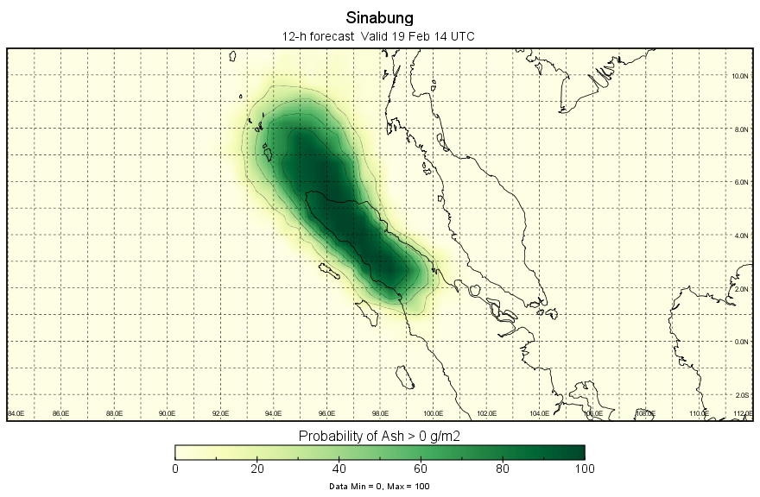
DEPS 12-h forecast
Ash/No-ash Probability

Slide 9
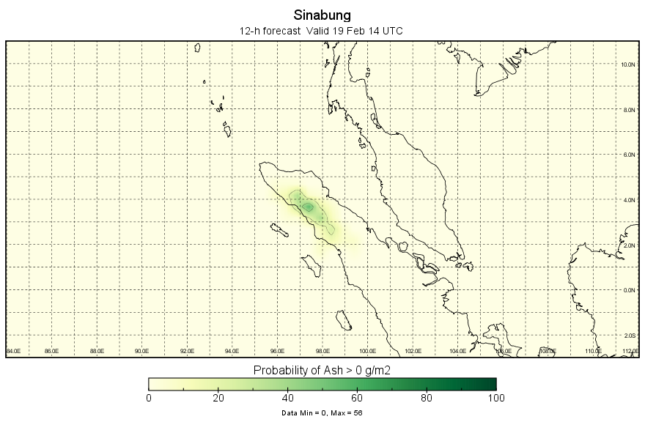
DEPS 12-hr forecast (2)
Probability of >1 g/m2 ash

Slide 10
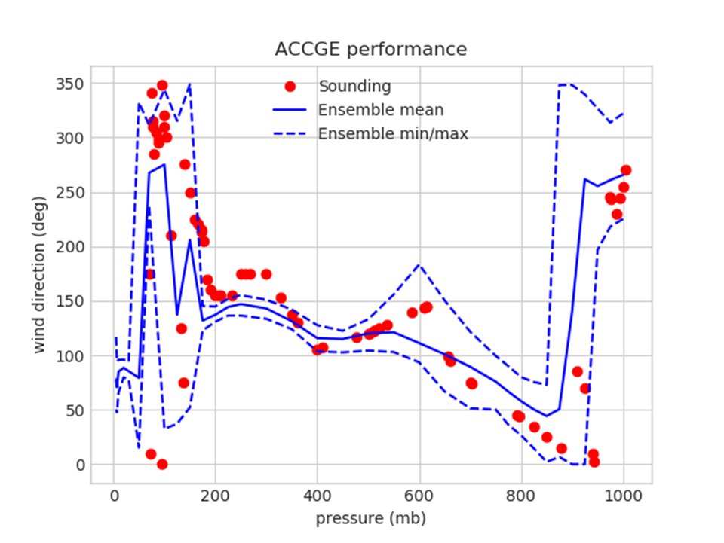
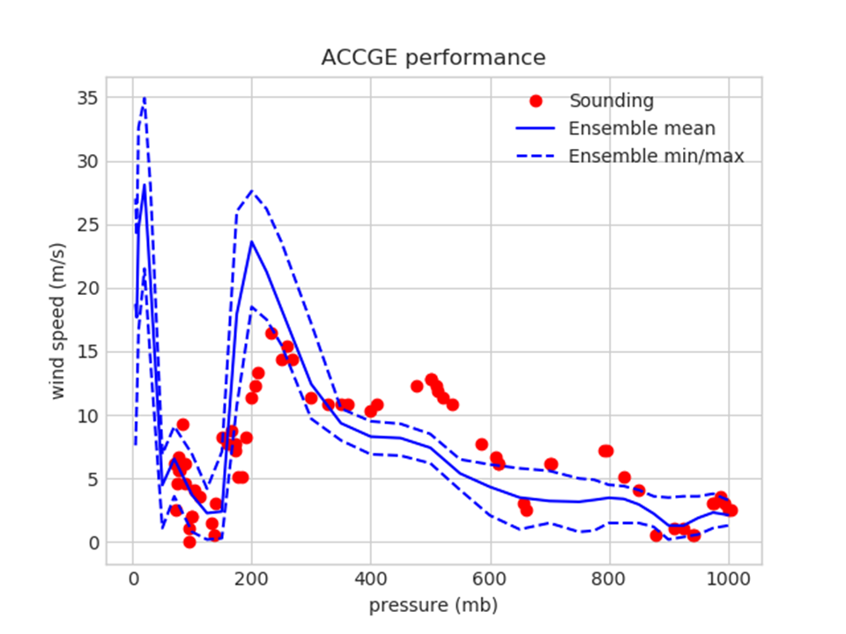
Understanding the forecast shortcomings
NWP data -- biases and/or insufficient spread in ensemble data
Wet deposition – ash off to the west is 'rained out' later in forecast, but not in all members
Choice of data threshold – which is best?
Model initialization – Time, height, type, etc
Model physics – ash fallout, aggregation

Slide 11
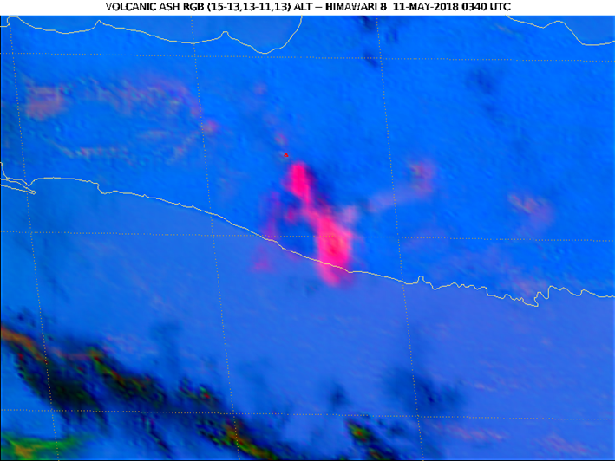
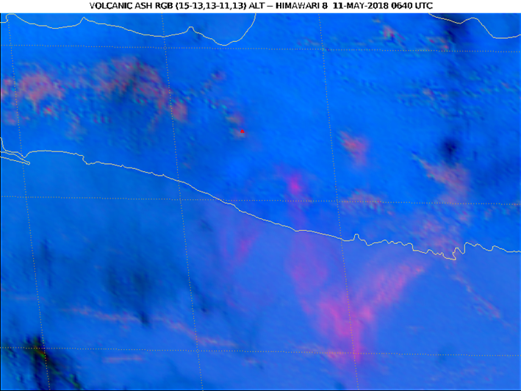
11 May 2018 Merapi eruption
Small eruption in central Java at 0040/11 May
Very clear conditions, good retrieval info
Volcanic Ash RGB shows ash cloud clearly
Heights were difficult to determine
Initial :~14.5 km
Post-analysis: 8-9 km
+3 hrs
+6 hrs

Slide 12
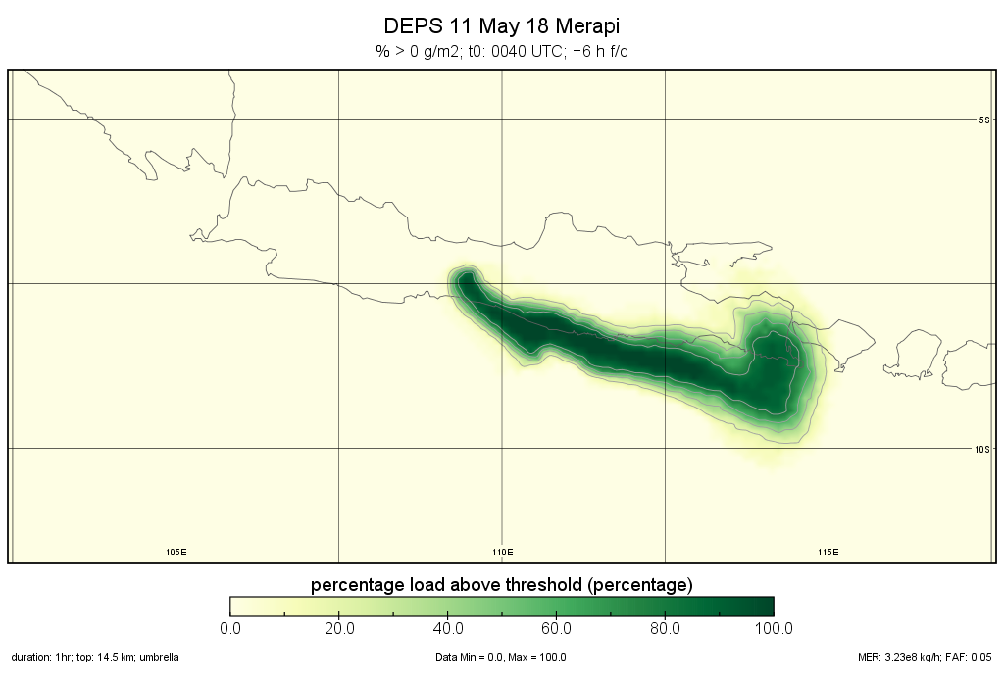
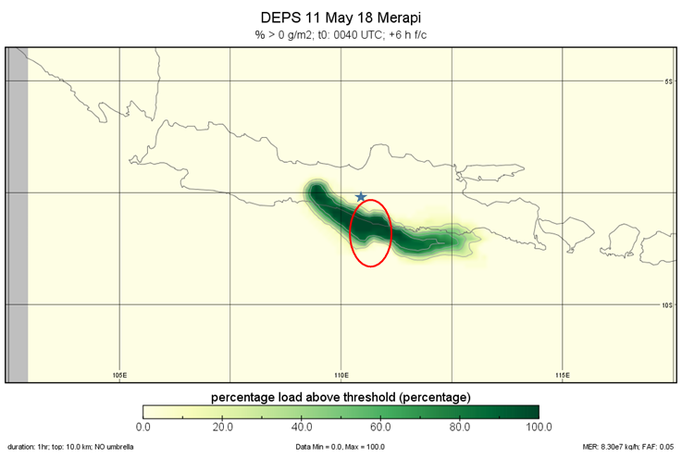
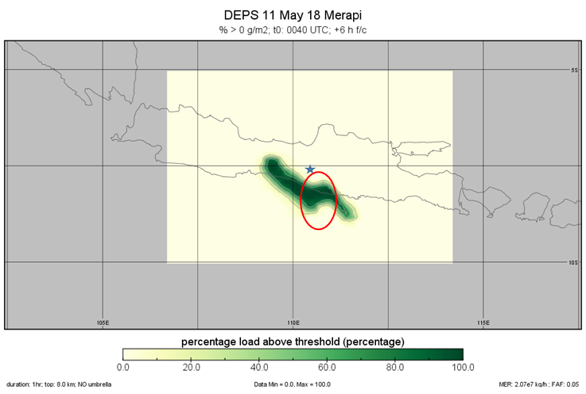
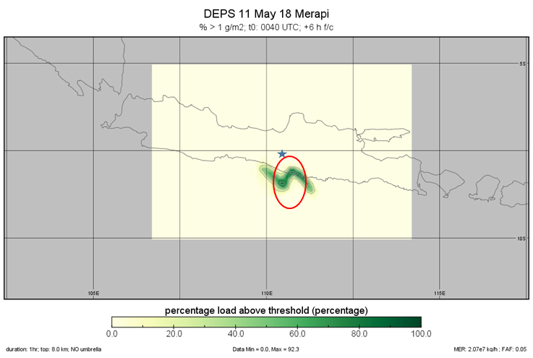
Importance of initialization
14.5 km
10.0 km
8.0 km

Slide 13
Integration of observations with dispersion model
Model uncertainties can be reduced by incorporating observations
Combine observations and multiple simulations to better represent the source term and improve the forecast
See the following for further detail
Zidikheri & Potts (2016): A simple inversion method for determining optimal dispersion model parameters from satellite detections of volcanic sulfur dioxide, JGR
Zidikheri, Lucas, Potts (2017): Estimation of optimal dispersion model source parameters using satellite detections of volcanic ash, JGR
Zidikheri, Lucas, Potts (2017): Toward quantitative forecasts of volcanic ash dispersal: Using satellite retrievals for optimal estimation of source terms. JGR
Zidikheri, Lucas, Potts (2018): Quantitative verification and calibration of volcanic ash ensemble forecasts using satellite data, JGR

Slide 14
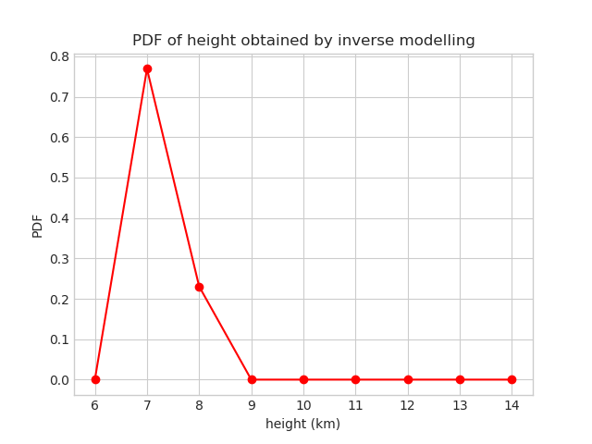
Top height of Merapi eruption plume
By using the inverse approach with the observed VAAC polygons for this case, we can estimate the probable height of the eruption plume.
The model suggests the plume height is between 7 and 8 km

Slide 15
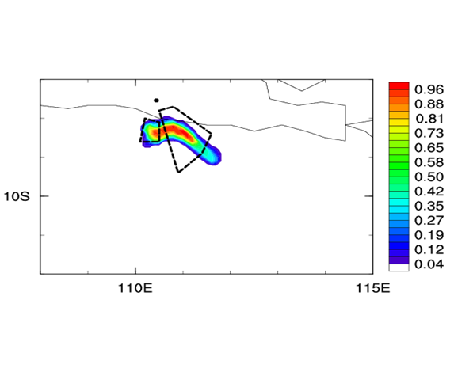
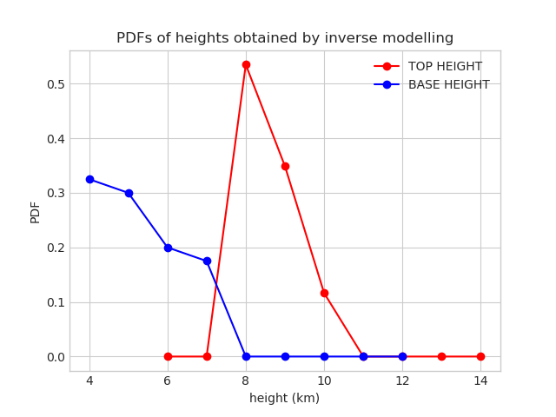
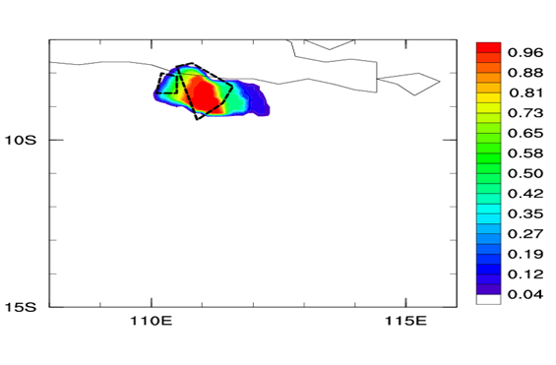
Distal Ash Initialization
The model is initialised from observations, not necessarily in the vicinity of the volcano
Need to combine with inverse modelling to estimate the top and bottom of ash cloud
Source term initialization @0040
Distal Ash initialization @ 0400 UTC
Cloud top 8-9 km and cloud base 4-5 km (or less)

Slide 16
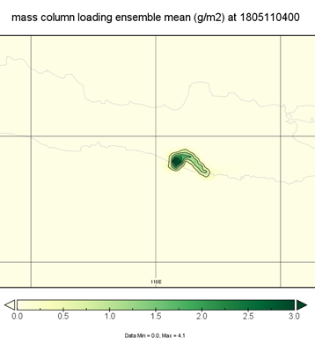
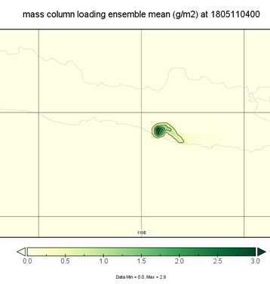
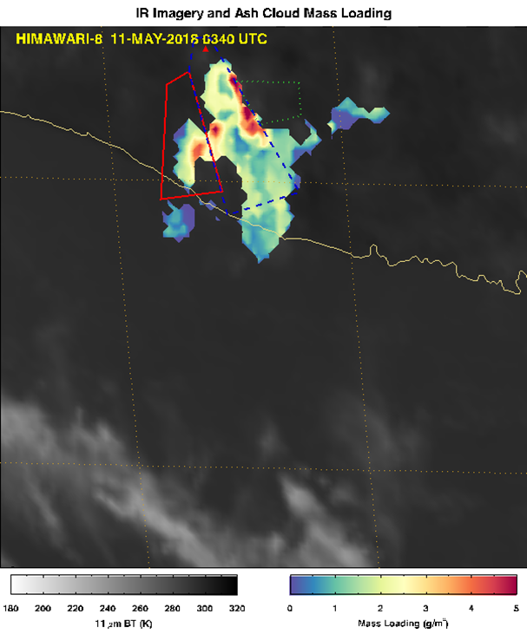
Quantitative Estimates
Use satellite retrievals to optimize source term
Several approaches being developed
Multidimensional optimization
Empirical parameterization
Both methods greatly reduce the amount of ash carried compared to 'standard run'
Can also combine with distal ash initialization
Challenging to estimate errors associated with satellite retrievals
multidimensional
empirical
Peak ML 4.1 g/m2
Peak ML 2.9 g/m2

Slide 17
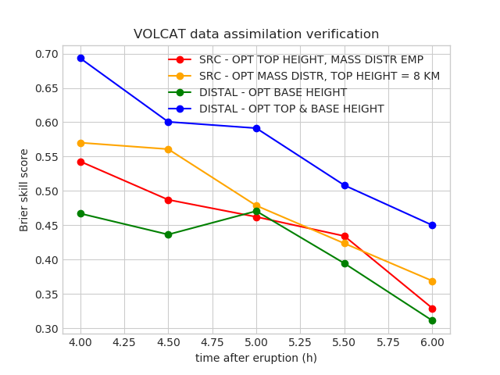
Incorporating observations improves forecasts
Better Skill
This aspect remains work in progress. The aim is to have a prototype system for inverse modelling by the end of current project (June 2019)

Slide 18
Summary
Many challenges remain along the road to producing real-time quantitative, probabilistic forecasts of volcanic ash
Better NWP
Better Initialization (both distal and better source term)
Careful interpretation of the results
Incorporating observations into the forecasting process shows promise
Observations of position
Quantitative ash retrievals from satellite (where available)
Combining observations and modelling potentially allows for an understanding of the 3-D structure of ash clouds that is otherwise unavailable

Slide 19
Thank you
chris.lucas@bom.gov.au

