Slide 1
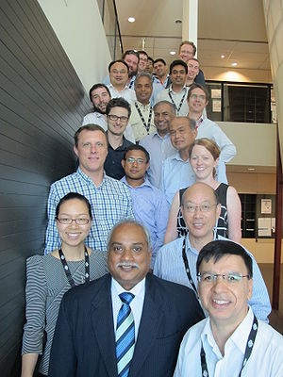
Evaluation of NWP rainfall forecasts for
7-day ensemble flow forecasting service
Dr. Sophie Zhang
Water Forecasting Services – Bureau of Meteorology
27 November 2018, Bureau R&D Workshop
Prasantha Hapuarachchi Aynul Kabir
Mohammed Hasan
Mohammed Bari
Sophie Zhang
Narendra Tuteja
Jayaratne Liyanage
Nilantha Gamage
David Robertsen (CSIRO)
James Bennett (CSIRO)

Slide 2
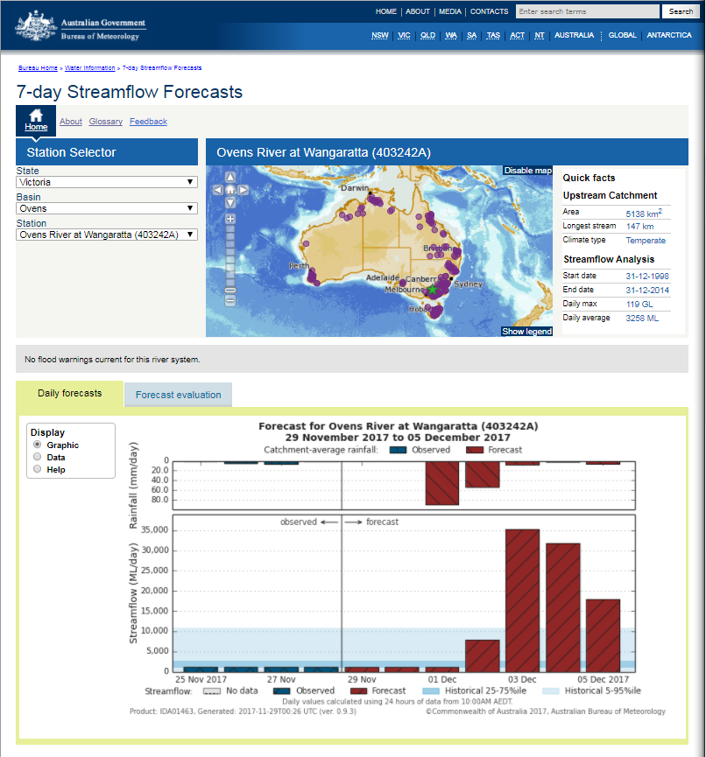
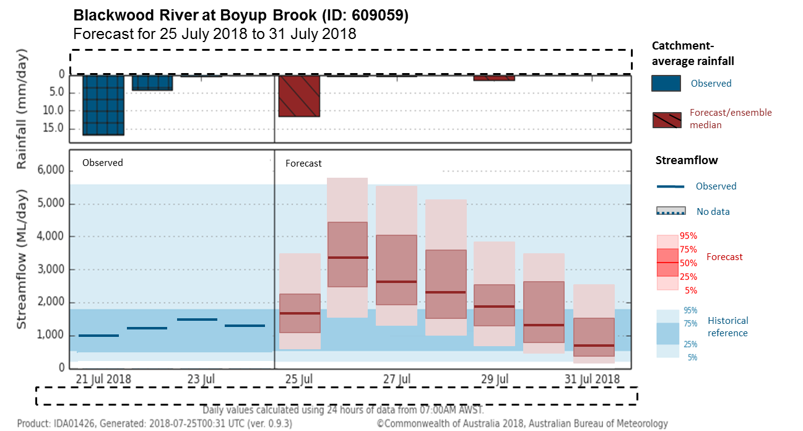
Service Development – 7day streamflow forecasts
Current deterministic forecasts
Numbers of
Forecast locations:
 | Public | Regd. users
TAS | 22 | 24
WA | 25 | 28
SA | 3 | 4
NT | 14 | 16
VIC | 34 | 43
NSW | 38 | 56
QLD | 32 | 38
Total | 168 | 209
Ensemble forecasts in development
http://www.bom.gov.au/water/7daystreamflow

Slide 3
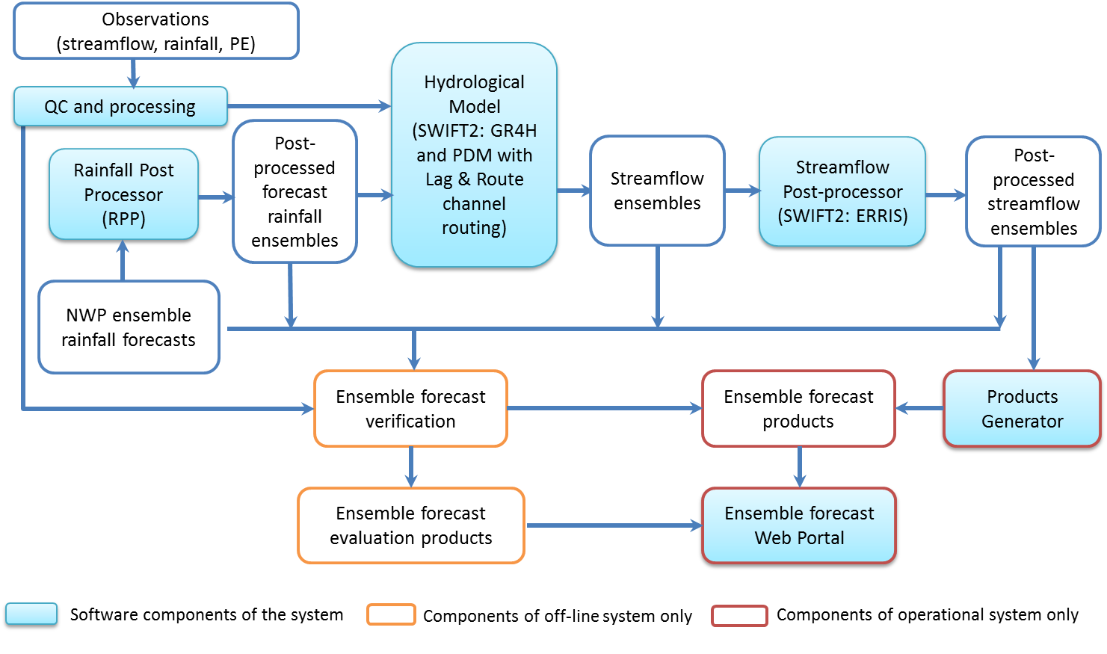
Workflow and Evaluation methodology
Data period (overlapping):
2014 – 2016 (3 years)
Rainfall/Flow evaluation:
with and without
post-processing
Temporal resolution:
daily
Metrics:
Bias, CRPS, KS-D
Corrected Flow
Raw Flow
RPP Rain
Rainfall products:
ACCESS-G
ACCESS-GE2 (24 ens)
PME
ECMWF (50 ens)
Raw Rain

Slide 4
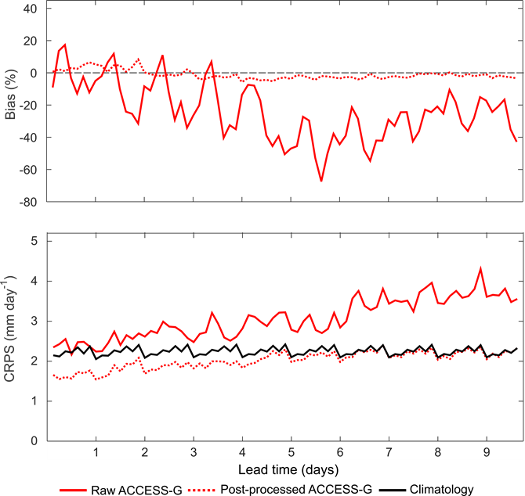
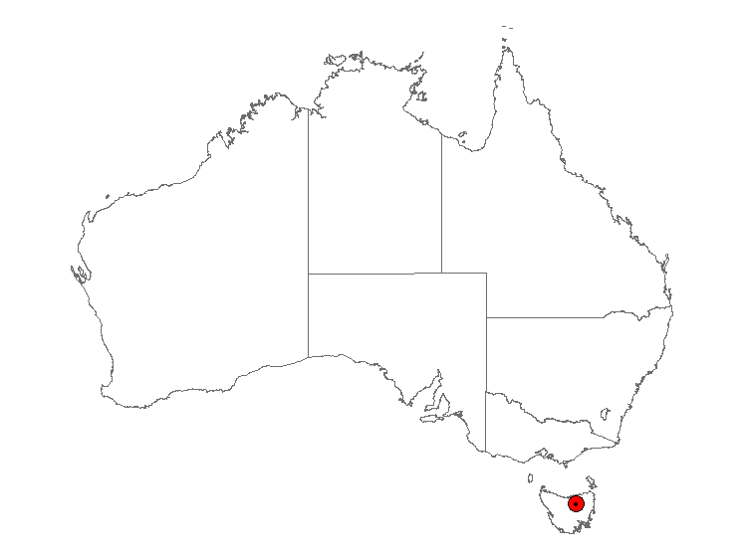
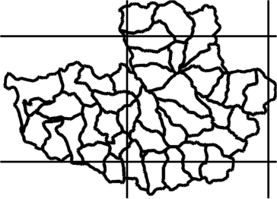
Rainfall post-processing *Robertson et al. (2013); Shreshtha et al. (2013)
Observations
Raw ACCESS-G
Post-processed ACCESS-G

Slide 5
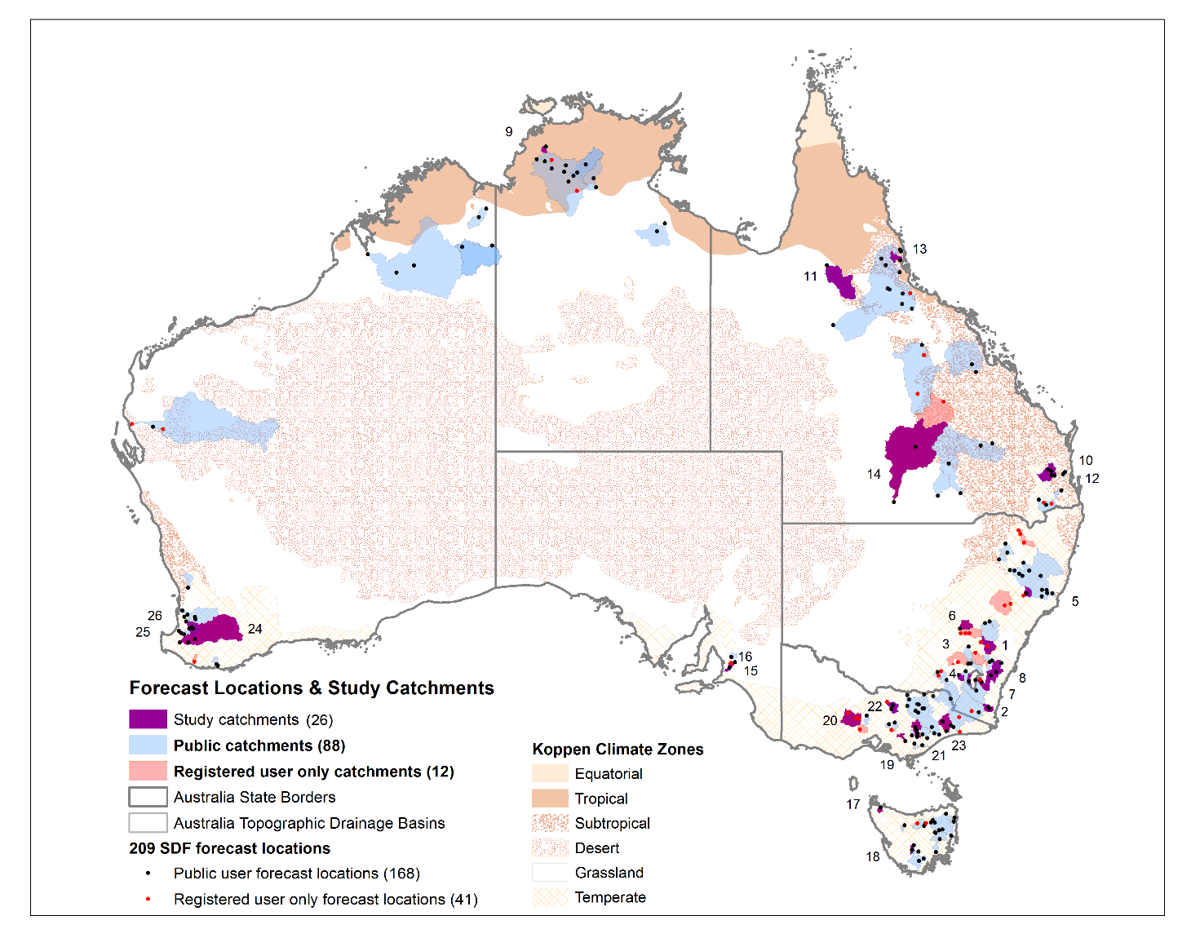
26 Study Catchments
No | Region | Catchment | Area (km²) | Site Name (Outlet)
1 | NSW | Abercrombie | 2632 | Abercrombie River at Abercrombie No.2
2 | NSW | Bega | 316 | Bemboka River at Morans Crossing
3 | NSW; ACT | Cotter | 130 | Cotter River at Gingera
4 | NSW | Goobarragandra | 668 | Goobarragandra River at Lacmalac
5 | NSW | Hunter | 1189 | Hunter River at Belltrees
6 | NSW | Mandagery | 1697 | Mandagery Creek at Eugowra Smithfield
7 | NSW; ACT | Queanbeyan | 906 | Queanbeyan River at Wickerslack
8 | NSW | Shaolheaven | 4660 | Shoalhaven River at Fossickers Flat
9 | NT | Adelaide | 638 | Adelaide River at Railway Bridge
10 | QLD | Brisbane | 3875 | Brisbane River at Gregor Creek
11 | QLD | Gilbert | 11537 | Gilbert River at Rockfields
12 | QLD | Stanley | 246 | Stanley River at Woodford Alert-B
13 | QLD | Tully | 1388 | Tully River at Euramo
14 | QLD | Warrego | 44786 | Warrego River at Cunnamulla Weir
15 | SA | Onkaparinga | 224 | Onkaparinga D/S Hahndorf Creek
16 | SA | Torrens | 347 | Torrens River at Gorge Weir
17 | TAS | Duck | 347 | Duck River at Scotchtown
18 | TAS | Florentine | 445 | Florentine River above Derwent River
19 | VIC | Latrobe | 558 | Latrobe River at Willow Grove
20 | VIC | Loddon | 1029 | Loddon River at Newstead
21 | VIC | Macalister | 1903 | Macalister River D/S Lake Glenmaggie
22 | VIC | Seven Creeks | 1519 | Seven Creeks at Kialla West
23 | VIC | Tambo | 2676 | Tambo River D/S Ramrod Creek
24 | WA | Blackwood | 19201 | Blackwood River at Nannup
25 | WA | Collie | 1328 | Collie River East at Coolangatta Farm
26 | WA | Mcknoes | 27 | McKnoes Brook at Urquharts

Slide 6
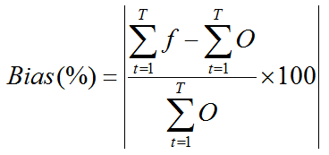
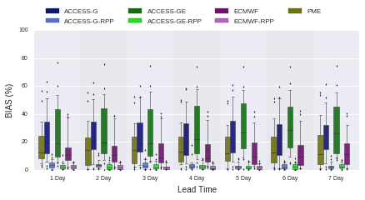
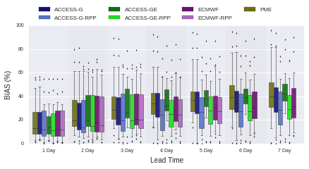

Evaluation: bias (%)
Raw and post-processed rainfall
post-processed streamflow

Slide 7
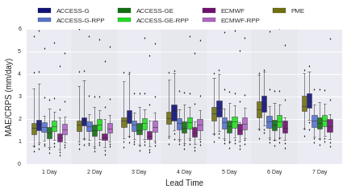
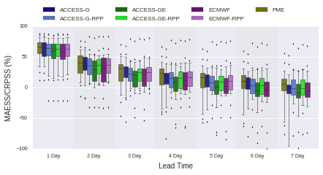
Evaluation: skill MAE/ CRPS (mm/day)
Raw and post-processed rainfall
post-processed streamflow

Slide 8
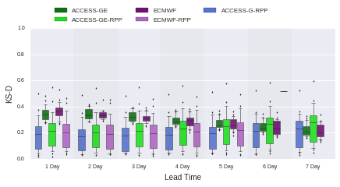
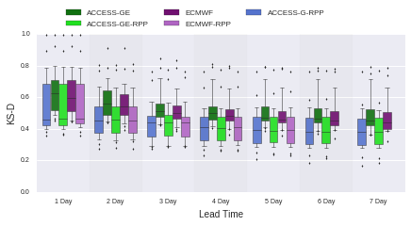
Evaluation: reliability (KS-D)
Raw and post-processed rainfall
post-processed streamflow

Slide 9
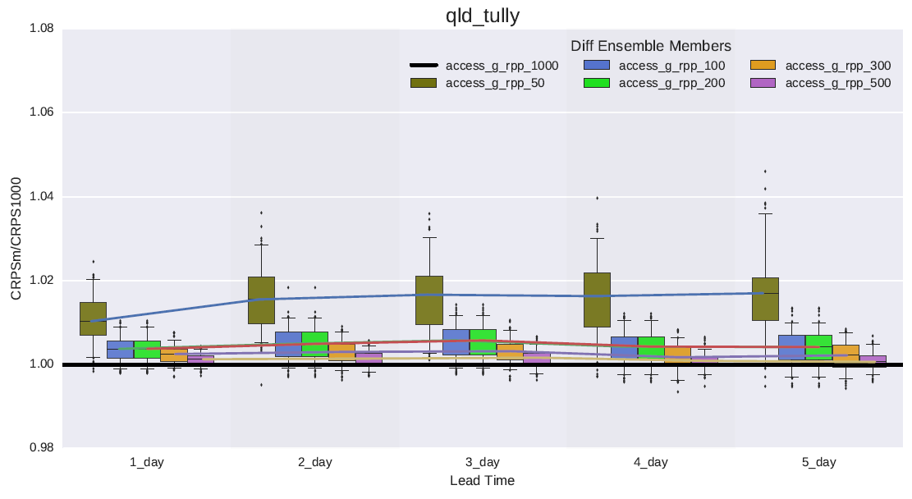
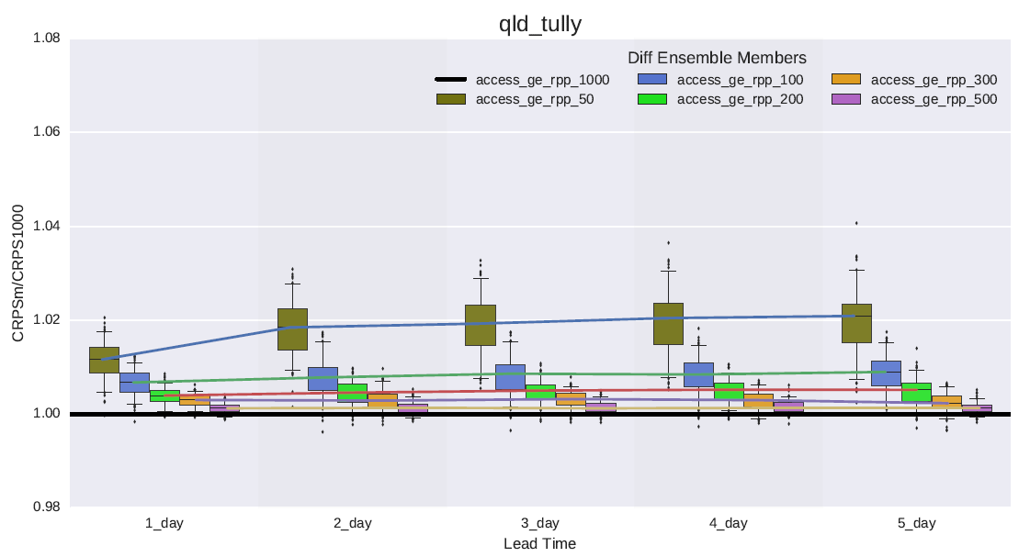
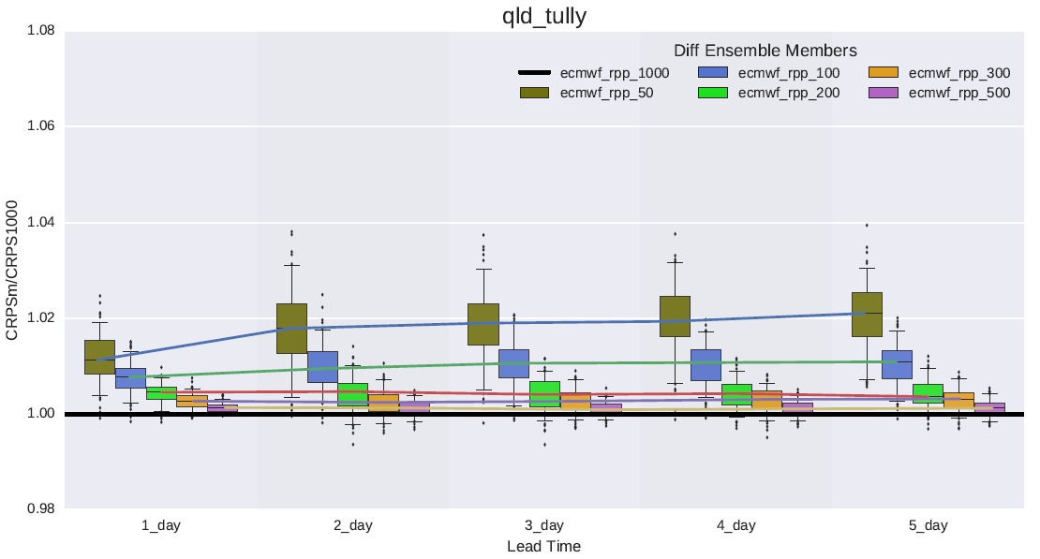
Investigation of optimal ensemble number
200 ensemble size
Notes:
VAT has two components – built in HyFS + Python scripts

Slide 10
Summary: rainfall forecasts
Metric | Raw forecasts | Post processed
Bias (%) | ECMWF forecasts are relatively less biased, followed by PME. | Significantly reduced biases across all catchments at all lead-times.
CRPS (mm/day) | Increases with the lead-time. | Improves ACCESS-G rainfall forecasts, but no notable improvement in ECMWF and ACCESS-GE.
Reliability (KS-D) | Slightly improves with the lead-time. | Significant improvement compared to raw rainfall.

Slide 11
Summary: streamflow forecasts
Metric | Raw forecasts | Post processed
Bias (%) | Largely variable from catchment to catchment. Post-processed rainfall produces streamflow with slightly lower bias. | Significantly reduced biases at short lead-times and the effect declines with lead-time.
CRPS (mm/day) | Post-processed rainfall driven streamflow is slightly improved and found to be consistent. | Improves significantly at shorter lead-times and noticeable improvements up to 6 days.
Reliability (KS-D) | Improves for all rainfall products with the lead-time. Post-processed rainfall driven streamflow is slightly better. | Improves for all rainfall products with lead-time. Post-processed rainfall driven streamflow is significantly better.

Slide 12
Outcomes
Raw forecast rainfall forecast performance order (ECMWF, ACCESS-GE, PME, ACCESS-G)
Both rainfall and streamflow post processing are required for the operational system
200 ensembles of each NWP rainfall forecasts recommended for operational service
Super ensemble comprised of 401 members are now planned for operational implementation
200 post processed ECMWF rainfall forecasts
200 post processed ACCESS-GE2 rainfall forecasts
PME deterministic forecasts (mean of NWP models available to Bureau)

Slide 13
Thank you
Questions?
Notes:
Photo: Eildon spillway(Alison Pouliot)

