Slide 1
Single-Valued Forecasts in an Ensemble World
Michael Foley and Nick Loveday
Forecast Systems Team
Bureau of Meteorology

Slide 2
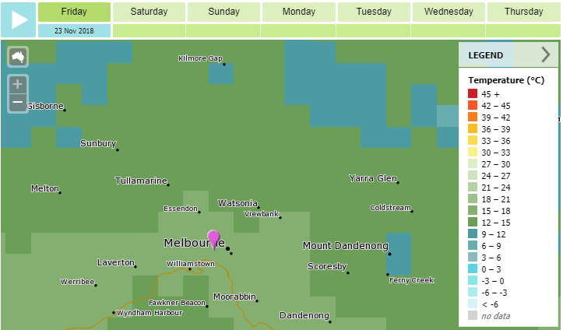
What's the Temperature Going to Be?

Slide 3
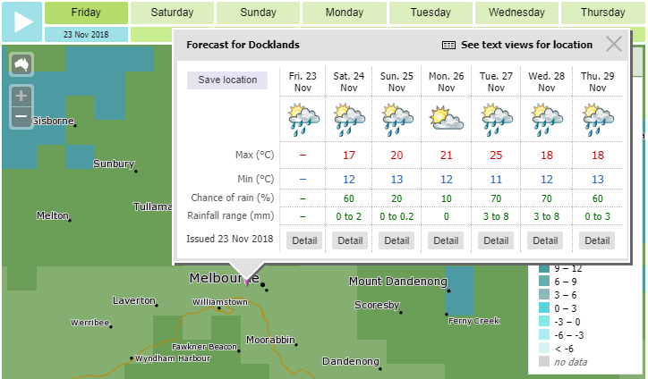
What's the Temperature Going to Be?
single
value

Slide 4
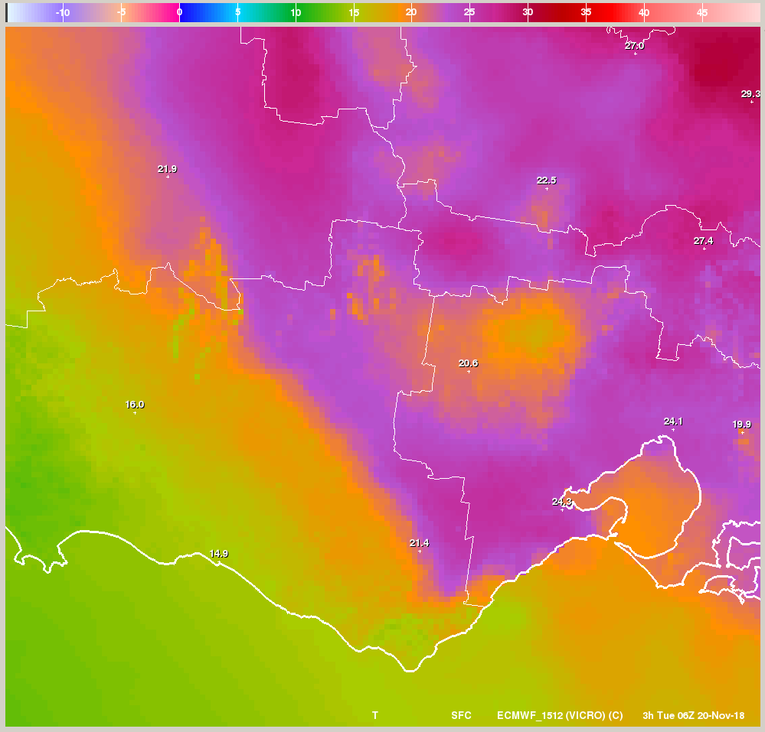
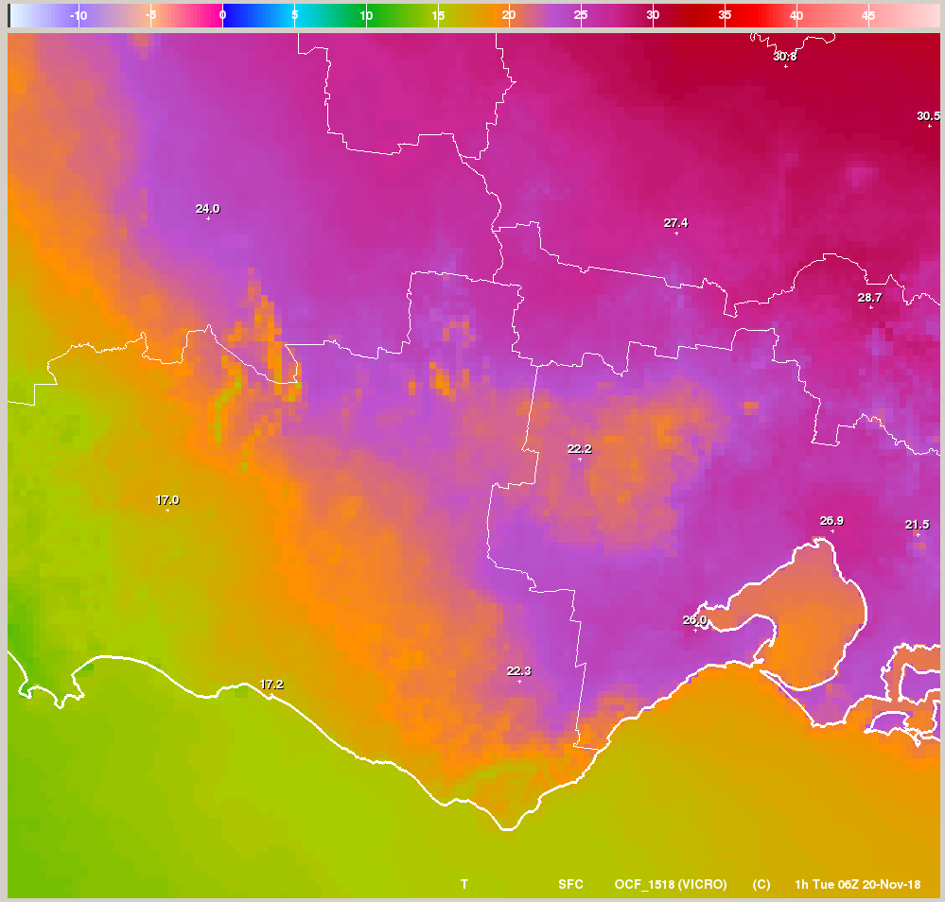
What Should a Single-Valued Forecast Look Like?
Single Scenario
Consensus
cold front
Day +4 screen-level temperature at 5pm

Slide 5



How Valuable is a Forecast System?
Event which requires decision e.g. Temperature exceeding 35°C
Expenses:
cost is the expense of protecting against the event
loss is the expense if unprotected event occurs
Determine Relative Economic Value of forecasts $V$is a function of $\frac{\text{cost}}{\text{loss}}$.
$$V= \frac{\text{climatological} \text{expense} − \text{expense} \text{with} \text{forecast}}{\text{climatological} \text{expense} − \text{expense} \text{with} \text{perfect} \text{forecast}}$$

Slide 6
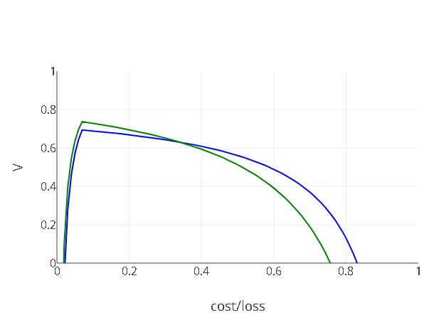
Will Temperature Exceed 35°C at 5pm (+36 h)?
ACCESS-R better
OCF better
Single Scenario | Consensus
ACCESS-R deterministic NWP | OCF bias-corrected poor man's ensemble
Data for 200 stations across southern Australia, last 3 summers

Slide 7

Difference in Value for Two Forecast Systems
$$∆V∝(1−\frac{\text{cost}}{\text{loss}})∆h −\frac{\text{cost}}{\text{loss}}∆f$$
(user)
number of hits (forecasts & obs)
number of false alarms (forecasts & obs)

Slide 8
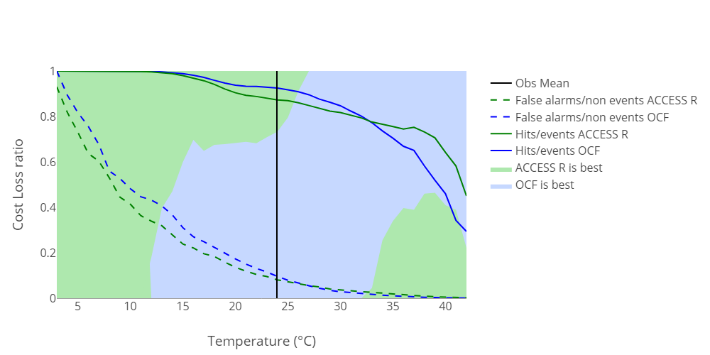
OCF/ACCESS-R Value Comparison
Temperature at 5pm (+36 h)
Best for all
Data for 200 stations across southern Australia, last 3 summers

Slide 9
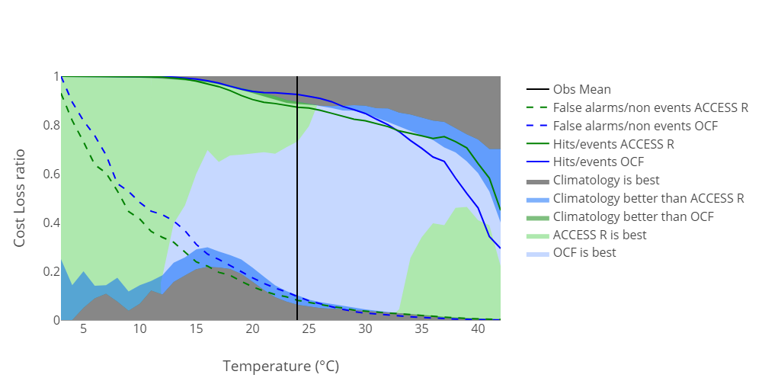
OCF/ACCESS-R/Climatology Value Comparison

Slide 10
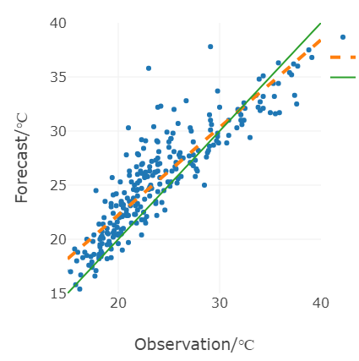


Linear Model of Error Characteristics
$$y= λ x+δ$$
$$y= x$$
Scale parameter 𝜆 relates to conditional bias
Displacement δ relates to unconditional bias β
Standard deviation 𝜎 relates to random error spread
5 pm Temperatures for Melbourne (Olympic Park), last 3 summers

Slide 11
Characteristics of Linear Model
Single Scenario | Consensus
Could have less conditional bias | Minimizes random errors
𝜆 nearer 1 | 𝜎 smaller

Slide 12
Characteristics of Linear Model
Single Scenario | Consensus
Could have less conditional bias | Minimizes random errors
𝜆 nearer 1 | 𝜎 smaller
 | 𝜎 | 𝜆 | β
ACCESS-R | 2.38 | 0.935 | -0.193
OCF | 1.96 | 0.905 | 0.086
Temperature at 5pm (+36 h)
Data for 200 stations across southern Australia, last 3 summers

Slide 13

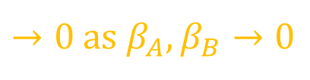
Theoretical Value Relationship For Systems $A$ and $B$
Assuming:
relative economic value
linear error model
Gaussian random errors
for the 'best for all' threshold $\overline{x}+\frac{β_{A}σ_{B}−β_{B}σ_{A}}{\left(1−λ_{A}\right)σ_{B}−\left(1−λ_{B}\right)σ_{A}}$
forecasts from $A$ are more valuable than from $B$for all $\frac{\text{cost}}{\text{loss}}$ if $$\frac{σ_{A}}{λ_{A}}<\frac{σ_{B}}{λ_{B}}$$
$→0$ as $β_{A},β_{B}→0$

Slide 14
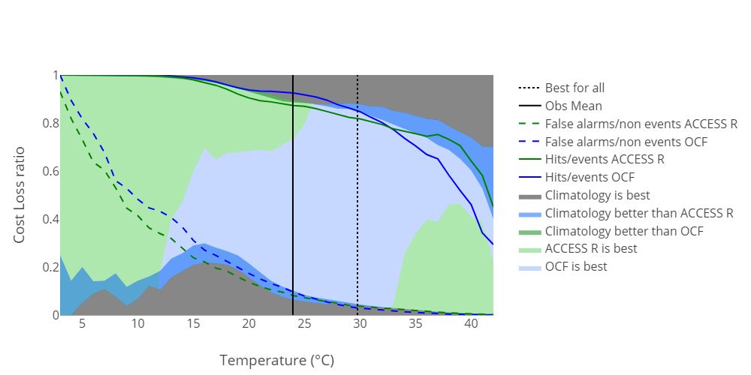
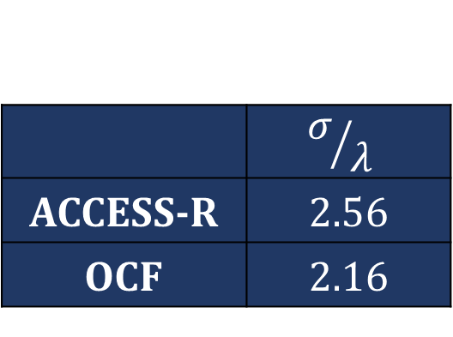
Insights
Consensus best for all due to smaller random errors
 | $${\text{σ}}/{\text{λ} }$$
ACCESS-R | 2.56
OCF | 2.16
Deterministic NWP better due to less conditional bias
fewer false alarms ⇐
⇒ more hits

Slide 15
So What?
Bias-corrected consensus gives best general single-valued forecast service for average conditions
For extremes, best single valued service depends on user sensitivity
more impetus for probabilistic service (e.g. chance of exceeding 35°C)
Address conditional biases in
post-processing
forecaster intervention

Slide 16
Thank you
Michael Foley
michael.foley@bom.gov.au

