Slide 1
Ensemble NWP Verification
Chris Bridge
BoM

Slide 2
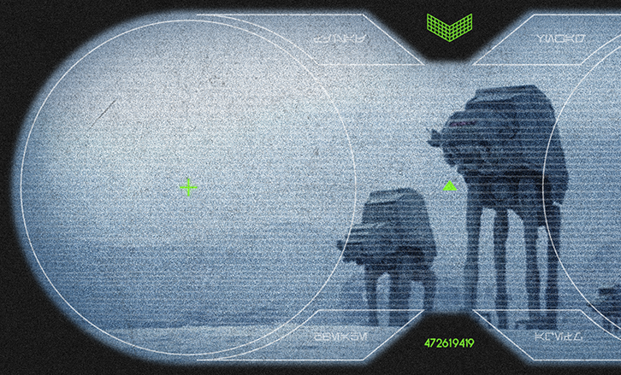
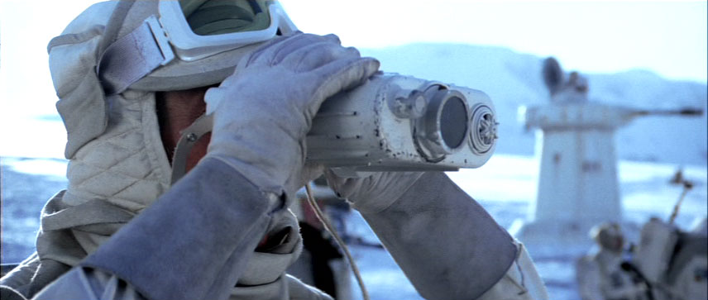
They’re coming…
NWP ensembles (EPS) are coming to the Bureau!
GE3
CE3
Notes:
Bureau – the Access NWP ensembles are not the first operational EPSs in the Bureau but they will be the first operational NWP EPSs

Slide 3
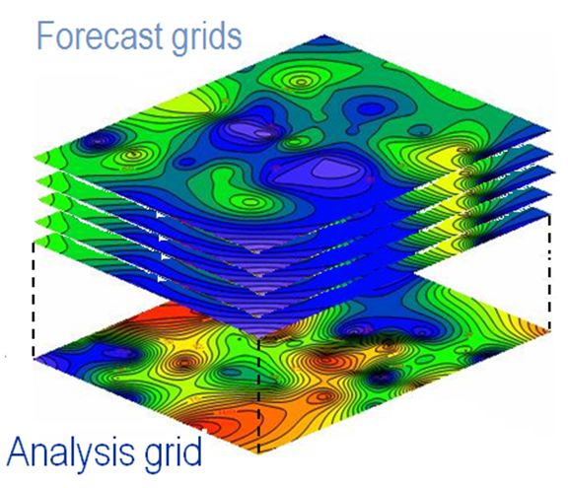
EPS Verification
Getting started
Can we go further?
fcsts
obs
T (ºC)
Notes:
Objective vs subjective

Slide 4
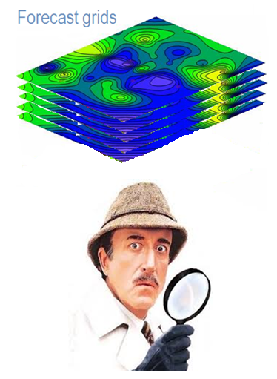
EPS Verification
Getting started
Can we go further?

Slide 5
Getting started: GE3
GE3 needs to be verified:
during development;
during operational trials;
once operational
To meet these aims we used WMO verification specifications.
To meet WMO reporting commitments.
Mature set of EPS verification measures
To enable comparisons with other EPS centres
Notes:
Verif against model's own analysis for almost all parameters.
Mention the kishou web site.

Slide 6
Getting started: WMO verification
Deterministic
measures
Probabilistic
measures
Anomaly correlation coefficient
Reliability diagram
Brier (skill) score
RMS error
(& ensemble spread)
Relative economic value
Relative operating characteristic
Continuous ranked probability score (CRPS)
Notes:
Mike mentions single-value
Mike's REV is the most interesting – move from forecast quality to value. High quality does not guarantee high value.
Deryn will mention reliability

Slide 7

Getting started: the CRPS
fcsts
obs
CRPS is a measure of the difference between the forecast and observed probabilities
More formally:
Perfect score = 0
Equivalent to MAE for deterministic fcsts
Allows obs can also be represented probabilistically.
pdf
x
fcsts
obs
cdf
x
(cdf diff)²
x

Slide 8
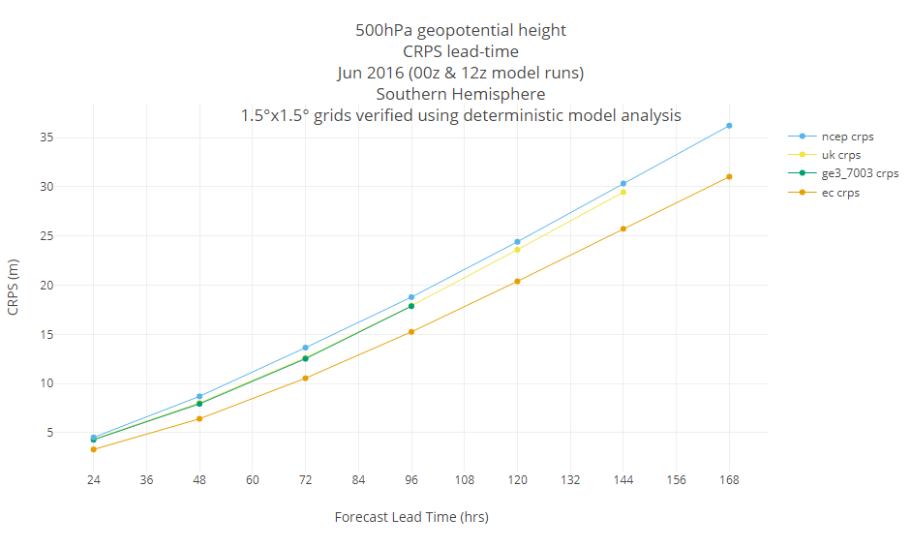
Getting started: A CRPS plot
Small CRPS is good
Notes:
Hindcast trial – we have only generated scores out to 96hrs so far
Note period is June 2016, a snap shot of overseas model perf a couple of years ago

Slide 9
Getting started: more to do!
Preliminary verification results show GE3 stacks up reasonably well in the “chasing pack".
Plenty more of the GE3 trial still to run.
Need to start verification of the city-scale EPSs. More of a challenge?
Notes:
We have verification results for different scores and different parameters.
WMO-based verification is a start – we may be interested in developing additional measures…ECMWF's headline measures CRP skill score for 850Pa temp

Slide 10
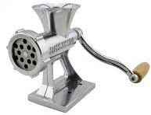
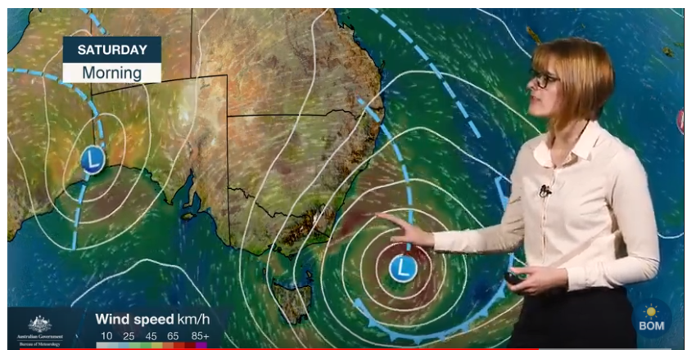

Can we go further: downstream users
If we had the operational 'green light' tomorrow which downstream users might be interested in our EPSs?
NWP post-processing team?
Forecasters
External users: e.g. the energy industry?
Notes:
Some thought given to downstream users both within and outside of the Bureau.
How will NWP output be used?
Who are the down stream users?
Will we need to 'sell' the benefits of an EPS?
Will we need to educate potential users on the utility of our EPSs?
Where does verification fit in?
Post-proc: coordinate efforts to make sure we verify raw model output and a post-processed version against the same truth/obs. Role of Improver?
Forecasters: Appetite got more EPS output as part their day-to-day work. Can we work with them to produce objective verification that meets their needs. Rainfall seems to be of most interest.

Slide 11

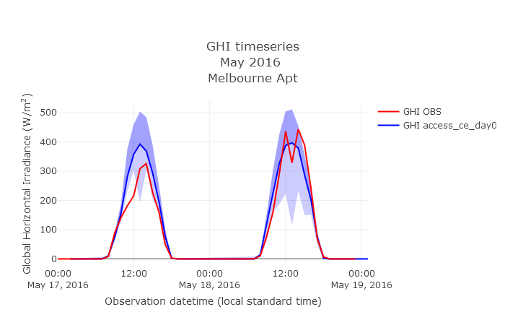
Can we go further: solar
Solar irradiance forecasting:
Can a city-scale EPS provide useful uncertainty information about sunshine amounts?

Slide 12
Summary
Ensemble NWP is coming to the Bureau - we need to verify that these systems are of a sufficient quality.
We have started with global EPS verification based on WMO guidelines, we need an approach for the city-scale EPSs too!
Can we further explore working with down stream users to help with their verification needs?

