Slide 1



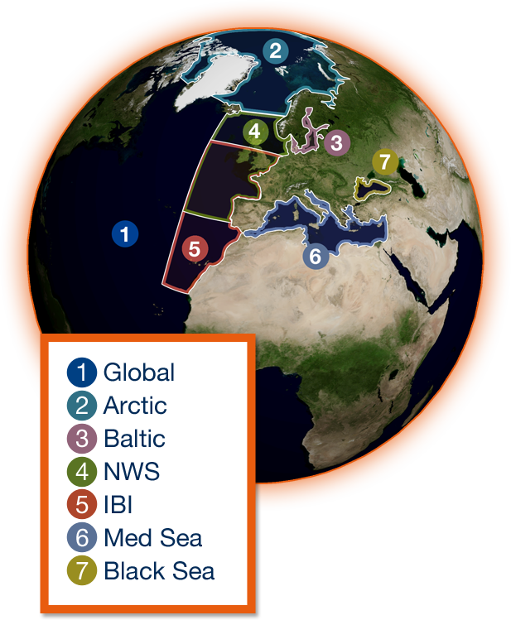
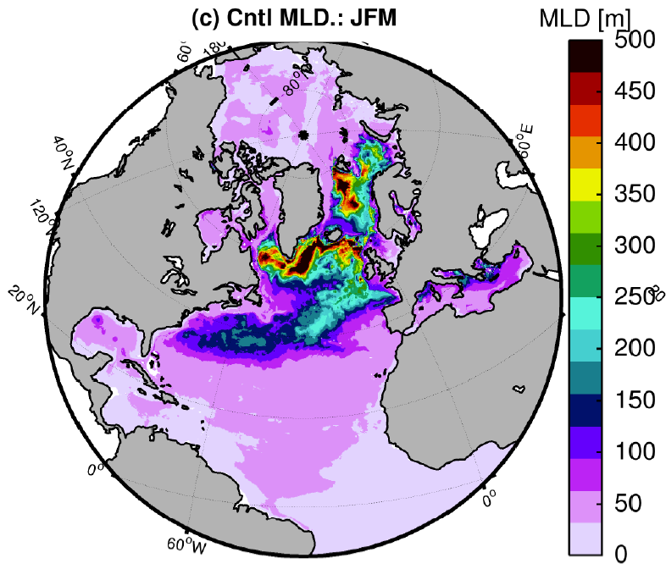
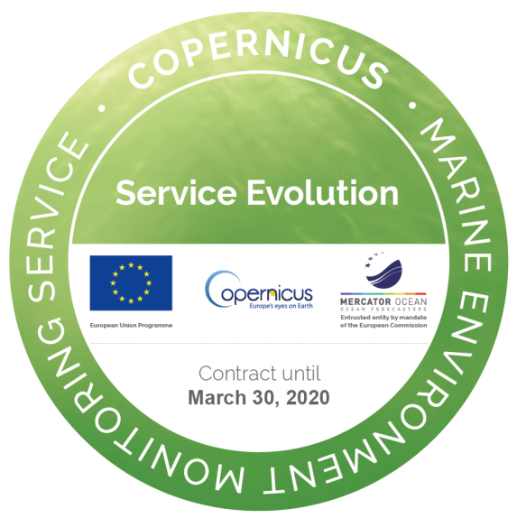
The Copernicus Arctic Marine Forecasting Center
Øyvind Breivik, Malte Müller, Kai H Christensen, Ana Carrasco, Øyvind Sætra, Alfatih Ali (MET Norway), Vidar Lien (IMR) and Laurent Bertino (NERSC)

Slide 2
Outline of talk
The Copernicus Marine Environment Monitoring Services (CMEMS)
The Arctic component (ARC-MFC) of CMEMS
The TOPAZ ensemble forecast system
Applications and use
The ARC-MFC wave model
Wave effects in the ocean
Wave attenuation in the marginal ice zone
Coupling and further development of ARC-MFC

Slide 3
The Copernicus Marine Environment Monitoring Services (CMEMS)
CMEMS uniqueness:
Operate ocean forecast and reanalysis (physics & bio)
Open & Free data distribution
Added value to Copernicus satellites (data assimilation)
Distributed European Service
Delegated to Mercator Océan
CMEMS Opportunity
A major initiative supporting ambitious modeling systems development and validation
Intended for sustainable operations by the EU
Mercator Océan is becoming a European center

Slide 4
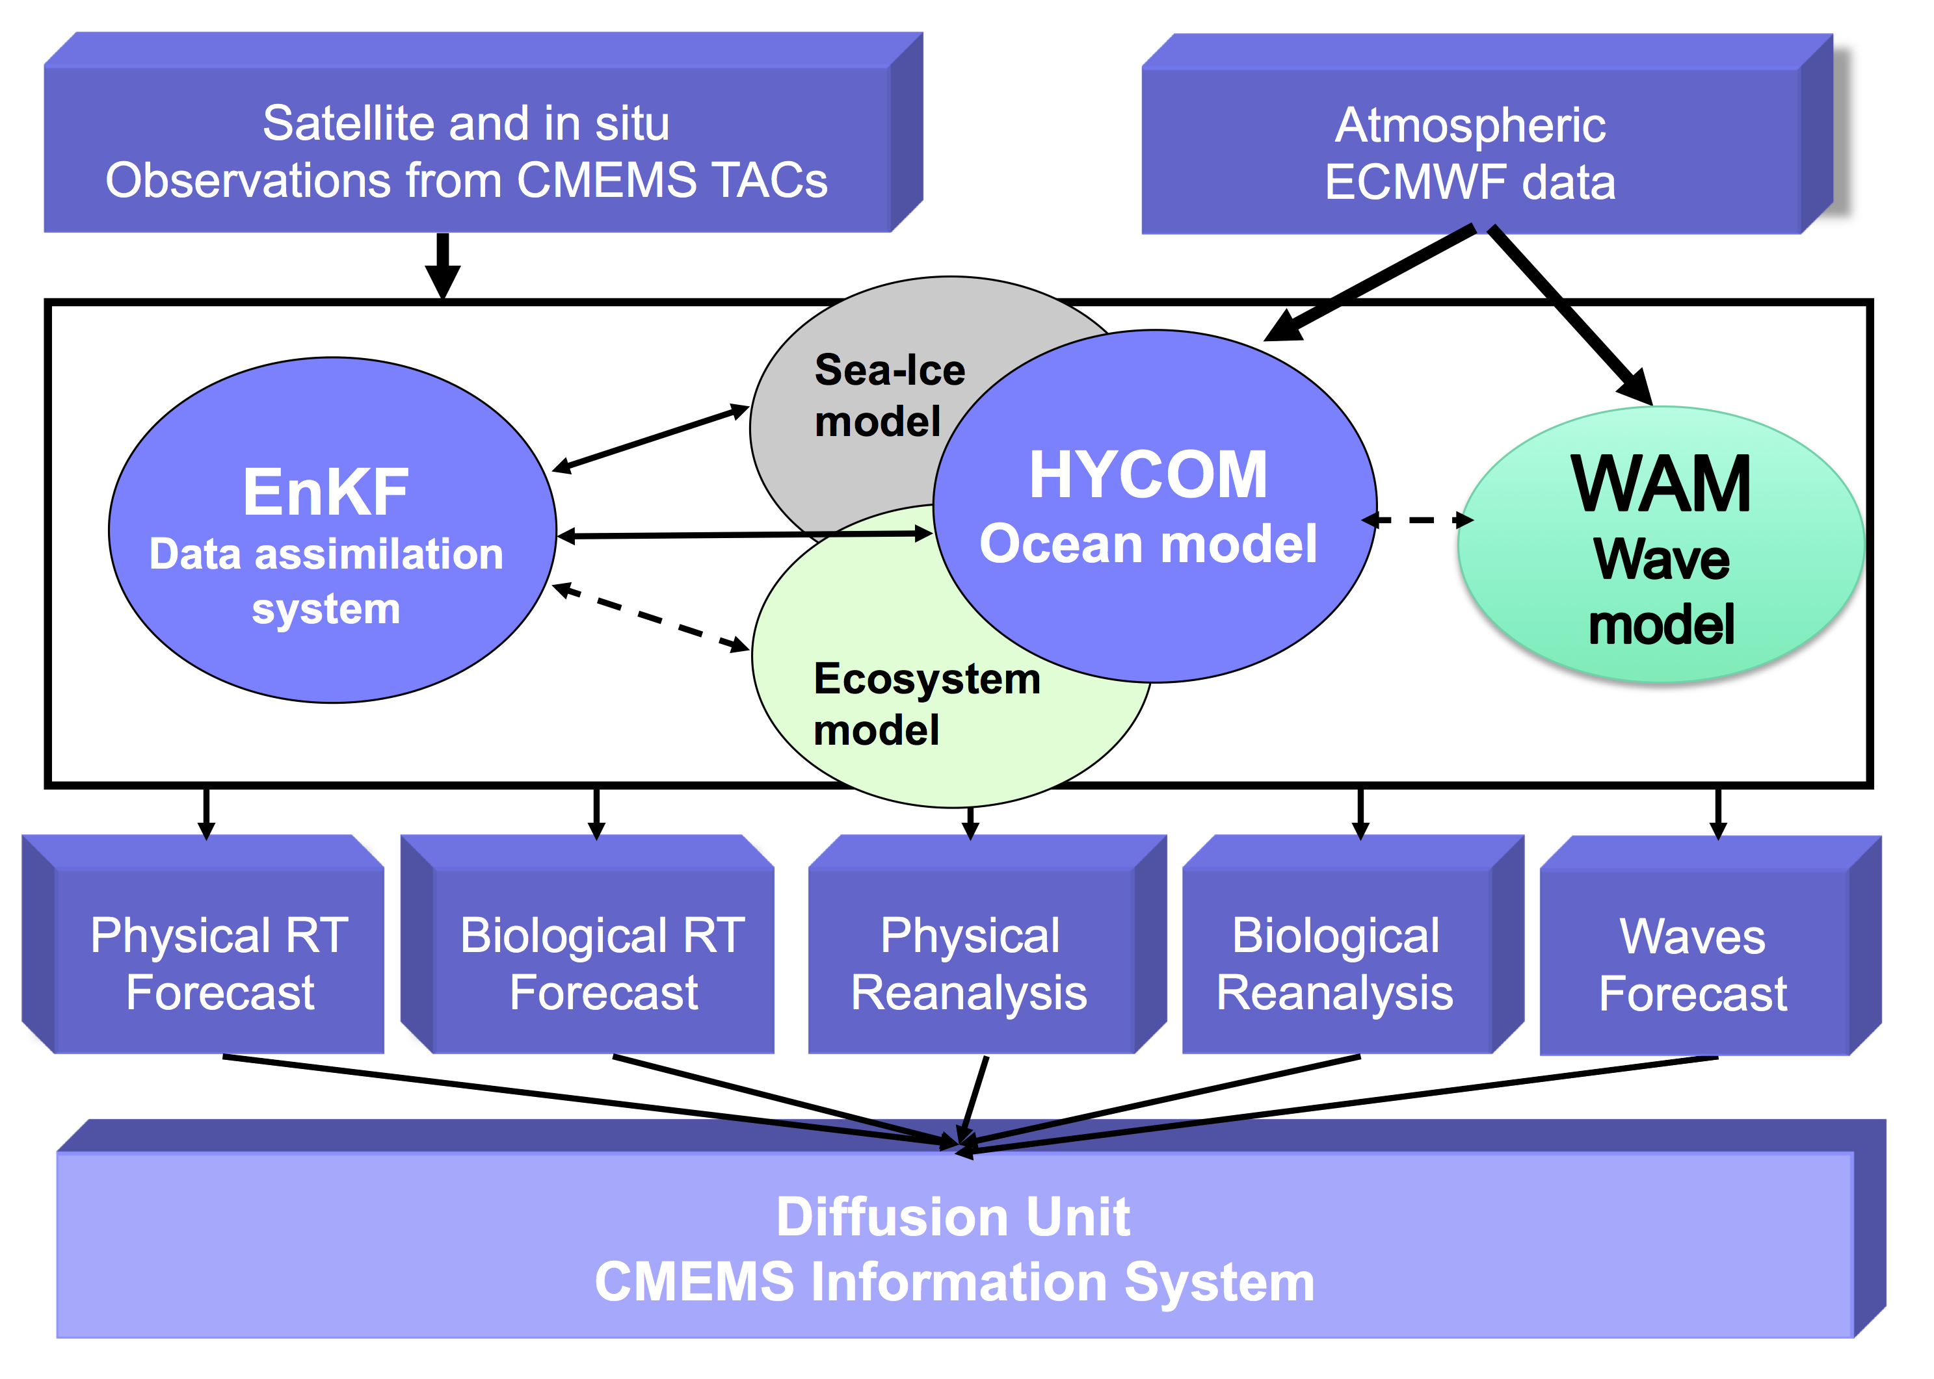
The ARC MFC

Slide 5
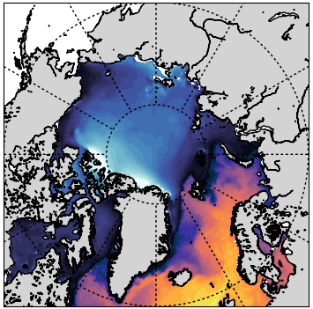
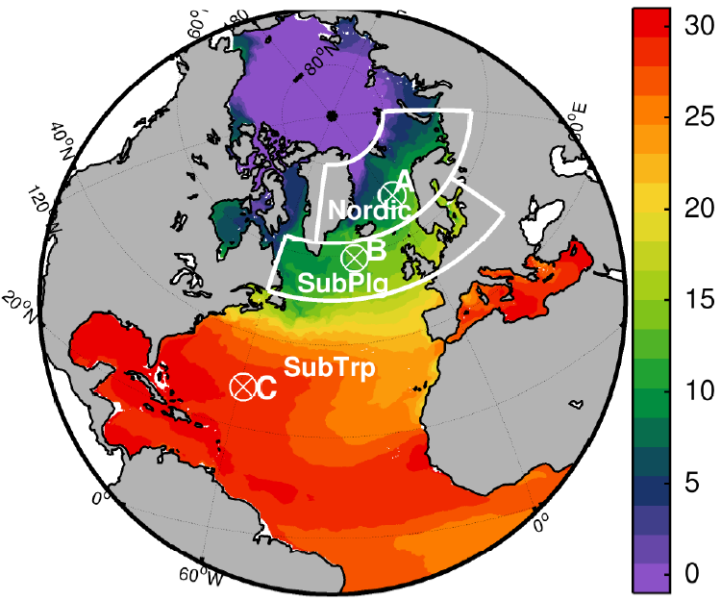
The TOPAZ/HYCOM System
HYCOM run operationally at MET Norway
EnKF data assimilation (100 members)
Ecosystem model
Coupled sea-ice model (CICE)
10-day forecast performed once a day
Freely available through CMEMS
http://marine.copernicus.eu/
5
Notes:
The TOPAZ system consist
- provide 10-day forecasts of the daily-mean of 3D and hourly surface variables:
ecosystem/
physical and sea ice.
5

Slide 6
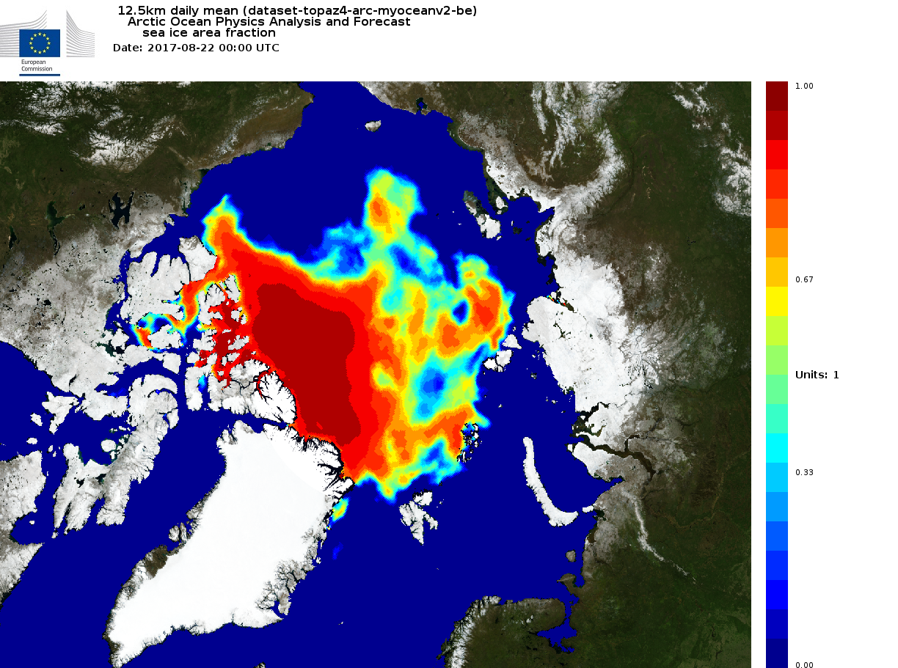
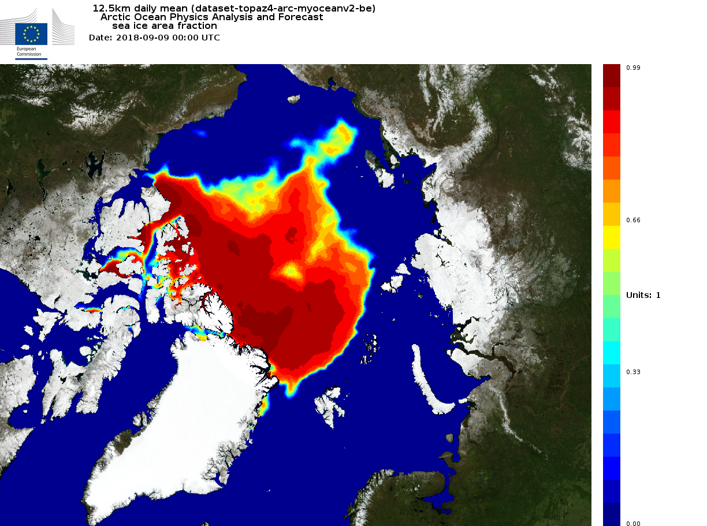
Sea ice concentration forecast: 22 Aug 2017
The TOPAZ/HYCOM System
HYCOM run operationally at MET Norway
EnKF data assimilation (100 members)
Ecosystem model
Coupled sea-ice model (CICE)
10-day forecast performed once a day
Freely available through CMEMS
http://marine.copernicus.eu/
Sea ice concentration forecast: 09 Sep 2018
6
Notes:
The TOPAZ system consist
- provide 10-day forecasts of the daily-mean of 3D and hourly surface variables:
ecosystem/
physical and sea ice.
6

Slide 7
Ensemble Kalman filtering
Forecast
Analysis
Forecast
Member 1
Member 2
...
Member 3
2
1
Member 99
Member 100
3
Initial uncertainty
Model uncertainty
Measurement uncertainty
Observations

Slide 8
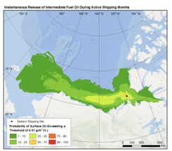
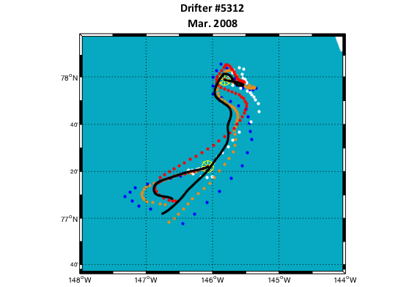
Who are using ocean forecasts?
Water surface oiling probabilities.
RPS ASA for WWF (Gearon et al. 2014)
Coastal and Marine environment
StormGeo, C-Core
WWF
Oil Industry - Total, Equinor (formerly Statoil)
What do people do?
Downscaling to coastal forecasts
Oil spill forecasts / scenarios
Which Products?
Ocean currents
Ocean temperature, salinity
Waves
Ocean primary production
Sea ice drift
North Alaska, Simulated and observed ice trajectories
D. French McCay, RPS ASA, 2017

Slide 9
Who are using ocean forecasts?
Search and rescue:
Compute Lagrangian S&R trajectories from each of TOPAZ members forecast.
Take the convex hull of the end points.
Calculate the probability of containment (POC)
Hull area increases with forecast range
But hit rate remains identical (reduced accuracy)
Results improve when replacing the deterministic model by the ensemble mean
Melsom et al. (2012)

Slide 10
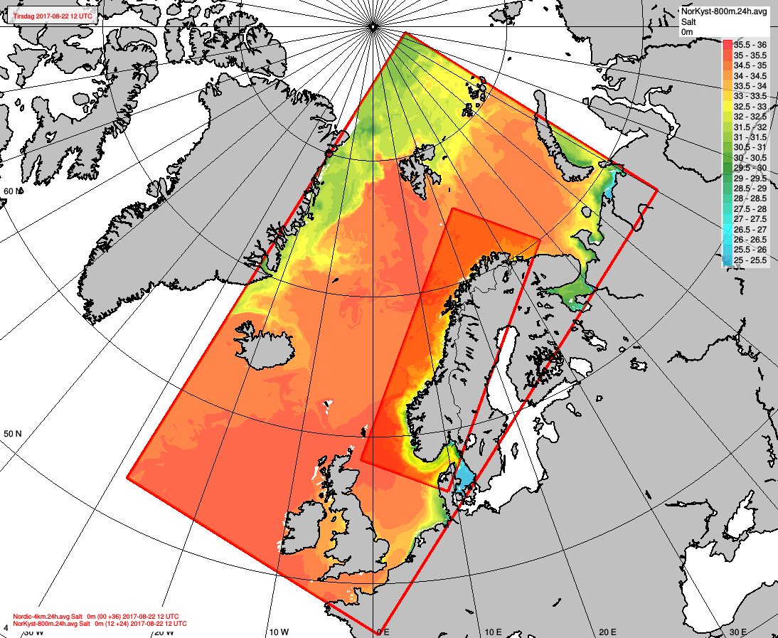
Who are using ocean forecasts?
Boundaries for high-res ROMS models with ice
Nordic-4km:
- Run twice daily (00 and 12)
- 120h forecast length
- Forced by ECMWF atmosphere
- TOPAZ on open boundaries
NorKyst-800m:
- Run once a day (00)
- 66h forecast length
- AROME 2.5km atmospheric forcing
- Nordic-4km on open boundaries
TPXO tides
EVP ice rheology
10
Notes:
10

Slide 11
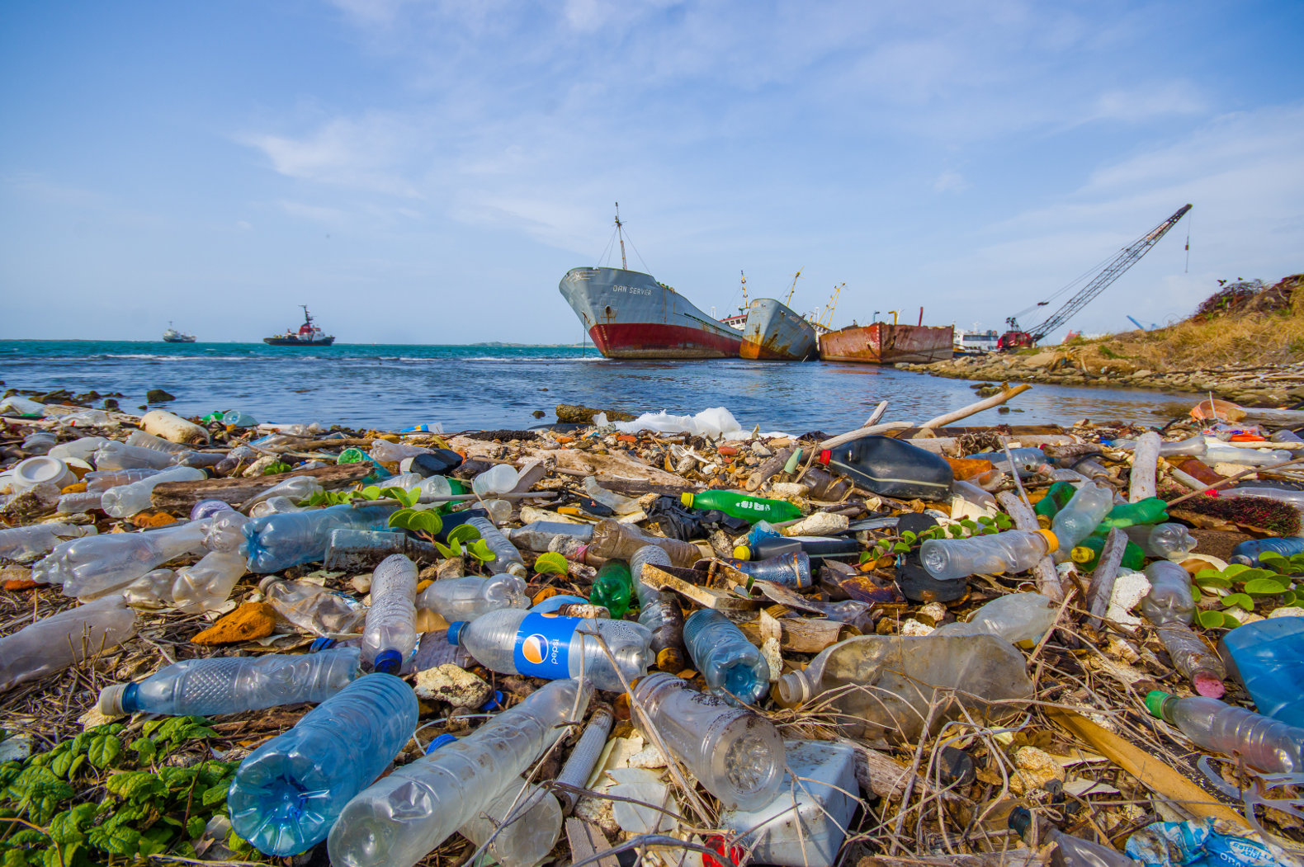
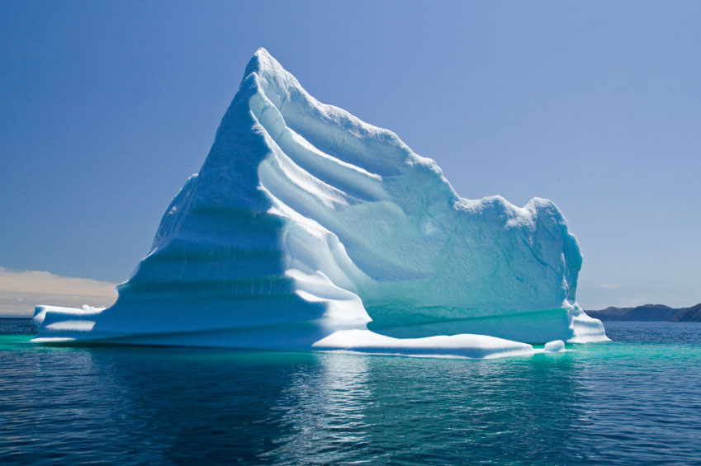
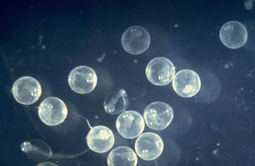
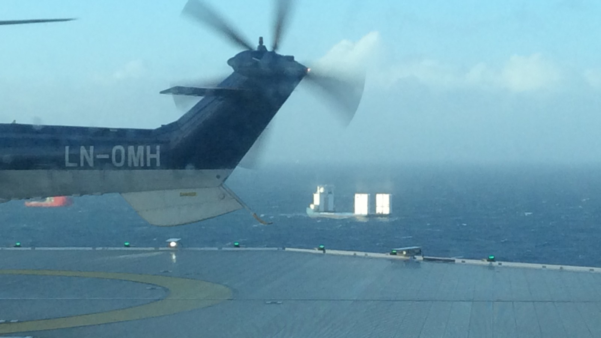
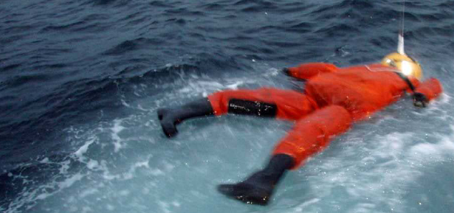
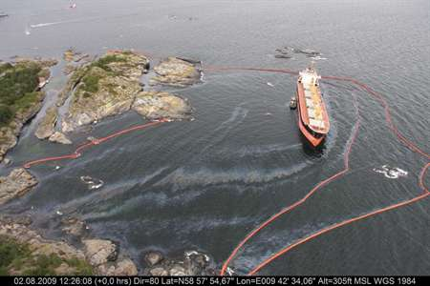
Stochastic Lagrangian trajectory models
Plastics and microplastics (under development)
Icebergs (under development
Drifting ships
Fish eggs
OpenDrift
Oil drift
11
Search and rescue

Slide 12
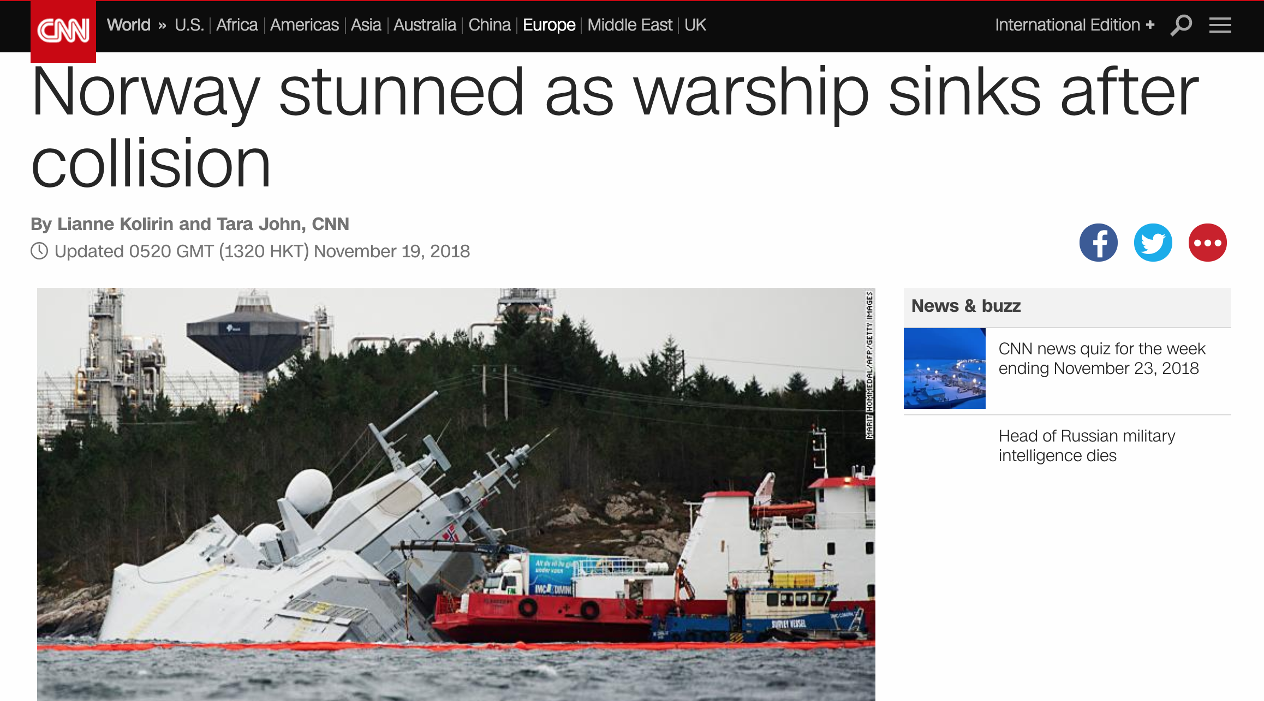

Slide 13
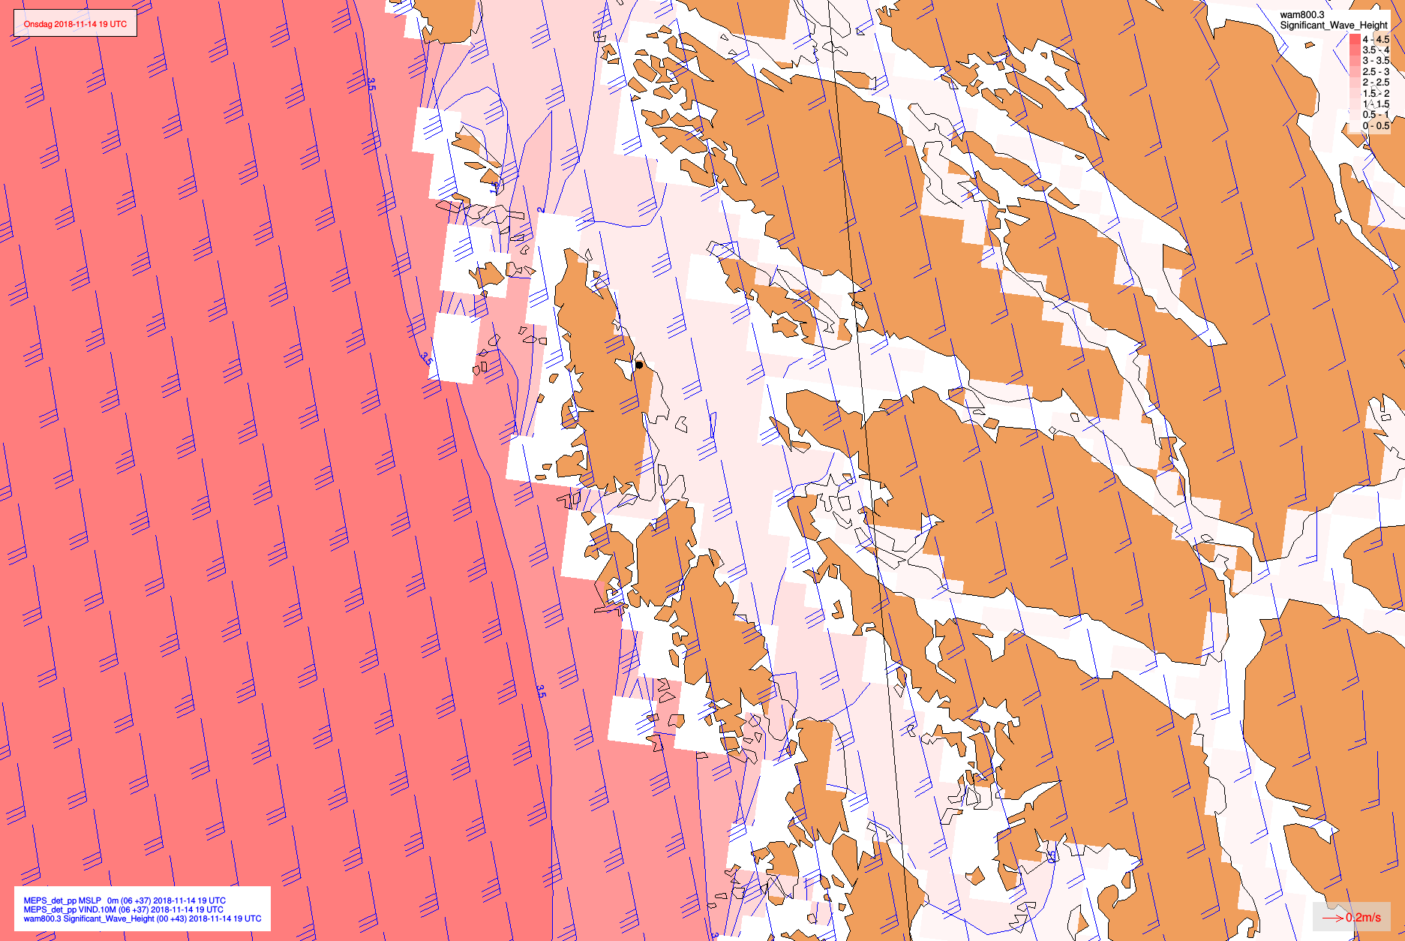
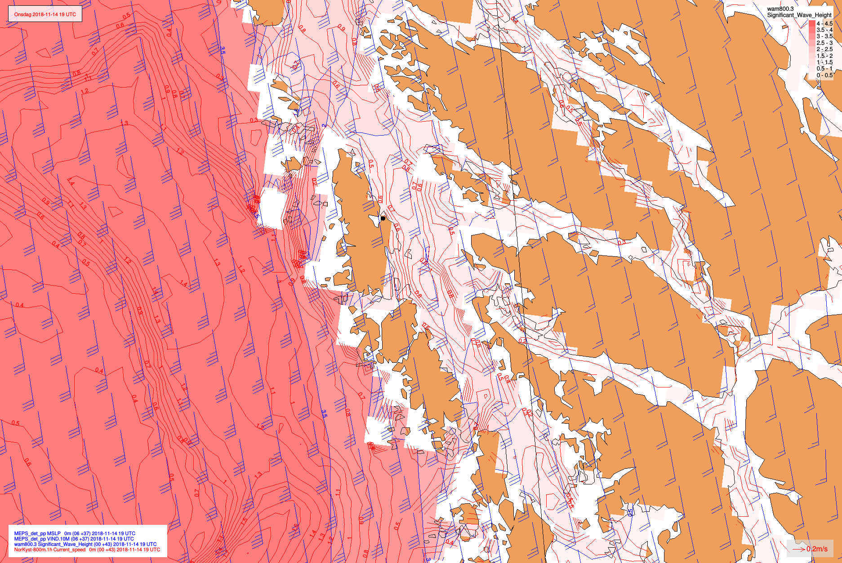
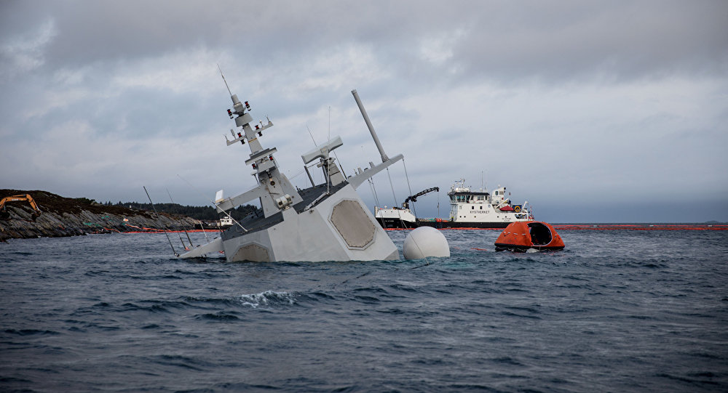
HNoMS Helge Ingstad
Red: Significant wave height (WAM800m)
Blue: 10 m wind (Arome 2.5km)
Red curves: Current speed (Norkyst800)

Slide 14
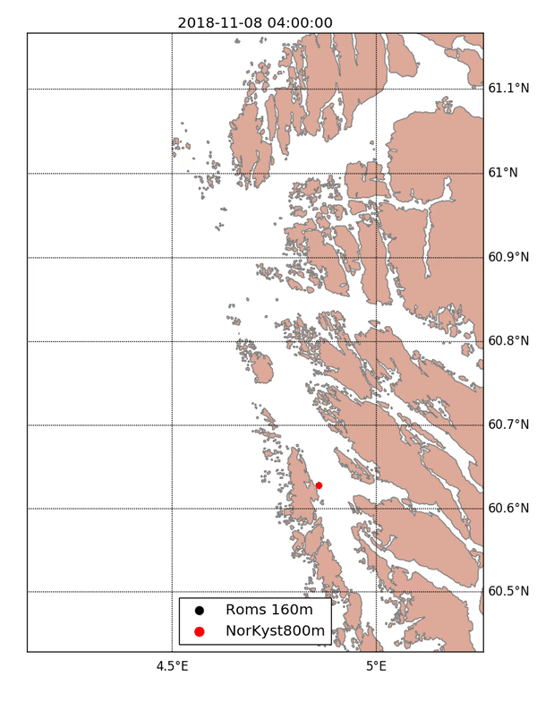
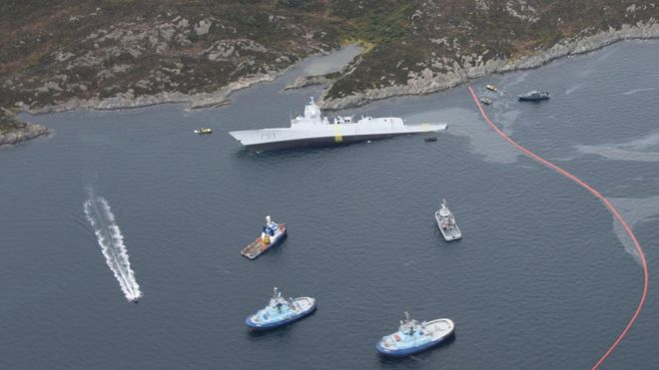
HNoMS Helge Ingstad
Two OpenDrift oil spill runs
Red: Operational Norkyst800m
Black: Experimental 160m-model run in collaboration with the Instititute of Marine Research (IMR)

Slide 15
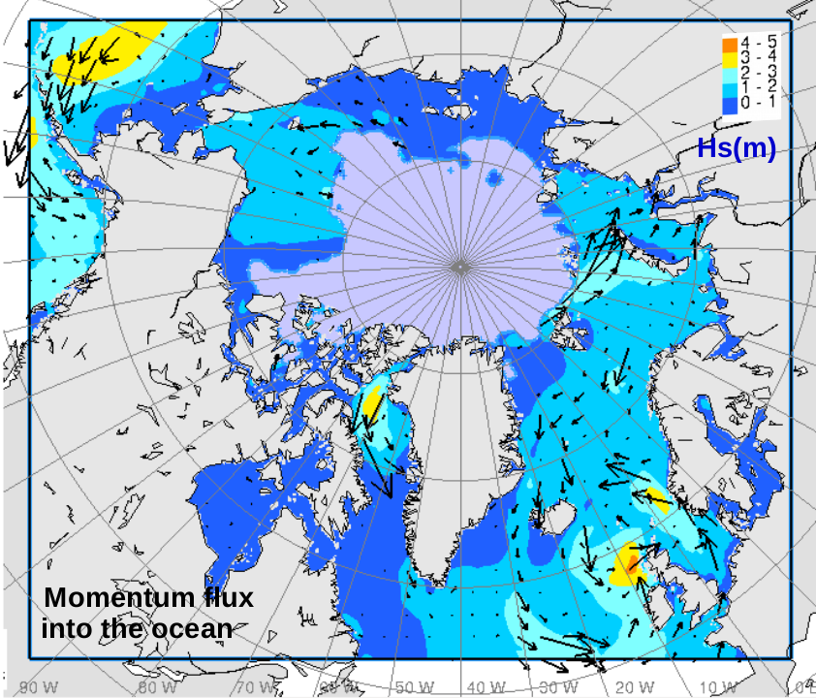
Implementation of wave effects in the TOPAZ system
Wave parameters are now becoming available through the coupling of the TOPAZ system to the WAM wave model
Two effects are of particular interest:
mixing in the upper ocean (in testing)
the effect on sea ice (under development)

Slide 16
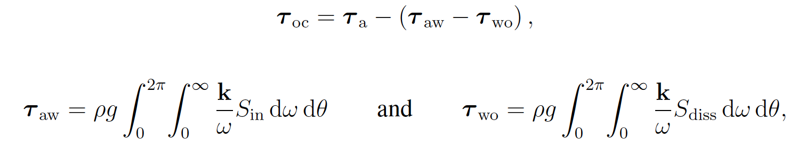
Implementation of wave effects in the TOPAZ system
Momentum fluxes (stresses)
between the atmosphere, the wave field and the upper ocean:

Slide 17
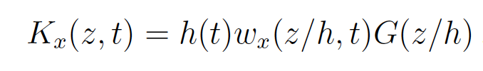
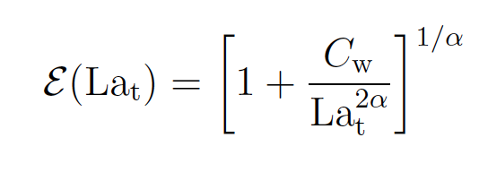
Implementation of wave effects in the TOPAZ system
Langmuir turbulence
Five different parameterizations tested on the KPP turbulence scheme:
McWilliams and Sullivan (2000) enhancement factor:

Slide 18
Langmuir turbulence
Some parameterizations have a huge impact on the mixed-layer depth (MS00) – it doesn’t necessarily mean it is so ...

Slide 19
Langmuir turbulence
MLD:
Substantial deepening by McWilliams and Sullivan (2000)

Slide 20
Langmuir turbulence
SST:
Substantial surface cooling by McWilliams and Sullivan (2000) due to excessive mixing
Li and Fox-Kemper al (2017) shows overall the best performance

Slide 21
Langmuir turbulence
Heat content:
Substantial warming by McWilliams and Sullivan (2000)
Li and Fox-Kemper al (2017) shows overall the best performance
Ali et al, under revision with Ocean Modell

Slide 22
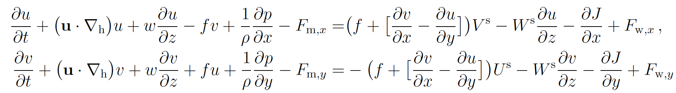
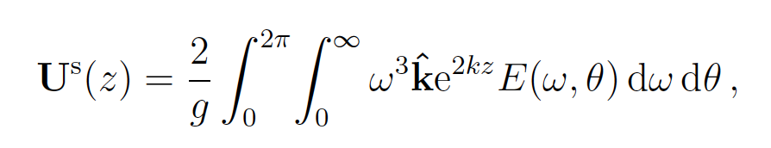
Implementation of wave effects in the TOPAZ system
Coriolis-Stokes force:
Stokes tracer advection:
Stokes drift profile:

Slide 23
Coriolis-Stokes + Stokes tracer advection ...
Negligible
impact

Slide 24
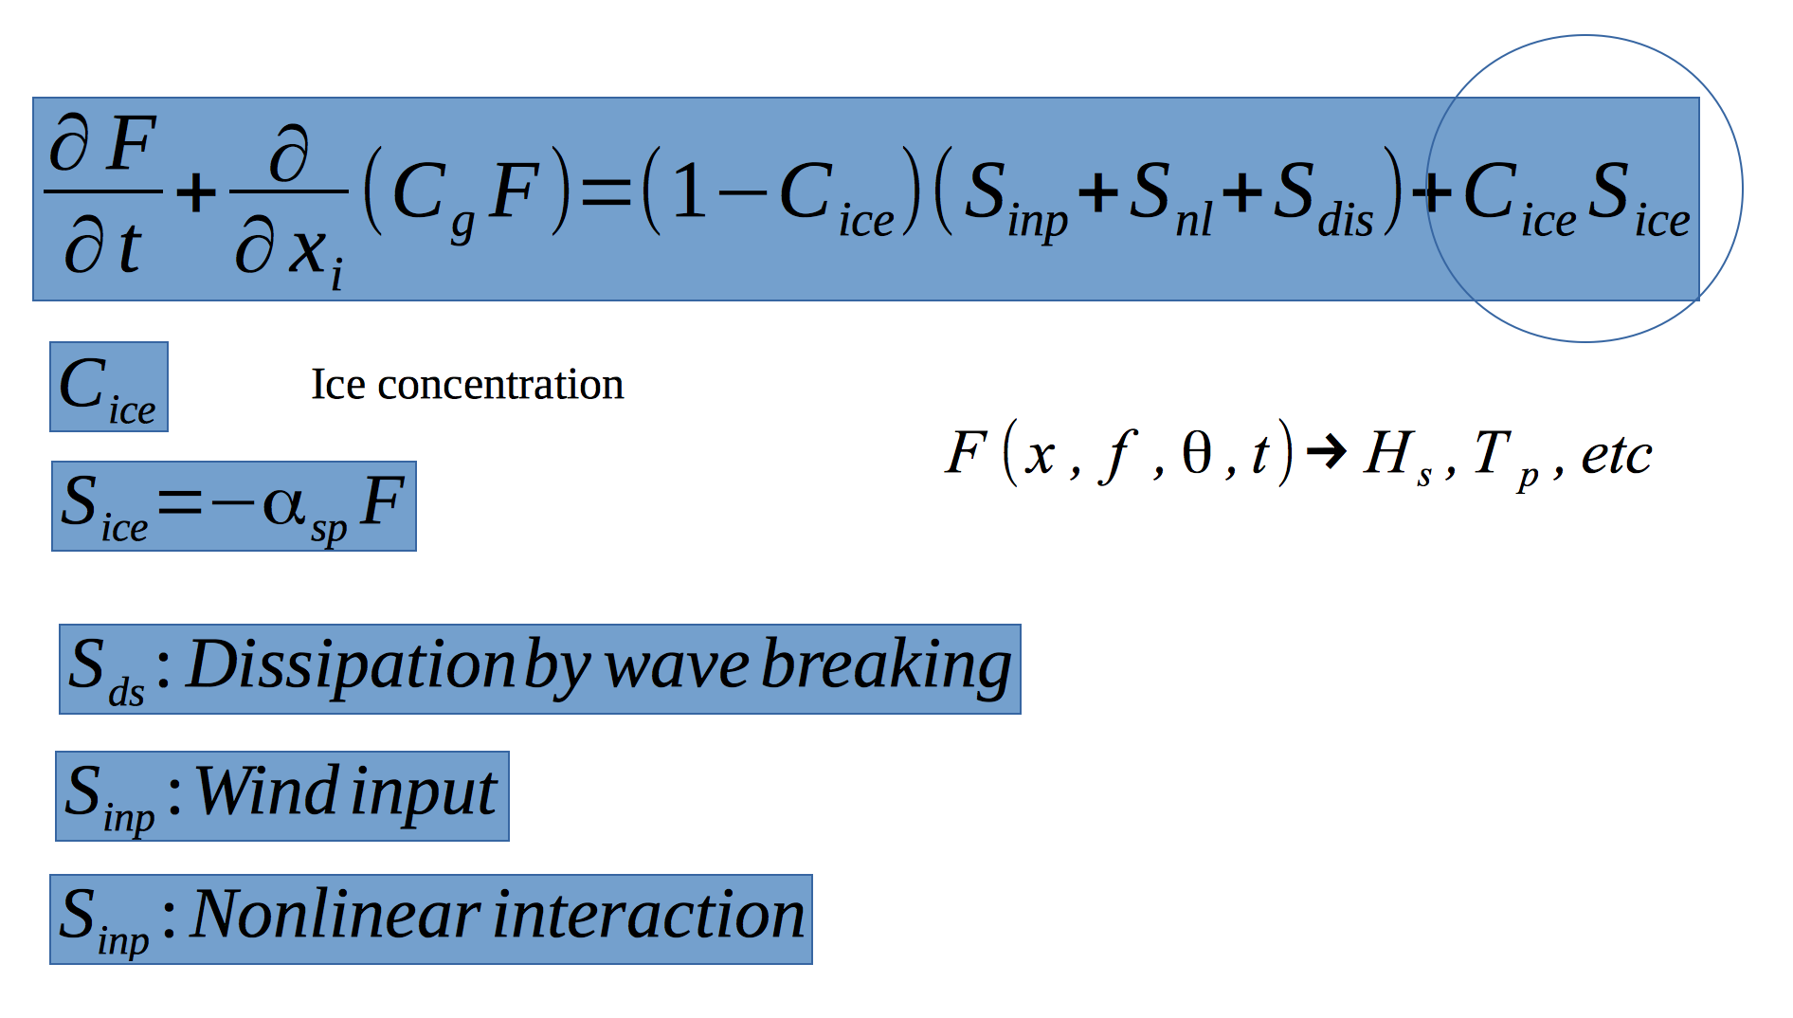
Implementation of wave effects in the TOPAZ system
Wave attenuation in sea ice:

Slide 25
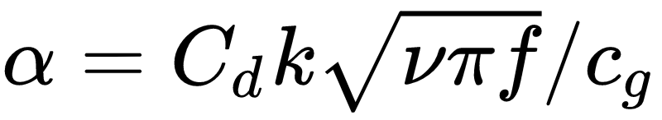
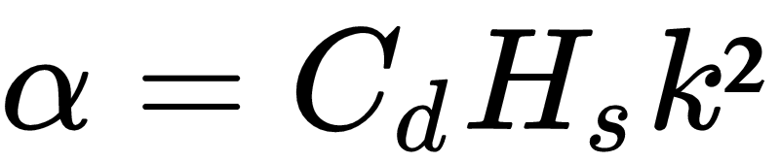
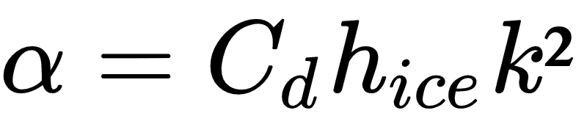
Implementation of wave effects in the TOPAZ system
Ice attenuation models
Liu and Mollo-Christensen
Kohout et al. (2011)
Sutherland et al. (2017)

Slide 26
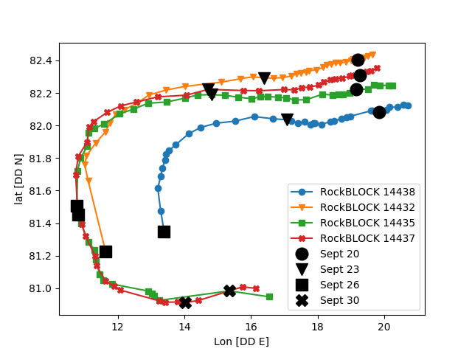
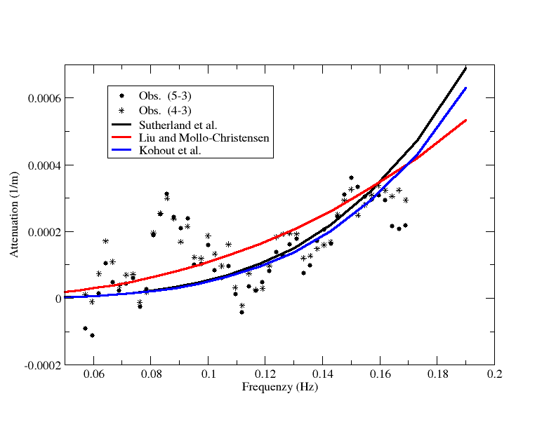
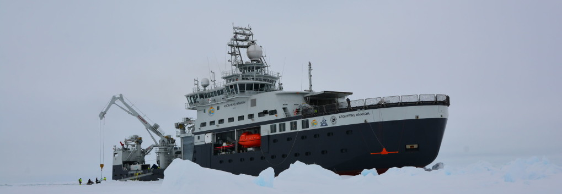
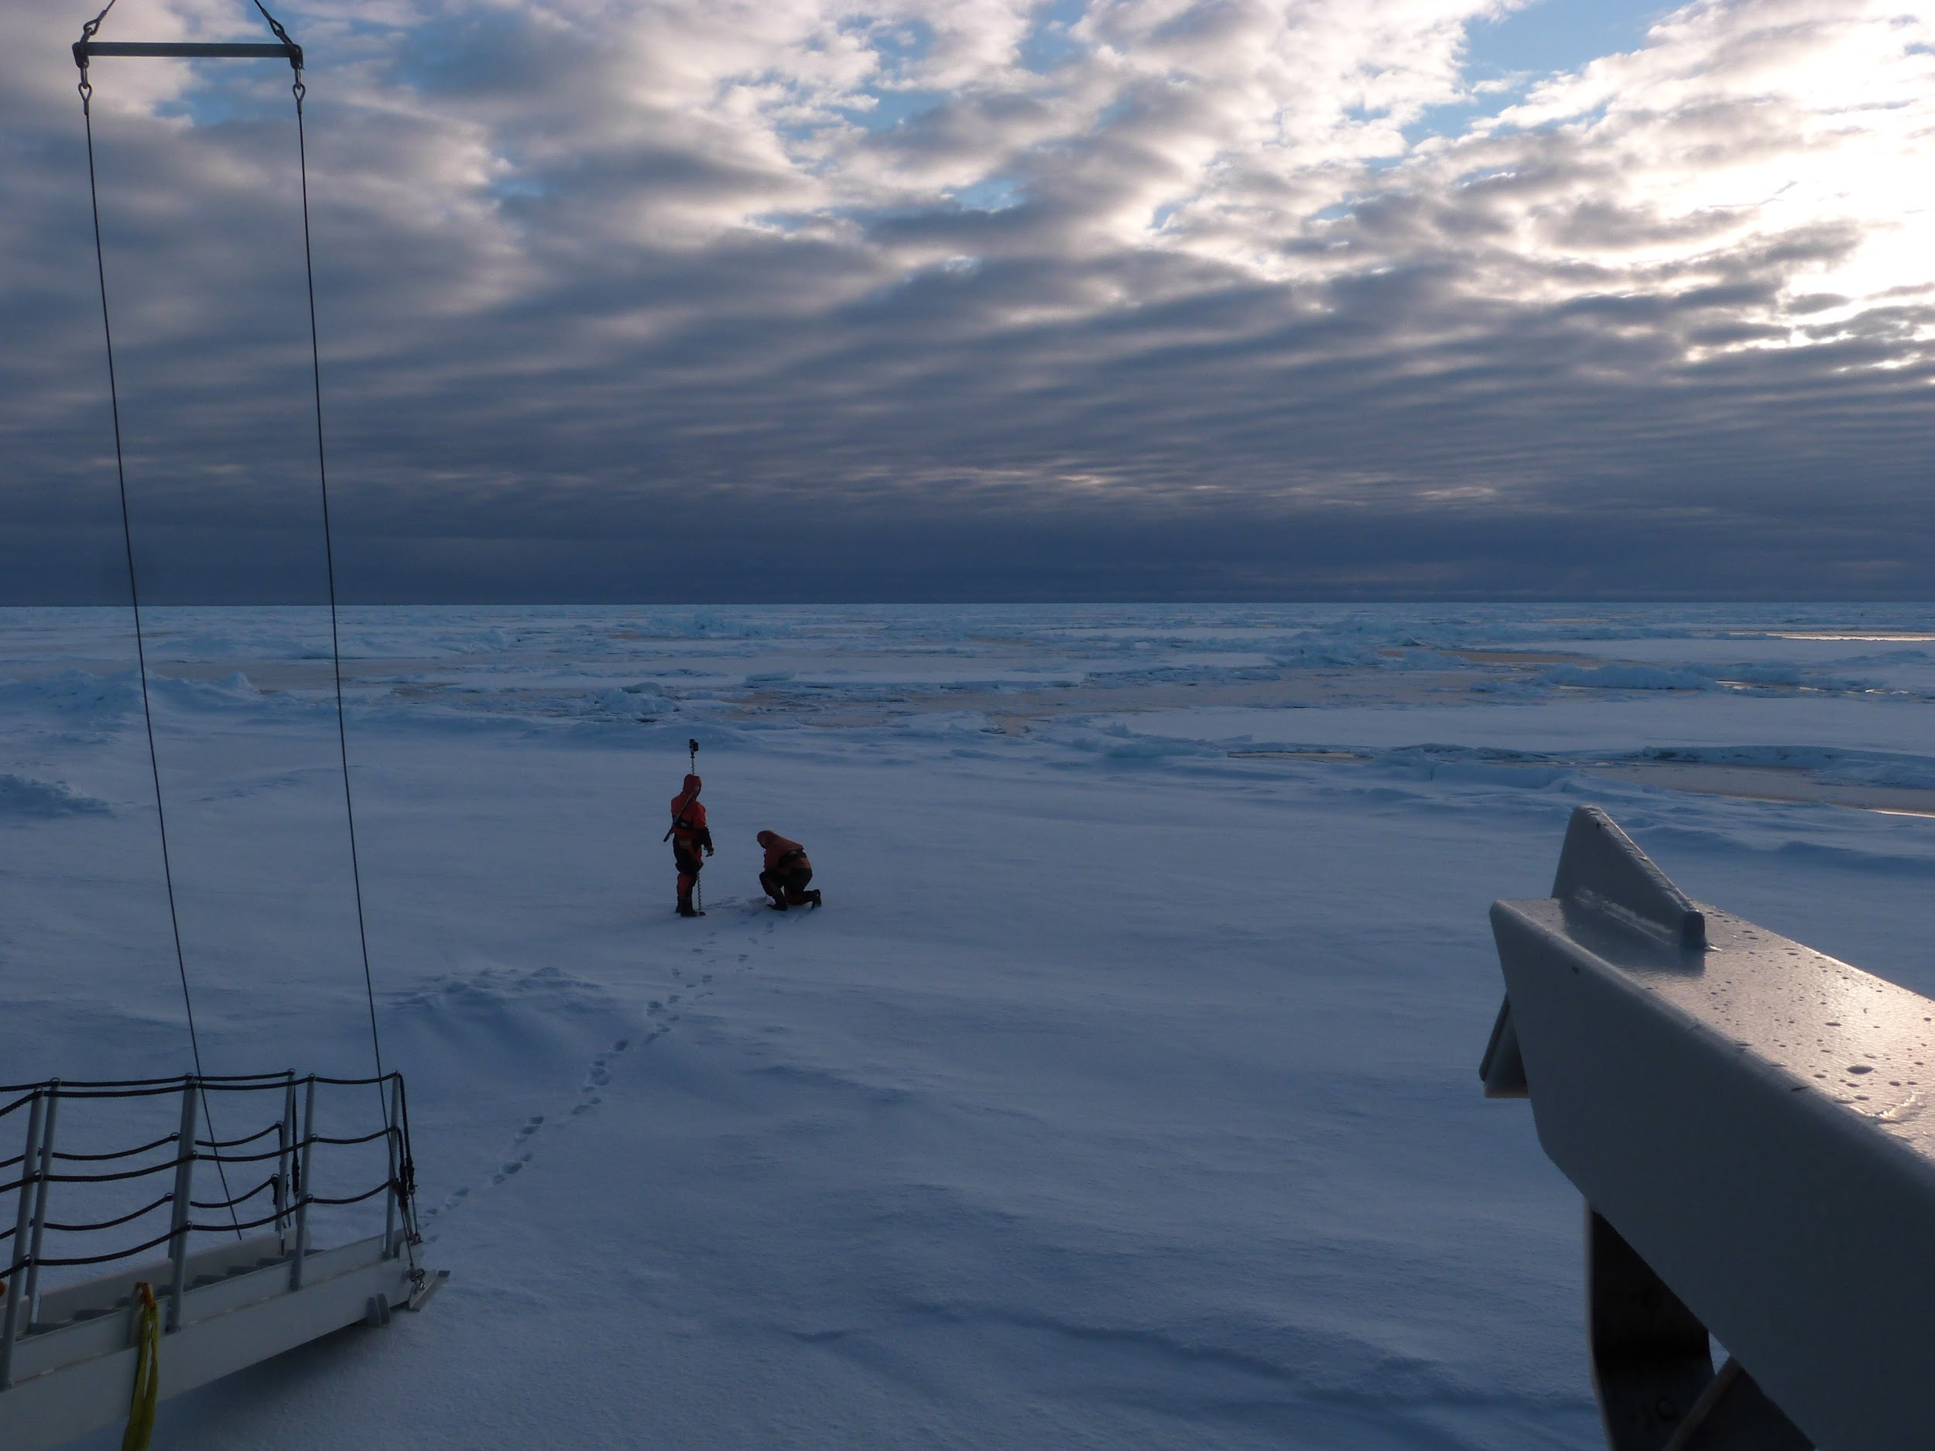
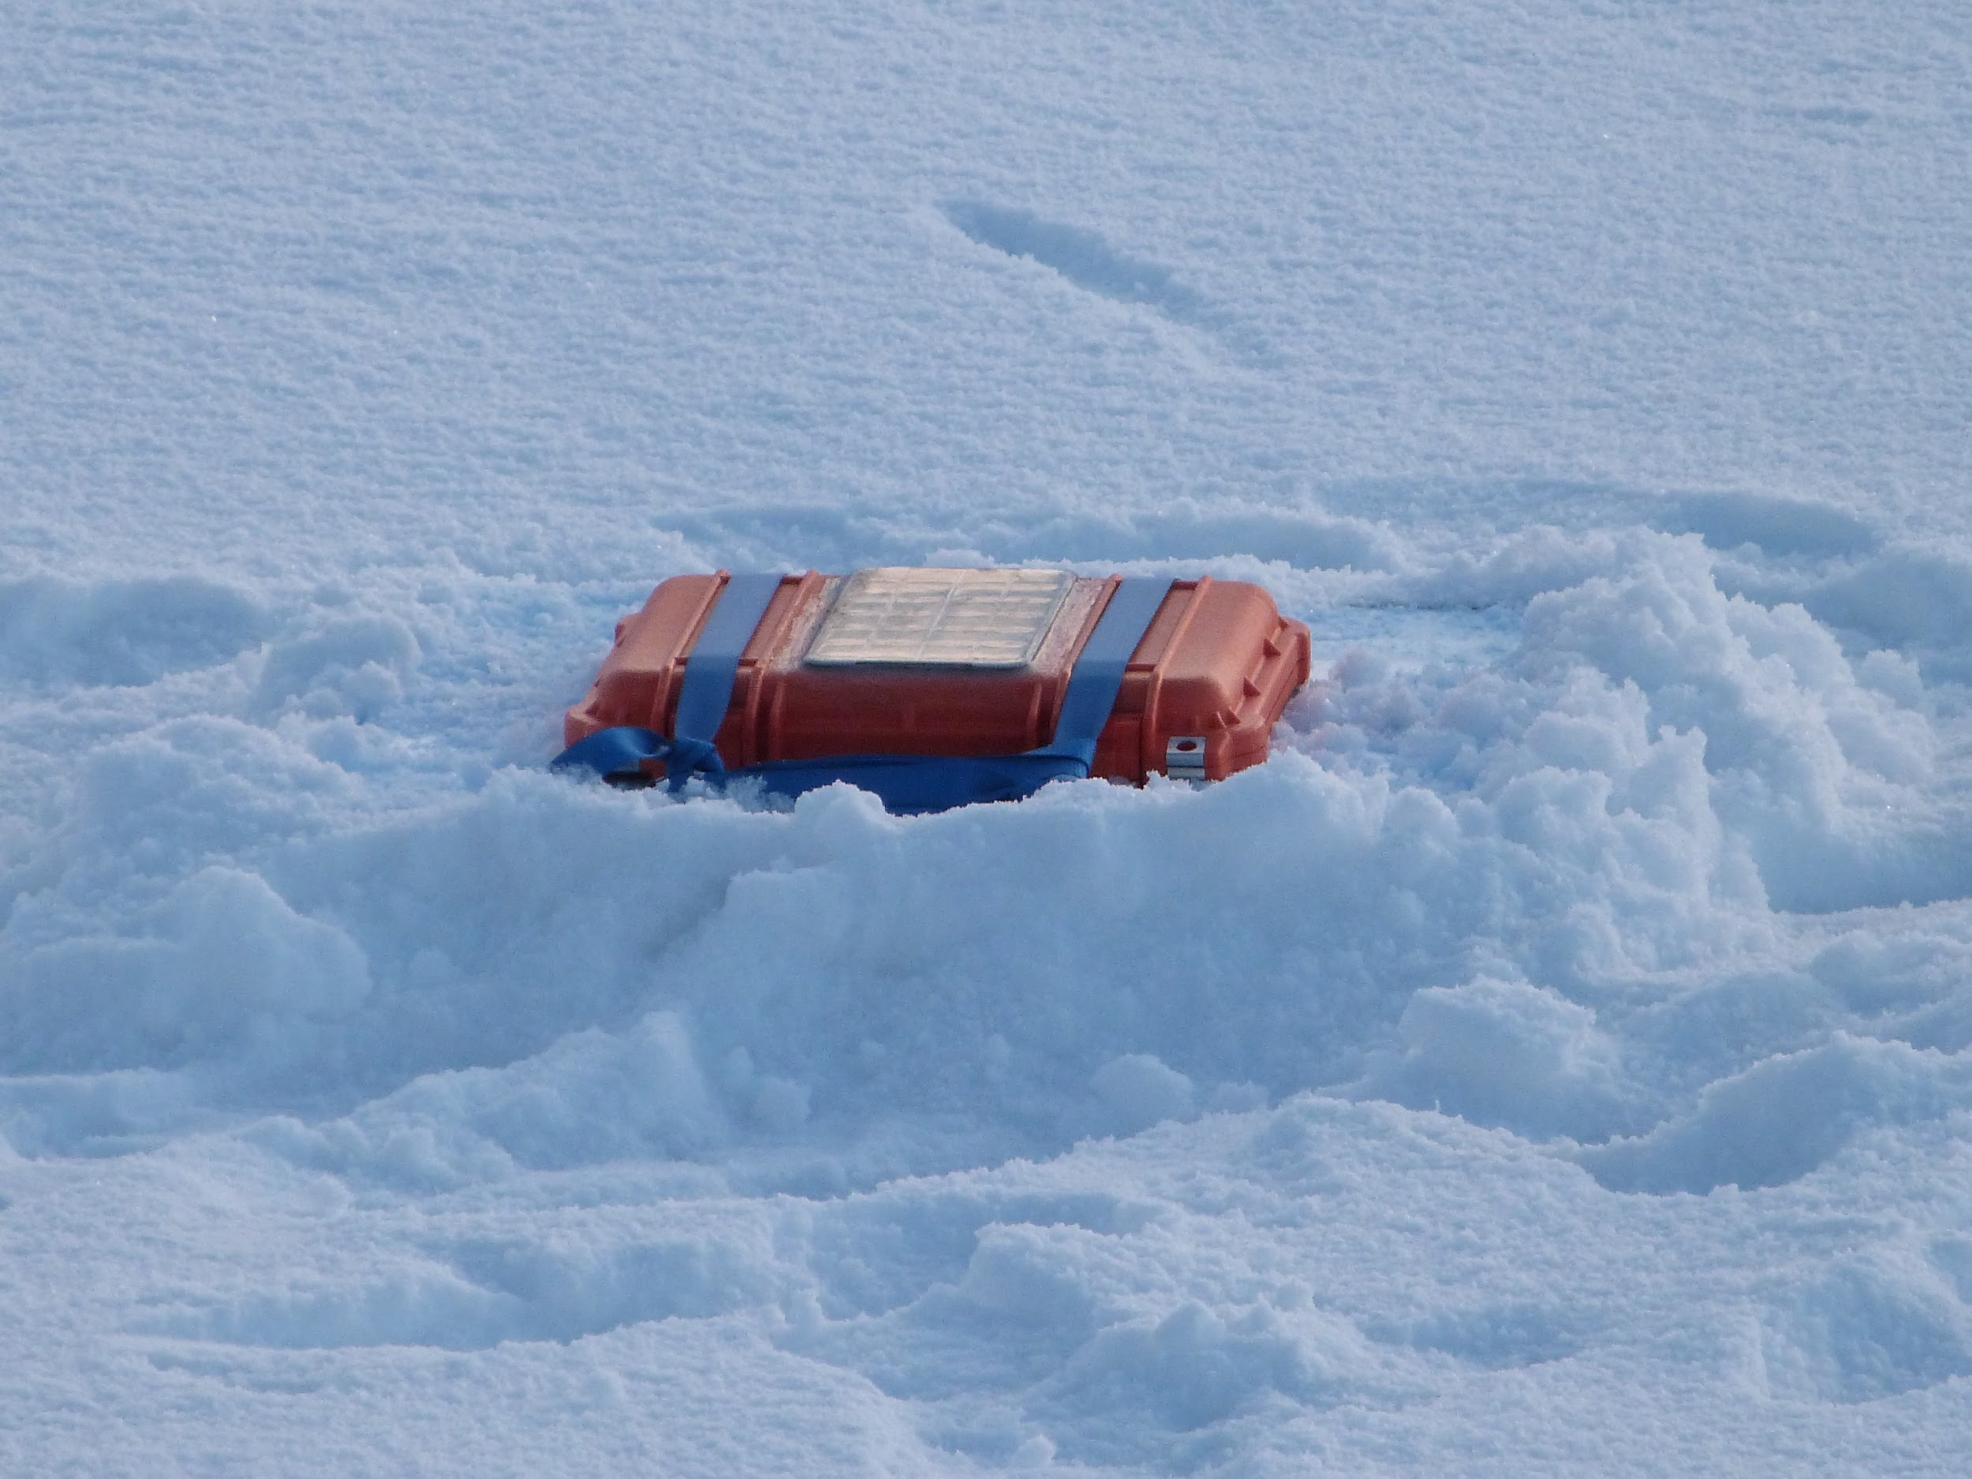
Implementation of wave effects in the TOPAZ system
Starting to collect field work to assess parameterizations – Cruise north of Svalbard September 2018

Slide 27
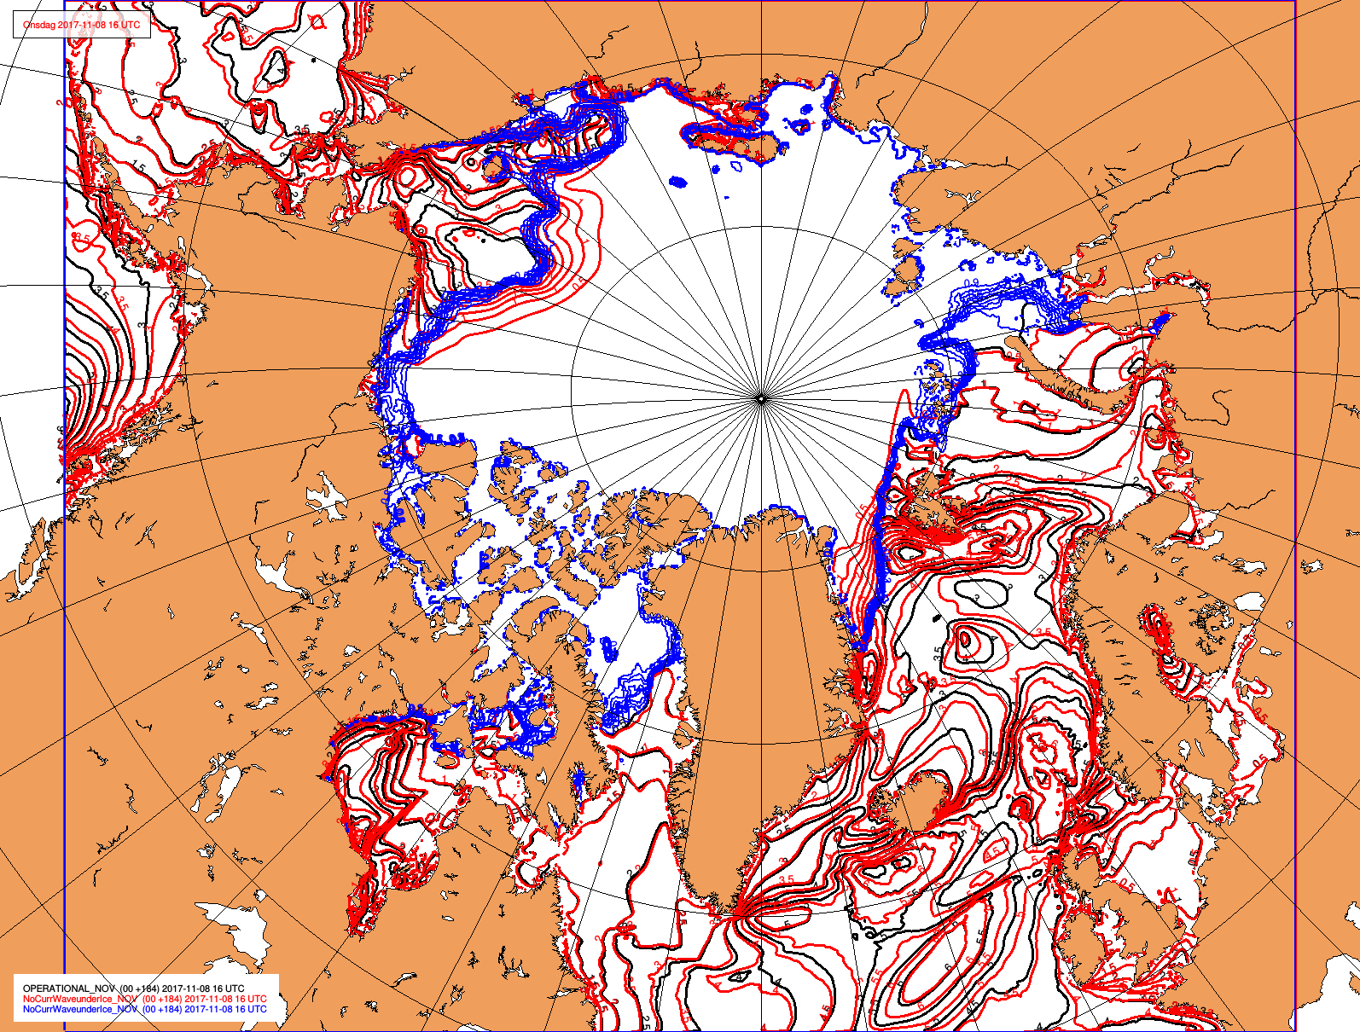
Implementation of wave effects in the TOPAZ system
Wave attenuation in sea ice: Wave damping affects the marginal ice zone (MIZ) sea ice in substantial areas around Svalbard. Modelling this is still challenging, but important for a future coupled system

Slide 28
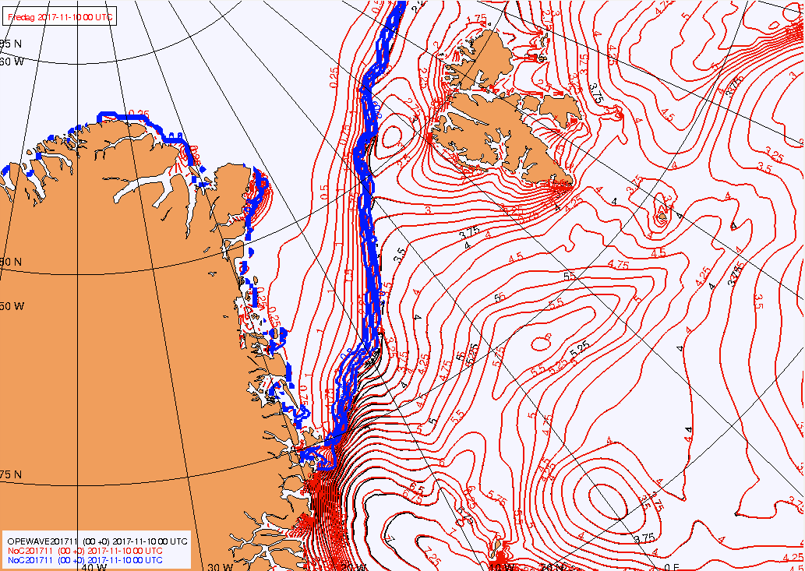
Implementation of wave effects in the TOPAZ system
Wave attenuation in sea ice: Wave damping affects the marginal ice zone (MIZ) sea ice in substantial areas around Svalbard. Modelling this is still challenging, but important for a future coupled system

Slide 29
Development plans
Mid-term (3 years)
6 km resolution
Tides at 3km resolution
Improve forecast accuracy of ice drift & ice edge
Improve consistency of ocean, ice and waves
Carbon cycle included
Reduce biases in biological model
Assimilation of ocean colour in NRT
Long term (10 years)
Data assimilation in Lagrangian coordinates
Coupling to atmosphere
Assimilate incredibly HR satellite data
Sub-mesoscale resolution
Non-hydrostatic terms
Unstructured grids
Many biological tracers

Slide 30
Three years from now
Satellite and in situ
obs from CMEMS TACs
Lateral bc
GLO MFC
Atmospheric
ECMWF data
Sea-Ice
model
WAM Wave model
NeXtSIM
Sea-Ice
model
EnKF
Data assimilation
system
HYCOM
Ocean model
2021
HYCOM
Tidal model
Ecosystem model
Physical RT
Forecast
Biological RT
Forecast
Physical
Reanalysis
Biological
Reanalysis
Waves
Forecast
Waves
Reanalysis
Diffusion Unit
CMEMS Information System

Slide 31
Conclusions
The ARC-MFC forecast system is operational and delivers daily 10-day ensemble forecasts
The forecast system is used by a wide range of end users and provides the boundaries for the Norwegian high-resolution ocean forecasts
The system will be extended in the near future to higher resolution (including tides)
A fully coupled ocean-sea ice-wave forecast system will be operational in about three years
The impact of waves the sea ice and upper-ocean mixing is large enough to justify the added complexity and cost of coupling the wave model to the TOPAZ model system

