Slide 1

Ensemble forecast system for TC storm surge
Diana Greenslade, Stewart Allen, Andy Taylor, Frank Colberg, Justin Freeman, Holly Sims, Eric Schulz, Mirko Velic, Prasanth Divakaran, Jeff Kepert, Andrew Donaldson, Rick Bailey, Mikhail Entel
Research and Development Branch (now Science to Services)
Bureau National Operations Centre (now National Operations Centre)
Information Systems and Services Division (now Data and Digital)
Hazards Warnings and Forecasts Division (now National Forecast Services)

Slide 2
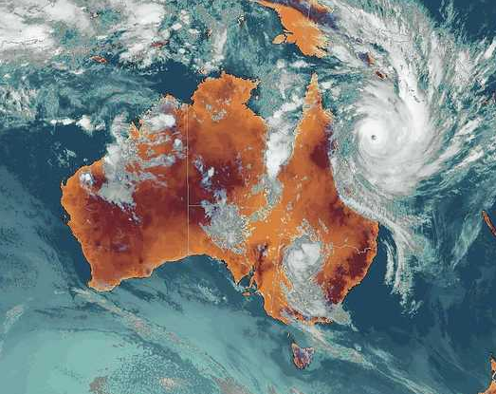
Background
Bureau mandate (Met Act 1955) to provide warnings for extreme weather
2013 - 'Review of the Bureau of Meteorology’s capacity to respond to future extreme weather and natural disaster events….'
Additional funding to ….. Implement an advanced storm tide prediction system……
Three year project: mid-2014 to mid-2017
Dynamical Tropical Cyclone Storm Surge Forecast System

Slide 3
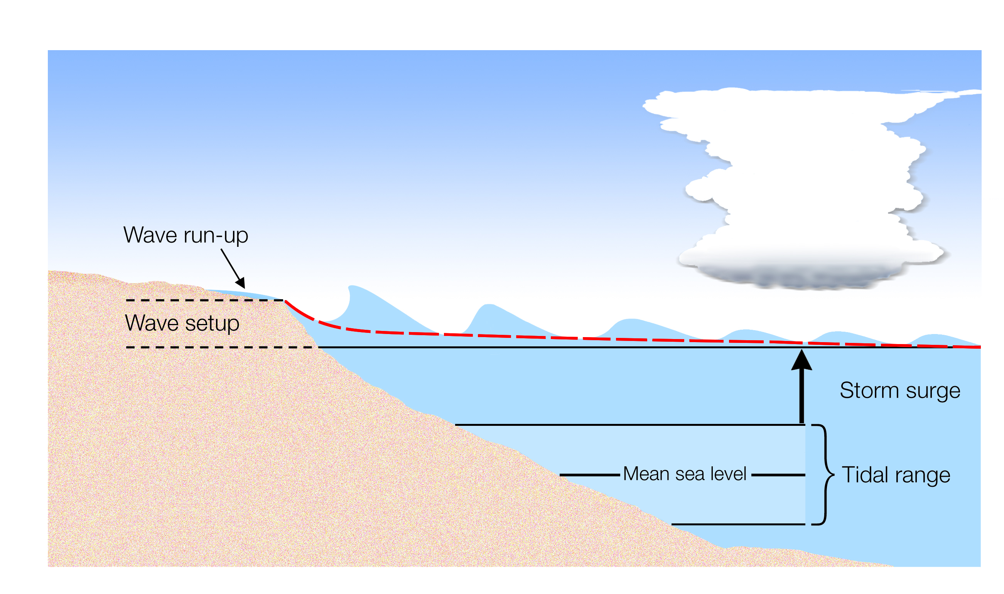
Storm tide
Storm surge: An increase in coastal sea-level and/or inundation due to winds and atmospheric pressure
Storm tide = Storm surge + tide + wave setup

Slide 4
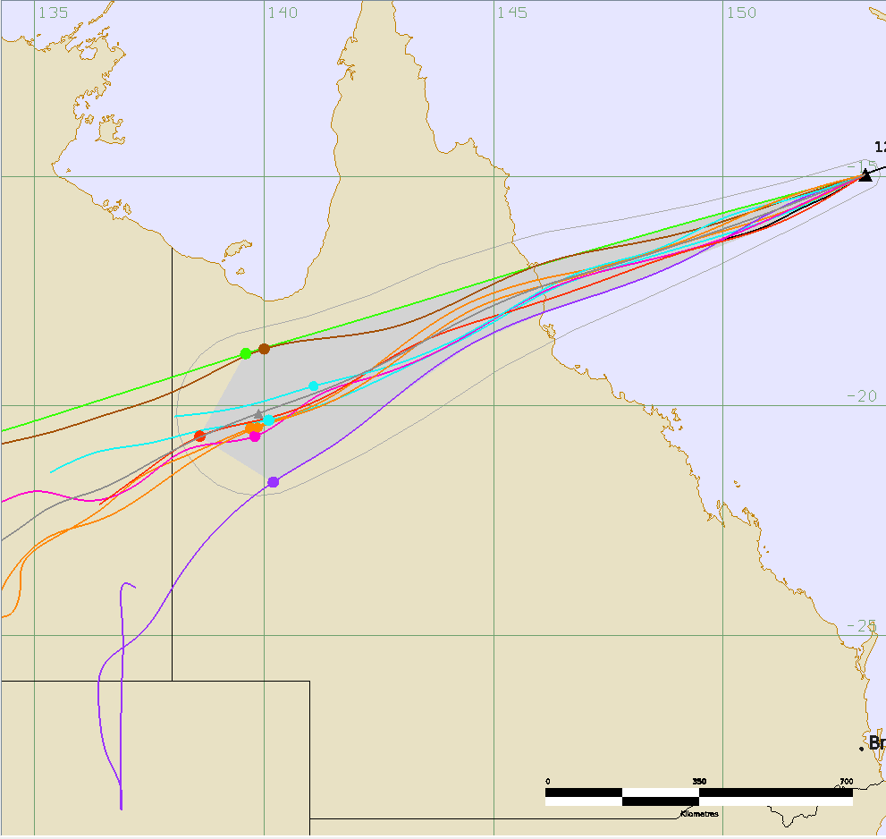
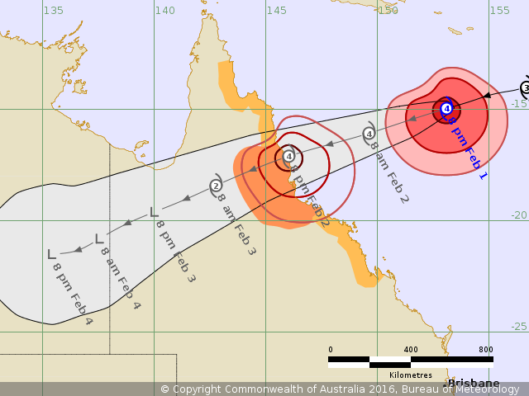
Tropical Cyclone storm surge system
Ideal solution for storm surge predictions would be to drive storm surge model with surface forcing from Numerical Weather Prediction (NWP) model
Standard NWP models generally do not predict Tropical Cyclones (TCs) sufficiently well
Specialised TC models exist but are only one input into official TC forecast
Challenge 1 is to provide storm surge forecast consistent with Official Forecast Track

Slide 5
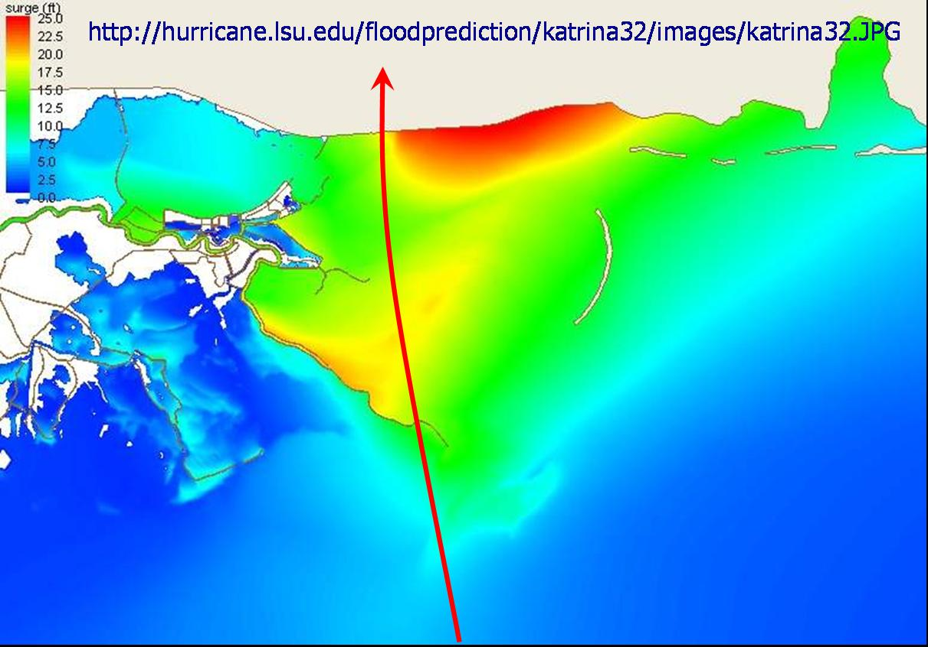
Tropical Cyclone storm surge system
Storm surge amplitudes highly sensitive to errors in forcing
Particularly true of spatial distribution in relation to landfall point
Challenge 2 is to address the uncertainty in the forcing
TC Katrina
Image by Ivor Ll. van Heerden, Center for the Study of Public Health Impacts of Hurricanes.

Slide 6
Tropical Cyclone storm surge system
Use BoM official forecast track
Derive ensemble of tracks (DeMaria et al., 2009)
  Based on track errors over past 5 years
Derive gridded forcing field from parametric TC vortex
  Modified Rankine vortex including asymmetry due to storm forward motion
Run ensemble of storm surge models

Slide 7
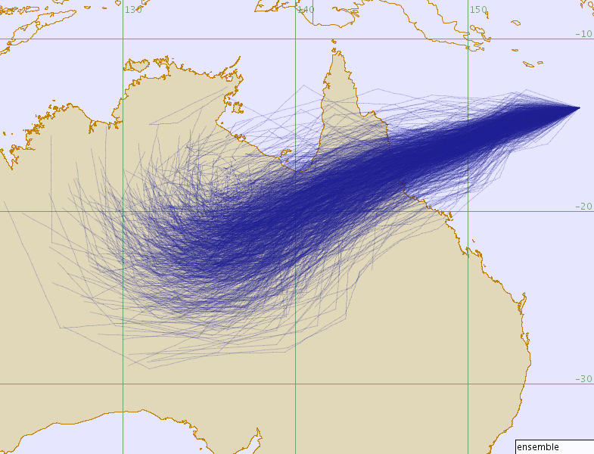
Tropical Cyclone storm surge system
Use BoM official forecast track
Derive ensemble of tracks (DeMaria et al., 2009)
  Based on track errors over past 5 years
Derive gridded forcing field from parametric TC vortex
  Modified Rankine vortex including asymmetry due to storm forward motion
Run ensemble of storm surge models

Slide 8
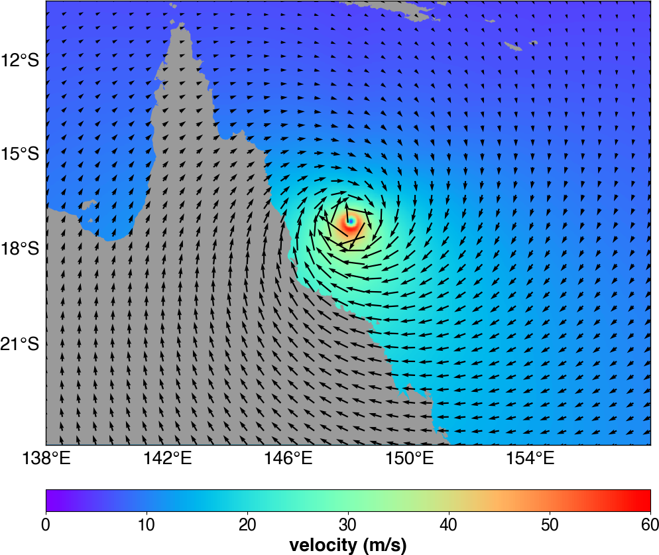
Tropical Cyclone storm surge system
Use BoM official forecast track
Derive ensemble of tracks (DeMaria et al., 2009)
  Based on track errors over past 5 years
Derive gridded forcing field from parametric TC vortex
  Modified Rankine vortex including asymmetry due to storm forward motion
Run ensemble of storm surge models

Slide 9
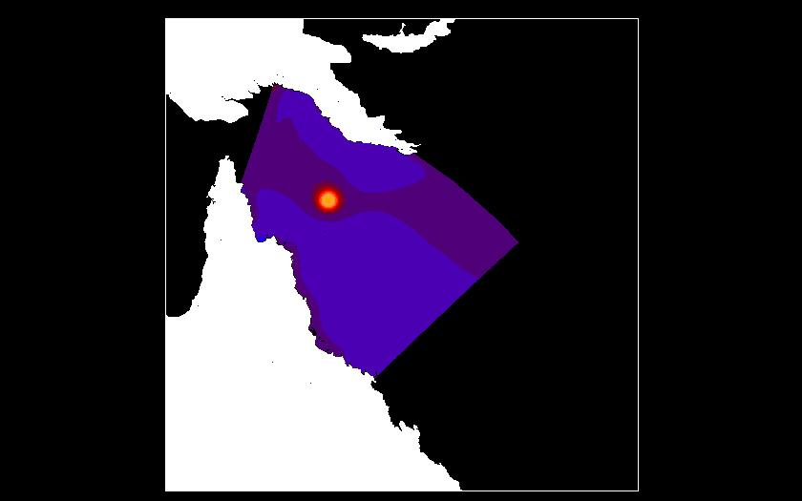
Tropical Cyclone storm surge system
Use BoM official forecast track
Derive ensemble of tracks (DeMaria et al., 2009)
  Based on track errors over past 5 years
Derive gridded forcing field from parametric TC vortex
  Modified Rankine vortex including asymmetry due to storm forward motion
Run ensemble of storm surge models

Slide 10
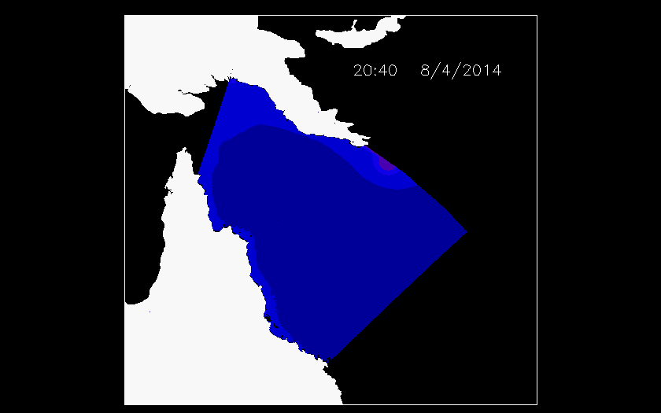
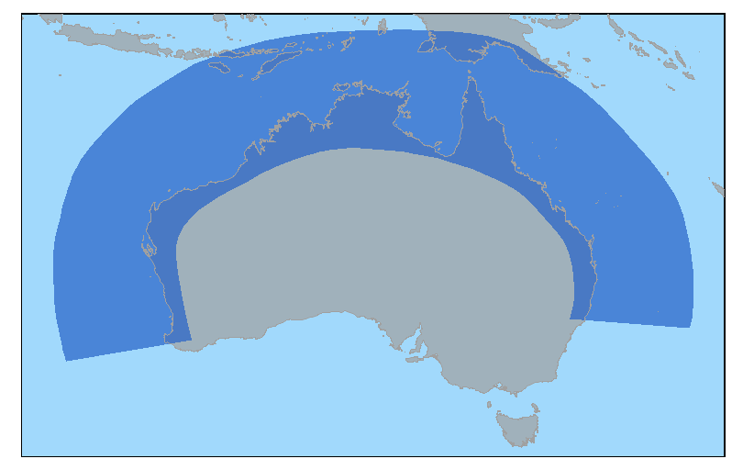
Tropical Cyclone storm surge system
ROMS (Regional Ocean Modelling System)
  2D barotropic mode
  Open boundary conditions
  Coastal spatial resolution ~2.5km
Re-locatable domain (subset of full grid) to reduce computational time
200 ensemble members (randomly chosen from 1000 possible tracks)
72 hour forecast
Wave set-up (from AUSWAVE-R) and tides linearly added to surge

Slide 11
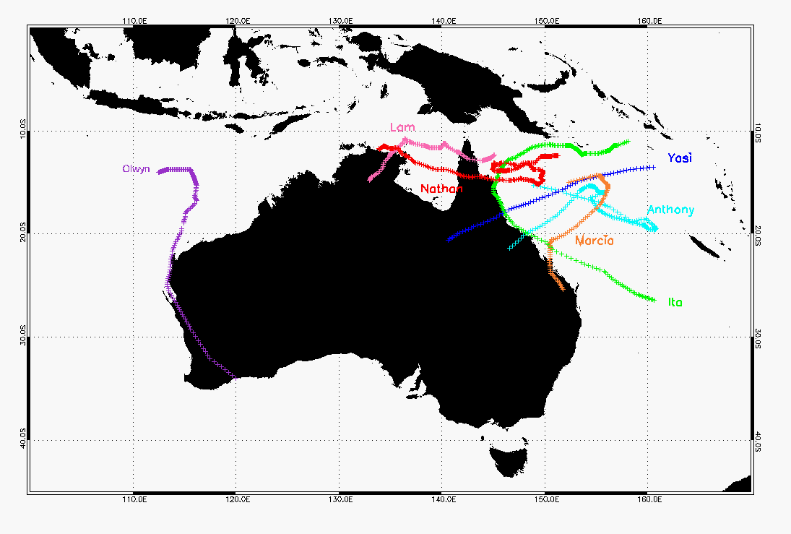
Tropical Cyclone storm surge system
Verification
  'Best track' hindcast runs verified for 7 recent TCs
  28 observations of surge at tide gauges
  Assess amplitude and timing of peak surge

Slide 12
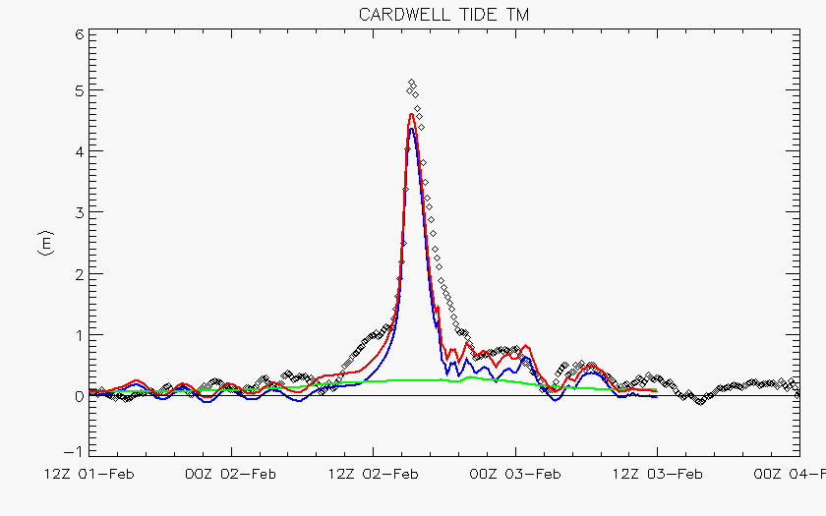
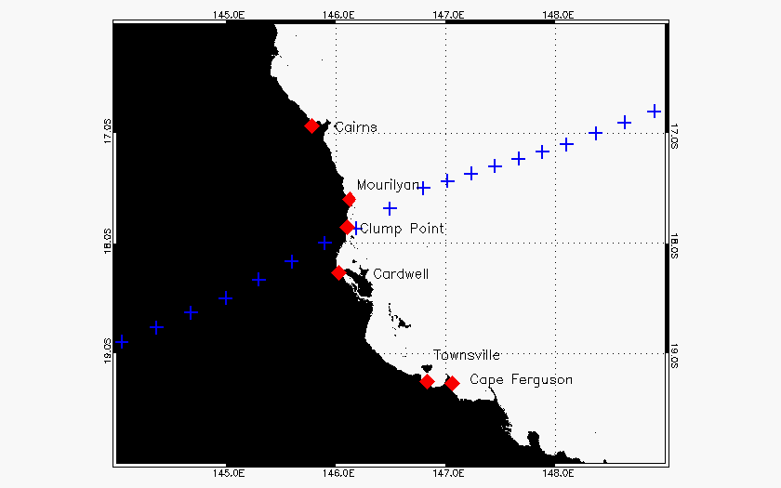
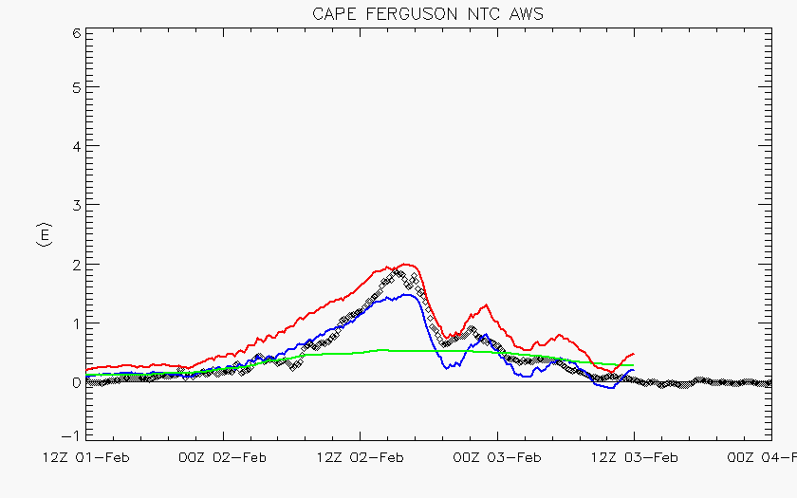
TC Yasi – Best track
Jan/Feb 2011

Slide 13
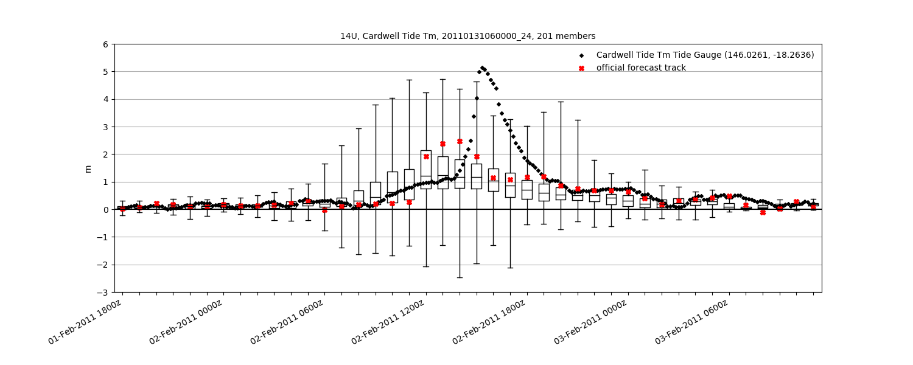
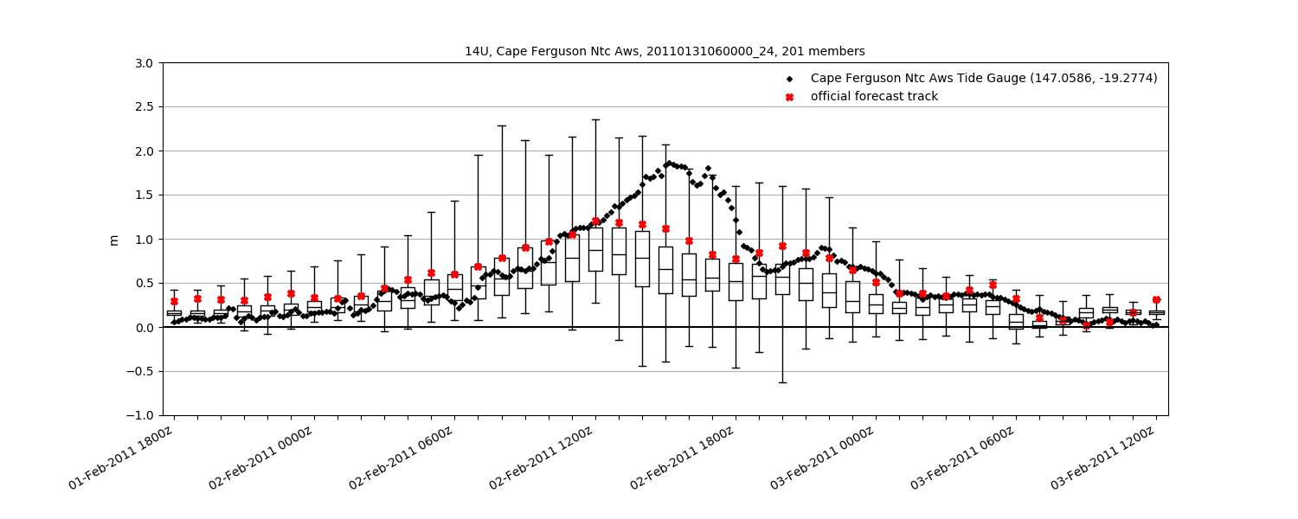
Ensemble Forecasts

Slide 14
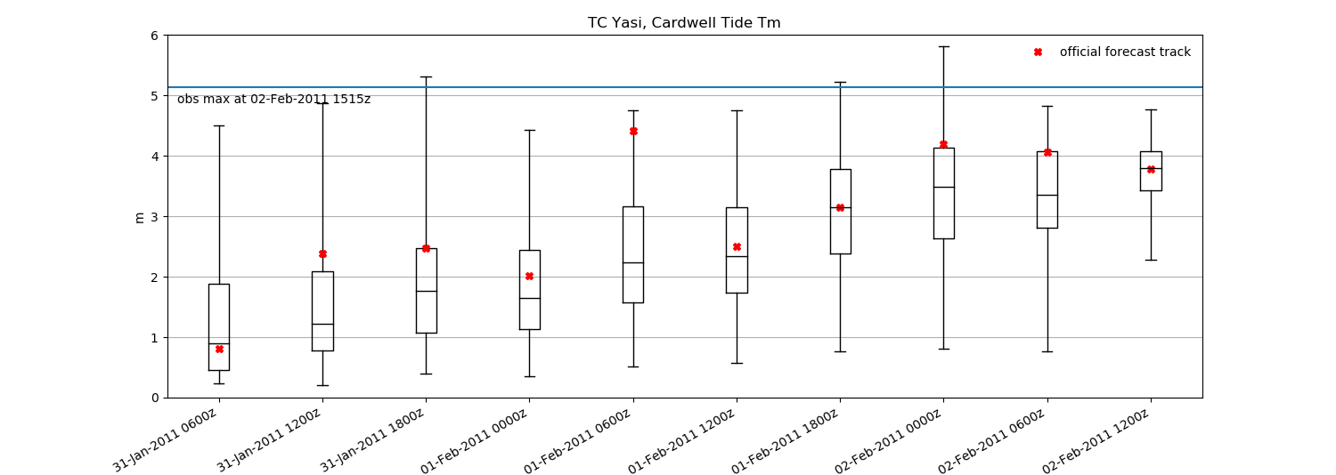
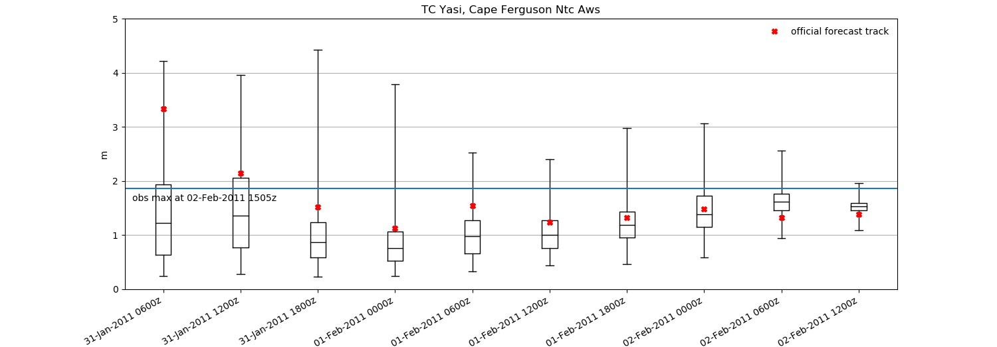
How does 'worst case' vary with time

Slide 15
Further work
Further verification of ensemble system
  Seven recent TCs
  Reliability diagrams – enough data?
Number of ensemble members
Improve wave set-up for ensemble system

Slide 16
Thank you
Greenslade, D., Taylor, A., Freeman, J., Sims, H., Schulz, E., Colberg, F., Divakaran, P., Velic, M. and Kepert, J., October 2018, A First Generation Dynamical Tropical Cyclone Storm Surge Forecast System Part 1: Hydrodynamic model, Bureau Research Report No. 031 http://www.bom.gov.au/research/research-reports.shtml

