Slide 1


Wind and wave extremes from atmosphere and wave model ensembles
Ian R. Young¹; Alberto Meucci¹; Øyvind Breivik²
ameucci@student.unimelb.edu.au
¹Department of Infrastructure Engineering, University of Melbourne
²Norwegian Meteorological Institute and University of Bergen, Norway

Slide 2
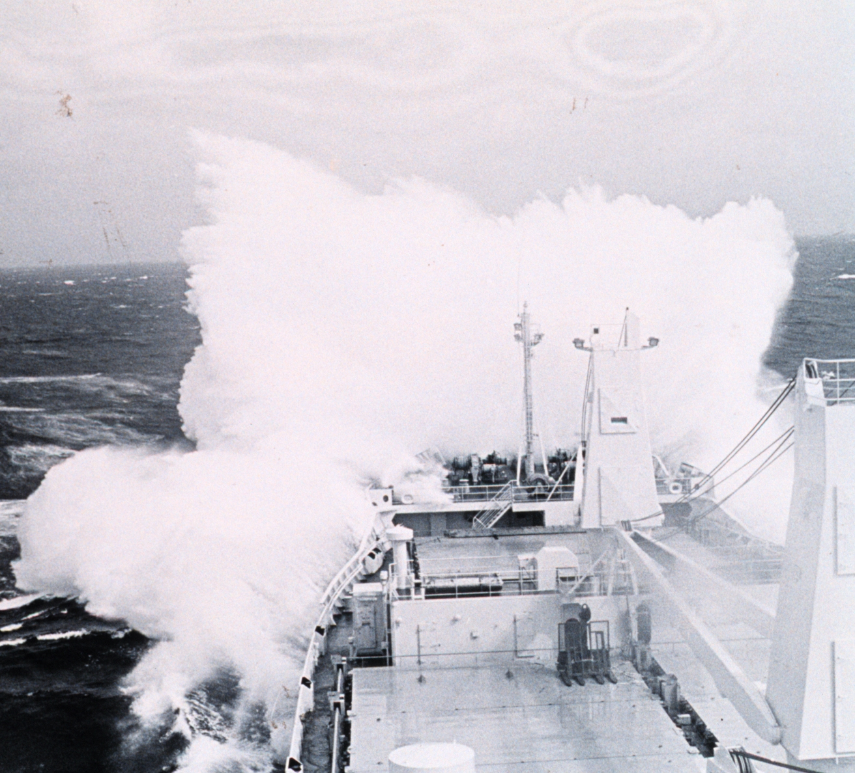
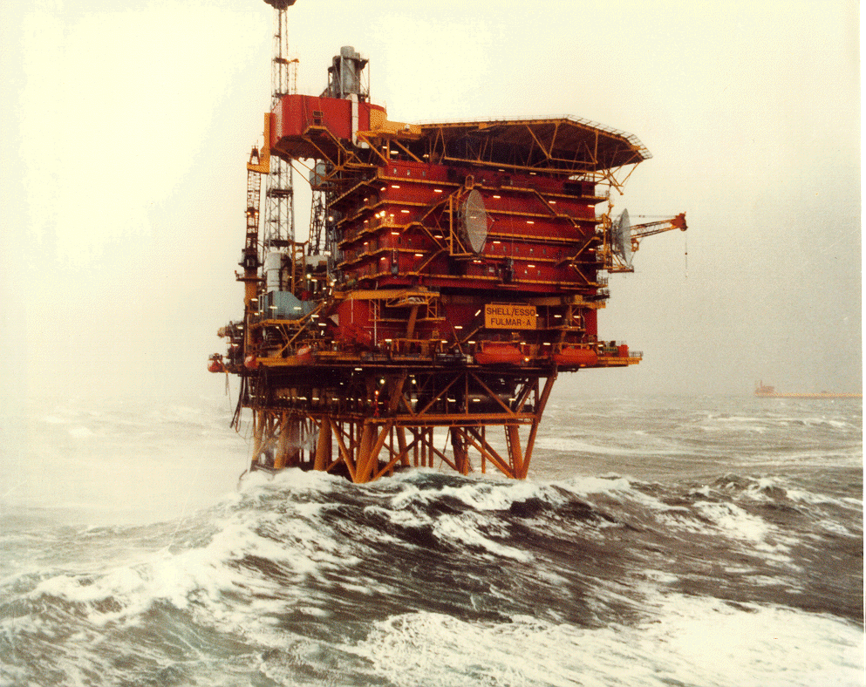
Extreme Value Analysis
Typically use long time series of measured or model data
Determine the PDF
Extrapolate to the required probability level – eg. 100 yr return period

Slide 3
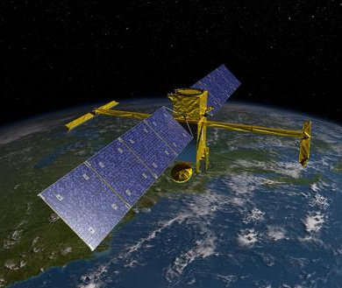
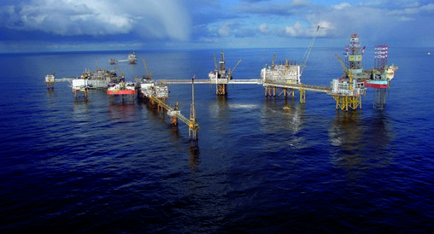
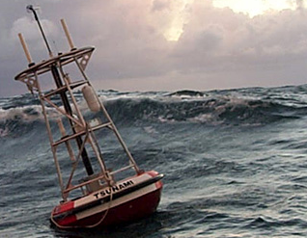
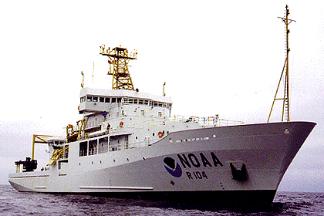
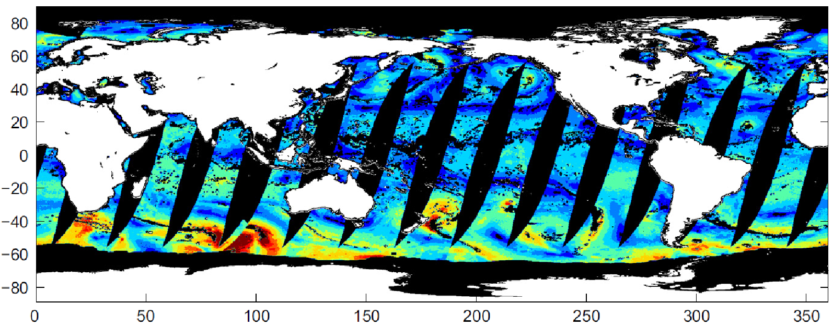
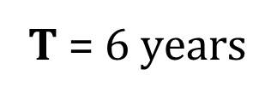

Data limitations
Constraints in time
Constraints in space
ECMWF Atmosphere and wave model ensemble forecast dataset (ENS)

Slide 4

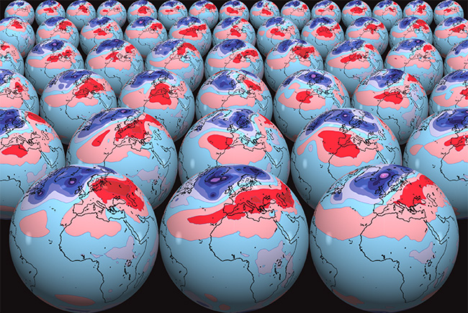
Dataset: ENS prediction system
Uncertainties of NWP
Inaccurate estimates of the current state (i.e. initial conditions)
Numerical models inadequacies: parameterization & unresolved scales
Stochastic-dynamic approach:
52 forecasts twice a day
1 HRES
1 Control Forecast
50 ENSembles
50 ENS
(Molteni et al., 1996)

Slide 5
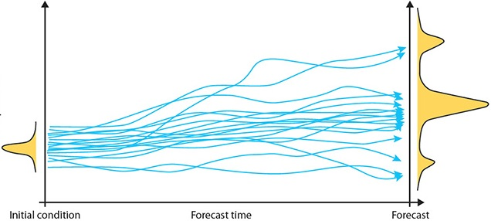
(Breivik et al., 2013, 2014)
Dataset: ENS forecasts at advanced lead times
Independent and Identically Distributed (i.i.d)
(Coles, 2001)
50 ENS
Advanced lead times:
Day 9
Day 10
Day 9
Day 10
MAX (+216h, +222h +228h, +234h, +240h)
March 2010 – March 2016
1°x1° global grid resolution
Extreme Value Analysis (EVA):
100 years RP
H_{s} - U_{10N}

Slide 6
Methodology testing
(Breivik et al., 2013)
No significant correlation between ensemble members at advanced lead times Independent and Identically Distributed
(i.i.d)
ENS#1 – ENS#50
Model climatology comparable to the observed climatology distribution
(Young et al., 2017)
ENS – SAT

Slide 7
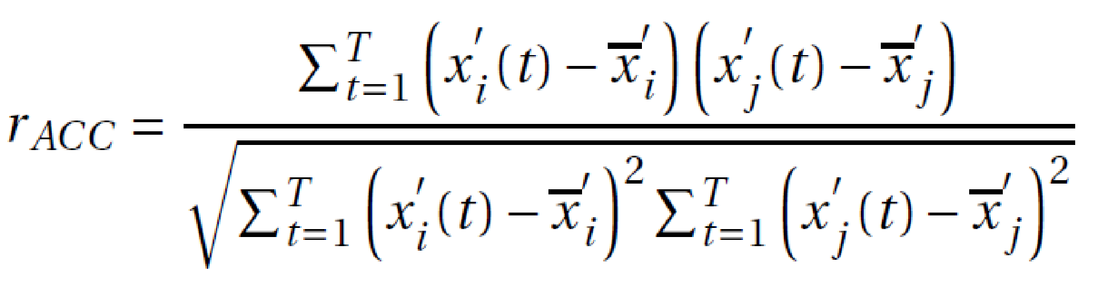
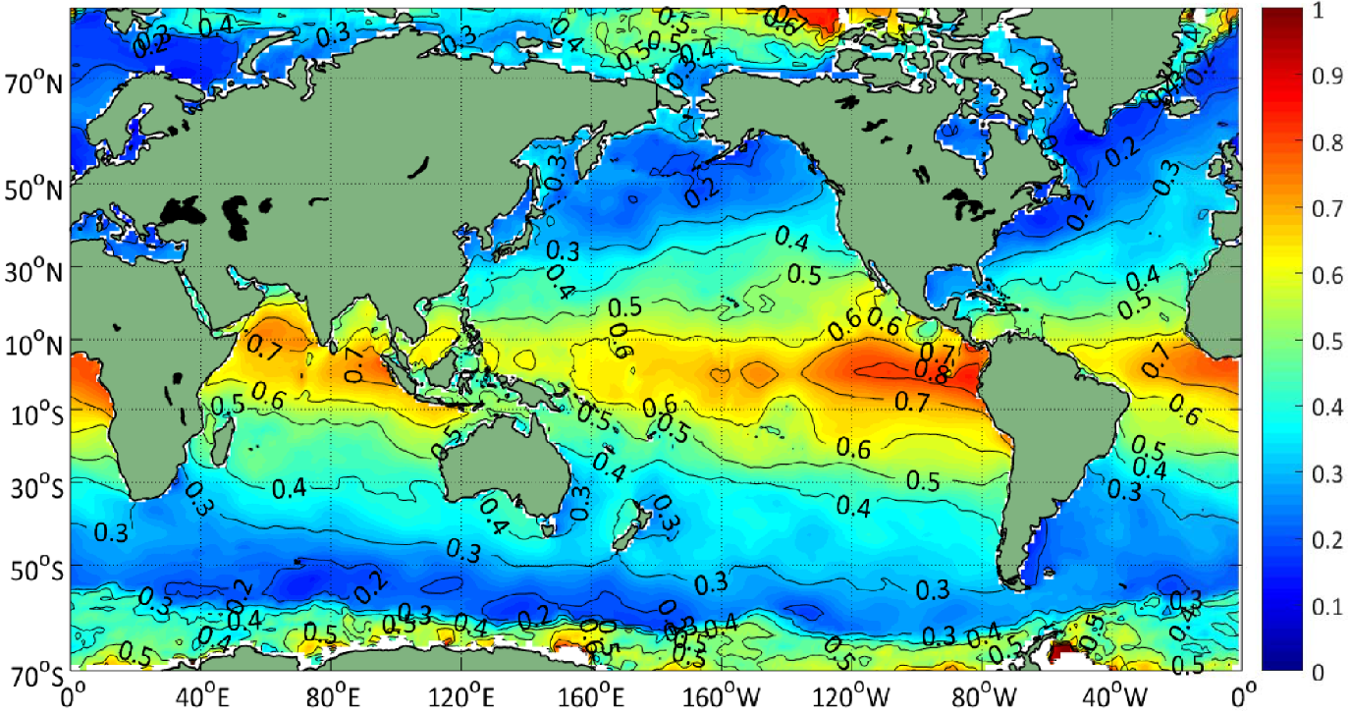
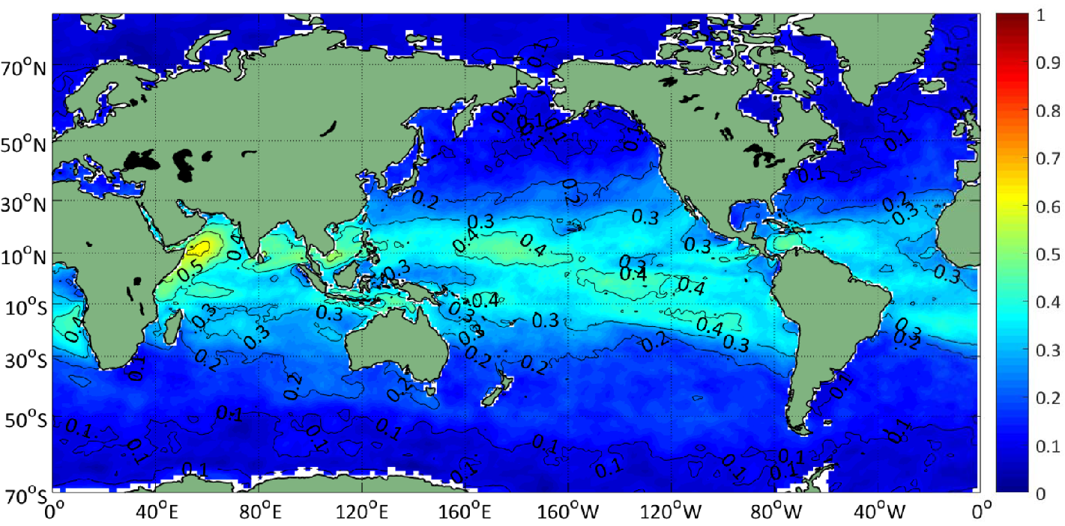
Centered anomaly correlation
(Wilks, 2011)
ENS#1 – ENS#50
H_{s} +216h
U₁₀ +216h

Slide 8
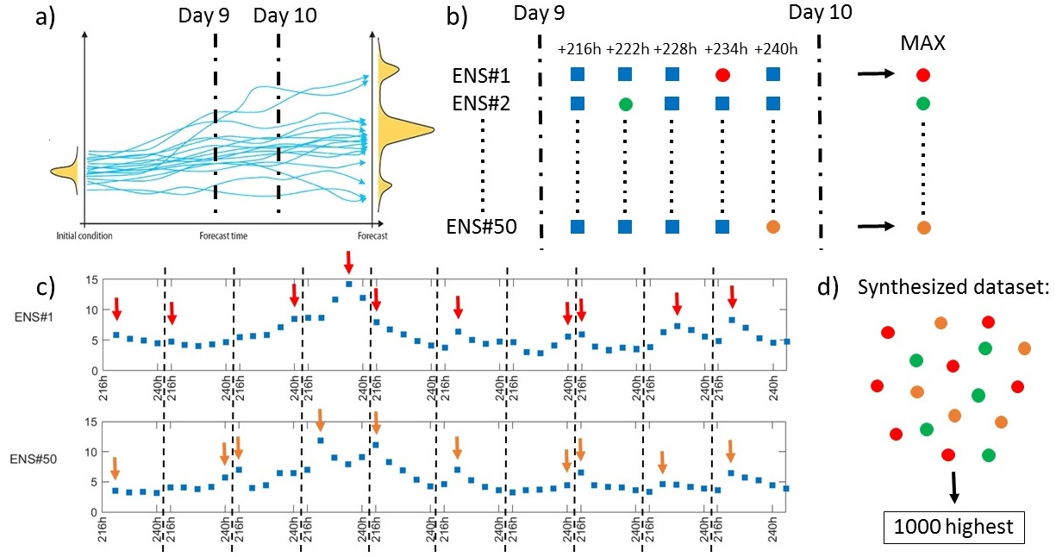
Construction of the dataset

Slide 9
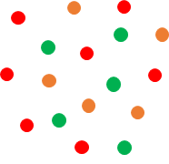
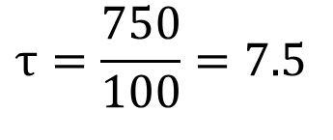
ENS DRE approach
(Breivik et al., 2013, 2014)
Δt = 6h
Δt = 6 x 5 = 30h
T_{eq} = 750 years
1000 highest peaks

Slide 10
ENS DRE H_{s} 100 years RP

Slide 11
ENS DRE U_{10N} 100 years RP

Slide 12
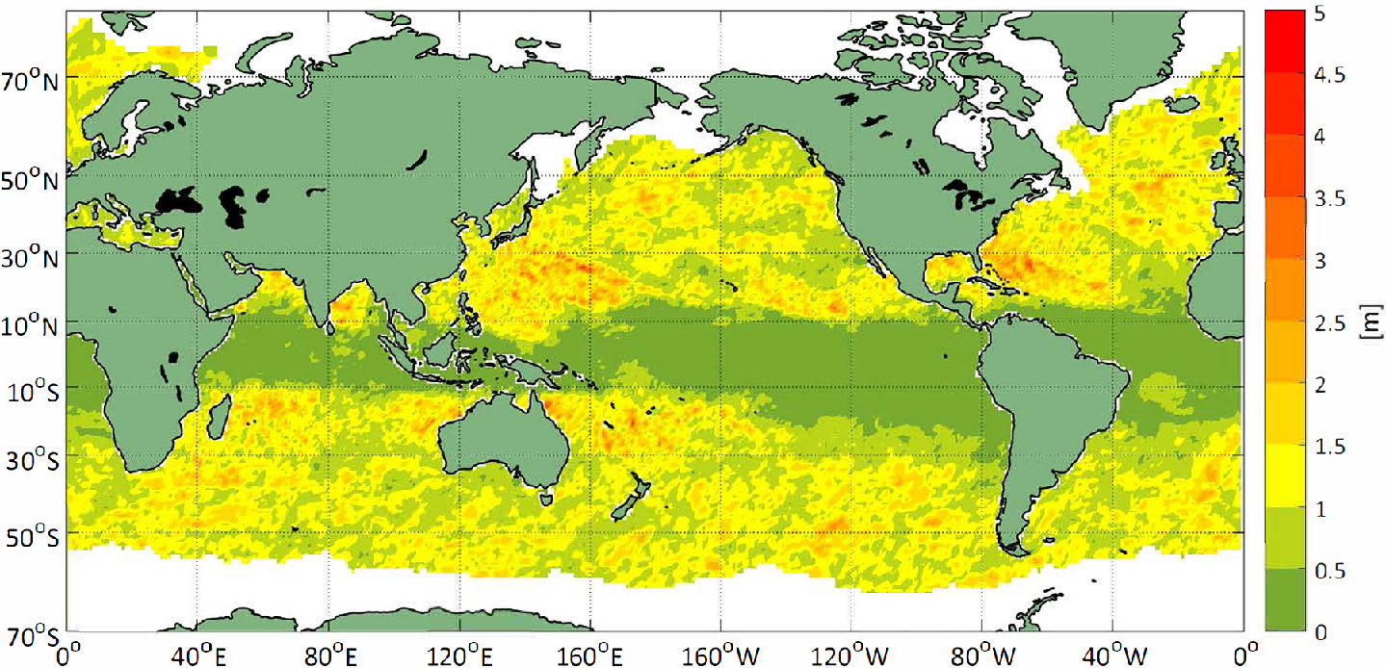
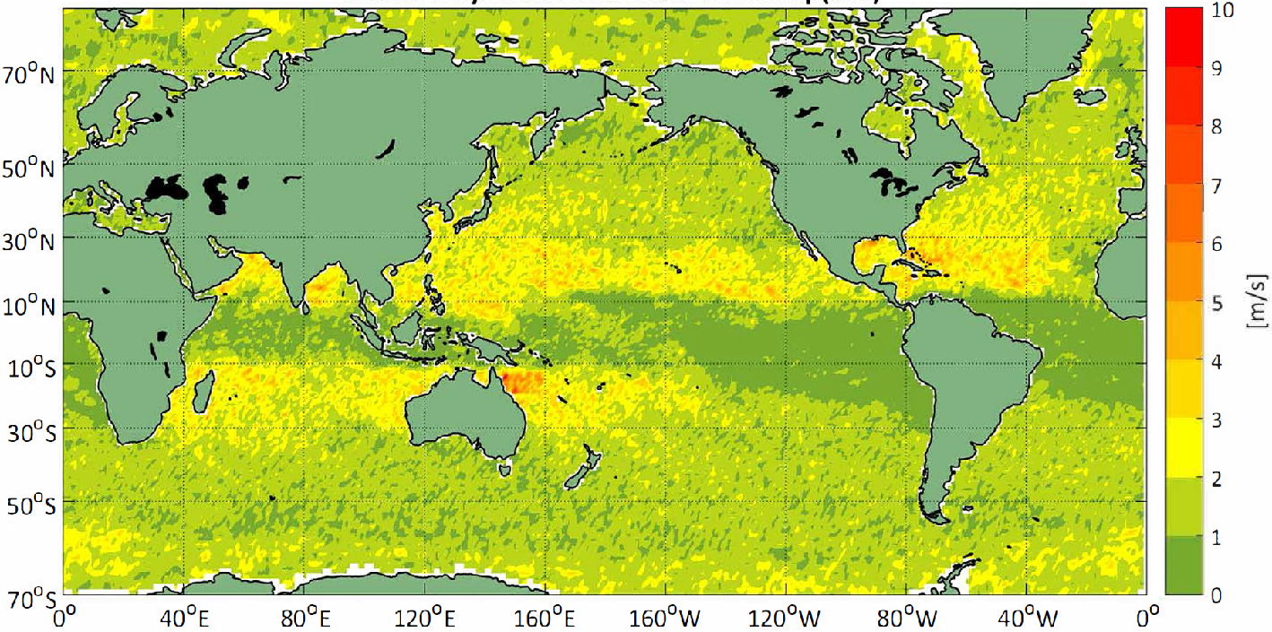
ENS DRE H_{s} 95% CI
DRE 95% CI bootstrap estimates
(Breivik and Aarnes, 2017)
ENS DRE U_{10N} 95% CI

Slide 13
ERA-Interim POT 99.8% H_{s} 100 years RP
ENS DRE H_{s} 100 years RP
ENS DRE U_{10N} 100 years RP
ERA-Interim POT 99.8% U_{10N} 100 years RP

Slide 14
Limitations
Tropical Cyclones still not correctly reproduced at the current resolution
Confidence intervals are also larger in TC areas
Increased resolution is computationally expensive
Possible biases in the model representation of strong winds
(Pineau-Guillou et al., 2017)
Stationarity may not be the case for ocean extremes
(Young et al., 2011)

Slide 15
Potential
(i.i.d)
Selection of 5 different ENS advanced lead times
6 years of data
Synthesized 750 years
Short time series guarantees stationarity and avoid effects of model changes
Smaller Confidence Intervals
Sounder justification of the forecast representative time parameter:
(Breivik et al., 2013, 2014)
Δt = 6h
Δt = 6 x 5 = 30h
Buoys Return Periods estimates fall in the confidence limits of the DRE

Slide 16
Conclusions
Advantages of the ENS approach
Low correlation at advanced lead times that guarantees independence
Short time series of data that guarantees stationarity and avoid effects of model changes
Possibility to synthesize an equivalent time series of duration far longer than the simulation period
Possibility to use direct inference statistics
Increase of confidence levels

Slide 17
References
Breivik, Ø., Aarnes, O. J., Bidlot, J.-R., Carrasco, A., and Saetra, Ø. (2013). Wave extremes in the northeast Atlantic from ensemble forecasts. Journal of Climate, 26(19):7525–7540.
Bidlot, J. R., Holmes, D. J., Wittmann, P. A., Lalbeharry, R., & Chen, H. S. (2002). Intercomparison of the performance of operational ocean wave forecasting systems with buoy data. Weather and Forecasting, 17(2), 287-310.
Breivik, Ø., Aarnes, O. J., Bidlot, J. R., Carrasco, A., & Saetra, Ø. (2013). Wave extremes in the northeast Atlantic from ensemble forecasts. Journal of Climate, 26(19), 7525-7540.
Breivik, Ø., Aarnes, O. J., Abdalla, S., Bidlot, J. R., & Janssen, P. A. (2014). Wind and wave extremes over the world oceans from very large ensembles. Geophysical Research Letters, 41(14), 5122-5131.
Breivik, Ø. and Aarnes, O.J., (2017). Efficient bootstrap estimates for tail statistics. Natural Hazards and Earth System Sciences, 17(3), p.357.
Coles, S., Bawa, J., Trenner, L., & Dorazio, P. (2001). An introduction to statistical modeling of extreme values (Vol. 208). London: Springer.
Lopatoukhin, L., Rozhkov, V., Ryabinin, V., Swail, V., Boukhanovsky, A., and Degtyarev, A. (2000). Estimation of extreme wind wave heights. Technical report, WMO.
Lorenz, E. N. (1963). Deterministic nonperiodic flow. Journal of the atmospheric sciences, 20(2), 130-141.
Molteni, F., Buizza, R., Palmer, T. N., & Petroliagis, T. (1996). The ECMWF ensemble prediction system: Methodology and validation. Quarterly journal of the royal meteorological society, 122(529), 73-119.
Wang, X. L., Feng, Y., & Swail, V. R. (2014). Changes in global ocean wave heights as projected using multimodel CMIP5 simulations. Geophysical Research Letters, 41(3), 1026-1034.
Wilks, D. S. (2011). Statistical methods in the atmospheric sciences, volume 100. Academic press.
Young, I. R., Zieger, S., & Babanin, A. V. (2011). Global trends in wind speed and wave height. Science, 332(6028), 451-455.
Young, I., Sanina, E., and Babanin, A. (2017). Calibration and cross-validation of a global wind and wave database of altimeter, radiometer and scatterometer measurements. Journal of Atmospheric and Oceanic Technology, (2017).

Slide 18
Test locations

Slide 19
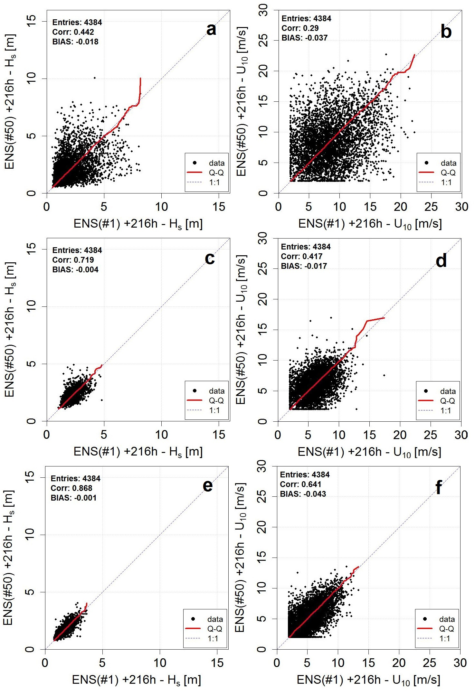
NH: ENS#1 – ENS#50
North Atlantic H_{s}
North Atlantic U_{10N}
North East Pacific H_{s}
North East Pacific U_{10N}
North Indian Ocean H_{s}
North Indian Ocean U_{10N}

Slide 20
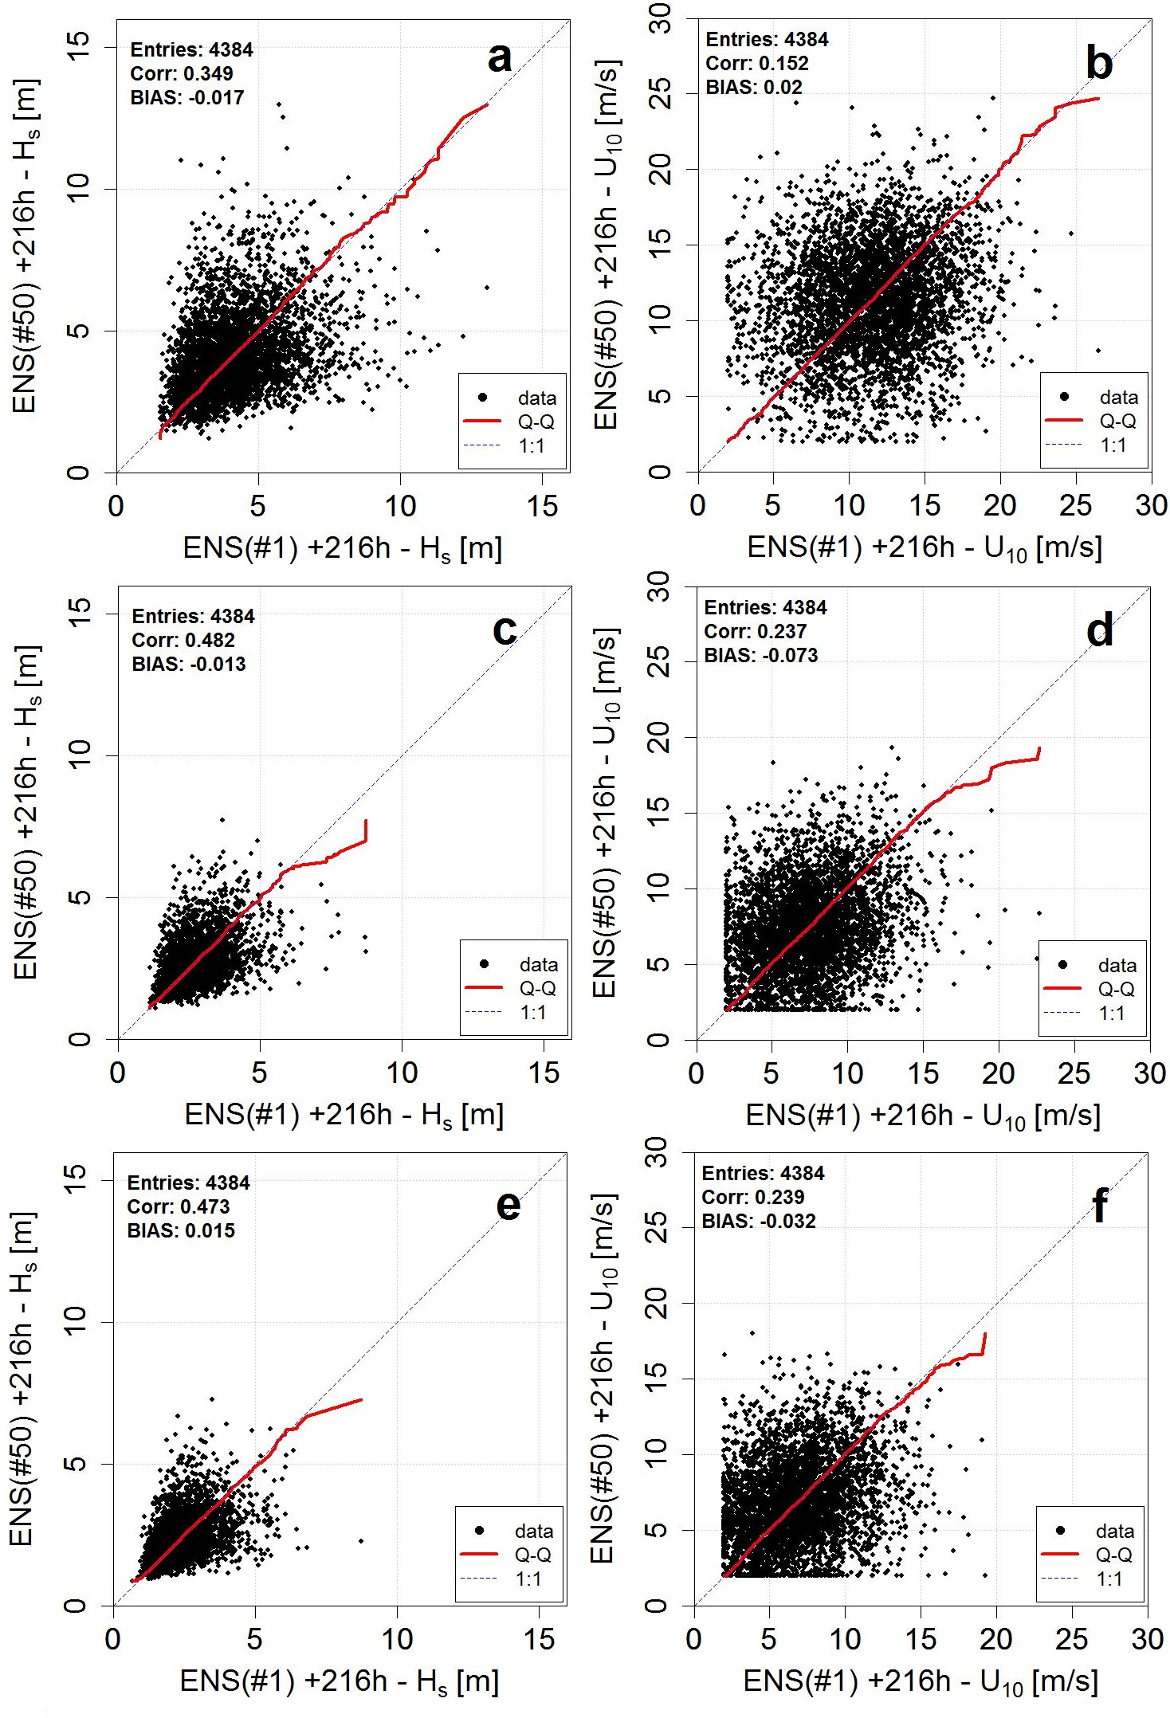
SH: ENS#1 – ENS#50
Southern Ocean H_{s}
Southern Ocean U_{10N}
South West Pacific H_{s}
South West Pacific U_{10N}
South Atlantic H_{s}
South Atlantic U_{10N}

Slide 21
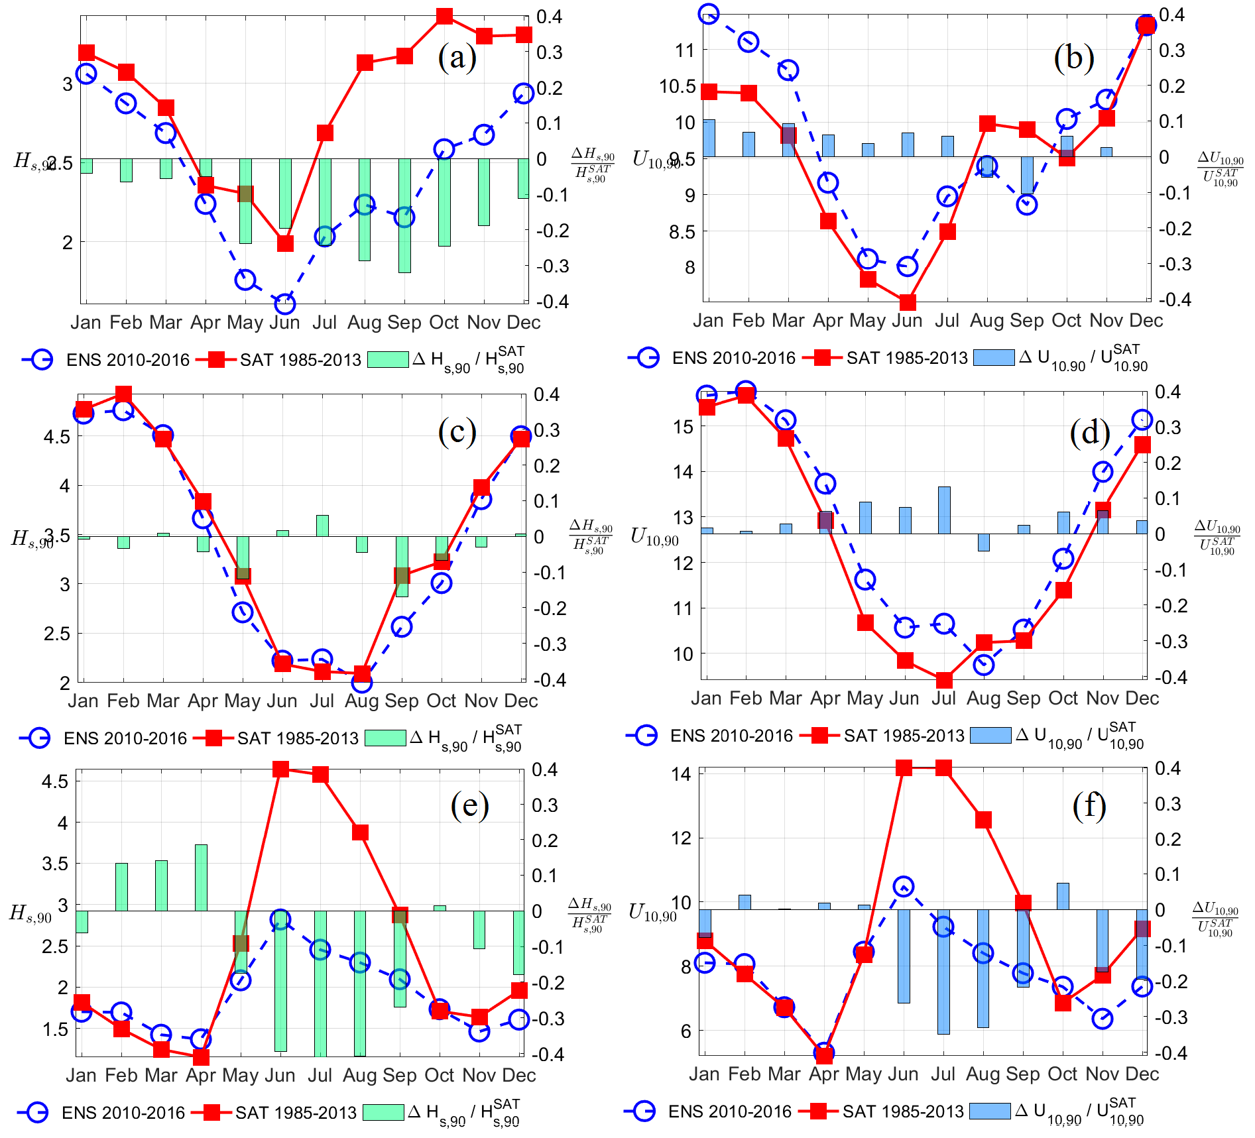
NH: ENS+240h - SAT
Monthly 90th percentiles
North Atlantic H_{s}
North Atlantic U_{10N}
North East Pacific H_{s}
North East Pacific U_{10N}
North Indian Ocean H_{s}
North Indian Ocean U_{10N}

Slide 22
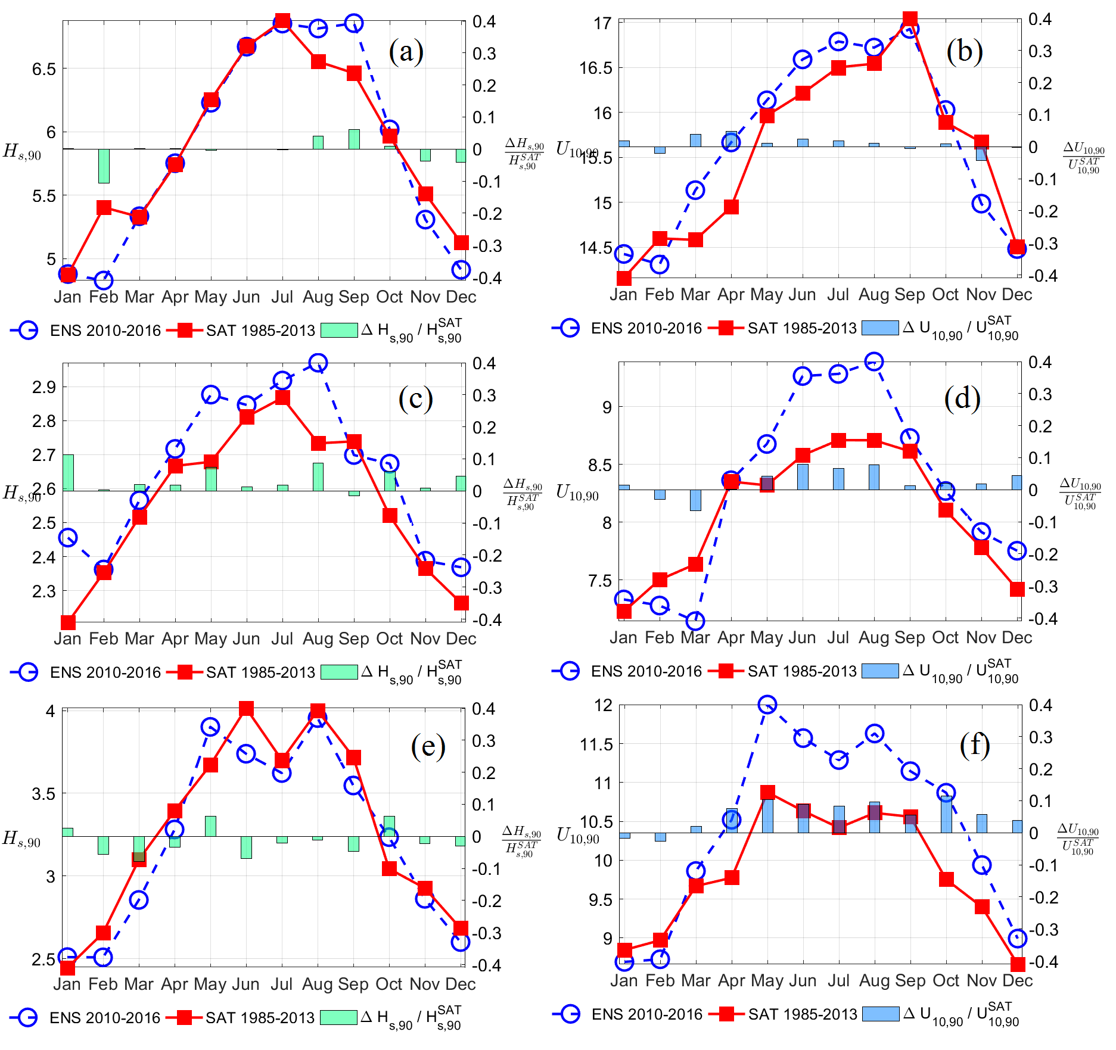
SH: ENS+240h - SAT
Monthly 90th percentiles
Southern Ocean H_{s}
Southern Ocean U_{10N}
South West Pacific H_{s}
South West Pacific U_{10N}
South Atlantic H_{s}
South Atlantic U_{10N}

Slide 23
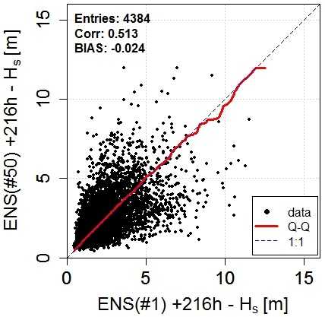
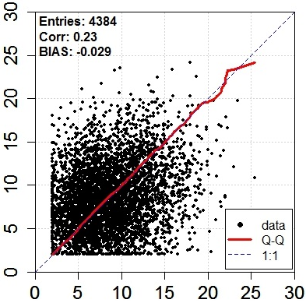
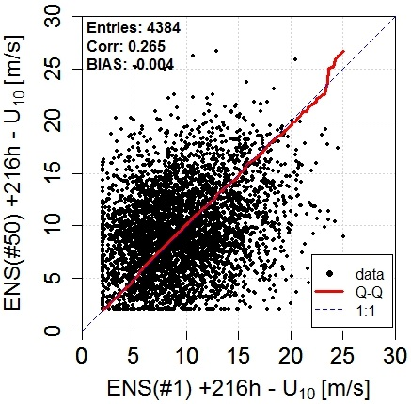
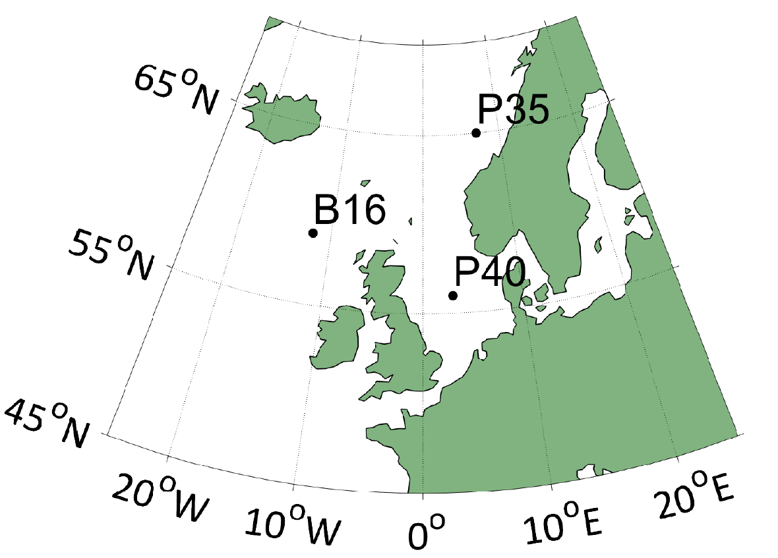
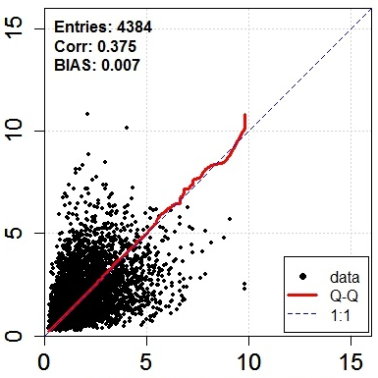
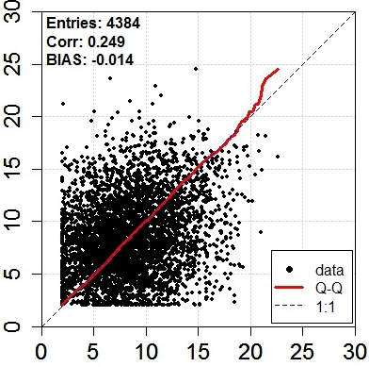
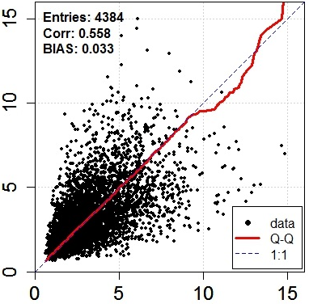
Criteria check
P35
P40
B16
ENS#1 – ENS#50

Slide 24
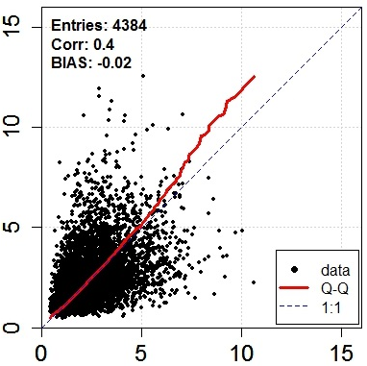
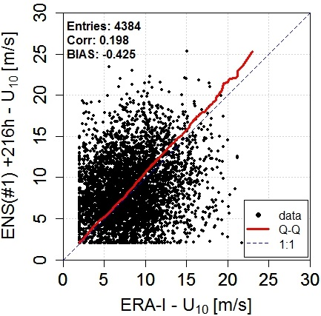
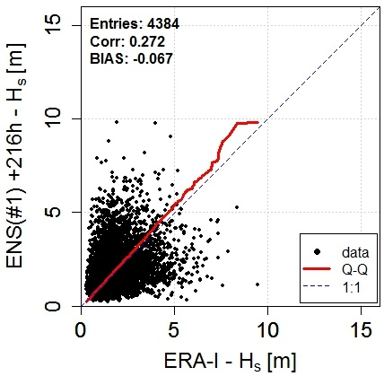
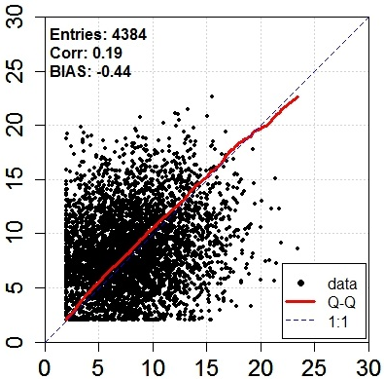
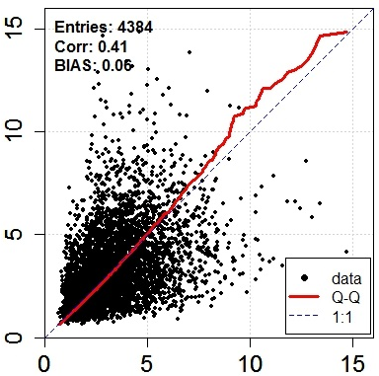
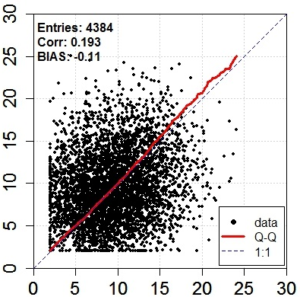
Criteria check
P35
P40
B16
ENS#1 – ERA-I

Slide 25
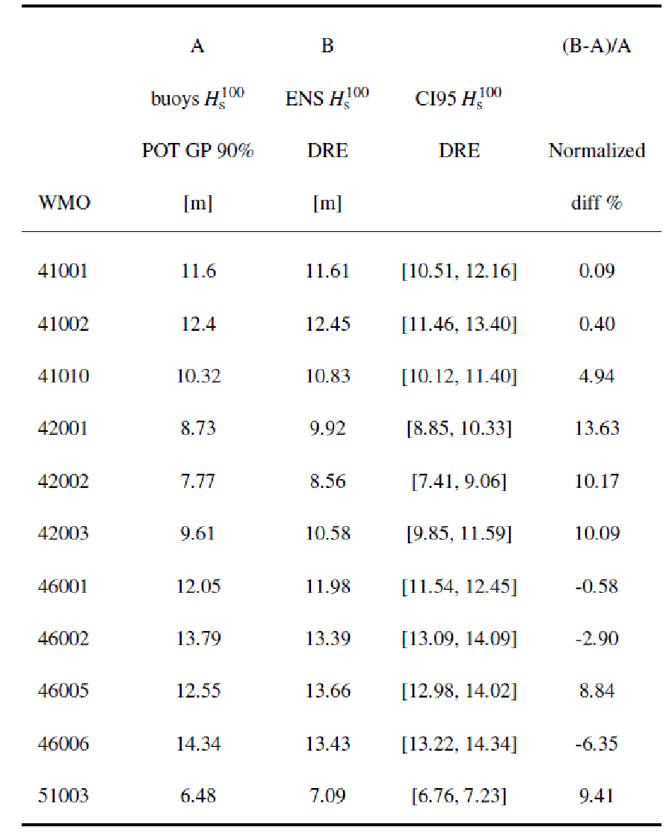
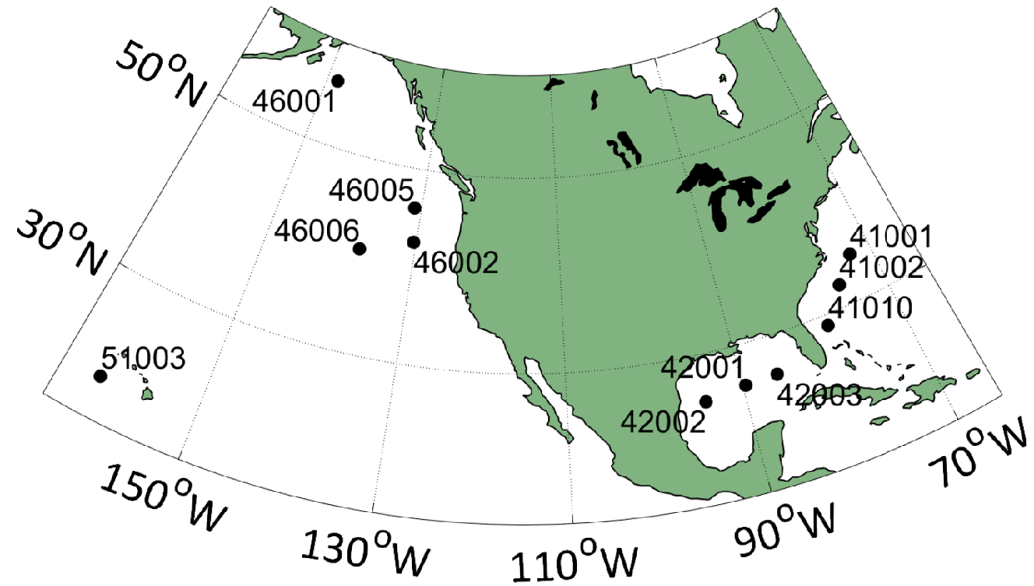
Buoys Validation H_{s}
POT 90%
(Bidlot et al., 2002)
Synoptic time centred averages
±2 hrs
48 hour peak independence
(Lopatoukhin et al., 2000)

Slide 26
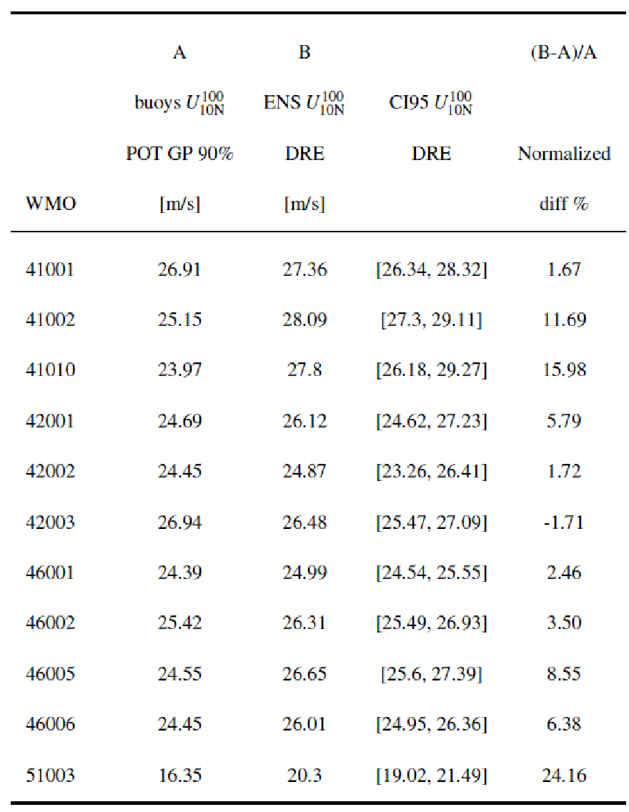
Buoys Validation U_{10N}
POT 90%
(Bidlot et al., 2002)
Synoptic time centred averages
±2 hrs
48 hour peak independence
(Lopatoukhin et al., 2000)

Slide 27
ENS IDM H_{s} 100 years RP (Gumbel)
ENS DRE H_{s} 100 years RP
ENS DRE U_{10N} 100 years RP
ENS IDM U_{10N} 100 years RP (W2P)

