Slide 1




Bluelink ocean forecasting developments:
OceanMAPS, ensemble forecasting and Maritime continent
Brassington, Oke, Divakaran, Sakov, Velic, Huang, Zhong, Fiedler, Chamberlain, Hogg and Kiss + Dietachmayer, Colberg and Zeiger

Slide 2
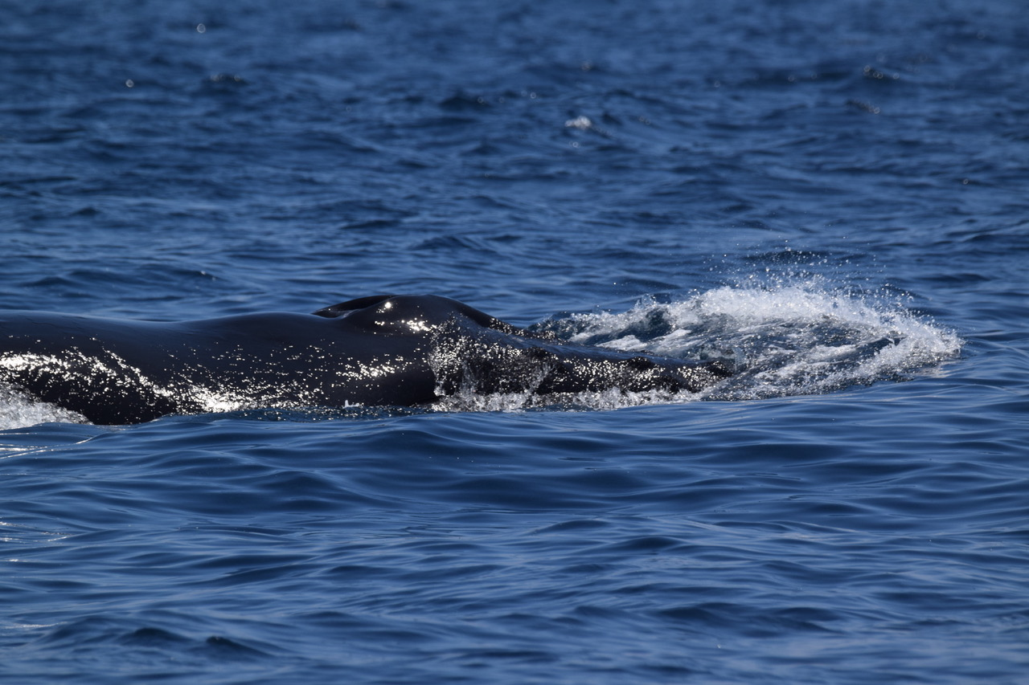
Notes:
There is a beautiful ocean out there.
Despite being a desk jockey oceanographer it is nice to get out there occassionally

Slide 3
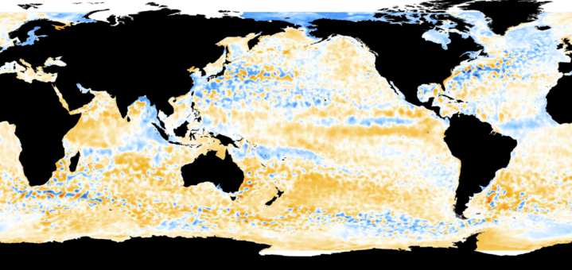



Ocean Model Analysis and Prediction System
OceanMAPS version 3.1
Ocean Model
MOM 4p1, Griffies et al., 2008
z* vertical coordinate
Smith and Sandwell, v11.1
3599×1499×50
0-360, 75S-75N (0.1°×0.1°)
0-15 m (Δz = 5 m)
15-90 m (Δz~5 to 10 m)
90-200m (Δz=10 m)
Minimum column depth – 15 m
GOTM, K-eps mixed layer scheme
No tides
No sea-ice
Data Assimilation
ENKF-C (Sakov, 2014)
Ensemble optimal interpolation
State vector (eta, T, S, u, v)
144-member ensemble
Restart initialisation
Observations
Satellite altimetry (Jason3, Sentinel3A, Cryosat2, AltiKa)
Satellite SST (Metop-A, Metop-B, VIIRS, AVHRR, AMSR2)
In situ profiles Argo, CTD, XBT
Forcing
ACCESS-G APS2 (fluxes)
Climatological river discharge
Thanks also to GFDL, the
global ocean observing system, IMOS and JCOMM
Notes:
Highlight the information content – 10km resolution
Credible representation of the shelf processes, boundary currents, upwelling, downwelling
Port, bay beach scale require further downscaling through nesting
However, additional information is also required with coastal observing systems

Slide 5
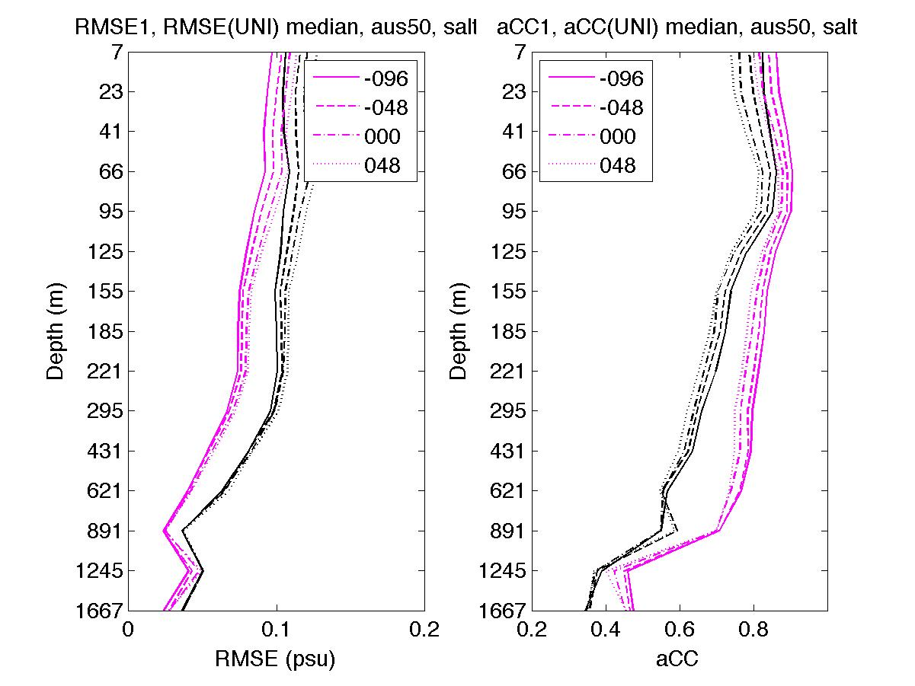
Multi-cycle ensemble forecasting - recap
SST

Slide 6
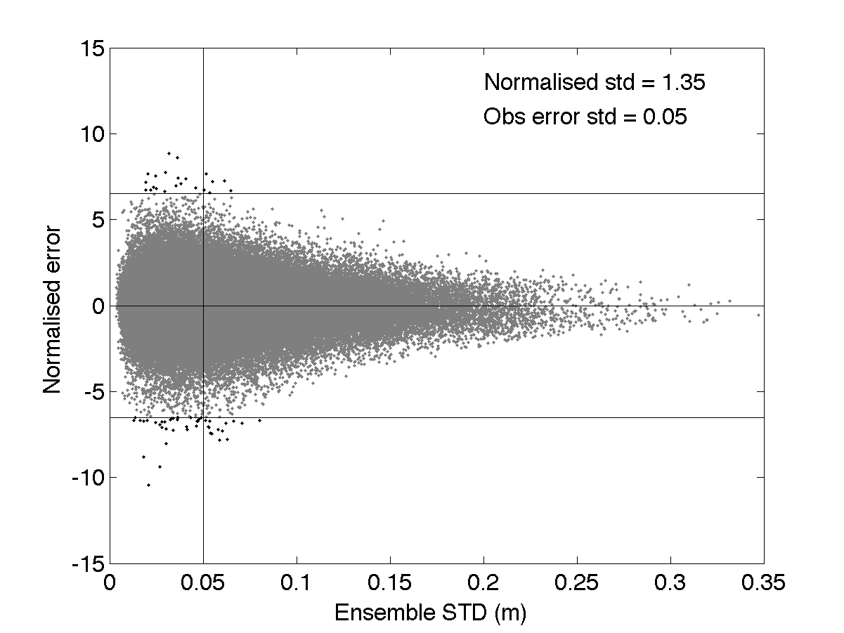
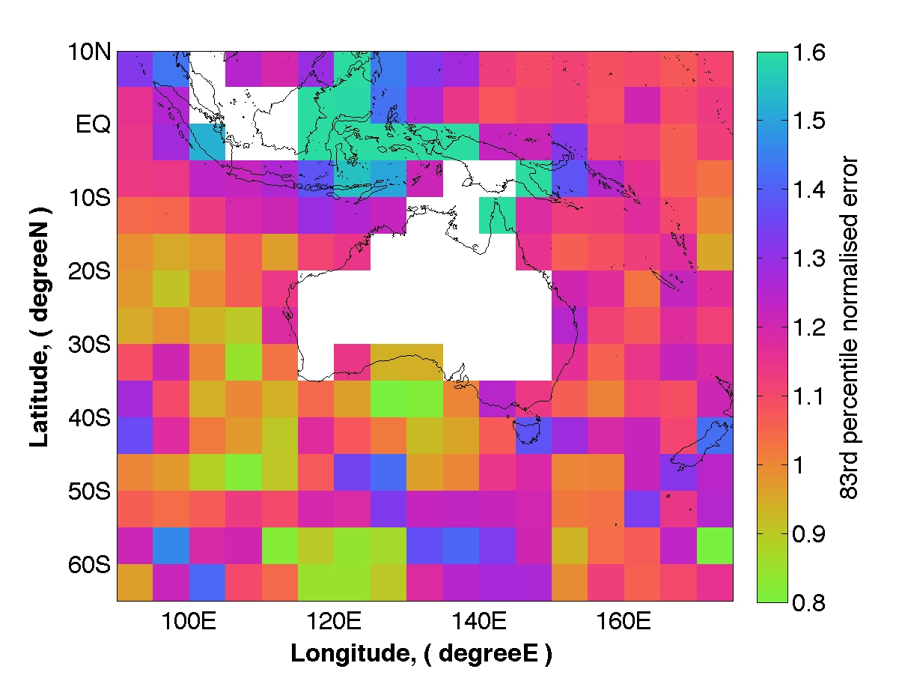
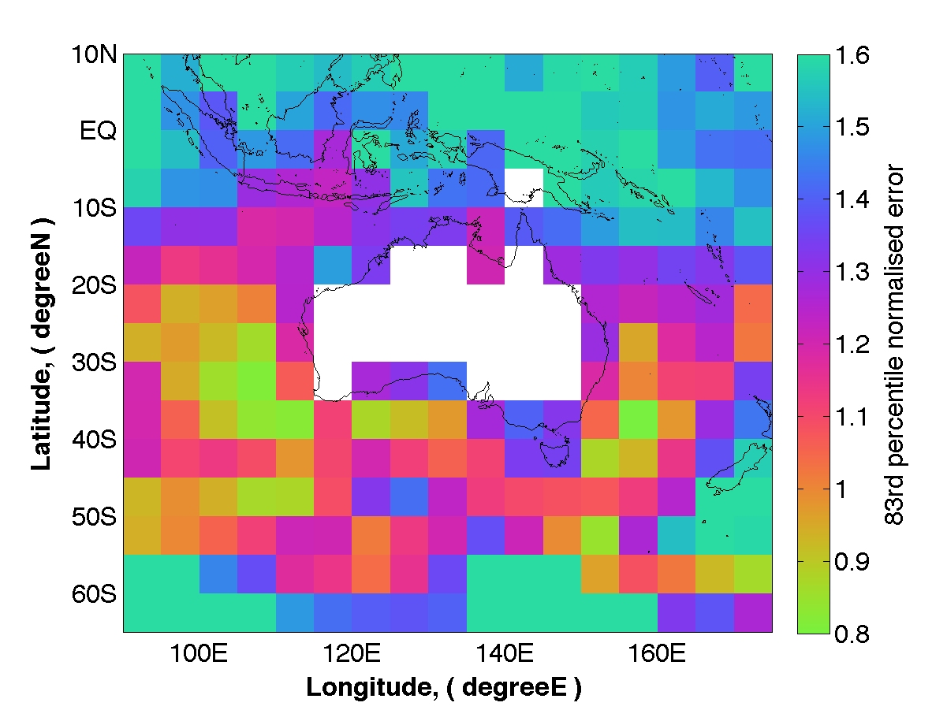
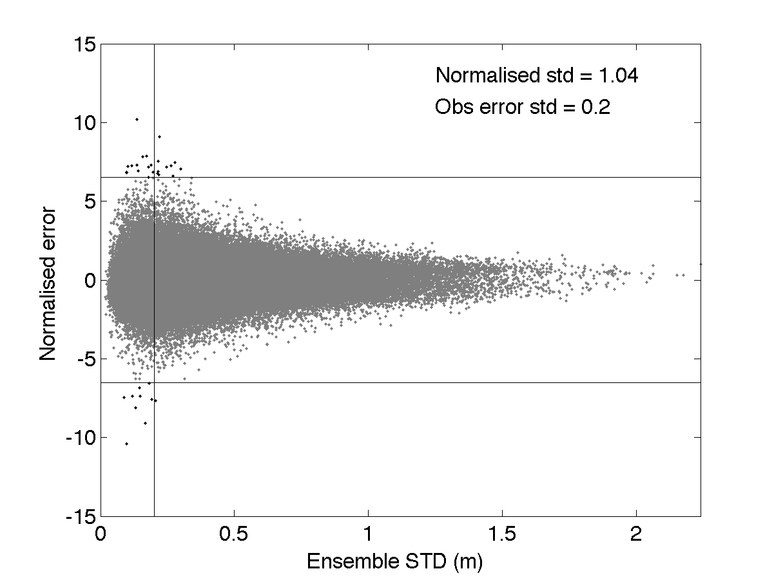
SSH
East Australian Current
SST

Slide 7
Monthly mean, ensemble mean and variance
SST monthly average ensemble mean
SST monthly average ensemble STD
Jan 2012
Jan 2012
Jan 2013
Jan 2013
Notes:
Monthly ensemble STD is confined to the fronts
The position and magnitude of the frontal temperature is captured in the uncertainty.

Slide 8
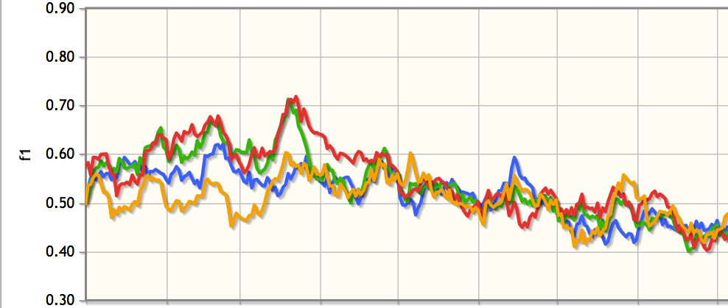
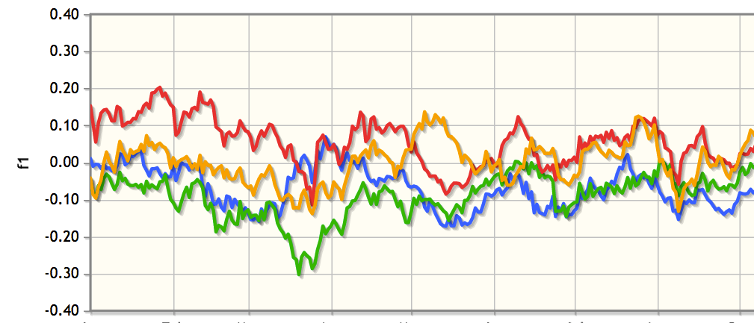
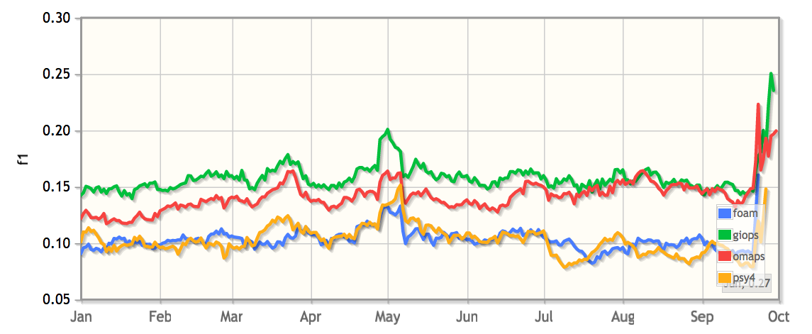
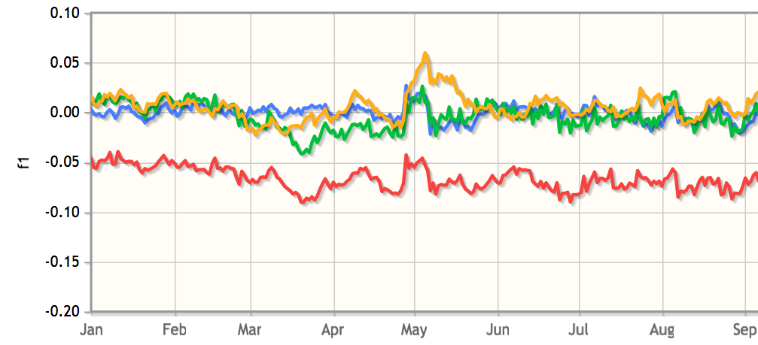
Global verification/intercomparison
Day 1 forecast
Mean Absolute Difference
Mean Difference
Temperature
Salinity
2018
__ Australia __ UK __ France __ Canada

Slide 9
OceanMAPS – roadmap and progress
➔
✔✔
✔✖
?
✔
➔
➔
✔
✖
?
✔
?

Slide 10
Ocean Model Analysis and Prediction System
OceanMAPS version 3.2 – TARGET 2018
Ocean Model
MOM 5.1
z* vertical coordinate
Smith and Sandwell, v11.1
3599×1499×50
0-360, 75S-75N (0.1°×0.1°)
0-15 m (Δz = 5 m)
15-90 m (Δz~5 to 10 m)
90-200m (Δz=10 m)
Minimum column depth – 15 m
GOTM, K-eps buoyancy
No tides
No sea-ice
Data Assimilation
ENKF-C (Sakov, 2014)
Ensemble optimal interpolation
State vector (eta, T, S, u, v)
144-member ensemble
Restart initialisation
Observations
Satellite altimetry (Jason3, Sentinel3A, Cryosat2, AltiKa)
Satellite SST (Metop-A, Metop-B, VIIRS, AVHRR, AMSR2)
In situ profiles Argo, CTD, XBT
Forcing
ACCESS-G APS2 (bulk-formulae)
Climatological river discharge
Thanks also to GFDL, the
global ocean observing system, IMOS and JCOMM
Notes:
Highlight the information content – 10km resolution
Credible representation of the shelf processes, boundary currents, upwelling, downwelling
Port, bay beach scale require further downscaling through nesting
However, additional information is also required with coastal observing systems

Slide 11
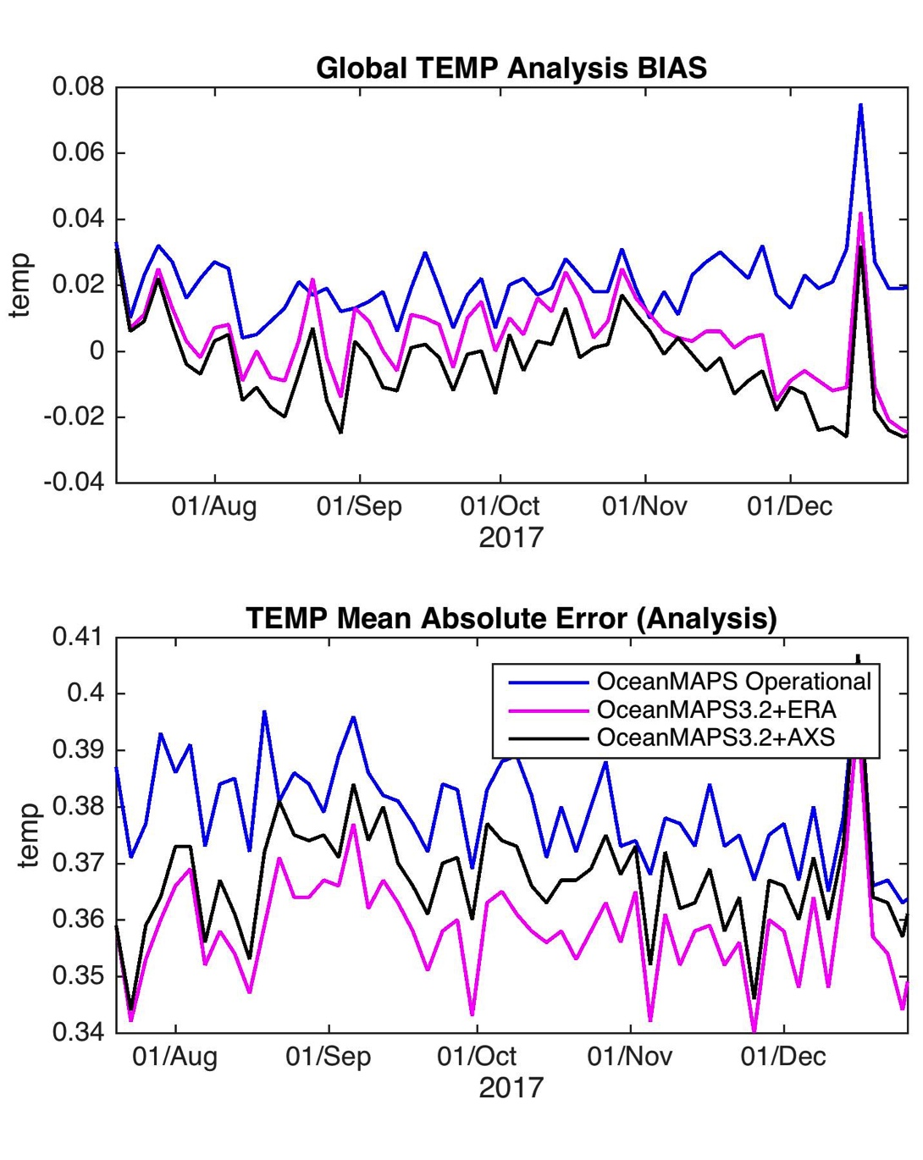
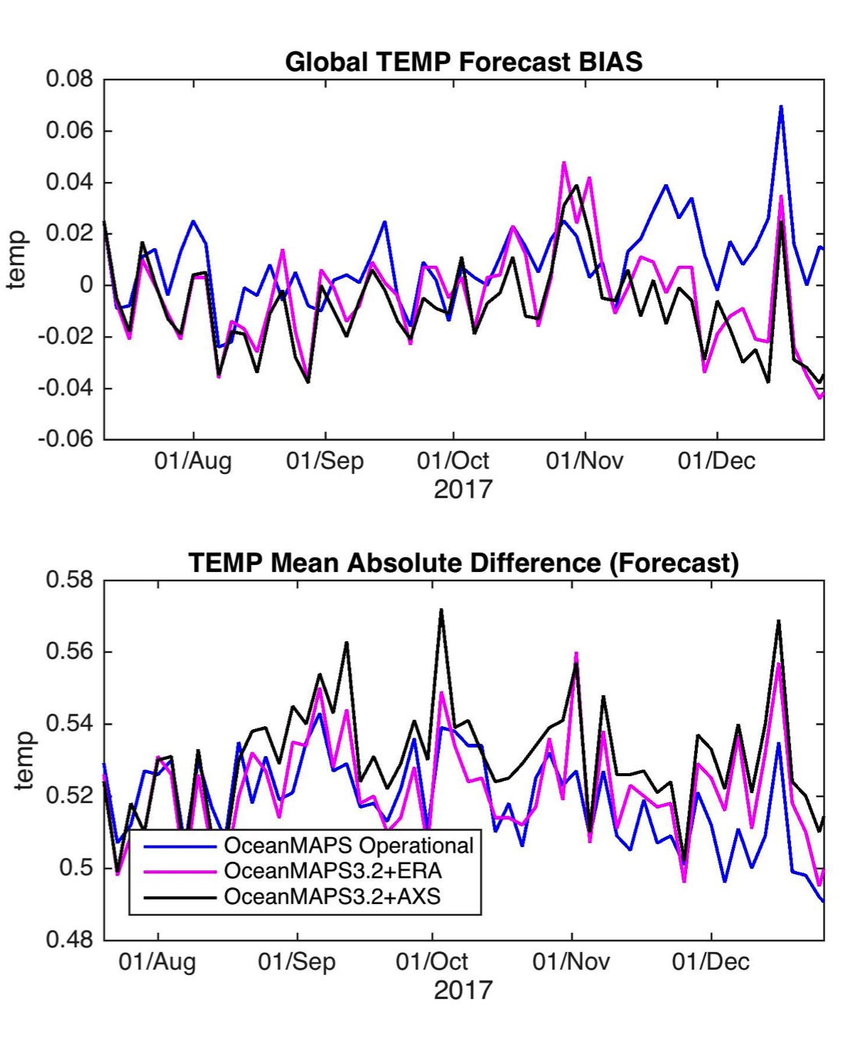
ANALYSIS
FORECAST
Divakaran et al

Slide 12
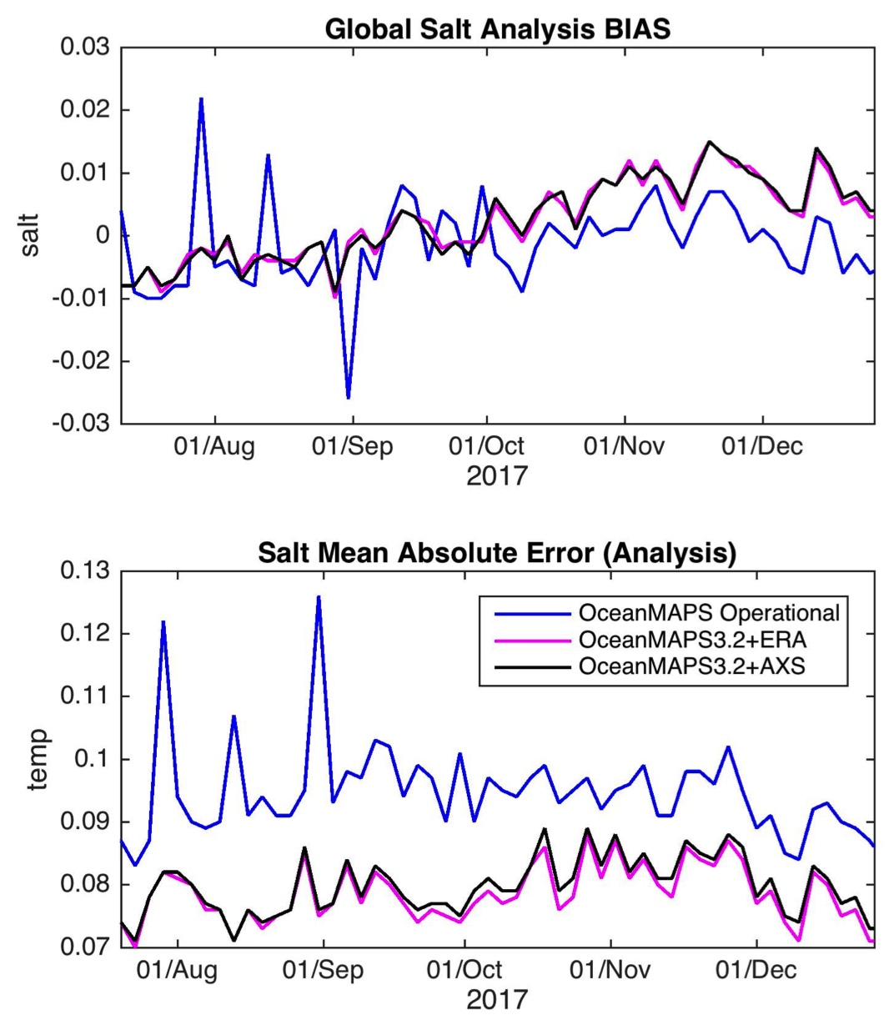
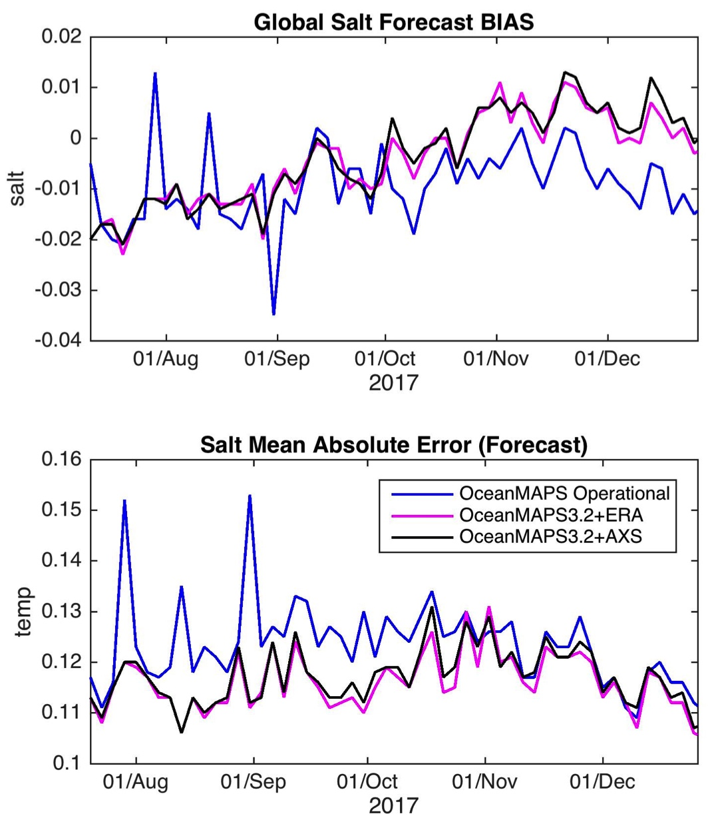
ANALYSIS
FORECAST

Slide 13
Toward EnKF initialisation / ensemble forecasting
OFAM3 + EnKF
  96-member ensemble
  Sat-altimetry, Sat-SST, profiles
  2 year hindcast
  3 day hindcast cycle
  Localisation: 150 km SLA and SST
        450 km T and S
  4% capped inflation
  SST bias correction
Resources:
  CPU: ~9 kSU / cycle
  Footprint: 4-7 TB
  Full restart: 2.8 TB
Sakov

Slide 14
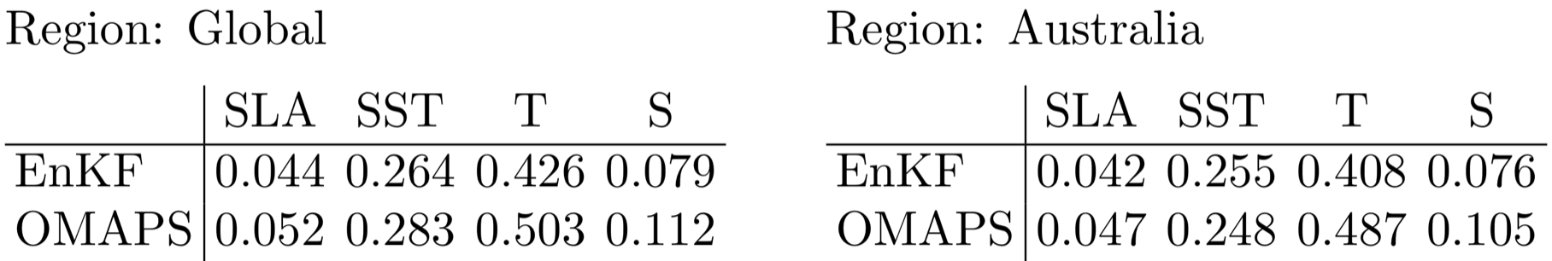
Ensemble Kalman Filter DA
OceanMAPSv3 vs OFAM3+EnKF
15%
7%
15%
29%
11%
-2%
16%
28%
Notes:
Systematically better than the op system

Slide 15
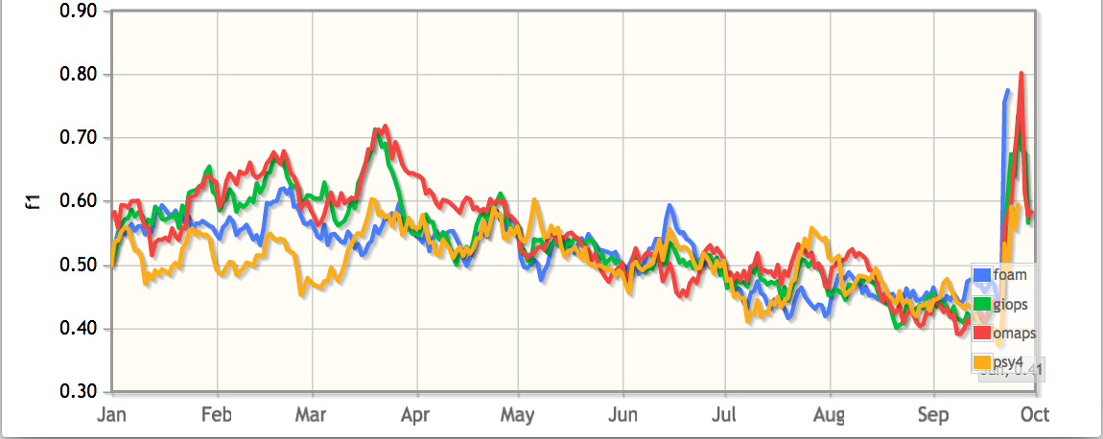
Potential performance gain from EnKF
Mean Absolute Difference – Day 1 forecast
Temperature
Temperature
EnKF offers competitive to leading performance
or
Tactical neutrality to advantage
Sea level anomaly
Salinity
2018
__ Australia __ UK __ France __ Canada

Slide 16
OFAM3+EnKF vs OceanMAPSv3
z = 0 m
|v|, EnKF member 1
|v|, OMAPS
0.0
0.5
1.0
0.0
0.5
1.0

Slide 17
OFAM3+EnKF vs OceanMAPSv3
z = 65 m
|v|, EnKF ens. mean
|v|, OMAPS
0.0
0.5
1.0
0.0
0.5
1.0

Slide 18
OFAM3+EnKF
z = 65 m
|v|, EnKF ens. mean
T, EnKF ens. spread
0.0
0.5
1.0
0.0
1.0
2.0

Slide 19
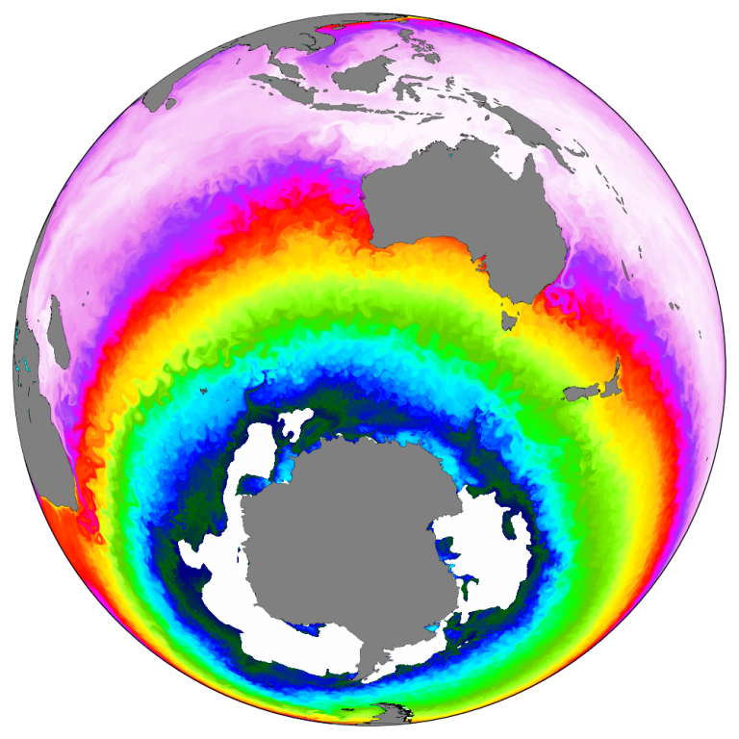
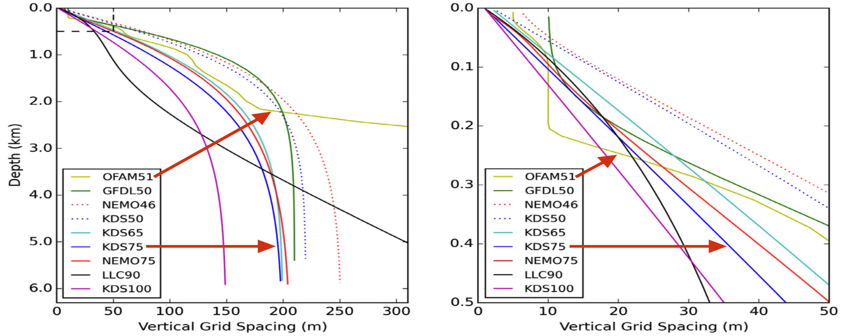
Consortium for ocean and Sea Ice Modelling Australia (COSIMA)
Next generation global ocean forecasting
OFAM3
MOM4.1
Near-global
0.1°×0.1°
Uniform
51 vertical levels
Δz_{top} = 5 m
Δz_{max} = 906 m
H_{bottom}= 4509 m
ACCESS-OM2-01
MOM5.1
CICE5.1
Full global model
0.1°
Mercator projection to 65S
75 vertical levels
Δz₁ = 1.1 m
Δz_{max} = 198 m
H_{bottom}= 5837 m
Modular Ocean Model version5 and CICE 5.1
developed by the ARC linkage
Improved representation of:
warm layer
sonic layer depth
below layer gradient

Slide 20
OFAM3+EnKF
Ensemble spread
OFAM-75+EnKF
Ensemble spread
z = 65 m
z = 62 m
T, EnKF ens. spread
T, EnKF ens. spread
0.0
1.0
2.0
0.0
1.0
2.0

Slide 21
Toward ensemble ocean forecasting
  Real-time research trial in 2019
    Ensemble nowcast
    Focus defence, SAR and public applications
    Probability of threshold exceedance
    Observation impact / Observation design
      DFS and SRF diagnostics
Notes:
Given the EnKF foundation we will explore

Slide 22
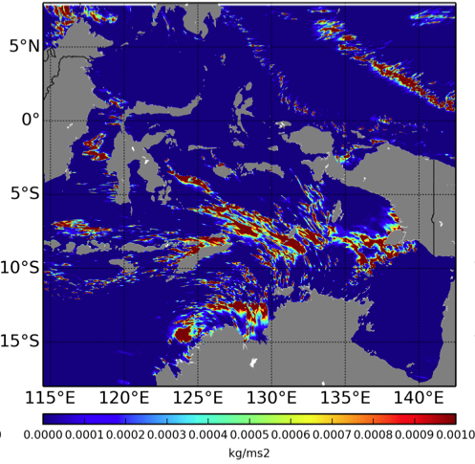
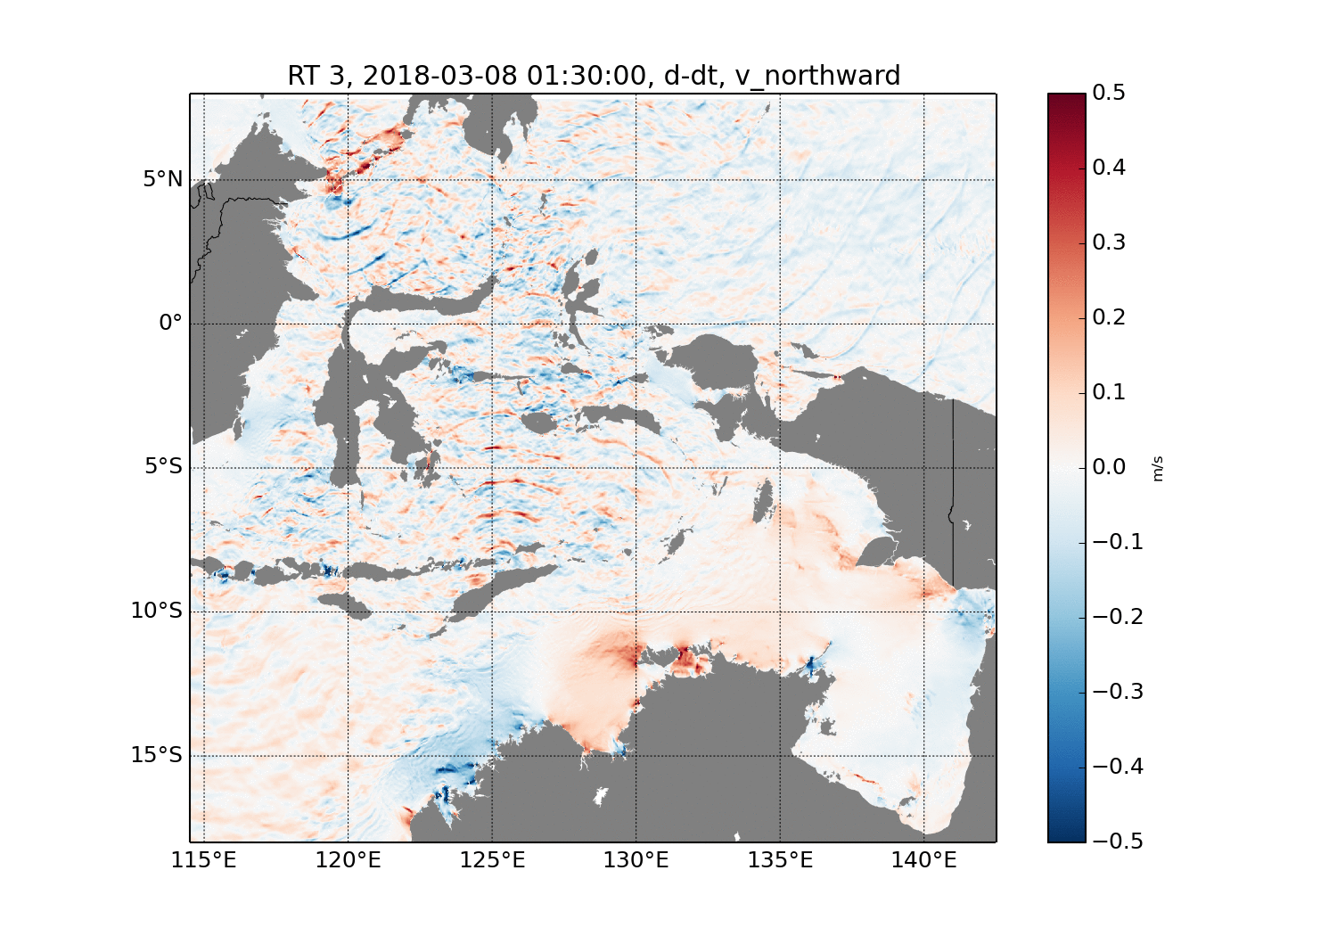
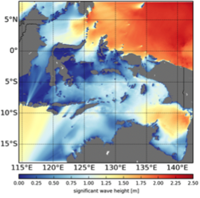
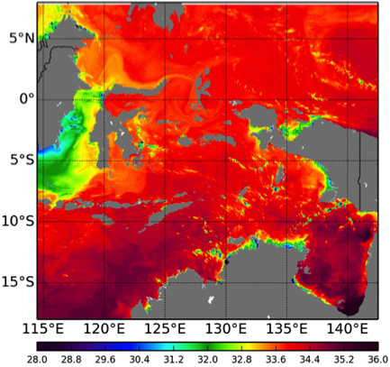
Maritime Continent forecast system
  Significant impact on Australia’s economy and security
  Large domain, regional, nested, downscaled (1/50 x 1/50)
  Resolve convection, resolve internal tides
  Fixed domains, optimised, verified/validated (skill)
  Software suitable for Bureau HPC (ACCESS/WavewatchIII/ROMS)
Atmosphere
Wave
Ocean
Brassington, Dietachmayer, Colberg, Zeiger

Slide 23
Maritime Continent development progress
Pilot Project Outcomes
Ocean component
significant added value (resolving internal tides)
ACCESS-R performed better than ADEPT forcing
Wave component
Improvements due to resolving straits/islands
ACCESS-R similar to ADEPT forcing (except storms/TC’s)
Atmospheric component
Stability over New Guinea for extreme systems (TC’s)
Convection optimisation required
NEXT STEP
Model optimisation
Ocean DA strategy
Ocean reanalysis

Slide 24
Future directions
Next 1-3 years
Ensemble Kalman Filter Data Assimilation (EnKF)
75-level Ocean Model (ACCESS-OM2-01)
Ensemble ocean forecasting
Coupled ice forecasting (CICE)
Coupled ocean-ice-wave forecasting (MOM5-WWIII)
Outlook 3+ years
SWOT (wide-swath altimetry)
Ensemble atmospheric forcing
Coupled ocean-atmosphere forecasting
Coupled BGC
Higher resolution global (1/30) and explicit tides
MOM6 and MPAS model development

Slide 25
Supplementary slides

Slide 26
ADEPT configuration - summary
Atmosphere
Unified Model v10.6
80 terrain-following levels
Top of model 38.5 km
Full Euler (non-hydro)
Semi-implicit/
Semi-Lagrangian
Explicit convection
Options:
RA1-T (physics - tropics)
RA1-M (physics – mid-lat)
Boundary conditions
APS2 ACCESS-R
Initial conditions
Downscaling ACCESS-R
Ocean
ROMS
30 sigma-levels
SRTM30+ bathymetry
Hydrostatic
Mellor-Yamada
4th order and 3rd order upstream
Forcing (options)
ACCESS-R (RT1)
ACCESS-ADEPT (RT2)
Boundary conditions
OceanMAPS
TPXO7.2
Dai and Trenberth, rivers
Initial conditions
Downscaling OceanMAPS
Wave
WAVEWATCH III
implicit
Variable grid (525,836)
29 freq bins (0.035-0.5047)
Directional inc 10d (36)
SRTM30+ bathymetry
Forcing (options)
ACCESS-R
ACCESS-ADEPT
Boundary conditions
AUSWAVE-R

Slide 29
NEW DIAGNOSTIC – Anomalies/extremes
Seasonal climatology from BRAN (u,v,T,S,eta)
  Construct daily mean annual cycle
  SVD (parallel code from CTD)
  Leading modes (annual, semi-annual)
Spatial and daily anomaly distribution
  9 grid cell x 20 year sample

Slide 30
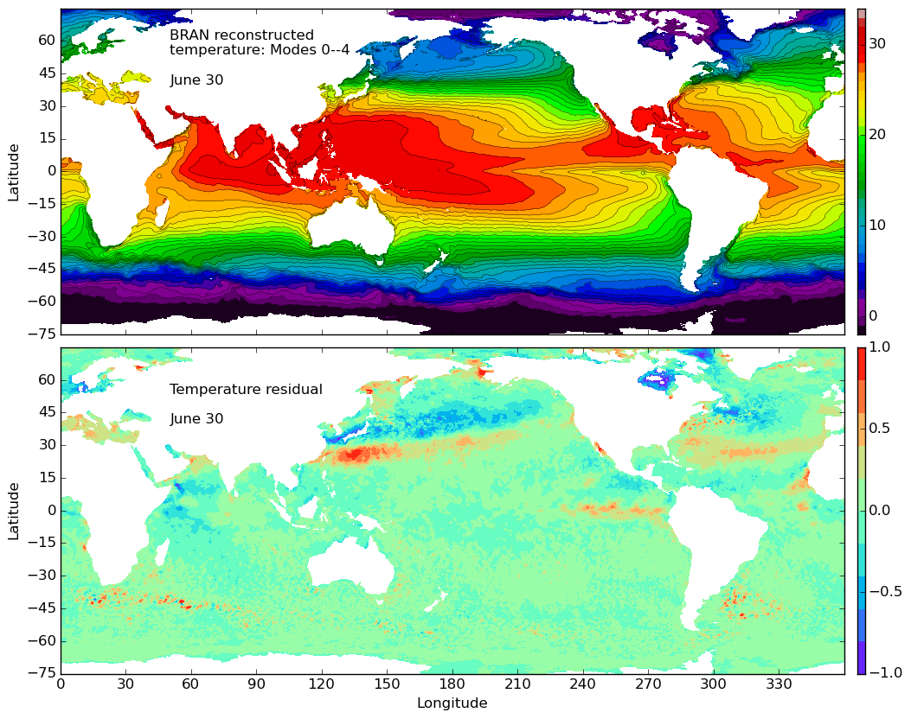

Slide 31
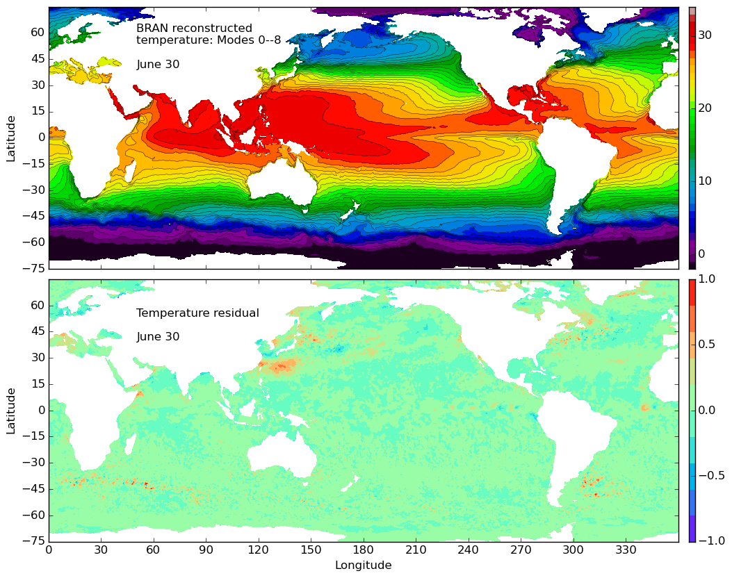
NEW FEATURE – Anomalies/extremes

Slide 32
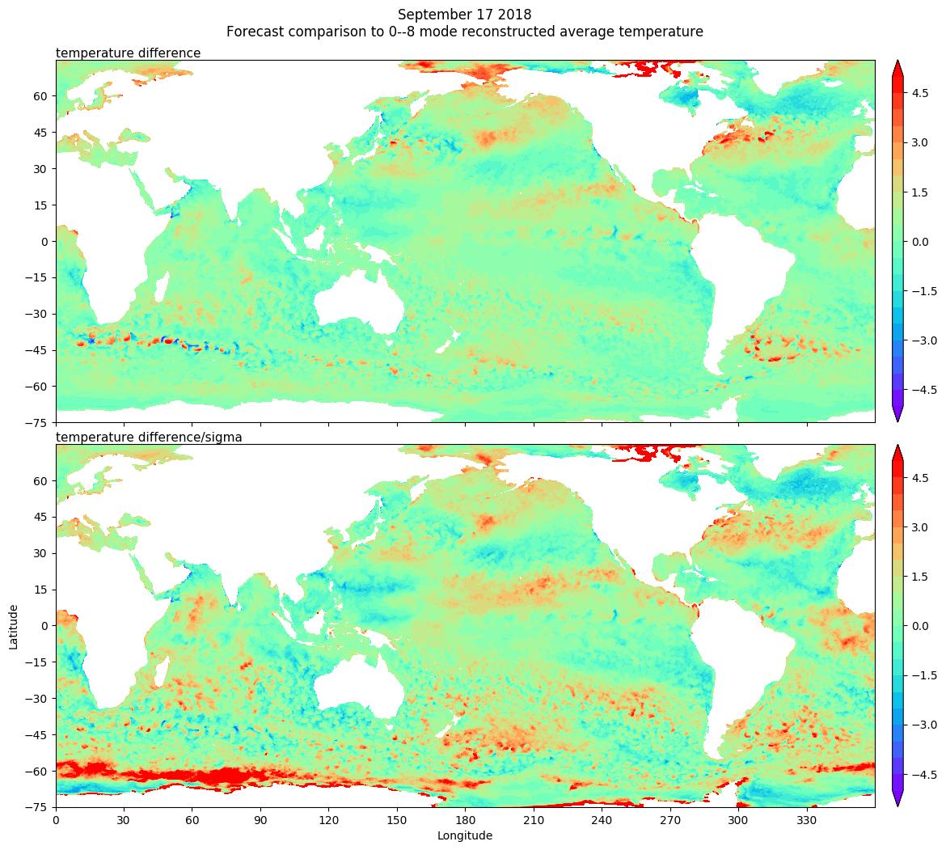
NEW FEATURE – Anomalies/extremes

Slide 33
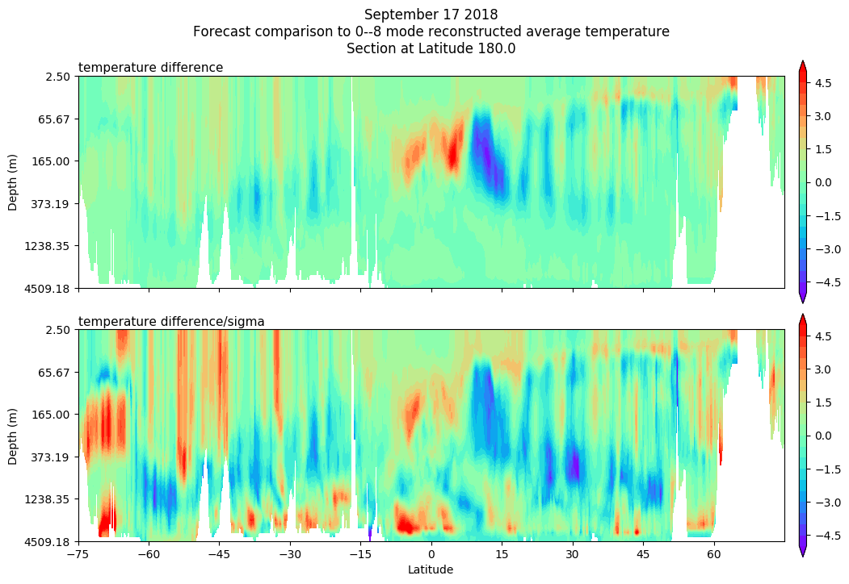

Slide 34
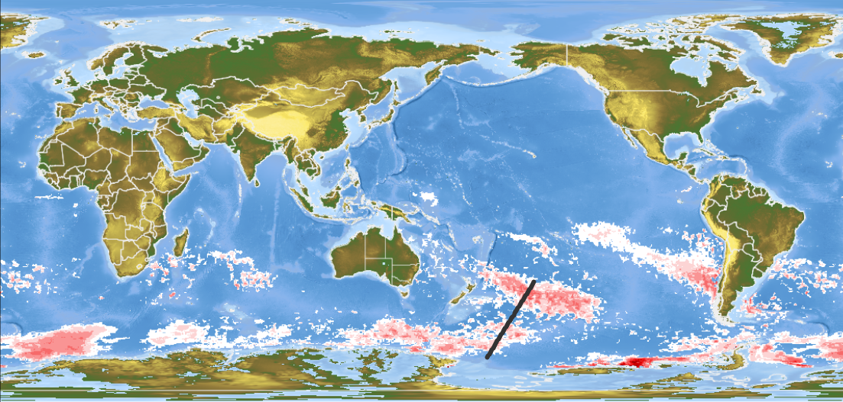
Positive anomalies
15 FEBRUARY 2017

Slide 35
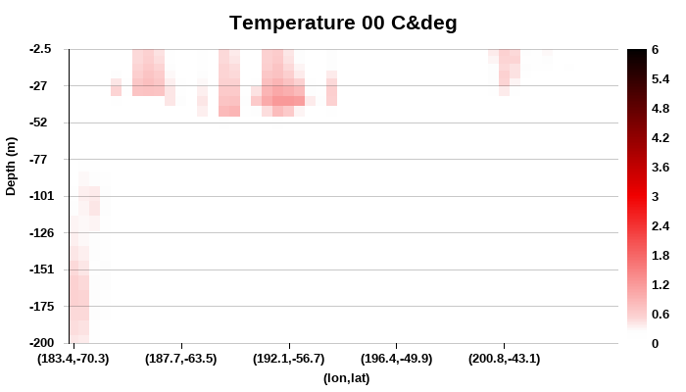
25 JANUARY 2017

Slide 36
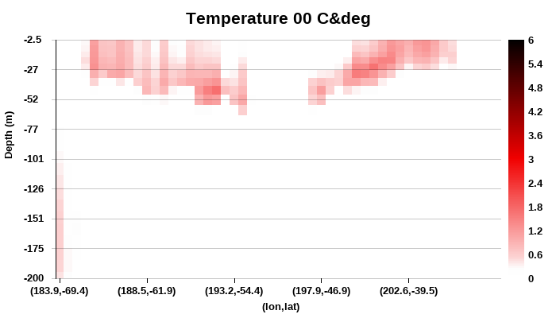
10 FEBRUARY 2017

Slide 37
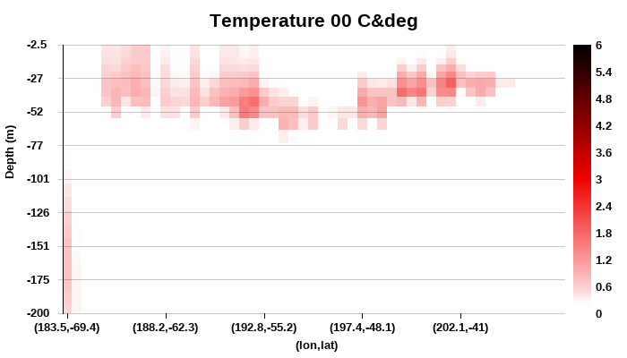
2 MARCH 2017

Slide 38
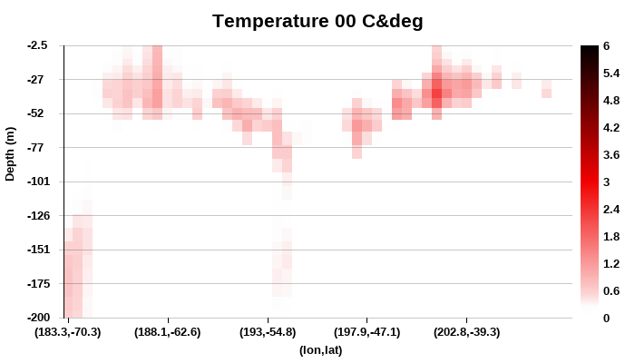
15 MARCH 2017

Slide 39
Companion capability
Data deconstruction/reconstruction
A secure compression of ocean forecast products using a database of empirical orthogonal functions derived from a 25 year reanalysis application to low bandwidth defence communications.
Consortium Ocean and Sea-Ice Modelling in Australia
An ARC linkage grant project for development of ACCESS-OM2-01 a global ocean sea-ice model based on MOM5 and CICE. This model will be adopted and developed with OceanMAPS and BRAN. A second model based on MOM6 will also be developed.
Sonar verification
A suite of metrics to assess the performance of the vertical sound speed profile from ocean forecasts.
Australian Defence Environmental Prediction Toolkit
Operational regional atmospheric, wave and ocean forecasts downscaled at high resolution within the global model. A ROMS, WWIII and ACCESS system with 1/50 x 1/50 resolution.

Slide 40
Ensemble forecasting
Notes:
Objective

Slide 41
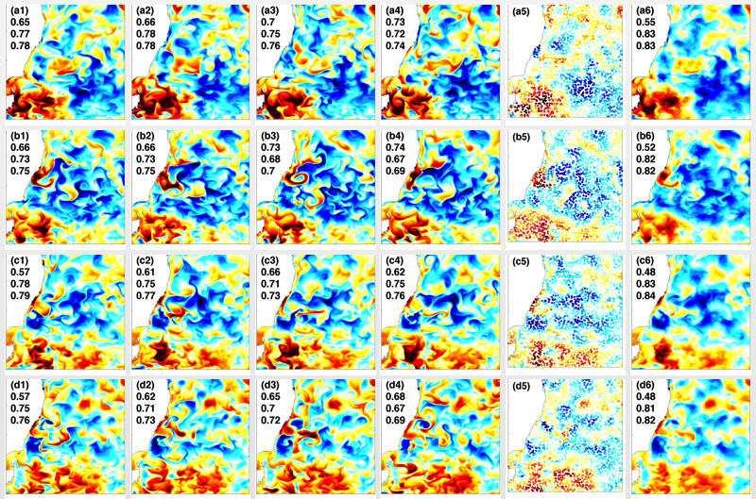
Cycle 1
Cycle 2
Cycle 3
Cycle 4
Obs
Average
1st March
1st April
1st May
1st June

Slide 42
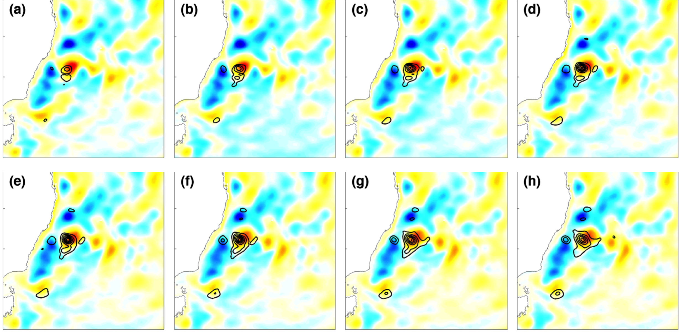
Ensemble variance - SSHA
Notes:
Contours of weighted ensemble variance (0.02:0.01:0.1) of Sea surface height anomaly overlayed by the super-observations with error magnitudes exceeding 0.01 for the forecast hours, -096, -072, -048, -024, 000, 024, 048, 072 for the 1st-8th Jul.

Slide 43
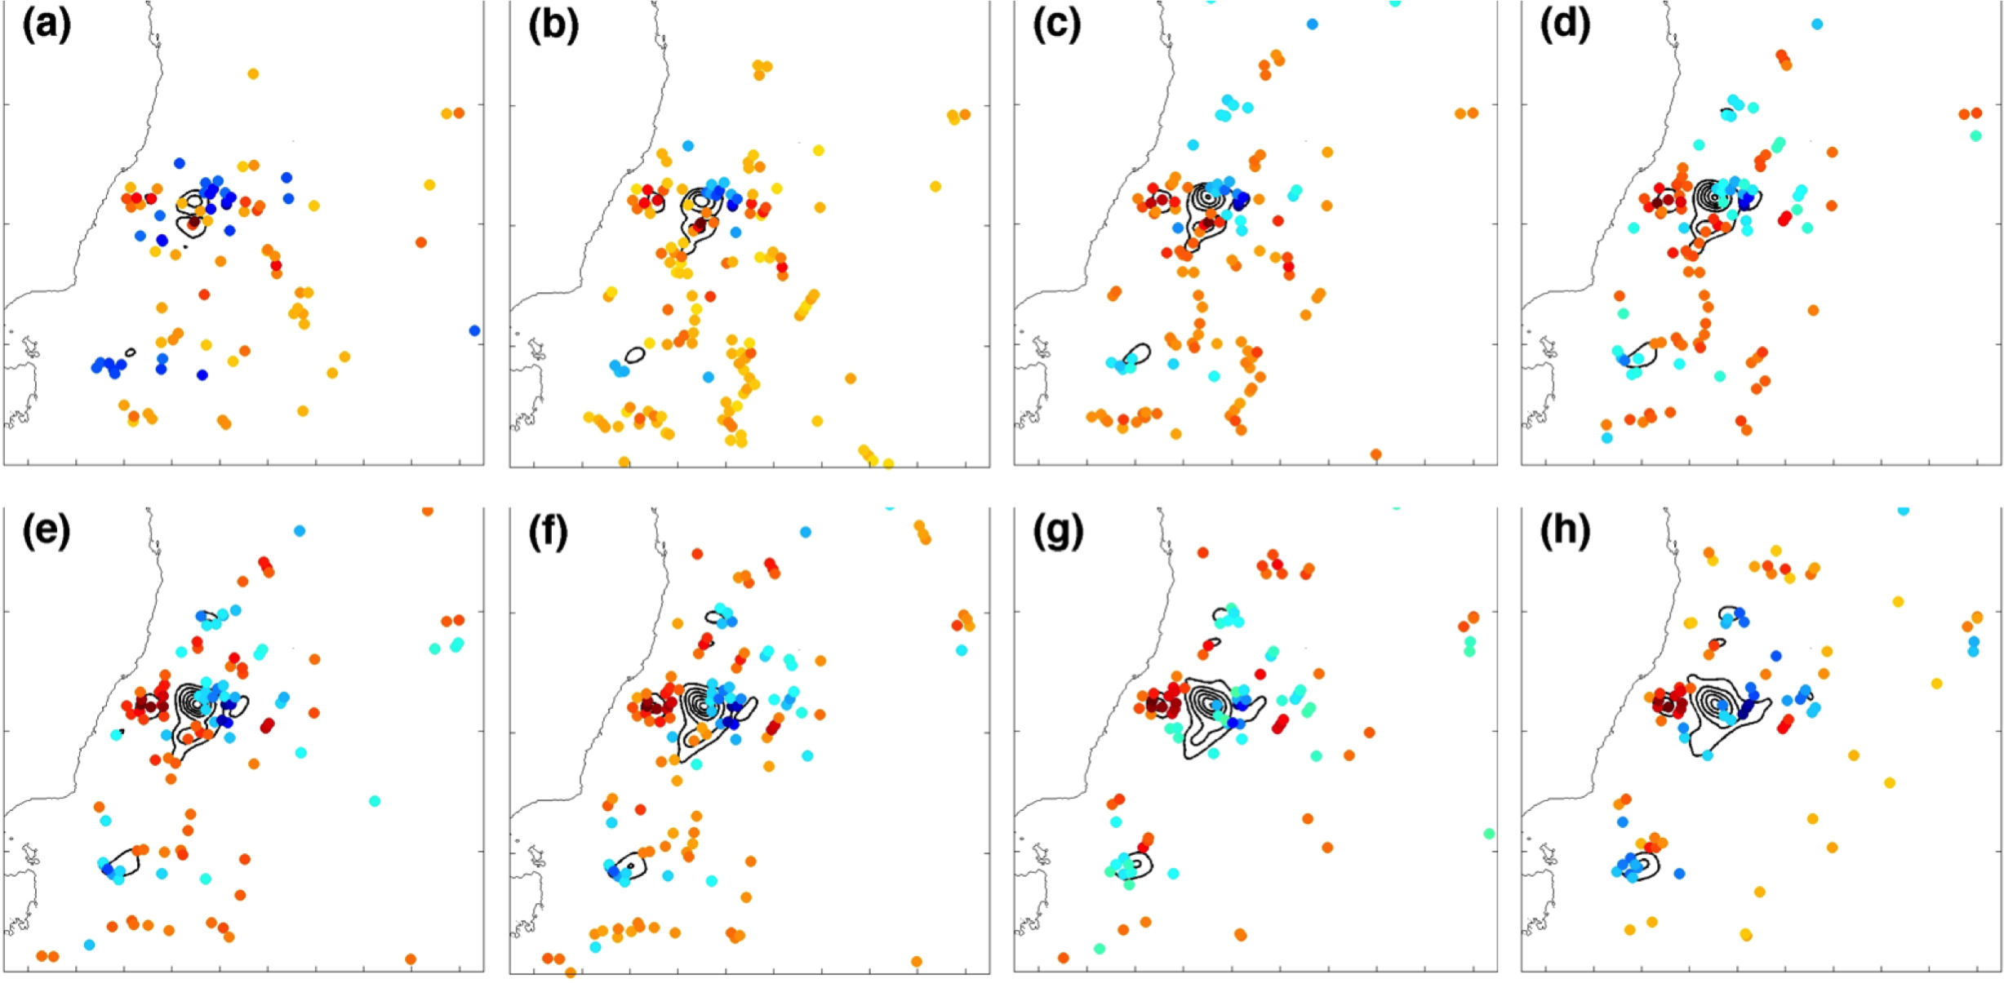
Ensemble variance - SSHA
Notes:
Contours of weighted ensemble variance (0.02:0.01:0.1) of Sea surface height anomaly overlayed by the super-observations with error magnitudes exceeding 0.01 for the forecast hours, -096, -072, -048, -024, 000, 024, 048, 072 for the 1st-8th Jul.

Slide 44
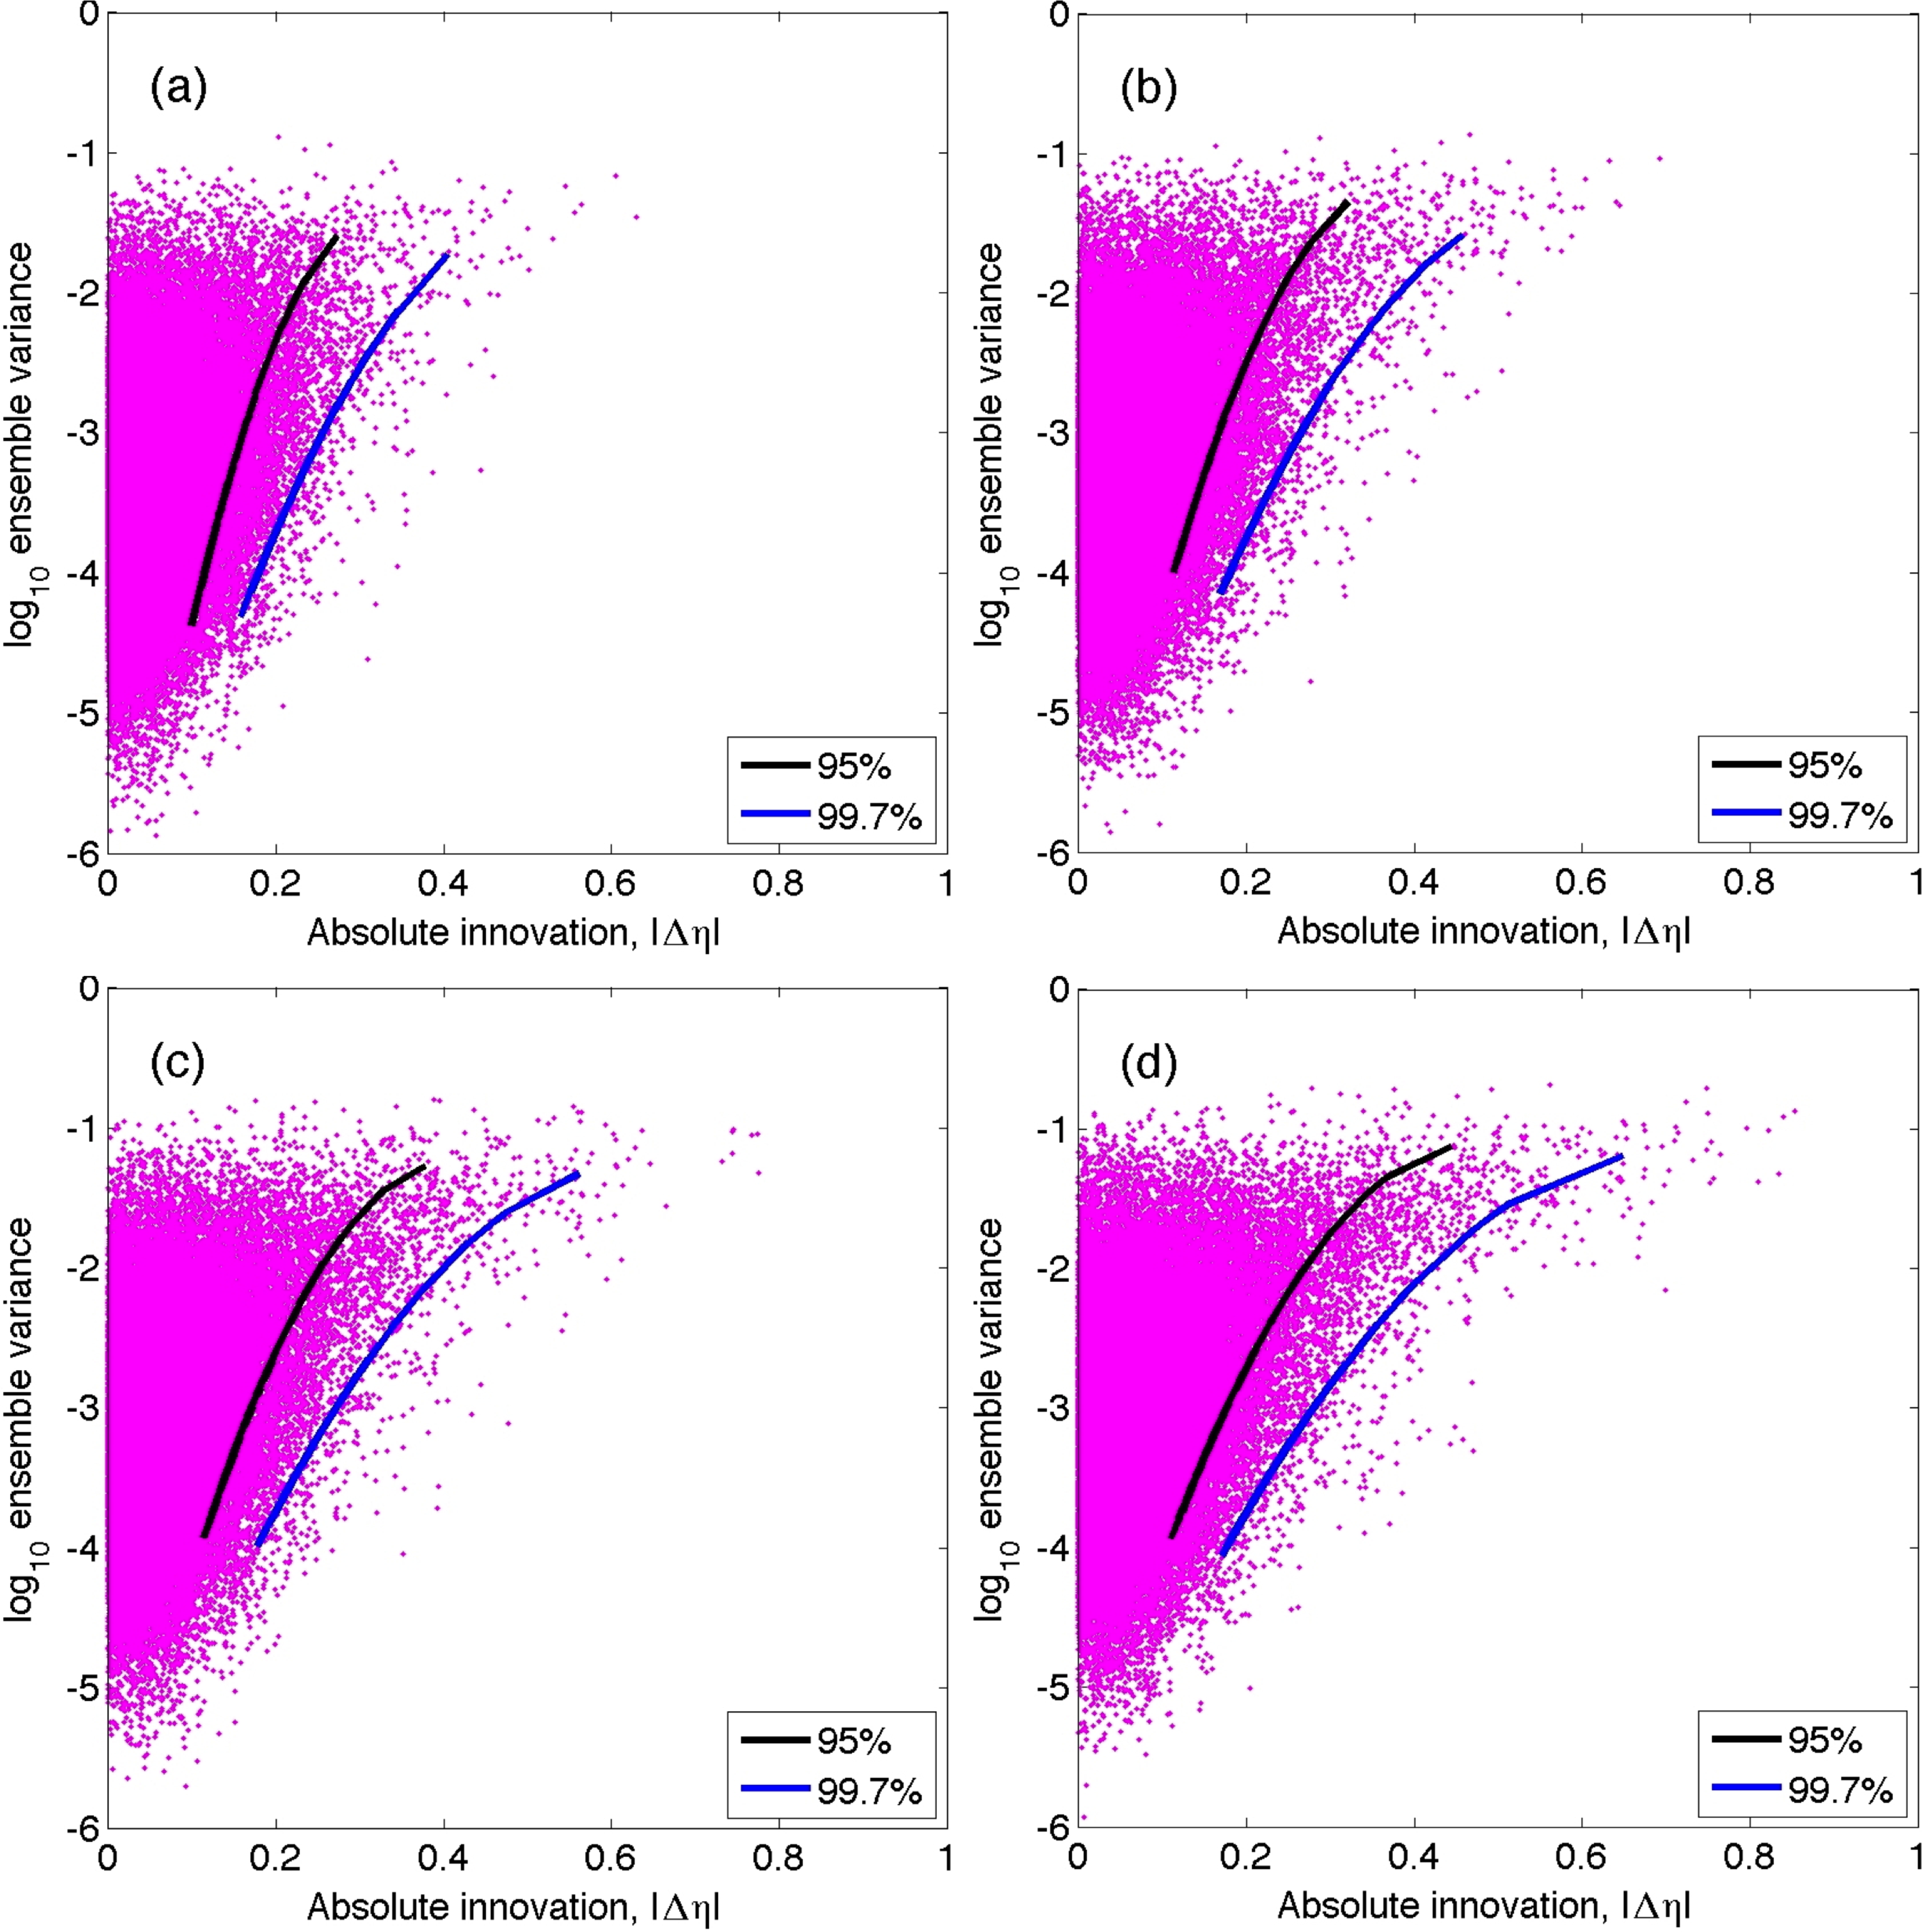

Slide 46
32S
SSH
Annual average ensemble STD
34S
2013 - 2015
36S
38S
40S
42S
44S
145E
150E
155E
160E
165E
SST
Annual average ensemble STD
32S
2013 - 2015
34S
36S
38S
40S
42S
44S
145E
150E
155E
160E
165E

