Slide 1

US Navy Ocean Prediction
P.J. Hogan¹, E.J. Metzger¹, C. Rowley¹, N. Barton²,
S. Frolov², O.M. Smedstad¹, P. Thoppil¹
Naval Research Laboratory
¹Oceanography Division, Stennis Space Center, MS
²Marine Meteorology Division, Monterey, CA
Bureau of Meteorology R&D Annual Workshop 2018
Ensemble Methods – Nowcasting to Climate Change
Melbourne, Australia
26-29 November, 2018

Slide 2

Outline
Global Ocean Forecast (GOFS) development
  GOFS 3.0
  GOFS 3.1
  GOFS 3.5
GOFS Ocean Reanalyses
Uncoupled Global Ocean Ensembles
Navy Earth System Model (NESM)/Earth System Prediction Capability (ESPC)
  Deterministic
  Ensembles
Products
Future Plans

Slide 3
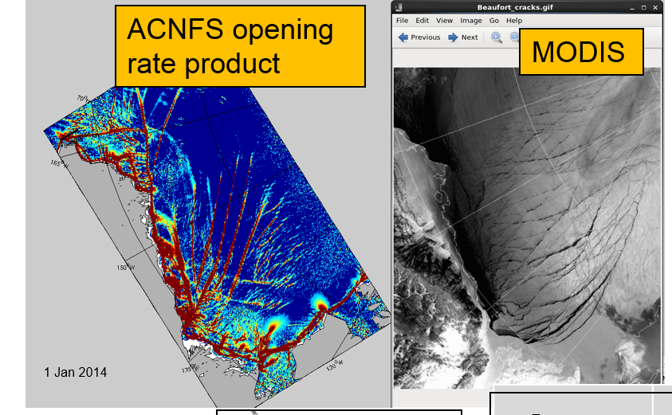
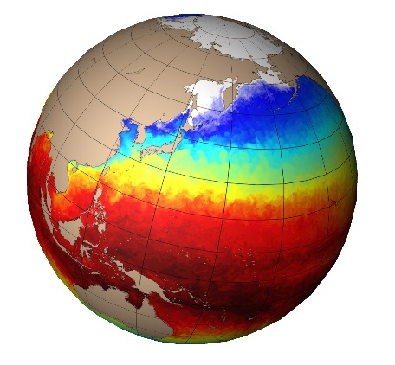
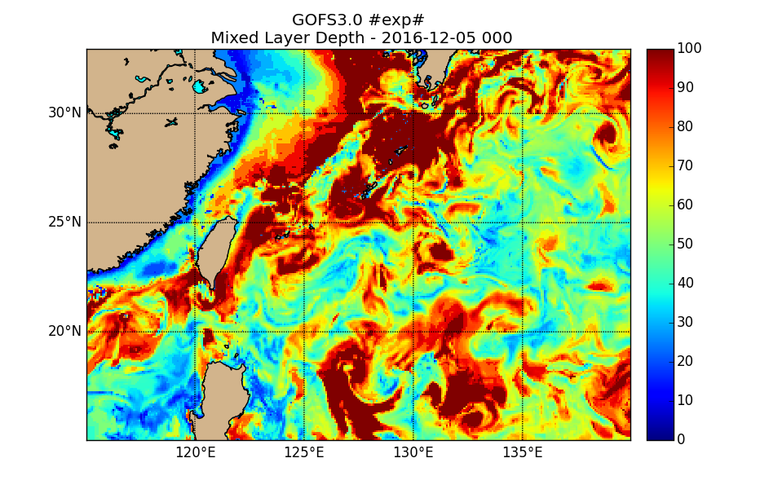
Timeline of GOFS Development
Predict surfacing areas in ice - Safety of navigation
Transition to FNMOC
Global Ocean Forecast System 3.5
Coupled Ocean-Sea Ice
Tides
Transition to FNMOC
Global Ocean Forecast System 3.1
Coupled Ocean-Sea Ice
Predict the acoustic environment - Search, Sanitize, Avoid
Transition to FNMOC
Global Ocean Forecast System 3.0
6.4 N2N6E Funds
Global Ocean Modeling and Prediction
2005-2018
6.2 ONR NOPP
HYCOM with Data Assimilation
2005-2009
6.2 ONR NOPP
HYCOM Build
2000-2004
6.2 ONR NOPP
HYCOM with Tides 2010-2014
6.1 NRL Base
Low Latitude
Dynamics
2000 - 2011
6.1 NRL Base
Indonesian
Throughflow
2007 - 2010
6.1 NRL Base
DISTANCE
Arctic ARI
2011 - 2016
6.1 NRL Base
Kuroshio and Ryukyu
Currents
2012 - 2017
6.1 NRL Base
Water Mass Formation in Nordic Seas
2016 - 2018
2000
2005
2010
2015
2020
Notes:
Non-trivial to move from R&D to operations

Slide 4
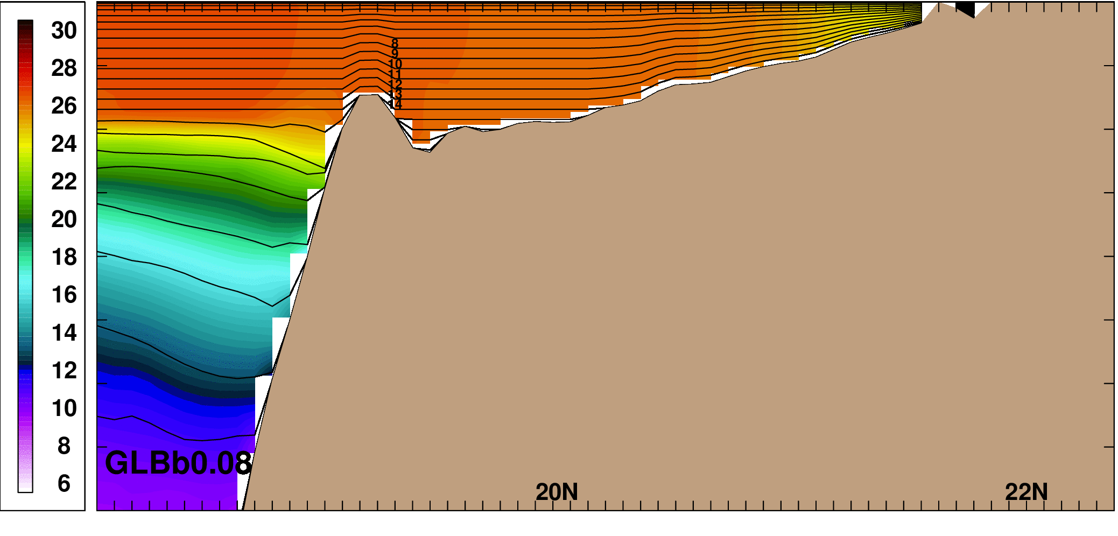
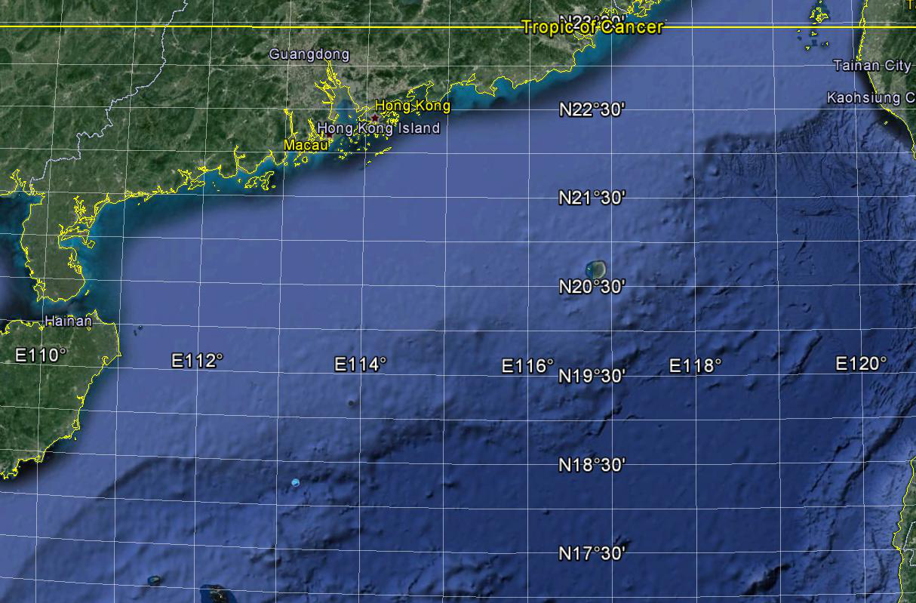
Global Ocean Prediction Impact
GOFS 3.0 is based on the HYbrid Coordinate Ocean Model (HYCOM).
Isopycnal, z (pressure) or sigma (terrain following) coordinates that can change on a timestep by timestep basis.
GOFS 3.0 was declaed operational in March 2013.
GOFS 3.1 just declared operational in Nov. 2018.
Cross-section of temperature (°C) in the northern SCS
Z coordinates in
unstratified water
100
Sigma coordinates
in shallow depths
200
Isopycnal coordinates
in stratified water
300
400
SCS Circulation Dynamics
China
SCS

Slide 5
Timeline of GOFS Development
GOFS 3.0: 1/12° 32 layer HYCOM/NCODA-3DVAR/MODAS synthetics/e-loan ice
Operational system running on Navy DSRC Cray XC40 computer (Gordon)
Switch from NOGAPS to NAVGEM 1.1 forcing in August 2013
Switch from NAVGEM 1.1 to NAVGEM 1.2 forcing in April 2014
Switch from NAVGEM 1.2 to NAVGEM 1.3 forcing in March 2016
GOFS 3.1: 1/12° 41 layer HYCOM/NCODA-3DVAR/ISOP synthetics/CICE
Add nine near surface layers
Two-way coupled HYCOM with Los Alamos CICE model
Replace MODAS synthetics w/ Improved Synthetic Ocean Profiles (ISOP)
Currently in OPTEST for ocean (FNMOC) and ice (NIC)
GOFS 3.5: 1/25° 41 layer HYCOM/NCODA-3DVAR/ISOP synthetics/CICE/tide
Increase equatorial horizontal resolution to ~3.5 km
Tidal forcing
CICE 5.1.2 physics (improved rheology)
Items in red are different from the preceding system

Slide 6
Global Ocean Prediction Impact
GOFS Ocean Applications:
  Provides a first look at the ocean environment, “on demand, anywhere, anytime”.
  Provide boundary conditions for regional nested models
  Provide real time predictions of derived acoustical parameters including sound speed and sonic layer depth
  Provide forecasts of ice thickness, concentration, and drift for both the Arctic and Antarctic.
  Forecasts for tactical planning
  Optimum track ship routing
  Search and rescue
  Location of high current shear zones

Slide 7
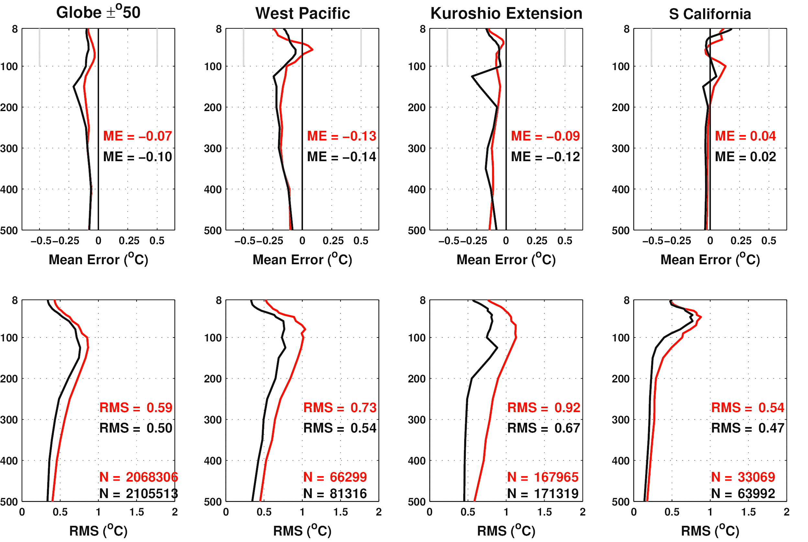
Global Ocean Prediction Impact
GOFS 3.1 Validation: T vs. depth error at the analysis time
For the global
domain, ME is
similar but GOFS
3.1 has lower
RMSE than 3.0.
Regionally the
results vary.
GOFS 3.0
GOFS 3.1
Mean error
RMSE
Mean over
this depth range
Number of
observations
All biases are less than the +/- 0.5°C defined by FNMOC

Slide 8
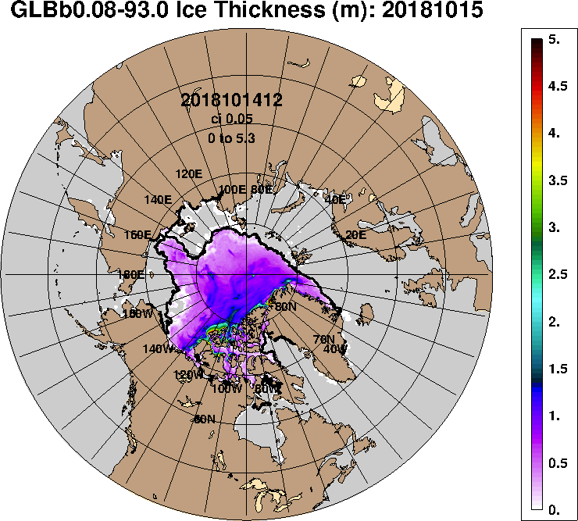
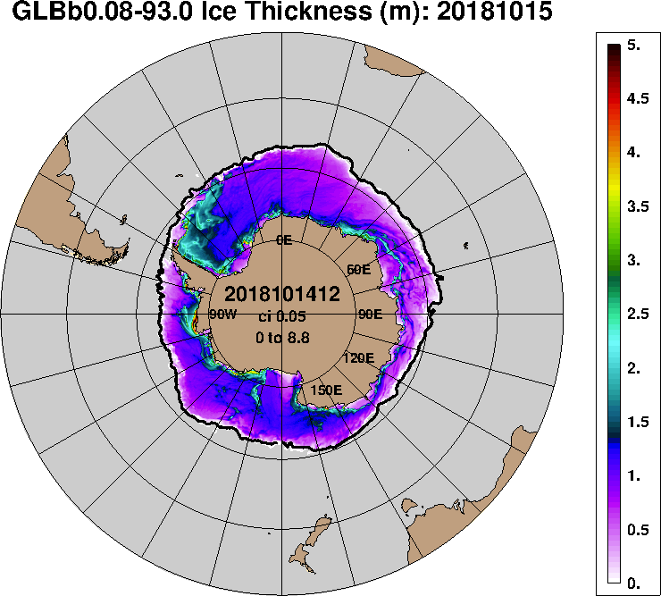
Impact to the Warfighter
Predicting the Sea Ice Edge
GOFS 3.1 Support to the National Ice Center (14 Oct. – 05 Nov. 2018
Ice Thickness (m)
Satellite
Satellite
Black line is independent sea ice edge analysis produced by the NIC

Slide 9
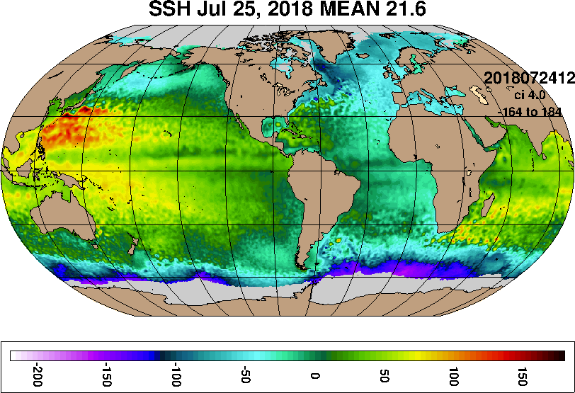
GOFS 3.5 (1/25° HYCOM)
GOFS 3.5 validation testing is currently underway, scheduled for
transition in 4QFY19.
  Increase the horizontal resolution from 1/12° to 1/25°
  Add tidal forcing
  Reanalysis year needed for the Validation Test Report (VTR) completed (2017)
  Expensive, and 3 hourly
  output is challenging, and
  barely sufficient for tides.

Slide 10
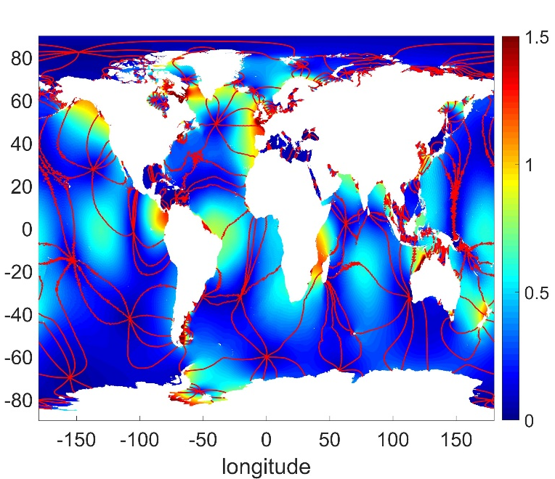
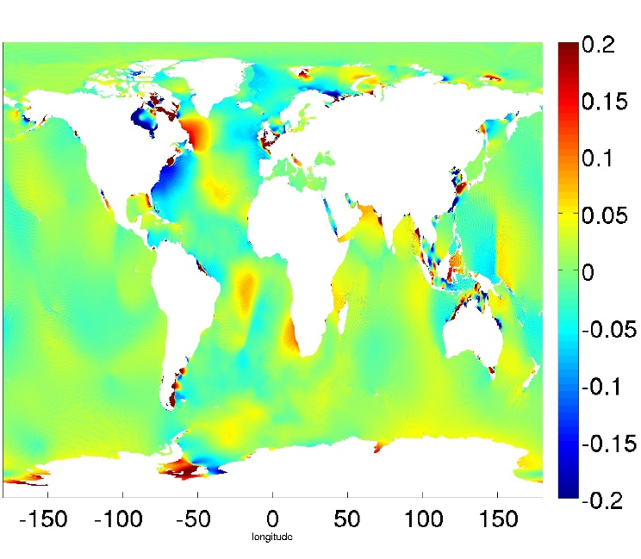
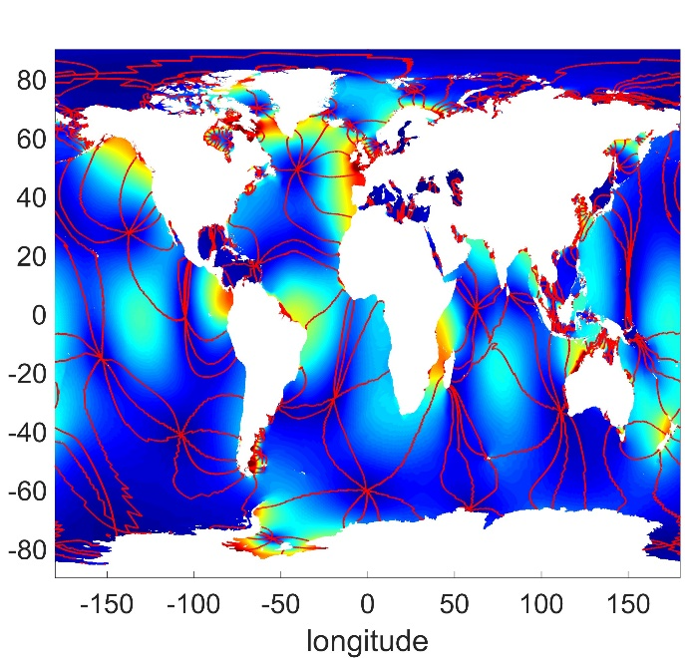
GOFS 3.5 (1/25° HYCOM)
Global Ocean Forecast System (GOFS) 3.5
GOFS 3.5 M₂ barotropic tidal amplitude (colors) and phase (red lines) compared
against TPXO, a highly accurate satellite altimetry constrained tide model
TPXO
GOFS 3.5
GOFS 3.5 - TPXO
Globally averaged RMS difference = 2.58 cm
(includes the impact of difference in both phase and amplitude)

Slide 11
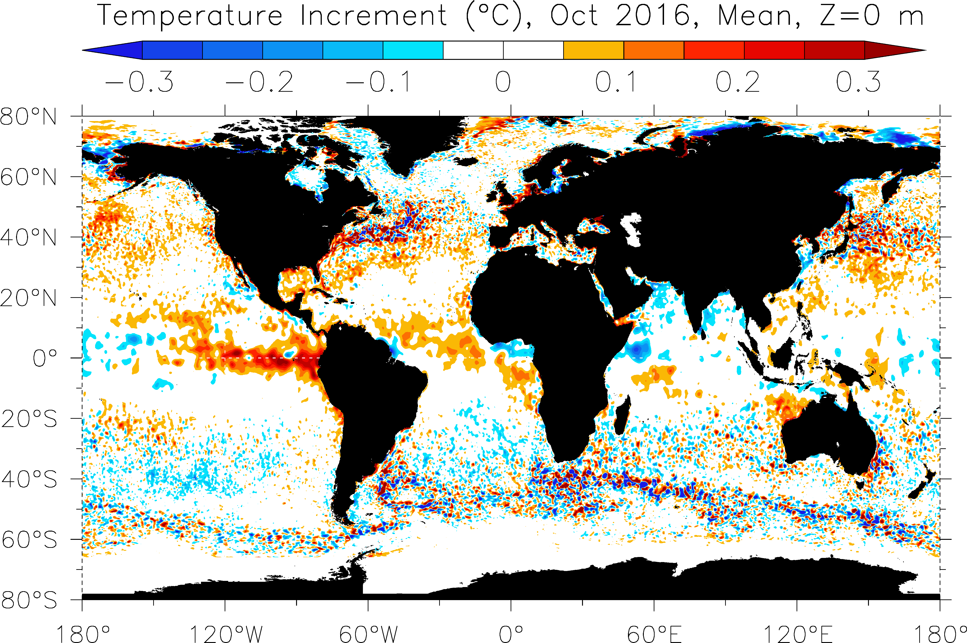
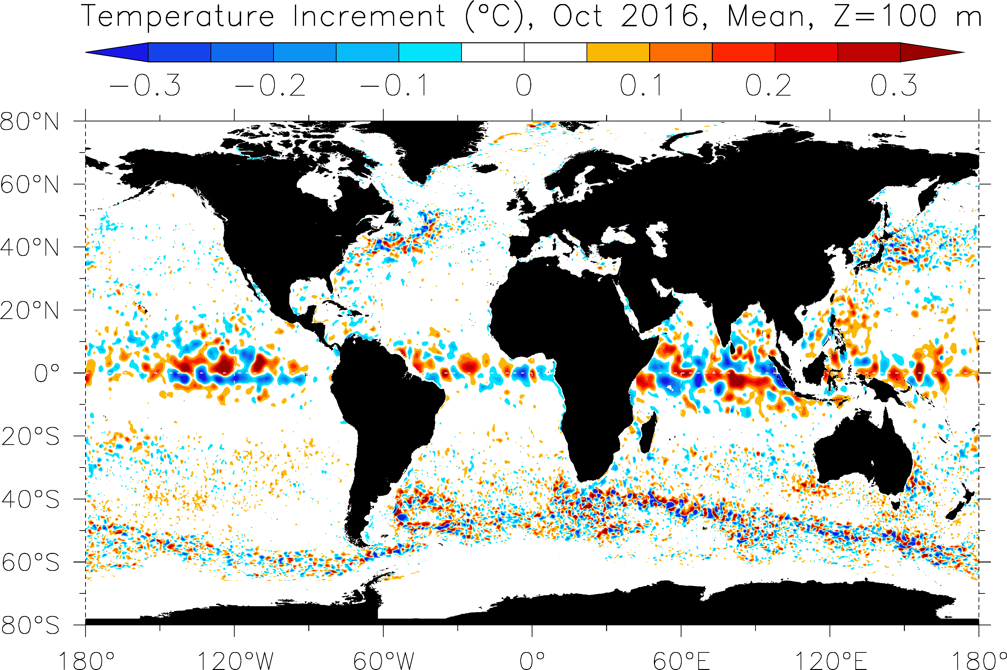
NEW GOFS 3.1 Reanalysis
  Ran a 20-year GOFS 3.0 reanalysis in 2014, used for ensemble experiments.
  Currently running a GOFS 3.1 (1/12º HYCOM/CICE/3DVar) reanalysis 1994-2018 (25 years), forced with NCEP CFSR/CFSv.2 surface forcing.
  There are will be 7 streams that cover 21 years, 1996-2017. Each segment allows for 6 months adjustment to transients. Will take ~9 months to run.
Can be used for bias correction, ensemble spread augmentation, etc.

Slide 12
Ensembles from the GOFS Ocean Reanalysis
January 1
April 1
July 1
1994
Spread growth
Spread collapse
Ensemble Spread
2013
HYCOM Reanalysis
20 January 1 states
90 day cycle with NCODA
No observation perturbation
No forcing perturbation
90 day free forecast
No forcing perturbation
Notes:
What is the climatological model spread?
What is the timescale of spread collapse without perturbed obs or
some other source of uncertainty?
What is the rate of growth of ensemble spread from the basic model variability?

Slide 13
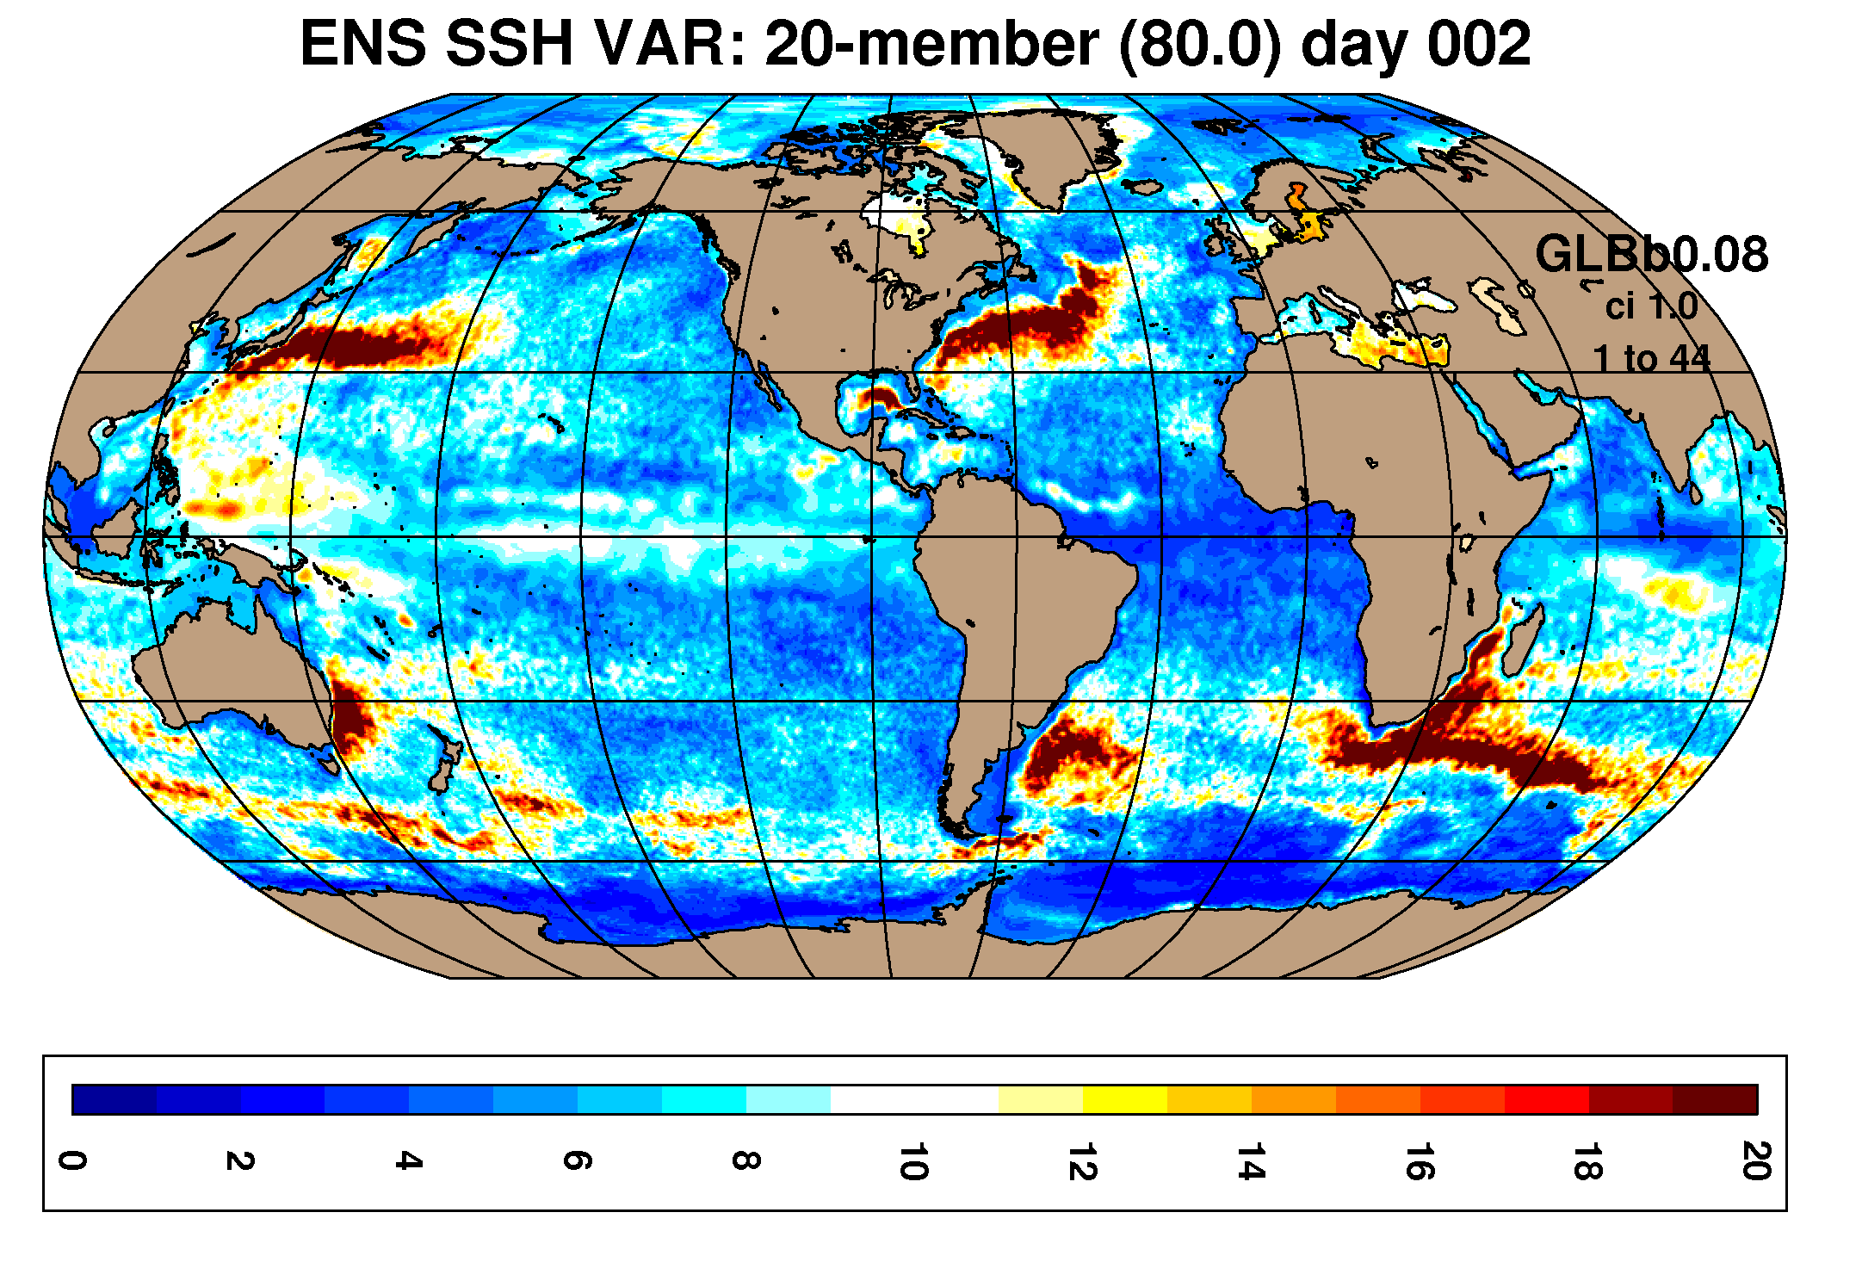
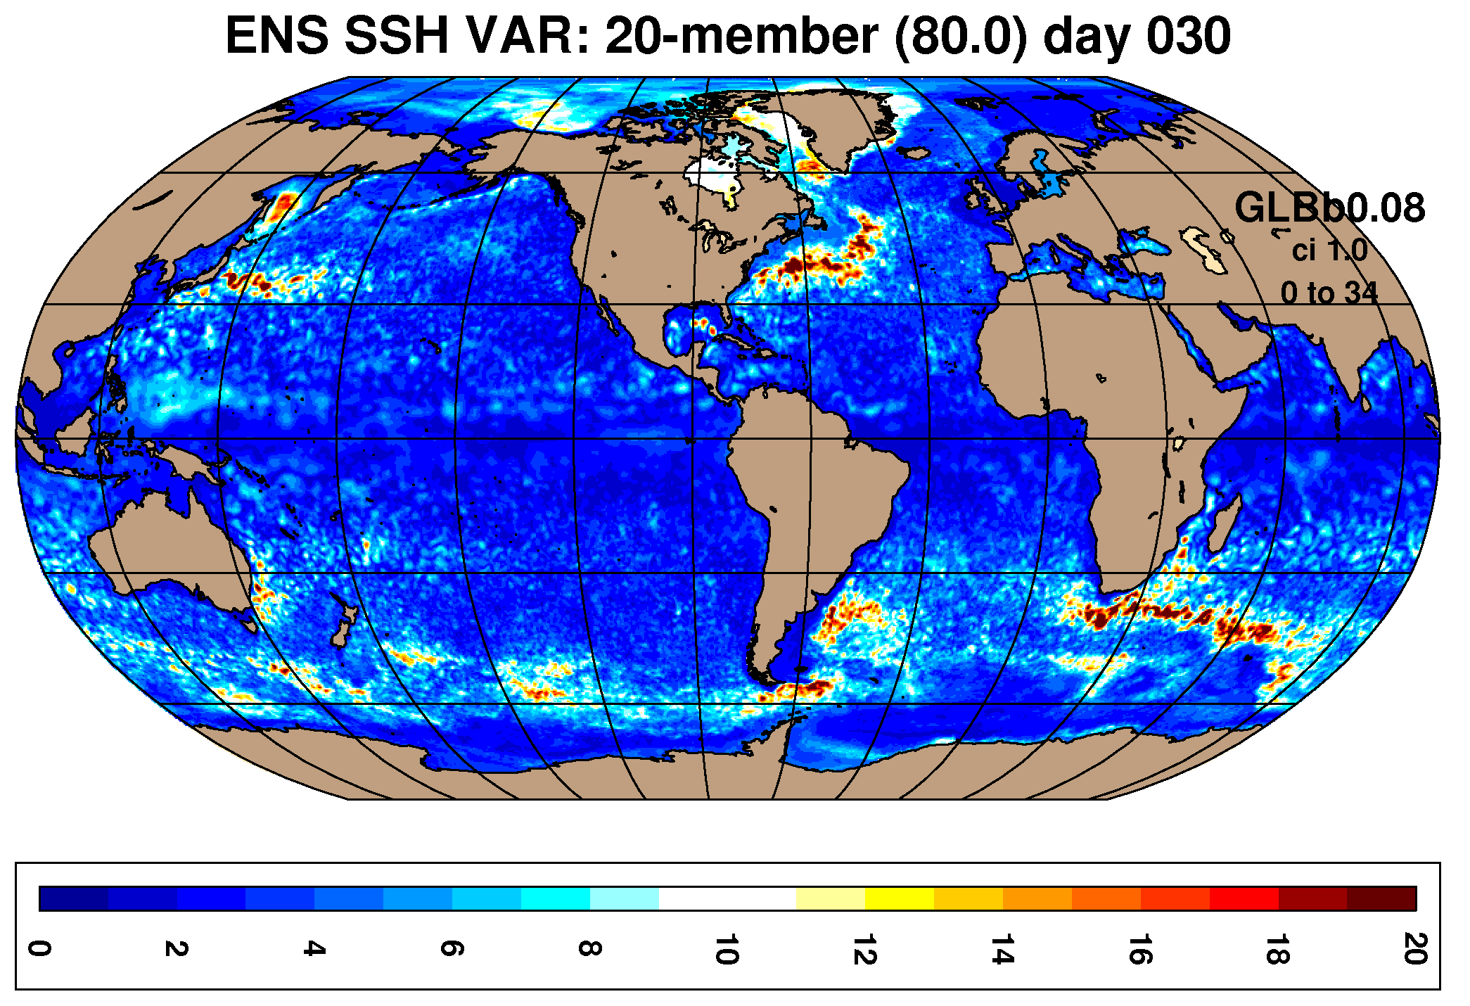
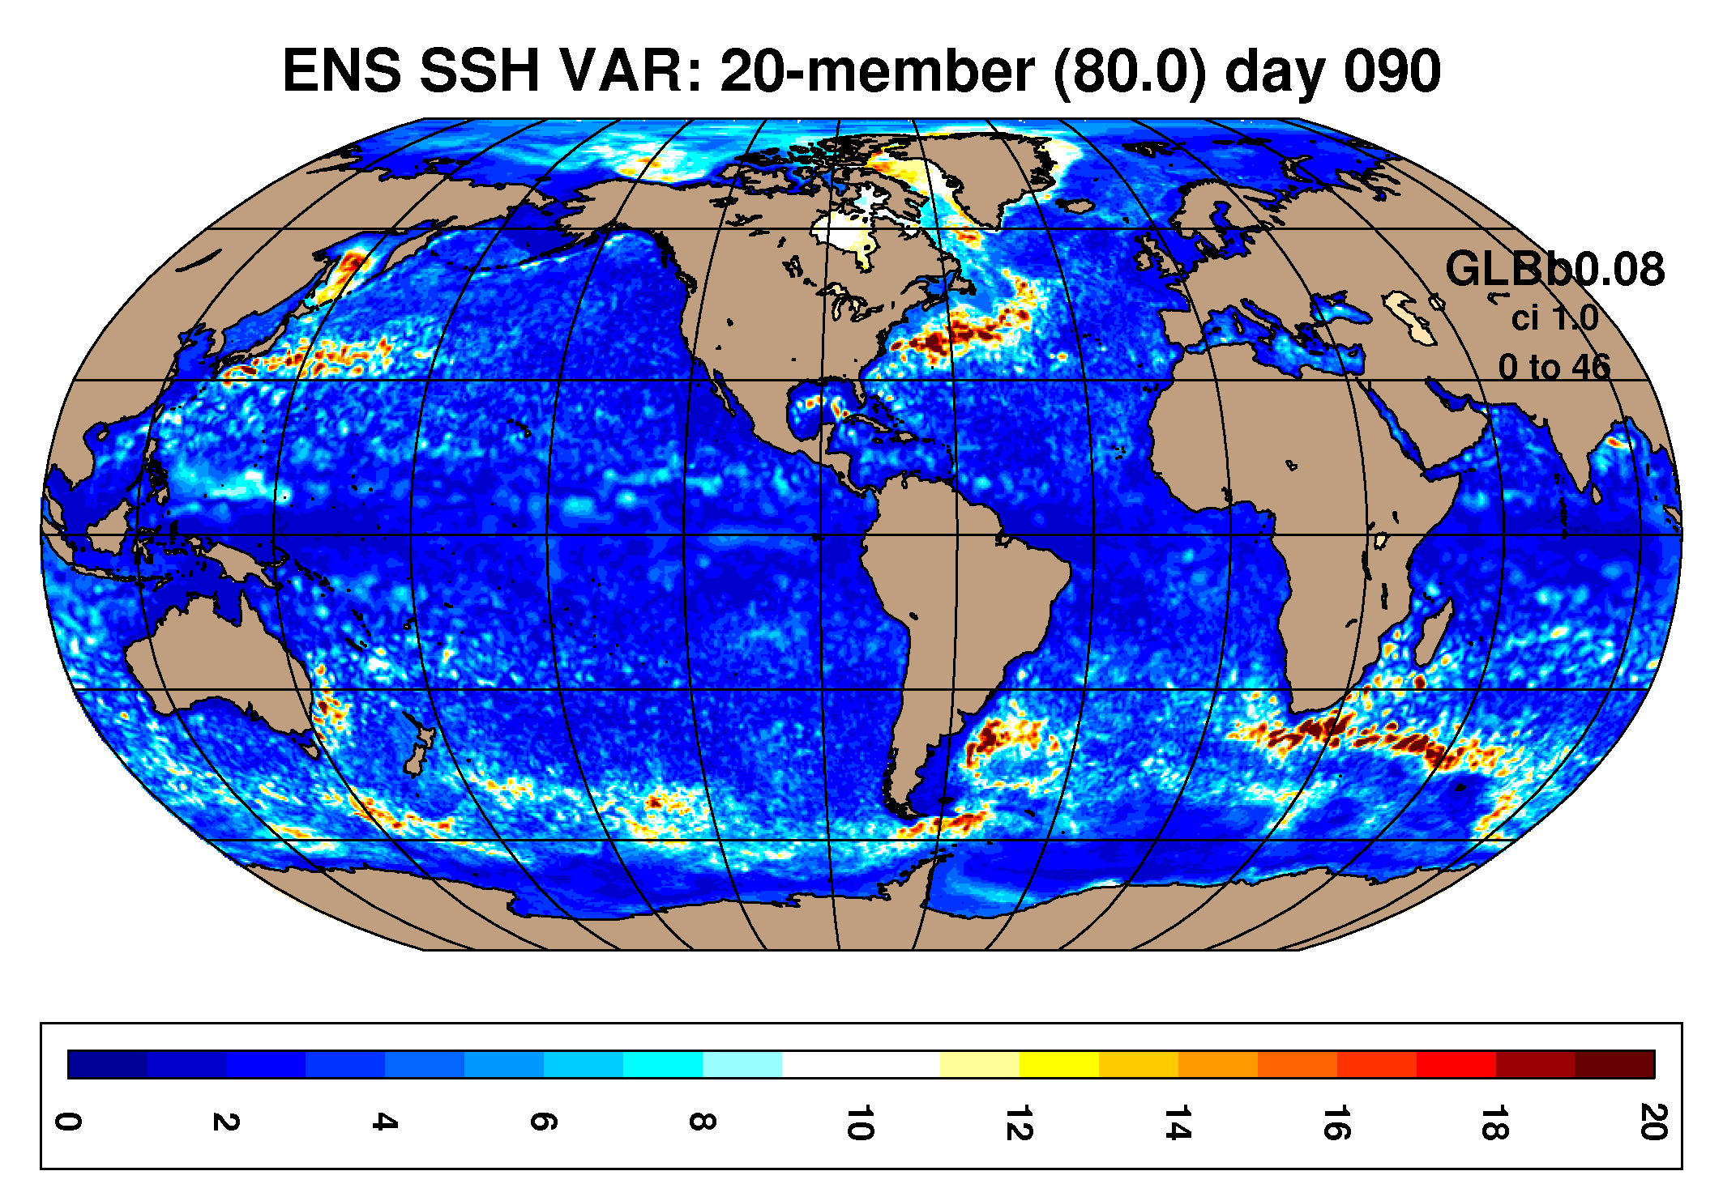
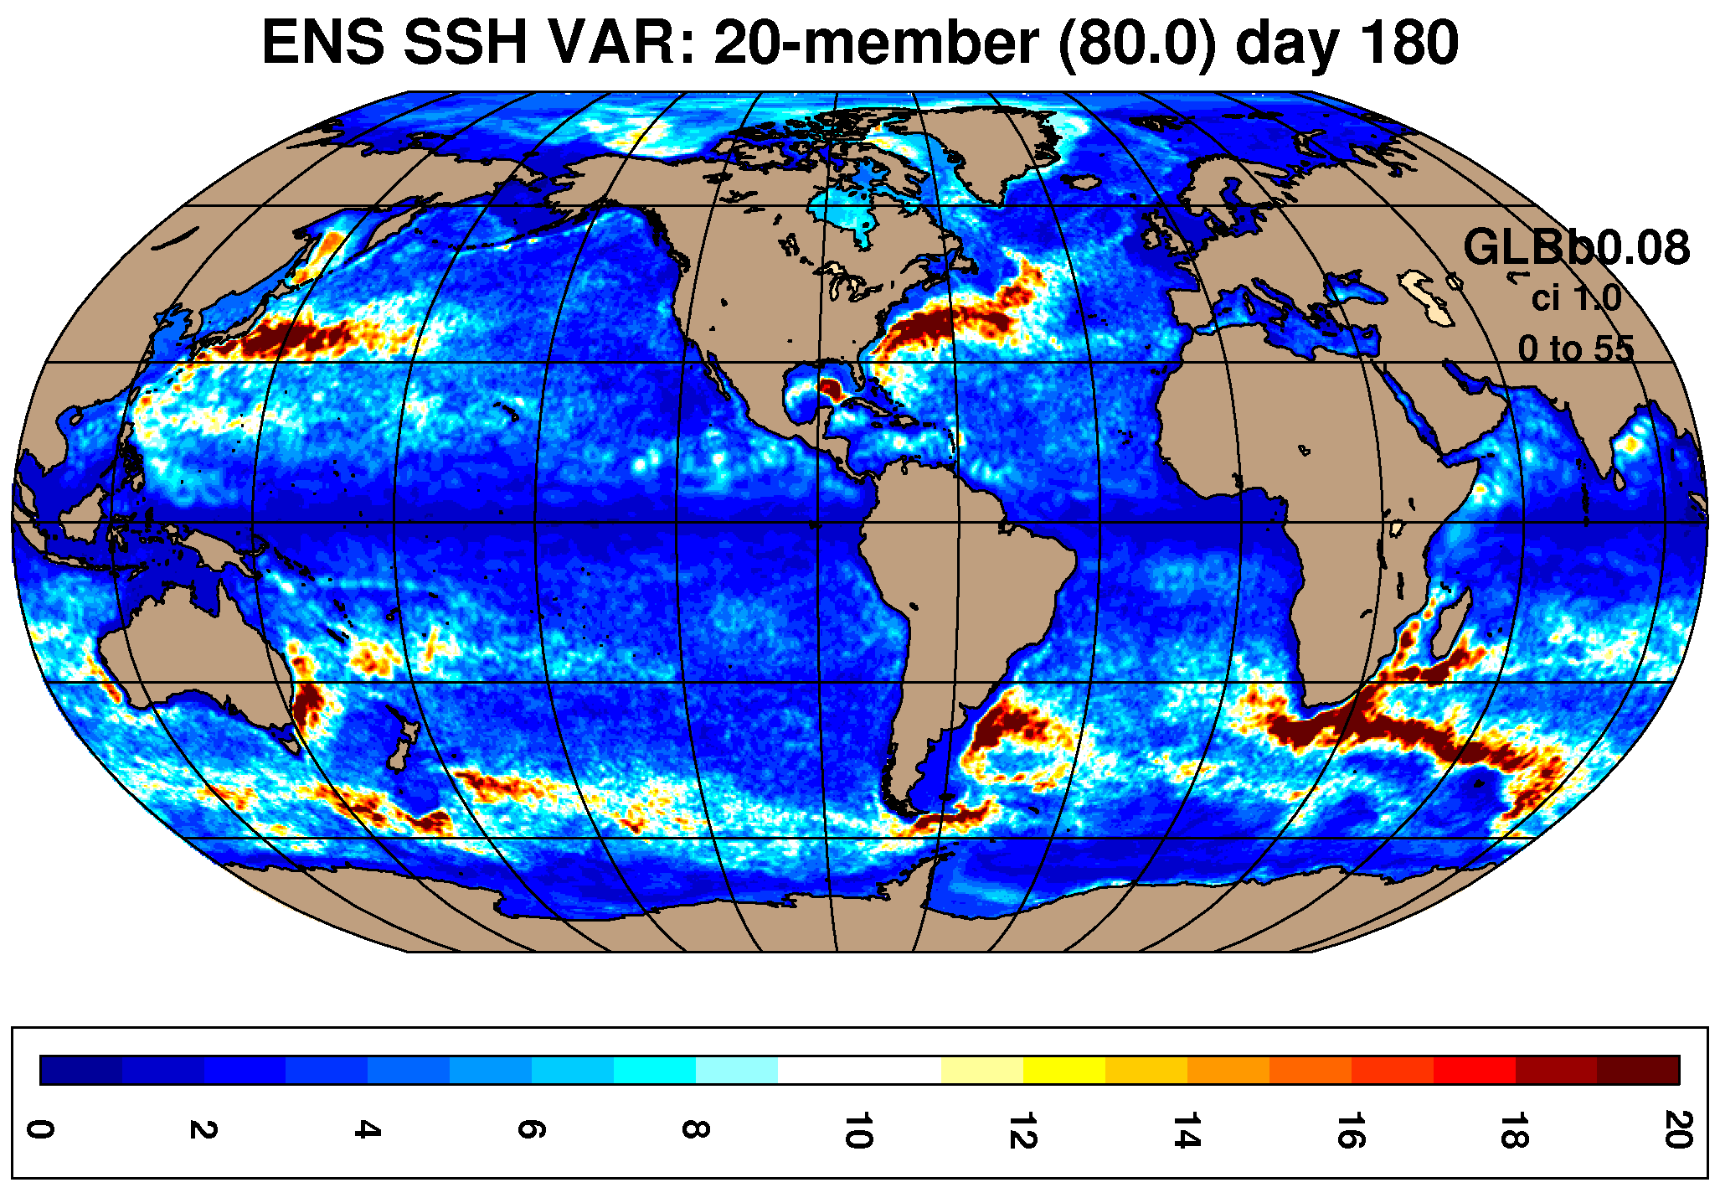
Reanalysis/Ensemble Experiments
Sea Surface Height after 90 days of DA cycling and 90 days forecast
January 01 climatological variance
Variance after 30 days cycling
Ens. forecast
at 90 days
shows skill
relative to climate
Variance after 90 days cycling
Variance after 90 days forecasting

Slide 14
Validation of Ensemble Experiments
Global Ensemble Experiments (20 members each):
Perturbed Initial Conditions
Plus Perturbed Observations
Plus Perturbed Winds (yearly offsets)
Perturbed observations + atmosphere (41-layer, coupled ESPC)
Forecast verification periods: Apr 2, Apr 15, May 15, Jun 15
Purpose: Examine the impact of different sources of uncertainty
What is the climatological model spread?
What is the impact on error for adding additional sources of error?
What are the time scales for constraining the solutions with data assimilation? Time scales for growing spread in forecast mode?
What is the rate of growth of ensemble spread from the basic model variability?
Are the ensemble spreads realistic? Spread-Skill, rank histograms, etc.

Slide 15
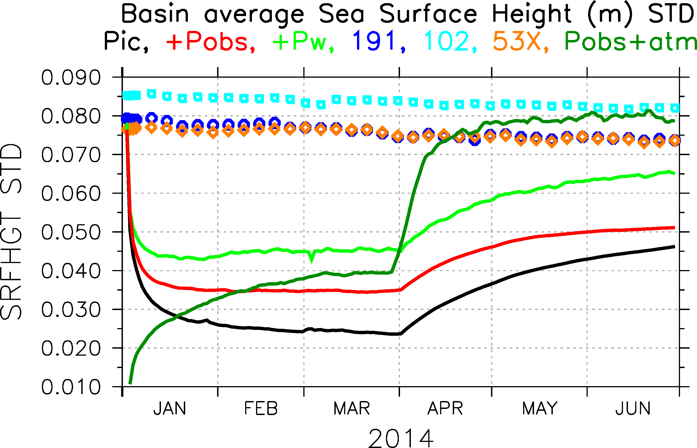
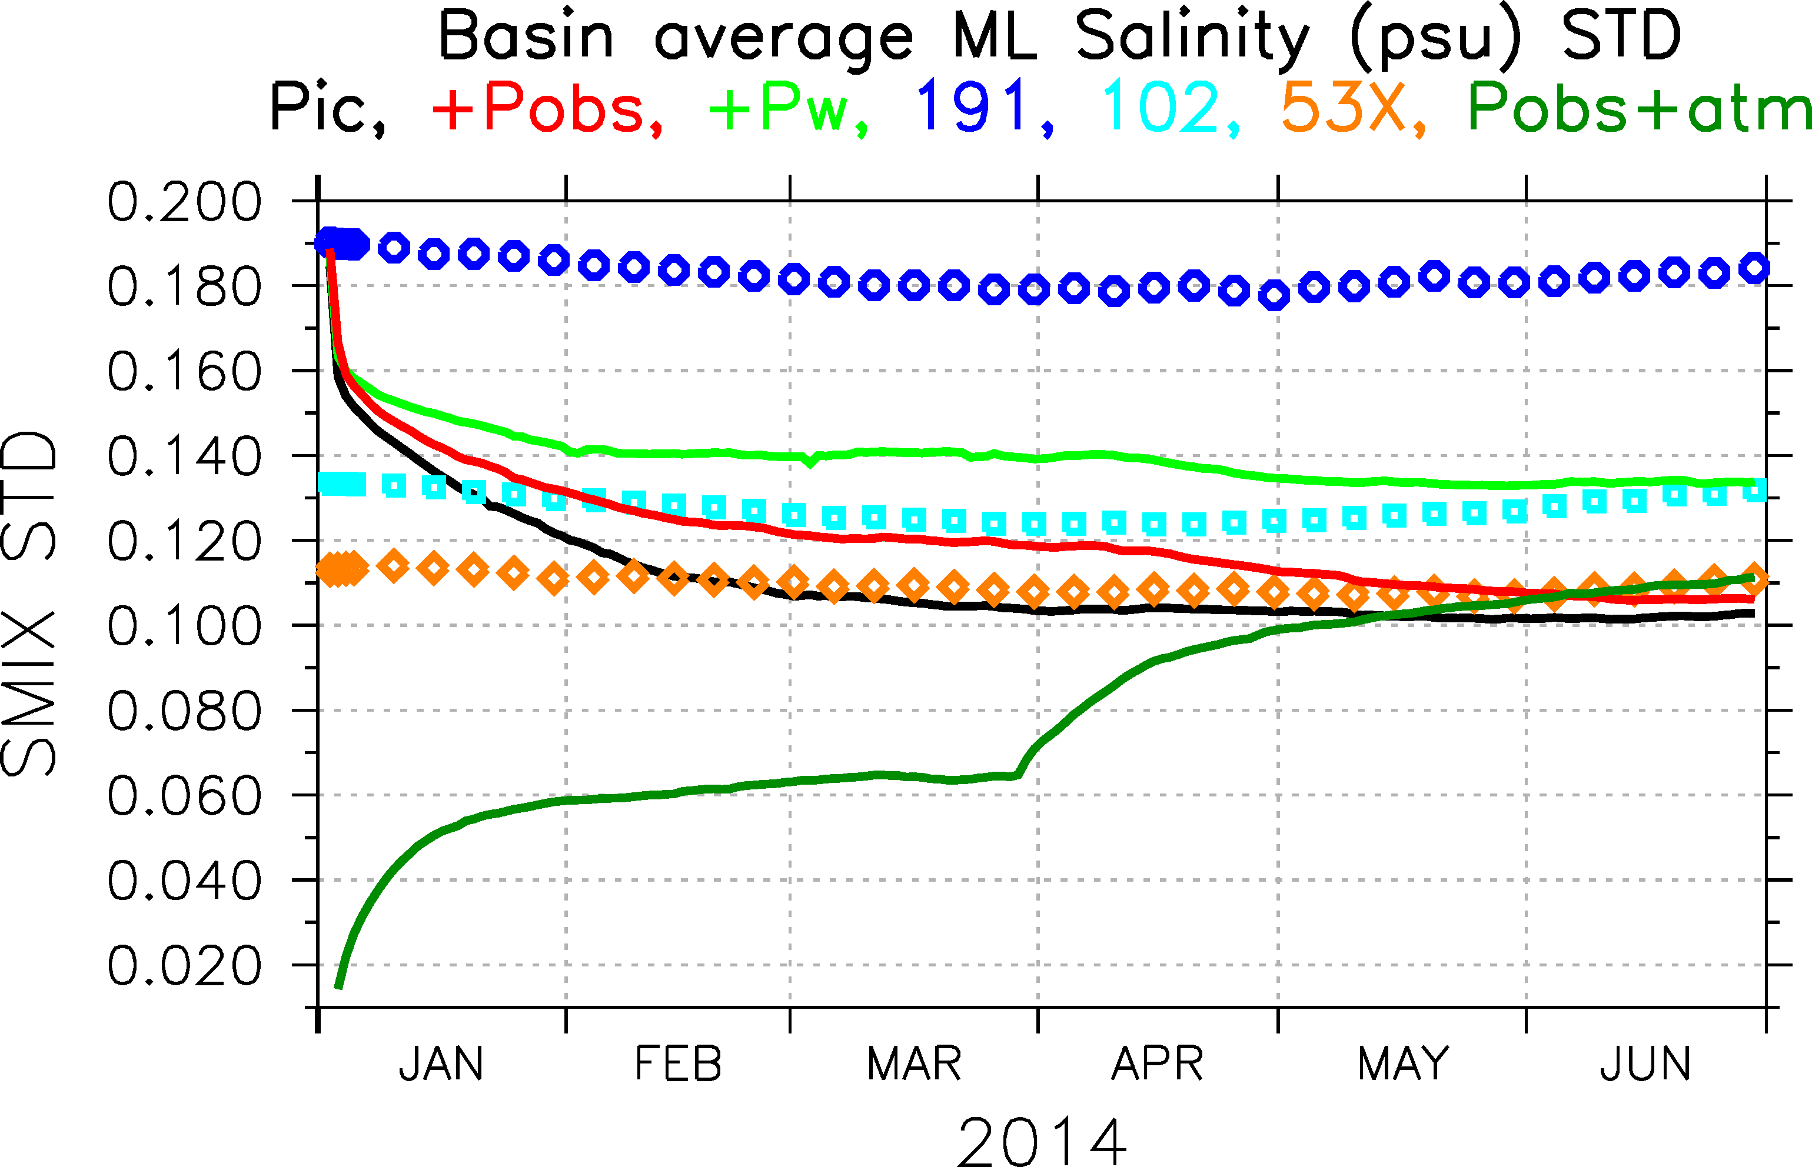
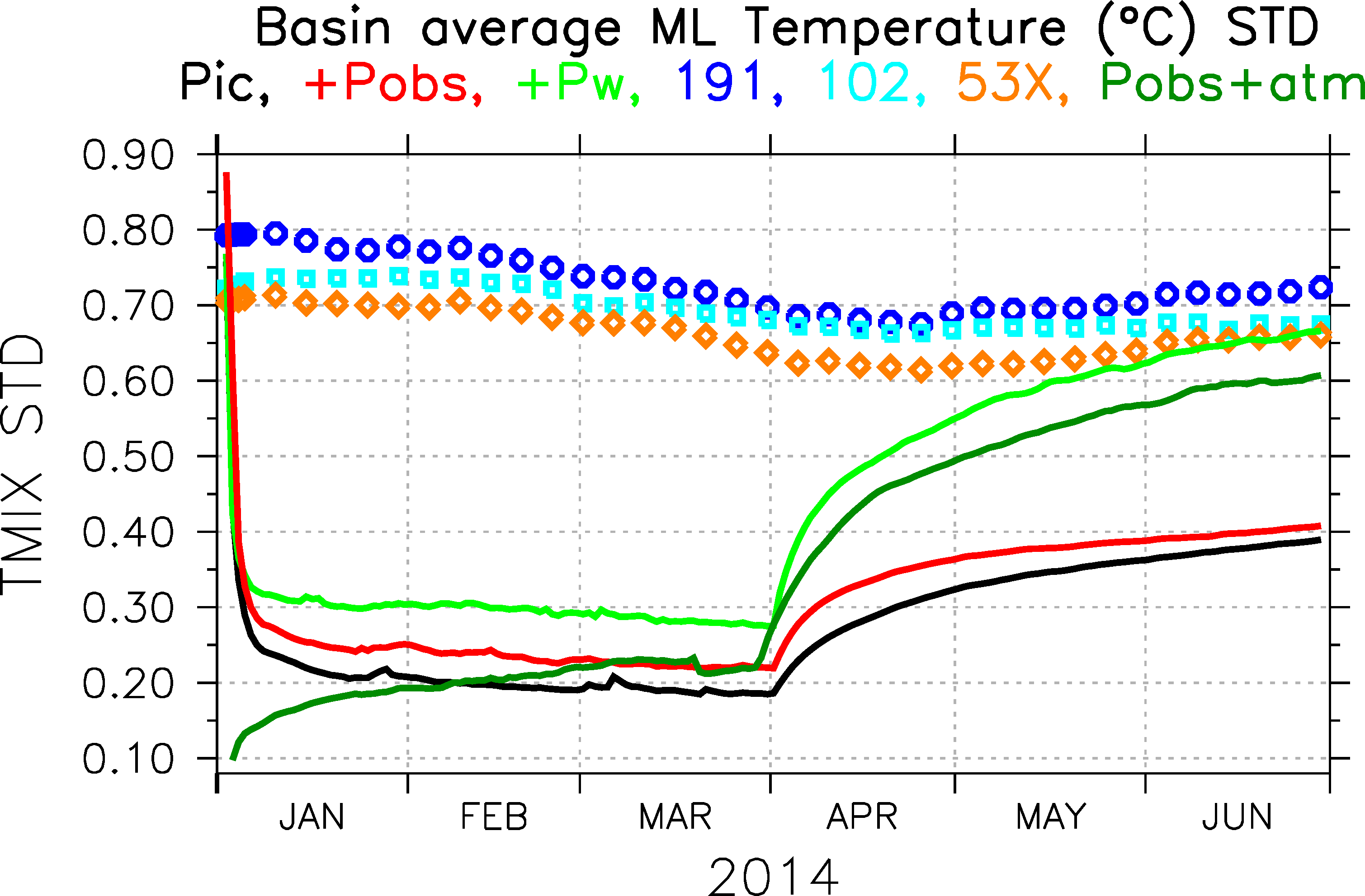
GOFS 3.1 Reanalysis Experiments
Mean Global Ensemble Spread
Climatological (interannual) experiments
P_{ic}+P_{obs}+P_{winds}
P_{ic}+P_{obs}
P_{ic}
data assimilation
forecast mode

Slide 16
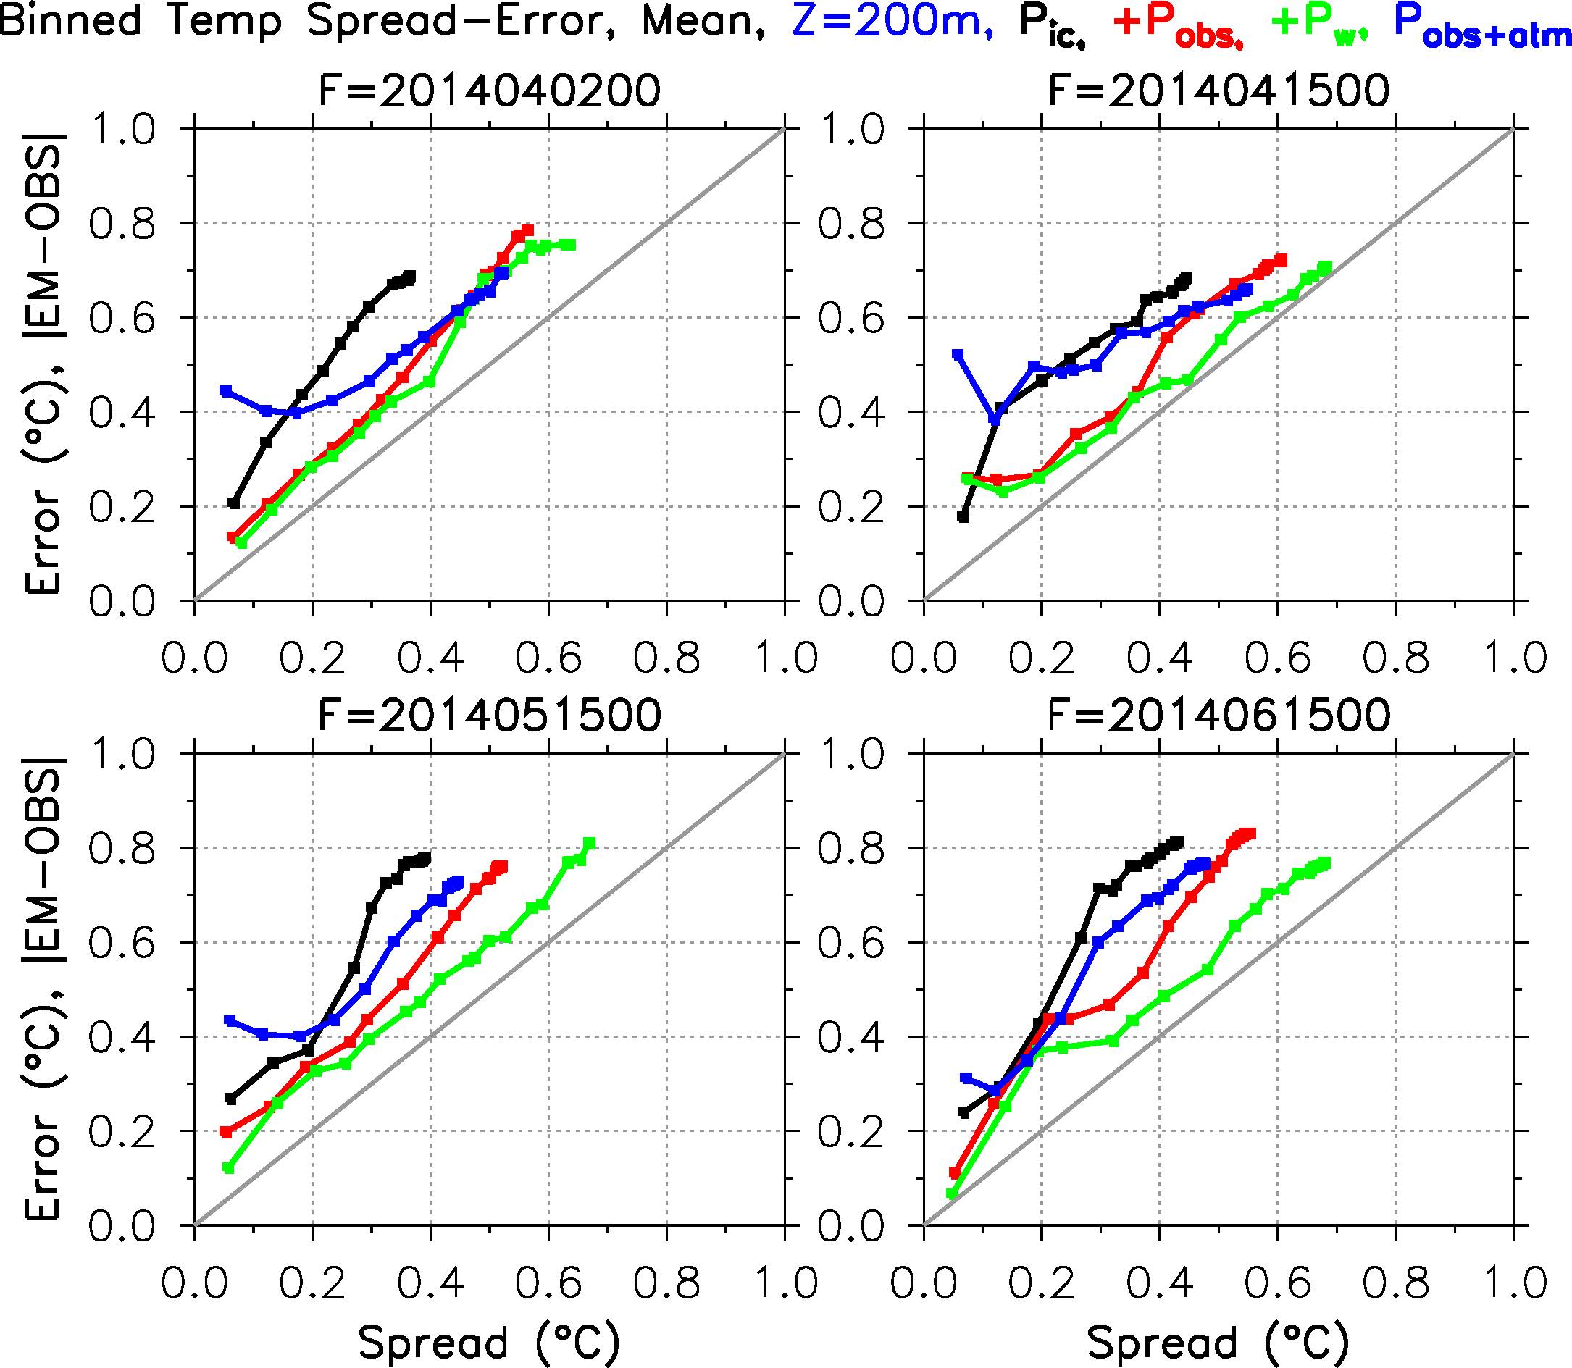
Validation of Ensemble Experiments
Spread-skill relationship for 200m Temperature
Again, the ensembles become more properly dispersive as more
error sources are accounted for.

Slide 17
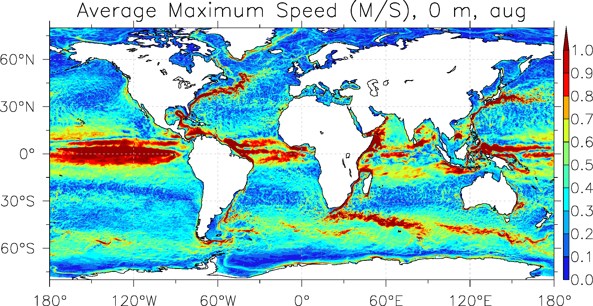
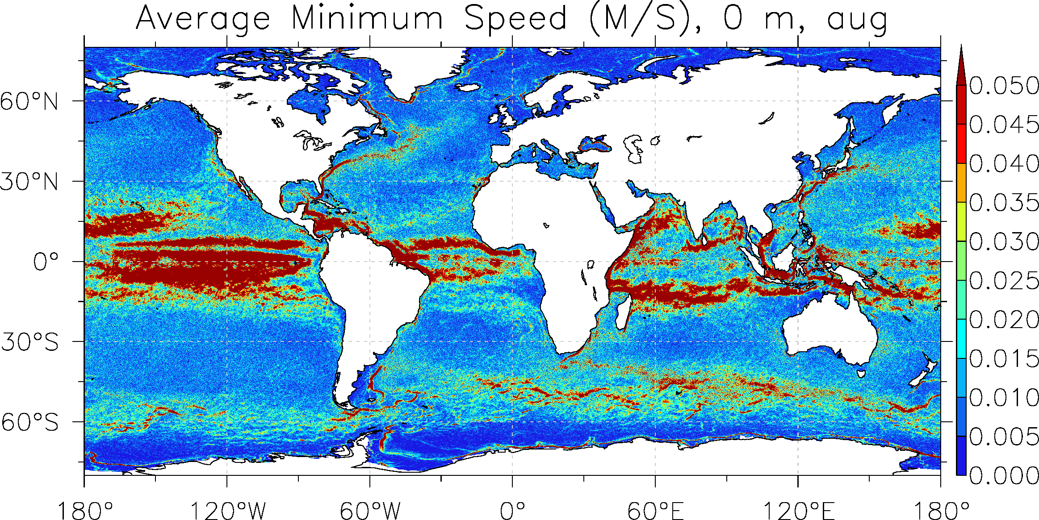
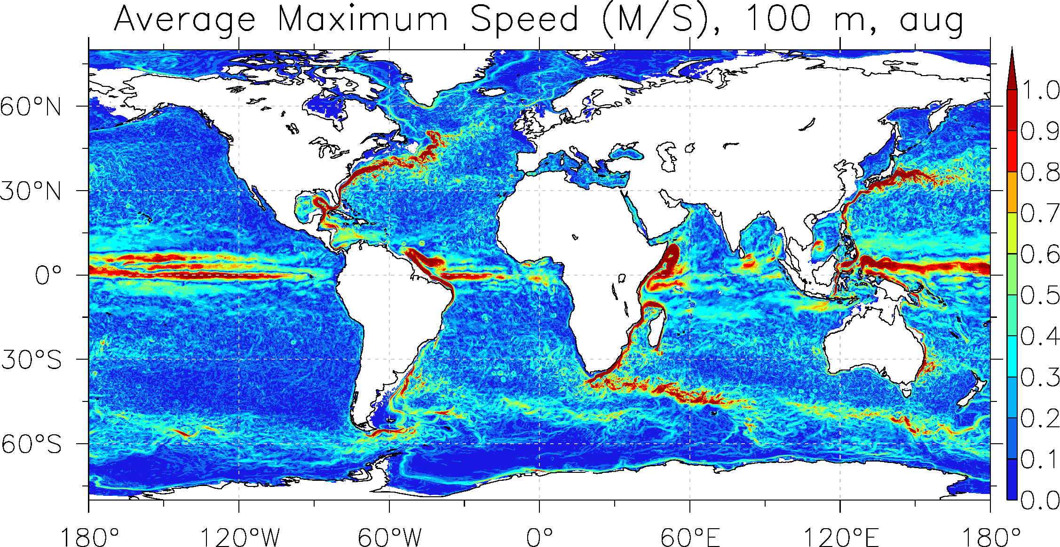
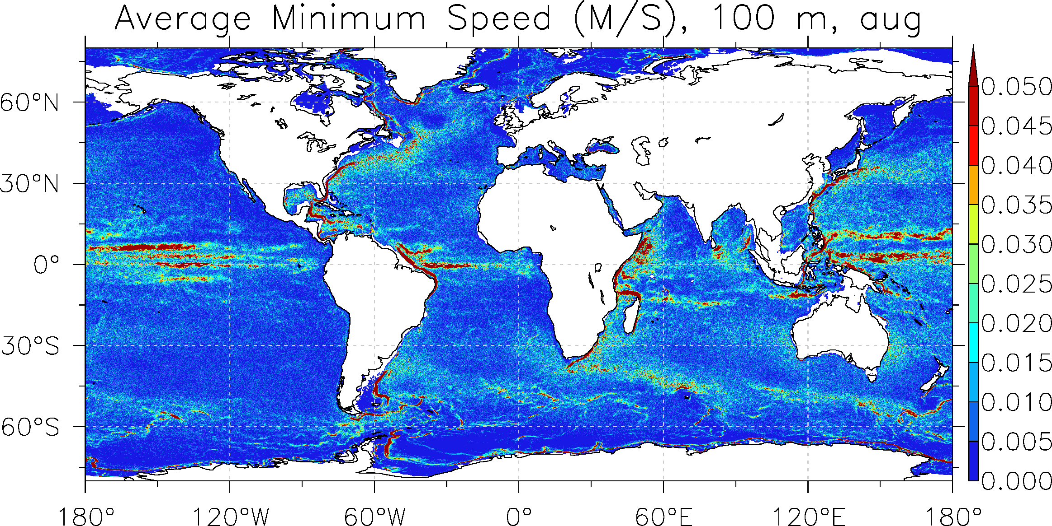
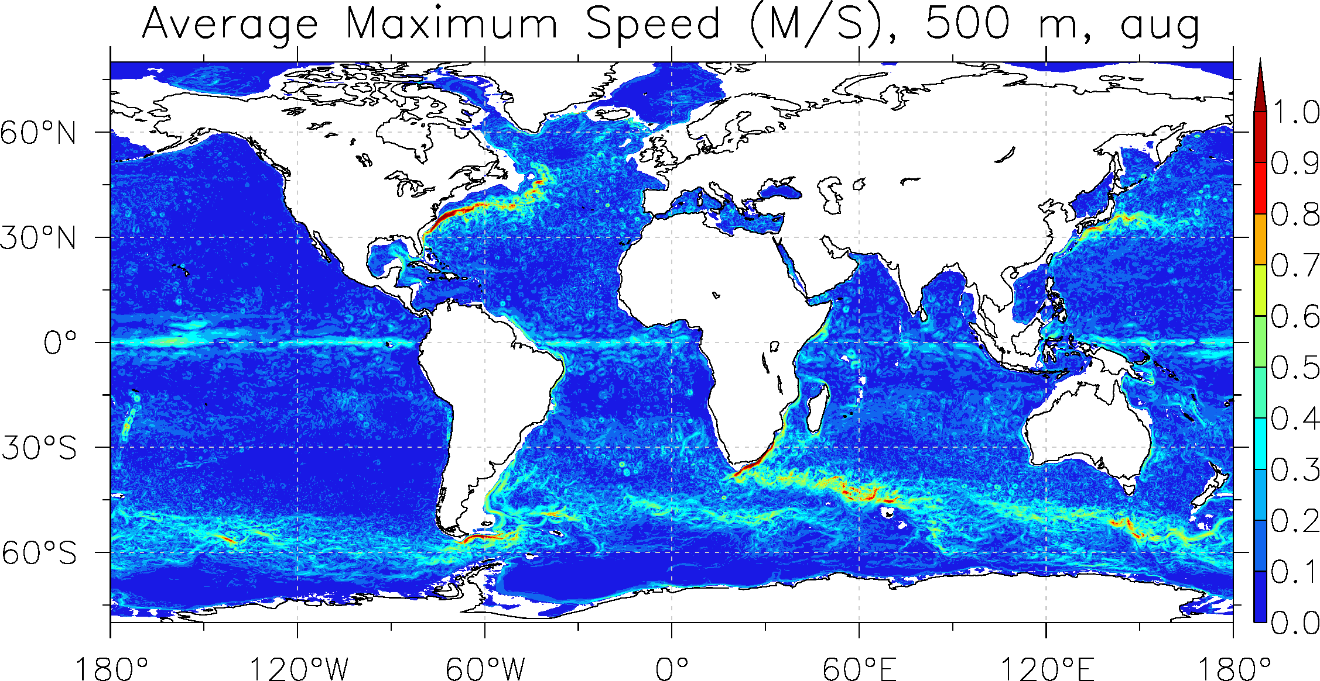
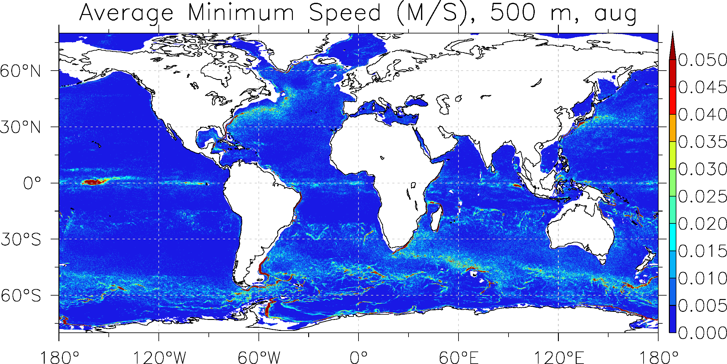
Reanalysis Products
August Maximum Speed
August Minimum Speed
Note
colorbar
difference
0 m
100 m
500 m

Slide 18
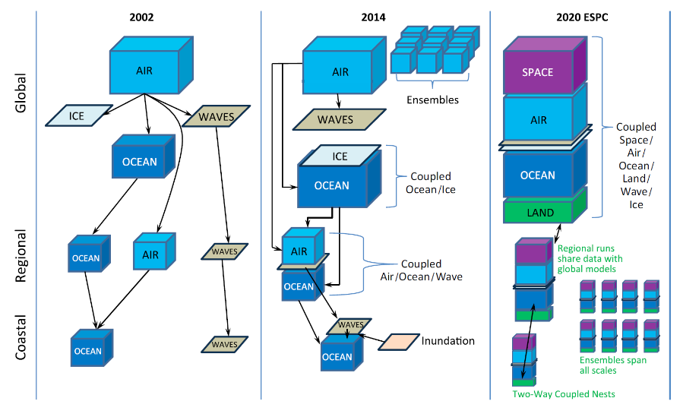
ESPC: Earth System Prediction Capability
2002
2014
2022 ESPC
Global
Regional
Coastal
NLOM
GOFS 3.0
IOC: 2019

Slide 19


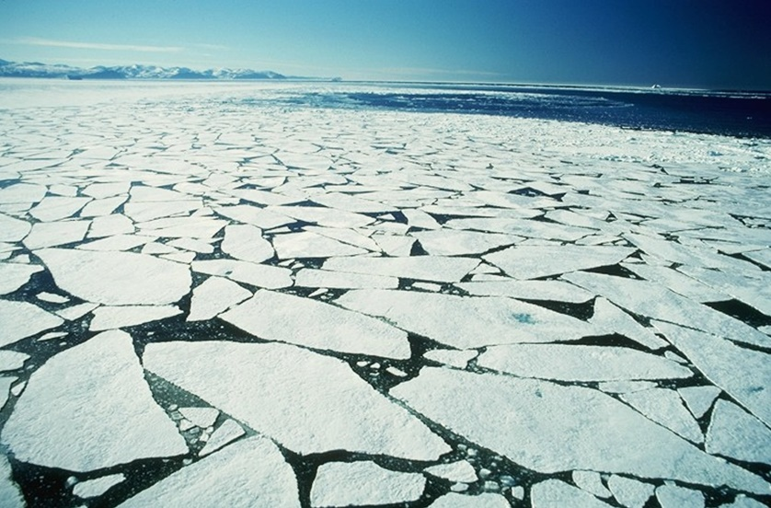
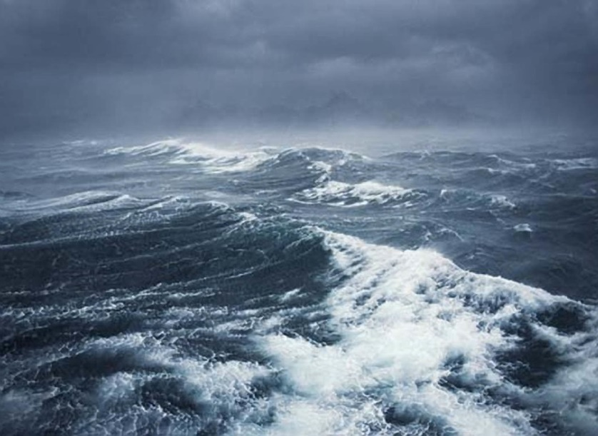
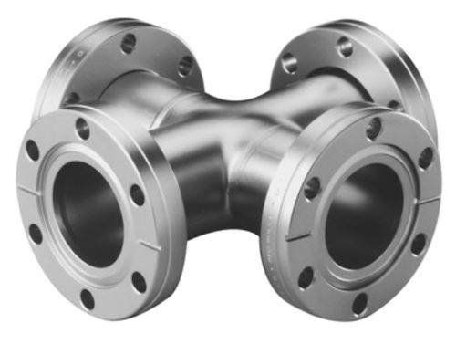
ESPC Model Components
NAVGEM
HYCOM
CICE
WW3
ESMF/NUOPC Coupler
Navy Earth System Model (NESM)

Slide 20
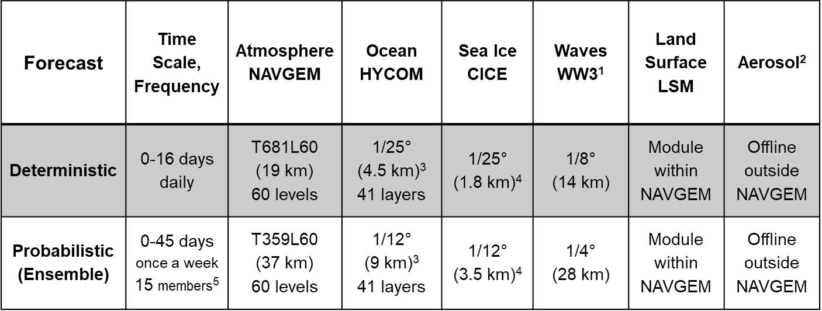
Resolution of Coupled Components
Horizontal and vertical resolutions at Initial Operational Capability (IOC)
¹ One-way coupling of atmosphere-ocean-sea ice to WW3.
² One-way coupling of atmosphere to aerosol.
³ Horizontal resolution at the equator.
⁴ Horizontal resolution at the North Pole.
⁵ The exact number of members will be determined by the operational resources available.

Slide 21
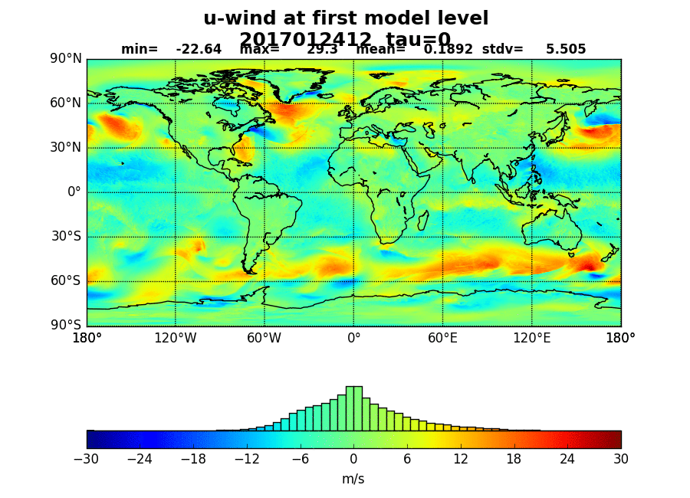
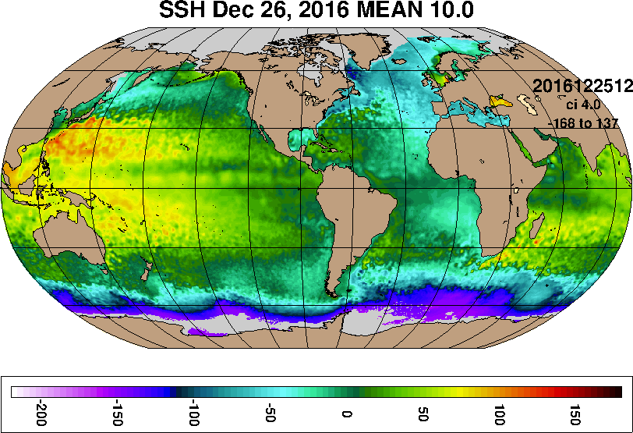
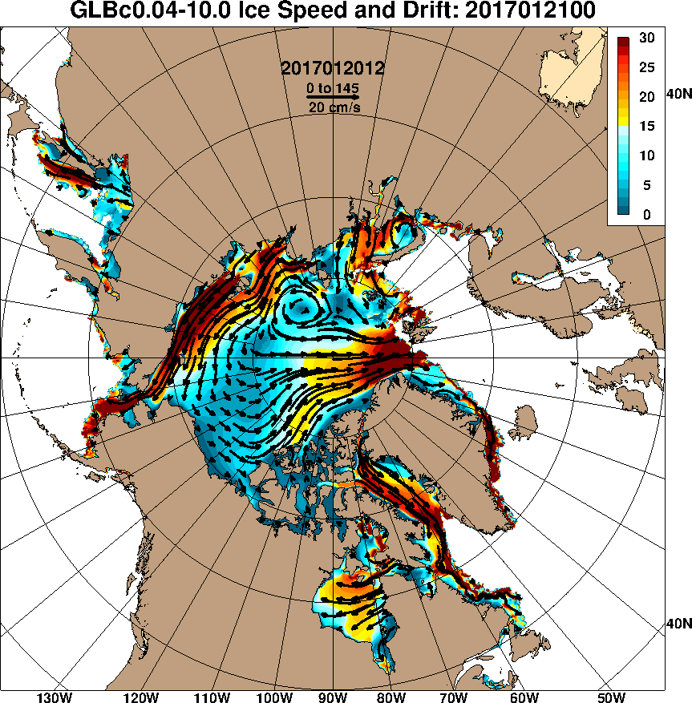
NESM: Navy Environmental Modeling System
Deterministic Resolution (1/25º) NESM
Dec. 26 2016 – Jan. 22 2017
NAVGEM (T681) zonal wind
HYCOM SSH
CICE sea ice speed & drift

Slide 22
NESM Ensembles
NESM ensemble perturbations are generated by perturbing the
observations (ocean, ice, atmosphere) in the data assimilation systems.
  Waves are 1-way coupled, 2-way is work in progress.
The obs perturbations are scaled by the obs error of each data source.
  LETKF and stochastic forcing are works in progress.
The data assimilation is weakly coupled at this point (covariances not shared).
  strongly coupled DA is work in progress.
16 members are being used for the initial capability (15 perturbed, 1 unperturbed).
  One year/one member requires ~2 M CPU hours on 2100 cores of a Cray XC30/40 (32M hrs).
All members ran 15 Dec. 2017 to 31 Feb. 2018 (validation is 01 Feb 2017 to 31 Jan. 2018).
60-day forecasts were performed once/week for each member.
  One year/one member/week requires ~1.5M CPU hours on 2100 cores of a
  Cray XC30/40 (24 M hrs).

Slide 23
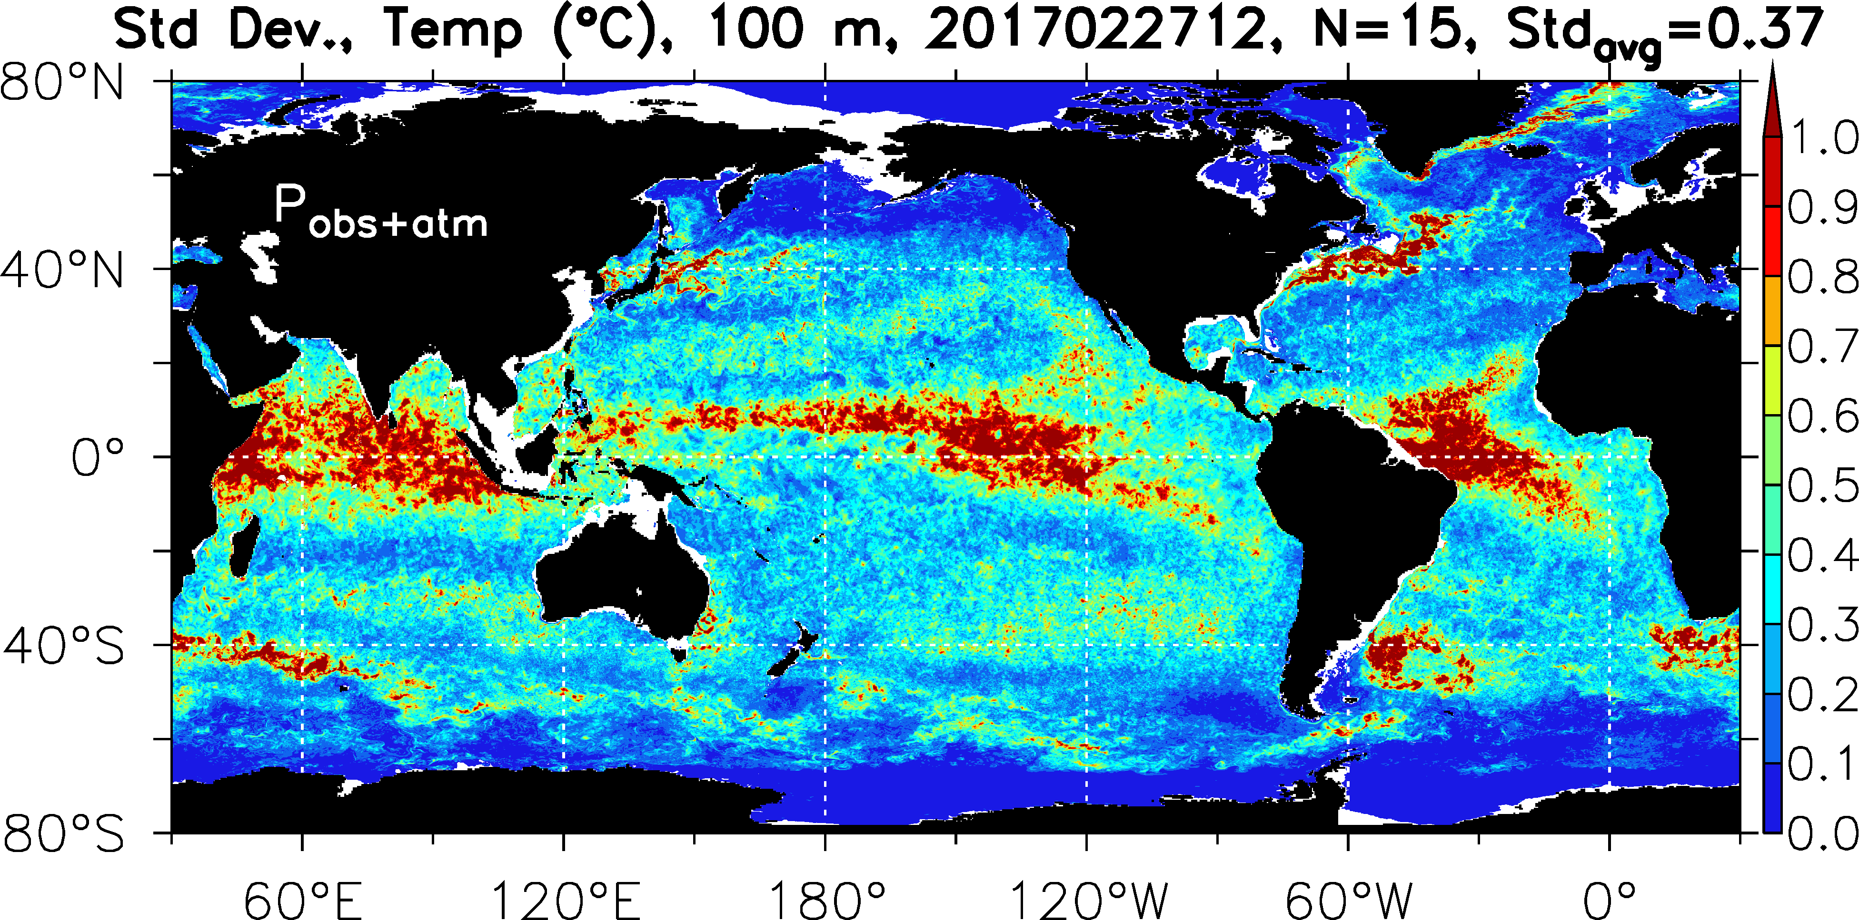
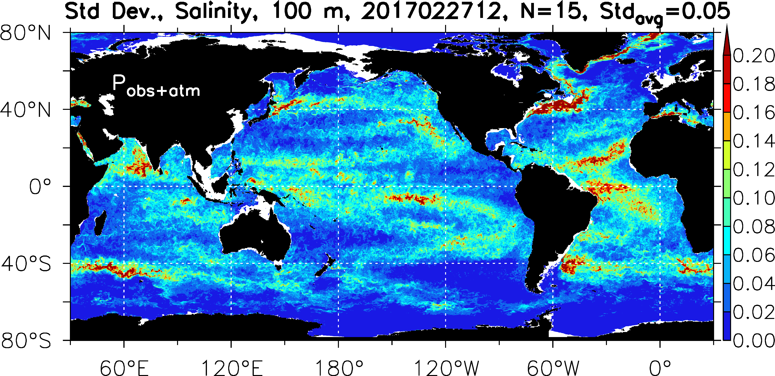
NESM Ensemble Spread
Temperature @100m
ensemble spread highest
in western boundary and
equatorial current systems
For the 27 Feb. 2017 analysis
Salinity @100m
ensemble spread highest
Near rivers, in areas of
High E-P and near western
boundary currents

Slide 24
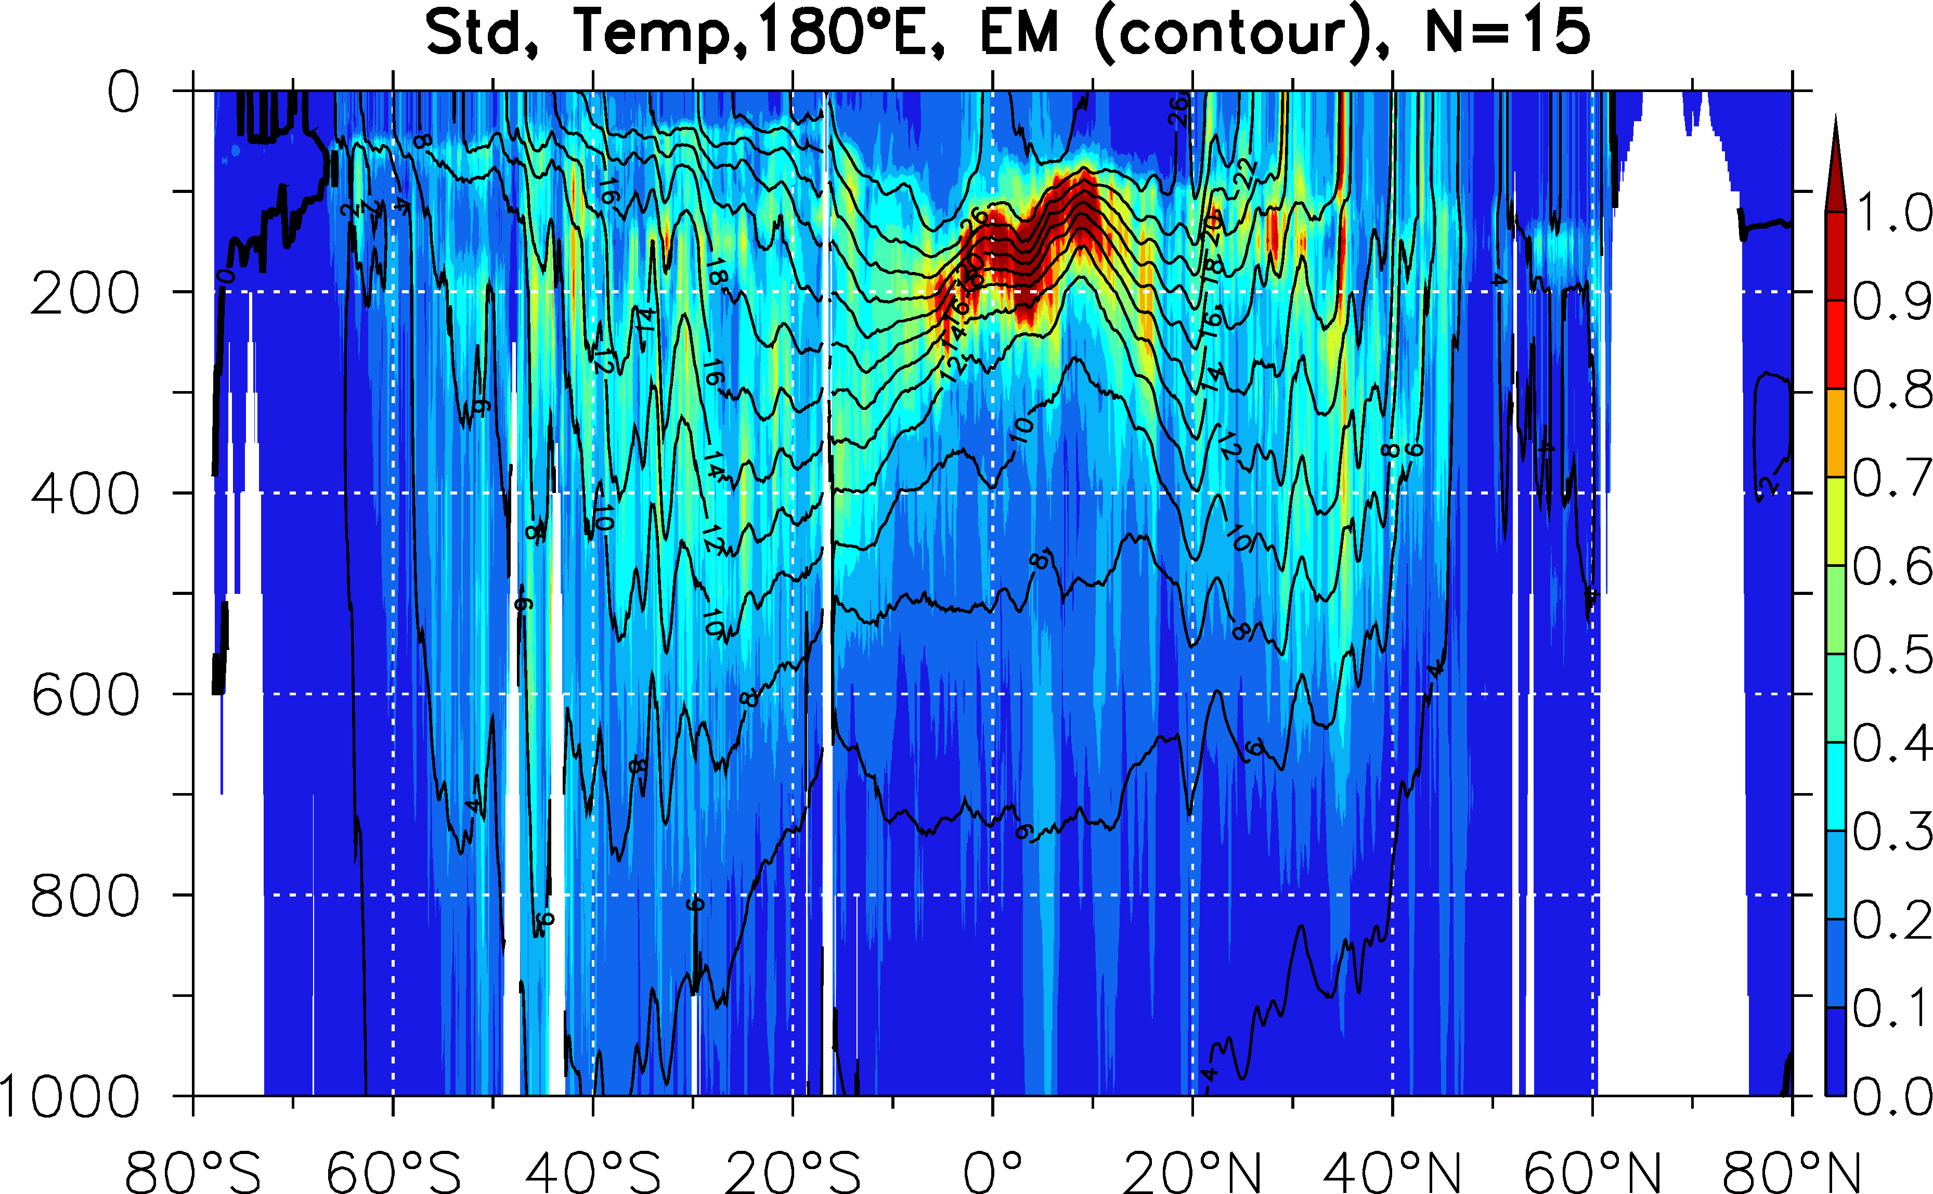
NESM Ensemble Spread
Cross-section of Temperature Spread vs. Depth at 180Eº
Latitude section along 180 E shows maximum spread in the thermocline between 10N-10S in the energetic equatorial undercurrent regime

Slide 25
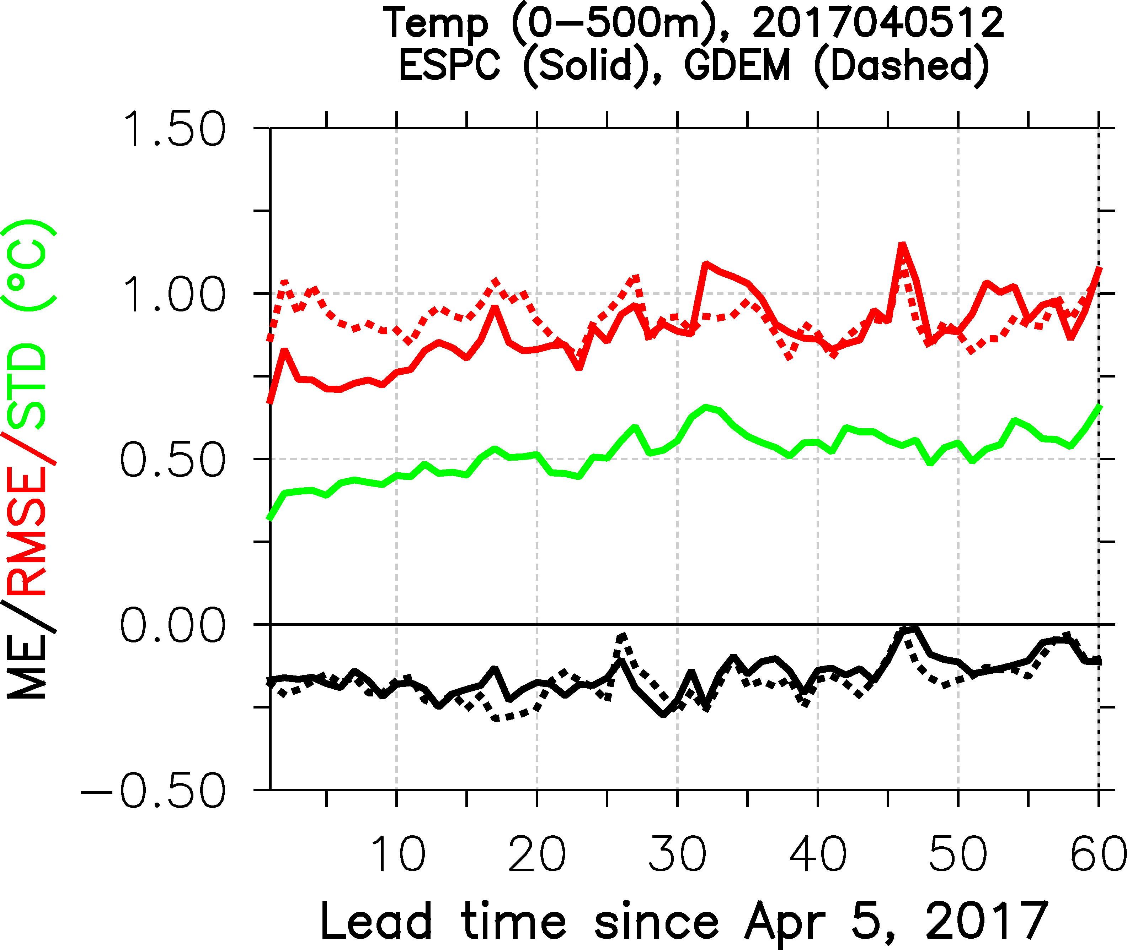
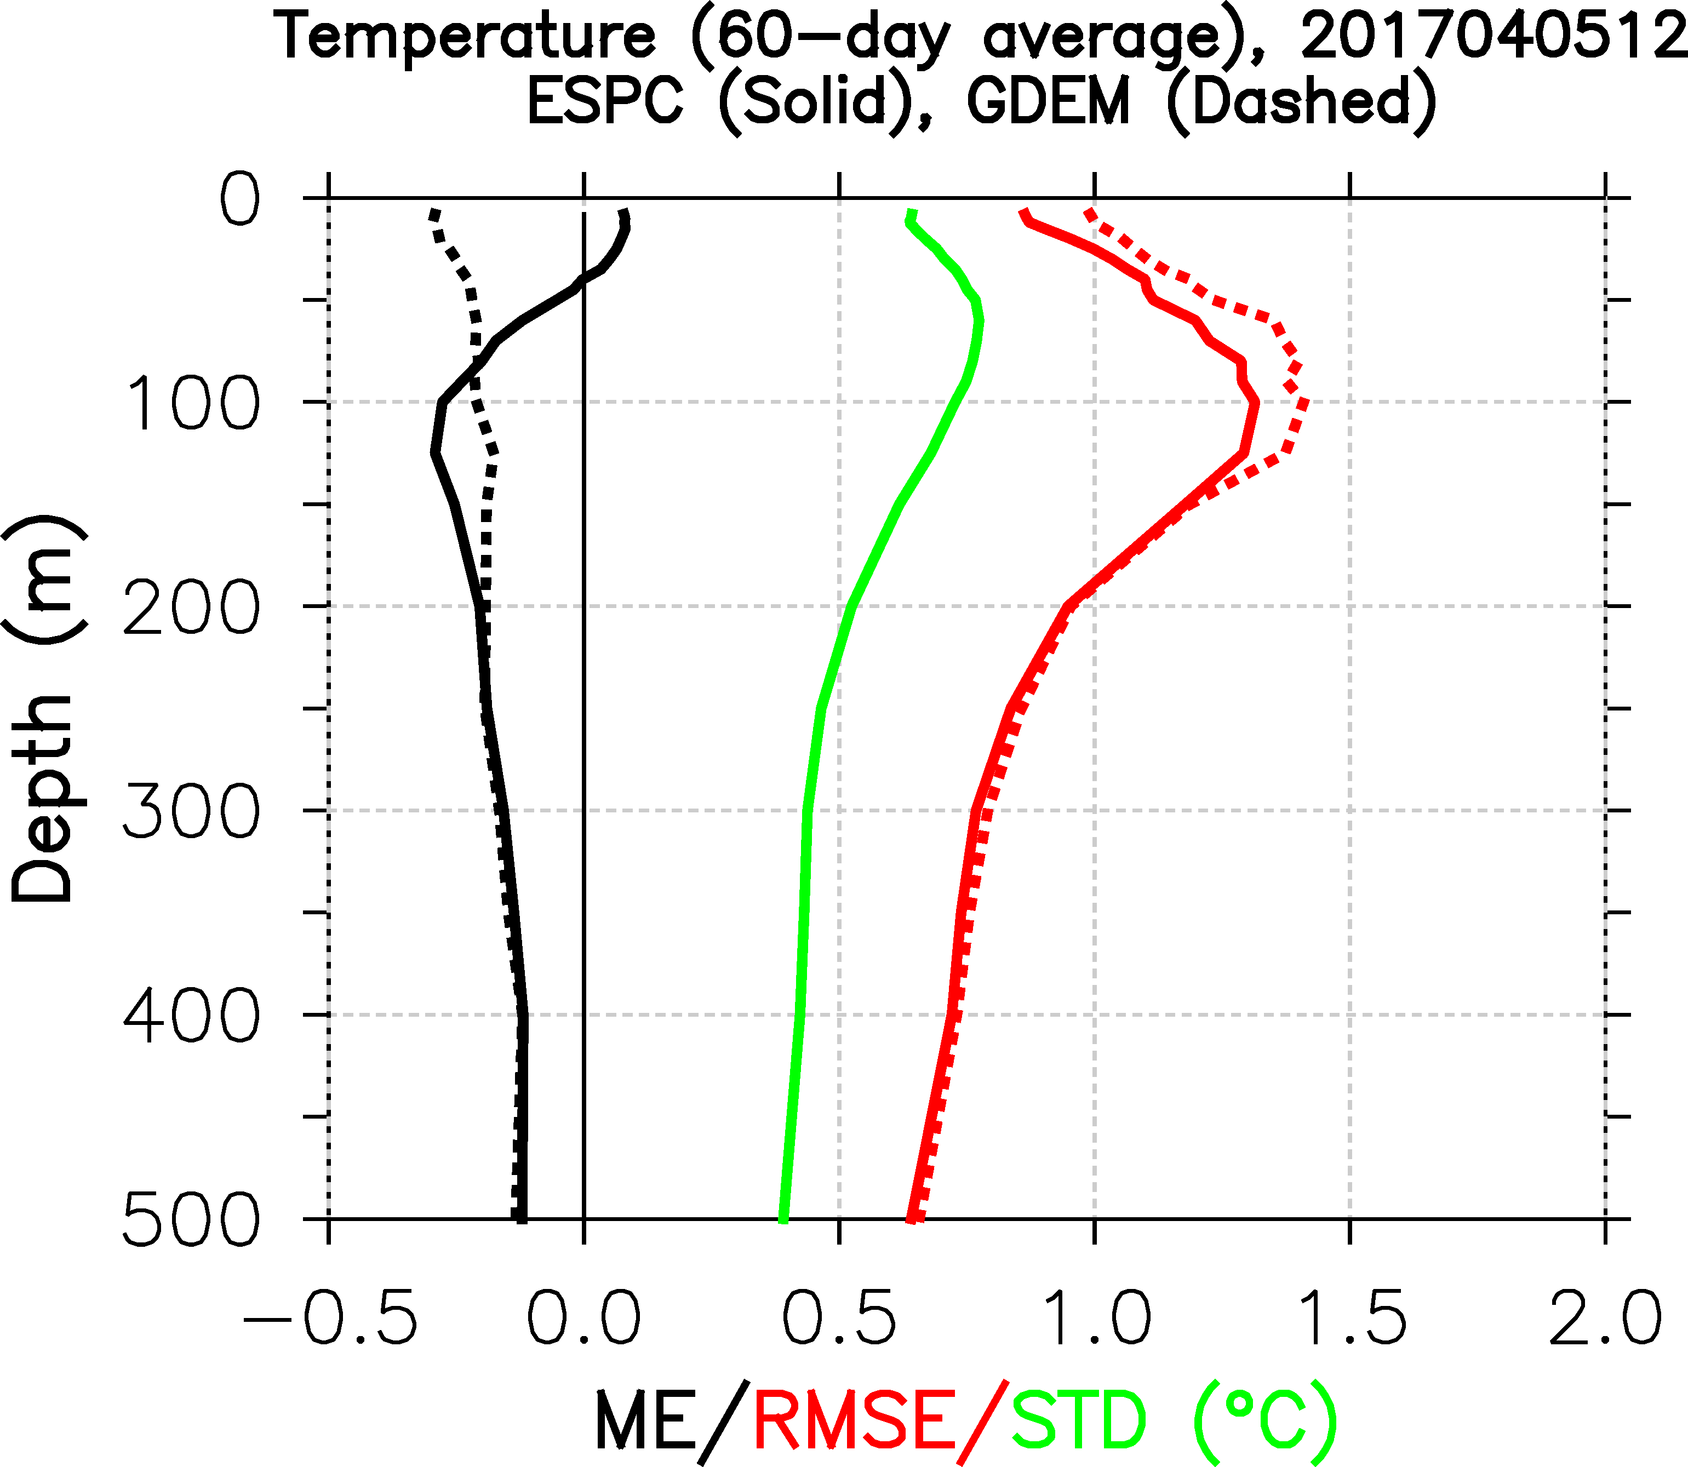
NESM Ensemble Validation
Verification against observations for April 05, 2017 analysis
~24 days
~125m

Slide 26
Ocean Analysis/Forecast Scorecard
“perfect”
Ocean only reanalysis
Coupled Reanalysis
Coupled Reforecast
Climatology
“worse”
Score_model(i) = 1 – (Error_model(i) / Maximum_error(i))
Total_score_model = mean (Score_model(i))
Using a scorecard from the operational system, ocean-only and coupled analyses are similar and coupled forecast is comparable out to ~10 days

Slide 27
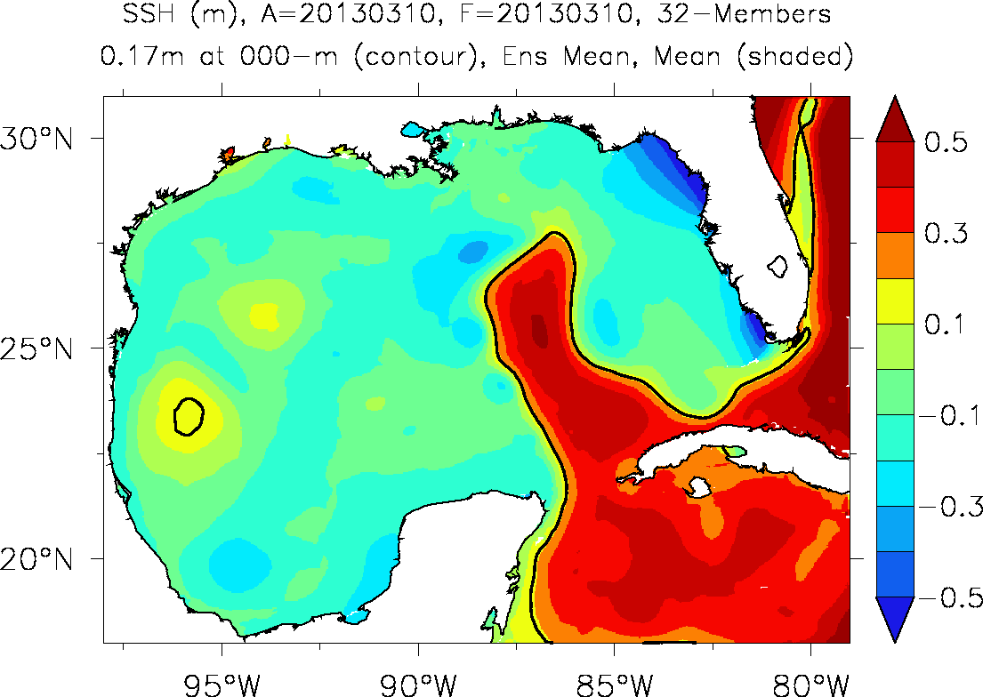
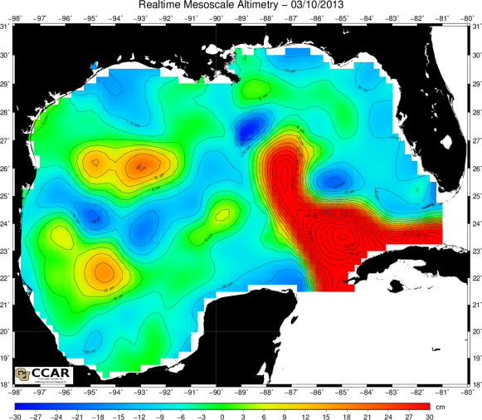
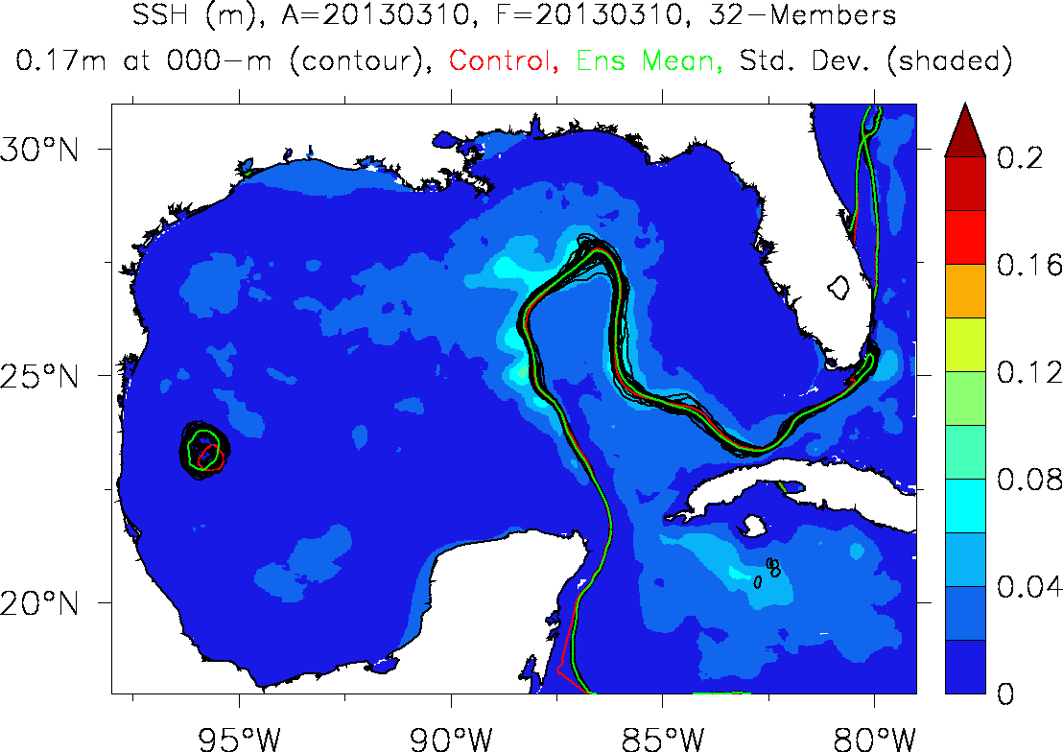
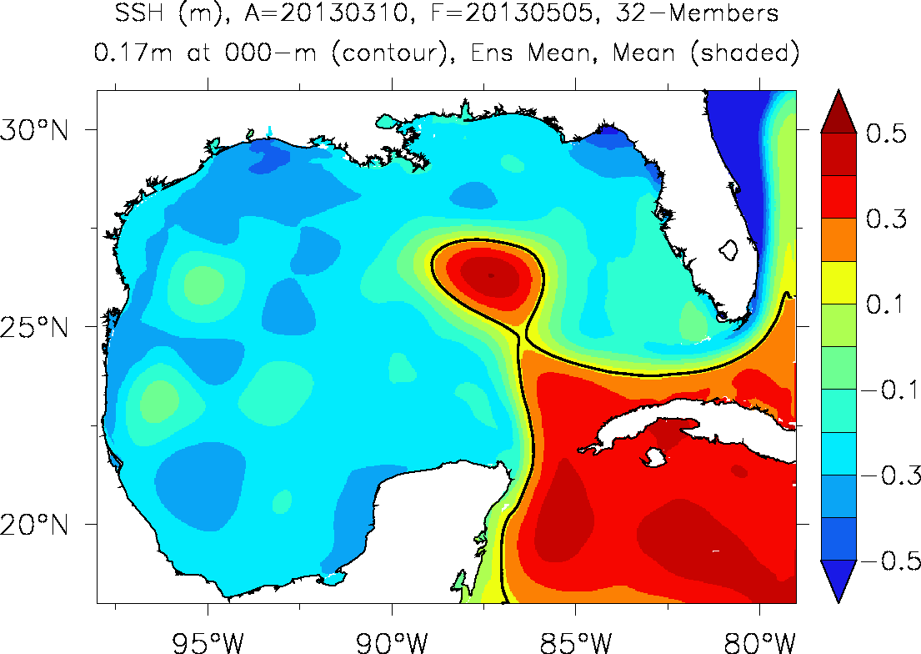
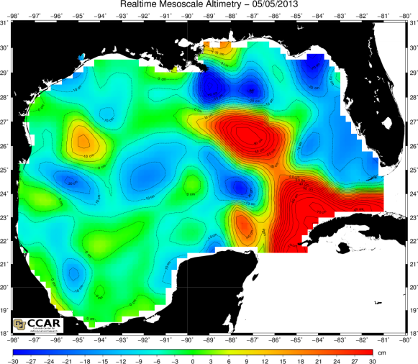
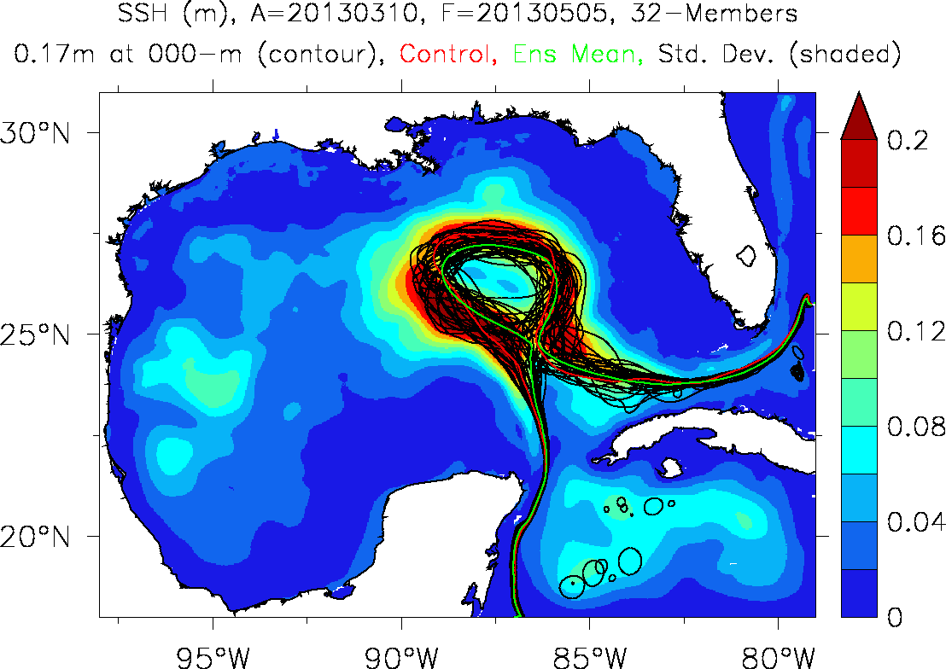
Regional Ensembles – Gulf of Mexico
Regional Ocean Ensemble Example
03/10/13 Ensemble Mean Analysis
03/10/13 Altimeter SSH
03/10/13 Ensemble Analysis Spread
05/05/13 Ensemble Mean Forecast
05/05/13 Altimeter SSH
05/05/13 Ensemble Forecast Spread
17 cm SSH contours

Slide 28
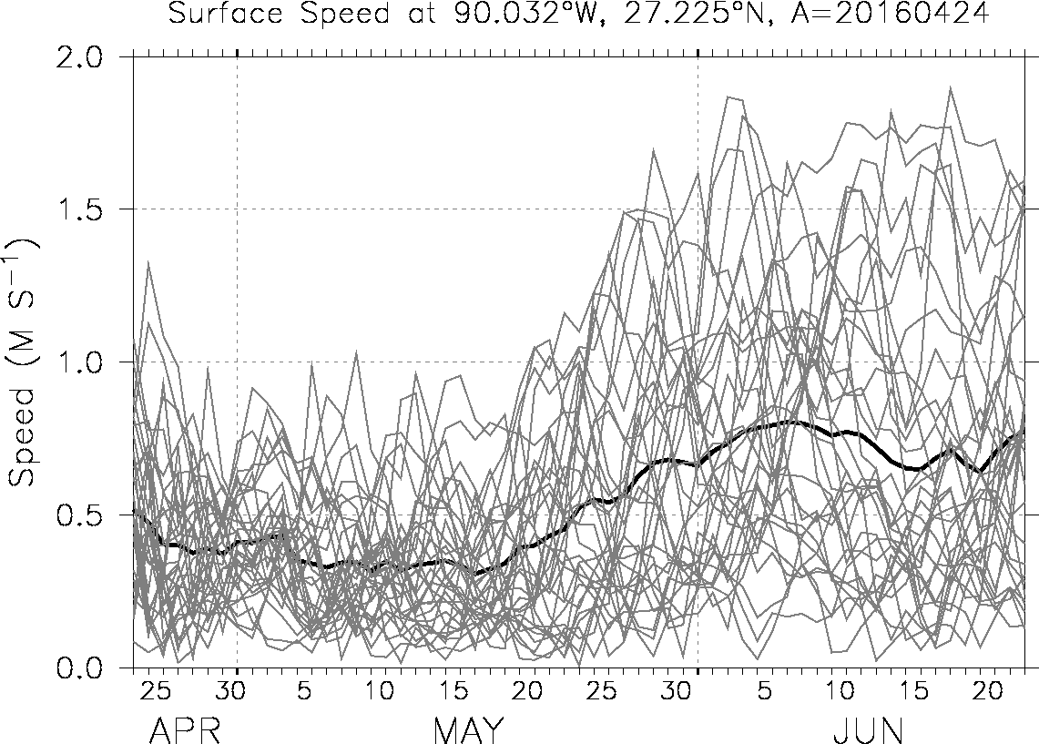
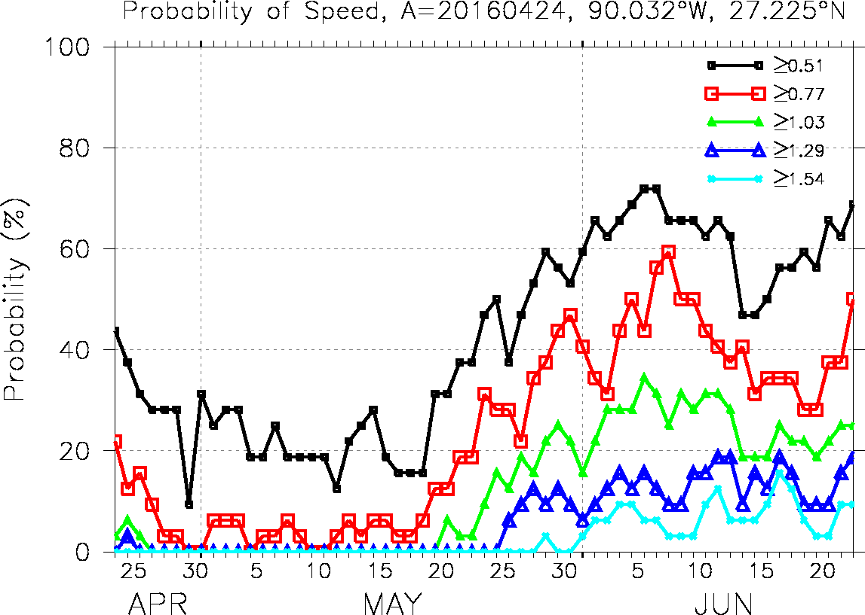
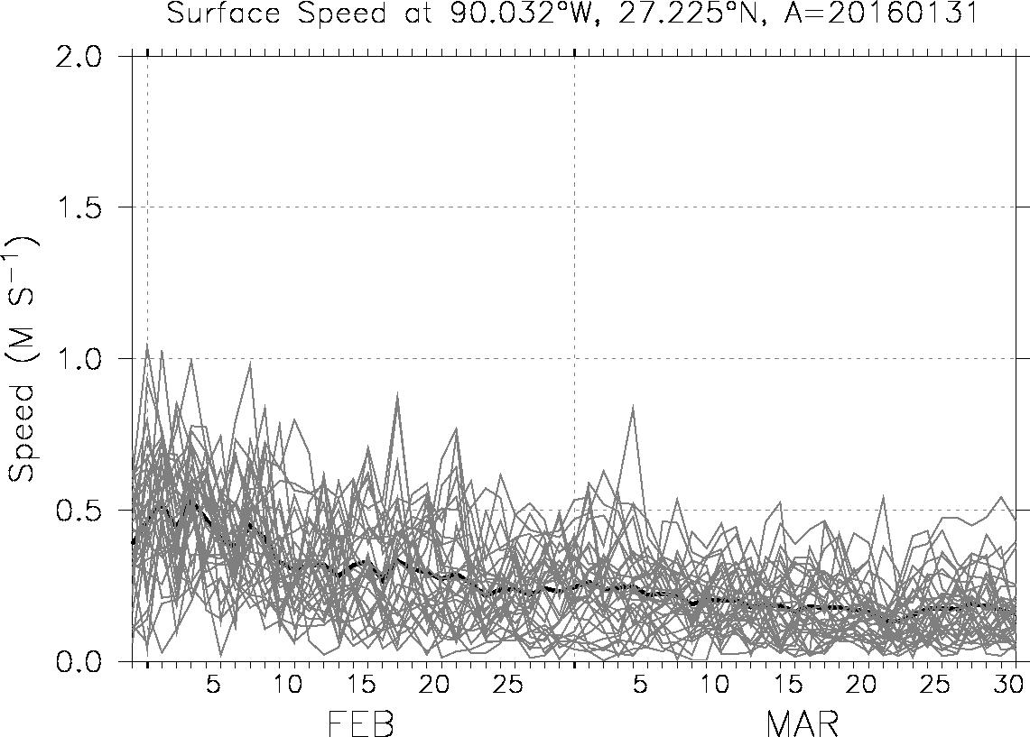

Forecast Ensemble Spread at a Point
A = 24 April 2016
A = 24 April 2016
At a point….mean and spread
Statistically binned…..
A = 31 Jan. 2016
A = 31 Jan. 2016

Slide 29




Surface Speed Probabilities
April. 02 – Jul. 02 2018
Greater than 1.5 kt.
Greater than 2.0 kt.
Greater than 2.5 kt.
Greater than 3.0 kt.

Slide 30



Risk Assessment Codes/Risk of Occurrence
Risk of occurrence is the integrated (cumulative) PDF for any variable
April. 02 – Jul. 02 2018
PDF
mode
Risk Assessment Code for Currents Threshold
25%
50%
CDF
For this case, velocity thresholds: 0.7-0.5-0.25-0.15 m/s
Can be done for any model quantity
The user sets the thresholds
Can also be used for plumes, trajectories, etc.
Risk Assessment Code (RAC)
Data reduction is key.
Need the ability to distill the global ensemble
output into useful decision making aids.

Slide 31
Future Plans
The Ocean Model
  ESPC to replace GOFS ~FY22
  Coupled Uncertainty
  HYMOM? (MOM6/HYCOM merge?)
  Adaptive grids (dynamically adaptive)
The Data Assimilation
  LETKF (for DA, initial conditions, and uncertainty); hybrid covariances
  Multi-scale (SWOT)
  Strongly Coupled DA (coupled covariances)

Slide 32
US Navy Forecasting Developments
Thanks!
http://www7320.nrlssc.navy.mil
http://hycom.org/ocean-prediction
http://www.hycom.org/dataserver/glb-analysis

Slide 33




Coupled Uncertainty
Ocean Generalized Stochastic Equation
Stochastically Perturbed
ParameterizationTendencies (SPPT)
Flexibility to represent wide range of model error
Fronts and tropical cyclones
Vertical mixing,
numerical errors
Ocean fronts and
flux interfaces
Large scale pressure centers
Mesoscale features
Atmospheric forcing

Slide 34

Reanalysis Products
01 Jan Climatological Surface Sound Speed
mean
standard
deviation
From the GOFS 3.1 reanalysis, saved on the standard NAVO 40 levels.

Slide 35


Impact to the Warfighter
Predicting Temperature Fronts
Tactical Ocean Feature Analysis (TOFA)
Sea Surface Temperature Gradients (°F/10 nmi)
GOFS 3.1
Satellite
Norwegian Sea
Norway
Norway
Acoustical properties change significantly in high temperature gradient areas
GOFS 3.1 can provide TOFA forecasts out to seven days
Satellite derived images often obscured because of cloudiness
Above products produced by Fleet Numerical Oceanography Center

Slide 36

Validation of Ensemble Experiments
April 1 2014 (first day of forecast)
Ocean ensembles are typically
under-dispersive (and ours are
no different)
The ensembles become more
properly dispersive as more
error sources are accounted for.

Slide 37

New Capability: Global LETKF
Ocean Obs
Existing NCODA assimilation
SST: Ship, Buoy, AVHRR (GAC/LAC), GOES, AMSR-E, MSG, AATSR
Temp/Salt Profiles: XBT, CTD, Argo Float, Buoy (Fixed/Drifting), Gliders
SSH: Altimeter, T/S profiles
Sea Ice: SSM/I
Ocean QC
Existing cycling system used
to generate single (deterministic)
global ocean forecast
Innovations
3D Var
increments
Incremental
update cycle
HYCOM
Localization
Atmospheric
perturbations
Xª_{N}
X^{a’}_{N}
EnKF
Drift control
HYCOM
Hybrid
covariance
Pª
Pª
Stochastic
perturbations
X^{f},P^{f}
Background error covariance
EnKF for
global
uncertainty
Post processing/
calibration
Identify biases and correct via
calibration; use as inputs for
risk management tools
N = number of ensemble members

