Slide 1


Climate driven changes in wave extremes from an ensemble of Global Climate Models
Alberto Meucci¹; Ian R. Young¹; Mark Hemer²
ameucci@student.unimelb.edu.au
¹Department of Infrastructure Engineering, University of Melbourne
²CSIRO Ocean and Atmosphere, Hobart, Tasmania

Slide 2
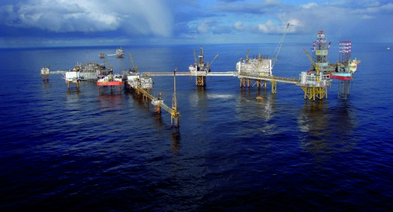
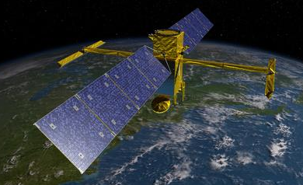
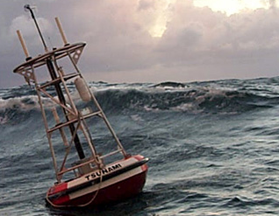
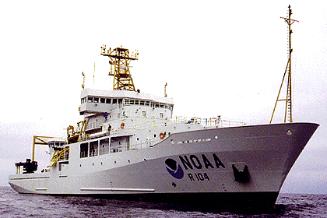
Motivation of the study
Challenges of long-term extremes estimation
Changes of MetOcean extremes
(Young et al., 2011; Hemer et al. 2013; Wang et al. 2014; Aarnes et al. 2017)
Robust technique to estimate extremes for future climates
Notes:
(Wang et al., 2014) study made statistical projections of changes in ocean wave heights using sea level pressure (SLP) information from 20 CMIP5 (Coupled Model
Intercomparison Project Phase 5) global climate models for the 21st century.

Slide 3
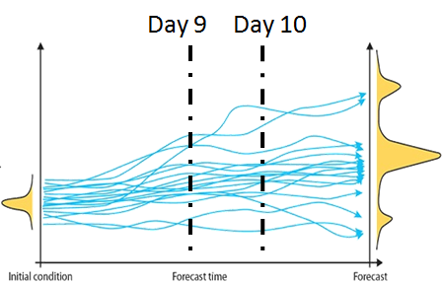
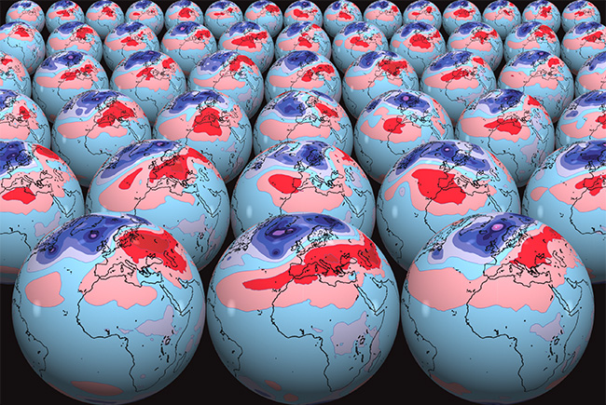
Ensemble of operational forecasts
(Breivik et al., 2013, 2014); (Meucci et al., 2018)
Single model ensemble approach
(Molteni et al., 1996)
50 ENS
EVA 100 years RP
H_{s} - U_{10N}
Notes:
Using several models and scenarios is the appropriate technique to deal with uncertainty (Deque, 2007)

Slide 4

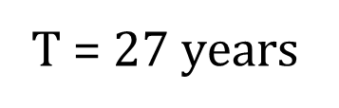
Ensemble of Global Climate Models
Multiple models ensemble approach
(Taylor et al., 2012; Hemer et al., 2016)
WaveWatch III 6-hourly datasets forced using 7 CMIP5 GCM surface winds
Single model
Inter-model significance
T $\text{= }\text{2}\text{7} \text{years}$
$${\text{T}}_{\text{eq}}\text{ = }\text{1}\text{89} \text{years}$$
ACCESS 1.0
BCC-CSM1.1
GFDL-CM3
HadGEM2-ES
INMCM4
MIROC5
MRI-CGCM3
BC on CFSR-WWIII
Historical dataset
1979-2005
POT EVA
H_{s}
End 21st Century
2081-2100
RCP4.5
RCP8.5
Notes:
Using several models and scenarios is the appropriate technique to deal with uncertainty (Deque, 2007)

Slide 5
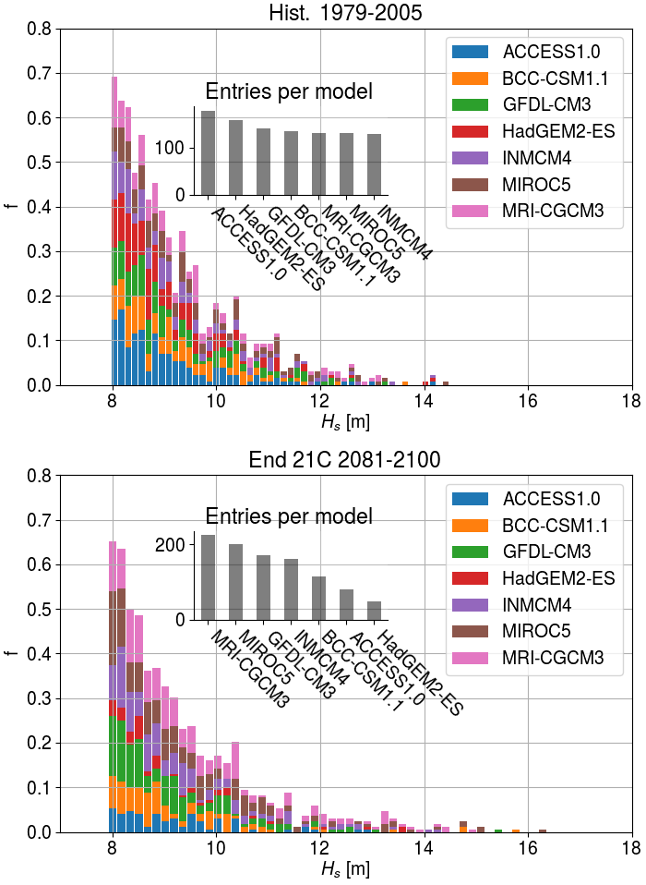
Methodology approach
Selection of extremes:
POT 90th percentile for each model
1000 highest peaks
ens1000
(Lopatoukhin et al., 2000)
Representative time interval:
(Breivik et al., 2013, 2014)
Historical dataset 1979-2005:
$${\text{T}}_{\text{eq}}\text{ = }\text{27} \text{years}\text{ ∙ 365 ∙ 4 }\text{hindc}\text{asts} \text{a} \text{day}\text{ ∙ 6}\text{h} \text{∙}\text{ 7 }\text{GCMs} \text{=} \text{189} \text{years}$$
Future projection dataset 2081-2100:
$${\text{T}}_{\text{eq}}\text{ = }\text{20} \text{years}\text{ ∙ 365 ∙ 4 }\text{hindc}\text{asts} \text{a} \text{day}\text{ ∙ 6}\text{h} \text{∙ 7 }\text{GCMs} \text{=} \text{140 }\text{years}$$

Slide 6
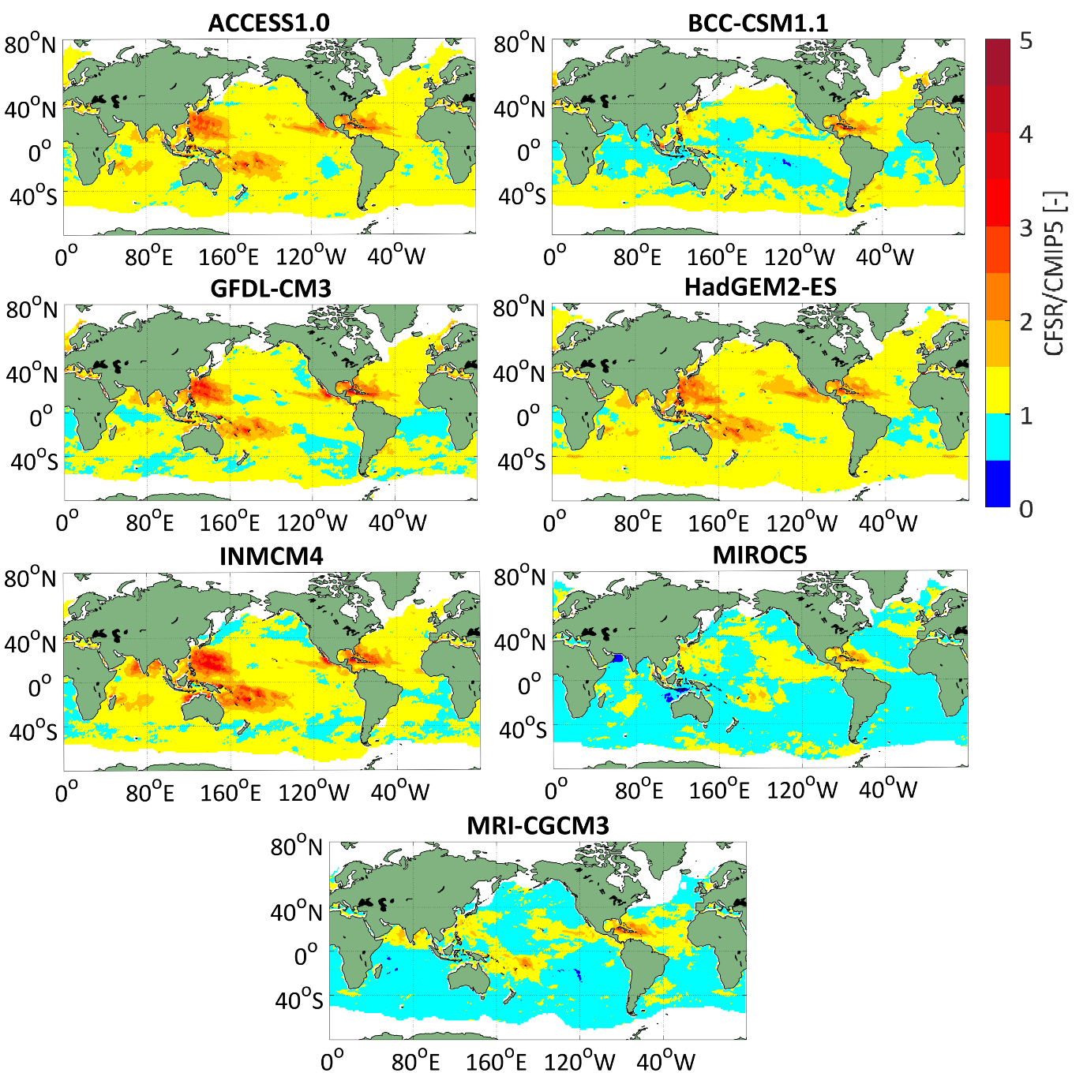
Methodology testing
Model climatology comparable to the observed climatology
100years Hs CFSR 99.8% POT
CFSR/CMIP5
Bias Correction of historical datasets based on 99.8% H_{s,100}
POT 99.8%

Slide 7
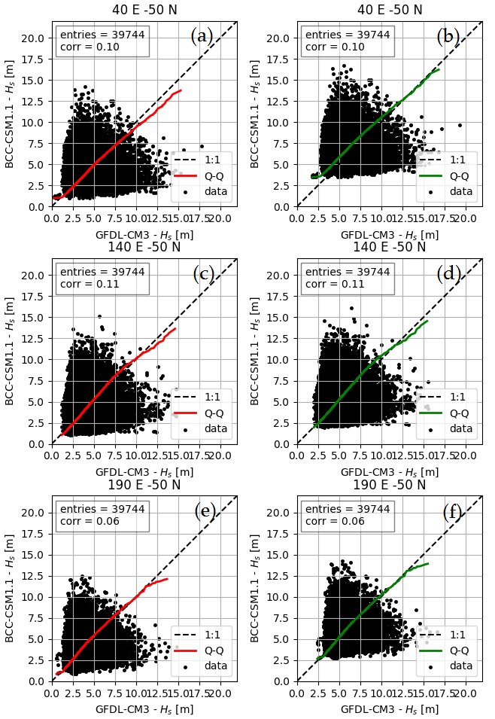
Methodology testing
SO1
Independent and identically distributed (i.i.d) model extremes
GFDL-CM3
BCC-CSM1.1
SO2
(Coles, 2001)
SO3
Notes:
GFDL-CM3: Geophysical Fluid Dynamics Laboratory Earth System Model 3 (NOAA - National Oceanic and Atmospheric Administration)
BCC-CSM1.1: Beijing Climate Centre, Climate System Model, 1-1
MIROC5: Model for Interdisciplinary Research on Climate, version 5 (University of Tokyo)

Slide 8
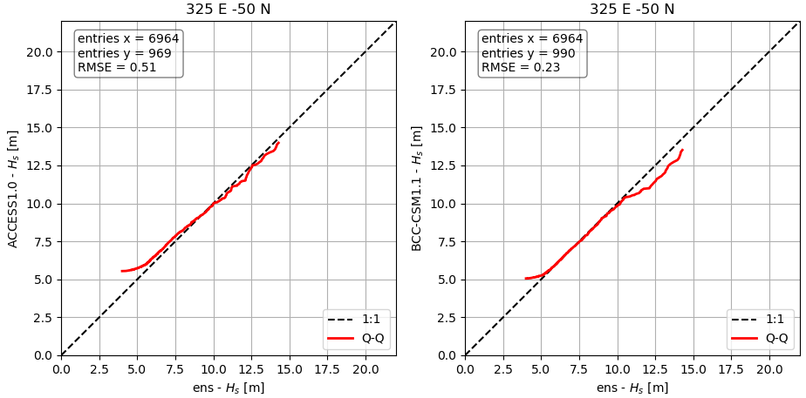
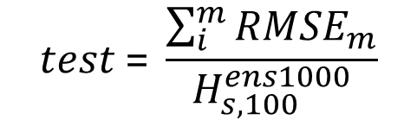
Hist. 1979-2005
Methodology testing
Selection of extremes over 90th percentile
NO-BC End 21stC. 2081-2100
Normalized sum of 7 RMSE:
$$test \text{= }\frac{\sum_{i}^{m}{{RMSE}_{m}}}{H_{s,100}^{ens1000}}$$

Slide 9
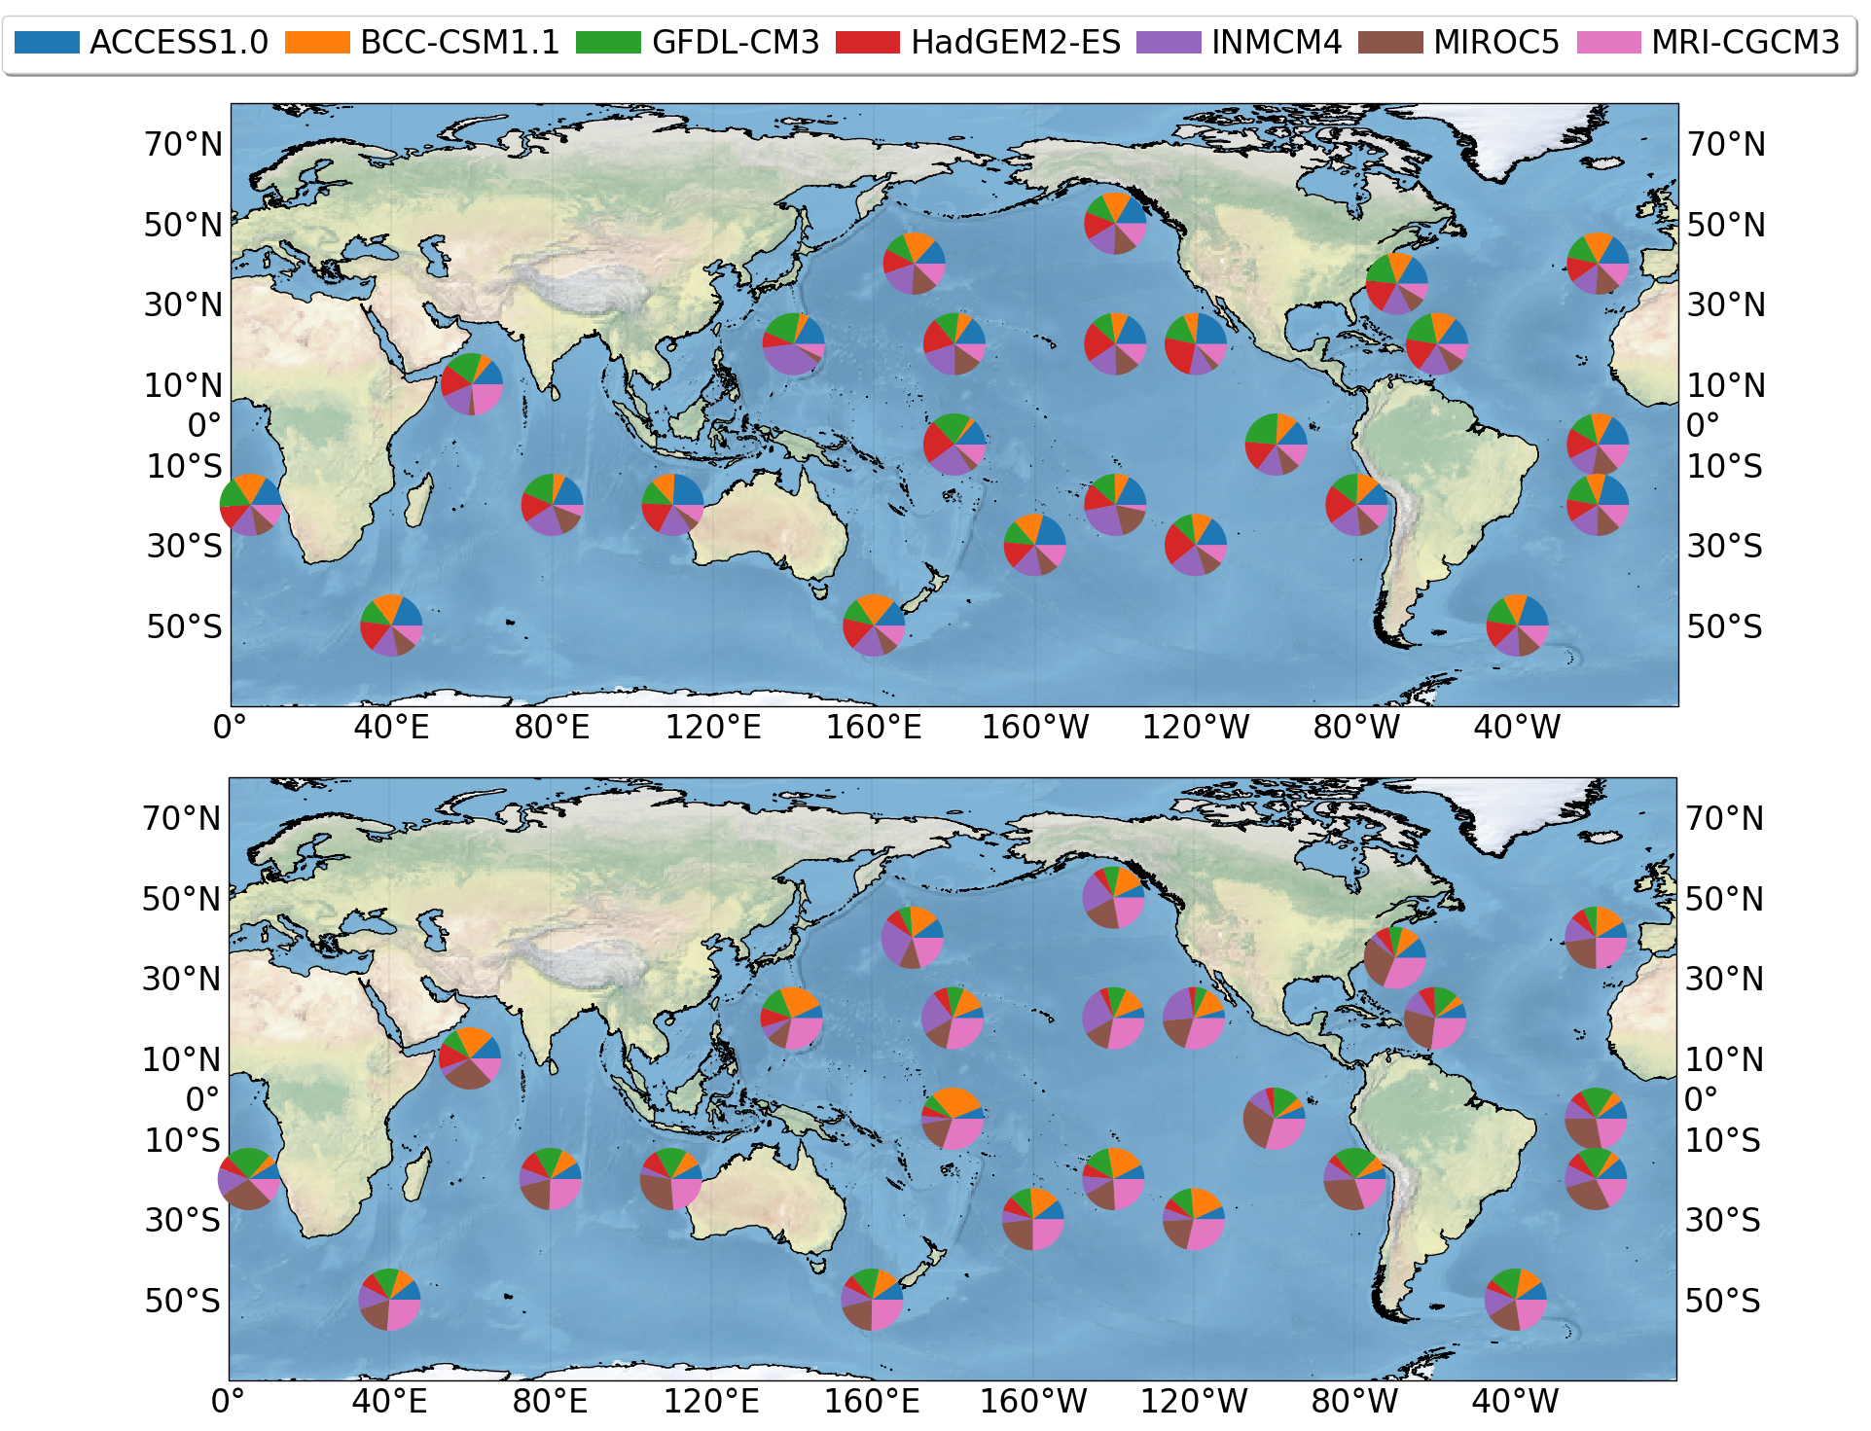
Methodology testing
Hist. 1979-2005
NO-BC End 21stC. 2081-2100

Slide 10
H_{s} 100 years RP ens1000 – Hist. 1979-2005

Slide 11
H_{s} 100 years: Hist. – End 21st Century RCP 4.5
H_{s} [m]

Slide 12
H_{s} 100 years: Hist. – End 21st Century RCP 8.5
H_{s} [m]

Slide 13
Potential
Questions
Tropical Cyclones still not correctly reproduced by GCMs
Bias Correction for future projections
Results are consistent with previous studies
(Hemer et al. 2013; Wang et al. 2014; Aarnes et al. 2017)
Inter-model low correlation guarantees independence
Possibility to synthesize an equivalent time series of duration longer than the simulated period, reducing confidence intervals
Improved GCMs and additional models considered into the analysis may allow use of direct estimates from in sample statistics

Slide 14
References
Aarnes, O. J., Reistad, M., Breivik, Ø., Bitner‐Gregersen, E., Ingolf Eide, L., Gramstad, O., ... & Vanem, E. (2017). Projected changes in significant wave height toward the end of the 21st century: Northeast Atlantic. Journal of Geophysical Research: Oceans, 122(4), 3394-3403.
Breivik, Ø., Aarnes, O. J., Bidlot, J.-R., Carrasco, A., and Saetra, Ø. (2013). Wave extremes in the northeast Atlantic from ensemble forecasts. Journal of Climate, 26(19):7525–7540.
Breivik, Ø., Aarnes, O. J., Abdalla, S., Bidlot, J. R., & Janssen, P. A. (2014). Wind and wave extremes over the world oceans from very large ensembles. Geophysical Research Letters, 41(14), 5122-5131.
Breivik, Ø. and Aarnes, O.J., (2017). Efficient bootstrap estimates for tail statistics. Natural Hazards and Earth System Sciences, 17(3), p.357.
Coles, S., Bawa, J., Trenner, L., & Dorazio, P. (2001). An introduction to statistical modeling of extreme values (Vol. 208). London: Springer.
Hemer, M. A., Fan, Y., Mori, N., Semedo, A., & Wang, X. L. (2013). Projected changes in wave climate from a multi-model ensemble. Nature climate change, 3(5), 471.
Hemer, M. A., & Trenham, C. E. (2016). Evaluation of a CMIP5 derived dynamical global wind wave climate model ensemble. Ocean Modelling, 103, 190-203.
Lopatoukhin, L., Rozhkov, V., Ryabinin, V., Swail, V., Boukhanovsky, A., and Degtyarev, A. (2000). Estimation of extreme wind wave heights. Technical report, WMO.
Meucci, A., Young, I. R., & Breivik, Ø. (2018). Wind and Wave Extremes from Atmosphere and Wave Model Ensembles. Journal of Climate, 31(21), 8819-8842.
Molteni, F., Buizza, R., Palmer, T. N., & Petroliagis, T. (1996). The ECMWF ensemble prediction system: Methodology and validation. Quarterly journal of the royal meteorological society, 122(529), 73-119.
Taylor, K. E., Stouffer, R. J., & Meehl, G. A. (2012). An overview of CMIP5 and the experiment design. Bulletin of the American Meteorological Society, 93(4), 485-498.
Wang, X. L., Feng, Y., & Swail, V. R. (2014). Changes in global ocean wave heights as projected using multimodel CMIP5 simulations. Geophysical Research Letters, 41(3), 1026-1034.
Young, I. R., Zieger, S., & Babanin, A. V. (2011). Global trends in wind speed and wave height. Science, 332(6028), 451-455.

