Slide 1
Bias correction of Tropical Cyclone Structure in ECMWF-Ensemble Prediction System for Australia
Saima Aijaz, Jeff Kepert, Harvey Ye, Zhendong Huang, and Alister Hawksford
Australian Bureau of Meteorology
Bureau of Meteorology Annual R&D Workshop
Melbourne, 26-30 November 2018

Slide 2
Why?
There is a need from industry to manage their tropical cyclone risk in a safe, economical, efficient and effective manner
What is the highest feasible intensity?
What is the risk that wind / wave thresholds will be exceeded?
When is the most likely time that those thresholds could be exceeded?
When is the earliest time that those thresholds could be exceeded?
Existing systems…
Existing Ensemble Prediction Systems (EPS) have limited use in TC forecasting – can we improve them for use in this application?

Slide 3
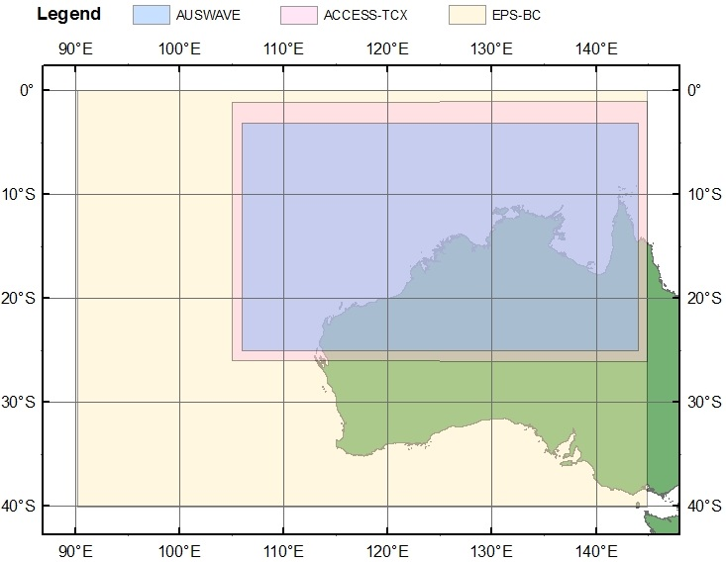
EPS Bias Correction (BC) features
Extent is 0°S to 40°S and 90°E to 145°E
Horizontal spatial resolution of 25 km
1 vertical level (at 10 metres above sea level)
51 ensemble members
Starts from a base time at 00:00 and 12:00 UTC each day
Produce 10 day forecasts from each base time.

Slide 4
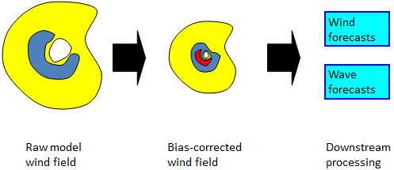
Probabilistic Wind Guidance
Diagnose TC biases in ensemble from ECMWF-EPS
Remove TCs and replace with bias-corrected synthetic TC
Compute wind exceedance probabilities
Rerun wave predictions using bias-corrected model and compute wave exceedance probabilities

Slide 5
EPS-BC: flow-chart
Download EPS from ECMWF
Insert new cyclones with bias-corrected properties into grids
Calculate wind probability products
Diagnose TC track, intensity, etc for each ensemble member
Determine cyclone properties for each ensemble member
Run wave model on each ensemble member
Calculate bias-corrected intensity and size for mean of each cluster
Calculate wave probability products
Cluster analysis of cyclones

Slide 6
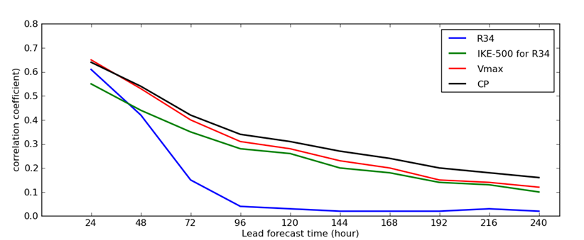
EPS-BC: potential predictors
Potential predictors derived from ensemble data:
Intensity: maximum wind, maximum symmetric wind, central pressure
Inner core size: radius of maximum winds
Outer size/strength: wind radii (R34, R30, R25, etc), integrated kinetic energy to various radii (IKE-300, IKE-400, IKE-500)
Notes:
Tropical cyclones can be characterised with a reasonable degree of accuracy by measuring relatively few parameters, such as their location; intensity; size of eye; and size of outer circulation.

Slide 7
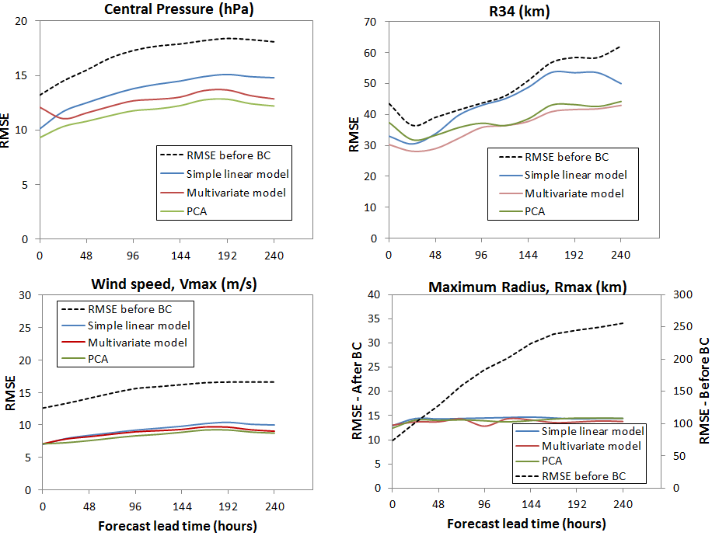
EPS-BC statistical models
Models
Simple linear regression
Multivariate linear regression
Principal component analyses

Slide 8
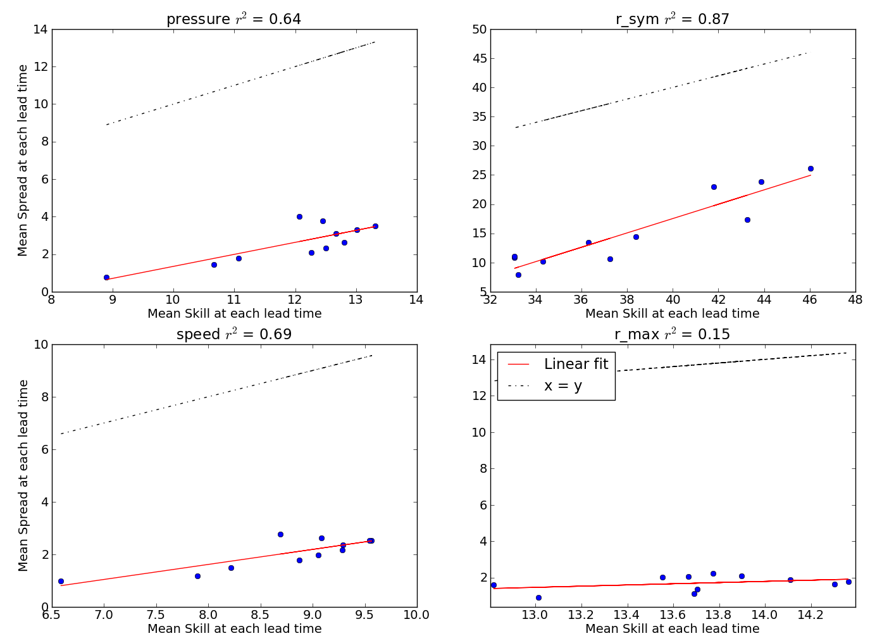
EPS-BC: reflects uncertainty
CP
R34
Maintain spread by correcting ensemble mean while keeping perturbations about the mean unchanged
Ensemble is underspread at all time ranges
Similar underspread is present in the raw ensemble data
Vmax
Rmax
Notes:
Corrected forecasts tend to cluster too closely around the climatological mean, this is bad, the uncertainty should be greater at long range!
At long range, statistical correction schemes tend to “regress to the mean”
If we bias-correct ensemble members individually, at long range the ensemble will tend to lose spread
Instead we correct the ensemble mean, but keep the perturbations about the mean unchanged

Slide 9
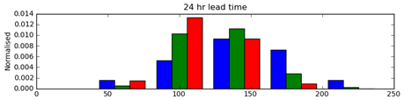
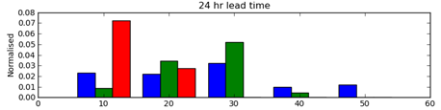
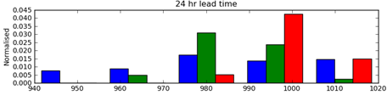
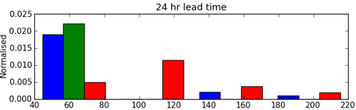

EPS-BC
verification
R34 (km)
Vmax (m/s)
CP (hPa)
Rmax (km)

Slide 10
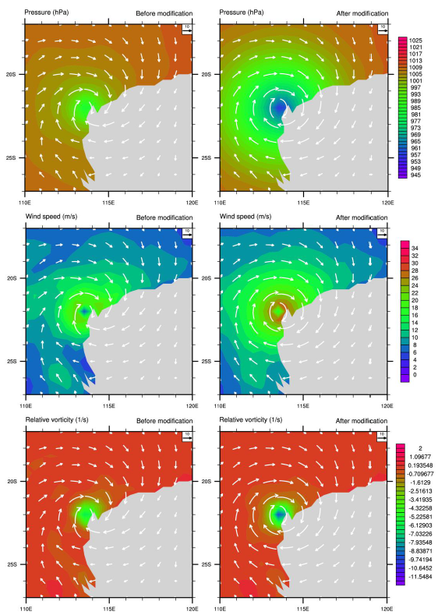
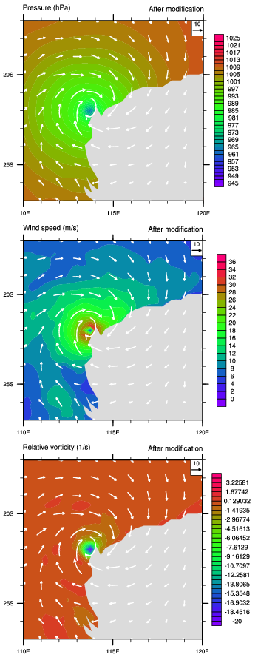
EPS-BC: vortex insertion
Raw
Insert (Best track)
Insert (EPS-BC)
We update the symmetric vortex, preserving model asymmetry
Better skill
Better training data
Model expected to have skill with asymmetry
Pressure
Wind
Speed
Rel.
Vorticity

Slide 11
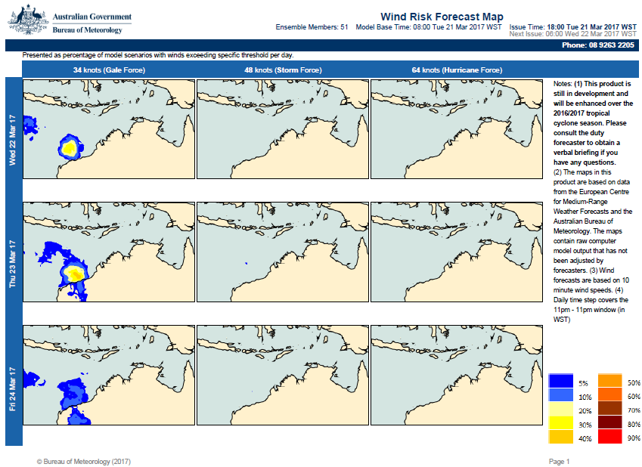
EPS-BC: final product
Notes:
Presented as percentage of model scenarios with winds exceeding specific threshold per day.

Slide 12
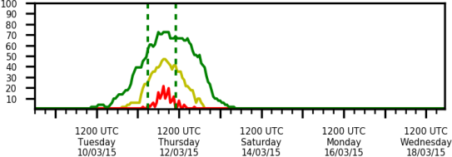
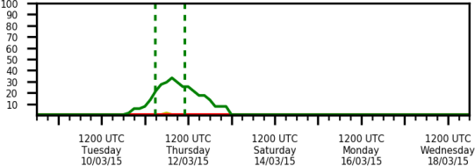
EPS-BC
Conclusions
Increased accuracy of forecast TC parameters from the ECMWF-EPS
Spread-skill relationship and other probabilistic forecast skill measures are improved:
Reduced bias
Probabilities of wind and wave exceedance are more accurate
Benefits
Objective warning of risk of severe wind events is given sooner
EPS-BC
Raw
Gale force (34 knots)
Storm force (48 knots)
Hurricane force (64 knots)

