Slide 1
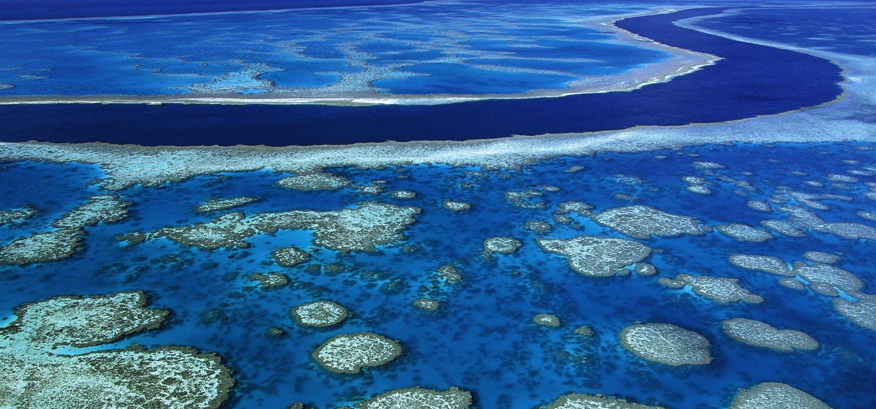
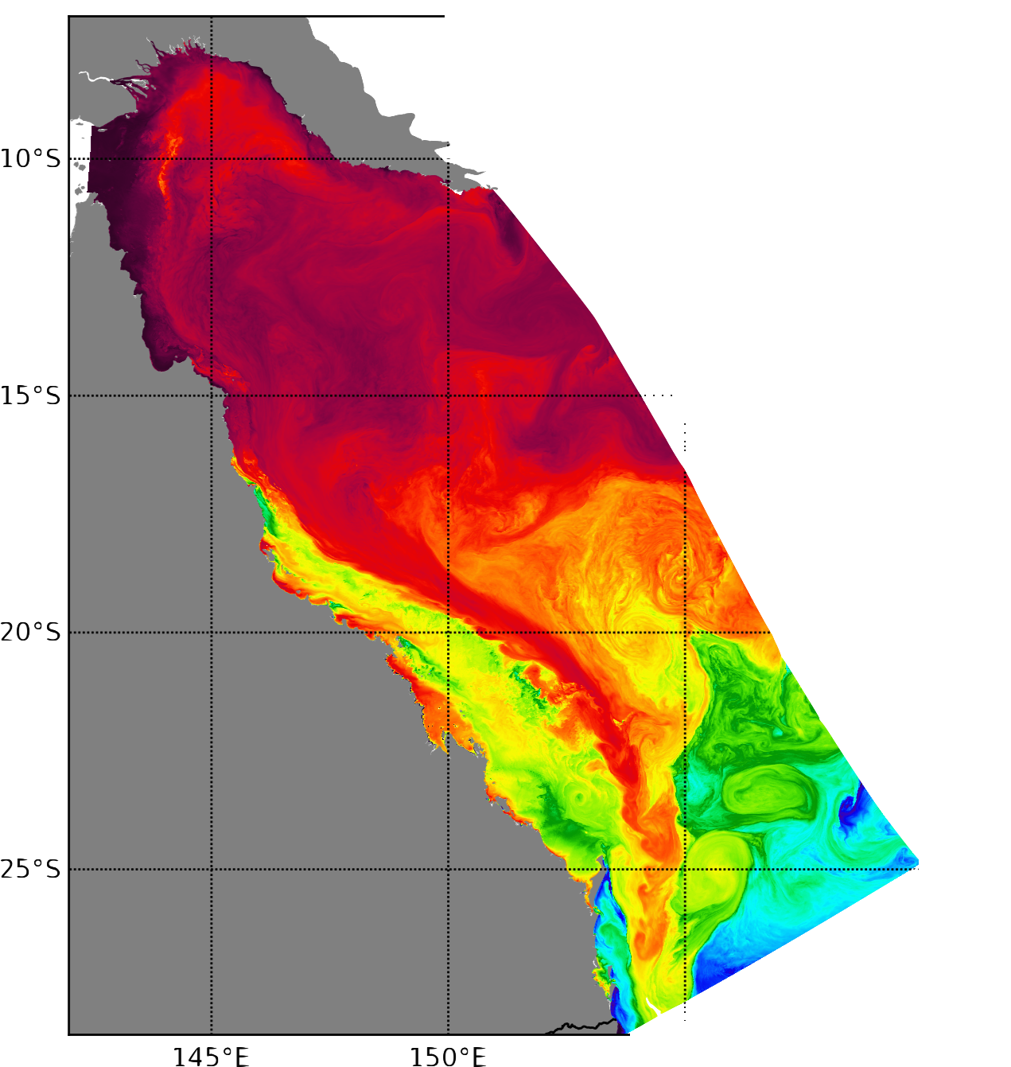





The eReefs coastal ocean modellling systems
Colberg Frank, Gary Brassington, Paul Sandery, Pavel Sakov, Saima Aijaz
R&D workshop, 28th NOV 2018, Melbourne
Notes:
What I mean by operational is not a system that has dedicated support 24 hours per day such as the bureau system oceanmaps or access-r.
The buerau and csiro ereef sytem are run on a best efford reasearh basis rather.

Slide 2
Overview
Motivation
Systems and setup
  Example: river implementation, plume modelling
DA systems (EnOI, EnKF)
System performance
  Examples: SST Spread, River plume
Summary and outlook

Slide 3
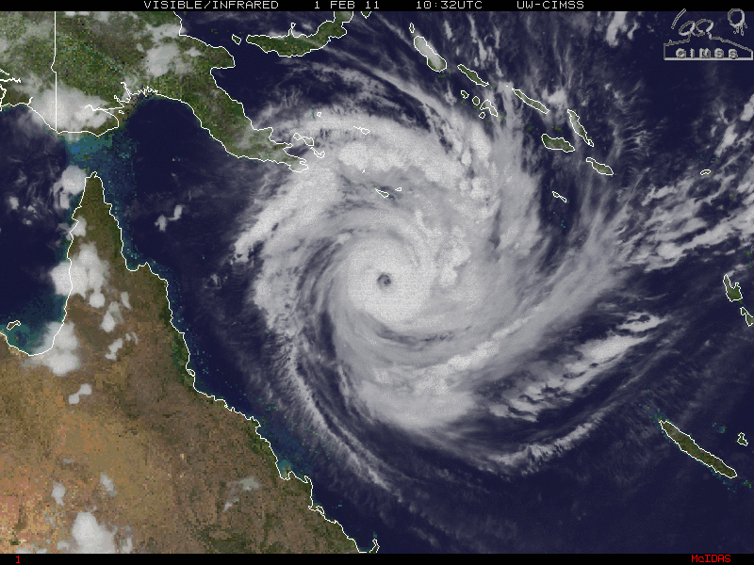
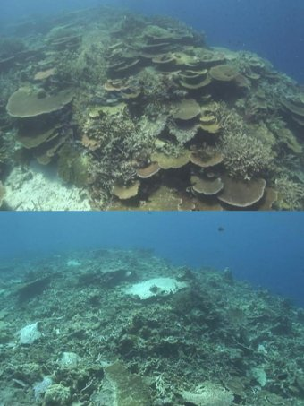
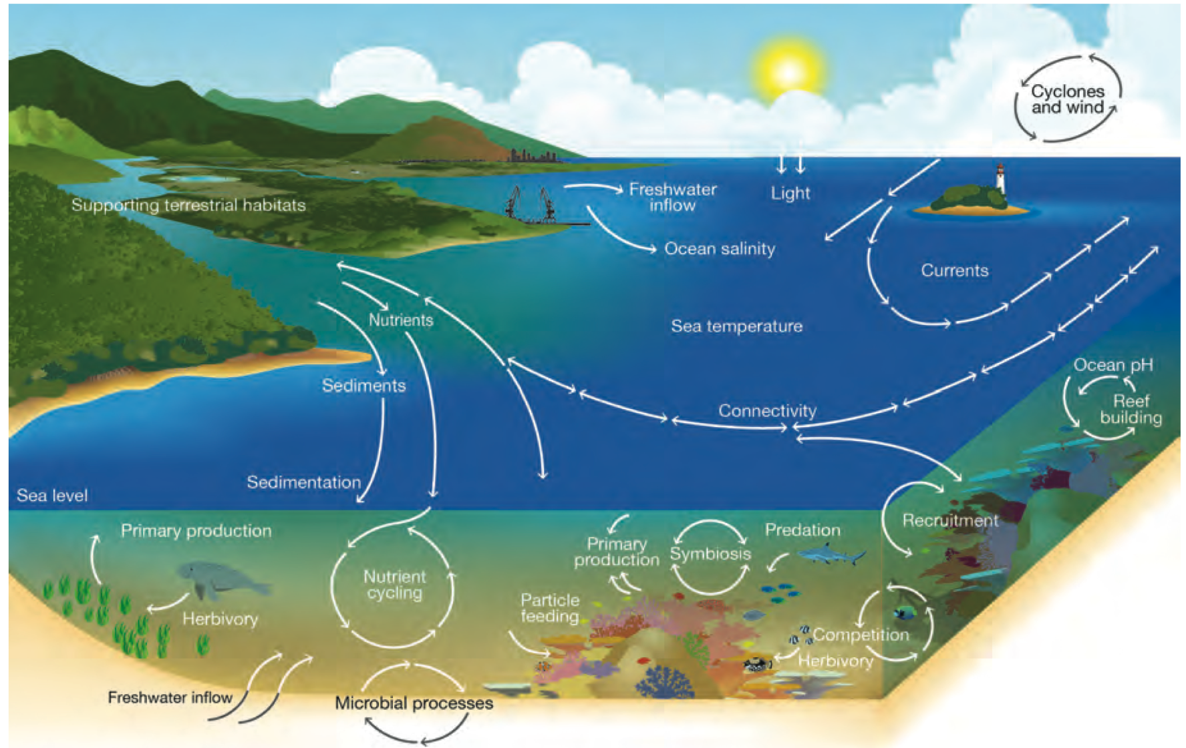
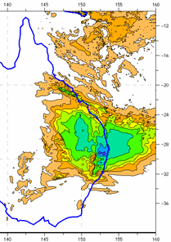
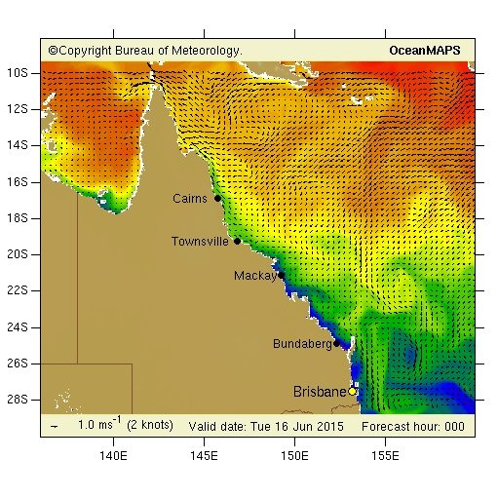
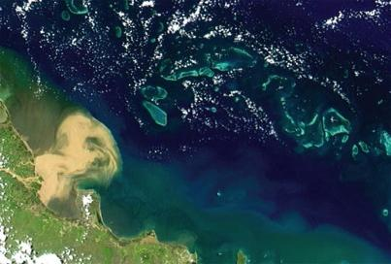
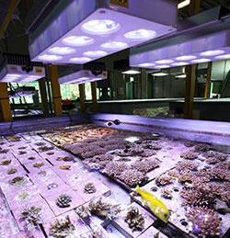
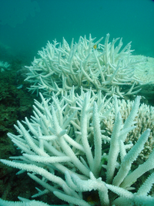
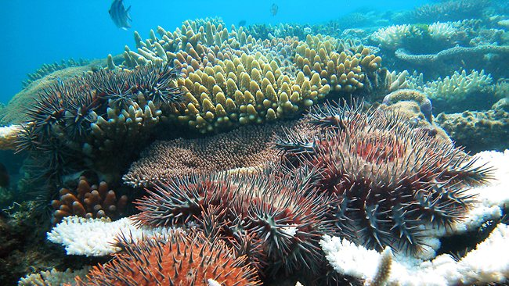
Multiple sources of stress
Mechanical stress
Water quality stress
Thermal stress
pH stress
Notes:
Water quality and thermal stress are the focii
Mechanical stress will be partially estimated
WQS: no BGC model but tracing the footprint
influence of land based nutrients and sediments on water quality via river runoff
Crown of Thorns Starfish (COTS) infestation is regarded as one of the major threats to the reef, and elevated nutrients in the seawater are believed to enhance their proliferation

Slide 4
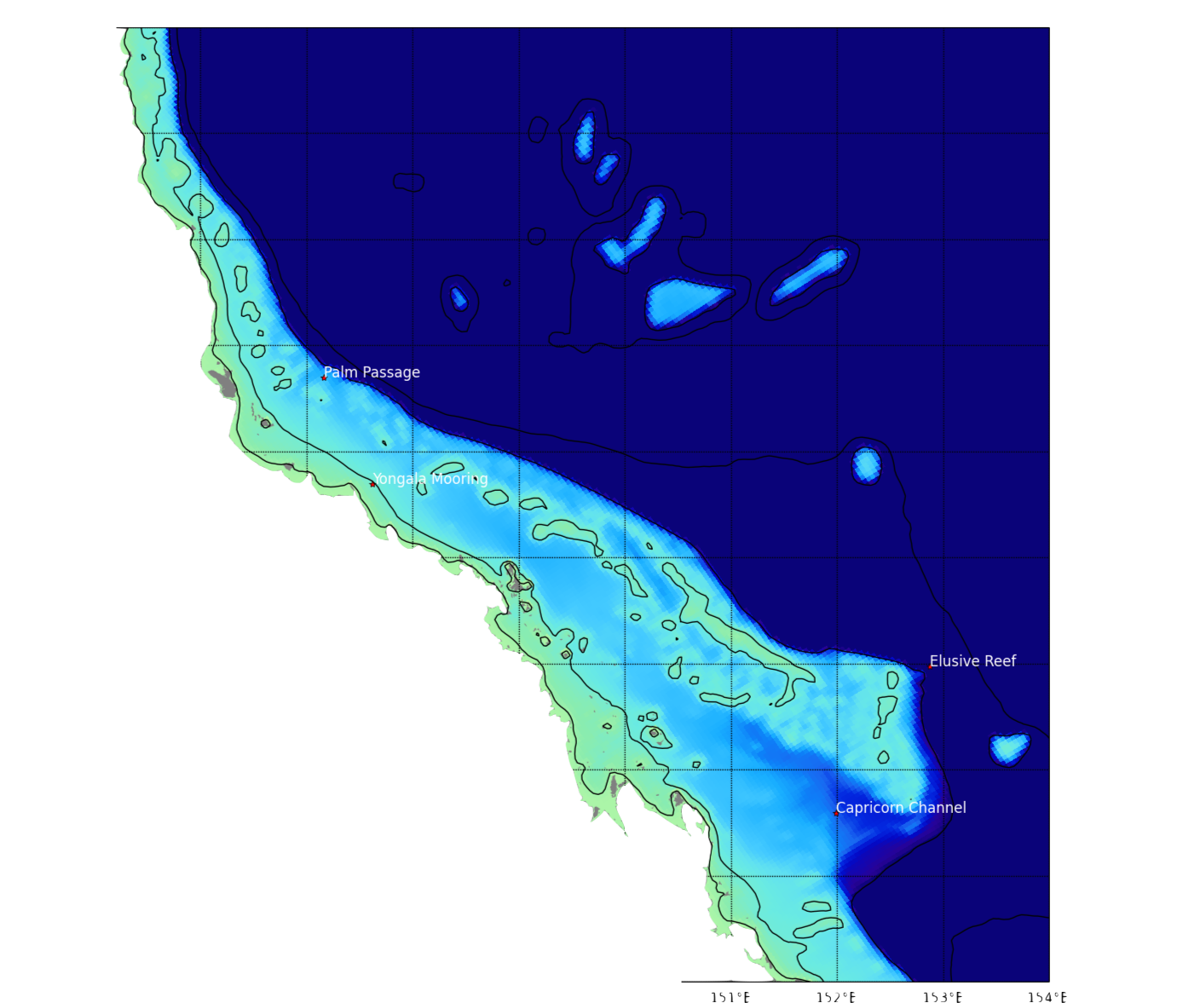
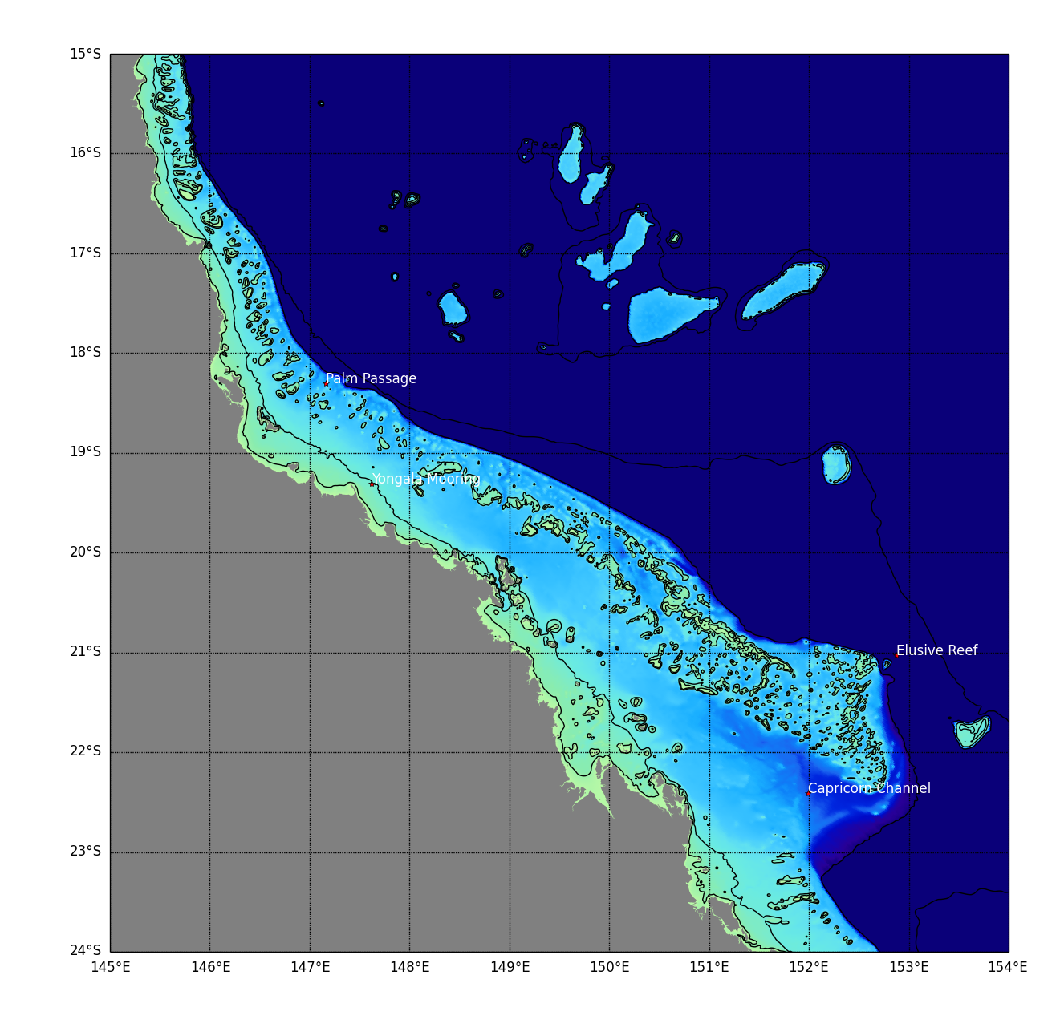
Model setup
Focus in on physical properties
Passive tracers and age can give an indication of river plume
ROMS-FC:
  4km: 512x128x30 ~2,000,000
ROMS-HR:
  500m: 4327x1565x25 ~ 170,000,000
Bathymetry – blended product
  GBR 100 (Rob Beaman, JCU)
  GA Plus 250m (James Daniell)
  GA 250m (White201811050000well)
Palm Passage
Swaines
Elusive Reef
4km
500m
SST
Notes:
Main points
As part of the ereef project we are aiming to operationally forecast the circulation around the GBR, this requires a good ocean model.
2 model developed covering area shown
Challenge reef matrix
Main focus on transport/ velocities over the reef → hence 500m model
Reefs matrix better resolved → transport better modeled → aim to improve fc model assuming hr model is closer to the truth
Zoom to see differences, showing 10,30,150,550, isobaths
Last: example files size, challenges for storage

Slide 5
Model systems
ROMS-FC:
  4km: 512x128x30 ~2,000,000
ROMS-HR:
  500m: 4327x1565x25 ~ 170,000,000
Bathymetry – blended product
  GBR 100 (Rob Beaman, JCU)
  GA Plus 250m (James Daniell)
  GA 250m (Whitewell)
  Reanalysis 4km (2006-2016) EnOI, CFSR, BRAN2p5
  Reanalysis 4km (2006-2016) EnKF, CFSR, BRAN2p5
  Realtime 4km (EnOI, ACCESS-R, OceanMAPS v3.0)
  Near realtime 4km (EnKF, ACCESS-R, OceanMAPS v3.0)
  Hindcast 500m (2009-2011), CFSR, BRAN2p5
Palm Passage
Swaines
Elusive Reef
4km
500m
SST
Notes:
Main points
As part of the ereef project we are aiming to operationally forecast the circulation around the GBR, this requires a good ocean model.
2 model developed covering area shown
Challenge reef matrix
Main focus on transport/ velocities over the reef → hence 500m model
Reefs matrix better resolved → transport better modeled → aim to improve fc model assuming hr model is closer to the truth
Zoom to see differences, showing 10,30,150,550, isobaths
Last: example files size, challenges for storage

Slide 6
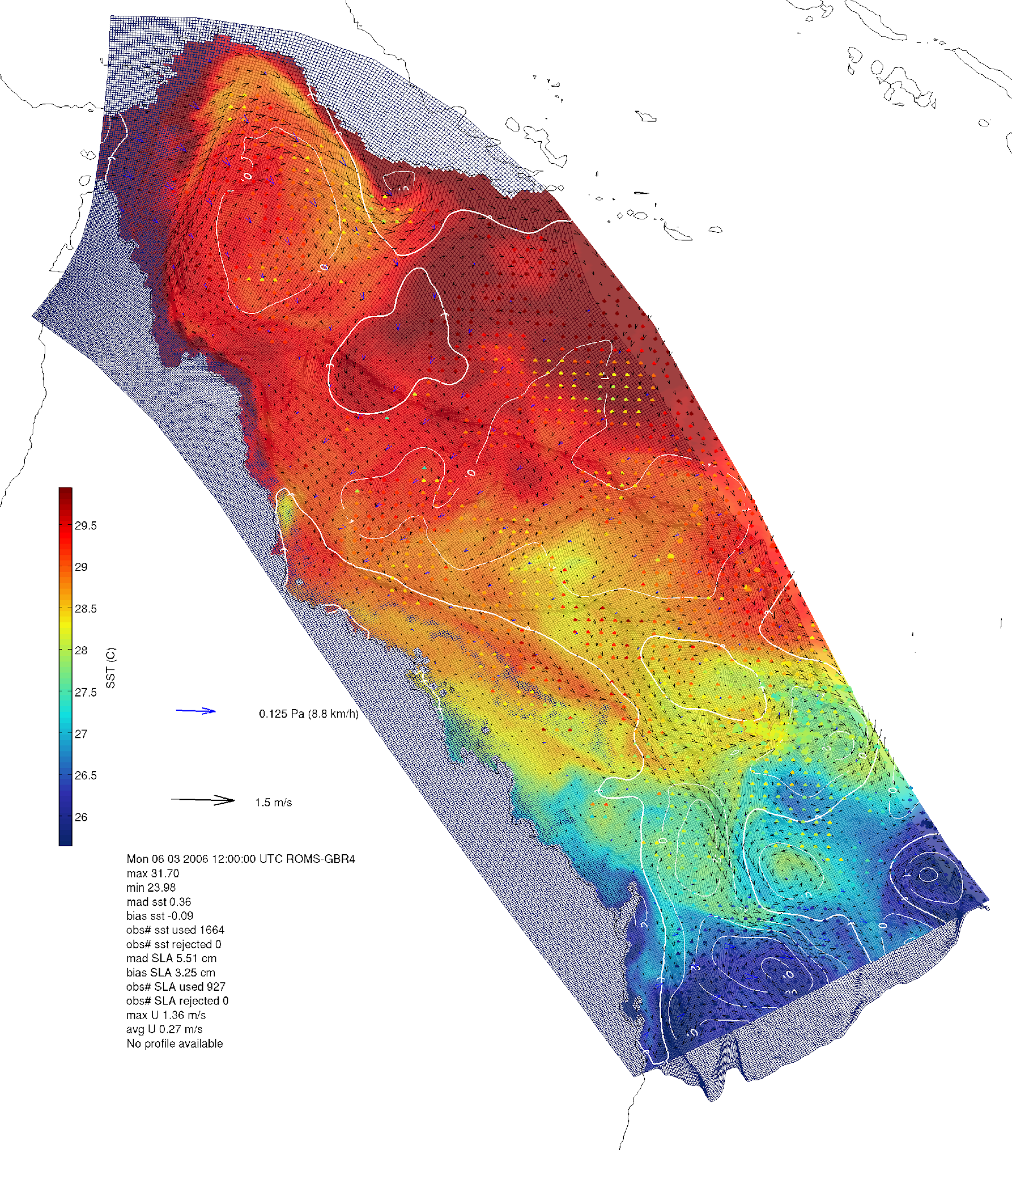
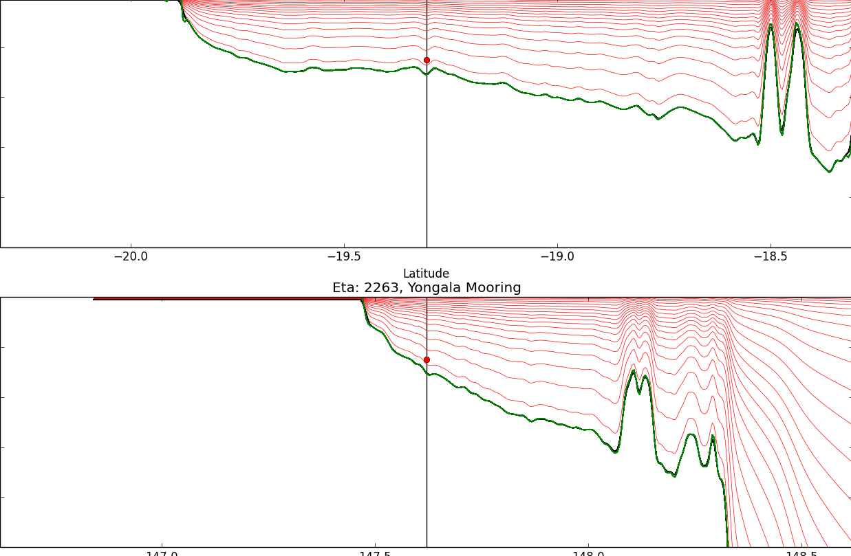
Daily (x4) hydrodynamic forecasts
Focus in on physical properties
Passive tracers and age can give an indication of plume
Hydrostatic primitive equations
Curvilinear grid ~4km
30 terrain-following
OceanMAPS open boundary conditions
ACCESS-R atmospheric forcing
TPXO7.2 tidal forcing
Daily (x4) forecast of T,S,U,V, SSH
3 days out
Single cell channel estuaries
24 active rivers – volume rate
Passive and age tracers
Particle trajectories
Uses DA
Bathymetry – blended product
  GBR 100 (Rob Beaman, JCU)
  GA Plus 250m (James Daniell)
  GA 250m (Whitewell)

Slide 7
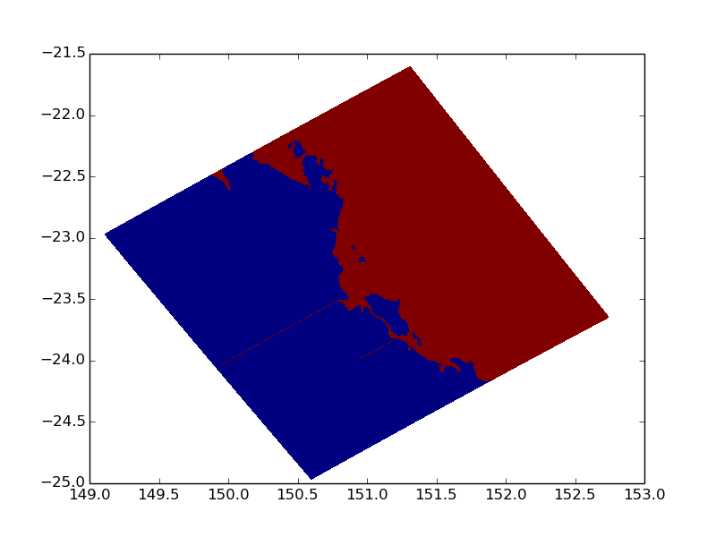
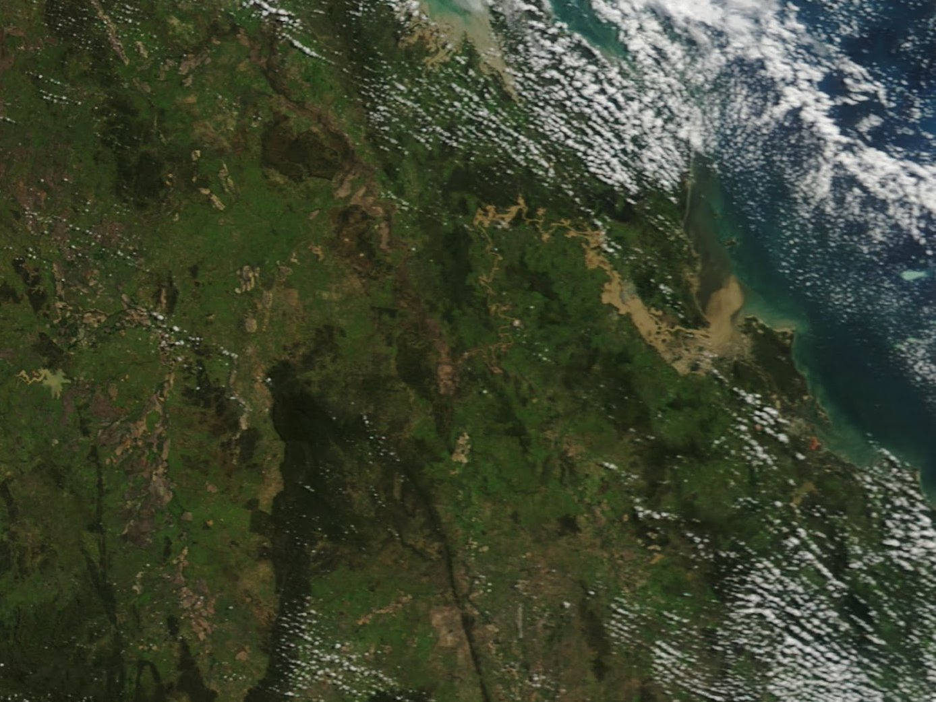
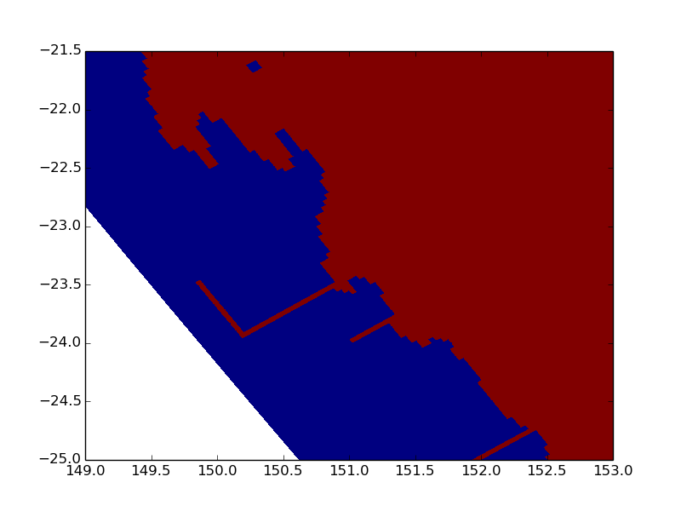
  BOM- Explicit modelling of estuary
Explicit modelling of estuaries
(1) Aim to preserve river volume
Balance between model stability and (1)
The Gap
136.6 KM
~ 64 hours from The Gap – RM (Amir)
-> ~0.5-0.6m/s
RM
RIVER MODEL RIVER WIDTH [m] RIVER LENGTH [m] RIVER VOL [m3/s ] MODEL VOL [m3/s] MODEL/OBS NOCELLS
Fitzroy 500m 288.805911962 136600.0 333360000.0 306000000.0 0.917 204
Fitzroy 4km 288.805911962 136600.0 333360000.0 536174694.529 1.60 34
4km
Average velocity in model channel:
4km: ~ 0.55m/s
500m:~0.8m/s
  Fitzroy Channel
Notes:
Problem: add freshwater to ocean. Ocean resolution too coarse to match river scales. Each river has natural river profile (fresh water on top and salinity intrusions).
(1) Solution add estuary like river in bathymtry via adjusting the depth the bathymetry to match river volume. Has added benefit that is can account for time delays from flow data to river mouth.
Problem a lot of unkjonw physical entities like river volume, drag in river bed etc.
(2) Dynamic salinity input
Fitzroy most obvious example where this makes some sense
Basic idea is to dynamically adjust the river profile which is unique to each river with a model that is much coarse than observed estuaries

Slide 8
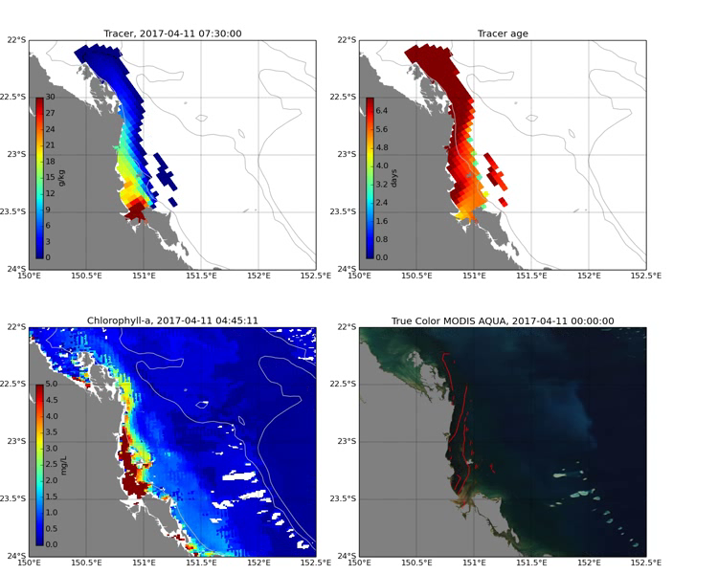
  Explicit modelling of estuary
  Example: Fitzroy River
Explicit modelling of estuaries
(1) Aim to preserve river volume
Balance between model stability and (1)
~ 64 hours from The Gap – RM
The Gap
TC Debbie, March/ April 2017
136.6 KM
TRACER
TRACER AGE
RM
4km
CL-A
  Fitzroy Channel
MODIS
Notes:
Example of river channel to the right for the Fitzroy – channels allow for accounting of distance channel acounts for the dsitance betwee measurement and river mouth
Left example of modelling plume caused by Tc Debbie – upper tracer and age lower CLA MODIS

Slide 9
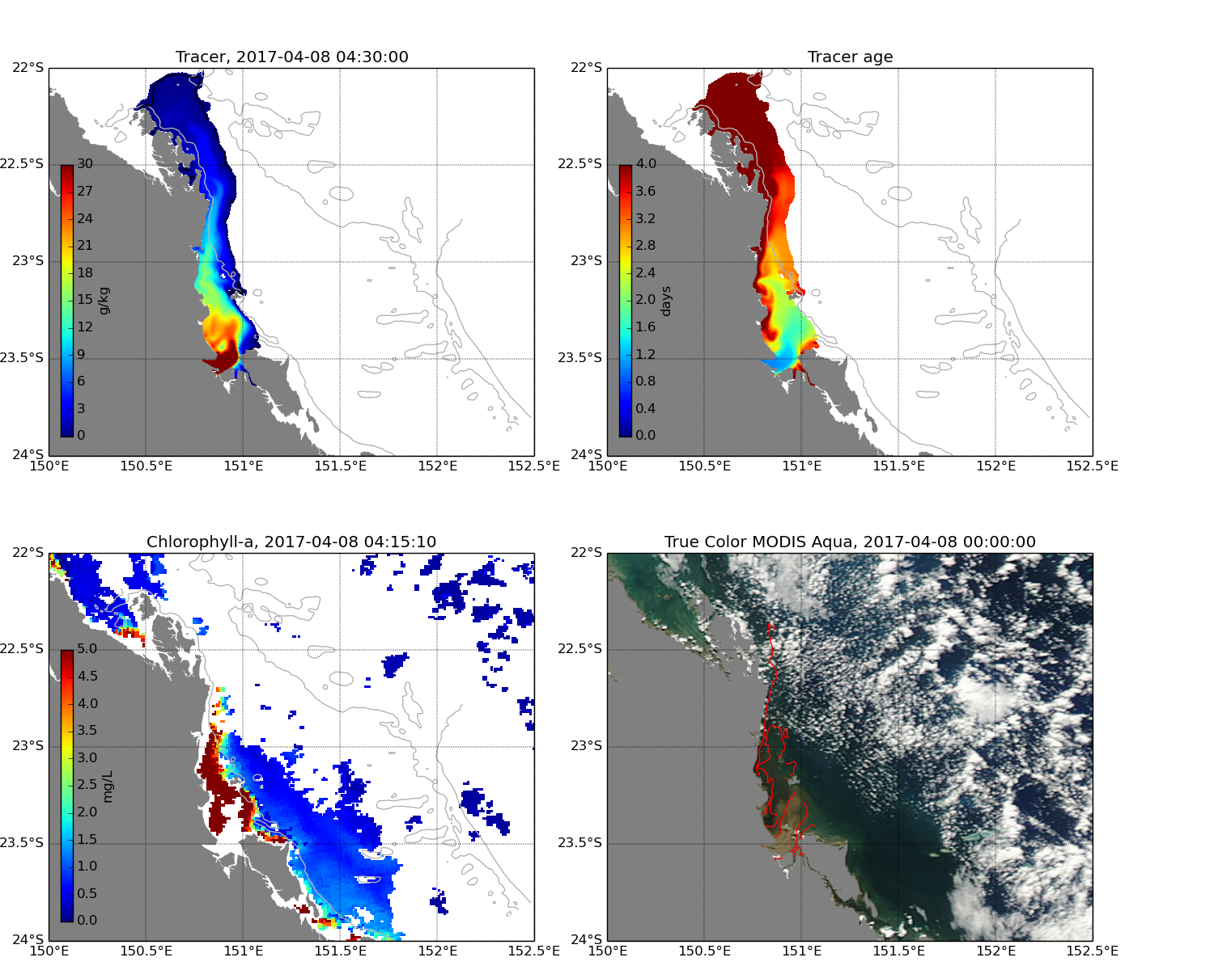
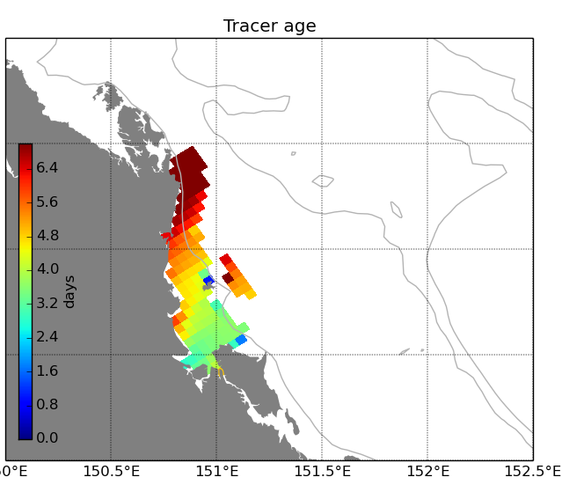
  Explicit modelling of estuary
  Example: Fitzroy River
Explicit modelling of estuaries
(1) Aim to preserve river volume
Balance between model stability and (1)
~ 64 hours from The Gap – RM
-> ~0.5-0.6m/s
The Gap
136.6 KM
RM
MODIS
500m
4km
4km
Notes:
Sediment (silicate) rich plume not well captured by 4km model
500m model does better job

Slide 10
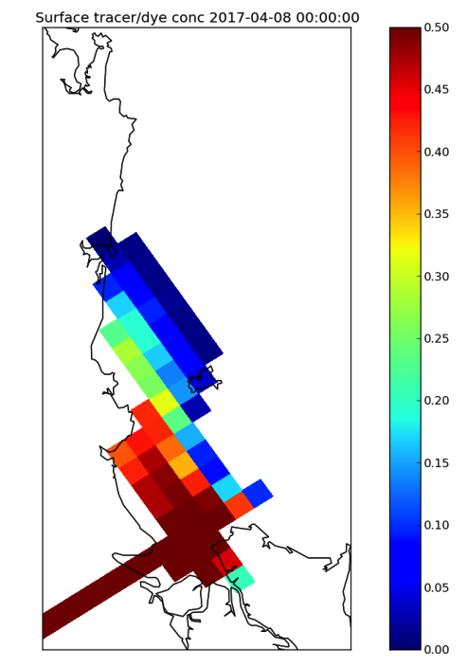
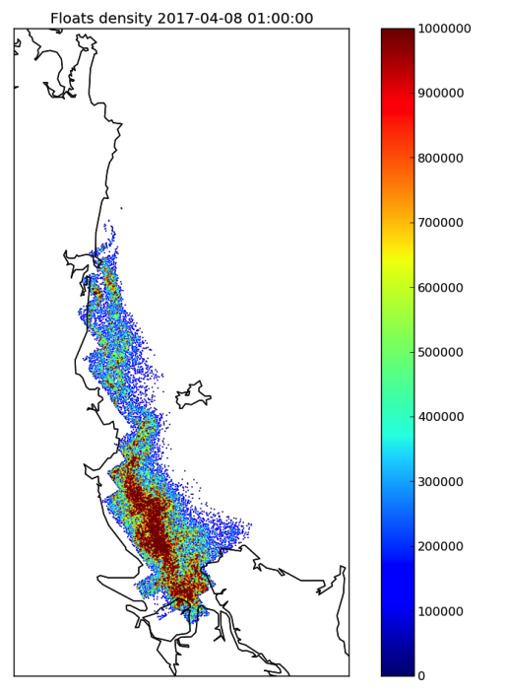
Fitzroy plume - TC Debbie
Fitzroy plume - TC Debbie
Tracer concentration
Particle density
~ 64 hours from The Gap – RM
-> ~0.5-0.6m/s
The Gap
136.6 KM
RM
MODIS
4km
4km
Notes:
Lagrangian particles have been implemented
Gather some additional information on sub grid scale
Specialist method using vornoi tesselation has been used to calculated mass with floats

Slide 11
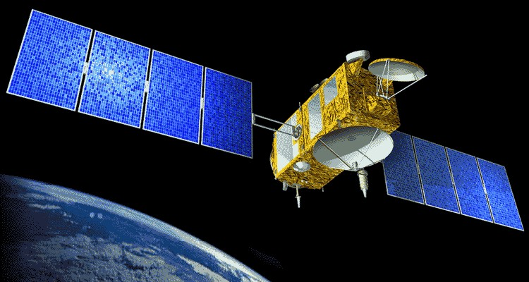
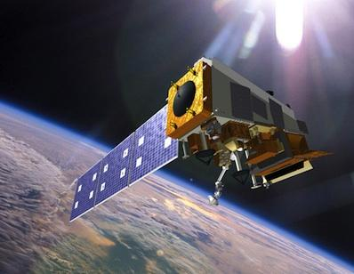

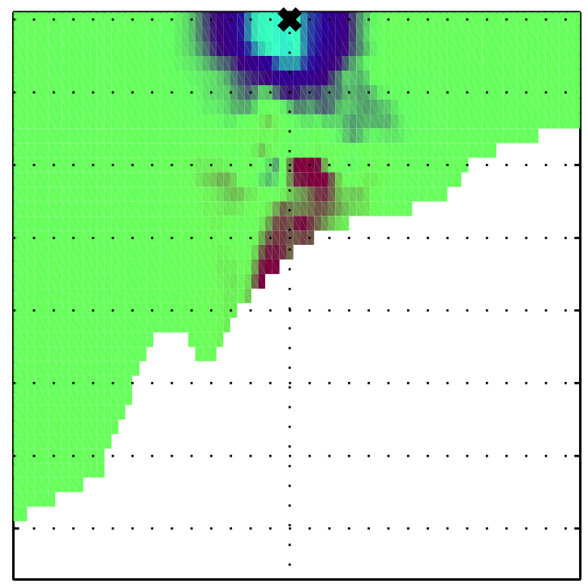
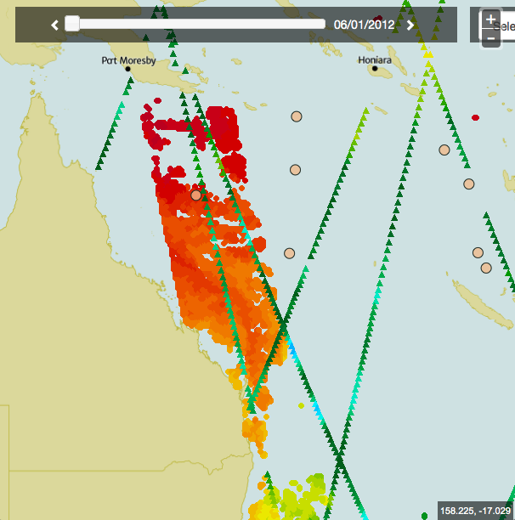

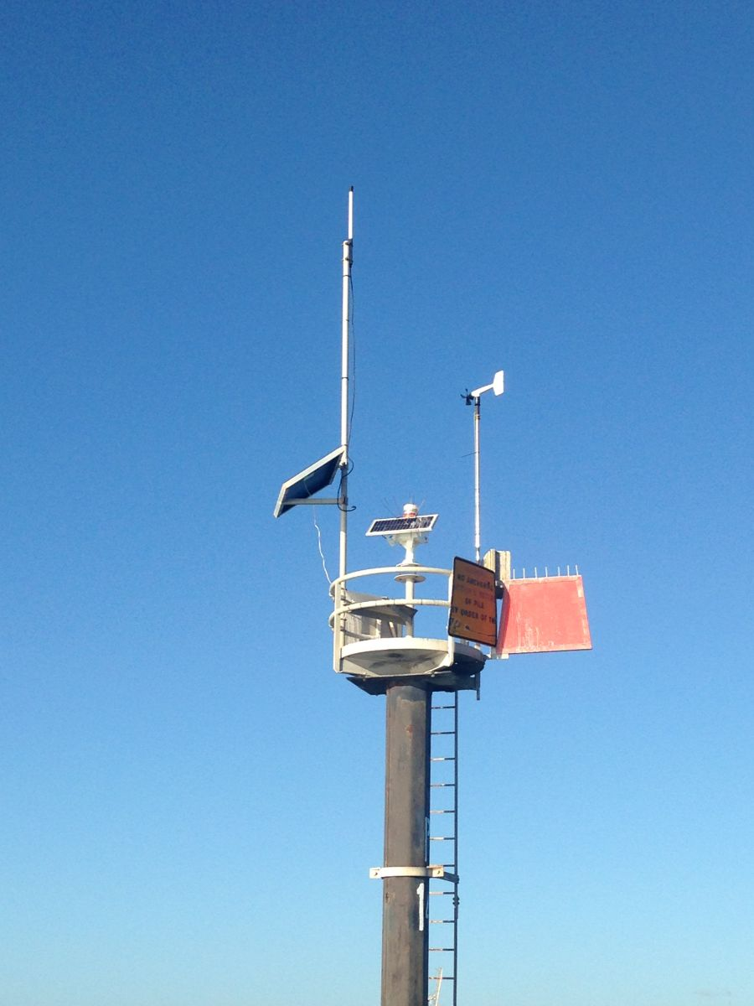
Data assimilation hydrodynamic forecasts/ reanalysis
Data assimilation
EnOI and EnKF
Satellite altimetry
  Jason3, AltiKa, Cryosat-2
  Sentinel-3A
Satellite SST
  AMSR2, METOP-B, VIIRS
  Himawari-8
In situ
  Argo, CTD, XBT
Notes:
EnOI is used

Slide 12
Data assimilation hydrodynamic forecasts/ reanalysis
EnOI system
  static ensemble - 310 members → Cheaper to run
  3 day observation window, FGAT, Restart Initialisation
  Detiding → harmonic tidal analyses (ROMS internal)
  → 10 year Reanalyses
  → Forecast model based on EnOI run using cold start
EnKF system
  Consistent/ better error model as ensemble is propagated
  Provides: uncertainty estimates around river discharge
  96 ensemble member propagated after analysis (~100 times more expensive)
  SST bias correction, inflation, localisation
  Detiding → using barotropic model
  → Reanalyses 10 years (3 day observation window)
  → Forecast model trial (1 day observation window)
\
Data assimilation
EnOI and EnKF
Satellite altimetry
  Jason3, AltiKa, Cryosat-2
  Sentinel-3A
Satellite SST
  AMSR2, METOP-B, VIIRS
  Himawari-8
In situ
  Argo, CTD, XBT
Notes:
SST bias correction: The SST is the observation type with the by far the largest impact on the system. As a consequence, any systematic bias of the model leads through cross-covariances to systematic bias in increments of other variables
The eReefs EnKF forecasting system utilises experience gained by BoM from developing EnKF system in the Bluelink project
The major new elements in the eReefs EnKF system are that it is based on the ROMS ocean model; has higher resolution (about 4km versus 10km); and includes tides.
Comparing with the ensemble optimal interpolation (EnOI), the EnKF provides greater theoretical consistency and therefore, in theory, better forecasting skill (performance). Its other important advantages is the dynamic error estimate and ensemble prediction capability. Note that due to the propagation of ensemble of model states the EnKF requires substantially larger (of order of 100x) computational resources than the EnOI and is more sensitive to various suboptimalities, such as the model error, observation bias, over-fitting of observations, system nonlinearity, and so on.
The EnKF system targets constraining model circulation at mesoscale and (partially) sub- mesoscale by assimilating the remotely sensed sea level anomaly (SLA) and sea surface temperature (SST) observations along with in-situ temperature (T) and salinity (S) observations from Argo floats.The SLA and T,S observations are located mainly in the deep parts of the model, while the SST observations are generally available both in the off-shelf and shelf areas.
Ensemble size: The EnKF system has 96 ensemble members.
Cycle length: The cycle length is set at 3 days
De-tiding: To assimilate observations of a certain type it is necessary to match them from the model side by calculating the corresponding ensemble of observations. Considering assimilation of the sea level, there are several possible options related to using/subtracting the dynamic atmospheric correction, static atmospheric correction (“inverse barometer”), mean dynamic topography (MDT), and tide from the observations and the model. The particular combination of the options chosen for the sea level variable depends on the quality of the observations and the model, including that of the variety of models and forcings involved from both sides.
It was found empirically that the best performance is achieved by assimilating sea level anomalies calculated by subtracting the MDT, barometric correction, and tide.
internal ROMS de-tiding. Technically this can only be done via the model averaging, which means that to centre the observation windows one needs to propagate the model beyond the assimilation time.
In the EnKF system we decided to implement de-tiding via running the barotropic version of the model. This turns out to be the simplest option in terms of the system design that yields with basically no computational overhead. Performance-wise it can be marginally worse (∼ 1mm for the mean absolute deviation of the forecast innovation) than the internal ROMS de-tiding. This can be resulted from using the instantaneous rather than daily averaged model fields, which may have somewhat larger variability.
Model stability: R-factors:0 Tuning of impacts of observation of each particular type is performed via a set of multiples applied to observation error covariances. These multiples are referred to as “R-factors”. A larger R-factor corresponds to smaller observation impact. The EnKF system uses R-factor 1.5 for SLA, 16 for SST, and 4 for T and S.
SST bias correction: The SST is the observation type with the by far the largest impact on the system. As a consequence, any systematic bias of the model leads through cross-covariances to systematic bias in increments of other variables.

Slide 13
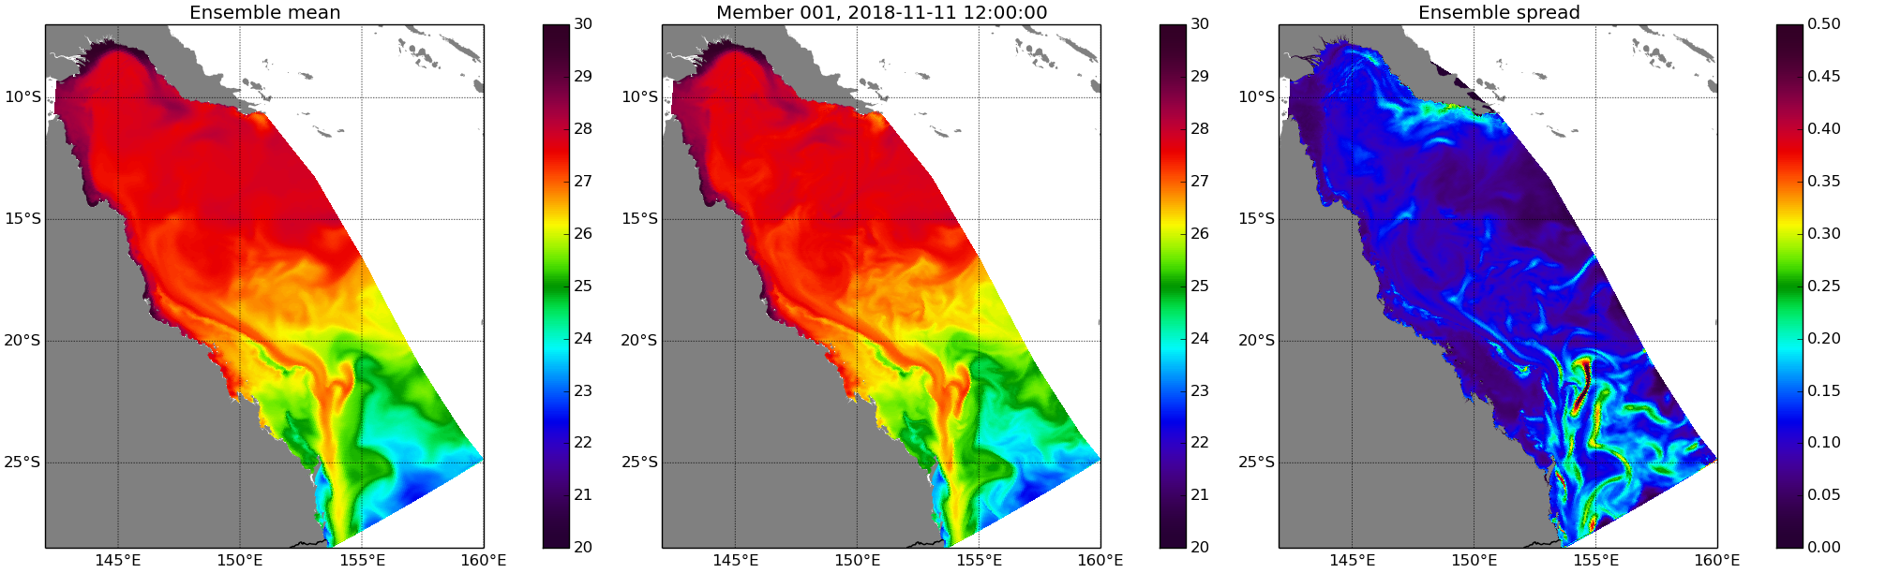
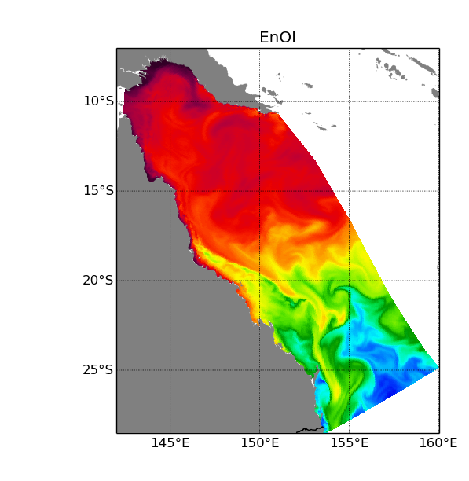
Example: SST realtime systems
2018-11-11
Upper: SST for ensemble mean, member 001 and ensemble spread.
Lower: SST for EnOI system.
obs.type # obs. |for.inn.| |an.inn.| for.inn. an.inn. for.spread an.spread
ENOI SST 82022 0.247 0.124 0.081 -0.005 0.623 0.623
ENKF SST 63227 0.223 0.153 0.075 0.006 0.152 0.108
Notes:
Shown ensemble mean, member 1 and spread.
Largest spread around southern bit where EAC is strongest – general EKE is largest here
ENOI SST also shown for same day. SST somewhat warmer GET STATS for day

Slide 14
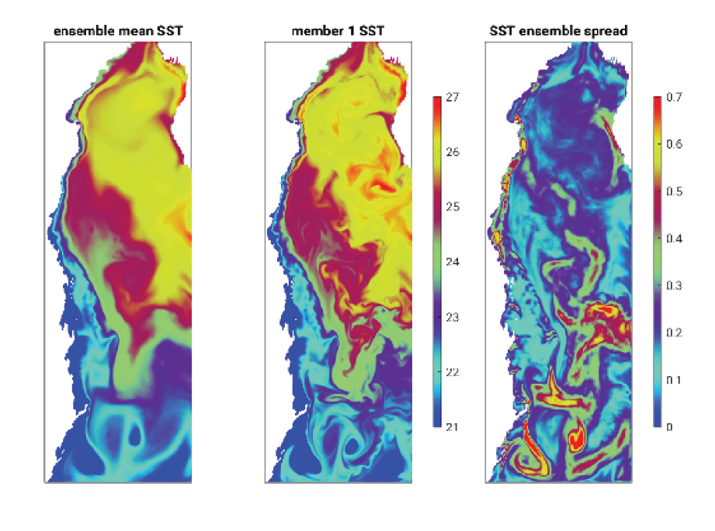
Example EnKF SST spread

Slide 15
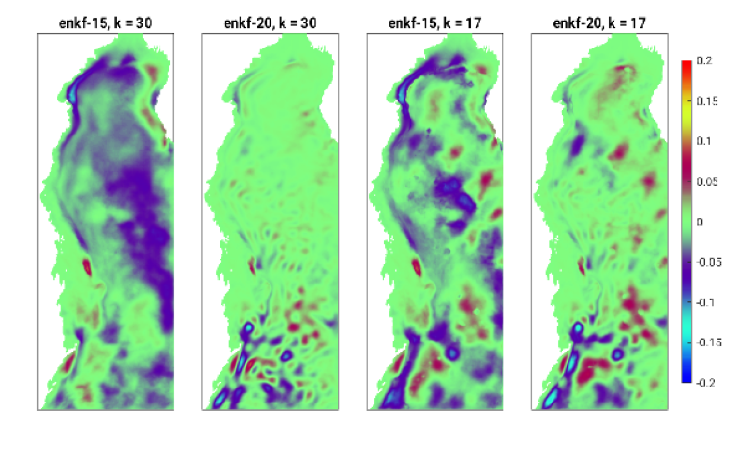
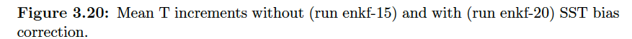
Example: Increments with/ without bias correction (EnKF)
SST largest impact on system
Bias projects on to increments of other variables via cross-covariances
Notes:
Examble of impact of sst bias correction
SST bias correction: The SST is the observation type with the by far the largest impact on the system. As a consequence, any systematic bias of the model leads through cross-covariances to systematic bias in increments of other variables.

Slide 16
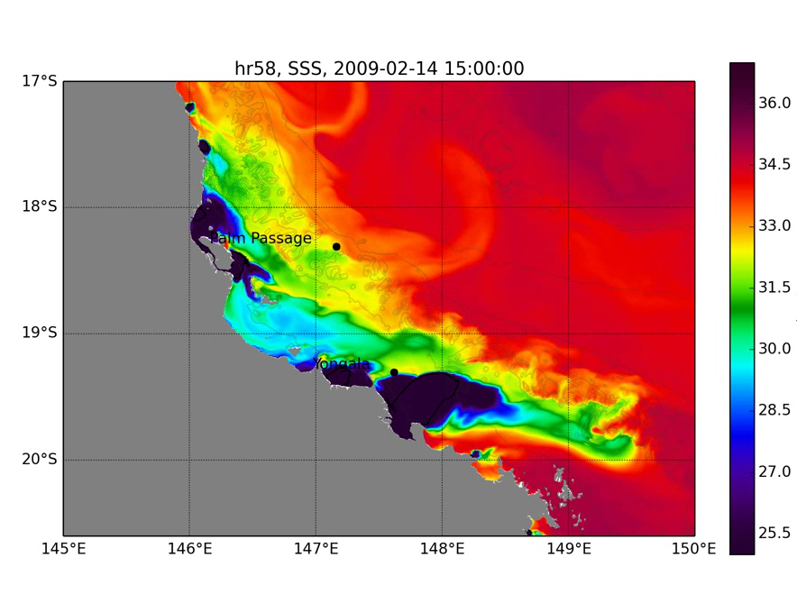
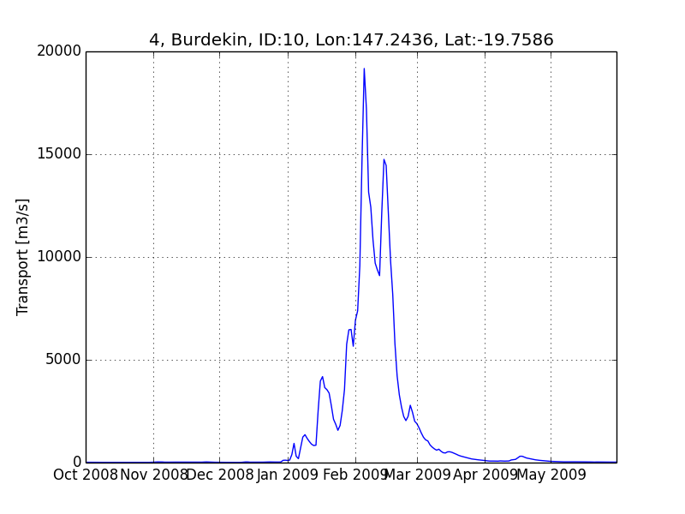
Example: Burdekin river discharge event 2009
2009 Flooding event.
A series of moderate to heavy rainfalls during January 2009 saturated the Burdekin catchment. Subsequently, the first heavy rainfall event in February lead to moderate flooding.

Slide 17
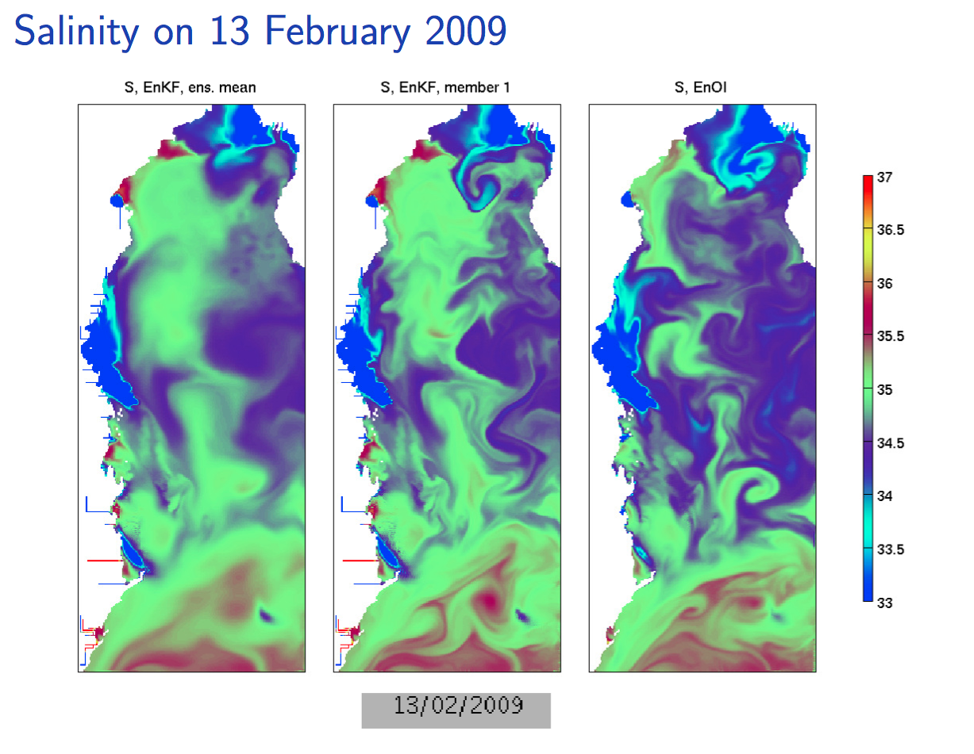
Example: Burdekin river discharge event 2009
2009 Flooding event.
A series of moderate to heavy rainfalls during January 2009 saturated the Burdekin catchment. Subsequently, the first heavy rainfall event in February lead to moderate flooding.
Notes:
Burdekin river discharge

Slide 18
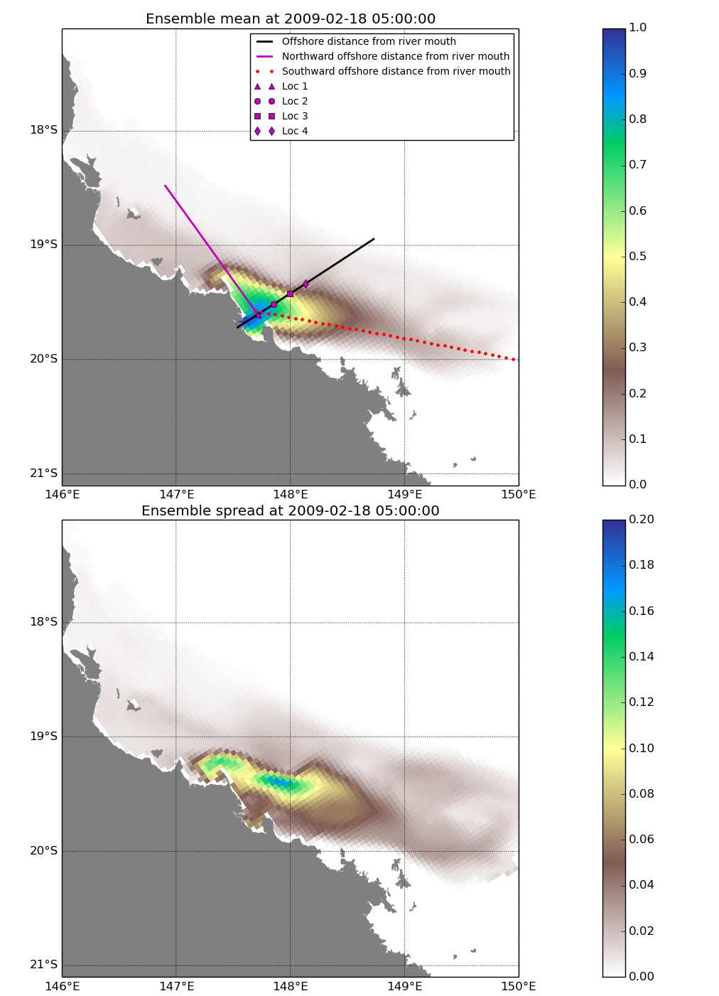
Example: Burdekin river discharge event 2009
Ensemble mean
Ensemble Spread
Probabilistic plume distribution
Figure 6.26: Ensemble mean (top panel) and ensemble spread (bottom panel) of surface tracer concentrations on 18 February 2009 0500. Locations for data extraction are shown as point symbols and cross-sections.
Notes:
One of the main reasons to use EnKF system is that we can make use of the ensemble and calculate a spread for modelled river plumes and distribtion probabilities
Shown here is an example for the 2009 Burdekin river discharge event.
Figure 6.26 shows the spatial variation of the ensemble mean and the ensemble spread
2254 on 18 February 2009 near the peak of the Burdekin River discharge. In the river channel,
2255 the ensemble mean concentration is close to the maximum value of 1 kg/m3. This is
2256 because the tracer is introduced at an initial concentration of 1 in all ensemble members
2257 and at all sigma layers within the channel. Subsequently the tracer is transported virtually
2258 undiluted in the shallow water channel. As a result, we see high concentrations with little
2259 variation (ensemble spread) of less than 0.02 in the river channel. Away from the river
2260 channel, the ensemble mean concentrations fall with increasing distance from the river
2261 mouth (Figure 2), and the ensemble spread ranges between 0.01 and approximately 0.2.
2262 As the river plume is transported away from the river source, it is advected by the tidal
2263 currents and also subject to vertical mixing, the combined effect of which leads to dilution
2264 and dispersion of the tracer plume. When the vertical gradients in velocities are small
2265 then the tracer is likely to be uniform distributed in the water column, particularly in the
2266 shallow water depths

Slide 19
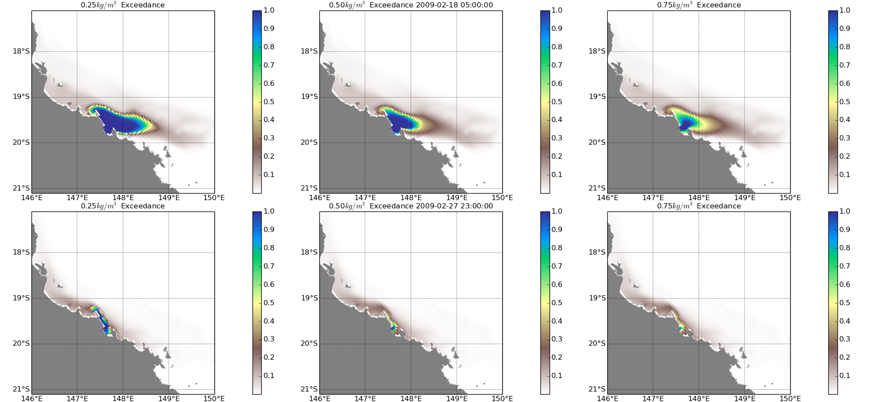
Exceedance probabilities, tracer concentration
Example: Burdekin river discharge event 2009
Figure 6.30: Exceedance probability of exceeding 0.25 kg/m3 (left), 0.50 kg/m3 (middle), and 0.75 kg/m3 (right) on 08 Feb 2009 (top), 18 Feb 2017 (middle), and 27 Feb 2017 (bottom).
Notes:
Exceedence probablities at height of discharge and after

Slide 20
Forecast innovations stats reanalyses and realtime systems
MAD/ BIAS
MAD/ BIAS
MAD/ BIAS
MAD/ BIAS
System | SLA | SST | TEM | SAL
ENOI RT COLD | 0.065/ 0.01 | 0.29/ -0.003 | 0.35/ 0.01 | 0.09/ -0.007
ENOI RT HOT | 0.052/ -0.025 | 0.26/ 0.022 | 0.48/ 0.33 | 0.09/ -0.004
ENKF RT TEST | 0.054/ -0.002 | 0.23/ 0.02 | 0.46/ -0.09 | 0.11 -0.006
ENKF RE | 0.057/ 0.013 | 0.298/ -0.002 | 0.522 / -0.26 | 0.1/ -0.018
ENOI RE | 0.059/ -0.07 | 0.346/ -0.055 | 0.535 / 0.14 | 0.1/ -0.015
Cold start system: 5 DA cycles start with OMAPS initial conditions 18 days before forecast
ENOI RT COLD (main system)
http://130.56.244.252/forecasts/index.php?pg=roms_4km_fc
Rather large bias in subsurface temperature for the hot start system
ENKF test system OK but larger error for salinity
Good performance for SLA, SST and TEM (cold start system)
Reanalyses similar performance ENKF system better on SST

Slide 21
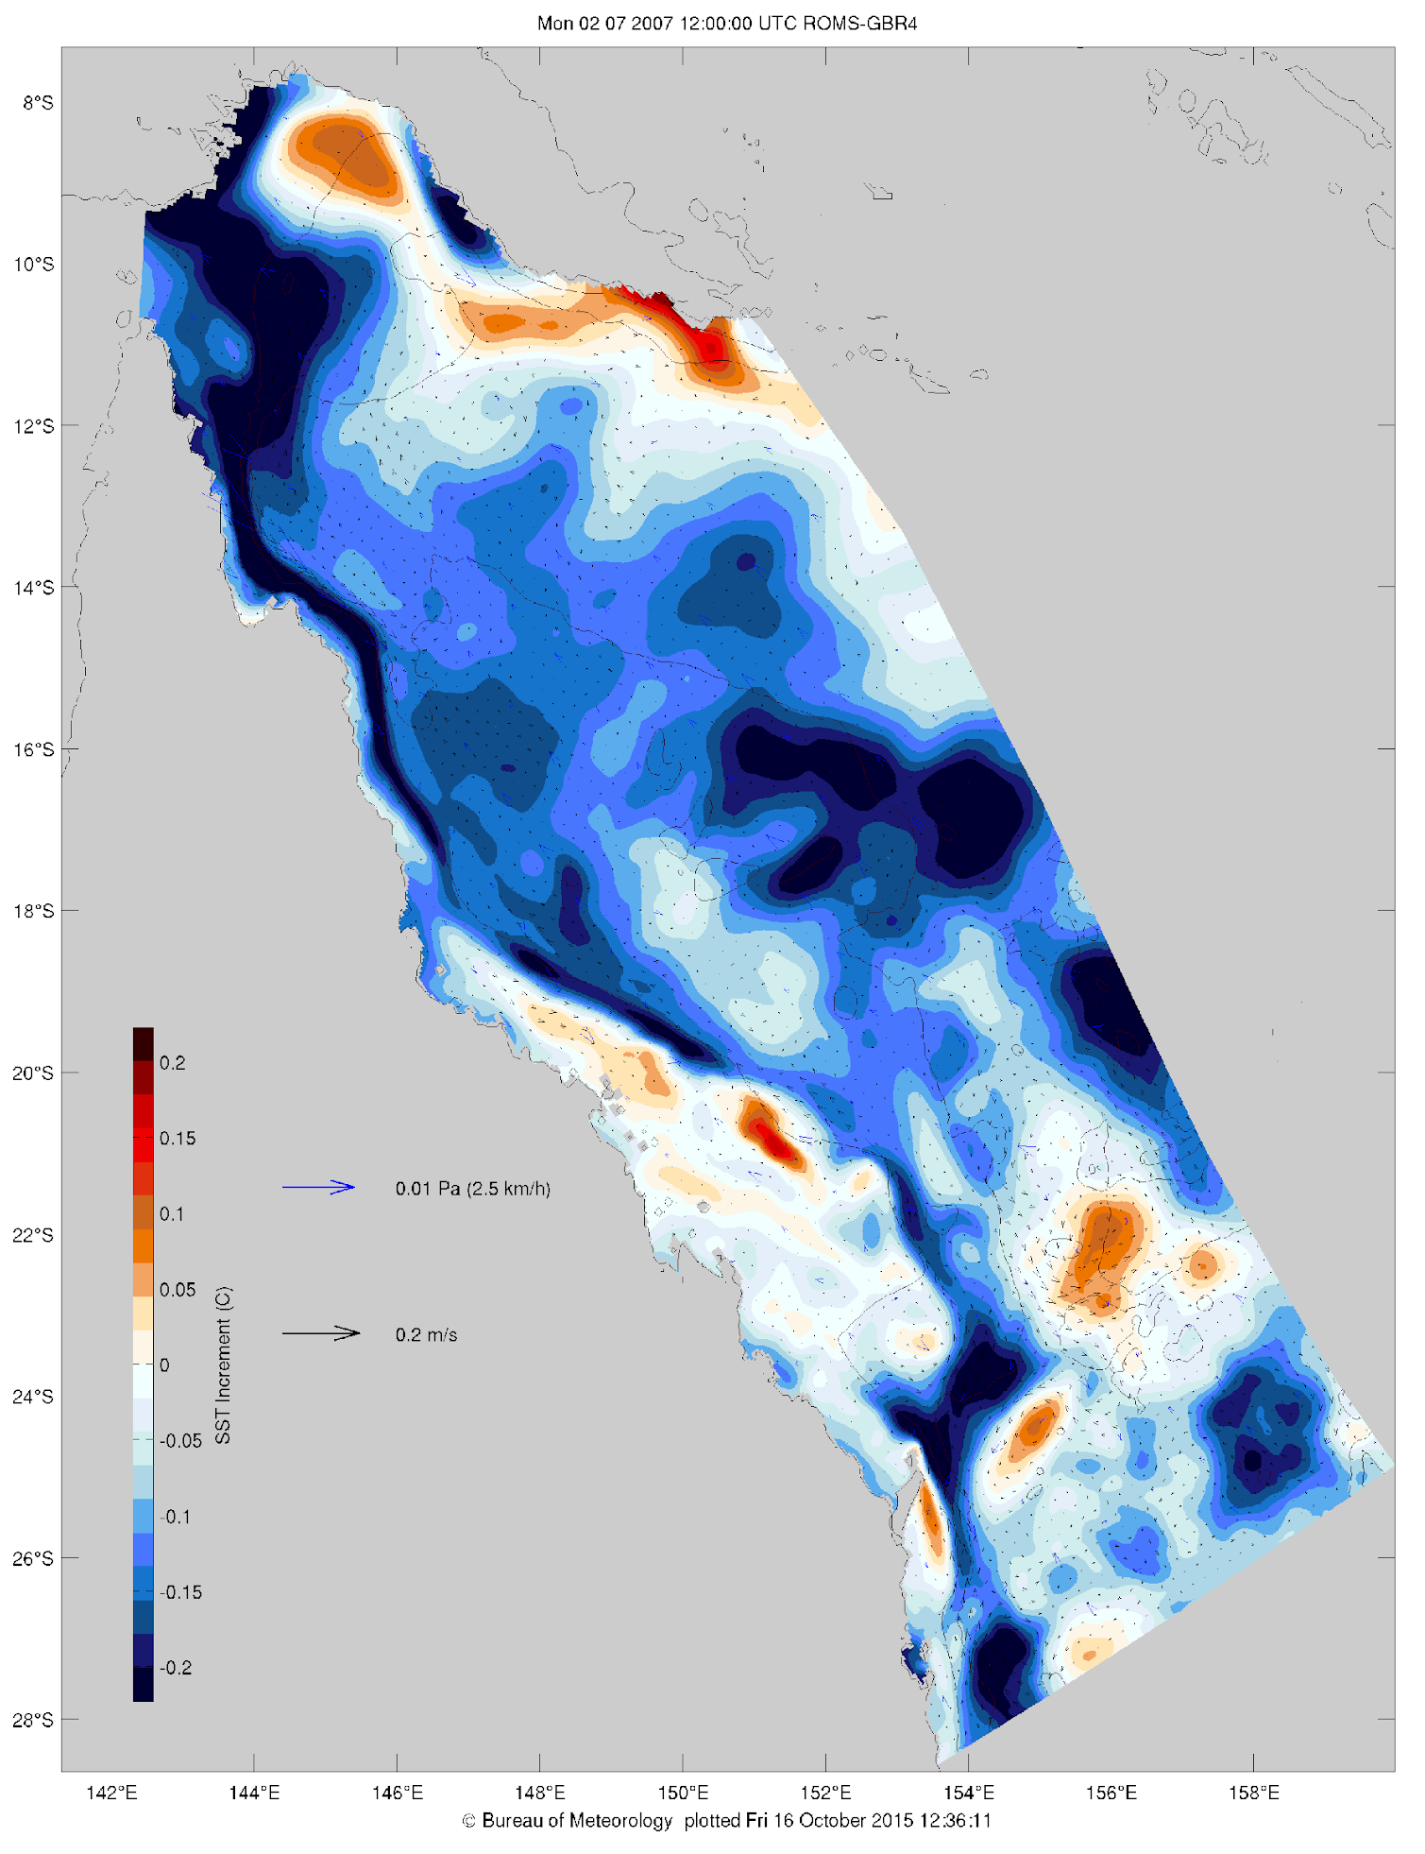
Summary and Outlook
Realtime system and reanalyses developed for the GBR region
DA methods: EnOI and EnKF
Realtime products are NOT operational but run on best effort basis on the NCI HPC
Challenge: Systematically understand where the system is doing well and where not → Include spatial analyses
From single model to multi model ensemble (collaboration with CSIRO)
Data Enhanced Virtual Laboratory (DEVL) as a platform to compare model results

