Slide 1

An Ensemble Optimal Interpolation SST Analysis based on the EnKF-C System
Helen Beggs¹, Pavel Sakov¹, Paul Sandery² and Gary Brassington¹
¹Bureau of Meteorology, Melbourne, Australia
²CSIRO Oceans and Atmosphere, Hobart, Australia
Bureau of Meteorology R&D Workshop, Melbourne, 26th- 29th November, 2018

Slide 2
Introduction
The Bureau's existing optimal interpolation (OI) SST analysis systems (Global Weekly, GAMSSA and RAMSSA) are based on legacy Fortran code developed in the 1980's for the BoM Oceanic Sub-surface Thermal Analysis Scheme (Blomley et al, 1989)
This code base is difficult to maintain
The Ensemble Kalman Filter data assimilation C code (EnKF-C), developed by the Bureau under the Bluelink Project, is a lightweight, generic parallelised framework that is currently used for data assimilation into the Bureau's OceanMAPS v3.1 ocean model
Based on EnKF-C, an Ensemble Optimal Interpolation (EnOI) Global SST analysis system ("GSAS") has been developed
GSAS is being assessed for its suitability to eventually replace the Bureau's operational OI SST analyses

Slide 3
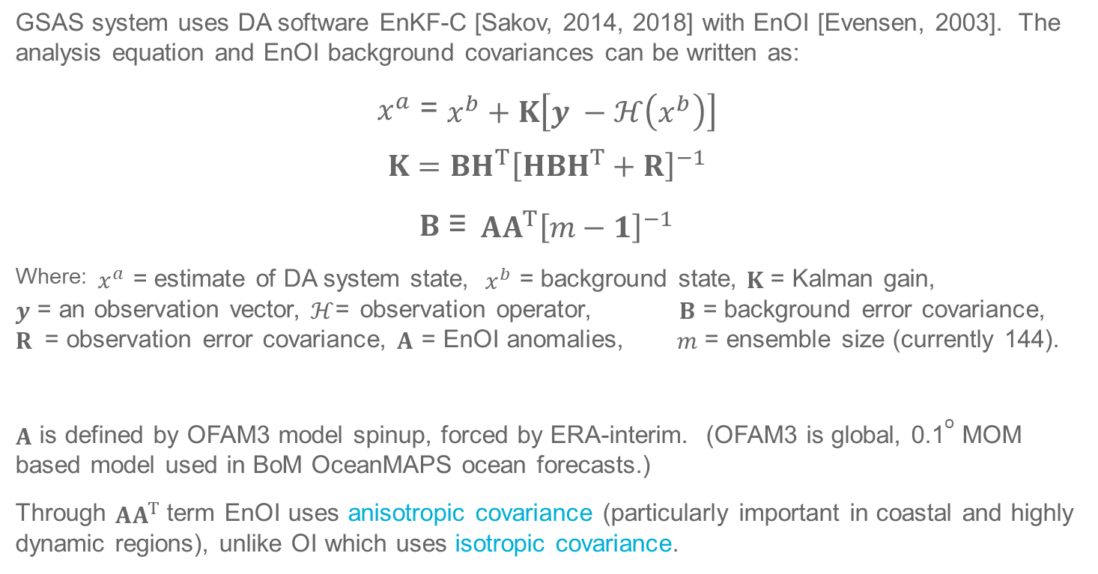
EnKF-C EnOI
GSAS system uses DA software EnKF-C [Sakov, 2014, 2018] with EnOI [Evensen, 2003]. The analysis equation and EnOI background covariances can be written as:
$x^{a}$ = $x^{b}+K\left[y −ℋ\left(x^{b}\right)\right]$
$$K=BH^{T}{\left[HBH^{T}+R\right]}^{−1}$$
$B$ ≡$AA^{T}{\left[m−1\right]}^{−1}$
Where: $x^{a}$ = estimate of DA system state, $x^{b}$ = background state, $K$ = Kalman gain, $y$ = an observation vector,$ℋ$= observation operator, $B$ = background error covariance, $R$ = observation error covariance, $A$ = EnOI anomalies, $m$ = ensemble size (currently 144).
$A$ is defined by OFAM3 model spinup, forced by ERA-interim. (OFAM3 is global, 0.1º MOM based model used in BoM OceanMAPS ocean forecasts.)
Through $AA^{T}$term EnOI uses anisotropic covariance (particularly important in coastal and highly dynamic regions), unlike OI which uses isotropic covariance.
Notes:
References: Sakov, Pavel (2018) EnKF-C User Guide, version 1.68.8, June 19, 2014 – February 7, 2018 (https://github.com/sakov/enkf-c)
Sandery, Paul et al. (2018) Great Barrier Reef and Coral Sea Ocean Reanalysis (in prep.)
EnOI requires only a single deterministic model run to generate a background state, and only a single solution of the analysis equations to update the background. By contrast, an EnKF generally requires the integration of m model runs to represent the time-varying background error covariances and a background state (often based on the ensemble mean), and m solutions of the analysis equations where all ensemble members are updated. The GSAS EnOI system uses an ensemble of intraseasonal anomalies from a free running model to estimate the background error covariances (B). The background state estimate, xb, is given by the ensemble mean. The background error covariance (B) is represented by the EnOI anomalies (A).
The Kalman gain is the relative weight given to the measurements and current state estimate, and can be "tuned" to achieve particular performance. With a high gain, the filter places more weight on the most recent measurements, and thus follows them more responsively.
The Innovation vector is given by $\left[y −ℋ\left(x^{b}\right)\right]$.
In the EnKF-C system the R-factor defines a multiple of observation error variance and can be used to tune the Kalman gain in order to achieve a more balanced observation error – ensemble spread relationship. K-factor is used to avoid large increments in the analysis and improve balance without discarding associated observations, which can provide important information to the system.

Slide 4
Advantages of EnKF-C
Open source (https://github.com/Sakov/enkf-c)
Coded in C for GNU/Linux platforms
Uses super-obs to handle different resolution input products and representativeness errors
Flexible error covariance models including ensemble based methods
Generates innovation statistics for each instrument in user-defined regions
Able to account for observation error for each data stream
Able to adaptively QC observations
Multivariate analysis – able to include other data types (e.g. in situ)
Easy to install new observations
Parallelised and computationally efficient (< 24 hours to process 1 year on NCI)

Slide 5
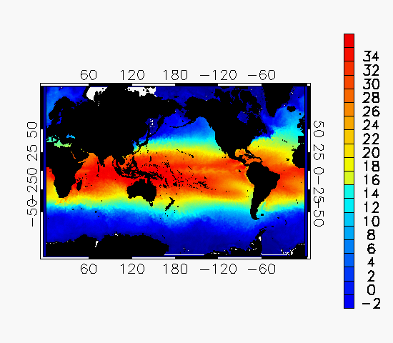
Global SST Analysis System (GSAS) EnOI SST analyses
6 Mar 2018
Resolution: Daily, 0.1º near global (±75ºN)
Depth: Foundation SST estimate - by rejecting daytime obs for ACCESS-G NWP winds < 6 m/s
Available: 2017 to present
Method: Ensemble optimal interpolation
Uses background model ensemble error covariances formed from OFAM3 ocean model
Support Localisation Radius: 100 km (initial tests)
Background: Initially Bluelink Reanalysis (BRAN), followed by previous day's GSAS analysis
Inputs: (All data bias-corrected and QL = 5)
9 km NAVOCEANO GAC AVHRR (N-18/19, METOP-A/B) L2P SST1m
2 km night-only OSPO VIIRS (Suomi-NPP) L3U SST(0.2m)
~50 km JAXA AMSR-2 (GCOM-W) L2P SSTsubskin
No sea ice (at present)
GSAS SSTfnd
Notes:
No sea ice input at present. We are considering using the sea-ice concentration from the COSIMA Project.

Slide 6
GAMSSA/RAMSSA Daily SST Analyses vs GSAS
 | GAMSSA | RAMSSA | GSAS
Resolution (degrees) | 0.25 | 0.08333 | 0.1
Domain | 180ºW–180ºE, 90ºS–90ºN | 60ºE–190ºE, 70ºS–20ºN | 0ºE–360ºE, 75ºS–75ºN
Depth | Foundation | Foundation | Foundation
Method | OI | OI | EnOI
Background Field | Previous day's analysis plus climatology | Previous day's analysis plus Global Weekly SST | Previous day's analysis
Satellite SST Inputs | NAVO GAC AVHRR, AMSR-2 | NAVO GAC AVHRR, AMSR-2, IMOS HRPT AVHRR | NAVO GAC AVHRR, AMSR-2, S-NPP VIIRS
In situ SST Inputs | Buoys and Ships (from GTS) | Buoys, ships, Argo, XBT, CTD (GTS) | None
Sea-ice inputs | NCEP 1/12º sea ice analysis | NCEP 1/12º sea ice analysis | None
Notes:
NAVO GAC AVHRR and IMOS HRPT AVHRR SSTs are bias-corrected using sses_bias. AMSR-2 data are not bias-corrected in RAMSSA and GAMSSA, but are in GSAS.

Slide 7
GSAS SSTfnd(t – 1) – Satellite SSTfnd(t) 1 Jan – 31 Dec 2017
Compared previous day's GSAS SSTfnd with super-obbed satellite SSTfnd over Global domain and Australian domain (90ºE–180ºE, 50ºS–5ºN).
Forecast innovation statistics are given for mean daily bias and mean daily MAD.
Analysis | Global Matchups | Global Bias (K) | Global MAD (K) | Australian Matchups | Australian Bias (K) | Australian MAD (K)
GSAS (AVHRR, AMSR-2) | 679,290,837 | -0.001 | 0.335 | 75,210,816 | -0.004 | 0.313
GSAS (AVHRR, AMSR-2, VIIRS) | 790,599,632 | -0.006 | 0.306 | 88,323,649 | -0.009 | 0.287
Ingesting VIIRS results in a reduction of ~0.03 K in mean daily innovation MAD.
Notes:
GSAS (AVHRR, AMSR-2) – gsas-01.11
GSAS (AVHRR, AMSR-2, VIIRS) – gsas-01.12

Slide 8
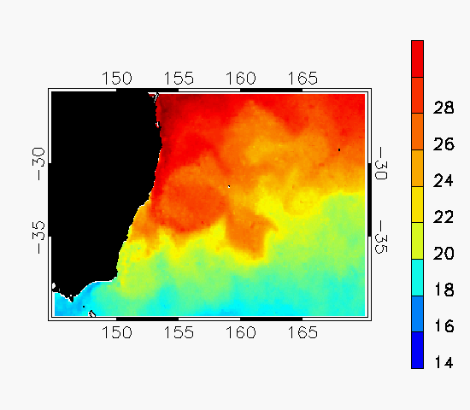


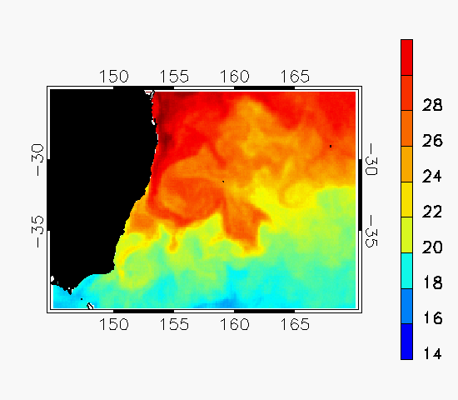
GSAS vs OI analyses (RAMSSA and CMC)
SST: East Australian Current 1 March 2018
Operational RAMSSA (no VIIRS) (9 km)
CMC (VIIRS) (10 km)
GSAS (no VIIRS) (10 km)
GSAS (VIIRS) (10 km)

Slide 9




GSAS vs OI analyses (RAMSSA and CMC)
SST: East Australian Current 1-31 March 2018
Operational RAMSSA (no VIIRS) (9 km)
CMC (VIIRS) (10 km)
GSAS (no VIIRS) (10 km)
GSAS (VIIRS) (10 km)

Slide 10
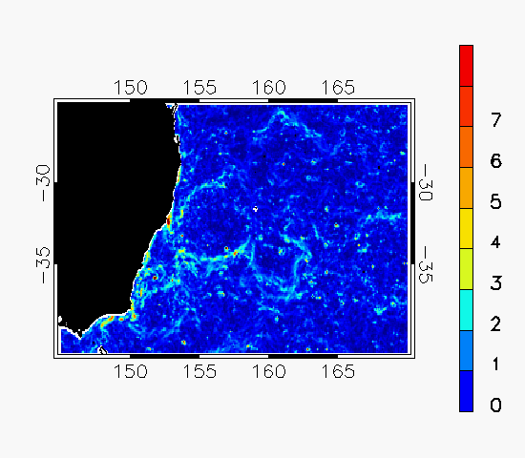
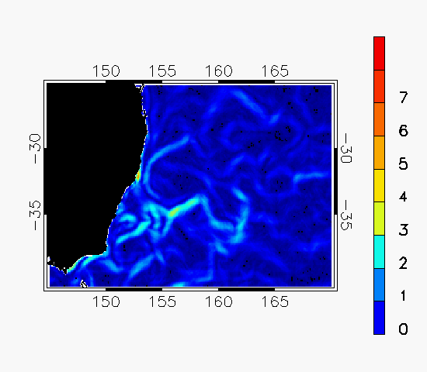
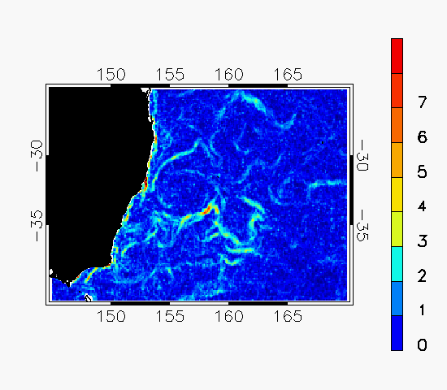
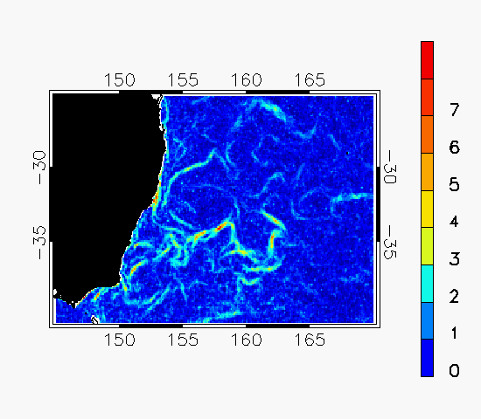
GSAS vs OI analyses (RAMSSA and CMC)
Gradients: East Australian Current 1 March 2018
Operational RAMSSA (no VIIRS) (9 km)
CMC (VIIRS) (10 km)
GSAS (no VIIRS) (10 km)
GSAS (VIIRS) (10 km)

Slide 11




GSAS vs OI analyses (RAMSSA and CMC)
Gradients: East Australian Current 1-31 March 2018
Operational RAMSSA (no VIIRS) (9 km)
CMC (VIIRS) (10 km)
GSAS (no VIIRS) (10 km)
GSAS (VIIRS) (10 km)

Slide 12
Analysis SSTfnd(t – 1) – Buoy SSTfnd(t) 1 Jan – 31 Dec 2017
Compared previous day's SST analysis SSTfnd with drifting and tropical moored buoy SSTfnd over Global domain and RAMSSA Australian domain (60ºE–190ºE, 70ºS–20ºN). Data collocated if within same grid cell, and winds > 6 m/s (day), > 2 m/s (night).
Analysis | Global Matchups | Global Bias (K) | Global STD (K) | Australian Matchups | Australian Bias (K) | Australian STD (K)
25 km GAMSSA | 502,924 | 0.030 | 0.542
9 km RAMSSA |  |  |  | 230,673 | 0.097 | 0.536
10 km GSAS | 355,338 | 0.045 | 0.613 | 206,144 | 0.033 | 0.549
10 km GSAS (inc VIIRS) | 355.618 | 0.125 | 0.604 | 206,126 | 0.118 | 0.541
10 km CMC (inc VIIRS) | 844,549 | 0.061 | 0.520 | 206,167 | 0.080 | 0.502
Notes:
Note: CMC has similar inputs to GSAS (OSPO VIIRS L3U, NAVO GAC AVHRR L2P, REMSS AMSR-2 L3, buoys and ships, CMC ice concentration.
For the same period, NESDIS SQUAM gives global matchup statistics with independent Argo data of:
GAMSSA: mean = -0.08 K, STD = 0.47 K
CMC0.1deg: mean = -0.06 K, STD = 0.30 K
GSAS (AVHRR, AMSR-2) – gsas-01.11
GSAS (AVHRR, AMSR-2, VIIRS) – gsas-01.12

Slide 13
Conclusions so far…
GSAS appears to resolve surface ocean features more effectively than RAMSSA or CMC, and appears smoother than RAMSSA, but does not provide SSTs in semi-enclosed coastal regions (e.g. Port Phillip Bay).
GSAS accuracy slightly lower than GAMSSA or CMC analyses, possibly due to lack of tuning of localisation radius and background error covariance
Globally, GSAS forecast innovation STD is 0.07 K higher than for GAMSSA, using the same satellite SST data inputs.
Over Australian domain, 10 km GSAS forecast innovation STD is ~0.01 K higher than operational 9 km RAMSSA (and only 0.04 K higher than 10 km CMC), even without assimilating in situ data into GSAS.
Assimilating night-time VIIRS data into GSAS reduces the GSAS forecast innovation MAD compared with super-obs by ~0.03 K.

Slide 14
Future EnOI SST Work in 2019
Test not bias-correcting AMSR-2 SSTs
Test setting the localisation radius to be high (> 100 km) but limiting the number of observations to be used closest to the location
Develop regional EnOI SST analysis products at 10 km and 2 km resolution, that can also provide SSTs in semi-enclosed coastal regions
Convert GSAS output to GHRSST GDS2 L4 files, including NCEP 9 km ice mask
Validate the OFAM3 model background ensemble covariances that are used to form GSAS
Investigate impact of alternative (fully global) background ensemble covariance models so that GSAS can become fully global (currently ±75ºN)
Include global sea ice from COSIMA Project ???

Slide 15
Questions?
Thank You!
Contact: helen.beggs@bom.gov.au

Slide 16
Additional slides for discussion

Slide 17
GSAS SSTfnd(t – 1) – Reference SST(t) 1 Jan – 31 Dec 2017
Compared previous day's GSAS SSTfnd with:
Super-obbed satellite SSTfnd
Argo SSTdepth
over Global domain and Australian domain (90ºE–180ºE, 50ºS–5ºN).
Note: Statistics are given for mean daily bias and mean daily MAD.
Reference | Global Matchups | Global Bias (K) | Global MAD (K) | Australian Matchups | Australian Bias (K) | Australian MAD (K)
Satellite | 790,599,632 | -0.006 | 0.306 | 88,323,649 | -0.009 | 0.385
Argo | 173,176 | -0.221 | 0.572 | 24,087 | -0.117 | 0.417
Notes:
GSAS (AVHRR, AMSR-2) – gsas-01.11
GSAS (AVHRR, AMSR-2, VIIRS) – gsas-01.12

Slide 18
Analysis SSTfnd(t) – Buoy SSTfnd(t) 1 Jan – 31 Dec 2017
Compared SST analysis SSTfnd with drifting and tropical moored buoy SSTfnd over Global domain and RAMSSA domain (60ºE–190ºE, 70ºS–20ºN). Data collocated if within same grid cell, and winds > 6 m/s (day), > 2 m/s (night).
Analysis | Global Matchups | Global Bias (K) | Global RMSD (K)
10 km GSAS | 355,653 | 0.038 | 0.582
10 km GSAS (inc VIIRS) | 355,614 | 0.117 | 0.565

Slide 19
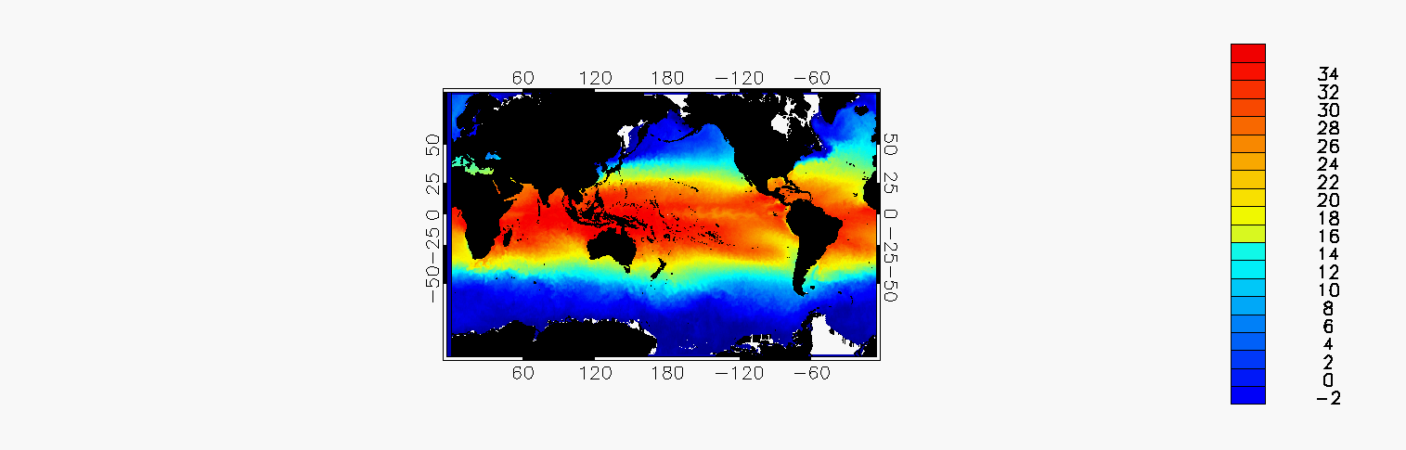
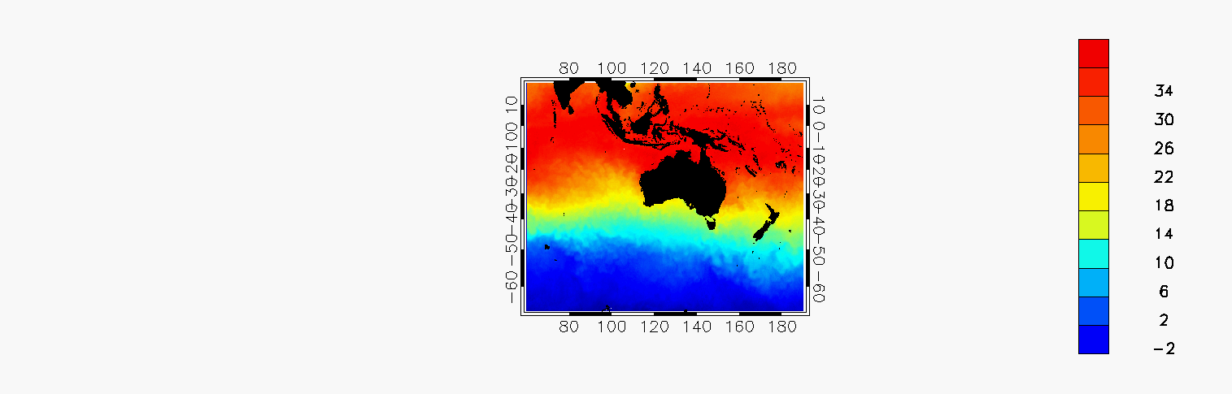
Daily Global and Regional Multi-Sensor SST analyses (GAMSSA and RAMSSA) http://www.bom.gov.au/marine/sst.shtml
6 Mar 2018
Resolution: Daily, 0.25º global, 0.083º regional
Depth: Foundation SST estimate - by rejecting obs for NWP winds < 6 m/s (day), < 2 m/s (night)
Available: 2007 to real-time (GDS1.6: AO.DAAC; GDS2: AODN)
Method: Optimal interpolation (Beggs et al., 2011)
BG Correlation Length Scales: 50 km (GAMSSA) and 20 km (RAMSSA)
Background: Combination of previous day's RAMSSA/GAMSSA SST and Reynolds and Smith (1994) climatology (1961-1990).
Inputs: (all satellite data bias-corrected except AMSR-2)
1 km IMOS HRPT AVHRR (N-18/19) L2P SST(0.2m) (QL ≥ 4)
9 km NAVO GAC AVHRR (N-18/19, METOP-A/B) L2P SST1m (QL = 5)
Night-time ACSPO VIIRS L3U SST(0.2m) (QL = 5) (Test RAMSSA)
~50 km JAXA NRT AMSR-2 (GCOM-W) L2P SSTsubskin (QL = 5)
Buoy and ship in situ SSTdepth (GTS)
NCEP 1/12º sea ice analyses
GAMSSA SSTfnd
RAMSSA SSTfnd
Notes:
Note: All satellite observations are bias-corrected (except AMSR-2) using sses_bias values in GHRSST L2P/L3U files. Only QL = 5 SSTs are used, except for HRPT AVHRR which used QL ≥ 4 SSTs.
Observation Correlation Length Scales: GAMSSA: 20 km RAMSSA: 12 km
Background Correlation Length Scales: GAMSSA: 50 km RAMSSA: 20 km
Observation Estimated Standard Deviations estimated for each satellite using matchups with buoys (updated as required).
Data Access: http://podaac.jpl.nasa.gov/dataset/ABOM-L4HRfnd-AUS-RAMSSA_09km
And http://podaac.jpl.nasa.gov/dataset/ABOM-L4LRfnd-GLOB-GAMSSA_28km

Slide 20
Bureau SST requirements for NWP and Coupled models (2011 – 2013)
Future BoM NWP SST Requirements
City-coverage 0.015º resolution NWP systems (APS3 ACCESS-C from 2019)
Requires regional, daily SSTfnd or 6-hourly SSTskin, L4 with ~0.05º - 0.1º feature resolution
Global 0.125º resolution NWP systems (APS3 ACCESS-G from late 2018)
Requires global, daily SSTfnd or 6-hourly SSTskin, L4 with ~0.1º - 0.2º feature resolution?
Before end of 2020, under APS4 ACCESS BoM will probably have a single experimental NWP system at ~300 m resolution for fog forecasting at Perth City airport, but SST not required as inland model domain. However, other more coastal regions may follow…
Could an EnKF-C EnOI SST analysis or EnKF-C Ocean Forecast SST be the solution for higher spatial/temporal resolution SST?

