Slide 1

Ensembles in the ocean for seasonal forecasting and reanalyses applications
Implications for Predictability
Basis for extended range prediction
Simple conceptual models to understand predictability
Magdalena Alonso Balmaseda
Contributions from
Hao Zuo, Eric de Boisseson, Patrick Laloyaux, Simon Lang, Kristian Mogensen, Tim Stockdale, Antje Weisheimer

Slide 2
Outline
Setting the scene
Ocean versus atmosphere
Ocean ensembles for coupled forecasting: Focus on seasonal at ECMWF
A history of developments
Ensembles in ORAS5 - SEAS5
Widening the scope of ensembles in the ocean
Seamless Coupled Prediction -Coupled DA
Not discussed here: Ongoing developments for ensembles in the ocean
Ensemble of ocean reanalysis –Parameter Estimation –Quantifying ocean chaos – stochastic parameterizations

Slide 3
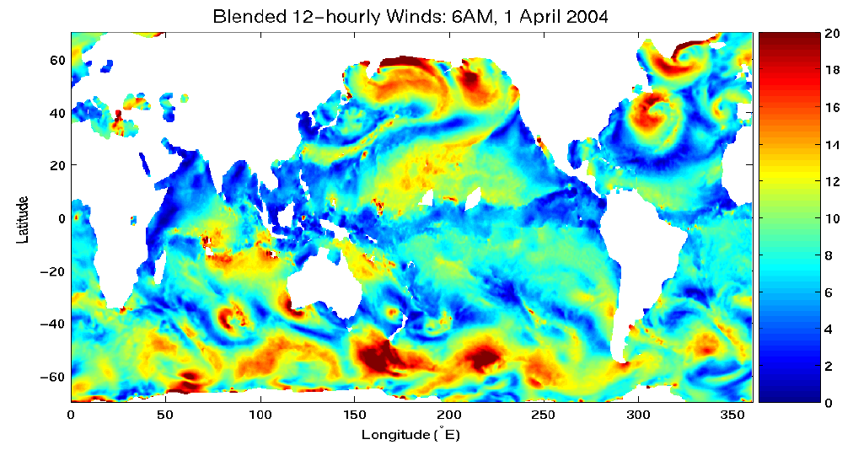
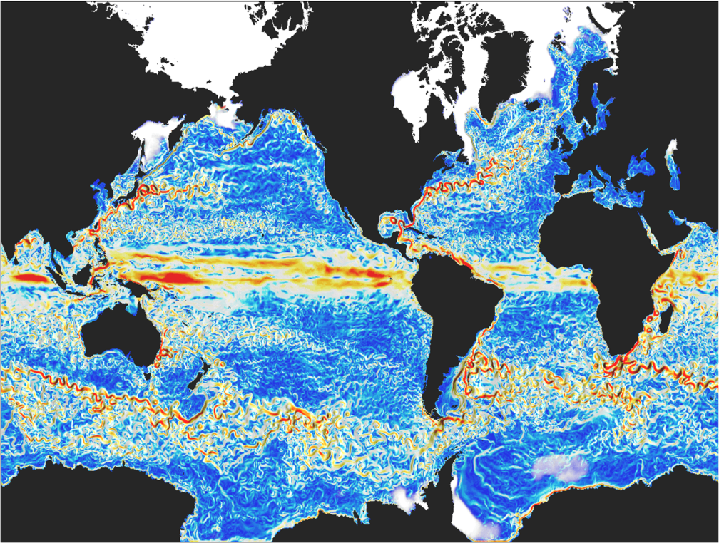
2 - Ocean Weather
Ocean v Atmosphere: reminder
Atmospheric wind speed (12h)
Ocean velocity 5-day mean
Spatial scales
Continental boundaries
Temporal Scales, Memory and observations
Ocean has long memory -thermal and dynamical inertia.
Number of observations in atmosphere ~10³-10⁴ times more than in the ocean.
So the ocean (re-) analyses take long time to spin up.
Internal – forced –coupled variability and stability
Ocean large scale variability is mostly forced by atmosphere.
The ocean internal chaotic component is associated with eddy scale
There are unstable ocean-atmospheric coupled modes at planetary scale, e.g. ENSO
Ocean - atmosphere interaction also occurs at small eddy and frontal scale: stable or unstable?
Notes:
3
Note the different spatial scales of atmosphere and ocean.

Slide 4
Ensembles in the Ocean: an ECMWF perspective
A brief history of developments at ECMWF: 2002-2017
Main driver: seasonal forecasting –ENSO
Evolution and choices
How to generate ensemble of ocean i.c for seasonal forecast?
From the atmospheric perspective, seasonal forecast is a boundary condition problem
From the ocean perspective, seasonal forecast is an initial value problem
Need to sample uncertainty in ocean initial conditions
Difference with respects to Ensembles in NWP:
A-posteriori calibration of forecast PDF is needed in monthly seasonal
No major efforts in tuning the perturbations to achieve reliable forecasts.
Assessment of the ensemble reliability is important
System with 2 time scales: days in the atmosphere and months in the ocean.

Slide 5
Are Singular Vectors a valid approach for operational seasonal forecasts?
Medium Range: Singular Vectors
We need the TL& Adjoint of the full coupled model is required.
BUT…
The linear assumption would fails for the atmosphere at lead times relevant for seasonal (~>1month).
Alternatives
Other approaches for optimal sampling of initial condition uncertainty:
Breeding Vectors (NASA, BoM. Not shown here)
SV using Generalized Linear Propagators
Sample known i.c. uncertainties, without considering optimality
Tangent propagator
Initial pdf
forecast pdf
Uncertainty in initial conditions may not be the dominant source of error

Slide 6


Generalized Singular Vector Problem (I)
Linear propagator
Generalized Linearized Propagator (not necessary tangent linear)
Given a final N and initial norm L, the growth in x can be measured by
Initial pdf
forecast pdf
Optimal perturbations are those that maximize λ
Different ways of estimating the Linear Propagator P(τ)
Empirical (or Inverse modelling): basically a regression :
A simplified linear dynamical model (equilibrium atmosphere rather than tangent linear)
A hybrid system: Ocean GCM coupled to a simplified atmosphere

Slide 7

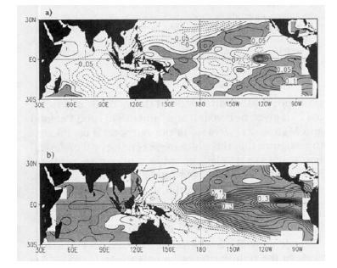
Generalized Singular Vector Problem (II)
Linear Propagator estimated empirically via regression model (Inverse modelling)
Initial
SST
From temporal records of observations
von Storch and Xu 1990 MJO (POPs Principal Oscillation Patterns)
Blumenthal 1991 ENSO
Penland and Sadershmuck 1995, ENSO (inverse modelling)
From temporal records of model evolution
Xue et al 1997a,b; Fan et al 1999 ENSO
Hawkins and Sutton 2009 Decadal Prediction AMOC
Final
SST
Penland and Sadershmukh 1995
This approach is based on temporal sampling of existing timeseries: Difficult to capture flow dependence or errors of the day.
Judgement: not appropriate for ensemble generation.in operational systems.
These are powerful tools for a-posteriori diagnostics of ensemble statistics for evaluation of forecasts;. Ensemble Sensitivity. Magnusson 2017 QJRMS

Slide 8
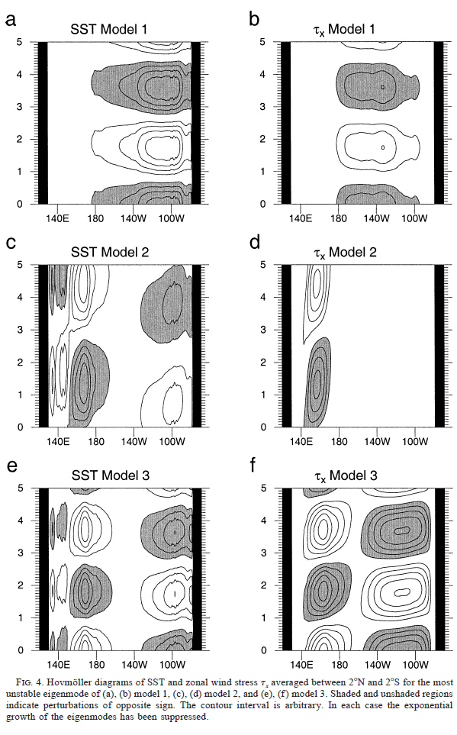
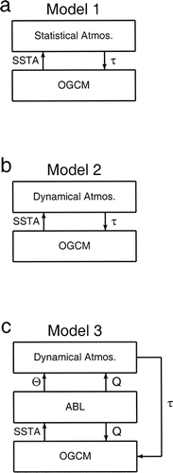
Generalized Singular Vector Problem (III)
Hybrid:
TL and Adjoint of Ocean model
+
simplified linear atmospheric model
:
Moore et al 2003 used NEMO coupled to
A linear statistical atmosphere
A linearized dynamical atmospheric model
Linearized dynamical + ABL
Strong dependence on the details of the linearized atmosphere model.
Judgement: this approach not suitable for operational implementation.
This approach was also used to estimate optimal forcing perturbations (or Stochastic Optimals, see later)

Slide 9
ENSEMBLE GENERATION
Representing Known Analysis Uncertainties
Seasonal versus Medium Range
Source of Uncertainty
Different Strategies
2002
Uncertainty in wind stress
Uncertainty in SST
+
Uncertainty on ocean reanalyses spin-up
Uncertainty in missing processes (sea ice in SEAS4 by analogues)
+
Other surface fluxes
Observation representative errors
2011
2016

Slide 10
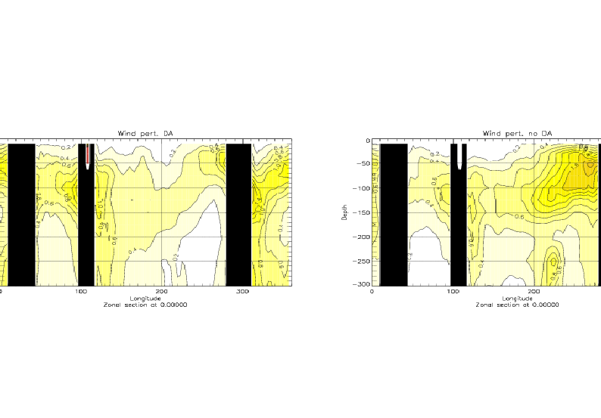
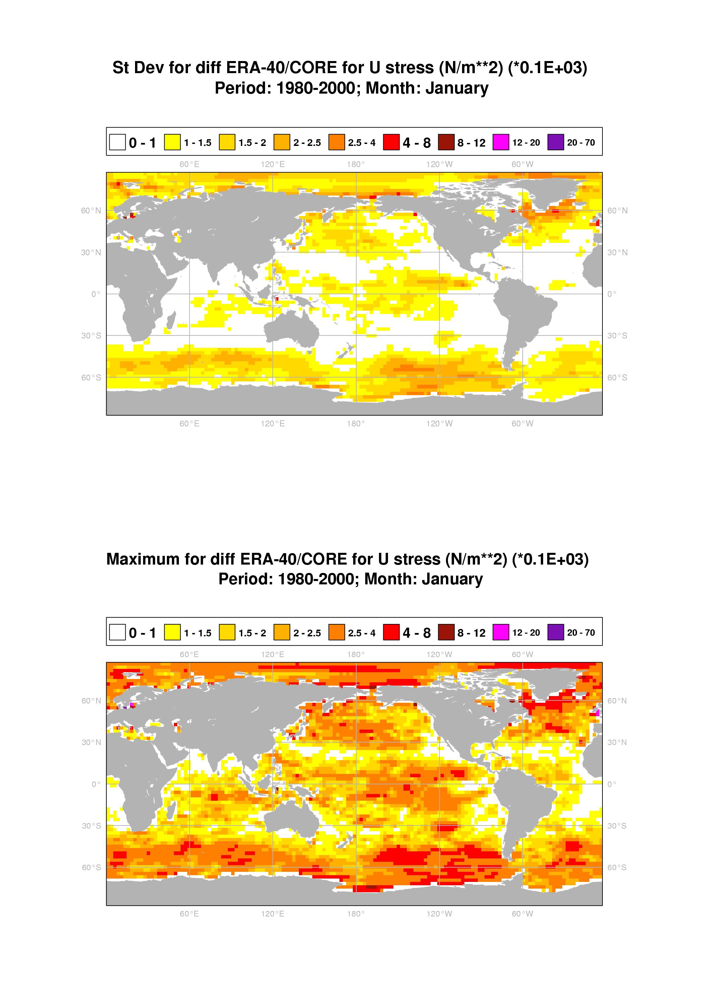
1.1 Wind stress perturbations
SDV Ocean Subsurface T: No Data assimilation
Uncertainty in wind stress as largest source of uncertainty
Create data base with errors in the monthly anomalies of wind stress, arranged by calendar month:
Random draw of monthly perturbations, applied during the ocean analyses.
Create a centered ensemble of 5 reanalysis is constructed symmetric wind perturbations
-P2 -P1 0 P1 P2
-
SDV of Wind Stress Perturbation
SDV Ocean Subsurface T: Data assimilation
C.I 0.2 deg C

Slide 11
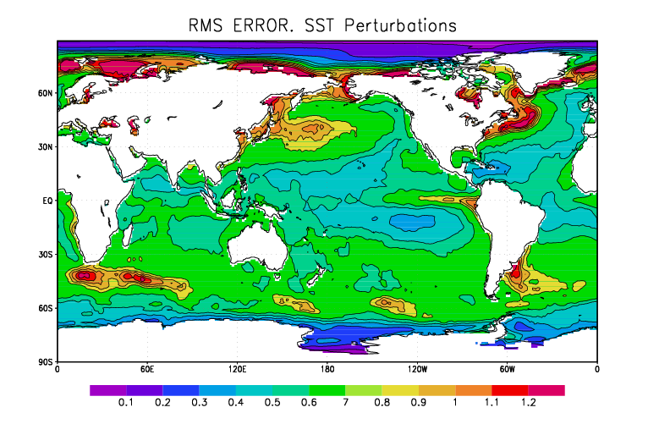
1.2 SST Perturbations
-Create data base with errors of weekly SST anomalies, arranged by calendar week:
V1. Error in SST product: (differences between OIv2/OI2dvar)
+ Errors in time resolution: weekly versus daily SST
V2.
V3.
-Random draw of weekly perturbations, applied at the beginning of the coupled forecast. Over the mixed layer (~60m)
-A centred ensemble
SST Perturbations SDV

Slide 12
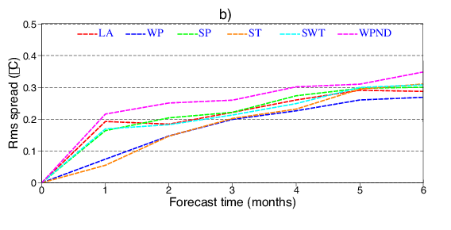
Comparison on contributions to the Ensemble Spread in seasonal forecasts
Wind Perturbations (WP)
SST Perturbations(ST)
Stochastic Physics (SP)
Wind Perturbations No DA (WPND)
All(SWT)
Lag-averaged(LA)
The spread by different methods converge to the same asymptotic value after 5-6 months.
SST and Lag-averaged perturbations dominate spread at ~1month lead time.
With DA, the wind perturbations grow slowly, and notably influence the SST only after 3m. Similar growth as SP.
Without DA, the initial spread (<3m) is larger. The asymptotic value is slightly larger
Is the level of spread sufficient?
ST
SP
From Vialard et al, MWR 2005

Slide 13
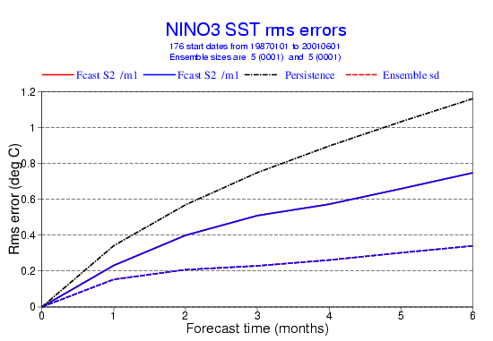
Is the ensemble spread sufficient? Are the forecast reliable?
Forecast System is not reliable:
RMS > Spread
Can we reduce the error? How much? (Predictability limit)
Can we increase the spread by improving the ensemble generation?
To improve the ensemble generation we need to sample other sources of error:
a) Model error: multi-model
b) To design other optimal methods: Stochastic Optimals, Breeding Vectors, …
Or a-posteriori calibration of the ensemble.

Slide 14
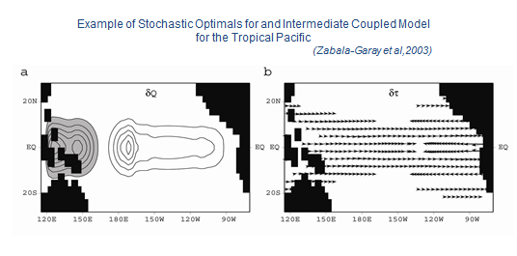
Linear Theory:
Stochastic Optimals
Consider a stochastically forced linear ENSO oscillator:
f(t) is coherent in space and white in time.
Which are the patterns of f(t) that maximize the variance of s?
(Farrell and Ioannou, 1993, Moore et al 2003)

Slide 15
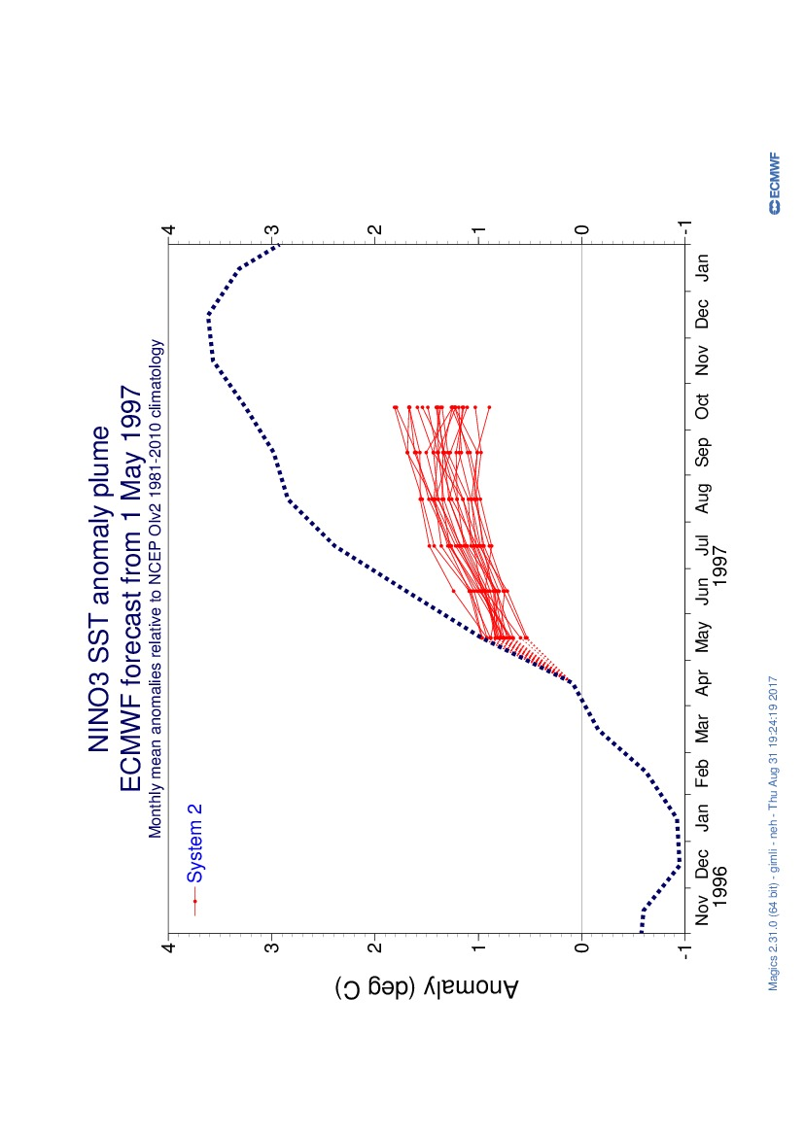
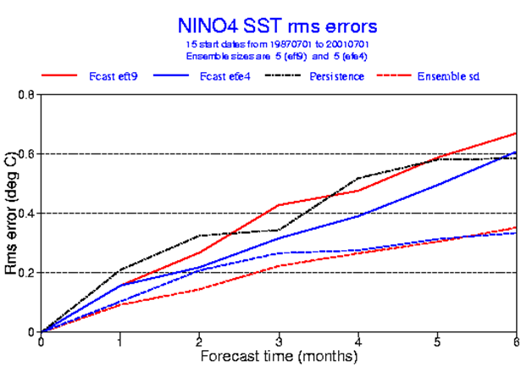
Adding Perturbations online
Atmosphere model
Ocean model
Initial conditions
S2 failed to forecast the onset of the 1997-8 El Nino.
Vitart et al 2003 attributed failure to lack of Westerly Wind Bursts associated with the MJO.
Can we add perturbations to the coupled model to account for known deficiencies?.
We tried Stochastic Optimals and Synthetic WWB
.
S2 SO Pert
Improvement but still under dispersive ensemble. Other deficiencies related with too strong negative feedback : Model was not able to produce ENSO (Balmaseda et al 2003). Judgement: do not implement. It should be sorted out by model improvement

Slide 16
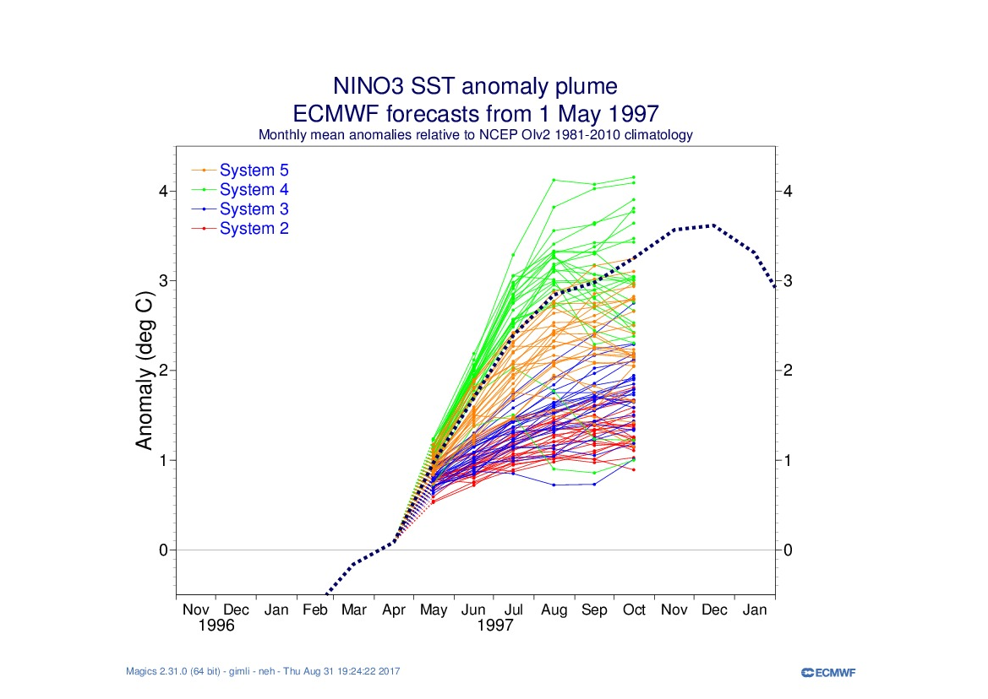
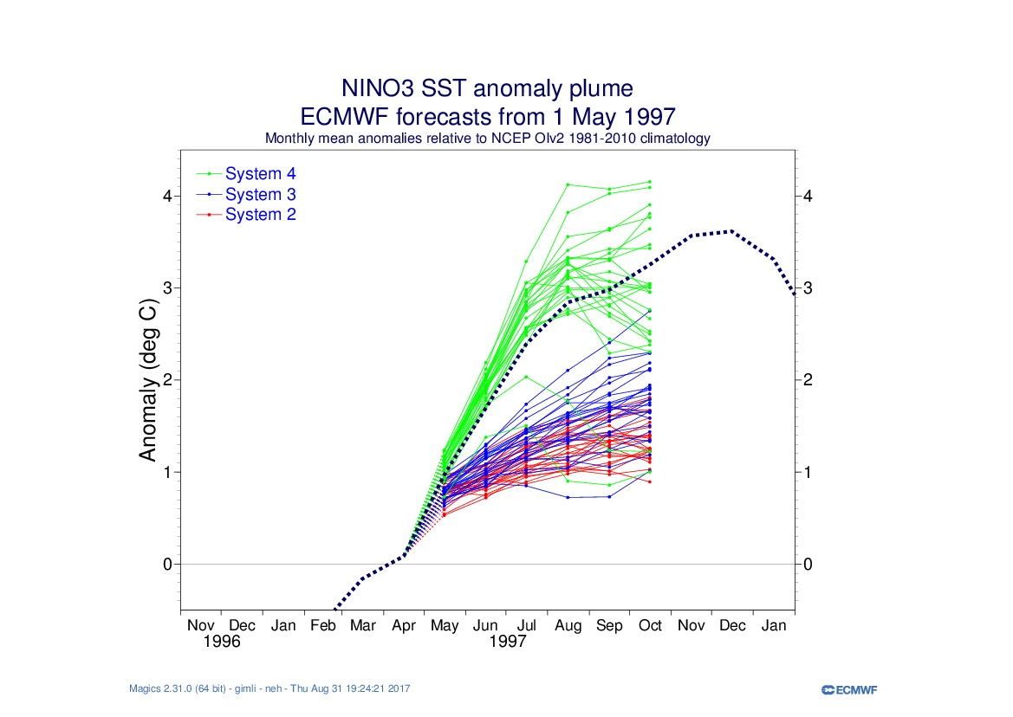
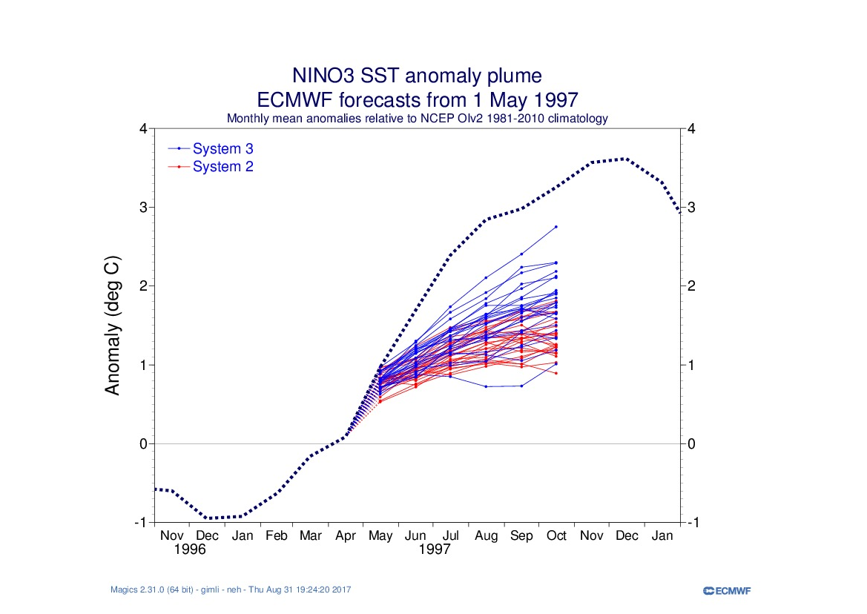
Over the years: SEAS2 – SEAS3 –SEAS4 – SEAS5
SEAS5 became operational in Nov 2017

Slide 17
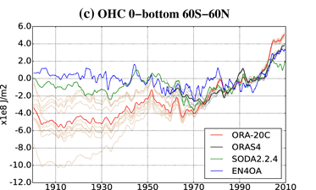
Ocean ensemble in the operational ECMWF coupled forecasting systems Sampling uncertainty in ocean initial conditions via an ensemble of 5 ocean reanalyses.
ORAS2 – S2 : vintage 2002
2016: ORAS5
+ Revised Forcing perturbations v3:
Multivariate Wind-SST-SeaIce-FreshWater-Solar Radiation
+ Uncertainty in ocean reanalyses spin up
+ Observation perturbation: representativeness error
2017: SEAS5
Ocean initial conditions from ORAS5
Additional SST initial perturbations
Atmospheric singular vectors
Stochastic Physics
Sampling Spin-Up uncertainty in ocean reanalyses
Also used in ORA-20C CERA-20C and CERA-SAT (see later)
From de Boisseson et al 2017

Slide 18
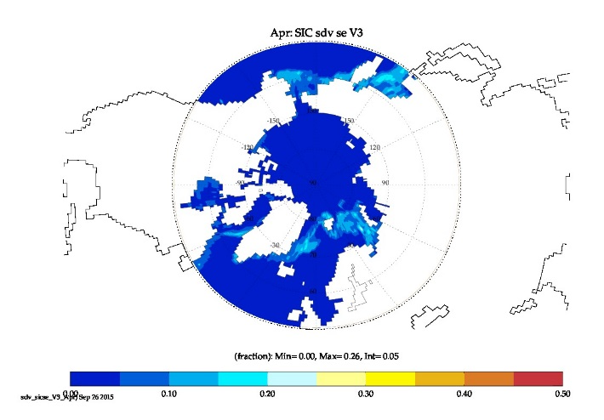
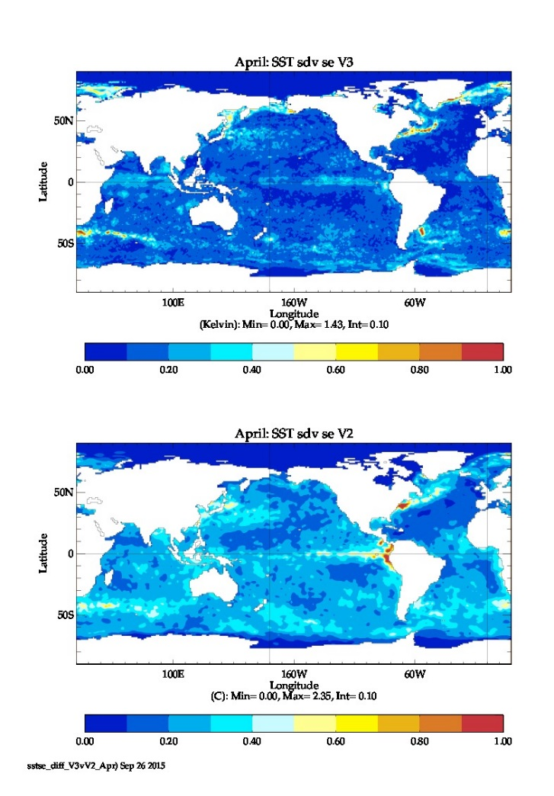
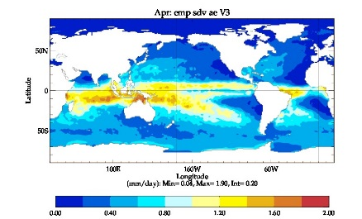
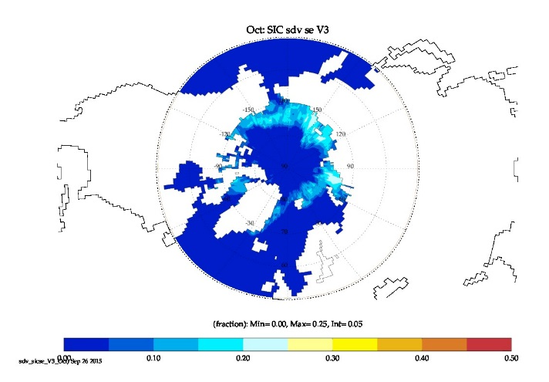
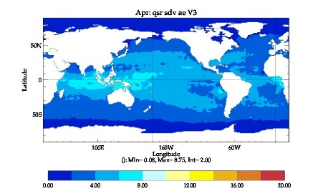
A glance at other perturbations
V3 Forcing Perturbations in ORAS5
Multivariate - Updated data sets – 2 temporal scales – Multiple uncertainty sources
Still conservative: do not sample error in the mean.
SDV SST SE New (V3)
SDV PME
SDV SIC Apr
SDV SST SE OLD (V2)
SDV Abs Solar
SDV SIC Oct
Zuo et al 2017, Hirahara et al 2016

Slide 19
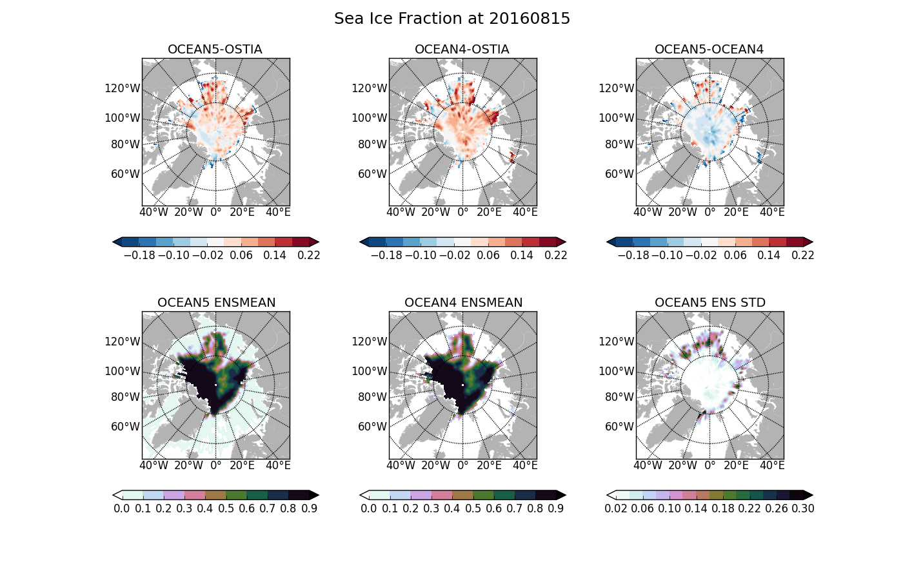
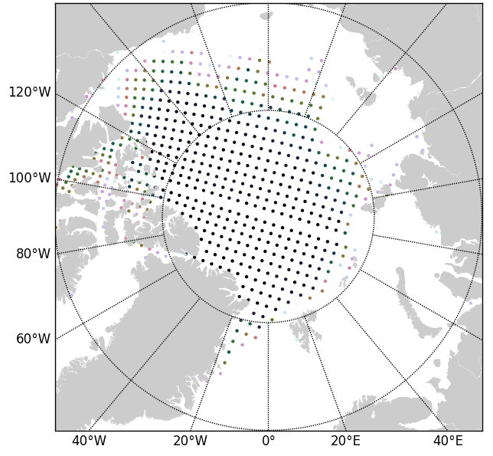
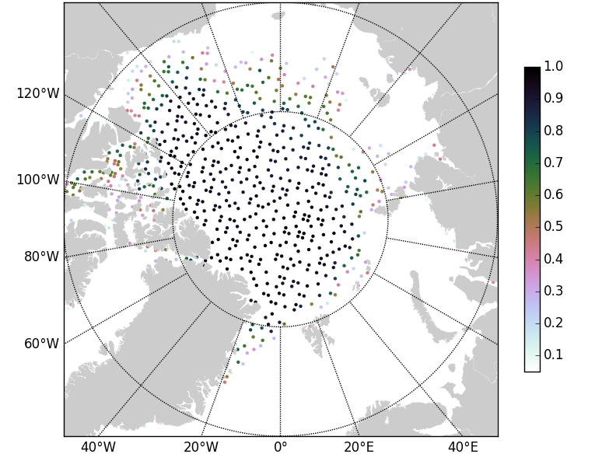
Perturbing the Observations
Representativeness error
1) Profile displacement and stretching
2) Thinning with random seed in different ensemble members:
More observations are used in the ensemble
To be used in EDA for the ocean.
Thinning of Sea Ice Concentration Observations
Regular thinning
Random sampling
+ forcing perts
+ other obs perts
Zuo et al 2017, Tech. Memo 795
Notes:
Maximum ensemble spread for SIC and SIT can be found when near Canadian Archipelago, in the northern of Baffin Bay and along the west coast of Greenland, with maximum std of 10% and 0.35 m, for SIC and SIT respectively. In the northern edge of the Barents Sea and Kara Sea at the ice edge, SIC spread can reach ~7% and that accounts up to half of the SIC in the same area.

Slide 20
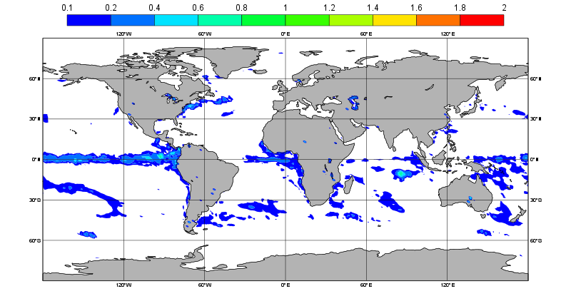
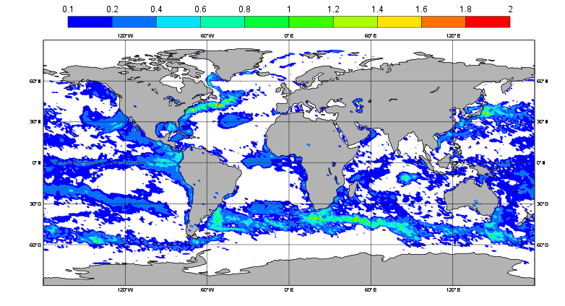
Ensemble spread in coupled medium-range forecasts
Impact of ocean resolution
10 member, TCO639 realtime system, 1 initial date, SST StDev, fc step 120h
1 deg
¼ deg
From Simon Lang
Spread appears in areas where ocean intrinsic variability is large + convective regions
Question: does the local air-sea interaction favours/damps instability growth?
=> Can we quantify the chaotic behaviour of the ocean in uncoupled mode?

Slide 21
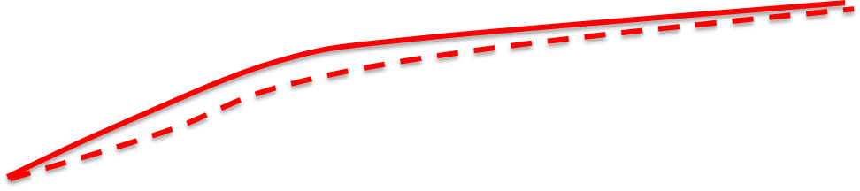
2.2) Sampling model error: The Real Time Multimodel
2002 - SEAS2
2005 –EUROSIP multimodel ensemble
- Bayesian calibration
2017 – SEAS5
RMS error of Nino3 SST anomalies
Persistence
ECMWF
EUROSIP
SEAS5
Bayesian Calibration
ensemble spread

Slide 22
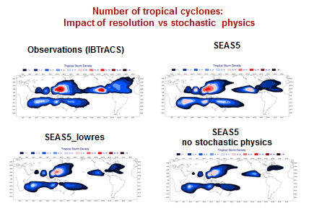
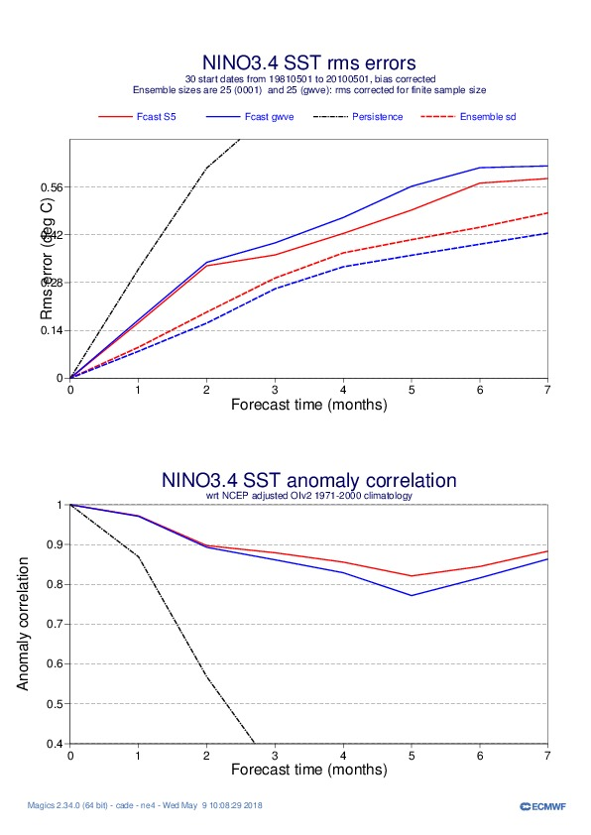
Impact of stochastic physics on SEASONAL Forecasts: SEAS5
Stochastic physics helps to improve reliability of ENSO forecasts:
Reduce RMS error, increase spread
It improves amplitude of MJO
It improves the statistics of tropical cycles. Impact comparable to resolution increase
SEAS5
SEAS5-NoSP
RMSE
ensemble spread
Courtesy of Antje Weisheimer

Slide 23

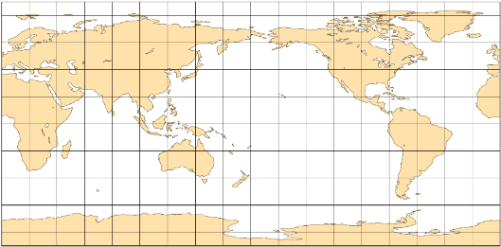
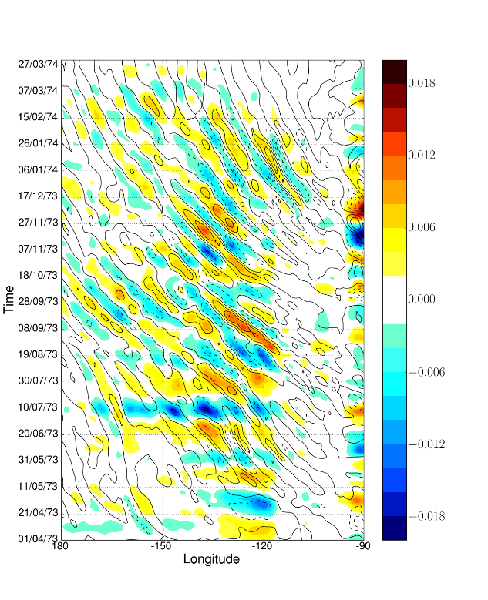
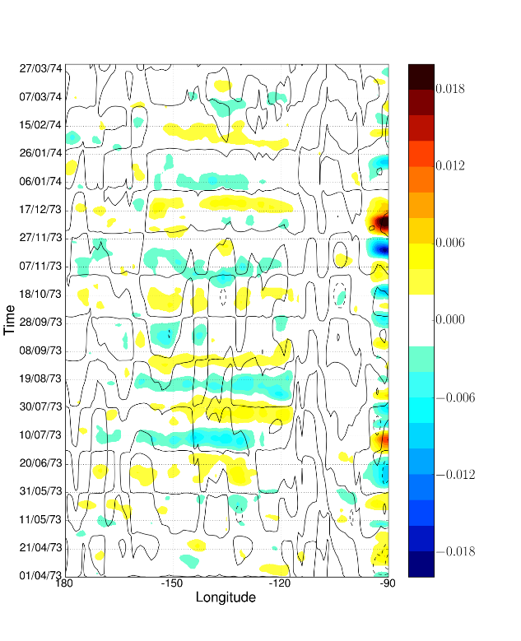
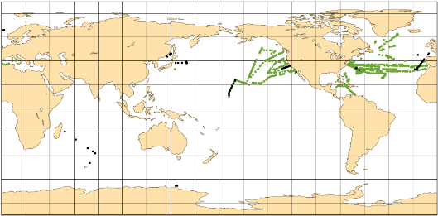
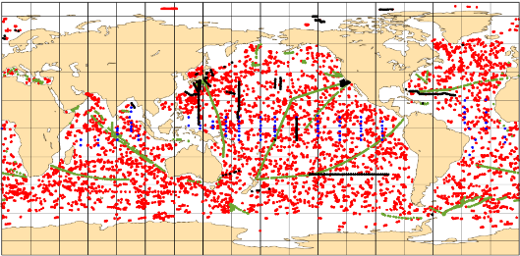
The ECMWF Coupled Reanalyses efforts ensemble of earth system data assimilation
CERA-20C
CERA-SAT
Observation uncertainties
Model uncertainties
Model forcing uncertainties
Reanalysis uncertainties
Ocean temperature obs assimilated in CERA-20C
TIWs in Coupled/Uncoupled reanalysis of the 20th-Century
1901
CERA-20C
ERA-20C
1950
2010
high-pass filtered SST (colour) and wind stress (contour)
Laloyaux et al 2018 Eric de Boisseson

Slide 24
What about the ensemble spread in coupled data assimilation?
Compare ensemble spread of CERA-20C with equivalent uncoupled ocean reanalysis.
Uncoupled: Forcing and SST perturbations . By design, only capture only seasonal dependence
Coupled: Spread generated by coupling. SST from HadISST.
same observations, same data assimilation, same observation perturbations
We diagnose the flow dependence of the spread: Decadal, interannual, intraseasonal
Work in progress

Slide 25
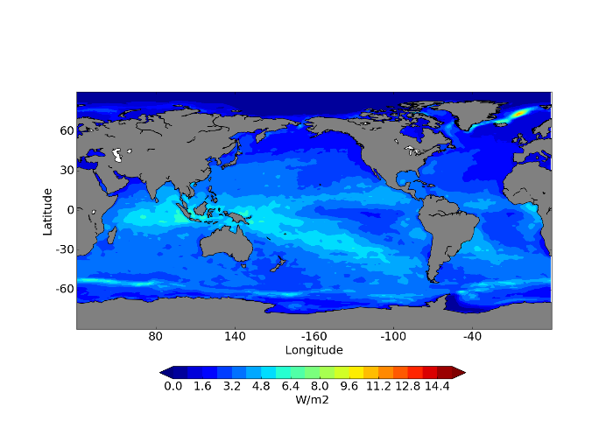
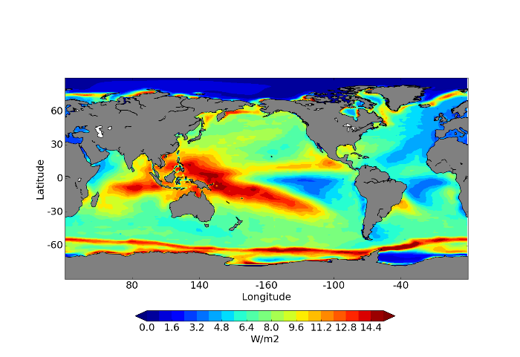
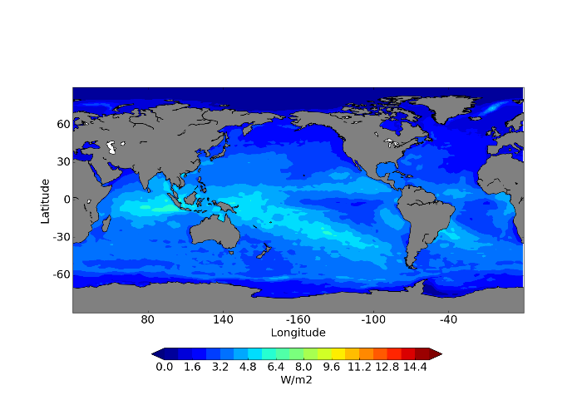
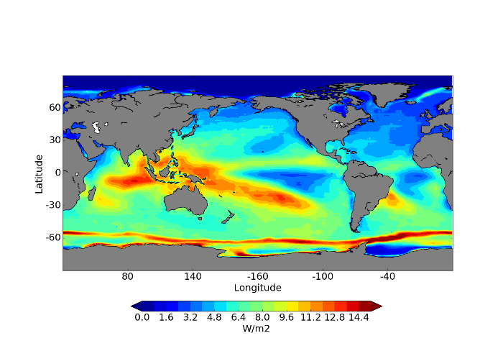
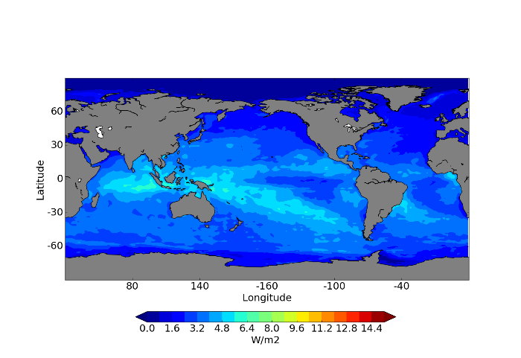
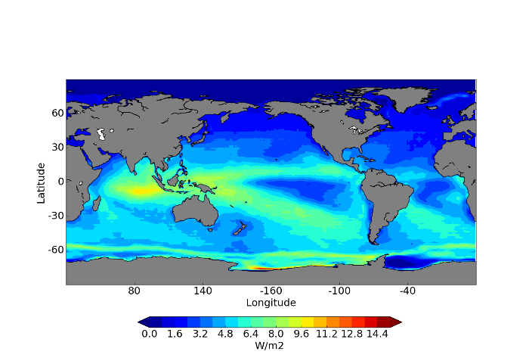

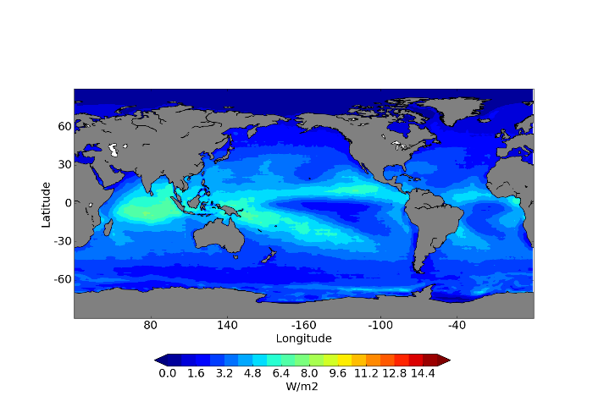
Decadal variations of spread
ORA-20C
Solar radiation
CERA-20C
1900s
1940s
1970s
2000s

Slide 26
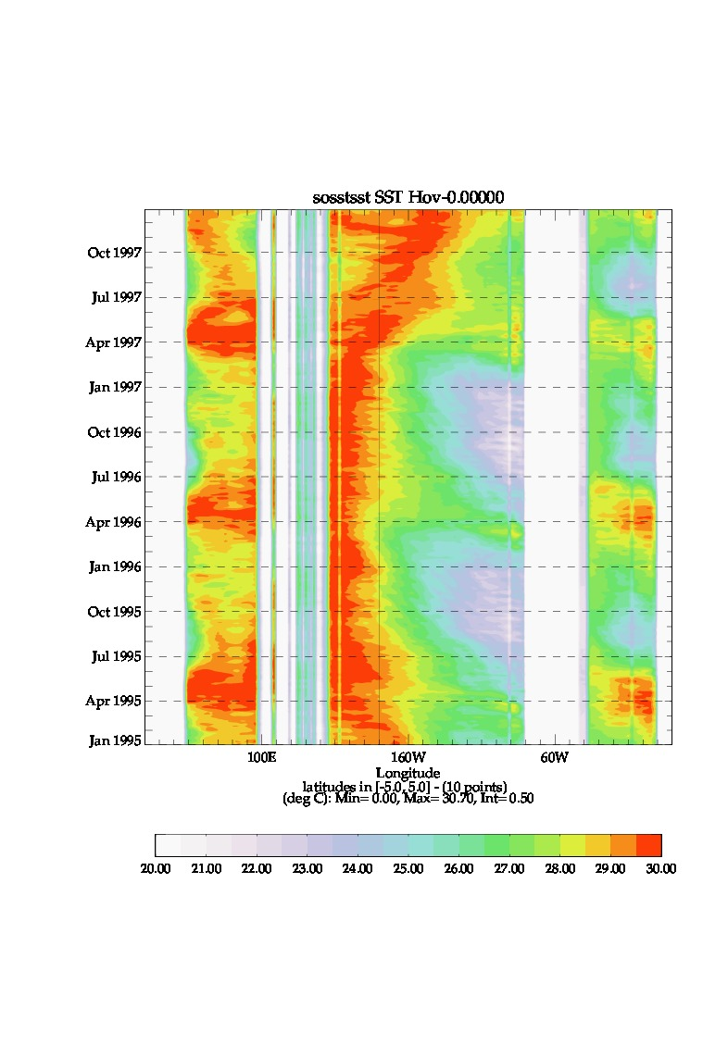
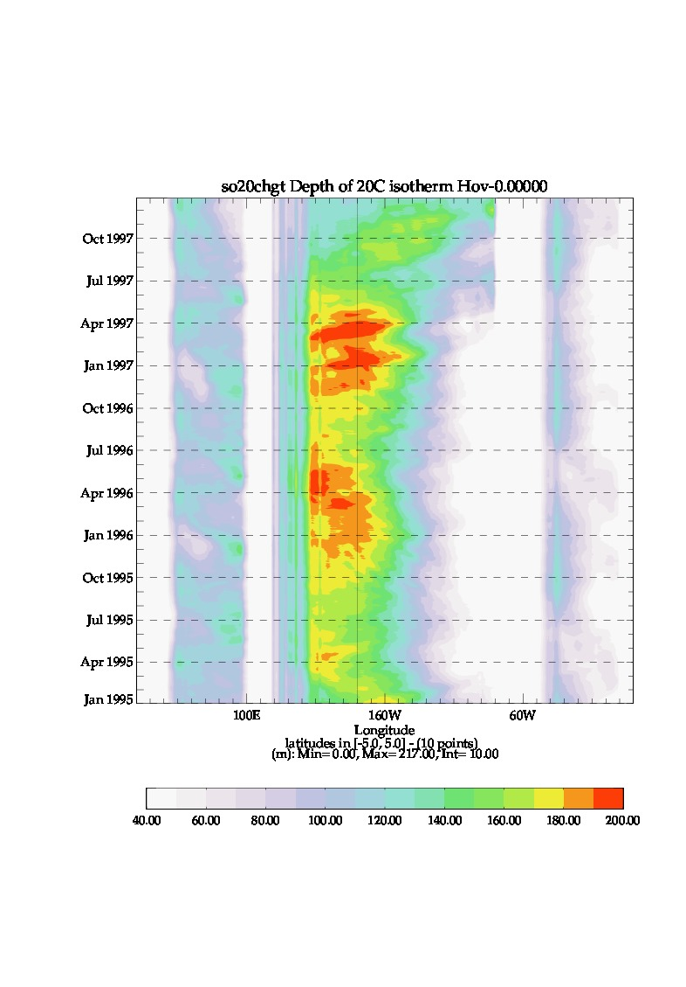
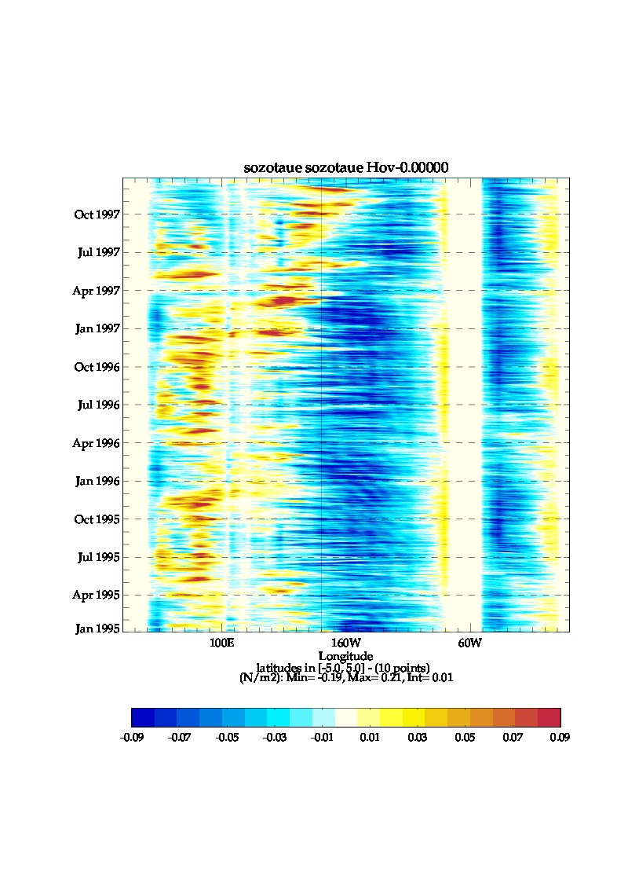
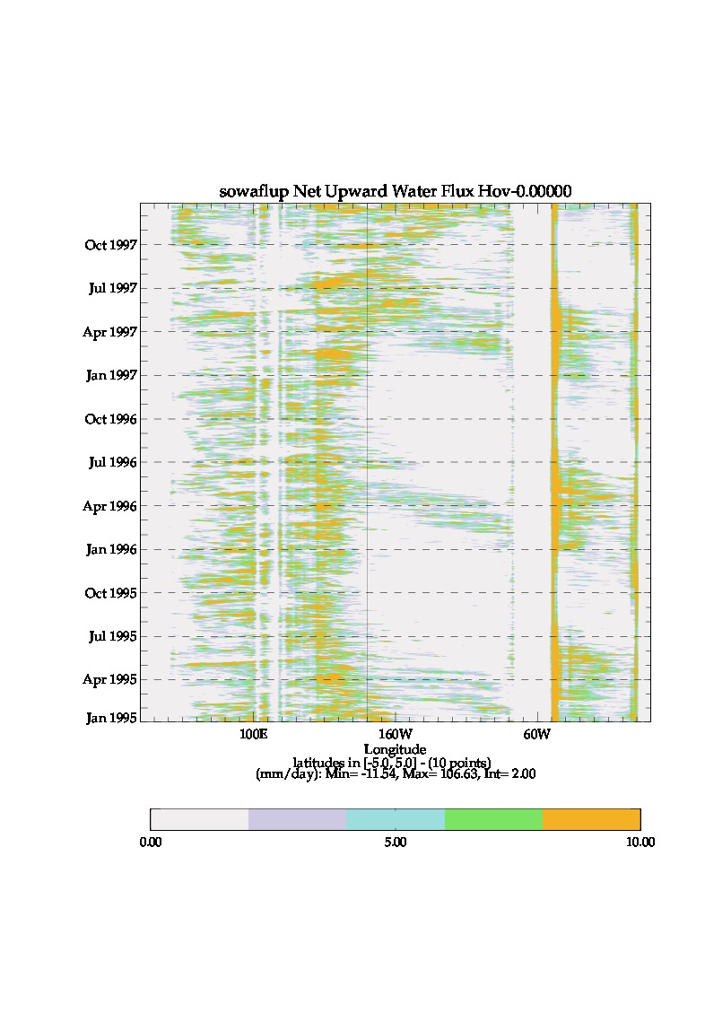
Zoom on 1996-1997: Onset of El Nino
Equatorial daily time series of actual reanalysis fields
SST
Thermocline depth
Zonal Wind Stress
Fresh Water Flux
Coherent behaviour among variables SST-Precipation-Wind and thermocline response
Seasonal cycle, intraseasonal variability and onset of El Nino can be appreciated

Slide 27
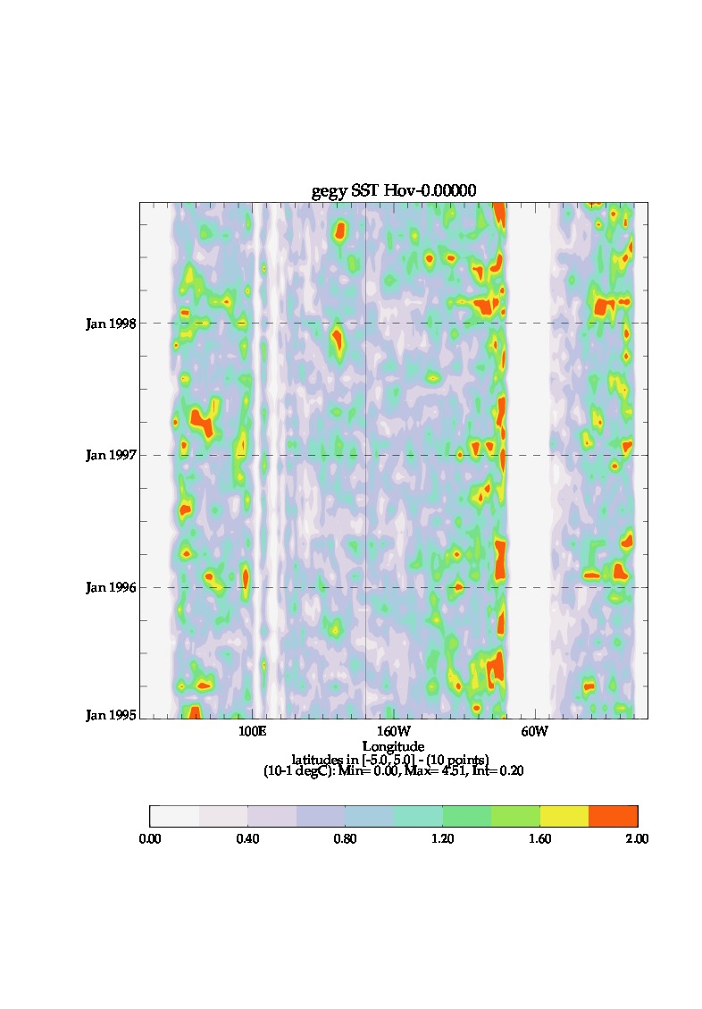
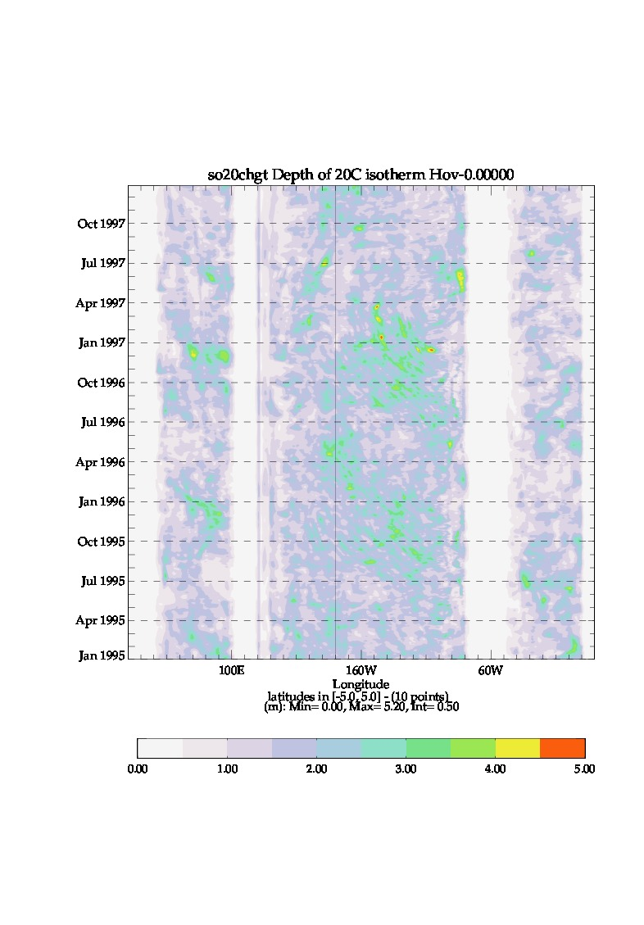
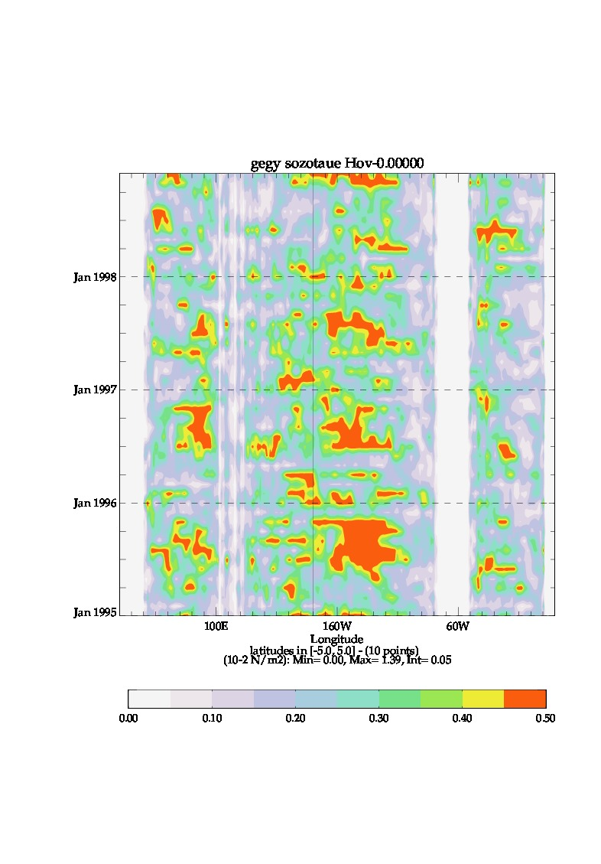
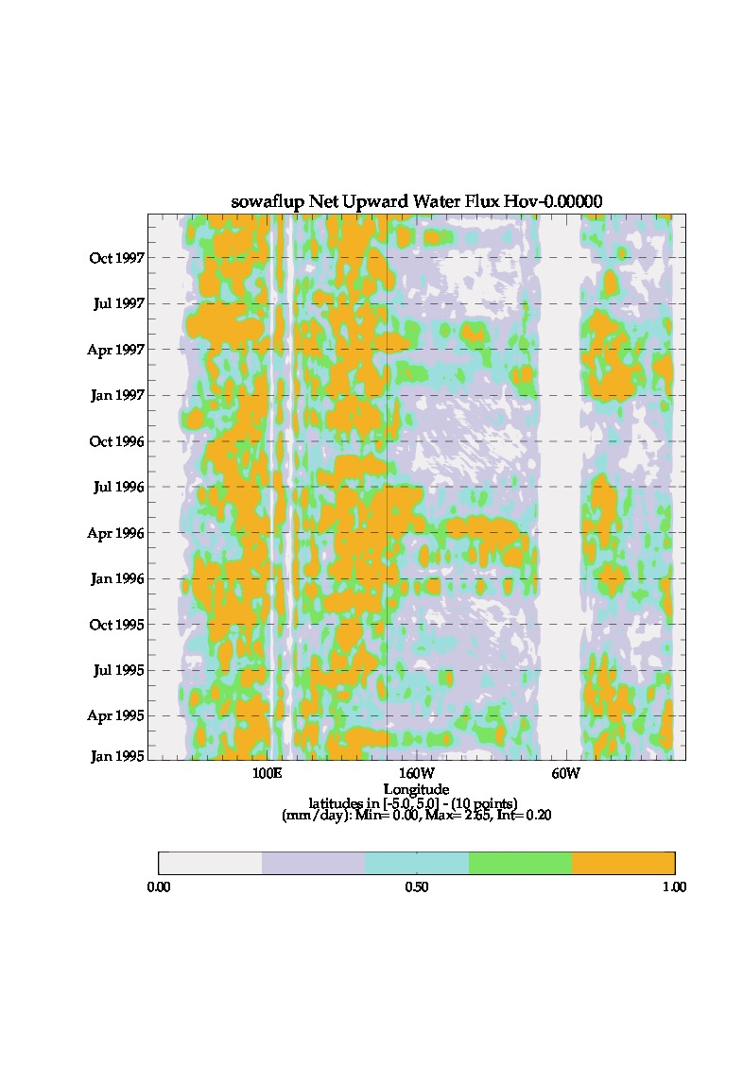
Zoom on 1996-1997: Onset of El Nino
Equatorial daily time series of UNCOUPLED ensemble spread
SST
Thermocline depth
Zonal Wind Stress
Fresh Water Flux
Coherent spread between ocean and atmopheric variables only at seasonal time scales (by design)
Ocean variables -SST and Thermocline depth- spread show intraseasonal –TIWs- and interannual modulation

Slide 28




Zoom on 1996-1997: Onset of El Nino
Equatorial daily time series of COUPLED ensemble spread
SST
Thermocline depth
Zonal Wind Stress
Fresh Water Flux
Artefact:
Monthly modulation of HadISST spread
Artefact:
Spread collapses at TAO mooring locations
Coherent behaviour among variables SST-Precipation-Wind and thermocline at seasonal-intraseasonal-interannual time scales

Slide 29
Zooming on the period 1996-1997
Summary and outlook
Differences between ocean-atmosphere and marine-weather/climate applications
A brief history of the ECWMF ensemble generation in the ocean
Evolution Design Opportunity
The new v3 ensemble generation used in ORAS5
Random thinning allows using more observations in ensemble methods.
A first step towards the EDA in the ocean.
A comparison of ensemble in coupled and uncoupled data assimilation:
The CERA system captures decadal – interannual – subseasonal dependence of spread
New opportunities for increased reliability of coupled forecasts, especially in tropics
Next developments
Hybrid Methods for Coupled Data Assimilation
Stochastic physics in ocean.

Slide 30
EXTRA SLIDES

Slide 31

Impact of stochastic physics: MJO forecasts
Stochastic physics has neutral impact on RMS error
Significant increase in the ensemble spread over entire forecast range
More reliable MJO forecasts
Amplitude is increased by ~10%
 | no stochastic physics | control
SEAS5

Slide 32




Number of tropical cyclones:
Impact of resolution vs stochastic physics
Observations (IBTrACS)
SEAS5
SEAS5 no stochastic physics
SEAS5_lowres

