Slide 1
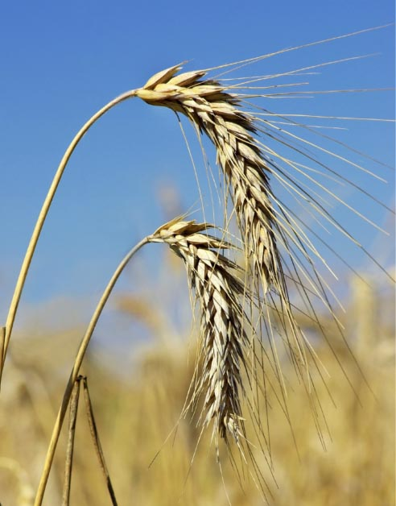
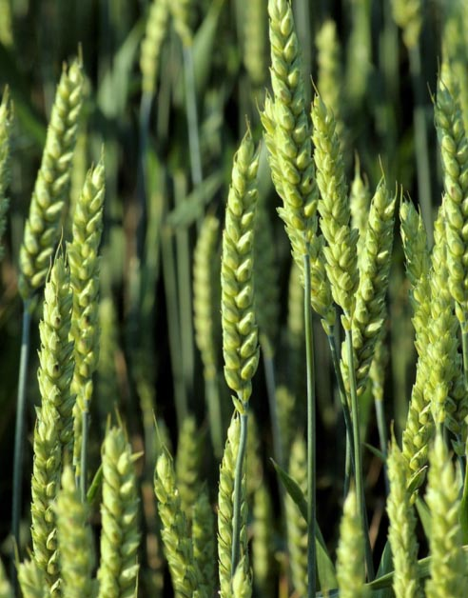
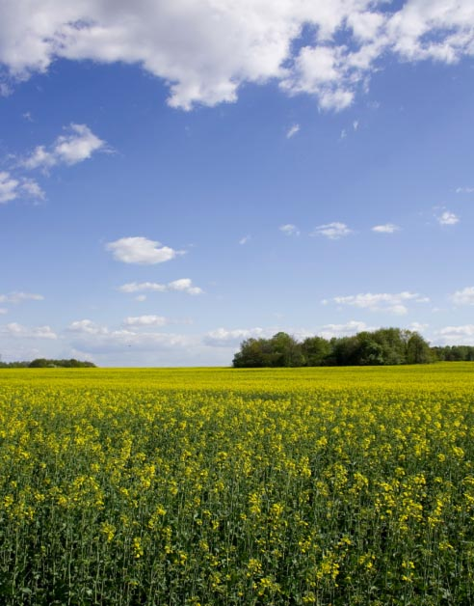

Ensemble forecast products for user decisions on multi-week to seasonal timescales
Debbie Hudson, Oscar Alves, Andrew Marshall, Catherine de Burgh-Day, Morwenna Griffiths, Luke Shelley, Harry Hendon, Andrew Watkins

Slide 2

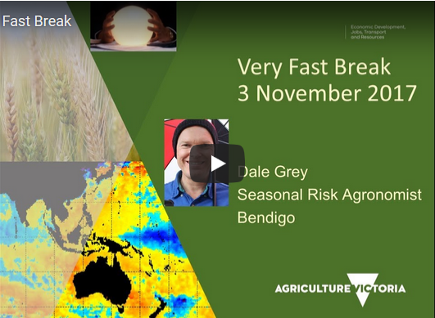
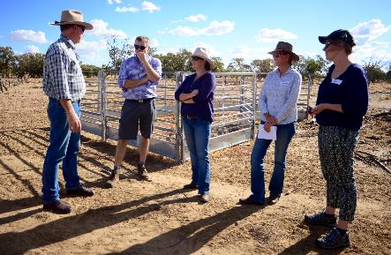
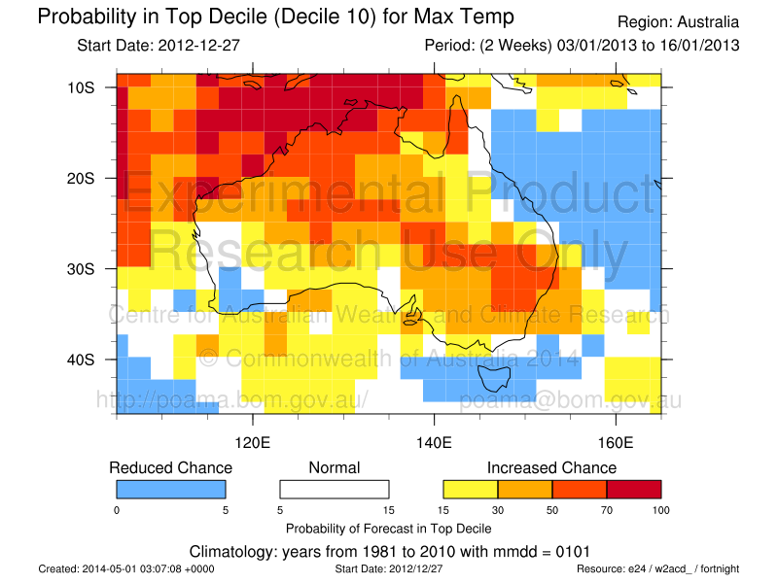
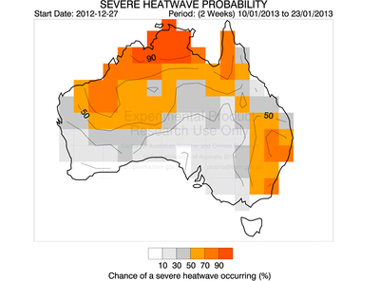
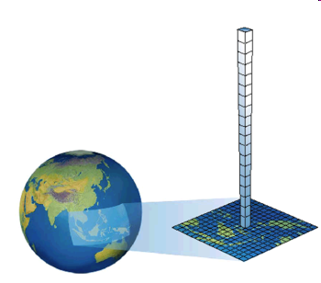
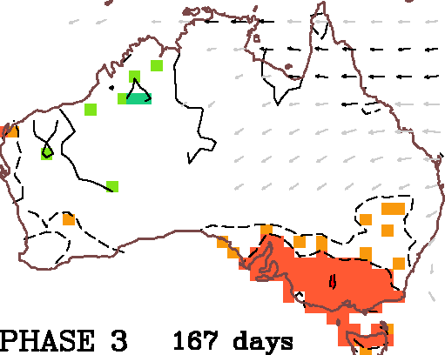
Forewarned is forearmed
Managing the impacts of extreme climate events
Feedback
Work Package 4:
Extension and training
USERS
Work Package 3:
Interfacing to Industry decisions
Adoption
Adoption
Photo: Jennifer Metcalfe, Econnect Communications
Adoption
Feedback
Feedback
Work Package 2:
Extreme forecast products development and delivery
Feedback
Feedback
Research partners
BoM
Univ. Melbourne
Monash Univ.
Univ. S. Queensland
SARDI
DEDJTR
DAFQ
Birchip Cropping Group
Rural RDC & other partners
Meat and Livestock Australia
Grains RDC
Sugar Research Australia
Cotton RDC
AgriFutures Australia
Dairy Australia
Wine Australia
Australian Pork
Work Package 1:
User needs and
Forecast system development

Slide 3
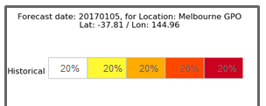

Work Package 2: Developing and delivering forecasts
Work package 2:
Extreme forecast products development and delivery
Develop a range of heat, cold and rainfall experimental extremes forecast products from ACCESS-S on multi-week to seasonal timescales;
Make experimental products available on a research web server for trial and feedback;
Deliver operational forecasts for a subset that have sufficient accuracy and utility. The products will be of broad utility across industries (i.e. not highly tailored for a specific industry).

Slide 4
What is an extremes forecast product?
Forecasting climate extremes
Averaged/accumulated over a period (e.g. week, fortnight, month, season)
e.g., extremely hot month, extremely dry season
Forecasting extreme weather events (beyond the 7-day forecast)
Likelihood of weather events in a given period
e.g., probability of heatwaves, frosts, heavy rainfall events

Slide 5
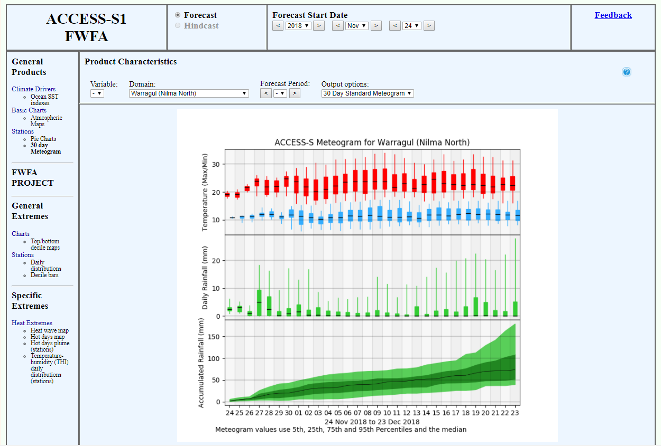
Experimental forecast products
R&D web portal
ACCESS-S
99-member ensemble
Forecasts are updated every day
Outlooks for multi-week (sub-seasonal) and seasonal timescales

Slide 6
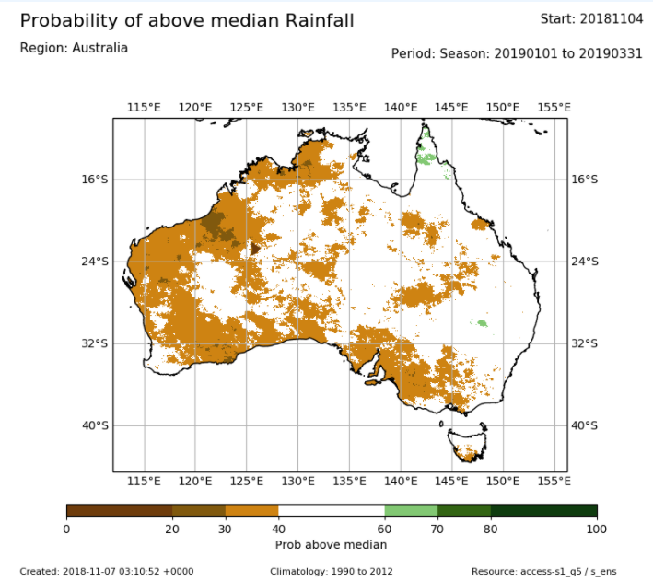
Currently available product operationally is:
Probability of above median
Forecast for JFM 2019 Rainfall

Slide 7
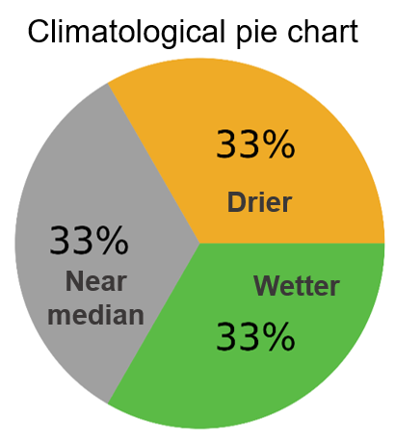
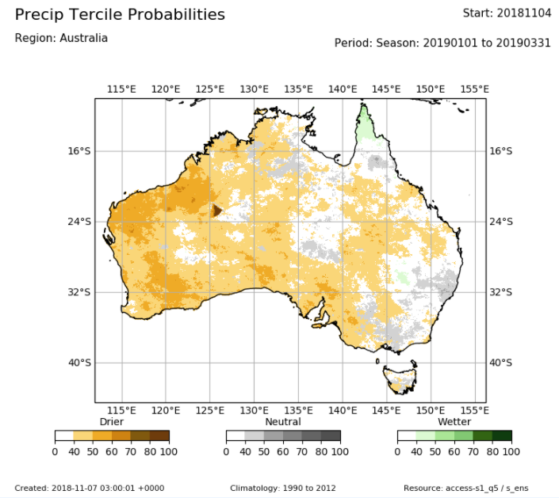

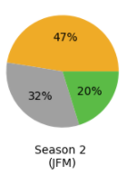
Getting more information from the forecast:
Tercile probabilities
Forecast for JFM 2019 Rainfall: Probability for most likely tercile category

Slide 8
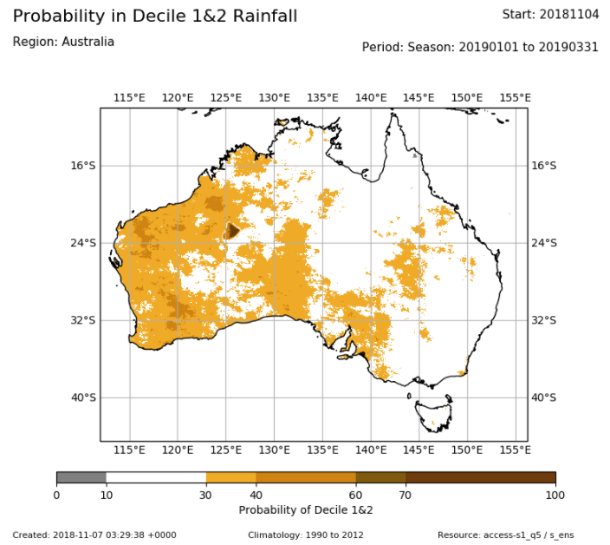
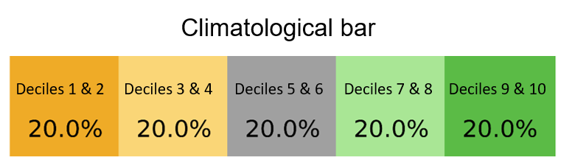

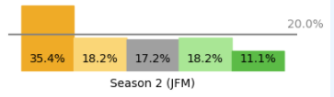
Getting even more information from the forecast:
Chance of being in outer deciles (e.g., very dry)
Forecast for JFM 2019 Rainfall: Chance of being in decile 1&2
Increased likelihood of having Decile 1&2 (brown colours) (i.e. of being amongst the driest fifth of JFM seasons
Climatological expected probability for Decile 1&2 (20%)

Slide 9
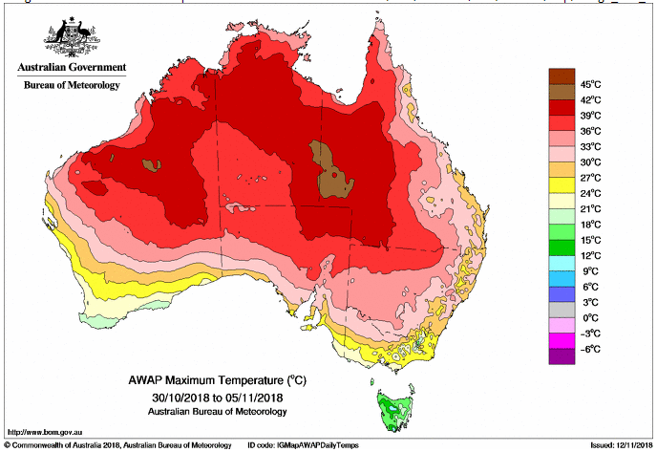
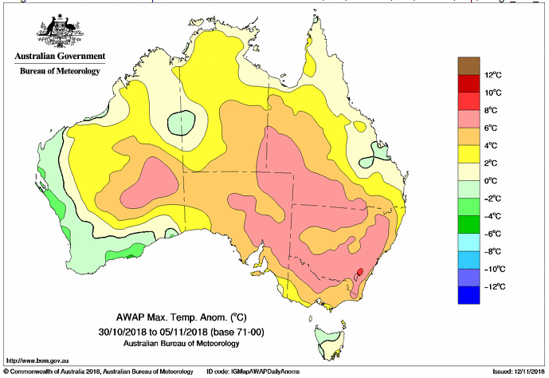
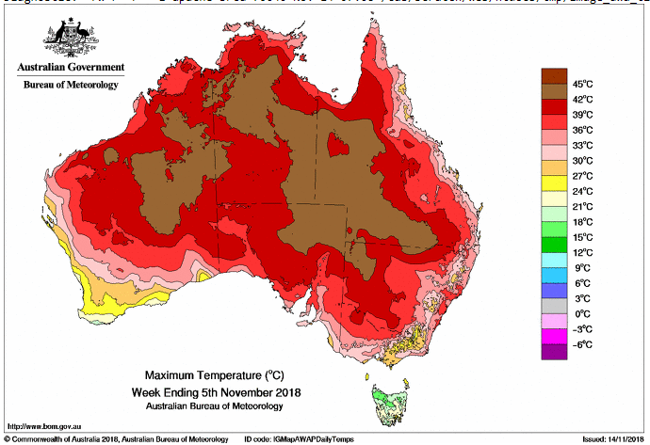
Heat extremes example
Average Tmax for the week
Observed: Week 30 Oct – 5 Nov
Tmax anomaly
Highest Tmax experienced in the week
Notes:
Camden NSW 34.04S, 150.69E Dairy, Red meat – Peak on 2 Nov

Slide 10
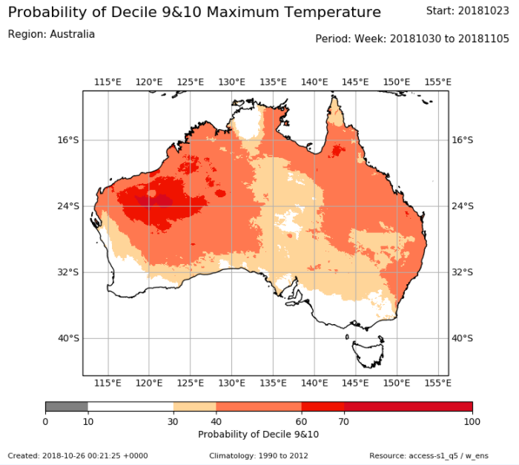
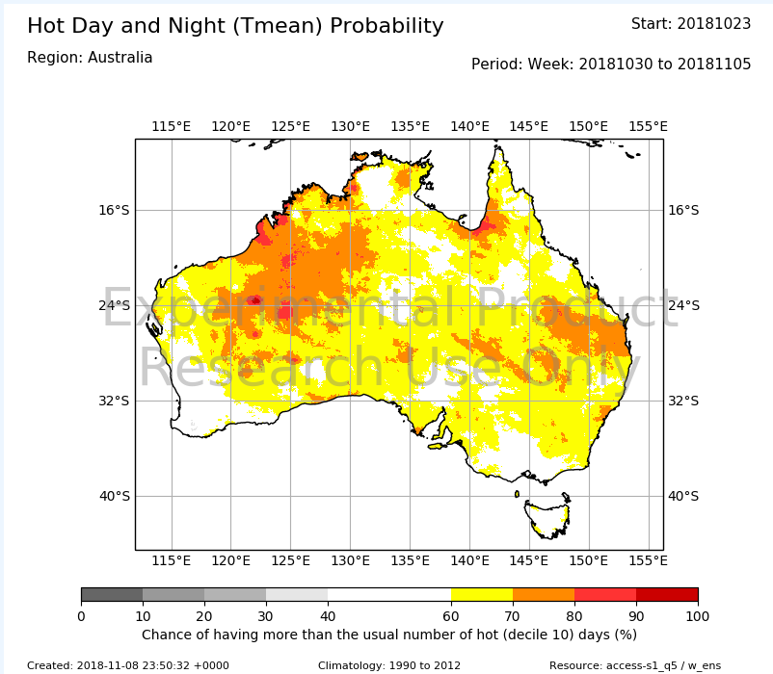
Heat extremes example
Forecast for 30 Oct - 5 Nov (from 23 Oct, i.e., week 2 of the forecast)
Chance of having more hot days+nights than usual in the forecast period
Chance of having a decile 9-10 week
"Hot": decile 10 days
T_{mean} > 90th percentile threshold of observed daily T_{mean}
The days do not have to be consecutive

Slide 11
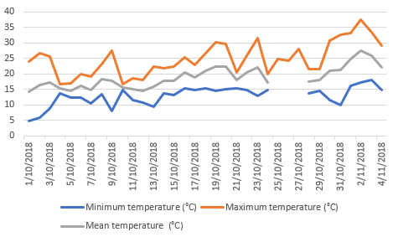
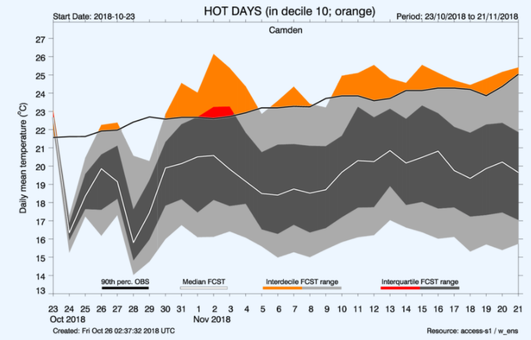
Camden (NSW)
OBSERVATIONS
34.04S, 150.69E
Black line: The observed 90th percentile threshold of daily T_{mean}
Calculated by looking back over the historical period for the particular time of year. 10% of days are hotter than this threshold for the given time of year.
Increased hot day risk: "Orange" if some of the forecast ensemble are forecasting temperatures exceeding the historical (climatology) 90th percentile
This is the 75th percentile i.e. more than 25% of the ensemble are forecasting temps > historical (climatology) 90th percentile. The chance of "hot days" is 25% (i.e., more than double the normal risk, which is 10%)
FORECAST from 23 Oct
The "plume" is the forecast
White line: middle (median) value of the forecast ensemble
Dark grey: interquartile range (between the 25th and 75th percentiles of the forecast ensemble). 50% of the forecast distribution have values in this range.
Light grey: interdecile range (between the 10th and 90th percentiles of the forecast ensemble). 80% of the forecast distribution have values in this range.

Slide 12
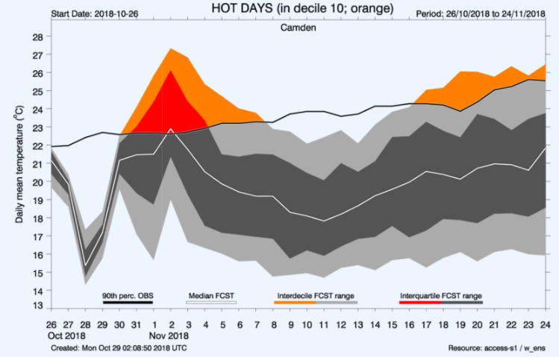
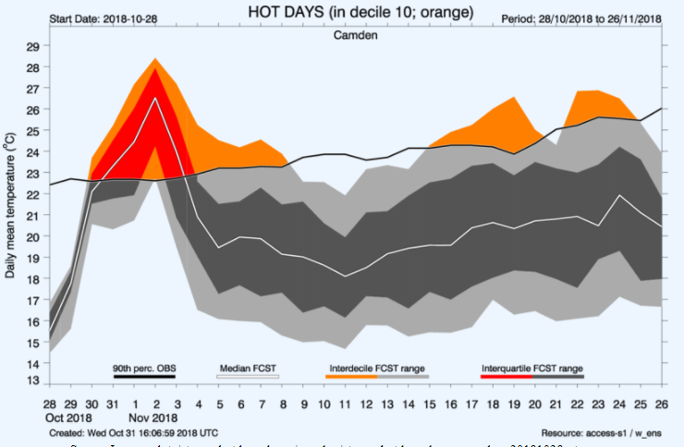

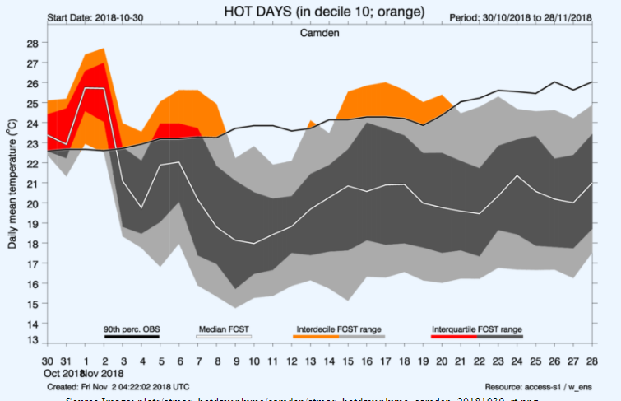
OBSERVATIONS
Camden (NSW)
34.04S, 150.69E
FORECAST from 23 Oct
FORECAST from 26 Oct
FORECAST from 28 Oct
FORECAST from 30 Oct
Risk = probability x impact

Slide 13
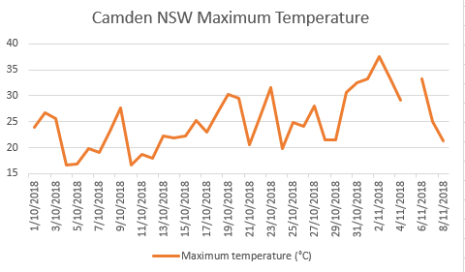
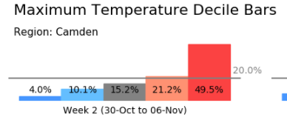
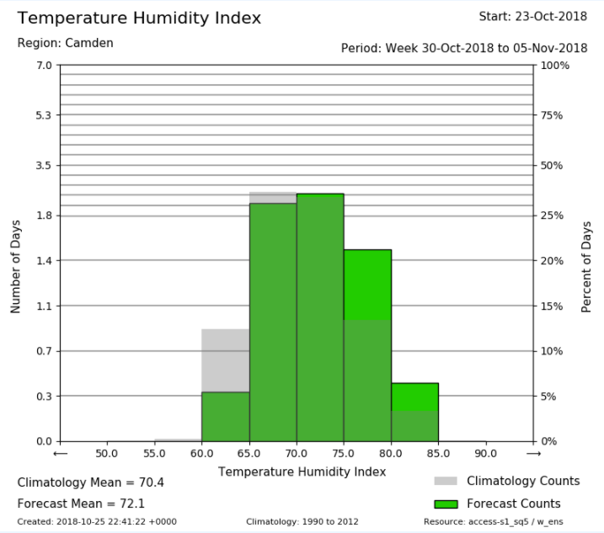
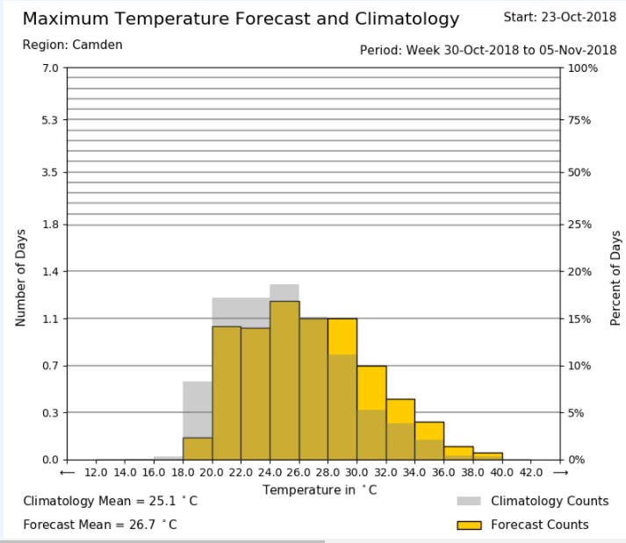
Camden (NSW)
OBSERVATIONS
34.04S, 150.69E

Slide 14
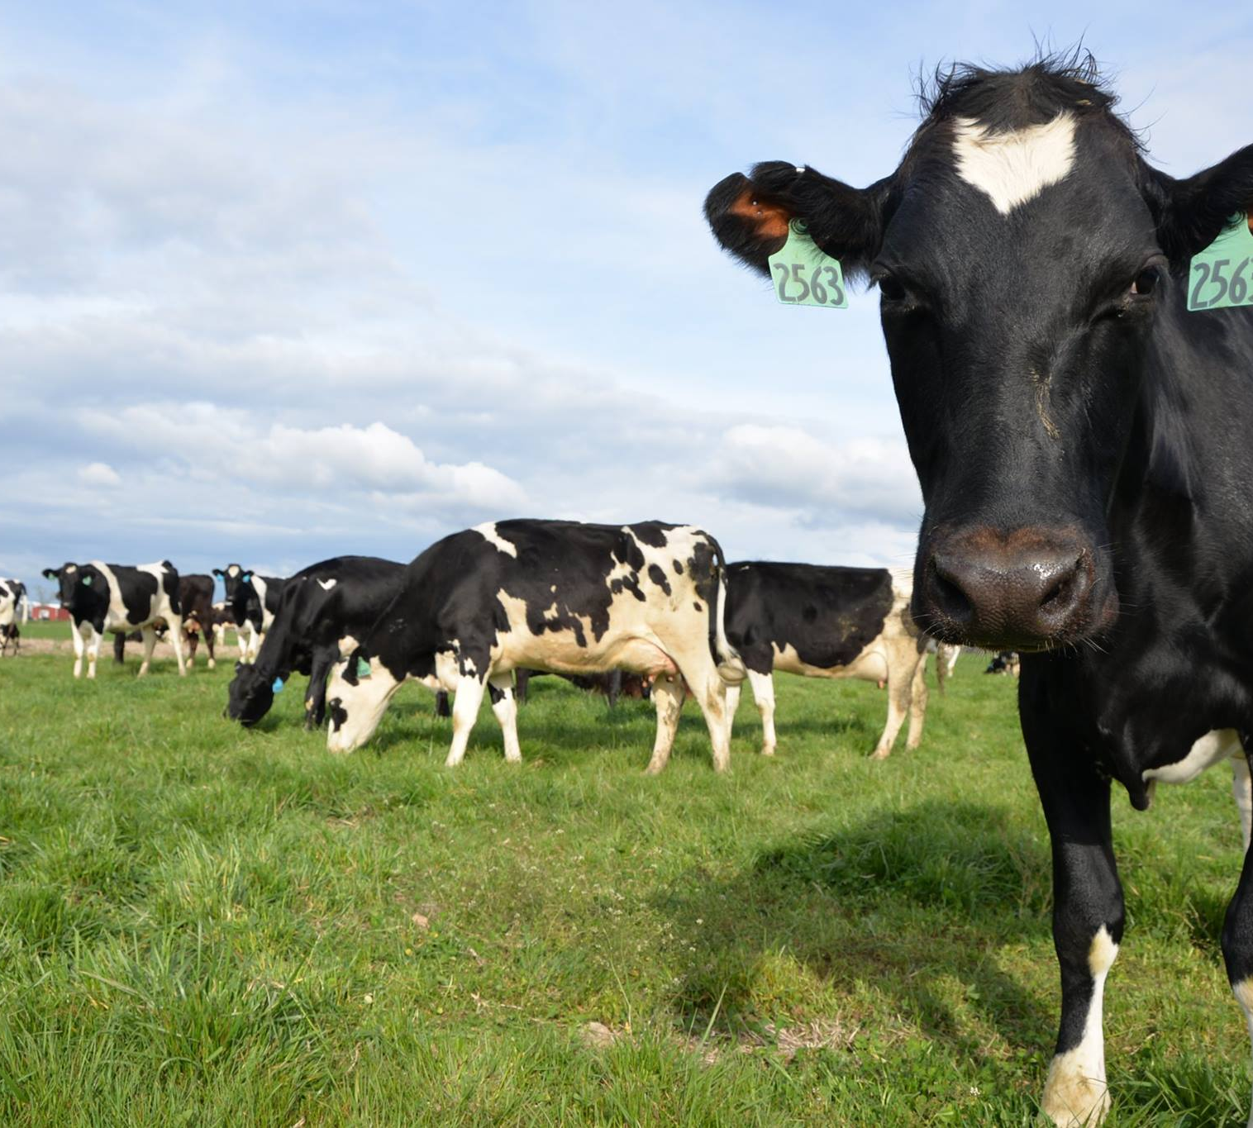
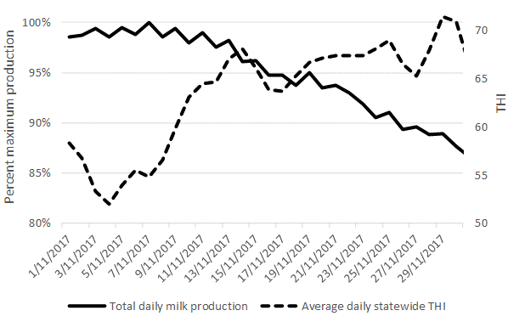
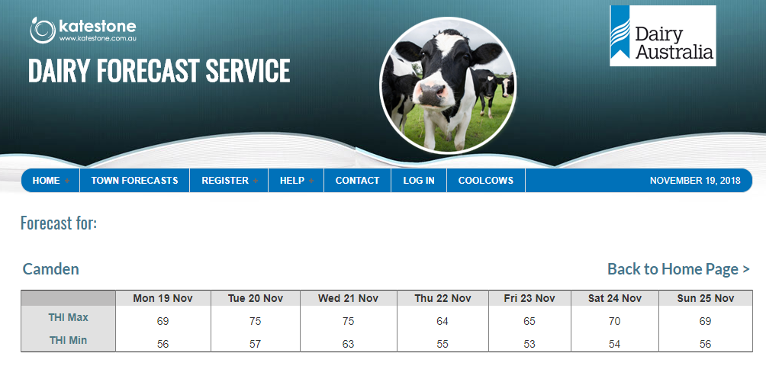
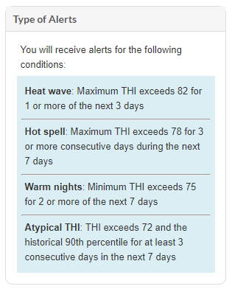
THI used by Dairy Industry
Heatwaves affect milk composition and production
Example: Nov 2017 Victorian heatwave
https://coolcows.dairyaustralia.com.au/
https://dairy.katestone.com.au/
2nd hottest November on record
12% decline in milk production from the first to last week
A loss of 2,500 litres/average farm
From: Richard Eckard, University of Melbourne

Slide 15
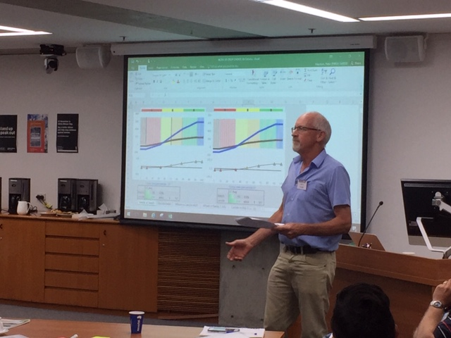
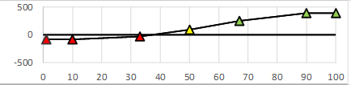
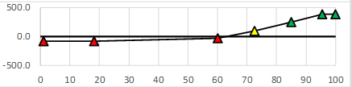
Ensemble forecasts and decision-making
Peter Hayman (SARDI) and Barry Mudge (Barry Mudge Consulting)
Barry Mudge (1/11/18)
Example: Planting vetch for sheep to graze OR lentils to be harvested
Profit ($/Ha)
Lentils
Profit ($/Ha)
Lentils
Vetch
Vetch
Difference
Difference
Profit ($/Ha) as a function of growing season rainfall decile (percentile)
Compare "downside risk" and "upside benefit" wedges
The upside benefit of planting lentils far outweighs the downside risk
How does a forecast change the expected outcome?
downside risk increases with increased chance of being dry
60% of the time vetch is better
BUT downside risk is still outweighed by potential gains if normal/wet season eventuates. For risk neutral farmer, lentils are still better

Slide 16
Some key challenges (BoM perspective)…
Communicating probabilities
2015/16 engagement: User comprehension is linked with user satisfaction i.e. those that answered comprehension questions incorrectly were 3 times as likely to be dissatisfied with the service
Conveying accuracy/skill
Forecast quality does not necessarily reflect value
Summary skill measure (average over hindcasts). Does not show windows of forecast opportunity
Large sampling uncertainty around scores of most interest
Hindcast ensemble size (e.g., 11-members) is smaller than real-time (e.g., 99-members)
The years included in hindcast period will influence the skill
Data for data assimilation is more sparse as go back in time
Seamless forecasts – integrating with the NWP forecast

Slide 17
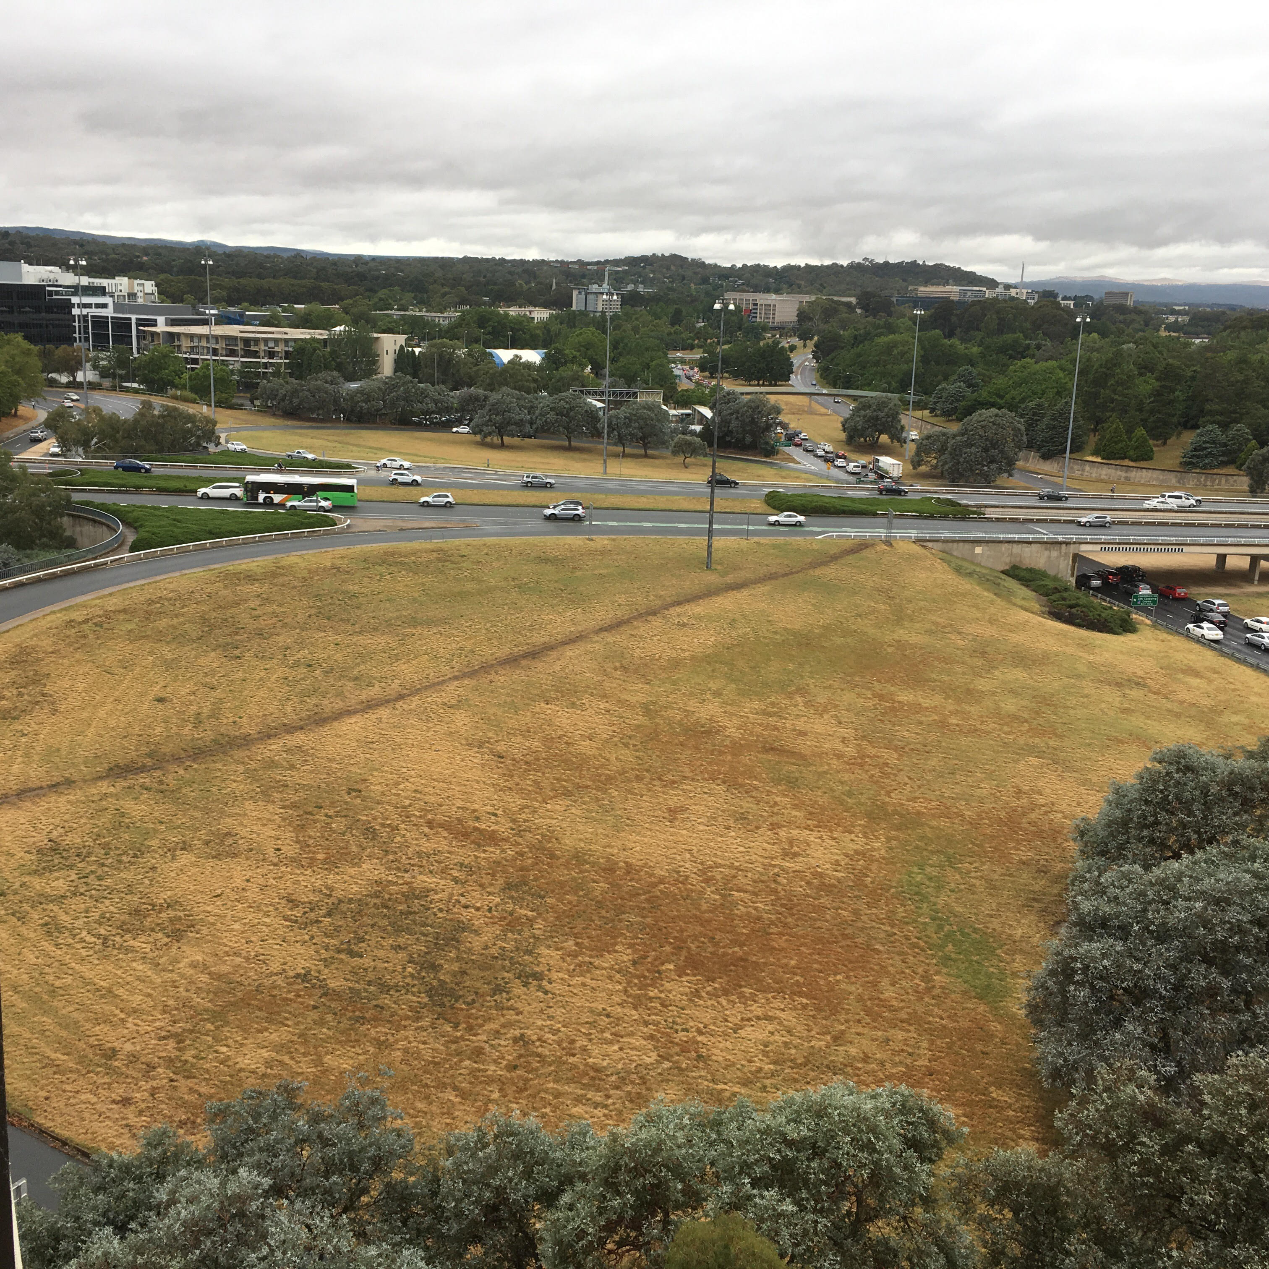
Why consult with users and have partnerships?
No matter how accurate a weather forecast or climate outlook is:
If it doesn’t provide information users need
If it isn’t issued when users are making their critical decisions
If it is misinterpreted
If it cannot help make a decision….
*The forecast has little real value
The sidewalk
the user wants
The sidewalk that
was built
Canberra 2017

Slide 18
Partnerships with users will become increasingly important in order to unlock the true potential and value of multi-week and seasonal forecasts
Thank you…
Debbie Hudson
03 9669 4796
Debbie.Hudson@bom.gov.au

