Slide 1

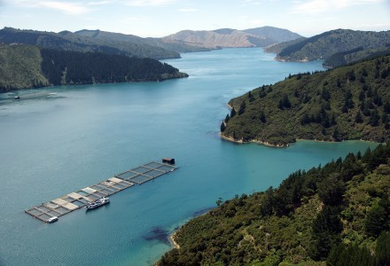
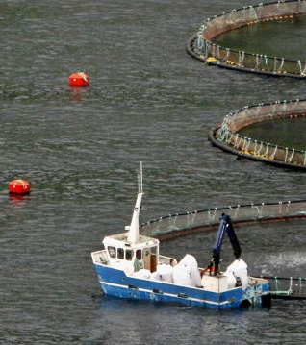
ACCESS-S1 ocean forecast products for marine industry applications in New Zealand
BoM R&D Workshop
November 2018
Catherine de Burgh-Day Claire Spillman, Craig Stevens, Graham Rickard, Oscar Alves

Slide 2
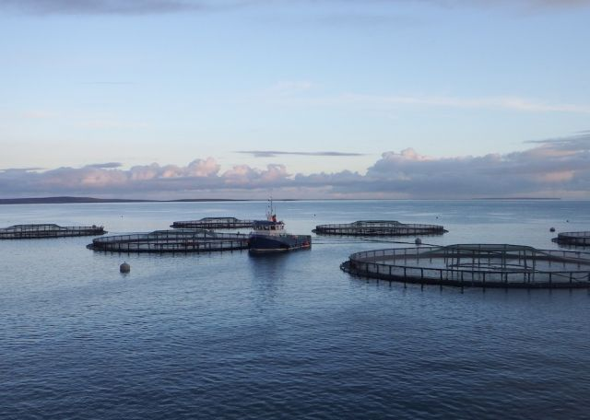
OCForNZ – Ocean Forecasts for Marine Industries in New Zealand
3 year collaborative research project between the Australian Bureau of Meteorology and NIWA
Develop experimental ocean forecast products for NZ (initial focus on SST-derived forecasts for aquaculture)
Provide early warning of extreme events such a marine heat waves
Multiweek to seasonal timescales
Using ACCESS-S1 model

Slide 3
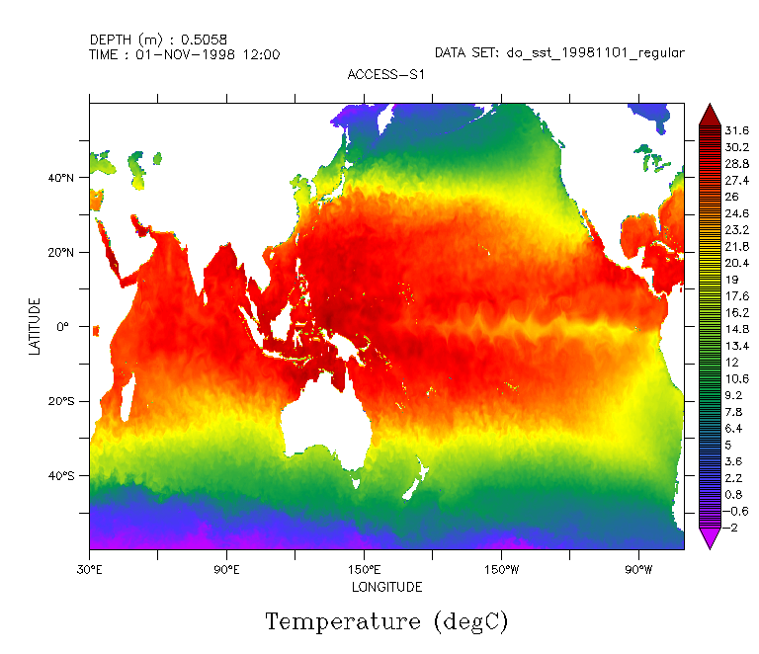
Australian Community Climate & Earth System Simulator – Seasonal V1
New Bureau seasonal ensemble forecast system
Dynamical global coupled ocean-atmosphere model
99 ensemble members
UKMO collaboration
Ocean model: NEMO
Horizontal: 25km x 25km
Vertical: 1 m near the surface to ~200 m near bottom (6000 m depth)
Eddy permitting
Hindcast dataset 1990-2012 (11 ensembles)
Animation: Xiaobing Zhou. Ocean model: NEMO/NEMOVAR (Waters et al 2015)
Notes:
S1: As is is from UKMO, including their initial conditions. We are running longer hindcast and more start dates.
S2: Local enhancements, ensemble generation scheme, coupled data assimilation??
NEMOVAR assimilates satellite and in situ sea-surface temperature (SST) observations, in situ temperature and salinity profiles, altimeter sea-level anomaly (SLA) observations and satellite sea ice concentration (Waters et al 2015)
• Satellite SST data from the Advanced Very High Resolution Radiometer (AVHRR) onboard the NOAA and MetOp satellites, Advanced Along-Track Scanning Radiometer (AATSR) and Advanced Microwave Scanning Radiometer–Earth Observing System (AMSRE) instruments. These are obtained through the Group for High-Resolution Sea-Surface Temperature (GHRSST) project (http://www.ghrsst.org). These are L2P data (swath data), which have been spatially averaged prior to assimilation using a 13 km radius. The foundation SST is assimilated in FOAM, so SST observations with diurnal warming are excluded by using
only observations made at night or in high winds.
• Surface temperature in situ data from ships, moored and drifting buoys, available over the Global Telecommunications System (GTS).
• Along-track altimeter sea-level anomaly (SLA) data from the Jason-1, Jason-2 and Envisat satellites, provided by Aviso/CLS http://www.aviso.oceanobs.com).
• In situ temperature and salinity profile data from the EN3 dataset (Ingleby and Huddleston, 2007).
• Sea ice concentration data from Special Sensor Microwave Imager (SSM/I) satellites provided by EUMETSAT OSISAF (http://osisaf.met.no).

Slide 4
ACCESS-S1 Skill Evaluation
First step in developing OCForNZ Products is to assess skill around New Zealand
SST and 300m Heat Content
Seasonal, monthly and multiweek
Ensemble mean skill:
Spatial and for regional indices
Pearson correlation coefficient and RMSE
Compare the model to persisted observations (is the model skilful over persistence)
Probabilistic Skill
Regional Indices only
Reliability Diagram and ROC
Drivers of skill in the model

Slide 5
ACCESS-S1 Skill Evaluation
First step in developing OCForNZ Products is to assess skill around New Zealand
SST and 300m Heat Content
Seasonal, monthly and multiweek
Ensemble mean skill:
Spatial and for regional indices
Pearson correlation coefficient and RMSE
Compare the model to persisted observations (is the model skilful over persistence)
Probabilistic Skill
Regional Indices only
Reliability Diagram and ROC
Drivers of skill in the model
Spatial Ensemble mean skill:
de Burgh-Day, C. O., Spillman, C. M., Stevens, C., Alves, O., & Rickard, G. (2018). Predicting seasonal ocean variability around New Zealand using a coupled ocean-atmosphere model. New Zealand Journal of Marine and Freshwater Research, 1-21.
Regional Skill:
In preparation…

Slide 6
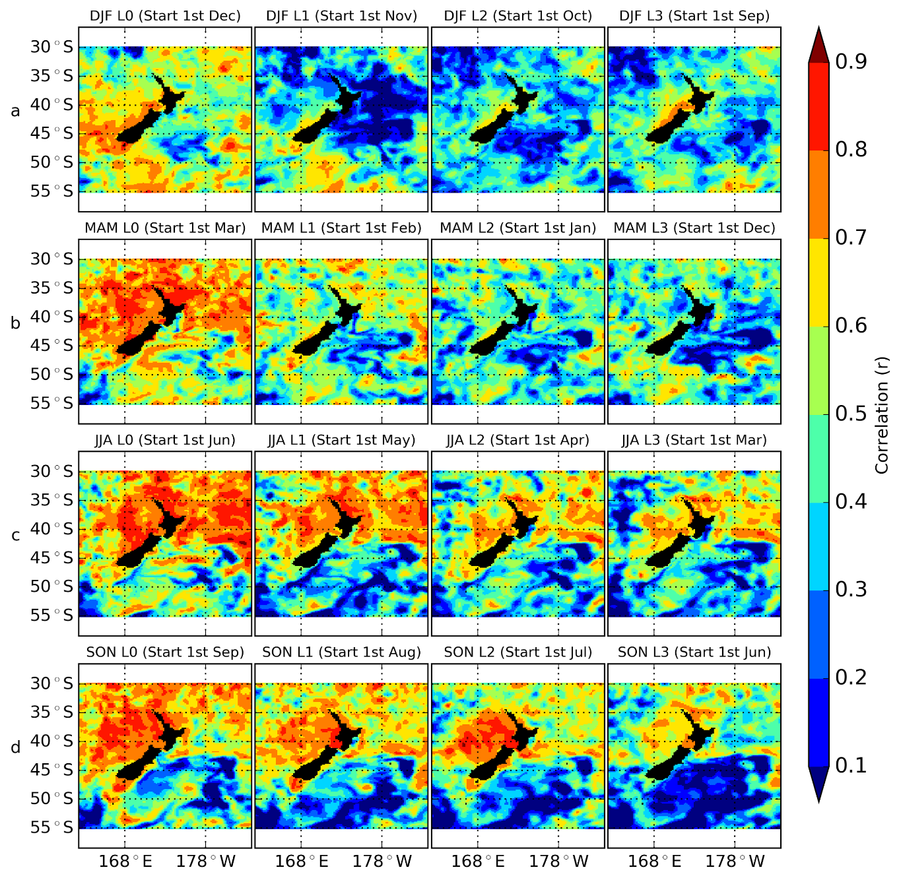
Ensemble Mean Spatial SST Skill: e.g. Seasonal
From lead 0 months
From lead 1 month
From lead 2 months
From lead 3 months
Model Seasonal prediction vs Reynolds AVHRR V2 OI SST
Correlation across hindcast years (1990-2012)
Better skill at shorter lead times
Better skill in the North and West vs South and East
Higher correlation inshore vs offshore. E.g. % grid cells with correlation > 0.6:
Summer
Statistically significant
Autumn
Winter
Region | Inshore | Offshore
Summer L0 | 66% | 44%
Autumn L0 | 73% | 60%
Winter L0 | 78% | 53%
Spring L0 | 77% | 47%
Not statistically significant
Spring
6
Figure: de Burgh-Day et. al. 2018

Slide 7
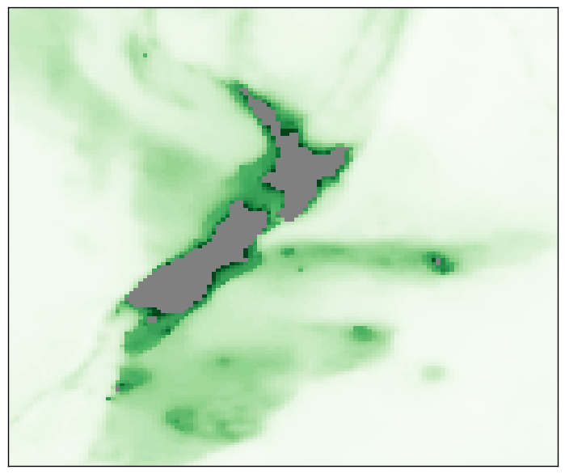
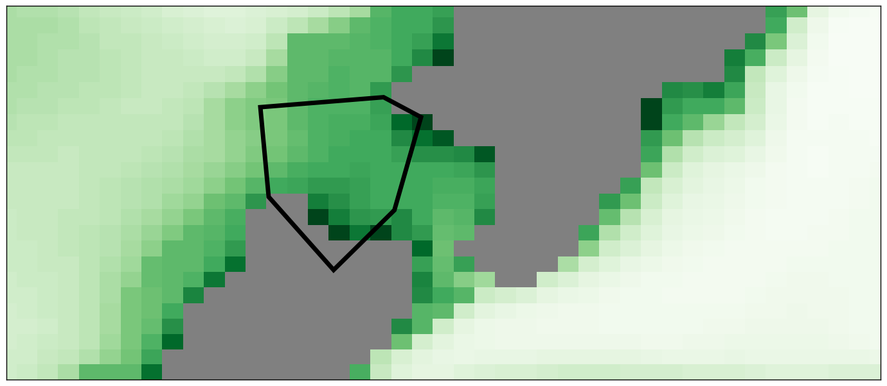
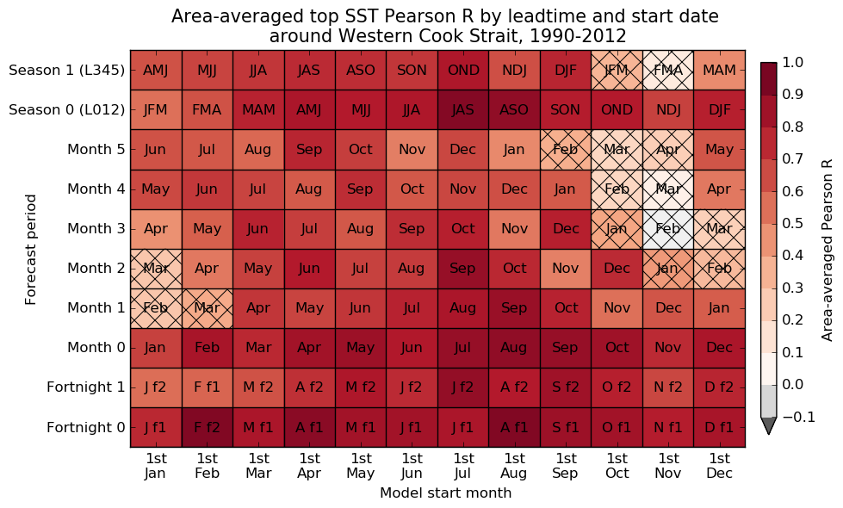
Ensemble Mean Regional SST Skill: e.g. Western Cook Strait
Model vs. Reynolds AVHRR V2 OI SST
Correlation of area averaged SST anomalies across hindcast years (1990-2012)
Hatched boxes: not statistically significant
Better skill at shorter lead times
Better skill in the cooler months
Drop in skill around seasonal transitions (feedback processes)

Slide 8
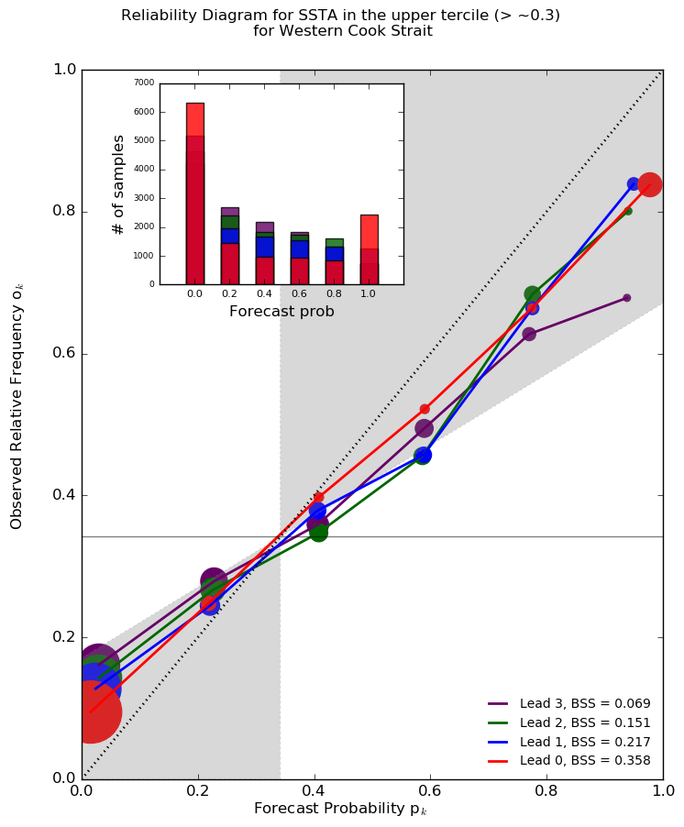
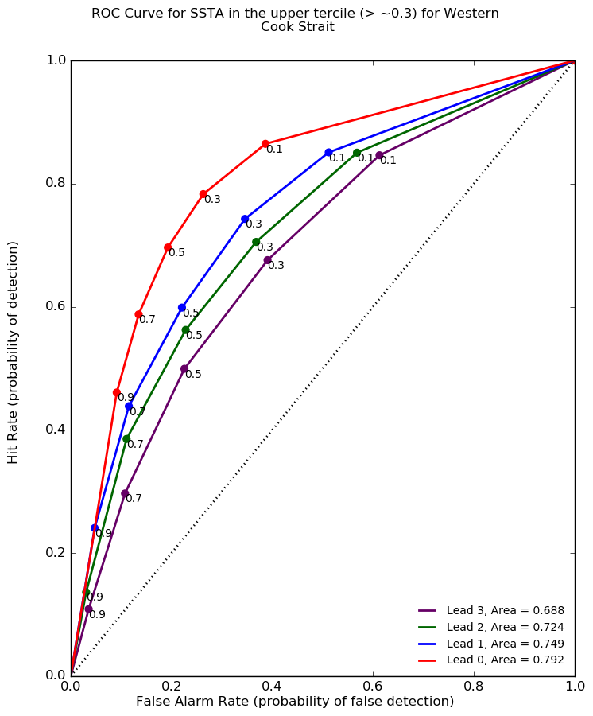
Regional Probabilistic SST Skill: e.g. Western Cook Strait
E.g.: Forecasting for SST Anomalies in the upper tercile
Reliability Diagram
ROC
Observed Relative Frequency
Hit Rate
Forecast Probability
False Alarm Rate
Notes:
Reliability Diagram
– do we do a good job forecasting the likelihood of an event given the observed frequency of occurrence
- A perfect forecast would be on the 1:1 line. Anything in the grey shaded area is doing pretty well
ROC
– given we forecast an event as happening if it's over a probability threshold, how often is that forecast correct, and how often was it a false alarm?
- Anything above the 1:1 line is better than climatology

Slide 9
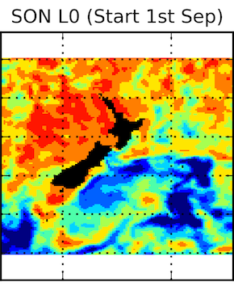
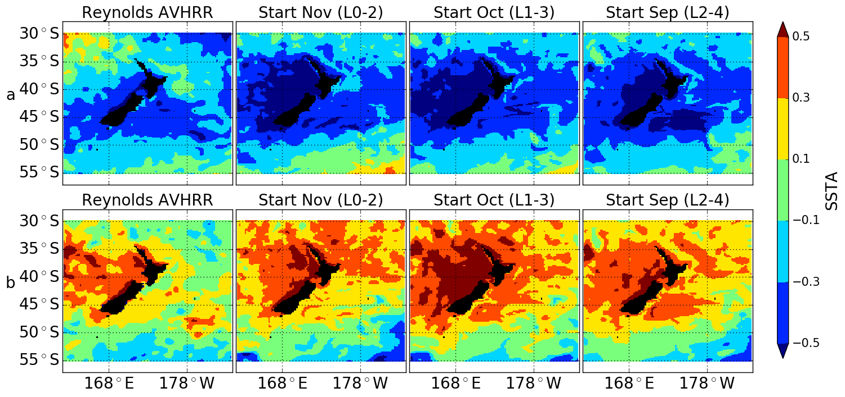
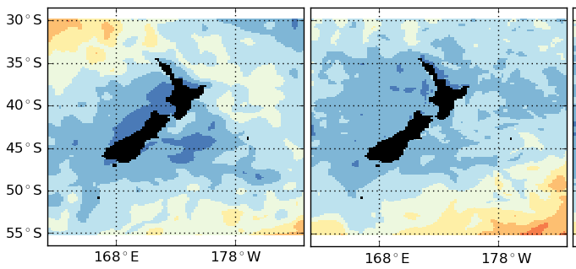
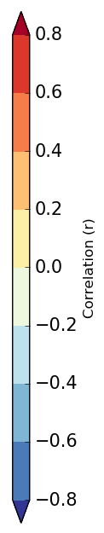
Drivers of Skill
Skill is better where currents are simple
Skill is poorer
Where currents are complex
In the south where the Southern Ocean warm bias affects the GC2 model
Model derives skill from ENSO: Teleconnections are good
Model loses skill because the magnitude of the ENSO response is too large
ACCESS-S1 Lead 012
Reynolds Obs
Composite El Nino
NDJ Nino3.4 correlated with NDJ SST
Reynolds Obs
ACCESS-S1 Lead 012
Composite La Nina

Slide 10
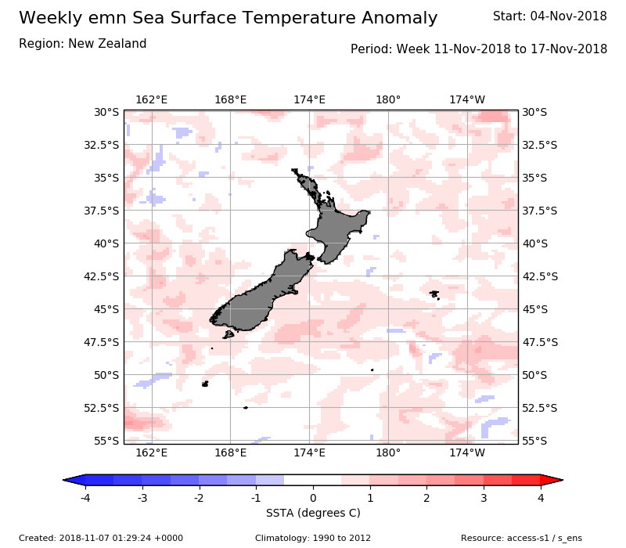
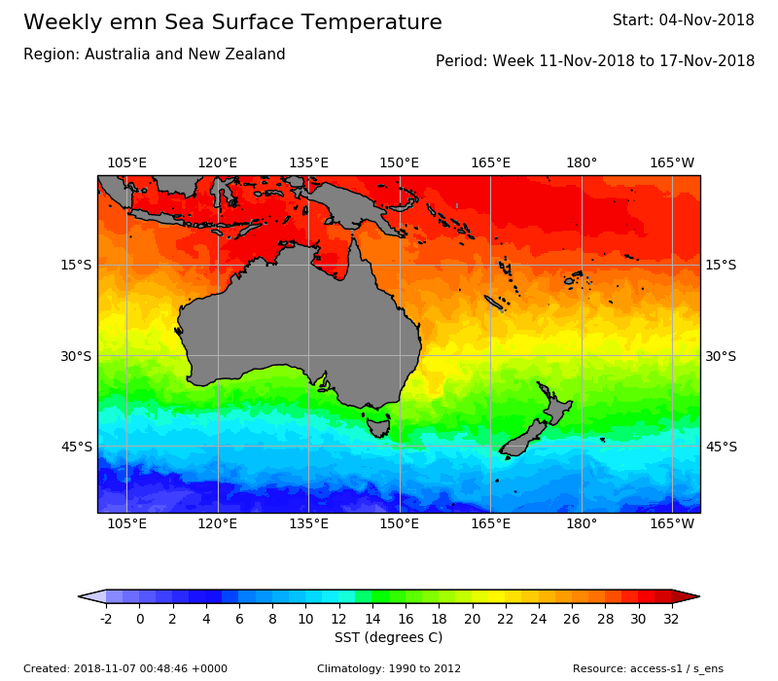
Trial Products
Ensemble mean SST and SSTA maps

Slide 11
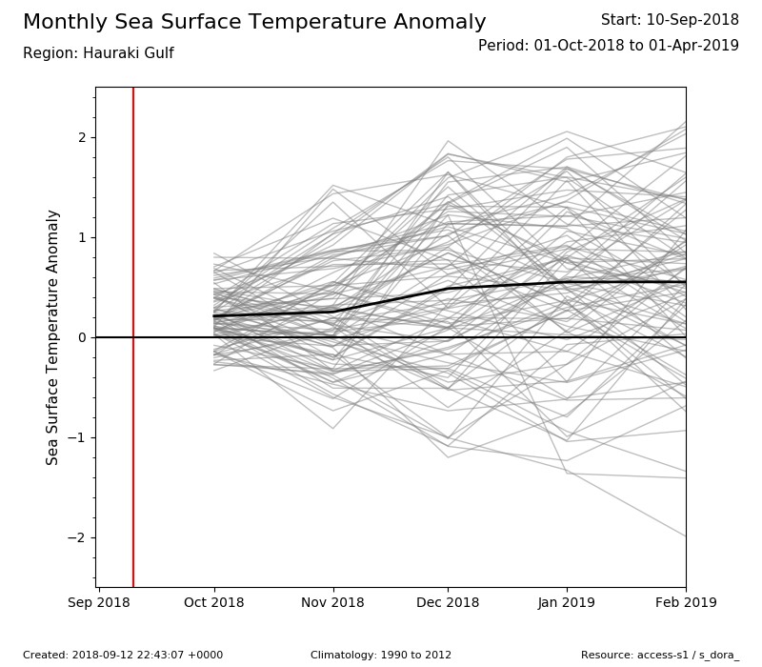
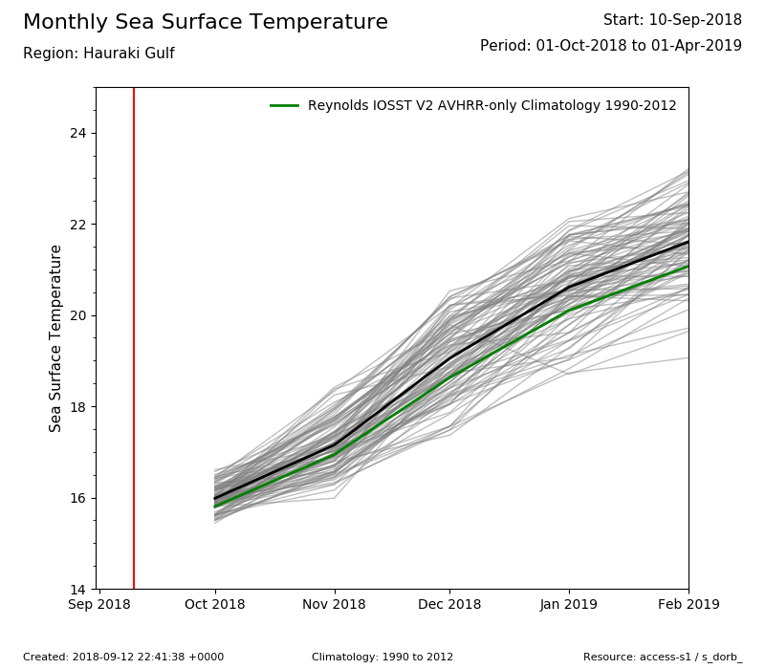
Trial Products
SST and SSTA plume plots

Slide 12
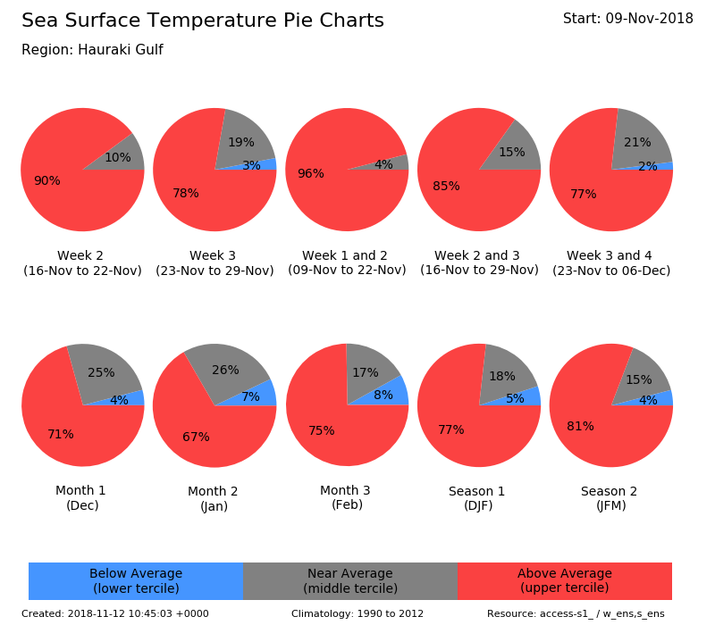
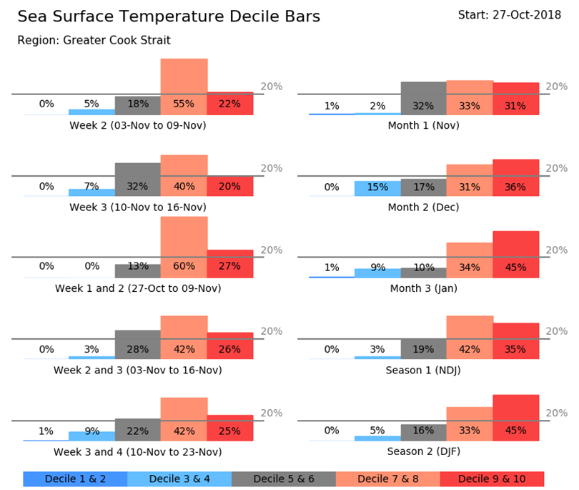
Trial Products
Probability of falling into each tercile/quintile of the hindcast

Slide 13
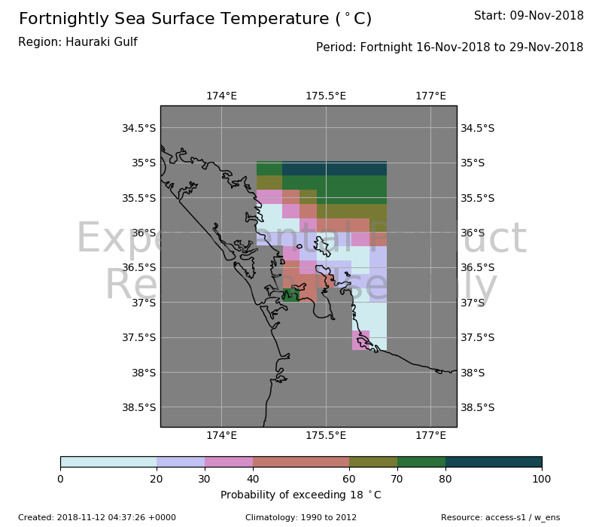
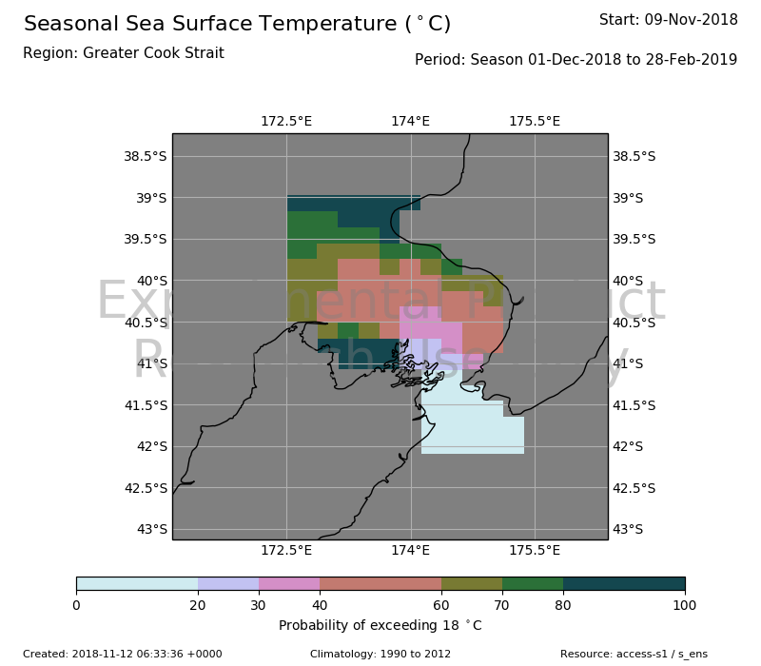
Trial Products
Probability of exceeding a SST threshold (e.g. 18 ◦C)

Slide 14
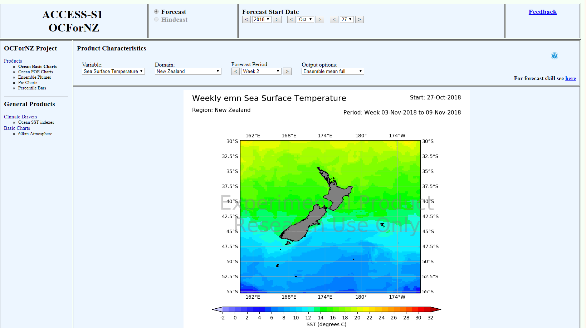
Trial Products

Slide 15
Summary
Have assessed ACCESS-S1 ensemble mean and probabilistic forecast skill around New Zealand
Trial forecast products are being developed including
Ensemble mean SST maps
Ensemble Plume plots
Probability of each tercile/quintile/decile
Probability of exceedance maps
Next: Increasing Industry engagement, exposing trial products, case studies of past extreme events…

Slide 16
Thank you
Catherine de Burgh-Day
catherine.deburgh-day@bom.gov.au
www.bom.gov.au/research
Claire Spillman*
claire.spillman@bom.gov.au
* Contactable after January
de Burgh-Day, C. O., Spillman, C. M., Stevens, C., Alves, O., & Rickard, G. (2018). Predicting seasonal ocean variability around New Zealand using a coupled ocean-atmosphere model. New Zealand Journal of Marine and Freshwater Research, 1-21.

