Slide 1
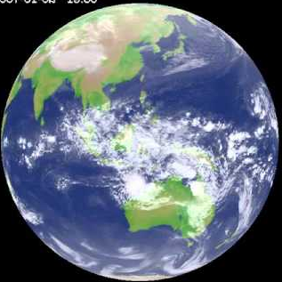

Ensemble MJO prediction with ACCESS-S1
Andrew Marshall, Harry Hendon, Debra Hudson
Bureau of Meteorology
Yuna Lim, Seok-Woo Son
Seoul National University
Kyong-Hwan Seo
Pusan National University
Xiaoxuan Jiang, Neil Holbrook
Institute for Marine and Antarctic Studies, UTas

Slide 2
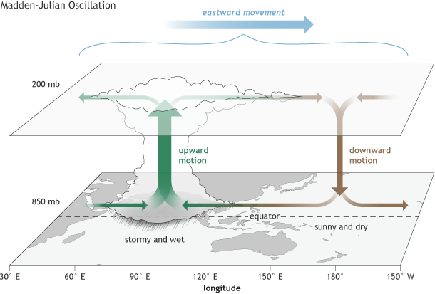
A global climate driver
Global impacts include
Monsoons
Tropical cyclones
El Niño
North Atlantic & North Pacific
Aus weather & climate extremes
Northwest Australian shelf
Leeuwin Current
Ocean surface waves

Slide 3
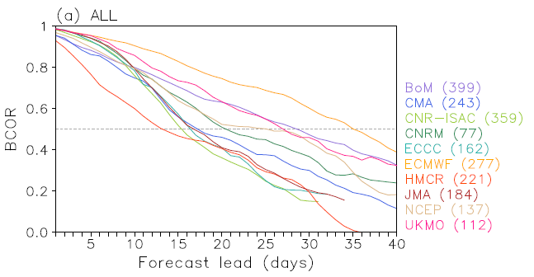
MJO prediction skill ranges 2-5 weeks (DJF)
Lim et al. (2018, Clim Dyn)
POAMA: 4 weeks (250km horizontal grid)
ECMWF: 5 weeks (32km / 65km horizontal grid)

Slide 4
Upgrading from POAMA-2 to ACCESS-S1
 | POAMA-2 | ACCESS-S1
Atmospheric model | Bureau BAM (~10 years old) | Latest UKMO atmospheric model (GC2)
Atmospheric resolution | Horizontal: 250 km Vertical: 17 levels | Horizontal: 60 km mid latitudes Vertical: 85 levels
Ocean model | MOM version 2 (~13 years old) | Latest European ocean model NEMO
Ocean resolution | Horizontal: ~200 km x 100 km Vertical: 25 levels | Horizontal: 25 km Vertical: 75 levels
Land surface model | Simple bucket model | State-of-the-art land surface model JULES
Sea ice model | No sea ice model | Latest sea ice model CICE (UK & USA)
Ensemble generation | Coupled breeding that generates coupled ocean and atmosphere perturbations | Random error perturbations for the atmosphere only
Hindcasts | 33 ensemble members six times per month, 1981-2013 | 11 ensemble members four times per month, 1990-2012

Slide 5
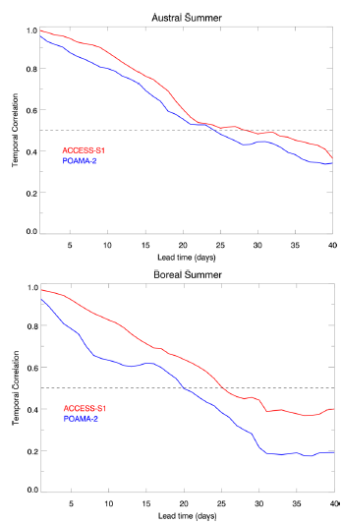
Improved MJO prediction skill in ACCESS-S1
Marshall and Hendon (2018, Clim Dyn)
Bivariate RMM index skill is improved by 4 days in (austral) summer and 5 days in winter

Slide 6
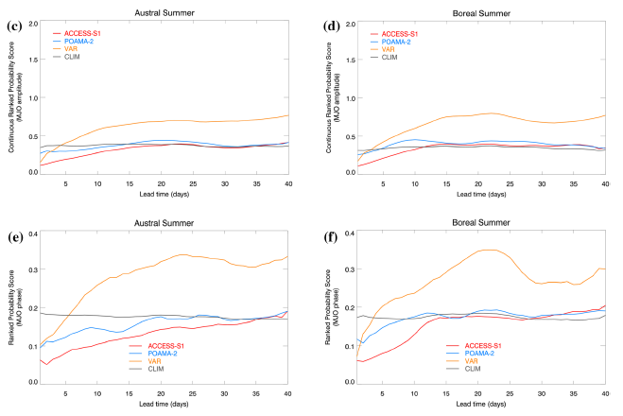
Improved MJO prediction skill in ACCESS-S1
MJO amplitude prediction skill improved by about 7 days
MJO phase prediction skill improved by about 9 days

Slide 7
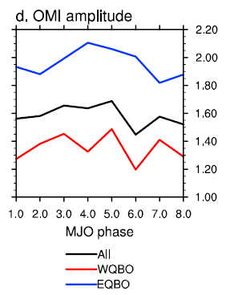
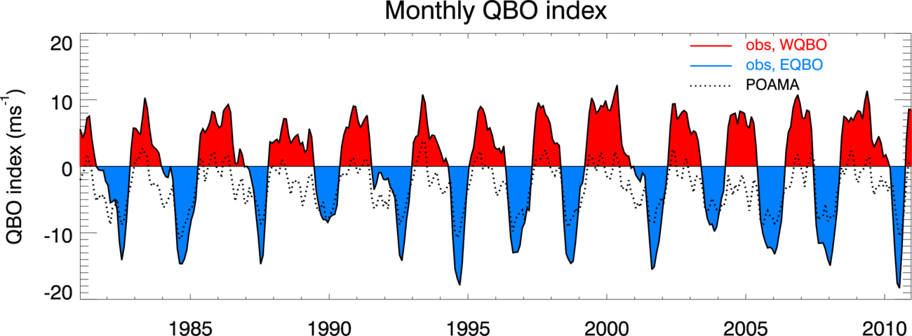
MJO modulated by the QBO in DJF
Yoo and Son (2016, GRL)
QBO: dominates interannual variability in tropical stratosphere. Downward propagating easterly & westerly mean zonal winds with a ~2 yr period and amplitude ~20 m/s near 50 hPa

Slide 8
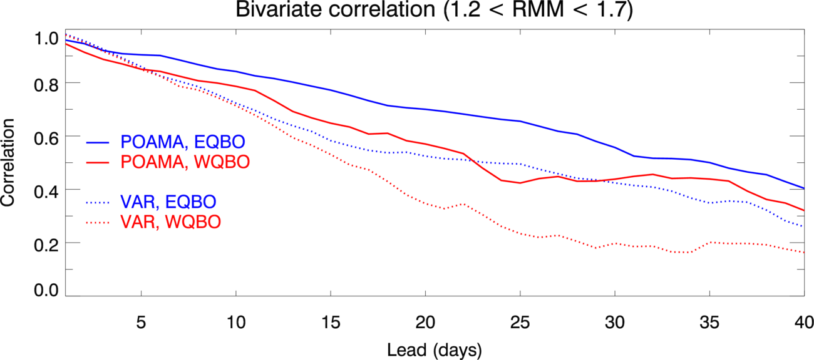
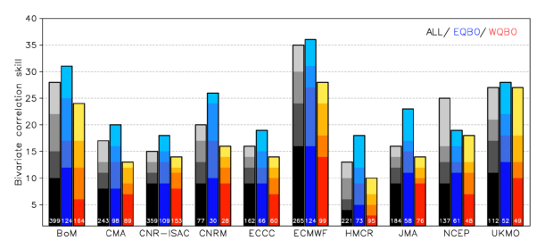
MJO skill is enhanced during EQBO years
Marshall et al. (2017, Clim Dyn), Lim et al. (2018, Clim Dyn)
Improved skill during EQBO is not solely due to the MJO being stronger
The QBO has an impact on warm pool convection that is captured in the forecast initialisation
(Hendon and Abhik 2018: enhanced destabilisation in upper troposphere during EQBO)

Slide 9
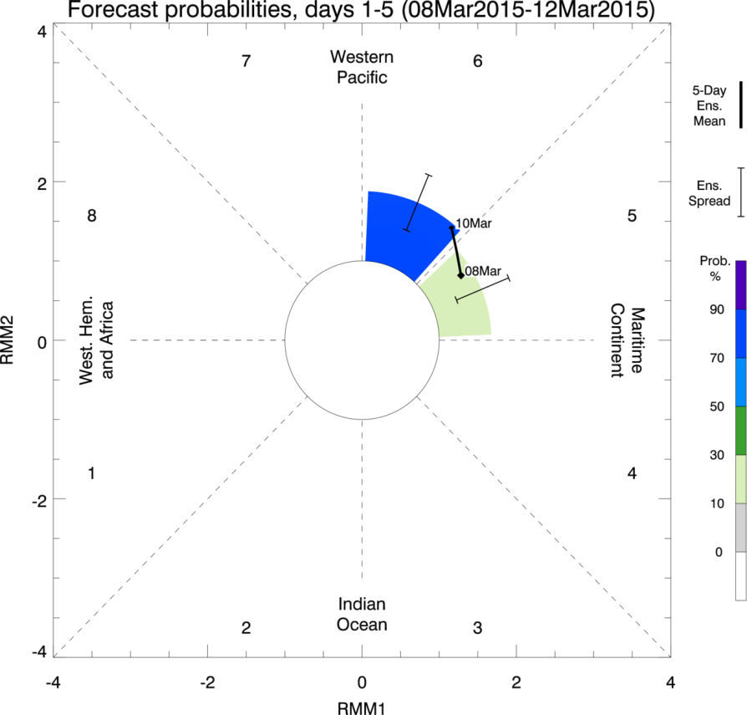
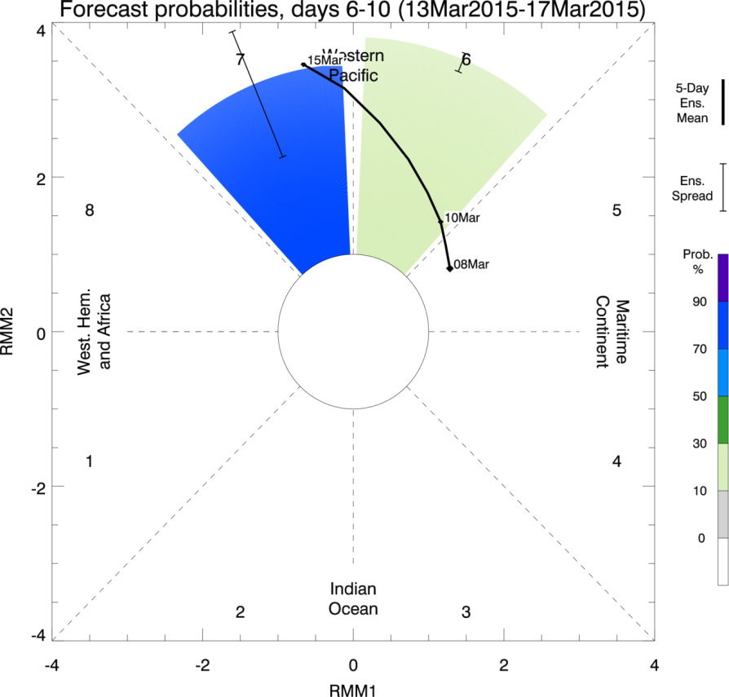
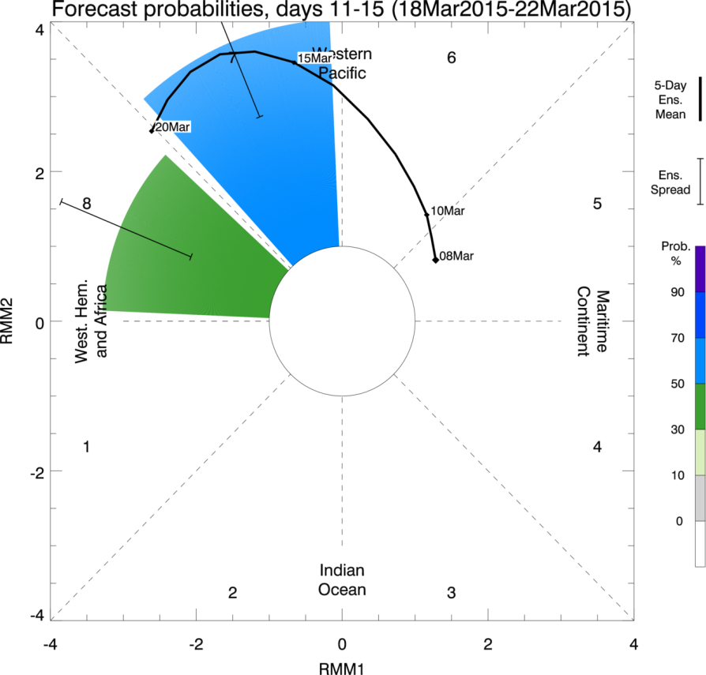
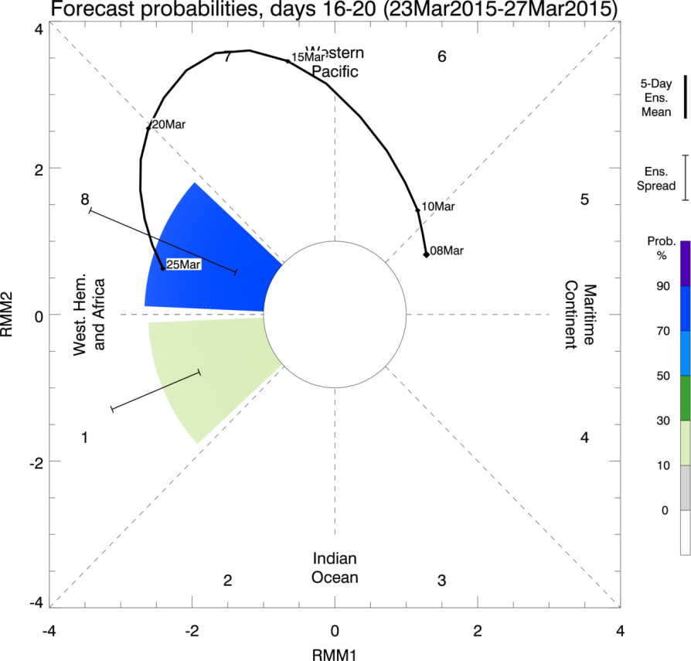
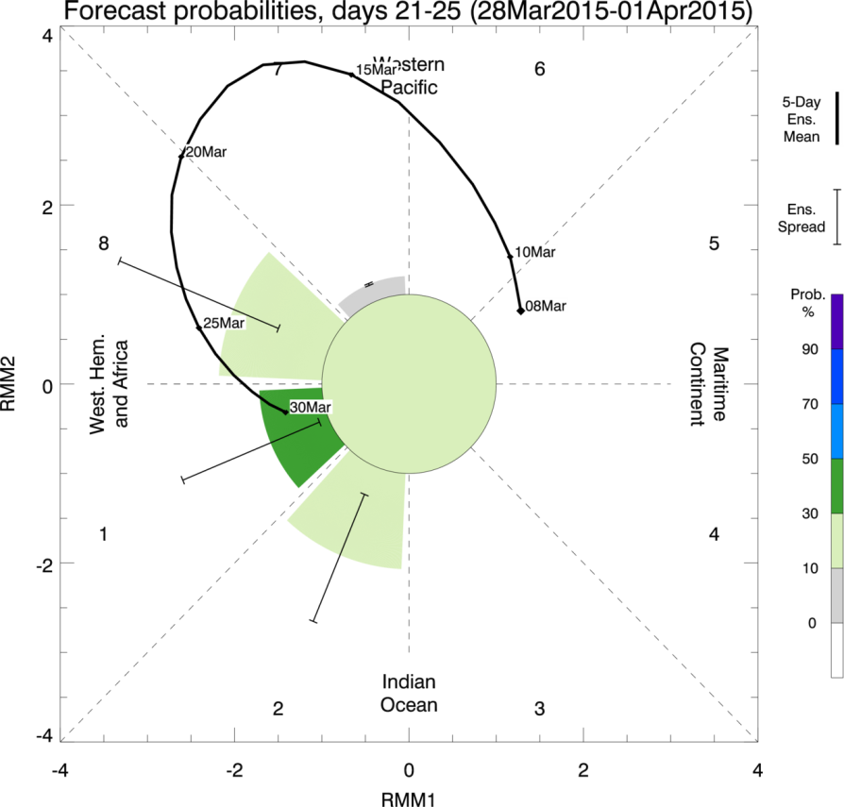
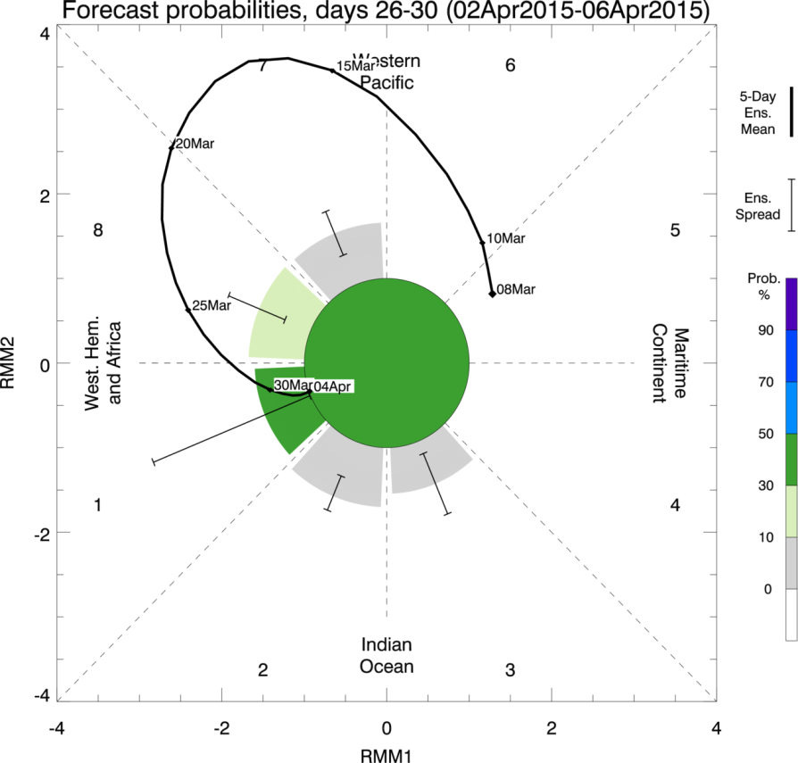
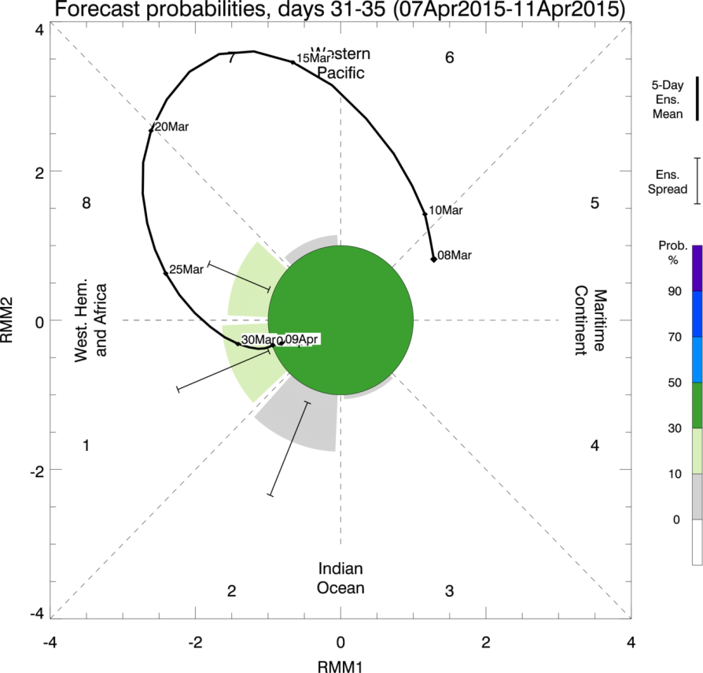
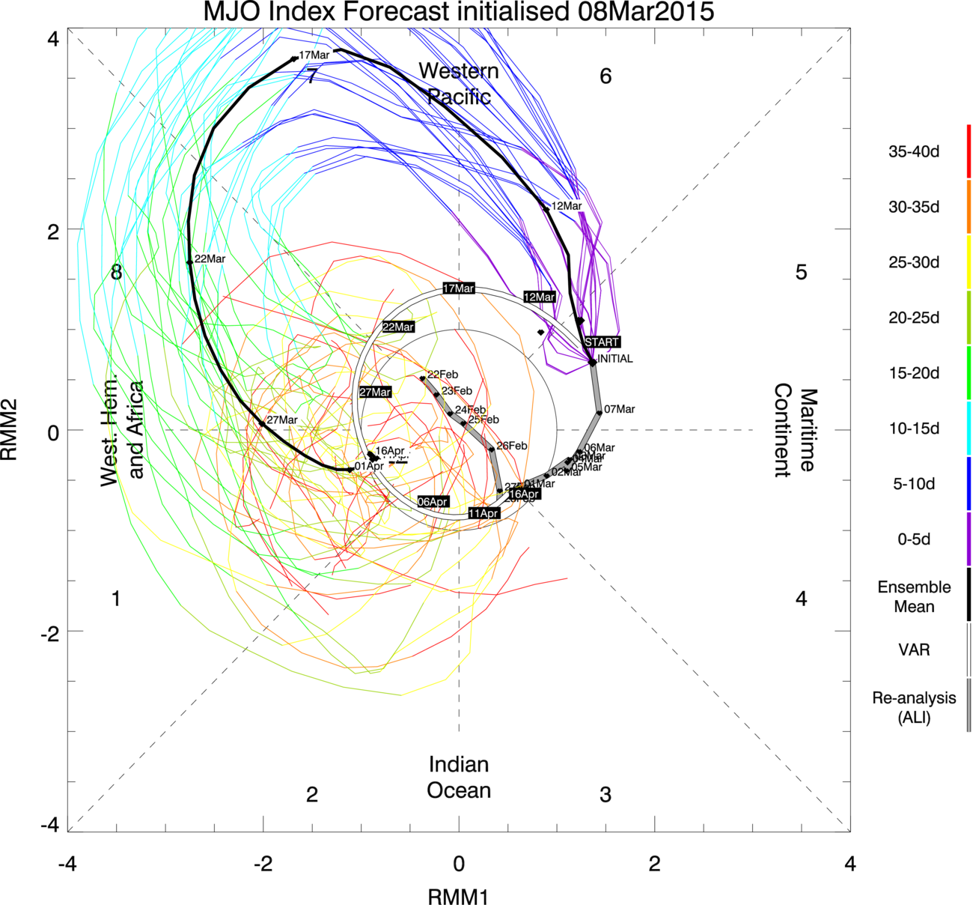
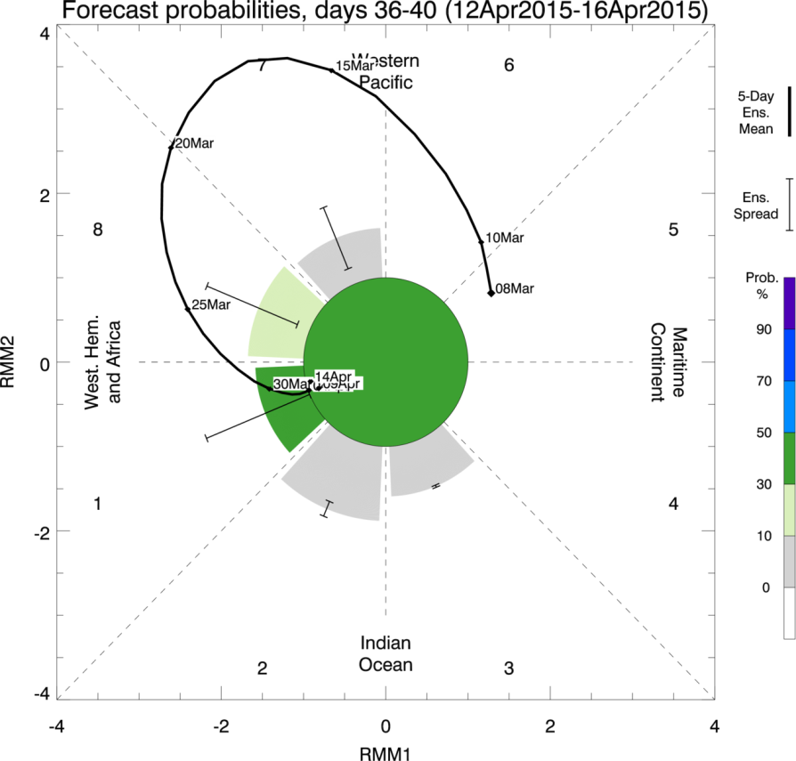
An new approach: probabilistic MJO prediction
Marshall et al. (2016, GRL)

Slide 10
Key messages
MJO prediction in ACCESS-S1 is expected to improve further when the ensemble generation method is upgraded in ACCESS-S2
The QBO is an untapped source of subseasonal predictability that can provide a window of opportunity for improved prediction of global climate
The new probabilistic MJO forecast display exploits useful ensemble member forecast information for the benefit of forecasting centres and MJO working groups

Slide 12
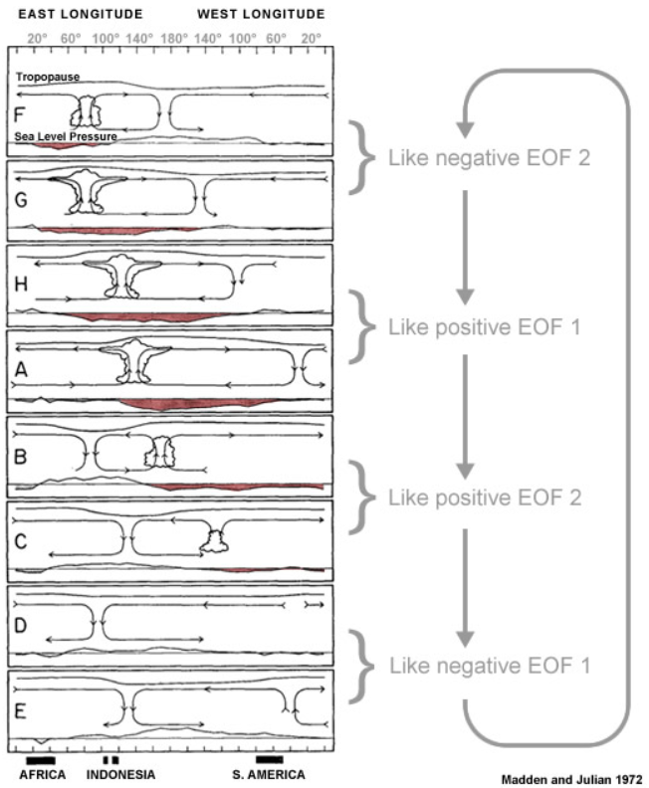
The Real-time MJO Multivariate (RMM) Index
Phase 2
Indian
Ocean
Phase 3
Phase 4
Maritime
Continent
Phase 5
Wheeler and Hendon (2004, MWR)
Phase 6
Western
Pacific
Madden and Julian 1972
Phase 7
Phase 8
West. Hem.
& Africa
Phase 1

Slide 13
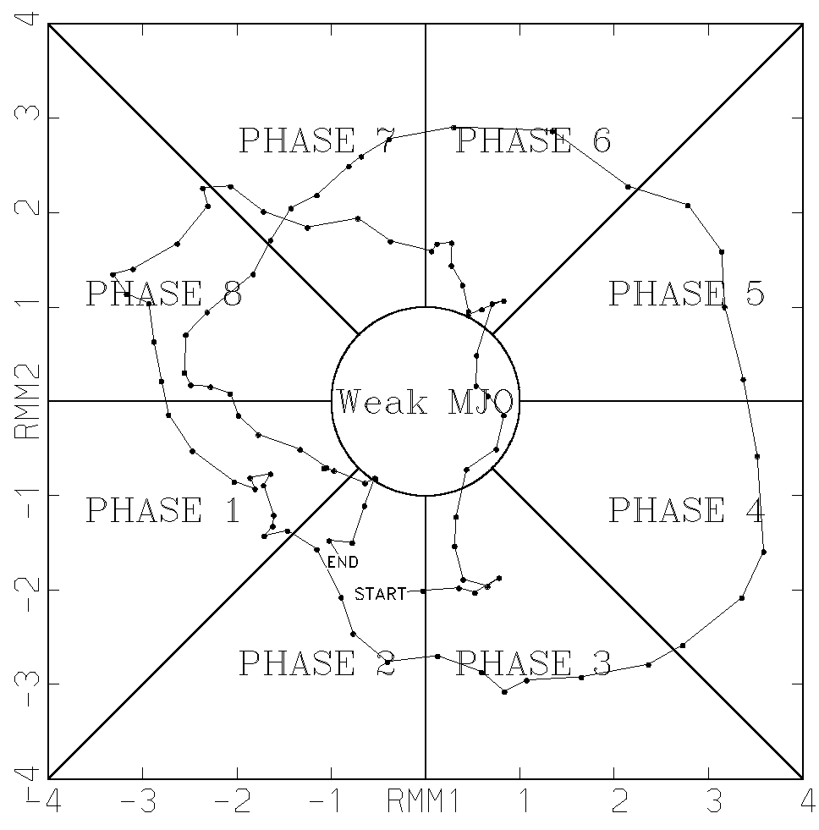
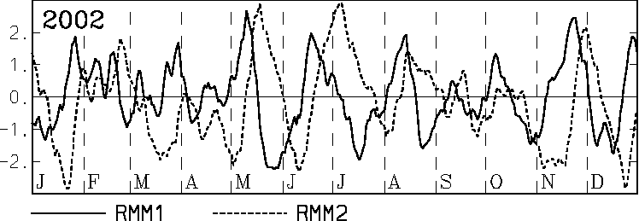
The Real-time MJO Multivariate (RMM) Index
Project (i.e. multiply) equatorially-averaged u200, u850 and OLR anomalies onto EOF1 and EOF2
to produce the principal component time series RMM1 and RMM2
Eastward
(Western Pacific)
(Western Hemisphere & Africa)
(Maritime Continent)
(Indian Ocean)
MJO phase diagram (RMM1, RMM2): progression of the MJO through different phases (locations)
i.e. tells us how OLR, u850 and u200 vary together on the MJO (subseasonal) timescale.

Slide 14
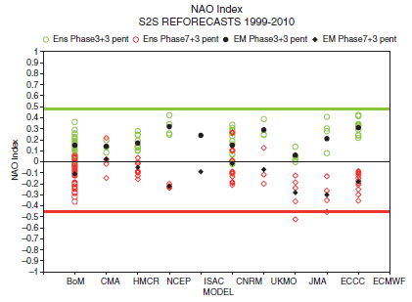
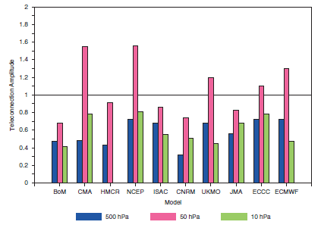
MJO teleconnections are often too weak
Vitart (2017, JQRMS)
Stronger than ERAI
Weaker than ERAI
Stronger
Weaker
Weaker than ERAI
Stronger than ERAI
11-15 days after a strong MJO in phase 3 / phase 7
Ratio of MJO Phase 3 teleconnection amplitude north of 60N, relative to ERAI

Slide 15

Probabilistic verification: Ranked probability (e.g. Hersbach 2000)
Hersbach (2000, Weather & Forecasting)
No. of forecast categories

