Slide 1
Stochastic Parametrisation and Seasonal Prediction
Tim Palmer
University of Oxford

Slide 2
Why Stochastic Parametrisation? (Palmer, 1995, 2001)
More consistent with theory
Improved scores
Reduced systematic errors
Increased computational Efficiency (Scalability)

Slide 3
Theory

Slide 4
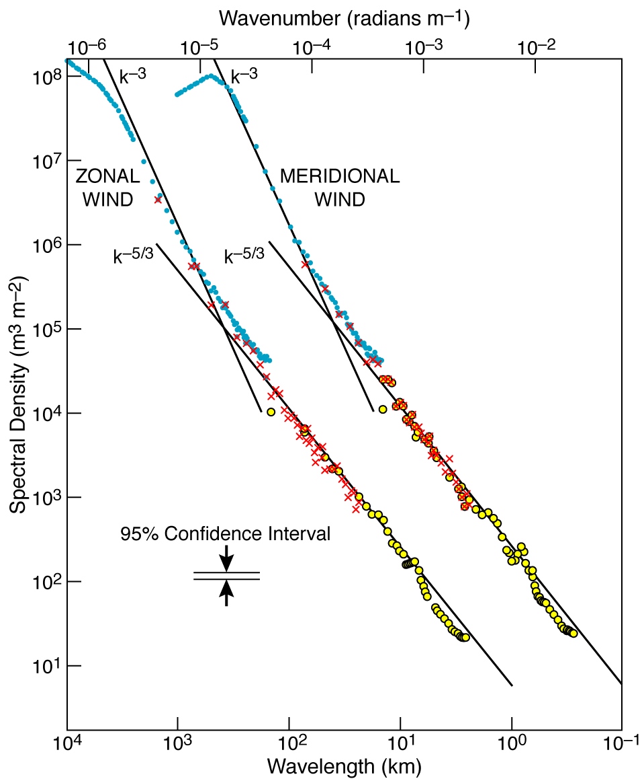
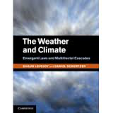

(Nastrom and Gage, 1985)

Slide 5
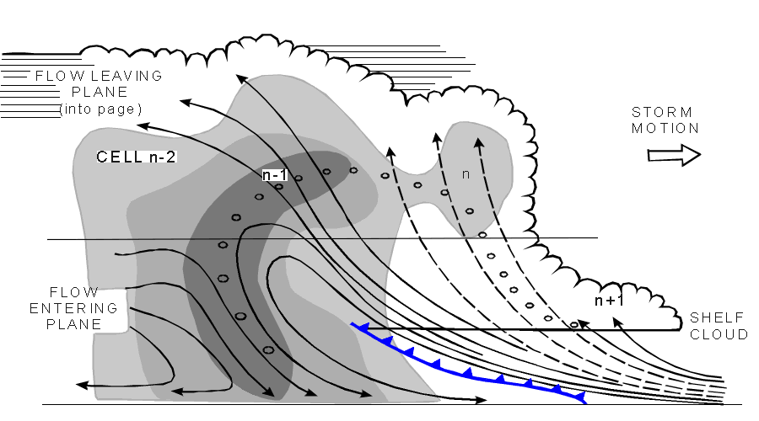
Convective parametrisation based on the (quasi-equilibrium) assumption that the world looks like this…
grid box
grid box

Slide 6
The reality of the situation
grid box
grid box

Slide 7
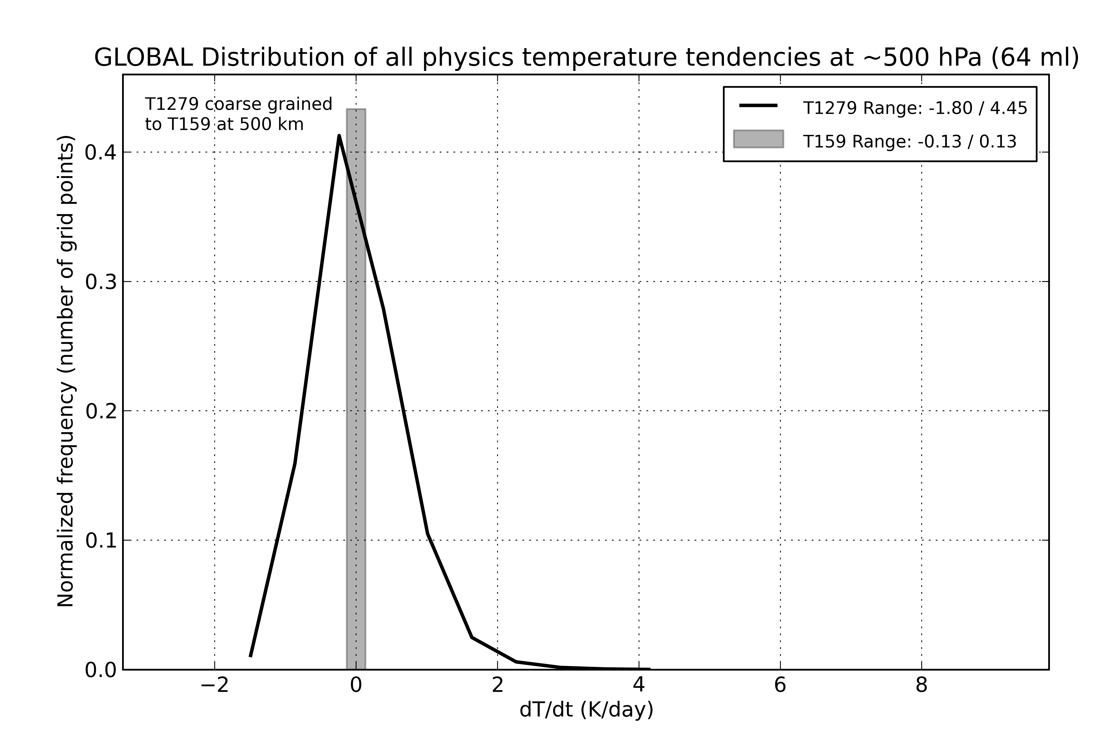
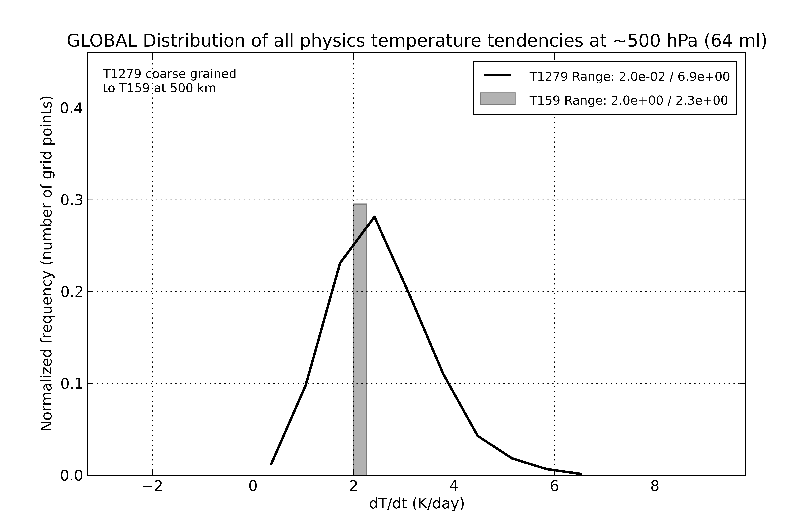
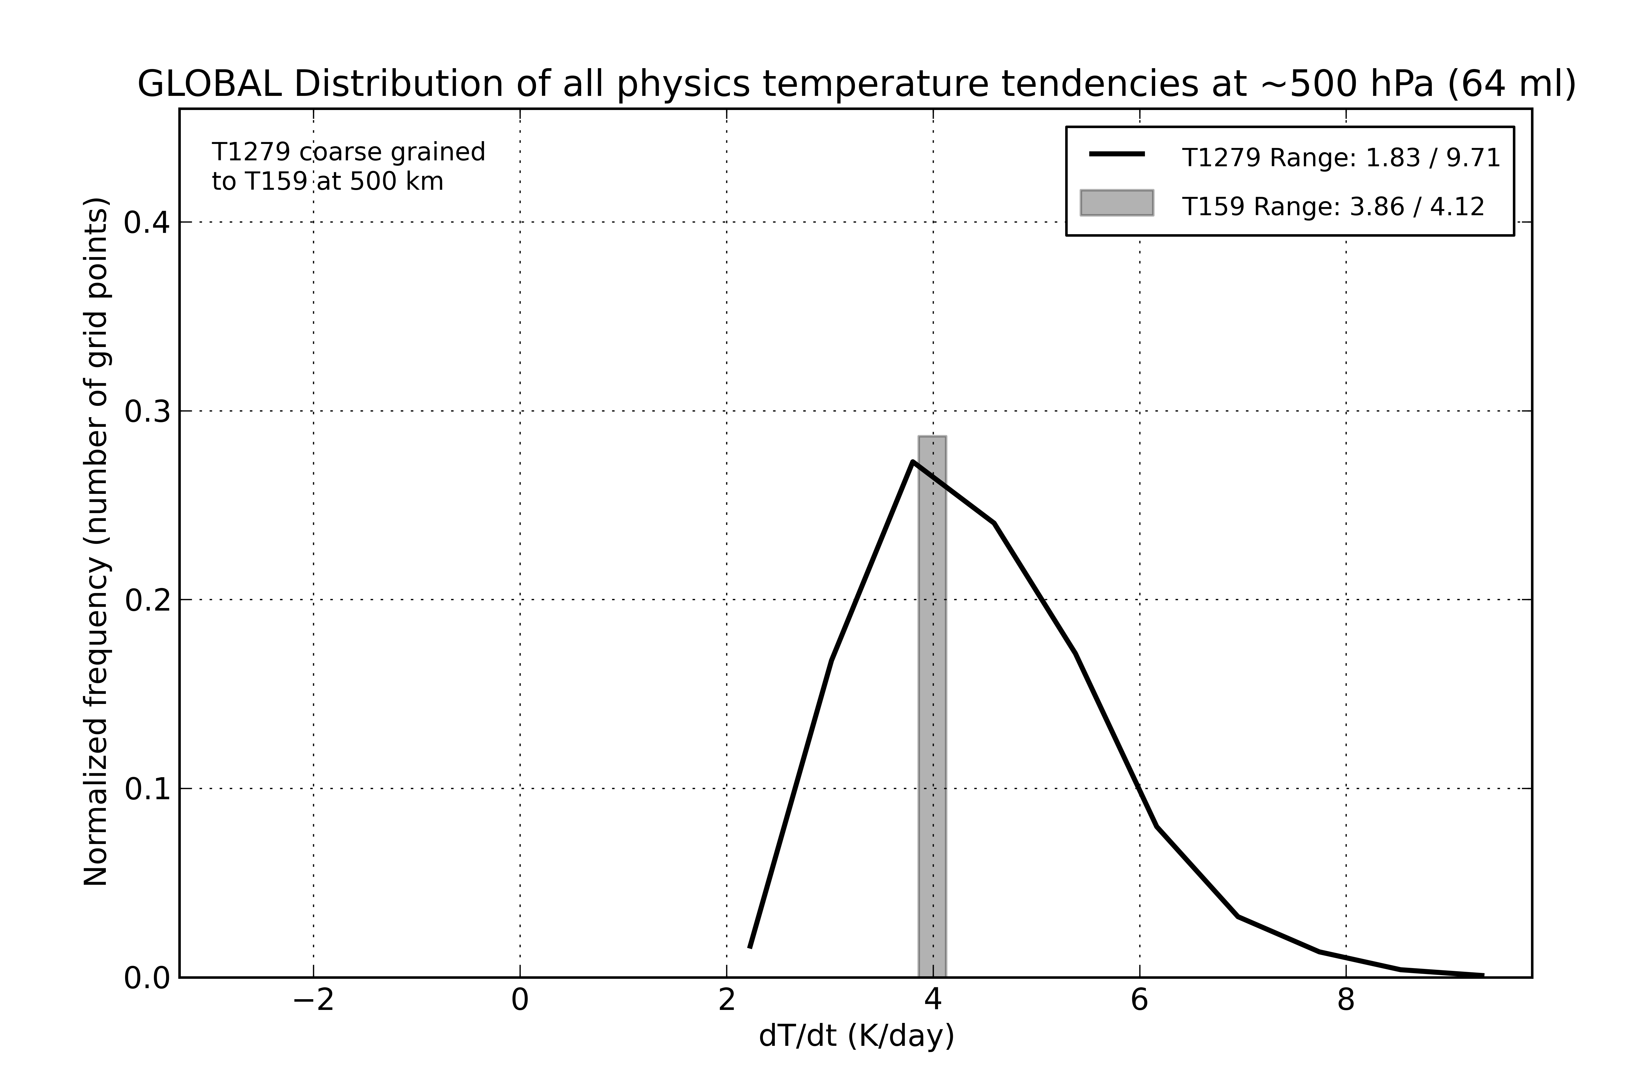
Coarse-graining (Shutts and Palmer, 2007)
Assume T1279 (16km) model = “truth”.
Assume T159 coarse-grain “model” grid.
Bar= Subset of total temperature parametrisation tendencies driven by T1279 fields coarse-grained to T159.
Curve= Corresponding “true” sub-T159-scale tendency.
Ie when the parametrisations think the sub-grid pdf is a thin hat function, the reality is a much broader pdf.
The standard deviation increases with parametrised tendency – consistent with multiplicative noise stochastic schemes.
Small tendency
Medium tendency
Large tendency
Callado-Palarès and Shutts,Phil Trans 2014

Slide 8
Stochastically Perturbed Parameterisation Tendencies (SPPT)
Buizza et al 1999; Palmer et al 2009
Operational scheme in ECMWF’s ensemble prediction system
Perturbations to total parametrised tendency of physical processes with multiplicative noise
for X={u,v,T,q}
r is a uni-variate random number described through a spectral pattern generator which is smooth in space and time
Spectral coefficients of r are described with an AR(1) process
Gaussian distribution, truncated at ±2s

Slide 9
Stochastic physics ensembles SPEs
Three components of the SPPT pattern generator with characteristic time and spatial scales
courtesy M. Leutbecher

Slide 10
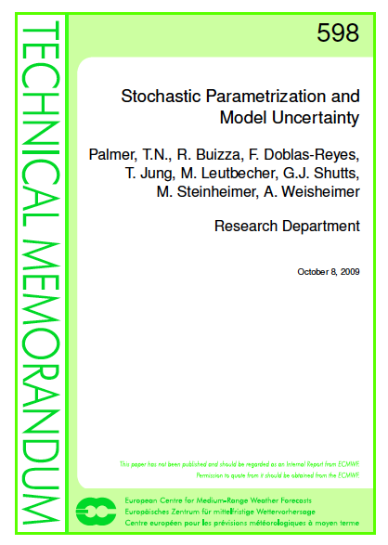
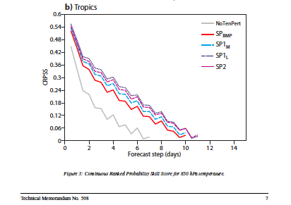

Slide 11
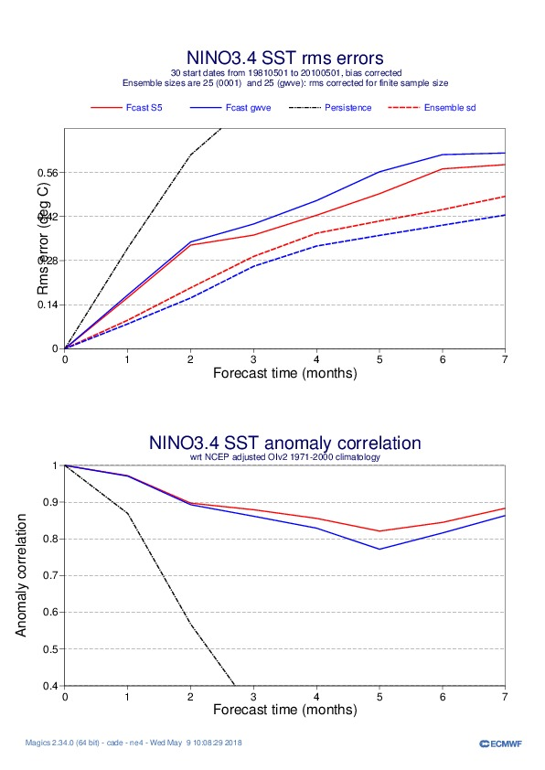
Impact of stochastic physics: ENSO forecasts
Stochastic physics helps reduce the RMS error
It also increases the ensemble spread
  More reliable forecasts
Increased anomaly correlation
 | control | no stochastic physics
SEAS5
RMSE
ensemble spread
Antje Weisheimer, personal communication

Slide 12
Impact of resolution and stochastic physics: ENSO bias
Stochastic physics reduce the cold bias
Reduction most pronounced for Aug – Nov
SEAS5 reduction of drift by up to 2/3 in Nov compared to no stochastic physics
Impact of stochastic physics approx. half the amplitude of impact of increased resolution (from Aug onwards)
Nino3.4 mean absolute SST
 | control | no stochastic physics
System 4
SEAS5_lowres
SEAS5
Antje Weisheimer, personal communication

Slide 13
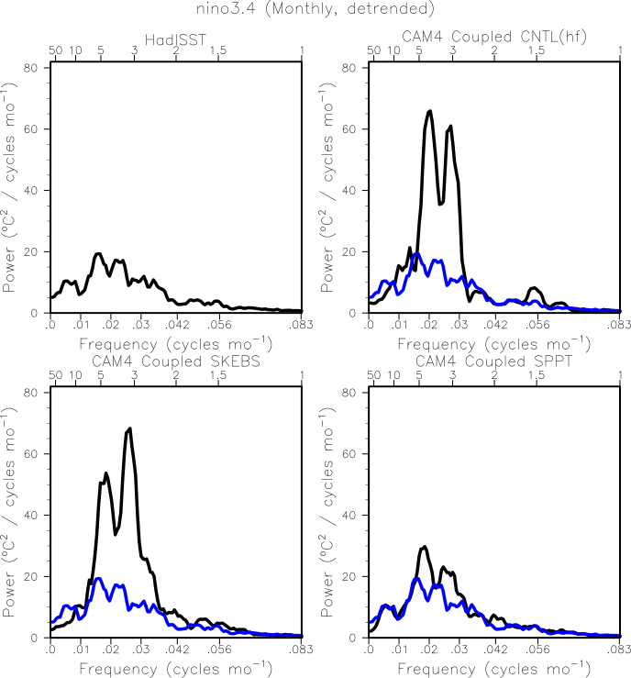
model
obs
NCAR, CAM4 ENSO without and with SPPT
Christensen et al, 2017

Slide 14
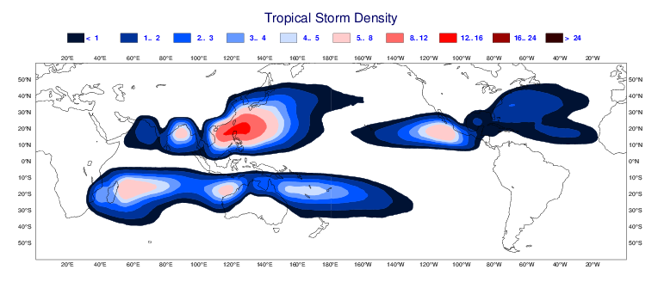
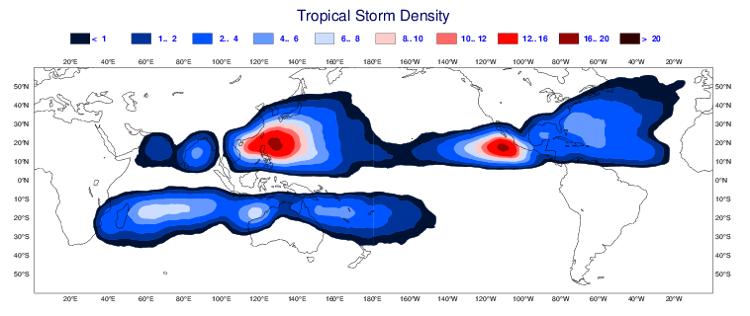
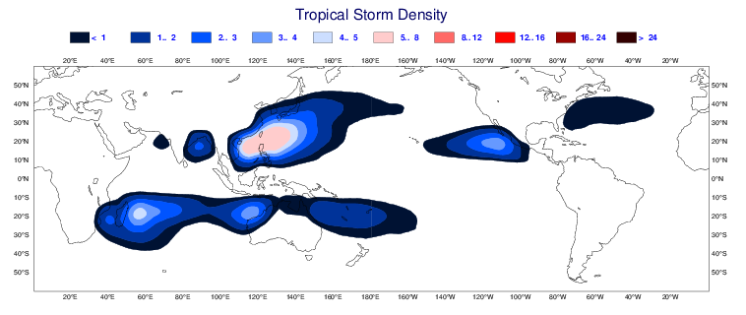
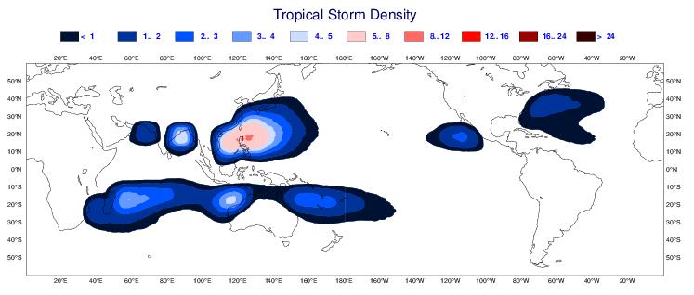
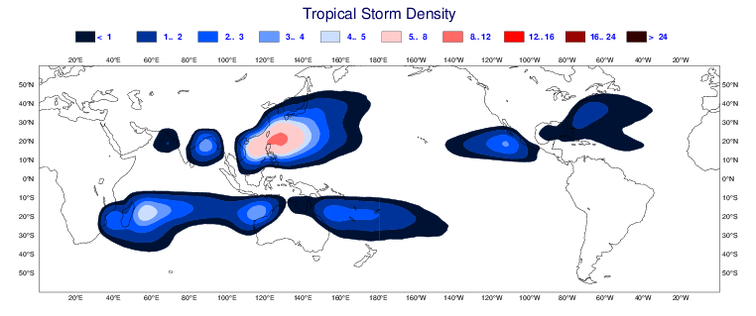
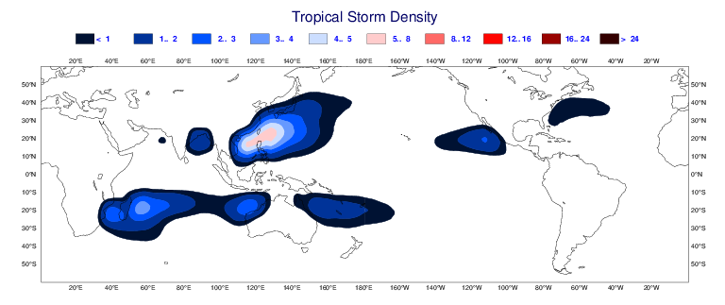
Number of tropical cyclones: Impact of resolution vs stochastic physics
Stochastic physics and resolution have similar impact
SEAS5
no stochastic physics
Observations (IBTrACS)
SEAS5
resolution
physics
SEAS5_low res
no stochastic physics
System 4
SEAS5_lowres
Antje Weisheimer, personal communication

Slide 15
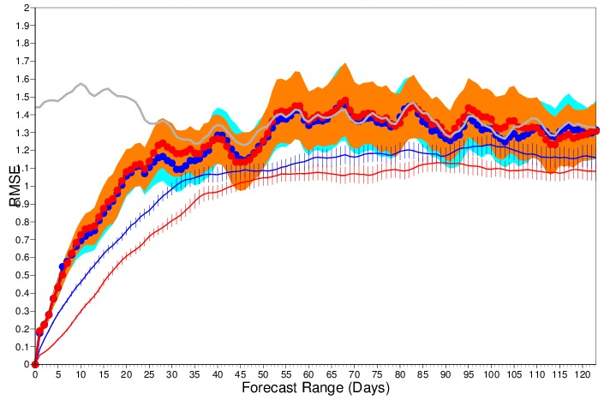
Impact of stochastic physics: MJO forecasts
Stochastic physics has neutral impact on RMS error
Significant increase in the ensemble spread over entire forecast range
  More reliable MJO forecasts
Amplitude is increased by ~10%
 | no stochastic physics | control
SEAS5
Antje Weisheimer, personal communication

Slide 16
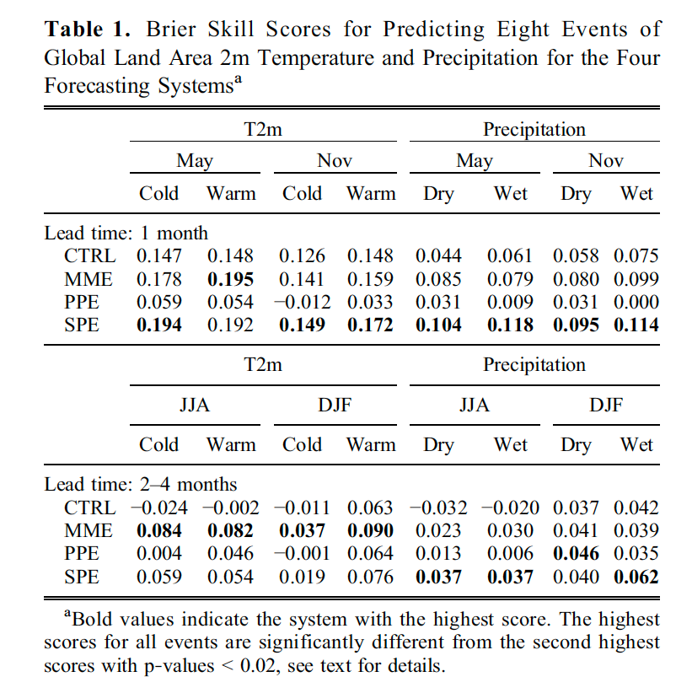
Comparing, MME, Perturbed parameters and stoch phys.
monthly
seasonal
Weisheimer et al, GRL (2011)

Slide 17
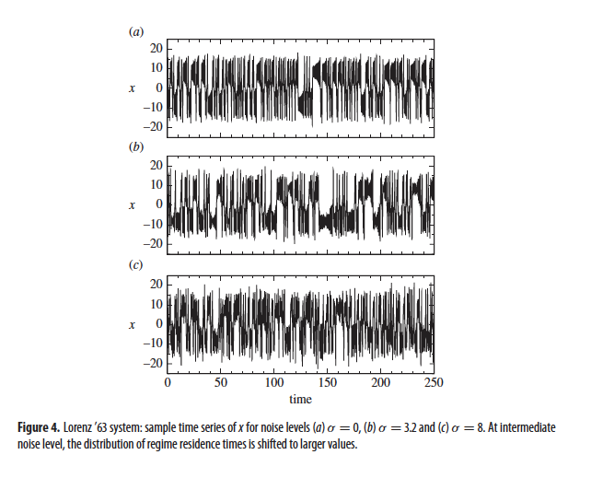
s=0
s=3.2
s=8
Kwasniok, 2014

Slide 18
Spread L63 and L63 stoch.
s=0
s=3.2
s=8
Spread decreases (not increases!) with stochastic noise
Kwasniok, 2014

Slide 19
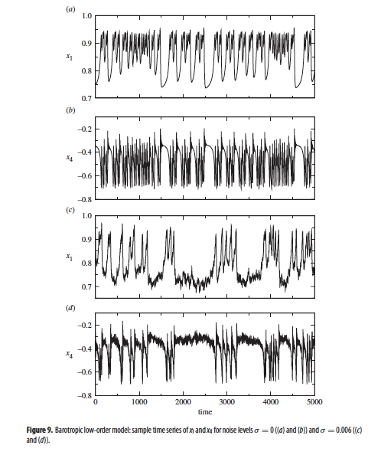
Without
Noise
With
Noise

Slide 20
Regime Analysis: k-means clustering
High Zonal Index
Low Zonal Index
Low Zonal Index
Low Zonal Index

Slide 21
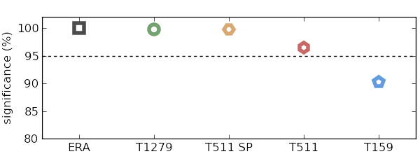
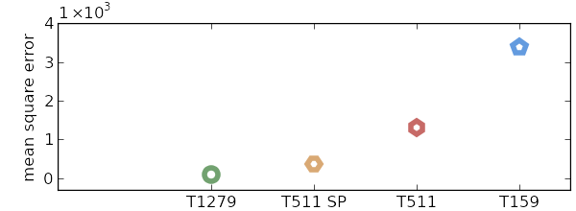
Athena: AMIP runs
Probability that clusters are not produced from a chance sampling of a gaussian
Dawson, Corti Palmer, GRL 2012
RMS error of simulated clusters against ERA

Slide 22
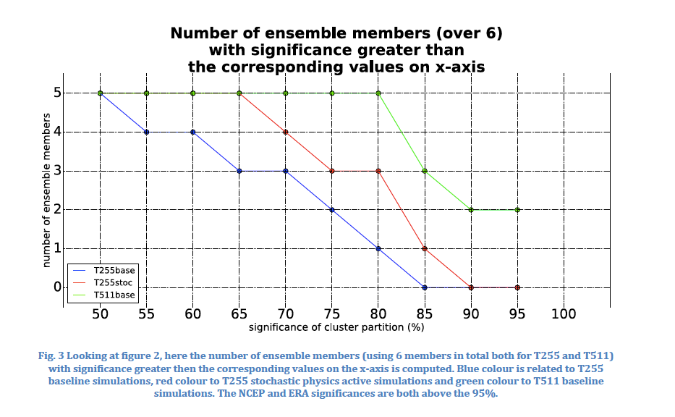
30 years: 1979-2008
EC-Earth 3.1
Atmosphere Only
PRACE- CLIMATE SPHINX
(out of 6)
T255SP
T511
T255
Irene Mavilla, Susanna Corti, Kristian Strommen

Slide 23
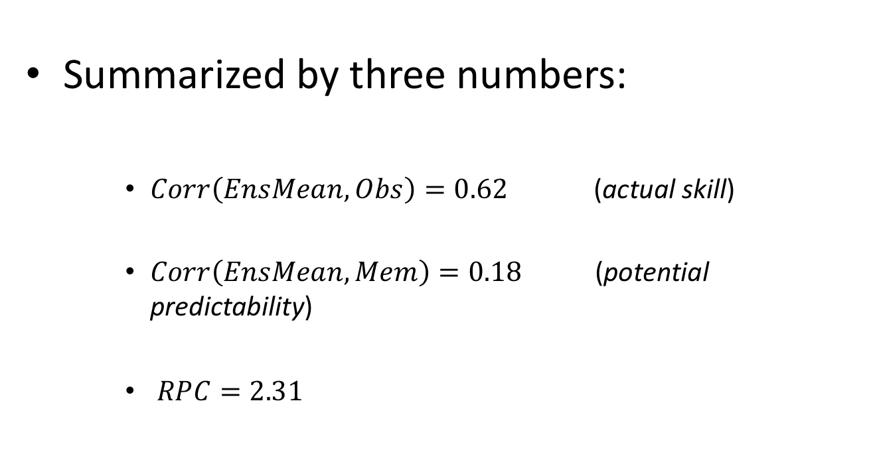
Signal to Noise Paradox for NAO (Eade et al, 2014).
Summarized by three numbers:
    $Corr\left(EnsMean, Obs\right)=0.62$ (actual skill)
    $Corr\left(EnsMean, Mem\right)=0.18$ (potential predictability)
    $RPC=2.31$

Slide 24
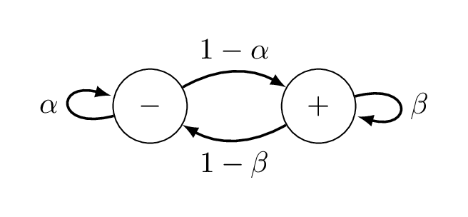
A regime view of the NAO
(Strommen et al, 2018)
Each day the atmosphere resides in one of these states, then moves randomly according to the persistence/transition probabilities.

Slide 25
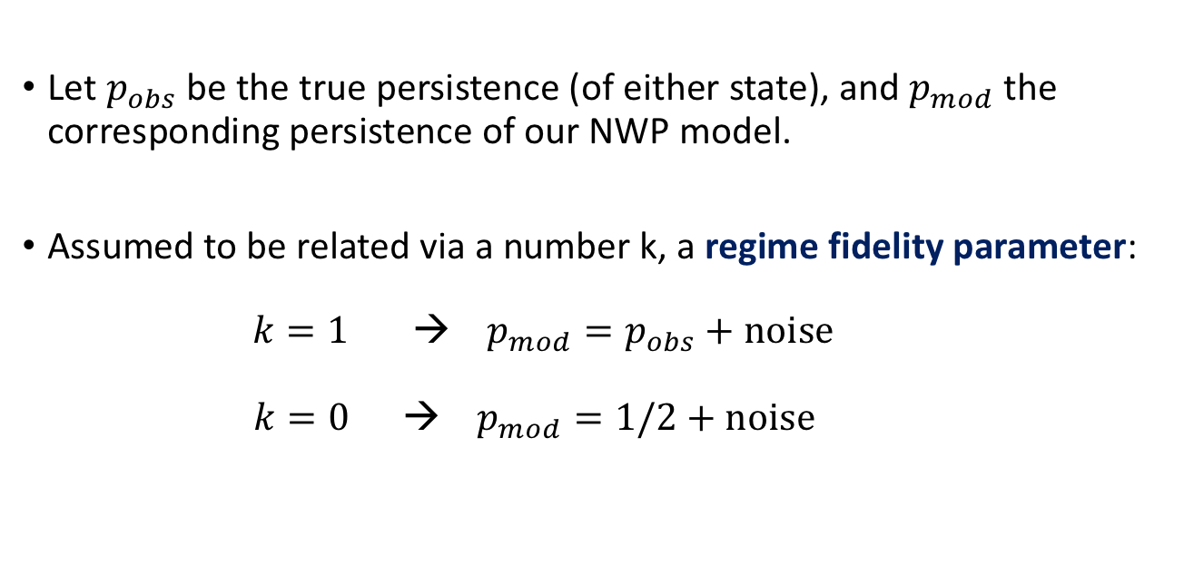
Representing model skill/error
Let $p_{obs}$ be the true persistence (of either state), and $p_{mod}$ the corresponding persistence of our NWP model.
Assumed to be related via a number k, a regime fidelity parameter:
$k=1$ → $p_{mod}=p_{obs}+noise$
$k=\text{0} → { p}_{mod}=1/2+noise$

Slide 26
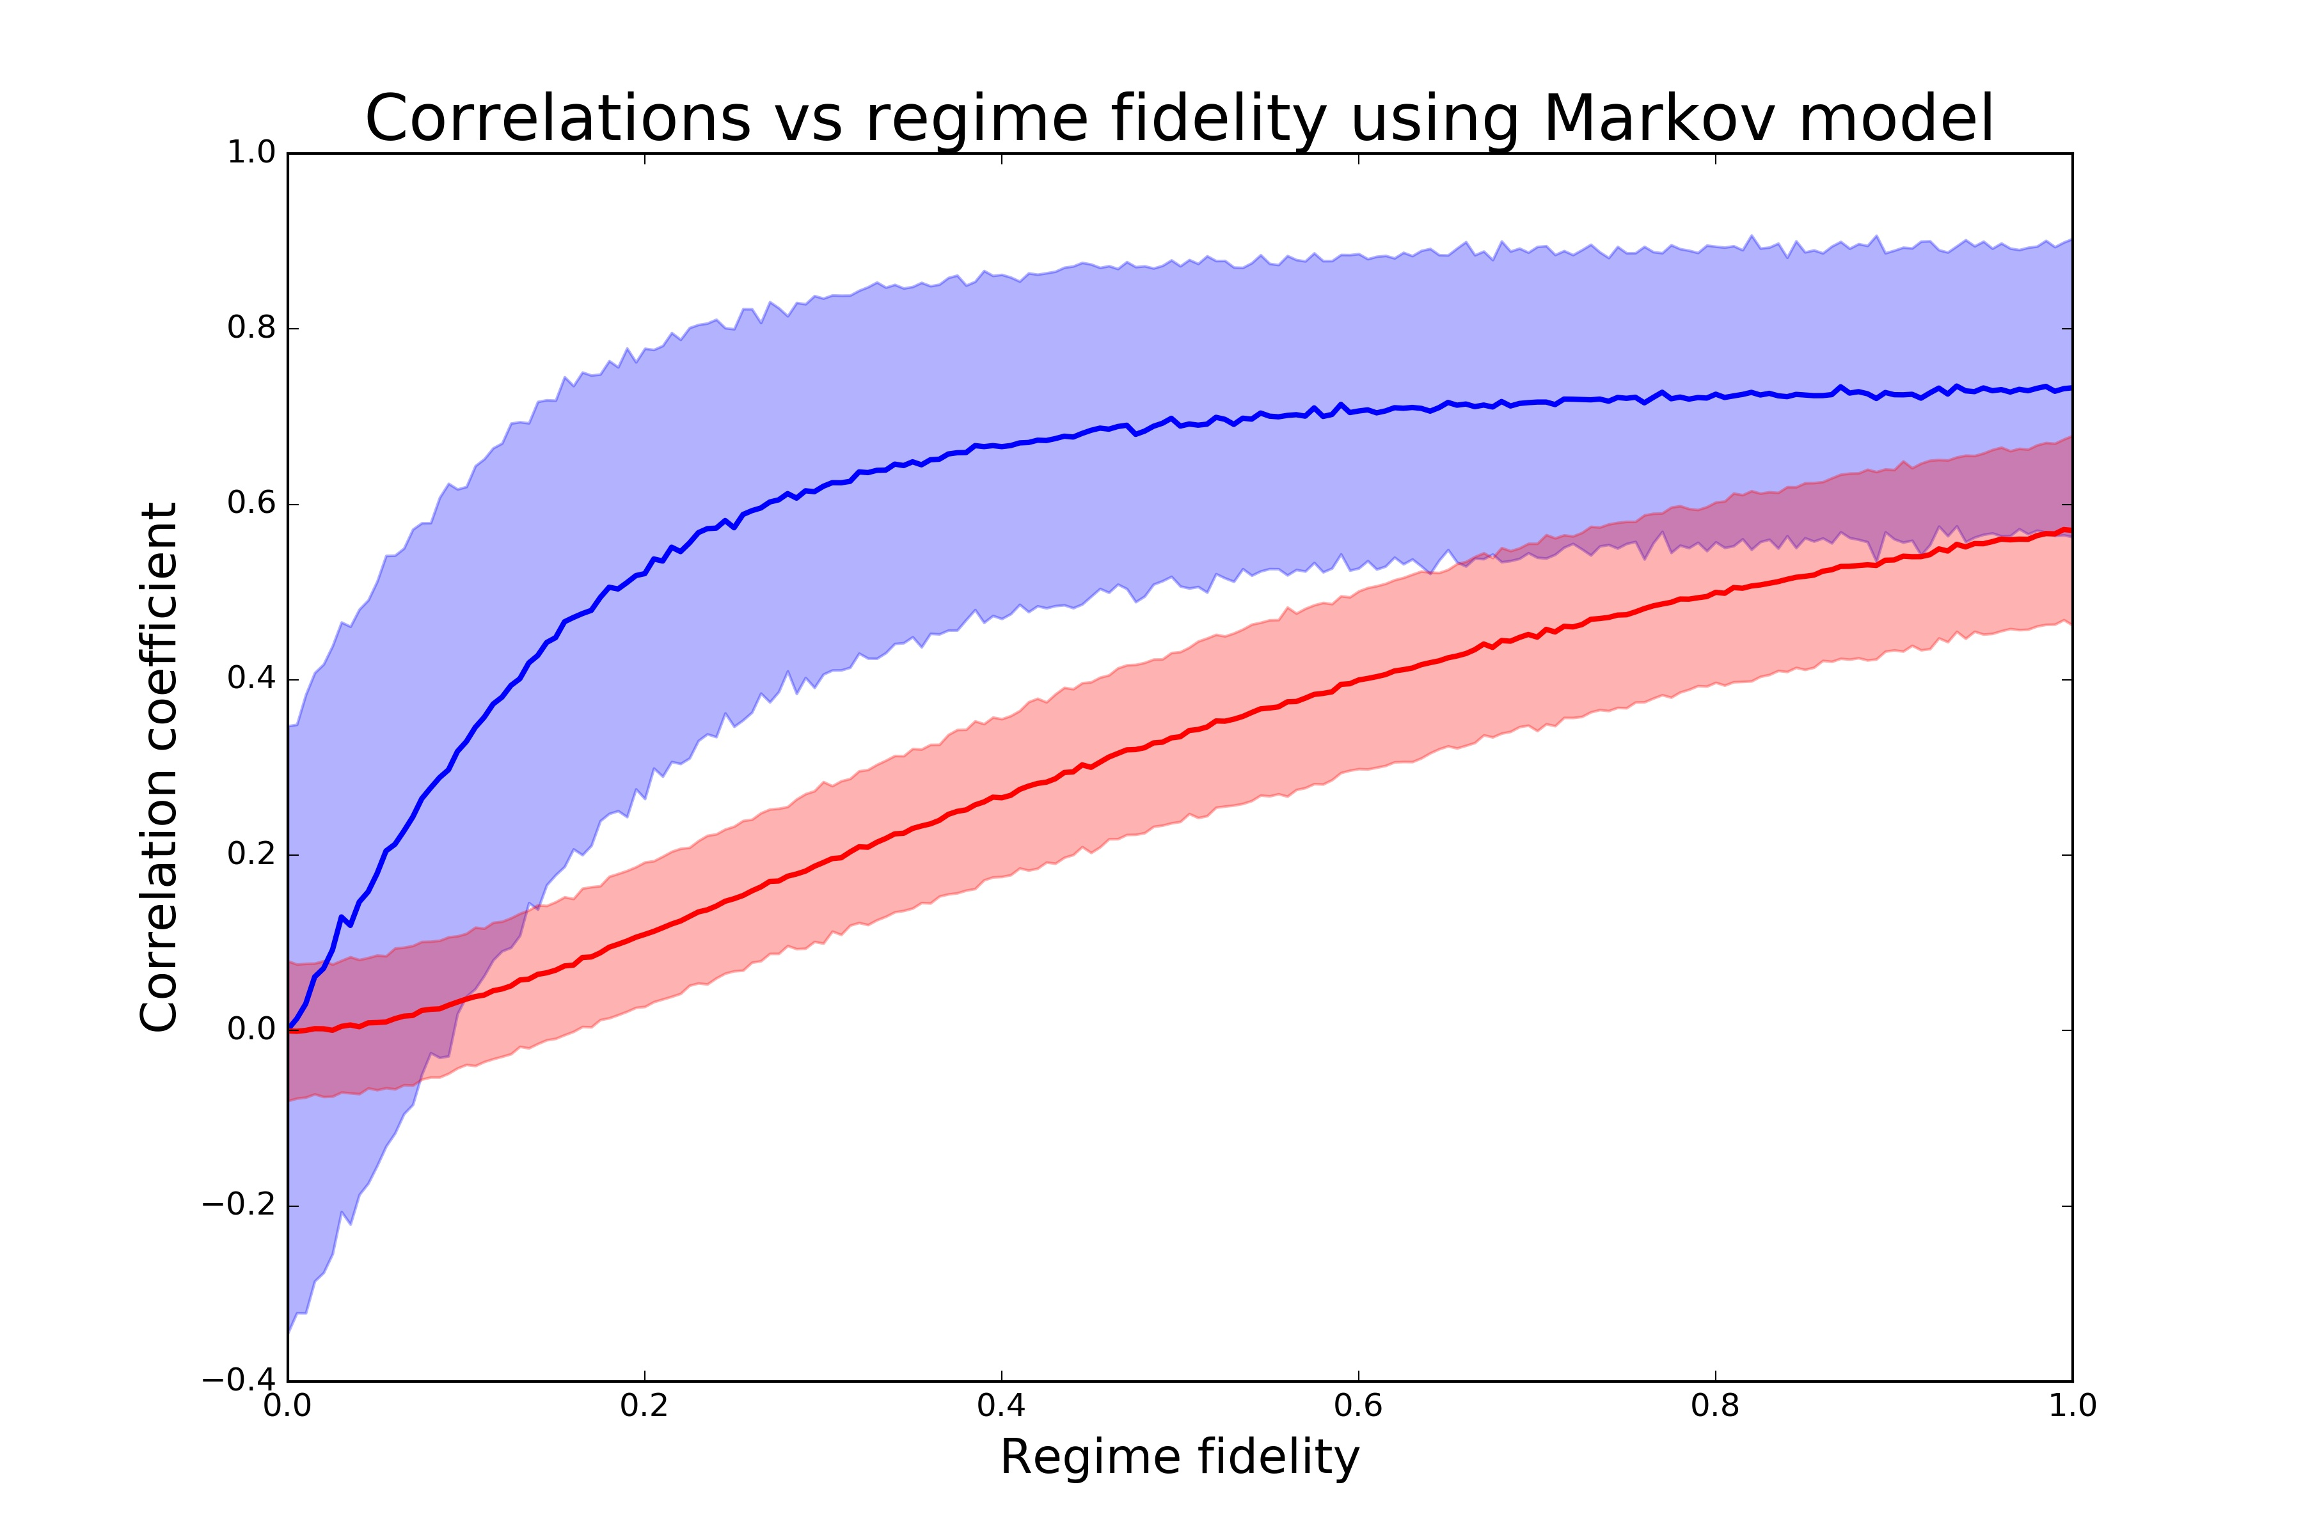
Results
Actual skill (blue)
Potential predictability (red)
Shading = 95% conf. intervals

Slide 27
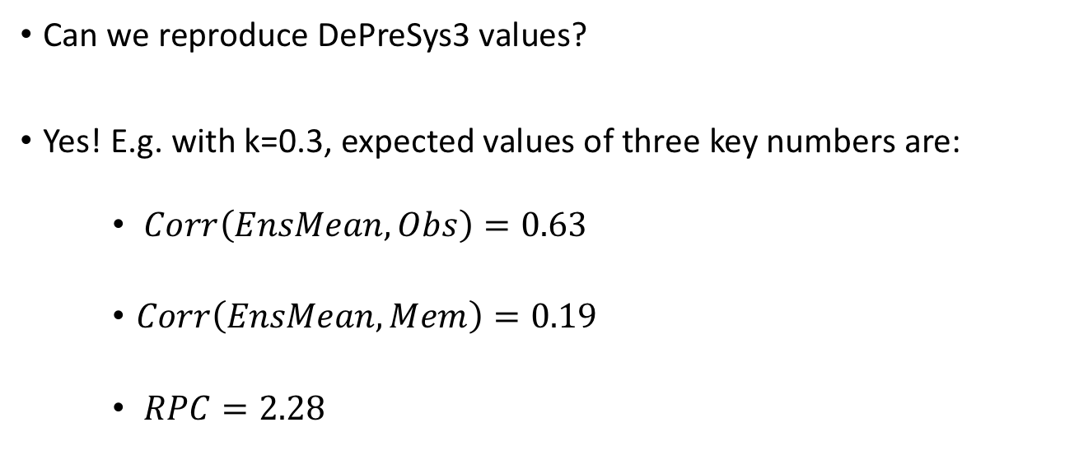
Results
Can we reproduce DePreSys3 values?
Yes! E.g. with k=0.3, expected values of three key numbers are:
    $Corr\left(EnsMean, Obs\right)=0.63$
    $Corr\left(EnsMean, Mem\right)=0.19$
    $RPC=2.28$
Virtually identical to actual DePreSys3 numbers

Slide 28
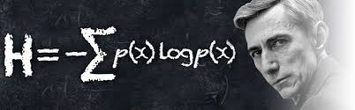

Let N denote the total number of bits in a conventional weather/climate model.
Stochastic parametrisation implies that the number of bits which carry real information is less than, likely much less than, N.
Stochastic Parametrisation and Information Content
Only communicate (on and off chip) the bits that contain real information.
Reinvest savings to increase model resolution

Slide 29
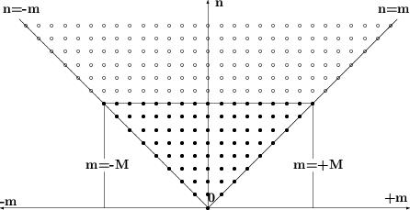
Stochastic Parametrisation
Triangular Truncation
Partially Stochastic
If parametrisation is partially stochastic, are we “over-engineering” our dynamical cores by using double precision bit-reproducible computations for wavenumbers near the truncation scale?
Are we making inefficient use of computing resources that could otherwise be used to increase resolution towards convective scales?

Slide 30
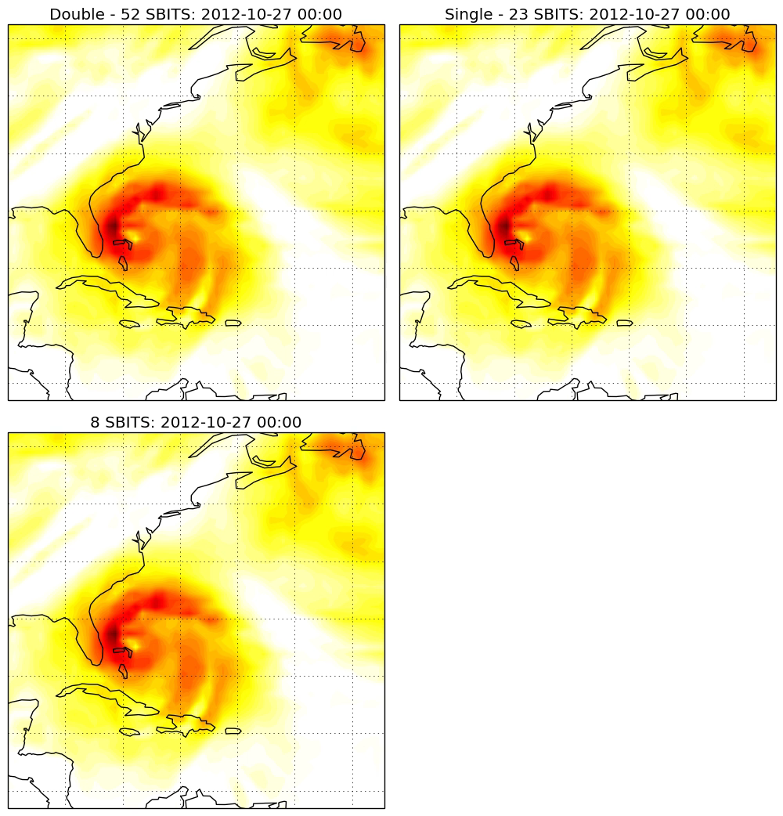
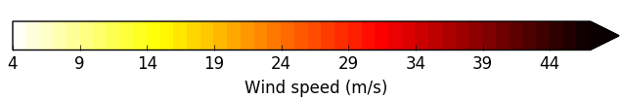
Hurricane Sandy
27/10/12 00:00
850hP wind speed
T255L91 ~ 80km
Mat Chantry, Personal Communication

Slide 31
Computer Science
Climate Science

