Slide 1
Using climate projections to understand impacts and inform agricultural adaptation
Richard Eckard & Brendan Cullen
Faculty of Veterinary and Agricultural Sciences
The University of Melbourne

Slide 2
Informing adaptation
Each industry requires regionally specific information about
Future rainfall patterns
Grass / crop growth patterns
Shifts between summer vs winter dominant growth
Within season temperature changes
Chilling requirements, frost
Tolerance limits - C3 or C4 plants
Changes in variability and frequency of extreme events
Heat waves, drought, flooding, frost

Slide 3
Case study 1: Climate change effects on pasture systems in SE Australia
5 grazing sites in eastern Australia
Subtropical SE Qld to cool temperate NW Tasmania
Climate data from SILO database
Baseline
1971–2000
30 potential realisations of 2000
Future climate scenarios
A1FI and A1B emission scenarios
Medium and high climate sensitivity
30 potential realisations of 2030 and 2070
CSIRO Mark 3 GCM (OzClim database)
Monthly projections for mean temperature (ºC) and rainfall (%) change
No detrending applied
Cullen et al. (2009)

Slide 4
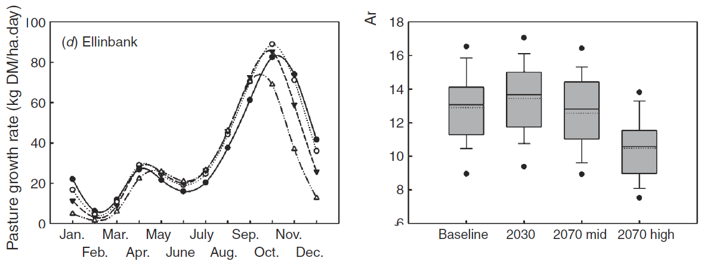
Case study 1: Climate change effects on pasture systems in SE Australia
SGS and DairyMod pasture models
(Johnson et al. 2003; Johnson et al. 2008)
Cullen et al. (2009)

Slide 5
Case study 1: Climate change effects on pasture systems in SE Australia
Changes to seasonal pasture growth
Higher winter growth and early spring growth rates
Earlier onset of a hotter a drier summer
Adaptation options
Focus on increasing winter pasture growth
Selection or breeding for deeper rooted and more heat tolerant pastures
Cullen et al. (2009)

Slide 6
Case study 2: Potential impacts of climate change on soil organic carbon and productivity in pastures of SE Australia
System and sites
Grazed pasture systems
Hamilton (high rainfall) & Birchip (low rainfall)
High and low SOC starting points
Climate libraries
2017 to 2090 daily sequence generated
Change factors applied to SILO data (1940-2017)
Detrended for temperature
SOM modelled with
SGS pasture model
Roth C soil OM model
Meyer et al. (2018)

Slide 7
Case study 2: Potential impacts of climate change on soil organic carbon and productivity in pastures of SE Australia
Scaling
Similar approach to Cullen et al. (2009)
Change factors derived from SimCLIM 2013 AR5
40 x CMIP 5 GCMs included in ensemble
GCMs selected for
10th, 50th and 90th PCTL
Temperature (GCMt)
Rainfall (GCMr)
Developed 5 future climate scenarios
For each 4.5 and 8.5 RCPs
Hot and dry (90th PCTL GCMt90) and 10th PCTL GCMr10)
Warm and dry (10th PCTL GCMt10 and GCMr10)
Intermediate (50th PCTL GCMt and GCMr)
Hot and wet (90th PCTL GCMt90 and GCMr90)
Warm and wet (GCMt10 and GCMr90)
Meyer et al. (2018)

Slide 8
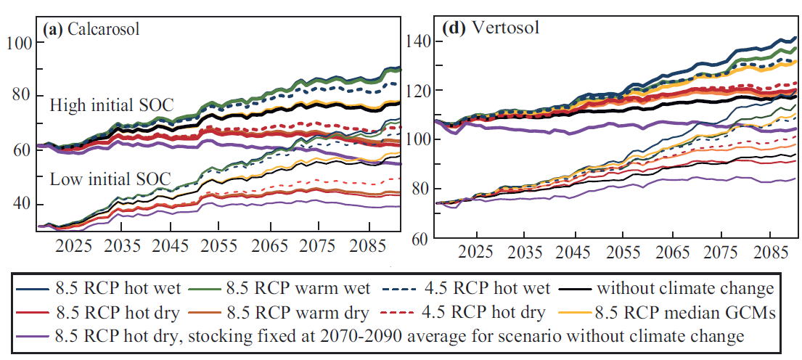
Case study 2: Potential impacts of climate change on soil organic carbon and productivity in pastures of SE Australia
Modelled change in SOC
2017 to 2090, for low and high initial SOC
Slower SOC accumulation under dry (realistic) projections
50 to 90% lower stocking rates by 2090
Meyer et al. (2018)

Slide 9
Case Study 3: Trends in wheat yields under representative climate futures: Implications for climate adaptation
10 wheat sites across southern Australia
Built on approaches of Cullen et al. (2009) & Meyer et al. (2018)
Climate Change in Australia, RCP4.5 and RCP8.5
Whetton et al. (2012)
Full suite of available GCMs was organised, then ranked using a multivariate ordering technique
Kokic et al. (2002)
‘most likely’ case - >30% of GCMs in agreement
Mean GCM selected
‘best’ case - highest rainfall and lowest temperature increase
Minimum temp GCM used
‘worst’ case - lowest rainfall and highest temperature increase
Maximum GCM used
Taylor et al. (2018)

Slide 10
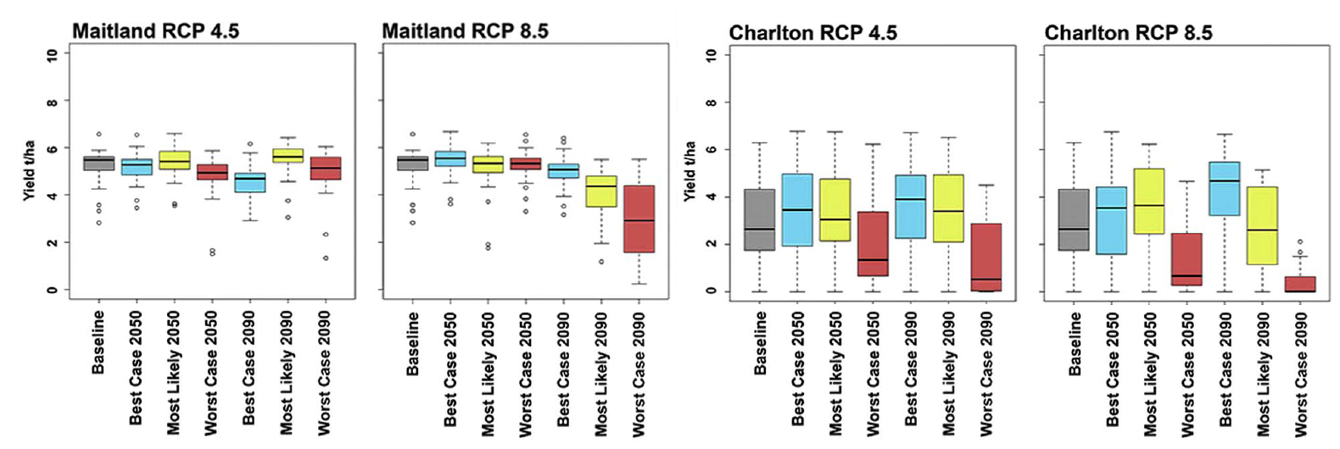
Case Study 3: Trends in wheat yields under representative climate futures: Implications for climate adaptation
Change factors applied to historical SILO data
Baseline period 1980 to 2010
2050 and 2090
APSIM model to simulate wheat
Taylor et al. (2018)

Slide 11
Case Study 3: Trends in wheat yields under representative climate futures: Implications for climate adaptation
Wheat yield declines by 2090
26% and 38% ‘most-likely’
RCP 4.5
41% and 49% ‘most-likely’
RCP 8.5
Variability increased
SD of 2.5 t/ha under the ‘most likely’
Adaptations
Drier regions
Transformational
Mixed farming systems
Mixed rainfall regions
Cultivar and sowing times
Taylor et al. (2018)

Slide 12
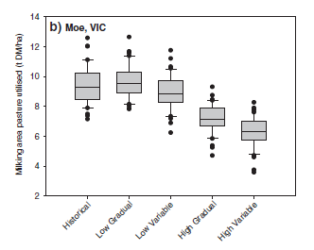
Extreme Events
Gradual vs variable scaling
Variable includes extreme climate events
Variable scaling consistently simulated lower pasture production than the gradual approach
Harrison et al. (2016)

Slide 13
Conclusions
Risk of compounding uncertainty in scaling
Is this an issue?
Scaling method
Less important than understanding general trends in rainfall and temperature within a season and region
Improvements require
Trends in variability
Extreme events

