Slide 1
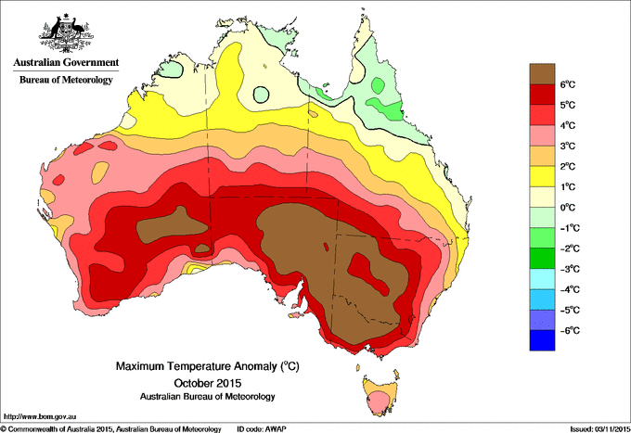
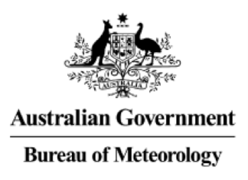

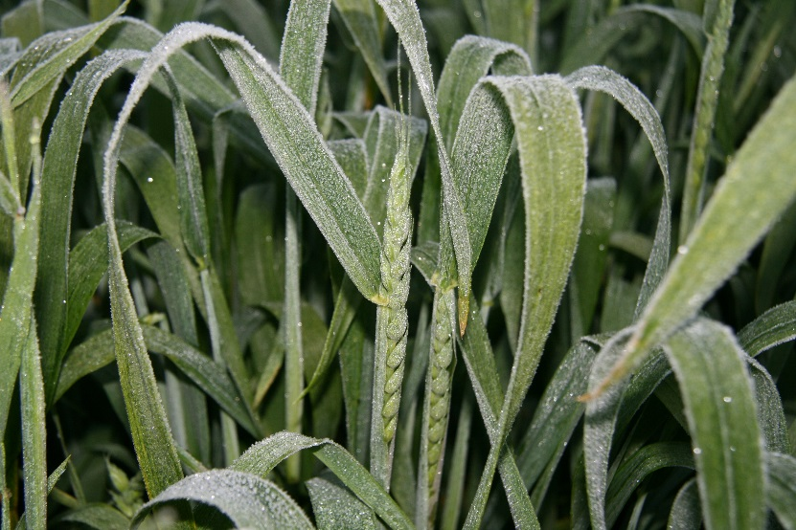
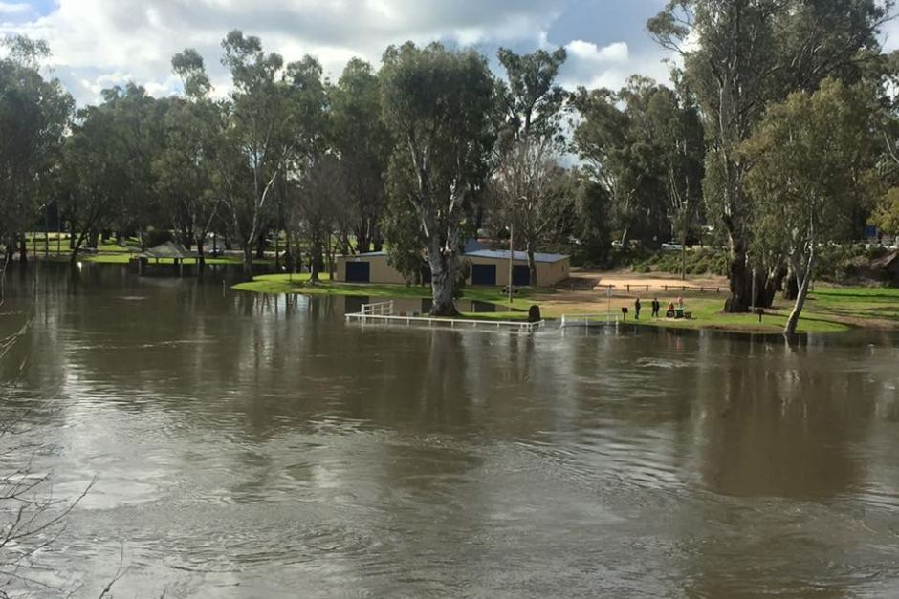
Seasonal Prediction Framework for attribution of extreme events in a changing climate
Pandora Hope, Guomin Wang, Eun-Pa Lim, Harry Hendon, Michael Grose, Mitchell Black, Acacia Pepler, Andrew Dowdy and Julie Arblaster
R&D Workshop November 2018 Pandora.Hope@bom.gov.au

Slide 2
Seasonal prediction is an initial value problem; The future weather/season's climate is determined by the initial conditions that are used to initialise the forecast model. Wang, G., Hope, P., Lim, E.-P., Hendon, H. H., & Arblaster, J. M. (2016). Three methods for the attribution of extreme weather and climate events. Bureau of Meteorology Research Report 018. http://www.bom.gov.au/research/publications/researchreports/BRR-018.pdf
Lim, E. P., H. H. Hendon, J. M. Arblaster, C. Chung, A. F. Moise, P. Hope, G. Young, and M. Zhao, 2016: Interaction of the recent 50 year SST trend and La Niña 2010: amplification of the Southern Annular Mode and Australian springtime rainfall. Clim. Dyn., 47, 2273–2291, doi:10.1007/s00382-015-2963-9.
We can attribute the drivers of an extreme event - climate change; atmosphere, ocean or land; Ocean basin

Slide 3
Coupled seasonal forecast model Predictive Ocean Atmosphere Model Australia –
POAMA is an atmosphere-ocean coupled system:
Atmospheric model: Bureau’s Atmospheric Model v3 (~250km x 250km x 17 vertical levels)
Ocean model: Australian Community Ocean Model 2 (200km x 50-150 km x 25 vertical levels)
coupled by Ocean Atmosphere Sea Ice Soil (OASIS, Valcke et al. 2000)
It is still the system for operational seasonal forecasts at the Australian Bureau of Meteorology
Skill score: correlation of 0.84 over 2000-2014 for all Octobers

Slide 4
Forecast Initialisation:
Realistic atmosphere and land initial conditions generated from ALI (Hudson et al. 2010 Clim. Dyn.)
Realistic ocean initial conditions generated from PEODAS (Yin et al. 2011 Mon. Wea. Rev.)
11 member ensemble forecasts (sometimes x3)
CO₂ concentration set to 407 ppm ~ current level (NOAA Mauna Loa CO₂ data)
Notes:
Note: ALI based on NCEP1, thus can extend back to 1960

Slide 5
Method
Using a seasonal forecasting framework for attribution of climate extremes to increasing atmospheric CO₂
Two forecast ensembles of the event:
One under current conditions,
A second with a background climate if CO₂ increase had halted at 1960: a 'low CO₂' world

Slide 6
Attribution Forecast Initialisation – current conditions, but background climate as it would be if CO₂ increase had halted at 1960.
CO₂ concentration was set to 315 ppm ~ 1960 level (NOAA Mauna Loa CO₂ data)
Realistic ocean initial conditions generated from PEODAS minus an estimate of the change due to CO2 over last 58 years
Realistic atmosphere and land initial conditions minus an estimate of the change due to CO2 over last 58 years

Slide 7
Estimate ocean change due to CO2 increase with POAMA long climate runs
The mean difference of the average ocean initial conditions between high and low CO₂ runs is used as an estimate of D_{Ocean}.
1960
1970
CO₂ 315 ppm
2000
2010
CO₂ 400 ppm
0 Time (year) 26 30
Notes:
Note: ALI based on NCEP1, thus can extend back to 1960. Similar to CMIP5 natural, except only CO2 altered, and only back to 1960

Slide 8
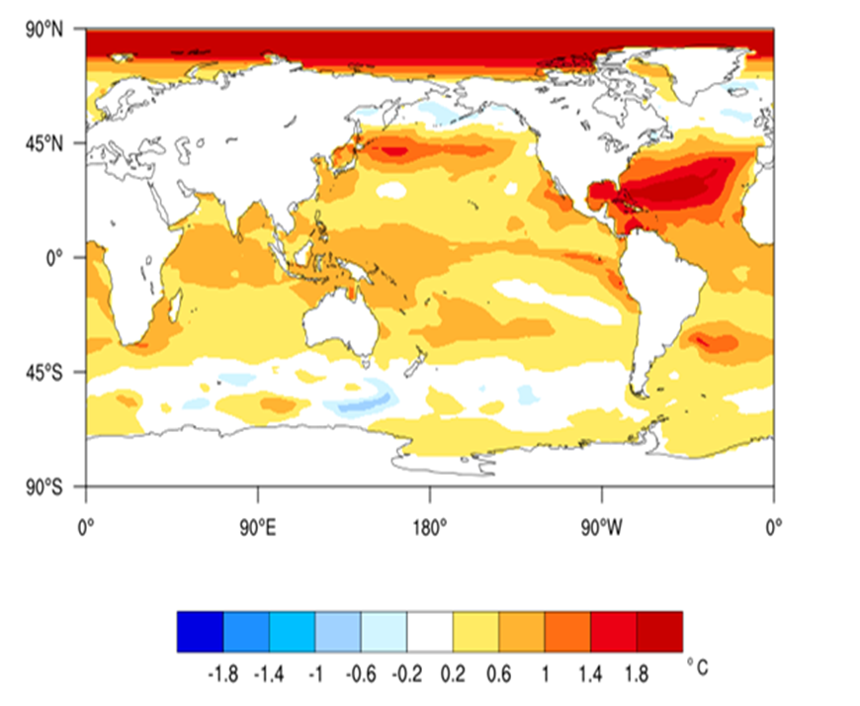
Docean = Difference of two 30 year long runs of POAMA with 400 ppm and 315 ppm CO2

Slide 9
Estimate Land and Atmosphere Changes due to CO2 increase, with POAMA forecasts
Both land and atmosphere respond to the oceans in ~two months time
Their change due to CO2 can be estimated by difference between the mean two month lead forecasts over many years. Reducing internal variability and enhancing the signal, reflecting the response to low CO2 and the lowCO2 ocean
IC: real except Ocean
CO₂ 315 ppm
IC: real
CO₂ ~400 ppm
2000
2001
…
2014
2000
2001
…
2014
0 2 months
1 Aug 1 Oct
0 2 months
Notes:
Note: ALI based on NCEP1, thus can extend back to 1960

Slide 10
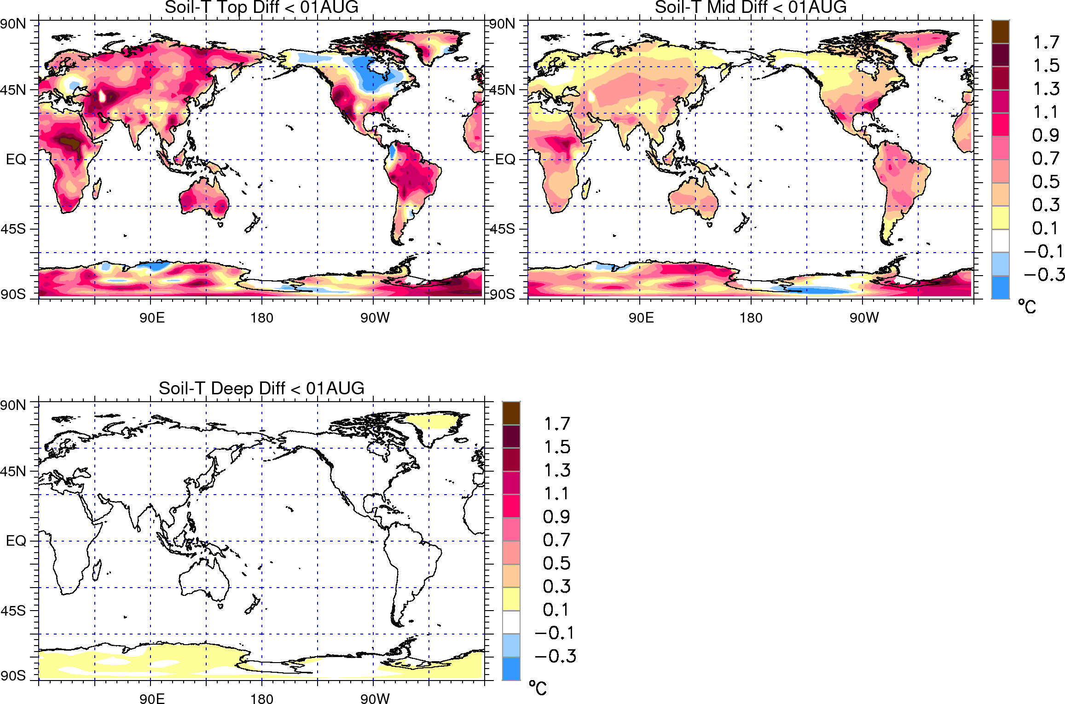
Soil Temperature anomaly

Slide 11
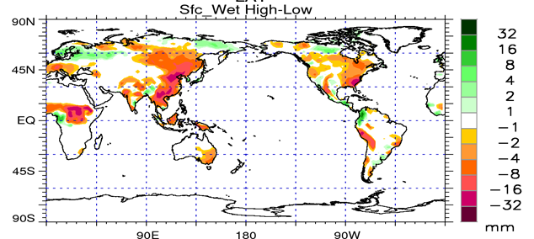
Estimating the impact of CO2 increase since 1960 on the soil moisture

Slide 12
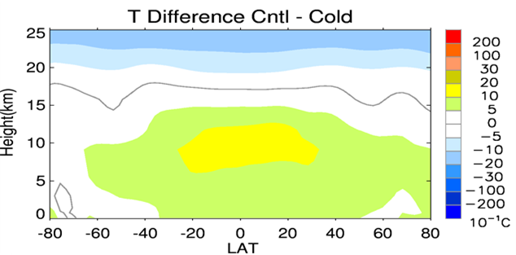
Estimating the impact of CO2 increase since 1960 on the full atmosphere
Atmosphere is sensitive to actual SST

Slide 13
Building a Climatology
The most recent 15 years around 2007: 2000-2014
11 ensemble members for one month forecasts starting in each year on 1st of the month.
15 years x 11 members = 165 member ensemble.
Corresponding 'counter-factual' 1960 climatology?
Using the same starts in 2000-2014, remove the anomaly from ocean, atmosphere and land and reforecast 165 members

Slide 14

October 2015 Tmax anomalies
Average daily maximum temperature
Australia-wide
+3.44°C
Largest anomaly of any month!
Notes:
First of all, we forecast the event

Slide 15
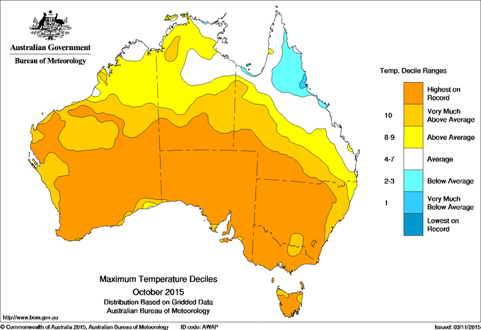
October 2015 Tmax deciles
Notes:
How to remove?

Slide 16
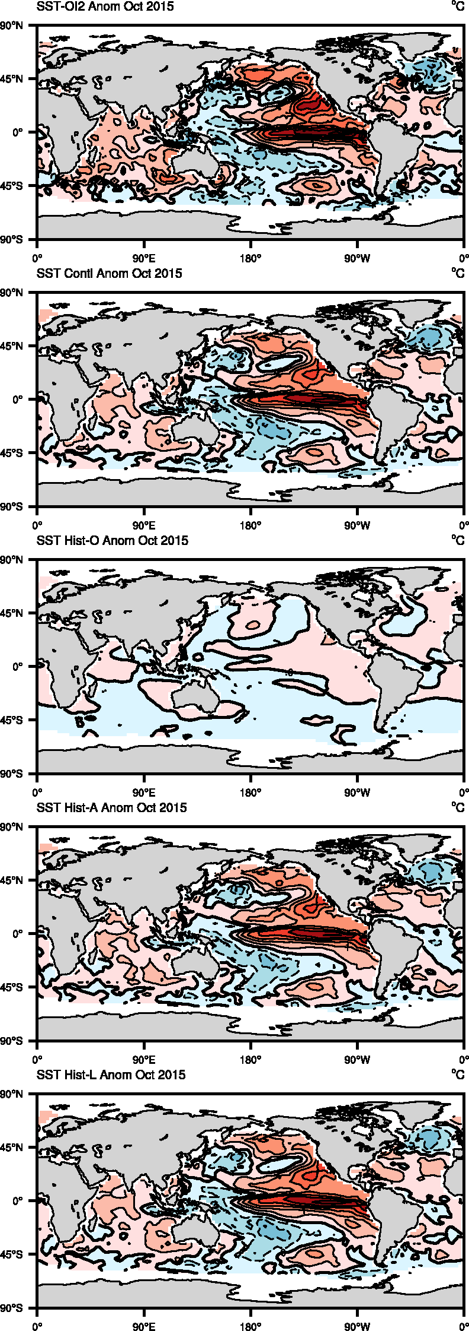
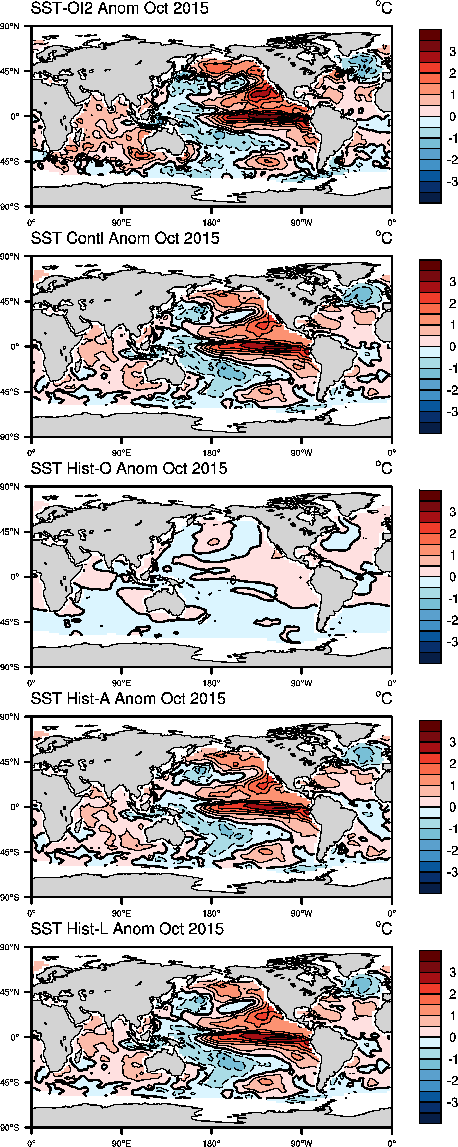
'Natural variability' Oceanic forcing October 2015
+1.4 +2.2 +2.3
IOD +0.76
+0.63
IOD: +0.76
Southern Indian Ocean +0.63 C
Nino4 Nino3.4 Nino3 +1.4 C +2.2 C +2.3 C

Slide 17
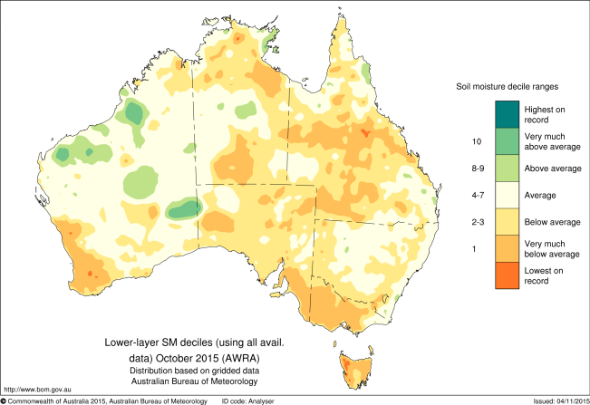
October 2015 lower-layer soil moisture deciles

Slide 18
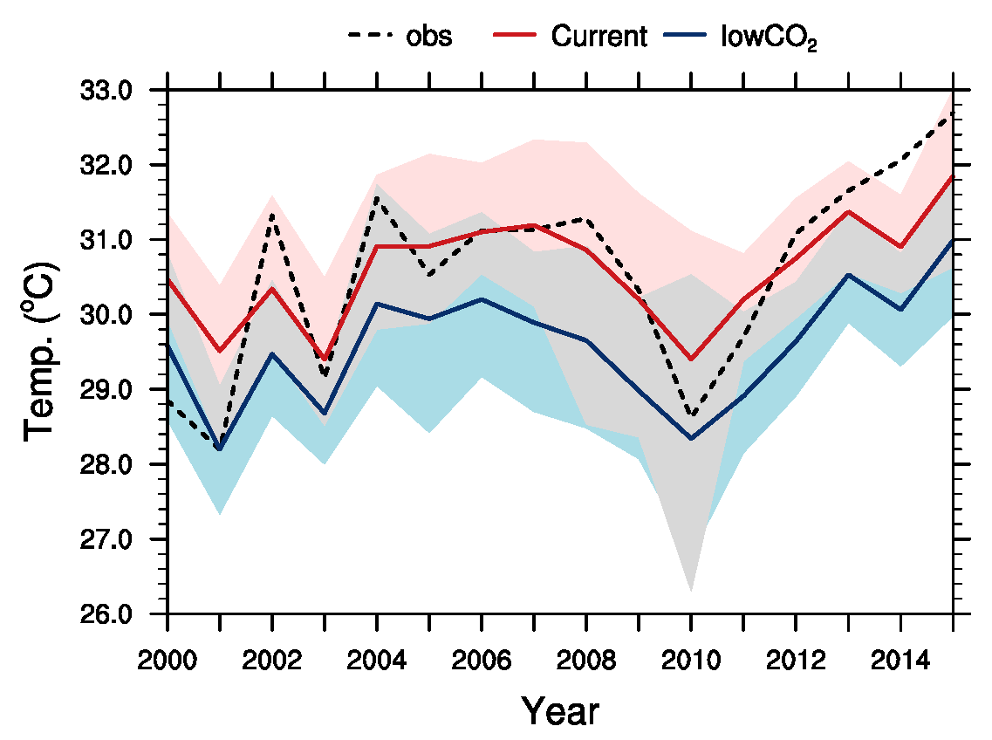
October climatology Observed, current forecast and low CO₂ forecast
11 member October forecasts from October 1

Slide 19
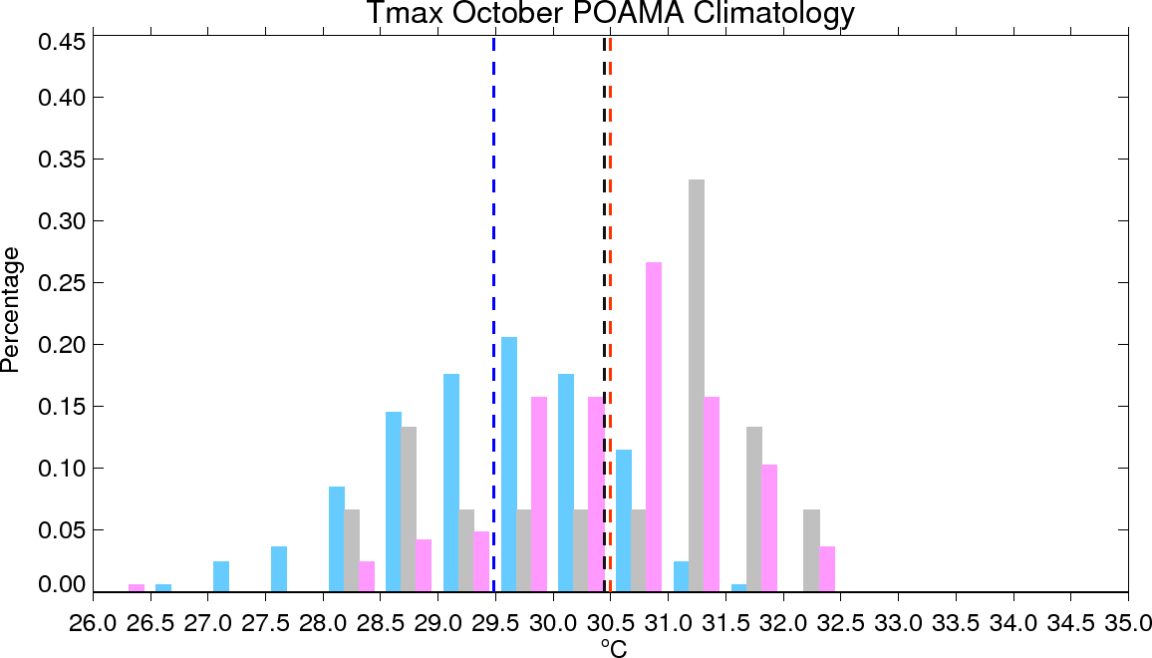
October climatology 2000-2014 Observed, 400 ppm forecast and low CO2 forecast
Climatology Distribution
Obs
Current
LowCO₂
Climatology Mean
Obs
Current
LowCO₂

Slide 20
The likelihood of setting a new record…
From the climatologies:
29 members of 165 surpassed the previous forecast ensemble-mean extreme under the current climate
In the low-CO2 climate, there were 2 members.
This means the FAR value for this event being a record was 1-(2/29) = 0.93
15 times more likely in the current climate than in a low-CO2 climate

Slide 21
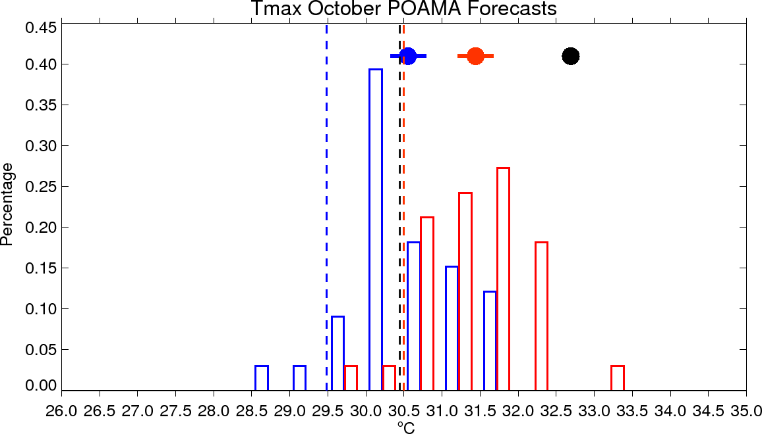
October 2015 forecasts. 33 members Red: current, ~400 ppm CO₂ Blue: low CO₂, ~315 ppm
Forecast Distribution
Current
LowCO₂
Obs & Forecast Mean
Obs
Current
LowCO2
The current climate compared to a lowCO2 climate
brought another 1°C of warmth
Hope et al. 2016

Slide 22
October 2015: Australian warmest month on record
Using the attribution method using the Bureau of Meteorology's seasonal forecasting system we can say:
The forecast 2015 anomaly was 2 degrees warmer than the low-CO2 climatology
2015 had a strong El Nino and positive IOD in October which drove high temperatures across the south, leading to Australia being 1°C relatively warmer than usual.
The current climate compared to a low-CO2 climate meant another 1°C of warmth

Slide 23
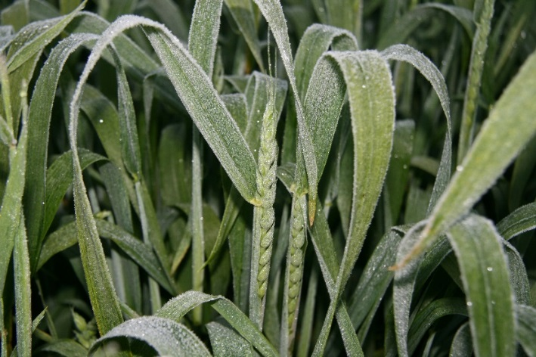
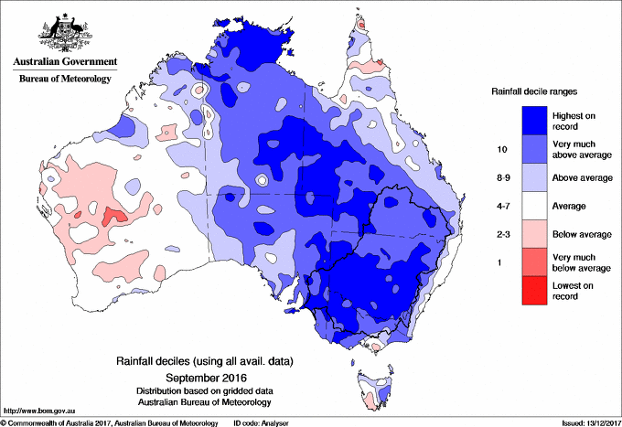
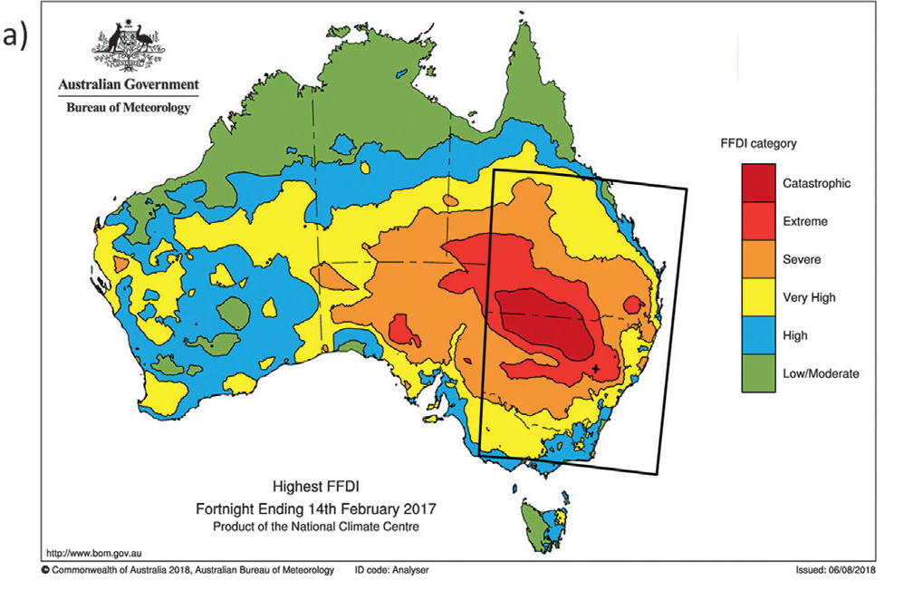
2016: Severe frosts in south west Australia in September Michael R. Grose, Mitchell Black et al. 2018
2016: The wettest September on record in the Murray Darling Basin
Hope, Lim et al. 2018
2017: Catastrophic fires in NSW in Feb. Assess a 'hybrid' FFDI
Hope, Black et al. 2018
BAMS special issue on explaining extremes of 20XX from a climate perspective

Slide 24
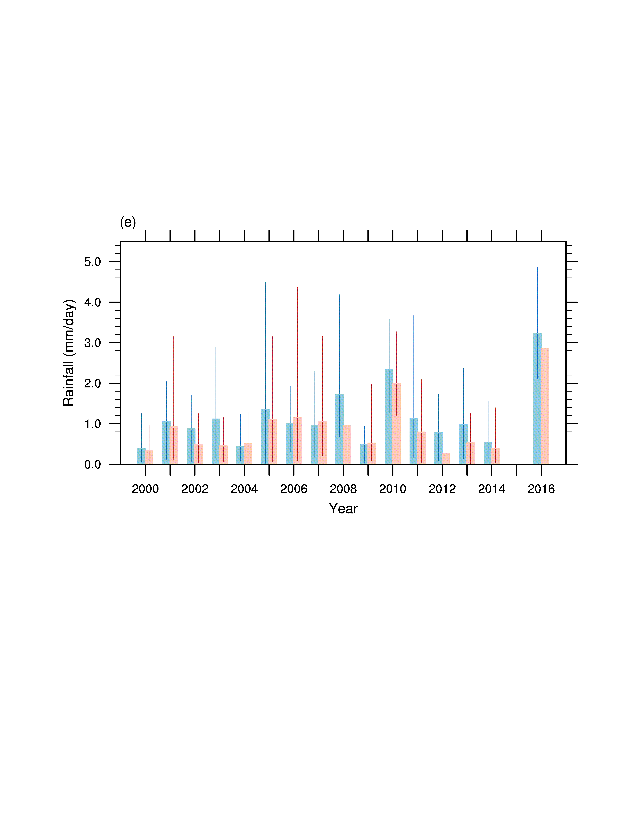
Red: Forecast Murray Darling Basin (MDB) rainfall under current conditions
Blue: Forecast MDB rainfall under 1960 conditions

Slide 25
Plans…
Australian Bureau of Meteorology is now using UK Met Office seasonal forecast model 'ACCESS-S' with different initialisation and ensemble generation
Transfer method to ACCESS-S – Need a new Docean(s?) - and a lot more run time
Think about forcing – ACCESS-S includes more 'forcers'
What is an 'extreme' event, what will 'trigger' analysis?

Slide 26
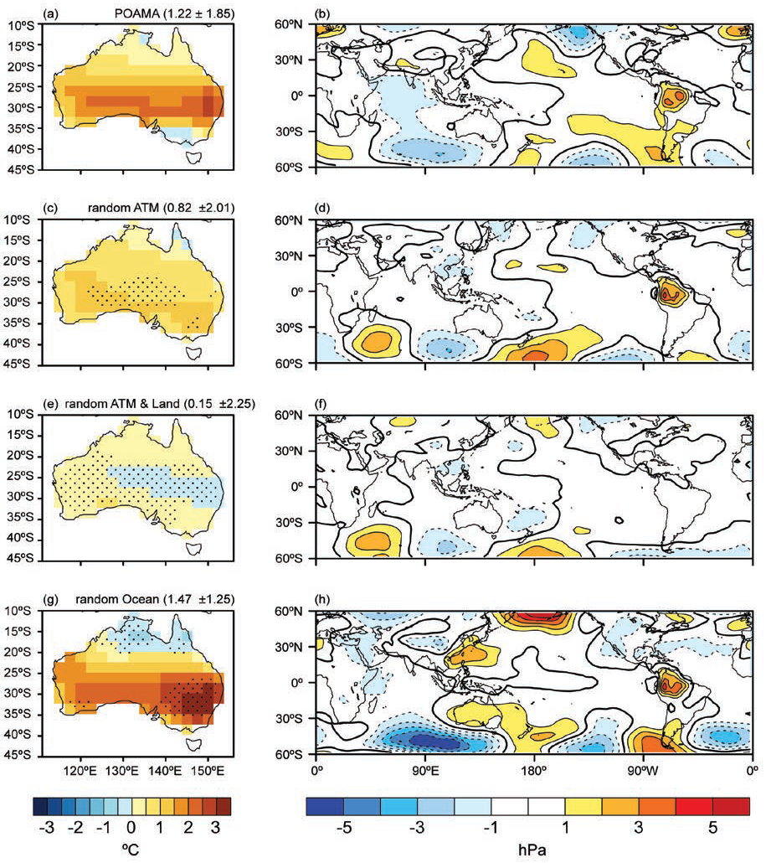
September 2013 Forecast
Forecast Tmax, MSLP anomalies
No information from atmospheric initial conditions
No information from atmospheric or land initial conditions
No information from ocean initial conditions
Arblaster et al 2014

Slide 27
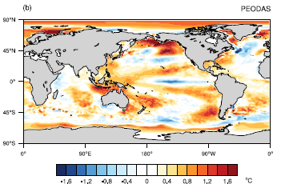
Contextualisation
Fix Ocean Basin (e.g. Indian Ocean) to climatology to determine how much of the forecast signal comes from that basin.

Slide 28
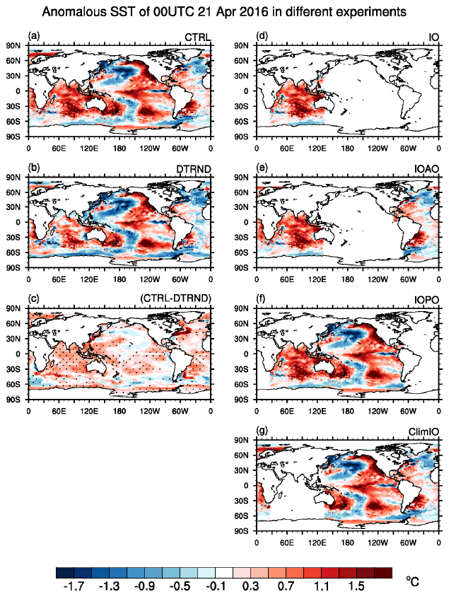
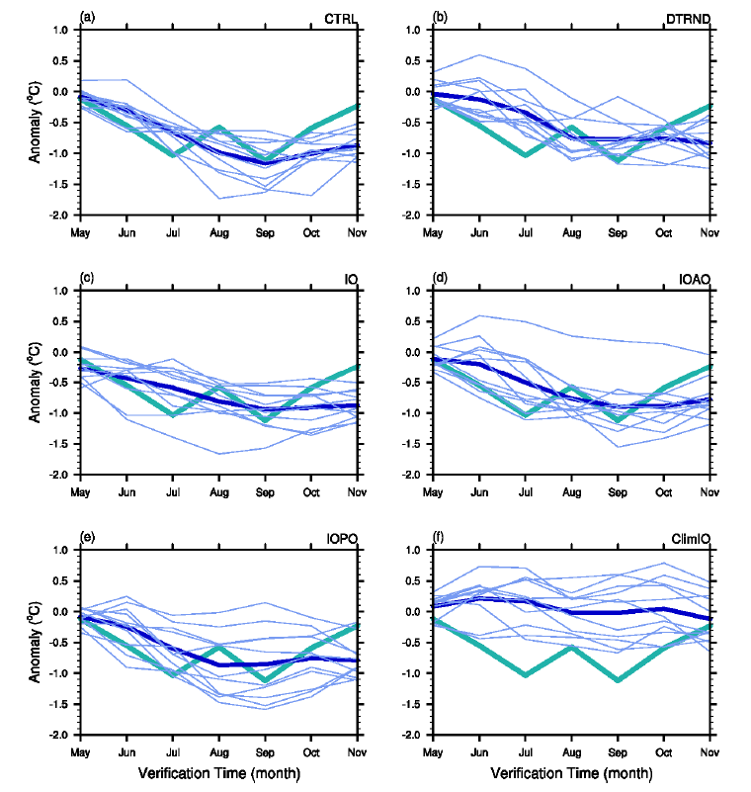
Lim and Hendon 2017, Scientific Reports

Slide 29
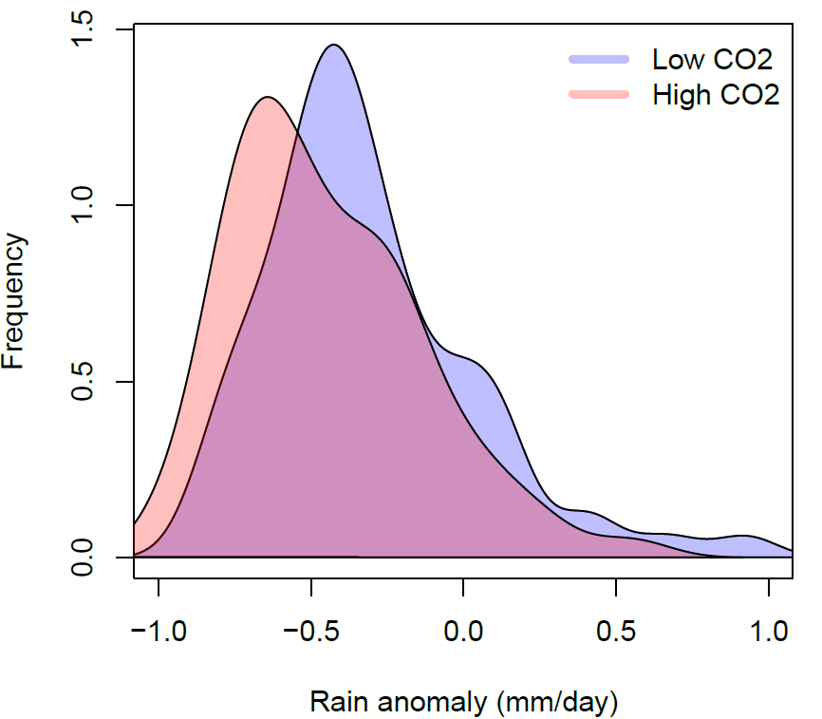
Thank You
Winter 2018
Pandora Hope
Pandora.Hope@bom.gov.au
Winter 2017 Rainfall SE Aust
Winter 2018
Rainfall
R&D Workshop November 2018 Pandora.Hope@bom.gov.au

Slide 30
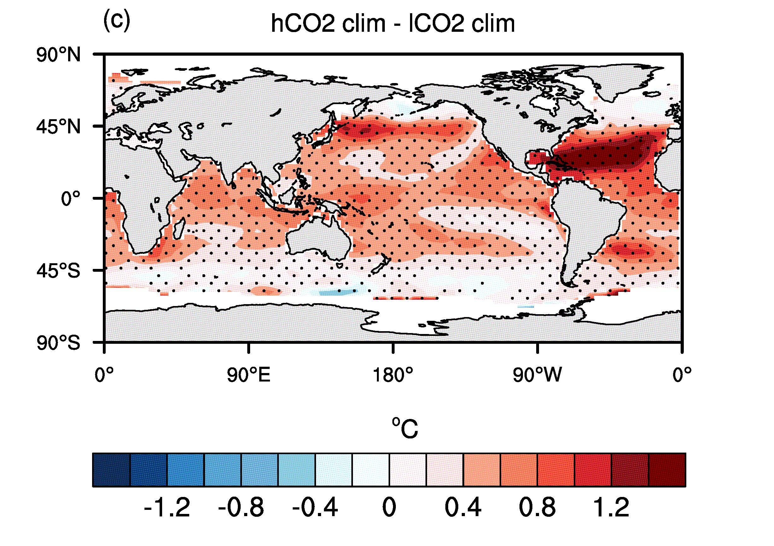
SST
2000-2014 Climatology
Current CO₂ – 1960 CO₂

Slide 31
Stott, pers comm. 2018

Slide 32
SST trend
Lim et al 2016

Slide 33
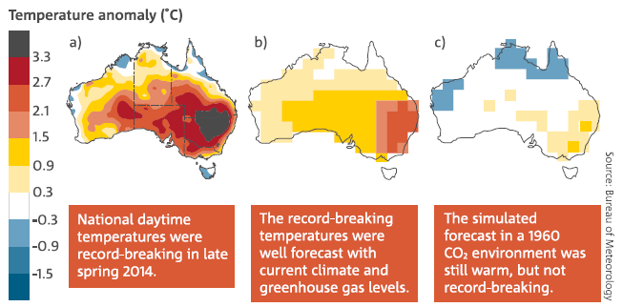
State of the Climate 2016 Determining the cause of extreme weather events
As the global climate system has warmed, changes have occurred to both the frequency and severity of extreme weather. In Australia, the most obvious change has been an increase in the occurrence of record-breaking heat. Quantifying the influence of increasing atmospheric greenhouse gases on extreme weather events is an important component of communicating and planning for future climate change.
Oct-Nov 2014 heat
Observed, and seasonal forecasts
Pandora.hope@bom.gov.au
Notes:
State of the climate – window into the future

