Slide 1
Long range forecasting of tropical cyclones
Paul Gregory with Joanne Camp (UKMO), Yuriy Kuleshov, Katrina Bigelow, Andrew Brown
October 2018

Slide 2
Overview
Storm tracking in low-resolution coupled models – OWZ tracker
Evaluation of full ACCESS-S1 hindcast at sub-seasonal timescales
Realtime ACCESS-S1 and ACCESS-GE results for season 2017-18
How our systems compares with the ECMWF products
Next steps?

Slide 3
Motivation
Since 2009 the BoM has issued statistical seasonal cyclone outlooks
Statistical model uses ENSO indices from July-September to give guidance of storm activity in the subsequent season
Model is calibrated against data going back to 1969-70
Physical basis for this model has become less significant¹
Since 2010, BoM has investigated coupled atmospheric-ocean models for seasonal cyclone forecast skill.
Neither POAMA or ACCESS-S1 have skill at seasonal timescales for predicting TC frequency
BUT – ACCESS-S1 has good skill at multi-week timescales
¹Andrew Dowdy, Long term changes in Australian tropical cyclone numbers, Atmospheric
Science Letters, October/December 2014

Slide 4
'Storm' trackers
Conventional storm trackers rely on vorticity, MSLP and wind speed
Frederic Vitart's ECMWF tracker is an example
How well do these work with coarser resolution coupled models?
E.g ACCESS-S1's atmospheric resolution ~60km
Kevin Tory's OWZ tracker was developed for CMIP models
Uses the Okubo-Weiss Zeta parameter and absolute vorticity to identify regions of solid body rotation
Thresholds of humidity and wind shear
Identifies tracks of conditions favourable to cyclone genesis
No MSLP fields, no wind-speed thresholds

Slide 5
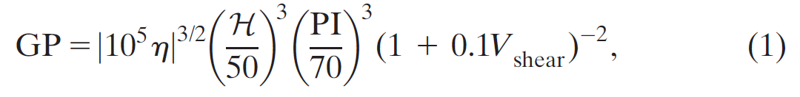
OWZ compared to 'Genesis Potential Index'
GPI: indicators of TC activity (Emanuel and Nolan (2004), ranked in order of importance according by Camargo et al (2009) for MJO modulation of TC genesis
Mid-level relative humidity (600 hPa) (@950 and 700 hPa)
Low-level absolute vorticity (850 hPa) (@850 and 500 hPa)
Vertical wind shear (850−200 hPa) (same)
(Potential intensity PI)
Kevin's OWZ scheme also uses specific humidity at 950 hPa

Slide 6
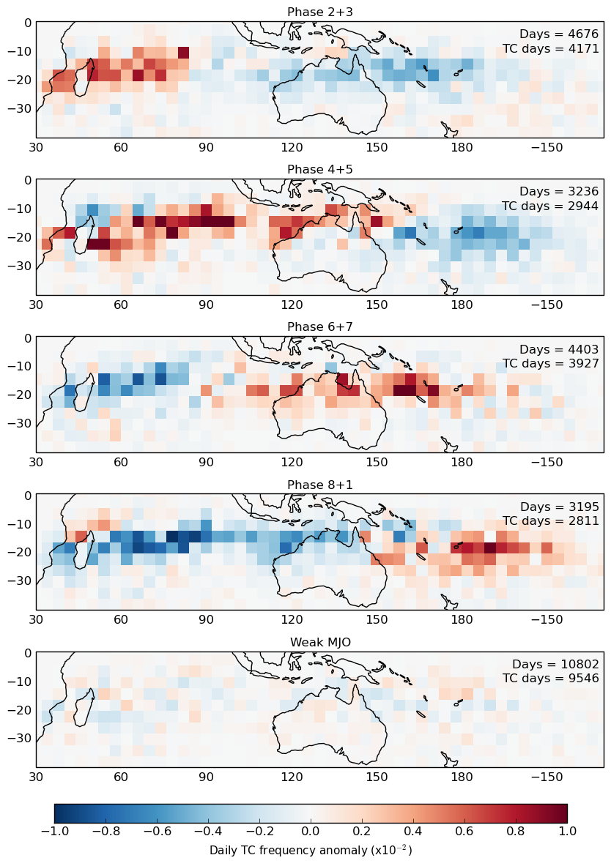
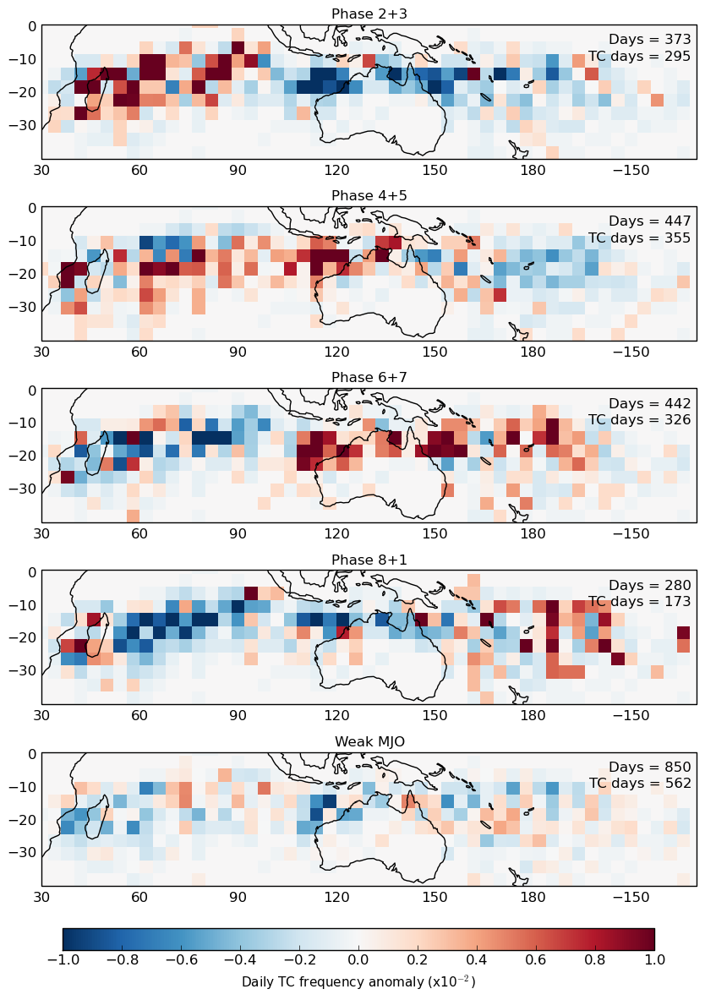
ACCESS-S1– multi-week skill
The MJO-TC relationship in ACCESS-S1
1990−2012
Days: 15-40
ACCESS-S1 correctly simulates regions of enhanced and reduced TC tracks w/MJO phase
Captures changes in the large-scale environment with the phase of the MJO e.g. mid-level relative humidity and low-level absolute vorticity.
J. Camp et al. Skilful multi-week tropical cyclone prediction in ACCESS-S1 and the role of the MJO, Quarterly Journal of the Royal Meteorological Society, February 2018
ACCESS-S1
Observations
Phase 2+3
Phase 4+5
Phase 6+7
Phase 8+1
Weak MJO

Slide 7
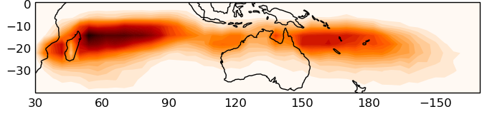
Forecast verification - reliability
Need as much data as possible!
Divide the southern hemisphere into 60 15°x20° boxes (Vitart et al 2010)
For each start date from Nov-April (24), year (23) and box (60) get the forecast probability of a TC occurrence (33,120 forecasts in total)
Then compare to observations (1 = event occurred; 0 event did not occur)
Start dates: 4 per month (1st, 9th, 17th and 26th ) from 1990−2012 for full hindcast

Slide 8
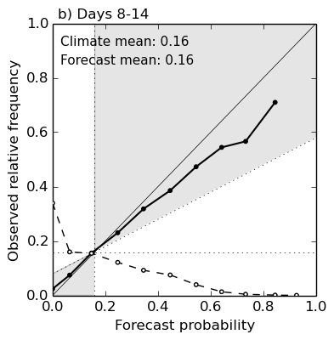
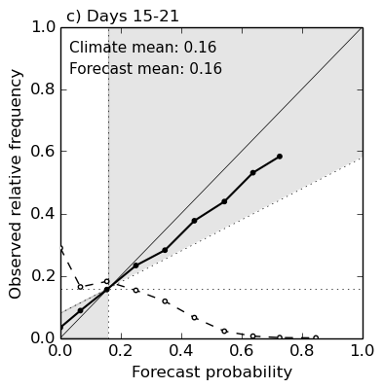
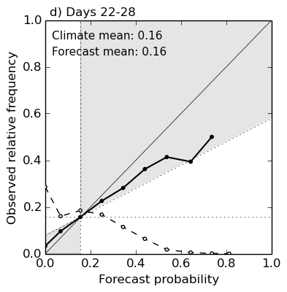
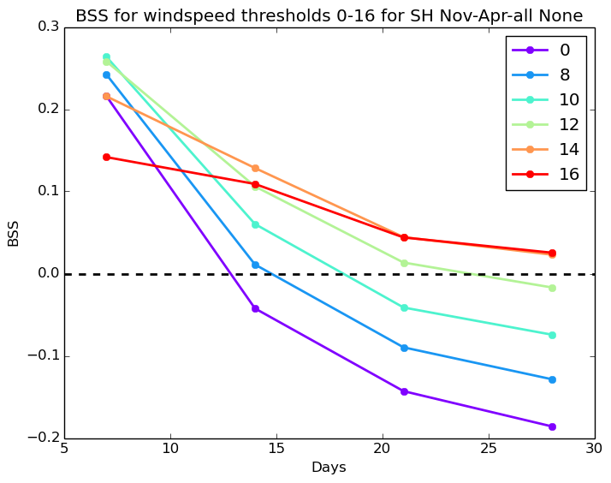
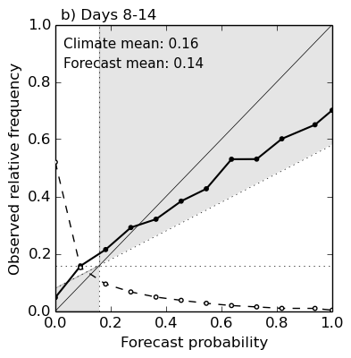
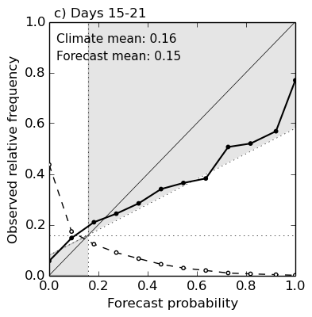
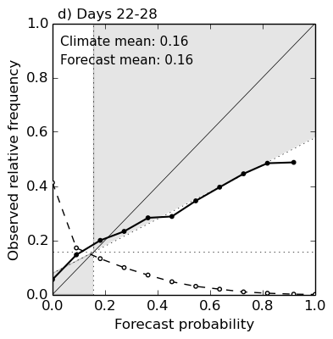
Results for November-April climatology
Reliability diagrams for Calibrated tracks (top) and raw tracks (bottom) for 15x20°overlapping boxes
Raw tracks have a 14 m/s windspeed threshold applied to 850 hPa winds which improves skill at longer leadtimes (see Figure at right)
Calibrated tracks
BSS 0.173
BSS 0.103
BSS 0.077
Raw tracks
BSS scores > 0 implies skill
(the higher the better)
BSS 0.128
BSS 0.044
BSS 0.023

Slide 9
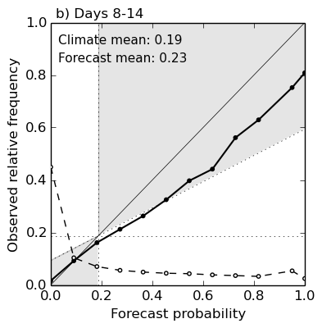
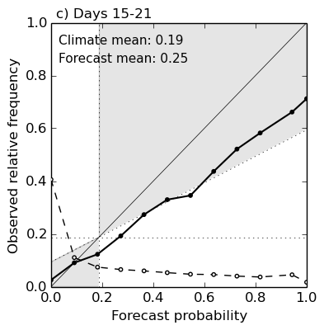
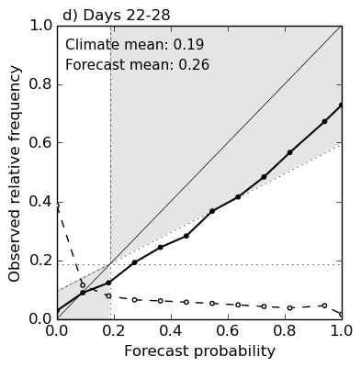
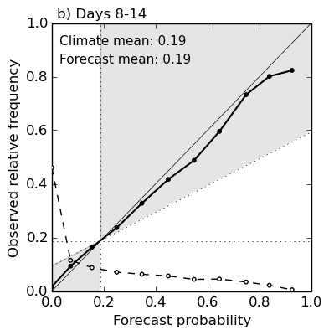

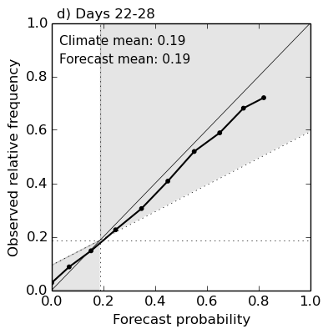
Performance in the North West Pacific
ACCESS-S1 shows better raw skill in the North West Pacific
Raw skill in 15 x 20°boxes from
0-30 N, 90-180 E for full hindcast
BSS 0.270
BSS 0.165
BSS 0.134
Calibrated skill in 15 x 20°boxes from
0-30 N, 90-180 E using full hindcast
BSS 0.329
BSS 0.259
BSS 0.240

Slide 10
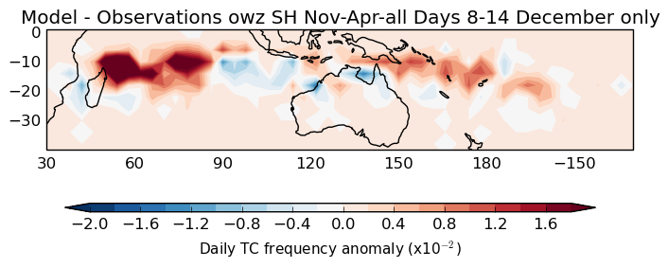
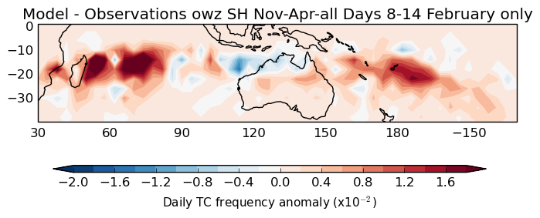
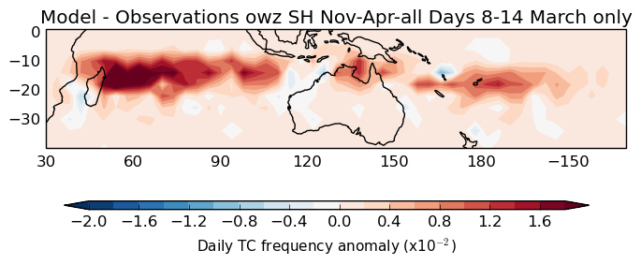
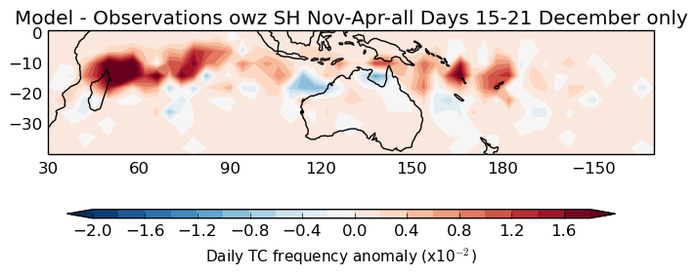
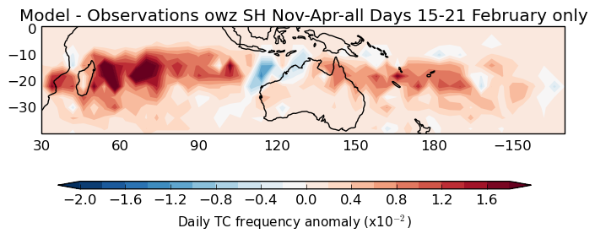
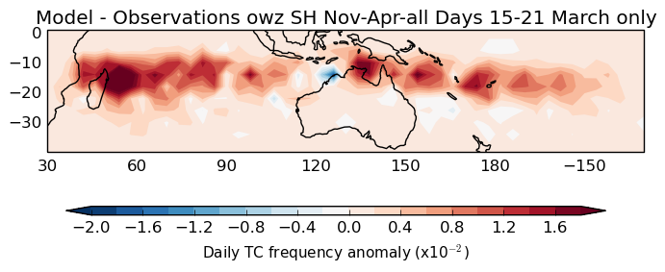
Monthly analysis
Full hindcast allowed analysis of ACCESS-S1 for each month from November-April
Hindcast bias changed during the season (especially near Australia)
Hindcasts initialised in April showed no skill!
Plots of TC frequency anomalies (forecast – observed) for different months in the hindcast.
From L to R : December, February and March. From top to bottom : Days 8-14, Days 15-21

Slide 11


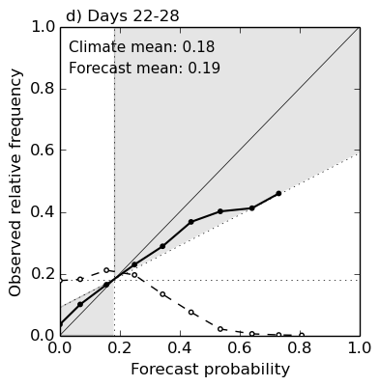
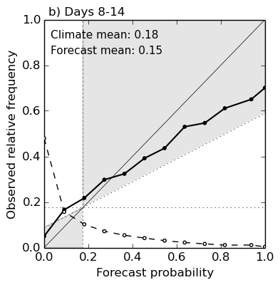
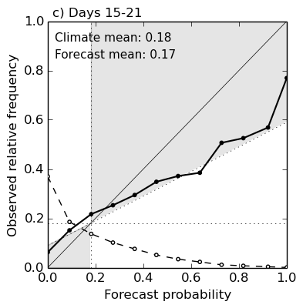
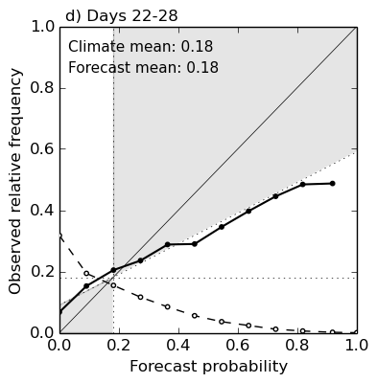
Results for November-March
Calibrated tracks (top) and raw tracks (bottom) for SH (15x20°overlapping boxes)
Applying monthly calibration gives poorer performance (in red)
Little difference in raw track skill with windspeed threshold
Operational ACCESS-S products will run from November-March only
BSS 0.156
BSS 0.093
BSS 0.060
BSS 0.144
BSS 0.085
BSS 0.042
BSS 0.129
BSS 0.040
BSS 0.005

Slide 12
Realtime 2017-18 evaluation (initial)
ACCESS-S1 was run in prototype mode for most of the 2017-18 cyclone season
38 forecasts were processed with mainly 11 ensemble members
Calibration used the initial hindcast (4 start dates from Nov-Feb)
Calibration had lesser impact outside this period
Results submitted to Royal Meteorological Society's Atmospheric Science Letters Journal.
Lead time | BSS
November-April | Raw* | Calibrated
Days 8-14 | 0.185 | 0.109
Days 15-21 | 0.070 | 0.027
Days 22-18 | 0.050 | 0.043
November-Feb | BSS
 | Raw* | Calibrated
Days 8-14 | 0.282 | 0.185
Days 15-21 | 0.143 | 0.165
Days 22-18 | 0.098 | 0.162
*with windspeed threshold

Slide 13
Realtime 2017-18 evaluation (final)
157 ACCESS-S1 forecasts with all 33 ensemble members
Performed after full hindcast was complete
Results were better than hindcast
Related to MJO in 2017-18?
Use of ACCESS-G c/f ERA to provide initial condition?
Extra ensembles?
Using monthly calibration provided no overall improvement
Investigation of lagged ensembles ongoing
Lead time | BSS
November-April | Raw* | Calibrated
Days 8-14 | 0.209 | 0.182
Days 15-21 | 0.125 | 0.140
Days 22-28 | 0.108 | 0.121
*with windspeed threshold

Slide 14
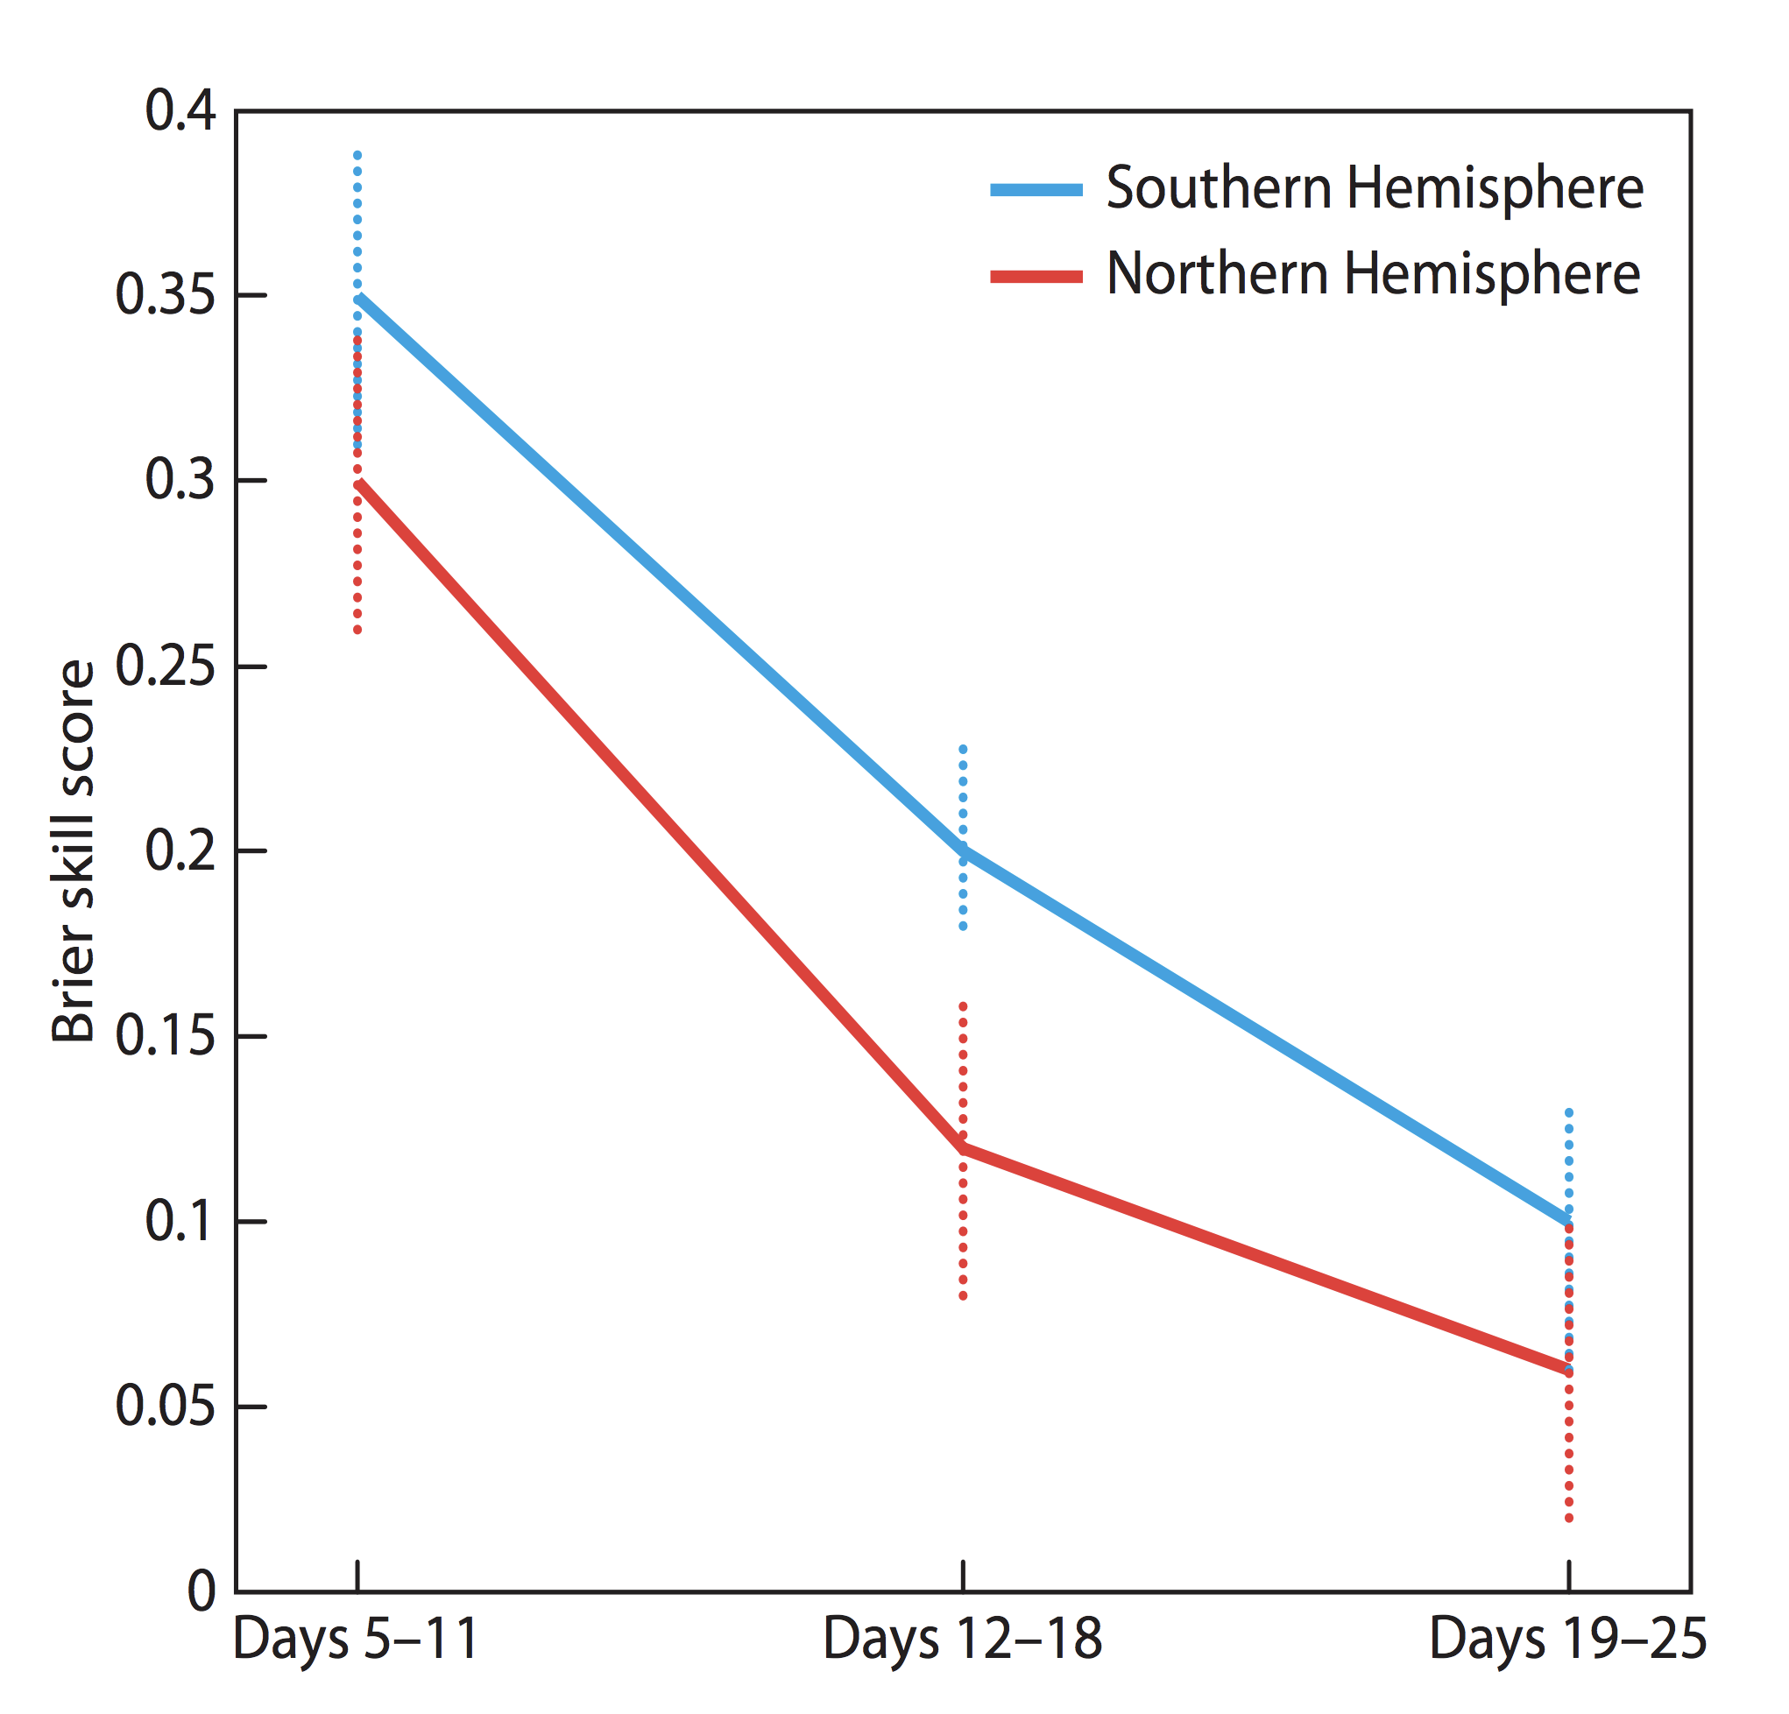
Comparison with ECMWF product
ECMWF multi-week skill assessed² in 2012
With same 15x20º verification regions and period (Nov-April)
Leadtime | ECMWF | ACCESS-S1
 |  | Raw* | Calibrated
Days 5-11 | 0.35 | 0.20 | 0.22
Days 12-18 | 0.21 | 0.08 | 0.12
Days 19-25 | 0.11 | 0.04 | 0.08
*with 14 m/s windspeed threshold
²F. Vitart et al., New tropical cyclone products on the web, ECMW Newsletter 130 – Winter
2011/12, pp 17-23

Slide 15
Comparison with ECMWF product (cont.)
We have skill in the multi-week space – can we do better in future?
ECMWF forecast suites
Weather
Sub-seasonal
Seasonal
NWP (days 0-15)
Integrated Forecast system (IFS)
atmospheric data assimilation
w/51 ensemble members*
Sub-seasonal (days 0-46)
Run NWP ensemble IFS at
coarser resolution with
atmospheric data assimilation
coupled to ocean
Seasonal (0-7 months)
SEAS5
Seasonal coupled model with
ocean data assimilation
BoM forecast suites
Weather
Sub-seasonal
Seasonal
NWP (days 0-10)
ACCESS Global Ensemble (GE2)
atmospheric data assimilation
w/24 ensemble members
Perturb seasonal model to
give sub-seasonal skill
Seasonal (0-7 months)
ACCESS Seasonal (S1)
Seasonal coupled model with
ocean data assimilation (S2)
*all ECMWF NWP is now coupled to the ocean as of July 2018

Slide 16
ACCESS-S1 vs ACCESS-GE2
ACCESS-S1 is a seasonal prediction model (UKMO Glosea5 system)
Uses an atmospheric model (UMv8.6 at 60 km resolution) coupled to an ocean model (NEMO)
Has no atmospheric data assimilation
Ensemble spread is generated with scaled random perturbations
ACCESS-GE2 is a global Numerical Weather Prediction model
Currently uses same atmospheric model at same resolution with atmospheric data assimilation using an Ensemble Kalman Filter
Ensemble spread is informed by current observations
ACCESS-GE2 has been in prototype testing for a few years
Upgraded model and resolution (GE3) to run in trial mode from late 2018

Slide 17
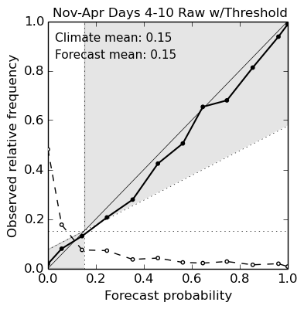
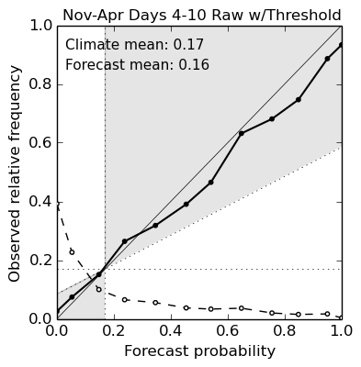
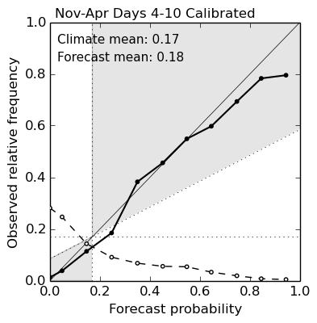
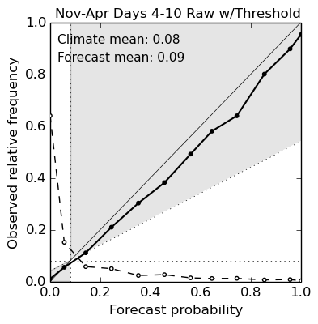

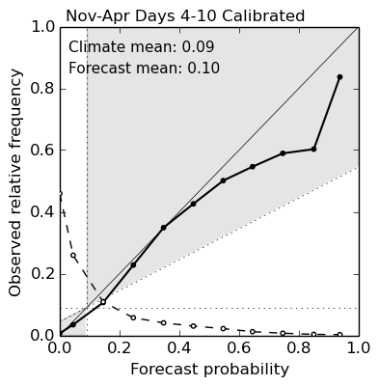
ACCESS-GE2 Realtime results for 2017-18
Comparison for 15x20°overlapping boxes (top-row) – days 4-10
Comparison for 10x15°overlapping boxes (bottom-row) – days 4-10
ACCESS-GE2 performs very well at finer spatial scales
ACCESS-GE2
ACCESS-S1
ACCESS-S1
15x20°overlapping boxes
BSS 0.379
BSS 0.302
BSS 0.302
ACCESS-GE2
ACCESS-S1
ACCESS-S1
10x15°overlapping boxes
BSS 0.331
BSS 0.276
BSS 0.260
BSS 0.128

Slide 18
Available products for 2018-19
Raw tracks – provide information on likely storm directions
ACCESS-GE2, days 4-10
ACCESS-S1, weeks 1- 4
Strike probabilities – show likelihood of storm tracks passing within a threshold distance
ACCESS-GE2, days 4-10 within 120 km radius
ACCESS-S1, weeks 1-4 within 300 km radius*
Calibrated probabilities – likelihood of storm activity within overlapping 15x20° and 10x15° boxes (Southern Hemisphere only)
ACCESS-S1, weeks 1-4
Other products dependent on customer feedback
*maintain consistency with ECMWF multi-week product

Slide 19
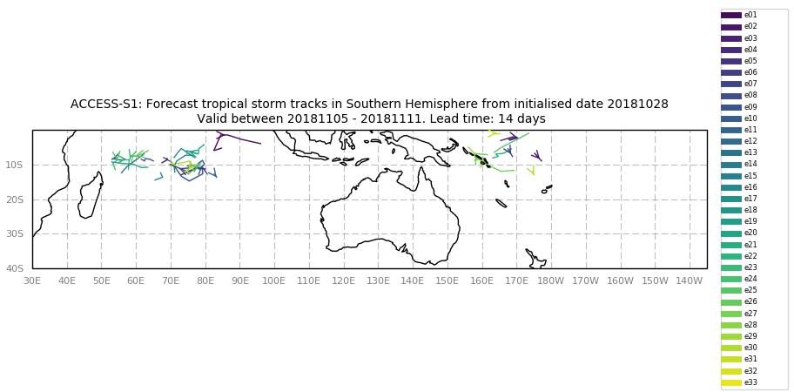
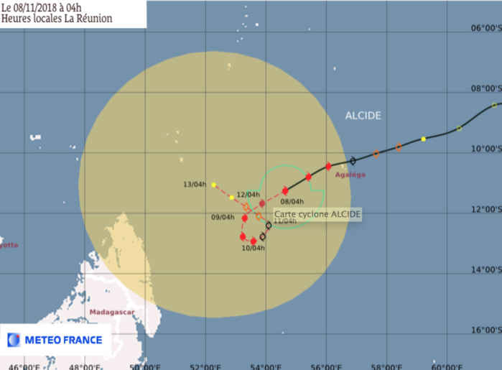
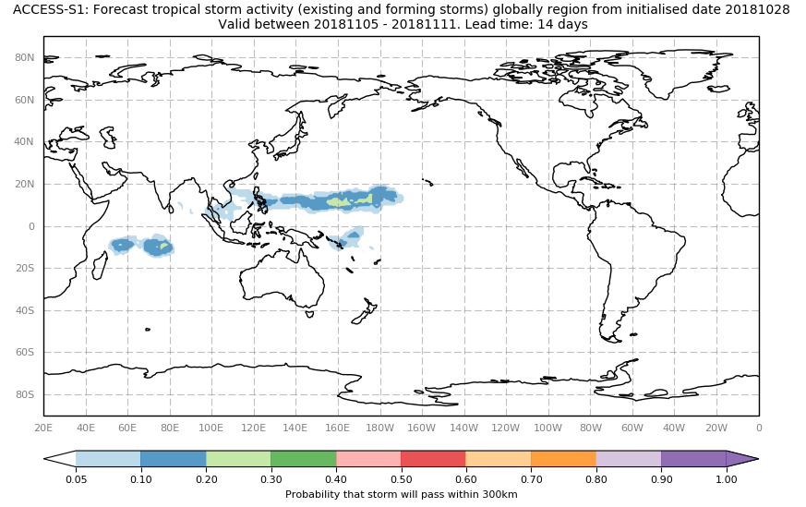
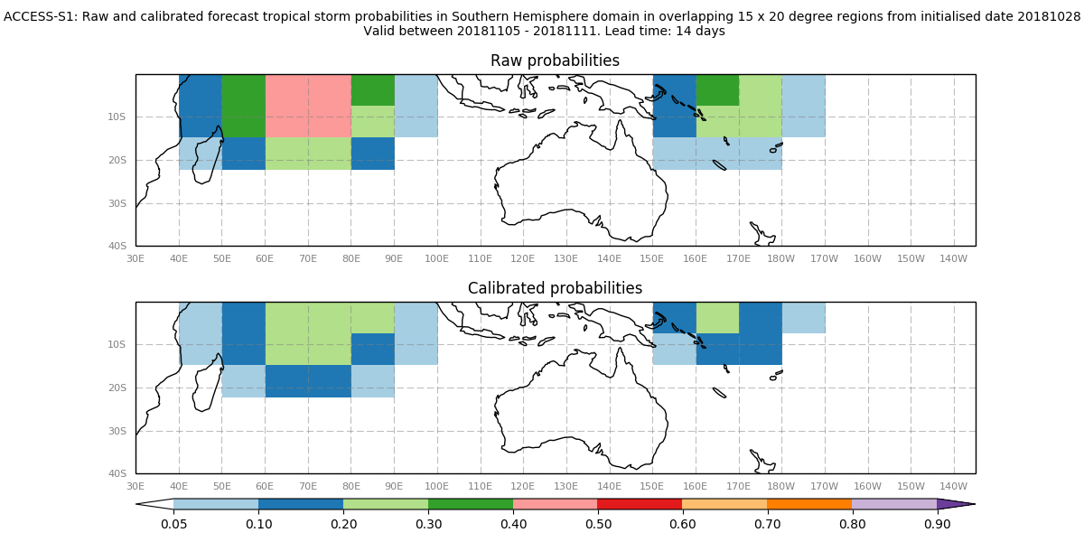
Available products for 2018-19
Availably internally* : http://enso.bom.gov.au/~pgregory/web/project/tc/
Hopefully availably externally soon (password-protected) : http://poama.bom.gov.au/
Cyclone Alcide – Nov 7-11
*thanks to the S2S Coupled Modelling team

Slide 20
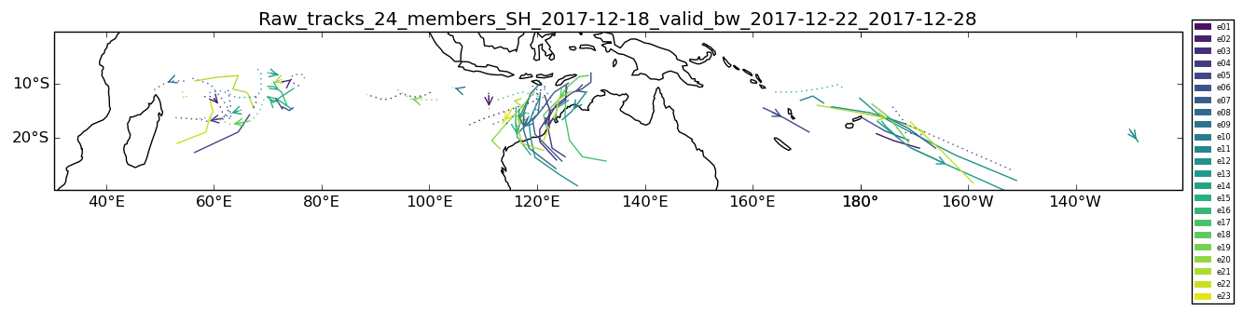
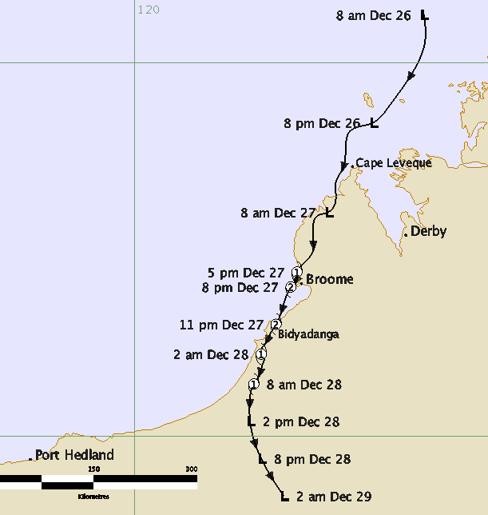
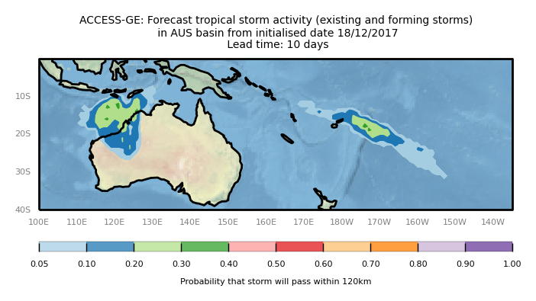
Case studies– ACCESS-GE2
4-10 day forecast for Cyclone Hilda issued on 18th December 2017
Hilda was active from 27th-29th December 2017

Slide 21
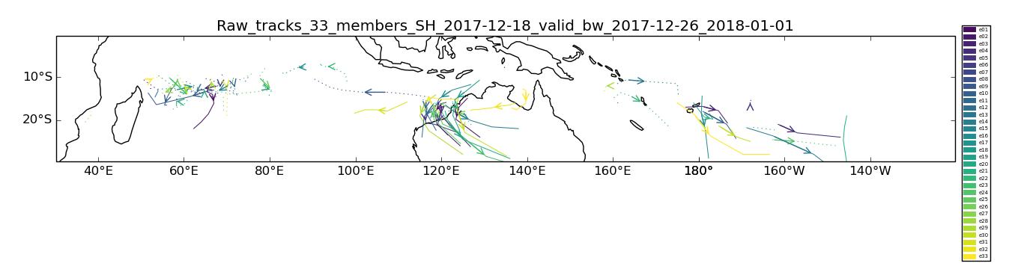
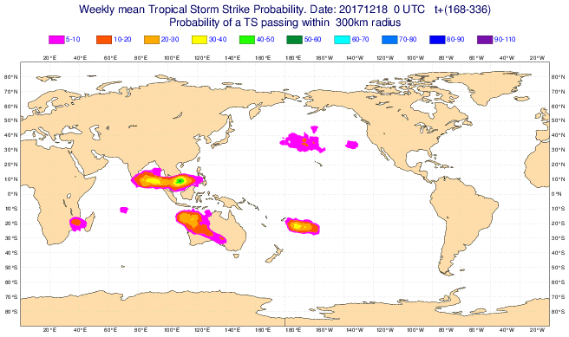
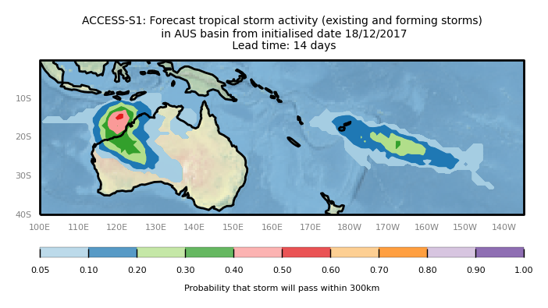
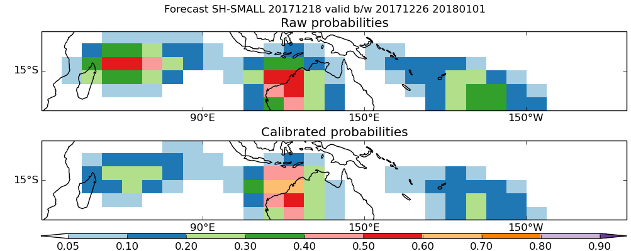
Case studies– ACCESS-S1
8-14 day forecast for Cyclone Hilda issued on 18th December 2017
ECMWF Forecast 20171218
Days 7-14

Slide 22
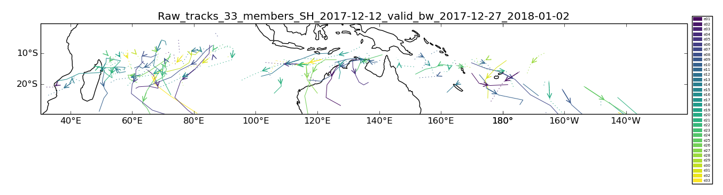
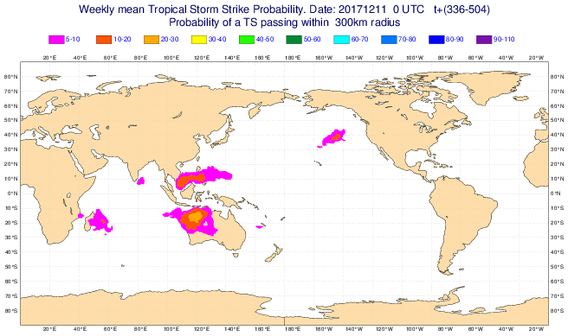
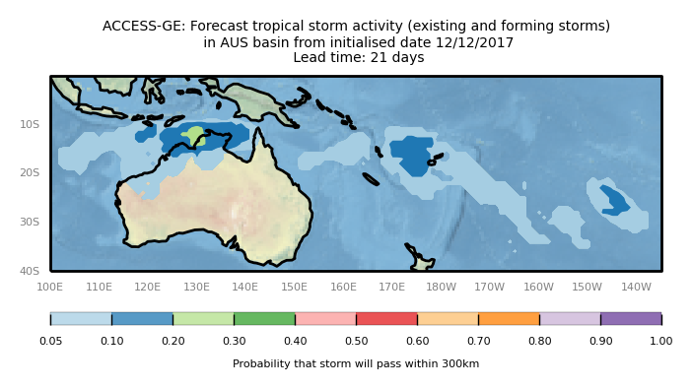
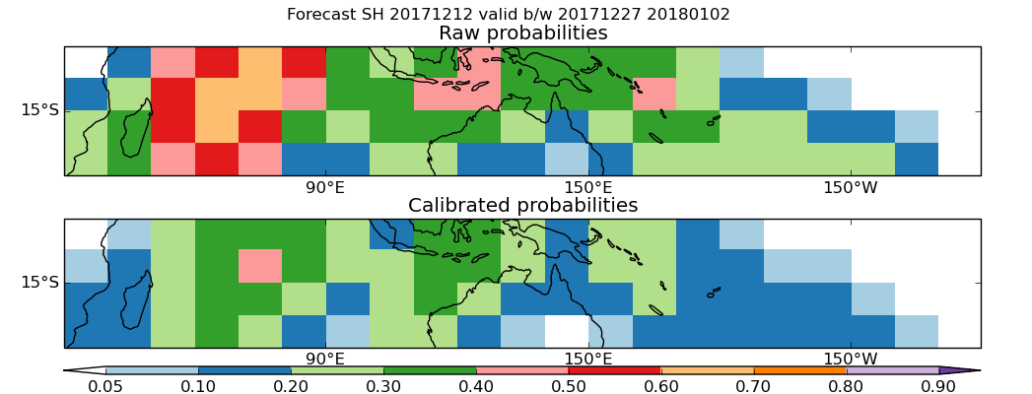
Case studies– ACCESS-S1
15-21 day forecast for Cyclone Hilda issued on 12th December 2017
ECMWF Forecast 20171211
Days 14-21

Slide 23
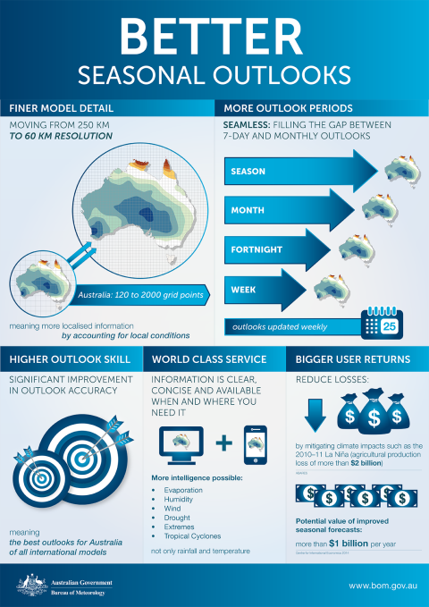
Path to Operations?
Existing user demand
Internal Extreme Weather Desk and WA Cyclone Forecasters
Bureau strategy
"Enhanced sub-seasonal to seasonal and multi-year forecasts."
"Seamless forecasts from days to seasons using enhanced ACCESS-S integrated with ensemble-based NWP."
Science and technology suite linked to customer needs which is fit for purpose and includes increased accuracy and rapid updates, multi-week models, greater efficiency in delivering routine services and machine to machine contact.
Organizational structure
Hundreds of BoM staff for operational delivery products for days 0-7
10-20 of BoM staff " " months 1-3
How many for days 7-28?

Slide 24
Path to Operations?
External user demand
Emergency services
Discussions with NT Emergency Services : "Any guidance between week two and week six is of great benefit."
WA DFES : " Mining industry still getting more data and ahead of emergency partners that is certainly the perception. These people go out and post things on Facebook .. we have then we have to put the cat in the bag. "
WA Senior Waterways engineer: "Big gap in the cyclone stuff, we pay a subscription to OZ Chaser* … has different things it says about the (cyclone) track, it’s nice to know in the back of my mind, to know ahead of time what s might be happening in the next two weeks"
Energy infrastructure off NW shelf
BoM currently supplies multi-week TC product commercially. Text-only, using inputs from ECMWF and MJO forecasts.
*https://www.ozcyclonechasers.com.au/

Slide 25
Further development?
ACCESS-GE3 operational 2019 : 18 ensembles every 6 hours, ~double spatial resolution c/f GE2.
A dedicated multi-week model?
Couple GE3 at coarser resolution to a shallow 'slab' ocean? (similar to ECMWF strategy)
Improved initialisation of seasonal model?
Use GE3 ensembles to inform atmospheric spread for ACCESS-S3?

Slide 26
Final comments
David Rodgers (World Bank and ex-head of UKMO) at APEC Climate Change Symposium 2017 Re: Use of ensembles.
"ECMWF is moving away from any deterministic forecasting. We have to understand and make decisions with uncertainty. But focusing on deterministic approach is not helpful which is why we make bad decisions. Getting users/stakeholders to make decisions informed by uncertainty will get us making better decisions. Forecasts may not be better, but they will more useful."
BoM National Forecast Services Group Plan 2017-22:
Goal statement: Leverage our knowledge and insight to have zero lives lost through natural hazards and increase social and economic benefits by $1 billion to all Australians by 2022.
Cyclone impacts cost $$$$ and lives.

