Slide 1
Ensemble methods for NextGen Projections: National climate projections in Australia
Michael Grose, Jo Brown, John Clarke, Aurel Moise, Jason Evans, Rob Colman
Plus members of the working group

Slide 2
Before we start
NextGen so far: Nov 2017 workshop, report and discussion paper, implementing plan in new NESP ESCC work
Part of an ongoing process, coordinating with many groups and projects - get in touch, get involved
Facilitated by the NESP ESCC role as a collaboration hub – DoEE, CSIRO, Bureau, 5x Universities and bringing in many partners (other Unis, UKMO, NIWA)
See the website www.nespclimate.com.au
Subscribe to Teleconnections, our quarterly update
Science webinars

Slide 3
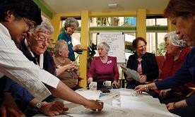
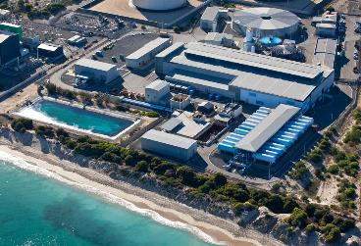

What are projections for?
Raising issues, awareness, stimulating thinking, inspiring interest and action
IAV assessment – informing the ‘top-down’ component
Informing specific adaptation decisions
Motivating emissions mitigation

Slide 4
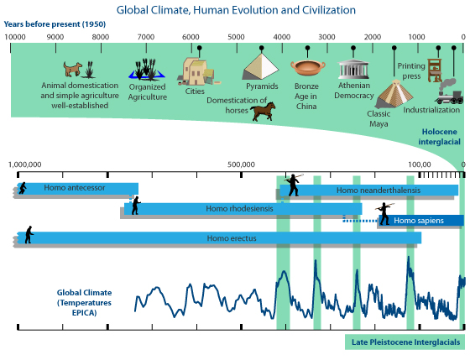
What are projections for?
5. Thinking about where the world is going
10,000 years
~360 generations
Stable climate
~250 years
~10 generations
+1 °C
2100
+3 generations
+1.5, 2 or +4 °C?
~0.5 or 1 m SLR?
2300
+10 generations
+2 or +8 °C?
1 or 3+ m SLR?
1,000,000 years
~36,000 generations
Graphic: John Garrett, obtained from Sceptical Science

Slide 5
What makes projections successful?
Credibility but low salience | Scientific papers in technical language
Salience but low credibility | Clickbait journalism about public health issues such as diet
Credibility and salience, but low legitimacy | A brilliant and easy-to-understand report sitting on a shelf gathering dust
Credible
Salient
Legitimate

Slide 6
Timeline – projects featuring new modelling
CMIP3
CMIP5
CMIP6
IPCC
FAR
IPCC
Supp.
IPCC
SAR
IPCC
TAR
IPCC
AR4
IPCC
AR5
IPCC
AR6
1990
1995
2000
2005
2010
2015
Greenhouse
1987
CFT
National
Releases
????
NARCLIM
Goyder
SEACI
IOCI
Various state projects
SEQld
VicCI & DELWP

Slide 7
Current and future
www.climatechangeinaustralia.gov.au Australia’s national climate projections released in 2015, various ongoing important state activities
New needs, new questions:
Meeting/breaking Paris targets, pathways to 2 °C or less: overshoot, CO₂ removal, climate engineering
Finance sector: $ costs, liability, global markets
Energy sector: extreme events, compounding impacts
Etc.
In the next ten years: many options, many sets of models to use, ensemble generation methods are important

Slide 8
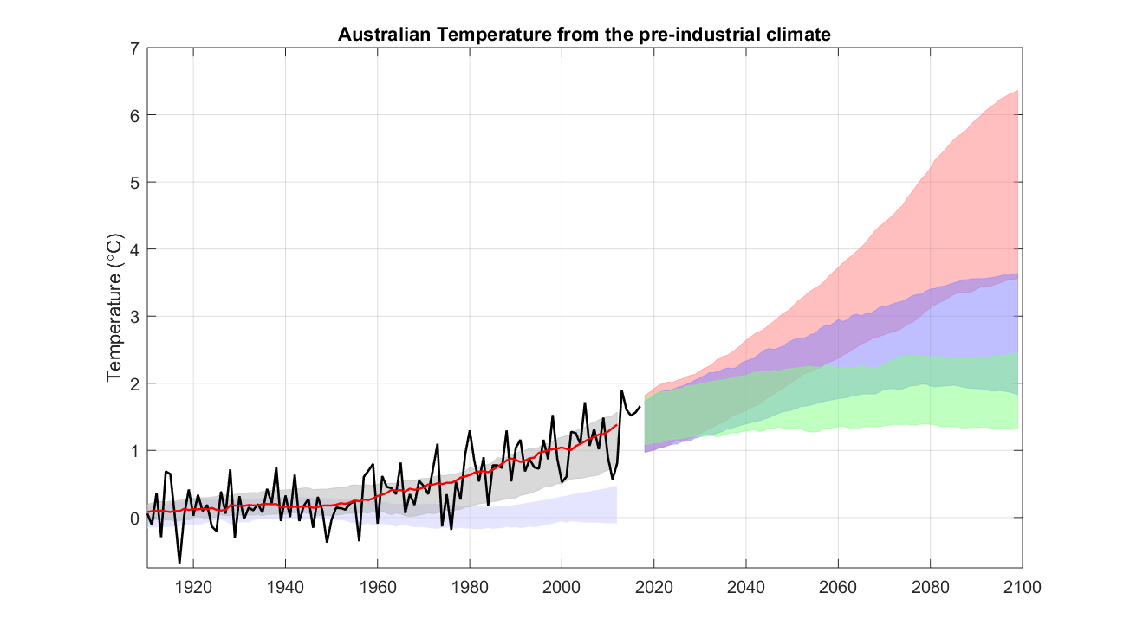
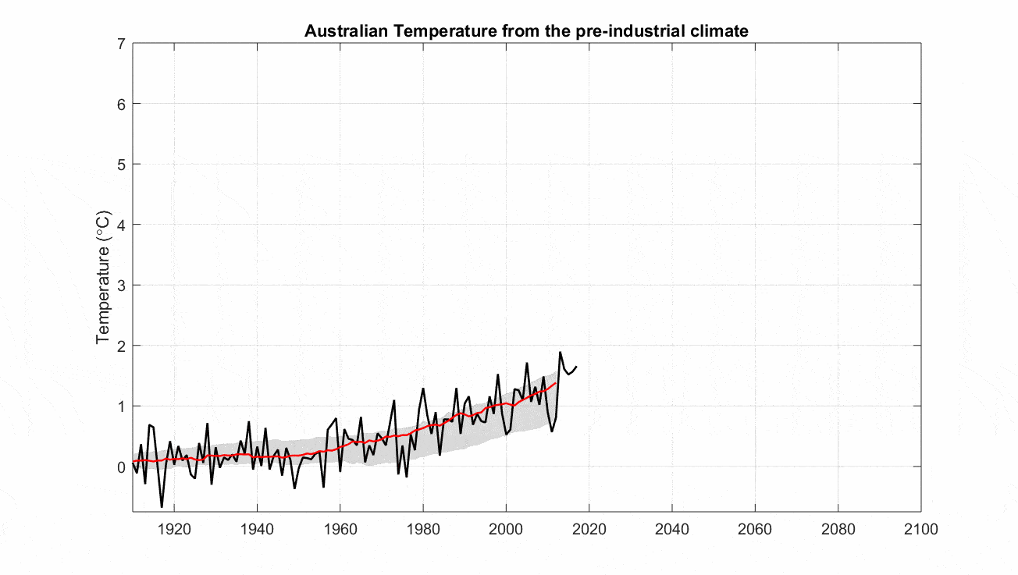
Framing projections – emissions, ranges, variability

Slide 9

The NextGen – timing and approach
Workshop consensus that a new major national release (v2.0 release) makes sense when new scientific assessment and GCMs are available
Link to international framework, not own system like UKCP18
Post IPCC AR6, CMIP6: 2023/24
Need for updates in the mean time (v1.5 release)
Enhanced guidance, data sets for new uses and users
Information on Paris targets, greater context of past-present-future
Inter-operability with other resources
More content on extremes
Assessment of the tsunami of new data as it comes in
New modelling
Ongoing underpinning research

Slide 10
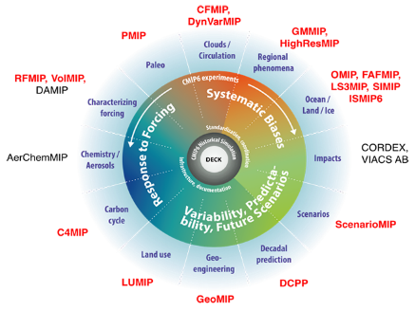

Tsunami of data (and acronyms) – CMIP6
ScenarioMIP – assess, accept/reject, weight models, independence issue only growing, improved methods (see Reto, Aurel and Gab talks)
Particular ensemble methods for particular phenomena (see Jo, Rob and Dewi talks)
HighResMIP – new insights, added value?
GEOMIP – report on climate engineering scenarios?
Insights from others: OMIP, LUMIP, PMIP etc.?
RCP-SSP matrix

Slide 11

Tsunami of data – downscaling/impacts, Paris, other
Move to coordinated downscaling, away from single-method – endorsement of CORDEX2 (see: Jason and Chantal talks)
New very high resolution (1.5 km) modelling of extremes where possible – multiple methods (WRF, CCAM, BARPA), strategic program
VIACS-AB – vulnerability, impacts, adaptation, climate services
ISIMIP, impact model comparison (see: Francis talk)
weather@home Global and ANZ (see: Mitchell talk)
Impacts at 1.5 and 2 °C and overshoot: time sampling CMIP5/6, HAPPIMIP, BRACE
Using multiple, disparate ensembles (see also: Pandora, Andrew talks)

Slide 12
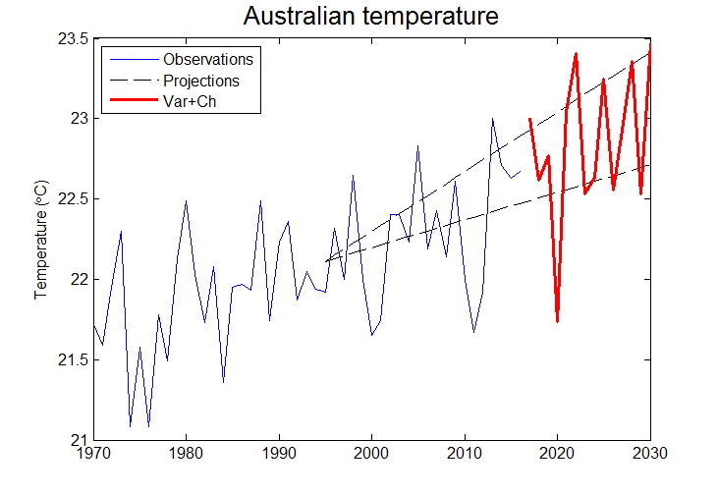
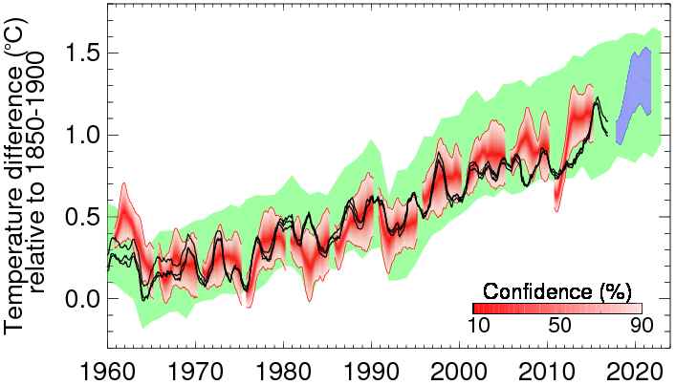


Bridging timeframes
Paleo, historical, current, near-term, projections
In particular the near-term to climate change is a big gap!
Decadal DCPP MIP, transition from initialised to free running models – science and communication issues

Slide 13


Using it all
CMIP6 ScenarioMIP
Initialised models, decadal pred.
Other MIPs
CORDEX2
Very high res.
New D/S
Perturbed physics ensemble(s)
HAPPIMIP, BRACE etc.
High-res GCMs
CMIP3 CMIP5
National, state, private sector, other needs

Slide 14

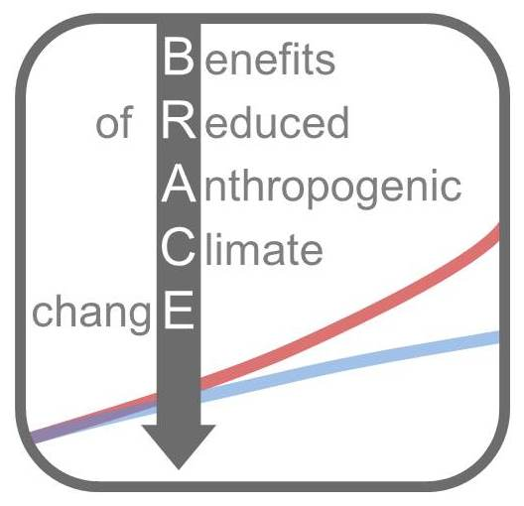

Intra- and Inter-Ensemble issues
Example: detail on change under Paris targets for Australia
HAPPIMIP:
Single AMIP model
Many, many members
Fine resolution
Run specifically for Paris
BRACE:
Single coupled model
Many members
Coarse resolution
Run specifically for Paris
Time sampling CMIP5/6:
Many coupled models
A few members each
Coarse resolution
Not run specifically for Paris
Ideal:
Many coupled models
Many members
Fine resolution
Run specifically for Paris
RCP-SSP and climate engineering scenarios

Slide 15
Thankyou

